Slide 1
The Current Status of COMET Experiment
Yu Xu
On Behalf of COMET Collaboration
School of Physics, Sun Yat-Sen University, China
The 29th International Workshop on Weak Interactions and Neutrinos

Slide 2

by higgstan.com

Slide 3
Outline
The COMET Experiment
Physics motivation
Design of the COMET Experiment
Current Status of COMET
Phase alpha commissioning
Summary

Slide 4
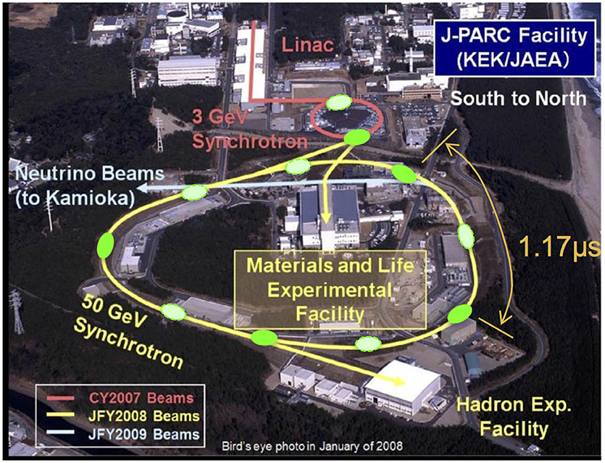

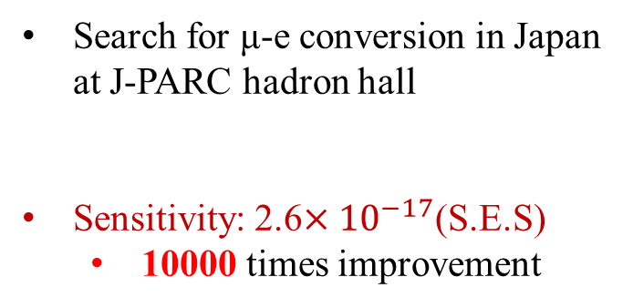
What is COMET: COherent Muon Electron Transition
Search for μ-e conversion in Japan at J-PARC hadron hall
Sensitivity: 2.6$×{10}^{−17}$(S.E.S)
  10000 times improvement

Slide 5
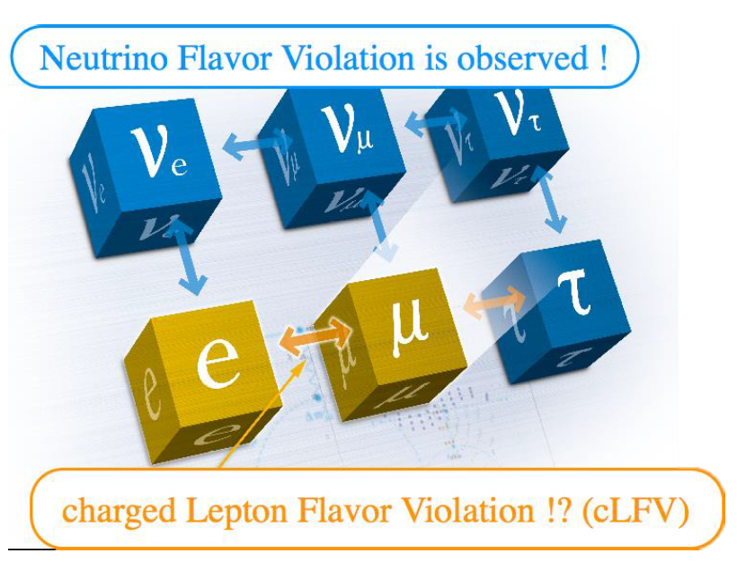

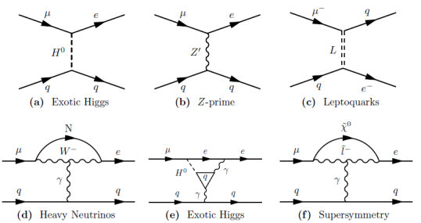
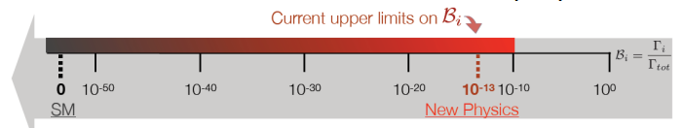

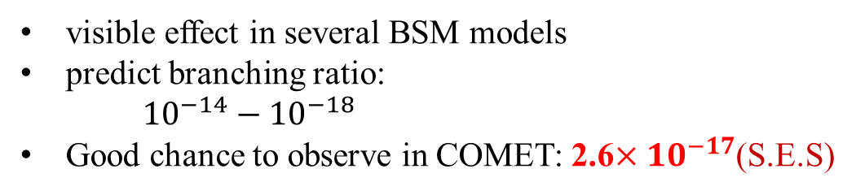
Why COMET: Charged Lepton Flavor Violation
cLFV highly prohibited in SM
visible effect in several BSM models
predict branching ratio:
${10}^{−14}−{10}^{−18}$
Good chance to observe in COMET: 2.6$×{10}^{−17}$(S.E.S)
𝑆𝐼𝑁𝐷𝑅𝑈𝑀 II: 7 × ${10}^{−13}$

Slide 6
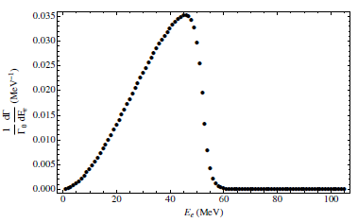
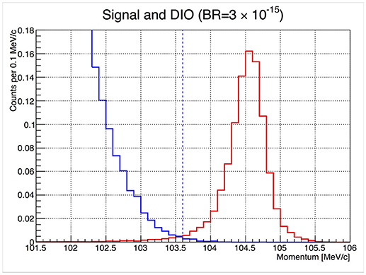
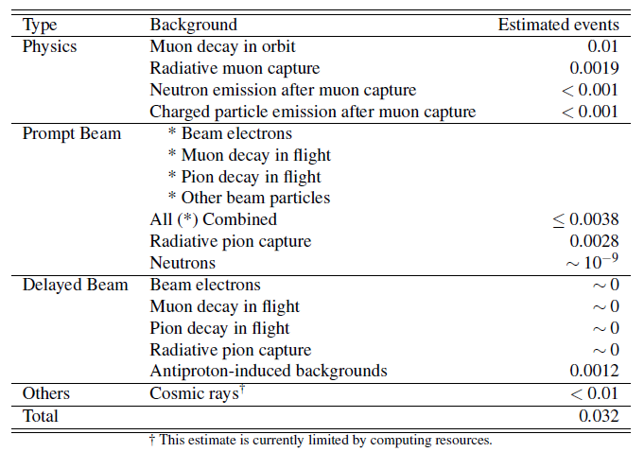
Signal & Background
DIO Background
Signal
cLFV Signal
DIO Background
Signal:
  Mono-energetic electron with energy of 105 MeV
Backgrounds: 0.032 events in total
  Intrinstic physics backgrounds
    High intensity beam for more statistics
  Beam related background
    C shape solenoid & strong magnitude
  Cosmic ray and other backgrounds
    Cosmic ray veto

Slide 7
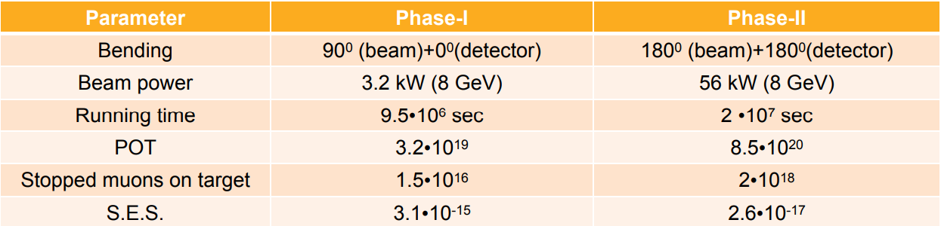
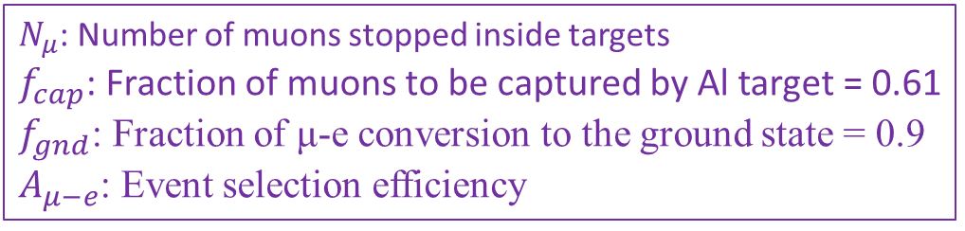
Physics Sensitivity
$N_{μ}$: Number of muons stopped inside targets
$f_{cap}$: Fraction of muons to be captured by Al target = 0.61
$f_{gnd}$: Fraction of μ-e conversion to the ground state = 0.9
$A_{μ−e}$: Event selection efficiency
3×${10}^{−15}$ S.E.S. achievable in ~150 days of DAQ time corresponds to Nμ=1.5×${10}^{16}$

Slide 8

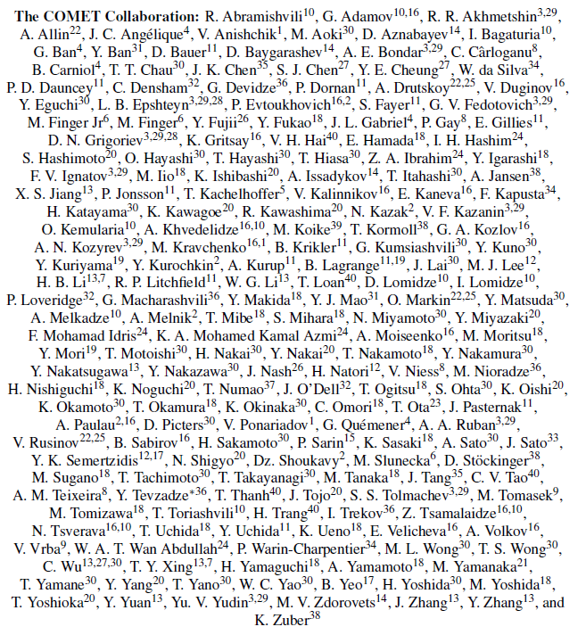
COMET Collaboration
About 200 collaborators
41 institutes, 17 countries

Slide 9
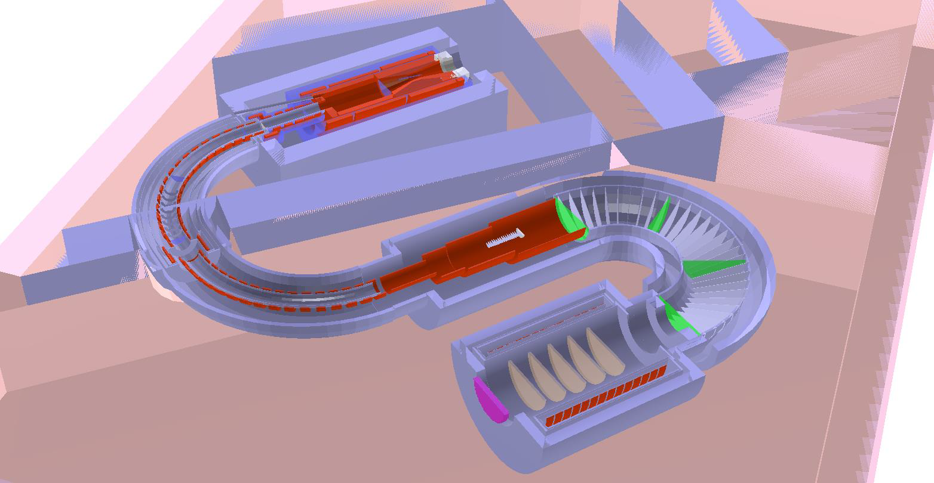


COMET: Detector System
Proton Beam
8 GeV, 56 kW
Production Target
Pion Capture Solenoid
5 T
Muon Transport Solenoid
Muon Stopping Target
Electron Transport Solenoid
$μ→$ e
$$π→μ$$
3 T
e
2 T
1 T
1 T
Electron Tracker and Calorimeter

Slide 10
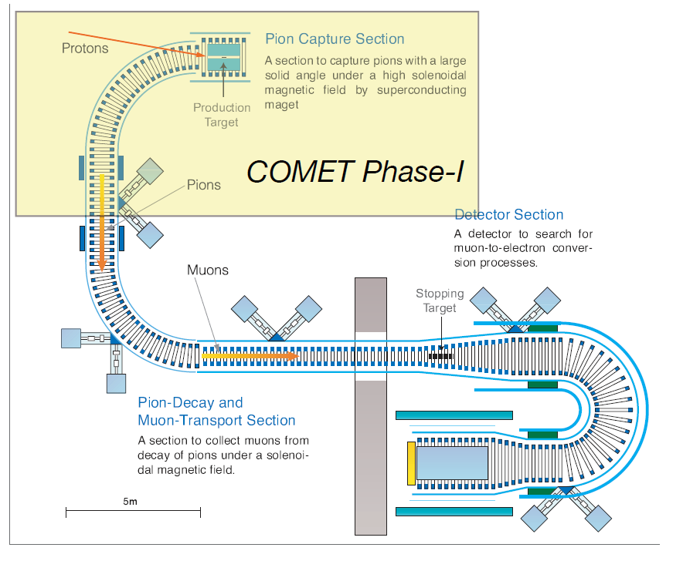
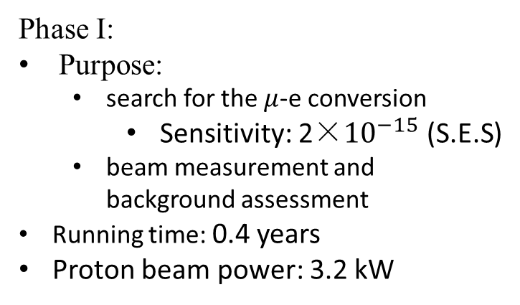
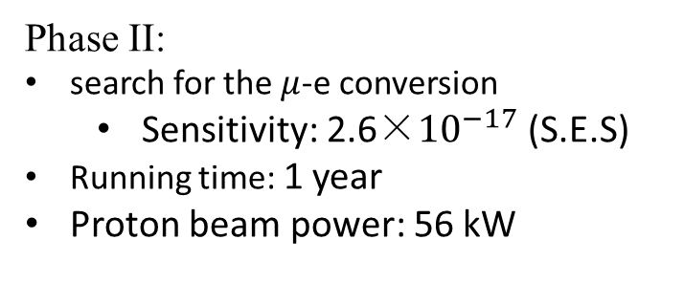
COMET: Two Staged Plan
Phase I:
Purpose:
  search for the $μ$-e conversion
    Sensitivity: 2×${10}^{−15}$ (S.E.S)
  beam measurement and background assessment
Running time: 0.4 years
Proton beam power: 3.2 kW
Detector Solenoid
Phase II:
search for the $μ$-e conversion
  Sensitivity: 2.6×${10}^{−17}$ (S.E.S)
Running time: 1 year
Proton beam power: 56 kW

Slide 11
COMET Phase I: Two purposes
Cylindrical Drift Chamber (CDC)
CyDet: search for μ-e conversion
Muon Stopping Target
Cylindrical Trigger Hodoscope (CTH)
ECAL
Straw Tube Tracker
StrECAL: beam measurement and background assessment

Slide 12
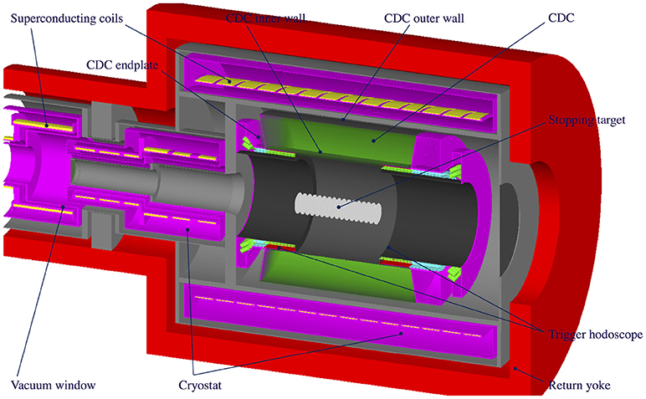
CyDet (Cylindrical Detector System)
Cylindrical trigger hodoscope (CTH)
  Two layers: plastic scintillator for t0 and Cerenkov counter for PID
  SiPM as readout
Cylindrical drift chamber (CDC)
  20 stereo layers: z information with few layers’ hits
  Helium based gas: minimize multiple scattering
  Large inner bore: to avoid beam flash and DIO electrons
  Momentum resolution: 200 keV/c (for p=105 MeV/c)
Muon Stopping Target
  Aluminum target with 17 disks
  100-mm radius, 0.2-mm thickness, 50-mm spacing

Slide 13
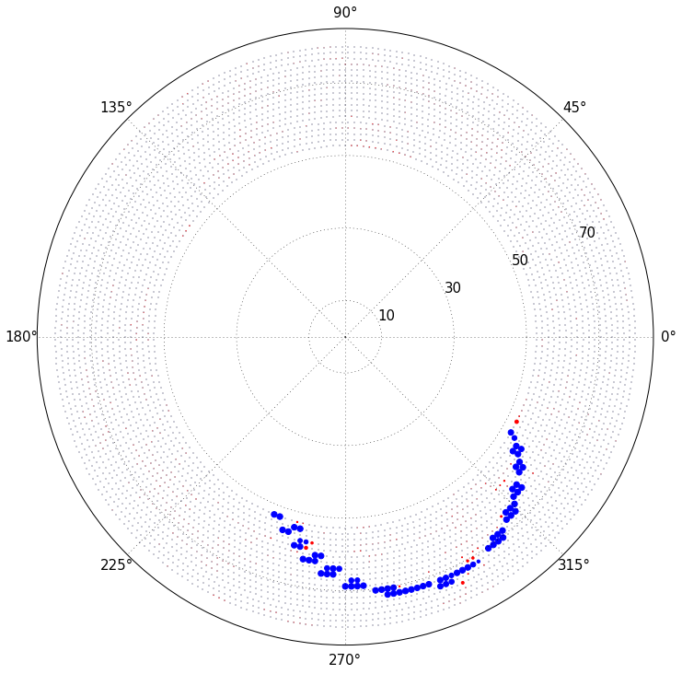
CyDet Event
Red: background processes
Blue: signal electron
Based on Boosted Decision Tree Method and Hough transformation

Slide 14
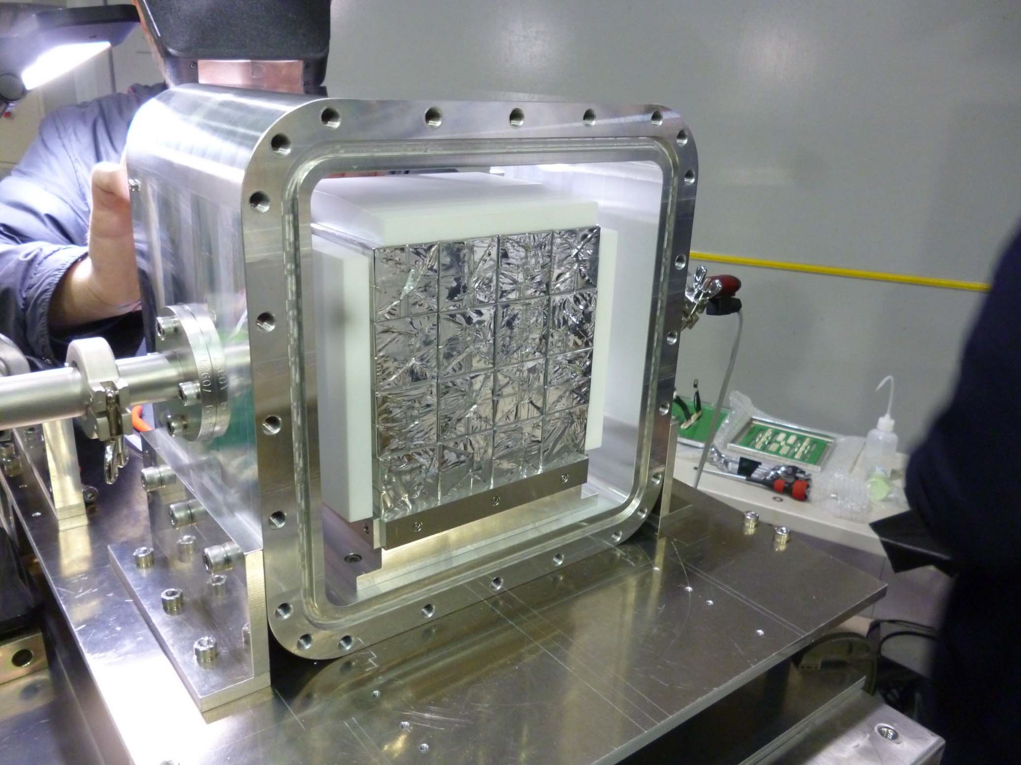
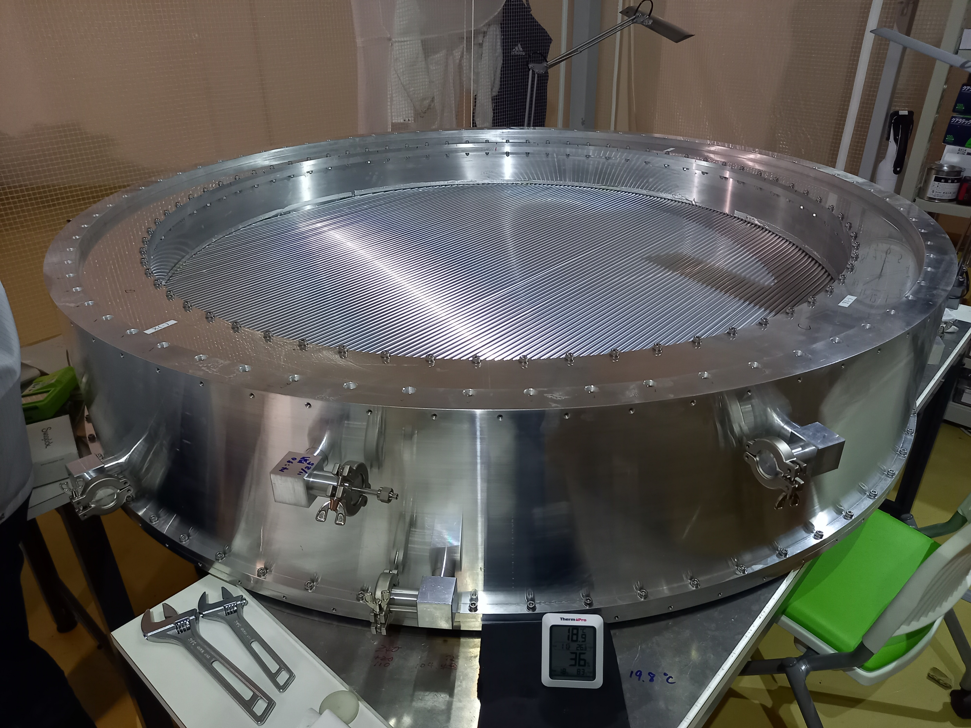
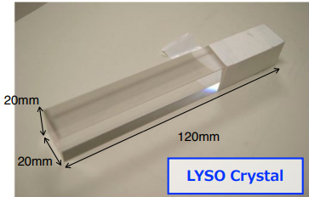
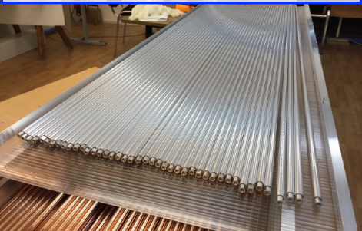

StrECAL (Straw Chamber+ECAL)
Straw Chamber
  A series of StrawTube Trackers
  Main tracker for Phase-I beam measurement & Phase-II physics run
  Each “station” consists of 240(~500) straws ×2, 5(>6) stations for Phase-I (Phase-II)
  20(12)µm thick/ 10(5)mmφ straw tubes for Phase-I (Phase-II)
Electromagnetic Calorimeter (ECAL)
  Measure the energy and time of particle
  500-1,000(~2,000) LYSO crystals for Phase-I(Phase-II)
    Size: 20*20*120 mm
    Fast time response + high light yield
$$e^{−}$$
ECAL 8x8 Prototype
StrawTube Tracker
Straw tubes

Slide 15
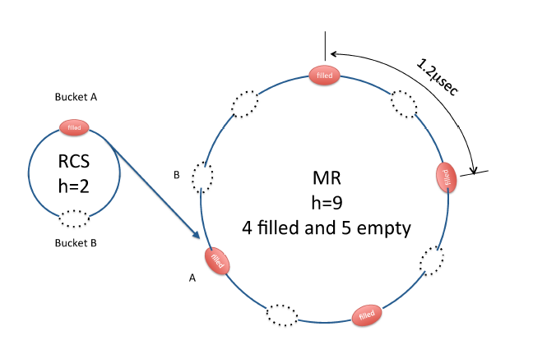
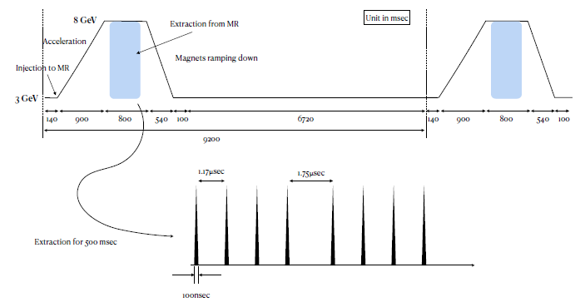
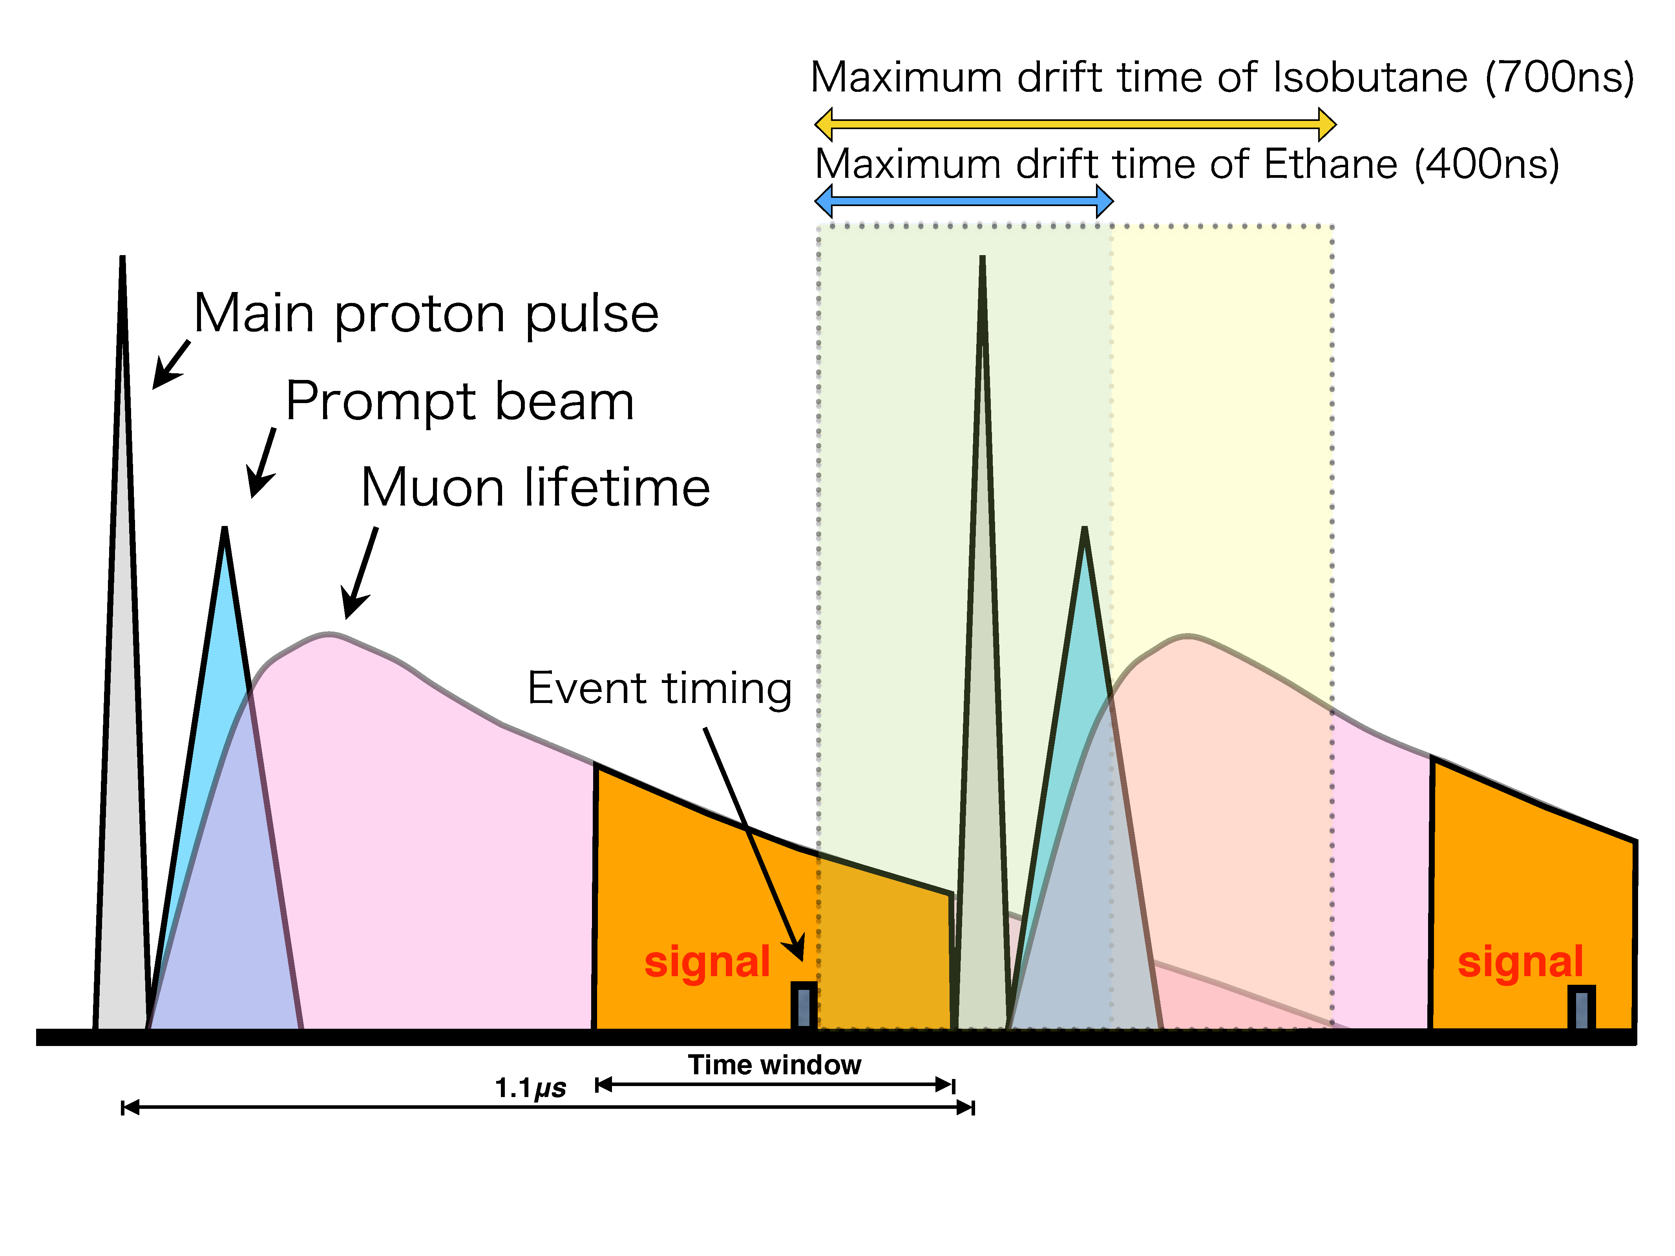

Bese: Proton Beam
8 GeV proton, slow extraction
High intensity: ${10}^{11}$ muons/sec (${10}^{8}$@PSI)
proton extinction factor: < 6 $×{10}^{−11}$

Slide 16
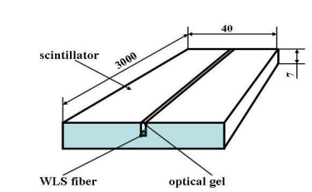
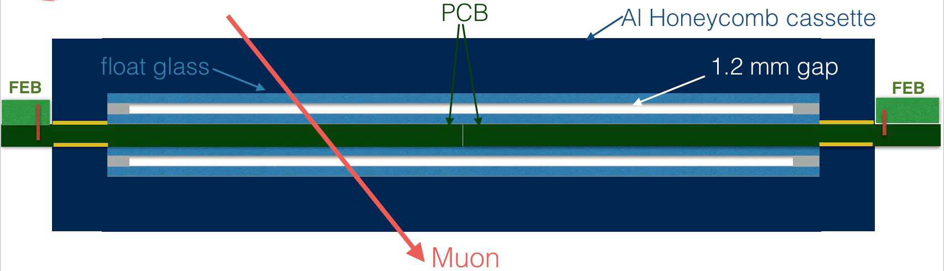
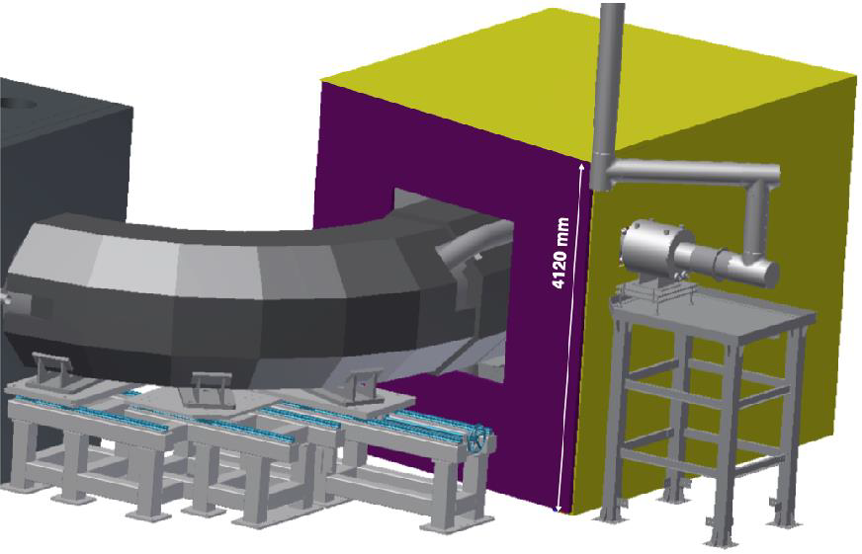
Cosmic-Ray Veto (CRV)
Yellow: plastic scintillators
4 layers of strips
veto ratio ~99.86%
Purple: RPC detector
design from Clermont

Slide 17
Phase I: preparation status

Slide 18
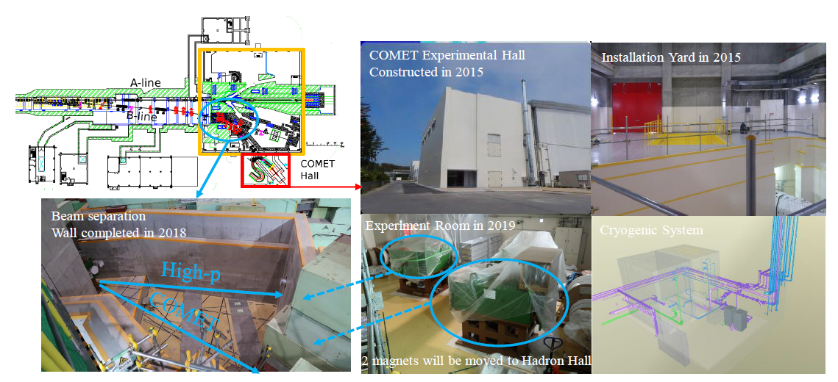
Status: Facility
Experimental Hall building completed
Cryogenic system under construction
  Refrigerator test completed.
  Helium transfer tube in production
Proton beamline ready
  Run & test in Phase alpha

Slide 19
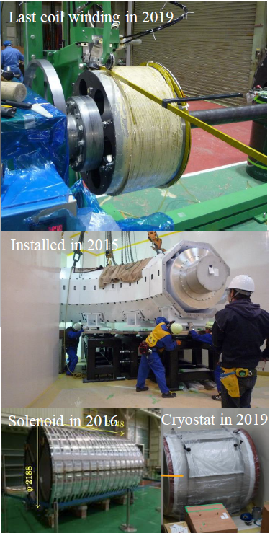
Status: Beamline
Capture solenoid
  Last coil winding in 2019
Transport solenoid
  Installed
Bridge & detector solenoid
  DS coil and cryostat ready. BS coil delivered.

Slide 20
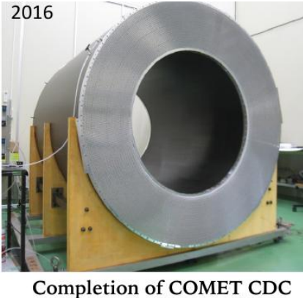
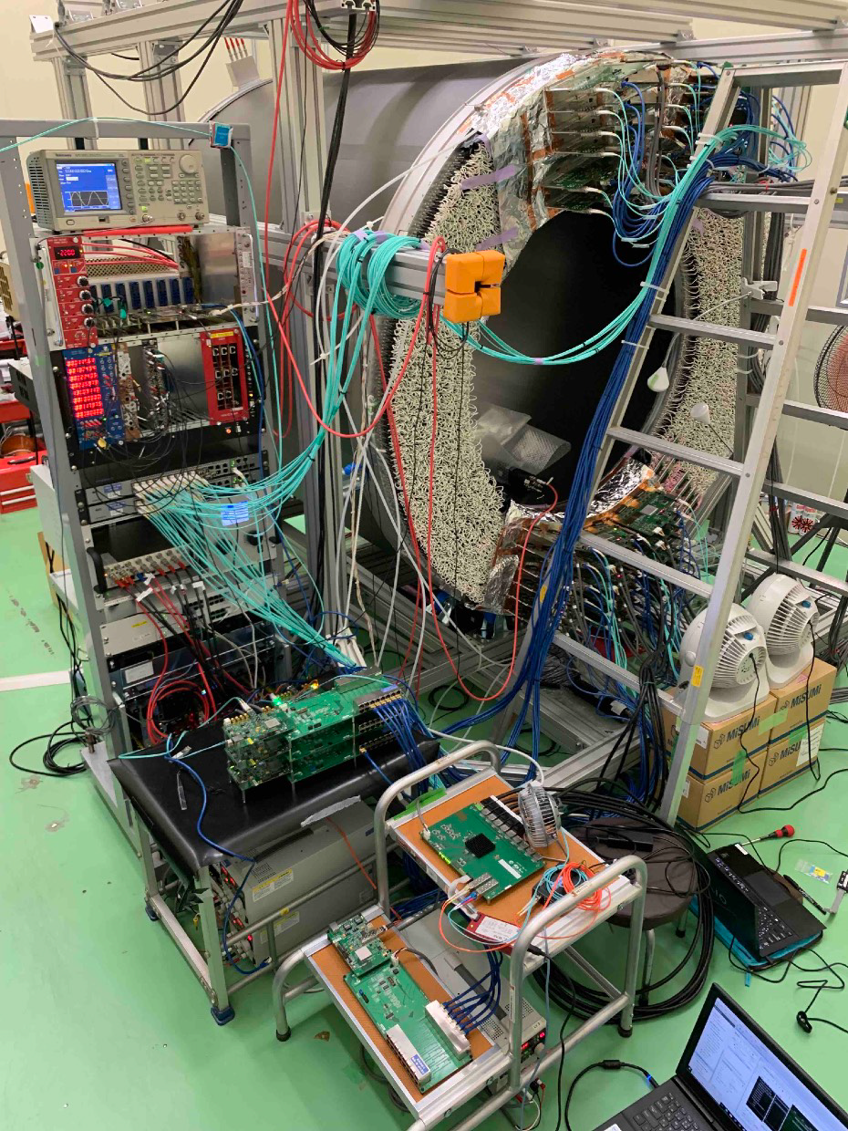
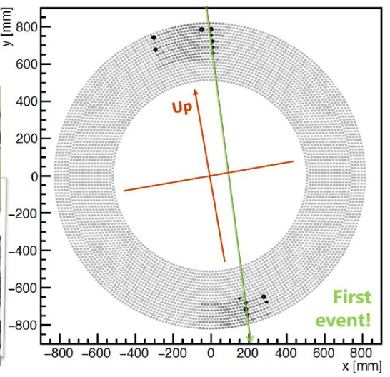
Status: CyDet
Cylindrical Drift chamber (CDC)
  Construction finished in 2016
  Cosmic ray test succeed
Front end electronics
  Finished the production and mass tests of 108 boards.
  Radiation tests published
Trigger system
  Cylindrical trigger hodoscope(CTH) under mechanical design.
  Trigger logic and trigger board design finished. Communication tests with FCT-FC7 trigger system is on going.
Trigger & DAQ
Front End

Slide 21
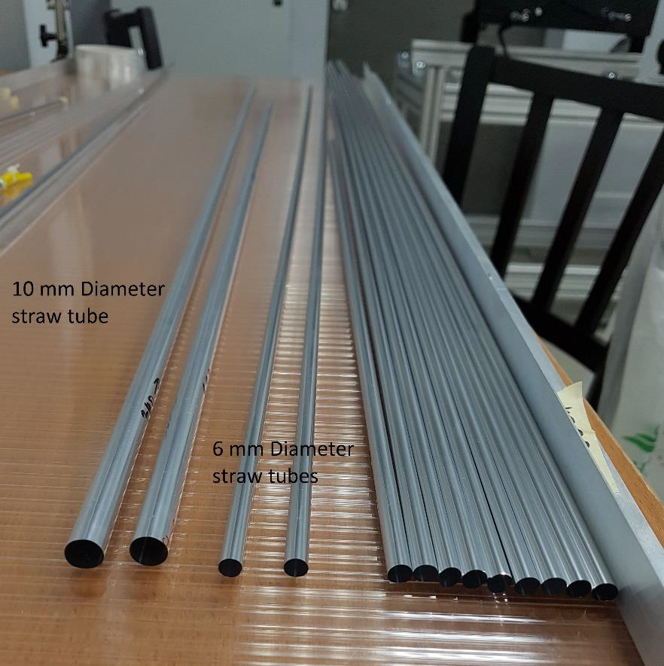
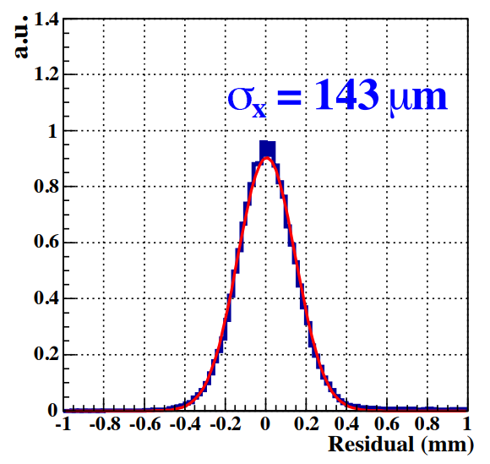
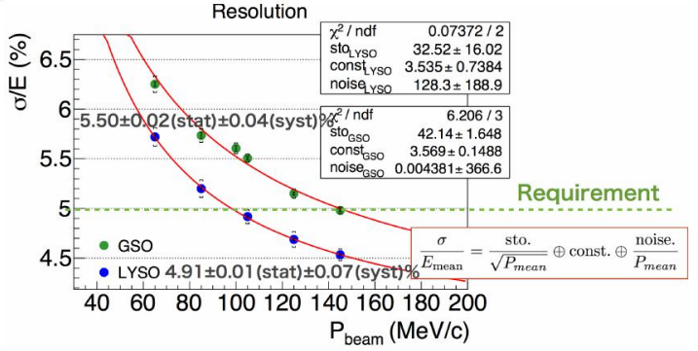
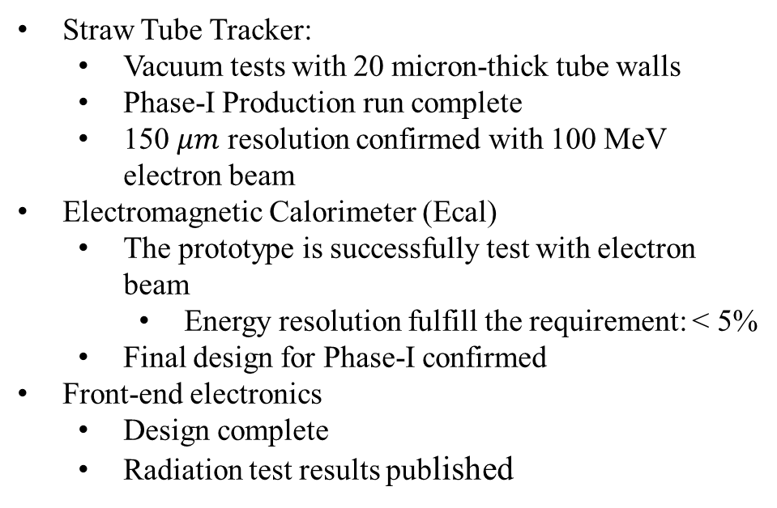
Status: StrEcal
Straw Tube Tracker:
  Vacuum tests with 20 micron-thick tube walls
  Phase-I Production run complete
  150 $μm$ resolution confirmed with 100 MeV electron beam
Electromagnetic Calorimeter (Ecal)
  The prototype is successfully test with electron beam
    Energy resolution fulfill the requirement: < 5%
  Final design for Phase-I confirmed
Front-end electronics
  Design complete
  Radiation test results published
StrawTube
ECAL

Slide 22
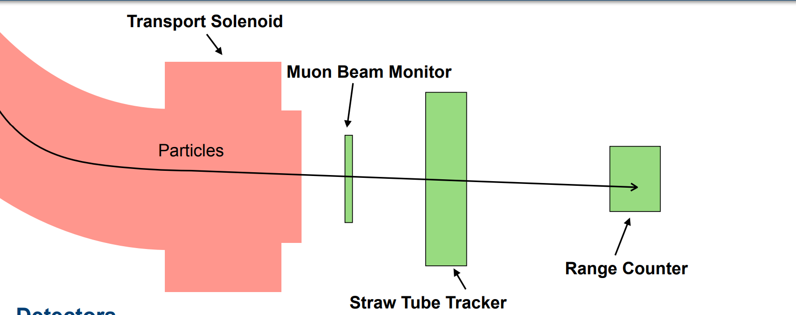
Why Phase alpha
Commissioning of
  the COMET proton beamline
  the COMET muon beam transport
Validation of simulation
Muon Beam Monitor (MBM):
  Position & time of the events
Straw Tube Tracker:
  Position & direction of the events
Range Counter (RC):
  muon’s decay time
  Triggers generation
Low intensity (0.26 kW) with 1 mm thick graphite target

Slide 23
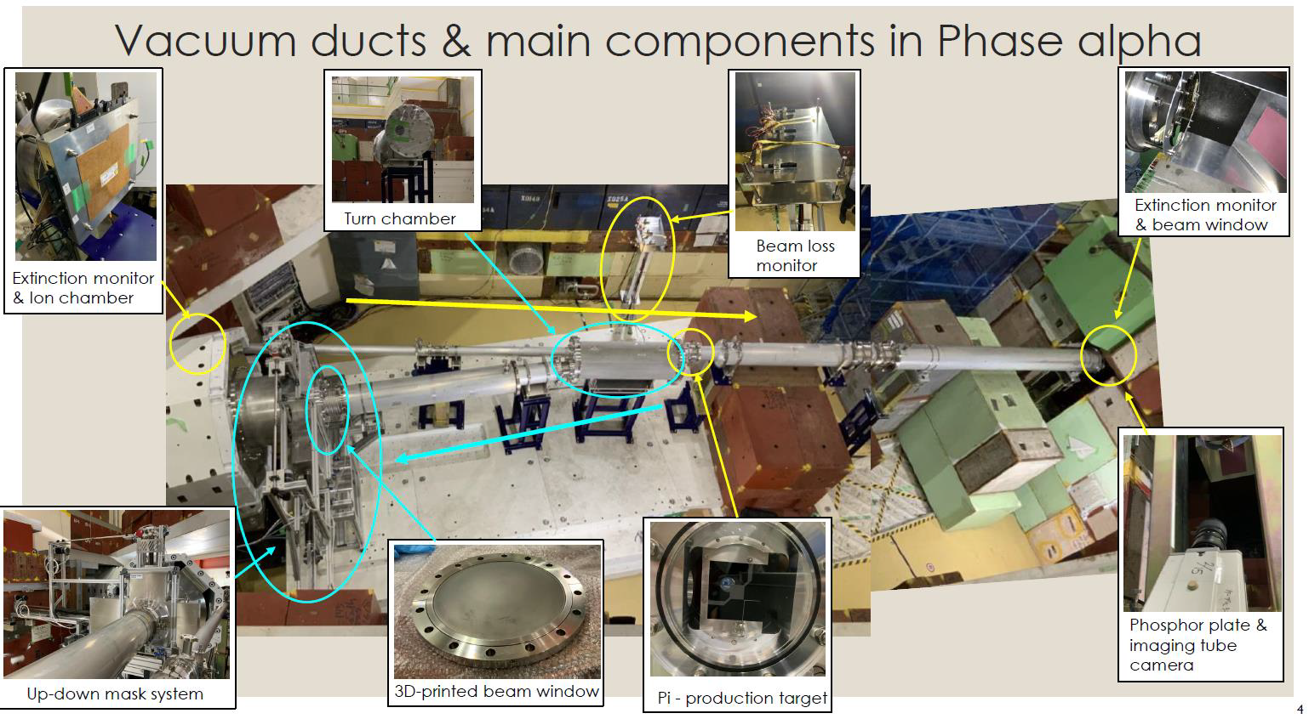
Phase alpha beamline
The beamline
No Pion Capture Solenoid & Field
Muon Transport Solenoid to be used in Phase-I&-II
The Pion Production Target contained in a vacuum pipe
  1mm graphite target
2D beam masking system implemented

Slide 24
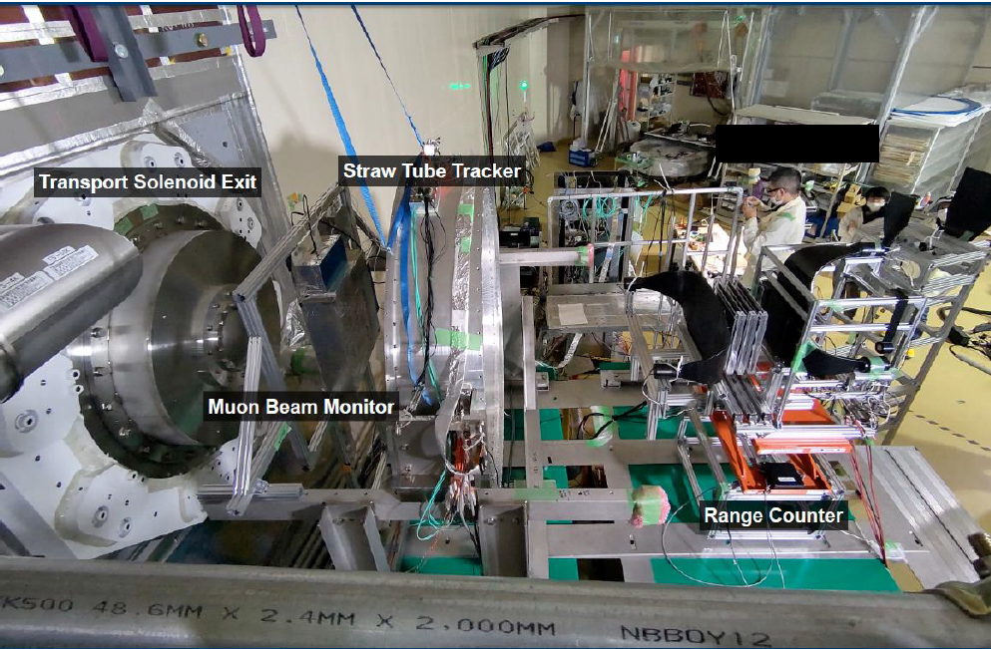

Slide 25
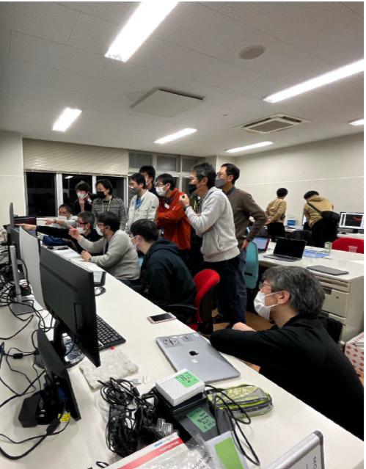
Phase-alpha Commissioning
Beam Time
  Commissioning: 10th – 14th Feb
  Main measurement: 3rd – 4th & 9th -15th March
    3rd − 4th: Principal check of beam muons
    4th − 8th: Beam stop due to accelerator problems
    9th − 13th: Muon momentum spectrum measurement
    13th − 15th: Positive-charged beam measurement
First muon observation in the COMET experimental area!
Collaborators seeing the first signals

Slide 26
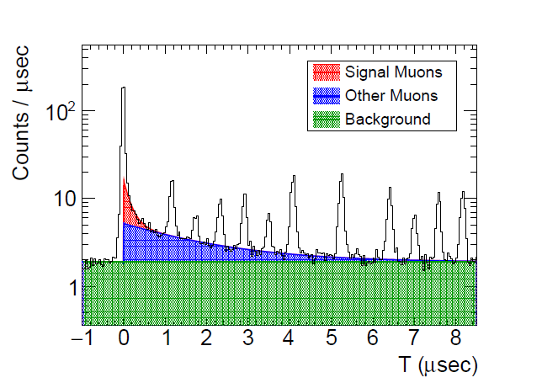
Muon Decay
Muon Decay Time Distribution
First demonstration of a solenoid beamline with 90 degree curvature.
Fitted by double exponential curves with a flat BG
  The bunch structure also taken into account in the fitting
A clear 'short component' was observed
  The first muon observation in the COMET experimental area!
Preliminary

Slide 27
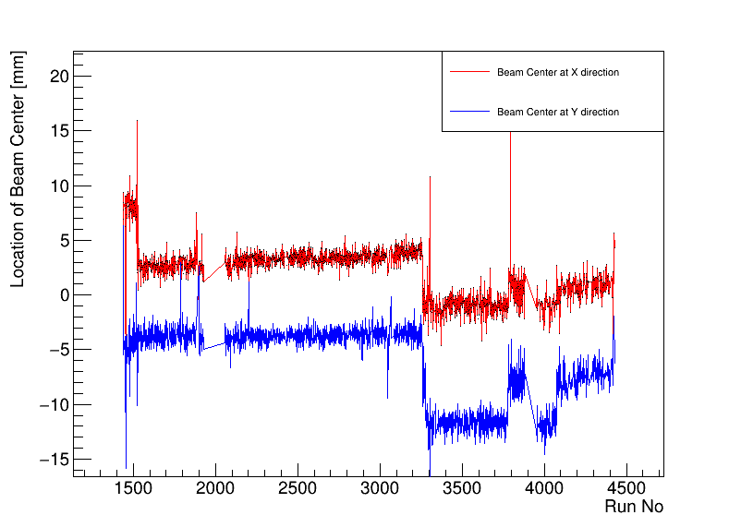
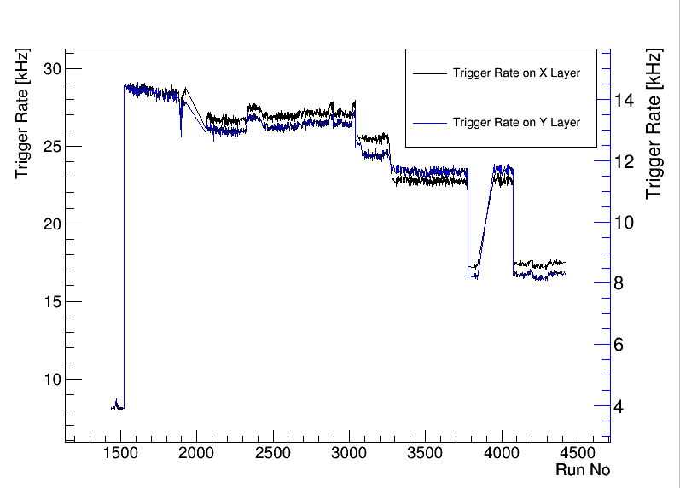
Run Status
Beam center & MBM trigger rate vs runs
  The muon beam runs stable during the commissioning time
  Jump points due to the change of beam configuration
    Beam on&off, magnet field off, beam masking system move, etc
Preliminary
Preliminary

Slide 28
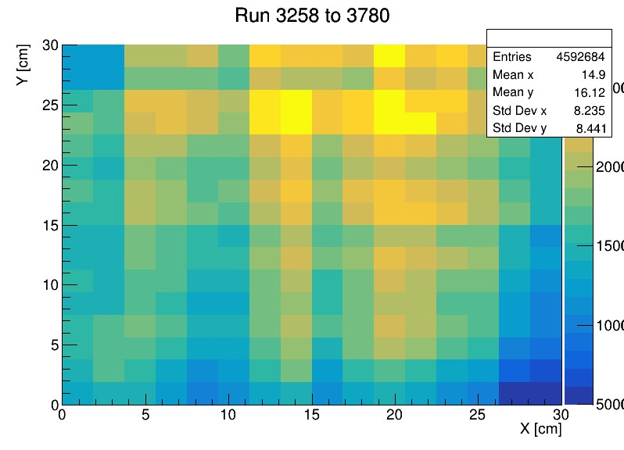
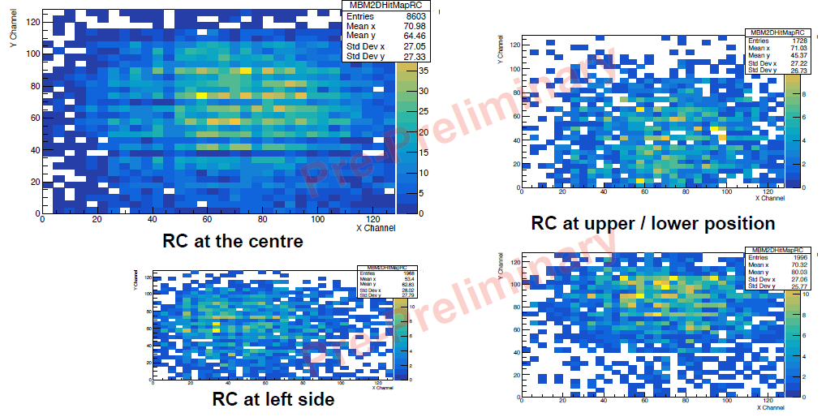
Beam Profile
MBM hits corresponding to RC triggers
Preliminary
Beam profile got by MBM
Further study ongoing

Slide 29
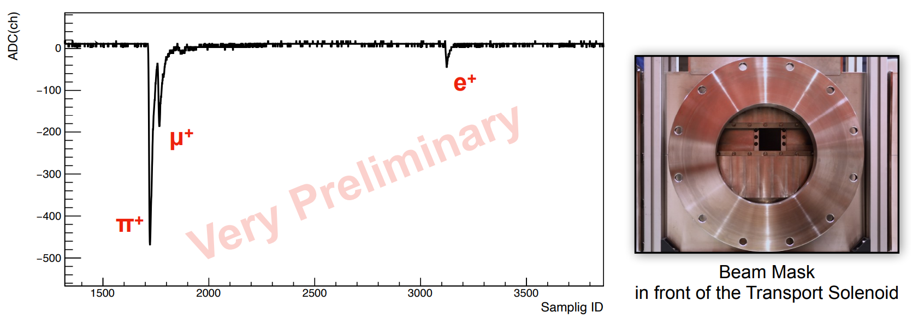
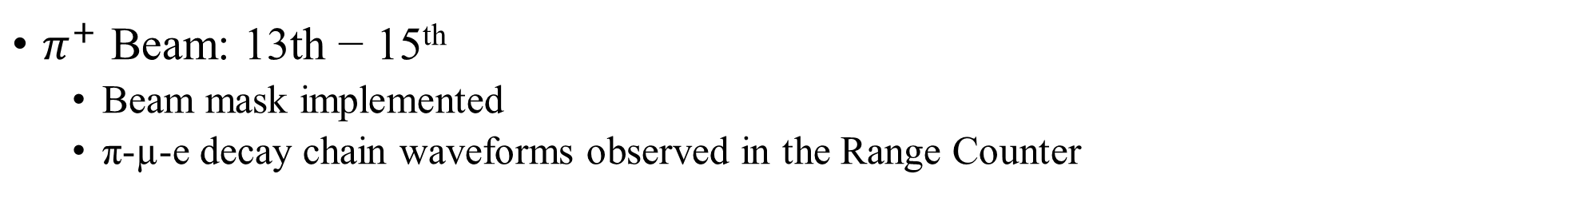
Positive Beam Measurement
$π^{+}$ Beam: 13th − 15th
  Beam mask implemented
  π-µ-e decay chain waveforms observed in the Range Counter

Slide 30
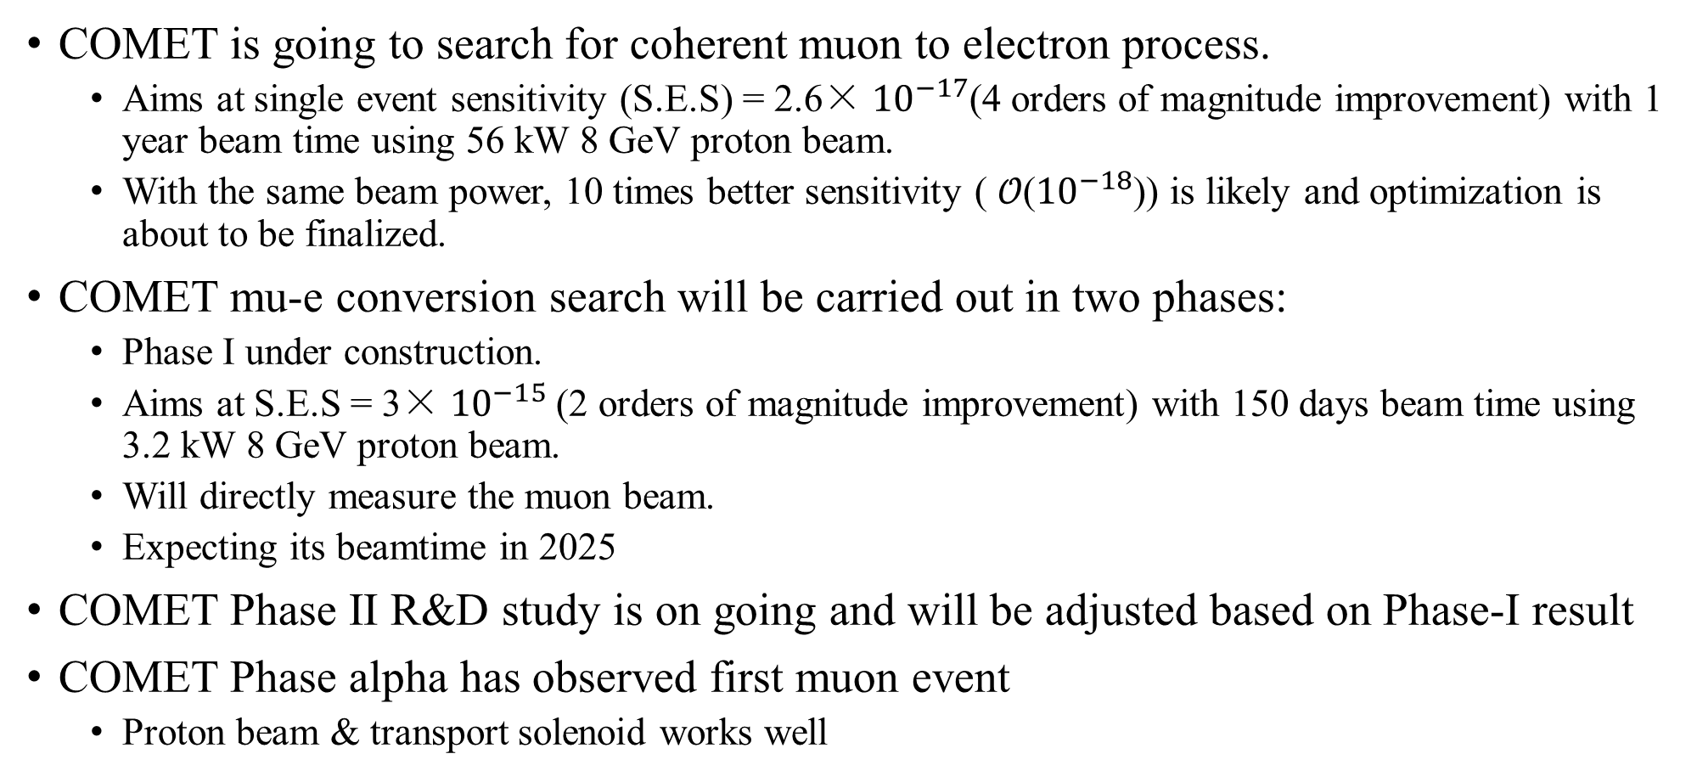
Summary
COMET is going to search for coherent muon to electron process.
  Aims at single event sensitivity (S.E.S) = 2.6× ${10}^{−17}$(4 orders of magnitude improvement) with 1 year beam time using 56 kW 8 GeV proton beam.
  With the same beam power, 10 times better sensitivity ( 𝒪(${10}^{−18}$)) is likely and optimization is about to be finalized.
COMET mu-e conversion search will be carried out in two phases:
  Phase I under construction.
  Aims at S.E.S = 3× ${10}^{−15}$(2 orders of magnitude improvement) with 150 days beam time using 3.2 kW 8 GeV proton beam.
  Will directly measure the muon beam.
  Expecting its beamtime in 2025
COMET Phase II R&D study is on going and will be adjusted based on Phase-I result
COMET Phase alpha has observed first muon event
  Proton beam & transport solenoid works well

Slide 31

Back Up

