Slide 1
Constraining Particle Dark Matter with eROSITA Early Data
Chingam Fong, Kenny C. Y. Ng, Qishan Liu
The Chinese University of Hong Kong

Slide 2
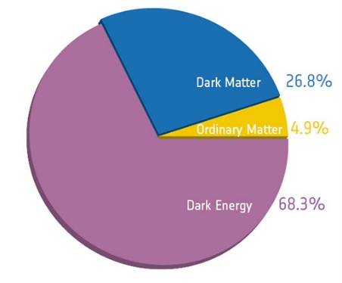
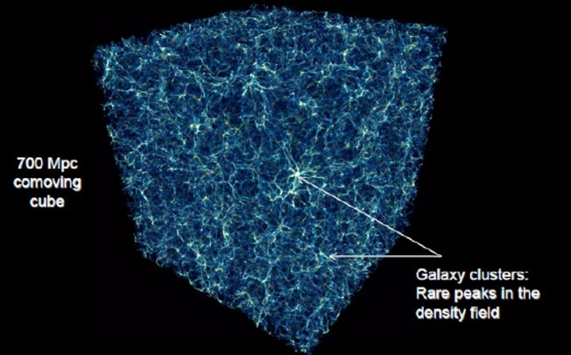
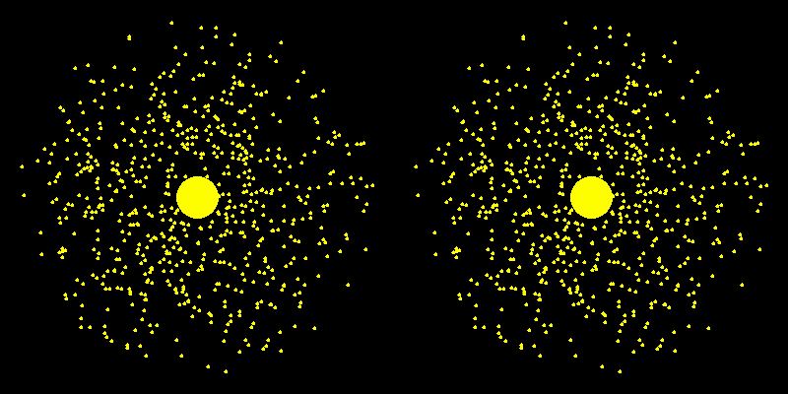
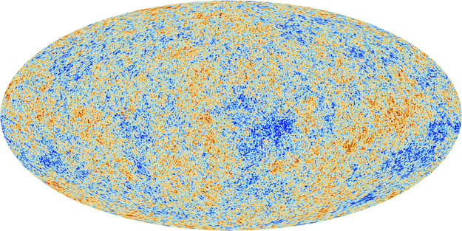
Galactic Dark Matter
Abundant everywhere in the universe
In Galaxy, density is described by Navrro-Frenk-White (NFW) profile
Astrophysical survey can probe DM’s nature through indirect detection
Search for DM has covered the whole EM spectrum (and then some)
M. L. Norman et al., 2007
Keplerian prediction Observation
A.V. Zasov et al., 2017

Slide 3
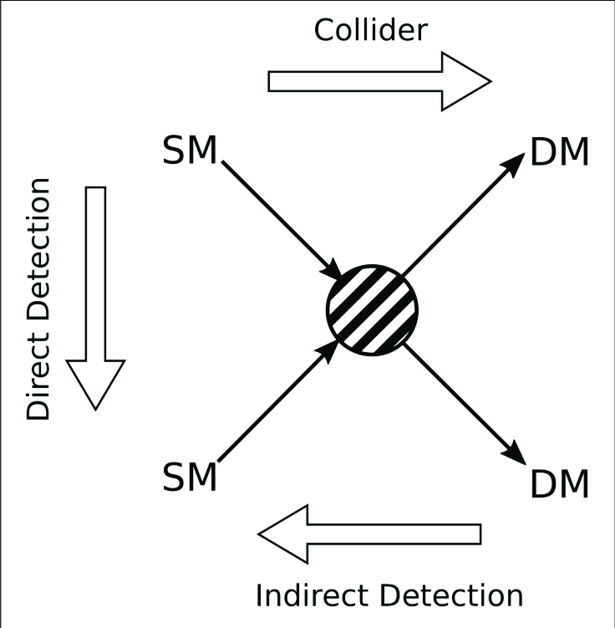
R. Alves Batista et al., EuCAPT White Paper, arxiv: 2110.10074
Acronyms: Extreme mass ratio inspirals (EMRI), stochastic GW background (SGWB), CMB spectral distortions (SD)
SM particle scattering
Gravitational effect
Decay/Annihilation
This work
Gravitational effect

Slide 4
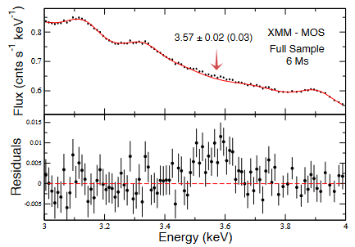
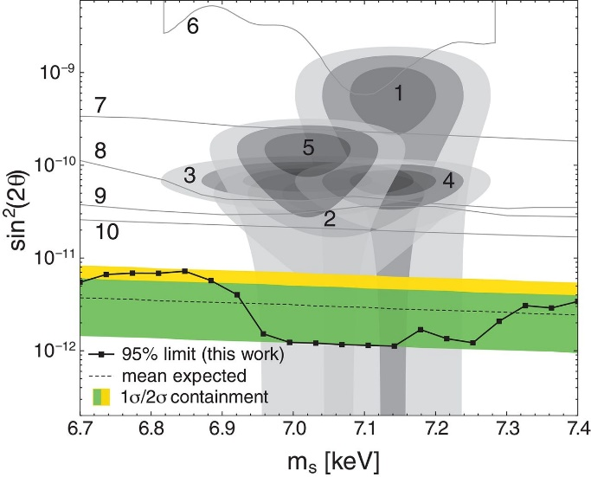
X-Ray DM Search
Galaxy cluster data Bulbul et al., 2014
Unexplained signature -> decay?
Rate determined by particle physics & DM profile
$Φ=\frac{Γ}{4πm_{χ}} ΔΩ\frac{dN}{dE}∫ρ\left[r\left(l,φ\right)\right]dl$
DM -> 1 or 2 equal energy photon(s)
$\frac{dN}{dE}=δ\left(E−m_{χ}/2\right)$
Sterile neutrino: (1 photon)
$Γ_{ν_{s}}=1.38⋅{10}^{−29}s^{−1}\left[\frac{\sin^{2}\left(2θ\right)}{{10}^{−7}}\right]{\left(\frac{m_{ν_{s}}}{1keV}\right)}^{5}$
Axion-like particles: (2 photons)
$Γ_{aγγ}=5⋅{10}^{−29}s^{−1}\left(\frac{m_{a}}{7keV}\right){\left(\frac{g_{aγγ}}{1.74{⋅10}^{−18}GeV^{−1}}\right)}^{2}$
V. V. Barinov et al., 2020
XMM Newton blank sky
C. Dessert, 2020

Slide 5
Neutrino Minimal Standard Model ($νMSM$)
J. F. Cherry & S. Horiuchi 2017
DM overproduction
Sterile neutrino
Righthanded counter part to active neutrinos
Can decay into 1 photon and 1 active neutrino (X-ray)
Galaxy satellite counts & phase space constraints
Warm DM will suppress small scale structure -> less sub halo -> less satellite “missing satellite problem” (Dwarf galaxy count constraint)
Structure: DM is “cold enough” -> sterile neutrino > 1.7 keV (Phase space)
BBN limit
Sterile neutrinos resonantly produced during BBN, limited by lepton asymmetry measured from Helium abundance (Shi-Fuller mechanism)
Non-resonant production in 0 lepton asymmetry (Dodelson-Widrow mechanism)

Slide 6
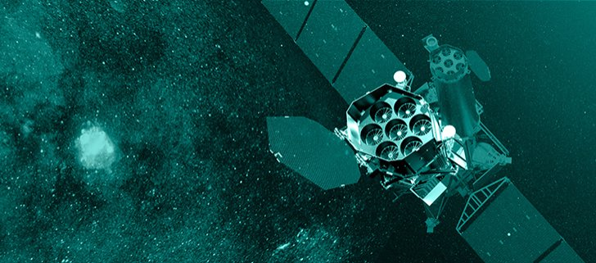
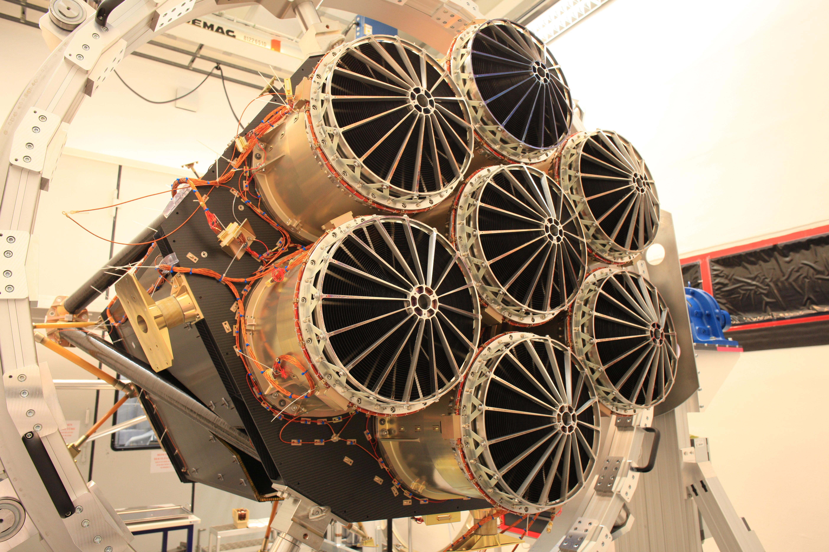
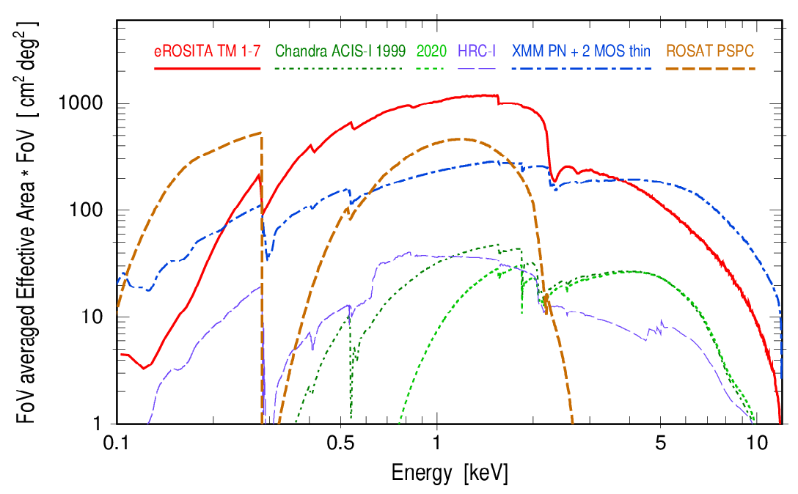
eROSITA Instrument & Mission
On board Spectr-Roentegn-Gamma (SRG) mission
Joint German-Russian operation launched in 2019
Excellent angular and energy resolution
Deepest all-sky X-ray survey after 4-year mission
P. Predehl et al., 2021

Slide 7
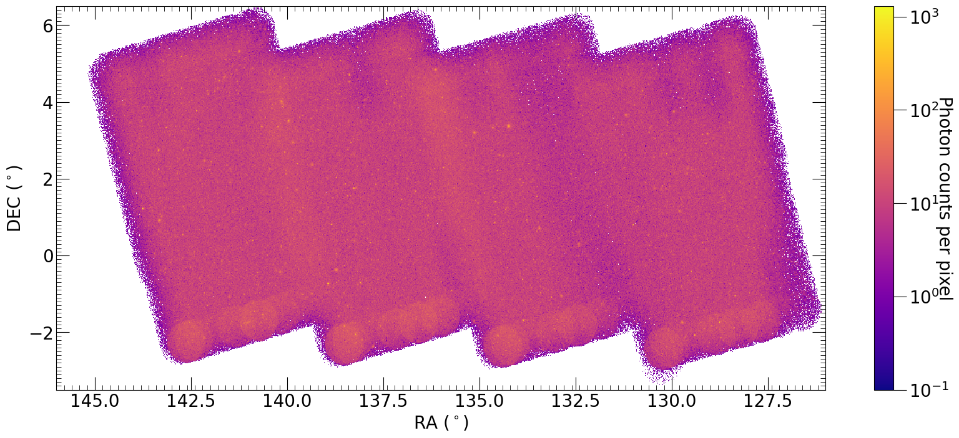
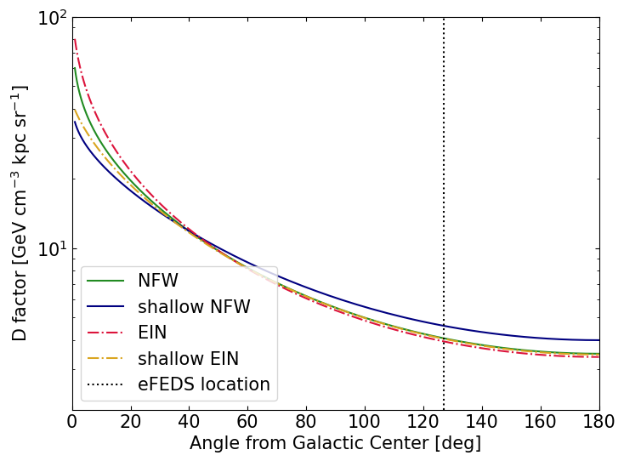
eFEDS Data
Part of eROSITA Early Data Release in 2021
360ks, 140deg² observation
Pros:
Largest area
Few point sources
Same exposure depth completed sky survey
Cons:
pointing away from GC, constraint not as strong
C. Fong, K. C. Y. Ng, Q. Liu, 2023 (in prep)
$$Φ=\frac{Γ}{4πm_{χ}} ΔΩ\frac{dN}{dE}∫ρ\left[r\left(l,φ\right)\right]dl$$

Slide 8
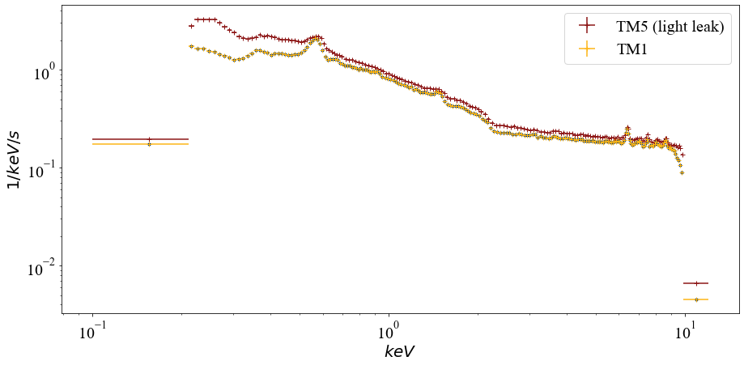
eFEDS Data Shenanigans
example “cheesemask” for point source removal
(blurred because it might induce trypophobia)
Data extracted and processed with eSASS
Point sources verified don’t matter, through “cheesemask”
eROSITA Science Analysis Software System removed flare, bad time interval
Light leak
TM5 & TM7 light filter failed
We removed all energy range below 1 keV

Slide 9
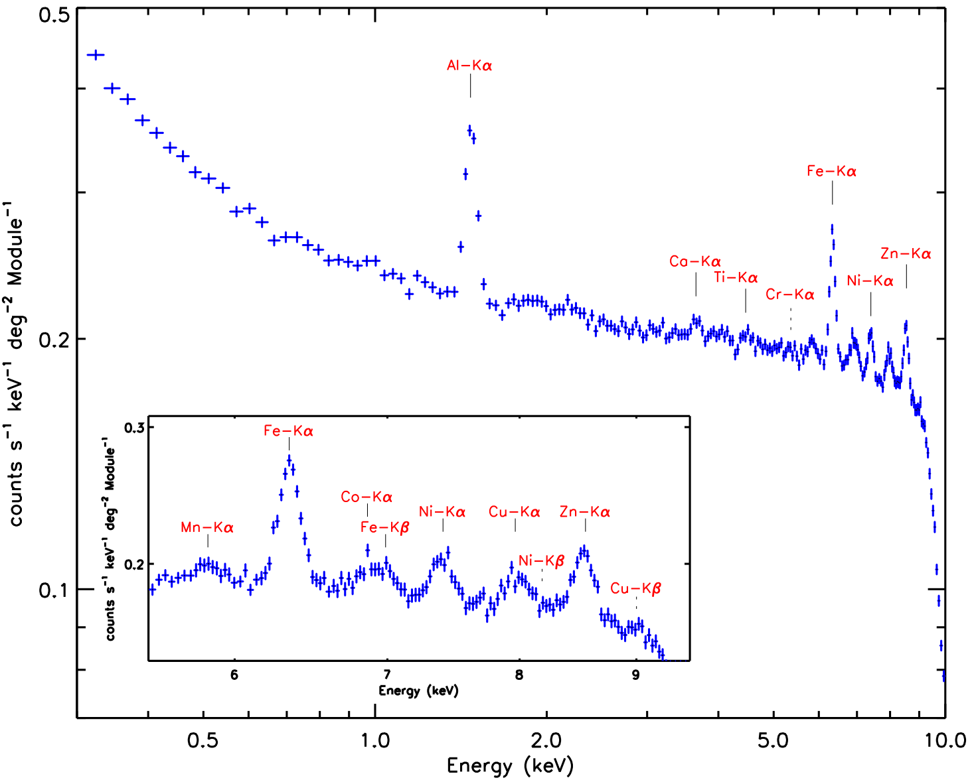
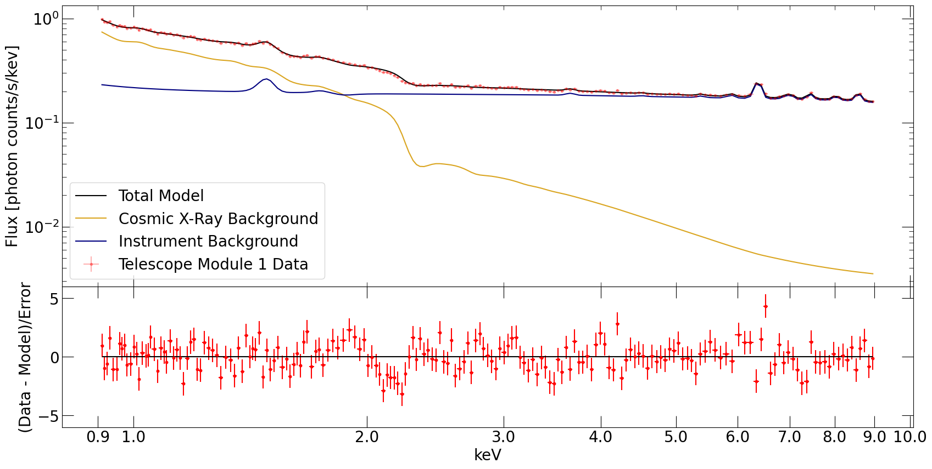
Construct Blank Sky Spectrum
P. Predehl et al, 2021
2 categories
Instrument background
Induced by high energy particle interacting with internal elements
From closed camera observation
A continuum and 14 gaussian lines
Astrophysical background
Unabsorbed apec - local bubble
Absorbed apec - local group
Absorbed powerlaw - diffuse sources
apec = model of ionized diffused gas
C. Fong, K. C. Y. Ng, Q. Liu, 2023 (in prep)
Takeaway: $χ^{2}/d.f.≈1$, a good fit.

Slide 10
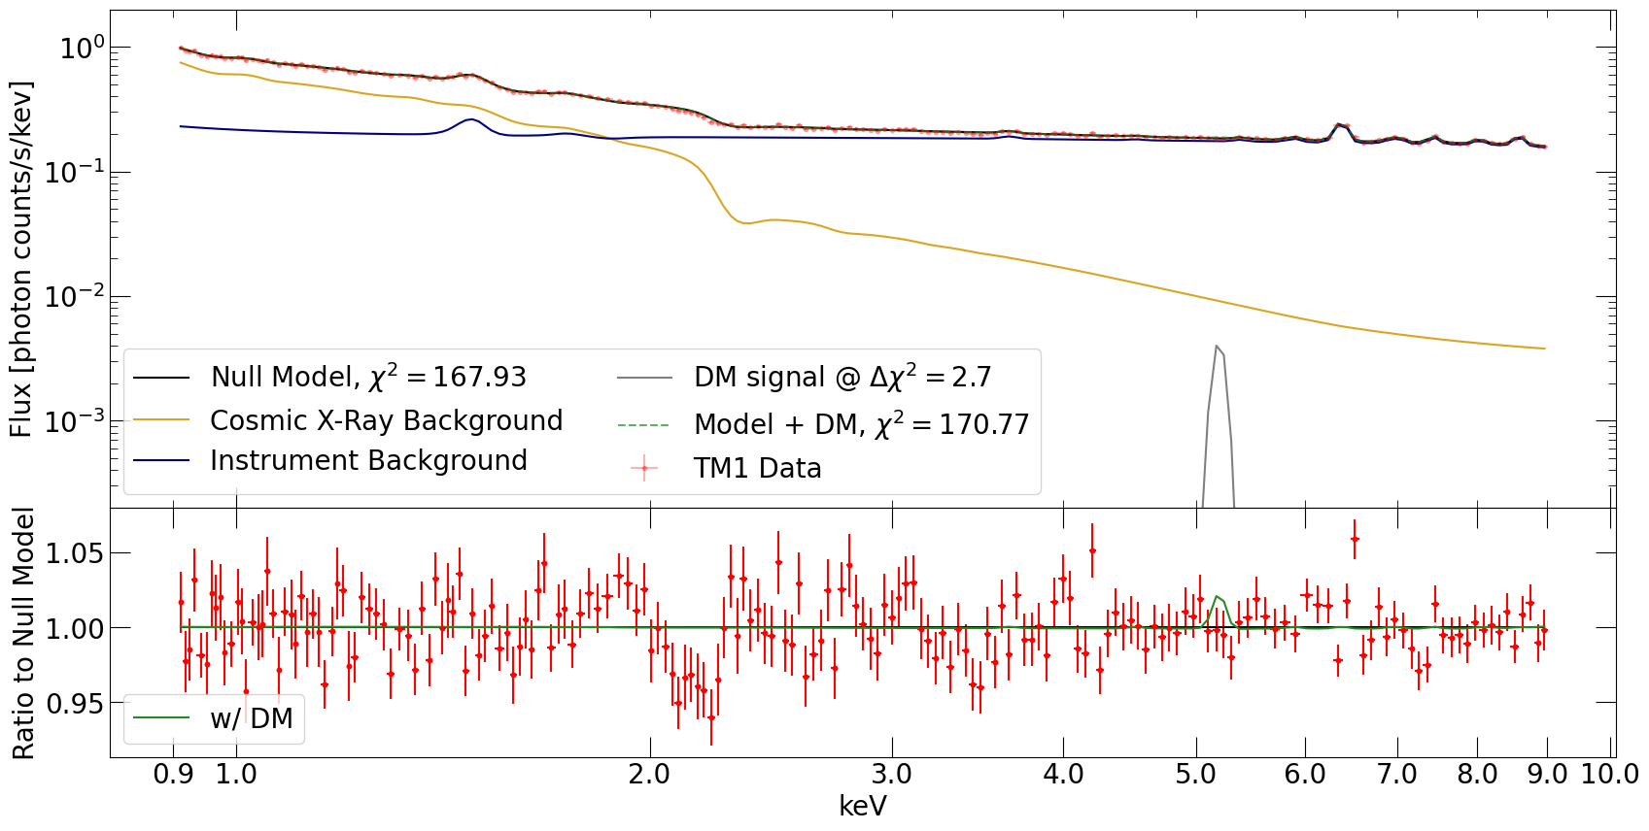
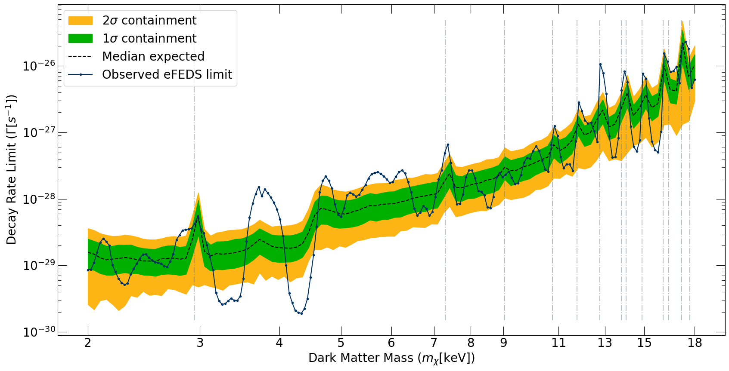
Dark Matter Test
Mock signal + Null model ${Σχ}^{2}\left(Γ\right)−Σχ_{0}^{2}=2.71$, 1 sided 95% upper limit
Increase confidence by doing 1000 Monte Carlo runs
Most limit falls within $2σ$ band
Out of bounds regions are either Gaussian line, or feature in response function
As eROSITA effective area model improves, our limits will be more reasonable
C. Fong, K. C. Y. Ng, Q. Liu, 2023 (in prep)

Slide 11
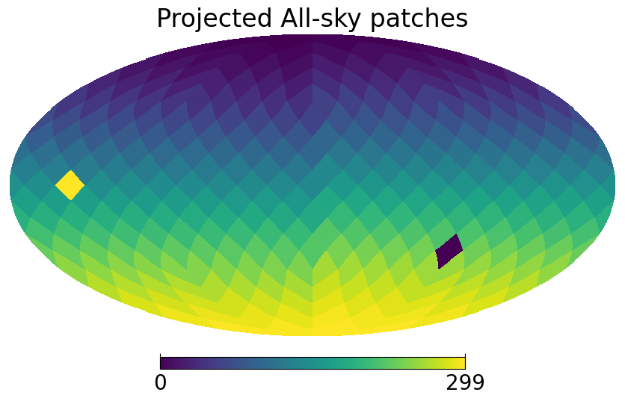
All sky projection
eFEDS
1 mock data set, perfect model assumed (Asimov procedure)
Healpy generated 300 patches of sky, same area as eFEDS
From DM column density D-factor estimate the limit obtainable from each patch
MW Center

Slide 12
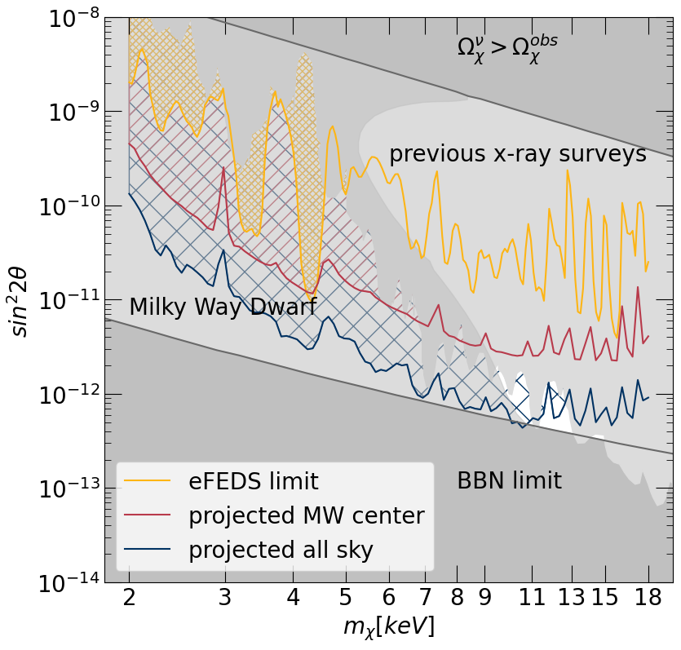
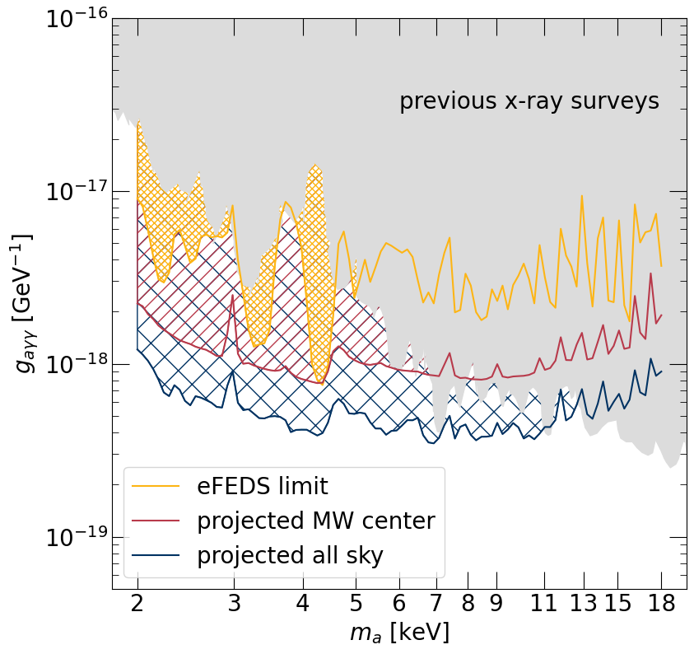
Particle Constraints
Sterile Neutrino DM parameters are nearly closed out
BBN limit, milky way dwarf galaxy count, previous x-ray tests
We predict eROSITA all-sky limit CAN (nearly) close out $νMSM$
Axion-like particle parameters has more “free room” to explore
C. Fong, K. C. Y. Ng, Q. Liu, 2023 (in prep)
Takeaway: even with early data, eROSITA is already probing into uncharted territories!

Slide 13
Conclusion & Outlook
We demonstrated the potential of eROSITA in astrophysical DM searches by using its early data to produce one of the best limit on DM lifetime in X-ray
By converting the limit into a few DM particle models, we ruled out new parameter space
With eROSITA planned (German) data release coming up in September 2023, we could produce even stronger limits, nearly rule out minimal neutrino standard model DM
New approaches and strategies could easily be adapted to our eROSITA DM search. E.g.: DM annihilation, use dense dwarf galaxy

Slide 14
Questions?

Slide 15
Rebinning
Equal width bins in log space
Narrower than 1 photon energy ($FWHM$) resolution but wider than many photon energy resolution ($FWHM/\sqrt{N}$)

Slide 16
Extra Topic: the Case for Delta Line
DM decay line signal can be redshifted either cosmologically in Extra Galactic (EG) DM signal, or by velocity dispersion in galactic DM
EG DM would have been shifted into a continuum.
We didn’t consider EG DM due to it will be degenerate with other continuum. In practice although the flux is high compared to galactic, EG flux doesn’t improve the fitting result.
Galactic flux red shift should be smaller than eROSITA energy resolution, such that the delta line assumption is still valid:
$\frac{Δf}{f}=\frac{v}{c}<\frac{ΔE}{E}≈0.1\%$
$v=3e5 km/s$ galactic DM definitely doesn’t have this much dispersion

Slide 17
Extra Topic: ALP DM 101
ALP
Unlike QCD Axion DON’T solve strong CP problem
Couples to EM field and converts to photon
Can decay into 2 photons

Slide 18
Extra Topic: Dark Photon and Limits
Can decays into 3 photons
Already constrained by other means, such as direct detection
In astrophysics side, can use lifetime of horizontal branch star and solar lifetimes
Comparing to astrophysical ones, eROSITA isn’t competitive.

