Slide 1
CloverS: Coherent eLastic neutrinO-nucleus scatteRing at CSNS
progress report
Qian LIU
University of Chinese Academy of Sciences
2023.7.5

Slide 2
Outline
Science of CE$ν$NS
Neutrino from CSNS
The Cryogenic undoped CsI detector
Background investigation
Expected output and schedules

Slide 3
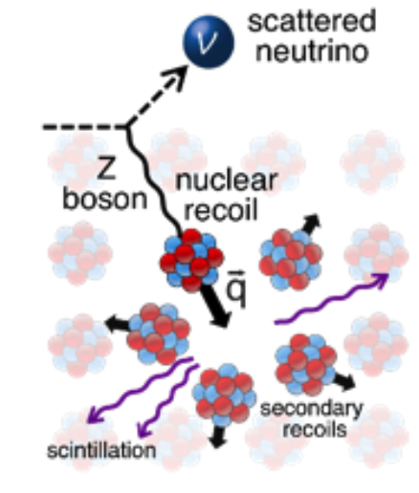
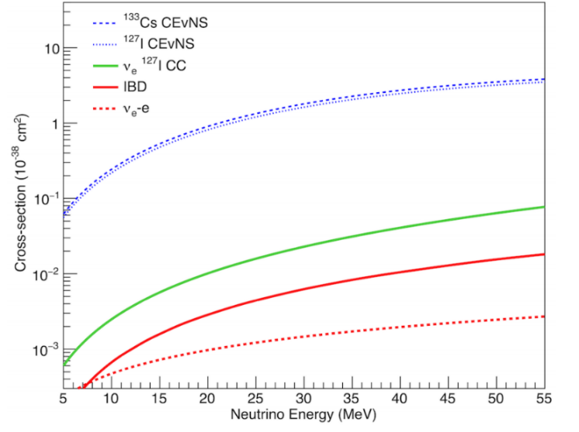
CEνNS coherent elastic neutrino-nucleus scattering
CEνNS cross section is large!
CEνNS : neutrino scatter on a nucleus via exchange of a Z boson.
CEνNS cross section is well calculable in the SM
$\frac{dσ_{0}}{dE_{r}}=\frac{G_{f}^{2}}{4π}m_{a}{\left[Z\left(4\sin^{2}{Θ_{W}}−1\right)+N\right]}^{2}\left(1−\frac{m_{a}E_{r}}{2E_{ν}^{2}}\right)$
Coherent up to $E_{ν}～ 50$ $MeV$
Nuclear form factor correction, important at $E_{ν}> 20$ $MeV$
High order corrections <5%
$$∝N^{2}$$

Slide 4
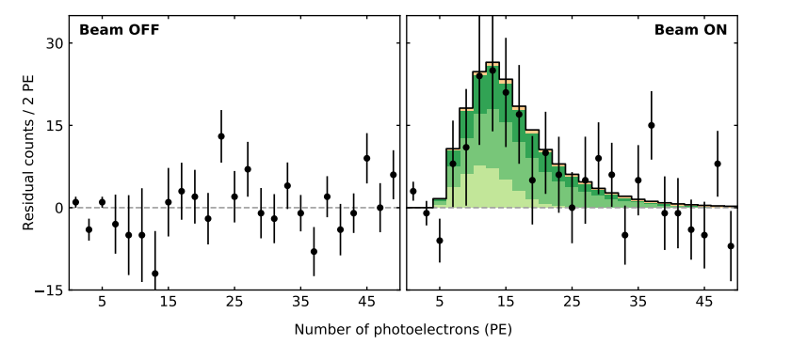
Motivation
COHERENT Collaboration Result
First Detection at 2017------CsI(Na)： $6.7σ$ significance，$1σ$ agreement with SM
2020-------LAr：
$3σ$ significance, $1σ$ agreement with SM
Verification at 2021------CsI(Na): $11.7σ$ significance, $1σ$ agreement with SM
Independent Experiment Verification is Important!

Slide 5
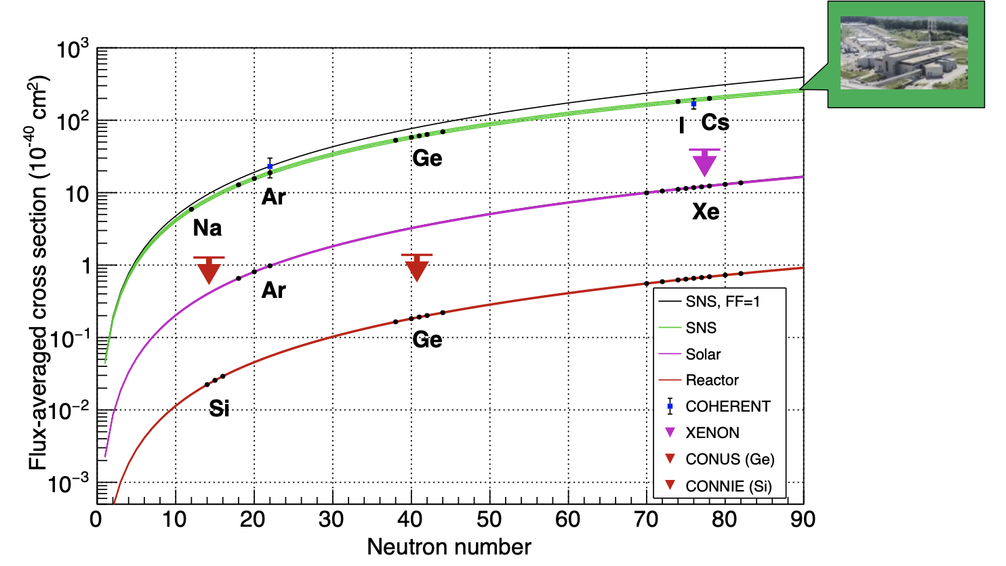
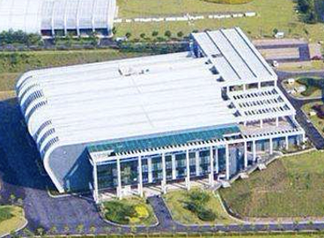
Motivation
CSNS
Any deviation from N² prediction can be a signature of beyond-the-SM physics
5

Slide 6
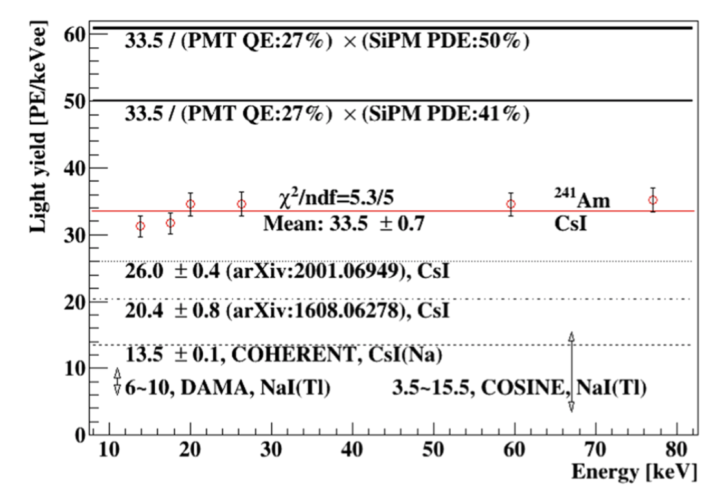
Proposal: Cryogenic pure CsI crystal @ CSNS
EPJC(2020)80:1146
CsI+R11065 PMT
@ 77K
CsI(Na) @ RT
COHERENT
At liquid nitrogen temperature ，CsI + R11065，33.5pe/keVee
The light yield is 2.5 times higher than that of COHERENT

Slide 7
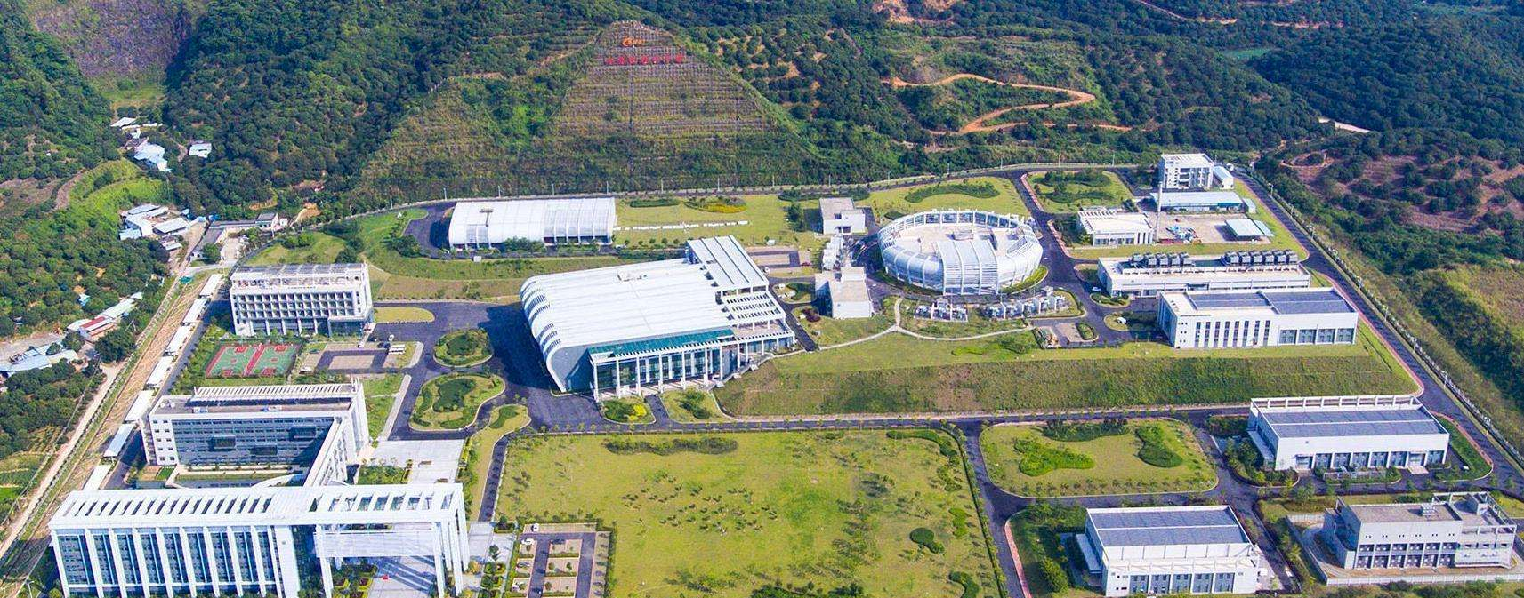
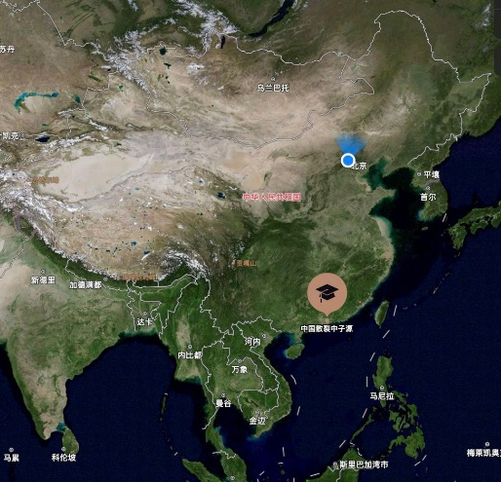
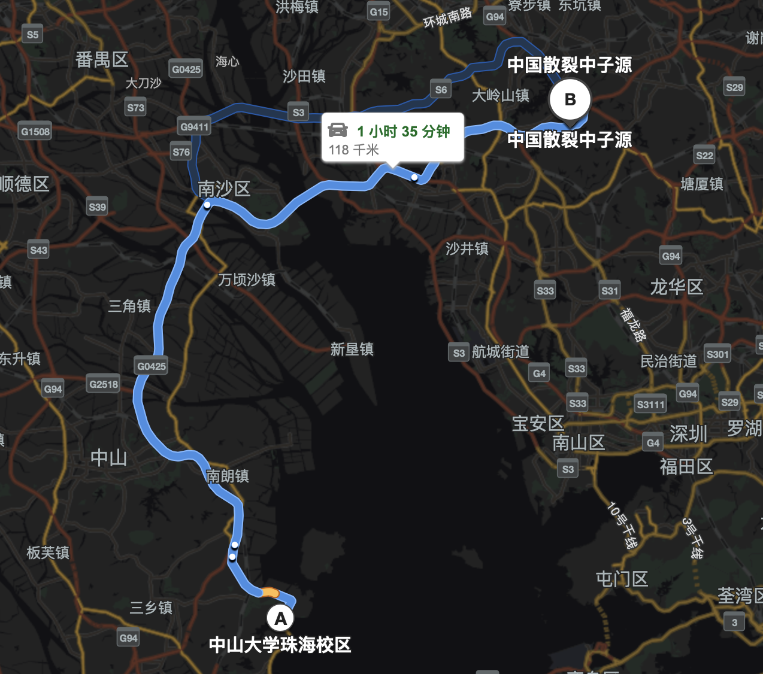
China Spallation Neutron Source CSNS
1.5 hours to CSNS
Guangdong Province
7

Slide 8
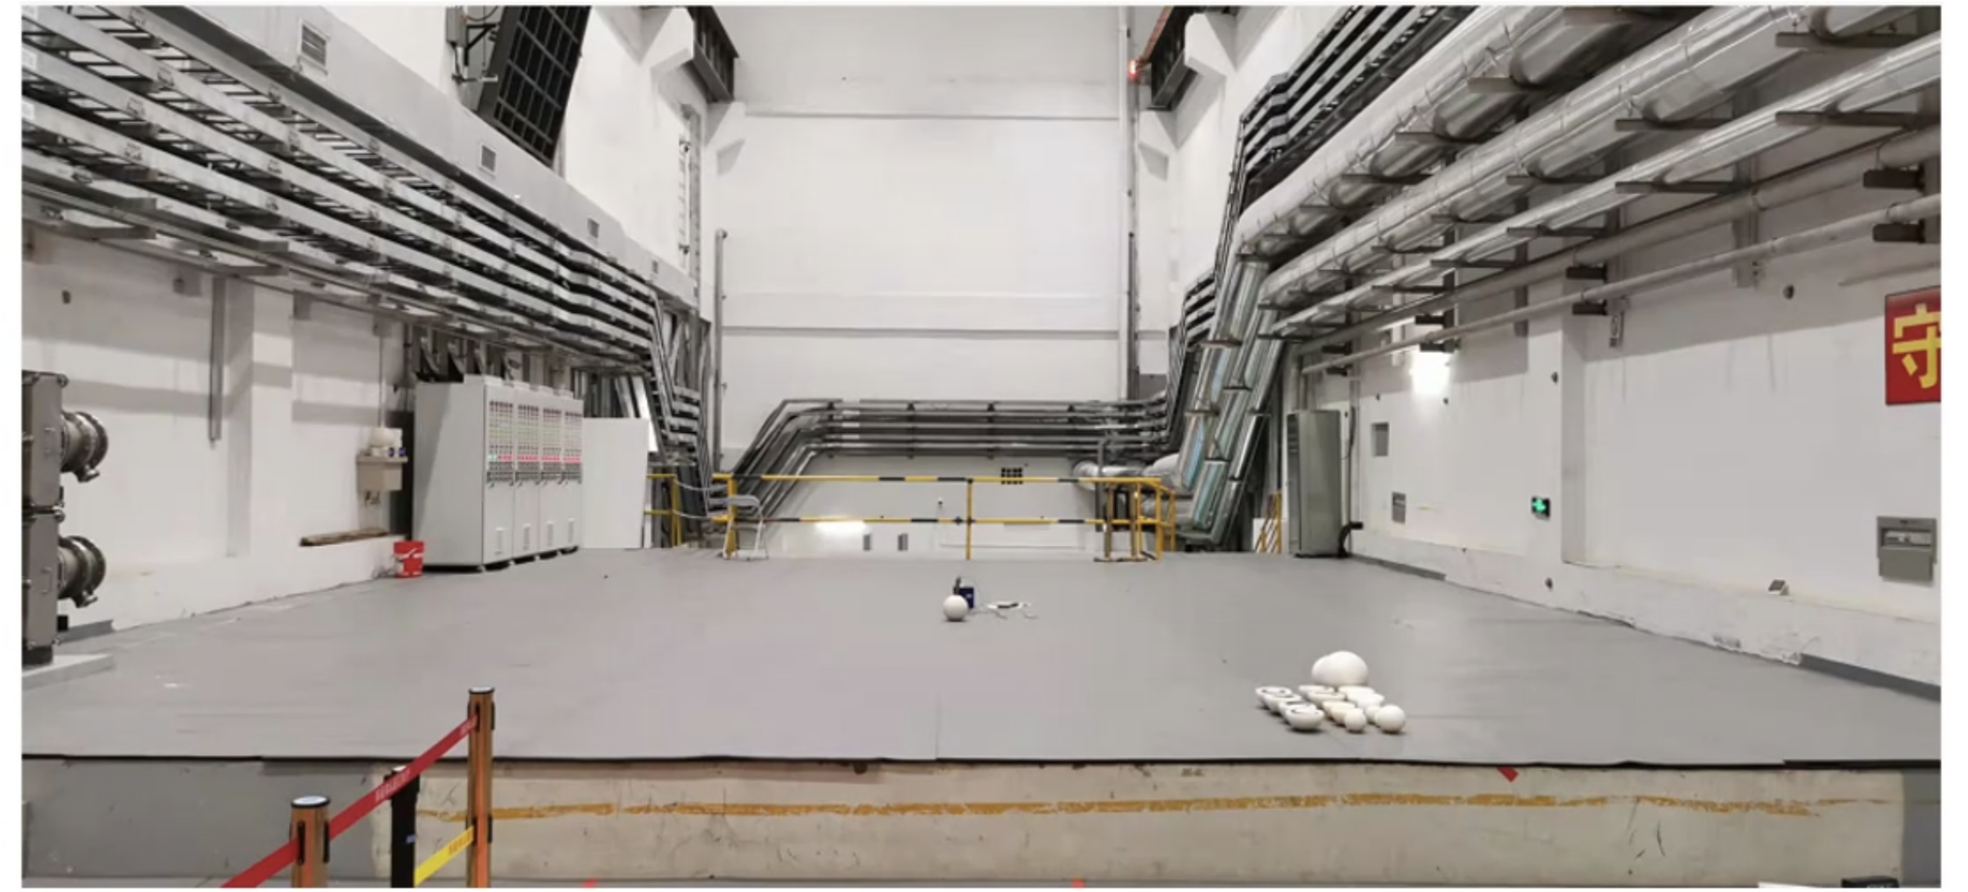
CSNS Top platform of the target station
Bonar Sphere detector
The collision point is located 7.7 meters below the platform
Pros
Significantly shorten the distance
& increase the neutrino flux
Cons
beam-related neutron backgrounds
shielding is needed

Slide 9
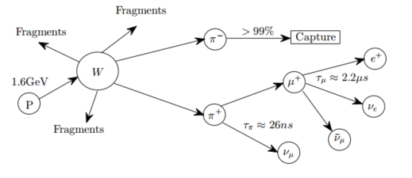
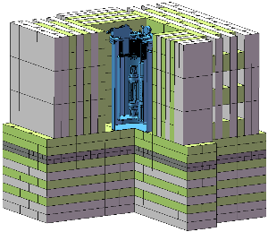
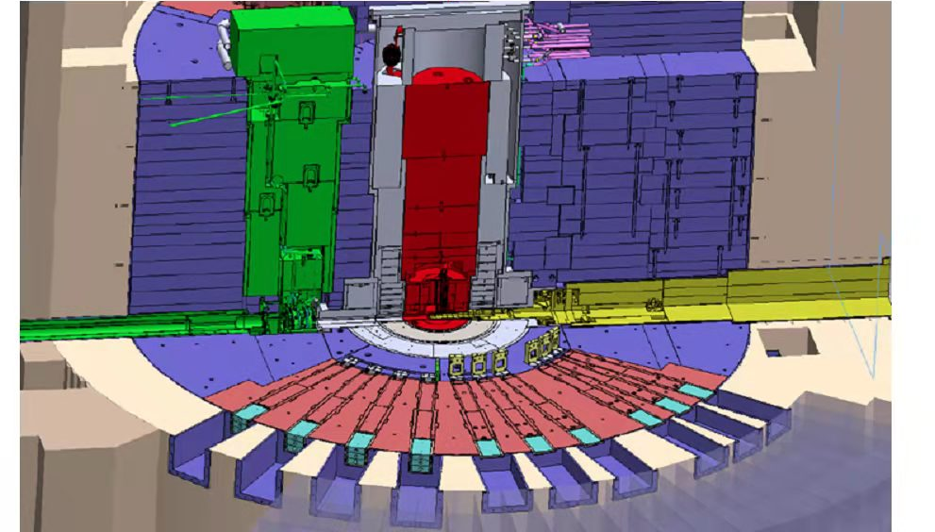
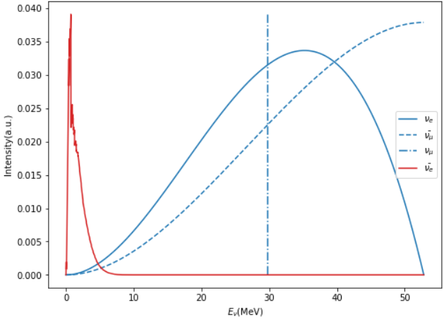
Neutrino flux @ CSNS
Huang, Ming-Yang Chinese Physics C 40.6 (2016): 063002.
Detector Location
Neutrino Flux: $2.42×{10}^{10} /cm^{2}h$ per flavor @ 10.5 m (7.7m + 2.3m shield + offset)
Neutrino production
Neutrinos via Pion Decay-at-Rest(DAR)
0.17/proton/flavor or higher!
Det. With Shielding
Red: rector neutrino
$${\overline{υ}}_{μ}$$
Blue: CSNS neutrino
$${\overline{υ}}_{e}$$
$$υ_{e}$$
$$υ_{μ}$$
9

Slide 10
CSNS vs. SNS
 | CSNS | SNS
Beam Powe(MW) | 0.14 (will upgrade to 0.15 in the near future) | 1.4
Proton Energy(GeV) | 1.6 | ~1.0
Target | W | Hg
Target size(cm³) | 5×15×60 | 39.9×10.4×50.0
Repetition rate(Hz) | 25 | 60
Neutrino production | 0.17/proton/flavor | 0.08/proton/flavor
Neutrino Flux ($cm^{−2}h^{−1})$ | $$2.42×{10}^{10}$$ | $$5.92×{10}^{10}$$
Distance to IP $(m)$ | 10.5 | 19.3

Slide 11
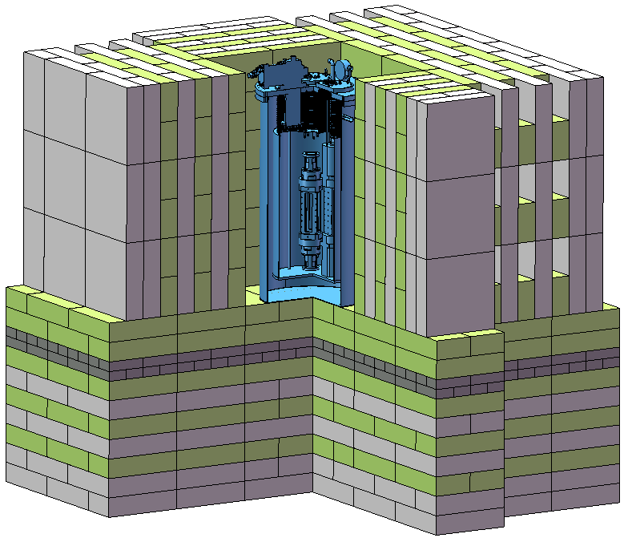
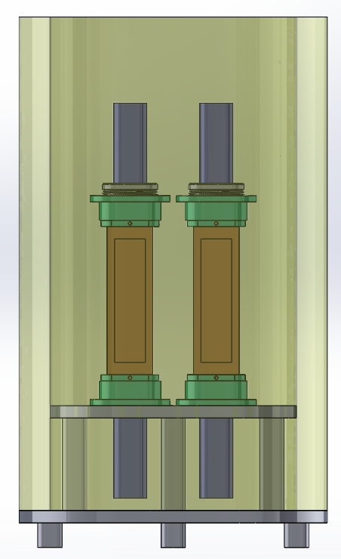
Experiment Design
LN2
R11065 PMT
double side readout
$$ν$$
Photons
CsI: 3kg × 4
N
Photons
PTFE
Dewar
~1.2m
Detector is ~10.5m from Target
(Shielding～2.3m)
CSNS beam provides trigger signal
Cosmic ray anti-coincidence system provides veto
Flash ADC data taking at 8 channel
50μs data taking window and waveform analysis

Slide 12
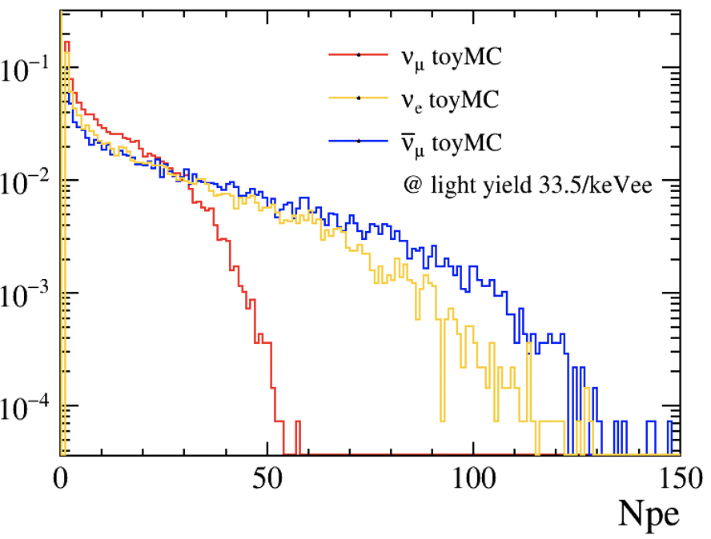
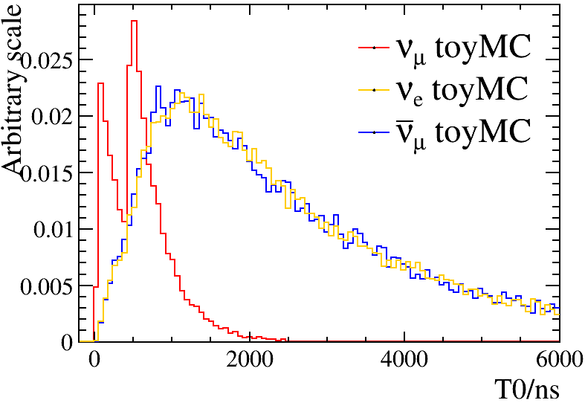
CEνNS Signal Spectrum
preliminary
preliminary
The following processes have been considered: Cross section, nuclear recoil energy, scintillation due to nuclear deposition, light collection, and converting into detector signals
The preliminary criteria：Npe ∈ [2,100],
The number of signal events per year：𝜈_𝜇 (134), 𝜈_𝑒 (154), 𝜈 ̅_𝜇 (197)

Slide 13
Background Investigation
80 cm HDPE
Radioactive background
Environmental gamma
Beam related neutron
Cosmic ray
Neutrino induced neutron
PMT dark count & Cherenkov light
60cm
5 cm PS
150cm
60 cm Lead
30 cm HDPE
Not to scale
To be optimized

Slide 14
Radioactive background
Radioactive isotopes from detector materials
Unit: mBq/kg
Mass:kg
 | K40 | Ra226 | Ra228 | Th228 | U238 | Ac228 | Bi214 | Pb212 | Pb214 | Th234 | Tl208 | Th232 | Pb210 | Ar39 | Co60 | Cs137 | Cs134 | Rb87 | Mass
PTFE | 0.343 | 0.12 | 0.11 | 0.065 | 1.96 | - | - | - | - | - | - | - | - | - | - | 0.17 | - | - | 32
Fe | 60 | - | - | - | - | 70 | 25 | 70 | 25 | 200 | 70 | - | - | - | 17 | 6 | - | - | 60
HDPE | 43.3 | - | - | - | 19.8 | - | - | - | - | - | - | 12.2 | - | - | - | - | - | - | 194
PMT | 37.1 | - | - | - | 5.2 | - | - | - | - | - | - | 13.4 | - | - | - | - | - | - | 9
Roman Lead | 1.3 | 0.3 | - | 0.3 | - | - | - | - | - | - | - | - | 120 | - | - | - | - | - | 2100
Modern Lead | - | 3 | - | 1 | 0.12 | - | - | - | - | - | - | - | 240000 | - | - | - | - | - | 7600
Liquid Nitrogen | - | - | - | - | - | - | - | - | - | - | - | - | - | 0.01 | - | - | - | - | 86
CsI | - | - | - | - | - | - | - | - | - | - | - | - | - | - | - | 150 | 50 | 8.7 | 12
COHERENT measured the radioactive background of CsI(Na) to be 10mBq/kg
KIM measure it to be typically 200mBq/kg，take KIMS’s result as a conservative estimation
14

Slide 15
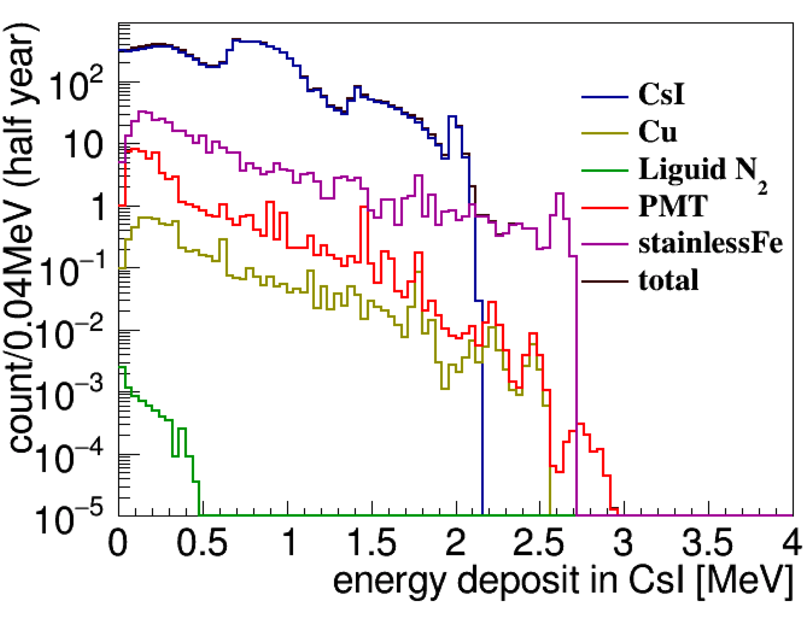
Radioactive background
CsI dominate, stainless steel and PMT follows.
After event selection，radioactive background events that surviving all cuts within [0.12 - 3] keVee，is ～23/year.
We can also try to measure the 661keV gamma peak of Cs137 to do a in-situ monitor of Cs137 background
15

Slide 16
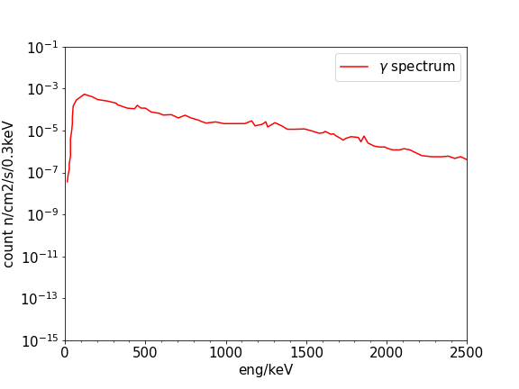
Environmental Gamma
Environmental gamma background
Accumulated spectrum for half an year
Environmental gamma rate
Energy deposition spectrum in CsI after the shielding
After shielding，contribution from environmental gamma is ~ 0.1/year
16

Slide 17
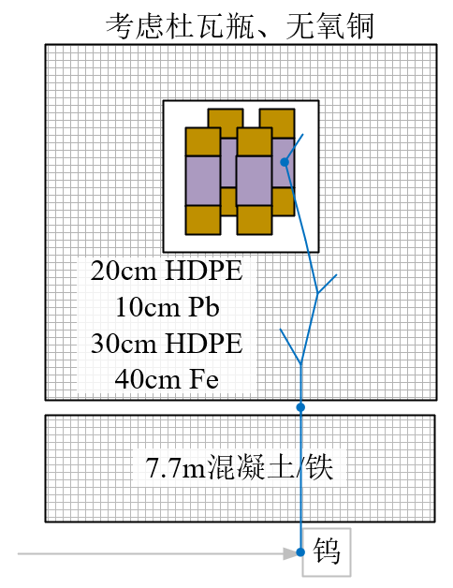
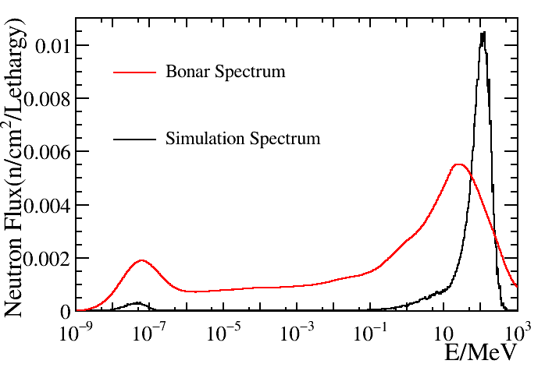
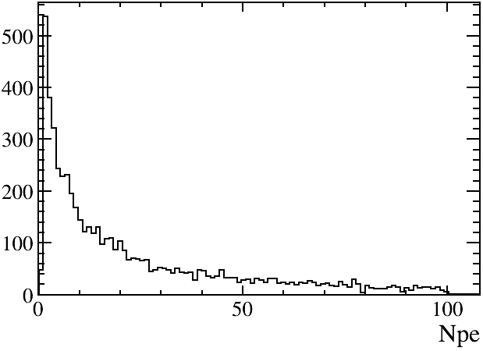
Beam related neutrons (BRN)
preliminary
Triggered by CSNS beam, only fast neutrons can reach CsI within our time window
After event selection, BRN rate ~2500/year with the shielding.
Energy deposition spectrum in CsI
preliminary
17

Slide 18
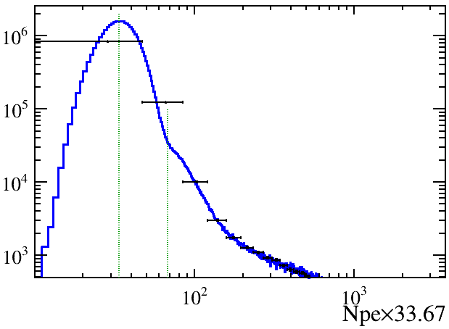
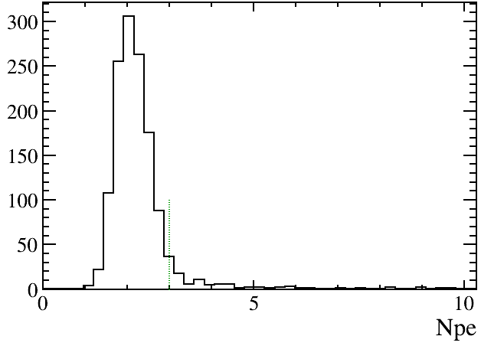
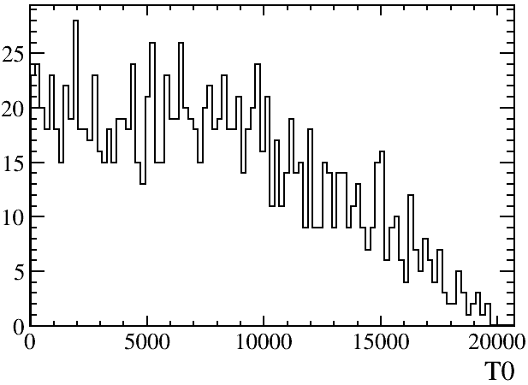
PMT dark count and Cherenkov background
PMT dark count rate has been measured to be (110Hz)
Coincidence of the dark count from two PMTs
| ${T0}_{1}−{T0}_{2}$|<10$μs$，T0 = min(${T0}_{1}, {T0}_{2}$)$∈[0, 20]μs$
${Npe}_{1}≥1$ & ${Npe}_{2}≥1$
Dark count rate ~300/year@Npe $≥4$
Experiment measured PMT dark count spectrum@77K
preliminary
PMT dark count rate
Time spectrum of PMT dark count
preliminary
preliminary
18

Slide 19
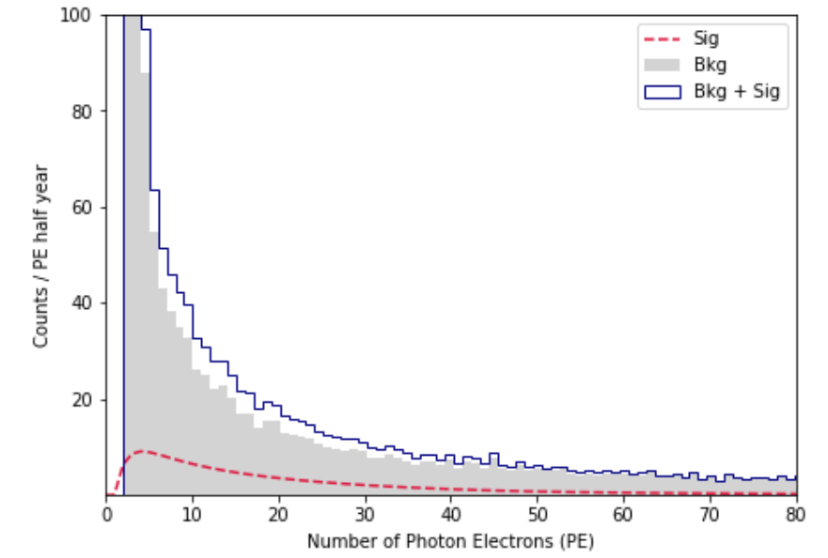
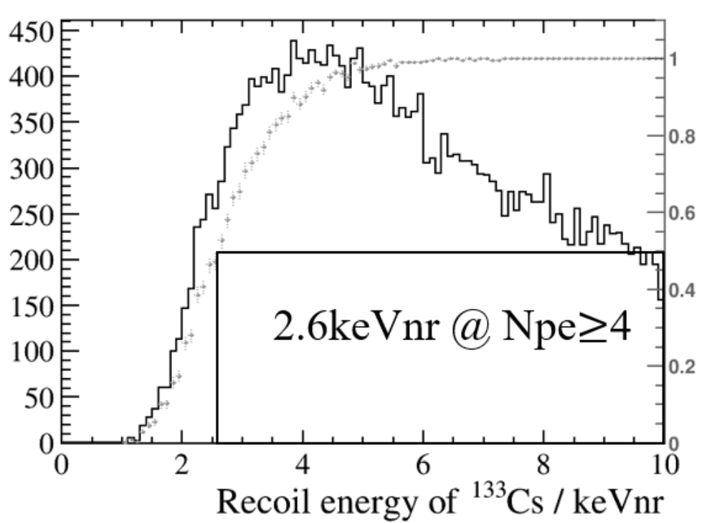
Threshold
cut
Contribution from PMT dark count
Selection Efficiency
NPE threshold taken as 4，Equivalently～2.6keVnr threshold
Potential to further down to 3。Background dominated by PMT dark count coincidence.
19

Slide 20
Background Investigation
Background type | Number of event sin 1 year | MC simulated | Event rate after cut (per year)
Radioactive background | $$2.32×{10}^{6}$$ | $$1.87×{10}^{7}$$ | 16
Environmental gamma | $$9.44×{10}^{8}$$ | $${10}^{10}$$ | 0.1
Beam related neutrons | $$5.38×{10}^{5}$$ | $${10}^{7}$$ | ～2500
PMT dark count | $$3.74×{10}^{6}$$ |  | ～300
Neutrino induced neutrons | - | - | negligible
Comic ray induced radioactive isotopes | - | - | negligible
20

Slide 21
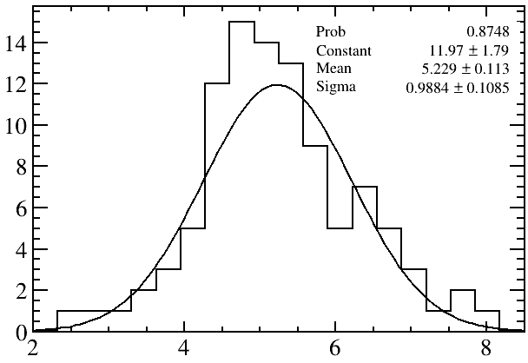
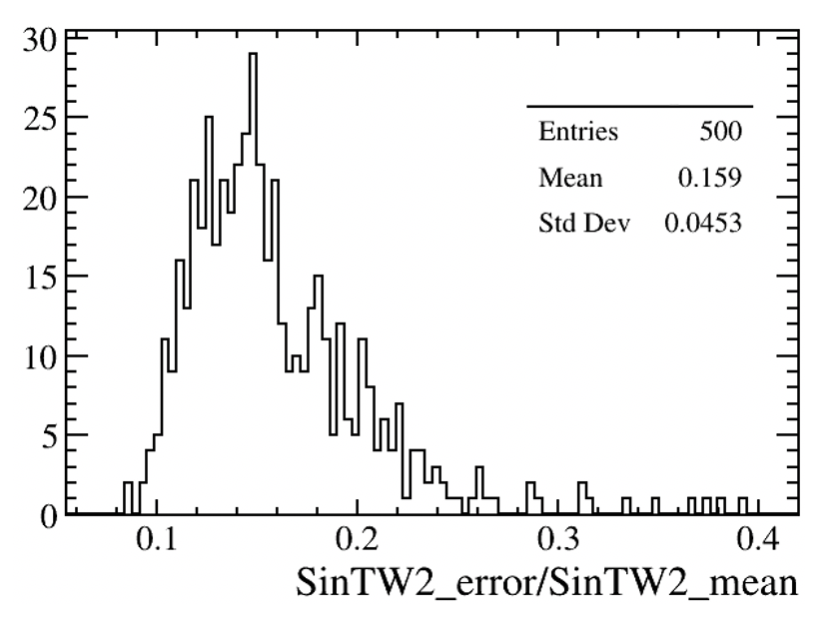
Expected sensitivity
12kg undoped CsI crystall，33.5p.e./keVee; 1 year data taking, significance～5.2σ
$\sin^{2}{θ_{W}}$ at low momentum transfer. Statistical error~16%
21

Slide 22
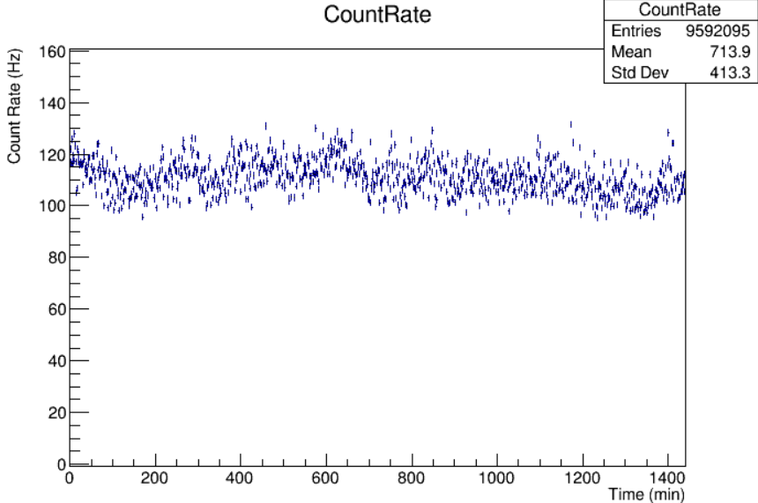
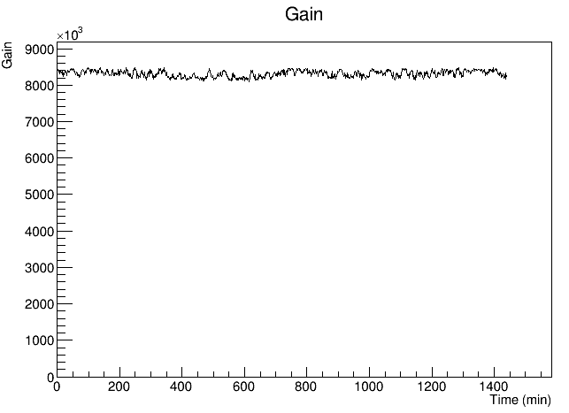
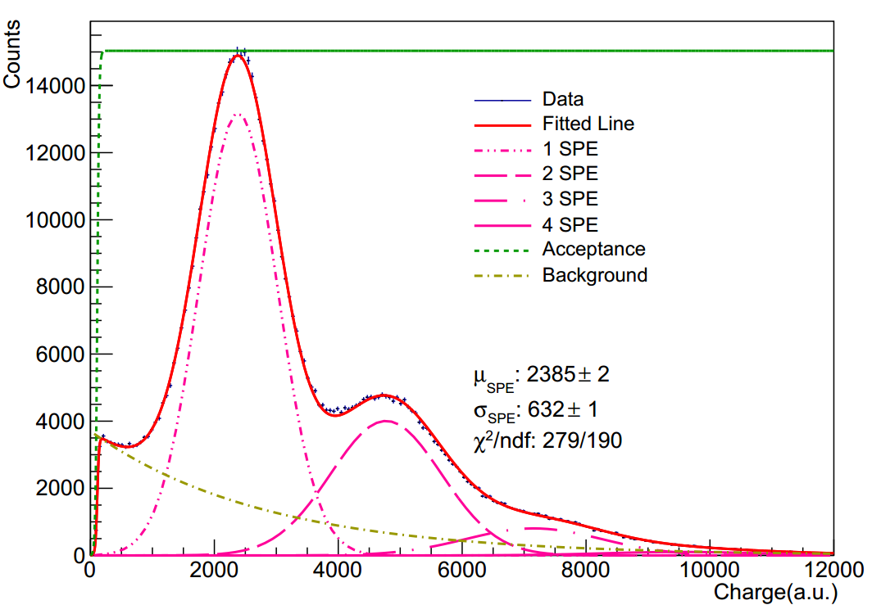
Experiment：PMT R11065
R11065
PMT dark count rate @ 77K: ～110Hz
PMT gain @ 77K: ～8.3E6，and stable
RMS 1.07%
22

Slide 23
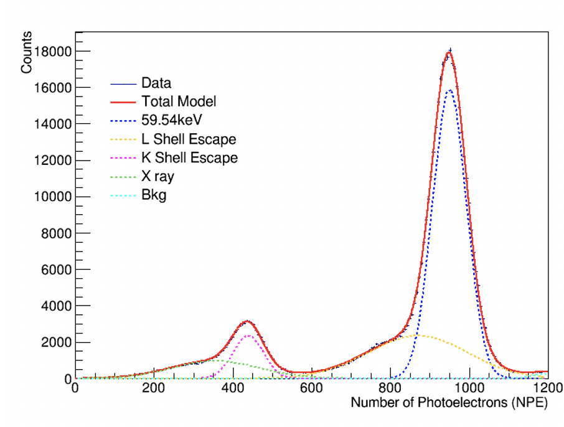
Prototype test
R11065
77K big CsI crystal light yield test～15.8p.e/keVee
The light yield can be further improved by enhancing the optical coupling and employing wavelength shifters, etc.
23

Slide 24
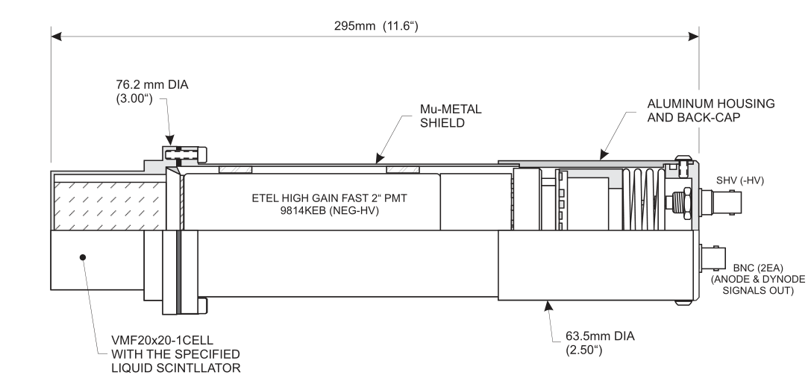
BRN measurement-LS detector
Use LS capable of N/$γ$ discrimination to measure the BRN
R11065
-HV(1950V)
net
EJ301
PMT
DT5751
PC
交换机
Beam
Trigger
Calibrated EJ301 Liquid Scintillator detector
Remote controlled HV unit.
DT5751 ADC
Signal triggered by CSNS beam
System controlled by a PC
Detector size: $φ=76.2$ mm $h=295$ mm
24

Slide 25
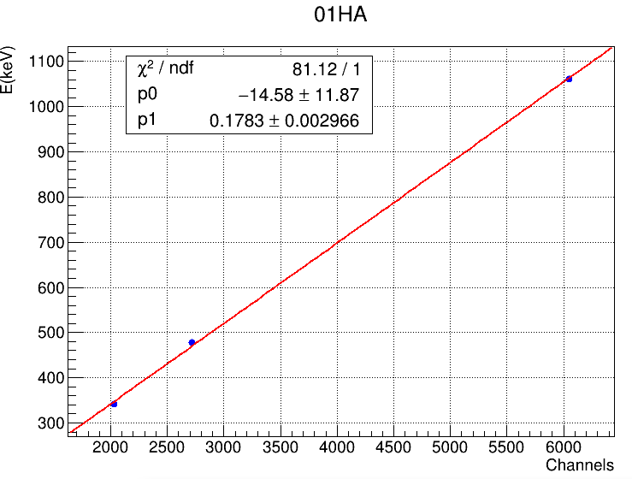
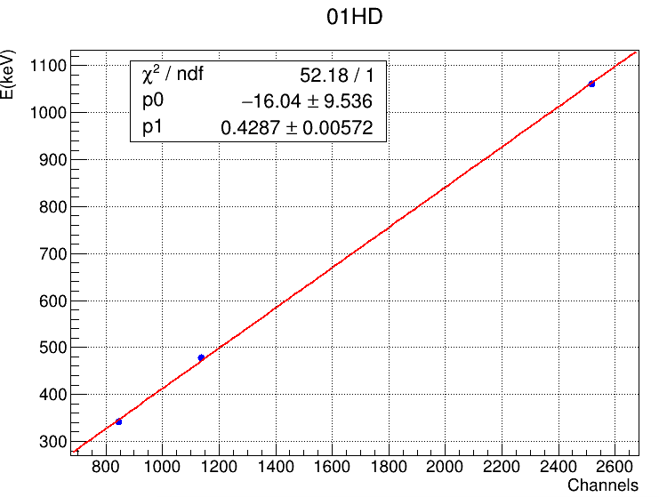
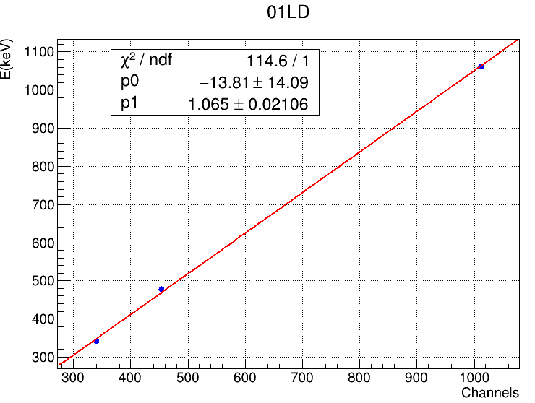
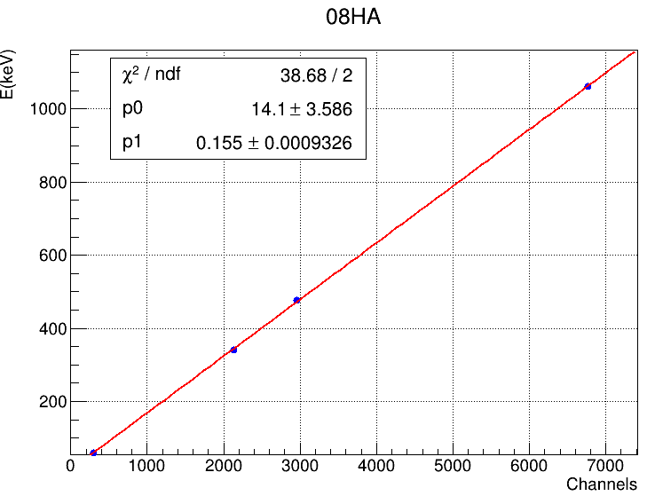
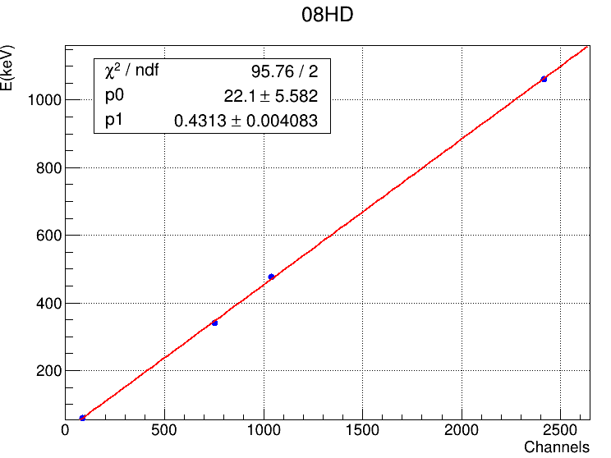
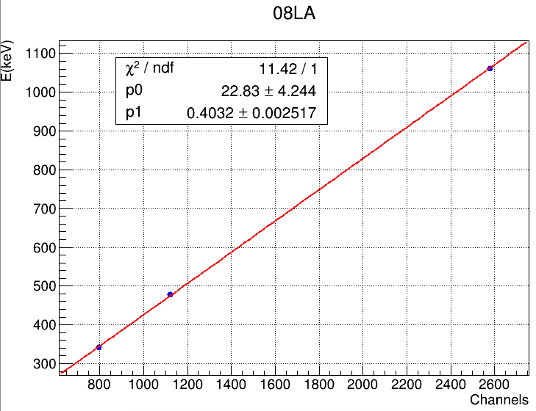
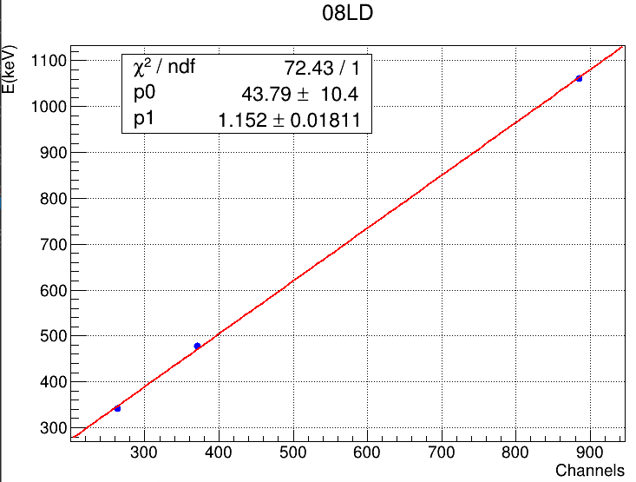
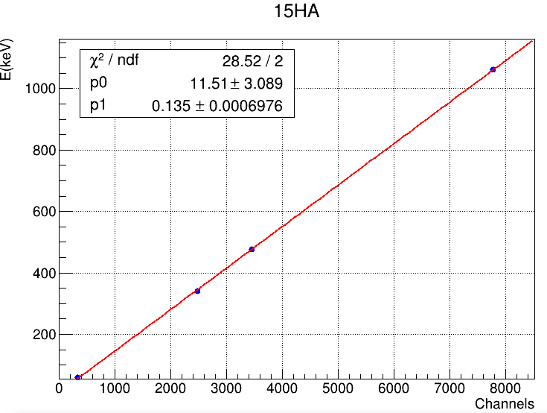
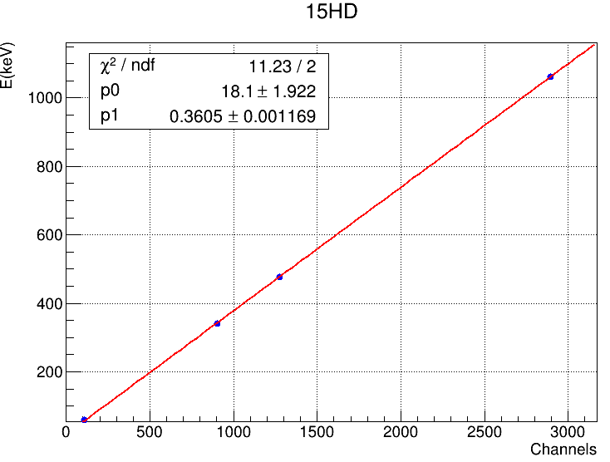
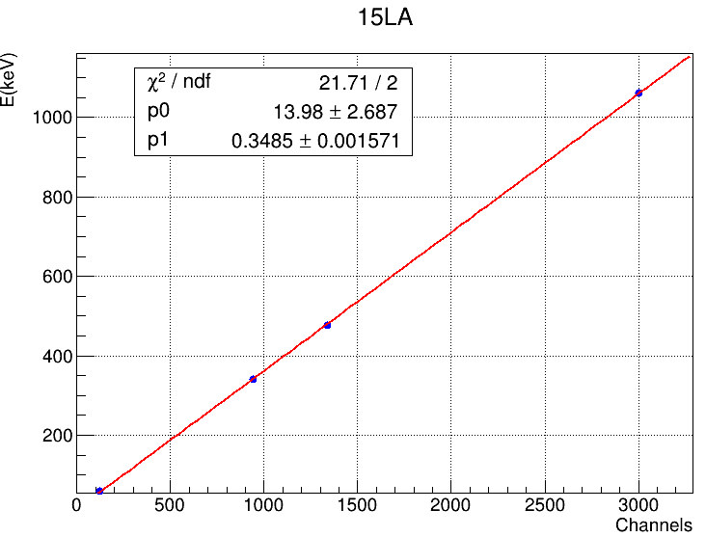
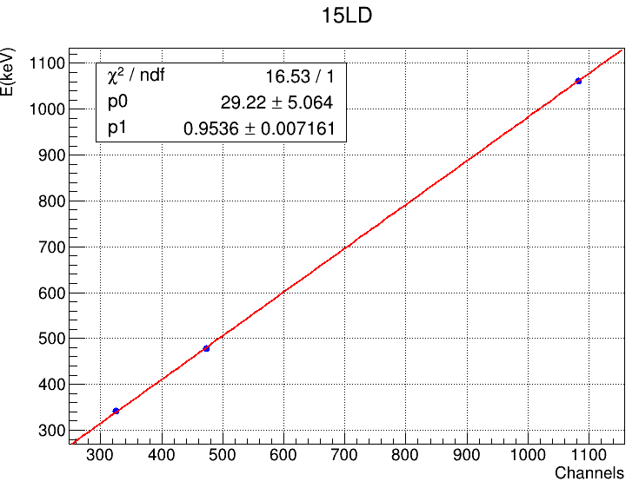
LS detector calibration
SN01
SN08
SN15
Good Linearity!
25

Slide 26
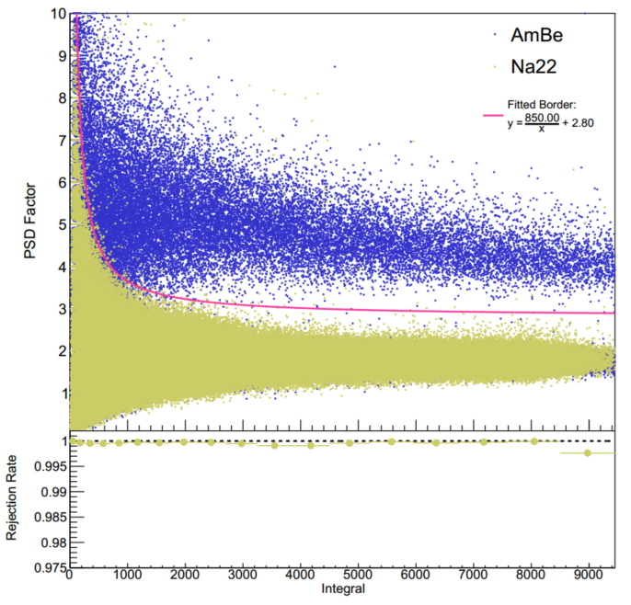
PSD Algorithm N-γ discrimination
Rejection rate to gamma > 99.5%；
Pink Line: Gamma border
Right side of Red Line:
Gamma and Neutron selection efficiency ~ 100%
Left side of Red Line:
Neutron selection efficiency < 100%
26

Slide 27
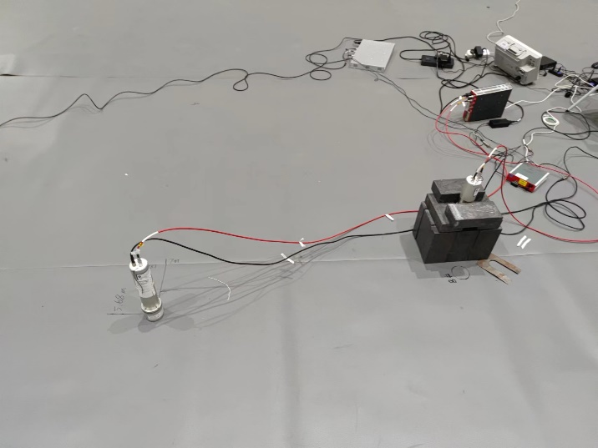
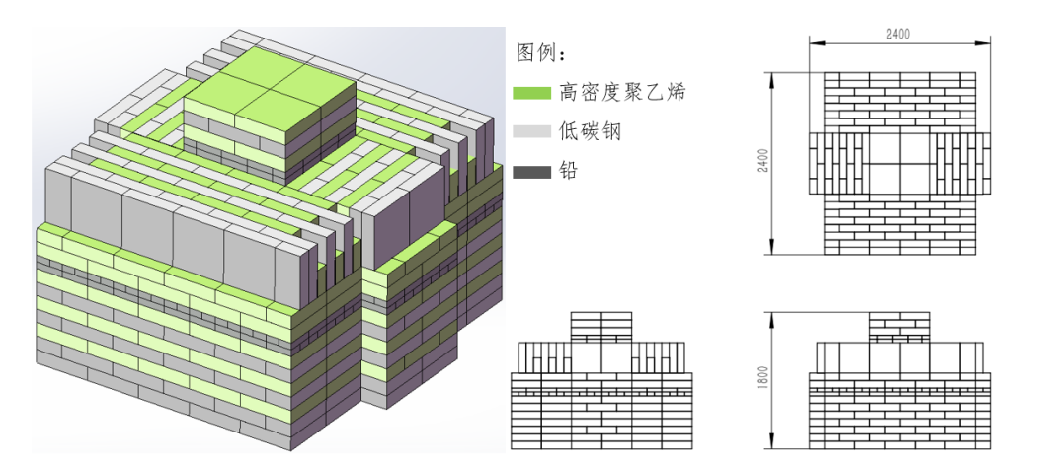
BRN measurement at CSNS
counts
The dual bunch structure with time interval ~ 410ns of the CSNS proton beam is clearly observed.
ns
Scanning the neuron counting rate at different positions in CSNS
X-axis : m
Beam
Y-axis ：m
(1.2, 0) selected to be the detector site
Shielding designed to be 2.4m wide and 1.8m high
27

Slide 28
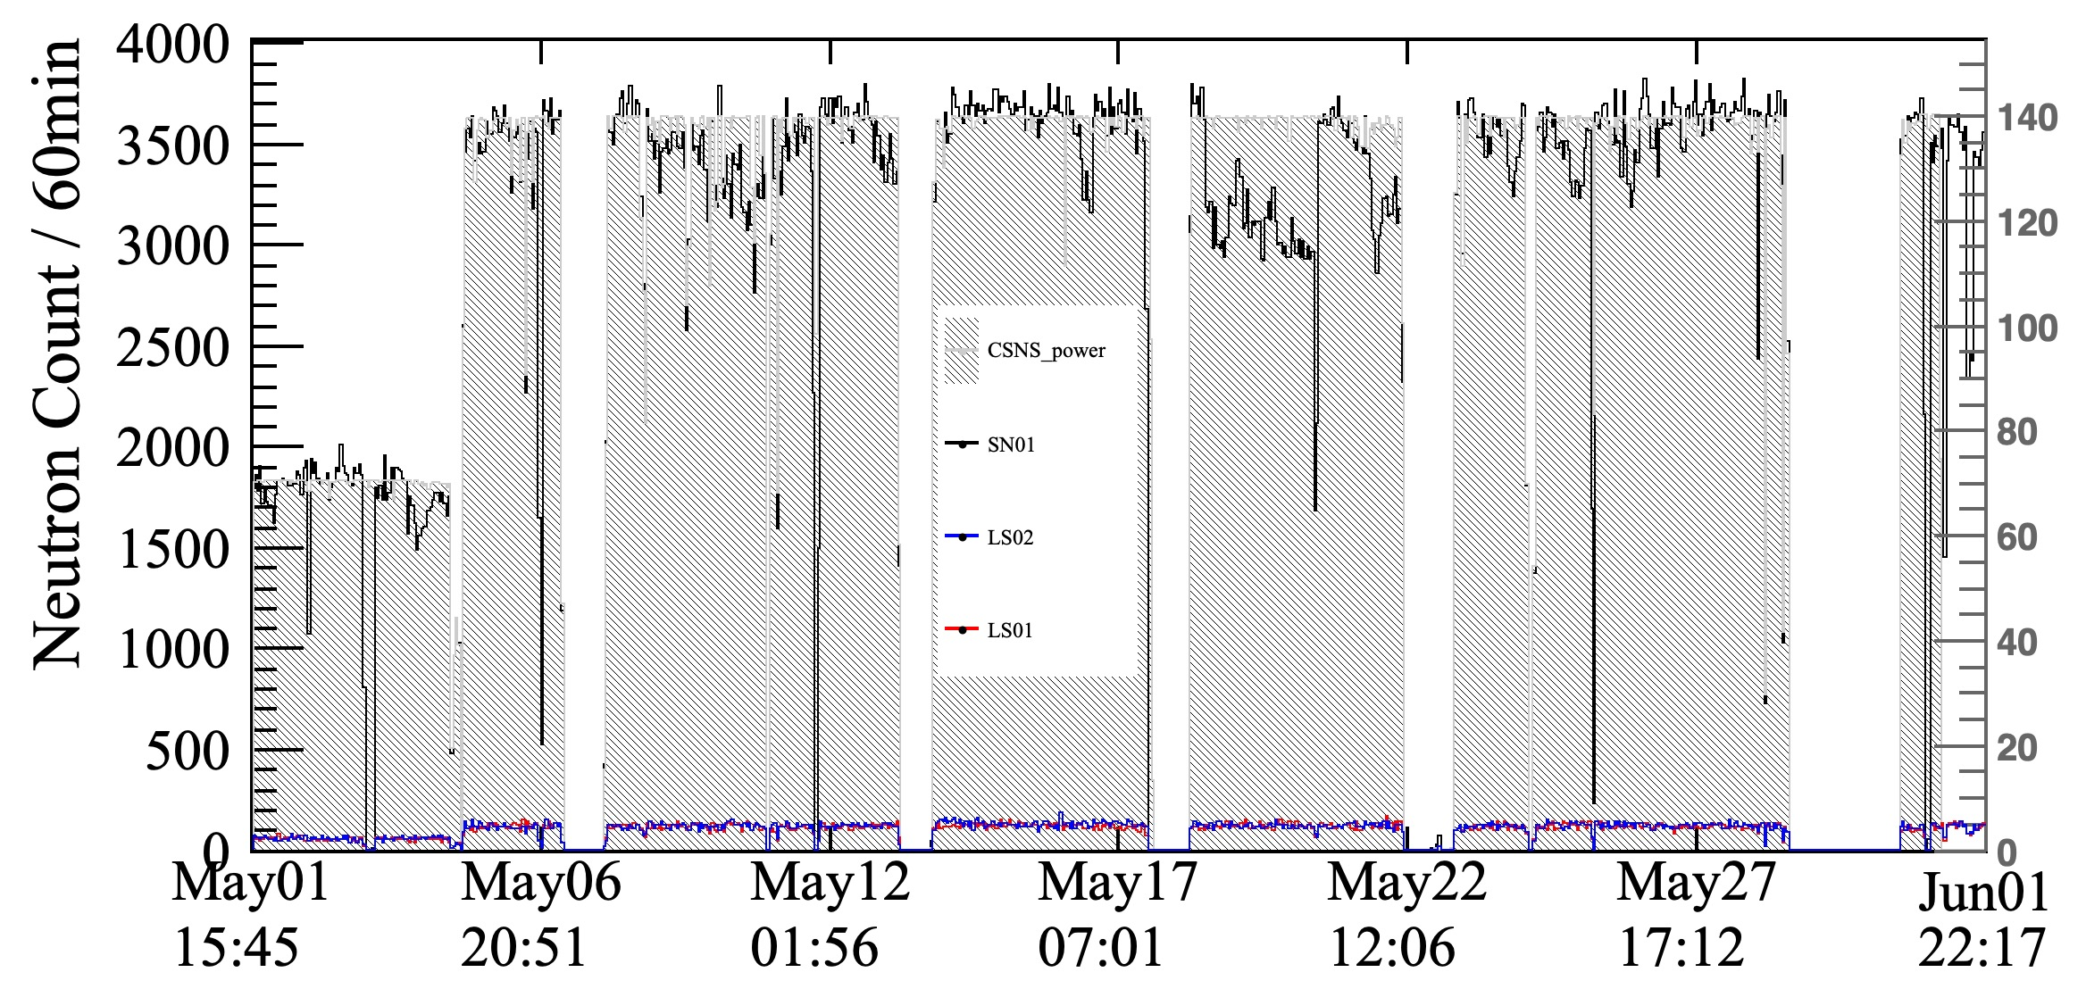
CSNS BRN rate monitoring
Beam Power / kW
SN01: 5’’, （1,0）
LS01: 2‘’, (-1.2, 0)
LS02: 2‘’, (-3, 0)
28

Slide 29
CSNS BRN rate distribution on the platform
2.4m
Normalized to beam power 135kW
(0,0)
(1.2,0)
Near (1.2，0), the neutron background situation is quite similar,
Around 25-50neutrons/h.
This includes the neutron detection efficiency of the LS detector.
29

Slide 30
BRN rate measurement plan
Building three different thickness settings of shielding and measuring the BRN rate.
Simulating the response matrix for each thickness setting of shielding, deconvolving it to obtain the neutron energy spectrum.
Approximately 100,000 events need to be accumulated for each setup, and the testing is estimated to take 2 weeks, with an additional week for installation.
30

Slide 31
CloverS Experiment Schedule
On site background study
Detector assembly fabrication
R11065
Start data taking
2022
2023
2024
2025
Start commissioning
Accumulate the first year data
31

Slide 32
Summary
The detection of Coherent Elastic Neutrino-Nucleus Scattering (CEνNS) involving neutrinos and nucleons is a significant frontier topic in particle physics. It holds great scientific importance for testing the Standard Model at low-energy scales and accurately measuring weak mixing angles.
The experimental setup at the China Spallation Neutron Source (CSNS) allows for placing the detector at a distance of 10.5 meters from the collision point. This greatly enhances the neutrino flux, making CEνNS detection feasible at CSNS.
Utilizing neutrinos from CSNS and employing a pure CsI scintillation crystal detector at liquid nitrogen temperature, the proposed detection scheme offers advantages such as high light yield and low detector dark noise. This effectively lowers the threshold for measuring nuclear recoil energy and thus enhances the sensitivity for CEνNS detection.
Some initial experimental demonstrations have been completed, and further refinement of the experimental plan will be carried out.
32

Slide 34
⁸⁷Rb
10 ppb is taken
34

Slide 35
BRN spectrum measurement
Unfolding Algorithm is implemented to extract BRN spectrum from LS data
Neutron spectrum with shielding is used to estimate the high energy neutron flux at CSNS. Lead will convert GeV neutrons into MeV neutrons can be measured by LS
LS
10cmPb
10cmHDPE
10cmHDPE+10cmPb
Response matrix of 10cmHDPE+10cmPb

Slide 36
BRN spectrum measurement
Combine the spectrum W/WO the shielding, consider the effect of the shielding, we can estimate the energy spectrum of BRN to 1GeV
LS
10cmPb
10cmHDPE
10cmHDPE+10cmPb
Unfolded Neutron Spectrum
Basically consistent with the Bonar result, uncertainty can be improved

