Slide 1
Light quark decays of doubly heavy baryons in light front approach
Speaker : Chang Yang (TDLI)
Date : 05 / July / 2023
DOI : 10.1140/epjc/s10052-023-11263-x

Slide 2
目录 Contents
1
Why did we do it
2
How did we do it
3
What did we get
4
Summary

Slide 3
目录 Contents
1
Why did we do it
2
How did we do it
3
What did we get
4
Summary
5

Slide 4
Why did we do it ——Introduction
Weak decays of quarks can play an important role in testing the standard model of particle physics.
Weak decays of quarks shaping our understanding of CP violation in our universe.
The study of weak decays of quarks insides a hadron provides a platform for the exploration of strong interactions.
Baryons composed of two heavy quarks are special interests and provide a unique arena to explore the QCD dynamics.
A previous analysis which mainly focused on the light-quark decays of heavy hadrons with one heavy quark. [S. Faller, T. Mannel, Phys. Lett. B 750, 653–659 (2015).]

Slide 5
Why did we do it ——Introduction
Very small phase space
Limited channel are allowed
we explore the s → u transition of doubly heavy baryons decays
The spin-1/2 to spin-1/2 decays
Spin-1 bc
Spin-0 bc
The spin-3/2 to spin-1/2 decays

Slide 6
Why did we do it ——Introduction
Small phase space
Difficult to experiments
measurements of semileptonic decay widths can help to provide reliable constraints on the form factors since the recoil is small.
due to the small phase space, the helicity suppression amplitudes in certain semi-leptonic decays are uplifted by the muon mass.

Slide 7
目录 Contents
1
Why did we do it
2
How did we do it
3
What did we get
4
Summary

Slide 8
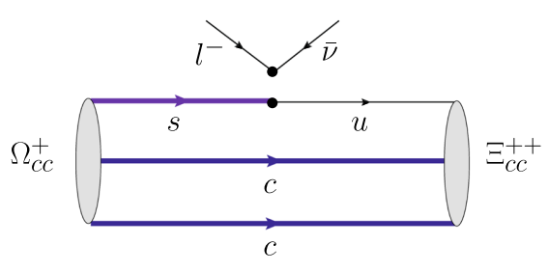
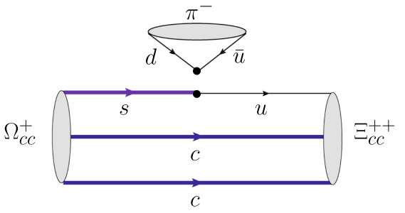
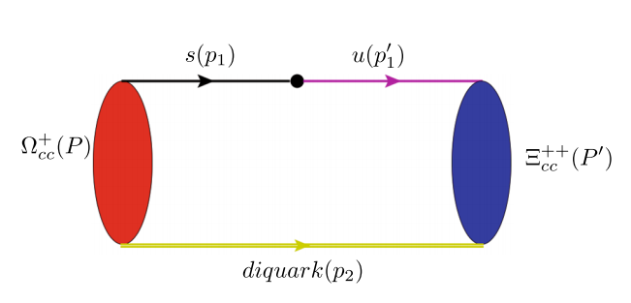
How did we do it —— Theoretical framework

Slide 9
How did we do it —— Theoretical framework
$C_{i}$ are Wilson coefficients
at $m_{s}$ scale

Slide 10
How did we do it —— Theoretical framework
Expressing the Hadron part with form factors
Spin-1/2 to Spin-1/2 :
Spin-3/2 to Spin-1/2 :
$$\overline{M}=M−M^{′}$$

Slide 11
How did we do it —— Theoretical framework
In Light-front quark model (LFQM) :
Spin-1/2 :
Spin-3/2 :

Slide 12
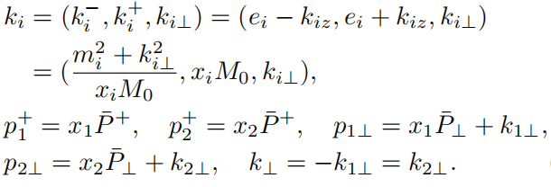
How did we do it —— Theoretical framework
The φ is a Gaussian-type function:
Dynamic relationship:

Slide 13
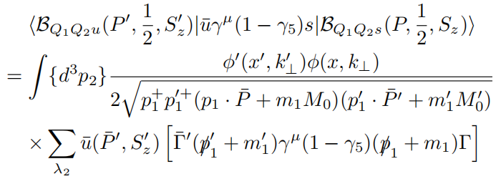
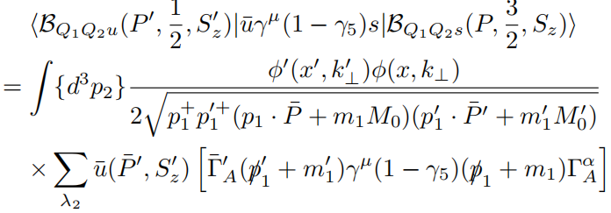
How did we do it —— Theoretical framework
Spin-1/2 to spin-1/2
Spin-3/2 to spin-1/2

Slide 14
How did we do it —— Theoretical framework

Slide 15
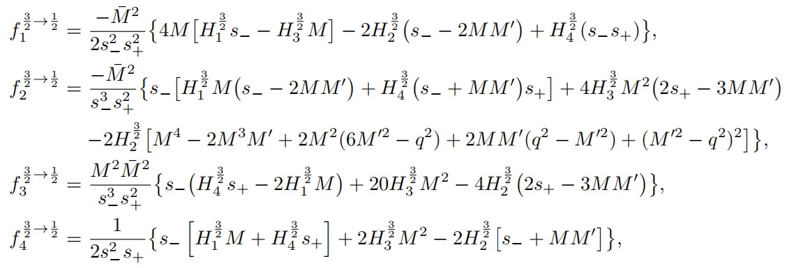
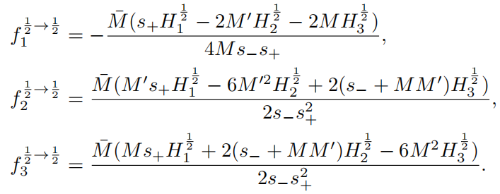
How did we do it —— Theoretical framework
Transformation relationship:

Slide 16
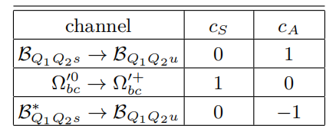
How did we do it —— Theoretical framework
The diquark can be scalar or axis-vector, the physical baryon state is the combination of the baryon state with scalar diquark and axis-vector in LFQM.

Slide 17
目录 Contents
1
Why did we do it
2
How did we do it
3
What did we get
4
Summary

Slide 18
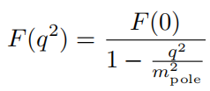
What did we get —— Numerical results
Form factors depends on $q^{2}$, and we take the single pole model
$m_{pole}=0.845 GeV$ for $f_{i}$
$m_{pole}=0.494 GeV$ for $g_{i}$
The form factors can also be extrapolated by fitting the functions in the un-physical region $q^{2}≤0$. In principle, the region of ${−q}^{2}$in the fit should be $−q^{2}≪{(m_{B}−m_{B^{′}}^{})}^{2}$for the accuracy.

Slide 19
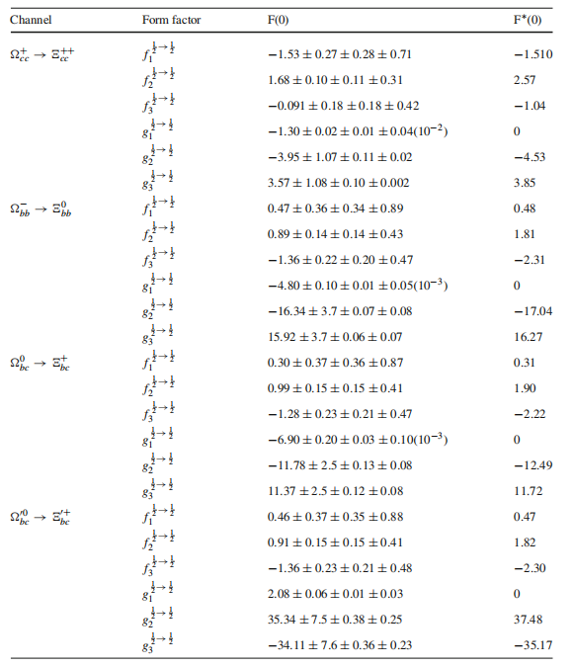
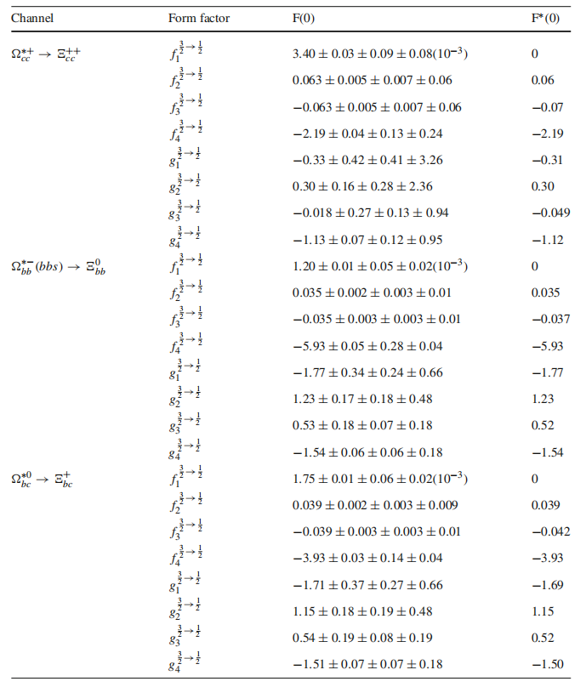
What did we get —— Numerical results

Slide 20
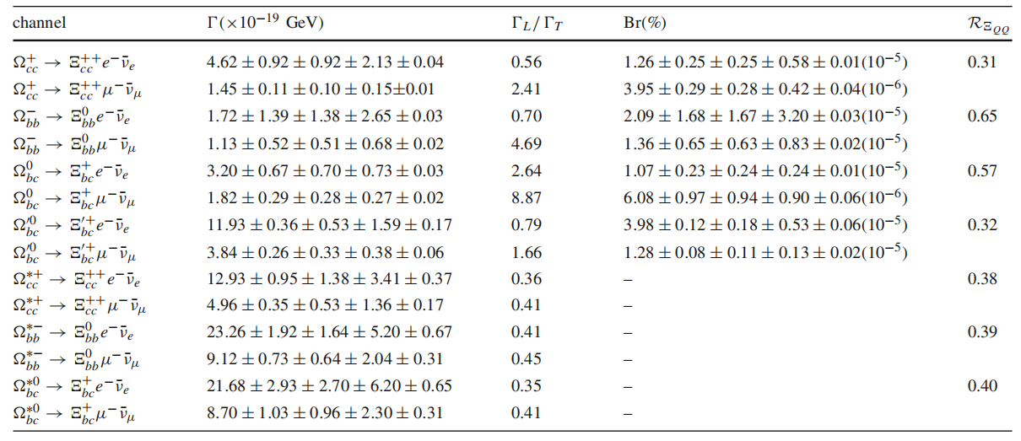
What did we get —— Numerical results
Numerical results of decay widths and branching fractions in doubly heavy baryon semileptonic decays using the form factor $F(q^{2})$.

Slide 21
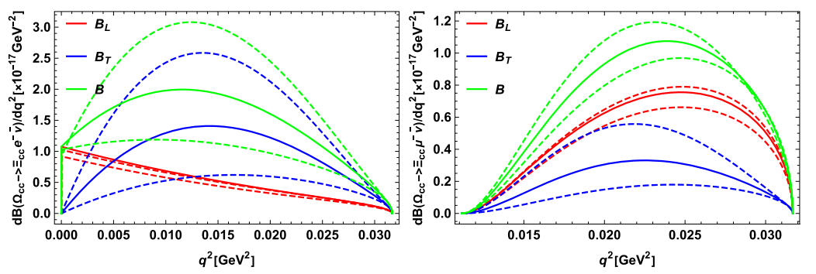
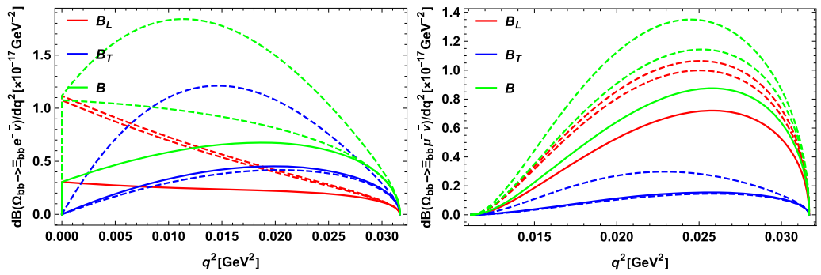
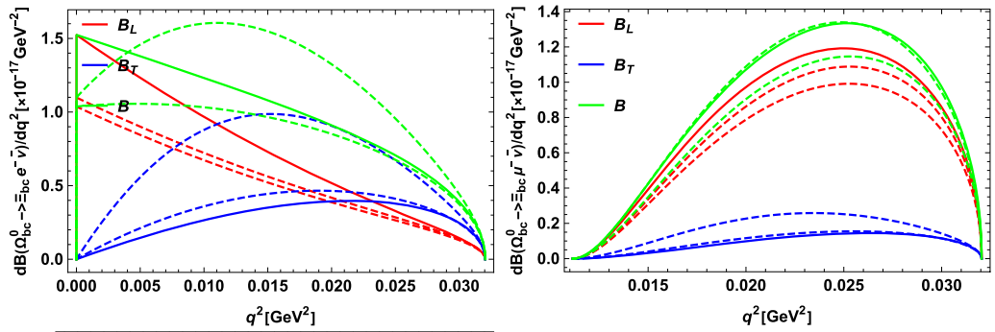
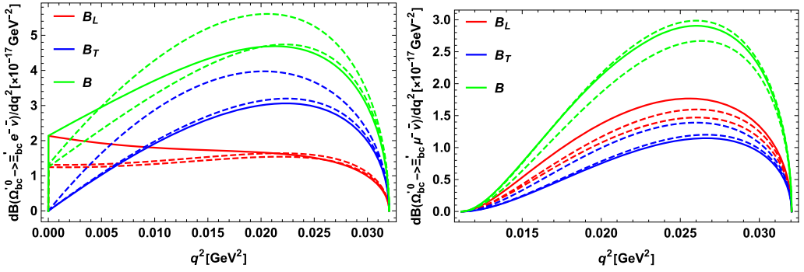
What did we get —— Numerical results
The differential decay width $dB/dq^{2}$ of spin-1/2 to spin-1/2 doubly heavy baryon decay processes. The $B_{L}$and $B_{T}$ represent the contribution of longitudinal polarization and transverse polarization.

Slide 22
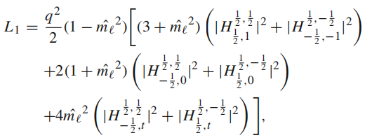
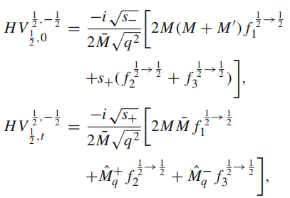
What did we get —— Numerical results
The differential decay width of semileptonic decays is:
Especially:

Slide 23
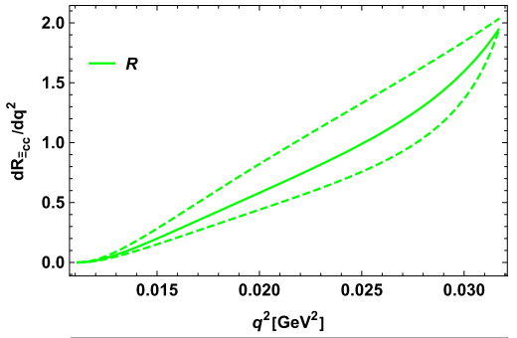
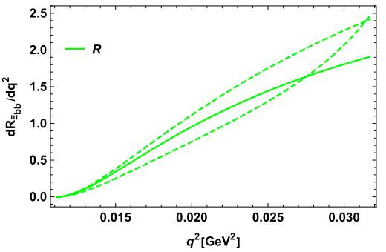
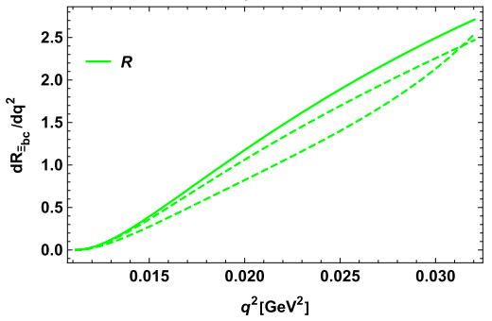
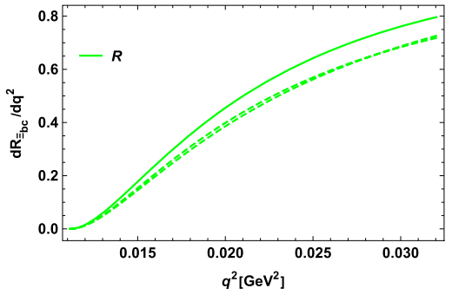
What did we get —— Numerical results

Slide 24
What did we get —— Numerical results
Numerical results of decay width and branching fraction in doubly heavy baryon nonleptonic decays using F($q^{2}$).
Numerical results of decay width and branching fraction in doubly heavy baryon nonleptonic decays using F($q^{2}$) when$N_{c}=3, 2, ∞$.

Slide 25
目录 Contents
1
Why did we do it
2
How did we do it
3
What did we get
4
Summary

Slide 26
Summary
Baryons composed of two heavy quarks are interesting and such light quarks decay of double heavy baryons are not previously explored, this work is to fill this blank.
Under the framework of LFQM and diquark approximation, using the form factors defined in the hadron matrix element, we estimate the decay width branching fractions of semileptonic and two-body nonleptonic decays.
Since the integral region in phase space is very small which is comparable to the $m_{μ}^{2}$, there are some strange phenomenological results. The decay processes induced by s → u with µ leptons in the final state offer possibilities of significant NP contributions not present in processes with electron.

Slide 27
Thank you！

