Slide 1




The European Spallation Source neutrino Super Beam plus Project ESSνSB+
Tamer Tolba (on behalf of the ESSnuSB+ collaboration)
Institut für Experimentalphysik, Universität Hamburg
The 29th International Workshop on Weak Interactions and Neutrinos (WIN2023), 02 – 08 July 2023

Slide 2
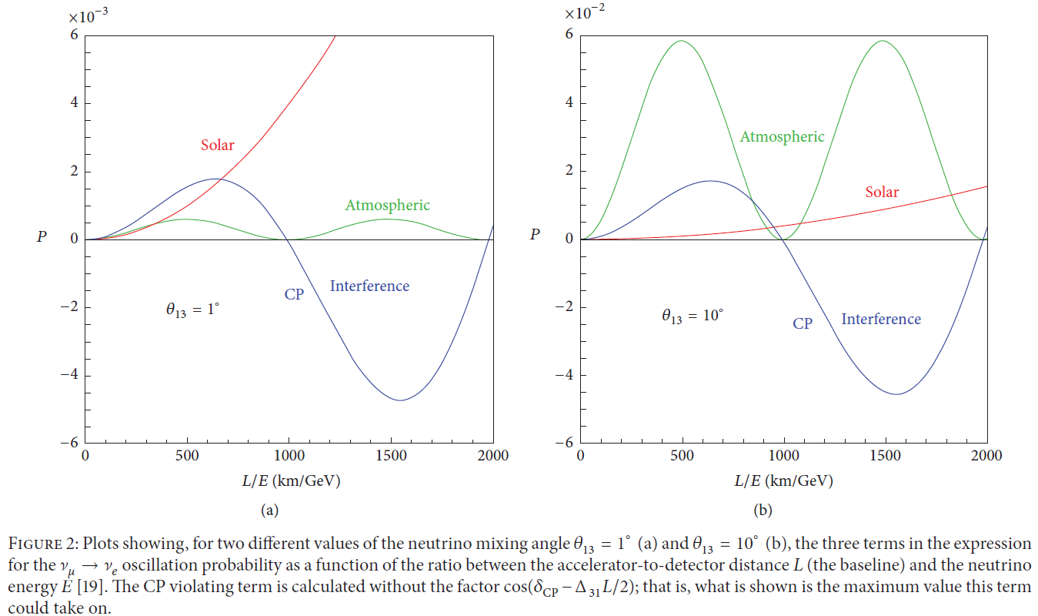

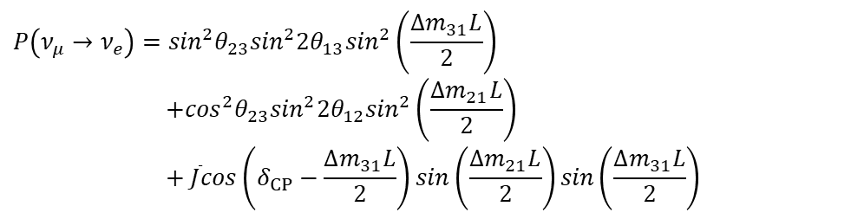
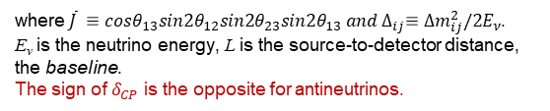
Neutrino oscillations (Leptonic CP-Violation)
$ν_{μ}→ν_{e}$ oscillation probability:
$$P\left(ν_{μ}→ν_{e}\right)=\sin^{2}θ_{23}\sin^{2}{2θ}_{13}\sin^{2}\left(\frac{{∆m}_{31}L}{2}\right)$$
$$+\cos^{2}θ_{23}\sin^{2}{2θ}_{12}\sin^{2}\left(\frac{{∆m}_{21}L}{2}\right)$$
$$+ \overline{J}cos\left(δ_{CP}−\frac{{∆m}_{31}L}{2}\right)sin\left(\frac{{∆m}_{21}L}{2}\right)sin\left(\frac{{∆m}_{31}L}{2}\right)$$
where$\overline{J} ≡cosθ_{13}sin{2θ}_{12}sin2θ_{23}sin{2θ}_{13} and ∆_{ij}≡{∆m_{ij}^{2}/2E}_{ν}$.
E_{ν} is the neutrino energy, L is the source-to-detector distance, the baseline.
The sign of $δ_{CP}$ is the opposite for antineutrinos.
θ₁₃ plays a significant role in evaluating the performance when planning “future” long baseline neutrino experiments
Important for CPV in leptonic sector
@ 1st oscillation max.
@ 1st oscillation max.
CP-interference dominates
Atm. term dominates
@ 2nd oscillation max.
@ 2nd oscillation max.
Solar term dominates
for small θ₁₃
for large θ₁₃
CP-interference dominates
arXiv:1110.4583v2 (2012)

Slide 3
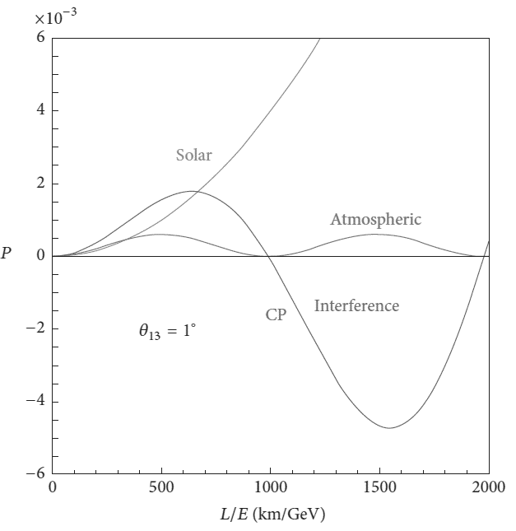
Neutrino oscillations (Leptonic CP-Violation)
$ν_{μ}→ν_{e}$ oscillation probability:
$$P\left(ν_{μ}→ν_{e}\right)=\sin^{2}θ_{23}\sin^{2}{2θ}_{13}\sin^{2}\left(\frac{{∆m}_{31}L}{2}\right)$$
$$+\cos^{2}θ_{23}\sin^{2}{2θ}_{12}\sin^{2}\left(\frac{{∆m}_{21}L}{2}\right)$$
$$+ \overline{J}cos\left(δ_{CP}−\frac{{∆m}_{31}L}{2}\right)sin\left(\frac{{∆m}_{21}L}{2}\right)sin\left(\frac{{∆m}_{31}L}{2}\right)$$
θ₁₃ found to be at higher
values ~ 8°
CPV is best studied at 2nd
Oscillation maximum
@ 1st oscillation max.
@ 1st oscillation max.
CP-interference dominates
Atm. term dominates
@ 2nd oscillation max.
@ 2nd oscillation max.
Solar term dominates
for small θ₁₃
for large θ₁₃
CP-interference dominates
arXiv:1110.4583v2 (2012)

Slide 4
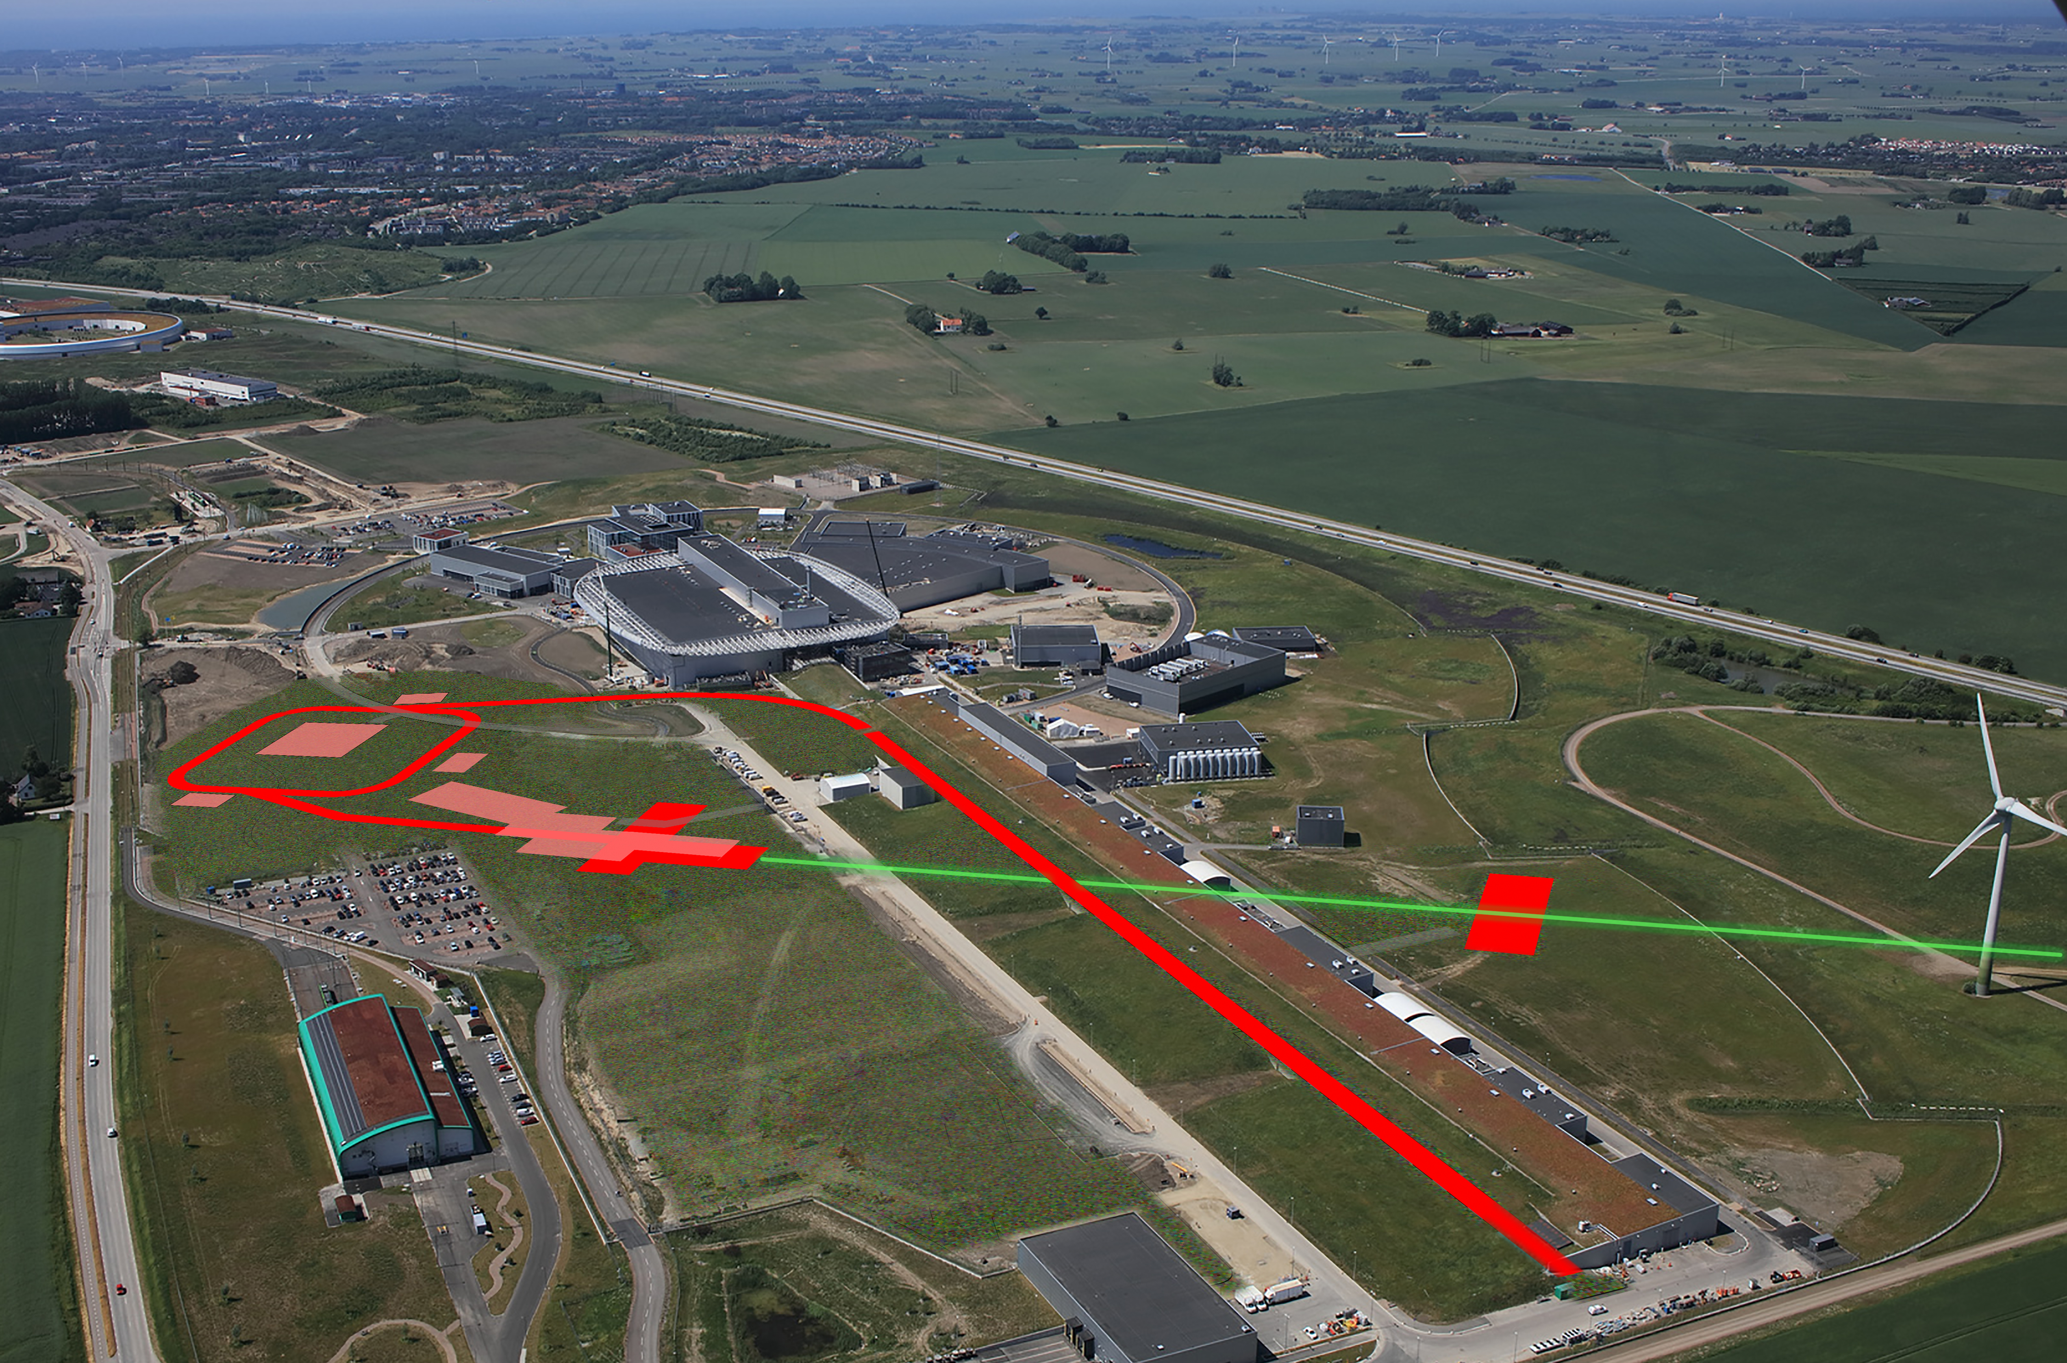
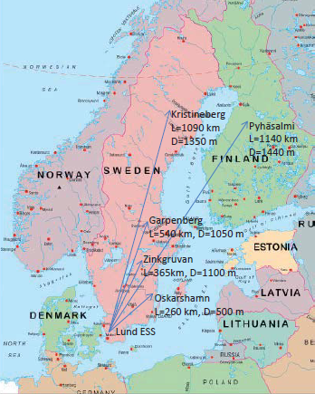

The European Spallation Source (ESS)
Oct. 2021
Lund
Target
Monolith
Exp. Hall
E01
Central Utility
Building
Linac
The ESS facility is under construction in Lund, Sweden
The most powerful proton linear accelerator ever built, with beam kinetic energy of 2 GeV and power of 5 MW
The world’s most powerful neutron source (~ 40x10¹⁵ n·cm⁻²·s⁻¹)
- Considered baselines to cover 2nd oscillation max.
- 360 km is the chosen baseline

Slide 5
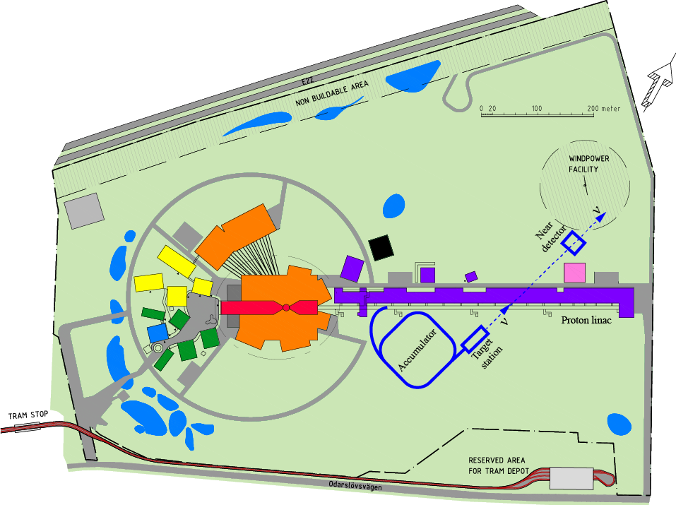

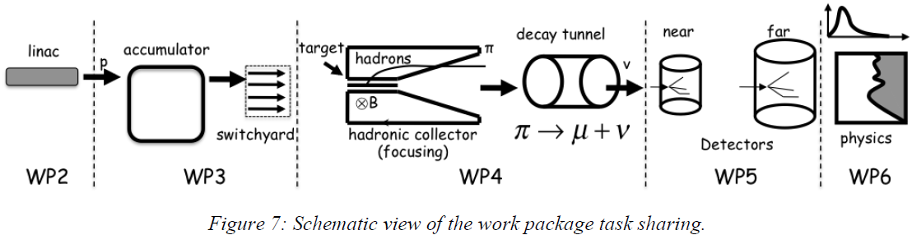
The European Spallation Source neutrino Super Beam (ESSνSB)
To Far Detector
located at second
ν oscillation max.
It will benefit from the powerful proton beam of the ESS LINAC to produce intense neutrino beam.
Aims at searching and measuring, with precision, for CP-violation in the leptonic sector, at 5σ significance level in more than 70% of the leptonic Dirac CP violating phase range,
The neutrino source-to-detector distance, the baseline, is set at the second oscillation maximum.
Linac
Upgrade
Accumulator
Target Station
Detector
Performance
Physics
Reach
A schematic overview of the main work packages (WP) within the ESSνSB project
April 2019
April 2019

Slide 6
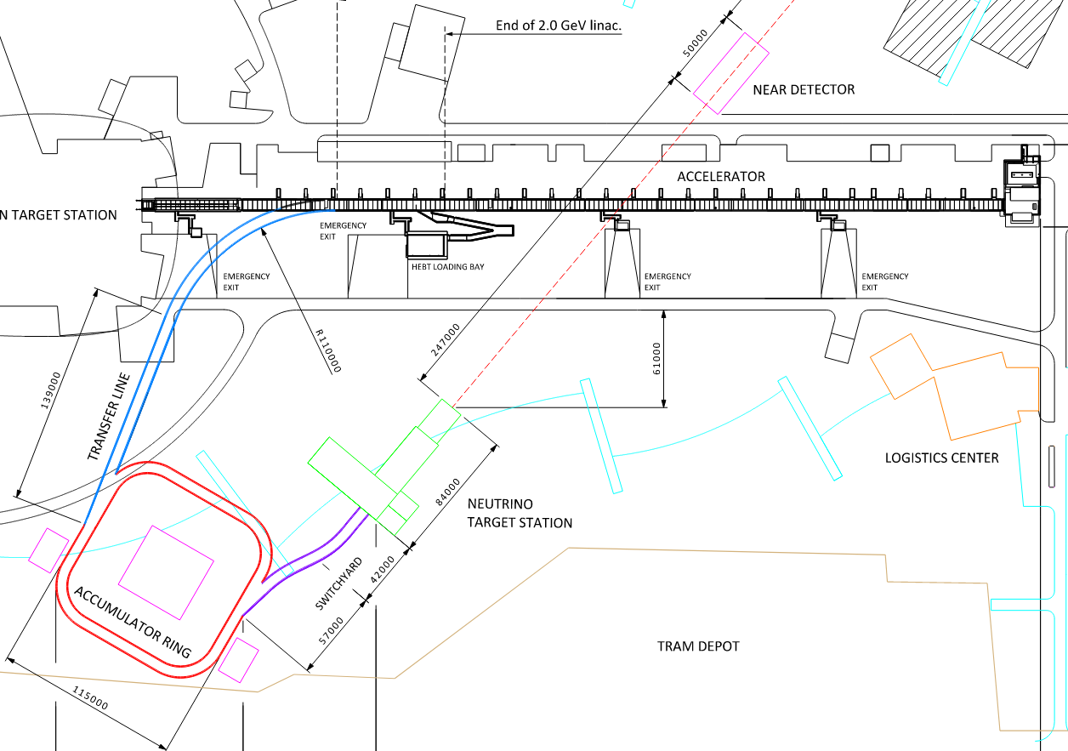
Upgrades to the ESS site
Upgrade of the accelerator
14 Hz to 28 Hz
use H⁻ instead of protons in ESSnuSB cycles
increase energy to 2.5 GeV kinetic
Build a near detector site
water Cherenkov detector
fine grained scintillator
emulsion detector
Build an accumulator ring
shorten ESS pulses from 2.86 ms to ≈ 1 μs
Build a neutrino target station
4 identical targets and horns
need switchyard

Slide 7
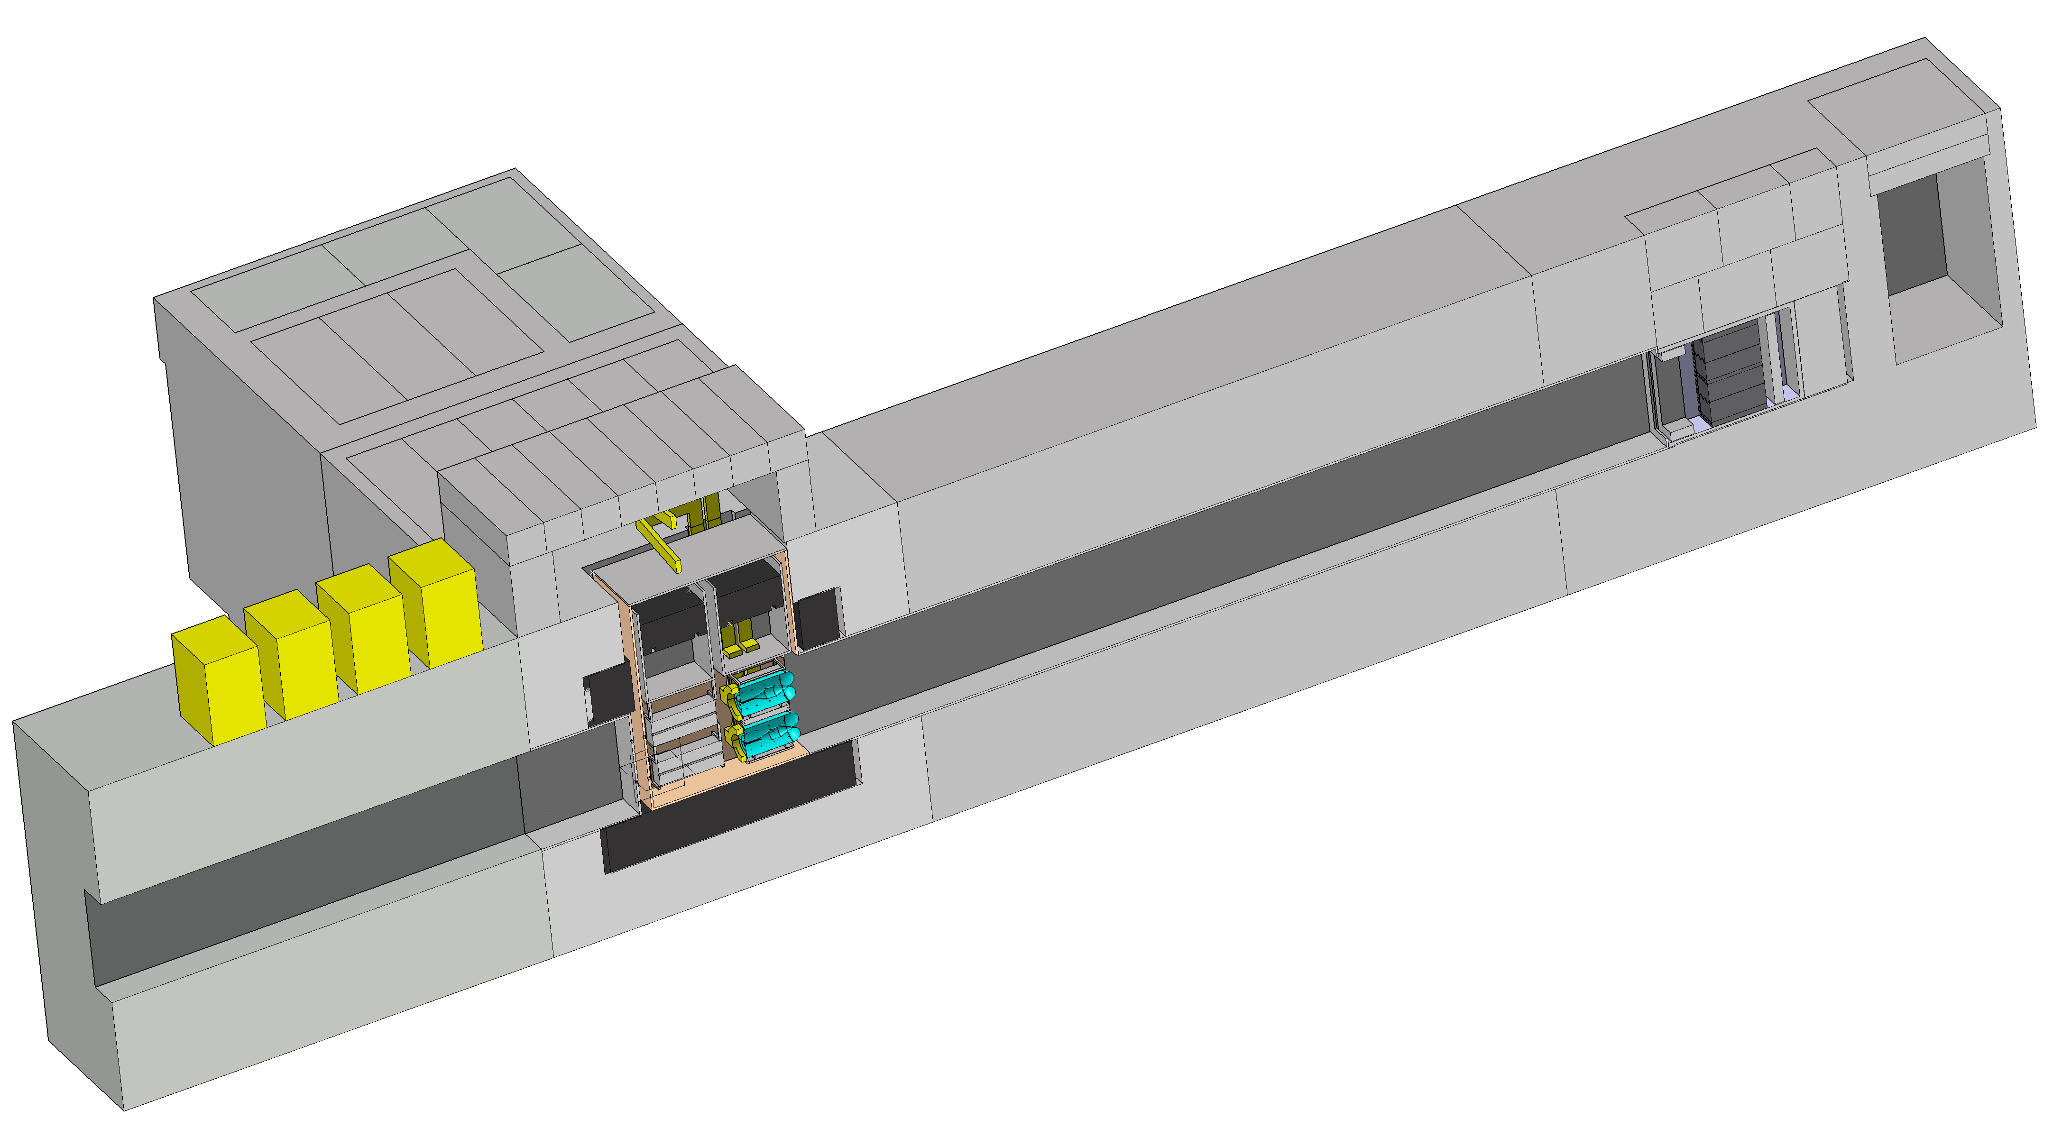
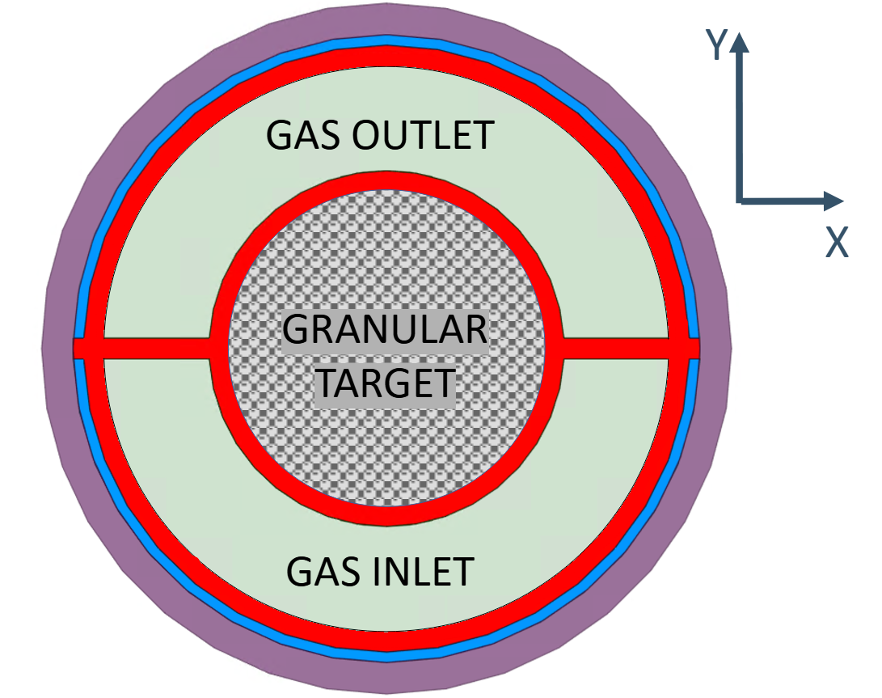
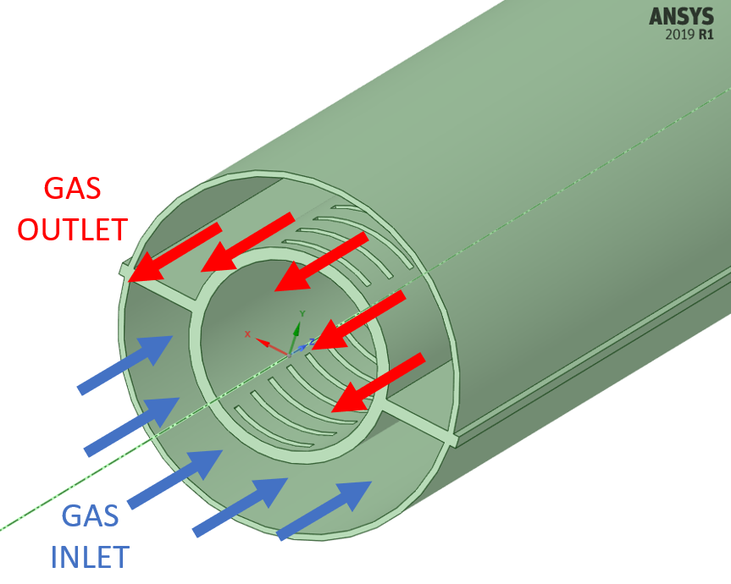
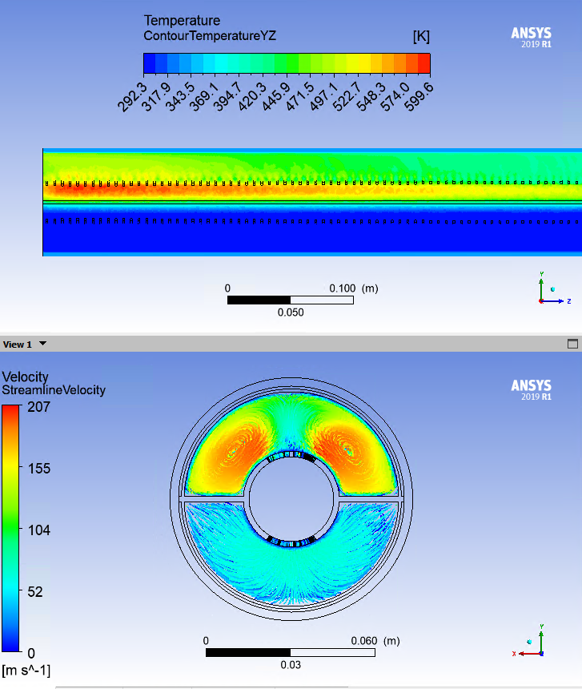
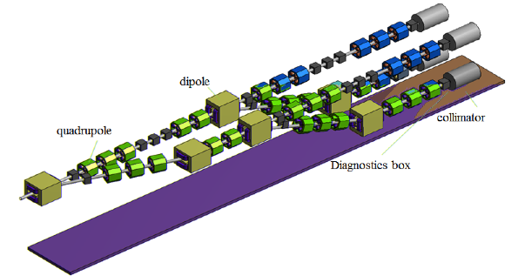
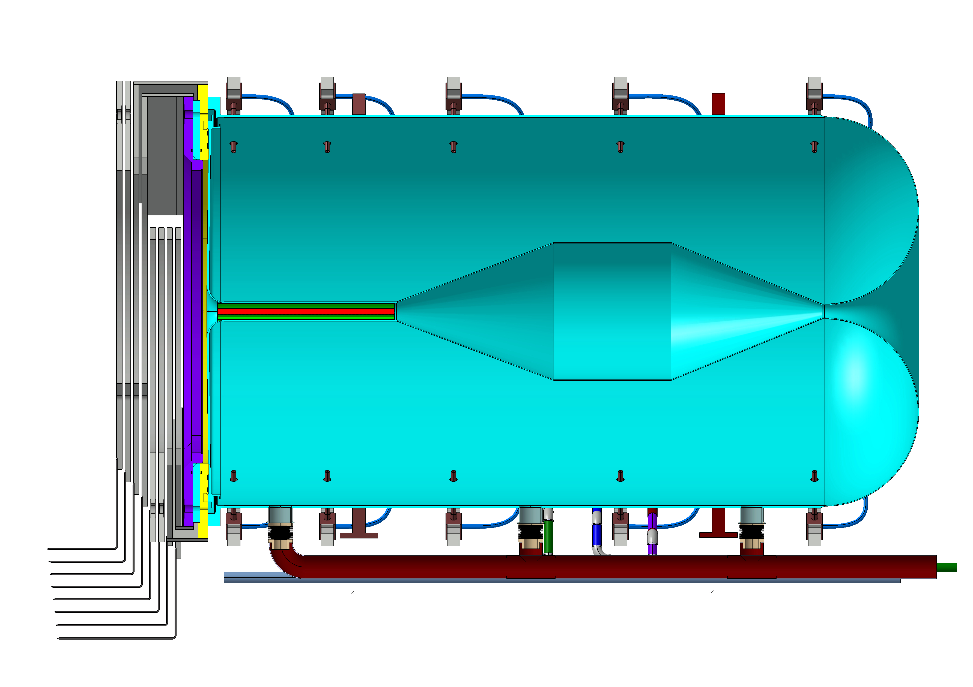
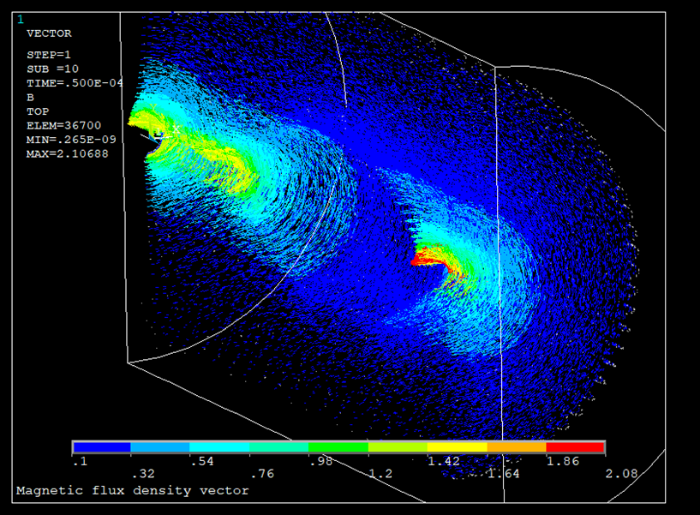
ESSvSB Target Station Facility
Power Supply Unit
16 modules (350 kA, 1.3 μs)
Located above the switchyard
Outside of radioactive part of Facility
Hot Cell
Able to manipulate/repair hadronic collector
Work under Radioactive Environment
Beam dump
Granular Target Concept
Target made of 3 mm titanium spheres cooled by transverse helium gas cooling
Morgue
To Store radioactive
wastes
Decay tunnel
Beam Switchyard
Tunnel
Proton Beam
(Ep=2.5 GeV, 14 Hz) 4 x 1.25 MW
Hadronic Collector
Magnetic field (350 kA; 1.3 μs pulse)
WP3 (Accumulator+Switchyard)
Beam Switchyard
Share the beam over
Four packed bed targets
Beam Switchyard
Horn
Shape optimized with genetic algorithm

Slide 8
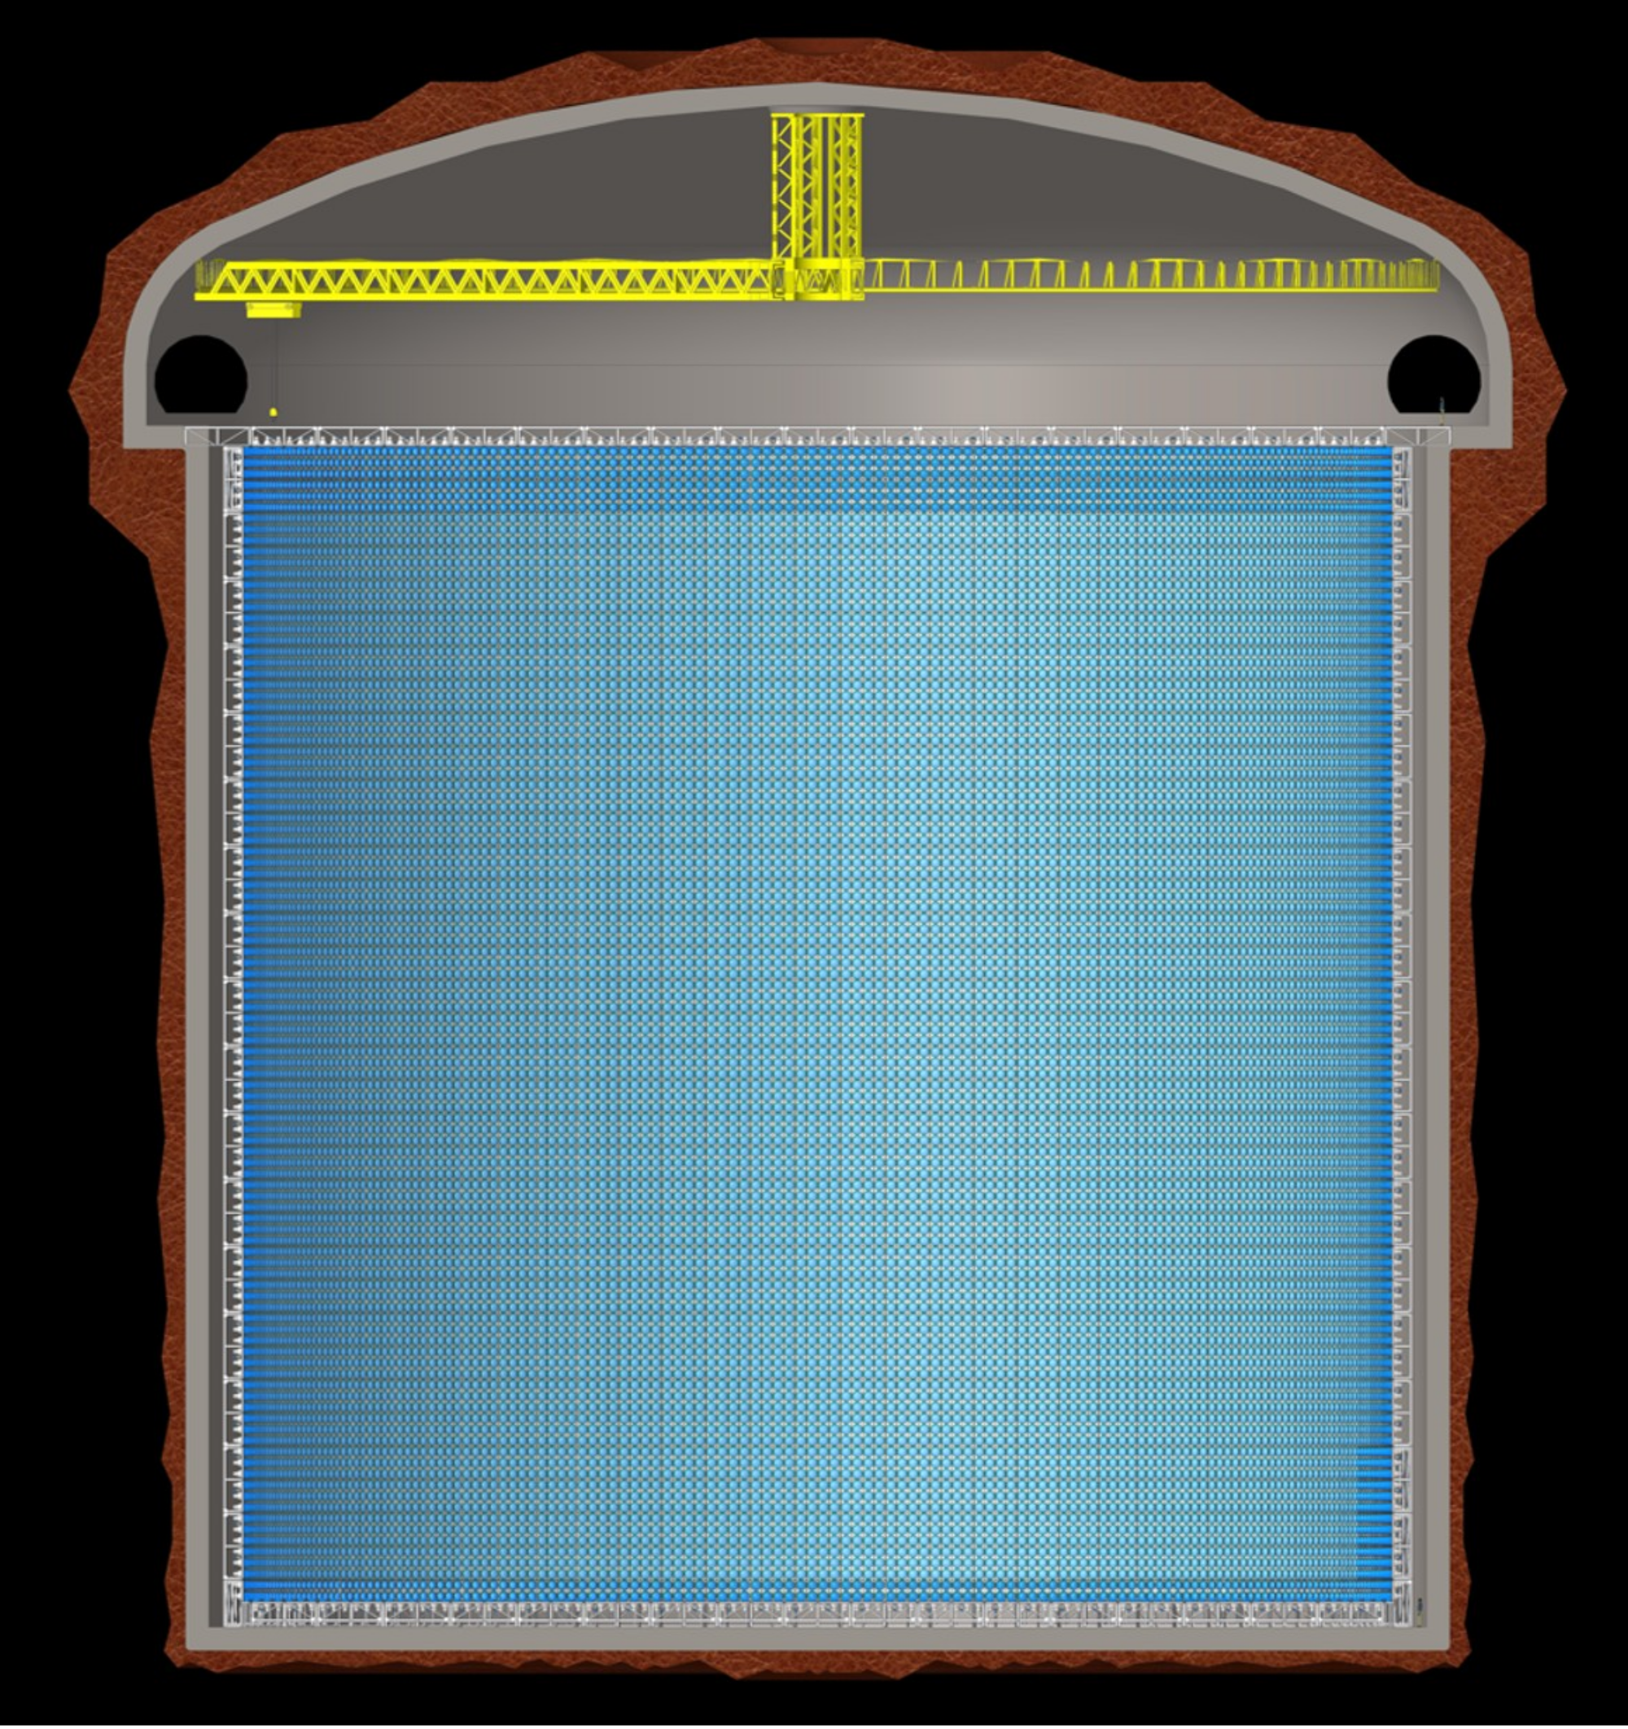
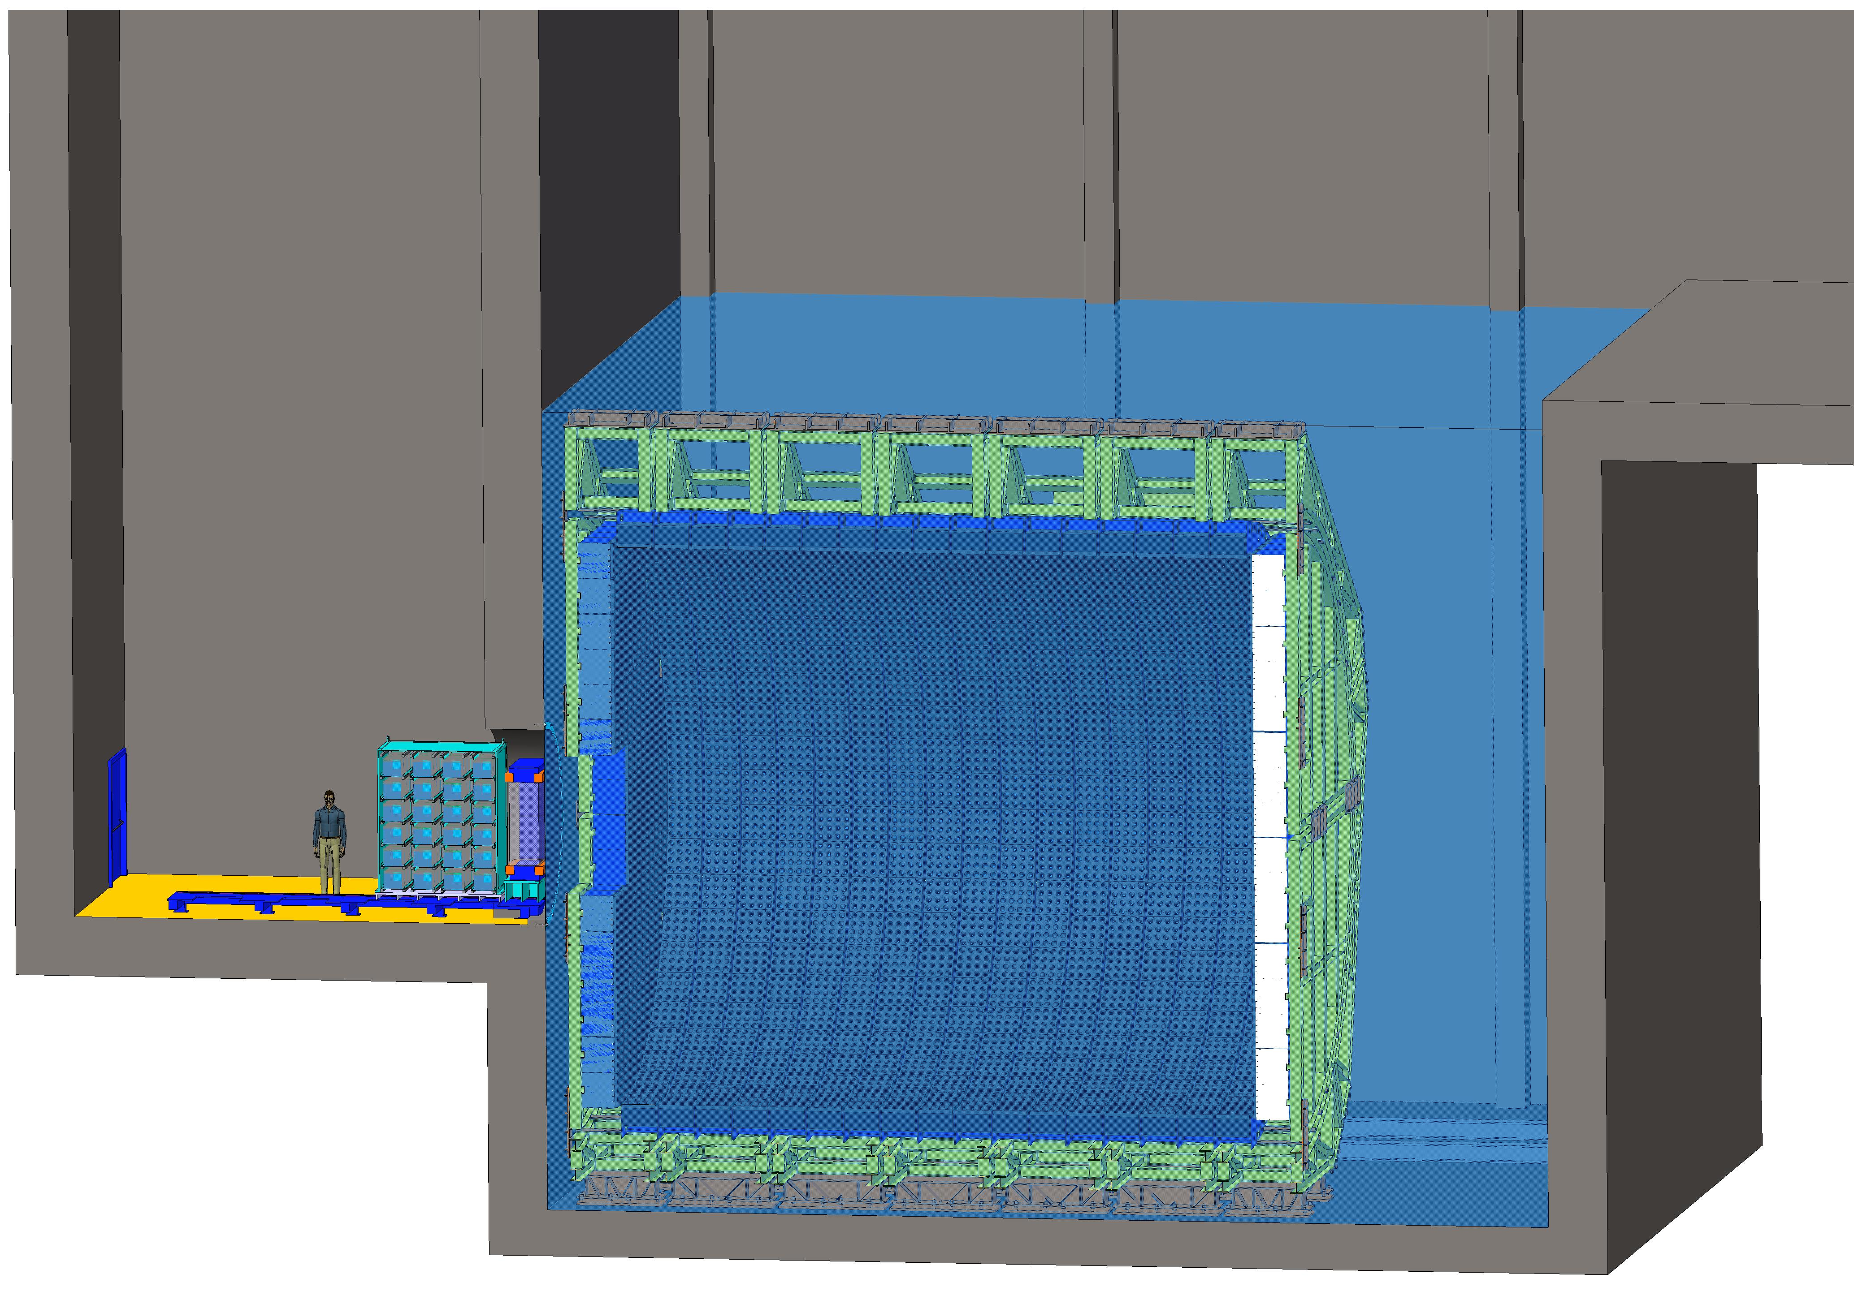
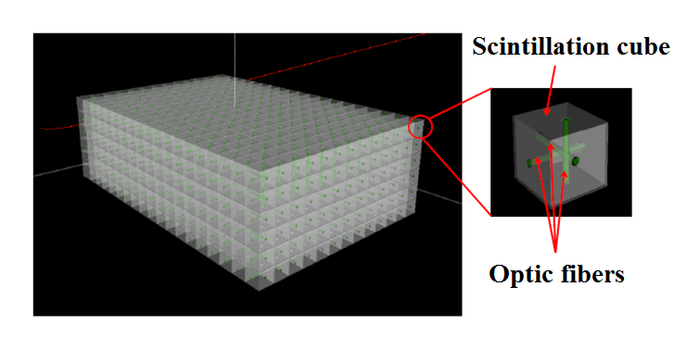
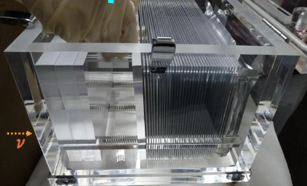
ESSvSB Near and Far Detectors
NINJA-like water-emulsion detector (1 t fiducial)
Super-FGD like detector (1 t fiducial)
Design
Memphis-like Water Cherenkov detector
2 x 270 kt fiducial volume (~20xSuperK)
Readout: 2 x 38k 20” PMTs
40% optical coverage
BL: 360 km (alternative 540 km)
75 m
ν beam
Near Water Cherenkov detector (0.77 kt fiducial)
75 m
Near Detector
Far Detector

Slide 9
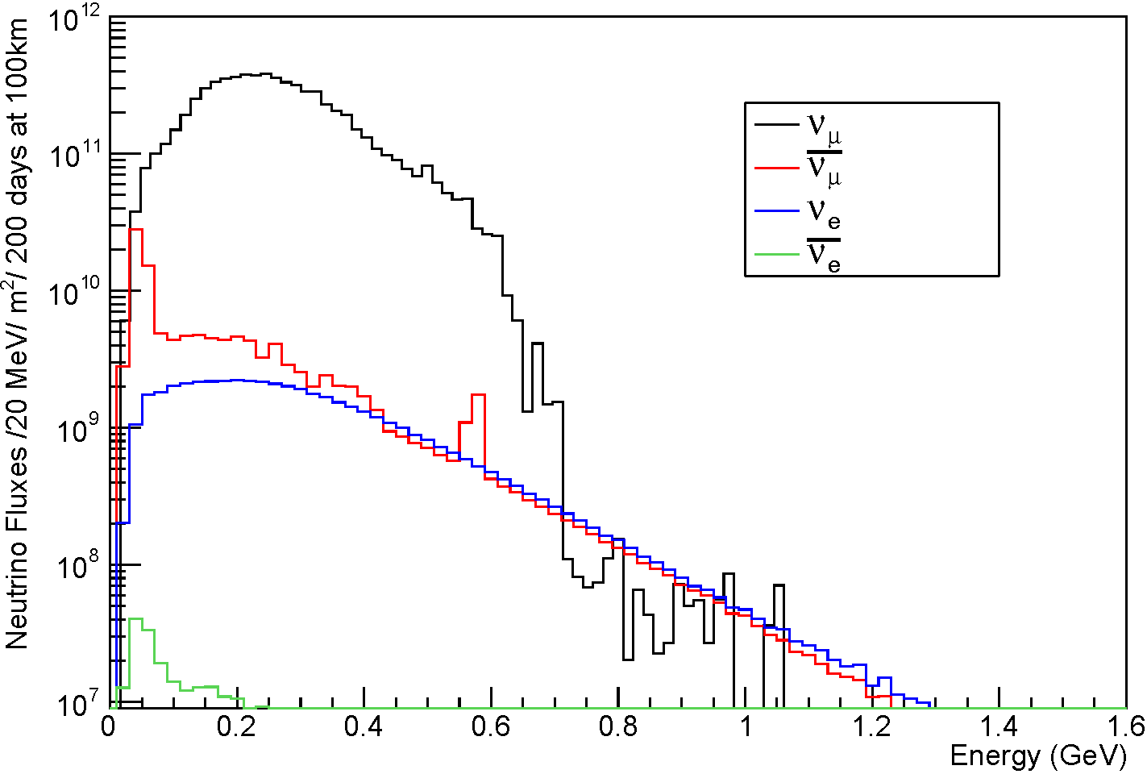
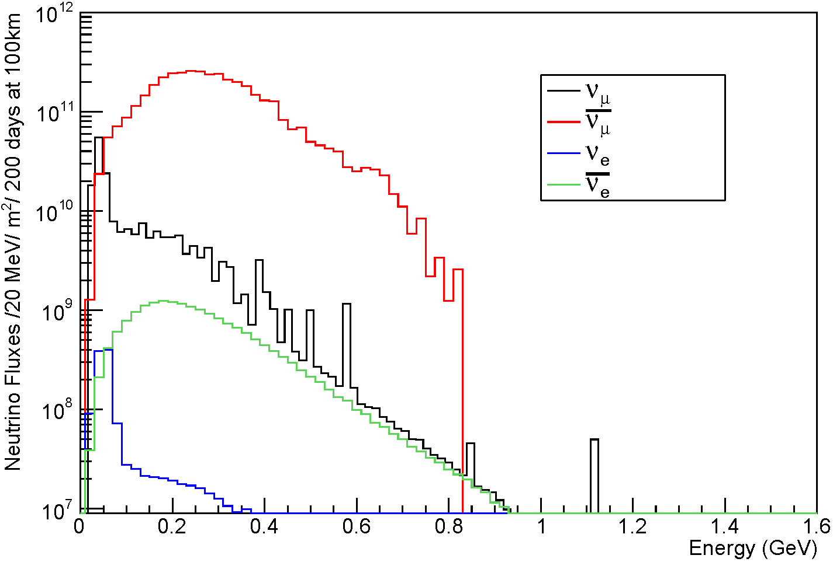
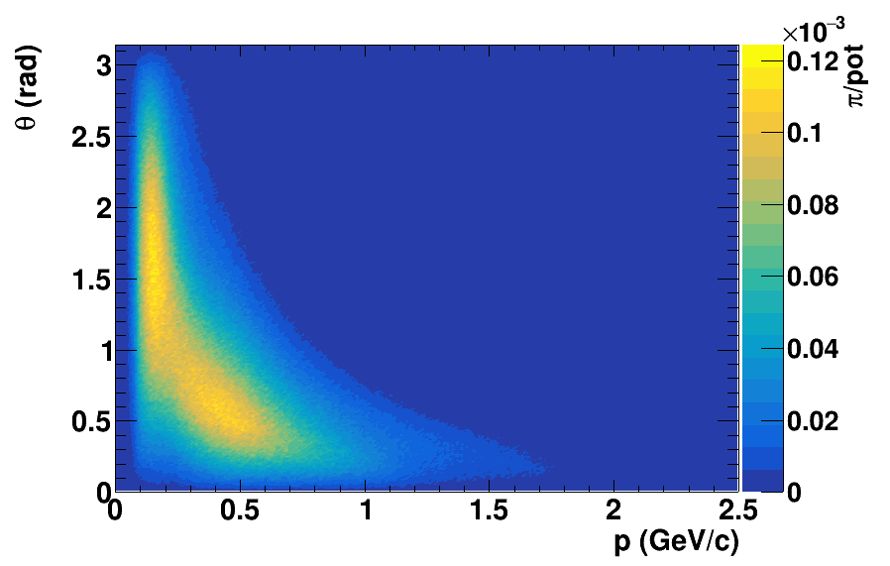
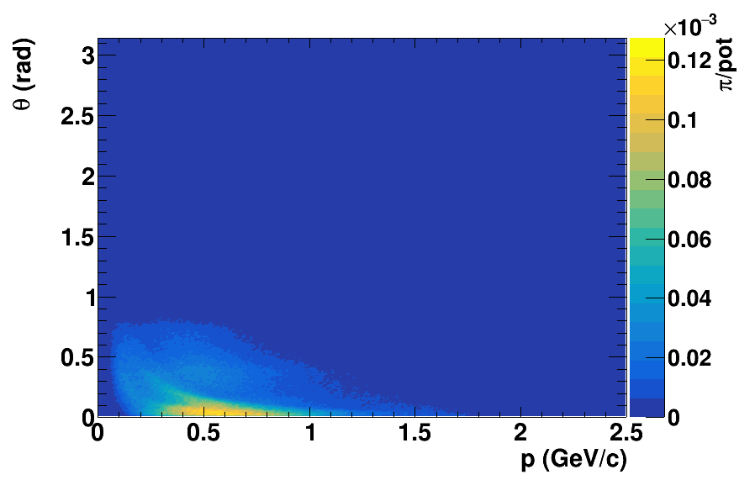
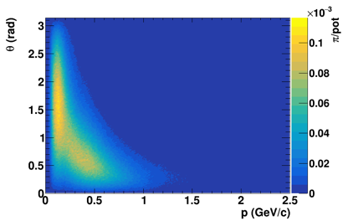
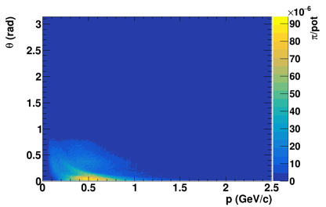
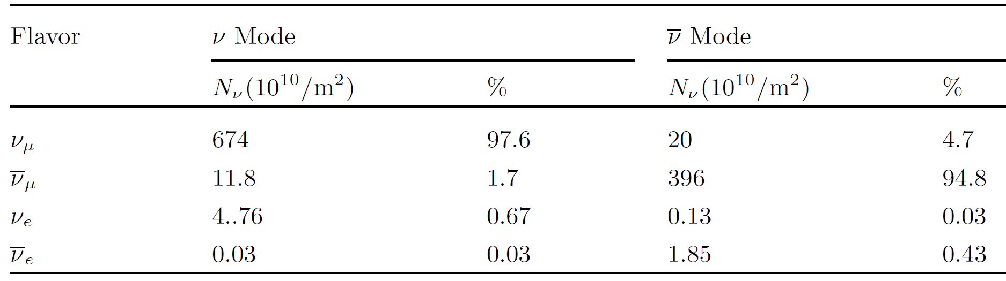



ESSνSB neutrino energy distribution
$π^{+} →$ $μ^{+}+ν_{μ}$
$π^{−} →$ $μ^{−}+ {\overline{ν}}_{μ}$
(Positive polarity)
(Negative polarity)
Positive polarity (v mode)
Negative polarity ($\overline{v}$ mode)
π⁺
π⁻
(At target level)
(After focussing)
π⁻
π⁻
(At target level)
(After focussing)
Neutrino flux at 100 km from the target per year
(in absence of oscillations)
Almost pure ν_{μ} beam
Small ν_{e} contamination which could be used to measure ν_{e} cross-sections in the near detector

Slide 10
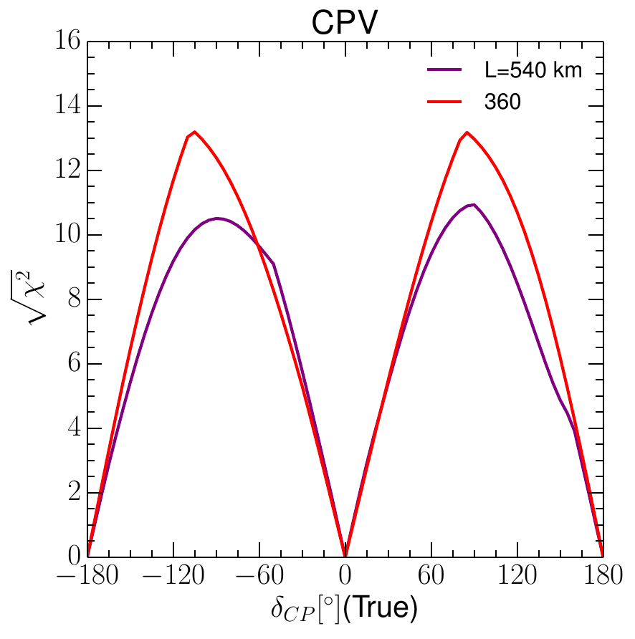
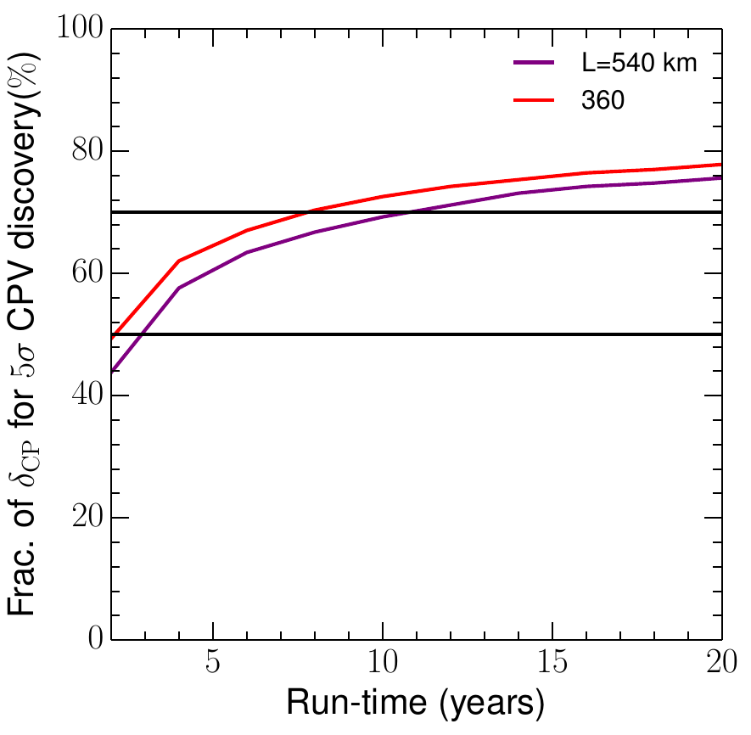
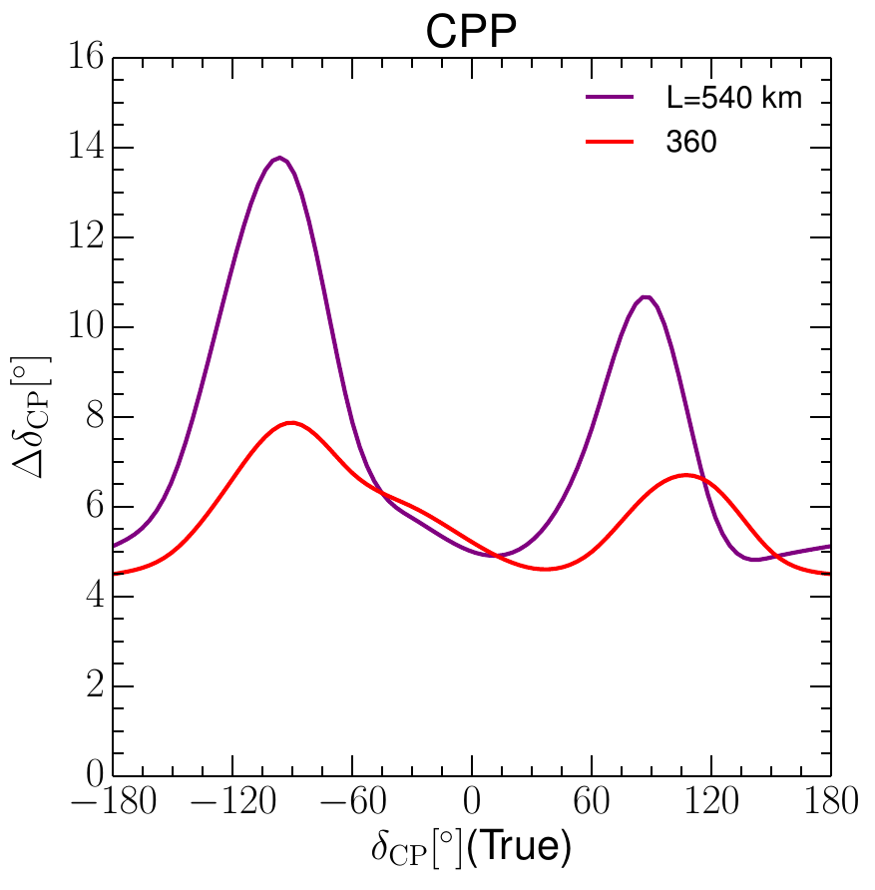
Physics Results
(Sensitivity and Precision)
A. Alekou et al., “Updated physics performance of the ESSnuSB experiment” Eu. Phys. J. C 81, (2021) 1130
72%
50%
5 σ
Sensitivity for δ_{CP} = ± π/2:
11 σ (540 km)
13 σ (360 km)
72% δ_{CP} coverage @ 5 σ:
11 years (540 km)
8 years (360 km)
High precision of δ_{CP} measurement

Slide 11
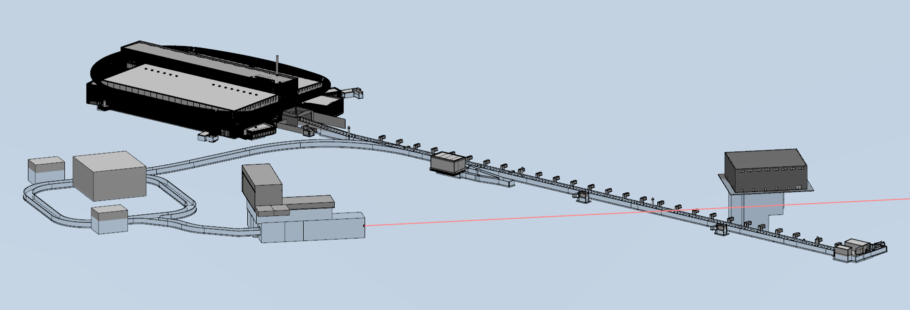
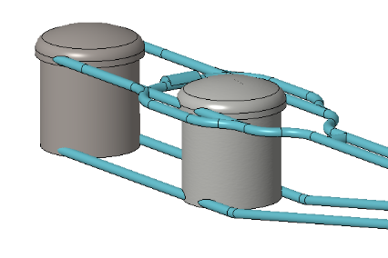

Final ESSvSB facility configuration
ESSvSB has been concluded in March 2022
near detector
far detector
accumulator
target station
Conceptual Design Report
Eur. Phys. J. ST. 231 (21), (2022) 3779

Slide 12
ESSνSB Other Opportunities
Super Beam
nuSTORM
+Decay At Rest and Coherent scat.
(with short pulses)
Neutrino Factory
Muon Collider

Slide 13
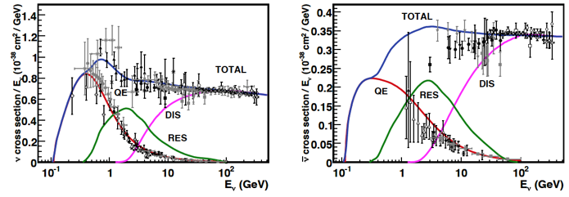
ESSνSB…systematic errors
  The influence on δ_{CP} of the systematic errors will be close to three times smaller as compared to other experiments
  Even so, it is of vital importance to measure the neutrino cross-sections in this energy range as precisely as possible for precise measurements of the δ_{CP}, especially since data on neutrino cross-sections in the neutrino energy range of ESSνSB, 0.2-0.6 GeV, is currently very scarce
ν
ν
ν
ν
neutrinos
π⁰
e
e
n
n
Missing measurements at the ESSνSB region: below 500 MeV
Elastic
Resonant (RES)
ν
l
ν
l
antineutrinos
n
n
n
hadrons
From eV to EeV: Neutrino cross sections across energy scales, Rev. Mod. Phys. 84, 1307 – Published 24 September 2012
Quasi-Elastic (QE)
Deep inelastic (DIS)

Slide 14
Upcoming Studies
(mainly cross-section measurements)
Cross-section measurements with:
Low Energy nuSTORM: π⟶ μ ⟶ e + ν_{μ} + ν_{e}
Low Energy ENUBET: π ⟶ μ + ν_{μ}
Design a transfer line from the ESSνSB accumulator ring to the target
Design a special target facility that depends on one horn-target system
Design a pion extraction and deflection system
Design an injection scheme for the extracted pions to the racetrack storage ring, where the pions will decay to muons
Design a storage ring for the low energy nuSTROM (for cross section measurements and sterile neutrino searches)
Design a Monitored Neutrino Beam (low energy ENUBET for cross section measurements)
Optimize the performance of the ESSνSB detectors
5
6
3&4
1
2

Slide 15

ESSvSB+
Research and Innovation actions
Innovation actions
Design Study
HORIZON-INFRA-2022-DEV-01
Title of Proposal:
Study of the use of the ESS facility to accurately measure the neutrino cross-sections for ESSνSB leptonic CP violation measurements and to perform sterile neutrino searches and astroparticle physics.
Acronym of Proposal: ESSνSB+

Slide 16
ESSvSB+ Collaboration
Participant no. | Participant organisation name | Part. short name | Country
1 (Coordinator) | Centre National de la Recherche Scientifique | CNRS | France
2 | Université de Strasbourg | UNISTRA¹ | France
3 | Rudjer Boskovic Institute | RBI | Croatia
4 | Tokai National Higher Education and Research System, National University Corporation | NU² | Japan
5 | Uppsala Universitet | UU | Sweden
6 | Lunds Universitet | ULUND | Sweden
7 | European Spallation Source ERIC | ESS | Sweden
8 | Kungliga Tekniska Hoegskolan | KTH | Sweden
9 | Universitaet Hamburg | UHH | Germany
10 | University of Cukurova | CU | Turkey
11 | National Center for Scientific Research "Demokritos" | NCSRD | Greece
12 | Aristotelio Panepistimio Thessalonikis | AUTH¹ | Greece
13 | Sofia University St. Kliment Ohridski | UniSofia | Bulgaria
14 | Lulea Tekniska Universitet | LTU | Sweden
15 | European Organisation for Nuclear Research | CERN | IEIO³
16 | Universita degli Studi Roma Tre | UNIROMA3 | Italy
17 | Universita degli Istudi di Milano-Bicocca | UNIMIB | Italy
18 | Istituto Nazionale di Fisica Nucleare | INFN | Italy
19 | Universita degli Istudi di Padova | UNIPD¹ | Italy
20 | Consorcio para la construccion, equipamiento y explotacion de la sede espanola de la fuente Europea de neutrones por espalacion | ESSB | Spain
^{[1]} Affiliated Partner
^{[2]} Associated Institute
^{[3]} International European Interest Organisation

Slide 17
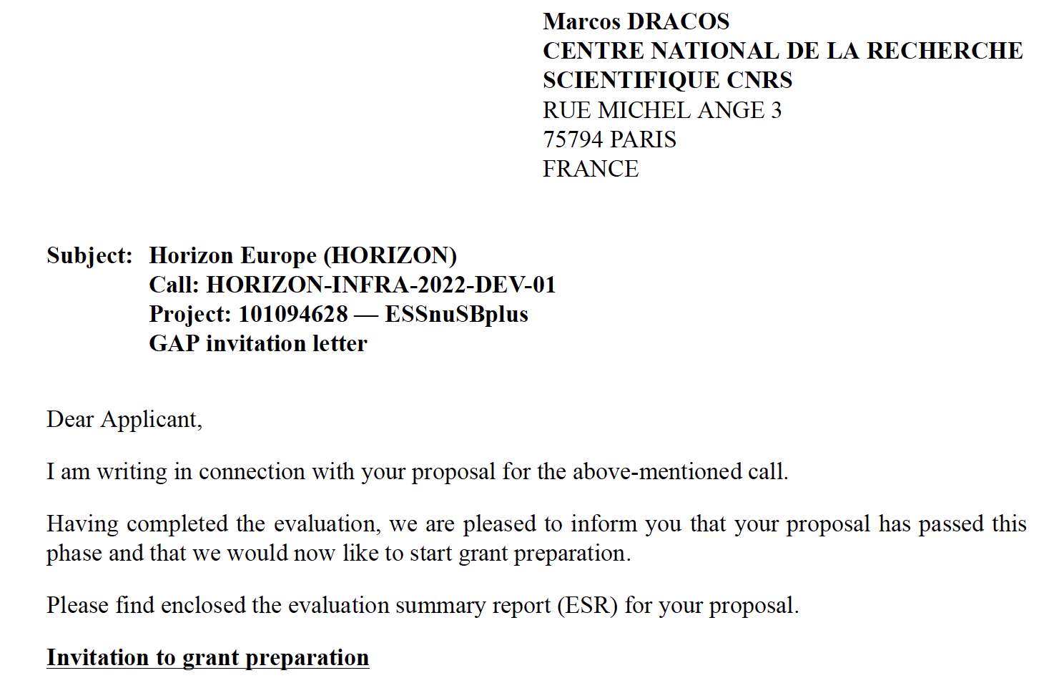

ESSvSB+ (Proposal PROJECT)
And the EU decision arrived earlier than expected… 26/07/2022
3 M€

Slide 18
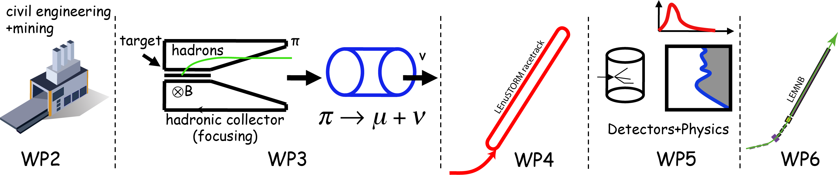
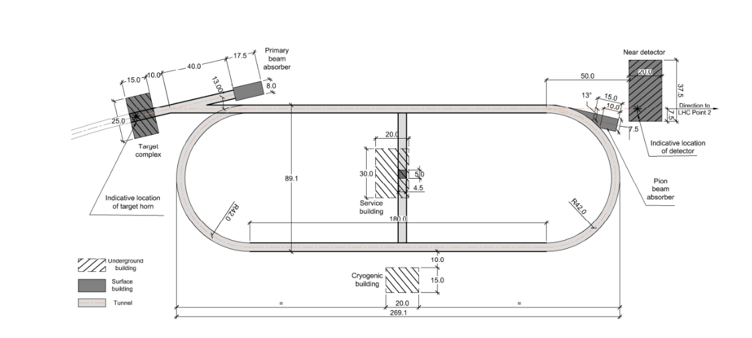
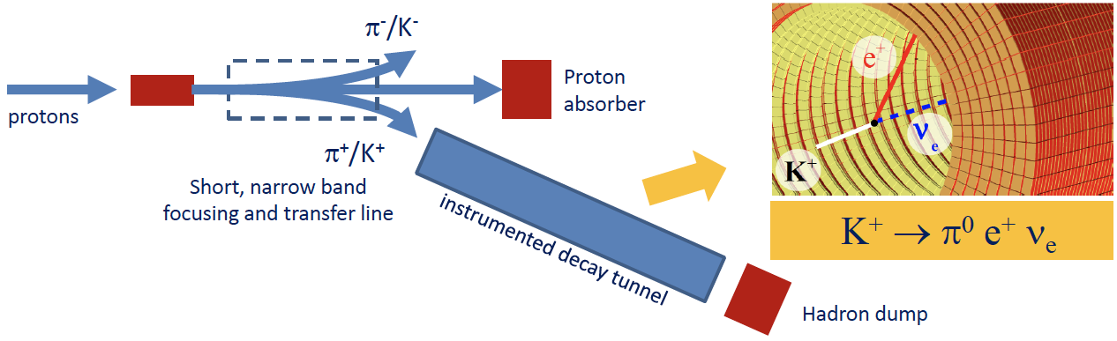

ESSvSB+ (Work-Packages)
cross-sections
sterile neutrinos
cross-sections
"High Energy" nuSTORM
"High Energy" ENUBET
build a "Low Energy" version

Slide 19
Conclusion
ESS can also become a neutrino facility, ESSνSB, already proved to have a very high physics performance and potential.
CPV: 5σ could be reached over 70% of δ_{CP} range by ESSνSB with large physics potential with less than 8° precision.
Complementary tasks of this project have been added in a second Design Study helping to make the whole project happen.
Precise neutrino cross-section measurements.
Sterile neutrino searches.
Muon studies
Rich muon program for future ESS upgrades.
New application submitted and now approved, and the projected started from 1 Jan., 2023
This facility offers great opportunity for the community and it is an ideal platform to house R&D activities and other neutrino and muon experiments

Slide 20







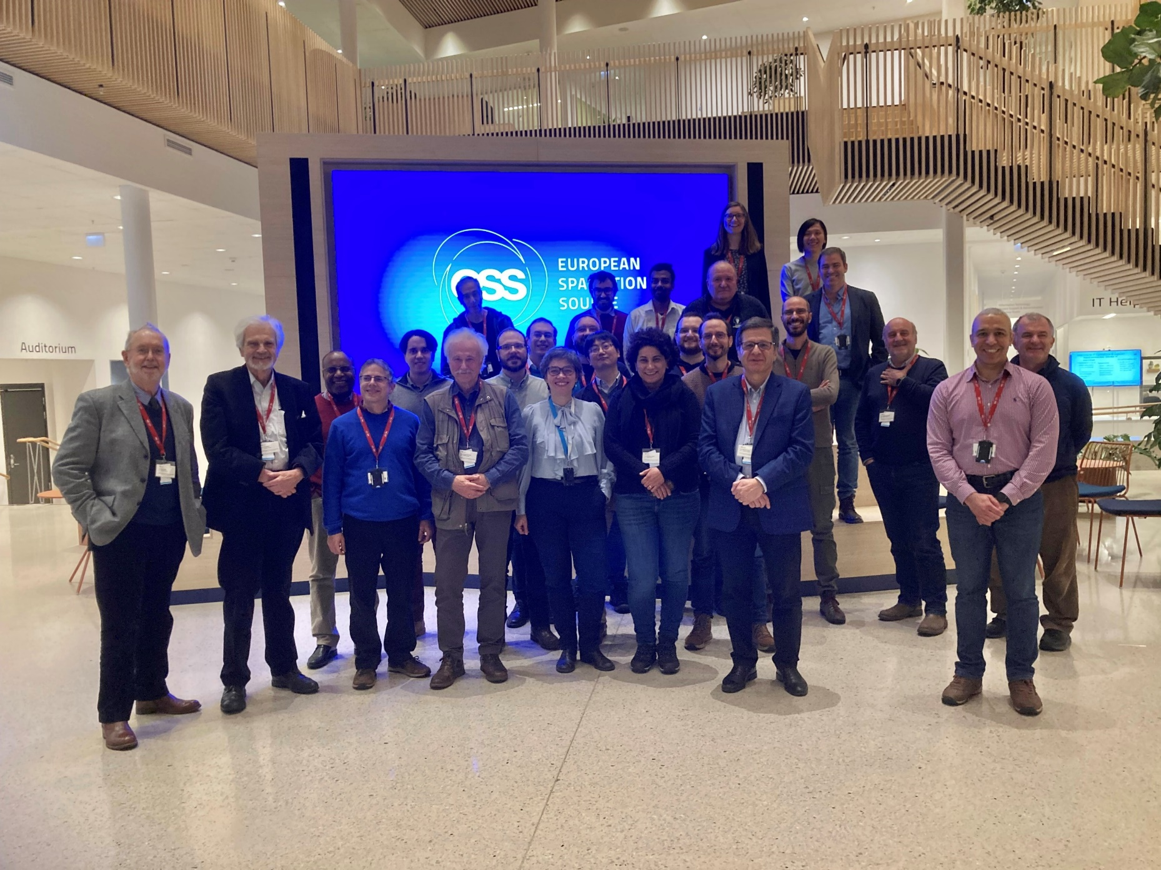








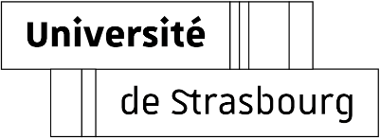

















Carole

Slide 21
Spare slides

Slide 22
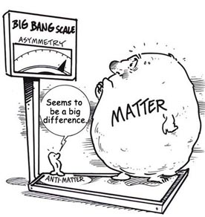
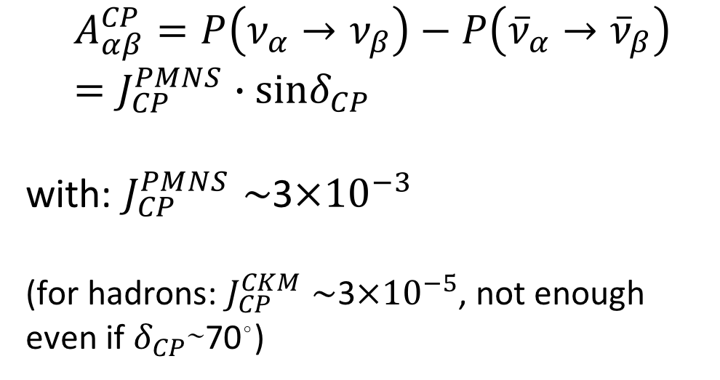
δ_{CP} and Matter-Antimatter Asymmetry Magnitude
(Jarlskog invariant)
(from the already observed CP violation in the hadronic sector)
Theoretical models predict that if |sinδ_{CP}|≳0.7 (45°<δ_{CP}<135° or 225°<δ_{CP}<315°), this could be enough to explain the observed asymmetry.
(Nucl.Phys.B774:1-52,2007, arXiv:hep-ph/0611338)

Slide 23
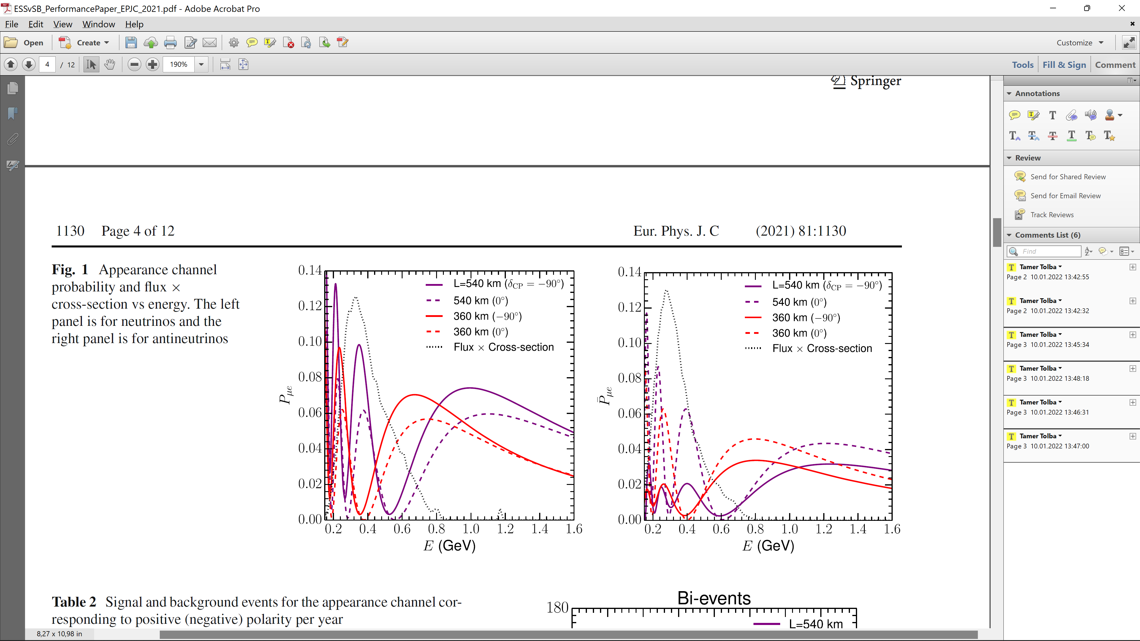
2nd Oscillation max. coverage
2nd oscillation max.
well covered by the ESS neutrino spectrum
1st oscillation max.

Slide 24
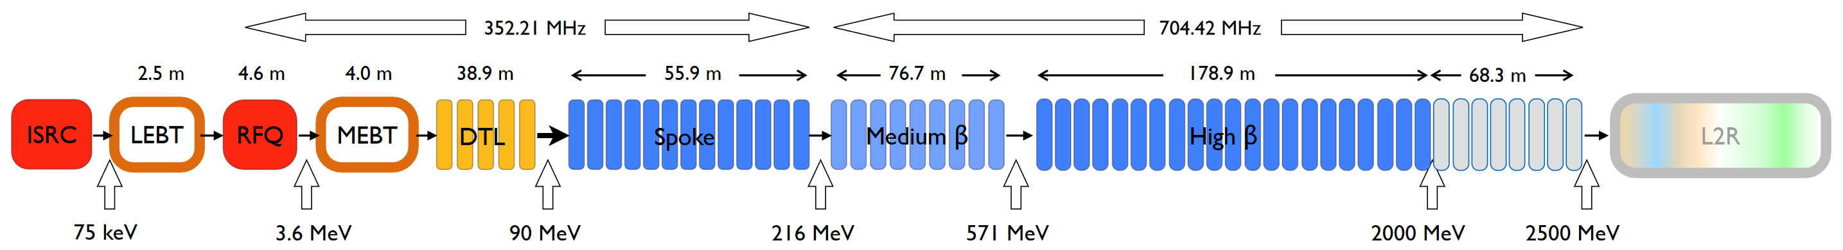
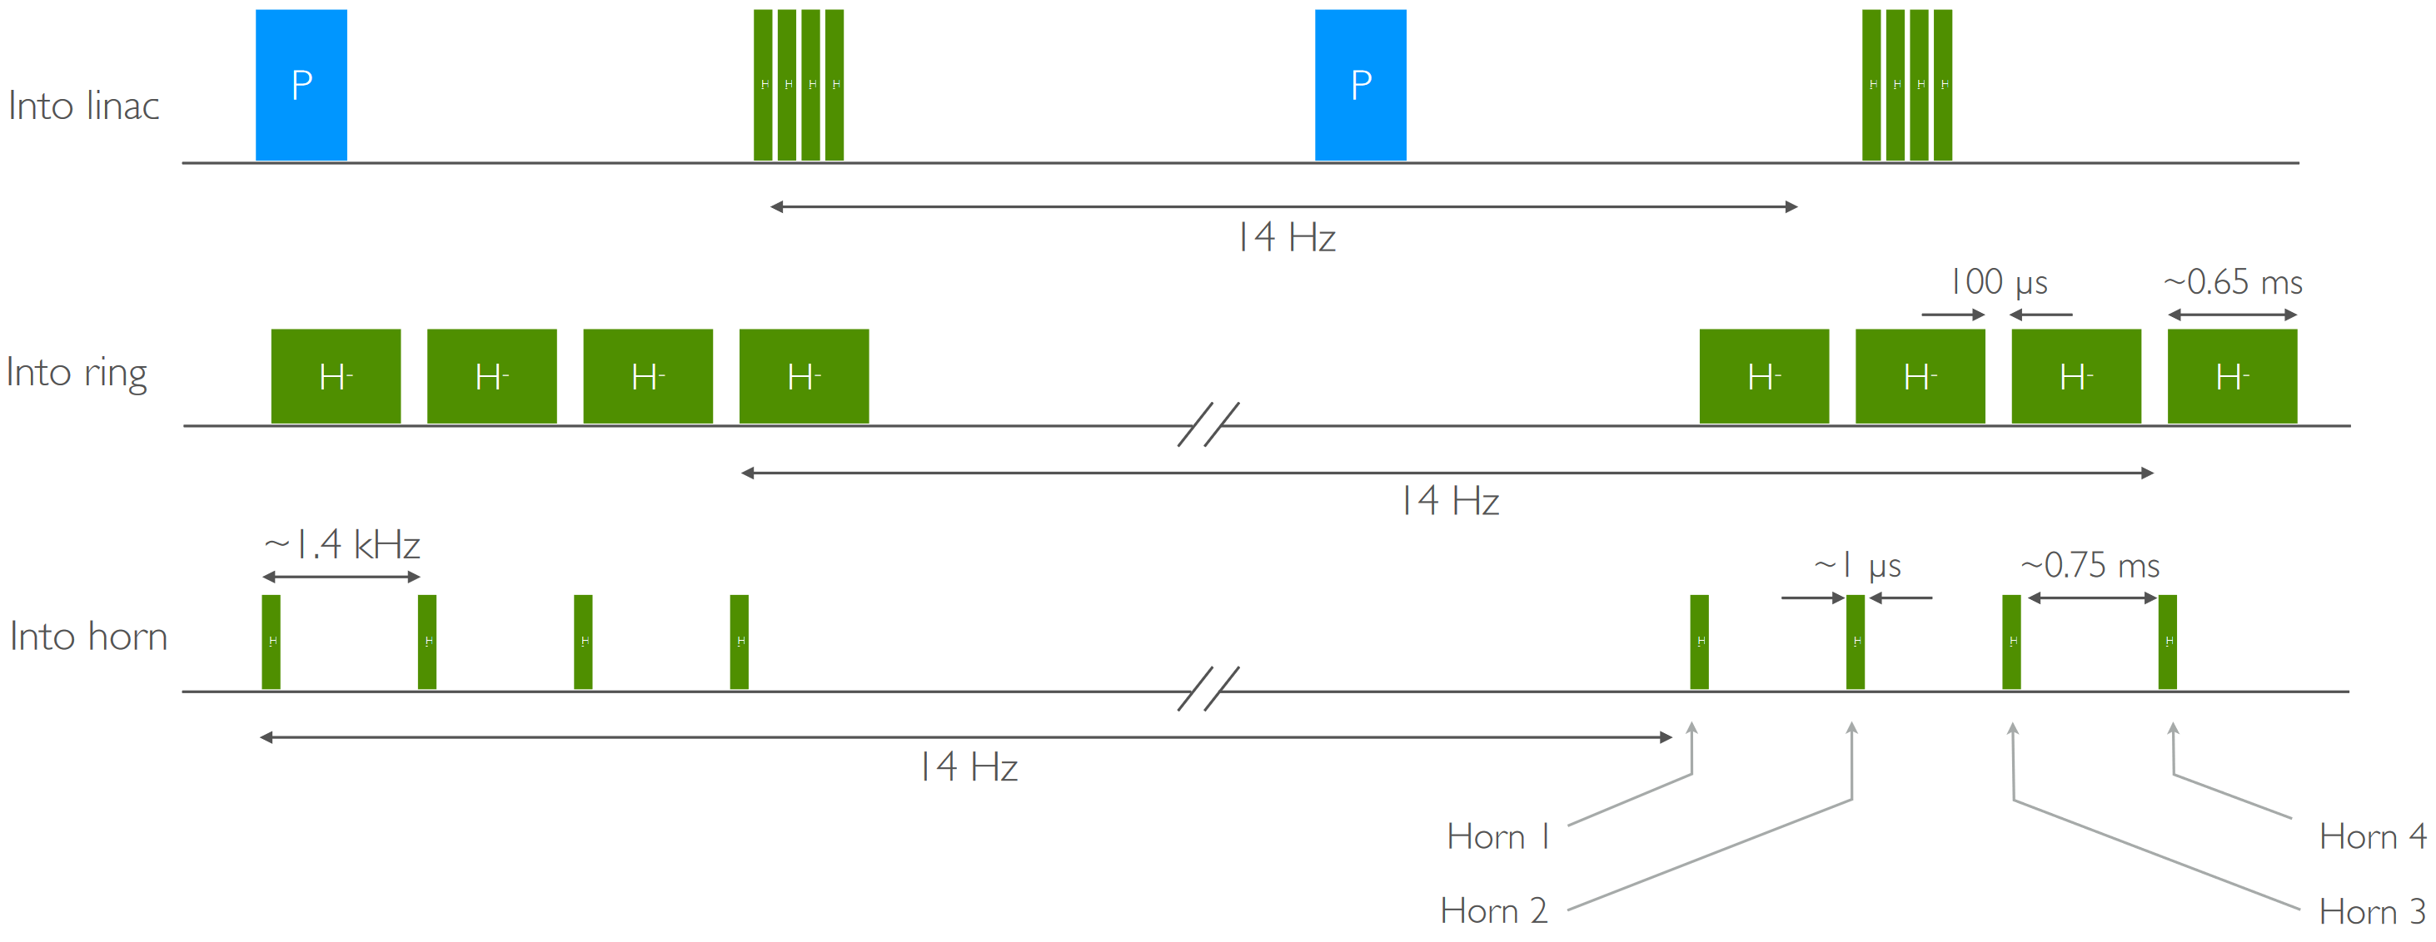
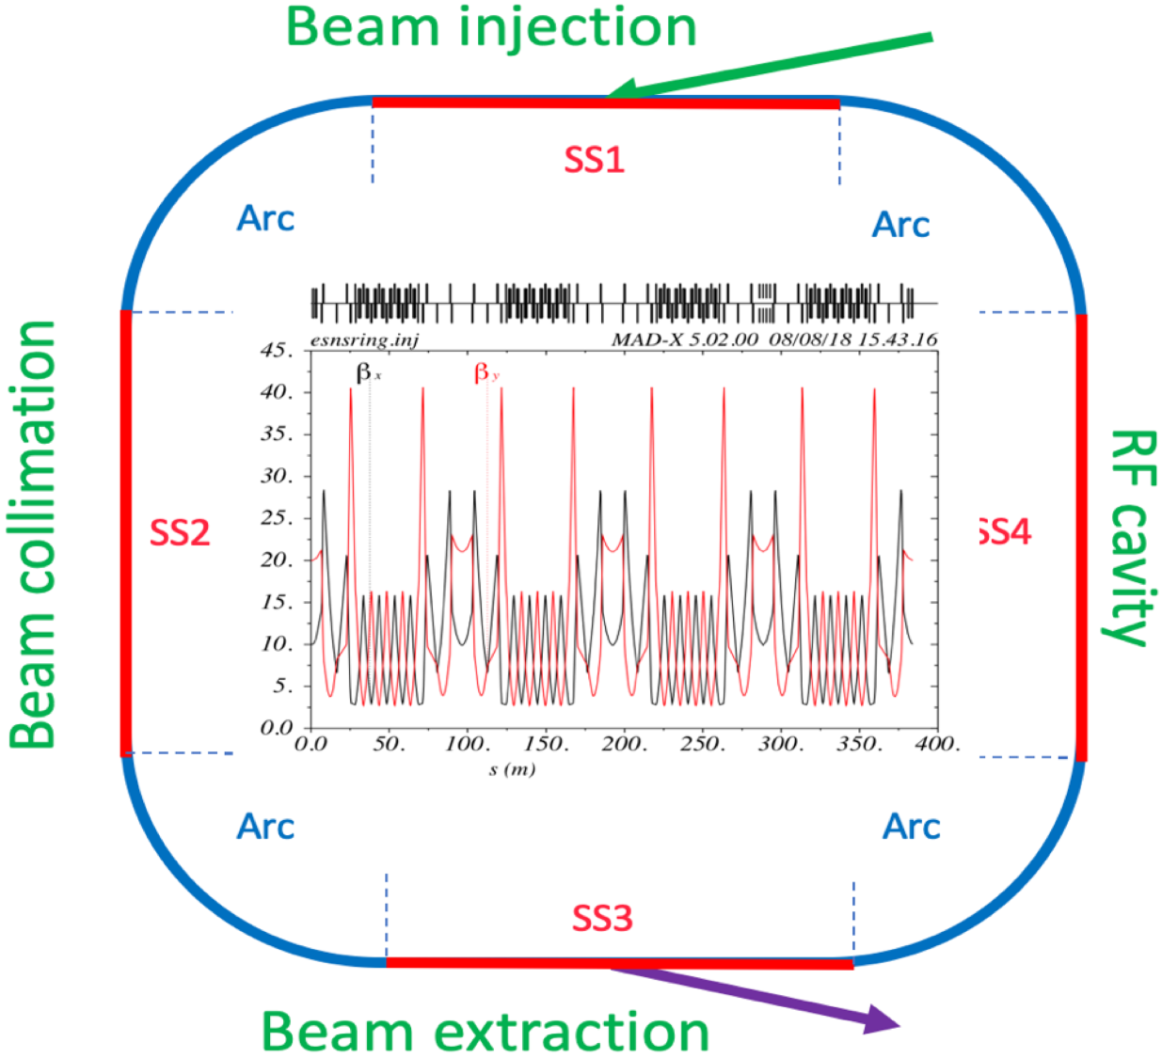
ESS Proton Linac upgrade and the accumulator ring
Pulsing scheme
ESSνSB proposes to increase the ESS LINAC power from 5 MW to 10 MW.
The dedicated proton beam will be shortened to 1.3 μs:
With the help of the accumulator ring.
Will be split in four (batches) already in the LINAC.
Each batch is accumulated and then extracted before the next batch enters the ring.
Each batch hits a different target thanks to the switching in the switchyard.
To avoid excessive injection losses, H⁻ ions are injected into the LINAC and stripped by a foil before entering the accumulator.
Ring-to-switchyard, L2R, transfer-line extract the proton pulses from the ring to the beam switchyard and distribute the resulting four beam batches over four targets.
Accumulator
Ring
● Accumulation and storage, no acceleration.
● 384 m circumference, 1.33 μs revolution period

Slide 25
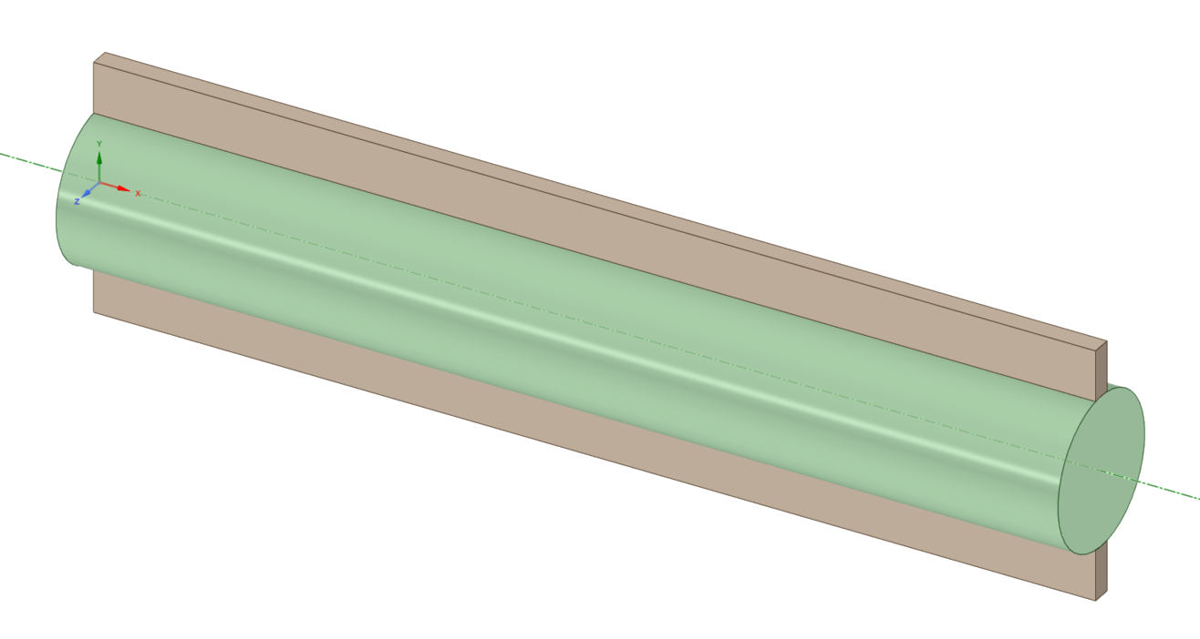
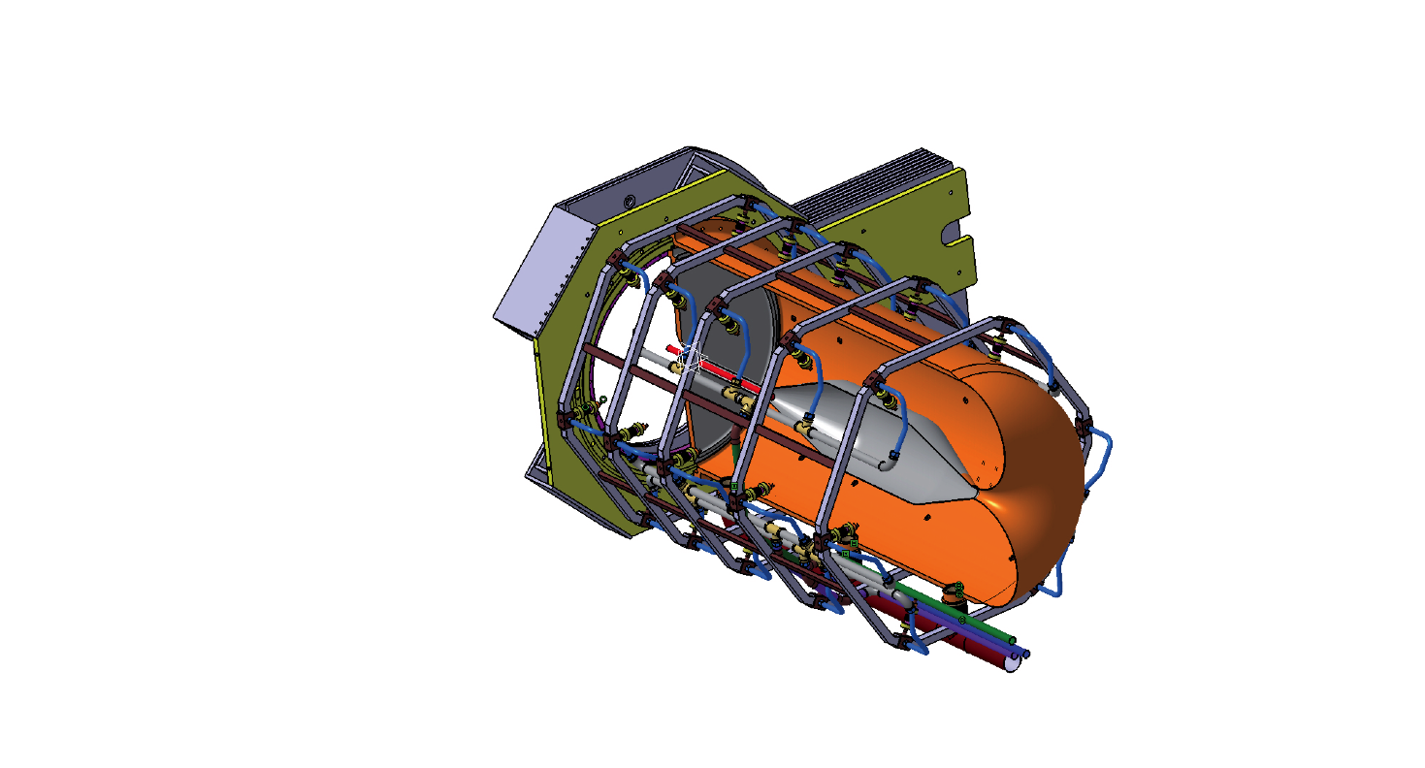
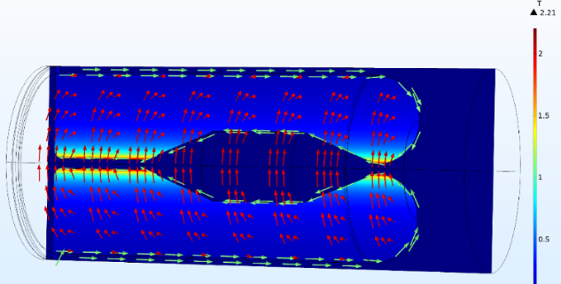

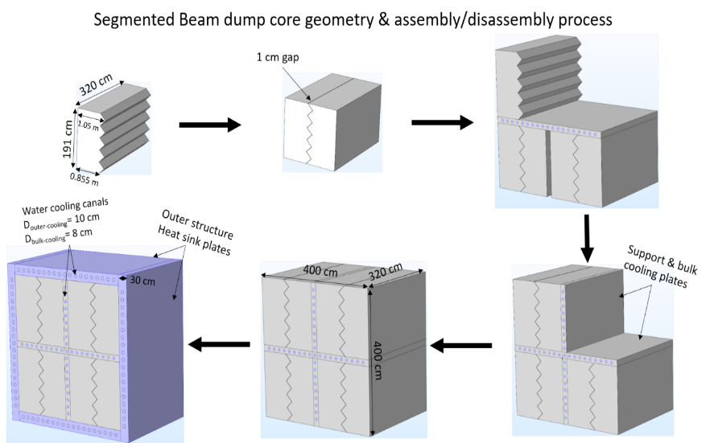
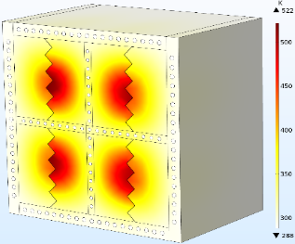

Target Station
2.21 T
4-Horn focusing system
Four separated horns, with target canister placed in the horn middle.
Aluminum conductor with outer (10 mm)/inner (3 mm) thickness and water cooled.
Horn current is 350 kA with 14 Hz/100 µs-pulse.
Toroidal $\vec{B}$ field inside the cavity, with max. B-value of 2.21 T.
Current polarity depends on the π± focusing operation mode.
Has a very low inductance of 0.9 μH and a low resistance value of 0.235 mΩ.
Packed-bed target
Four solid packed-bed, 1.5 mm radius Ti spheres, contained in a 15 mm-radius, 780 mm-long canister.
1.25 MW @ of 14 Hz ESS proton beam on target.
Cooled based on longitudinal He flow in the bulk of the canister
Disadvantage: drastic reduction in cooling the spheres at the canister back.
New multi-entries transverse cooling system is under study
Advantage: homogenous cooling of the spheres in the canister bulk.
Beam dump (Segmented-blocks core)
Protects the site behind the decay tunnel from radio-activation.
Different graphite core designs, with outer layout 4 x 4 x 3.2 m³.
Interior view of one horn (left). $\vec{B}$,$\left|\vec{B}\right|$ and current direction in the horn (right).
840 K
552 K
Cooling by transverse flow – Temperature
60 m/s
91 m/s
Target canister with cooling bars.
Cooling by transverse flow – superficial velocity
522 K

Slide 26
Updated Physics Performance
Updated horn design [1,2]
A Genetic Algorithm optimization study has been carried out using FLUKA for different
horn and decay tunnel geometries
Resulted in bigger horn (1.5x) and longer decay tunnel (25 m to 50 m)
➔ Obtained higher statistics in the neutrino, hence better performance of the experiment
➔ On-going studies to verify the feasibility of the new horn in terms of thermomechanical stresses.
Distance from neutrino source (baseline)
  ➔ 540 km (Garpenberg) and 360 km (Zinkgruvan)
Experiment run time
  ➔ 5 years neutrino mode and 5 years anti-neutrino mode
Assumed systematic error
  ➔ 5% on signal normalization and 10% on background normalization
[1] L. D’Alessi et al. [ESSvSB], "Optimization of the Target Station for the ESSnSB Project Using the Genetic Algorithm", NeuTel Conference 2021.
[2] L. D’Alessi et al. [ESSvSB], “Neutrino Beam Optimization for the ESSnSB Experiment”, International Research Network - Neutrino 2021

Slide 27




Performance Comparison
Already after 5 years very competitive performance
DUNE
HyperK

Slide 28

Systematic errors
Phys. Rev. D 87 (2013) 3, 033004 [arXiv:1209.5973 [hep-ph]]

Slide 29


Optimization for precision
Supposing that value of δ_{CP} is roughly known at ESSnSB time
Precision for different
neutrino (antineutrino)run times
Improvement and Optimization for precision
540 km
360 km
ESSnuSB
θ₁₂ = 33.44°
θ₁₃ = 8.57°
θ₂₃ = 49.2°
Δm²₂₁ = 7.42e-5
Δm²₃₁ = +2.52e-3
2nd osc. max.
507 ktons far detector
Optimal precision for known δ_{CP}
540 km
360 km

Slide 30



ESSvSB time frame
2022: End of ESSνSB Design Study, CDR and preliminary costing
2012: inception of the project
2016-2019: beginning of COST Action EuroNuNet
2018: beginning of ESSνSB Design Study (EU-H2020)
2022-2026: Preparatory Phase, TDR
2026-2028: Preconstruction Phase, International Agreement
2028-2036: Construction of the facility and detectors, including commissioning
2037-: Data taking
arxiv.org/abs/2206.01208
Nucl. Phys. B 885 (2014) 127

Slide 31


WP3 Tasks: Investigate Pion Extraction System (pES)
Large-Opening Dipole Magnet System
The secondary-beam distribution, at a distance of 10 m from the target/horn system, shows a 2D-Gaussian distribution with σ ~ 0.38 m (FWHM ~ 1 m)
➔ Requires large-opening dipole magnet!
10 m
Operates @ I_{max} = 1340 A and a central magnetic field strength of B_{max} = 0.54T (∫B dl ≈ 0.74Tm)
σ_{x/y} = 38 cm
1.5 m
3.9 m
0.84 m
2.8 m
1.5 m
1.5 m
Y
Z
Beam direction
X
BGO-OD @ at the ELSA facility in Bonn
x [cm]

Slide 32
ESSvSB+ (Work-Packages)
Engineering and Infrastructures
Civil engineering studies will be performed of the already proposed installations of ESSνSB.
During the same period, analogue studies will be performed at the Zinkgruvan mine at the place where the ESSνSB far detector will be installed.
  The analysis of the already existing data will be completed and described in a comprehensive report.
Target Station
An optimised design of the hadron collector for neutrino production has been produced during the ESSνSB studies. A first evaluation of whether this design is well suited also for pion collection for LEnuSTORM and LEMNB usage will be done.
A pion beam simulation will be performed. The resulting characteristics will be provided to WP4, WP5 and WP6 to define the initial design of the other ESSνSB+ parts.

Slide 33
ESSνSB+ WP
LEnuSTORM
Lattice and beam optics design will be elaborated from the existing higher energy proposals.
Shape and dimensions of the racetrack ring will be established.
The study will include the transfer lines from the ESSνSB complex to the target and from the initial capture an
extraction up to the injection point in the ring.
LEMNB
A preliminary design of the ca 30 m long EMNB decay tunnel will be made on the basis of the H2020 ESSνSB Design Study
and ERC ENUBET project.
Muons from pion decays, which are produced with an average emission angle of order 50 mrad at 1 GeV, are monitored
at the single-particle level using sampling calorimeters for muon/pion separation.
Thanks to the additional sample of electron neutrinos originating from the decay in flight, the ESS monitored neutrino beam will be able to assess also the electron neutrino versus muon neutrino difference of cross-sections below 1 GeV.

Slide 34
ESSvSB+ (Work-Packages)
Detector and physics performance:
Design of an additional detector which will be used by LEnuSTORM and LEMNB for cross-section measurements;
  it will also be used as LEnuSTORM near detector for sterile neutrino searches.
The near detector of ESSνSB will be used as a far detector of LEnuSTORM.
The WP will also use the information provided by all the other WPs to determine and maximise the physics reach of LEnuSTORM and LEMNB, taking into account the additional information coming from concurrently running experiments that may become available.
It will also compare the performance of ESSνSB+ with that of other planned or proposed facilities.
The potential of the ESSνSB far detector doped with Gadolinium for non-beam related physics (natural neutrino sources, proton decay) will be studied.

Slide 35
The ENUBET (Enhanced NeUtrino BEams from kaon Tagging)
- Proposes a dedicated facility to measure ν_{μ} and ν_{e} cross-sections precisely using a combination of monitored, narrow-band neutrino beams at the GeV energy scale and by instrumenting the meson-decay tunnel with a segmented calorimeter.
The ENUBET approach is based on monitoring the production of large-angle positrons from K⁺ → π⁰e⁺ν_{e} (Ke3) decays in the decay tunnel.
In addition, ENUBET will monitor muons produced in kaon and pion decays, thus providing a precise measurement of the ν_{μ} flux.
Due to the optimization of the focusing-and-transport system of the momentum-selected narrow-band beam of the parent mesons, the Ke3 decay represents the main source of electron neutrinos.
Furthermore, the positron rate may be used to measure the ν_{e} flux directly. Consequently, the monitored ν_{e} beam will lower the uncertainties on the neutrino flux and flavour for a conventional beam from the current level of O(7%-10%) to ∼ 1%.
Similar precision is expected for the ν_{μ} flux, with the bonus that the neutrino energy will be determined with a precision of ∼ 10% at the single neutrino level by the “narrow-band off-axis technique”, i.e. using only the position of the ν_{μ} interaction vertex.

Slide 36
nuSTORM (Neutrinos from Stored Muons)
It has been designed to deliver a definitive neutrino nucleus scattering programme using beams of (anti)v_{e} and (anti)ν_{μ} from the decay of muons confined within a storage ring.
The facility is unique, it will be capable of storing μ± beams with momentum of between 1 GeV/c and 6 GeV/c and a momentum spread of ±16%.
At nuSTORM, the flavour composition of the beam and the neutrino-energy spectrum are both precisely known.
The storage-ring instrumentation will allow the neutrino flux to be determined to a precision of 1% or better.

