Slide 1







Dual Rainbow Introduction
About the company／ Product & Service／Success Case
010-84673509
sales@dual-rainbow.com
www.dual-rainbow.com
Public @ Dual Rainbow

Slide 2

1
About the Company
Contents
The first part is to tell you who we are, about Dual Rainbow’s history, location and customers
2
Product & Service
The second part is about what we do, is to give a brief description of our products and service
3
Success Case
The last part is to show what we have done to give you a clear image
Public @ Dual Rainbow

Slide 3



01
About the Company
Brief Introduction
Location
Customer
Public @ Dual Rainbow

Slide 4


About the Company
Brief Introduction
Location
Customer
Intelligent Manufacturing
Technical Service
Distribution Service
2021
2023
2011
2013
Established in Beijing
Add intelligent manufacturing service
Exclusive agent of SensL (now onsemi)
Add technology service
Public @ Dual Rainbow

Slide 5
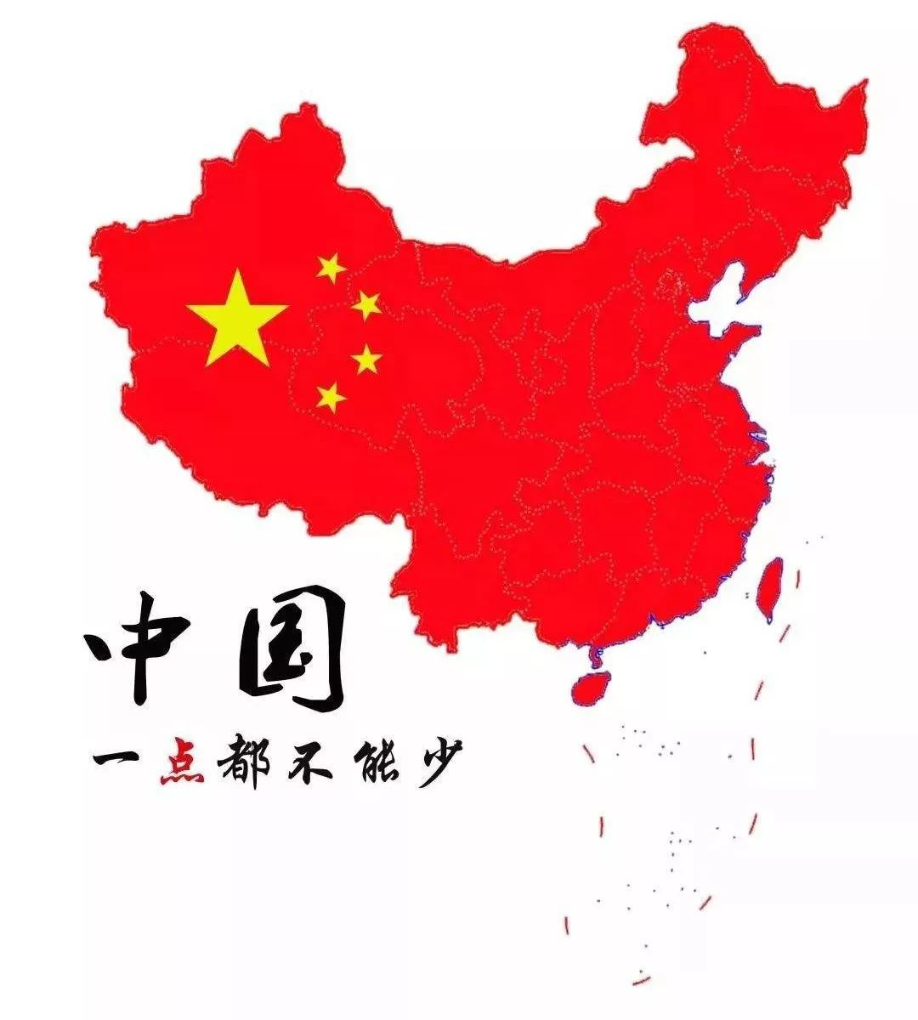

About the Company
Brief Introduction
Location
Customer
2011
Beijing
2017
Guangzhou
2019
Shenzhen
2021
Suzhou
2022
Wuhan
Public @ Dual Rainbow

Slide 6
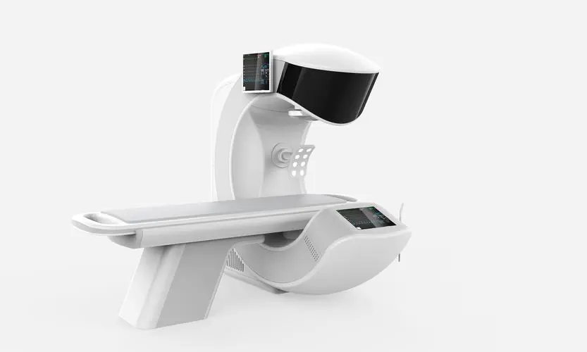


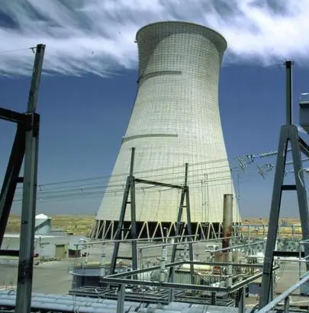

About the Company
Brief Introduction
Location
Customer
College & University
Research Institute
High-tech Enterprise
Medical
Security
Environment protection
Energy
Intelligent
Public @ Dual Rainbow

Slide 7



02
Product & Service
Product
Service
Manufacturing
Public @ Dual Rainbow

Slide 8
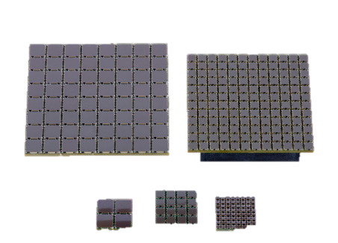

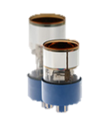
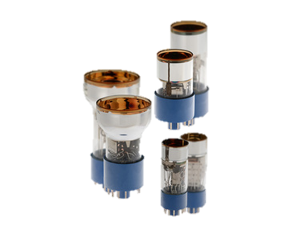




Products & Service
Product
Service
Manufacturing
SiPM
PMT
Spectrometer
Public @ Dual Rainbow

Slide 9
Products & Service
Product
Service
Manufacturing
Be an Excellent Marketing and Investment Partner
Marketing
Seed funding
Public @ Dual Rainbow

Slide 10


Products & Service
Product
Service
Manufacturing
Intelligent Manufacturing Service System
OEM
ODM
Public @ Dual Rainbow

Slide 11
03
Success Case
Public @ Dual Rainbow

Slide 12
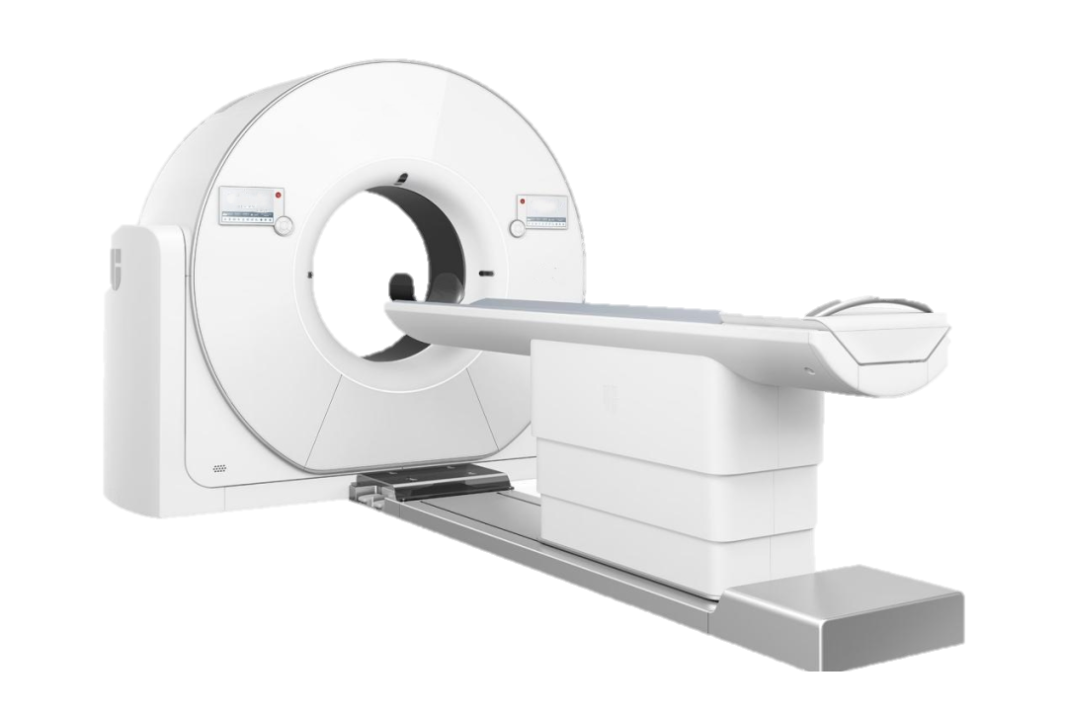
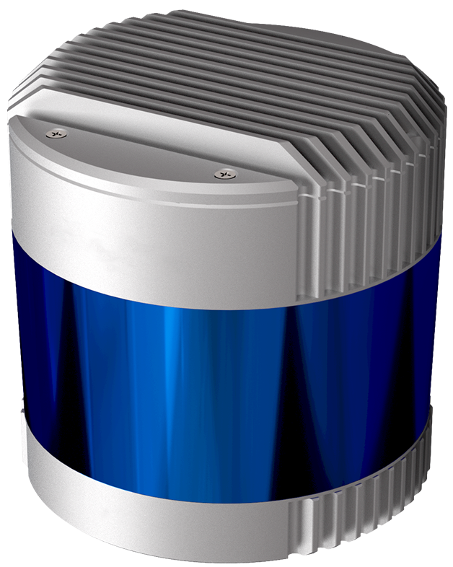
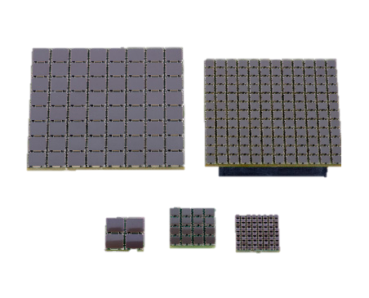
Success Case
PET/CT
Lidar
ODM
Public @ Dual Rainbow

Slide 13

Thank you
010-84673509
sales@dual-rainbow.com
www.dual-rainbow.com/
Public @ Dual Rainbow

