Slide 1
Cosmological implications for neutrino physics
Yvonne Y. Y. Wong, UNSW Sydney
The 29th International Workshop on Weak Interaction and Neutrinos, SYSU Zhuhai, July 2– 8, 2023

Slide 2
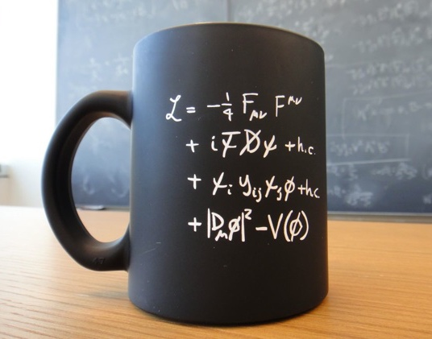
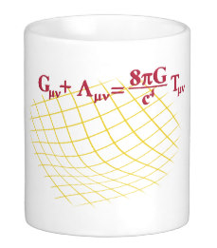
An unlikely partnership?
Neutrino = one of the lightest and most weakly-interacting known particles
Cosmology = gravitation on the largest observable scales
Standard model of particle physics
General relativity

Slide 3
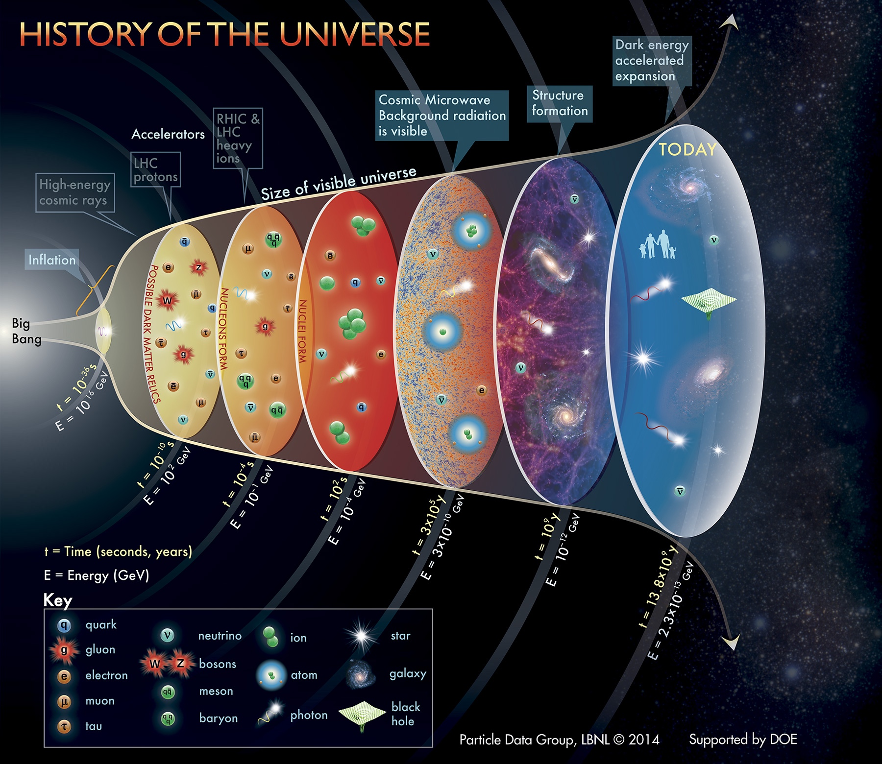
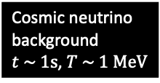
Primordial nucleo-synthesis
Cosmic neutrino background $t \sim 1s$, $T \sim 1 MeV$

Slide 4
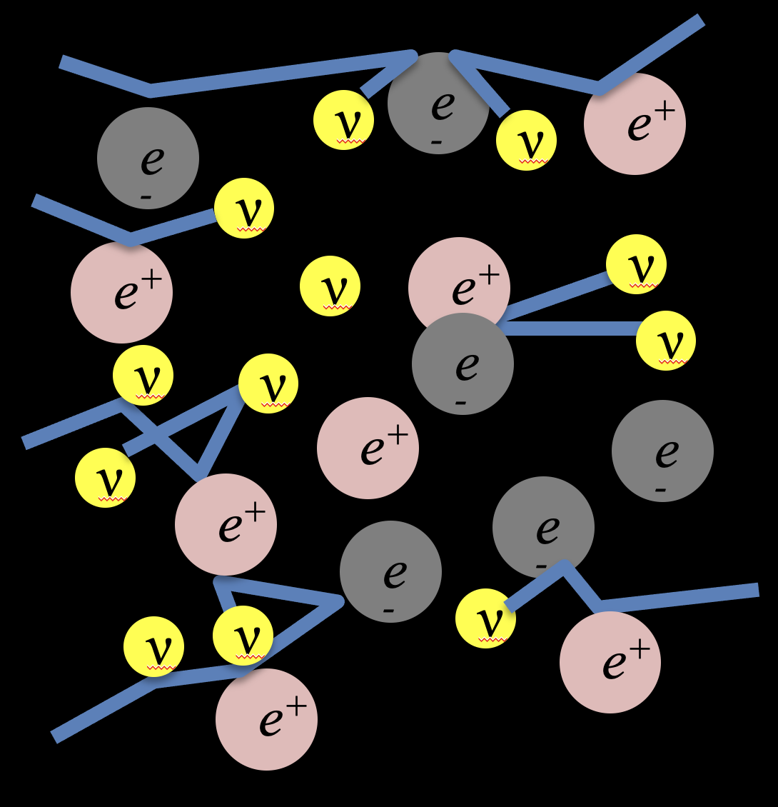
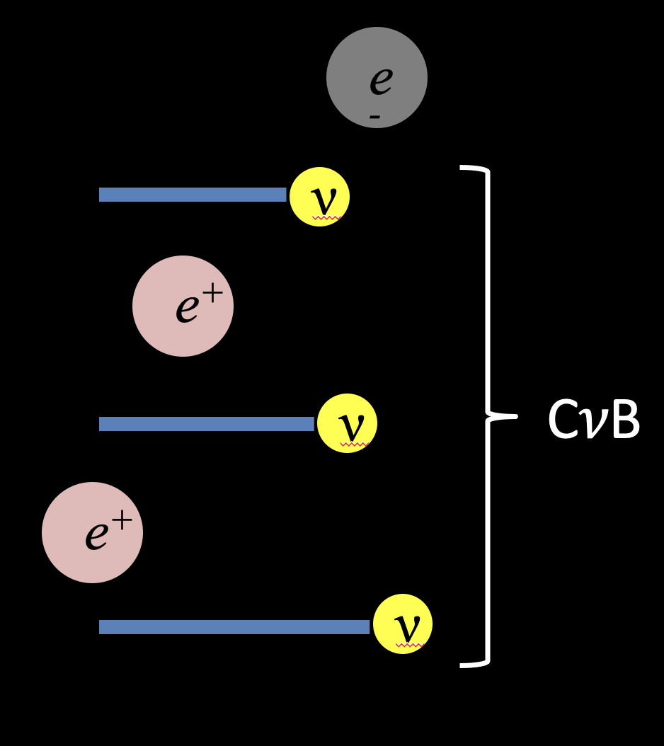



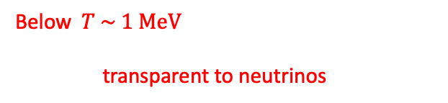
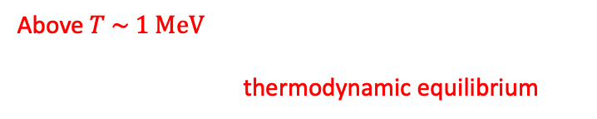
Formation of the C𝜈B…
Interaction rate:
$$Γ_{weak}\sim G_{F}^{2}T^{5}$$
Expansion rate:
$$H\sim M_{pl}^{−2}T^{2}$$
The C𝜈B is formed when neutrinos decouple from the cosmic plasma.
Neutrinos
“free-stream”
to infinity.
($T_{⊙core}\sim 1 keV$)
Above$T \sim 1 MeV$, even weakly-interacting neutrinos can be produced, scatter off $e^{+}e^{−}$and other neutrinos, and attain thermodynamic equilibrium
Below $T \sim 1 MeV$, expansion dilutes plasma, and reduces interaction rate: the universe becomes transparent to neutrinos.

Slide 5
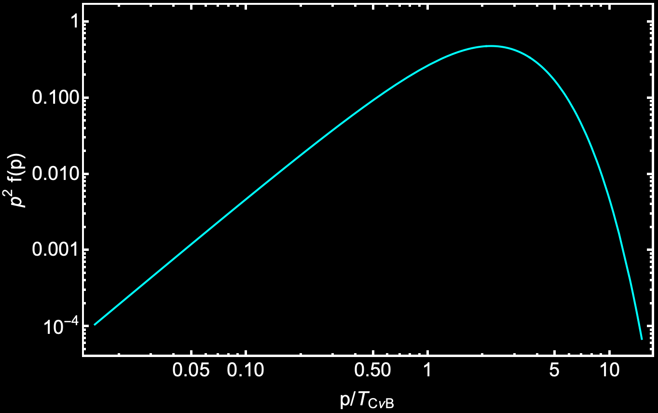





The cosmic neutrino background…
Standard model predictions
Per family of
neutrinos
+antineutrinos
Number density:
Energy density:
Relativistic (if $T_{CνB}≫m_{ν}$):
Non-rel (if $T_{CνB}≪m_{ν}$):
Relativistic Fermi-Dirac
distribution
$$nCνB≃110 {cm}^{−3}$$
$$ρ_{CνB}≃\frac{7}{8}{\left(\frac{4}{11}\right)}^{4/3} ρ_{CMB}$$
Temperature:
$$TCνB={\left(\frac{4}{11}\right)}^{1/3}TCMB$$
$$Ω_{CνB}≃\frac{m_{ν}}{93 h^{2} eV}$$
Neutrino dark matter

Slide 6
Primordial nucleo-synthesis
Cosmic neutrino background $t \sim 1s$, $T \sim 1 MeV$

Slide 7

What can cosmology do for neutrino physics?
Precision cosmological observations allow us to infer the properties of the cosmic neutrino background, from which to determine :
Absolute neutrino mass scale, $\sum{m_{ν}}$
Number of neutrino families, $N_{eff}$
  Deviations from SM prediction of $N_{eff}≈3$
  e.g., test for the existence of light sterile states
Neutrino decay/lifetime, $τ_{0}$
Non-standard neutrino interactions
  Self, neutrino-dark matter, neutrino-dark energy
  …
“Standard” tests
More exotic, but of growing interest

Slide 8
What can cosmology do for neutrino physics?

Slide 9
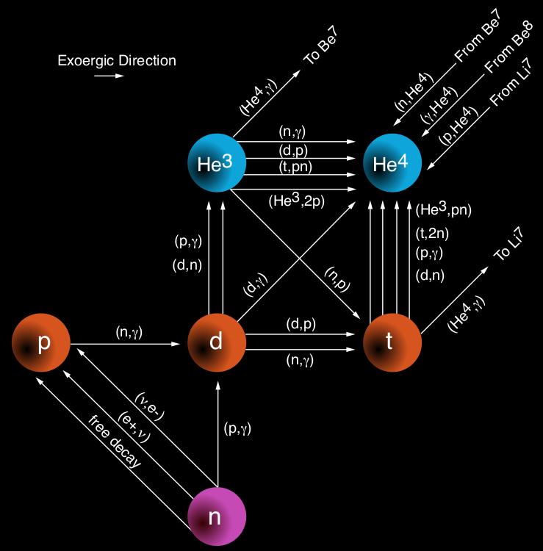
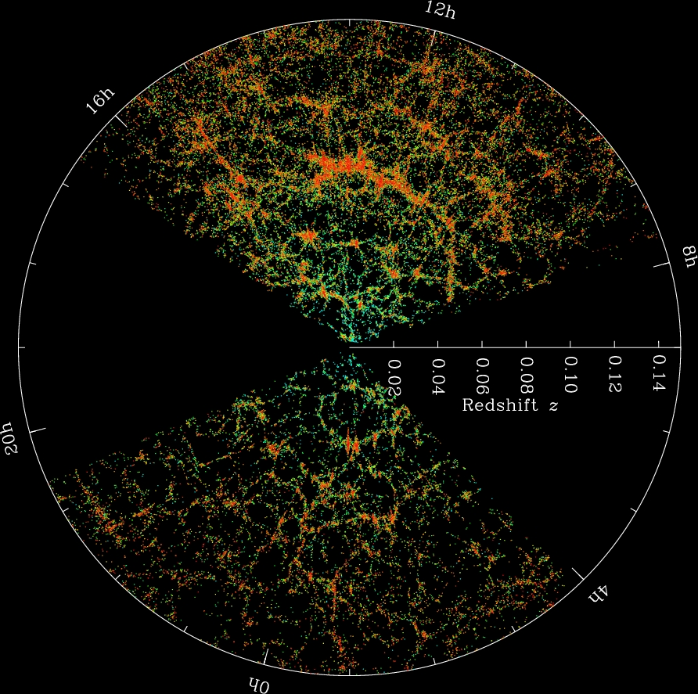

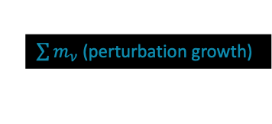


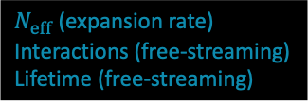




Cosmological observables…
+ Supernova Ia, local H₀, etc.
(No direct neutrino effects)
Light element abundances from primordial nucleosynthesis
Cosmic microwave background anisotropies
Large-scale matter distribution
$${He}^{3}$$
$${He}^{4}$$
$$p$$
$$d$$
$$t$$
$$n$$
$N_{eff}$ (expansion rate)
Interactions (free-streaming)
Lifetime (free-streaming)
$N_{eff}$ (expansion rate)
$\sum{m_{ν}}$ (perturbation growth)

Slide 10
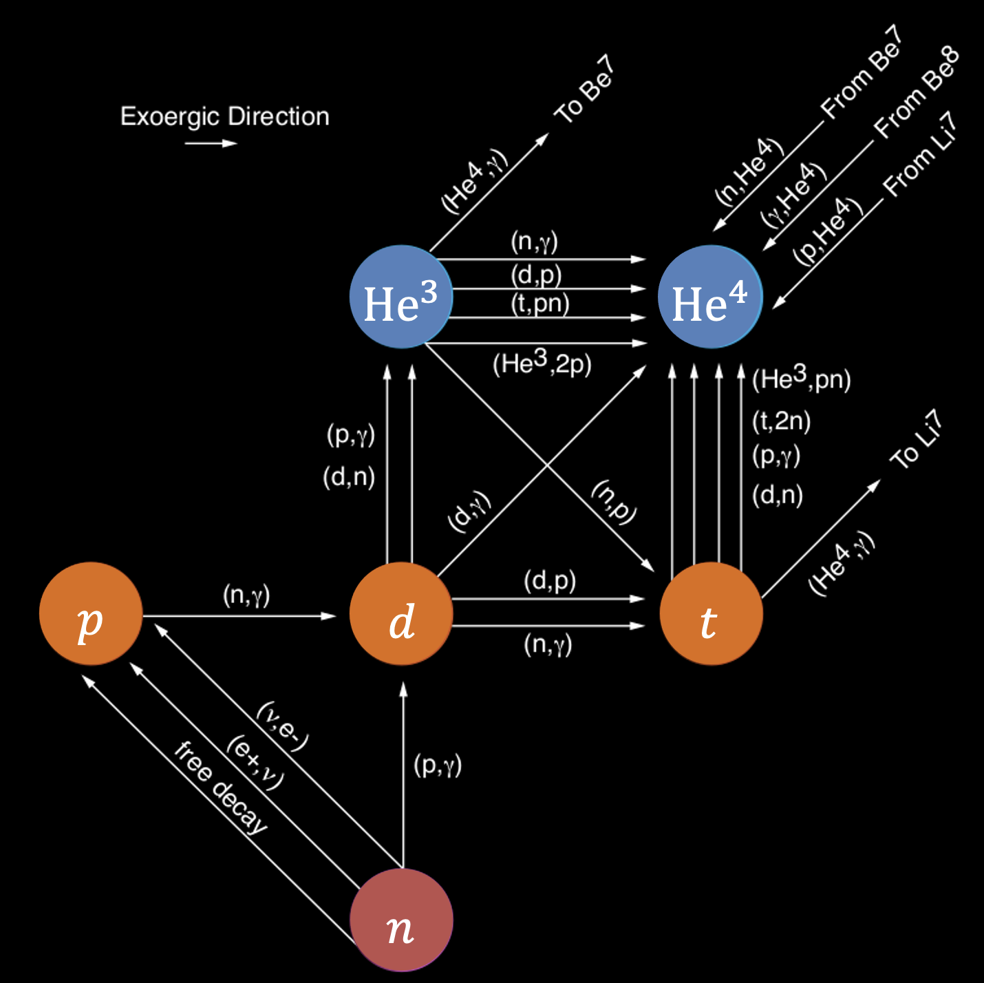
What do these probes really probe?
They may look different, but ultimately the information contained is
Universal expansion rate at different times
  How much matter, radiation, “in-between” (e.g., neutrinos), vacuum energy, etc.
Growth of fluctuations under gravity
  Kinematic properties and interactions of the various types of stuff in the universe; good for neutrino physics
Distance measurements
  Spatial geometry, dark energy; not directly relevant for neutrino physics but has indirect effects on inference

Slide 11
What do these probes really probe?
They may look different, but ultimately the information contained is
Universal expansion rate at different times
  How much matter, radiation, “in-between” (e.g., neutrinos), vacuum energy, etc.
Growth of fluctuations under gravity
  Kinematic properties and interactions of the various types of stuff in the universe; good for neutrino physics
Distance measurements
  Spatial geometry, dark energy; not directly relevant for neutrino physics but has indirect effects on inference

Slide 12
Neutrinos & the expansion rate…
The Hubble expansion rate depends on the energy content of the universe:
$$H^{2}\left(a(t)\right)=H_{0}^{2}\left(Ω_{m}a^{−3}+Ω_{r}a^{−4}+Ω_{Λ}+Ω_{k}a^{−2}+…\right)$$
Scale factor
Matter
Radiation
Cosmological constant
Spatial curvature
Neutrinos = radiation at early times
= matter at late times

Slide 13
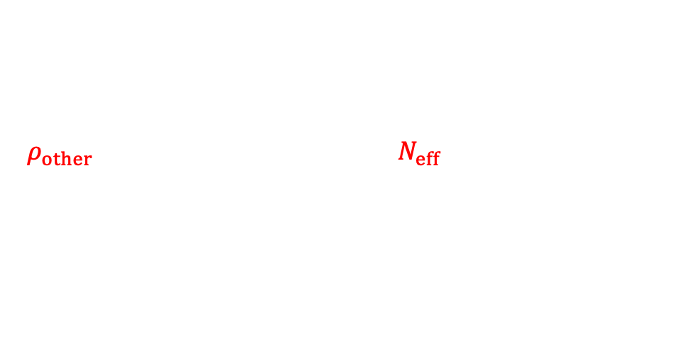
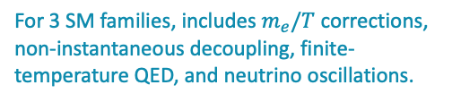

Neutrinos & the expansion rate…
The Hubble expansion rate depends on the energy content of the universe:
$$H^{2}\left(a(t)\right)=H_{0}^{2}\left(Ω_{m}a^{−3}+Ω_{r}a^{−4}+Ω_{Λ}+Ω_{k}a^{−2}+…\right)$$
Scale factor
Matter
Radiation
Cosmological constant
Spatial curvature
Standard cosmology at early times
$$ρ_{other}+ρ_{CMB}+\sum{ρ_{CνB}}=\left[1+N_{eff}×\frac{7}{8}{\left(\frac{4}{11}\right)}^{4/3}\right] ρ_{CMB}$$
$$N_{eff}^{SM}=3.0440±0.0002$$
For 3 SM families, includes $m_{e}/T$ corrections, non-instantaneous decoupling, finite-temperature QED, and neutrino oscillations.
Bennett et al, 2020, 2021;
Froustey, Pitrou & Volpe, 2020

Slide 14
Neutrinos & the expansion rate…
The Hubble expansion rate depends on the energy content of the universe:
$$H^{2}\left(a(t)\right)=H_{0}^{2}\left(Ω_{m}a^{−3}+Ω_{r}a^{−4}+Ω_{Λ}+Ω_{k}a^{−2}+…\right)$$
Scale factor
Matter
Radiation
Cosmological constant
Spatial curvature
$$ρ_{other}+ρ_{CMB}+\sum{ρ_{CνB}}=\left[1+N_{eff}×\frac{7}{8}{\left(\frac{4}{11}\right)}^{4/3}\right] ρ_{CMB}$$
Any relativistic, feebly-interacting, thermalised particle species will look like a neutrino cosmologically, e.g., light sterile neutrinos, thermal axions, etc.
$$N_{eff}^{SM}=3.0440±0.0002$$
For 3 SM families, includes $m_{e}/T$ corrections, non-instantaneous decoupling, finite-temperature QED, and neutrino oscillations.
Bennett et al, 2020, 2021;
Froustey, Pitrou & Volpe, 2020

Slide 15
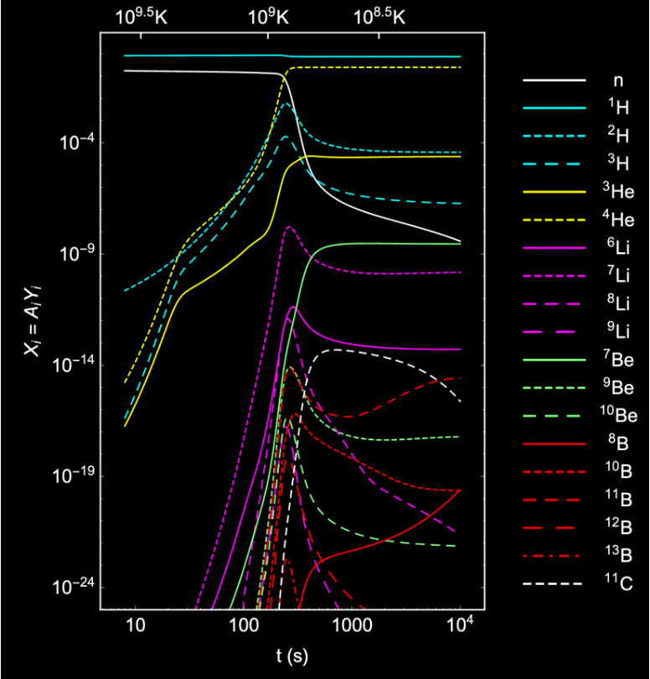
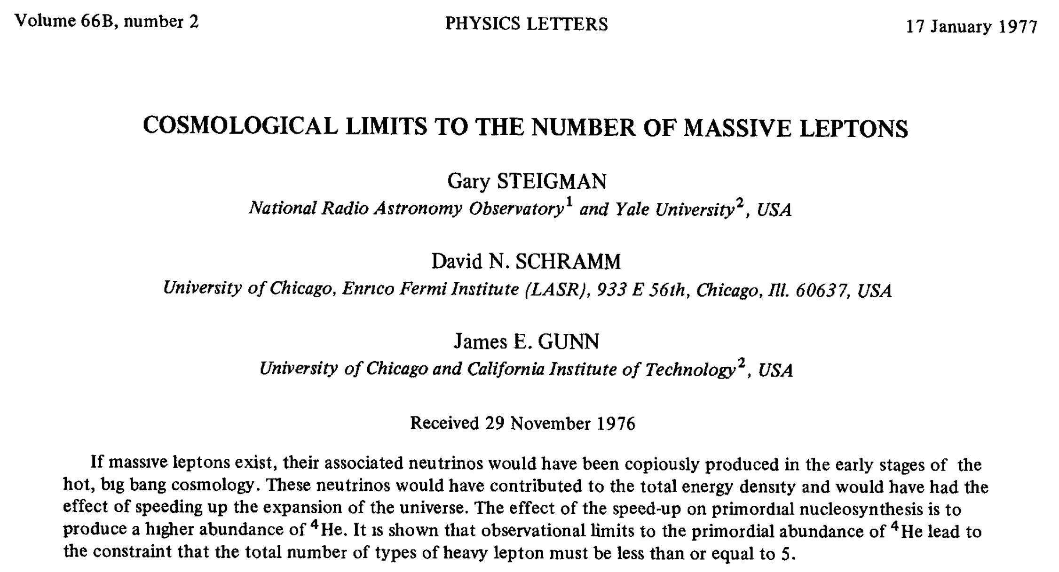
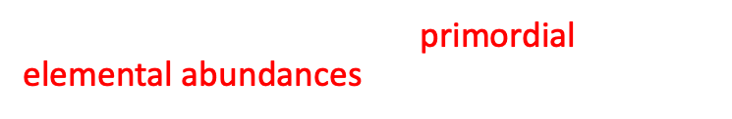

Nucleosynthesis & N_{eff}…
Constraining $N_{eff}$ with the primordial elemental abundances has a long history.
Abundance
Pitrou, Coc, Uzan & Vangioni 2018
Time after big bang [s]
How much of these elements is produced depends on how fast the universe expands.
$$N_{eff}<5$$

Slide 16
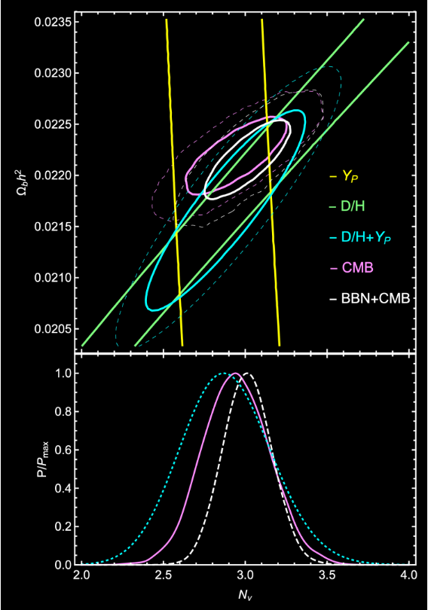


Nucleosynthesis & N_{eff}…
Constraining $N_{eff}$ with the primordial elemental abundances has a long history.
D/H = Deuterium
Y_{p} = Helium-4
Pitrou, Coc, Uzan & Vangioni 2018
$$N_{eff}=2.88±0.27 (68\% CL)$$
$$N_{eff}<5$$
Consistent with Standard Model prediction $N_{eff}≈3$

Slide 17
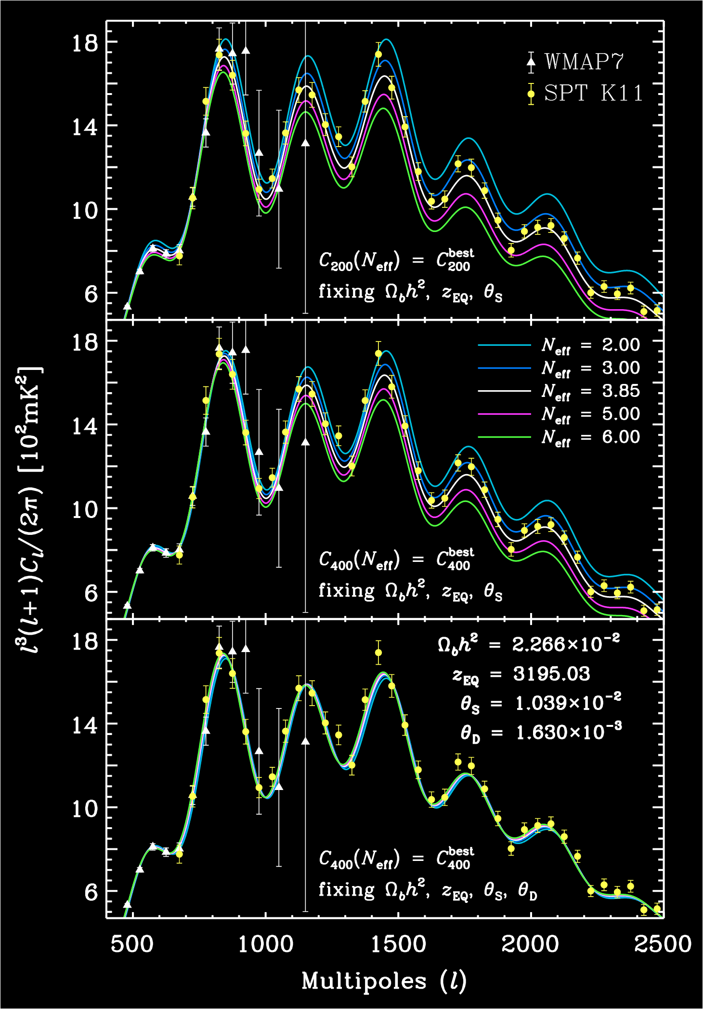
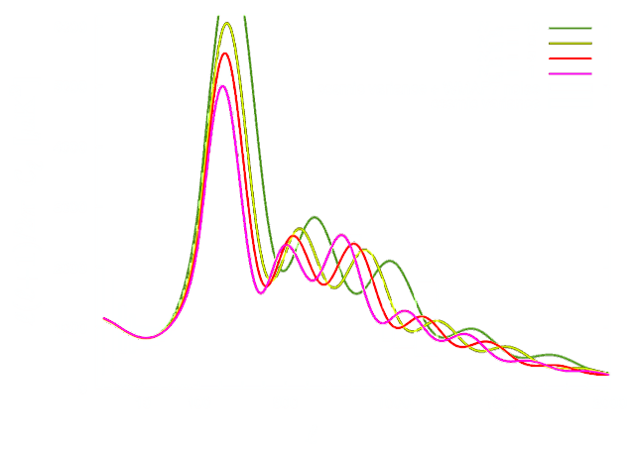



CMB anisotropies & N_{eff}…
Hou, Keisler, Knox, Millea & Reichardt 2013
$N_{eff}$ also affects the expansion rate at recombination.
Observable in the CMB temperature power spectrum
“Naïve” signature
“Irreducible” signature is in the CMB damping tail
Remarkably consistent with Standard Model prediction $N_{eff}≈3$
Planck TTTEEE+lowE
+lensing+BAO;
7-parameters
$$N_{eff}=2.99±0.34 (95\% CL)$$
Aghanim et al. [Planck] 2021

Slide 18
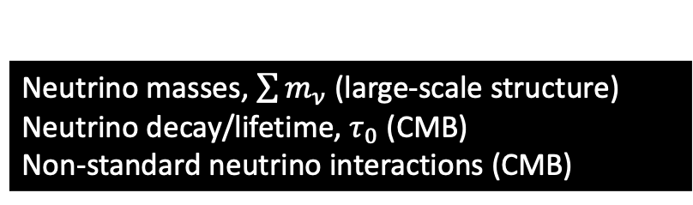
What do these probes really probe?
They may look different, but ultimately the information contained is
Universal expansion rate at different times
  How much matter, radiation, “in-between” (e.g., neutrinos), vacuum energy, etc.
Growth of fluctuations under gravity
  Kinematic properties and interactions of the various types of stuff in the universe; good for neutrino physics
Distance measurements
  Spatial geometry, dark energy; not directly relevant for neutrino physics but has indirect effects on inference
Neutrino masses, $\sum{m_{ν}}$ (large-scale structure)
Neutrino decay/lifetime, $τ_{0}$ (CMB)
Non-standard neutrino interactions (CMB)

Slide 19
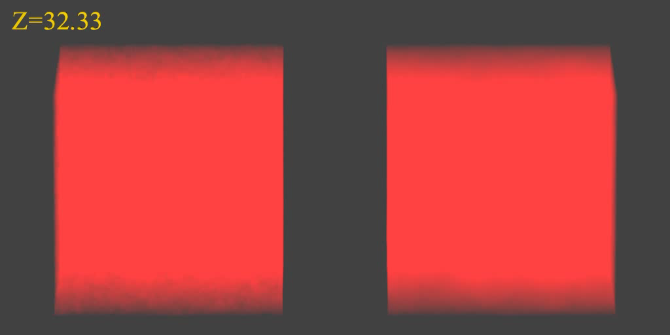


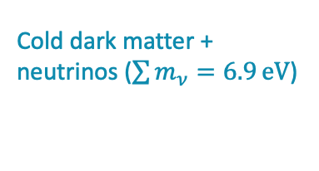

Neutrino masses & large-scale structure...
Cold dark matter only
Cold dark matter + neutrinos ($\sum{m_{ν}=6.9}eV$)
$$Ω_{CDM}≈10\%$$
$$Ω_{ν}=\frac{\sum{m_{ν}}}{93 h^{2}}≈15\%$$
$$Ω_{CDM}≈25\%$$
$$256 h^{−1}\text{Mpc}$$
~ 3% of largest observable distance
Simulations by Troels Haugbølle

Slide 20
Neutrino masses & large-scale structure...
Cold dark matter only
Cold dark matter + neutrinos ($\sum{m_{ν}=6.9}eV$)
$$Ω_{CDM}≈10\%$$
$$Ω_{ν}=\frac{\sum{m_{ν}}}{93 h^{2}}≈15\%$$
$$Ω_{CDM}≈25\%$$
$$256 h^{−1}\text{Mpc}$$
~ 3% of largest observable distance
Simulations by Troels Haugbølle

Slide 21
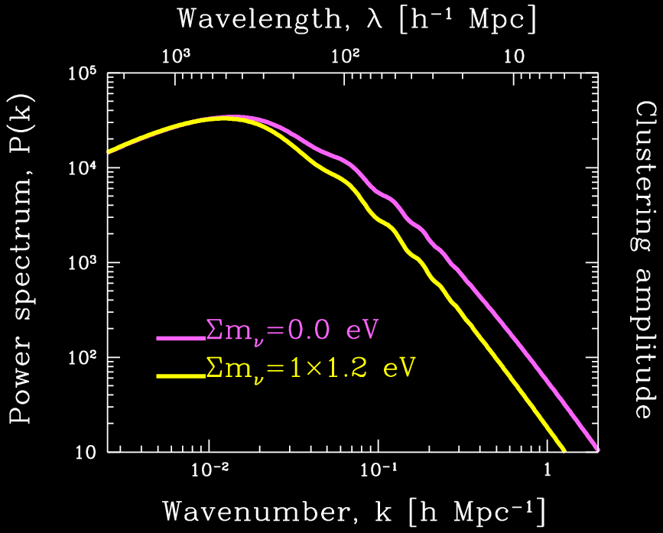
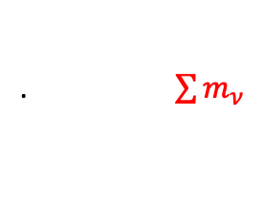
Matter power spectrum…
Replace some CDM with neutrino DM
Large-scale matter
power spectrum, P(k)
.$\frac{∆P}{P}∝\frac{Ω_{ν}}{Ω_{m}}∝\sum{m_{ν}}$

Slide 22
Matter power spectrum…
Galaxy clustering
/BAO
Cosmic
shear
CMB lensing
potential
(z~3-4)
Large-scale matter
power spectrum, P(k)
CMB “primary” (z~1000)
Cluster
abundance
Lyman-α
(z~2-4)
.$\frac{∆P}{P}∝\frac{Ω_{ν}}{Ω_{m}}∝\sum{m_{ν}}$

Slide 23
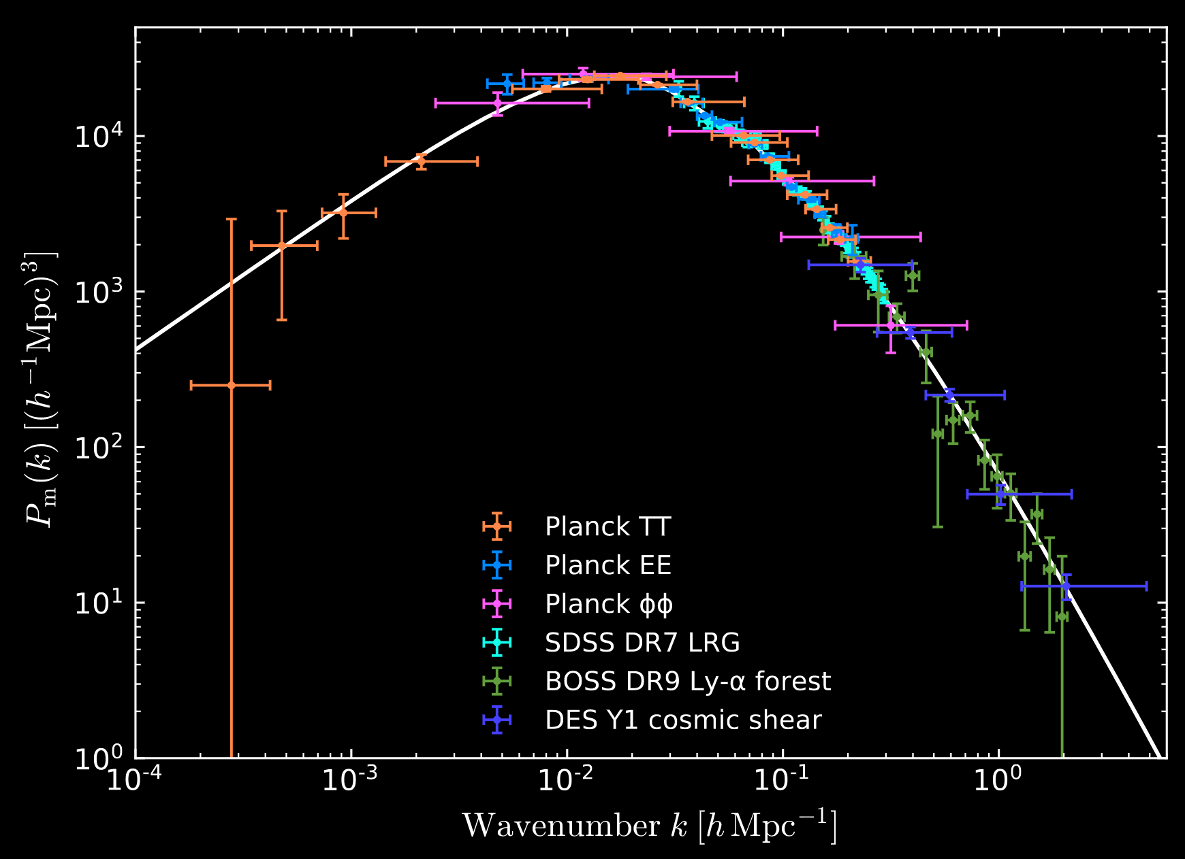
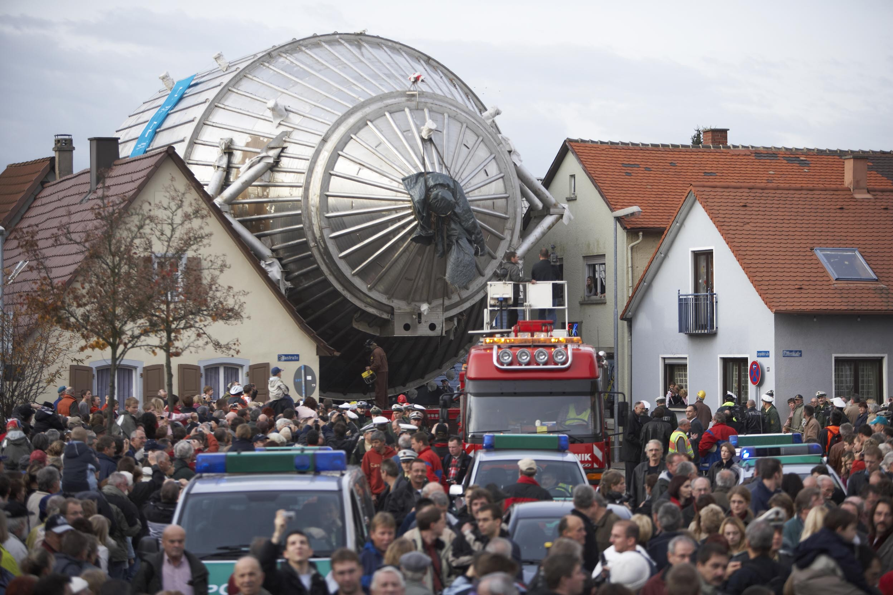


Neutrino mass from cosmology…
Large-scale matter power spectrum measurement ca. 2018
Current cosmological limits on the neutrino mass sum typically fall in the range:
.$\sum{m_{ν}}<O(0.1 −0.5)eV (95\% CL)$
Aghanim et al. [Planck] 2021
At face value a factor of 6 tighter than current lab bound from KATRIN, $\sum{m_{ν}}<3 eV$.
Aker et al. [KATRIN] 2019
p
n
ν
n
³H
e
p
n
p
³He
Ade et al. [Planck] 2018

Slide 24
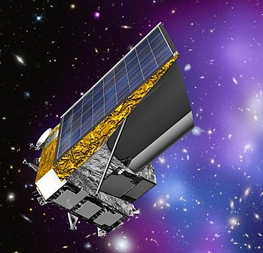
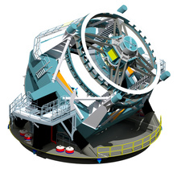

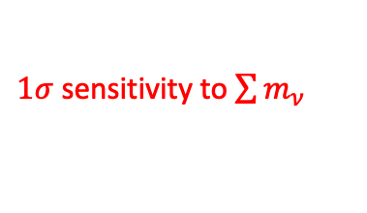






What to expect in the future?
$1σ$ sensitivity to $\sum{m_{ν}}$
$1σ$ sensitivity to $N_{eff}$
ESA Euclid
2023
$$0.011 −0.02 eV$$
$$0.05$$
LSST
2024
$$0.015 eV$$
$$0.05$$
Minimum $\sum{m_{ν}=0.06 eV}$
A $3σ−4σ$ detection of the neutrino mass sum may be possible!
From neutrino oscillations
(assuming normal mass ordering)

Slide 25
Matter power spectrum…
Galaxy clustering
/BAO
Cosmic
shear
CMB lensing
potential
(z~3-4)
Large-scale matter
power spectrum, P(k)
CMB “primary” (z~1000)
Cluster
abundance
Lyman-α
(z~2-4)
.$\frac{∆P}{P}∝\frac{Ω_{ν}}{Ω_{m}}∝\sum{m_{ν}}$

Slide 26
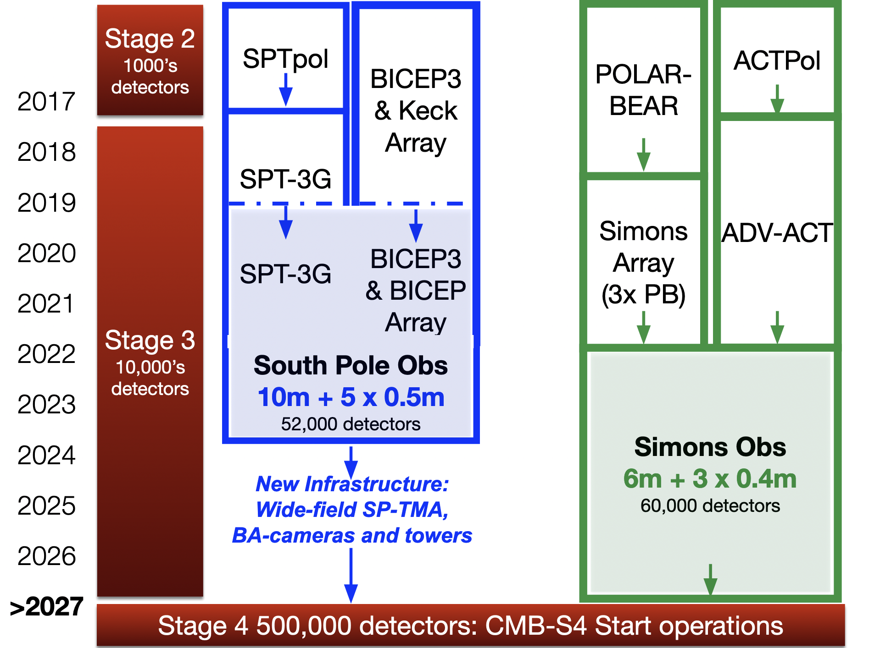
What to expect in the future?
CMB experiments
John Carlstrom

Slide 27
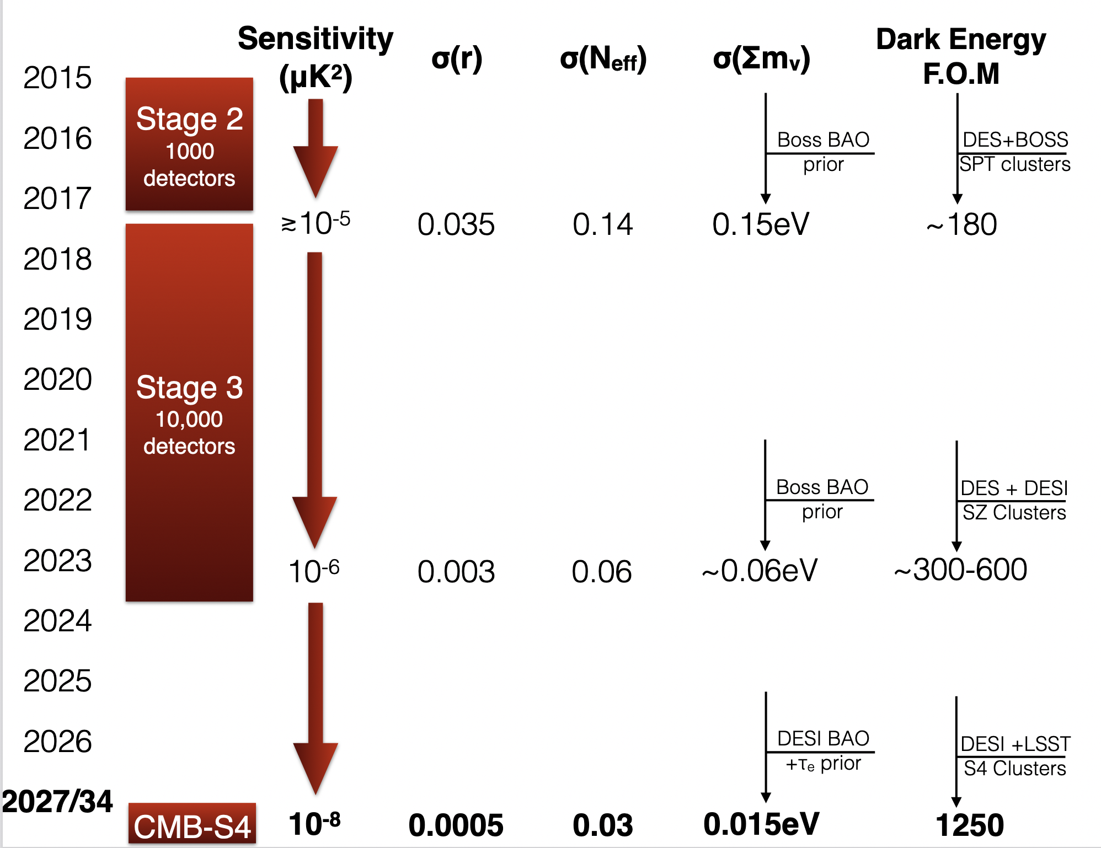
What to expect in the future?
CMB experiments
2027/34
John Carlstrom

Slide 28
Matter power spectrum…
Linear @z=0
z=1
z=3
Galaxy clustering
/BAO
Cosmic
shear
CMB lensing
potential
(z~3-4)
Large-scale matter
power spectrum, P(k)
CMB “primary” (z~1000)
Cluster
abundance
Lyman-α
(z~2-4)
.$\frac{∆P}{P}∝\frac{Ω_{ν}}{Ω_{m}}∝\sum{m_{ν}}$

Slide 29
What do these probes really probe?
They may look different, but ultimately the information contained is
Universal expansion rate at different times
  How much matter, radiation, “in-between” (e.g., neutrinos), vacuum energy, etc.
Growth of fluctuations under gravity
  Kinematic properties and interactions of the various types of stuff in the universe; good for neutrino physics
Distance measurements
  Spatial geometry, dark energy; not directly relevant for neutrino physics but has indirect effects on inference
Neutrino masses, $\sum{m_{ν}}$ (large-scale structure)
Neutrino decay/lifetime, $τ_{0}$ (CMB)
Non-standard neutrino interactions (CMB)

Slide 30
Formation of the C𝜈B…
Interaction rate:
$$Γ_{weak}\sim G_{F}^{2}T^{5}$$
Expansion rate:
$$H\sim M_{pl}^{−2}T^{2}$$
The C𝜈B is formed when neutrinos decouple from the cosmic plasma.
Neutrinos
“free-stream”
to infinity.
($T_{⊙core}\sim 1 keV$)
Above$T \sim 1 MeV$, even weakly-interacting neutrinos can be produced, scatter off $e^{+}e^{−}$and other neutrinos, and attain thermodynamic equilibrium
Below $T \sim 1 MeV$, expansion dilutes plasma, and reduces interaction rate: the universe becomes transparent to neutrinos.

Slide 31
Neutrino free-streaming & the CMB…
Standard neutrinos free-stream.
Free-streaming in a spatially inhomogeneous background induces shear stress (or momentum anisotropy).
Conversely, interactions transfer momentum and, if sufficiently efficient, can wipe out shear.
Free-streaming case
Interacting case
Peak
Scattering transfers
momentum and
wipes out shear
Trough
Sinusoidal
gravitational
potential
Peak
Trough
Peak

Slide 32


Neutrino free-streaming & the metric…
Neutrino shear stress (or lack thereof) leaves distinct imprints on the spacetime metric perturbations.
Scale factor
Conformal Newtonian gauge
$$ds^{2}=a^{2}\left(τ\right)[−\left(1+2ψ\right)dτ^{2}+\left(1−2φ\right)dx^{i}dx_{i}]$$
Shear stress
where
$$k^{2}\left(φ−ψ\right)=12πGa^{2}(\overline{ρ}+\overline{P})σ$$
In 𝛬CDM, mainly from
ultra-relativistic neutrinos and photons.
Mean energy density & pressure
Changes to $\left(φ−ψ\right) a$ffect the evolution of CMB perturbations and are observable in the CMB TT power spectrum.
Good probe of neutrino interactions around CMB formation times $(t∼400 kyr$) when the C𝜈B still constitutes a substantial fraction of the relativistic energy density.

Slide 33
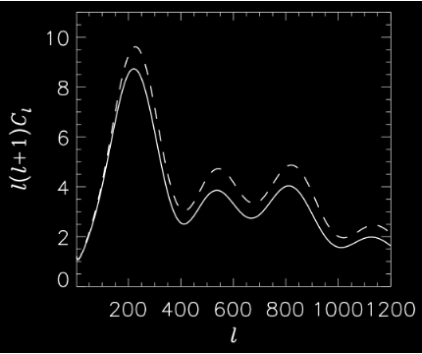
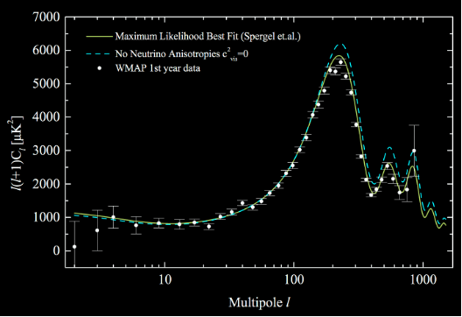
Neutrino free-streaming & the CMB…
That CMB prefers neutrino shear stress to no shear stress is well known.
No neutrino shear stress
Standard neutrino shear stress
Hannestad 2005
Melchiorri & Trotta 2005
The tricky part is, how do you translate this preference to constraints on the fundamental parameters of a non-standard neutrino interaction
→ What is the isotropisation timescale given a fundamental process?

Slide 34
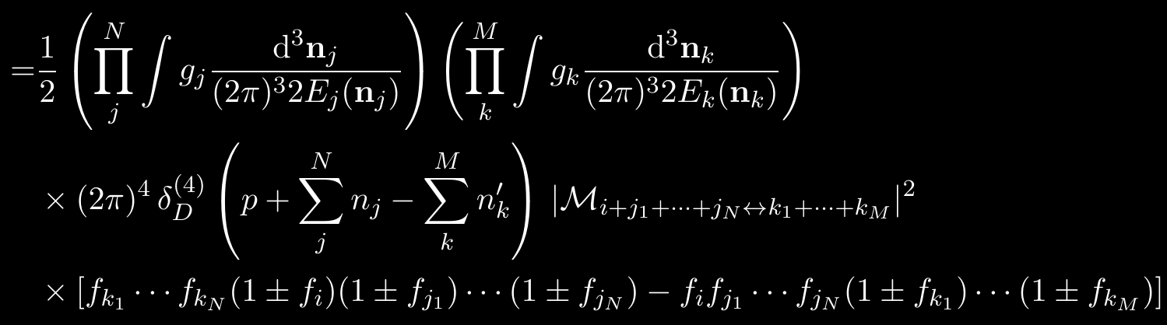
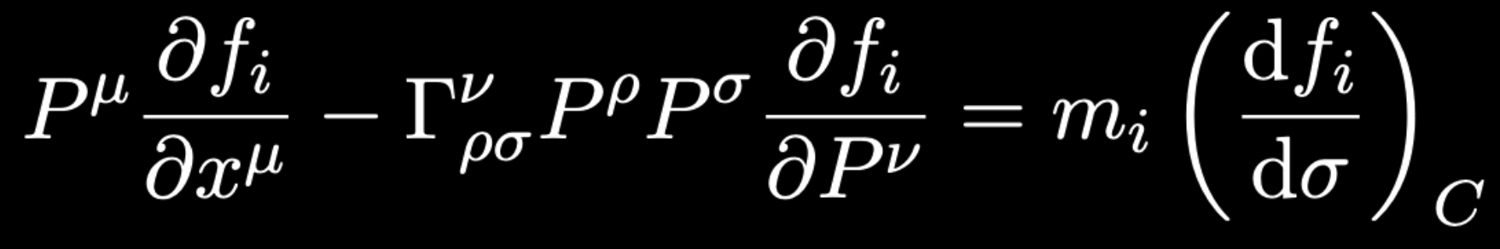

Isotropisation timescale…
Given an interaction Lagrangian, the isotropisation timescale is calculable.
Write down the Boltzmann equation:
Decompose in a Legendre series
The damping rate of the quadrupole ($ℓ=2$) moment is the isotropisation rate.
Tedious stuff, but this is really the only correct way to calculate these things, else you can get it very wrong… However, the result can usually be understood in simple terms. → Next slide

Slide 35





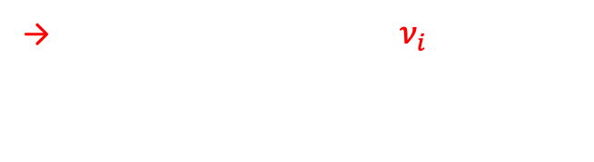




Isotropisation from 𝜈 self-interaction…
Consider a 2-to-2 scattering event $ν_{i}+ν_{i}→ν_{f}+ν_{f}.$
$$ν_{f}$$
→ Particles in two head-on $ν_{i}$beams need only scatter once to transfer their momenta equally in all directions.
$$ν_{f}$$
$$ν_{i}$$
$$θ$$
$$ν_{i}$$
$$ν_{f}$$
Isotropisation timescale
$$ν_{f}$$
The probability of $ν_{f}$ emitted at any angle $θ$ is the same for all $θ∈[0,π]$.
$$T_{isotropise} \sim 1/Γ_{scattering}$$
Cyr-Racine & Sigurdson 2014; Oldengott, Rampf & Y³W 2015;
Lancaster, Cyr-Racine, Knox & Pan 2017; Oldengott, Tram, Rampf & Y³W 2017;
Kreisch, Cyr-Racine & Dore 2019; Forastieri et al. 2019; etc.
Scattering rate

Slide 36
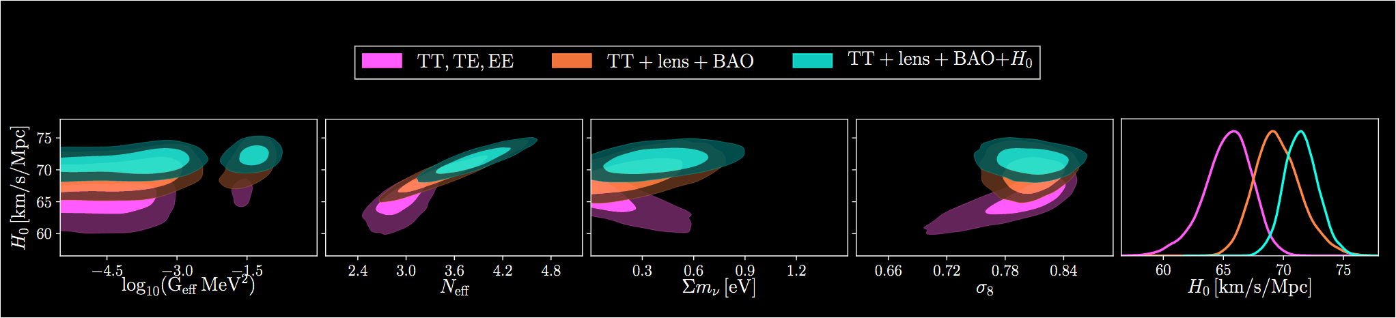

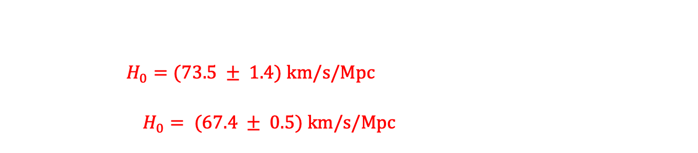
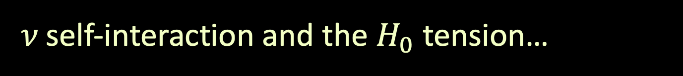
𝜈 self-interaction and the $H_{0}$ tension…
Kreisch, Cyr-Racine & Dore 2019
Recent claim that self-interaction alleviates the Hubble tension.
Local/late time: Cepheid-calibrated SNIa (SH0ES) and strong-lensing time delays (H0liCOW); $H_{0}=(73.5 ± 1.4) km/s/Mpc$
Global/early time: Statistical inference from CMB anisotropies (Planck), weak lensing, BAO; $H_{0}= (67.4 ± 0.5) km/s/Mpc$
Global
Local
This island:
$$G_{eff} \sim { 10}^{10}G_{F}$$
Disclaimer: I am not endorsing this result…

Slide 37







Isotropisation from relativistic (inverse) decay…
How long does it take $ν_{H}→ν_{l}+φ$ and its inverse process to wipe out momentum anisotropies? (Hint: it’s not the rest-frame lifetime of $ν_{H}$.)
In relativistic decay, the decay products are beamed.
Inverse decay also only happens when the daughter particles meet strict momentum/angular requirements.
$$φ$$
Assuming a massless $φ$
$$ν_{H}$$
$$θ_{φ}≈{m_{νH}}/{E_{νH}}$$
$θ_{νl}≈$ $\left(\frac{Δm_{ν}^{2}}{m_{νH}^{2}}\right)θ_{φ}$
$$ν_{l}$$
Barenboim, Chen, Hannestad, Oldengott, Tram & Y³W 2021
Chen, Oldengott, Pierobon & Y³W 2022

Slide 38



Isotropisation from relativistic (inverse) decay…
How long does it take $ν_{H}→ν_{l}+φ$ and its inverse process to wipe out momentum anisotropies? (Hint: it’s not the rest-frame lifetime of $ν_{H}$.)
In relativistic decay, the decay products are beamed.
Inverse decay also only happens when the daughter particles meet strict momentum/angular requirements.
$$φ$$
Assuming a massless $φ$
Isotropisation timescale
$$θ_{φ}≈{m_{νH}}/{E_{νH}}$$
$$ν_{H}$$
$θ_{νl}≈$ $\left(\frac{Δm_{ν}^{2}}{m_{νH}^{2}}\right)θ_{φ}$
$$ν_{l}$$
Rest-frame lifetime of $ν_{H}$
Boost
→ Isotropisation is a loooong process:
$$T_{isotropise} \sim {\left(θ_{φ}θ_{νl}\right)}^{−2} γ_{νH} τ_{rest}$$
$$≳400 kyr$$
Barenboim, Chen, Hannestad, Oldengott, Tram & Y³W 2021
Chen, Oldengott, Pierobon & Y³W 2022
→ Lower bound on $τ_{rest}$ as a function of $m_{νH}$ and $m_{νl}$.

Slide 39
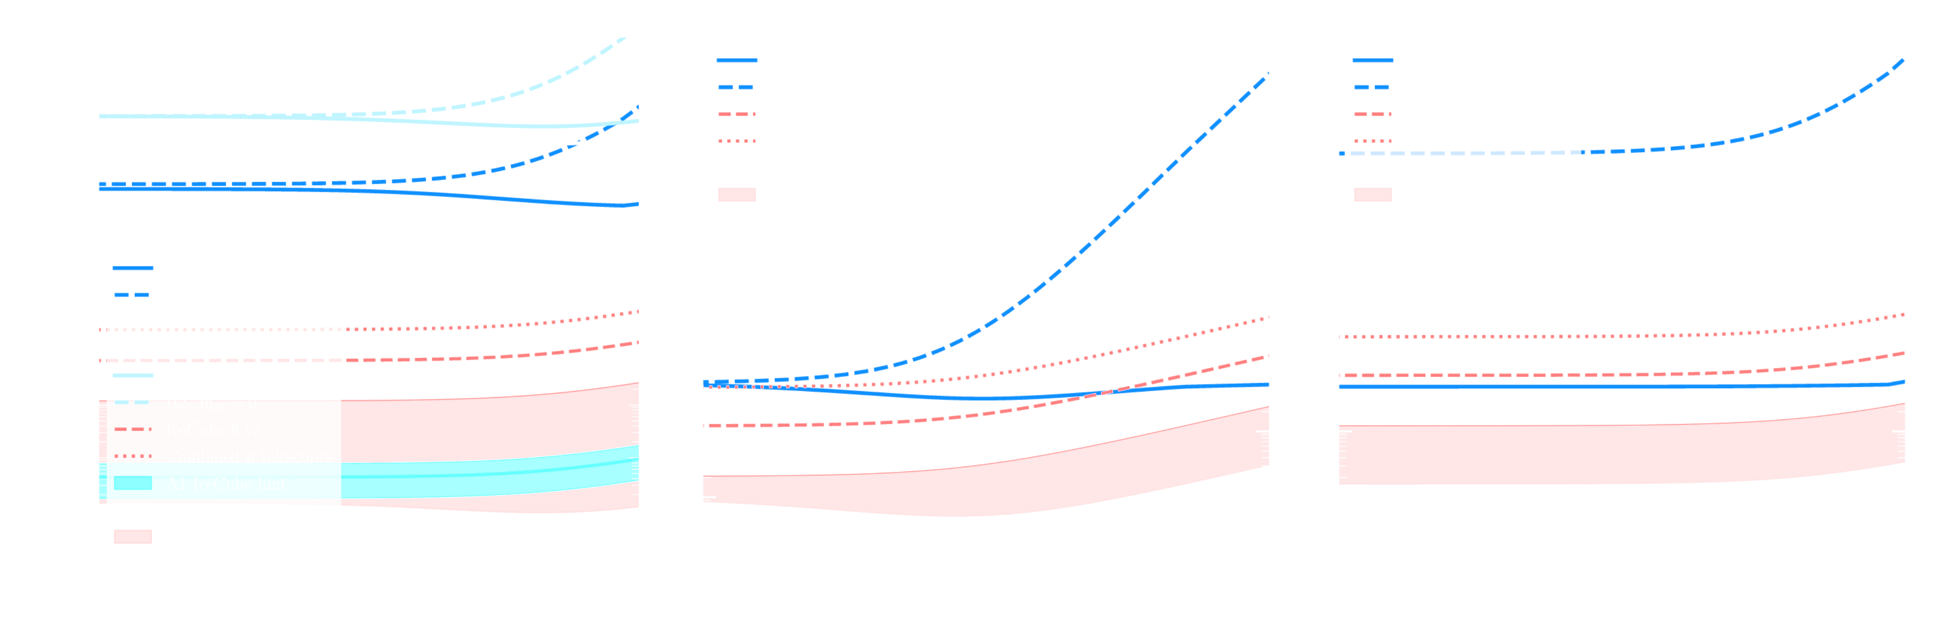







CMB lower bounds on the neutrino lifetime…
Mass-spectrum consistent constraints on invisible neutrino decay $ν_{H}→ν_{l}+φ.$
$$ν_{3}→ν_{2+1}(NO)$$
$$ν_{2+1}→ν_{3}(IO)$$
$$ν_{3}→ν_{2or1}(NO)$$
$$ν_{2or1}→ν_{3}(IO)$$
Allowed
IceCube & future 𝜈 telescope forecasts
$$ν_{2}→ν_{1} (NO)$$
$$ν_{2}→ν_{1} (IO)$$
Ruled out
IceCube constraints
IceCube constraints
Chen, Oldengott, Pierobon & Y³W 2022
* IceCube constraints & forecasts from Song et al. 2021

Slide 40
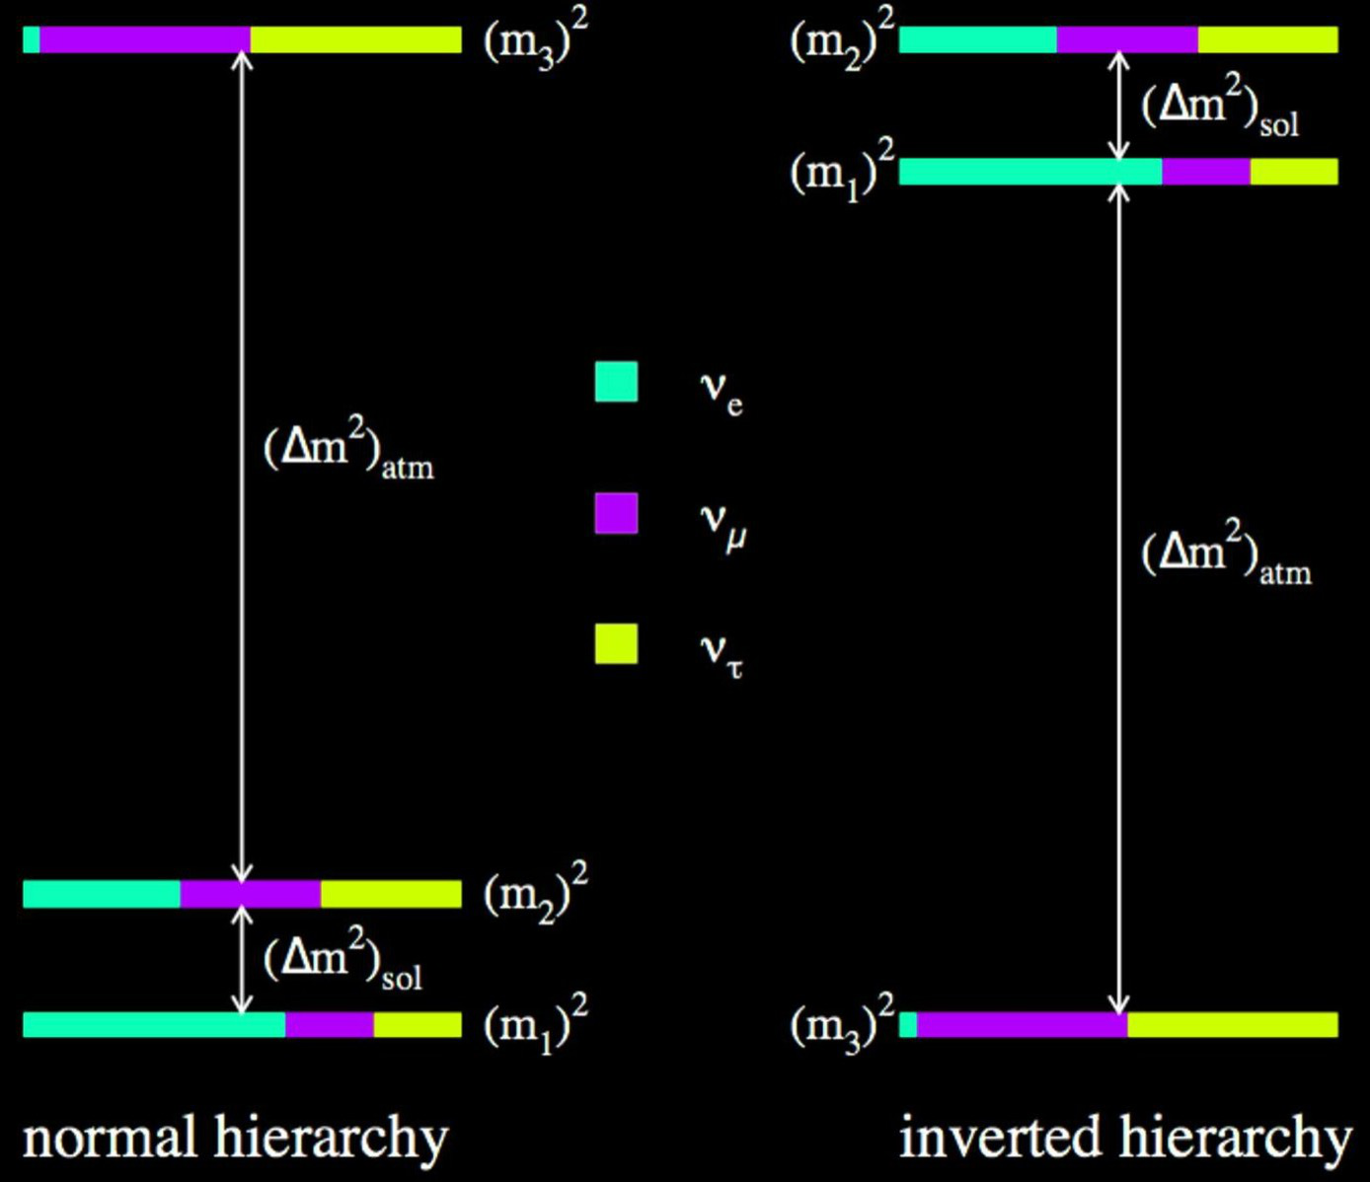
CMB lower bounds on the neutrino lifetime…
Mass-spectrum consistent constraints on invisible neutrino decay $ν_{H}→ν_{l}+φ.$
A3
$$ν_{3}→ν_{2+1}(NO)$$
$$ν_{2+1}→ν_{3}(IO)$$
$$ν_{3}→ν_{2or1}(NO)$$
$$ν_{2or1}→ν_{3}(IO)$$
Allowed
IceCube & future 𝜈 telescope forecasts
A2
$$ν_{2}→ν_{1} (NO)$$
$$ν_{2}→ν_{1} (IO)$$
Ruled out
IceCube constraints
IceCube constraints
Chen, Oldengott, Pierobon & Y³W 2022
For $ν_{2}→ν_{1}+φ$, neutrino telescopes and CMB probe the same parameter space.

Slide 41






Why I like this so much…
Previous CMB constraints on the neutrino lifetime were based on an (heuristic) isotropisation rate that turns out to be too large.
→ Resulting lower limit is too strong:
$$τ_{rest}≳{10}^{9}{\left(\frac{m_{ν}}{0.05 eV}\right)}^{3}s$$
e.g.,
Hannestad & Raffelt 2005
Basboll, Bjaelde, Hannestad & Raffelt 2009
Escudero & Fairbairn 2019
Compare this with our revised limits:
Chen, Oldengott, Pierobon & Y³W 2022
$ν_{3}→ν_{1,2}+φ$ (NO)
$$τ_{rest}≳{(6 −10)×10}^{5}s$$
$ν_{1,2}→ν_{3}+φ$ (IO)
There’s now some hope that other experiments can probe this process too.
$$ν_{2}→ν_{1}+φ$$
$$τ_{rest}≳(400−500)s$$

Slide 42
Summary…
The existence of a cosmic neutrino background is a fundamental prediction of SM+FLRW cosmology.
  Precision cosmological observations have allowed us to infer the properties of this background, from which to determine neutrino properties.
  e.g., masses, effective number of neutrinos, non-standard interactions, lifetime.
Conversely, better determination of neutrino properties in laboratory experiments will allow us to eliminate some model uncertainty in the cosmological parameter inference exercise.
  More precise and accurate constraints on the dark matter density, dark energy properties, inflationary physics, and other cosmological physics inaccessible in the laboratory.

