Slide 1
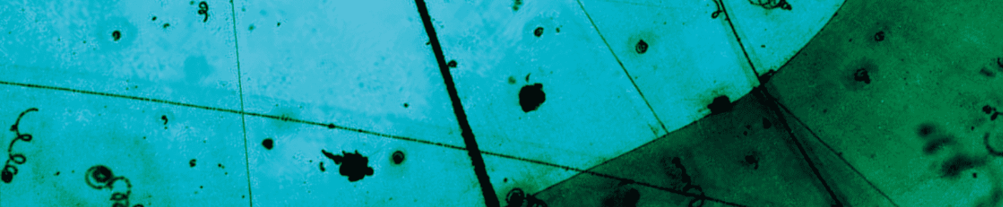
Neutrino Applications: From Science Fiction to Reality?
Jonathan Link
Center for Neutrino Physics, Virginia Tech
July 4, 2023
WIN2023 AT SYSU ZHUHAI CAMPUS, CHINA
July 3 - July 8, 2023

Slide 2
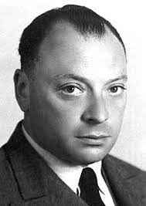
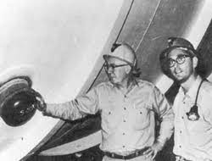
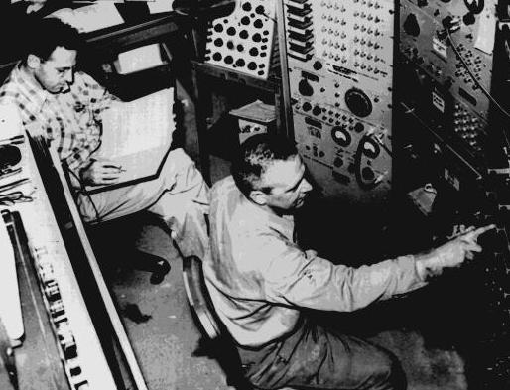
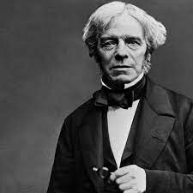
History and Context
Scientific Applications
Solar Neutrinos
Wolfgang Pauli
Ray Davis
and
John Bahcall
Fred Reines
and
Clyde Cowan
Geoneutrinos
Several parallel talks this afternoon:
Xuefeng Ding: Geoneutrino Measurement with Borexino
Nanami Kawada: Geoneutrino Measurement with KamLAND
Ruohan Gao: Geoneutrino Signal at JUNO Predicted by Geological Models
Michael Faraday

Slide 3
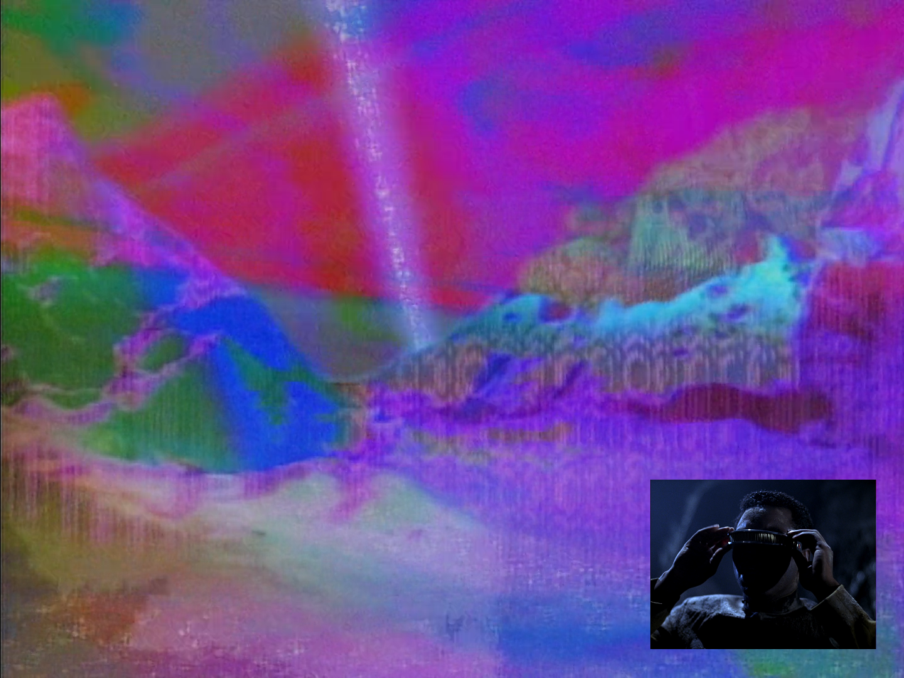

This is supposed to be a neutrino beam
…and he can see it
From:
Star Trek: The Next Generation
S3 E7 The Enemy (Nov 6, 1989)

Slide 4

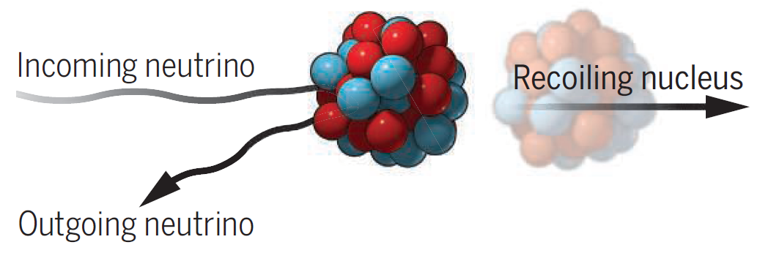
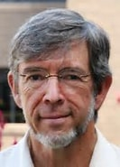
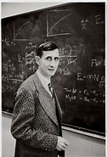
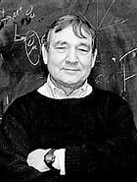
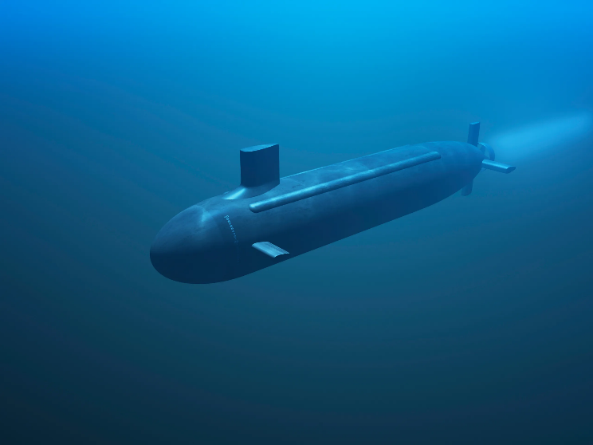

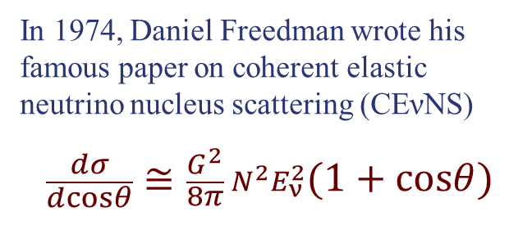
Coherent Scattering and Submarine Detection
In 1974, Daniel Freedman wrote his famous paper on coherent elastic neutrino nucleus scattering (CEνNS)
$$\frac{dσ}{dcosθ}≅\frac{G^{2}}{8π}{ N}^{2}E_{ν}^{2}(1+cosθ)$$
$$N^{2}$$
In 1984, Joseph Weber proposed a related process of neutrino coherent scattering off a crystal lattice. He claimed this would have an even grater enhancement proportional to the number of atoms squared.
There was a great concern in the US Defense Department that nuclear submarines could be tracked by their neutrinos.
ν_{e}
Crystal coherent scattering was disproven in a 1988 JASON report by Callan, Dyson and Treiman.
ν_{e}
ν_{e}
ν_{e}
Curt Callan
Freeman Dyson
Sam Treiman
ν_{e}
Their report also showed that submarine detection in the open ocean was not practical with accepted neutrino cross sections.
ν_{e}

Slide 5
Neutrino Applications: From Science Fiction to Reality?
Jonathan Link
Center for Neutrino Physics, Virginia Tech
July 4, 2023
WIN2023 AT SYSU ZHUHAI CAMPUS, CHINA
July 3 - July 8, 2023
?

Slide 6
Neutrino Application Concepts
Nearly all serious proposals for neutrino applications, outside basic science, involve detecting and preventing diversions of nuclear materials into nuclear weapons programs.
These are known as nuclear safeguards.
Monitoring reactor power Borovai & Mikaelyan, Atomic Energy 44, 508 (1978)
Monitoring heavy water reactors Christensen et al., Phys. Rev. Lett. 113, 042503 (2014)
Monitoring reactors for plutonium diversion Christensen et al., Science & Global Security 23, 20 (2015)
Detection of plutonium breeding blankets Cogswell & Huber, Science & Global Security 24, 114 (2016)
Determining reactor fuel type Jaffke & Huber, Phys. Rev. Applied 8 034005 (2017)
Monitoring of spent fuel Brdar et al., Phys. Rev. Applied 8 054050 (2017)
Determining if a large explosion was nuclear Foxe et al., Pure Appl. Geophys. 178, 2753 (2021)
Safeguarding military naval reactors Cogswell & Huber, Phys. Rev. Lett 128, 241803 (2022)
The highlighted proposals are based on tracking the fuel evolution or burnup.

Slide 7
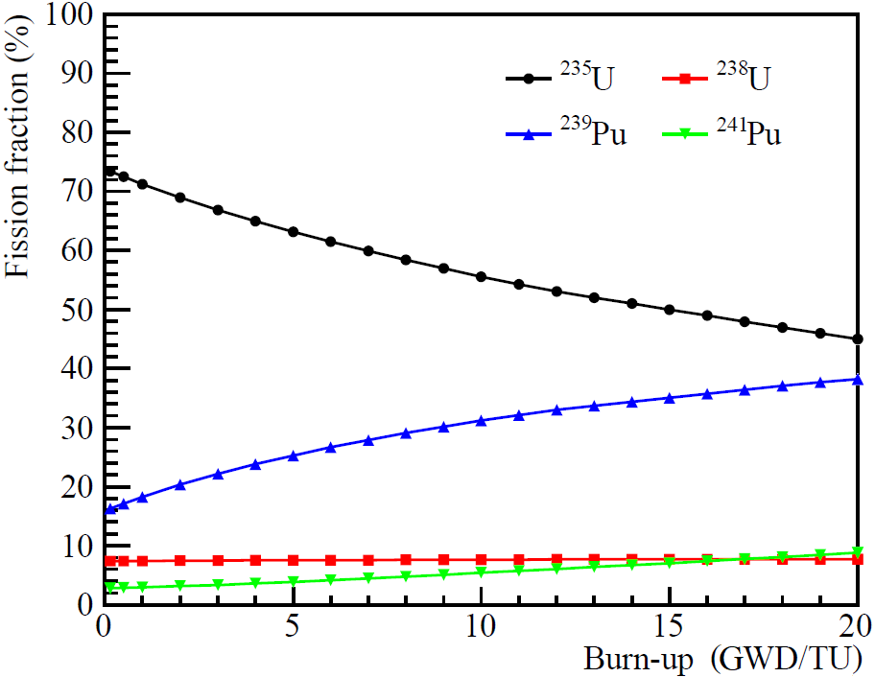
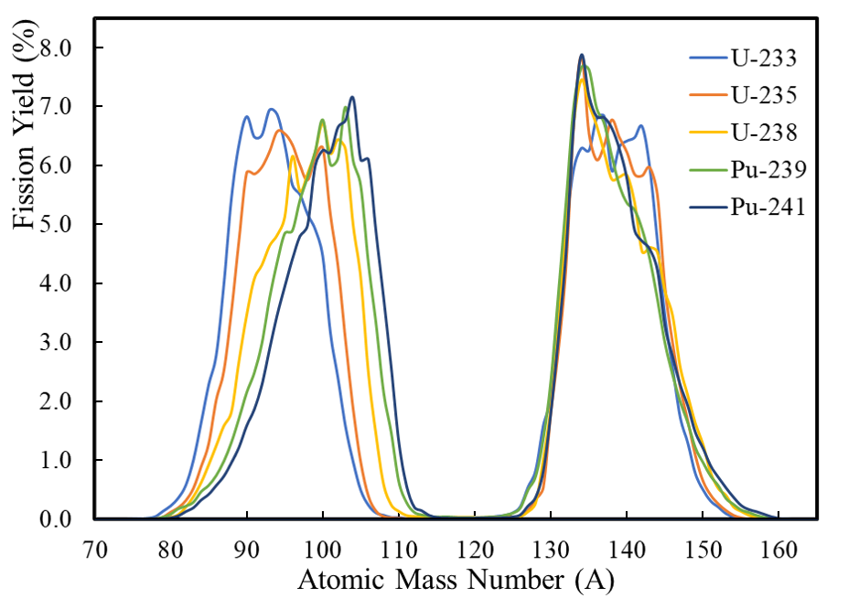
Evolution of the Neutrino Spectrum with Burnup
As the fuel burns in a low-enriched uranium reactor, the mix of fissile isotopes evolves,
Chinese Phys. C 41, 013002 (2017)
http://nndc.bnl.gov
And each fissile isotope has a unique set of fission fragment yields…

Slide 8
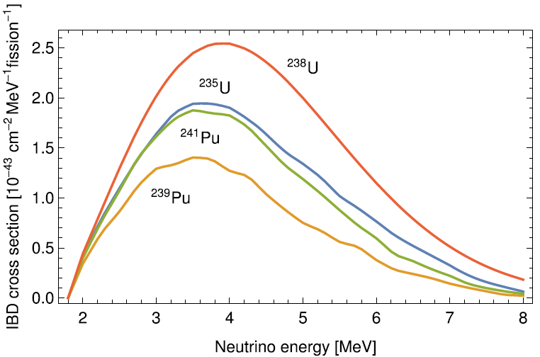
Evolution of the Neutrino Spectrum with Burnup
As a result, each fissile isotope has a slightly different neutrino spectrum.
So, we should be able to use the neutrino energy spectrum to measure the reactor fuel burn-up.
Theoretical Spectra

Slide 9
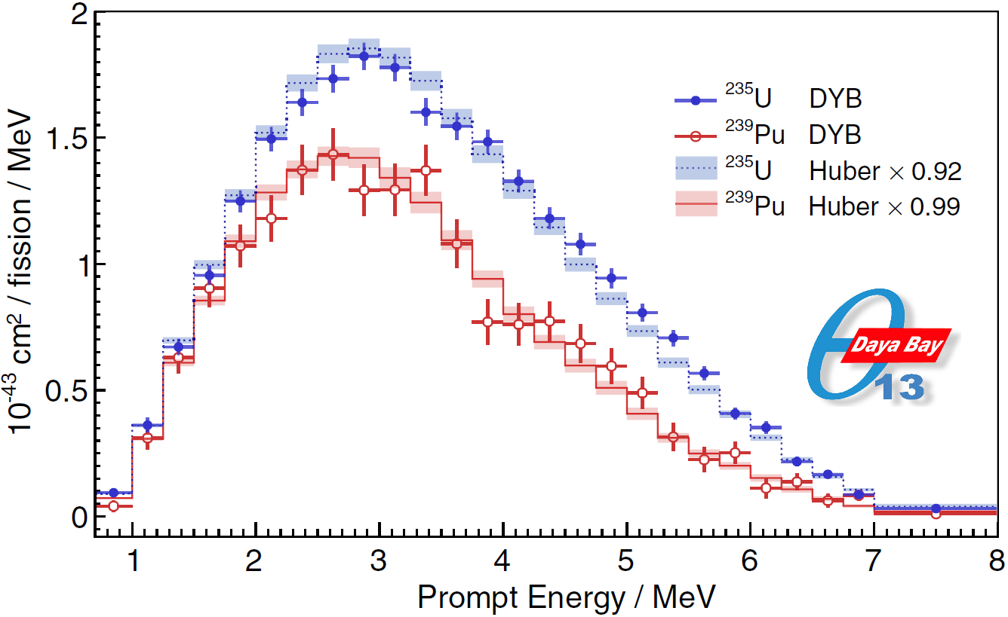
Daya Bay’s Neutrino Spectral Decomposition
Daya Bay performed a neutrino spectral decomposition using burn-up data from the reactor operators.
These data confirm that the different fissile isotopes have distinct neutrino spectra.
Notice the plutonium spectrum is shifted to lower energy relative to uranium-235.
Phys. Rev. Lett. 123, 111801 (2019)
Going forward, we will need much better isotope-specific reference spectra.
The Daya Bay study was done with detectors at 360 meters from two reactors, operating with their fueling cycles out-of-sync.

Slide 10
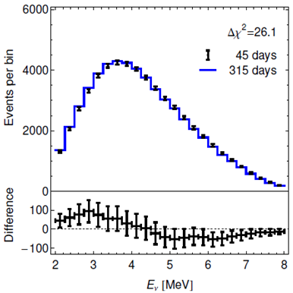
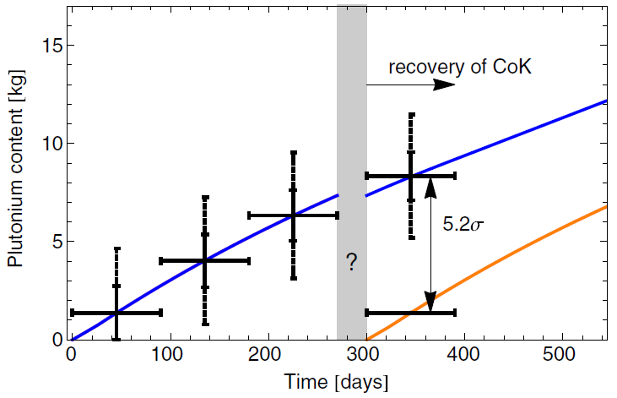
Neutrino Spectral Analysis
The basic idea is to measure the neutrino energy spectrum to determine the current rate of plutonium fission, and to watch it evolve over time.
If the operating reactor does not match expectations from its declared state, it may indicate an attempt to divert plutonium.
Christensen et al. PRL 113, 042503 (2014)
Without neutrinos, onsite inspectors would be required to know if a refueling happened during the shutdown.

Slide 11
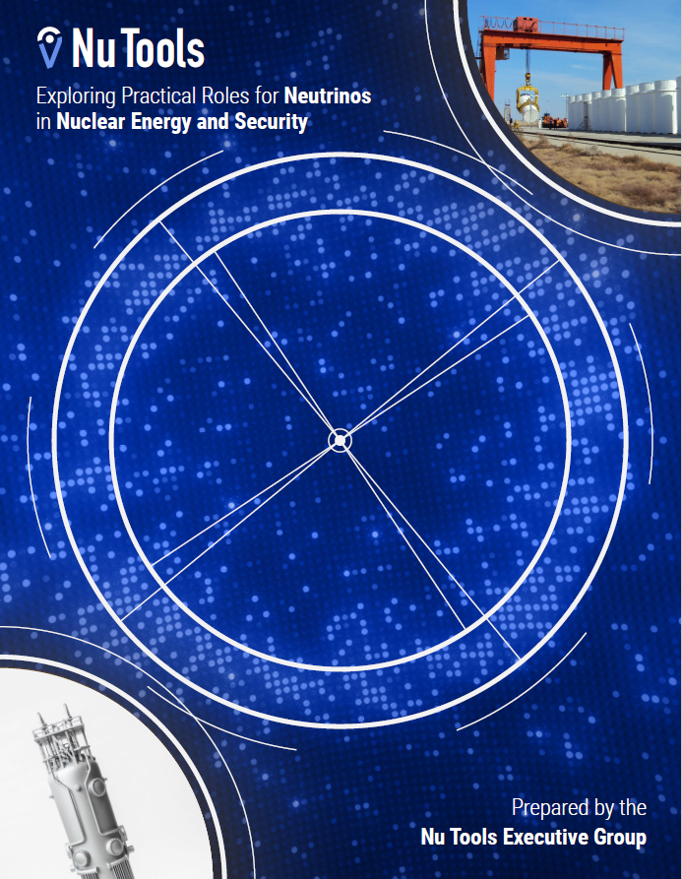
The Nu Tools Study
This study was commissioned by the US National Nuclear Security Administration (NNSA) to study possible application of reactor neutrino detection.
Nu Tools released its final report in August 2021:
https://www.osti.gov/biblio/1826602/
The report found promising potential for applications of neutrino detectors in
  Future nuclear deals, and
  Monitoring advanced nuclear reactors
The report rejected the idea that neutrinos could be used to discover unknown reactors or monitor reactors from afar.

Slide 12
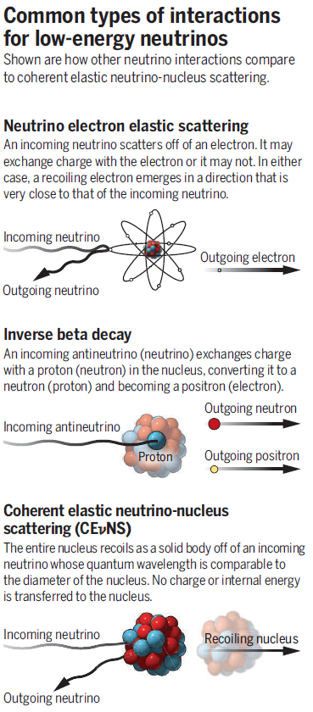
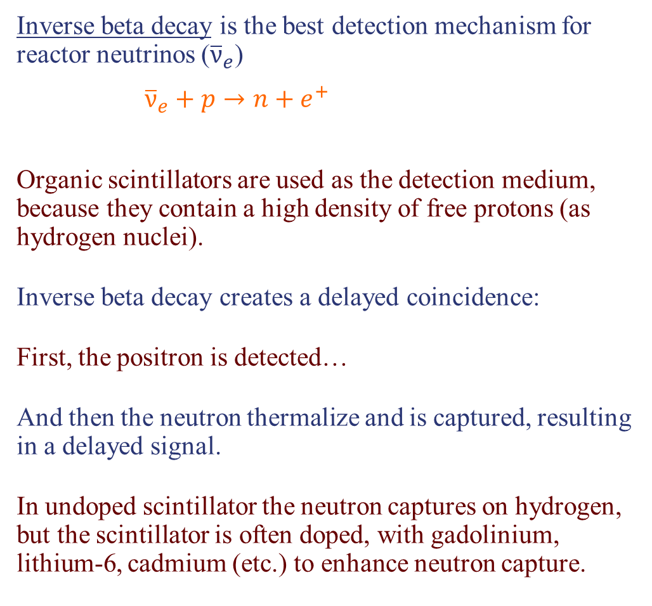
How to Detect Reactor Neutrinos
Inverse beta decay is the best detection mechanism for reactor neutrinos (${\overline{ν}}_{e}$)
${\overline{ν}}_{e}+p→n+e^{+}$
Organic scintillators are used as the detection medium, because they contain a high density of free protons (as hydrogen nuclei).
Inverse beta decay creates a delayed coincidence:
First, the positron is detected…
And then the neutron thermalize and is captured, resulting in a delayed signal.
In undoped scintillator the neutron captures on hydrogen, but the scintillator is often doped, with gadolinium, lithium-6, cadmium (etc.) to enhance neutron capture.
Thermal n capture

Slide 13
Technology Demonstrations
There have been at least 6 dedicated application technology projects:
Project | Year | Country | Mass | Technology | Citation
Rovno | 1994 | Russia | 510 kg | Homogeneous, Gd-doped Liquid | Atomic Energy 76, 123 (1994)
SONGS | 2008 | USA | 640 kg | Coarsely segmented, Gd-doped Liquid | J.Appl.Phys 103, 074905 (2008)
PANDA | 2014 | Japan | 360 kg | 2D Segmented Plastic with Gd Sheets | NIMA 757, 33 (2014)
Nucifer | 2016 | France | 739 kg | Homogeneous Gd-doped Liquid | Phys.Rev.D 93, 112006 (2016)
CHANDLER | 2020 | USA | 80 kg | 3D Segmented Plastic with ⁶Li Sheets | Phys.Rev.Applied 13, 034028 (2020)
VIDAAR | 2022 | UK | 1180 kg | 2D Segmented Plastic with Gd Sheets | JINT 17, P10009 (2022)
There is an evolution towards greater segmentation and replacing liquid scintillator with plastic.
Gd-doping is shifting towards ⁶Li, which is better for small detectors.
Additionally, there are at least 8 ongoing or recent short baseline experiments, some with duel-use potential as applications detectors.

Slide 14
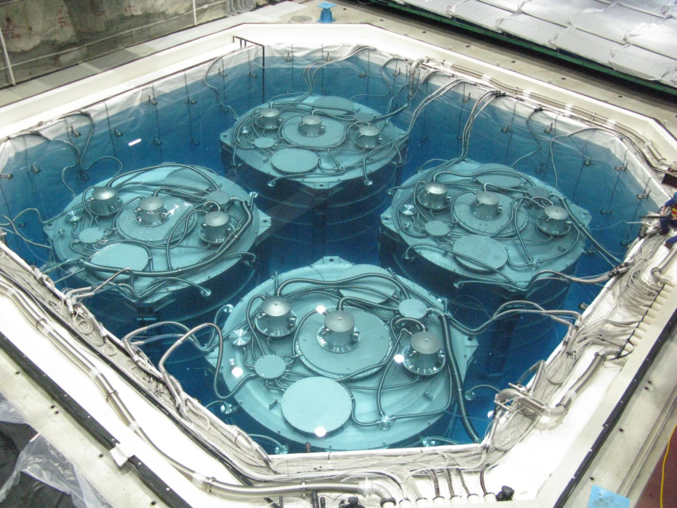
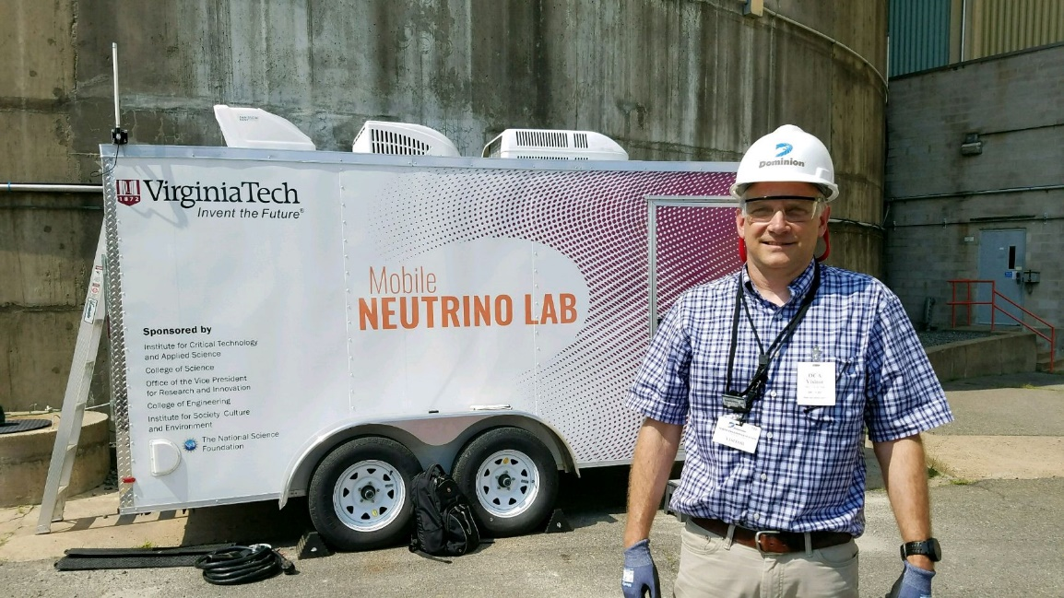
Challenges of Application Detectors
The Daya Bay Far Detectors
Practical applications detectors must operate above ground and may need to be mobile.
They can be deployed closer to the reactor, but they may have backgrounds correlated with reactor power.
New technologies are needed to overcome these challenges.
The θ₁₃ reactor experiments used extraordinary measures (¥$£€!!!) to control backgrounds:
  Deep underground detectors
  Non-scintillating buffer
  Instrumented water shielding

Slide 15
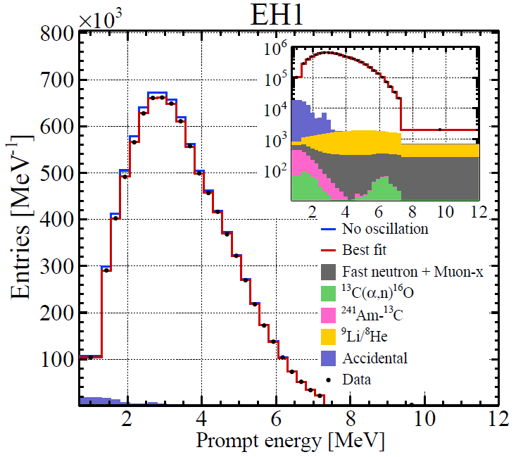
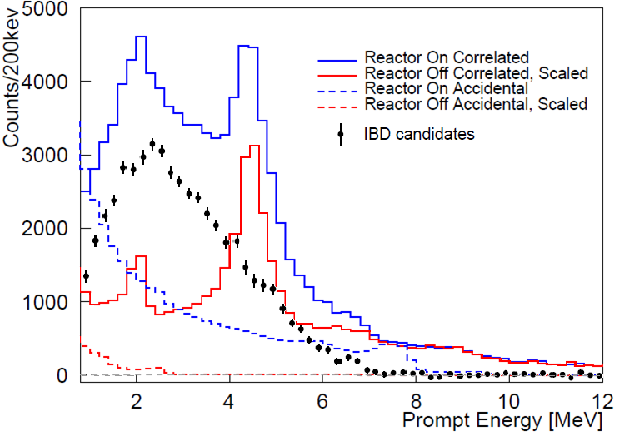
Challenges of Application Detectors
So, can we see that backgrounds are a much bigger problem for application detectors…
Daya Bay, Phys. Rev. Lett. 130, 16 (2023)
PROSPECT, Phys. Rev. D 103, 032001 (2022)
The analysis needs to be much cleverer to see through these backgrounds:
e⁺-n Spatial Correlations
Positron Topology Tags
Pulse Shape Discrimination
Reactor Off Subtraction
Δt Fits

Slide 16
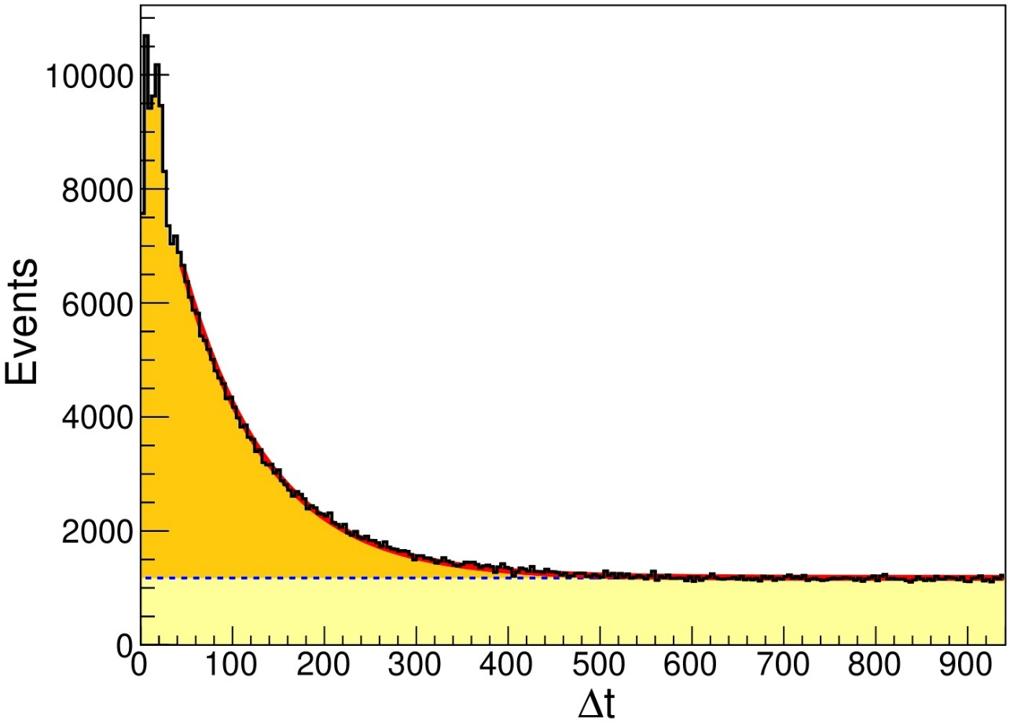
Random Coincident Backgrounds
Random coincident backgrounds have no structure in the time separation between the prompt and delayed signals (Δt)…
Phys. Rev. Applied 13, 034028 (2020)
But correlated events, like fast neutrons and inverse beta decays have an exponential Δt distribution.
Correlated Events
Random Coincident Events
You can remove random coincident backgrounds statistically by fitting the Δt distribution in energy bins.

Slide 17
Challenges of Application Detectors
The surface-level fast neutron flux creates new background features…
Daya Bay, Phys.Rev.Lett. 130, 16 (2023)
PROSPECT, Phys.Rev.D 103, 032001 (2022)
Correlated Double Neutrons with
H-capture
Fast Neutron Carbon
De-excitation
Fast Neutron Proton Recoil
Ten meters of water-equivalent shielding would be enough to knock down the primary fast neutron flux, but that’s too much to ask for almost all reactor sites.

Slide 18



The Value of Segmentation
An Example from CHANDLER
High segmentation allows us to tag the positron annihilation gammas interacting in neighboring cubes.
Neutrons are tagged by the slow scintillation decay time of the zinc sulfide scintillator (200 ns vs 10 ns).
The time ordered and spatial coincidence of specific positron and neutron tags separates IBDs from background.
$${\overline{ν}}_{e}$$
n
Inverse Beta Decay (IBD)
${\overline{ν}}_{e}+p→e^{+}+n$
$$e^{+}+e^{−}→γ+γ$$
$$n+{}_{ }^{6}{Li}→{}_{ }^{4}{He}+{}_{ }^{3}H$$
Cosmic-Ray Fast Neutron
$n+p→n+p$
$$n+{}_{ }^{6}{Li}→{}_{ }^{4}{He}+{}_{ }^{3}H$$
γ
γ
e⁺
p
p
n
n
⁶Li
⁴He
⁶Li
⁴He
Positron (e⁺)
Annihilation γs
³H
³H
Proton
Detected Light
Neutron Capture
Detected Light
Neutron Capture
In the field we saw 85 correlated fast neutrons for every IBD event, so we need powerful tools to reject them!
time
time
10 ns
50 μs
200 ns
10 ns
50 μs
200 ns

Slide 19
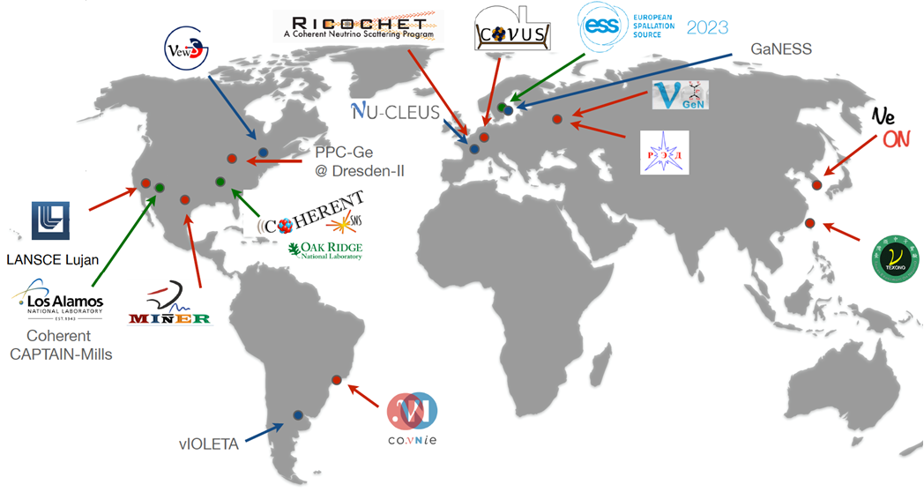
Coherent Elastic Scattering: Application Tech of the Future
, but many groups are in a race to see it at reactors.
So far, CEvNS has only been seen at one stopped pion source…
Future / Planned
Nuclear Reactors
Stopped Pion Beams
See Parallel Talks by:
Mingxuan Xue Keyu Ding Qian Liu Soobong Kim Yong-Peng Zhang
Qing Lin Kaixian Ni Alexey Lubashevskiy Litao Yang

Slide 20
Final Thoughts
Neutrino application are still science fiction,
But we’re getting closer, thanks to advances in detector technology, and an improving understand of the reactor neutrino flux and spectrum.
There is a building consensus that applications detectors should use segmentation, to take advantage of the unique topology of the IBD events.
Plastic scintillator makes the detectors more robust.
Using lithium-6 as the capture nucleus helps to contains the neutron capture in smaller detectors.
Coherent elastic neutrino nucleus scattering will be the applications technology of the future, but first we have to learn how to see it at reactors.

