Slide 1

The 29th International Workshop on Weak Interactions and Neutrinos (WIN2023)
Progress of
CICENNS Development
F.P. An, Y.K. Hor, S.B. Kim, J. Liao, J.J. Ling, W. Wang, Y. Wei, X. Xiao
Soo-Bong Kim
Sun Yat-sen University
@ SYSU Zhuhai Campus, CHINA
July 3 - July 8, 2023

Slide 2
Overview
Development of a 300 kg CsI(Na) detector
for Coherent Elastic Neutrino Nucleus Scattering (CICENNS)
Use low-radioactivity CsI(Na) crystal of 300 kg in total
Establish a new field of studying unexplored physics using CEvNS
Detection of ~30 MeV neutrinos from pion/muon decays at rest
(at spallation neutron source)
Precise measurement of sin²θ_{W} at low energies
NSI of neutrinos (← excess or deficit wrt SM prediction)
New physics (BSM) signature (← deviation from αN² prediction, precise F(Q²) with uncertainty < 5%)
Solar neutrino detection as a neutrino floor of direct dark-matter searches
Compact neutrino telescope for core-collapse supernova
Measurement of neutrino magnetic moment (← distorted recoil spectrum)
Sterile neutrino oscillation by neutral current (← distorted recoil spectrum)

Slide 3
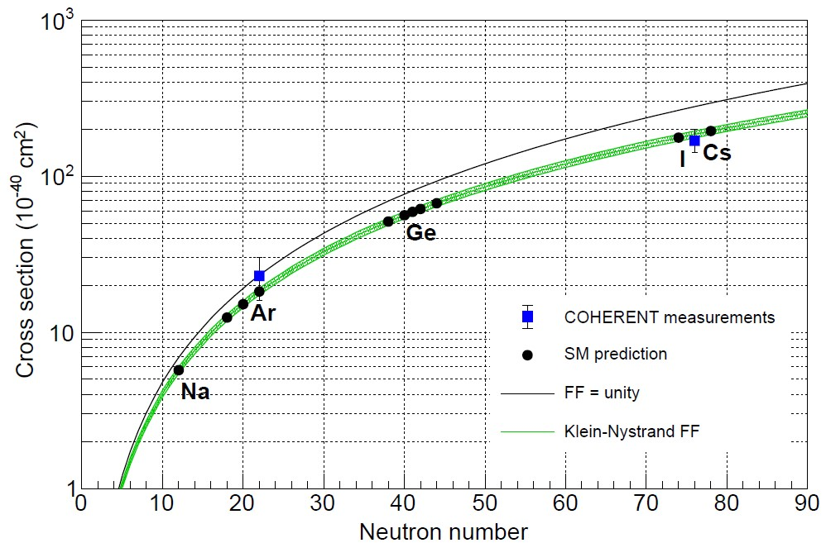
Enhanced Neutrino Cross Section via CEvNS
~1000 times enhanced cross section of neutrino-CsI via CEvNS
CsI crystal can provide sufficient CEvNS cross sections.

Slide 4
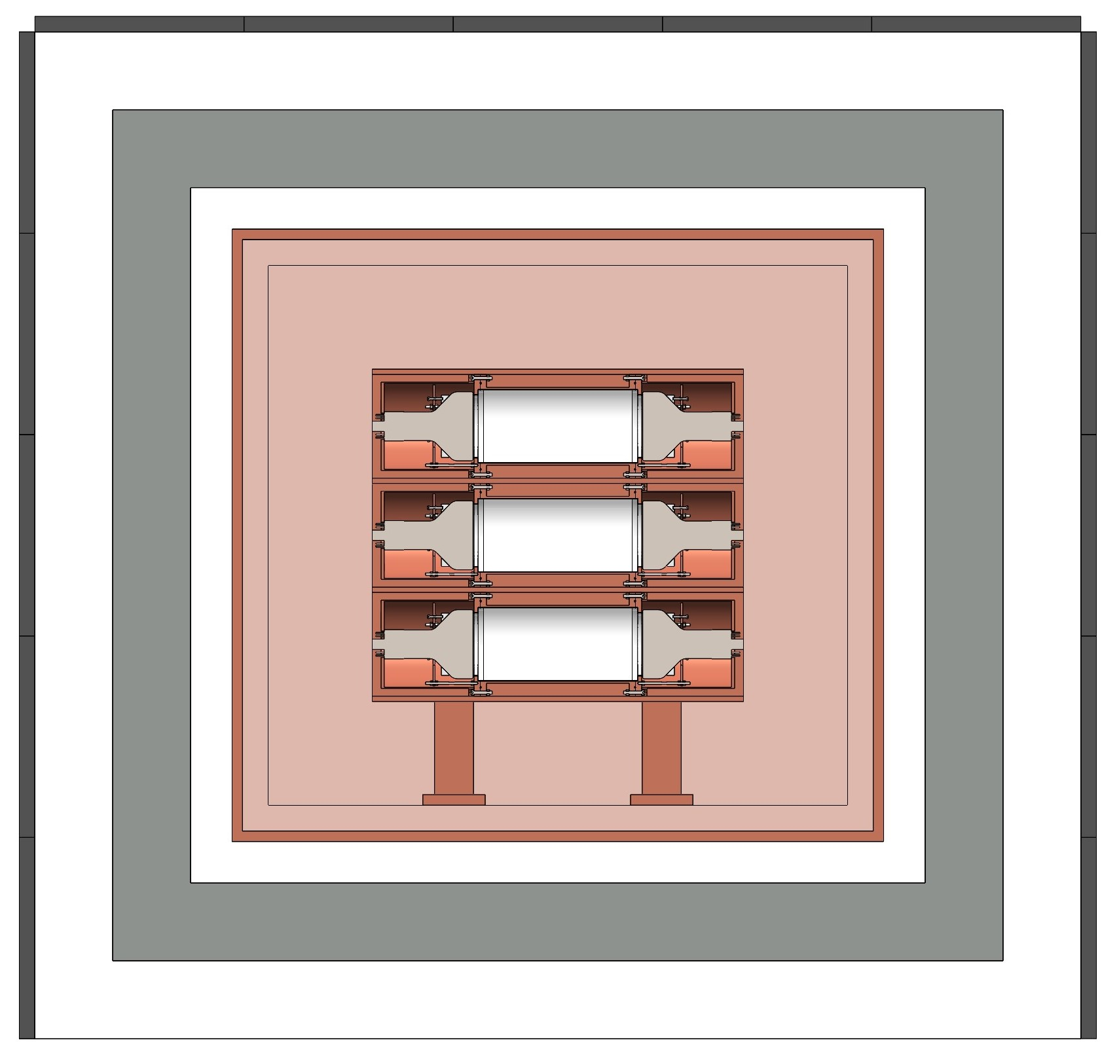
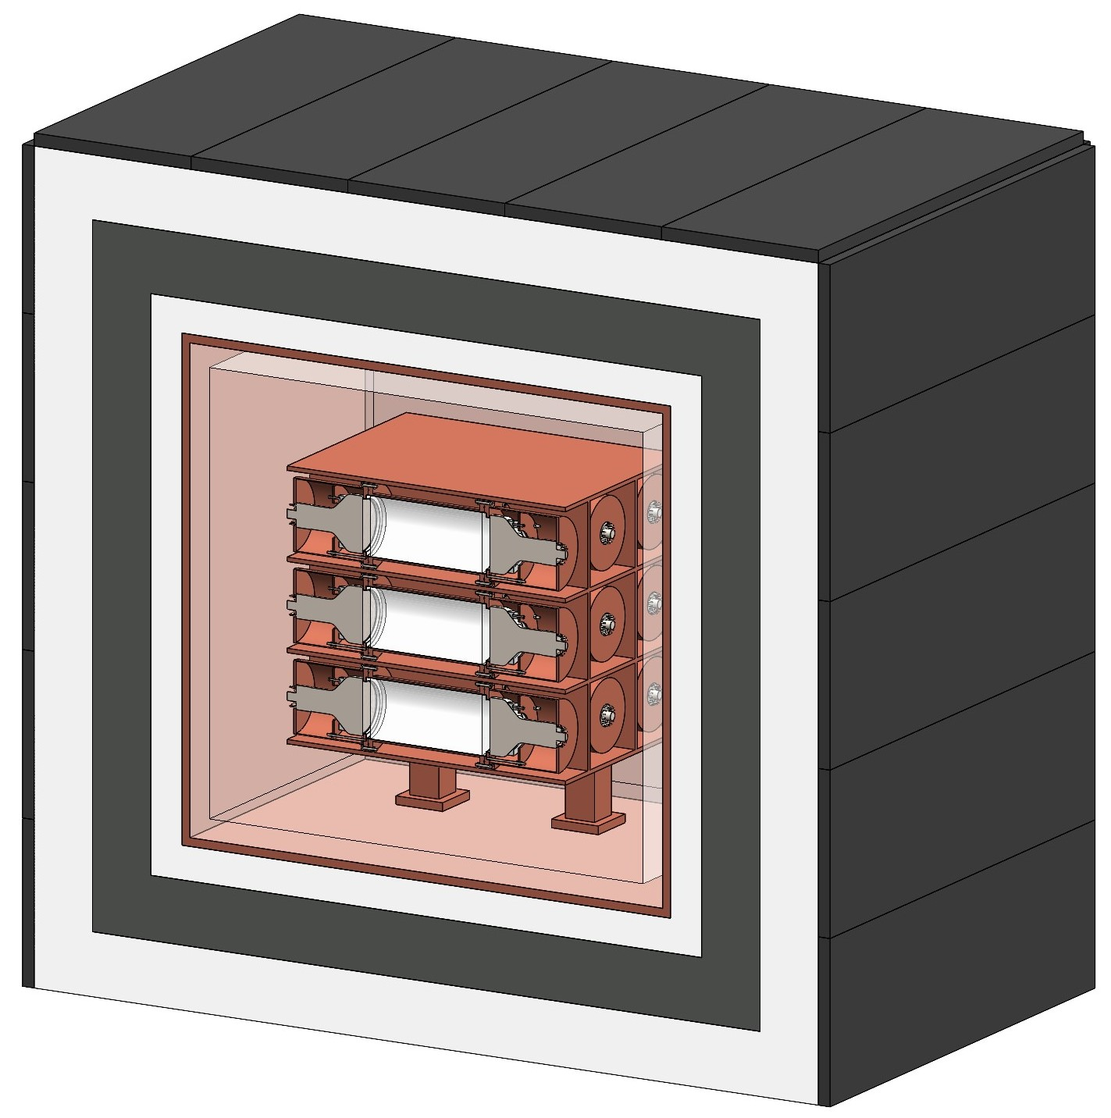
Schematic Drawing of CsI(Na) Crystal Detector
(CICENNS)
20 kg CsI(Na) x 15
14 cm (φ) x 28.7 cm each
Two 5-inch SBA PMTs
35 tons of shielding with Cu, LS, Pb, and HDPE

Slide 5
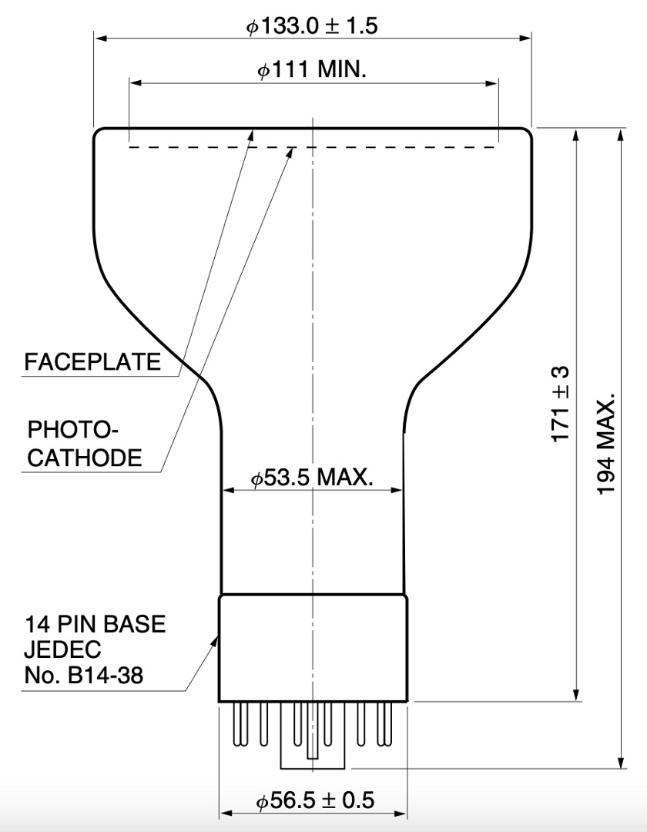
Hamamatsu SBA 5-inch PMT (R877-100)
QE: 35% at 420 nm
Gain: 4.4 x 10⁵ @1500V

Slide 6
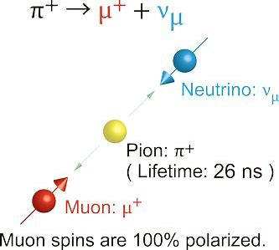
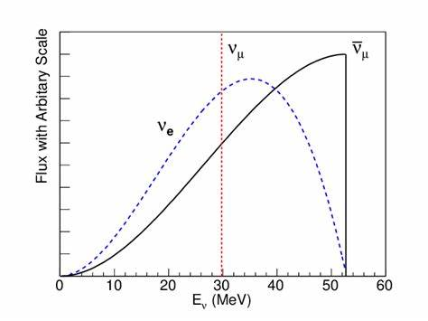
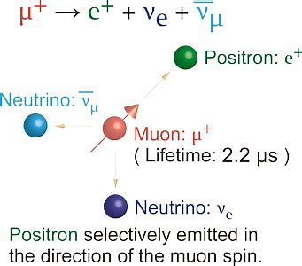
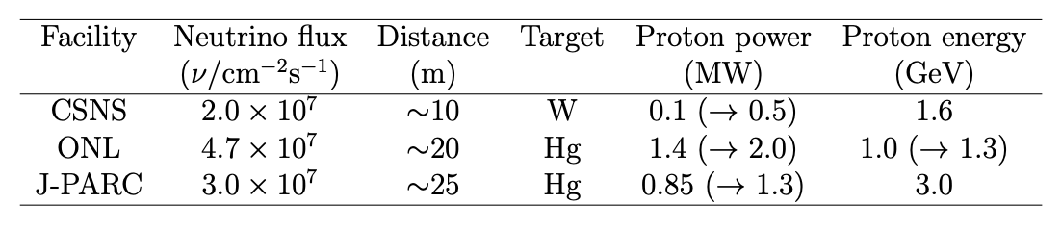
Neutrinos from pion/muon DAR at SNS

Slide 7
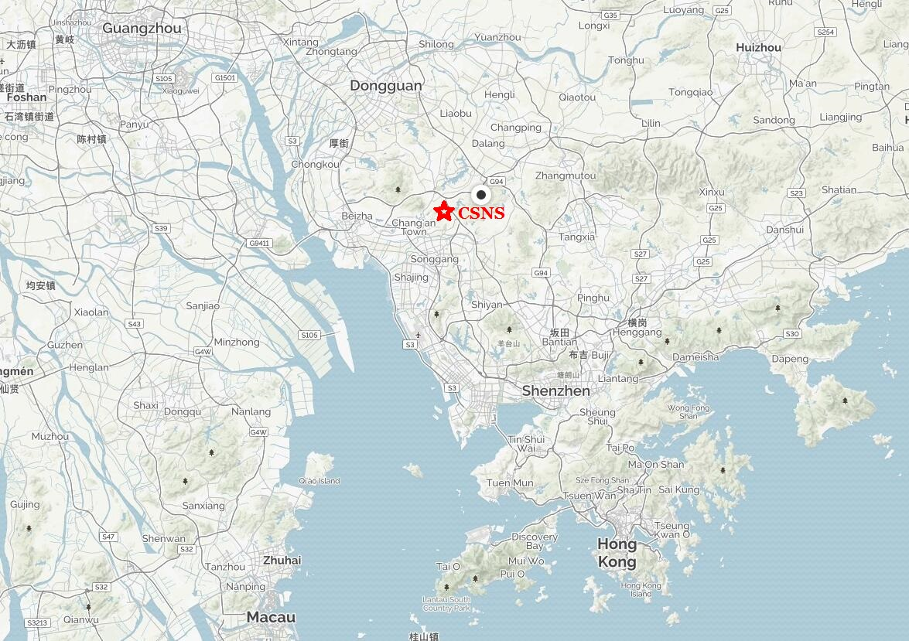
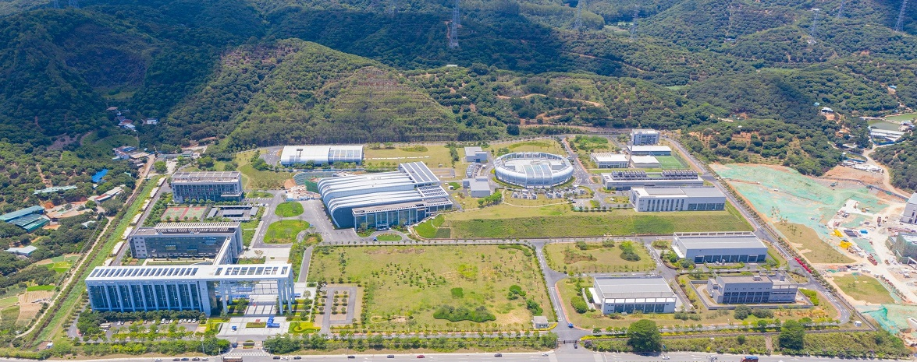
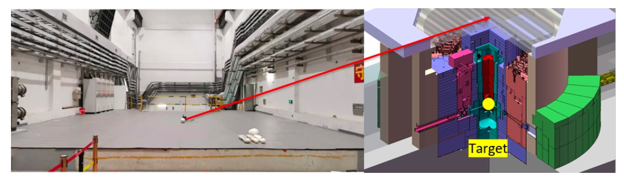
CSNS (China Spallation Neutron Source)
Guangzhou
SYSU
Shenzhen
Hong Kong
8.2 m above the beam target (7.2 m thick: steel, 1 m thick: concrete)
1.6 GeV proton beam
140 kW (→ 500 kW)
25 Hz repetition rate
(Taken from C. Su, Q. Liu and T. Liang, arXiv:2303.13423 (2023))
* Neutrino flux at 10.5 m: 2.0 x10⁷ /cm²/s (~40% of COHERENT)
→ ~2500 observed events with 300 kg (`300 events with 14.6 kg at COHERENT)

Slide 8
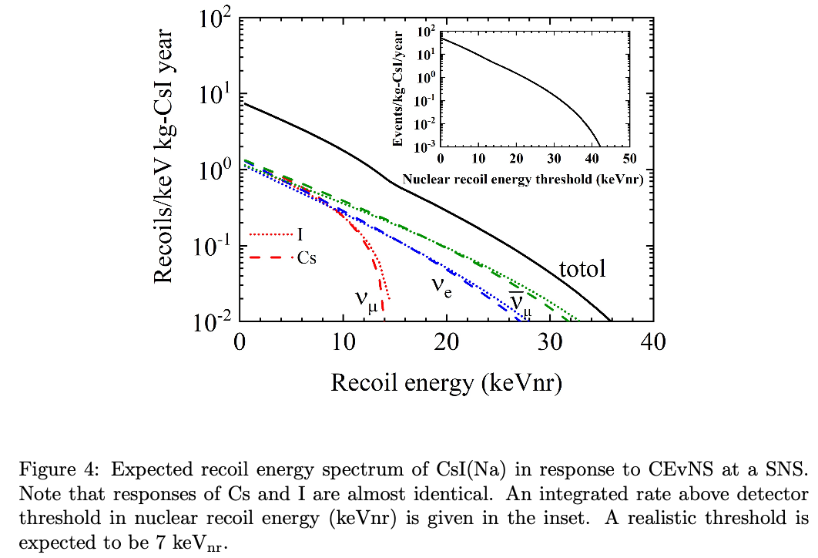
Expected CEvNS Signal of CICENNS at CSNS
14.6 kg CsI(Na) crystal for ~300 CEvNS events (PRL 129, 081801, 2022)
→ 300 kg CsI crystals for ~2,500 CEvNS events
(Neutrino flux at CSNS: ~40% of ONL)
if the energy threshold is ~5 keV_{nr},
→ ~4,000 CEvNS events if the energy threshold can be lowered to ~2 keV_{nr}.

Slide 9
Advantages of CsI(Na) for CEvNS
Substantial event rate due to a large coherence enhancement of high target massed of Cs and I
Simple detector response due to similar target masses of Cs and I
High light yield (40~60k photons per MeV or ~45 photons/keV_{ee}) to obtain ~5 keV_{nr} threshold using a superbialkali 5-inch PMT
Naturally low internal radioactivity and can be purified, below 100 keV
Much less afterglow (phosphorescence) than CsI(Tl) and short decay time of scintillation (τ ~ 0.6 μs)
PSD capability at large pe events
γ-ray peak at 57.6 keV from neutron capture on ¹²⁷I : internal monitor of fast neutron flux and energy calibration source
Can be expanded to a large target mass with a reasonable cost

Slide 10
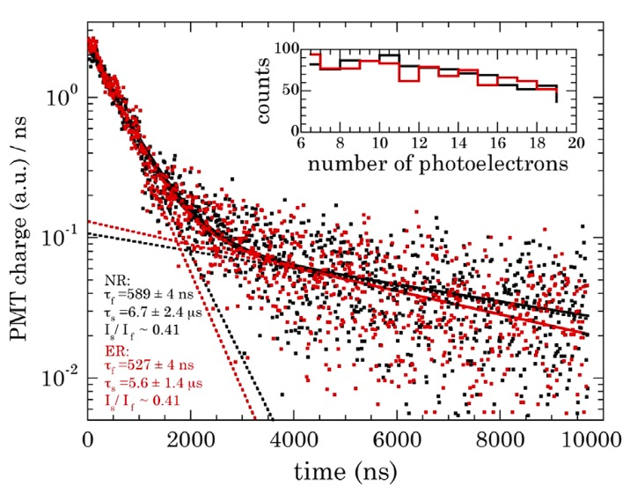
Short Scintillation Decay Time with Na Doping
Fast component: τ ~ 0.6 μs for CsI(Na) and τ ~ 1 μs for CsI(Tl)
(Ref: P.E. Francois and D.T. Martin, Int. J. App. Radiat. Isot. 21, 687 (1970) )

Slide 11
Improved Design of CICENNS
Lower internal radioactivity background due to ⁸⁷Rb.
20 ppb for COHERENT → ~1 ppb (energy threshold of ~2 keV_{nr})
Reduction (~3 orders of magnitude) of noise events due to PMT dark noise rate by attaching two PMTs to both ends of each crystal. Also lower energy threshold from 5 keV_{nr} to ~2 keV_{nr}.
Identify/veto “internal” (radioactivity from PMT) or “external” (radioactivity from shielding + beam related + cosmic muon induced neutrons) backgrounds with a LS+DIN layer surrounding crystals, providing active and passive shielding.
Improve the scintillation light collection by proper crystal encapsulation and tight PMT attachment to the crystal.
Plastic scintillation counters to identify external events including cosmic muons and entering neutrons.
4π shielding against various external backgrounds including beam neutron shielding.

Slide 12
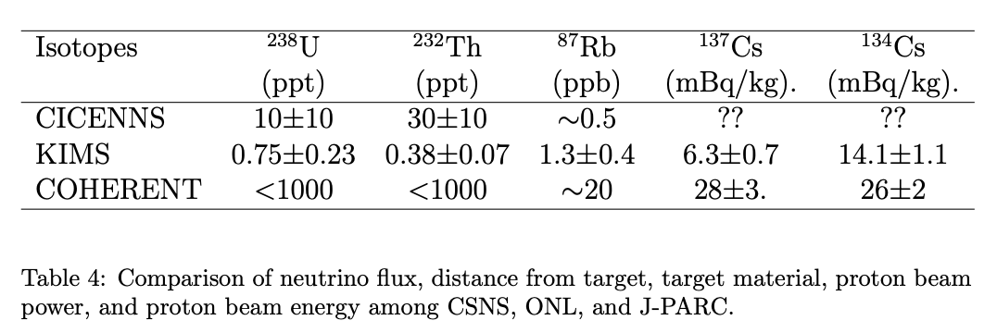
Internal Radioactivity of Crystal

Slide 13
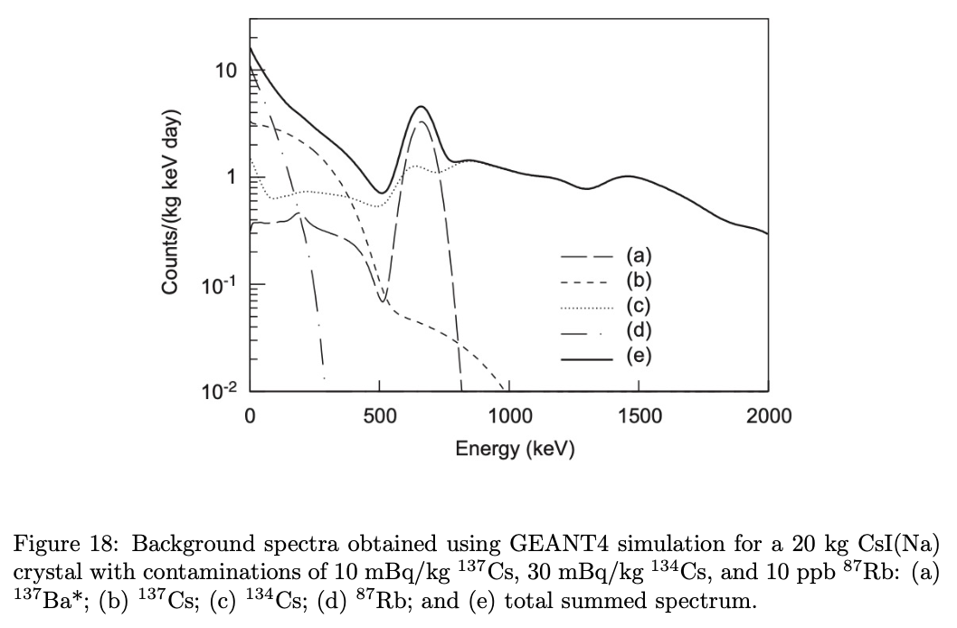
Internal Radioactivity Backgrounds (⁸⁷Rb)
(Ref: KIMS Collaboration, Nucl. Instr. Meth. A 571, 644 (2007) )

Slide 14
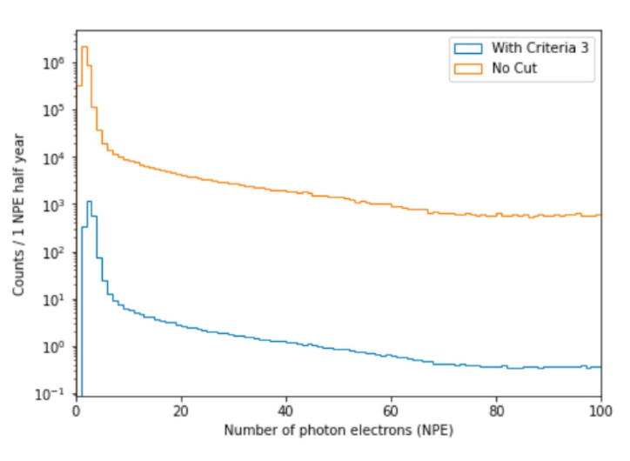
Reduction of PMT Noise Events
(Ref: COSINE-100 Collaboration, Eur. Phys. J. C 78, 107 (2018) )
By attaching two PMTs at both ends of a crystal, reduce PMT dark-current noise events by 3 orders of magnitude.
→ Lower energy threshold from 5 keV_{nr} to ~2 keV_{nr}
← With and without imposing a signal of at least 1 pe on both PMTs
By an algorithm of distinguishing a PMT noise pulse from a scintillating signal of a crystal, COSINE-100 obtained a PMT noise rejection power of 80% above 2 keV while maintaining 99% of signals.
← By exploiting fractions of “fast charge” within the first 50 ns and “slow charge” between 100 and 600 ns with respect to a total event charge

Slide 15
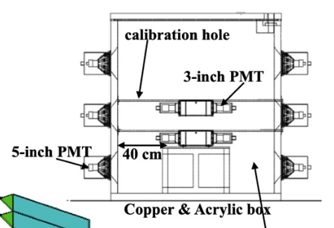
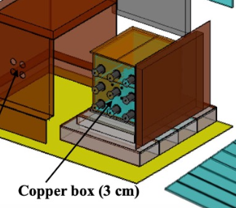
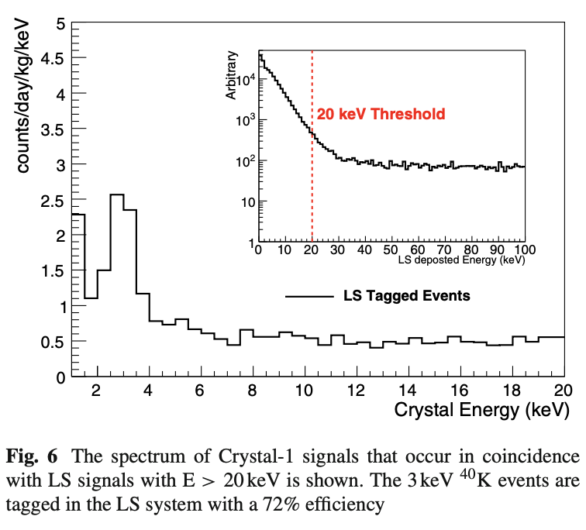
Active and Passive Shielding of Liquid Scintillator
(Ref: COSINE-100 Collaboration, Eur. Phys. J. C 78, 107 (2018) )
3 keV gamma emission from 40K decay in PMTs
Coincidence requirement between LS and a single crystal → time correlation above 20 keV in LS.
This LS+DIN will be also useful for vetoing external neutrons coming from the beam target as well as from the cosmic muon production.
→ 1200 L LAB based LS + MPPCs on a acrylic box

Slide 16
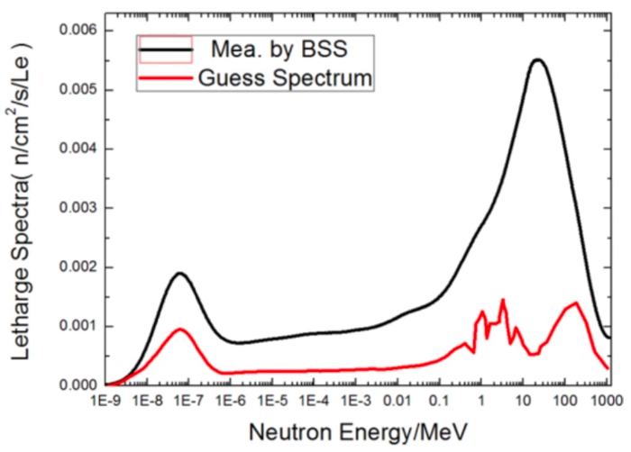
Backgrounds
Beam related neutron
← The most significant background
* Fast neutrons produced at the beam target due to imperfect shielding
- Neutron spectrum measured by ³He multi-sphere neutron spectrometer
(C. Su, Q. Liu and T. Liang, arXiv:2303.13423 (2023))
PMT dark current
* Coincidence required by two PMTs attached to a single crystal at both ends
* Apply an efficient algorithm by exploiting “fast charge” and “slow charge” fractions

Slide 17
Backgrounds
Radioactivity in detector materials
* Low internal radioactivity in CsI(Na) crystal by purification; ⁸⁷Rb, ¹³⁷Cs, …
* Crystals immersed in LS as an efficient tagging external gammas
* Attenuated by lead shielding
Environmental radioactivity
* Most of gamma rays from the environmental radioactivity are expected to be attenuated by lead and other shielding.
Cosmic muon induced neutrons and gammas
* High-energy cosmic muons can produce neutrons and delayed gamma rays inside and outside the detector.
→ We have been estimating the expected background event rates using a full detector simulation,

Slide 18
Timeline
Oct. 2022: Fund request submitted to SYSU.
Nov. 2022: Instrumentation fund obtained.
Dec. 2022: Bidding was completed for procurement.
Dec. 2022 - present.: Negotiation with CsI(Na) crystal manufacturers
Technical Design Report in preparation
Finalize the detector design with a full simulation
Under purchasing parts
Dec. 2023: All of detector components will be delivered.
May 2024: Completion of detector assembly
Aug. 2024: Cosmic muon data at SYSU
Sep. 2024: Deploy the detector at CSNS and take beam data.

Slide 19
Summary
We build a CICENNS detector to explore interesting measurements based on the CEvNS at CSNS,
We wish to finalize the detector design and a TDR in order to complete the detector construction till March 2024.
We cordially invite your joining this effort!
Thank you for your attention!

