Slide 1
Applications of Nuclear Technology Session Summary
-- Application and Detection Technology Development
Zhe Wang
Tsinghua University
July 8, 2023 @ WIN2023, Zhuhai

Slide 2
Applications of Nuclear Technology
16 parallel talks
Two plenary talks
  CEvNS with Noble Liquids, by Kaixuan Ni
  Neutrino Applications, by Jonathan Link

Slide 3
Contents
Reactor neutrino precision measurement and monitor
Geoneutrino measurements and prediction
CEvNS detection
Others:
  Jinping Neutrino Experiment
  Muon tomography
  Bolometer development

Slide 4
Part 1. Reactor neutrino precision measurement and monitor
  TAO - Cryogenic liquid scintillator, high light yield
  CHANDLER – Compact , low cost, surface-level, mobile

Slide 5
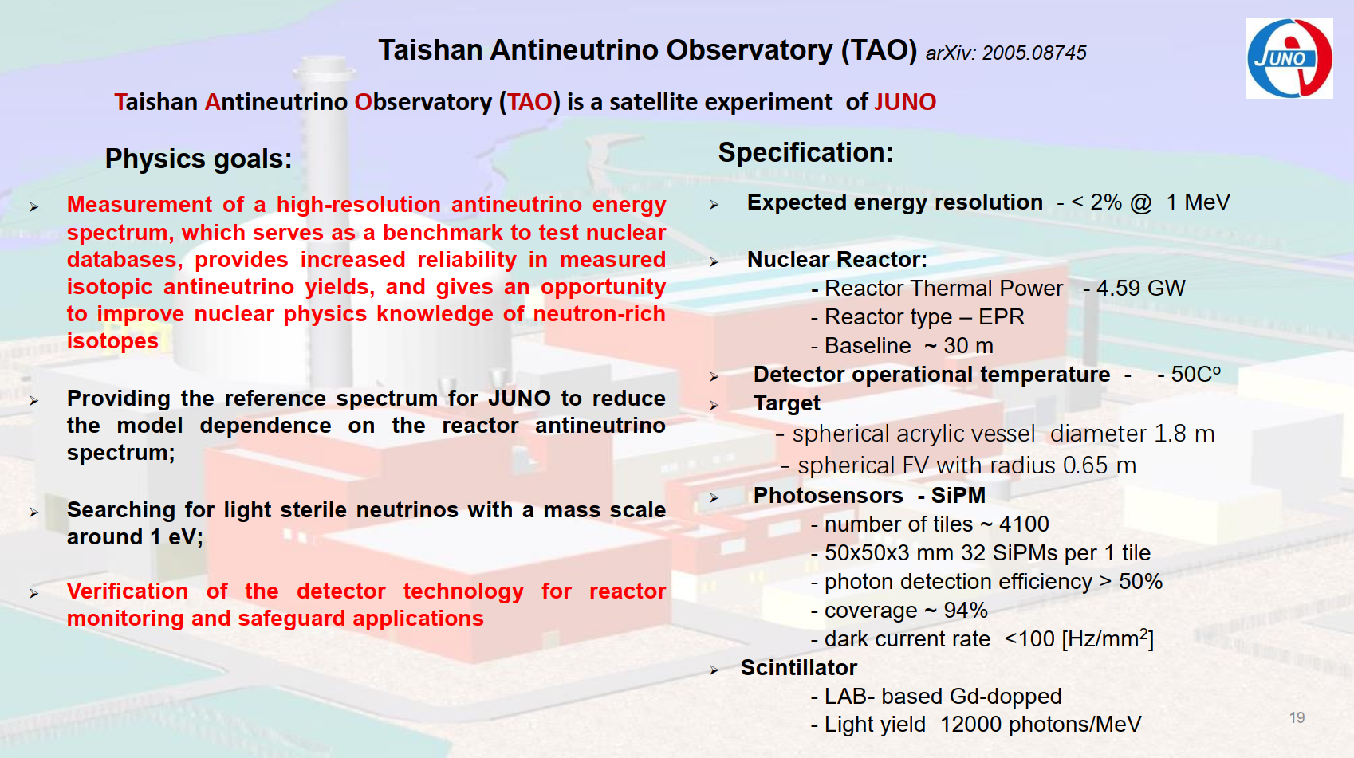
by Alexander Chepurnov

Slide 6
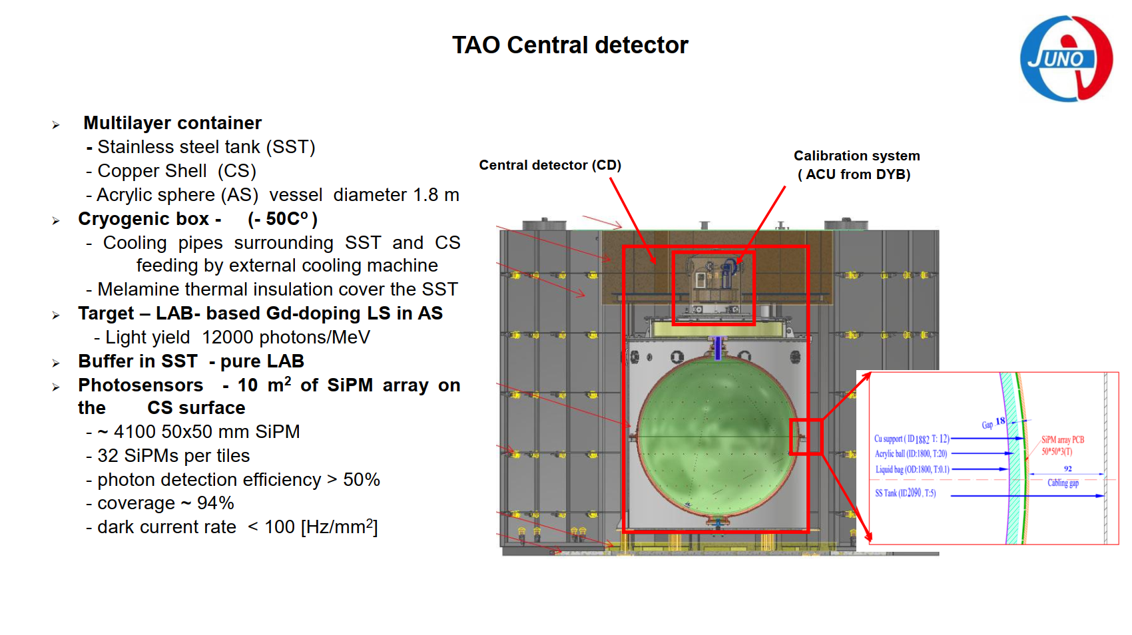

Slide 7
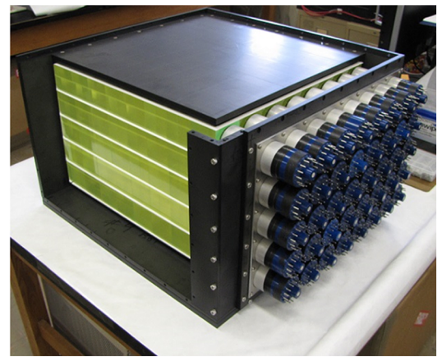
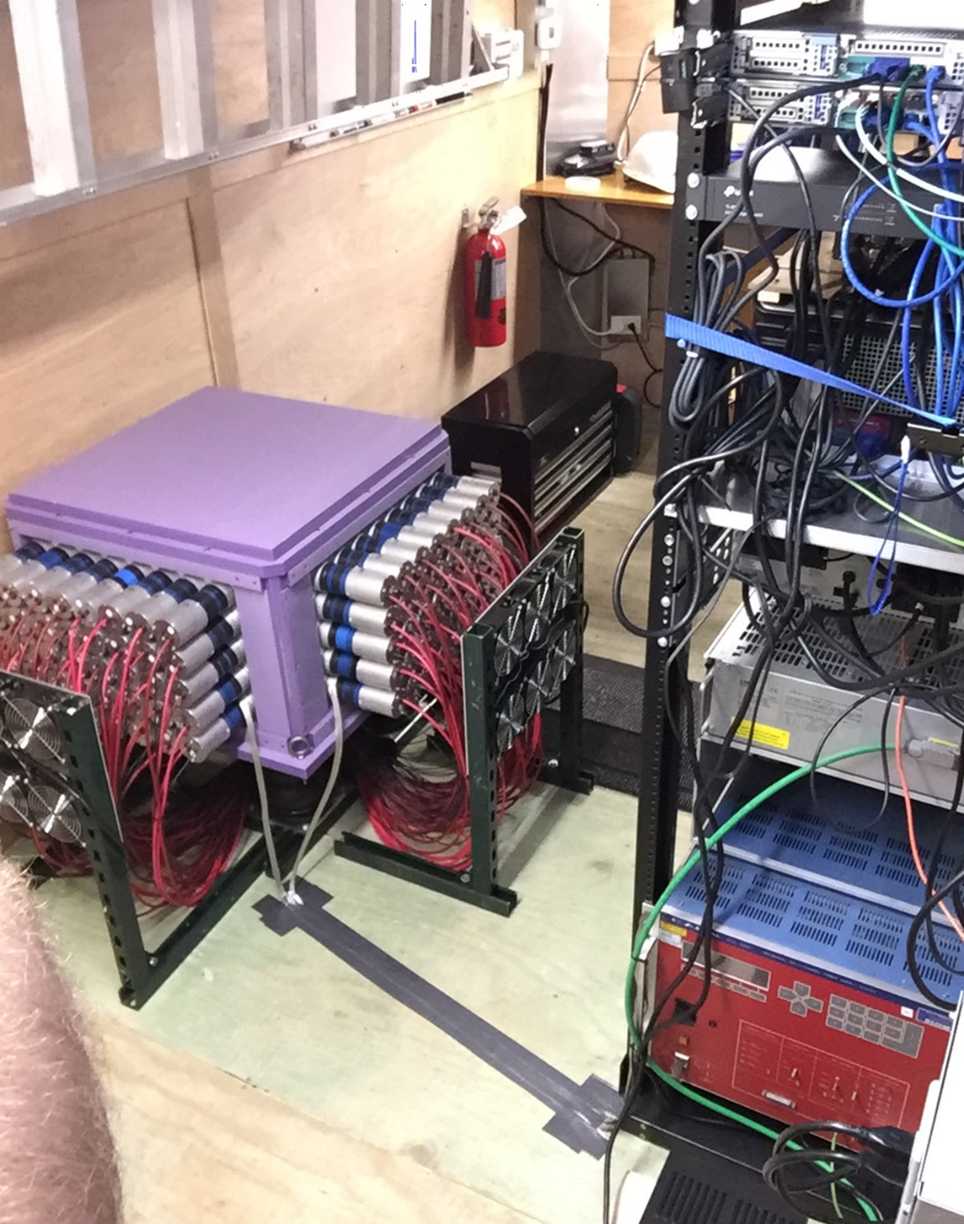
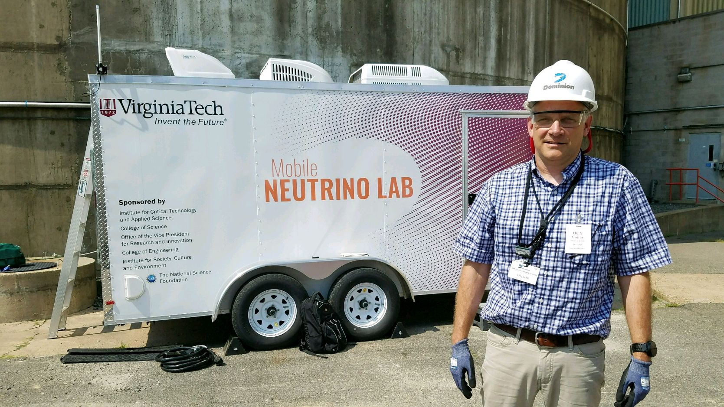
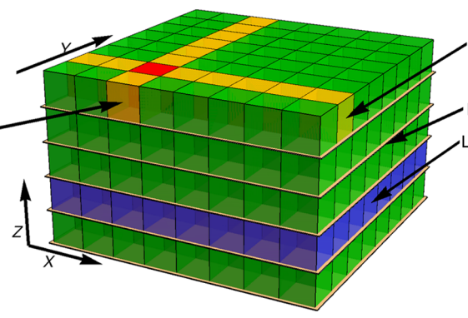
The Mobile Neutrino Lab —— MiniCHANDLER
by Jonathan Link
  The first demonstrated mobile neutrino detector,
  The first unshielded reactor neutrino detector, and
  One of the world’s smallest neutrino detectors.

Slide 8
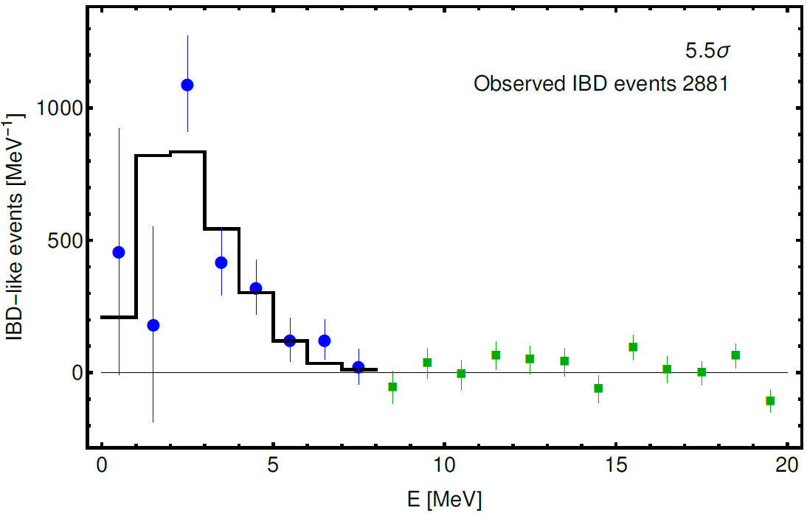
Observation of reactor neutrinos —— MiniCHANDLER
With the 80 kg prototype:
The detection of an antineutrino signal resulting from inverse beta decay at 5.5σ significance.
An observation of a positron spectrum in a small surface-deployed detector.
Going from MiniCHANDLER to full CHANDLER:
New optics; 2. Larger detector; 3. PMTs on four sides; 4. Half cubes.

Slide 9
Part 2. Geoneutrino measurement and prediction
  Measurements of Borexino and KamLAND
  Prediction for JUNO

Slide 10
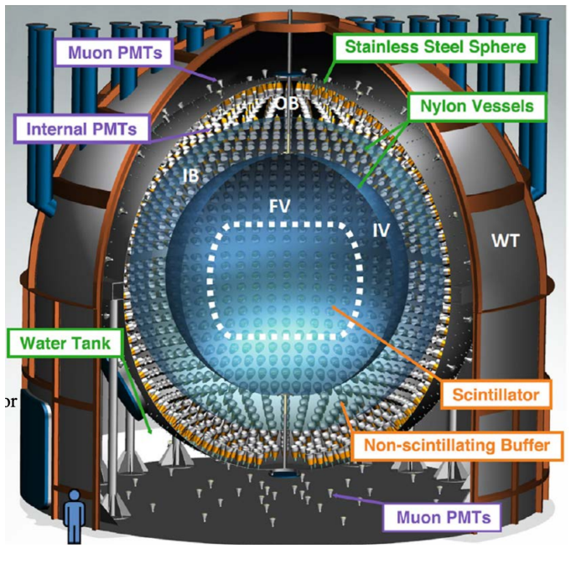
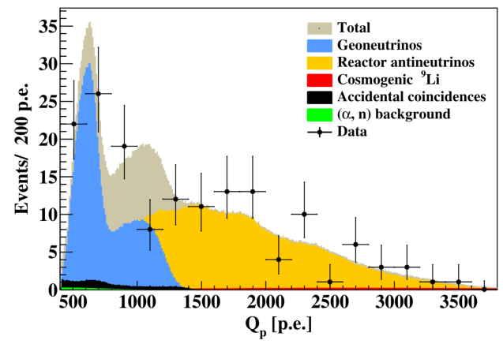
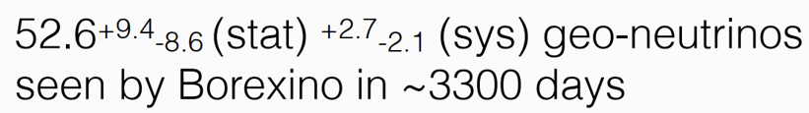
Geo-neutrino measurements with Borexino
by Xuefeng Ding

Slide 11
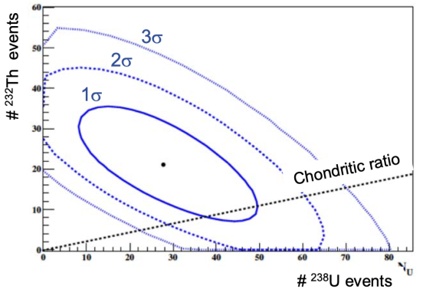
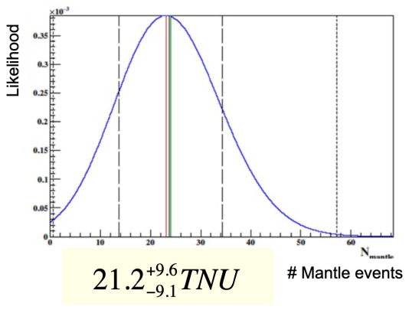
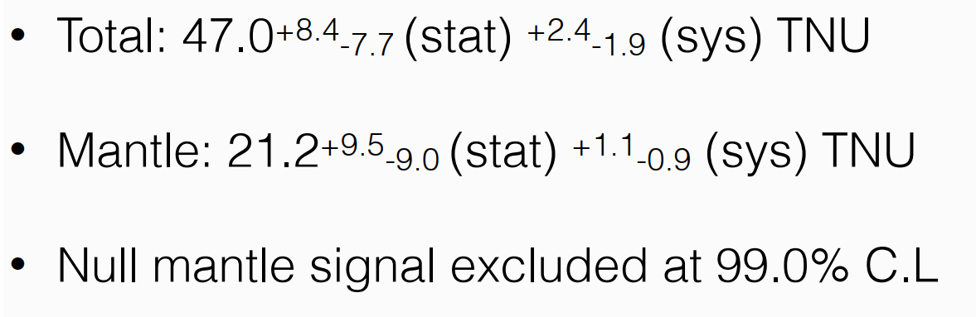
Geo-neutrino measurements with Borexino

Slide 12
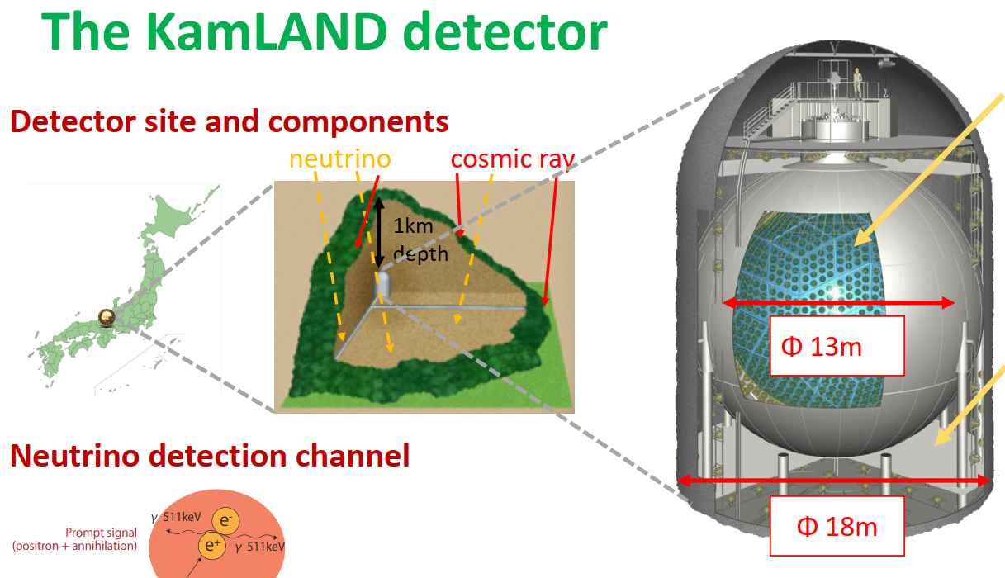
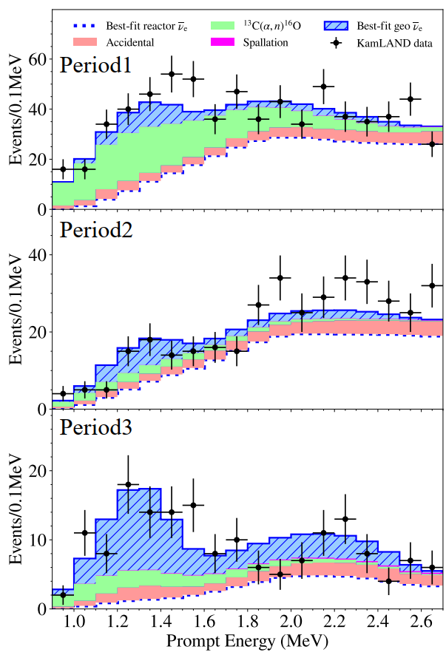
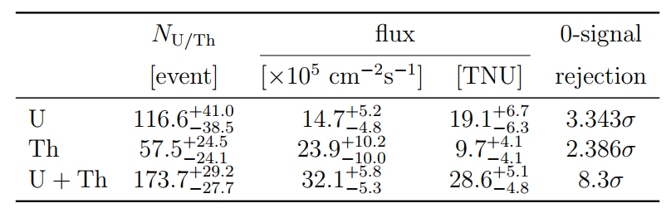
Geo-neutrino measurements with KamLAND
by Nanami Kawada

Slide 13
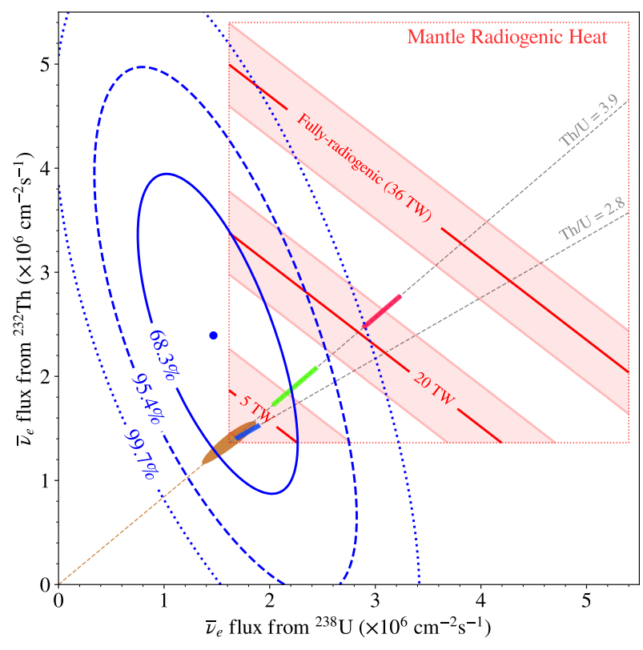
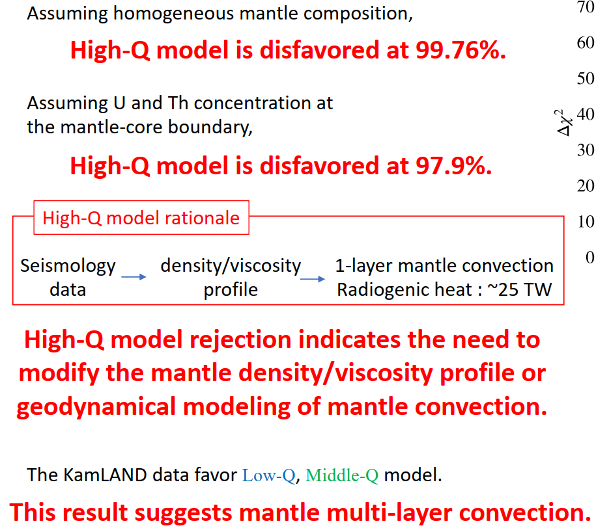
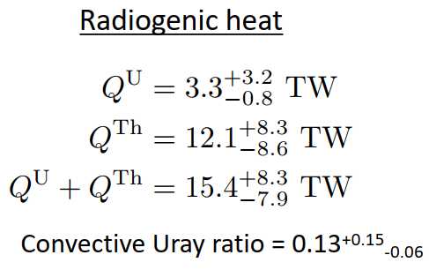
Comparison to Earth models

Slide 14
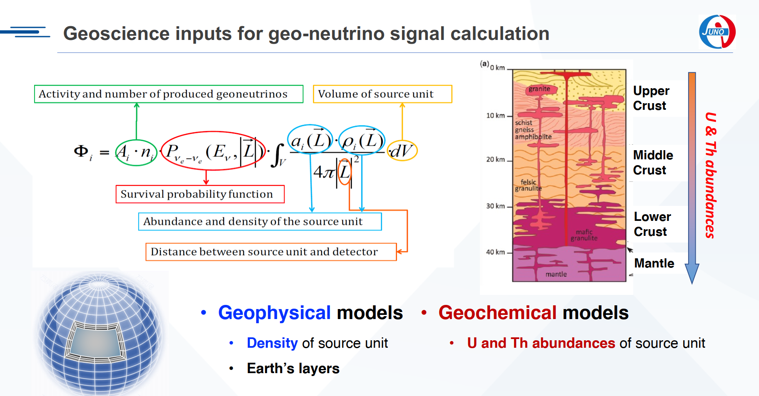
Geo-neutrino Signal Prediciton at JUNO
by Ruohan Gao

Slide 15
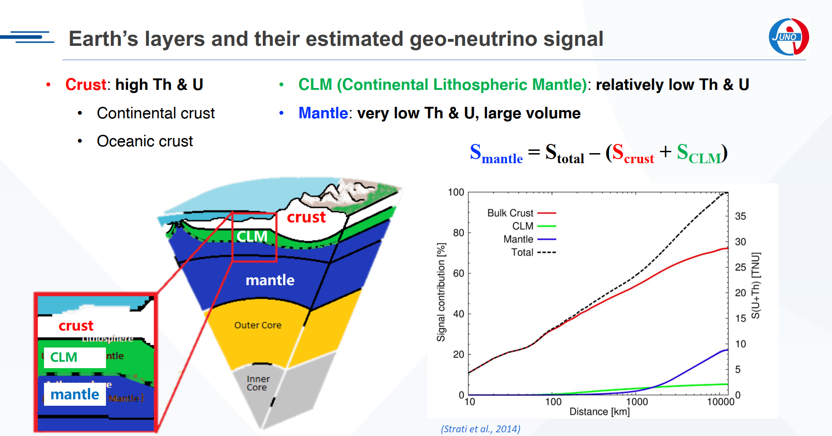

Slide 16

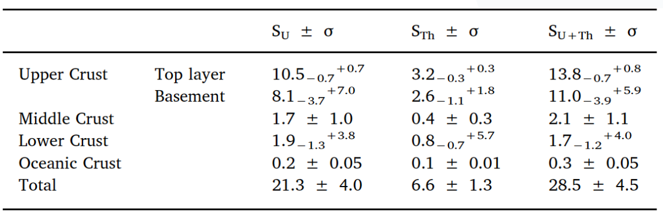


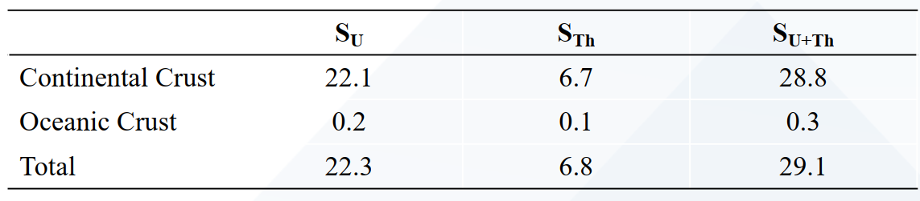
Geo-neutrino Signal Prediciton at JUNO
1. Geochemical model has larger influence on geo-neutrino signal prediction than
geophysical model, as the earth’s continental crust is highly heterogenous in
terms of U and Th abundances.
2. Local crust model (JULOC/JULOC-I) predicts higher geoneutrino signal than global models.
3. This is consistent with the wide distribution of high U/Th granite intrusions in the Cathaysia region around JUNO

Slide 17
Part 3. CEvNS detection
  COHERENT
  CloverS
  CICENNS
  Dual phase argon TPC
  RELICS
  CONUS
  νGen
  RECODE

Slide 18
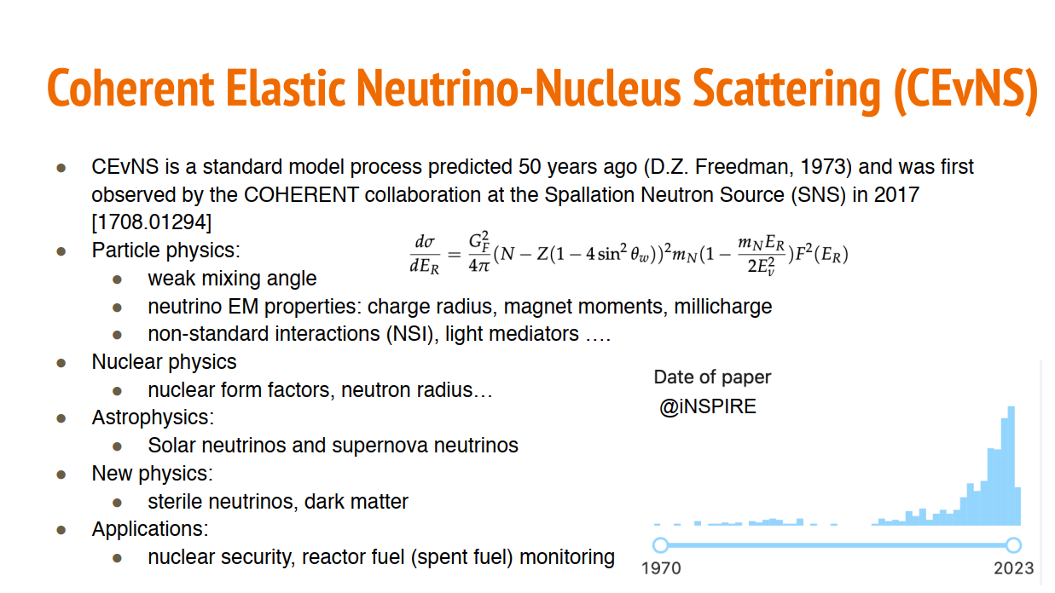
By Kaixuan Ni

Slide 19
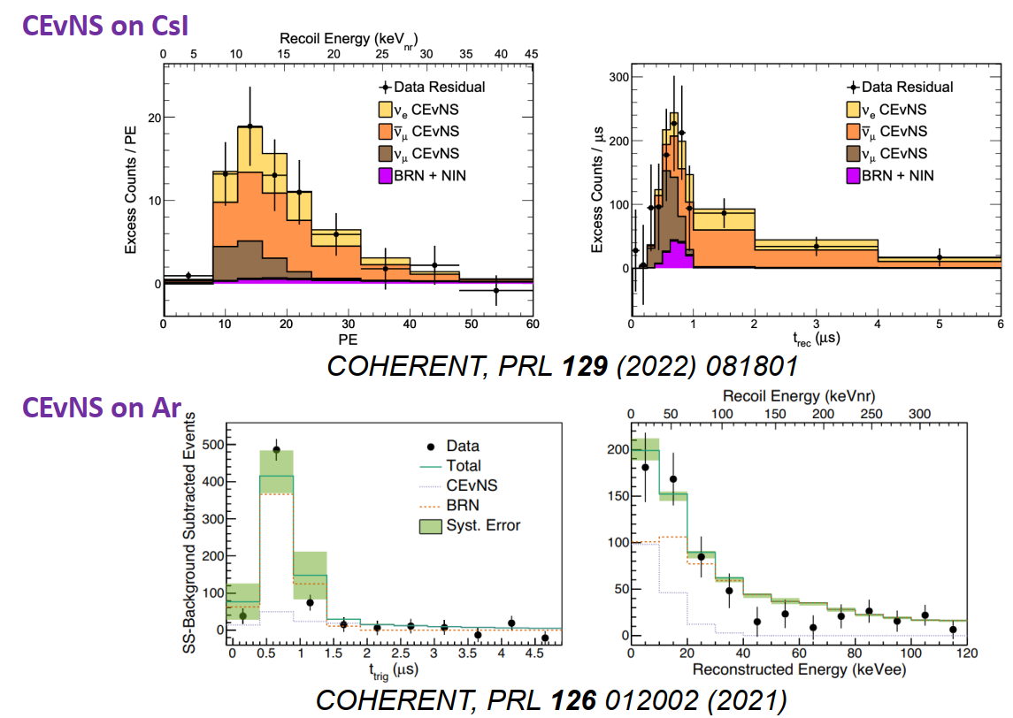
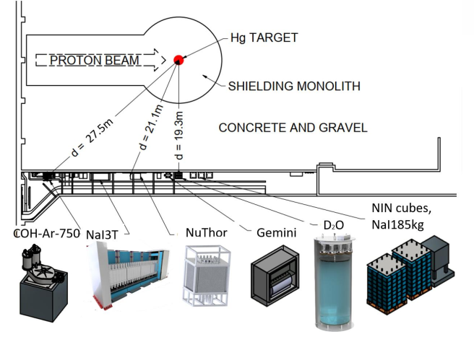
COHERENT
by Keyu Ding
Ongoing effort:
24 kg Ar, Single phase
16 kg Ge
3.4 ton NaI
...

Slide 20
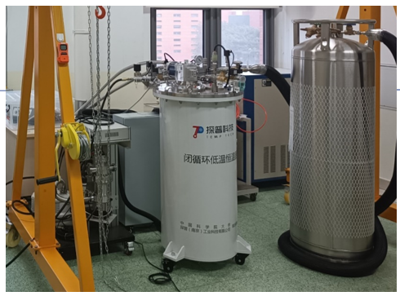
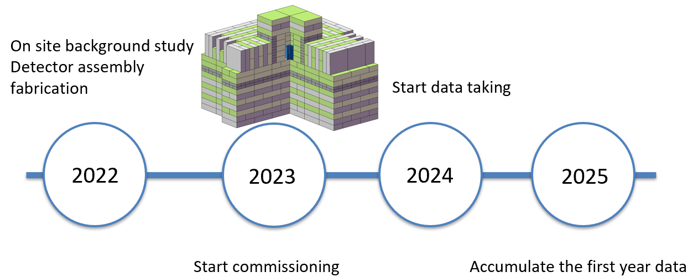
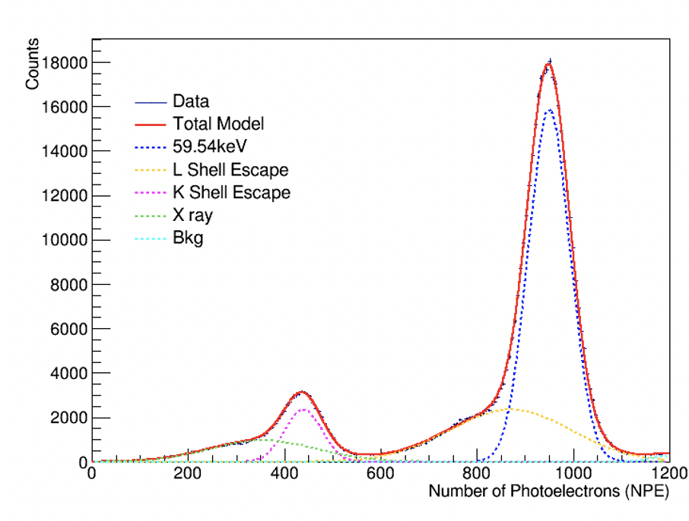

CloverS - Cryogenic undoped CsI, SNS, 12 kg, CSNS, China
by Qian Liu
Scanning the neuron counting rate at different positions in CSNS
77K big CsI crystal light yield test～15.8p.e/keVee
The light yield can be further improved by enhancing the optical coupling and employing wavelength shifters, etc.

Slide 21
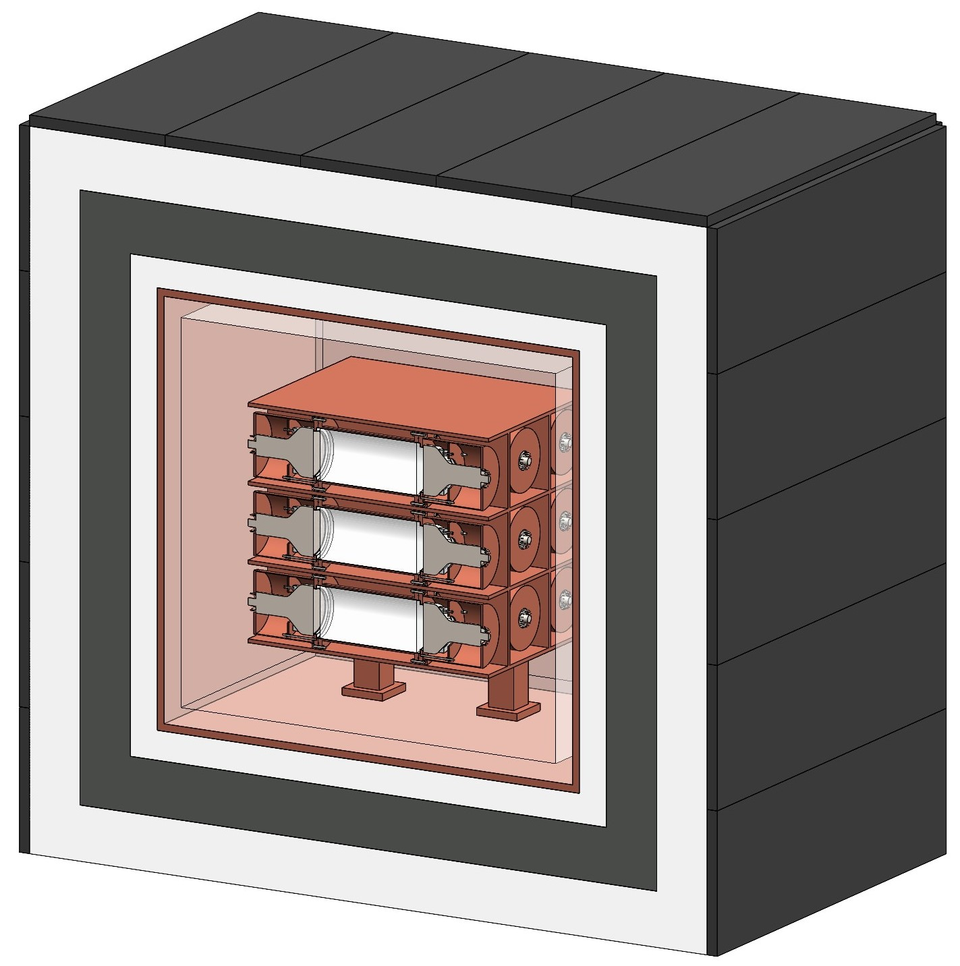
CICENNS - CsI(Na), SNS, 300 kg, CSNS, China
by Soo-Bong Kim
20 kg CsI(Na) x 15
14 cm (φ) x 28.7 cm each
Two 5-inch SBA PMTs
Oct. 2022: Fund request submitted to SYSU.
Nov. 2022: Instrumentation fund obtained.
Dec. 2022: Bidding was completed for procurement.
Dec. 2022 - present.: Negotiation with CsI(Na) crystal manufacturers
Technical Design Report in preparation
Finalize the detector design with a full simulation
Under purchasing parts
Dec. 2023: All of detector components will be delivered.
May 2024: Completion of detector assembly
35 tons of shielding with Cu, LS, Pb, and HDPE
Aug. 2024: Cosmic muon data at SYSU
Sep. 2024: Deploy the detector at CSNS and take beam data.

Slide 22
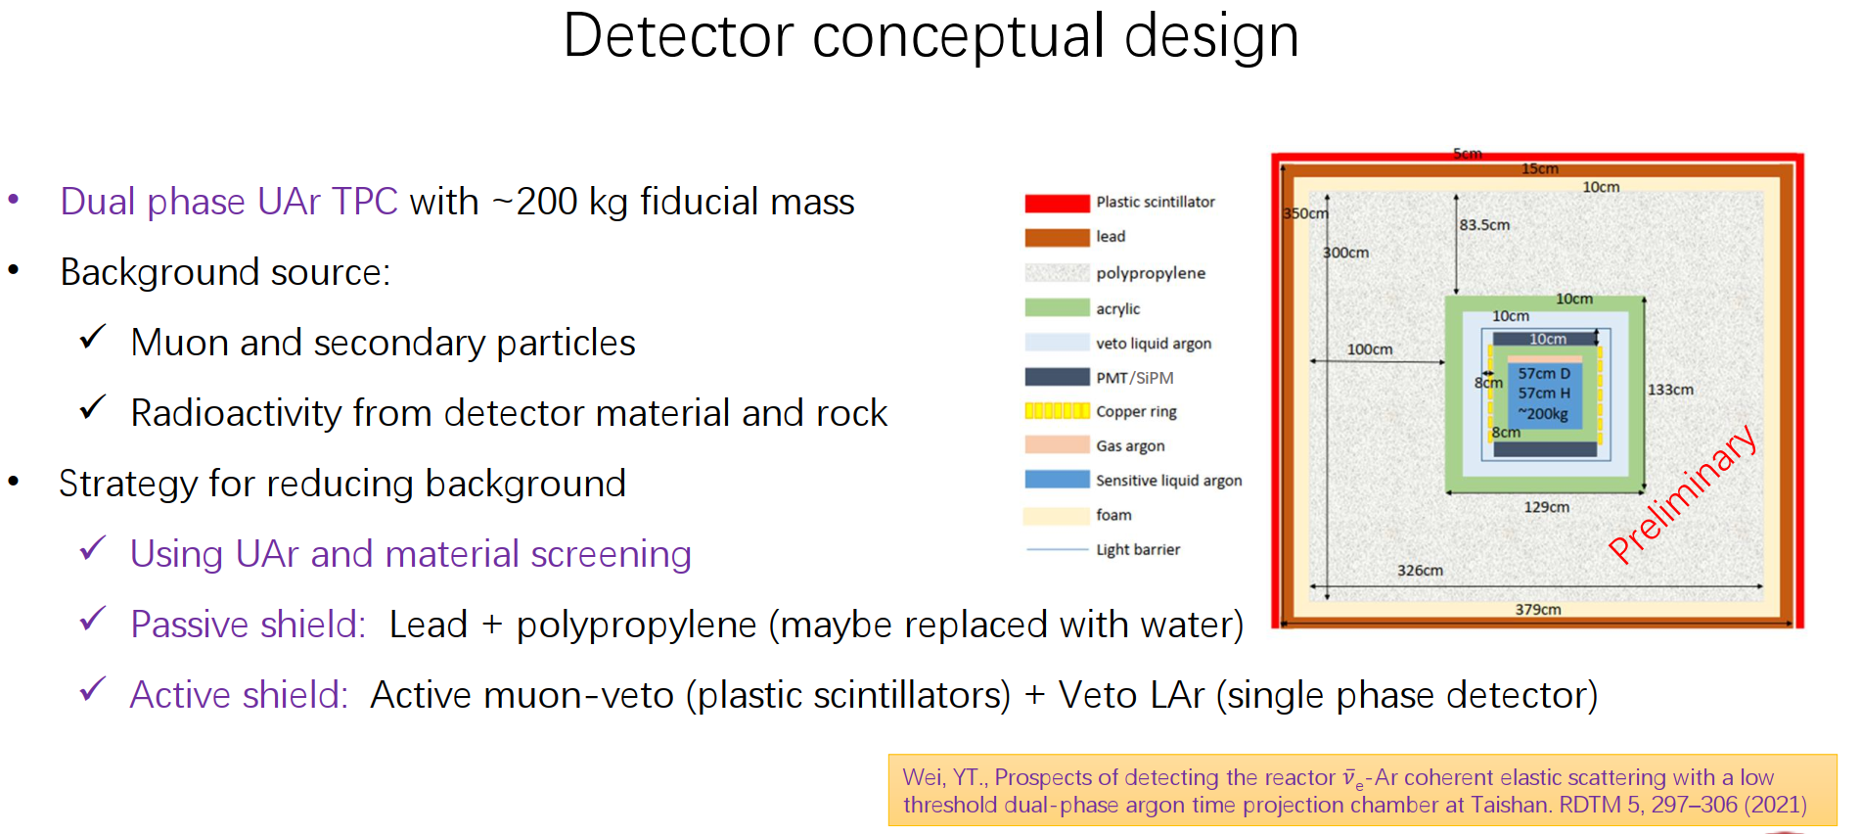
Dual phase argon - Ar, Reactor, 200 kg, Taishan, China
by Yongpeng Zhang

Slide 23
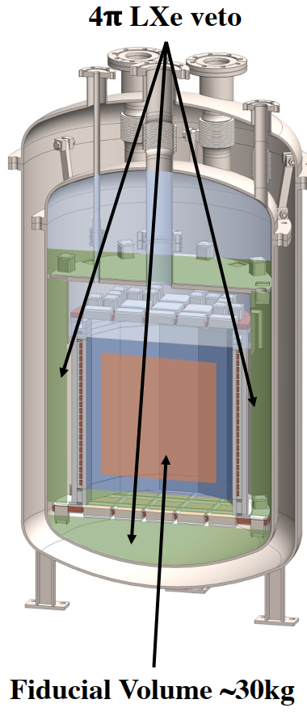
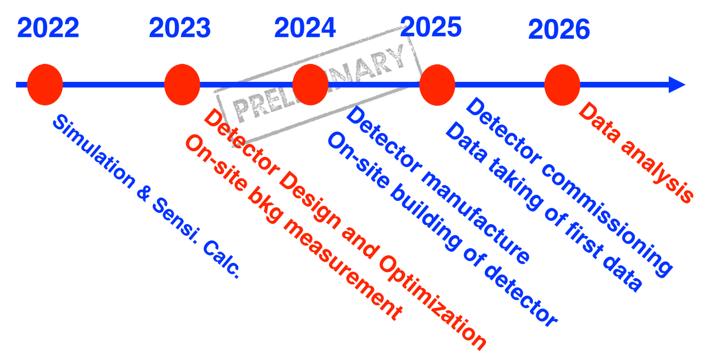
RELICS - Xe, Reactor, 30 kg, Taizhou, China
by Qing Lin

Slide 24
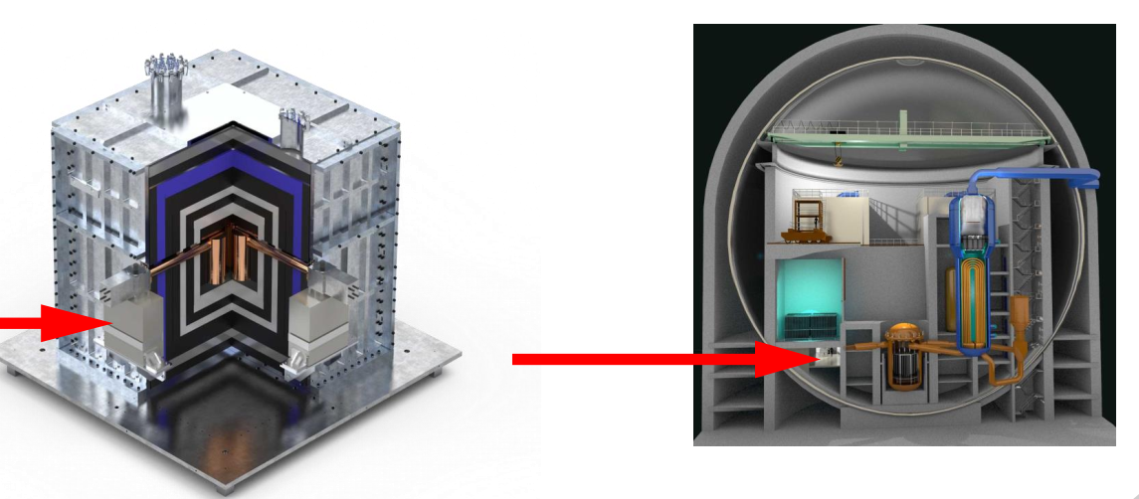
CONUS, - Ge, Reactor, 4 kg, KFR, Germany
by Kaixiang Ni

Slide 25
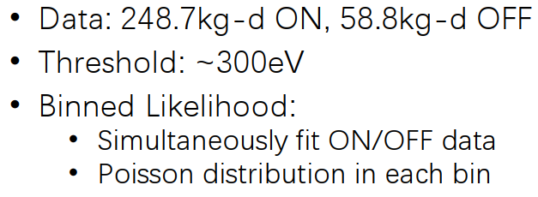
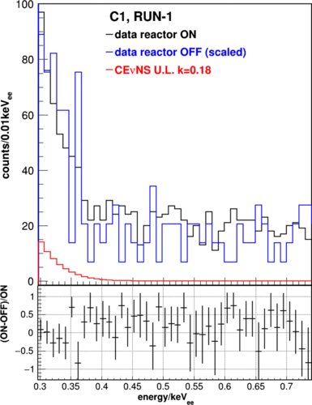
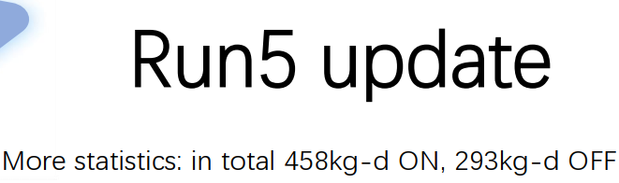
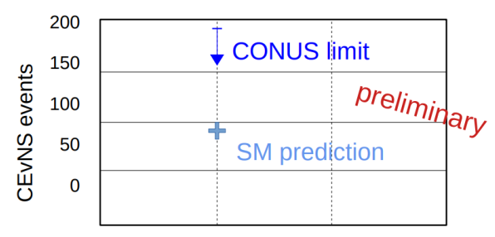
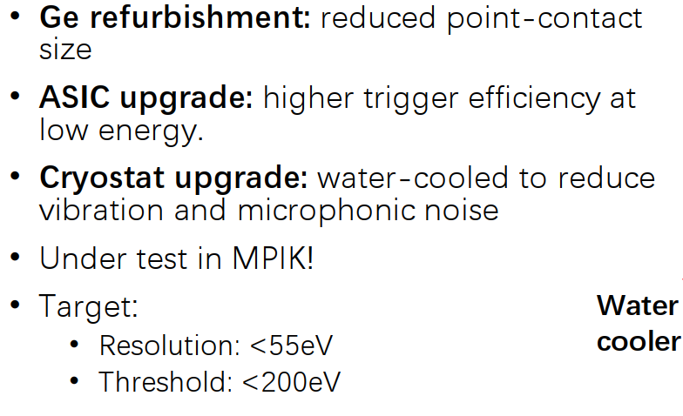
From CONUS to CONUS+
New Reactor: Kernkraftwerk Leibstadt (KKL), Switzerland
Upgraded Ge detectors
Phys.Rev.Lett. 126 (2021) 4, 041804

Slide 26
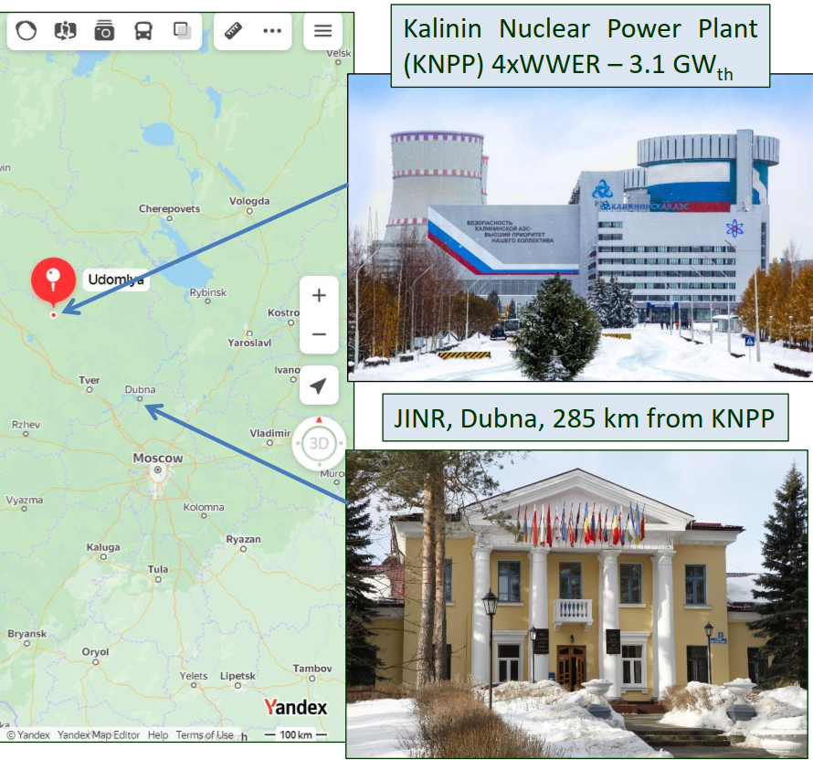
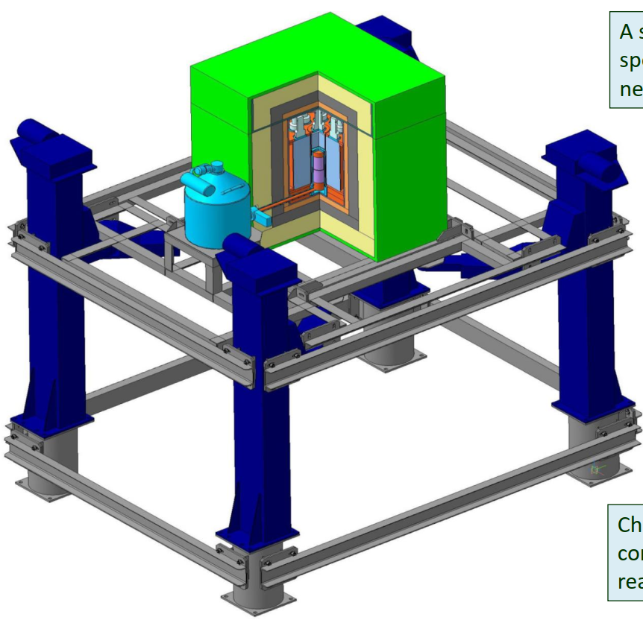
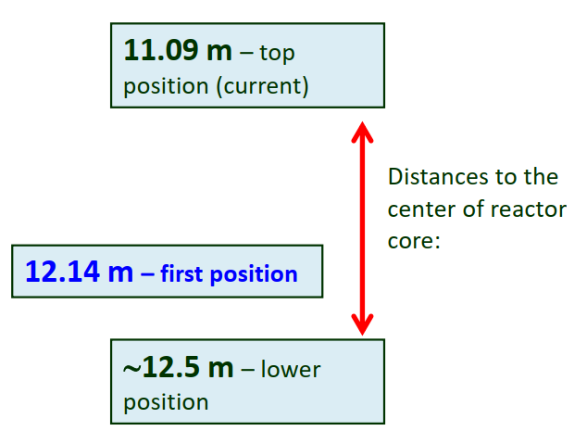
nGen - Ge, Reactor, 1.4 kg, KNPP, Russia
by A.Lubashevskiy

Slide 27
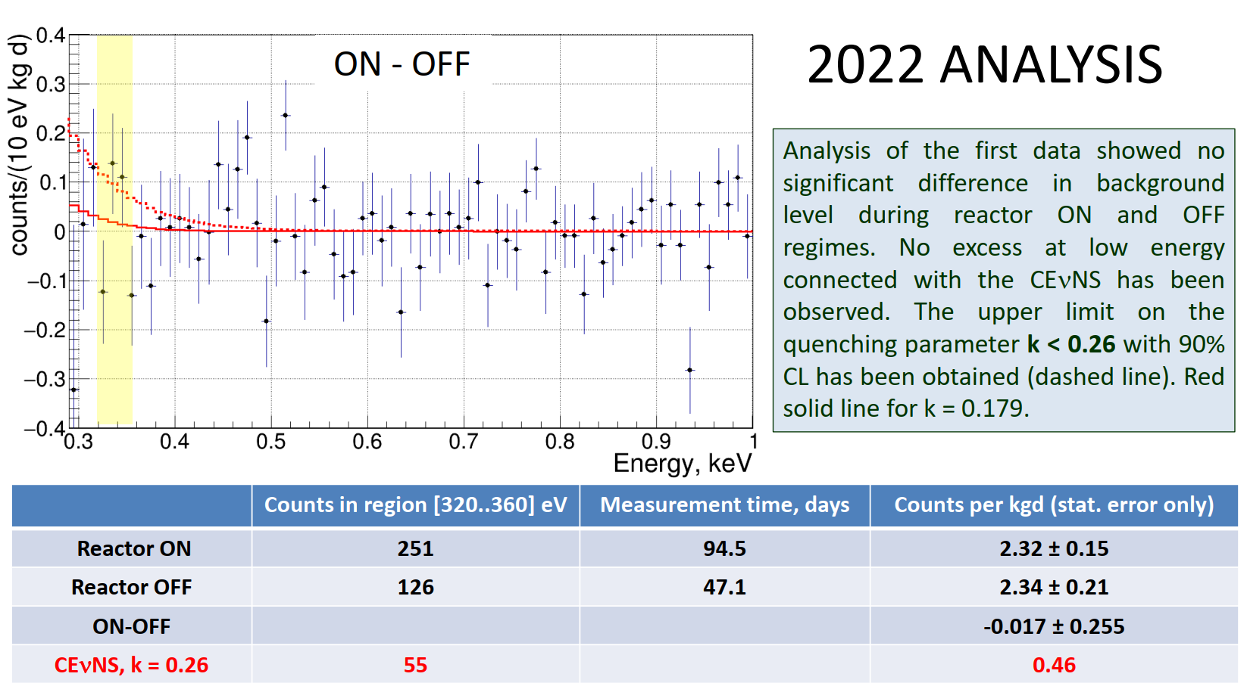
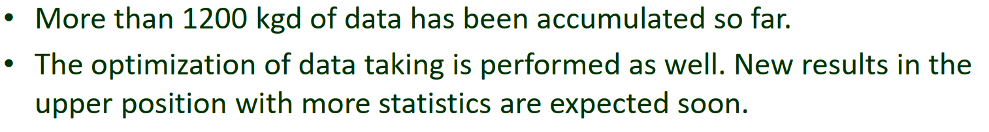

Slide 28
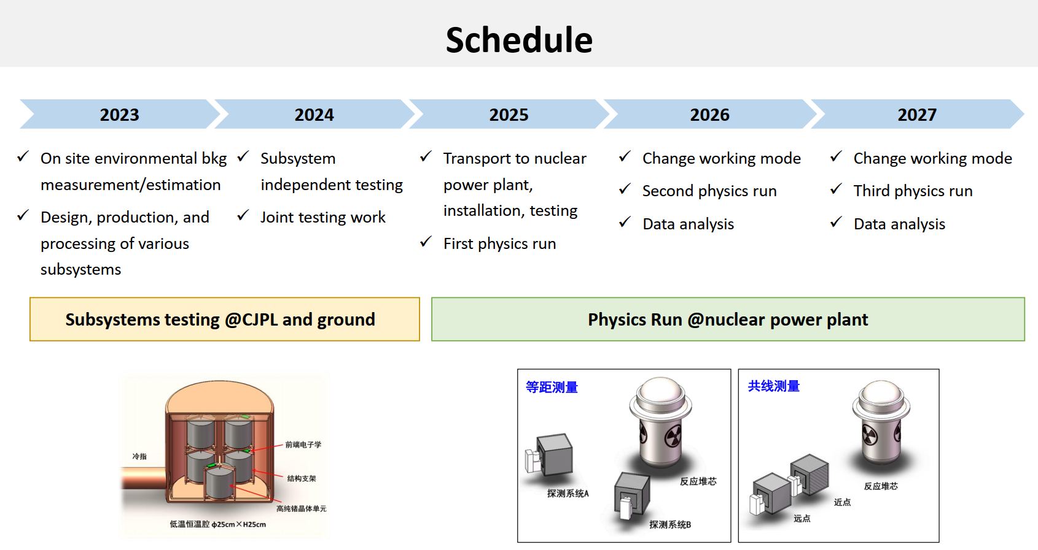
RECODE - Ge, Reactor, 10 kg, Taizhou
by Litao Yang
Experience from CDEX@CJPL

Slide 29
Part 4. Others
  Jinping Neutrino Experiment – A solar and geo neutrino observatory
  Muon tomography – Structure imaging
  Bolometer development – for 0νββ and CEvNS

Slide 30
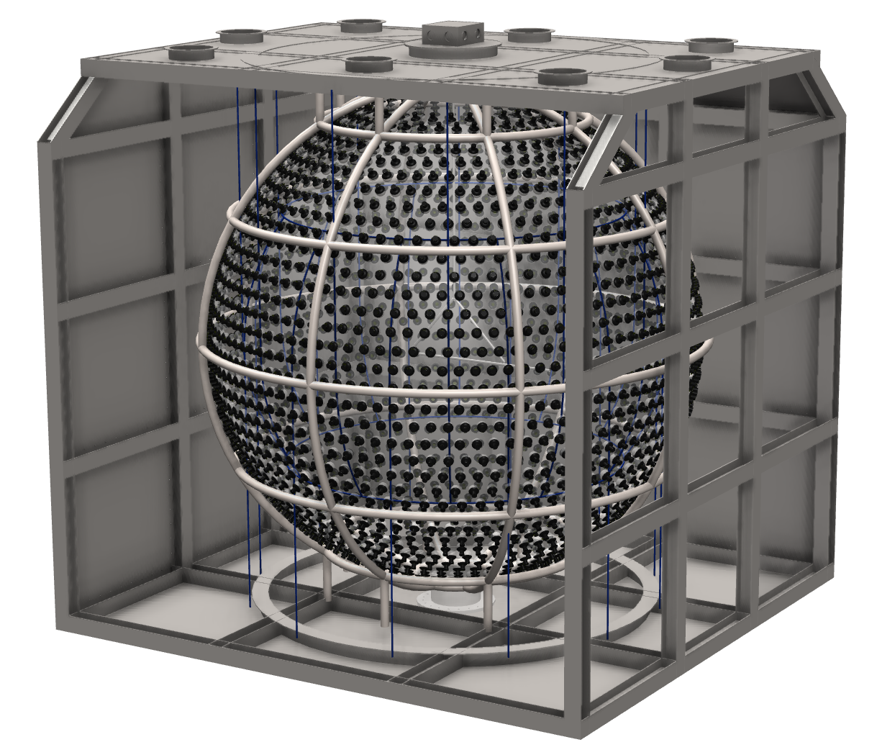
R&D of Jinping Neutrino Experiment
by Zhe Wang
500 Hundred-ton solar neutrino observatory at CJPL II
  Detector construction
  Replaceable detection media, allowed density range ± 20% wrt water, oil- or water- based liquid scintillator
Solar B-8 neutrino detection with water first
Explored the option with LiCl aqueous solution
Under construction.
Coming up soon.

Slide 31


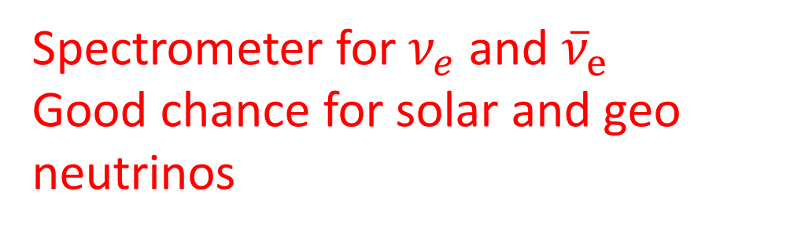
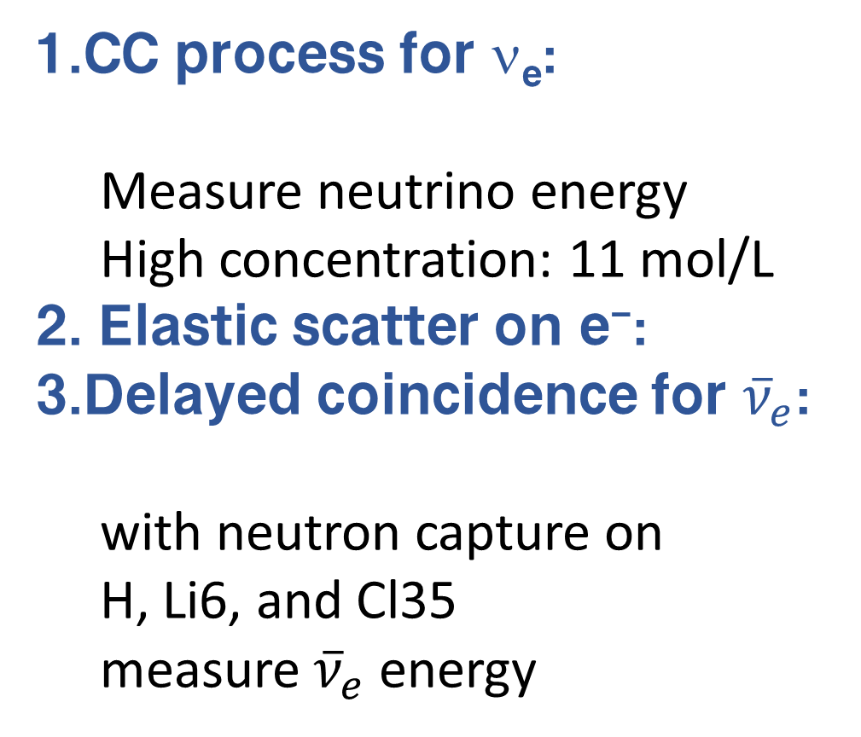
ν_{e} CC, ES, and ${\overline{ν}}_{e}$detections with saturated LiCl aqueous solution
CC process for ν_{e}:
  Measure neutrino energy
  High concentration: 11 mol/L
Elastic scatter on e⁻:
Delayed coincidence for ${\overline{ν}}_{e}$:
with neutron capture on
H, Li6, and Cl35
measure ${\overline{ν}}_{e}$ energy
Saturated LiCl solution
Attenuation length: 50 m at 430 nm
Adding 1 ppm C124 to LiCl aqueous solution, scintillation+Cherenkov
Spectrometer for $ν_{e}$ and ${\overline{ν}}_{e}$ Good chance for solar and geo neutrinos
http://jinping.hep.tsinghua.edu.cn

Slide 32
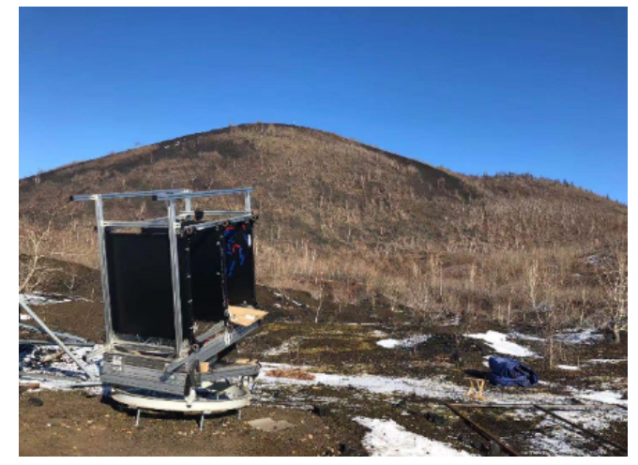
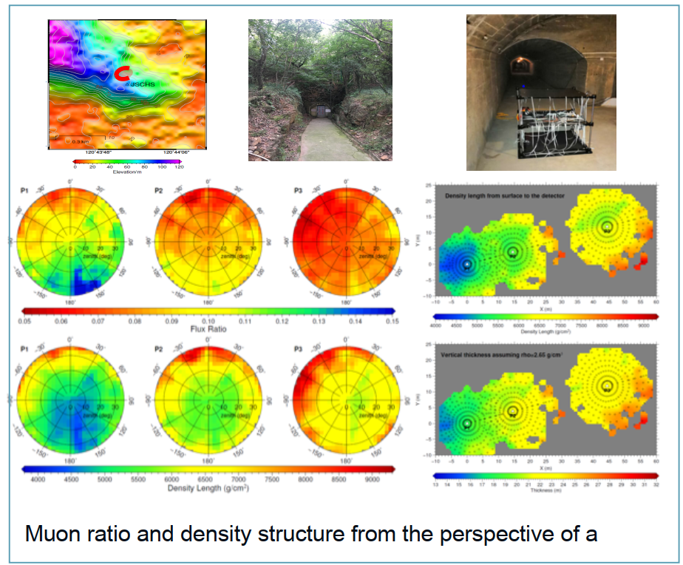


Muon Tomography
by Ran Han
Tunnel -- Changshu seismic station
Tunnel -- Xiaoying subway station
Volcano

Slide 33


Slide 34




Cryogenic phonon-scintillating bolometer technology and applications
by Mingxuan Xue
CdMoO4/Li2MoO4/Gd2SiO5 bolometer for 0νββ search

Slide 35






Cryogenic phonon-scintillating bolometer technology and applications
by Mingxuan Xue
CdMoO4/Li2MoO4/Gd2SiO5 bolometer for 0νββ search

Slide 36



PbWO4 bolometer for reactor CEvNS observation

Slide 37
Summary
Reactor neutrino precision measurement and monitor
  a. TAO and CHANDLER
Geoneutrino measurements and prediction
  a. Borexino and KamLAND; b. JUNO pred.
CEvNS detection: 8 Exp. coming up
Others:
  Jinping Neutrino Experiment coming up
  Muon tomography results
  Bolometer development

Slide 38
Thank you.
Apologize for the missing details and key points due to my limited knowledge.

