Slide 1
Testing
Lepton Flavor Universality
at Future Z Factories
Testing
Lepton Flavor Universality
at Future Z Factories
WIN2023
7 July 2023
(Anson) Tsz Hong Kwok
[Hong Kong University of Science and Technology]
Based on arXiv:2212.02433 with Tin Seng Manfred Ho, Xu-Hui Jiang, Lingfeng Li, Tao Liu

Slide 2
What is LFU? And Why?
SM assumes:
Three generations of leptons are the same
(having same couplings to the SM gauge bosons)
except having different masses.
[See also Laing Sun’s Talk]
1

Slide 3
SM assumes LFU
SM assumes LFU
Why is it true? Is it even true?
Secret behind the 3 generations?
Need to be tested with high precision!!!
Need to be tested with high precision!!!
SM extensions > extra LFU violating interactions
Flavor physics > indirect BSM searches.
2

Slide 4
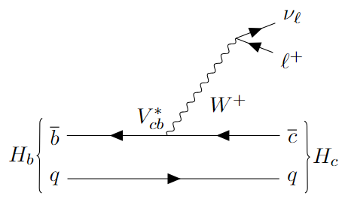
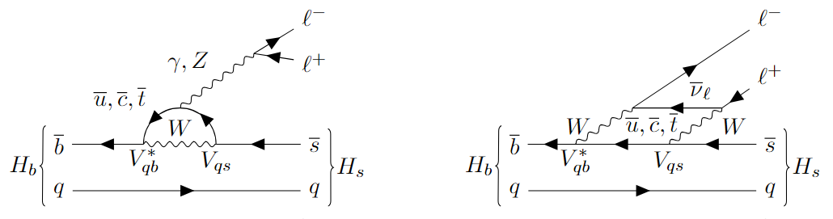
How to Test LFU?
b-hadron decays:
FCCC:
FCNC:
3

Slide 5
How to Test LFU?
b-hadron decays:
FCCC:
FCNC:
4

Slide 6
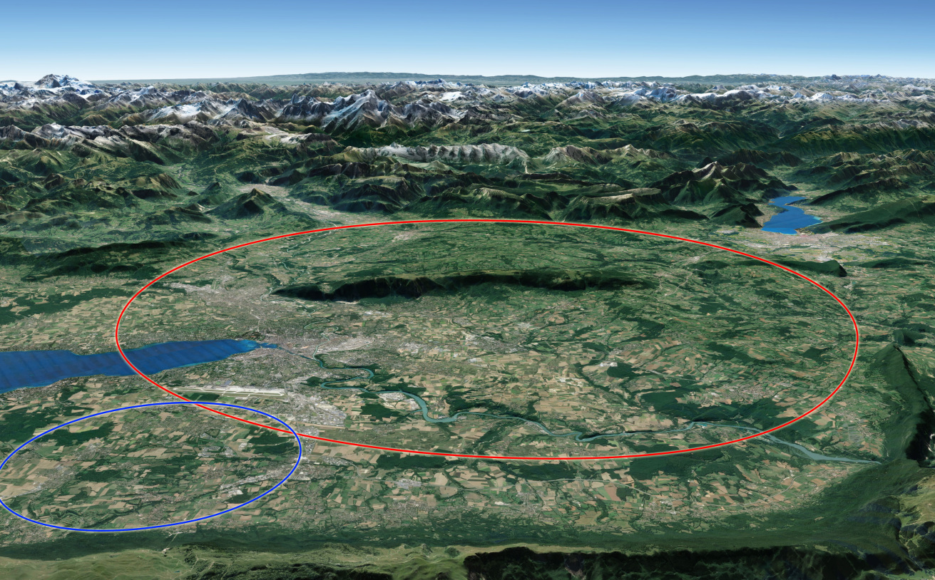
Future Z Factories
ee circular collider at COM energy ~ 91GeV
Produces O(10¹²-10¹³) Z bosons [Tera / 10$×$Tera-Z]
CEPC @ China
FCC-ee @ CERN
5

Slide 7
Why Z Factories?
Z Factories v.s. b Factories
Abundant H_{b}
High boost
Better tracking
Low vertex uncertainty
…
Z Factories v.s. Hadronic Machine
Clean environment
High acceptance
Fixed E_{cm}
Direct E_{miss} measurement
Better flavor tagging
…
6

Slide 8
Goal: Set b>cτν baseline for Z Factories
Advantages of Z Factories for us?
Variety b-hadrons accessible: ▶ b factories (e.g. Belle II) can’t produce B_{c}⁺, Λ_{b}⁰, (only few B_{s}⁰)
Having ν(s) Produced: (crucial to getting H_{b} info.) ▶ Better handle than LHCb
Studying τ Mode: ▶ More precise info. about τ decay
[Dong et al. (2018); Abada et al. (2019); Fujii et al. (2019); Berger et al. (2017); Aaij et al. (2018); Altmannshofer et al. (2018)]
7

Slide 9
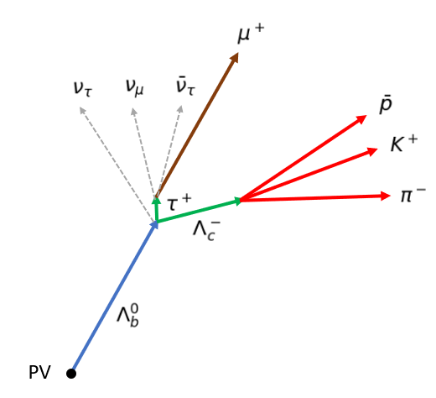
Signal (FCCC: b>cτν)
H_{c} decays to charged final states: H_{c} can be fully reconstructed!
Tera-Z can produce many of such H_{b}, while B-factories can’t do! (or just few)
8

Slide 10
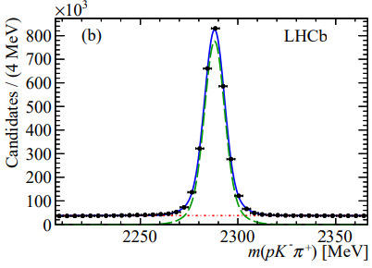
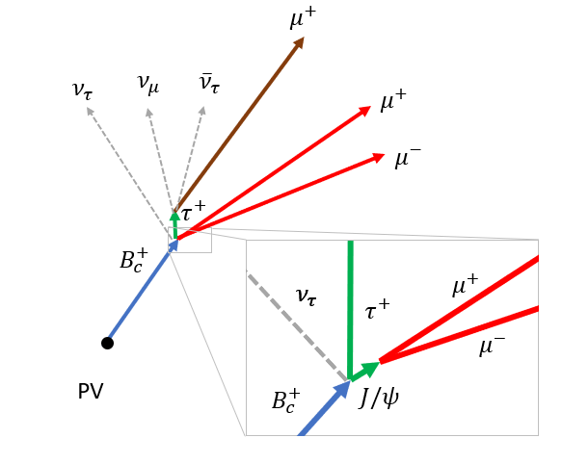
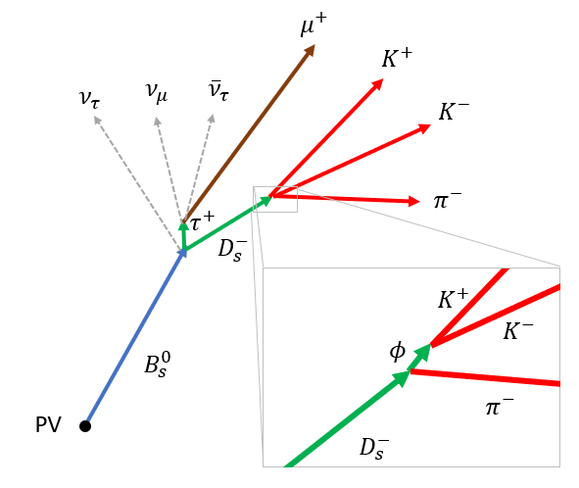
Reconstruction Scheme
1. Reconstruct H_{c} and identify μ
2. Deduce H_{b} decay vertex
If H_{c} is prompt:
H_{b} decay vertex = H_{c} decay vertex
If H_{c} is not prompt:
H_{b} decay vertex =
point at H_{c} trajectory closest to μ track
9

Slide 11
Reconstruction Scheme
3. Deduce b-hadron energy:
(Energy-momentum conversation)
Truth
Reconstruction
In good agreement!
(error ∼ O(1GeV))
10

Slide 12
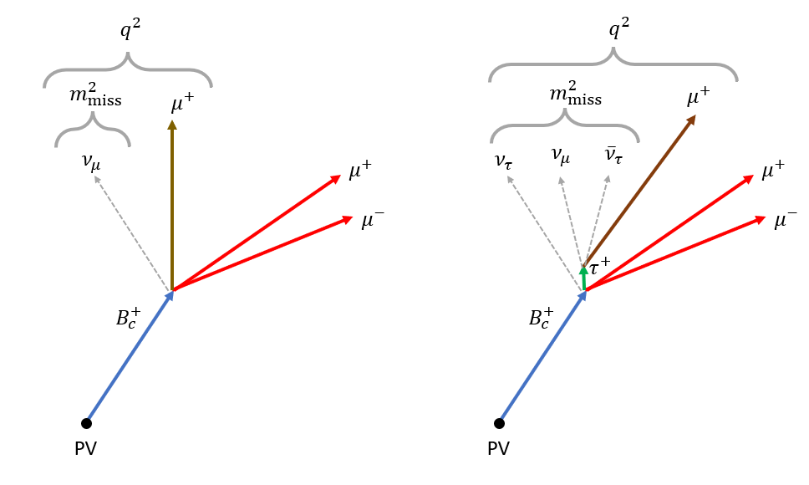
Discriminators for τ , μ Channel Separation
Momentum transferred to lepton system: q² ≡ (p_{Bc} − p_{J/ψ})²
Missing mass: m²_{miss} ≡ (p_{Bc} − p_{J/ψ} − p_{μ})²
The closest distance between secondary vertex (SV) and muon track
11

Slide 13
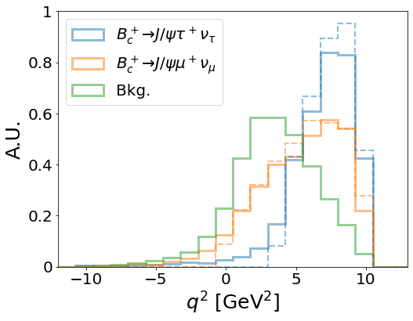
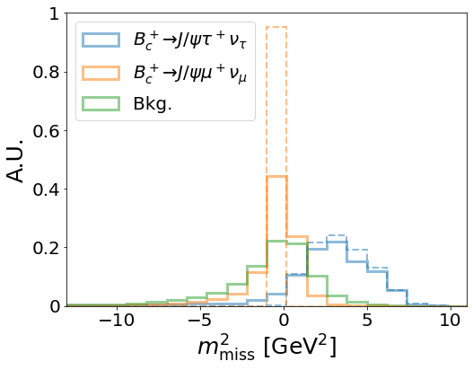
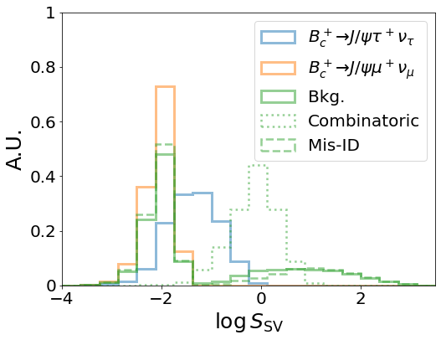
Discriminators for τ , μ Channel Separation
12

Slide 14
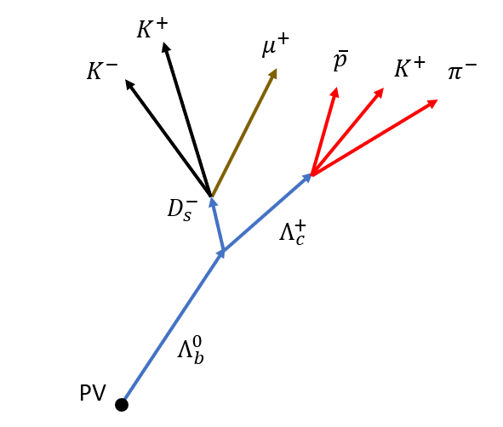
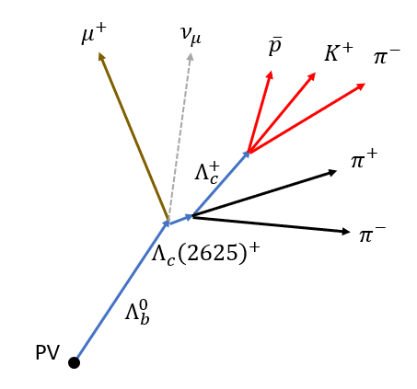
Backgrounds
Wrong H_{c} Production
For example:
Wrong lepton Production
For example:
13

Slide 15
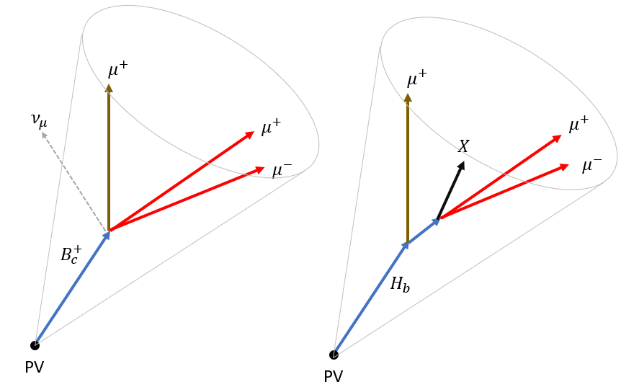
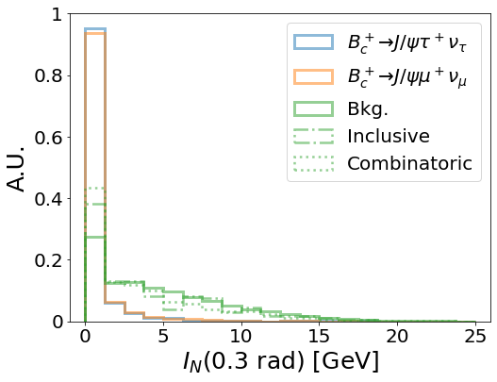
Discriminators for Background Separation
Isolation variable:
total energy, except the tagged final states, inside 0.3(0.6) rad of B cone
14

Slide 16
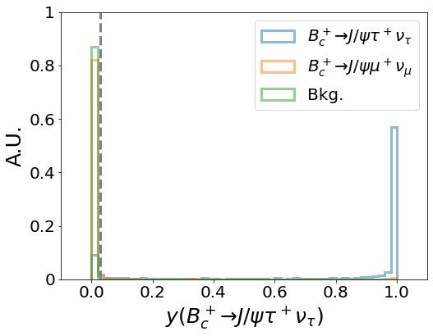
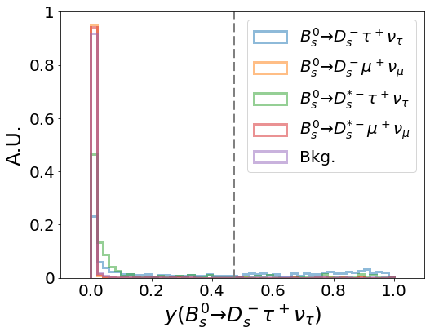
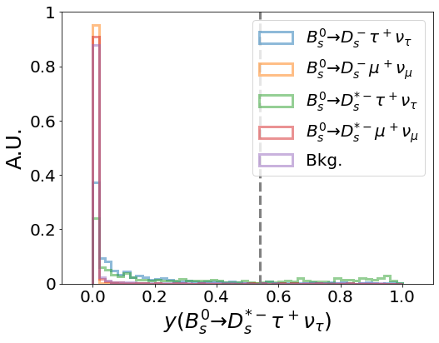
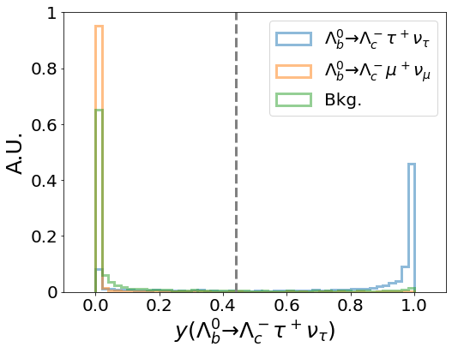
Stat. only BDT results
σ(R_{J/ψ})~4%
Suffered from small yield
$$\text{σ}\text{(}\text{R}\text{D}\text{s}\text{)\sim 0.}\text{4}\text{\%}$$
$$\text{σ}\text{(}\text{R}\text{Λ}\text{c}\text{)\sim 0.}\text{1}\text{\%}$$
σ(R_{Ds}∗)~0.3%
15

Slide 17
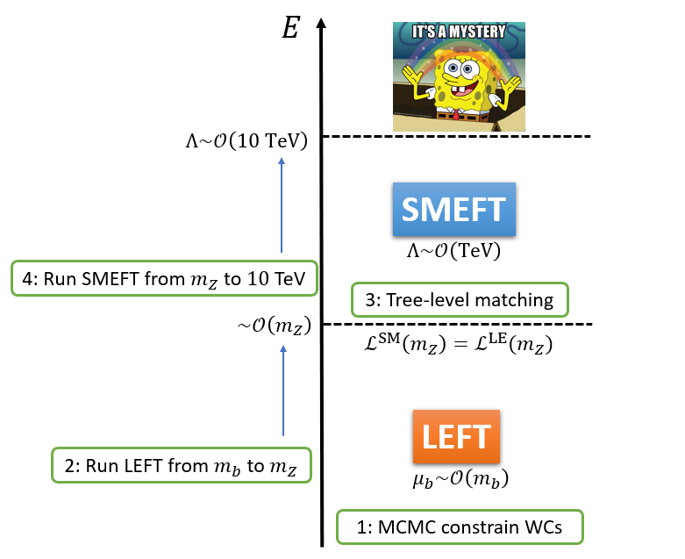
Theoretical
Workflow
[Grzadkowski et al. (2010)]
[Buras et al. (2015); Angelescu et al. (2018); Feruglio et al. (2018), Hu et al. (2019); Alasfar et al. (2020); Fajfer et al. (2021); Cornella et al. (2021)]
16

Slide 18
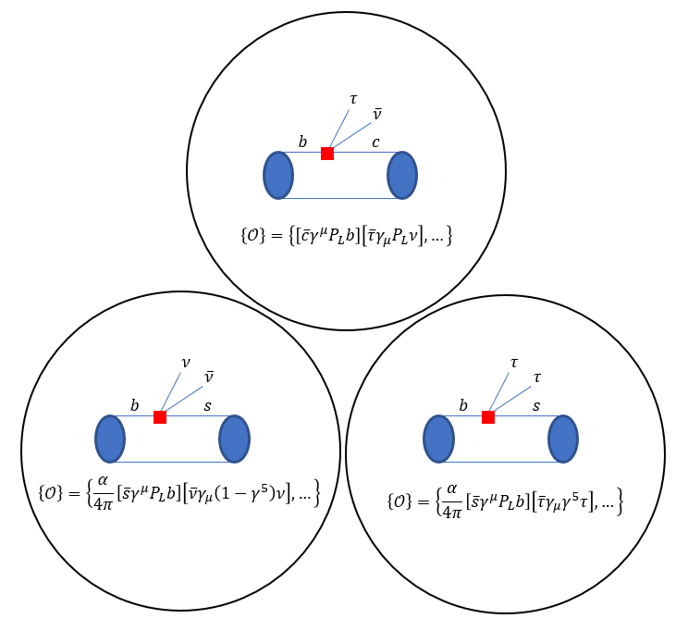
LEFT
At μ ∼ m_{b}
[Integrate out heavy SM fields (W , Z , h, t)]
No correlation
17

Slide 19
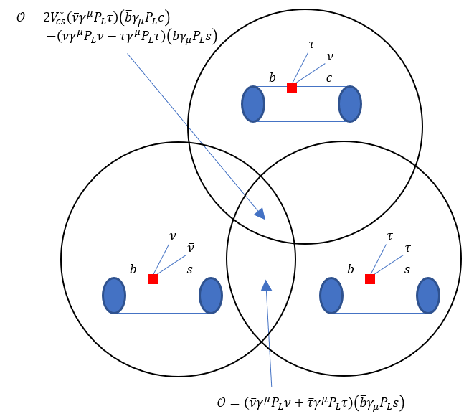
SMEFT
At Λ ~ multi-TeV
[All SM fields Under SM sym]
Correlated!!!
18

Slide 20
This Study
[Zheng et al. (2020); Kamenik et al. (2017); Capdevila et al. (2018); Li and Liu (2021); Buras et al. (2015); Li et al. (2022)]
19

Slide 21
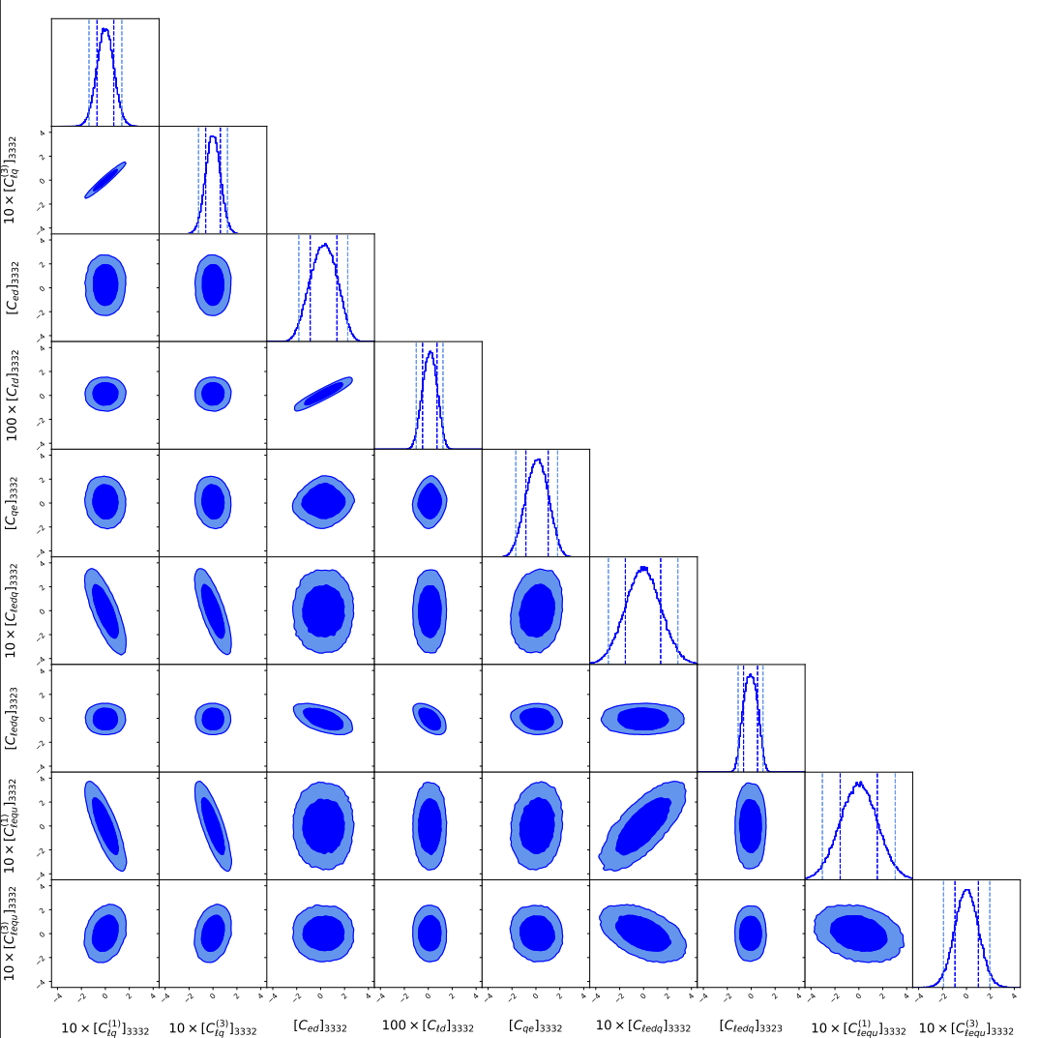
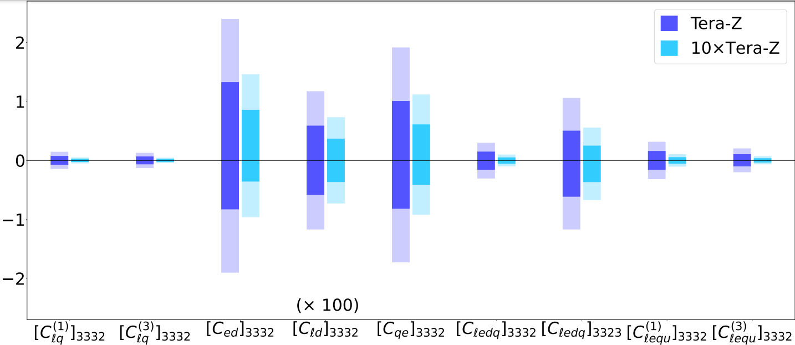
Wilson Coeff. Constraints
Constraint of NP up to multi-TeV when Wilson Coeff. are about O(1)
20

Slide 22
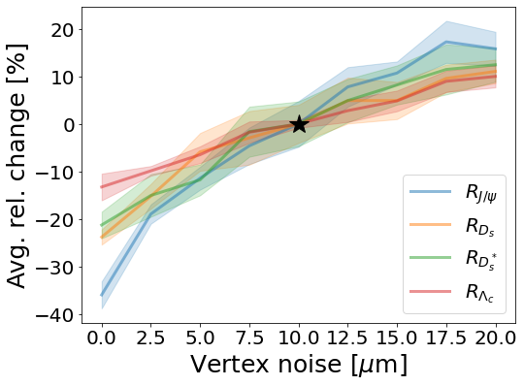
Detector Tracking Resolutions
Robustness: Vary vertex noise level (0, .., 10,…, 20 μm)
21

Slide 23
Conclusion
Z-pole can test Lepton Flavor Universality,
the secret behind generations, in a clean way!!!
Setting up a baseline of b → cτν for Z Factories
High precision in R_{J/ψ}, R_{Ds}, R_{Ds}∗, R_{Λc} : O(0.1%) − O(1%)
Abundant and energetic H_{b}
Clean environment
Known initial energy
EFT can prob NP up to 10TeV
Constraint of NP up to multi-TeV when Wilson Coeff. Are about O(1)
22

Slide 24
BACKUP

Slide 25
BACKUP

Slide 26
BACKUP

Slide 27
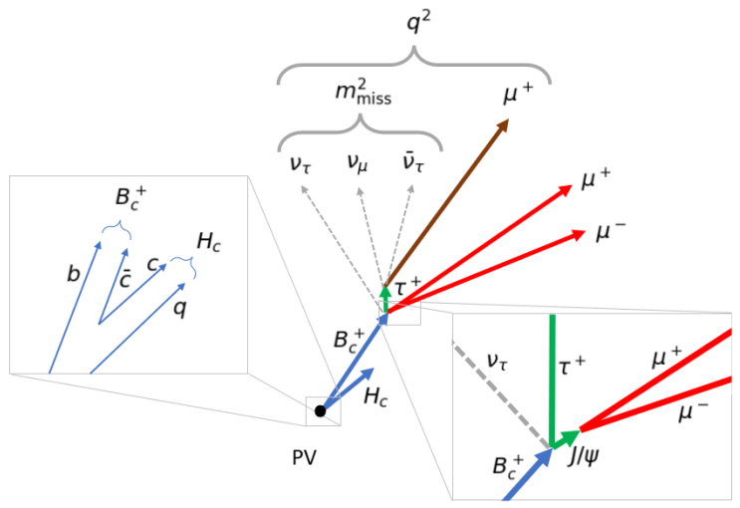
BACKUP

Slide 28
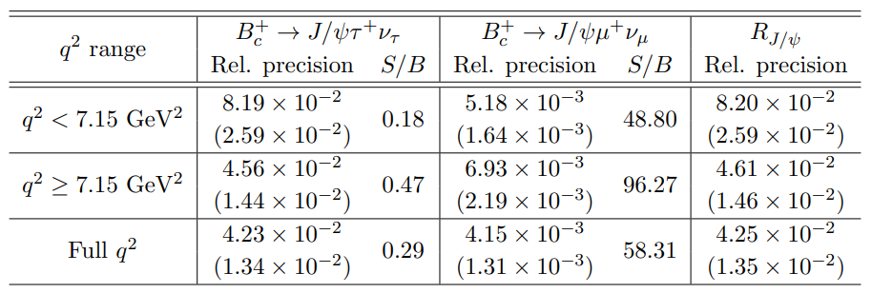
BACKUP

Slide 29
BACKUP

Slide 30
BACKUP

Slide 31
BACKUP

Slide 32
BACKUP

Slide 33
BACKUP

Slide 34
BACKUP

Slide 35
BACKUP

Slide 36
BACKUP

Slide 37
BACKUP

Slide 38
BACKUP

Slide 39
BACKUP

