Slide 1
High Energy Neutrinos and
Ultra-High-Energy Cosmic Ray Outburst from GRB 221009A
Haoning He （贺昊宁）
Purple Mountain Observatory
2023/07/05 Zhuhai

Slide 2
Outline
GRB as a candidate source for ultra-high energy cosmic rays
Neutrino messenger for studying GRB properties
Neutrinos and UHECRs from GRB 221009A

Slide 3
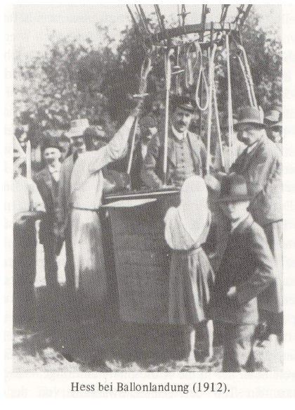
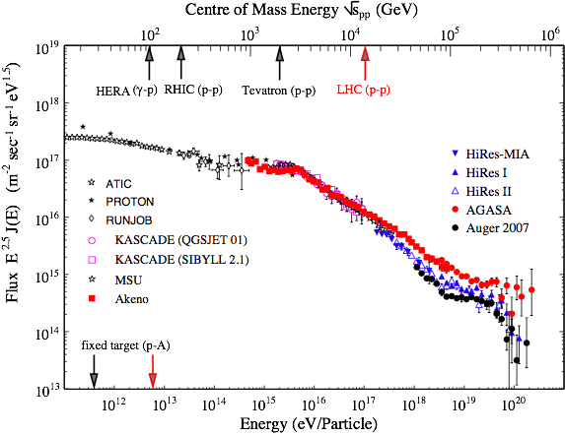
Origins of Cosmic rays
—— 111 years mystery
Knee
Ankle
Ultra-high energy cosmic rays: extragalactic origin

Slide 4
Accelerators of UHECRs
R_L<R → B*R>E/Zqv
Hillas Plot

Slide 5
CR acceleration in GRBs
Credit: P. Meszaros
Gamma-ray bursts are short-duration flashes of gamma-rays occurring at cosmological distances.
Internal shocks (Waxamn 1995)
External shocks (Vietri 1995)

Slide 6


Neutrino production in GRBs
Conditions:
1. protons acceleration
2. targets: photons or matter
Delta Resonance Approximation:

Slide 7
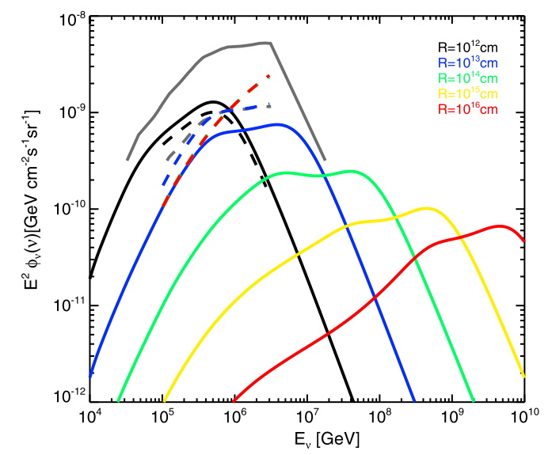
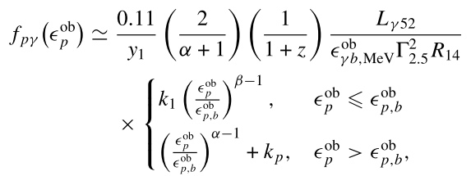
General dissipation scenario
——constrain the dissipation radius and the baryon loading factor
The fraction of proton energy converted into pions:
The baryon loading factor E_{p}/E_{γ} = 10
He H.N. et al. (2012) ApJ 752:29

Slide 8
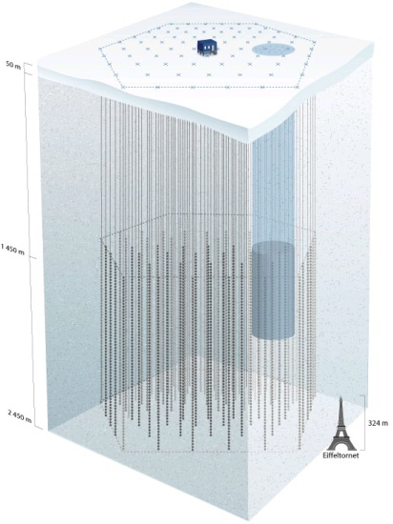
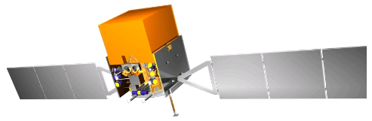
Search for GRB neutrinos by IceCube
Coincidence!
IceCube
Good information on timing and direction——> background reduction
No evidence of correlation between neutrino events and GRBs was found.
Prompt neutrino emission from GRBs is limited to <=1% of the observed diffuse neutrino flux.
The IceCube Collaboration (2022)
Possible Contributions from other GRB populations:
Untriggered GRBs (Liu & Wang 2013)
Low-luminosity GRBs (Murase & Nagataki 2006, Liu, Wang, Dai 2011)
Pop III GRBs (Gao & Meszaros 12)

Slide 9
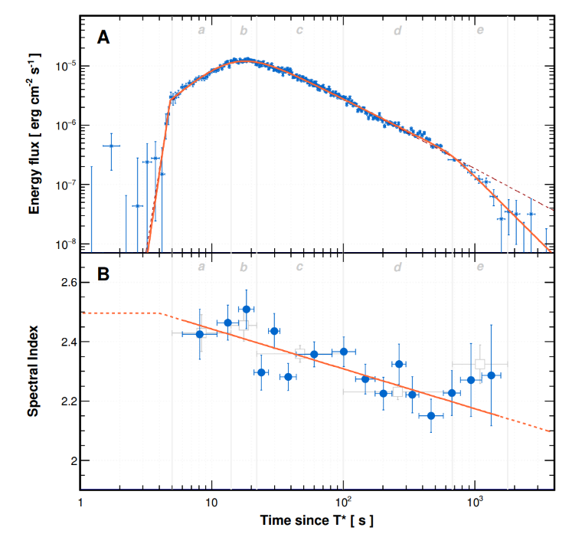
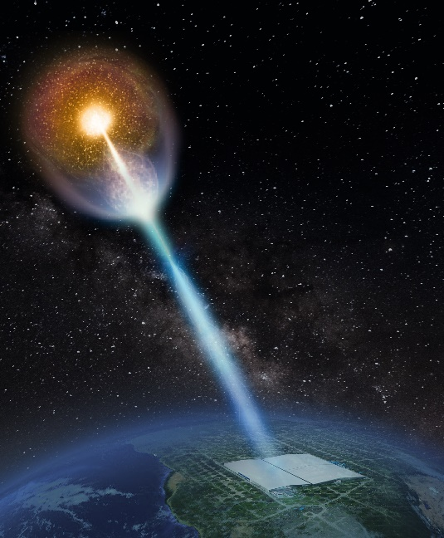
GRB 221009A
GRB 221009A was detected as the B.O.A.T. (“brightest of all time”) GRB with photons of energy up to >10 TeV, locating at z=0.151 (745 Mpc).
LHAASO reported the detection of the very high energy photon with energy up to ∼ 18 TeV from the GRB within ∼ 2000 s after the trigger (Huang et al. 2022).
The open angle of the jet is 0.8 degree, and the core of the jet is pointing to Earth (LHAASO collaboration 2023).
The features of the host galaxy is consistent with those of typical long GRB host galaxy at low redshift (Levan et al. 2023; Malesani et al. 2023).
LHAASO collaboration (2023)

Slide 10
Possible explanations on the high energy photon detection
The existence of axion-like-particles and two-photon coupling or the Lorentz-invariance violation (Galanti et al. 2022; Baktash et al. 2022; Troitsky 2022; Dzhappuev et al. 2022; Li & Ma 2023; Finke & Razzaque 2023)
Electromagnetic (EM) cascade initiated by UHECRs propagating in the inter-galactic spcae(Mirabal 2023; Das & Razzaque 2023; Alves Batista 2022).
EM cascade initiated by the photomeson production process of high energy protons or by the SSC photons from electrons in the burst (Wang et al. 2023).

Slide 11
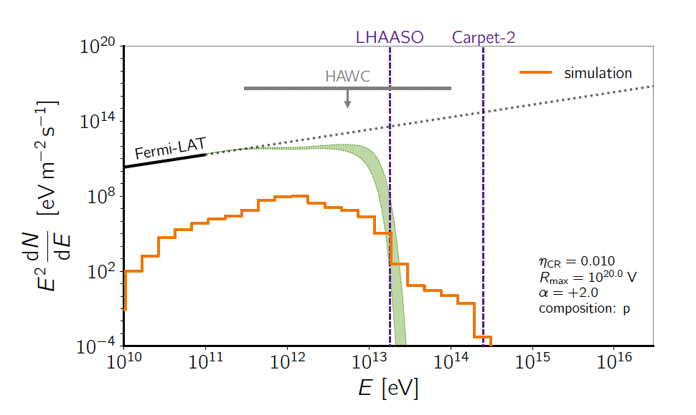
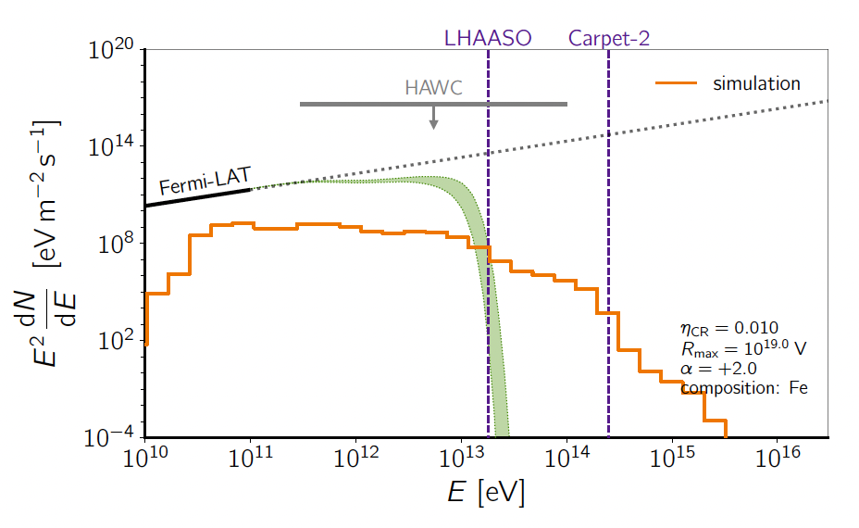
Cosmogenic Photons
Das & Rezzaque 2023
Rafael Alves Batista 2023
Heavier Nuclei Composition might lead to photons with energy extended to higher energy.

Slide 12
UHECRs from GRBs
In the host galaxy
In the Milky Way
The deflection/delay
by the Magnetic field
Propagation in the IGMF
The deflection/delay
by the GMF
Deflection/delay
due to the IGMF
In the GRB
Earth
Acceleration
/Production
Energy loss
Escape
Energy loss
due to
Photomeson interaction
/Pair Production
IGMF: Inter-galactic Magnetic Field
GMF: Galactic Magnetic Field

Slide 13
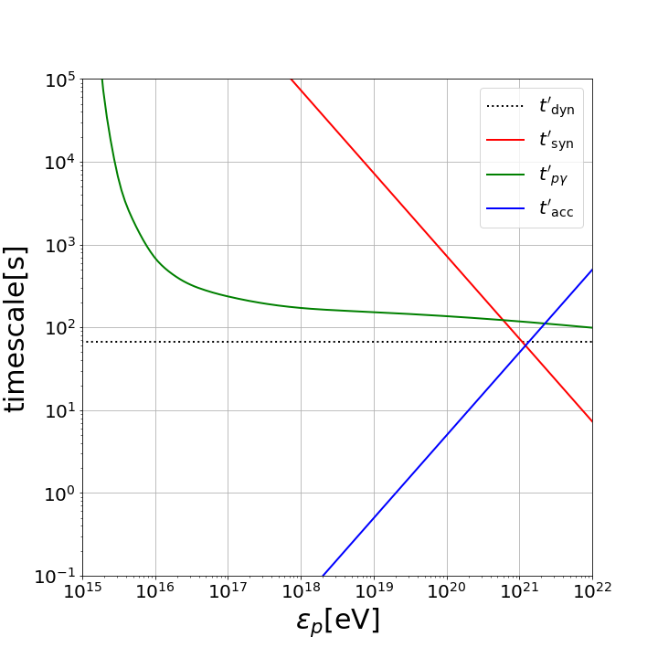
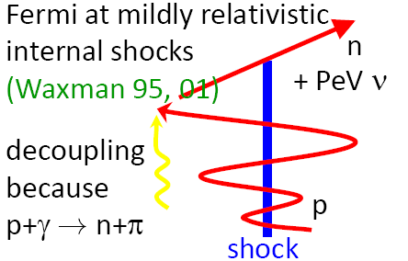
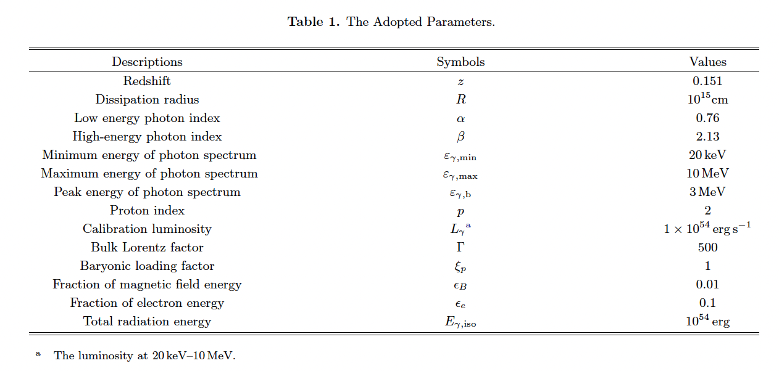

Proton Acceleration and Energy Loss in the GRB

Slide 14
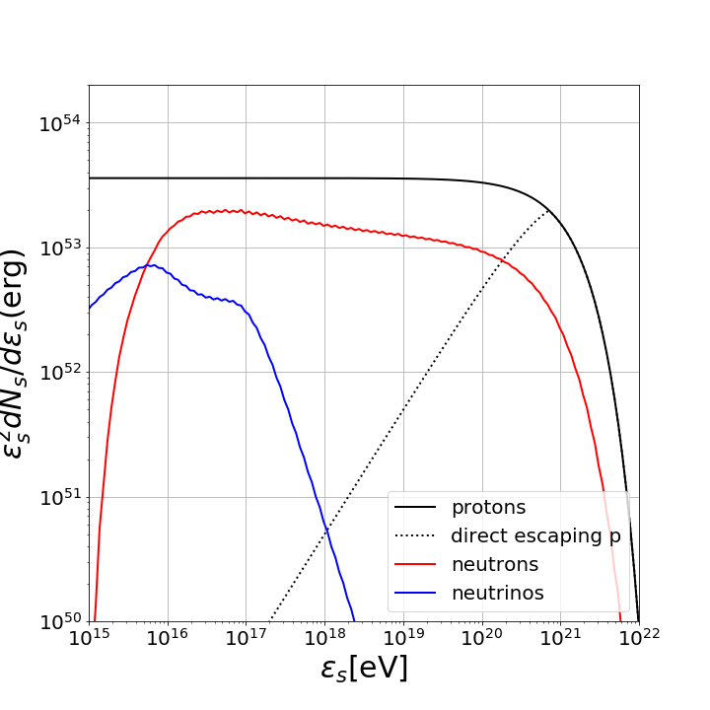
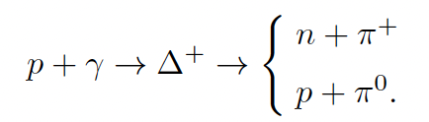



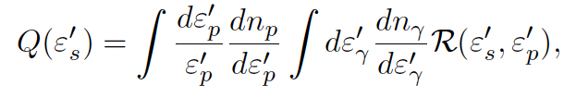
Neutron and Neutrino Production in the GRB
Adopting SOPHIA numerical code.

Slide 15
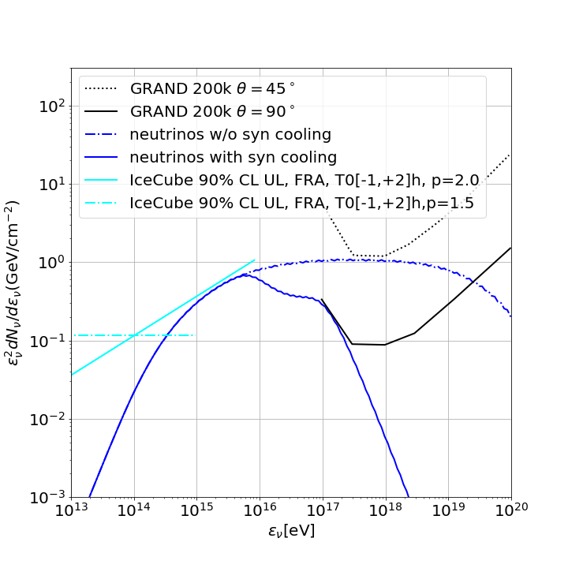
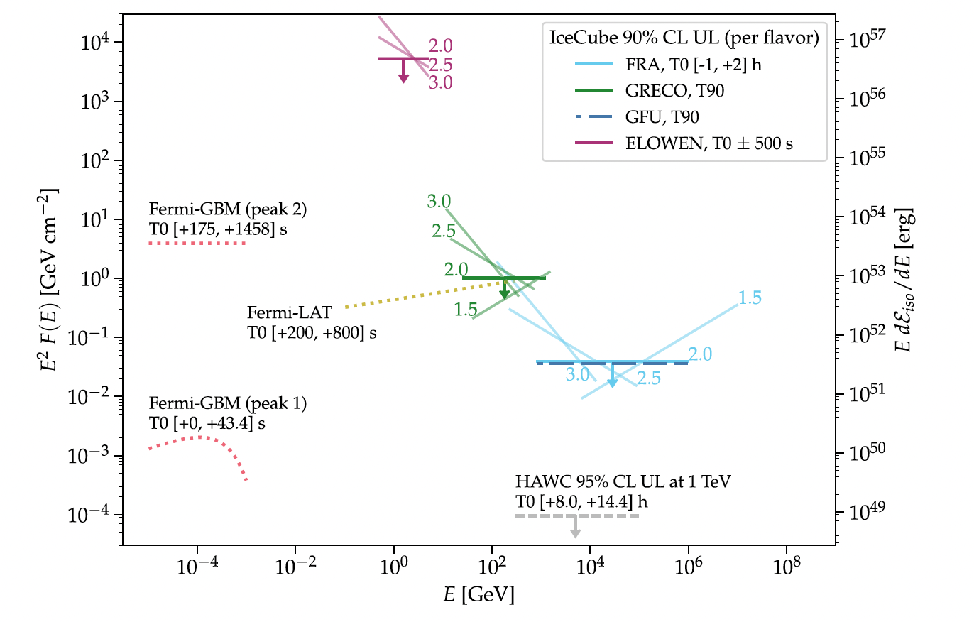
Neutrinos from GRB 221009A
synchrotron cooling
of muons and pions
IceCube upper limit on neutrinos
from GRB 221009A
The IceCube collaboration (2023)

Slide 16
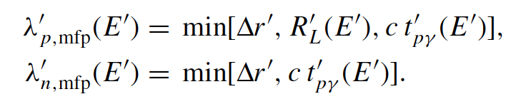
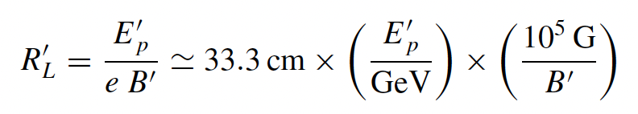
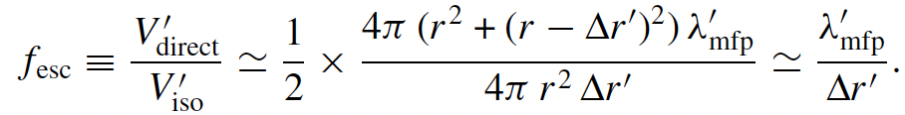
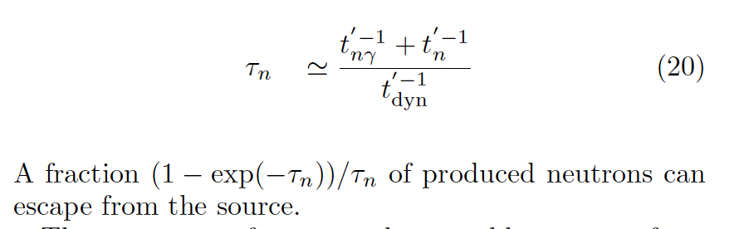
CRs Escape from the GRB
Proton Direct Escape：
The length of the mean free path:
The fraction of escape particles:
Neutron Escape：
Neutronsphere:
The remaining neutrons will escape at a certain radius
where the target photon density is low enough, since photon density drops as r^-3. (Barewald et al. 2013)

Slide 17
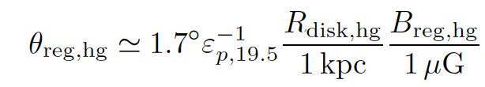
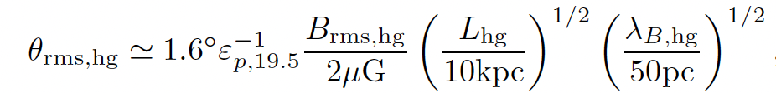
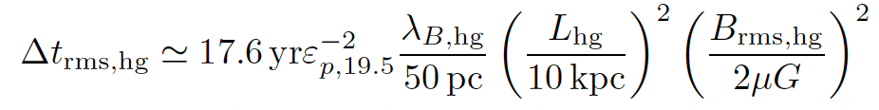


Escape from the Host Galaxy
Only protons with energy larger than 100 EeV are still pointing to Earth, after escape from the host galaxy.
Neutrons with energy larger than 10 EeV can escape from the host galaxy with no deflection and delay, before beta-decay.
Hereafter, we study the propagation of protons with energy larger than 100 EeV, and neutron-induced protons in the IGMF.

Slide 18
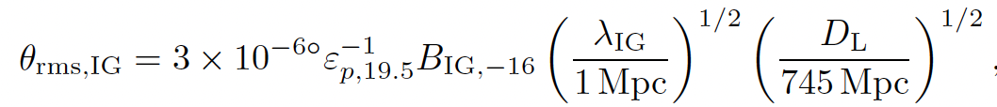
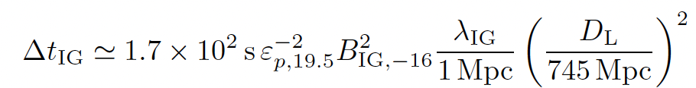
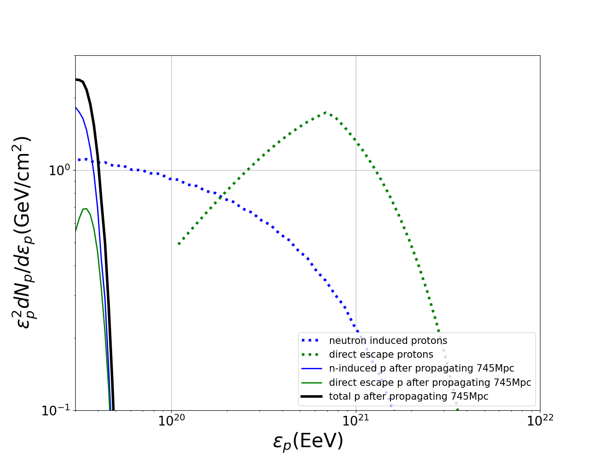
Proton Propagation in the IGMF
Deflection:
Energy Loss:
Energy Loss
The deflection is small, while the energy loss is considerable, calculated via CRpropa.

Slide 19
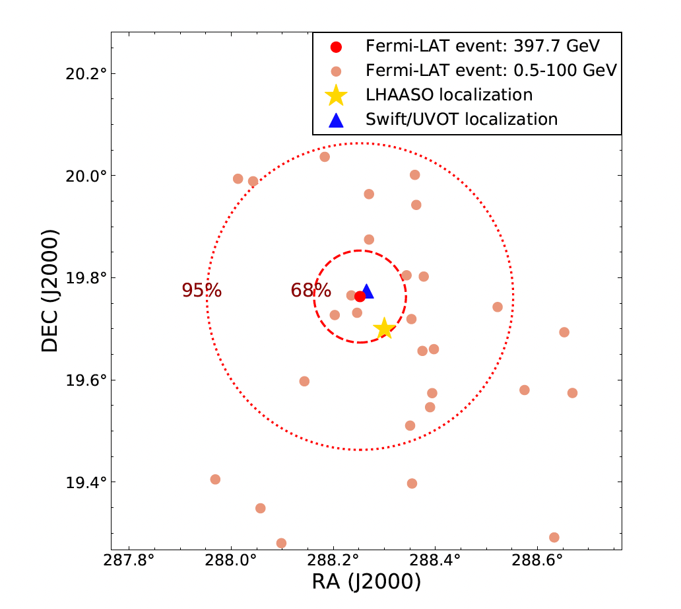
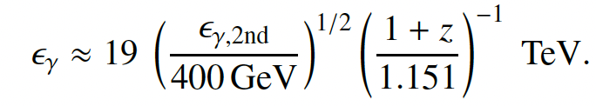
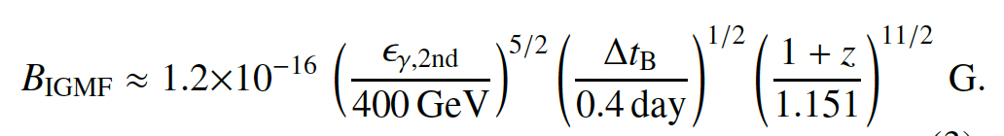
The Constraint on the Inter-galactic Magnetic Field (IGMF)
At 33554 s after the Fermi-GBM trigger,
there came a gamma ray with an energy of 400 GeV.
Xia et al. 2023

Slide 20
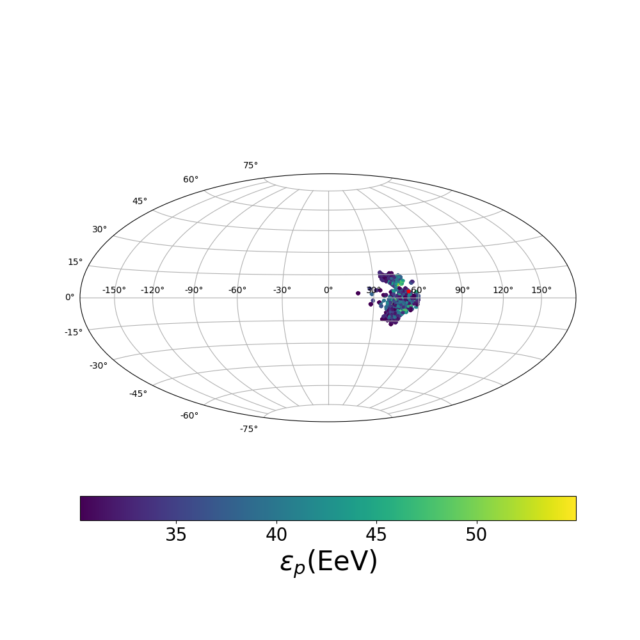
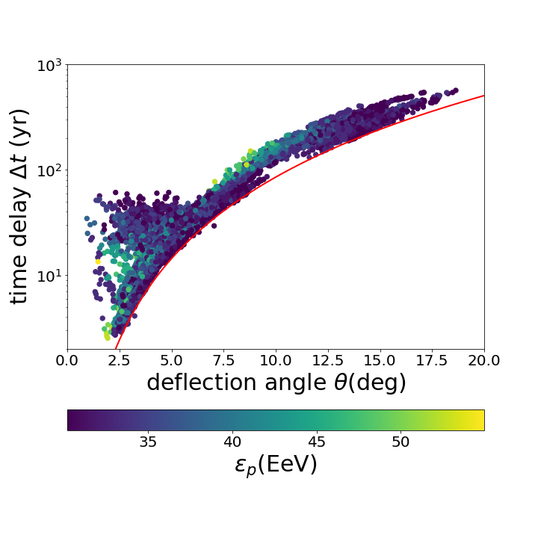
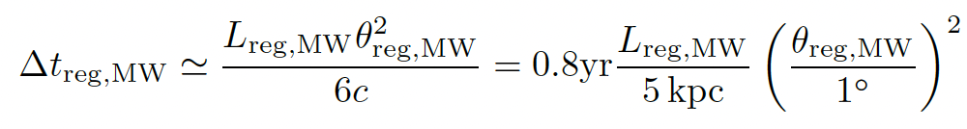
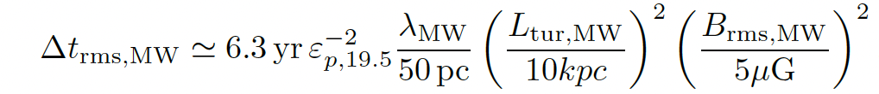
UHECRs Propagation in the Milky Way
The Lensed Map
Calculated via CRpropa, Jansson &Farrar (2012) GMF model

Slide 21
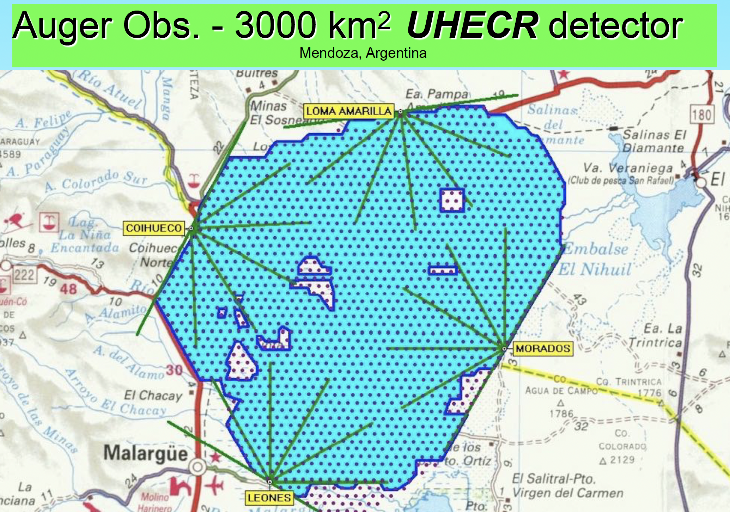
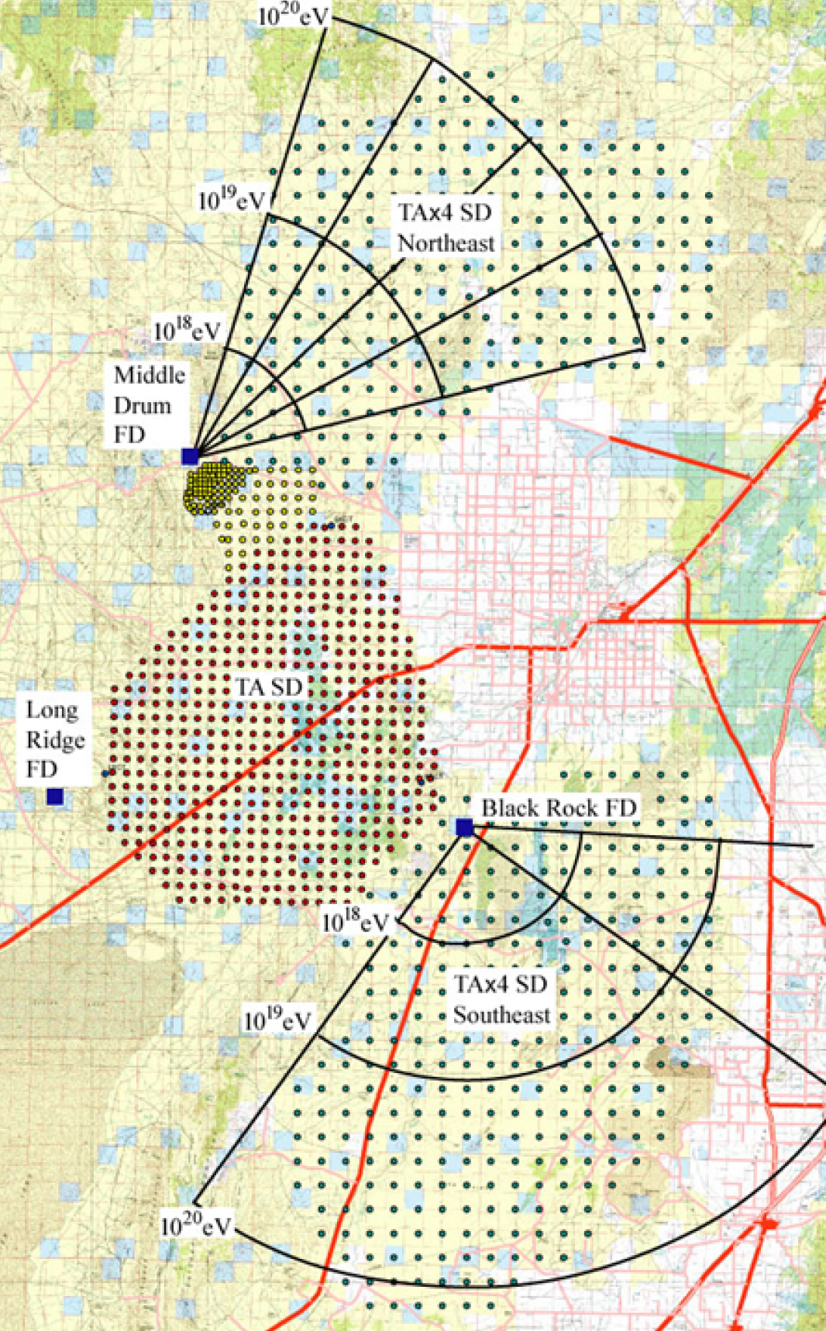
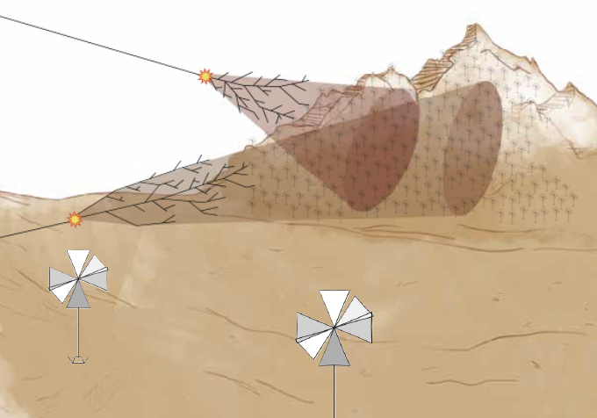
Can those Telescopes observe UHECRs multiplets from the GRB?
GRAND
Telescope Array*4
200,000 km^2

Slide 22
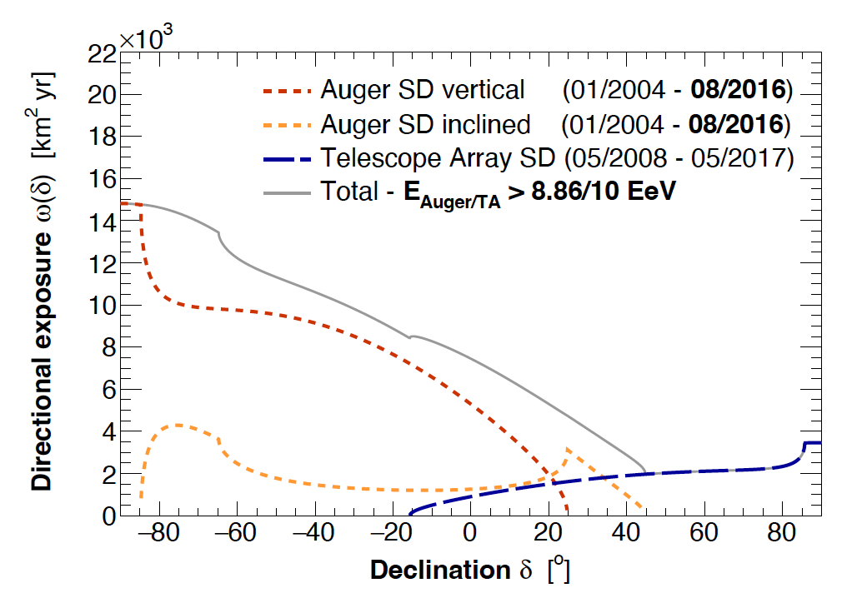
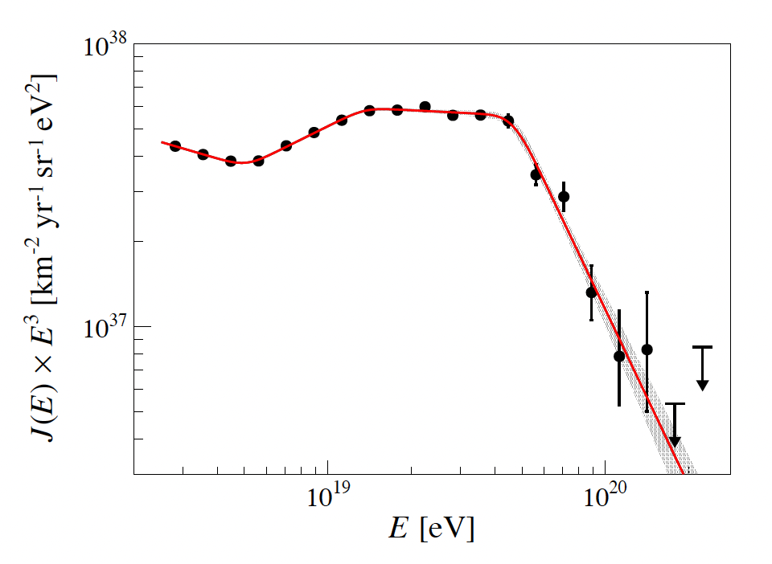
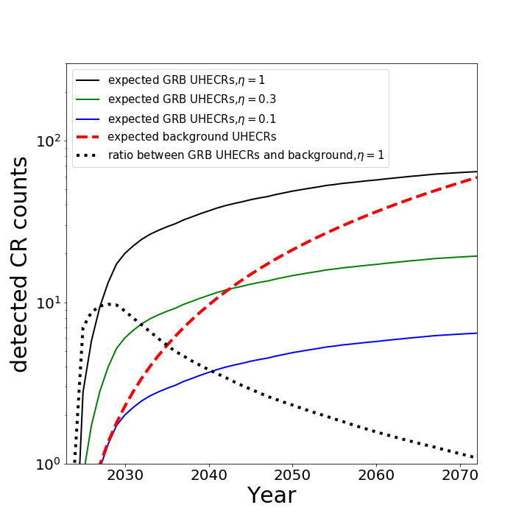
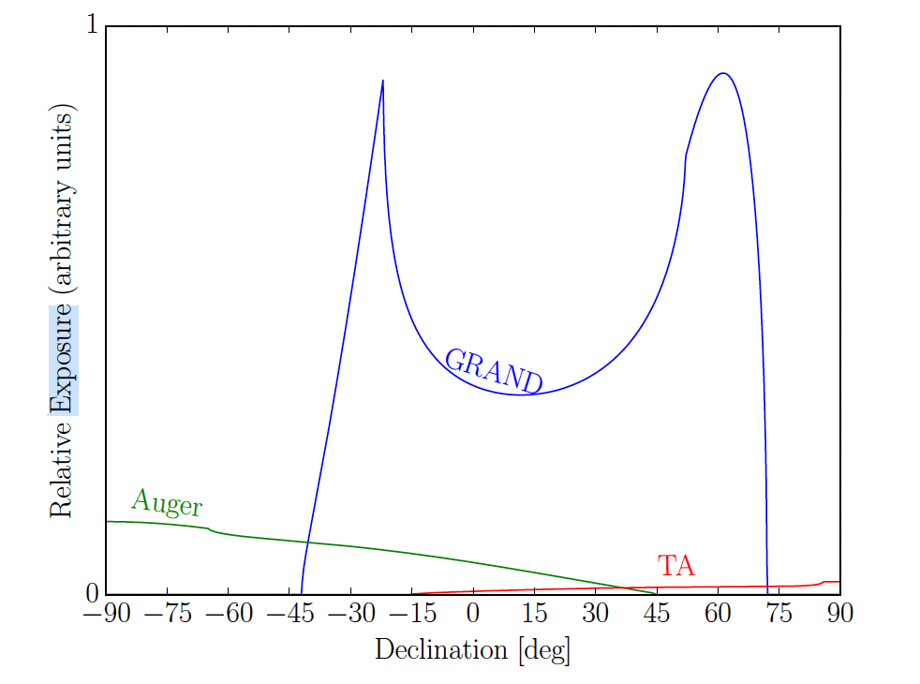
Expected UHECRs from GRB 221009A
(RA = 288.3, Dec = 19.7)
Spectrum of the isotropic UHECRs
detected by Auger
Exposure
Exposure
Expected UHECR counts
by Auger

Slide 23
A Rough Estimation on the Detection Rate of UHECRs
 | Annual Exposure( km^2 yr) | Angular Resolution (deg) | N_bg (30-50EeV, theta<3deg) by 2026 | N_sn (30-50EeV, theta<3deg) by 2026 | N_bg (30-50EeV, theta<3.6deg) by 2028 | N_sn (30-50EeV, theta<3.6deg) by 2028
TA | 167 | 1 | 0.23 | 0.92 | 0.46 | 3.2
TAX4 | 667 | 2.2 | 0.93 | 3.7 | 1.8 | 12.8
Auger | 437 | 0.5 | 0.61 | 2.4 | 1.2 | 8.35
Uncertainties:
The magnetic deflection effect
The baryon loading factor: eta=1
The composition of UHECRs: protons

Slide 24
Conclusions & Discussions
Only protons at the high energy end can escape from the burst and the host galaxy with a small deflection angle and delay time.
Neutrons can escape from the burst and the host galaxy easily.
Auger and TAX4 can constrain the model soon in the future few years.
The signal to background ratio peaks around 2028.
GRAND is a good detector on UHECR burst from GRB 221009A as long as the construction is completed in 2030s. Monte Carlo Bayesian method presented in (He et al. 2016, PRD 93, 043011) can be used to study the distribution of the observed UHECRs, and further check the correlation between UHECRs and the GRB.
There are uncertainties on the magnetic field, the baryon loading factor and the composition of UHECRs. Here we assume the composition of UHECRs as pure proton.
Thank you!

Slide 25
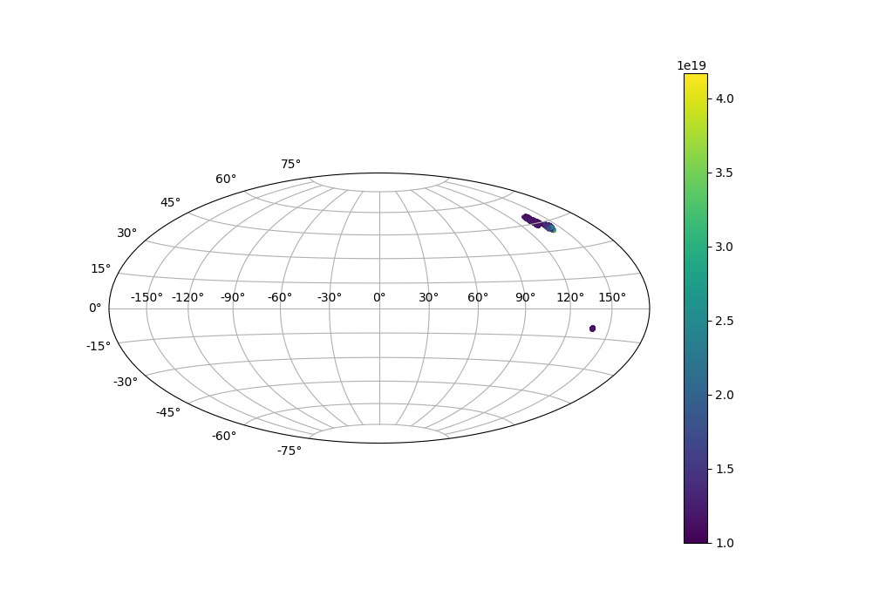
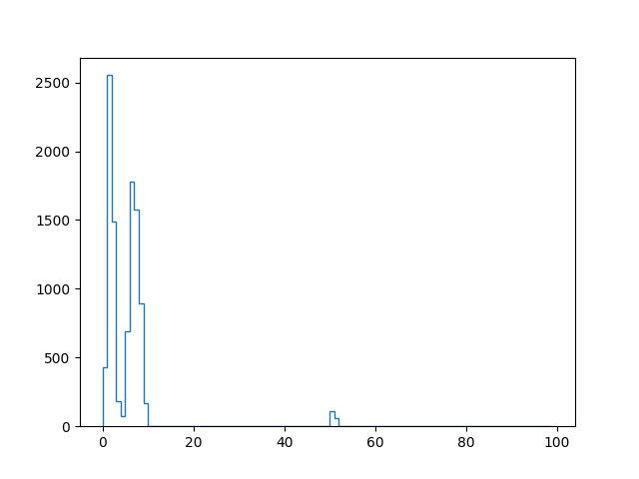
If we put the GRB in another direction
The Deflection Distribution
The Lensed Map
The UHECRs is less deflected and more protons arrive within 1 degree.
The Magnetic Selected Structure will help us to distinguish the UHECR multiplets.

Slide 26
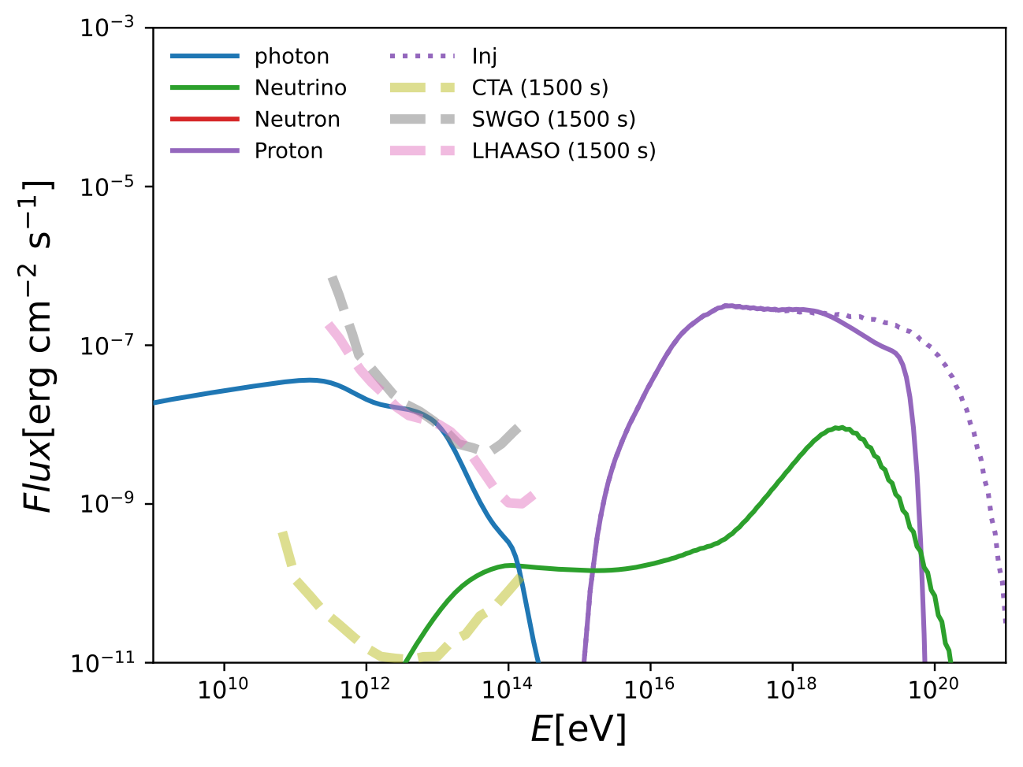
Cosmogenic Photons
Baryon Loading factor=0.1
We simulate the propagation of protons and photons in the Inter-galactic field.
Here we ignored the effect of the IGMF.
More details need to be checked.
Cosmogenic photons from such a bright GRB might be observed LHAASO, SWGO and CTA.

Slide 27
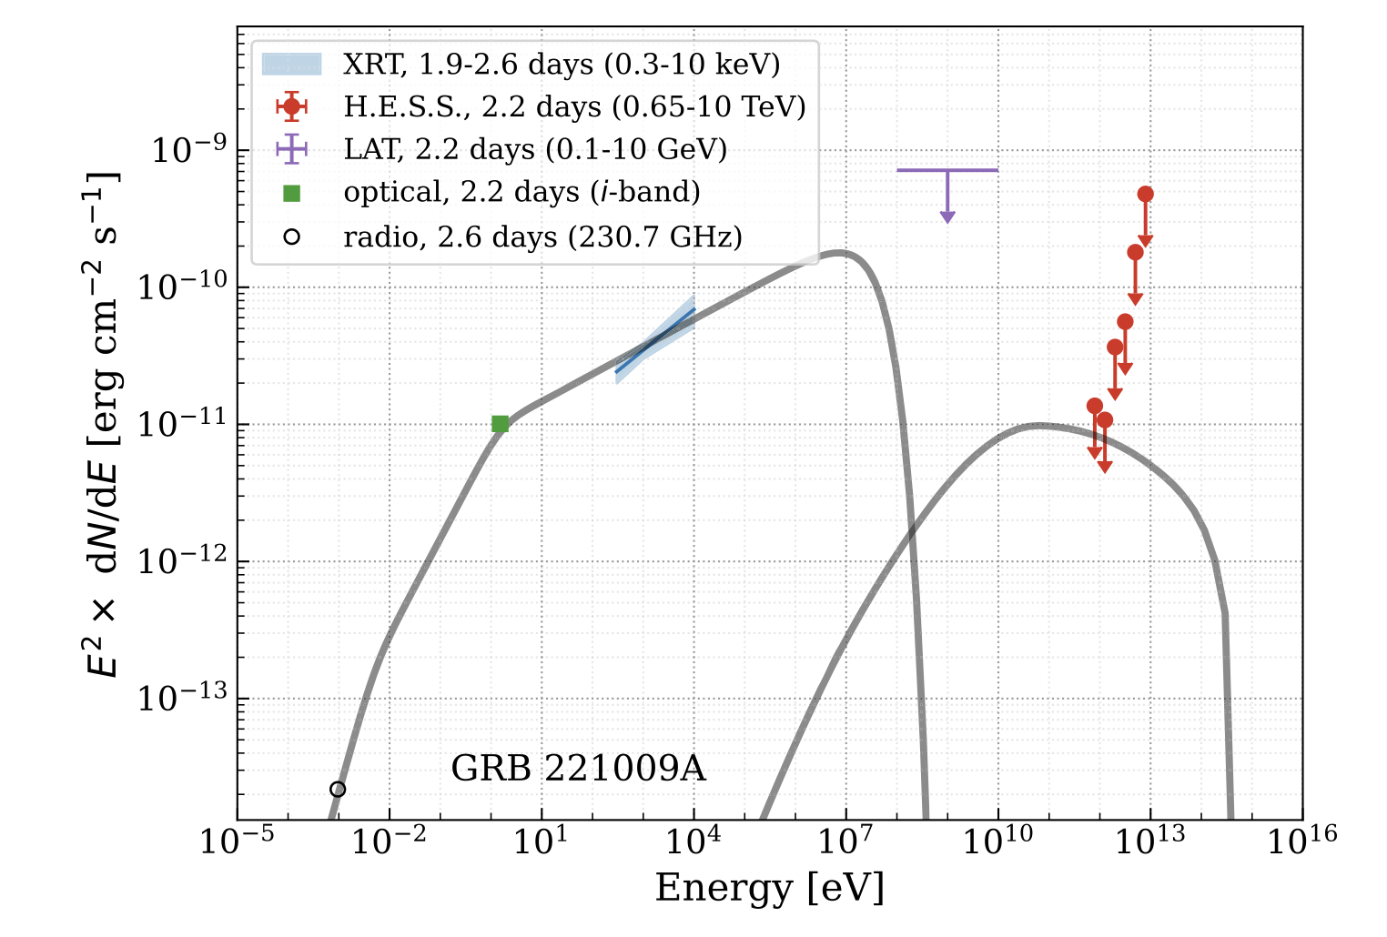

Slide 28
/**
@class PlanckJF12bField
@brief PlanckJF12bField: the JF12 galactic magnetic field model with corrections
suggested by the Planck Collaboration
See: Planck Collaboration, "Planck intermediate results. XLII.
Large-scale Galactic magnetic fields", A&A 596 (2016) A103;
arXiv:1601.00546

