Slide 1

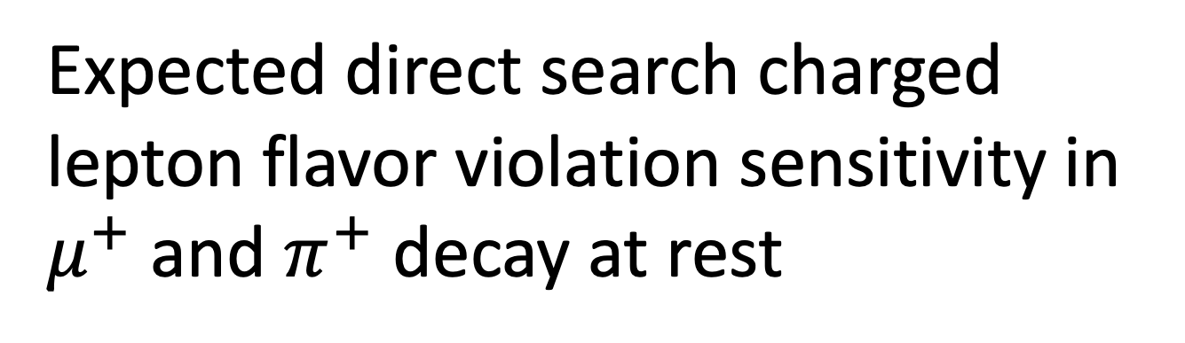
Expected direct search charged lepton flavor violation sensitivity in $μ^{+}$ and $π^{+}$ decay at rest
WIN2023 Flavor, Shihua Huang

Slide 2
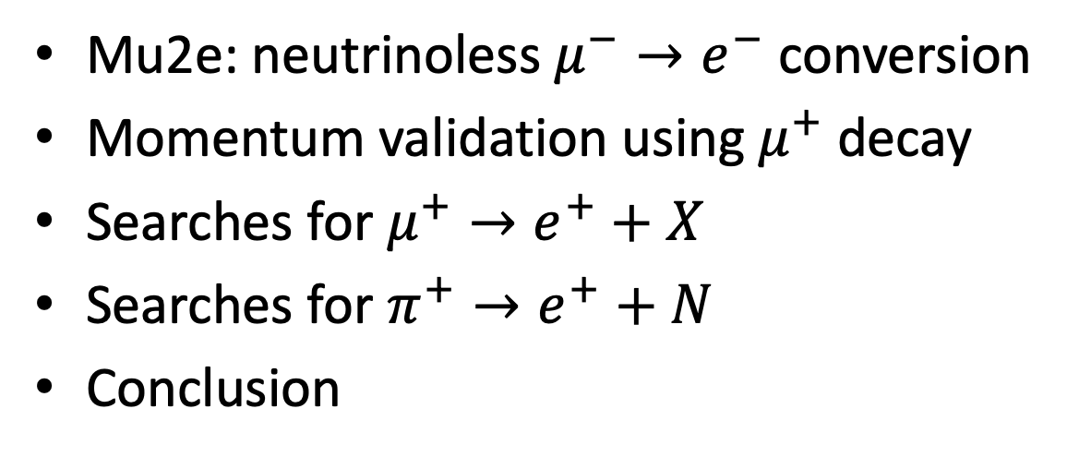
Contents
Mu2e: neutrinoless $μ^{−}→e^{−}$ conversion
Momentum validation using $μ^{+}$decay
Searches for $μ^{+}→e^{+}+X$
Searches for $π^{+}→e^{+}+N$
Conclusion

Slide 3
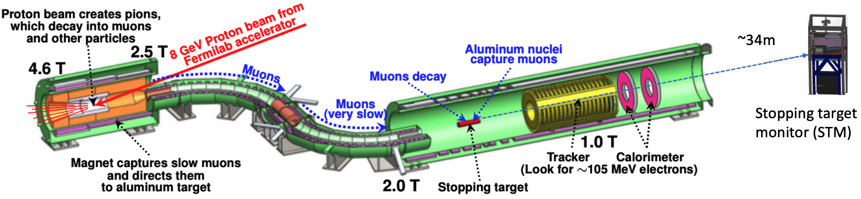
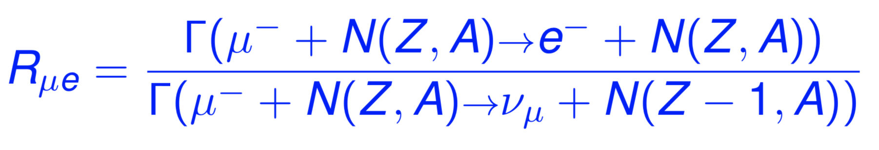
Mu2e Experiment at Fermilab
Measure Charged Lepton Flavor Violation with 2.5 x10⁻¹⁷ S.E.S
  The Mu2e experiment will search for μ → e conversion in aluminum with an expected upper limit in the absence of a signal of 8 × 10⁻¹⁷ (90% CL), 10,000× improved upon the SINDRUM II limit at 7 x 10⁻¹³
7/7/23

Slide 4
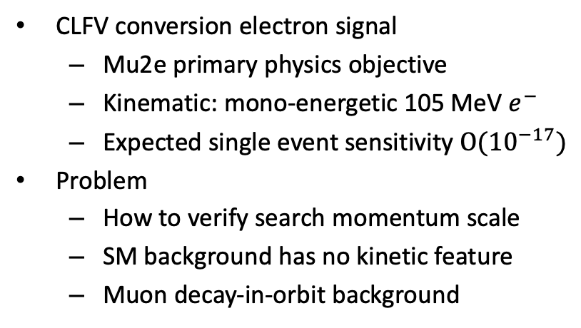

Mu2e: neutrinoless $μ^{−}→e^{−}$ conversion
CLFV conversion electron signal
  Mu2e primary physics objective
  Kinematic: mono-energetic 105 MeV $e^{−}$
  Expected single event sensitivity $Ο({10}^{−17})$
Problem
  How to verify search momentum scale
  SM background has no kinetic feature
  Muon decay-in-orbit background

Slide 5
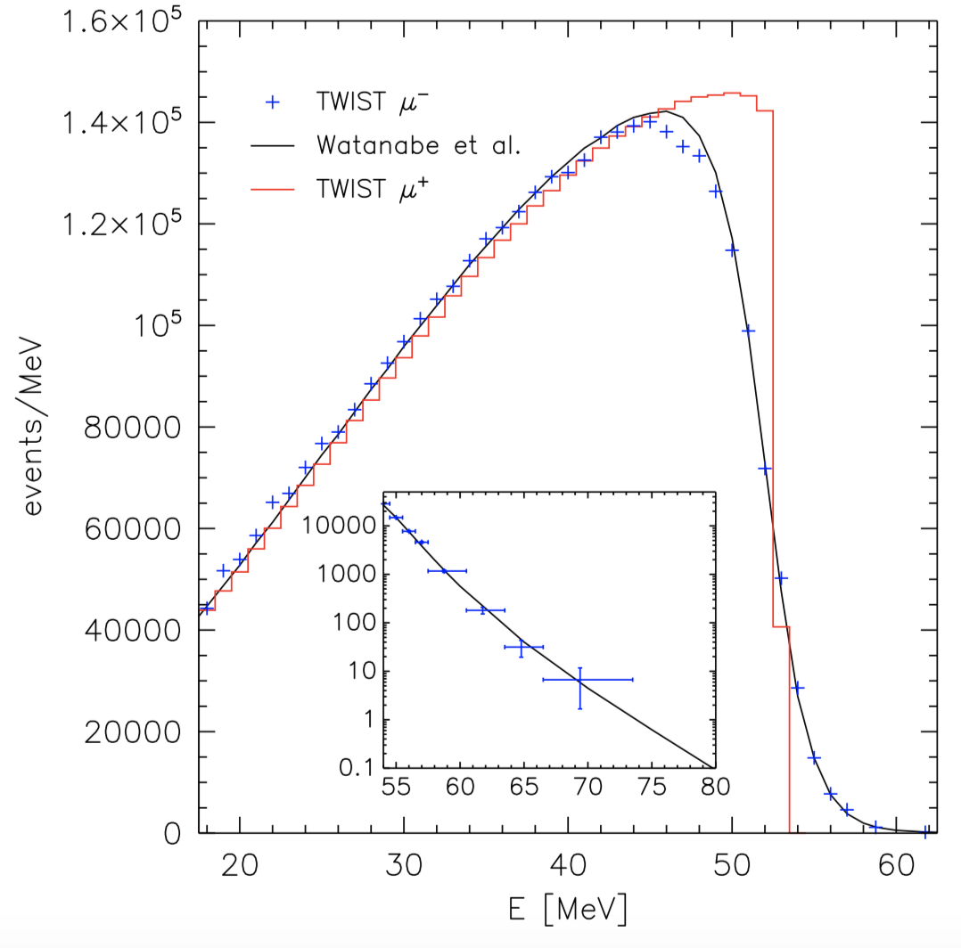
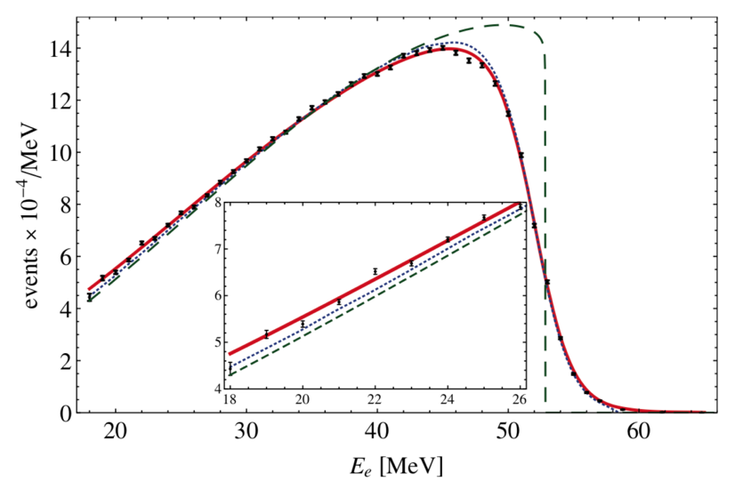




Momentum validation using $μ^{+}$decay
Advantages
TWIST result^{2,3}
  Michel $e^{+}$ have analogous kinematics and similar tracking features when viewed with 50% B-field
  Unlike $μ^{−}$, no complicate bound state interaction
  Known to O($α^{3}$) QED and NNLO hadronic effects¹
  53MeV Michel edge – clear momentum signature
$μ^{+}$; Known to
O($α^{3}$) precision
$μ^{−}$ DIO, bound state effects⁴

Slide 6
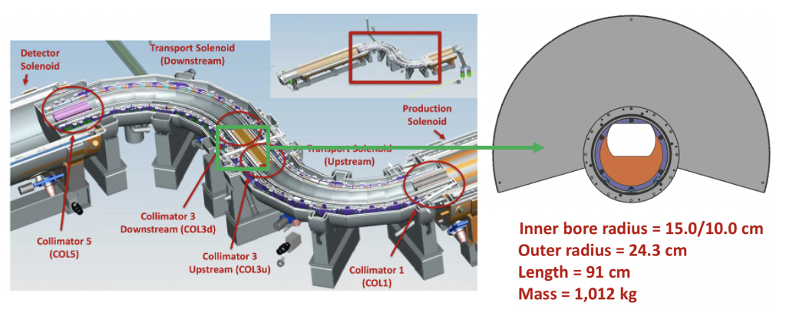
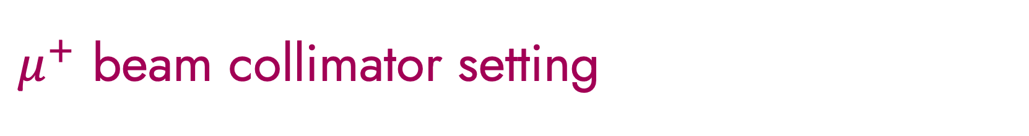
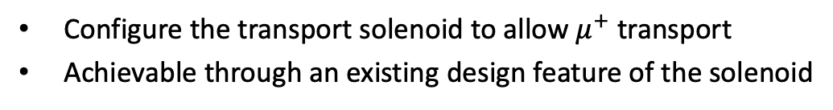
$μ^{+}$ beam collimator setting
Configure the transport solenoid to allow $μ^{+}$ transport
Achievable through an existing design feature of the solenoid

Slide 7
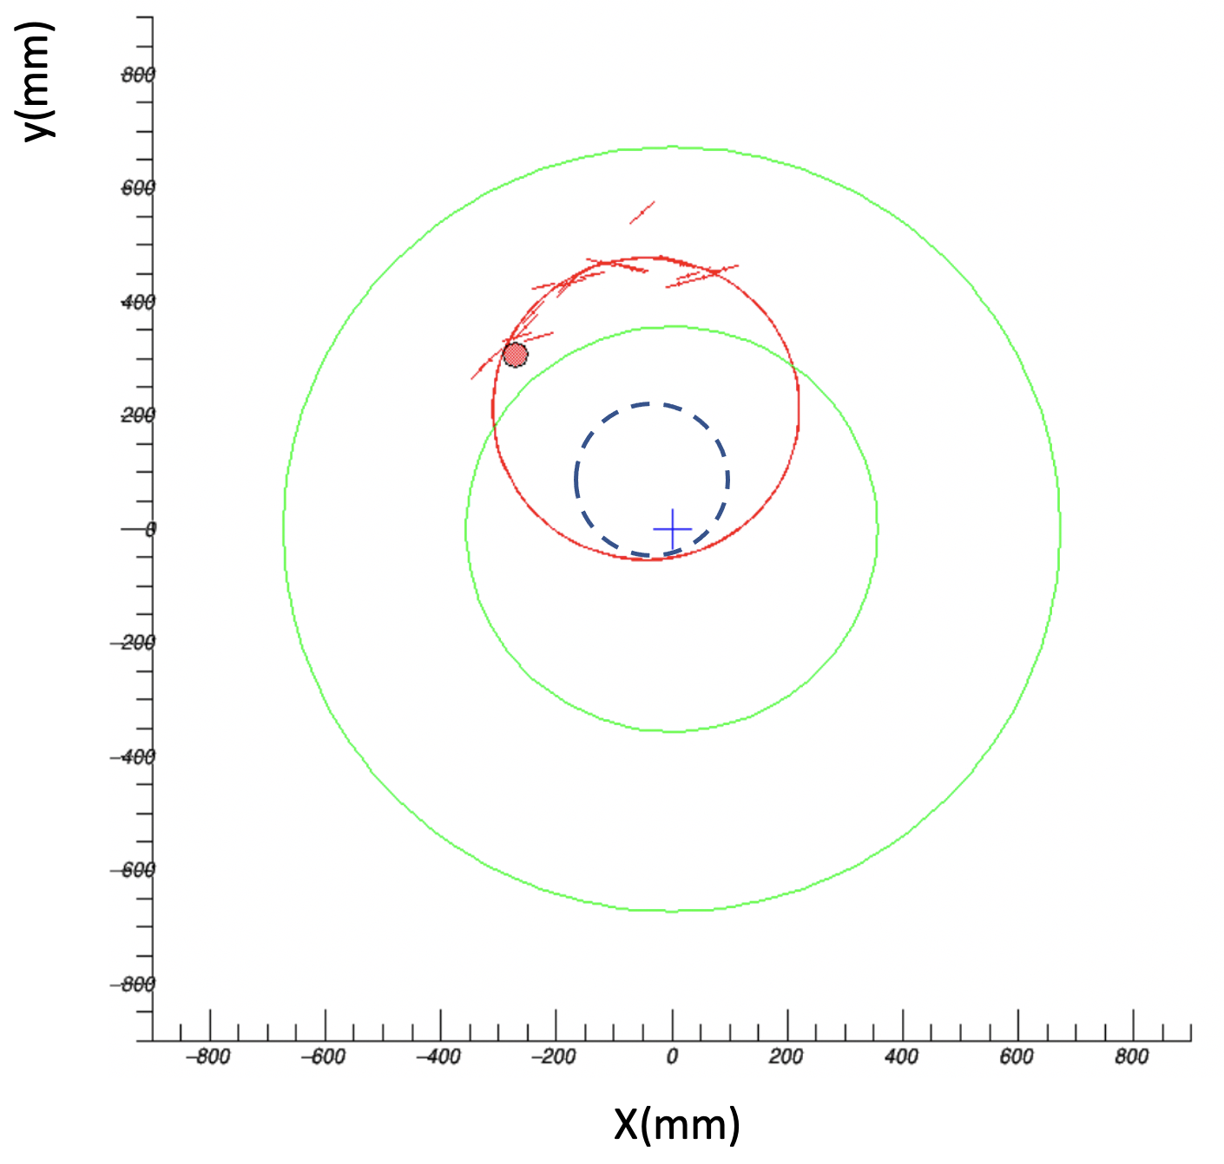
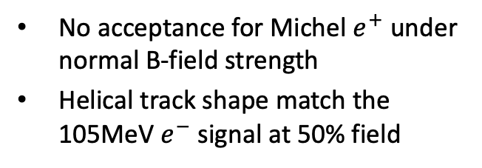
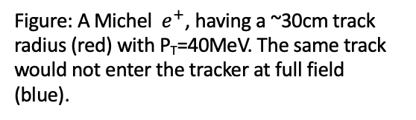
Reduced magnetic field
No acceptance for Michel $e^{+}$ under normal B-field strength
Helical track shape match the 105MeV $e^{−}$ signal at 50% field
Figure: A Michel$e^{+}$, having a ~30cm track radius (red) with P_{T}=40MeV. The same track would not enter the tracker at full field (blue).

Slide 8
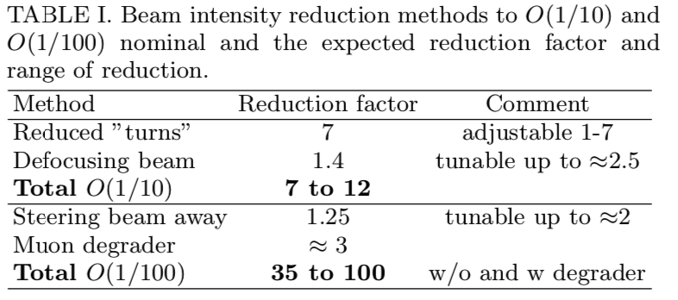
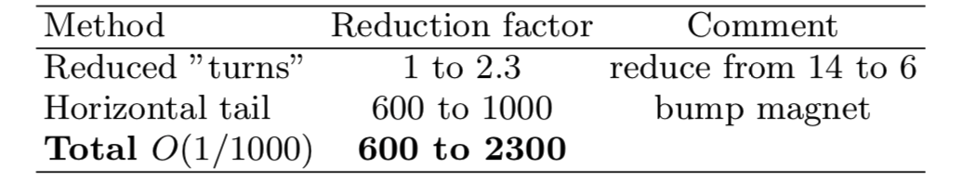
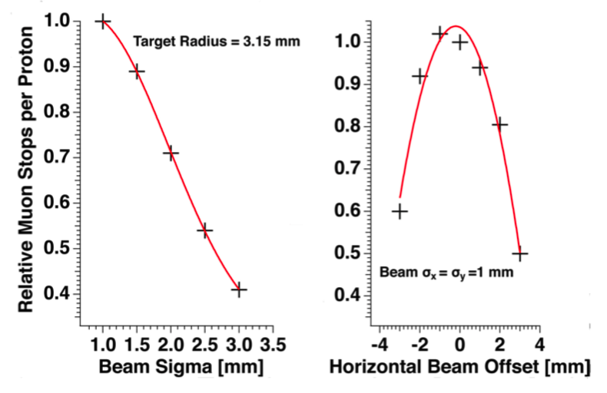
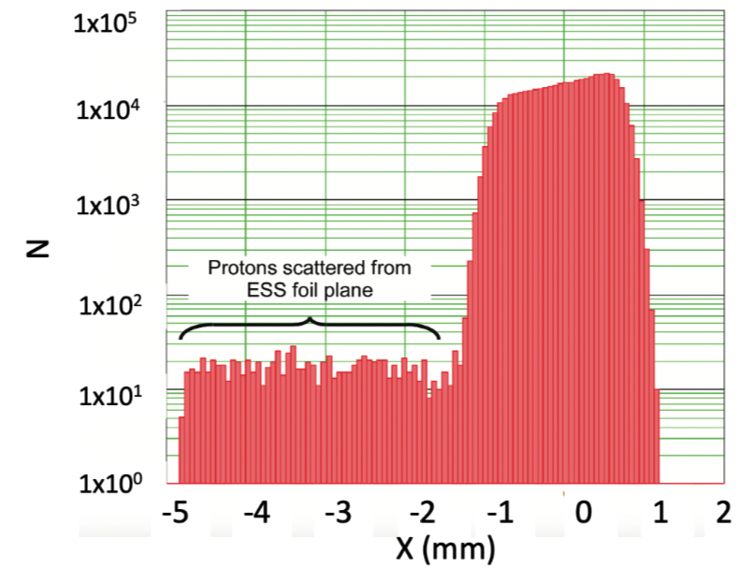

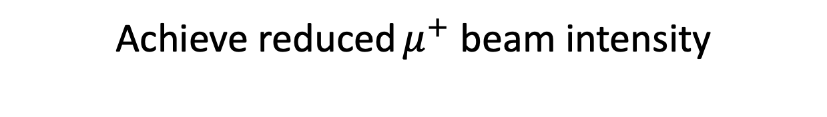
Achieve reduced $μ^{+}$ beam intensity

Slide 9
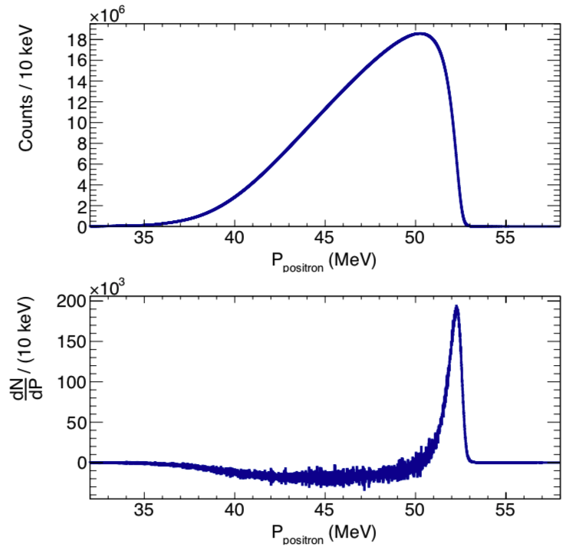
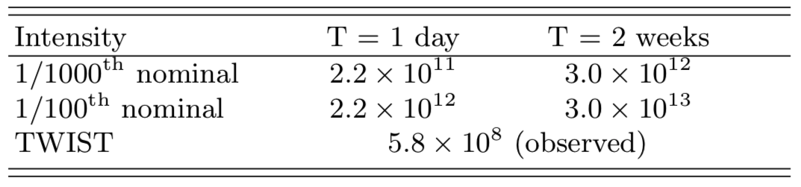
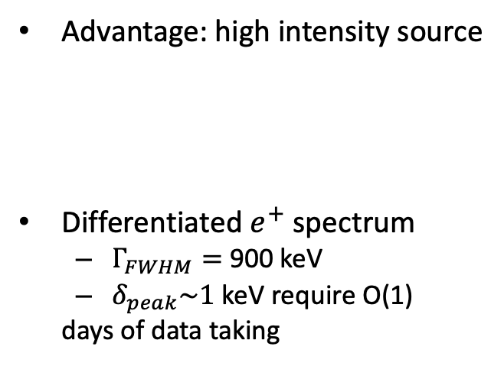
Momentum scale validation
Advantage: high intensity source
Differentiated $e^{+}$ spectrum
  $Γ_{FWHM}=$ 900 keV
  $δ_{peak}\sim 1$ keV require O(1)
  days of data taking

Slide 10
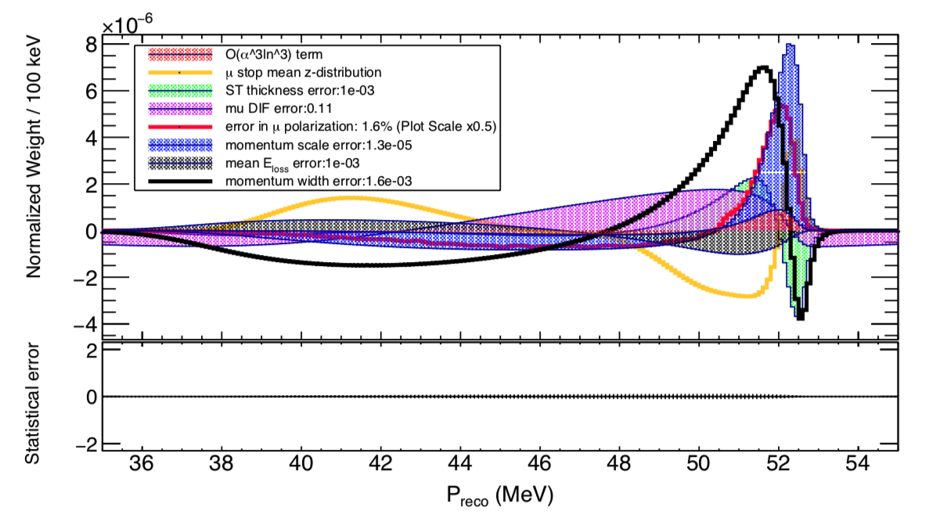
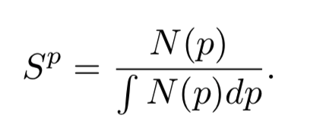
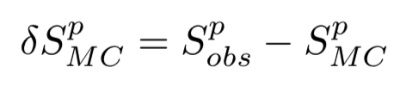
Systematic uncertainty

Slide 11
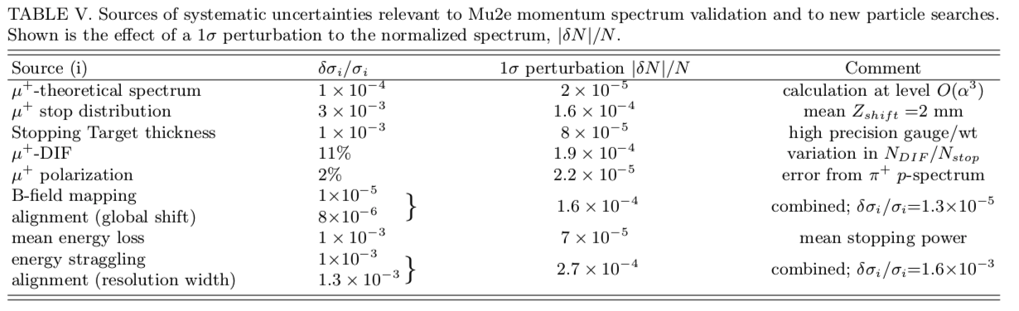
Systematic uncertainty

Slide 12
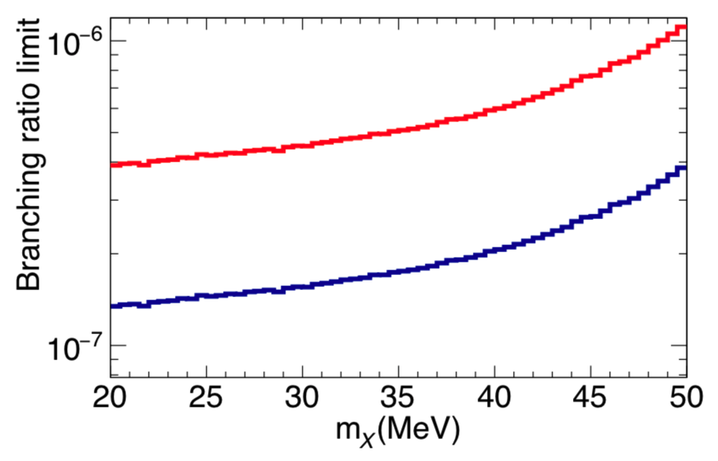
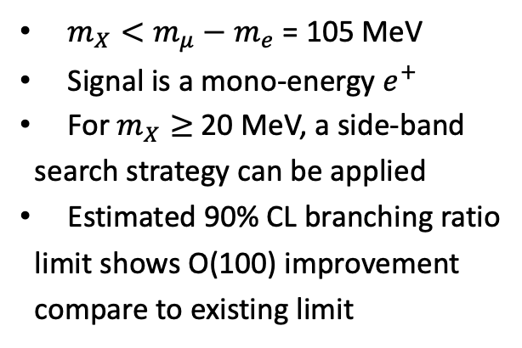



Searches for CLFV $μ^{+}→e^{+}+X$
$m_{X}<m_{μ}−m_{e}$ = 105 MeV
Signal is a mono-energy $e^{+}$
For $m_{X}≥$ 20 MeV, a side-band
search strategy can be applied
Estimated 90% CL branching ratio
limit shows O(100) improvement
compare to existing limit
$μ^{+}$ beam intensity = 1/1000 nominal
T = 2 weeks
$μ^{+}$ beam intensity = 1/100 nominal

Slide 13
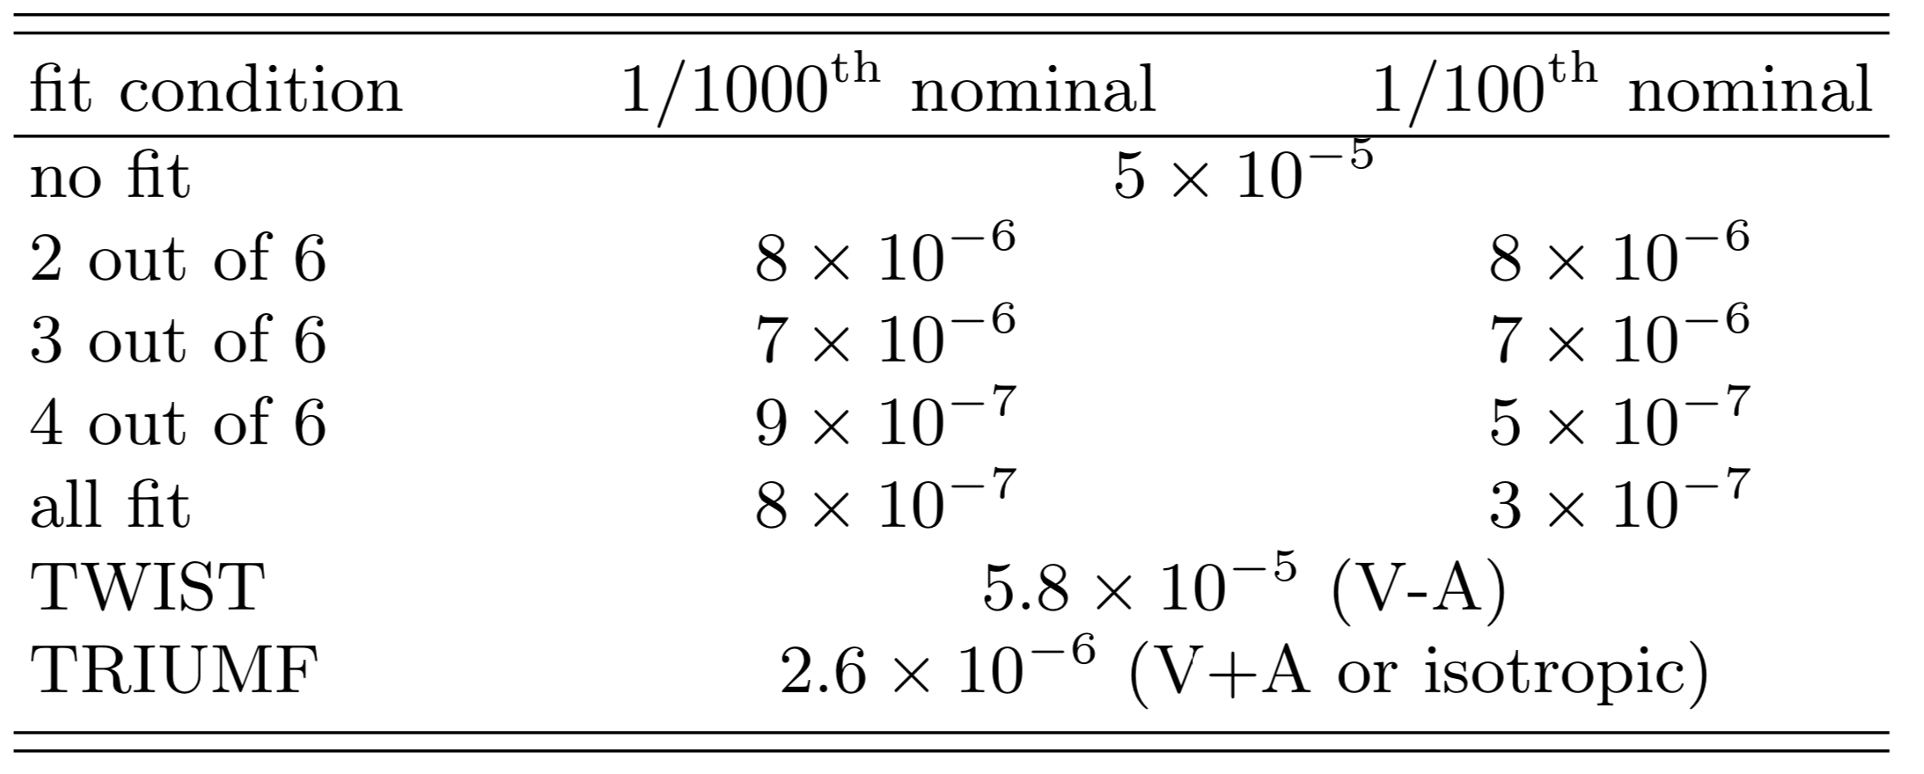
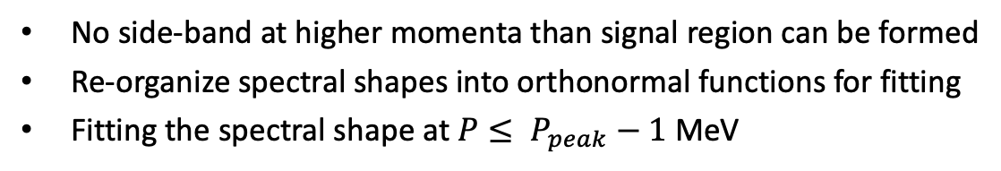

Searches for $μ^{+}→e^{+}+X$ ; $m_{X}=0$
No side-band at higher momenta than signal region can be formed
Re-organize spectral shapes into orthonormal functions for fitting
Fitting the spectral shape at $P≤ P_{peak}−1$ MeV

Slide 14
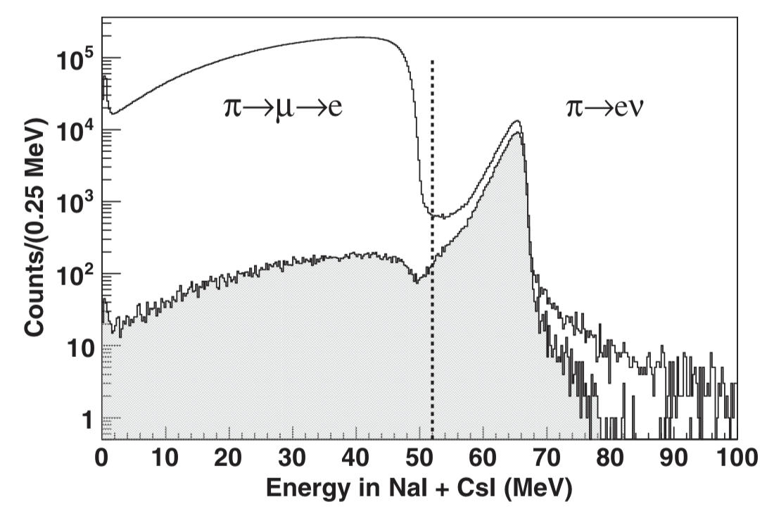


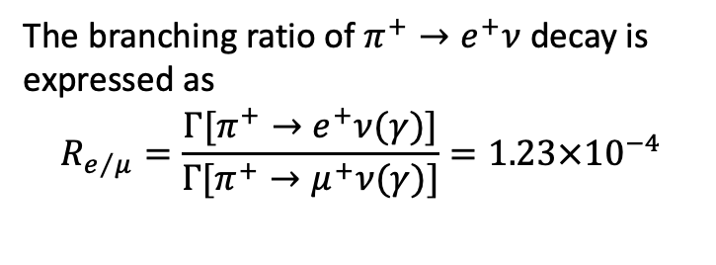
$π^{+}$validation: $π^{+}→e^{+}ν$
PIENU experiment
Why use $π^{+}$as validation method
  $π^{+}→e^{+}ν$, one $e^{+}$ as search signal
  Mono-energetic $e^{+}$ end state
  Radiative corrections known
  Momentum is above $μ^{+}$ Michel edge
69.8 MeV
After trigger cut
The branching ratio of $π^{+}→e^{+}ν$ decay is expressed as
$$R_{e/μ}=\frac{Γ[π^{+}→e^{+}ν(γ)]}{Γ[π^{+}→μ^{+}ν(γ)]}=1.23×{10}^{−4}$$
7/7/23

Slide 15
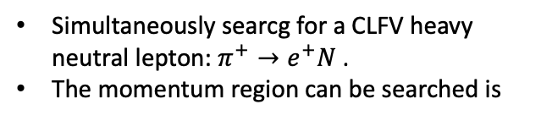
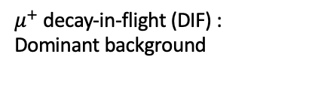
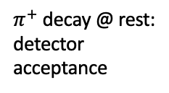
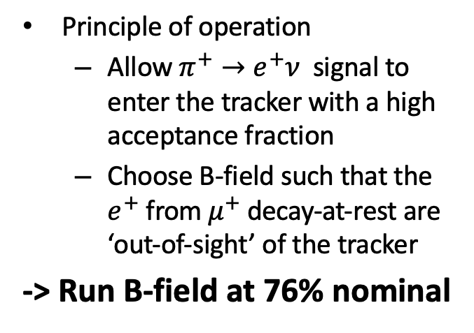

$π^{+}$ operation mode
Principle of operation
  Allow $π^{+}→e^{+}ν$ signal to enter the tracker with a high acceptance fraction
  Choose B-field such that the $e^{+}$ from $μ^{+}$decay-at-rest are ‘out-of-sight’ of the tracker
-> Run B-field at 76% nominal
$π^{+}$ decay @ rest:
detector acceptance
Total
Simultaneously searcg for a CLFV heavy neutral lepton: $π^{+}→e^{+}N$.
The momentum region can be searched is
$μ^{+}$ decay-in-flight (DIF) :
Dominant background
7/7/23

Slide 16
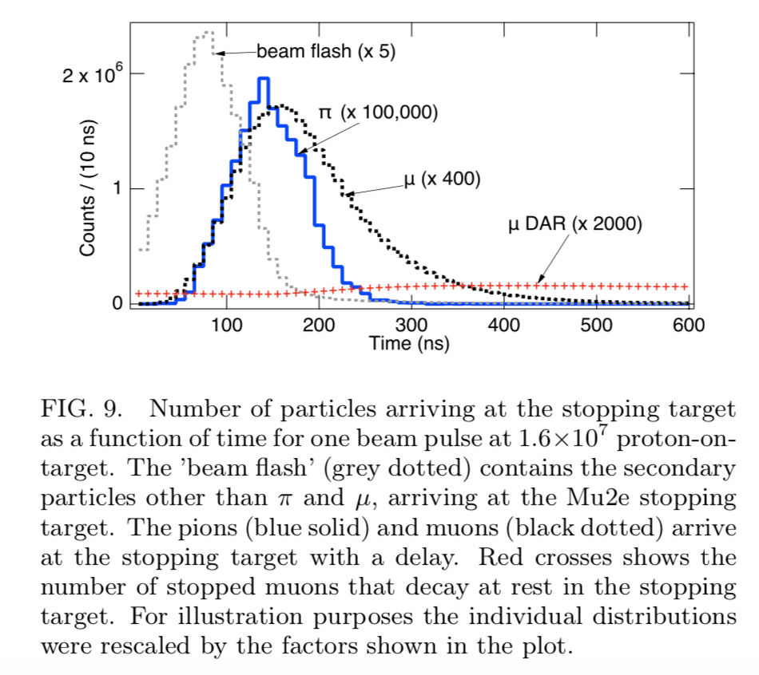

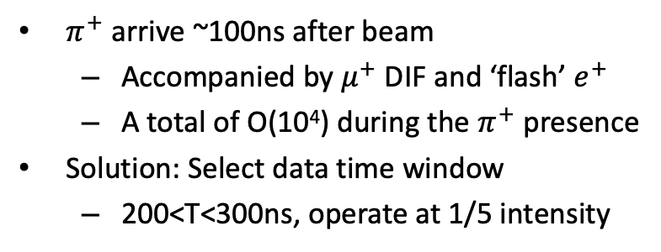
$π^{+}$ mode operation
$π^{+}$ arrive ~100ns after beam
  Accompanied by $μ^{+}$ DIF and ‘flash’ $e^{+}$
  A total of O(10⁴) during the $π^{+}$ presence
Solution: Select data time window
  200<T<300ns, operate at 1/5 intensity
Number of particles arriving at the stopping target versus time during one proton pulse.
Data window:
200<T<300ns
54<P<68MeV
Simulated e+ momentum versus time distribution passing through the Mu2e tracker, in one pulse.
7/7/23

Slide 17
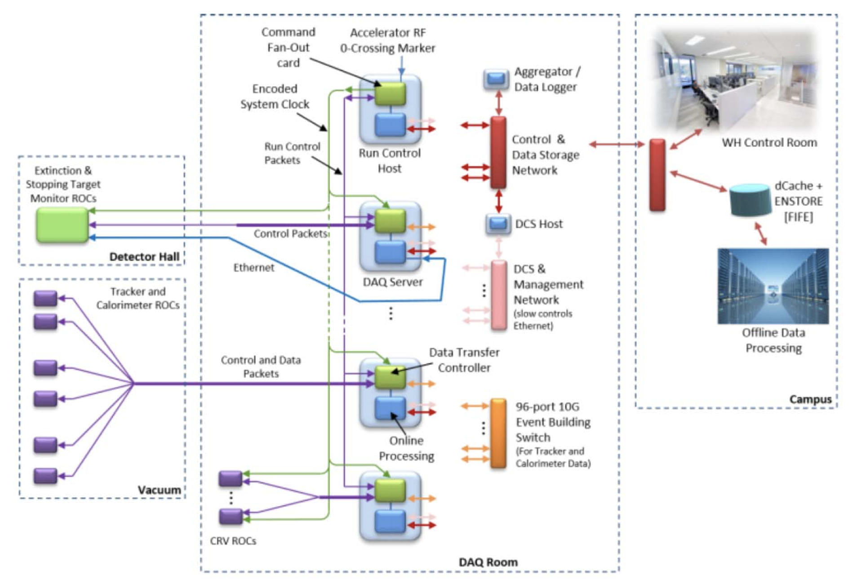
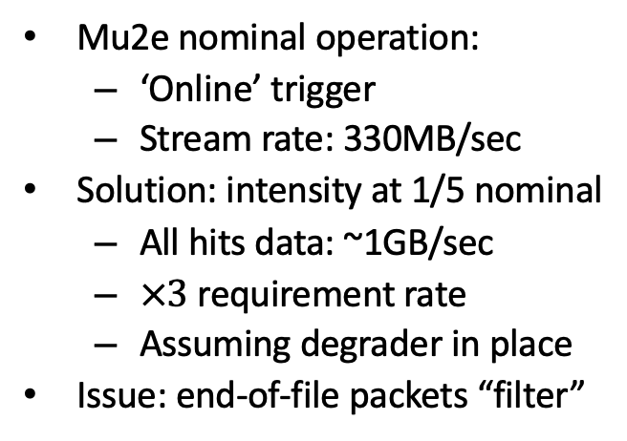
Problems: DAQ stream rate
Mu2e nominal operation:
  ‘Online’ trigger
  Stream rate: 330MB/sec
Solution: intensity at 1/5 nominal
  All hits data: ~1GB/sec
  $×3$ requirement rate
  Assuming degrader in place
Issue: end-of-file packets “filter”
7/7/23

Slide 18
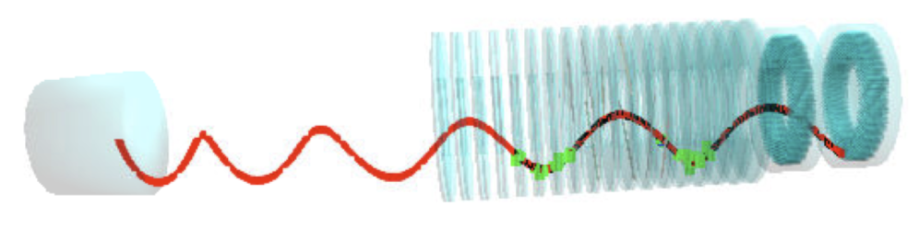
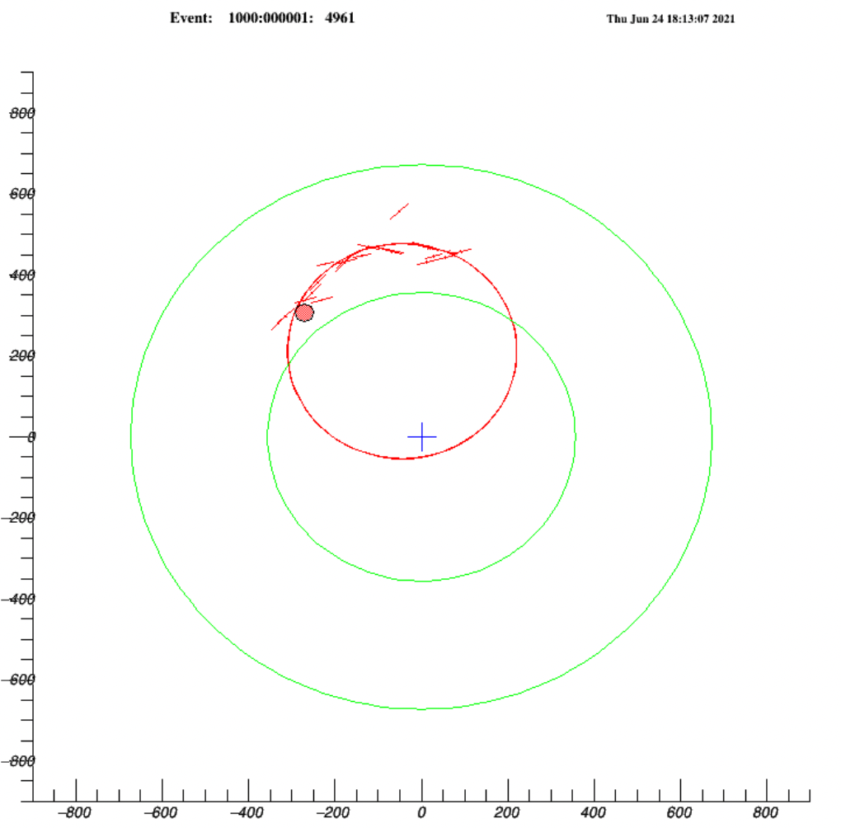
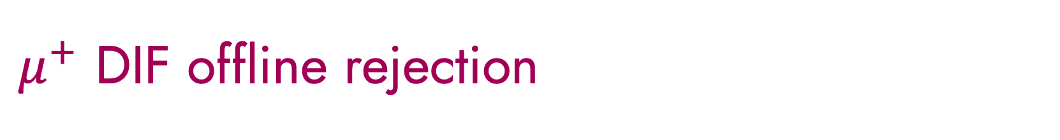
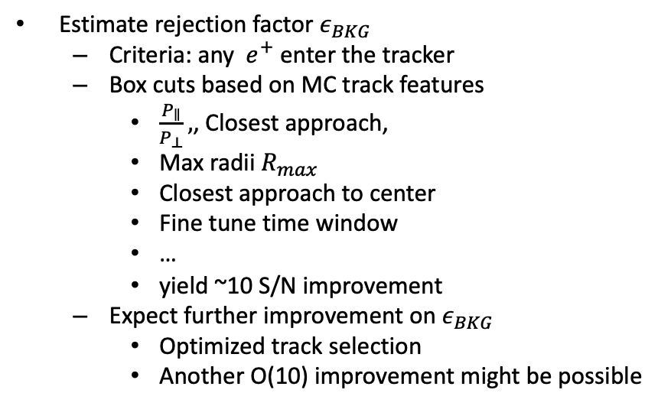
$μ^{+}$ DIF offline rejection
X
Estimate rejection factor $ε_{BKG}$
  Criteria: any$e^{+}$ enter the tracker
  Box cuts based on MC track features
    $\frac{P_{∥}}{P_{⊥}},$, Closest approach,
    Max radii $R_{max}$
    Closest approach to center
    Fine tune time window
    …
    yield ~10 S/N improvement
  Expect further improvement on $ε_{BKG}$
    Optimized track selection
    Another O(10) improvement might be possible
Z
target area
tracker
calorimeter
Rmax
7/7/23

Slide 19
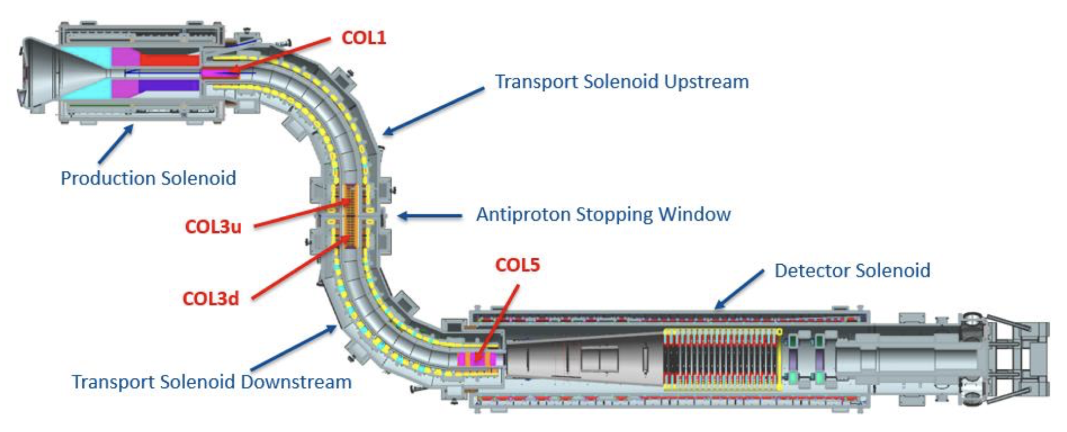
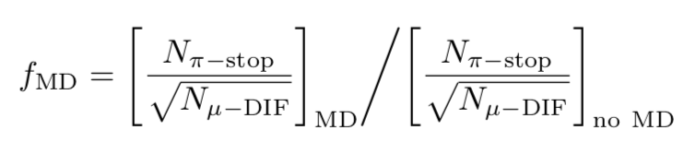
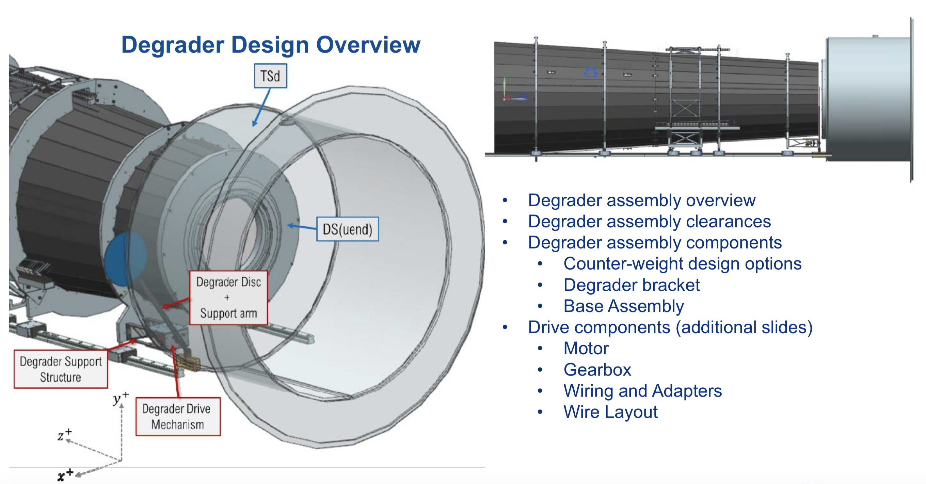

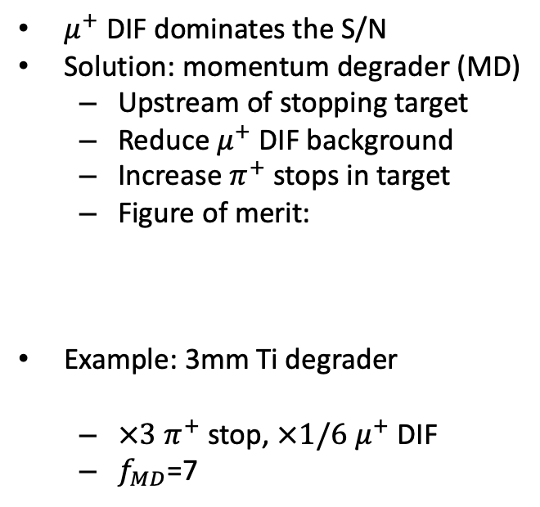
Reduce $μ^{+}$ DIF, increase $π^{+}$ stops
$μ^{+}$ DIF dominates the S/N
Solution: momentum degrader (MD)
  Upstream of stopping target
  Reduce $μ^{+}$DIF background
  Increase $π^{+}$ stops in target
  Figure of merit:
Example: 3mm Ti degrader
  $×3$ $π^{+}$ stop, $×1/6$ $μ^{+}$ DIF
  $f_{MD}$=7
X
Z
7/7/23

Slide 20





$π^{+}→e^{+}N$searches for $m_{N}>$20 MeV
Momentum calibration data can be re-purposed to search for new physics,${ π}^{+}→e^{+}N$.
Setting a limit on BR($π^{+}→e^{+}N$) translates to searching for excess $e^{+}$production
In case of observing a null result, a 90% CL branching ratio can be set, depending on running conditions;
90% CL limit;
$t_{exp}=14$days
proton intensity = 1/5 nominal
MD in place with $f_{MD}$=7
7/7/23

Slide 21

Conclusions
A Mu2e $μ^{+}$ validation run operating at 50% of nominal B-field
  On the O(1) day might achieve keV level momentum scale precision
  On the O(2) weeks validating the full momentum range
Proposed search for $μ^{+}→e^{+}+X$
  Complementing Mu2e’s main indirect search goal, $μ^{−}→e^{−}$ conversion
  10² improvement in branching ratio sensitivity limit at mass $m_{X}=$ 20 MeV
  $3×{10}^{−7}$branching ratio limit might be achievable assuming $m_{X}=$ 0
Proposed search for $π^{+}→e^{+}+N$
  Search for Heavy Neutral Lepton in the range 65 $≥m_{X}≥$ 20 MeV.
  A x10 improvement of $3×{10}^{−8}$branching ratio limit assuming $m_{X}=$ 20 MeV

Slide 22
References
[1] P. Banerjee, A. Coutinho, T. Engel, A. Gurgone, A. Signer, and Y. Ulrich, High-precision muon decay predictions for ALP searches, arXiv preprint arXiv:2211.01040 (2022).
[2] A. Grossheim, R. Bayes, J. Bueno, et al., “Decay of negative muons bound in al 27,” Phys. Rev. D, vol. 80, p. 052 012, 5 Sep. 2009. DOI: 10.1103/PhysRevD.80.052012.
[3] R. Watanabe, M. Fukui, H. Ohtsubo, and M. Morita, “Angular Distribution of Electrons in Bound Muon Decay,” Prog. Theor. Phys., vol. 78, pp. 114–122, 1987. DOI: 10.1143/PTP. 78.114.
[4] A. Czarnecki, M. Dowling, X. Garcia i Tormo, W. J. Marciano, and R. Szafron, “Michel decay spectrum for a muon bound to a nucleus,” Phys. Rev. D, vol. 90, no. 9, p. 093 002, 2014. DOI: 10.1103/PhysRevD.90.093002. arXiv: 1406.3575 [hep-ph].

Slide 23
Thank you!
Questions?

