Slide 1


Introduction of soft X-ray spectroscopy and plans in Shenzhen Innovation Light-Source Facility
需求牵引、错位发展、特色突出、集智创新
Yitao Cui
Division of Synchrotron radiation light source
Institute of Advanced Science Facilities, Shenzhen (IASF)
July 7th, 2023
Notes:
Good morning everyone, I am Yitao Cui, belongs to Division of SRF in our institute.
Firstly, let me thank prof. Ulf Kalson to propose this meeting and invited our friends from Dessy and Flash in Germany. Many thanks to Prof. Chunzhen Yang and Dr. Xiaoyu Guo for arrangement.
It is my great pleasure to instead of our division to show our project.

Slide 2

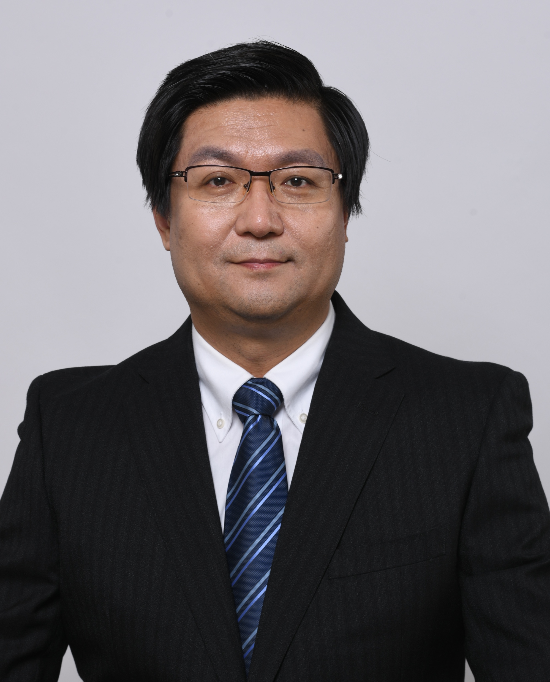
Biography
Ph.D. in Hiroshima University (2007);
Researcher @ HSRC/HU, JASRI/SPring-8; ISSP/UT; DICP/CAS;
Visiting Professor @UH; USTB.;
Researcher at IASF, Shenzhen since 2020 .
Interests: surface science, spintronics, rechargeable batteries, fuel cells, catalytic materials, and synchrotron-based techniques, especially in industrial in situ or operando applications.
Dr. Yi-Tao CUI
崔艺涛
Researcher
Shenzhen Innovation Light Source Facility (SILF) ，Institute of Advanced Science Facilities (IASF)

Slide 3

CONTENTS
1
2
3
4
Project
Background
Introduction to the project
Development Scheme
Project Team
Notes:
In the talk, we would like to share the project background, project introduction, project development scheme, and by the end I am going to introduce little bit about our team.

Slide 4
CONTENTS
1
2
3
4
Project
Background
Introduction to the project
Development Scheme
Project Team
Notes:
Today I am going to share the project background, project introduction, project development scheme, and by the end I am going to introduce little bit about our team.

Slide 5
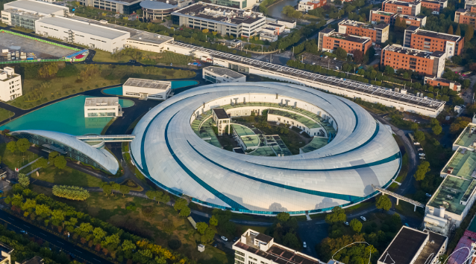
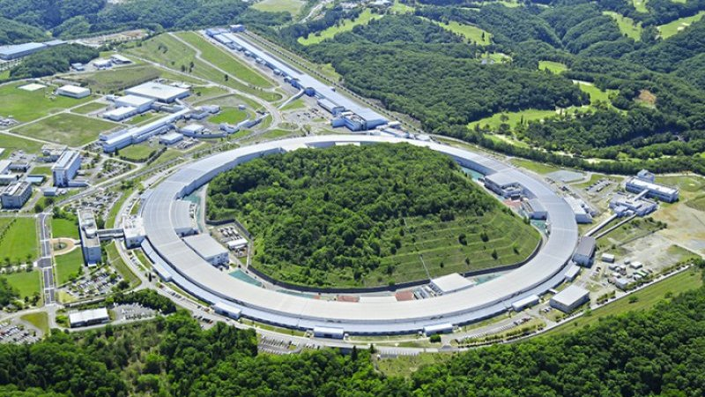
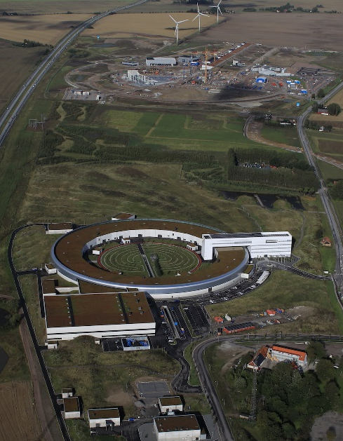
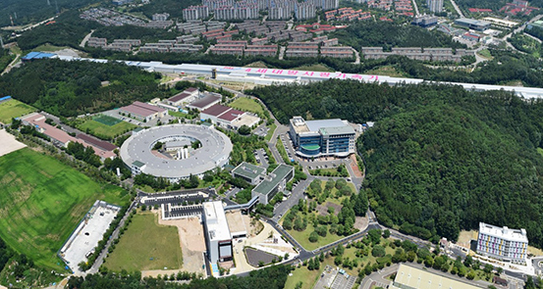
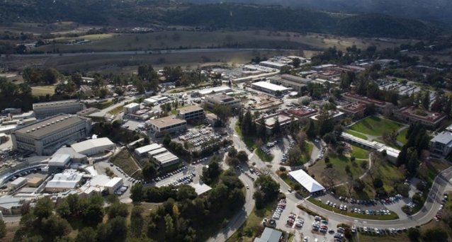
1.1 Synchrotron Facilities in the word
Construction mode: "synchrotron radiation source +" (free electron laser, spallation neutron source, etc.)
Shanghai, China
Hyogo, Japan
SSRF（3rd generation) | 2009
SPring-8（3rd generation）| 1997
SXFEL （FEL） | 2018
SACLA（FEL） | 2011
Pohang, South Korea
San Francisco, U.S.
Lund, Sweden
PLS-II（3rd generation) | 2009
SSRL（2nd generation) | 1976
MAX-IV（4th generation） | 2016
PAL-XFEL （FEL） | 2018
LCLS （FEL） | 2006
ESS（散裂中子源） | 2019
5
Notes:
Throughout the world, most of the top science and technology innovation centres are distributed in the bay areas. And usually big science facilities like SRF and FEL as important parts gathered and contribute much to the area.

Slide 6
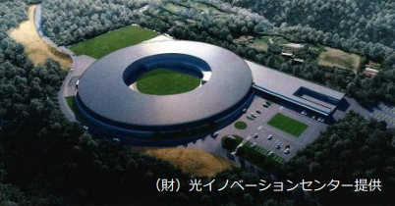
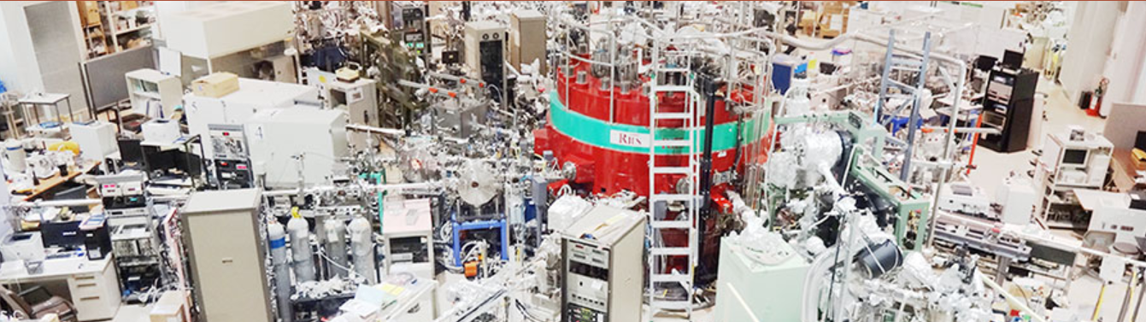
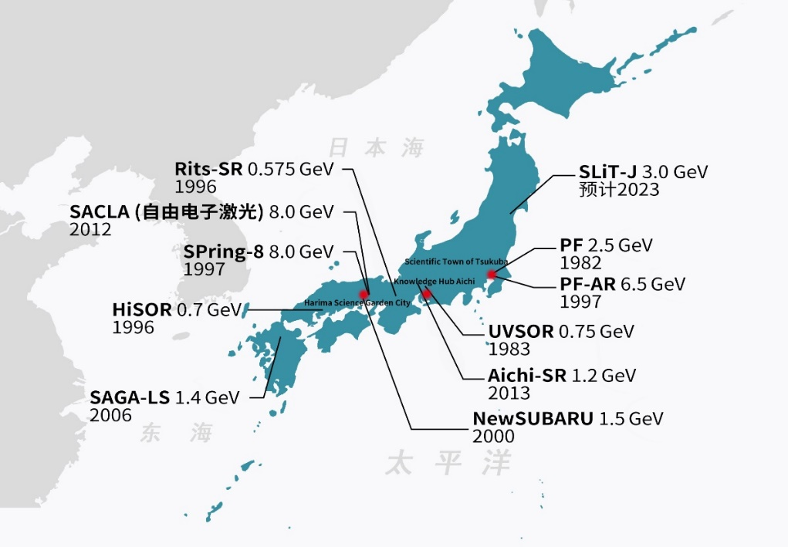
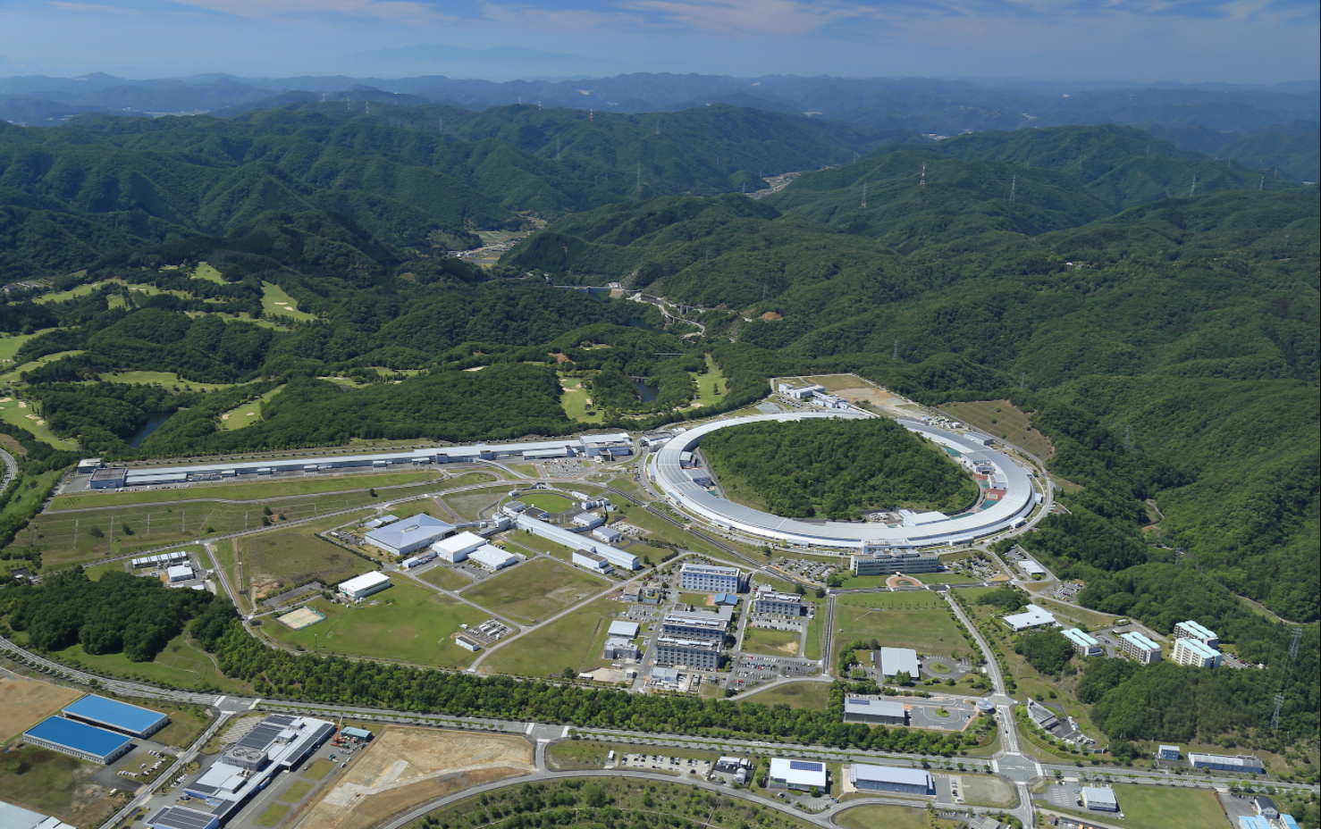
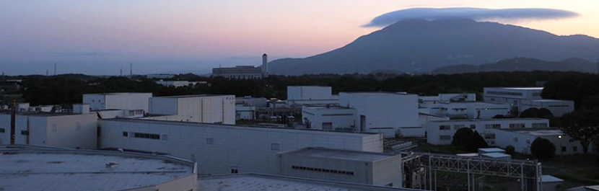
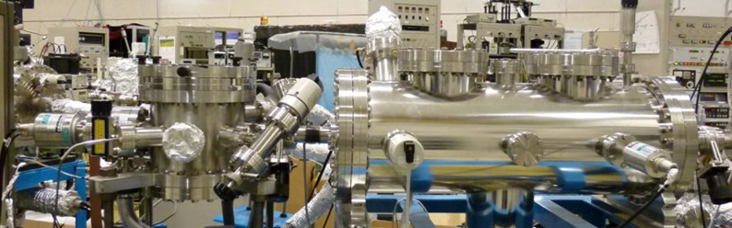
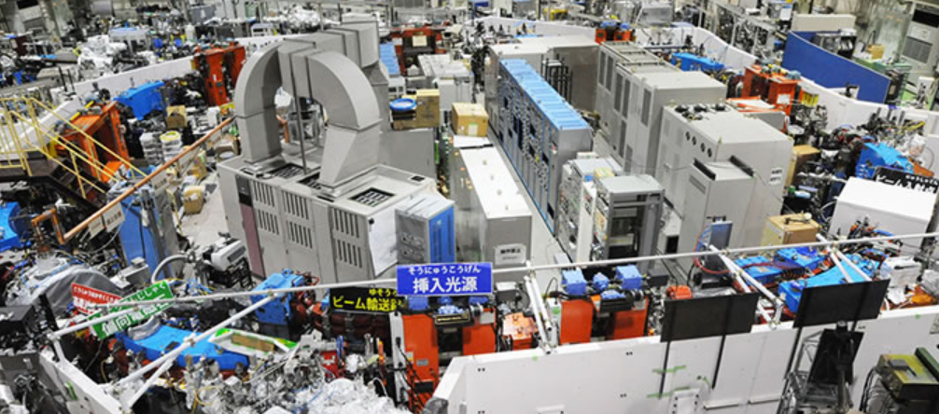
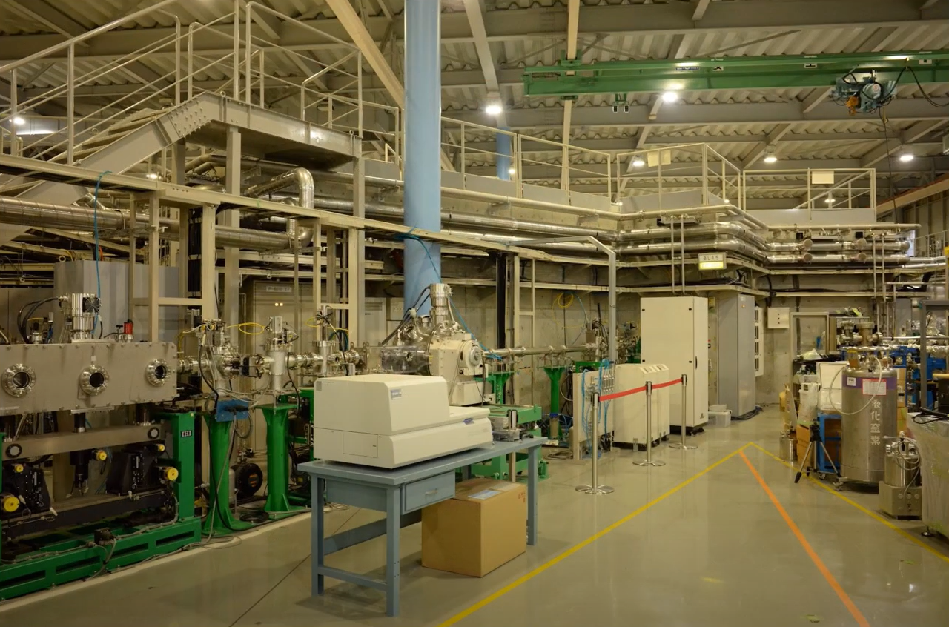
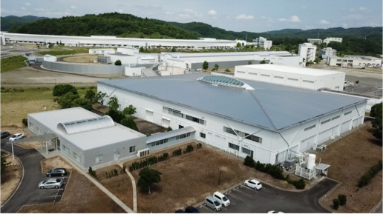
1.2 Industrial SR beamlines in Japan
SR light sources supports high-tech industries in Japan
SPring-8
Toyota Beamline
SAGA-LS
Industry beamline
New SUBARU
3 beamlines for Photolithography
Aichi-SR
Industry beamline
6
Notes:
Especially, the synchrotron based big science facility supports the high-tech Industrial in Japan.

Slide 7
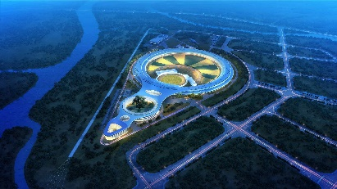
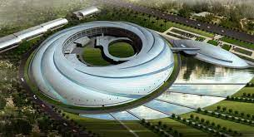
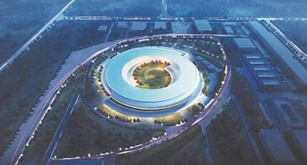
1.3 Synchrotron Facilities in China mainland
Beijing
High Energy Photon Source (HEPS)
Beijing Synchrotron Radiation Facility (BSRF)
HEPS (6 GeV), under construction
Beijing
Shanghai
Shanghai Synchrotron Radiation Facility (SSRF)
Shanghai Soft X-ray Free-Electron Laser Facility (SXFEL)
Shanghai
Hefei
SSRF (3.5 GeV), operation
Hefei
Hefei Light Source (HLS)
Hefei Advanced Light Source (HALS)
Shenzhen
Guangdong-Hong Kong-Maco:
13 Tillian RMB > Beijng+Shanghai
HALS (0.8 GeV), under design
7
Notes:
Currently, three Chinese synchrotron light source facilities are located in Beijing, Shanghai and Hefei.The Guangdong-Hong Kong-Macao Greater Bay area is the most economically developed region in China also need to the big facility for high quality development.

Slide 8

1.4 Science and Innovation in Great bay area
粤港澳大湾区的产业发展和基础研究发展，迫切需要布局综合粒子大科学设施
Large scale science facilities provide the basic platform for science research, technology development and innovation
光子 Photon
设施类型: 同步辐射光源、自由电子激光
Facility example: Synchrotron Radiation Facility (SRF) and Free Electron Laser (FEL)
电子 Electron
设施类型: 超高时空分辨率电镜
Facility example: Ultrafast Transmission Electron Microscope
质子 Proton
  设施类型: 质子源
  Facility example: Proton Source
产业需求聚焦 Innovation
功能高度互补 Function Complementary
软硬配套共享 Facility and Service Sharing
中子 Neutron
设施类型: 中国散列中子源
Facility example: China Spallation Neutron Source (CSNS)
中微子 Neutrino
设施类型: 大亚湾和江门反应堆中微子实验室
Facility example: Daya Bay and Jiangmen Reactor Neutrino Lab

Slide 9
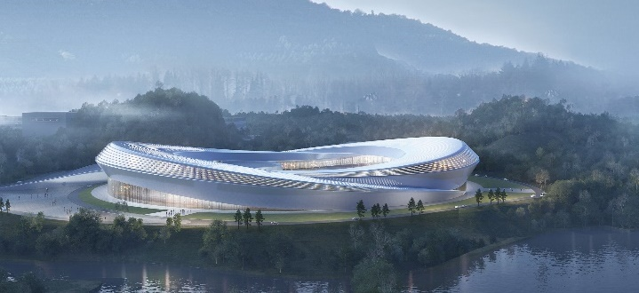
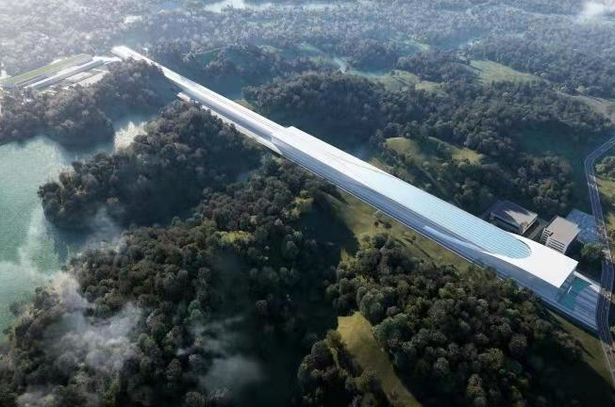
1.5 Light Sources plan in Shenzhen
发展宗旨：
紧密围绕高水平建设深圳综合性国家科学中心战略目标，面向国民经济主战场和世界科技前沿，充分吸纳国际国内高端创新资源，依托先行示范区政策、产业、资本、市场和技术等优势，承担重大科技基础设施和重大科研平台建设运营任务。
Value
IASF is driven to serve innovation and solve grand challenges based on large scale science and technology infrastructure. We are open and creative, pursuing scientific management and decision-making, and collaborating with global talents to brighten the Great Bay and to build a better world.
深圳中能同步辐射光源（效果图）
Render of Shenzhen Synchrotron Radiation Facility (Shenzhen Innovation Light Source Facility, “SILF”)
深圳超导软X射线自由电子激光（效果图）
Render of Shenzhen Superconducting Soft X-Ray Free Electron Laser (S³FEL)

Slide 10
CONTENTS
1
2
3
4
Project
Background
Introduction to the project
Development Scheme
Project Team
Notes:
Now I will introduce the Synchrotron Radiation Facility Project plan.

Slide 11
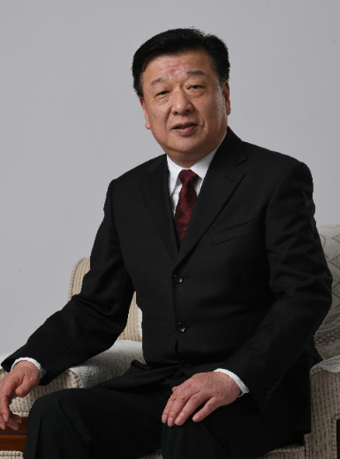
2.1 Overall Planning
建设具有第四代光源特征的深圳产业光源
To build a fourth-generation Synchrotron Radiation Light Source Facility (SRF) for Industries
定位：
需求牵引
错位发展
特色突出
集智创新
Driven by innovation, serve the demand, complementary with other facilities, distinctive characteristic, world wide cooperation
孙冬柏 院长、教授、总经理
中山大学原常务副校长
北京高能同步辐射光源（HEPS）工程科技委委员；
散裂中子源（CSNS）科学技术委员会委员；
国家重大科技基础设施建设中长期规划总体专家组副组长；
教育部重大科技基础设施专家委员会主任；
粤港澳大湾区国际科技创新中心 专家咨询组成员
Former Executive Vice President of Sun Yat-sen Univ.
Committee member of HEPS and CSNS
Leader of national taskforce of significant Sci & Tech Infra
Committee member of Bay-area Intl Sci & Tech innovation center

Slide 12
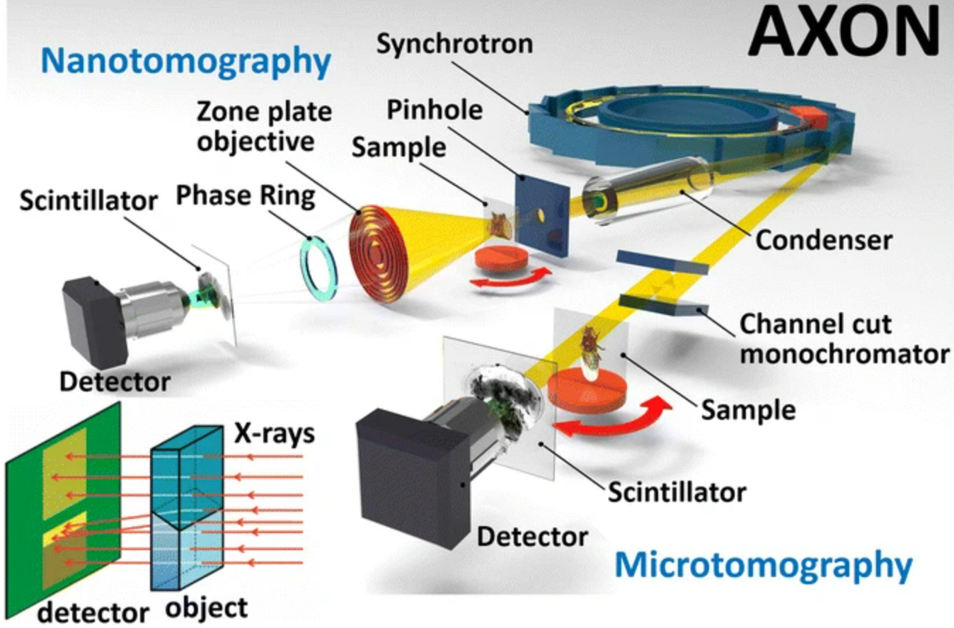
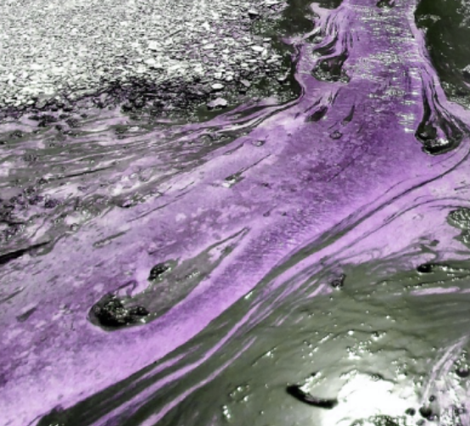
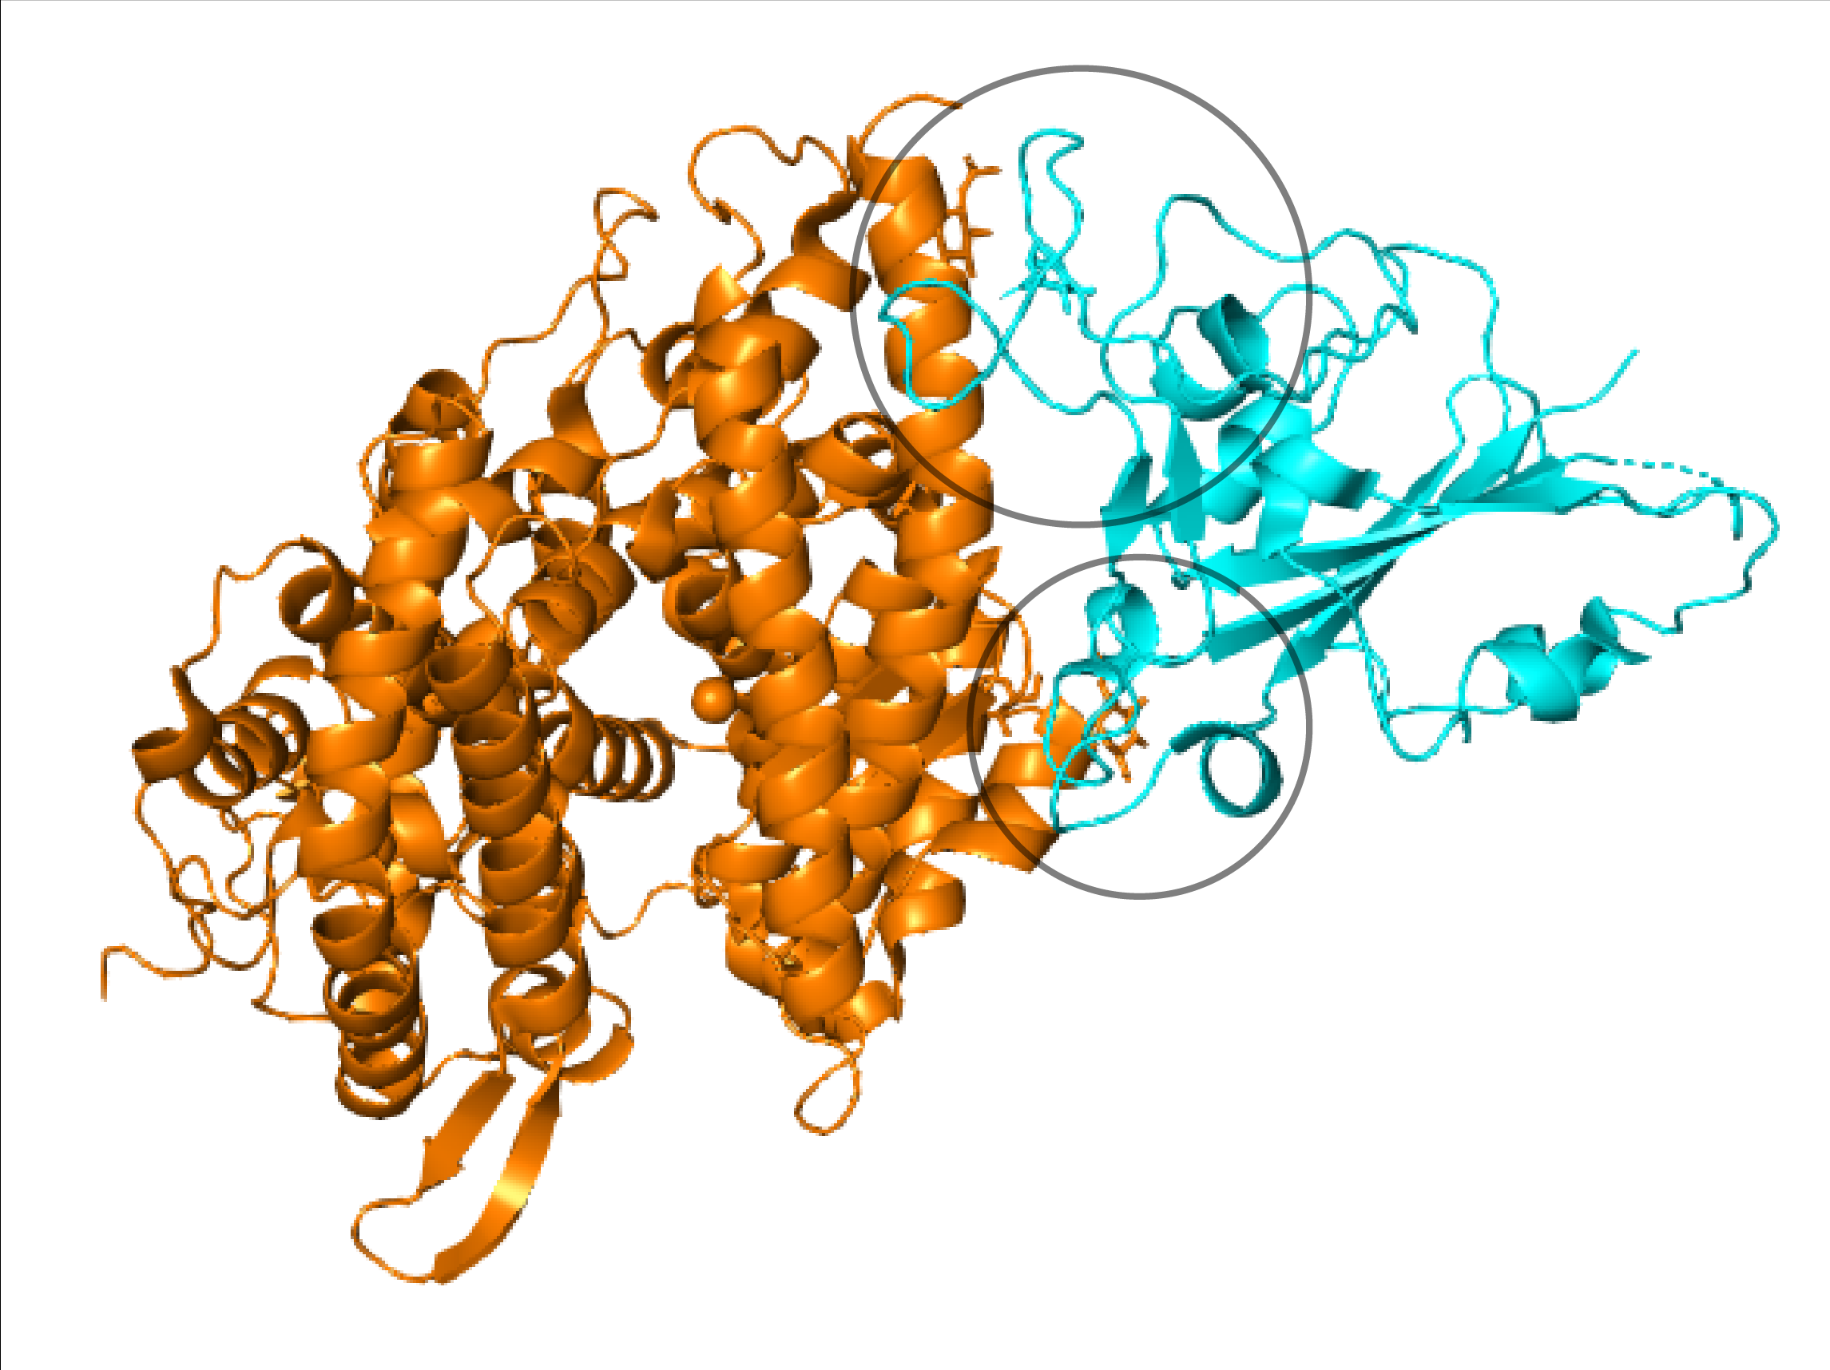
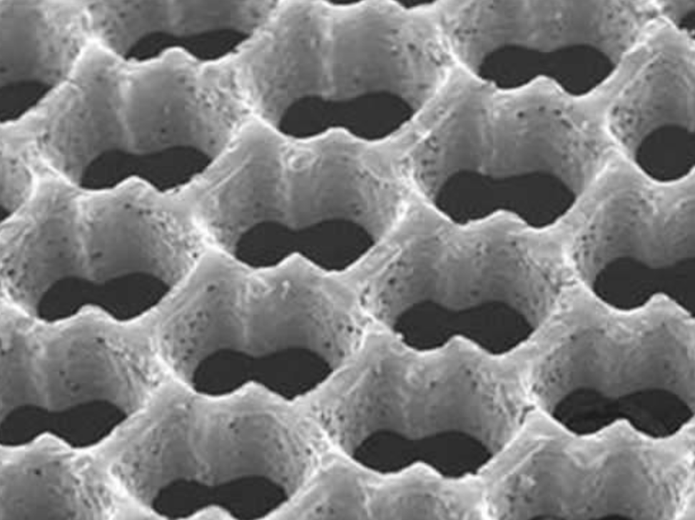
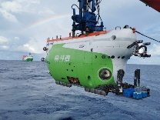
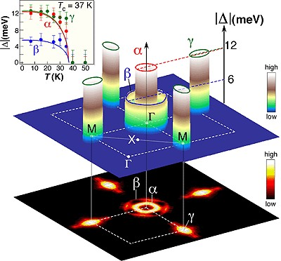
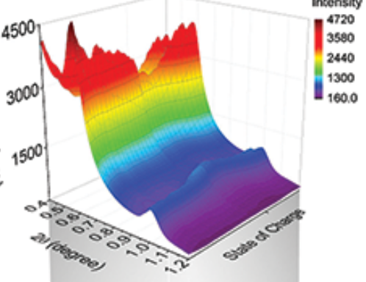
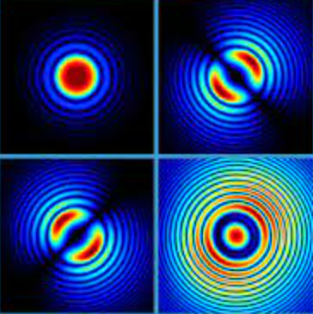


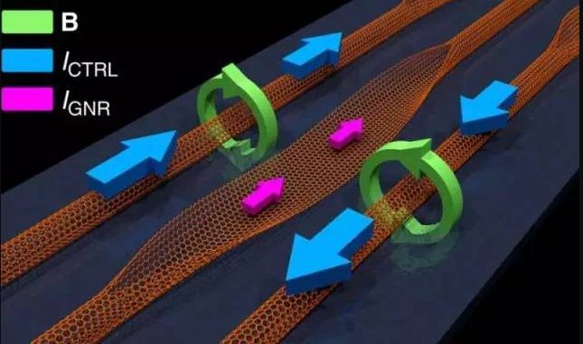
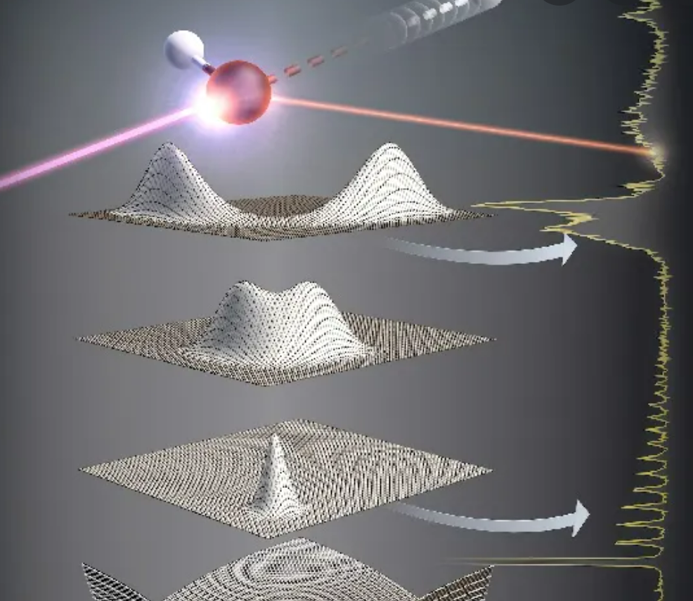
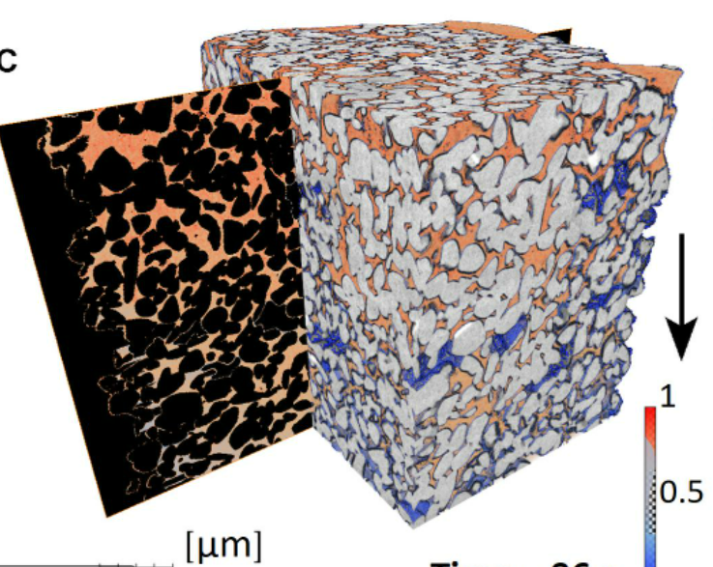
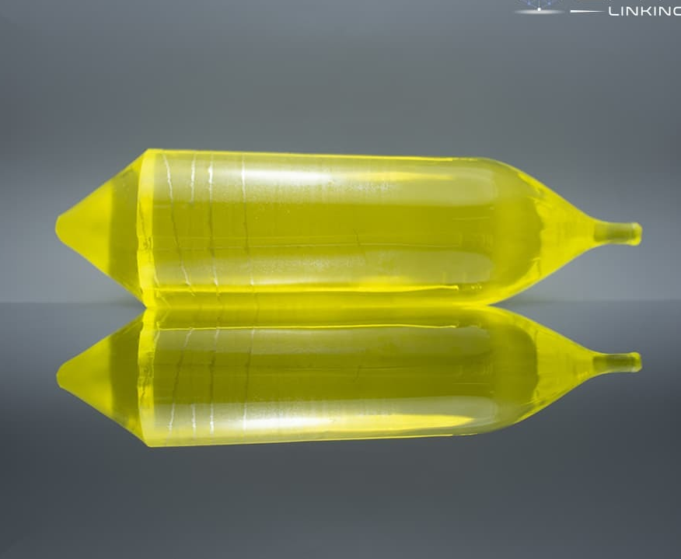
2.1 深圳产业光源建设目标
核能核电
谱学
能源化工
成像
应用领域
表征方法
生物医药
散射
方法
用户需求
生物材料
衍射
技术优势
海洋工程
软X射线
航空航天
时间分辨
汽车产业
物质的密码
生命的密码
工艺的密码
环境的密码
空间分辨
集成电路
能区覆盖
性能
量子材料
灵敏度
稀土材料
原位环境

Slide 13
Beamlines Planning
Phase–I: 27 Beamlines
Fundamental Science（6）
Innovation
Fundamental Science
Future Development
Industry Applications
High Energy Resolution Spectroscopy Beamline
Angle-resolved Photoemission Spectroscopy Beamline
High Pressure Diffraction Beamline
Large-Volume-Press High-Pressure Beamline
Energy and Environment Beamline
Nanoprobe Beamline
Advanced X-ray Techniques（8）
Transmission X-ray Microscopy Beamline
USAXS-SAXS-WAXS Beamline
Resonant Inelastic X-ray Scattering Beamline
X-ray Coherent Scattering Beamline
X-Ray and TEM Combination Beamline
White Beam XAFS Beamline
High-throughput White X-ray Diffraction and Fluorescence Beamline
White Beam MX Beamline
www.iasf.ac.cn
9/22

Slide 14
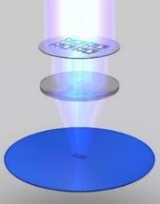
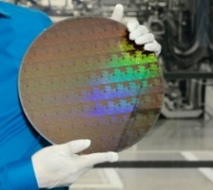

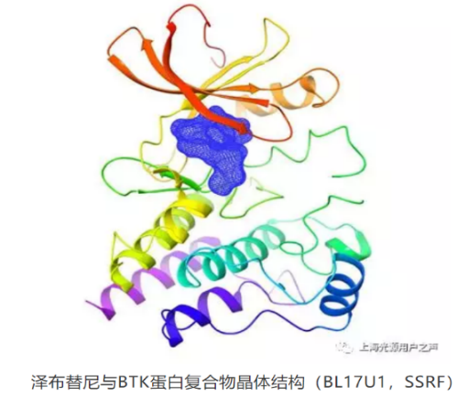
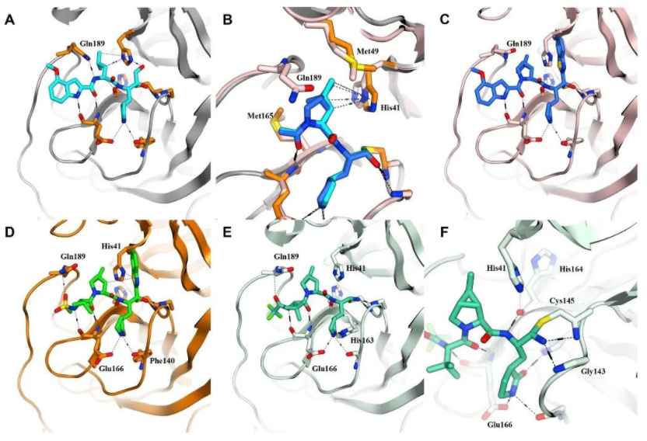
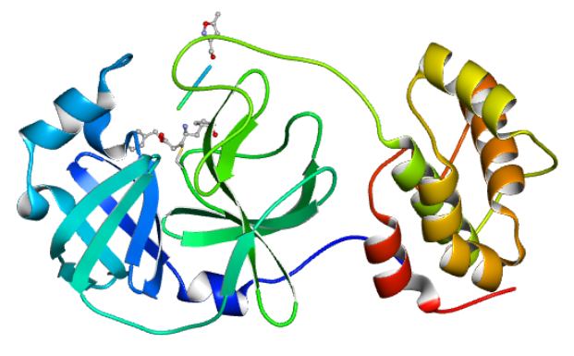
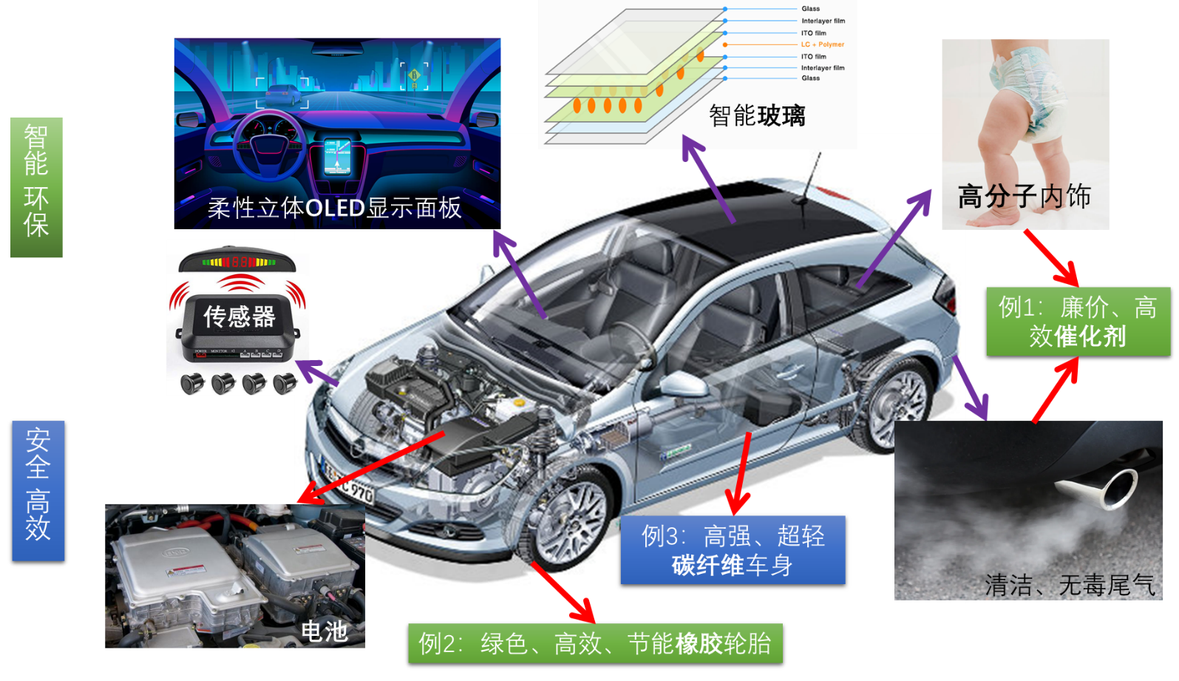
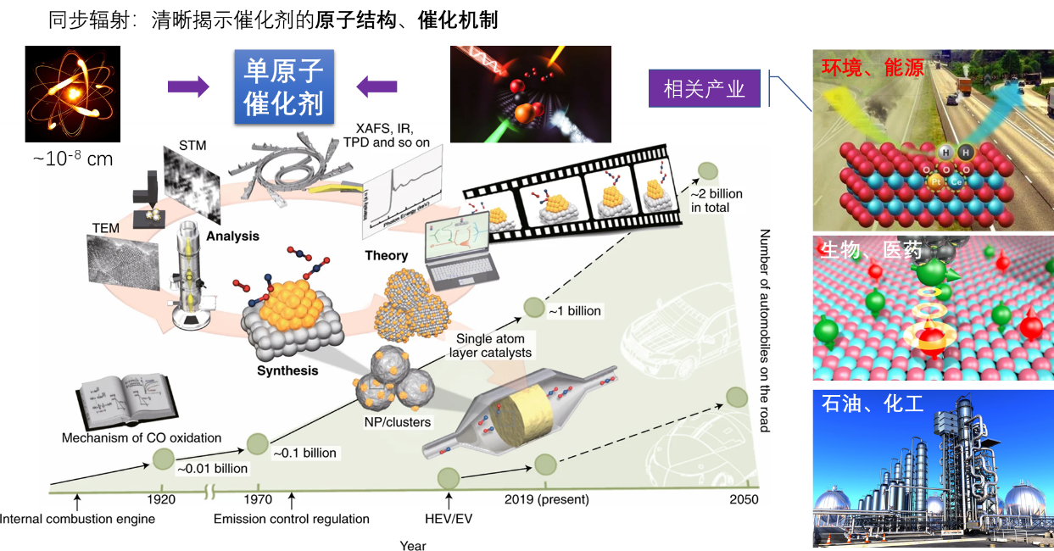
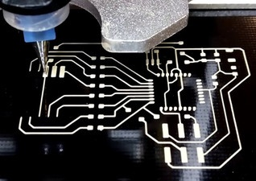
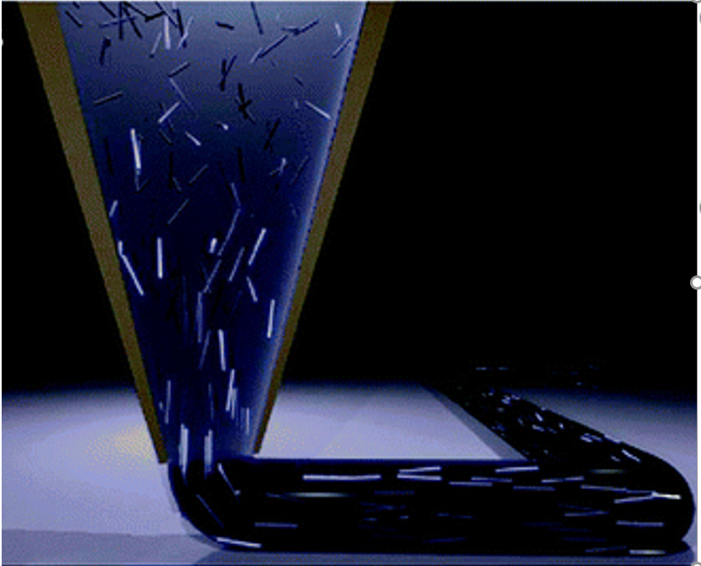
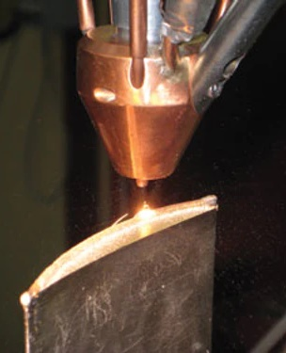
2.3 SR light source for innovation
ultraviolet
photolithography
Third generation semiconductor
Targeted anti-tumor drugs
COVID-19 vaccine and drugs
Large scale infectious virus
Integrated circuits: electronic information industry, etc
Emerging Industry
Biomedical : innovative drugs, virus prevention and control, etc
Advanced materials: battery materials, catalytic materials, etc
Advanced manufacturing: high-end manufacturing industry
Battery cars
Green chemical industry, dual carbon
printed electronics
Flexible
processing
manufacturing
14

Slide 15
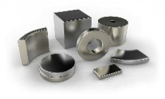
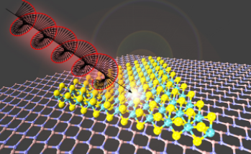
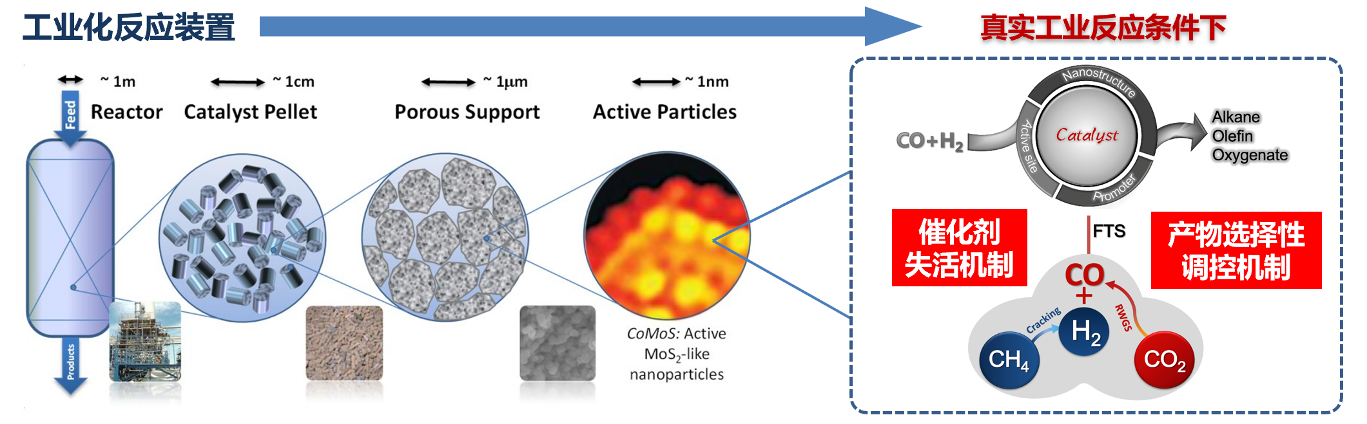
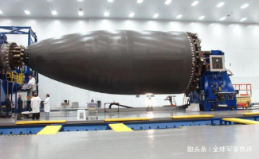
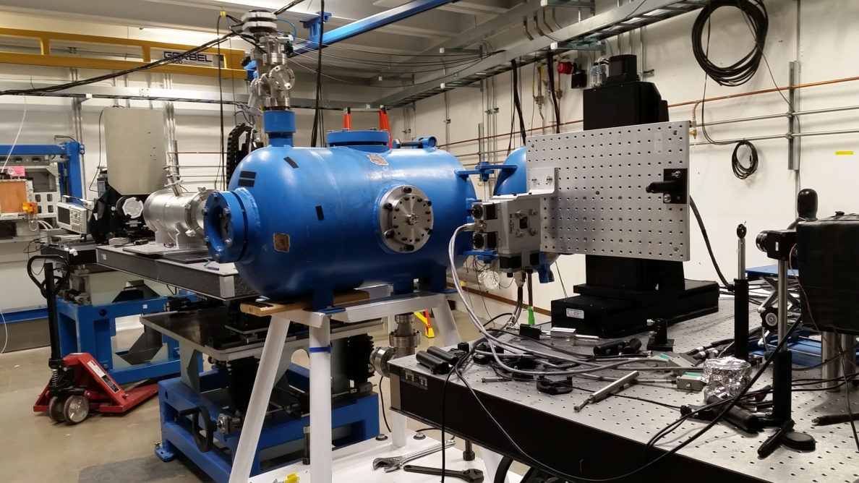
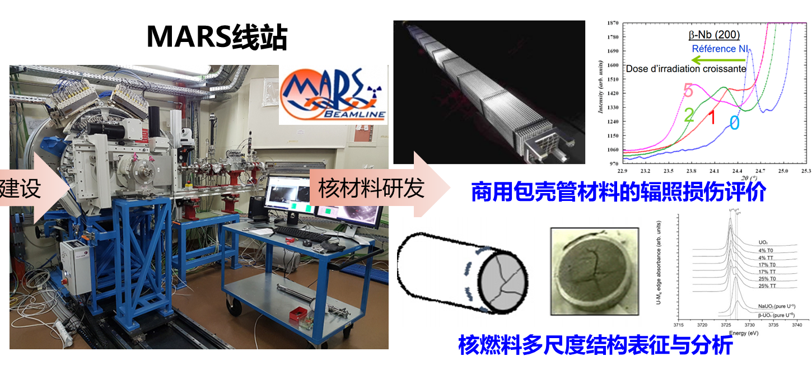
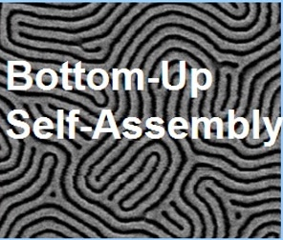
2.4 SR light source for development
Quantum materials
membrane protein
Permanent magnet material
Catalytic material
2D semiconductor material
Frontier developments: physics, chemistry, life sciences, etc
  future industry
Extreme conditions: Extreme performance and new processes
Major needs: energy, national security, etc
Future industries: high-end industries, disruptive technologies
Carbon fiber missile shell
Shockwave transient
Nuclear material development, performance, lifespan, and safety evaluation
direct self-assembly
High temperature superconducting applications
15

Slide 16

总体布局及性能指标
参数 | 设计指标
储存环电子束能量（GeV） | 3.0
电子束横向发射度（pm⋅rad） | 100
电子束流强（mA） | 300
周长（m） | 696
线站：55条（首期27条）
白光成像
全场纳米成像
超高压
X射线-电子束联用
大腔体高压
高分辨硬X射线谱学
服役评价
白光衍射
共振发射谱
环境能源
生物安全防护晶体学与成像
高分辨光电子谱学
增材制造
软X射线-太赫兹谱学
纳米探针
极紫外光刻
极紫外检测
高性能纤维及先进复合材料
极紫外材料
高通量药物发现
成品与工艺检测
膜蛋白药物发现
相干散射
精密加工
动力电池材料
柔性电子材料
驱动电机材料

Slide 17




2.5 Significance of the SILF Project
For Science and Innovation
Structure and mechanism study of pandemic virus
Molecularly targeted drugs research and critical illness diagnose
Life extension of nuclear power and nuclear waste treatment
Rare earth materials research and production
Energy research and clean energy development
Materials and technologies for future generation of green cars
High sensitivity detection technology for weak signal
Environmental science and technology
Air, soil and water pollution treatment
Ocean engineering materials service and properties evaluation
Quantum materials and device
development
Catalyst for High-tech Industry
17
Notes:
We expect to see that the Shenzhen Synchrotron radiation light source facility will significantly accelerate the development of science and innovation, as well as many high-tech industries in the Greater Bay Area.

Slide 18
  实验方法全
柔性电子材料
高性能纤维及先进复合材料
方法学
散射
成像
相干/综合
衍射
谱学
软X射线
增材制造
全场纳米成像
白光成像
动力电池材料
环境能源
X射线-电子束联用
高分辨硬X射线谱学
极紫外光刻
极紫外检测
极紫外材料
高分辨光电子谱学
软X射线-太赫兹谱学
共振发射谱
驱动电机材料
精密加工
服役评价
超高压
大腔体高压
高通量药物发现
膜蛋白药物发现
生物安全防护晶体学与成像
白光衍射
成品与工艺检测
相干散射
纳米探针

Slide 19

  能区覆盖广
10eV∼110keV
40
…
能区 keV
0.1
0.5
1
2
3
4
5
10
15
20
30
100
124
24.8
12.4
4.1
2.48
1.24
0.827
0.620
0.413
0.323
…
波长 Å
0.124
SOFT X-rays
Medium X-rays
Hard X-rays
C
Na
Si
Ar
Ti
Fe
Zn
Se
Sr
Rh
Cs
元素吸收边
N
Mg
P
K
V
Co
Ga
Br
Y
Ag
W
极紫外光刻线站
O
S
Ca
Cr
Ni
Ge
F
Cl
Sc
Mn
Cu
As
Mo
Sn
Pm
Au
共振发射谱线站
环境能源线站
极紫外材料线站
高分辨硬X射线谱学线站
软X射线-太赫兹谱学线站
X射线-电子束联用线站
高性能纤维及先进复合材料线站
相干散射线站
纳米探针线站
驱动电机线站
大腔体高压线站
白光衍射线站
服役评价线站
白光成像线站

Slide 20











  时间分辨快
500ns连续探测
界面动力学
光合作用
生物分子动力学
细胞运动
晶体氧析出
生物酶催化
药物代谢
1ns
1μs
1ms
1s
1min
增材制造线站
动力电池材料、X射线-电子束联用线站
白光成像线站
柔性电子材料线站
相干散射线站
白光衍射线站
增材制造线站—高速成像技术
时间分辨：0.5 μs
白光成像线站—CT技术
时间分辨：0.5 ms
柔性电子材料线站—SAXS技术
时间分辨：10 ms
动力电池材料线站—QXAFS技术
时间分辨：100 ms
快速熔化、凝固机理、气孔缺陷形成等
碳纤维复合材料、生物材料、新能源电池材料
喷墨打印、槽模涂布、成膜印刷工艺等
催化反应、电池充放电、纳米颗粒的成核与生长、相变等

Slide 21










  空间分辨强
硬X射线10nm级连续扫描
团簇、单原子催化剂
微晶体管材料
电池电极材料
生物样品
工业催化剂
碳纤维材料
0.1 nm
1 nm
100 nm
1 μm
100 μm
1 mm
0.1 m
X射线-电子束联用线站
X射线-电子束联用线站
空间分辨尺度
环境能源线站
驱动电机线站
纳米探针线站
柔性电子材料线站
白光成像线站
高性能纤维及先进复合材料线站
动力电池线站
相干散射线站
X射线-电子束联用线站 (0.1 nm)
XAFS-TEM 联用
纳米探针线站 (30 nm)
ptychography
环境能源线站 (0.5 μm)
XAFS-XRF联用
柔性电子材料线站 (10μm)
SAXS，WAXS方法
白光成像线站 (40 mm)
快速X射线成像
电子束
X射线

Slide 22






  联用技术多
Nano-XRF
+
Nano-XRD
+
Ptychography
纳米探针线站
XAFS
+
TEM
X射线与电子束联用线站
电子束
1 um
X射线
0.4 mm
高性能纤维及先进复合材料线站
动力电池线站
XAFS
+
XRD
USAXS
+
SAXS
+
WAXS

Slide 23

































服务精---建立数字光源系统
建设先进同步辐射光源系统
To build an advanced synchrotron radiation light source system
华为
专用装置
Digital light source
0
1
0
0
1
1
0
1
0
0
0
0
0
0
0
0
0
1
0
1
0
“大脑”&“中枢”
集设计按照调式、机器控制、
数据汇聚、数据人工智能分析
为一体
1
中广核
专用装置
0
0
0
0
0
0
1
0
1
1
0
1
1
0
0
0
1
1
1
0
1
0
0
1
0
0
1
1
1
1
0
0
0
0
0
0
1
1
0
0
0
0
0
0
0
0
0
0
0
0
0
南海
专用装置
0
0
0
0
1
0
0
0
1
0
0
1
1
1
1
1
1
0
1
0
1
1
1
1
0
1
0
0
1
1
0
1
1
1
0
Advanced X-ray devices
0
1
1
0
0
0
1
比亚迪
专用线站
0
1
1
0
1
0
“粗”筛
0
1
0
“精”检
0
0
0
“专”&“特”
企业实验室定制服务
沿途下蛋，企业化运营
0
比亚迪
专用装置
Synchrotron light-source
“博”&“精”
广谱和精细表征测试

Slide 24



  对象准---产业光源特性
  服务国民经济发展
以“数字光源”为纽带连接“分布式光源”与“集中式光源”
分布式光源：小型化专用装置（社区医院）
集中式光源：综合性产业光源（三甲医院）

Slide 25
CONTENTS
1
2
3
4
Project
Background
Introduction to the project
Development Scheme
Project Team
Notes:
I will introduce the construction plan of the facility.

Slide 26
  3.1 实验方法关键技术
TXM-XANES技术| 自研、北师大、PSI、ANT
纳米级运动控制技术| 三英精控、PI、LAB
动态显微CT技术| 自研、Aerotech、 SIOM
XAFS-TEM联用技术| 赛默飞、自研
串行晶体学技术| 自研、SSRF、上科大
QXAFS技术| 自研、USTC、 FMB
成像
高时间分辨XRD技术| Huber、MAC、DECTRIS
高能量分辨谱学技术|自研、XRS Tech
二维能量色散衍射技术| IHEP 、detrics 、自研
谱学
衍射
实验方法
软X射线
散射
大摆臂谱仪技术| ALS、SSRF
大面阵高动态范围探测器| lambda、detrics
光电子能量动量测量技术| Scienta、Specs、MBS
高速数据处理技术| 自研、SSRF、华南理工
低温强磁场XMCD技术| 鹏力、中科大、SSRF
相干
真空飞行管道技术| 自研、沈科仪
超高精度扫描系统| Kohzu、PI、Attocube
纳米聚焦技术| J-TEC、ZEISS、CINEL
数据采集与处理技术| lambda、detrics、自研

Slide 27

3.1 Experimental stations
Objective
  Innovation demand → Application → Scientific objective
Performance
  High temporal and spatial resolution detection technology and in-situ/operando facilities
Layout
Layout
  Experimental methodology → End station design → Layout of experimental hutch
Feasibility
  Feasibility analysis of key technology and devices
Key technology
Key devices
27
Notes:
The Commitment to facilitating fundamental scientific research and high-tech innovations encourages our scientists and engineers to design the end stations and to promote advanced X-ray characterization techniques that achieves better coherence, high time resolution, and space resolution.

Slide 28


3.3 Experimental stations
Experimental Station Feature : Comprehensive and Efficient
Sample holder universality
Experimental efficiency
High throughput高通量 experimental testing
Endurance experiment in situ testing
Flexible and adjustable testing process
Diversified sample environment
Convenient industrial equipment
Accurate positioning
Efficient experiment
服役评价线站采取“一线两分支、同时运行”设计，
Rapid structural screening of materials and in-situ characterizations are completed at the same time
28

Slide 29

3.2 光束线设计思路
波动光学
部分相干
光束线设计
物理
设计
超高面形精度
束线
布局
超高稳定性
高热
负载
压弯机构（重力补偿，
椭圆/超环面压弯）
振动（地基、环境、冷却）
热（恒温、热负载）
热变形（铟镓合金+非线性）
应力释放（时效、夹持）
装夹应力
超精密检测（50nrad）
主动反馈、动态响应
元件选择(U/W/DCM/DMM/FM/CRL)
非线性冷却
元件顺序(多模式切换、面形补偿)
直接冷却
元件姿态(平放、侧放)
部分冷却
元件位置（缩放比、热负载）
光束线是四代光源技术挑战之一
前端区
.
光束线
.
实验站
.

Slide 30
自适应纳米聚焦位相补偿系统| 上海光源
大尺寸X射线反射镜高精度面形检测技术| 上海光源
金刚石分束单色器晶片加工和表征技术| 深圳大学/上海光源
硬X射线微纳聚焦技术| 德国蔡司/日本JTEC/成都光电所/上海光源
3.2 光束线关键技术
光学
控制与束测
物理
束线自动调试优化系统| 上海光源
光束线
基于波动光学的光束线光学性能模拟技术| 高能所/上海光源
高精度光束位置探测系统|自研
机械
前端与真空
晶体单色器关键技术| 上海光源/山东大学/西安光机所
高热负载前端区关键部件| 沈阳科仪
高精度反射聚焦镜压弯技术| 长春光机所/沈阳科仪
光学元件碳污染在线清洗技术| 上海光源
高热负载缓释技术| 自研
光学元件纳米驱动及微振测控技术| 自研

Slide 31





3.2 Beamlines
Specifications and Layout
Design and Simulation
Feasibility
Energy range, energy resolution, spot size, flux, etc.
Main optical elements and equipment required from beamline source points to frontends , beamlines and sample points
Flux, spot size, divergence, etc.
Front end design, thermal analysis, element protection, interlock protection and beam measurement
Technical parameters of main components (such as monochromator) and simulations of thermal load
Feasibility of key technologies and key equipment
  Technical feasibility
  Equipment list
  Risk factors
31
Notes:
The layout of beamlines is guided by the experimental needs of scientific research and high-tech innovation. Apart from the obvious parameters, flux, photon beams have a number of electromagnetic attributes such as energy range, energy bandwidth, polarization state and time structure.
All must be controlled to provide high quality X-ray beams with excellent brightness and stability.

Slide 32
3.2 Beamlines
Scheme of beamlines
front end
.
Optical shed
.
Physical design
Ultra high surface accuracy
Layout
Ultra
stability
High thermal load
Beamline Design
Experimental shed
.
Difficulties of beamline design in the fourth generation light source ：
High thermal load ： Disperse high thermal power into different components; Adopting appropriate cooling methods and structures to cope with high thermal power density
Ultra high surface accuracy ： Disperse the pressure of surface accuracy to different components; Requirements for the balance between the length of the component and the surface shape accuracy
Ultrastability ： Assign stability requirements to different elements (light sources, equipment, environment, etc.); Taking proactive feedback components to further enhance system stability
32

Slide 33
纵向梯度超强弯铁| 杭州永磁、上海磁稳
  3.3 加速器关键技术
磁场高精度测量平台研制| 上海高研院、北京金谷海星
低温永磁波荡器样机研制| 沈阳科仪、上海高研院
高稳定性机械支撑| 合肥科烨、贝斯特众
高稳定度电源| 成都大博/西安爱科
高精度调锁机构| 工研精机、普束、克林
磁铁
动态电源| 西安爱科/成都大博
主被动减振及测量| 电工设计院、上海高研院
功率调节| 四川英杰/西安航天动力
机械
电源
低温恒温器| 合肥聚能、科烨
超导高频腔的研制|上海高研院
低温
加速器
高频
超导高频腔的加工和表面处理| 宁夏东方钽业、近物所
2K换热器| 杭州中泰、无锡佳龙
控制
真空
机器保护系统| 自研、Cosylab
小孔径薄壁真空盒| 合肥聚能、科烨
事件定时技术| Micro-Research Finland Oy、上海高研院
束测
吸气剂镀膜| 自研、高能所
RF屏蔽波纹管| 营口希泰、空天院
工业控制网络| 华为、锐捷
BPM探测器| 江苏安德信、京瓷
高性能数据获取| 自研、高能所
束流截面测量系统| 自研、上海高研院
束长在线测量系统| 西安光机所、上海高研院

Slide 34




3.3 Accelerator
Accelerator Physical Design ：
Storage ring: 3 GeV
Injector: Linac (0.2 GeV) + full energy booster(0.2-3 GeV)
A modified hybrid-7BA (ESRF-EBS like) lattice is adopted. Dipole magnets with high magnetic field (2.0/3.2 T) are used to meet the needs of high energy X-ray users.
SuperB
FMA
Twiss functions of storage ring unit
 | Energy /GeV | Circumference(m) | Emittance/pm | Straight-section Ratio | Dynamic Aperture
MAX-IV | 3.0 | 528(20) | 328 | 19% | $$260σ_{x}$$
ESRF-U | 6.0 | 844(32) | 130 | 21% | $$430σ_{x}$$
HEPS | 6.0 | 1358(48) | 34 | 21% | $$380σ_{x}$$
SILF | 3.0 | 696(28) | 48 | 24% | $$710σ_{x}$$
Dynamic aperture of storage ring
34
Notes:
This is the layout of the accelerator, which includes a 200 MeV linac, a 3GeV booster ring, and a 3GeV storage ring. The storage ring has a circumference of around 700 meters. A modified hybrid-7BA is adopted in the storage ring lattice. In the centre of the lattice, dipole magnets with high magnetic field are used to meet the needs of high energy X-ray users.首创四重对称性的7单元周期，可最大限度避开主要共振线对相位移动的影响，优化储存环磁聚焦结构的非线性，在降低发射度的同时保持大的动力学孔径

Slide 35










3.3 Accelerator
High strength\High quality Magnets
Fabrication;
Assembly process;
High-precision magnetic measurement
Small aperture vacuum chamber(thin thickness);
Ultra-high vacuum
Integrated extrusion;
Drawing forming;
NEG coating
Modified-H7BA
Lattice
High stability support;
High precision alignment
High-precision wedge adjustment;
Vibrating-wire alignment
High resolution beam measurement;
fast-response feedback
High sensitivity probes;
Advanced Electronics
High stability temperature control(in Storage-Ring tunnel)
Thermal insulation;
High performance air conditioner
35
Notes:
As the fourth-generation synchrotron light source, the modified-H7BA lattice needs to include some necessary parts, such as high strength magnets, small aperture vacuum chamber, high stability support, high resolution beam and so on.

Slide 36




3.4 Construction Site
Guangzhou
Dongguan
Science and Technology Innovation Corridor
Guangming Science City
Shenzhen
Hong Kong-Shenzhen Innovation and Technology Park
36
Notes:
Our facility will be built in Guangming Science City in Shenzhen.
The convenient transportation infrastructure links this region with other neighbouring innovation clusters, and connects Hongkong and Macao.

Slide 37


3.4 Construction Site
FEL
SILF
General Layout
Aerial Photo
37
Notes:
Considering all the situations in Guangming Science City, we finally chose this flat area to build the synchrotron radiation light source.
So far, we have conducted the vibration test, results show the vibration is less than 25 nm, which meets the requirement for light source operation.

Slide 38



38

Slide 39



39

Slide 40
  3.5 项目进度计划
主体工程建设周期6年（72个月）
1. 九通一平启动
2. 土建启动、主体工程正式开工（T₀）
3. 储存环出光（T₃/T₄）
4. 首批线站完成调试、试运行（T₄）
5. 启动项目总验收（T₆）

Slide 41
CONTENTS
1
2
3
4
Project
Background
Introduction to the project
Development Scheme
Project Team
Notes:
In this last part, I will give a brief view of our project team.

Slide 42



4.1 Mission & vision
The Institute of Advanced Science Facilities, Shenzhen (IASF) is a research institute responsible for Shenzhen’s large-scale science facilities’ whole life cycle planning, construction, operation, and maintenance.
At the primary phase, two active infrastructure projects have been funded and in the stage of designing: a diffraction limited synchrotron light source (SILF) and a superconducting soft-X-ray free electron laser (S³FEL).
IASF Administrative building
Shenzhen Innovation Light Source Facility (SILF)
Shenzhen Superconducting Soft X-Ray Free Electron Laser (S³FEL)
2020.8.18
The first building of IASF groundbreaking
42
Notes:
The Shenzhen Synchrotron Radiation Light Source Facility Project is one of two primary missions of the Institute of Advanced Science Facilities, Shenzhen (IASF).
IASF is a multi-disciplinary research institute established in 2020.
The institute is responsible for Shenzhen’s large-scale science facilities’ whole life-cycle planning, construction, operation and maintenance. Other than the synchrotron radiation facility, IASF is also designing and building a superconducting soft-X-ray free electron laser facility.

Slide 43
4.2 Project Team Structure
Shenzhen Synchrotron Radiation Light Source Facility Project
Mater
36%
Ph.D
56%
经理部总人数
116人
Accelerator Division
Beamline Station
End Station Division
Advanced Technology Division
B.S.
8%
Academician Stations
Distinguished Scientists
Project Management Office
Integrated Circuit Group
Accelerator Physics Group
Beamline Physics Group
Advanced Controls and Data Analytics Group
Employee：130人
Radio Frequency Group
Biomedicine Group
Beamline Optics Group
Control System Group
……..
中国科学院院士1人，中国工程院院士1人
…..
……
……
百千万人才工程国家级人选、国家有突出贡献专家、广东省“珠江人才计划”杰出人才1人
……
…..
…….
…….
青年千人1人/中科院百人2人
Magnet and Insertion Device Technology Group
Beam Diagnose and Detection Group
Extreme Conditions Group
Construction and Assembling Alignment Group
后备级领军人才3人/海外高层次人才C类7人
Utility Engineering Group
鹏城“孔雀计划”人才20人
Cryogenic Group
High-throughput Measurements Group
Utility Facility Group
Until：2023.05
43
Notes:
This is the Synchrotron Radiation Light Source Facility project’s team structure, we have four divisions and ___________groups to support this project.

Slide 44



首席科学家
赵 振 堂
首席科学家
科技委员会中方主席
Ulf Karlsson
首席科学家
科技委员会外方主席
赵 政 国
首席科学家
院士工作站
中国工程院院士
同步辐射光源工程经理部，首席科学家
中国科学院上海高等研究院，研究员、副院长
中国科学院上海应用物理研究所，原所长
上海市科技精英、上海市领军人才
瑞典皇家理工大学物理系与林雪平大学材料系，联合教授
Röntgen-Ångström，联盟主席
MAX-IV工业咨询委员会，主席
欧洲散裂中子源（ESS）设备评审委员会，成员
俄罗斯Kurchatov Institute战略咨询委员会，成员
欧洲科研基础设施战略论坛（ESFRI），瑞典国家代表
中国科学院院士
同步辐射光源工程经理部，首席科学家
中国科学技术大学，教授
实验粒子物理学家
美国物理学会会士

Slide 45











  项目负责人及骨干人员
顾问
刘桂民
副总工程师
司锐
副总经理
吴树奎
主干研究员（日本JASRI）
设施经验：中国科学院自动化研究所、日本高能物理研究所（KEK）、日本高辉度光研究中心（JASRI）、日本理化学研究所（RIKEN）
正高级工程师
中山大学教授、博导
全程参与上海光源的立项申请、预制研究、工程建设；上海光源的储存环、增强器等加速器的物理设计、调束与物理总体工作。
正高级工程师
中山大学教授、博导
上海光源线站工程（二期）中担任“中石化”分总体负责人和“散射衍射”分总体副负责人，完成了五条线站的设计与建设任务。
张小威
卓越科学家、研究员
设施经验：光子工厂、SPring-8、上海光源、HEPS
王勇
总工艺师
倪木一
总经理助理、工程办主任
储中明
研究员、南京大学教授、中国科学院“百人计划”学术帅才
设施经验：HEPS、SNS、LCLS-I、FRIB、SLAC国家加速器实验室等
正高级工程师
国家同步辐射实验室研究员-1982~至今伴随中国同步辐射光源建设全过程发展、Spring-8高级访问学者。长期从事粒子加速器真空系统工程设计和研究工作。
中山大学副教授、博导
加速器辐射防护、参与多个国际大科学工程建设
孙 冬 柏
院长、总经理
崔艺涛
副总经理、总体主任
陈荣昌
总体主任
国家有突出贡献专家
中山大学，原常务副校长
国家级一二层次“百千万”人才
广东省“珠江人才计划”杰出人才
正高级工程师
广岛大学、日本高辉度光科学研究中心、东京大学物性研究所等研究单位长期从事同步辐射技术应用和光束线开发建设
正高级工程师
意大利国家核物理研究所、ELETTRA：负责上海光源线站工程成像搬迁线站、中石化SinoE线站成像实验站等工程项目的设计和建设。同步辐射实验方法/X射线成像

Slide 46















  刘鹏飞
  加速器总体副主任
  加速器真空组副组长
  李雷
  多模态组组长
  周舟
  集成电路组副组长
  孟凡强
  先进制造组副组长
  杨纯臻
  环境化学/材料组组长
  秦宏亮
  光束线总体副主任
  光束线机械组组长
  何崇超
  加速器低温组组长
  杨斌
  大数据智能化组组长
  系统控制组组长
  李阳
  生物医药组副组长
  杨振
  加速器机械组副组长
  计展
  光束线机械组副组长
  唐正
  光束线光学组副组长
  康明涛
  加速器控制组副组长
  谢明远
  海洋材料组
  副组长
  罗涛
  加速器准直组副组长

Slide 47





4.3 Cooperation
Sun Yat-sen University doctoral
program（from 2019-2022，
75 doctoral students）
In January 2022, signed a cooperation agreement with SKY Technology Development
In January 2022, signed a cooperation agreement with Shenzhen University
Establish an consultant team from Shanghai
Domestic Partners： University of Science and Technology of China ， the Institute of Modern Physics (IMP) ， Shanghai Institute of Applied Physics ，Tongji University, Southern University of Science and Technology ，etc.
Overseas Partners ： The University of Hong Kong, The Hong Kong Polytechnic University, PSI，AAT，KEK，MAX-IV，etc.
47

Slide 48



World wide Opening Cooperation
Research Collaboration
Engage in the facilities’ construction and operation
Talent exchanges, post-doc program, joint degree program, internship
R&D platform
Greater Bay Area (Guangdong, Hong Kong, Macau)
Contact email: talents@mail.iasf.ac.cn

Slide 49



  Thank you！
深圳市光明区圳园路268号
美华美工业区A3栋
268 Zhenyuan St, Building A3, Meihuamei Industrial Park
Guangming District, Shenzhen, Guangdong, P.R.China
Notes:
Well, Thank you so much for your attention. That is pretty much of my presentation about the Shenzhen Synchrotron Radiation Light Source Facility Project,
Now I am open to your questions.
……
(回答问题可用的句子）
……
Alright, I really appreciate your questions and interests in our project!
We are sincerely looking forward to having you visit us and working together in the future.
If you have nay other questions, please feel free to reach out to us through the email below.
Thank you so much, everyone, have a nice evening!

