Slide 1
X-ray total scattering method and its applications
Jo-Chi TSENG July 7, 2023 @ WIN2023, synchrotron section
Jochi.tseng@spring8.or.jp

Slide 2
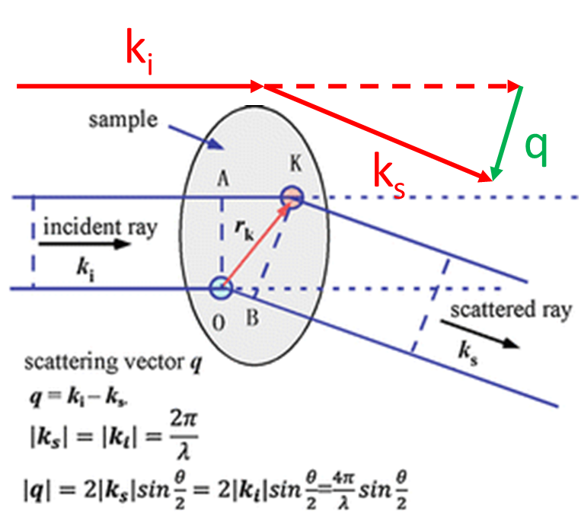
Scattering v.s. diffraction
Courtesy of max planck institute-PD Dr. Claudia Weidenthaler

Slide 3
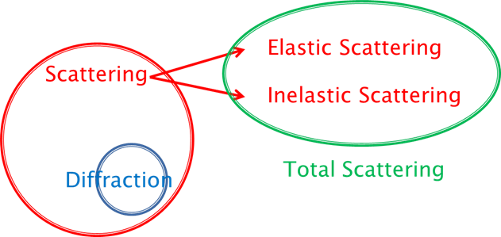
Scattering v.s. diffraction
Diffraction is a very special scattering event when the Bragg’s Law is fulfilled in a periodic structure.
Courtesy of max planck institute-PD Dr. Claudia Weidenthaler

Slide 4
Scattering v.s. diffraction
Diffraction is a very special scattering event when the Bragg’s Law is fulfilled in a periodic structure.
Crystalline & Amorphous materials
Requirement on collection of scattering event as much as possible
Crystalline materials
Requirement on accurate peak shape for structure evaluation
Courtesy of max planck institute-PD Dr. Claudia Weidenthaler

Slide 5
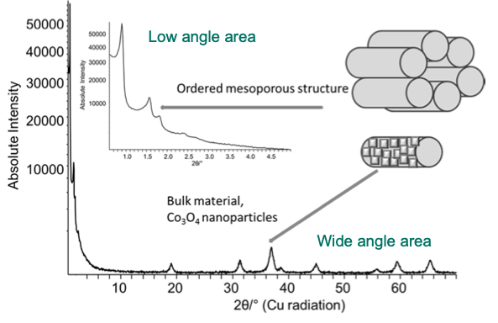
Scattering methods
Bragg’s Law: nλ=2dsinθ
θ++ → d --
Courtesy of max planck institute -PD Dr. Claudia Weidenthaler

Slide 6
Scattering methods
Bragg’s Law: nλ=2dsinθ
θ++ → d --
Bond lengths
Coordination numbers
Local structure
For Total scattering method:
High Q_{max}, high flux
--> high energy X-ray
Courtesy of max planck institute -PD Dr. Claudia Weidenthaler

Slide 7
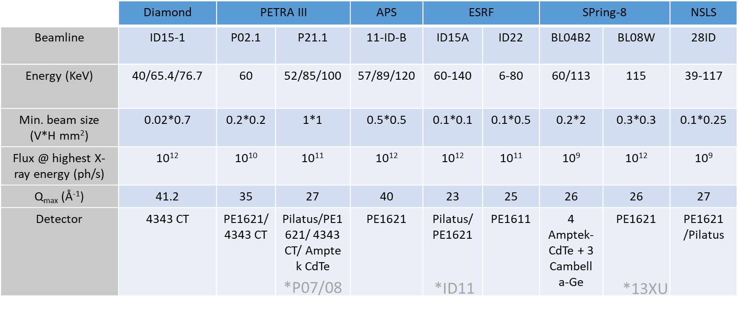
High energy X-ray beamlines
X-ray energy/photon flux, detector capability

Slide 8
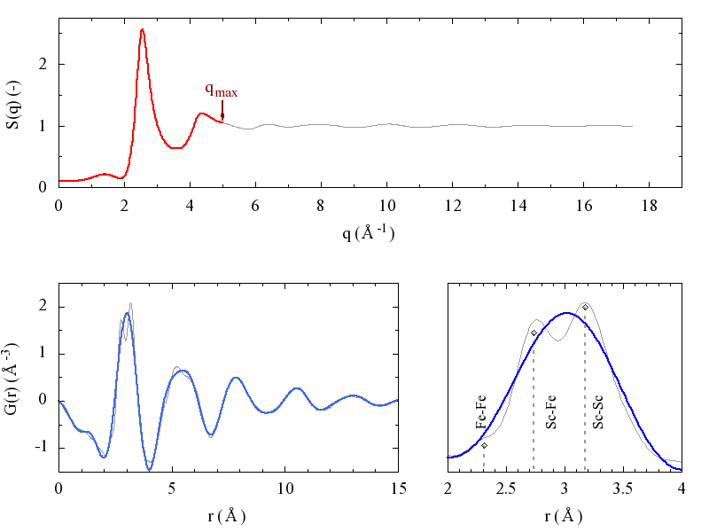
X-ray energy
In order to have sufficient peak resolution in real space one has to collect diffracted photons up to high magnitudes of scattering vector q.
Courtesy of DESY-Dr. Jozef Bednarčík

Slide 9
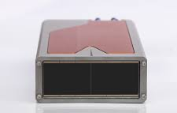
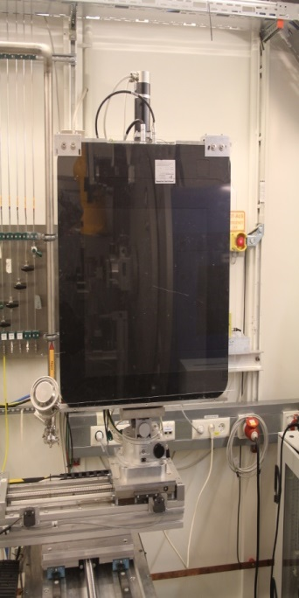
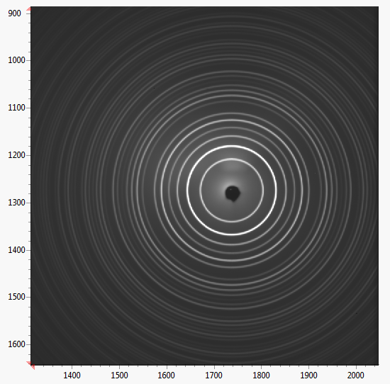
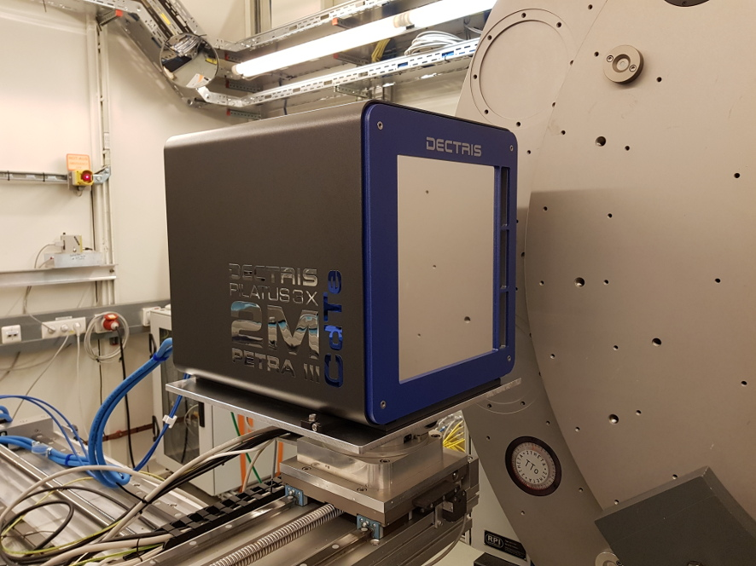
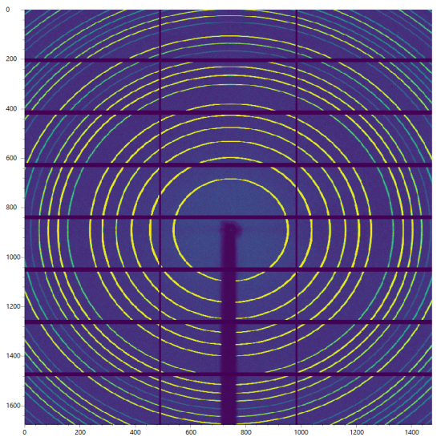
Developments @ Beamline
Detector
Perkin Elmer XRD1621
BL13XU
Lambda *6
LaB₆ (10s exposure)
Dectris Pilatus3 2M CdTe
LaB₆ (1s exposure)

Slide 10
High energy X-ray beamlines
X-ray energy/photon flux, detector capability

Slide 11
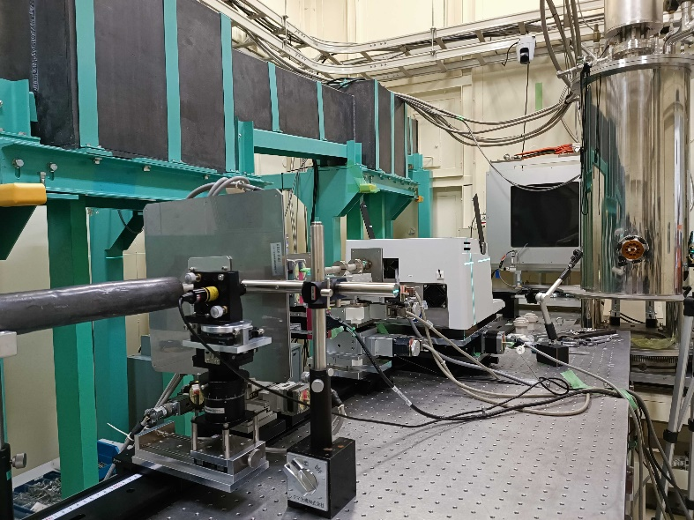
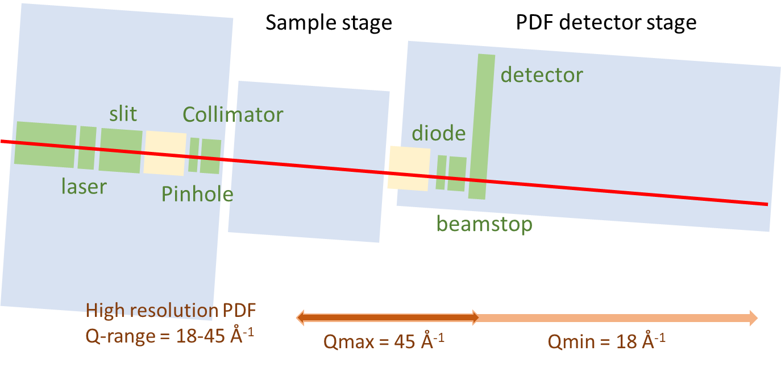
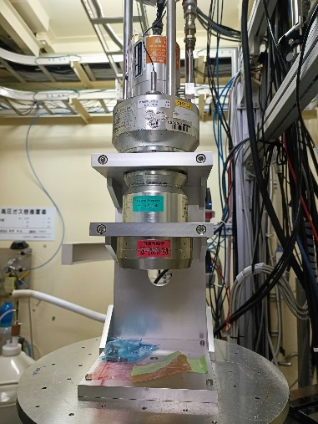
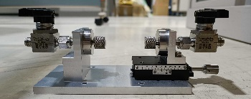
BL08W
115KeV, high flux, 5s - 10min/sample
Single scan
Heating (273K - 1100K)
He- Cryostat (15K - 273K)
Ball-milling (5Hz - 25Hz)
Electrochemistry
Gas adsorption

Slide 12
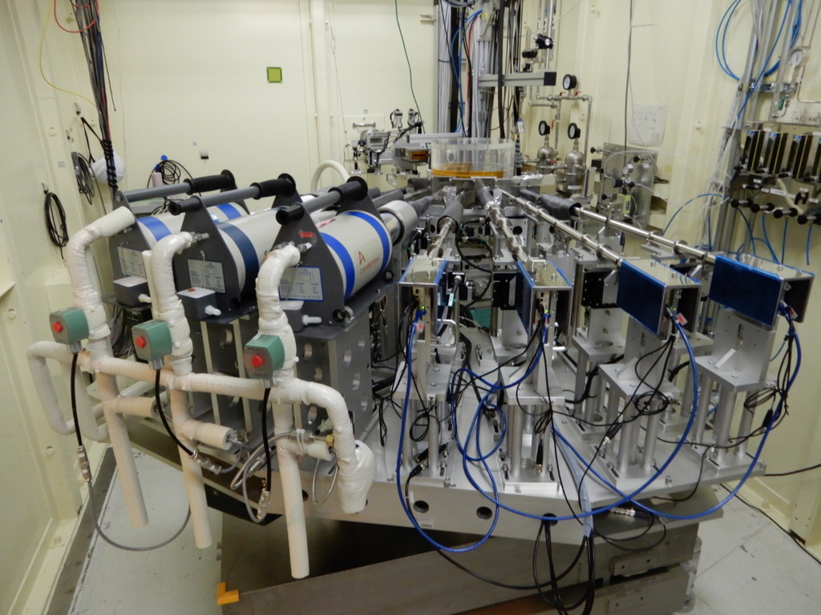
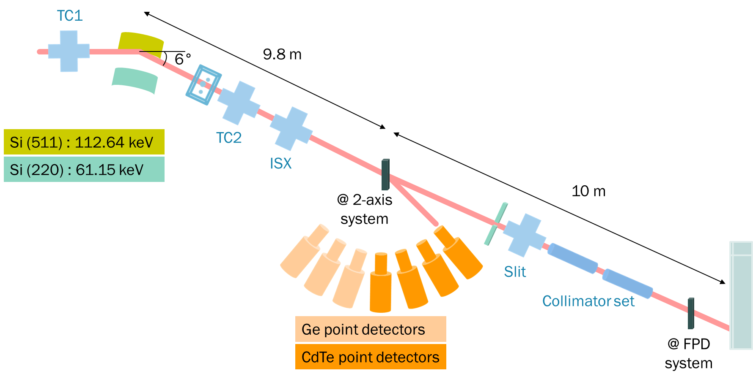
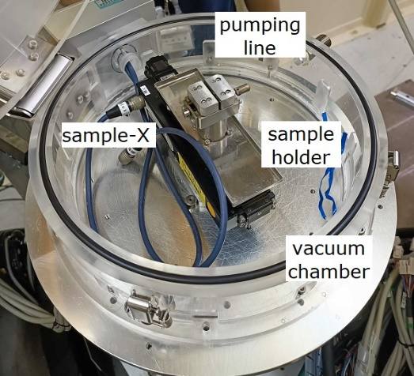
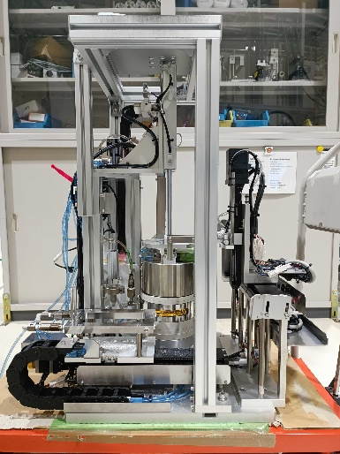
BL04B2
60KeV/113KeV, 2 hr/sample
Single scan
Heating (273K - 1100K)
He- Cryostat (15K - 273K)

Slide 13
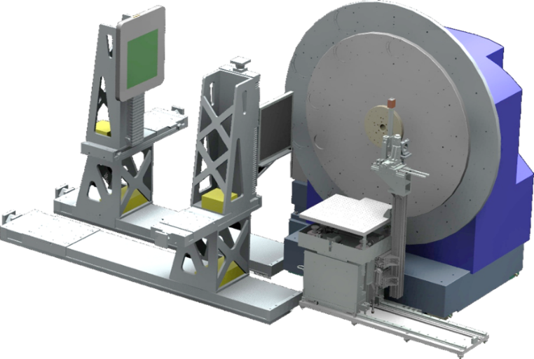
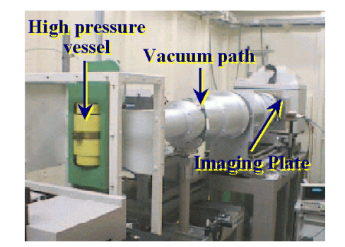
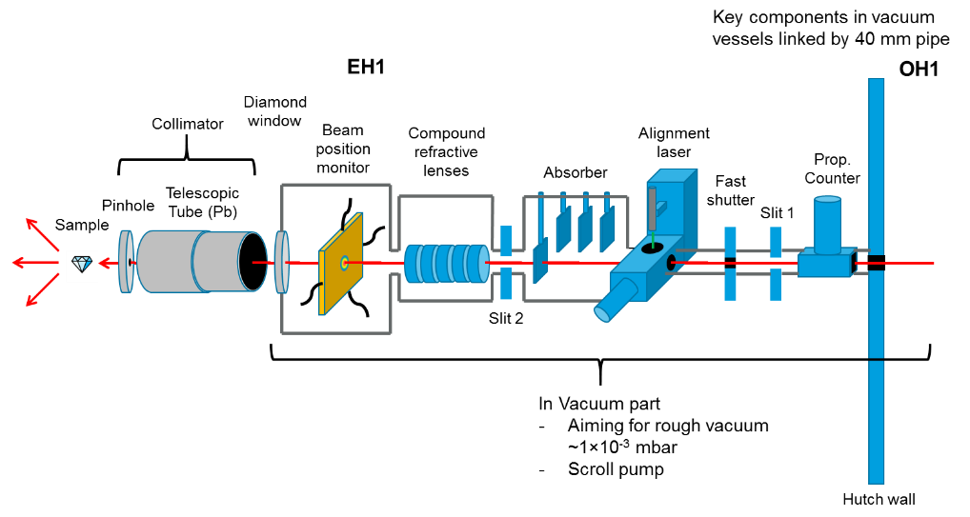
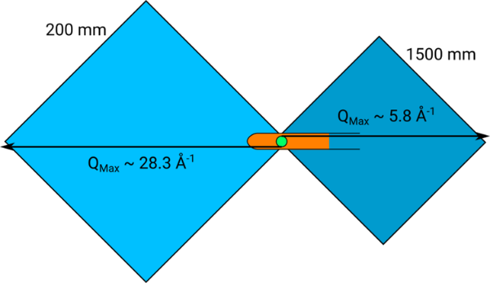
Future development and trend
XRD + PDF
Vacuum Path
Courtesy of DESY-Dr. Michael T. Wharmby, I15-1@diamond website

Slide 14
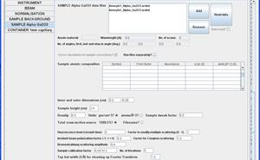
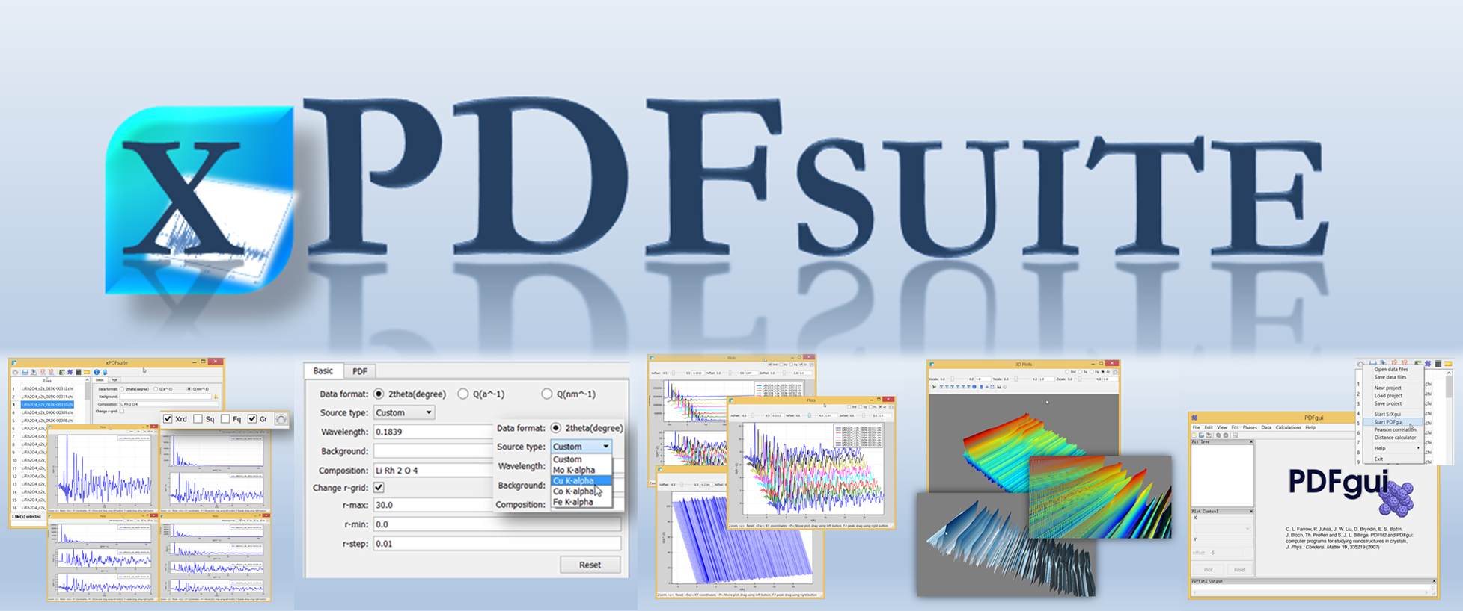
Total scattering data processing
Gudrun
Igor
TOPAS
pdfgetX/pdfgui
GSAS
DAWN

Slide 15
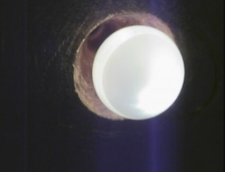
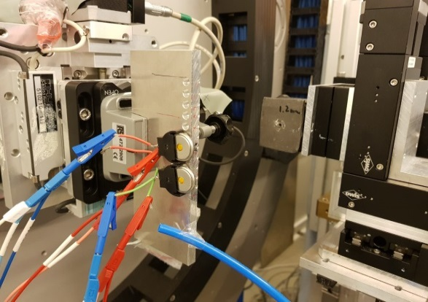
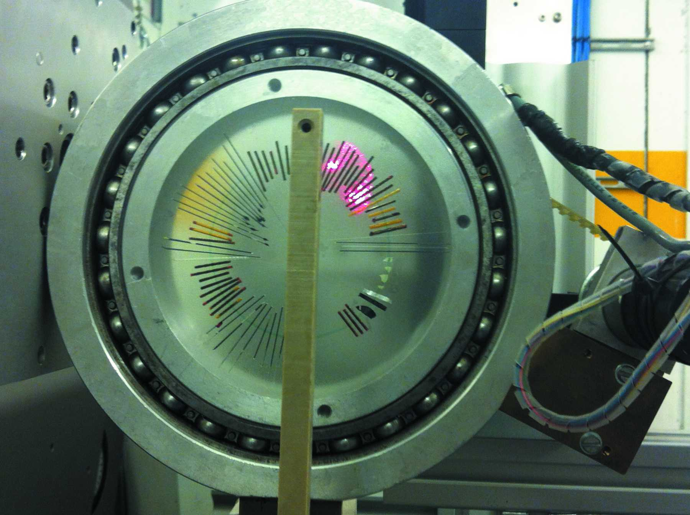
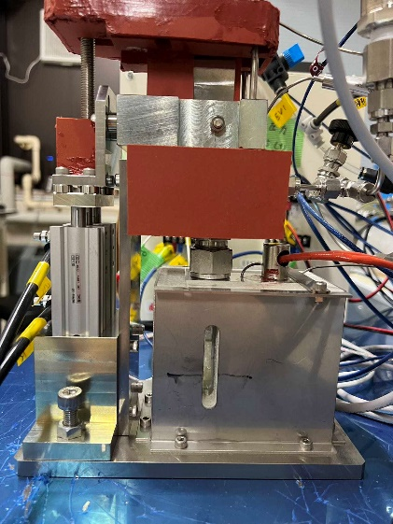
Combined method

Slide 16
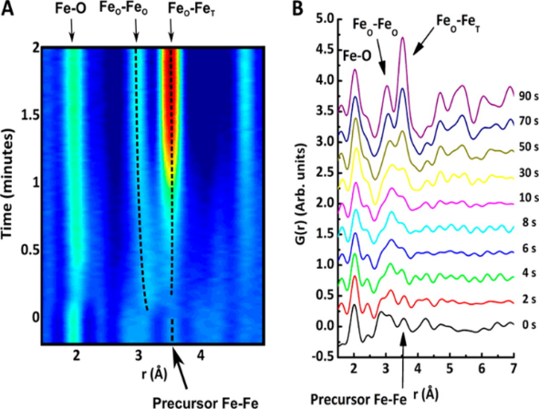
Synthesis Mechanisms
Hydrothermal synthesis process
ACS nano, 2014, 10, 10704-10714
Octa. Fe linked to citrate molecules→
edge-sharing [FeO₆] units → Tetra. iron units
Photocatalysis process
Chem. Eur. J. 2021, 27, 11600
Pentahedra Ti-O in solution → building to anatase by a core-shell structure → Ti-O bond shift (Ti³⁺ and oxygen defects) → crystallized to anatase after 350℃
Notes:
precursor ←→crystalline [Fe(H₂cit)(H₂O)]_{n},
corner-sharing octahedrally coordinated Fe3þ in a polymer-like structure linked by citrate molecules.
Nanoclusters consisting of edge-sharing [FeO₆] units form immediately during the hydrothermal treatment
Tetrahedrally coordinated iron ions are observed after a short time at 320ºC.

Slide 17
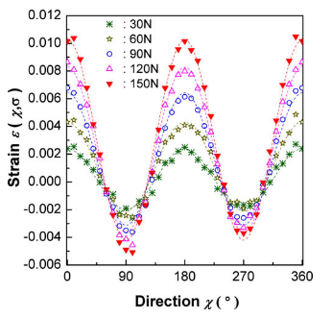
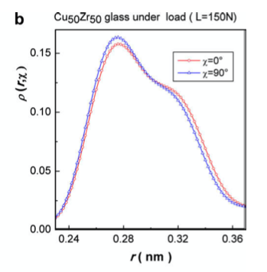
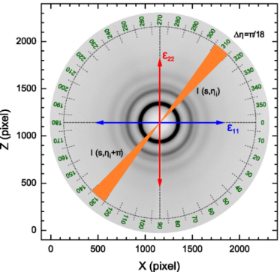
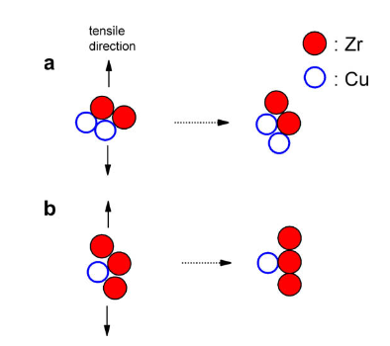
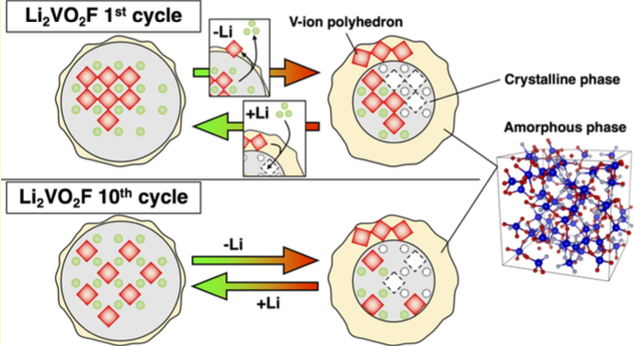
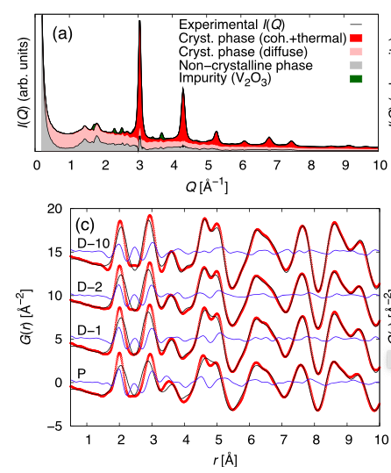
Deformation mechanism and interface
Anisotropic elastic strain of CuZr metallic glasses
Acta Materialia 57 (2009) 4133–4139
Strain-free at 54.7º →Zr-Zr increases along tensile direction while Cu-Zr decreases→ atomic rearrangement was suggested
Mixture of amorphous and crystalline phase
https://doi.org/10.1021/acs.chemmater.1c01466
During delithiation →crystallites turns to amorphous (V-V increase, V-O shift, suggested oct-V→ tetra-V by RMC)
Notes:
Al substitution induces local distortions around the Al/Sn atoms
Oxygen vacancies, induced by the Al substitution, are mostly located on an anion site around the Al atoms

Slide 18
Complementary Methods
Courtesy of DESY-Dr. Hermann Franz

Slide 19
Thank you for your attentions

