Slide 1


The Role of X-ray Absorption Spectroscopy in Developing Novel Heterogeneous Catalysts
WIN 2023
Dr. Molly Meng-Jung Li
Assistant Professor
Applied Physics Department
The Hong Kong Polytechnic University

Slide 2
Outline of talk
Heterogeneous catalysts
Complementary material characterisation techniques
XAS applications for novel heterogeneous catalysts:
Some examples
What we wish to do on catalysis research with XAS

Slide 3

Catalysis and catalyst
A chemical reaction occurs at accelerated rate due to the participation of an additional substance (catalyst)
Catalysis: Concepts and Green Applications. Gadi Rothenberg, Wiley-VCH, Weinheim, Germany
3 |

Slide 4

Homogeneous/heterogeneous catalysis
One phase
homogeneous catalysis
Two phases
heterogeneous catalysis
gas+gas, liquid+liquid
solid+gas, solid+liquid
4 |

Slide 5
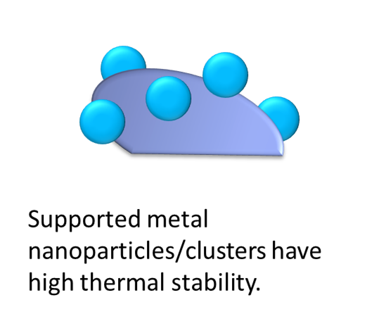
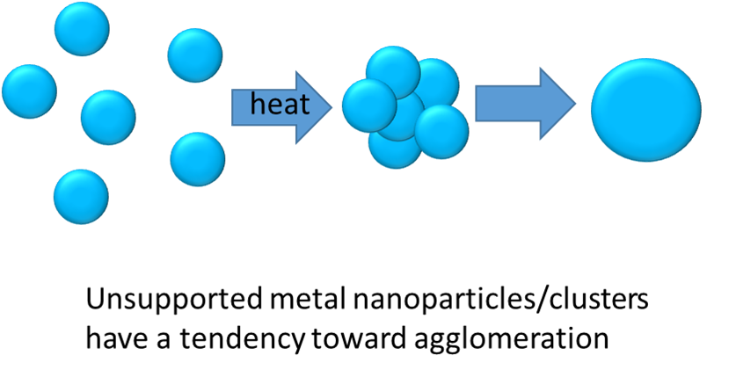
Supported metal catalyst
Support materials: High-surface-area, porous structure, low cost, high stability
For example: metal oxides, zeolites, carbon, etc.
5 |

Slide 6
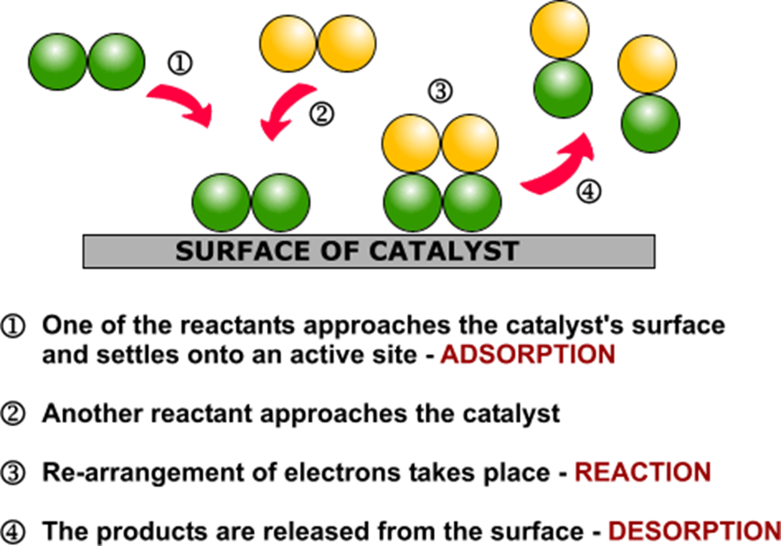
http://organicsynthesisinternational.blogspot.com/2015/07/heterogeneous-catalysis-and-catalyst.html
6 |

Slide 7

http://organicsynthesisinternational.blogspot.com/2015/07/heterogeneous-catalysis-and-catalyst.html
7 |

Slide 8
Complementary characterisation techniques
Crystal structure, local environment:
-XRD: long-range structural order
-XAS/EXAFS: short range structural order and bonding configuration
-Electron microscopy: local structure and morphology
Catalyst surface properties:
-TPR: metal-support interaction
-TPD: interactions between the adsorbed molecules and active sites
-TPO: oxidation property of catalyst, carbon deposition investigation
Electronic properties:
-XAS/XANES & XPS: Oxidation state, charge transfer
Catalyst surface composition:
- XPS & HSLEIS (ion scattering), STEM
Very useful when studying extremely small and active metal catalysts
8 |

Slide 9
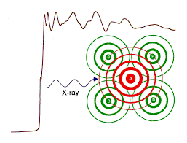

X-ray Absorption Spectroscopy (XAS)
An experimental technique at synchrotron radiation facilities
XAS is an element selective probe (very dilute systems can be studied)
Structural and electronic information
Can analyse amorphous powders/solutions
Powerful technique to resolve local structure/environment
Pics from https:// www.nsrrc.org.tw
9 |

Slide 10
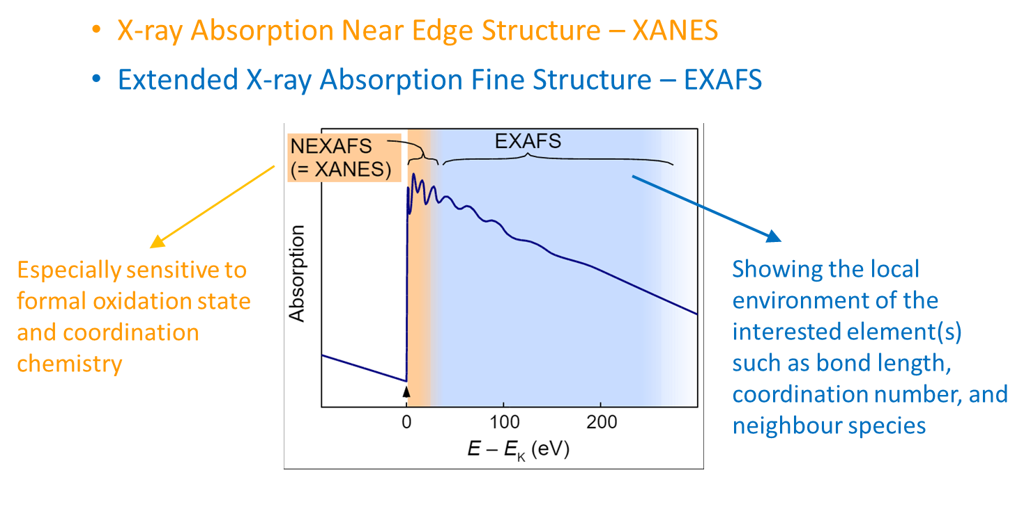
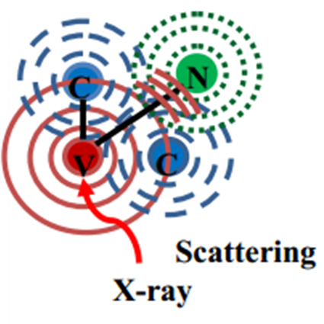
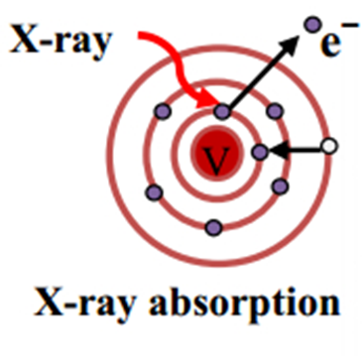
XANES & EXAFS
Pics from XANES: Theory2 - Chemistry LibreTexts,
AIMS Materials Science, 2017, 4(4): 856-866
and https://www.pinterest.com/
10 |

Slide 11
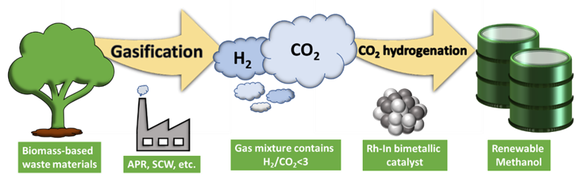
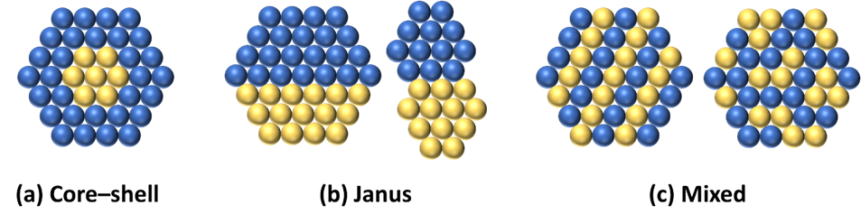
Rh-In bimetallic interface-activity
Rh
Rh+In
CH₄
Add In into Rh
CH₃OH
Efficient H₂ consumption for methanol synthesis
H₂ deficient condition
angew. chem. int. ed. 2020, doi: 10.1002/anie.202000841
11 |

Slide 12
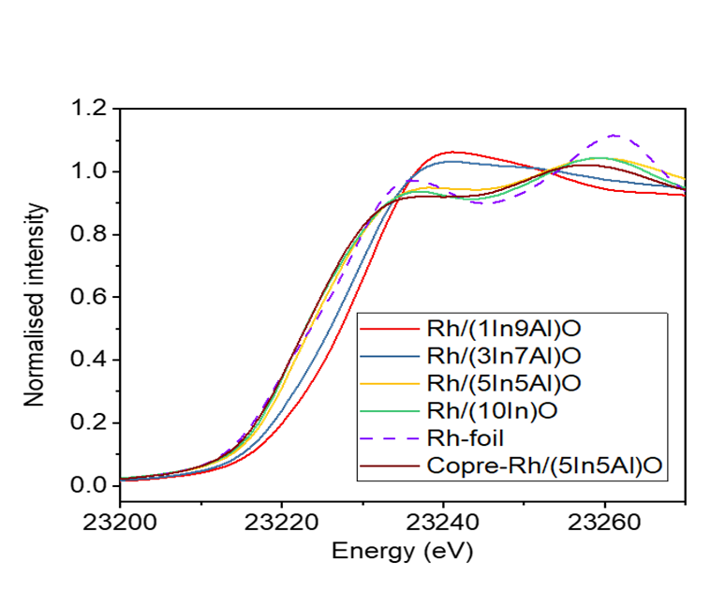
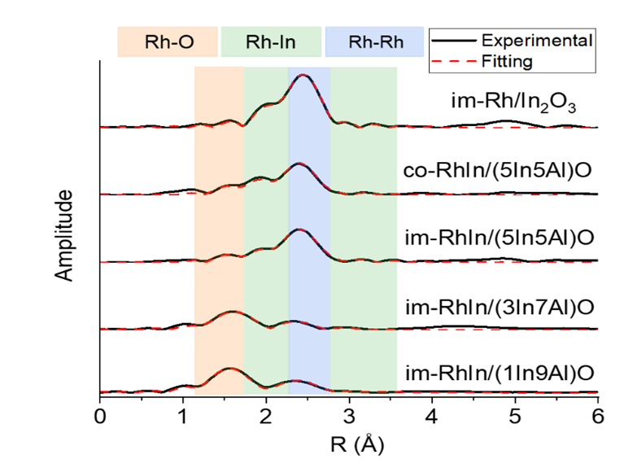
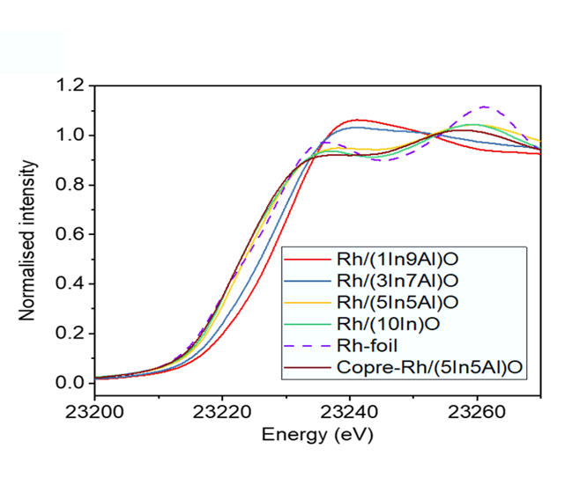
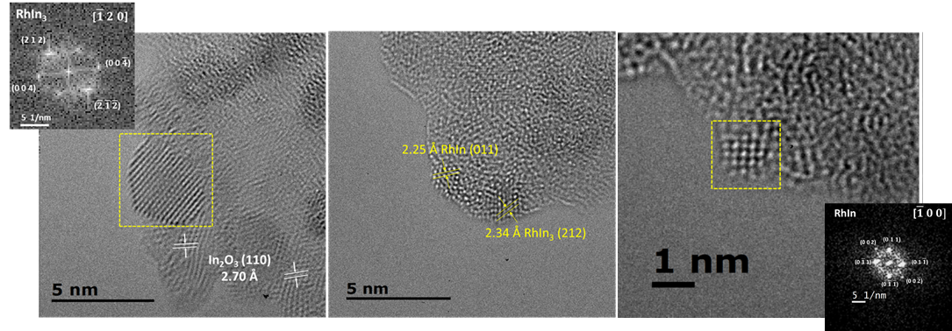
Rh-In bimetallic interface: structural analysis
X-ray Absorption Near Edge Structure
Extended X-ray Absorption Fine Structure
In concentration ↑
Rh absorption edge ↓
Rh K-edge
angew. chem. int. ed. 2020, doi: 10.1002/anie.202000841
12 |

Slide 13
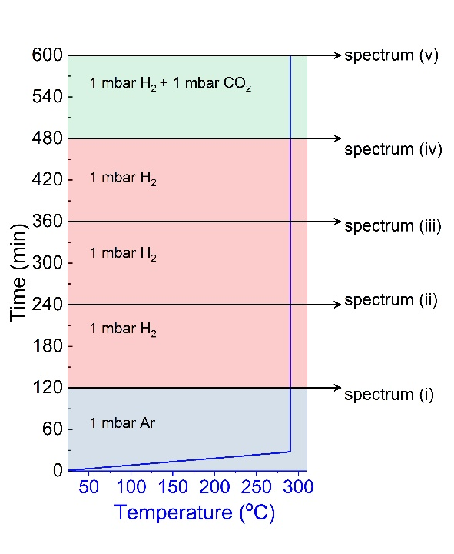
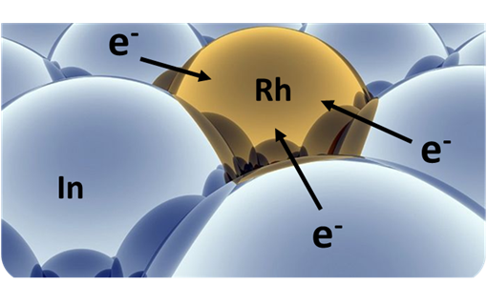
Rh-In bimetallic interface-solid/gas interactions
Monitoring changes of electronic structure under catalyst working condition
NAP-XPS experiment procedures
Rh⁰
Rh³⁺
angew. chem. int. ed. 2020, doi: 10.1002/anie.202000841
13 |

Slide 14
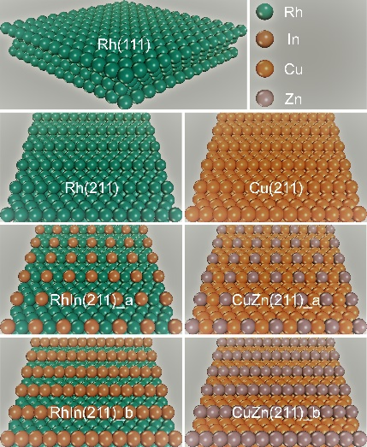
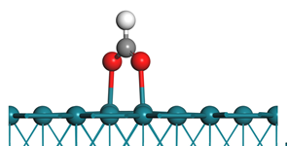
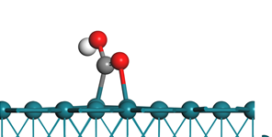
Rh-In bimetallic interface-reaction pathway
[a] E_{diff} (eV): Energy differences of surface adsorbed HCOO* and COOH* species.
E_{diff} = E_{HCOO*} – E_{COOH*}
E_{HCOO*} = E_{HCOO/sub} – E_{sub}
E_{COOH*} = E_{COOH/sub} – E_{sub}
[b] E_{ads} (eV): H adsorption energies
Preferred!
HCOO
(intermediate of CH₃OH formation)
COOH
(intermediate of CO formation)
angew. chem. int. ed. 2020, doi: 10.1002/anie.202000841
14 |

Slide 15
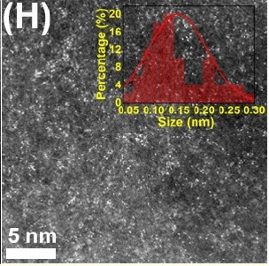
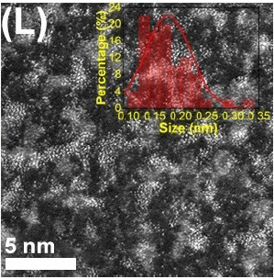
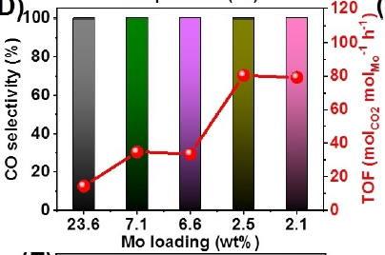
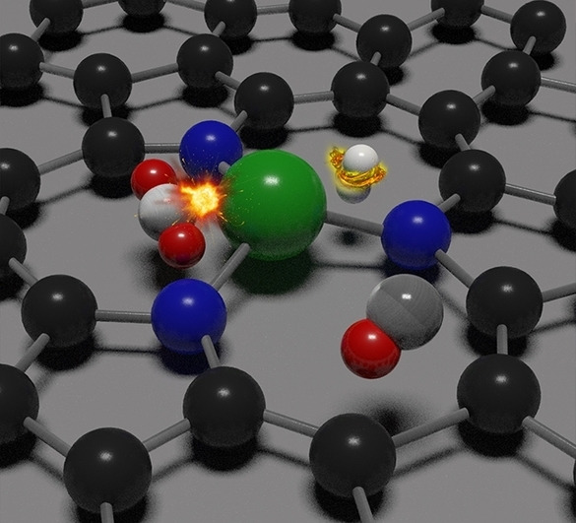
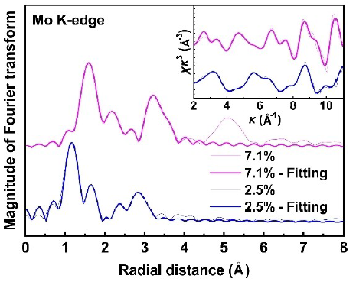
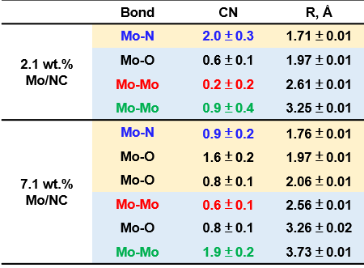
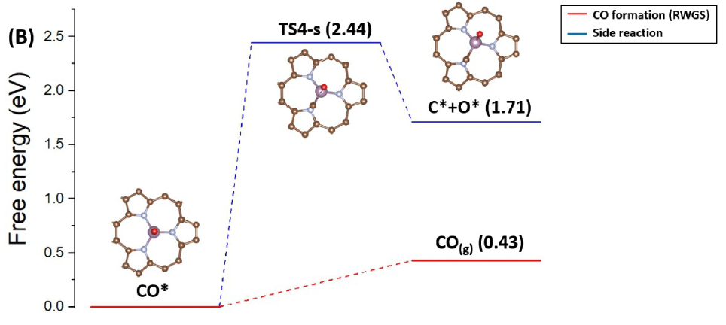
Determine single atom configuration
2.5%
7.5%
Isolated Mo atoms
Mo atoms and clusters were
uniformly distributed
Lowering the Mo loading dramatically
improved the TOF
Reverse water-gas shift reaction
(RWGS, CO₂+H₂ → CO+H₂O)
Sun*, Angew. Chem.Int. Ed.2022,61,e202203836

Slide 16
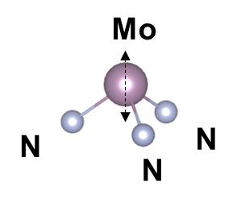
Determine single atom configuration
Further confirming coordination environment from the XANES features:
Mo K-edge XANES simulation
(Å)
Comes from the Mo-N3 configuration
The pre-edge feature comes from Mo-N coordination
As Mo content increases from 2.1 wt.% to 7.1 wt.%:
Mo/NC phases decreased, making less Mo-N3 contribution;
Therefore the pre-edge intensity decreased
Sun*, Angew. Chem.Int. Ed.2022,61,e202203836

Slide 17
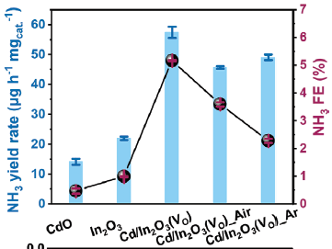
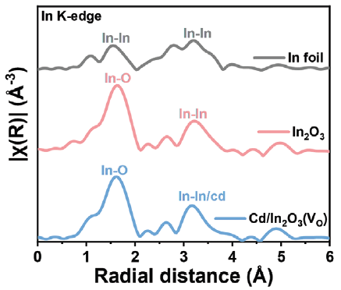
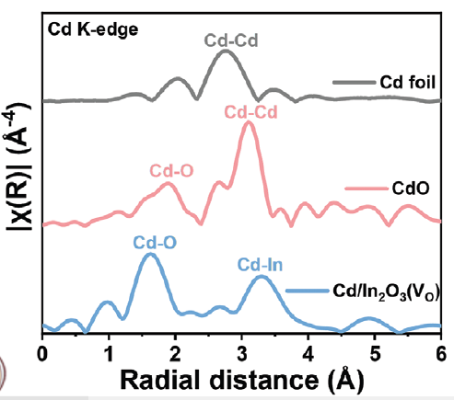
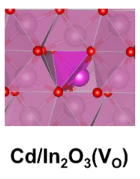
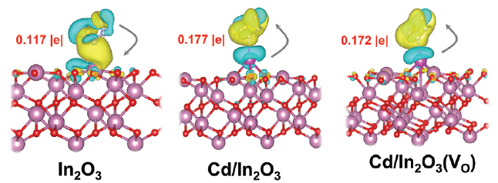
Determine the dopant atom configuration
Sun Zhenyu (BUCT)*, Adv. Funct. Mater. 2023, 33, 2209843
NH₃ Electrosynthesis
NRR activity: Cd/In₂O₃ (O_{V}) is the best
Cd substitutes the In atoms in In₂O₃ lattice.
Electron transfer from Cd/In₂O₃ and Cd/In₂O₃(V_{O}) to *N₂H₂ is higher than that of In₂O₃: stronger electron interaction

Slide 18
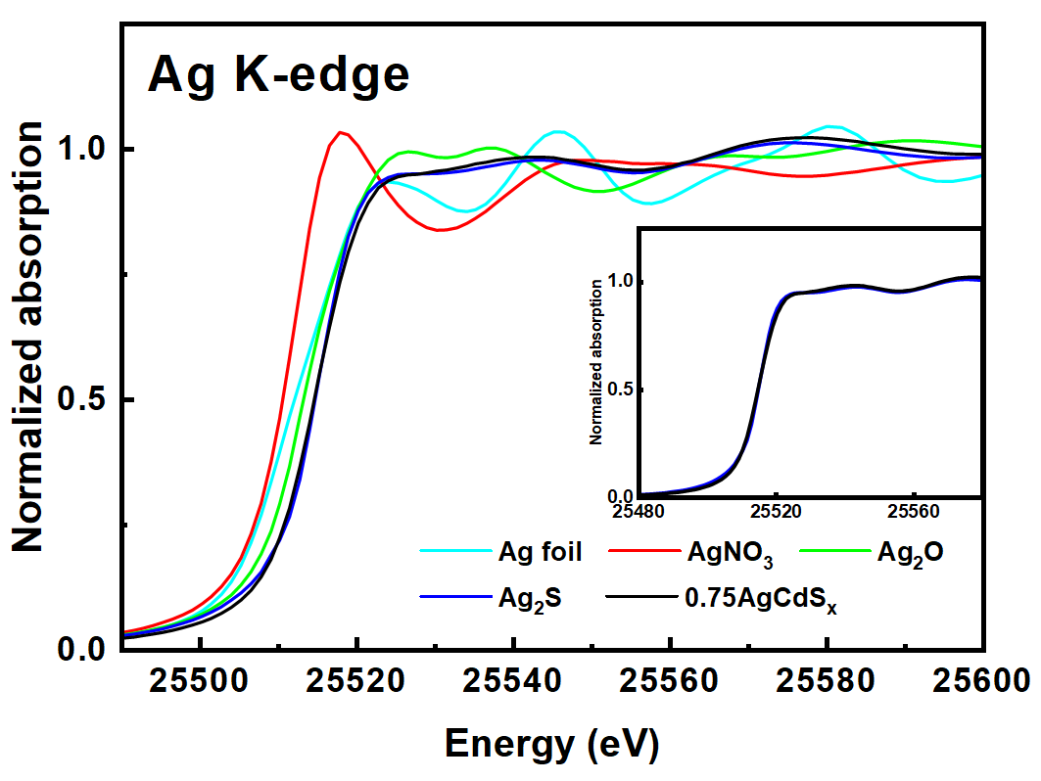
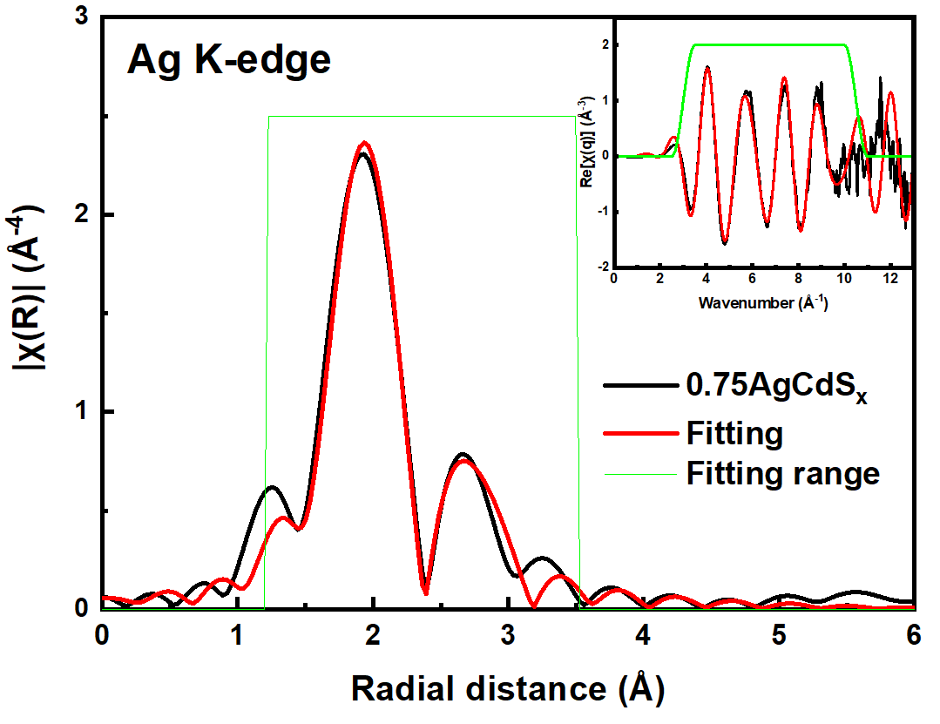
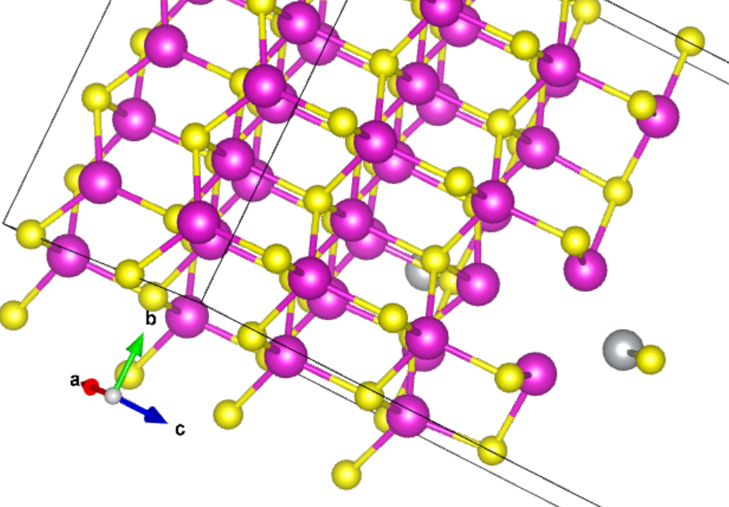
Determine the dopant atom configuration
Sample: When Ag atoms are doped to CdS, where will it stay?
Ag K-edge EXAFS fitting
parameters of AgCdS_{x}
Ag K-edge XANES
Ag K-edge EXAFS
Bond | CN | R, Å
Ag-S | 1.3 ± 0.1 | 2.47 ± 0.01
Ag-Cd | 1.6 ± 0.3 | 2.73 ± 0.04
Ag-Cd | 0.7 ± 0.2 | 2.91 ± 0.01
Ag-S
Ag-Cd
AgCdS_{x} exhibits a nearly identical XANES spectrum to Ag₂S, indicating:
Ag atom is surrounded by S atoms
Valance of Ag is nearly 1+.
AgCdS_{x} EXAFS can be well fitted using Ag-S and Ag-Cd bond
(Details see above table)
S vacancy
From XANES and EXAFS features, combined with DFT calculation results
The site of Ag atoms was determined
Unpublished

Slide 19
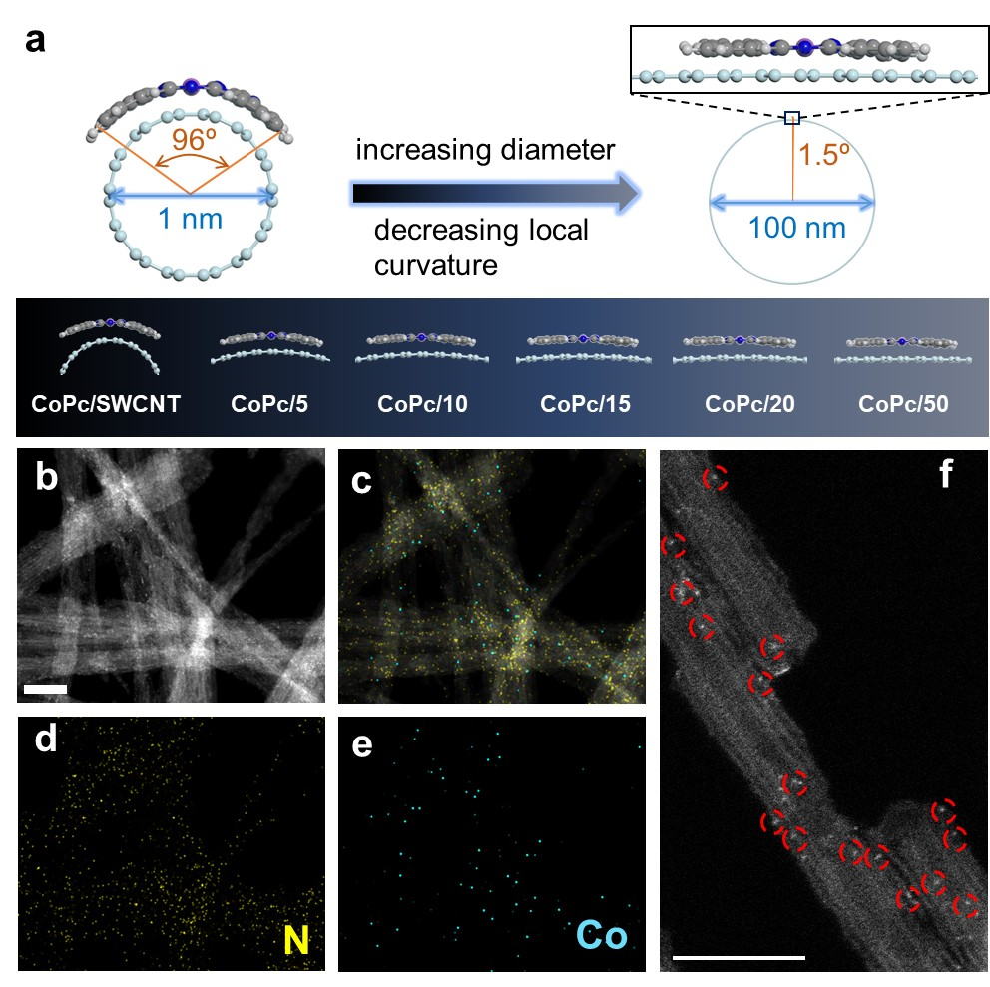
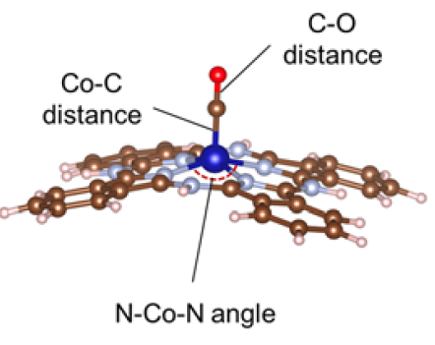
Support-induced local strain in molecular complex
Electrochemical CO₂ reduction performance
Curved CoPc has stronger CO binding
1s→4pz: Decline in CoPc/CNTs due to decreased symmetry
1s→4px,y: Lower valence of CoPc/CNTs due to interactions
Co-N1 length: elongated due to high degree of molecular bending for CoPc/SWCNT
Ye*, Nat. Catal., Accepted.
Notes:
Phthalocyanine 酞菁

Slide 20
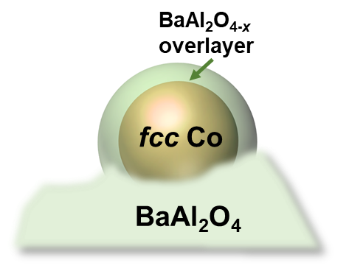
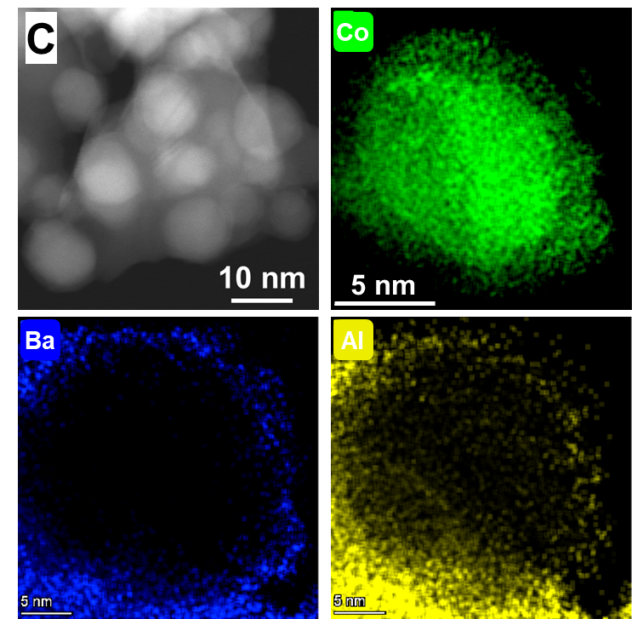
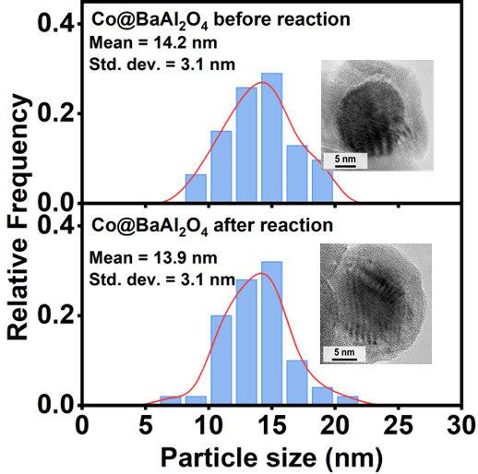
Identify unique core/shell interfaces
Core@shell configuration
The EXAFS of the post-reaction Co@BaAl₂O₄ reveals the distinct Co and BaAl₂O₄ phases, suggesting no migration of Co species at the metal-support interfaces during the long-term testing.
Unpublished

Slide 21
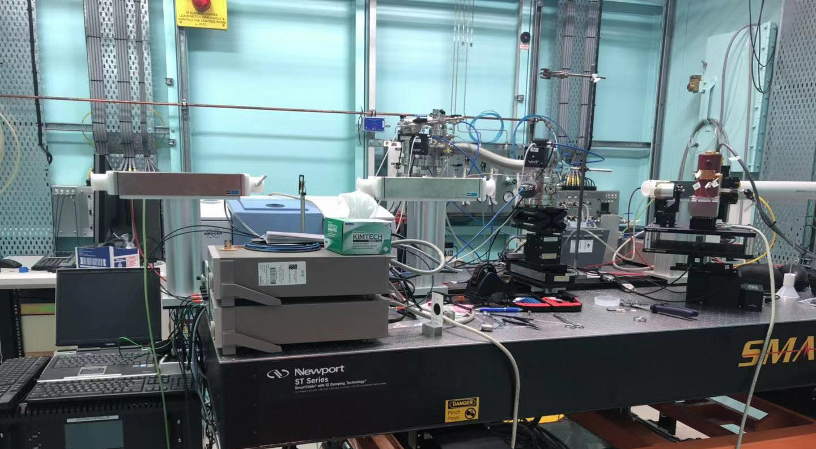
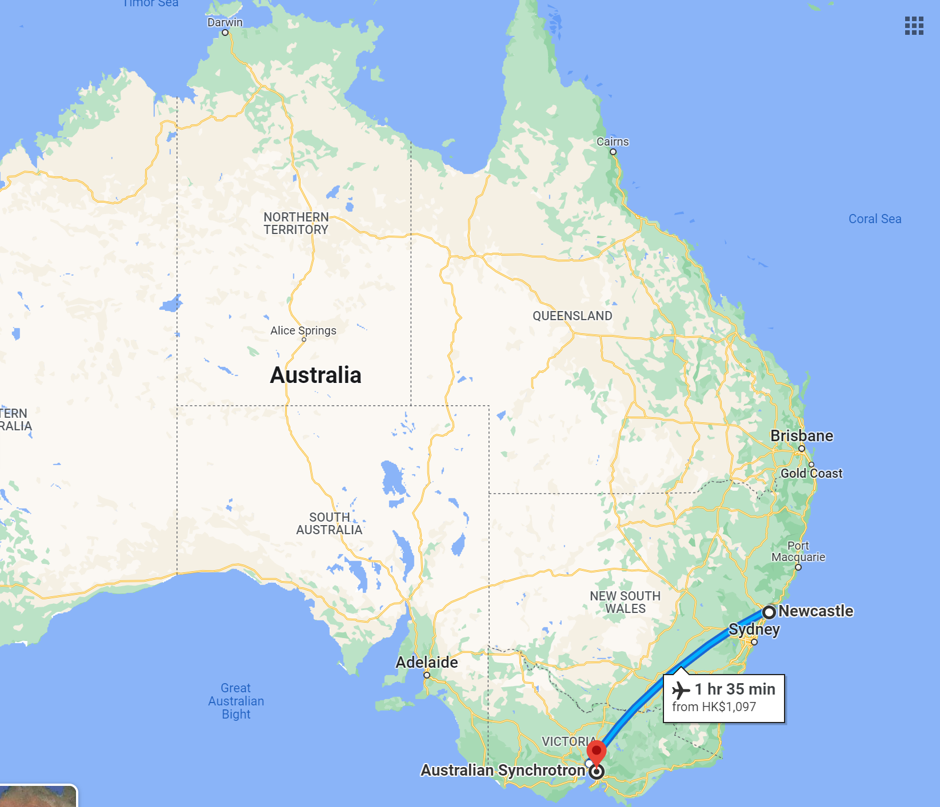
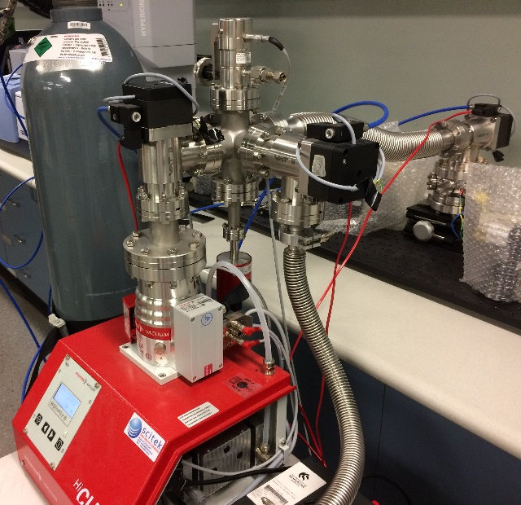
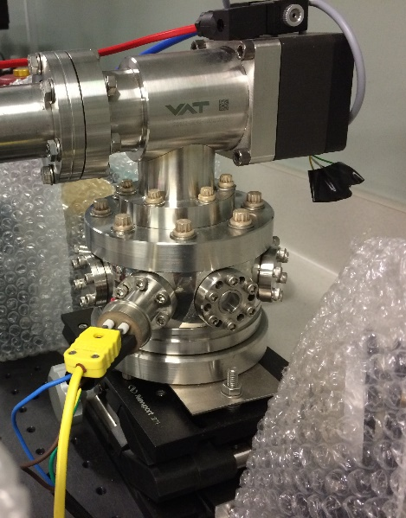
What we wish to do with XAS
In-situ XAS: real time determination of the
local chemical/structural environment
In-situ IR: interrogation of reactants, intermediates,
reactively-formed products bound at nanoparticle surface
Provide quantitative structure-function relationships
Our FTIR
Our Mass Spec (on the floor)
Other techniques:
XAS/Raman
XAS/XRD
XAS with ?
21 |

Slide 22
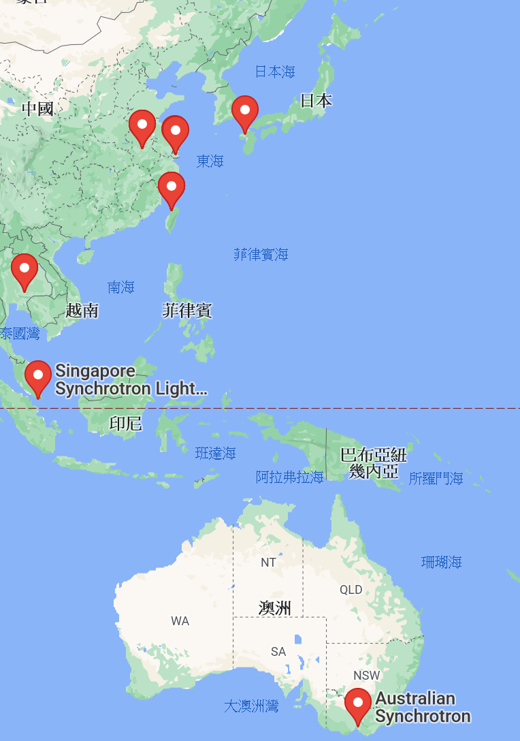





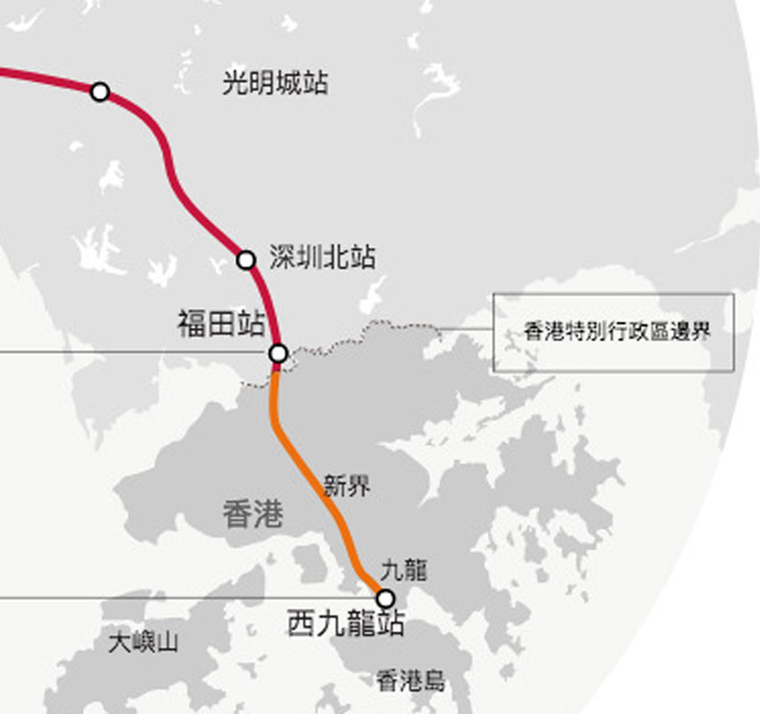


Now
🙁Far away
🙁No regular access
🙁Long waiting time
🙁Costly
🙁Limited gas options
Synchrotron resources
With SILF
🙂Easy access
🙂Great connection
🙂Most advanced
🙂Easy communication

