Slide 1
DAQ progress
2022.11.10

Slide 2
DAQ status
Update pixel configuration calculation program
Use a 512 * 1024 matrix to store the configuration information of the pixel array
To open pixels in row i and column j, set the corresponding position of the matrix to 1
Read the number of each bit of the matrix by column
0 0 0 · · · 0 0
0 · · · 0 0
· · ·
· · ·
· · ·
0 0 0 · · · 0 0
512
Read column by column
1024

Slide 3
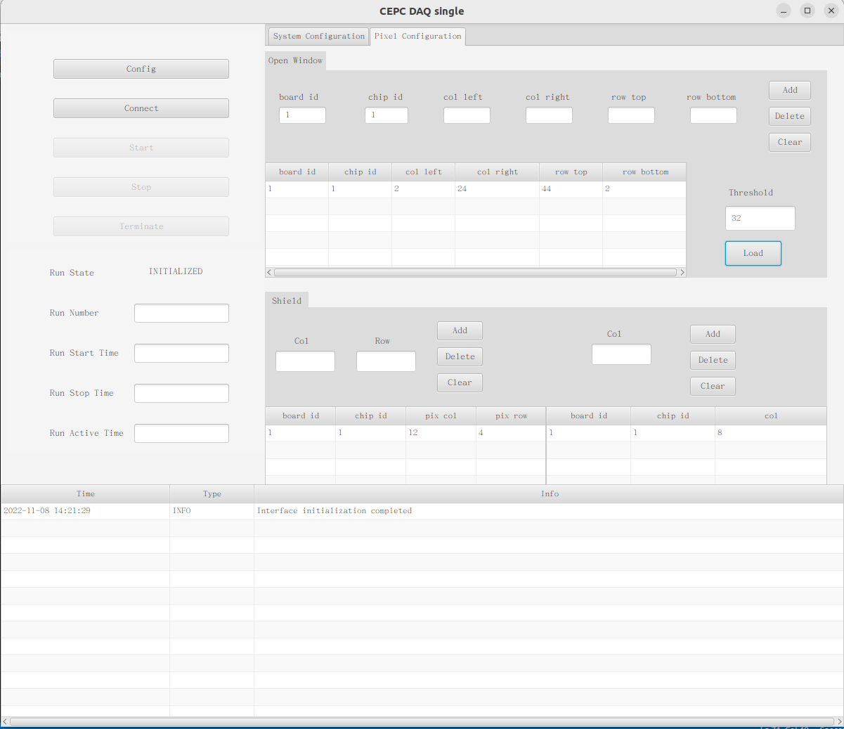
DAQ status
New functions and interfaces
Open rectangular window
Noise shielded pixels
Masked column

Slide 4
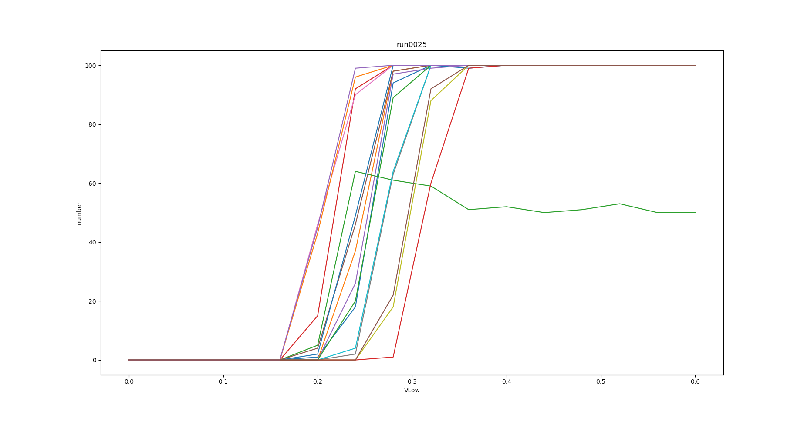
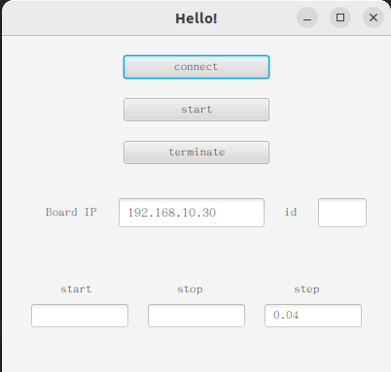
DAQ status
Threshold scanning
Is this normal?

Slide 5
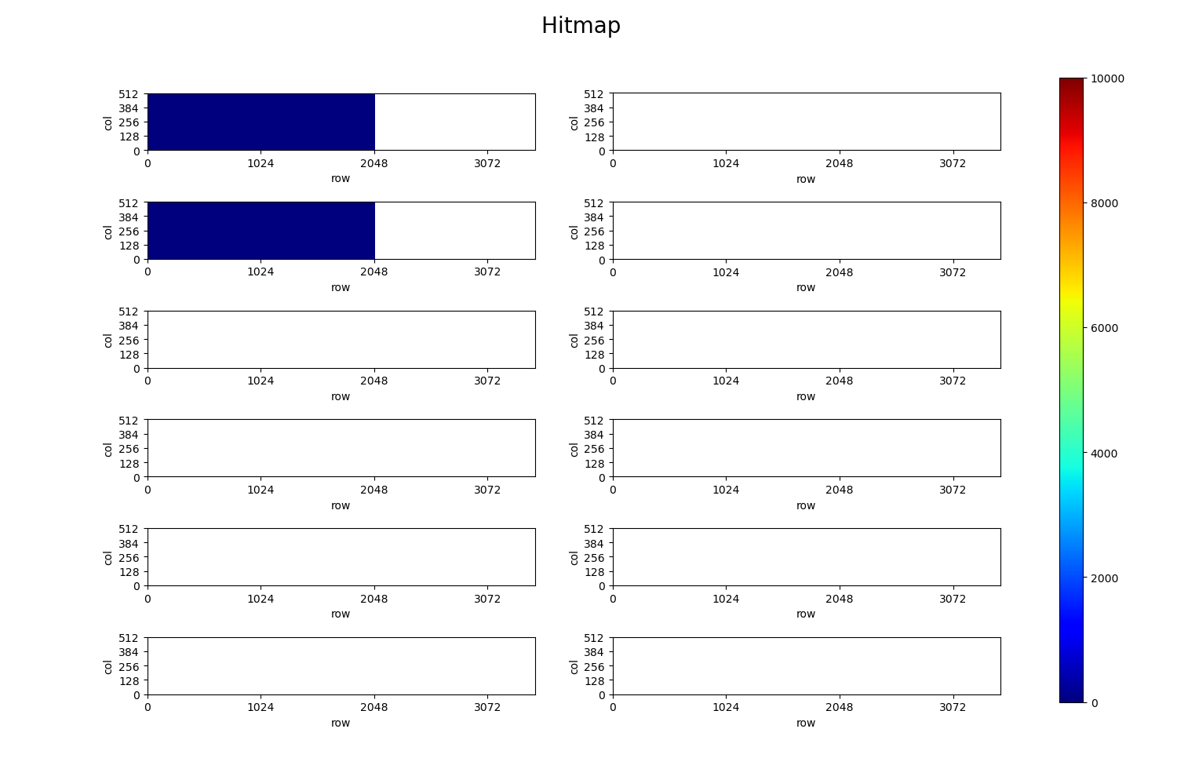
DAQ status
Online drawing
The speed is relatively slow.
At present, it is trying to improve and improve the drawing efficiency
Only the hit chips are displayed

Slide 6
Next
Test the correctness and stability of new functions
Improve the on-line hit map display program
Improve the threshold scanner to improve its stability
Multi chip configuration ?

Slide 7
THANKS

