Slide 1
Electronic progress
2022/11/10
Yan Ziyue

Slide 2
Flex readout
There are 3 flex boards with a total of 4 chips on them marked as 1_4, 1_7, 2_5 and 3_7. (1_4, flex board No.1, chip No.4)
While running in the OCT mode, the readout of 2_5 is most stable while no right results could be seen among the readout outcomes of 1_7 .
When testing the a_pulse readout, there no chips could providing reasonable data and the data would come out whether the a_pulse was sent or not.

Slide 3
OCT readout

Slide 4
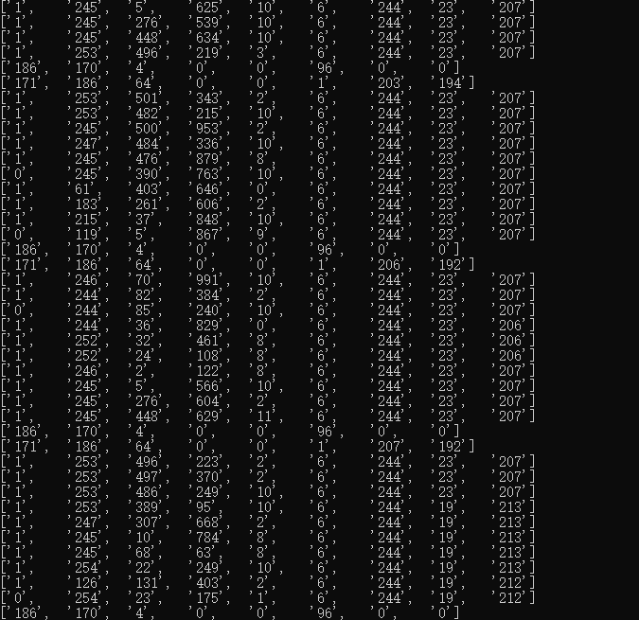
Pixel readout

Slide 5
INTERPOSER
A new INTERPOSER design matching current flex has been submitted to the manufactory.
Hopefully, the PCB products of INTERPOSER will arrive in next week.

