Slide 1
11/10

Slide 2
Build event
Statics: only have Timestamp, Row&Col
Build event: Cut events and translate origin statics to time&position
Row&Col to Position: mutiple pixel’s size
Timestamp to time:
0101 ..... 0101 .......... 1111
Small:8bit
Big: 28 bit
Time/Clock = (1<<28)*Big_ts + Small_ts
Code:/afs/ihep.ac.cn/users/h/huyiming/knossos_i/class

Slide 3
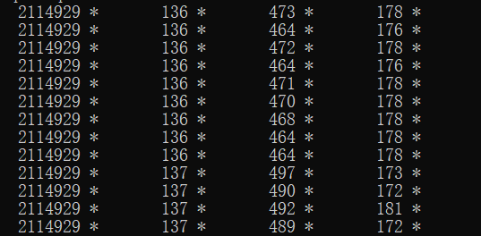
Judgement of Event
timeFPGA
timeChip
row
col
Using time as criterion

