Slide 1
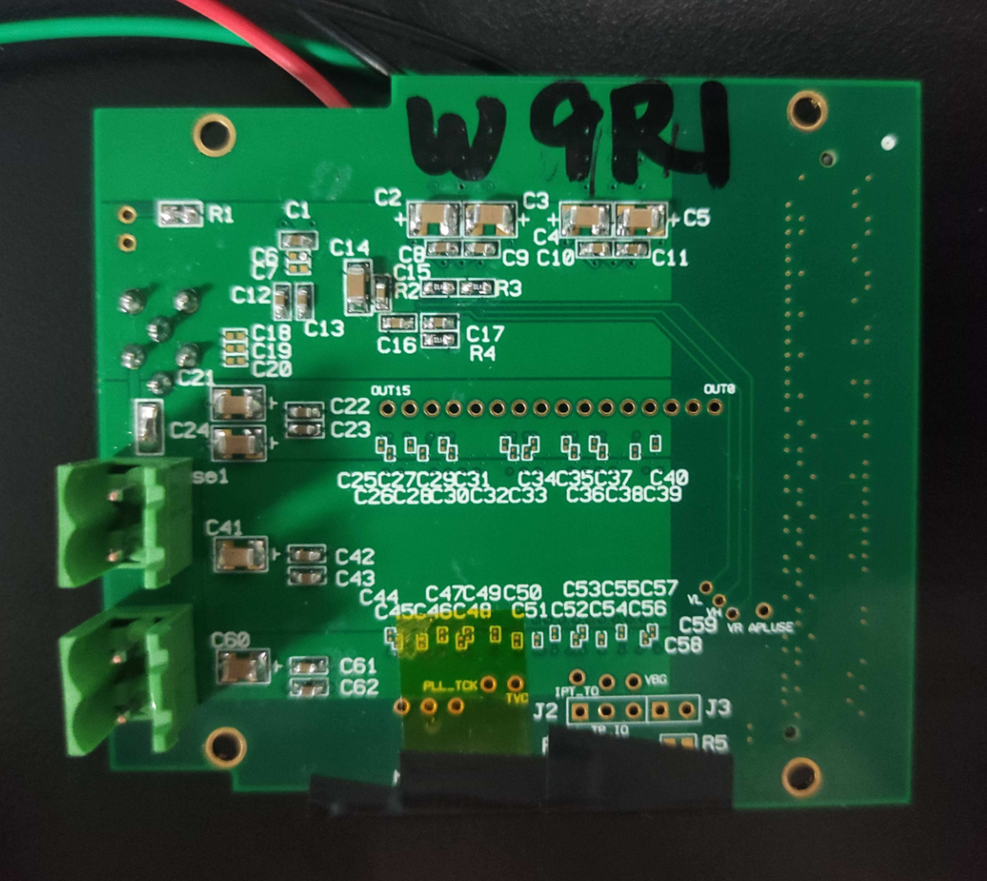
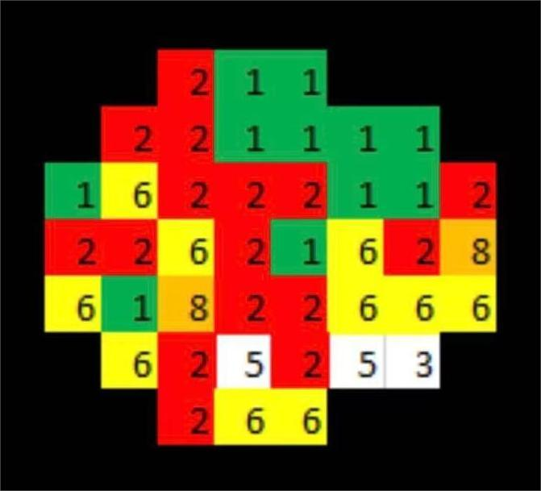
Chip W9R1 and W9R2 Test
Xiaoxu Zhang 2022/11/10
W9R1
(0,-3)
W9R2
(1,-3)
test board v1.1
Wafer 9 is based on the modified progress

Slide 2
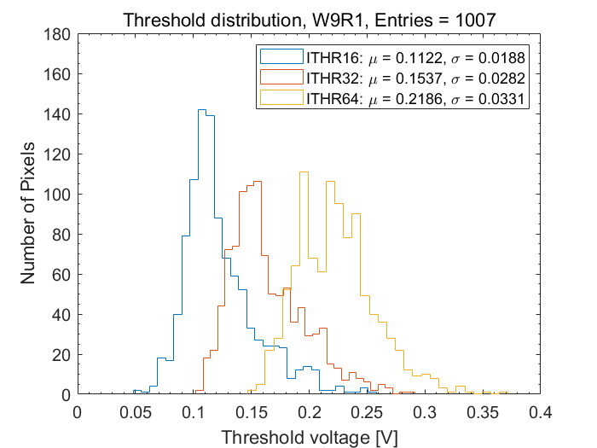
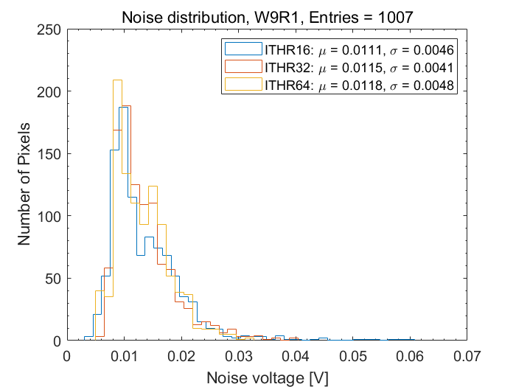
Chip W9R1
Power current [A] |  |  | Bias Voltage [V]
3V | 1.8A | 1.8D | VL | VH | VR | VCLIP | VCASP | VCASN | VCASN2
0.003 | 0.068 | 0.199 | 0.47 | 1.598 | 1.65 | 0.02 | 0.03 | 0.519 | 0.555
more like Landau distribution

Slide 3
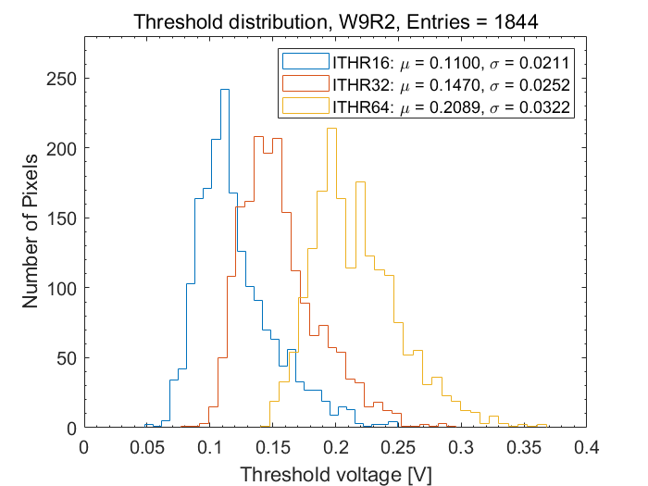
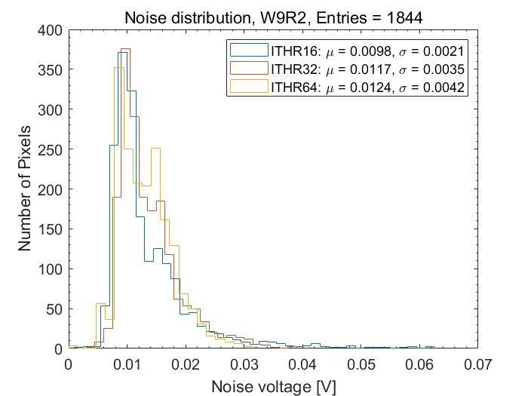
Chip W9R2
needs 355 column level mask
Power current [A] |  |  | Bias Voltage [V]
3V | 1.8A | 1.8D | VL | VH | VR | VCLIP | VCASP | VCASN | VCASN2
0.003 | 0.063 | 0.21 | 0.47 | 1.599 | 1.65 | 0.02 | 0.03 | 0.513 | 0.553
more like Landau distribution

Slide 4
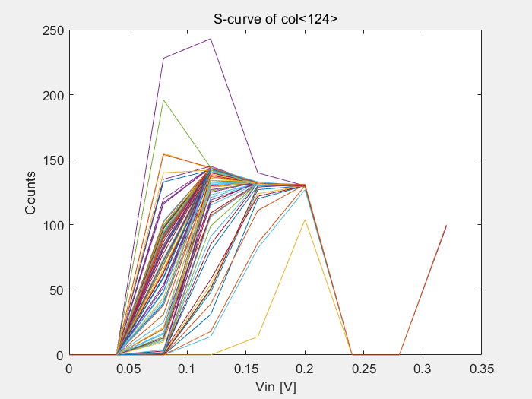
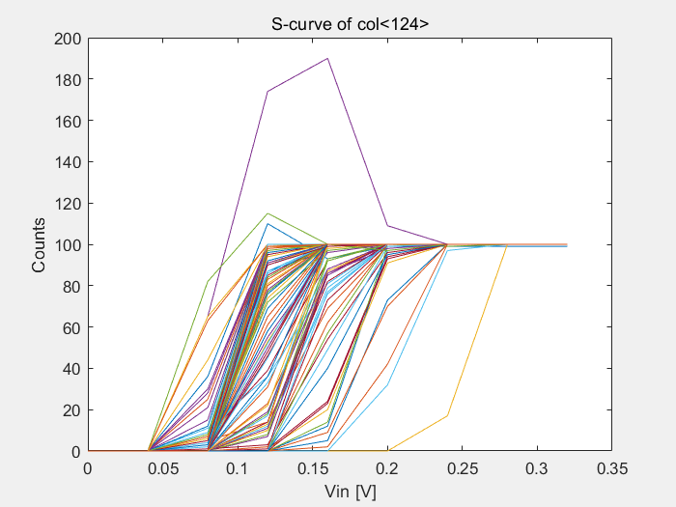
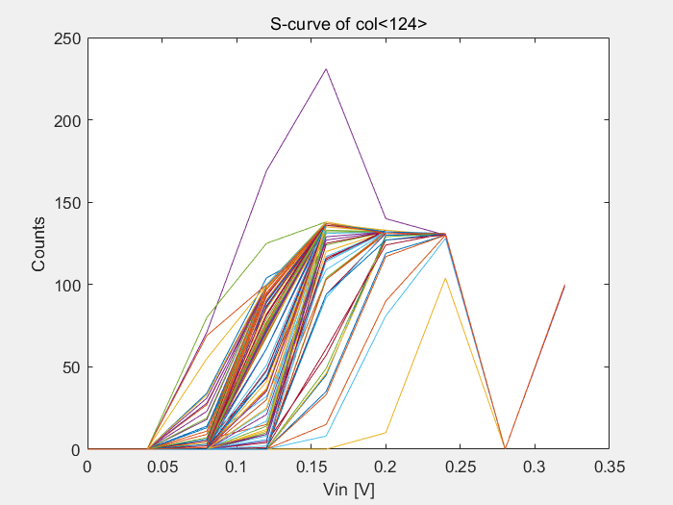
Nonrepeatability of same pixels both W9R1 and W9R2
more than 100
first time, bad data
second time, good data
third time, bad data

Slide 5
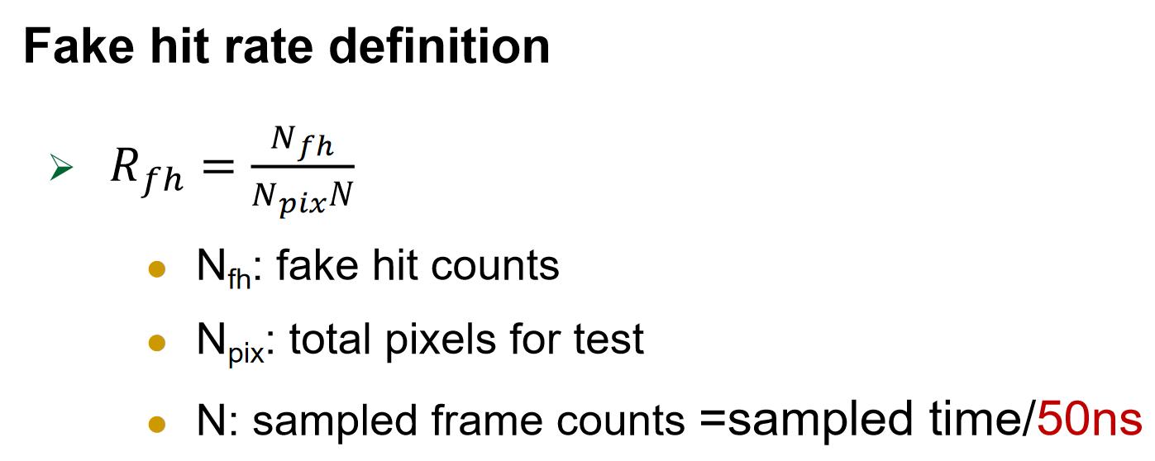
Fake hit rate test
 |  | Fake hit | Sampled time [s] | Fake hit rate
W9R1 | test 1 | 70799 | 100 | 6.8e-11
 | test 2 | 182 | 100 | 1.7e-13
 | test 3 | 2065 | 1800 | 1.1e-13
W9R2 | test 1 | 673819 | 100 | 6.4e-10
 | test 2 | 650 | 100 | 6.2e-13
 | test 3 | oscillates
Test process (ITHR 32)
test 1: no mask pixels, offline 100s
test 2: mask fake hit pixels in test 1, offline 100s
test 3: mask fake hit pixels in test 1 and test 2, offline 30min

Slide 6
summary
1. W9R2 needs column level mask, W9R1 does not.
2. Compared to W9R1, W9R2 has higher fake hit rate and easy to oscillates.
3. Threshold and noise distribution of both W9R1 and W9R2 is more like Laudau than Gaussian.
4. For both W9R1 and W9R2, S-curve test is nonrepeatability of same pixels.

