Slide 1
Preliminary considerations for the spin navigator
李民祥
Notes:
大家好，我是李民祥。今天我要讲的题目是通过让平衡极化率达到80%以上来维持对撞环中电子束的极化率在整个对撞时间内都大于80%。

Slide 2
The spin control of proton
A spin direction control scheme for the pRing: the usual method
IP
Spin Rotator
Only one spin closed orbit in the usual ring accelerator;
Spin direction
The OTM with an angle $φ=2πv_{spin}$ around the rotation axis, the spin closed orbit, $\overset{⃑}{u}=\left(u_{x},u_{s},u_{y}\right)$:
$$\left(\begin{matrix}\cos{φ} & \sin{φ} & 0 \\ −sin{φ} & \cos{φ} & 0 \\ 0 & 0 & 1\end{matrix}\right)$$
The spin direction needs to be equal to the spin closed orbit, which is usually the direction of the bending magnetic field of the arc section.
Fig.1. the usual method

Slide 3
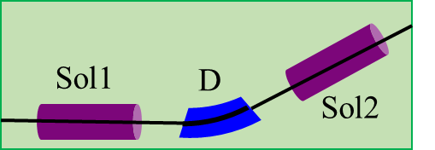
The spin control of proton
A spin direction control scheme for the pRing: Transparent Spin Method
IP
All directions are the spin closed orbit in the pRing, a figure-8 shaped synchrotron;
Spin navigator
Spin direction
The OTM with a rotation angle $φ=2πv_{spin}=0$:
$$\left(\begin{matrix}\cos{φ} & \sin{φ} & 0 \\ −sin{φ} & \cos{φ} & 0 \\ 0 & 0 & 1\end{matrix}\right)$$
$$\left(\begin{matrix}1 & 0 & 0 \\ 0 & 1 & 0 \\ 0 & 0 & 1\end{matrix}\right)$$
The Spin Transparent ring:
Set any required spin direction at any orbital location in a collider;
Maintain stable polarization during an experiment;
Accelerate the beam without polarization loss;
Fig.2. the Transparent Spin Method
Filatov Y N, Kondratenko A M, Kondratenko M A, et al. Transparent Spin Method for Spin Control of Hadron Beams in Colliders[J]. Physical Review Letters, 2020, 124(19): 194801.

Slide 4
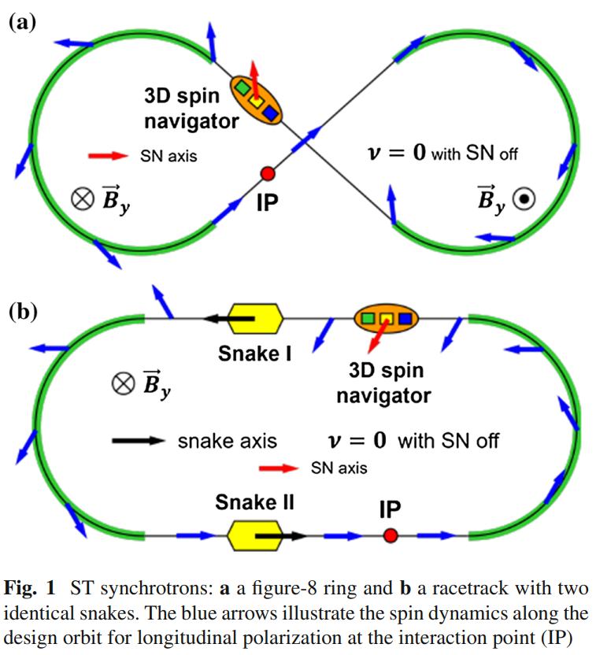
The spin control of proton
Transparent Spin
(c)
$$Gγ=k$$

Slide 5
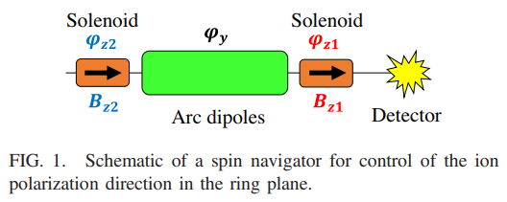
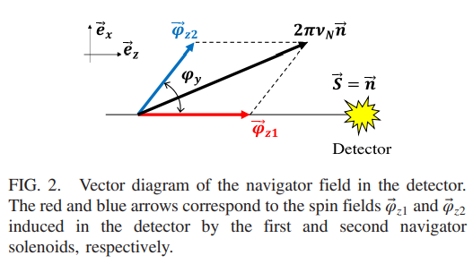
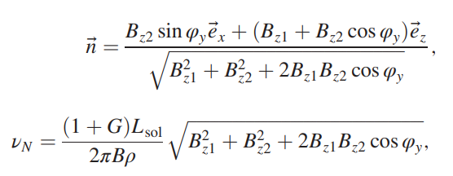
The spin navigator
The spin navigator provides rotation around the z and y axes.
$$φ_{y}=Gγ\frac{B_{D}L_{D}}{Bρ}=\frac{eGB_{D}L_{D}}{mcβ}$$
Filatov Y N, et al. Hadron polarization control at integer spin resonances in synchrotrons using a spin navigator[J]. PRAB, 2021, 24(6): 061001.

Slide 6
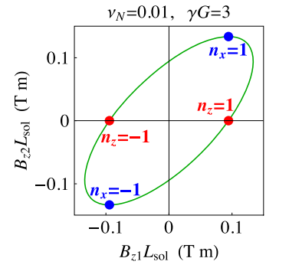
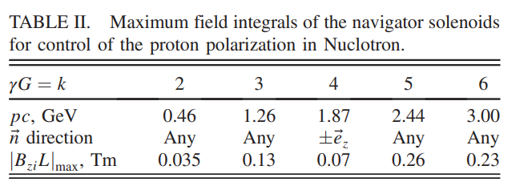
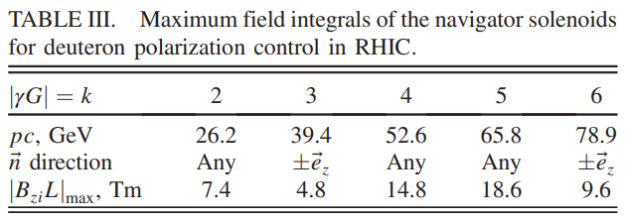
The spin navigator
The reasonably designed navigator can provide arbitrary spin directions.
The spin navigator was designed for RHIC in 2021.
particle | p | d
Kinetic energy(GeV/u) | 19.08 | 11.9
$\overset{⃑}{n}$ direction | Any | Any
${\left|B_{zi}L\right|}_{max}$ Tm | 0.929 | 3.179

Slide 7
谢谢！

