Slide 1
Test progress
Jia Zhou, Tianya Wu, Ziyue Yan
2022.11.17

Slide 2
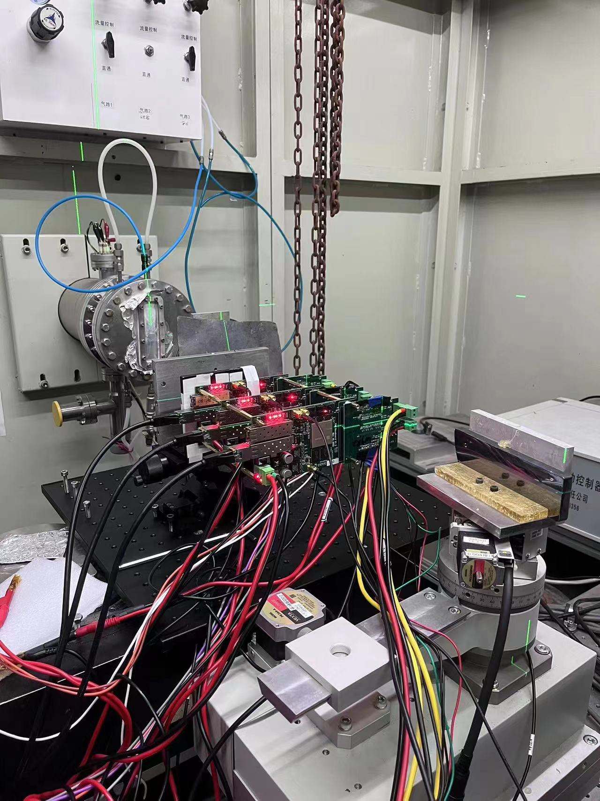
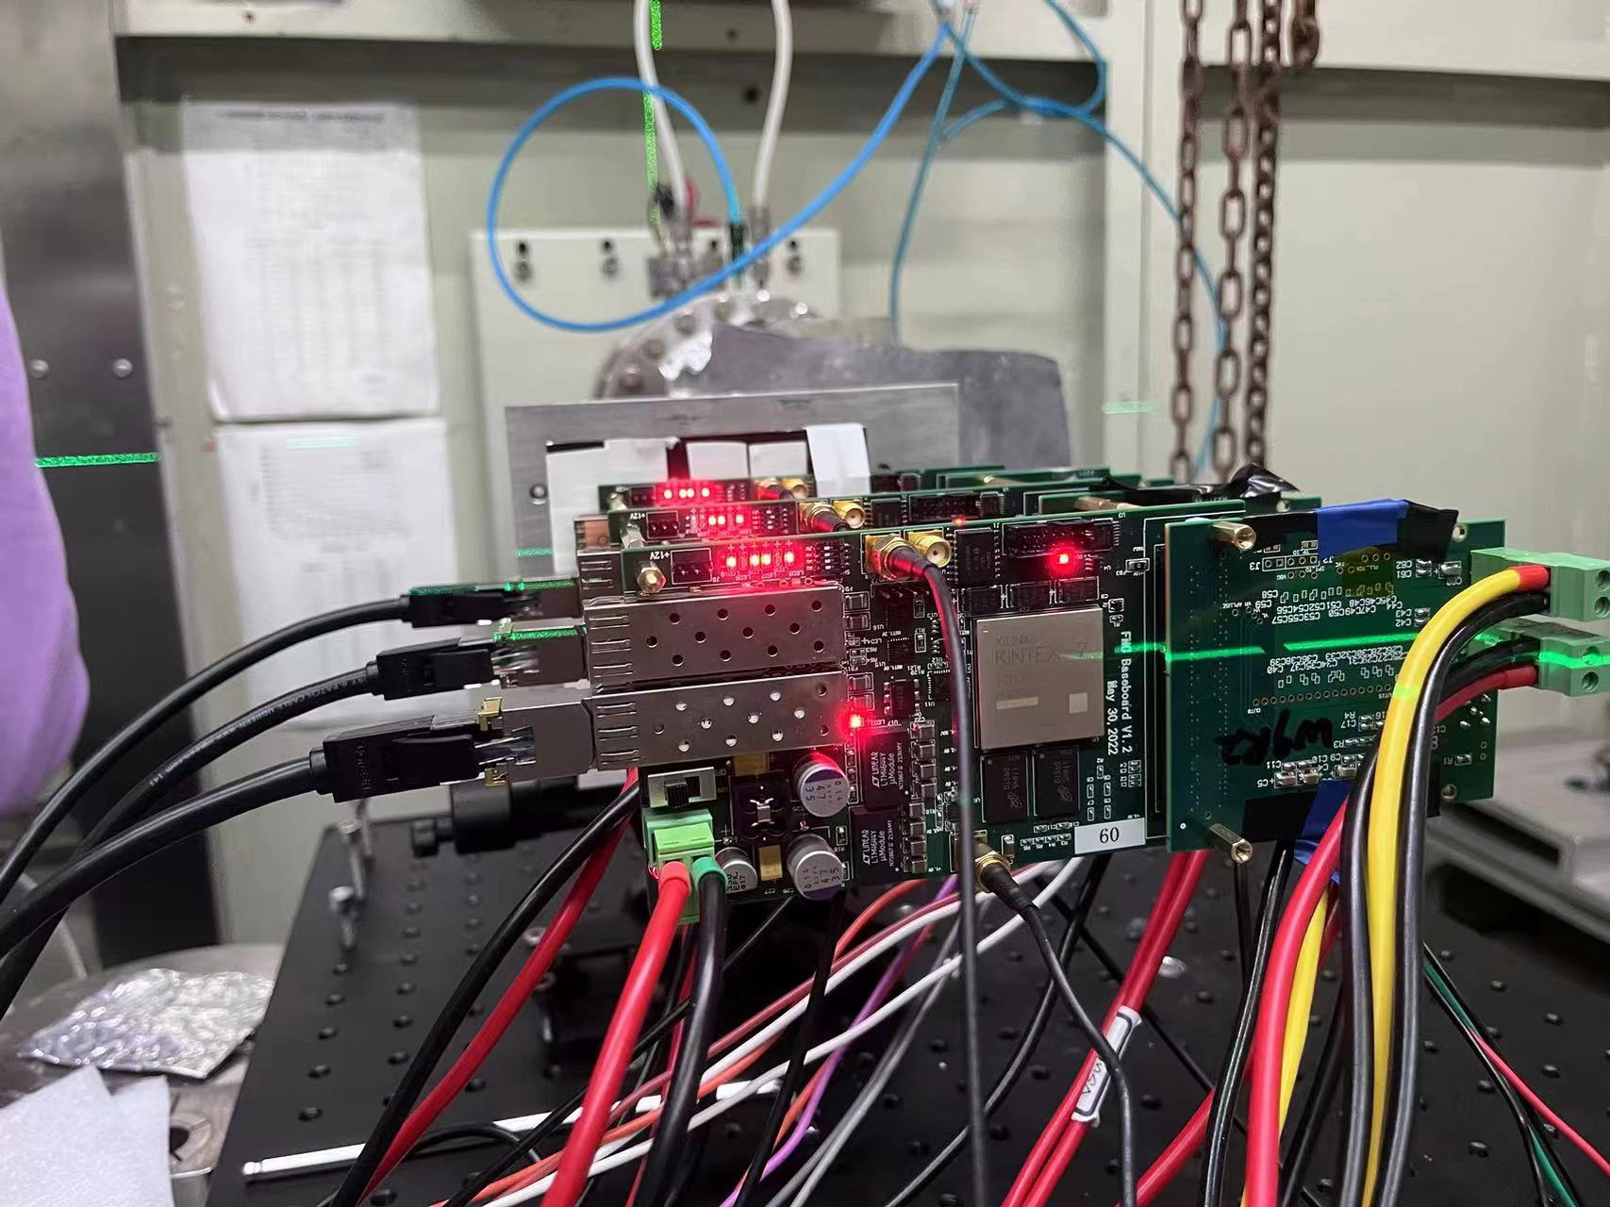
Beam test setup
IP : 192.168.10.30 (chip s1)
192.168.10.29 (chip 8)
192.168.10.31 (chip W9R2)
21-layer steel plate
（1mm/layer）
3 layers of lead
（1mm/layer）

Slide 3
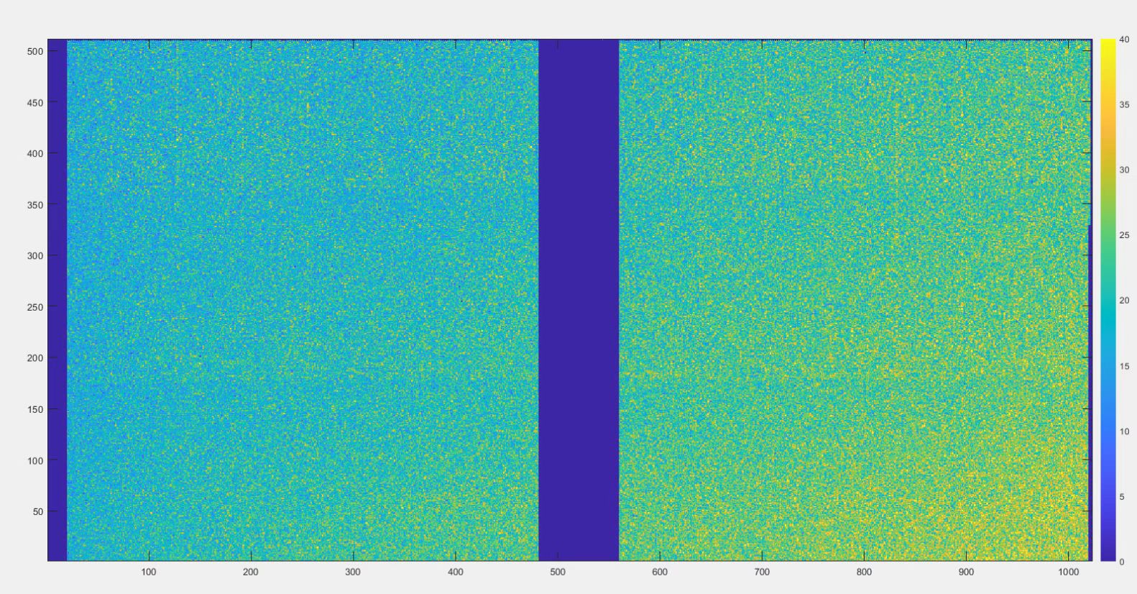
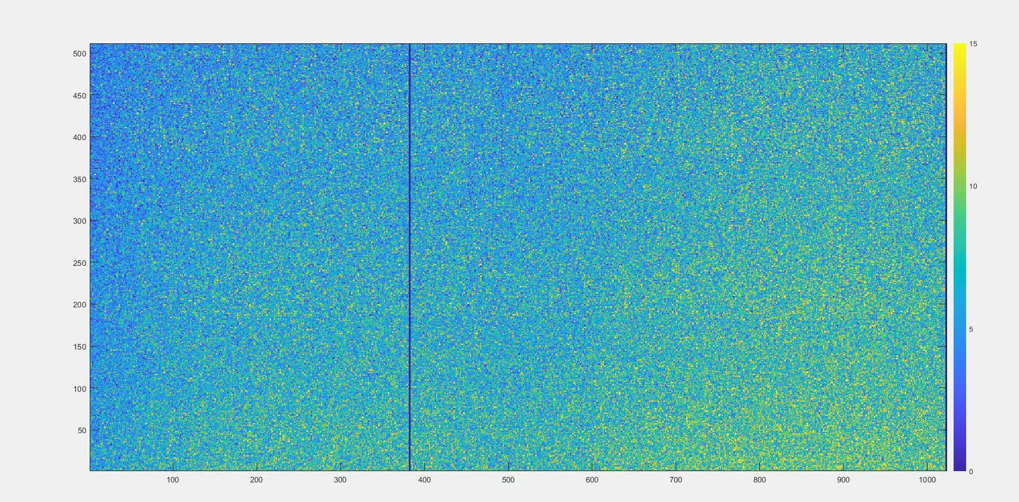
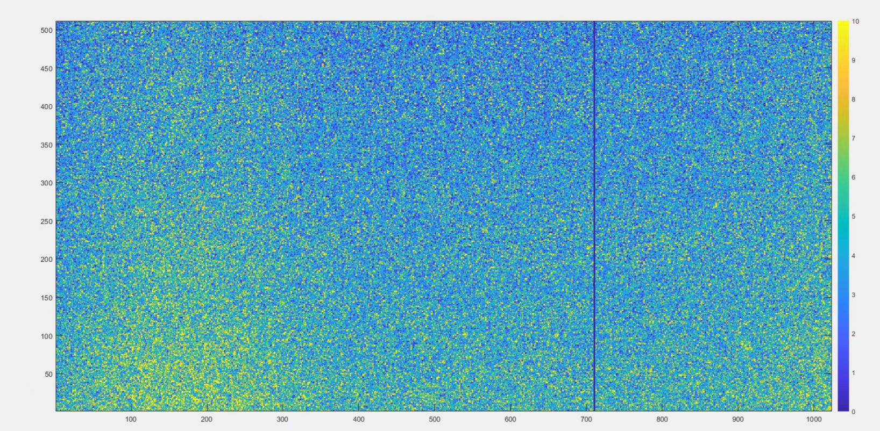
3 boards Hitmap
30 min
ITHR 96
Some pixels are masked
2mm * 4mm spot
Average data rate: 125KB/s
Front(50cm to source)
155.2MB
Middle(58cm to source)
53MB
Back(66cm to source)
30.2MB

Slide 4
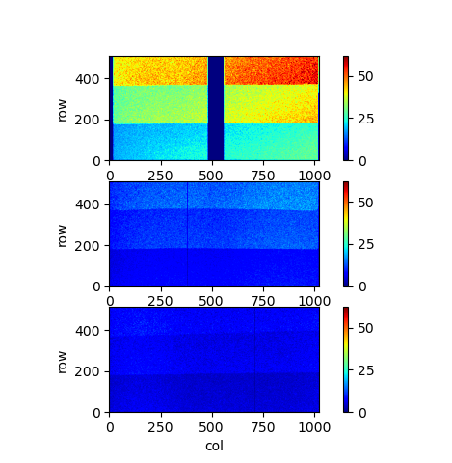
To be solved
Repeat out the numbers
When Apulse, the stop command fails to
reset the timestamp
The first package header sometimes is lost
When multiple boards are configured in parallel,
they cannot be read

Slide 5
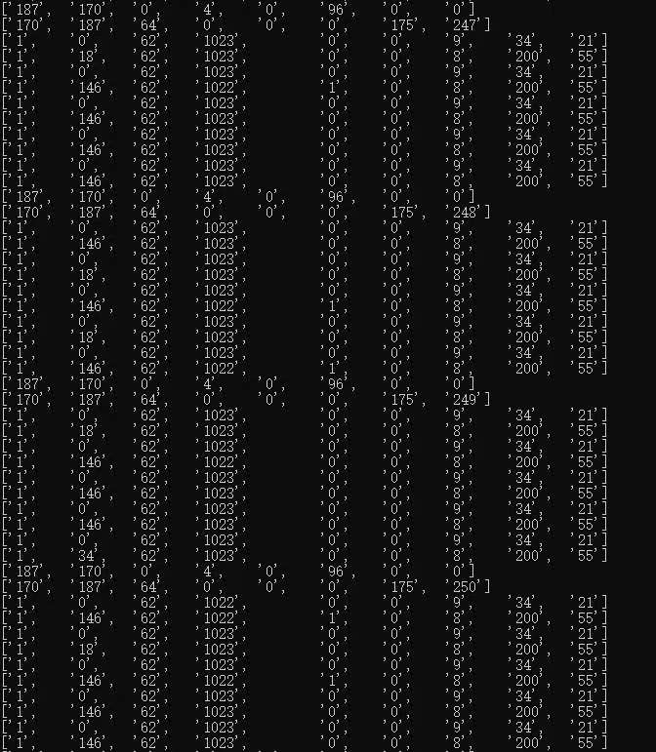
Flex readout
Examined the readout of two flex boards connected to the readout board(21 represents chip 5, 55 represents chip 7).

Slide 6
Apulse fanout
For timestamp calibration, we need to do an apulse test before start the beam test.
To avoid the inaccuracy caused by the gap between orders conducted by PC(the difference calculated as 0.6ms), an apulse fanout board is in need.

Slide 7
THANKS！

