Slide 1
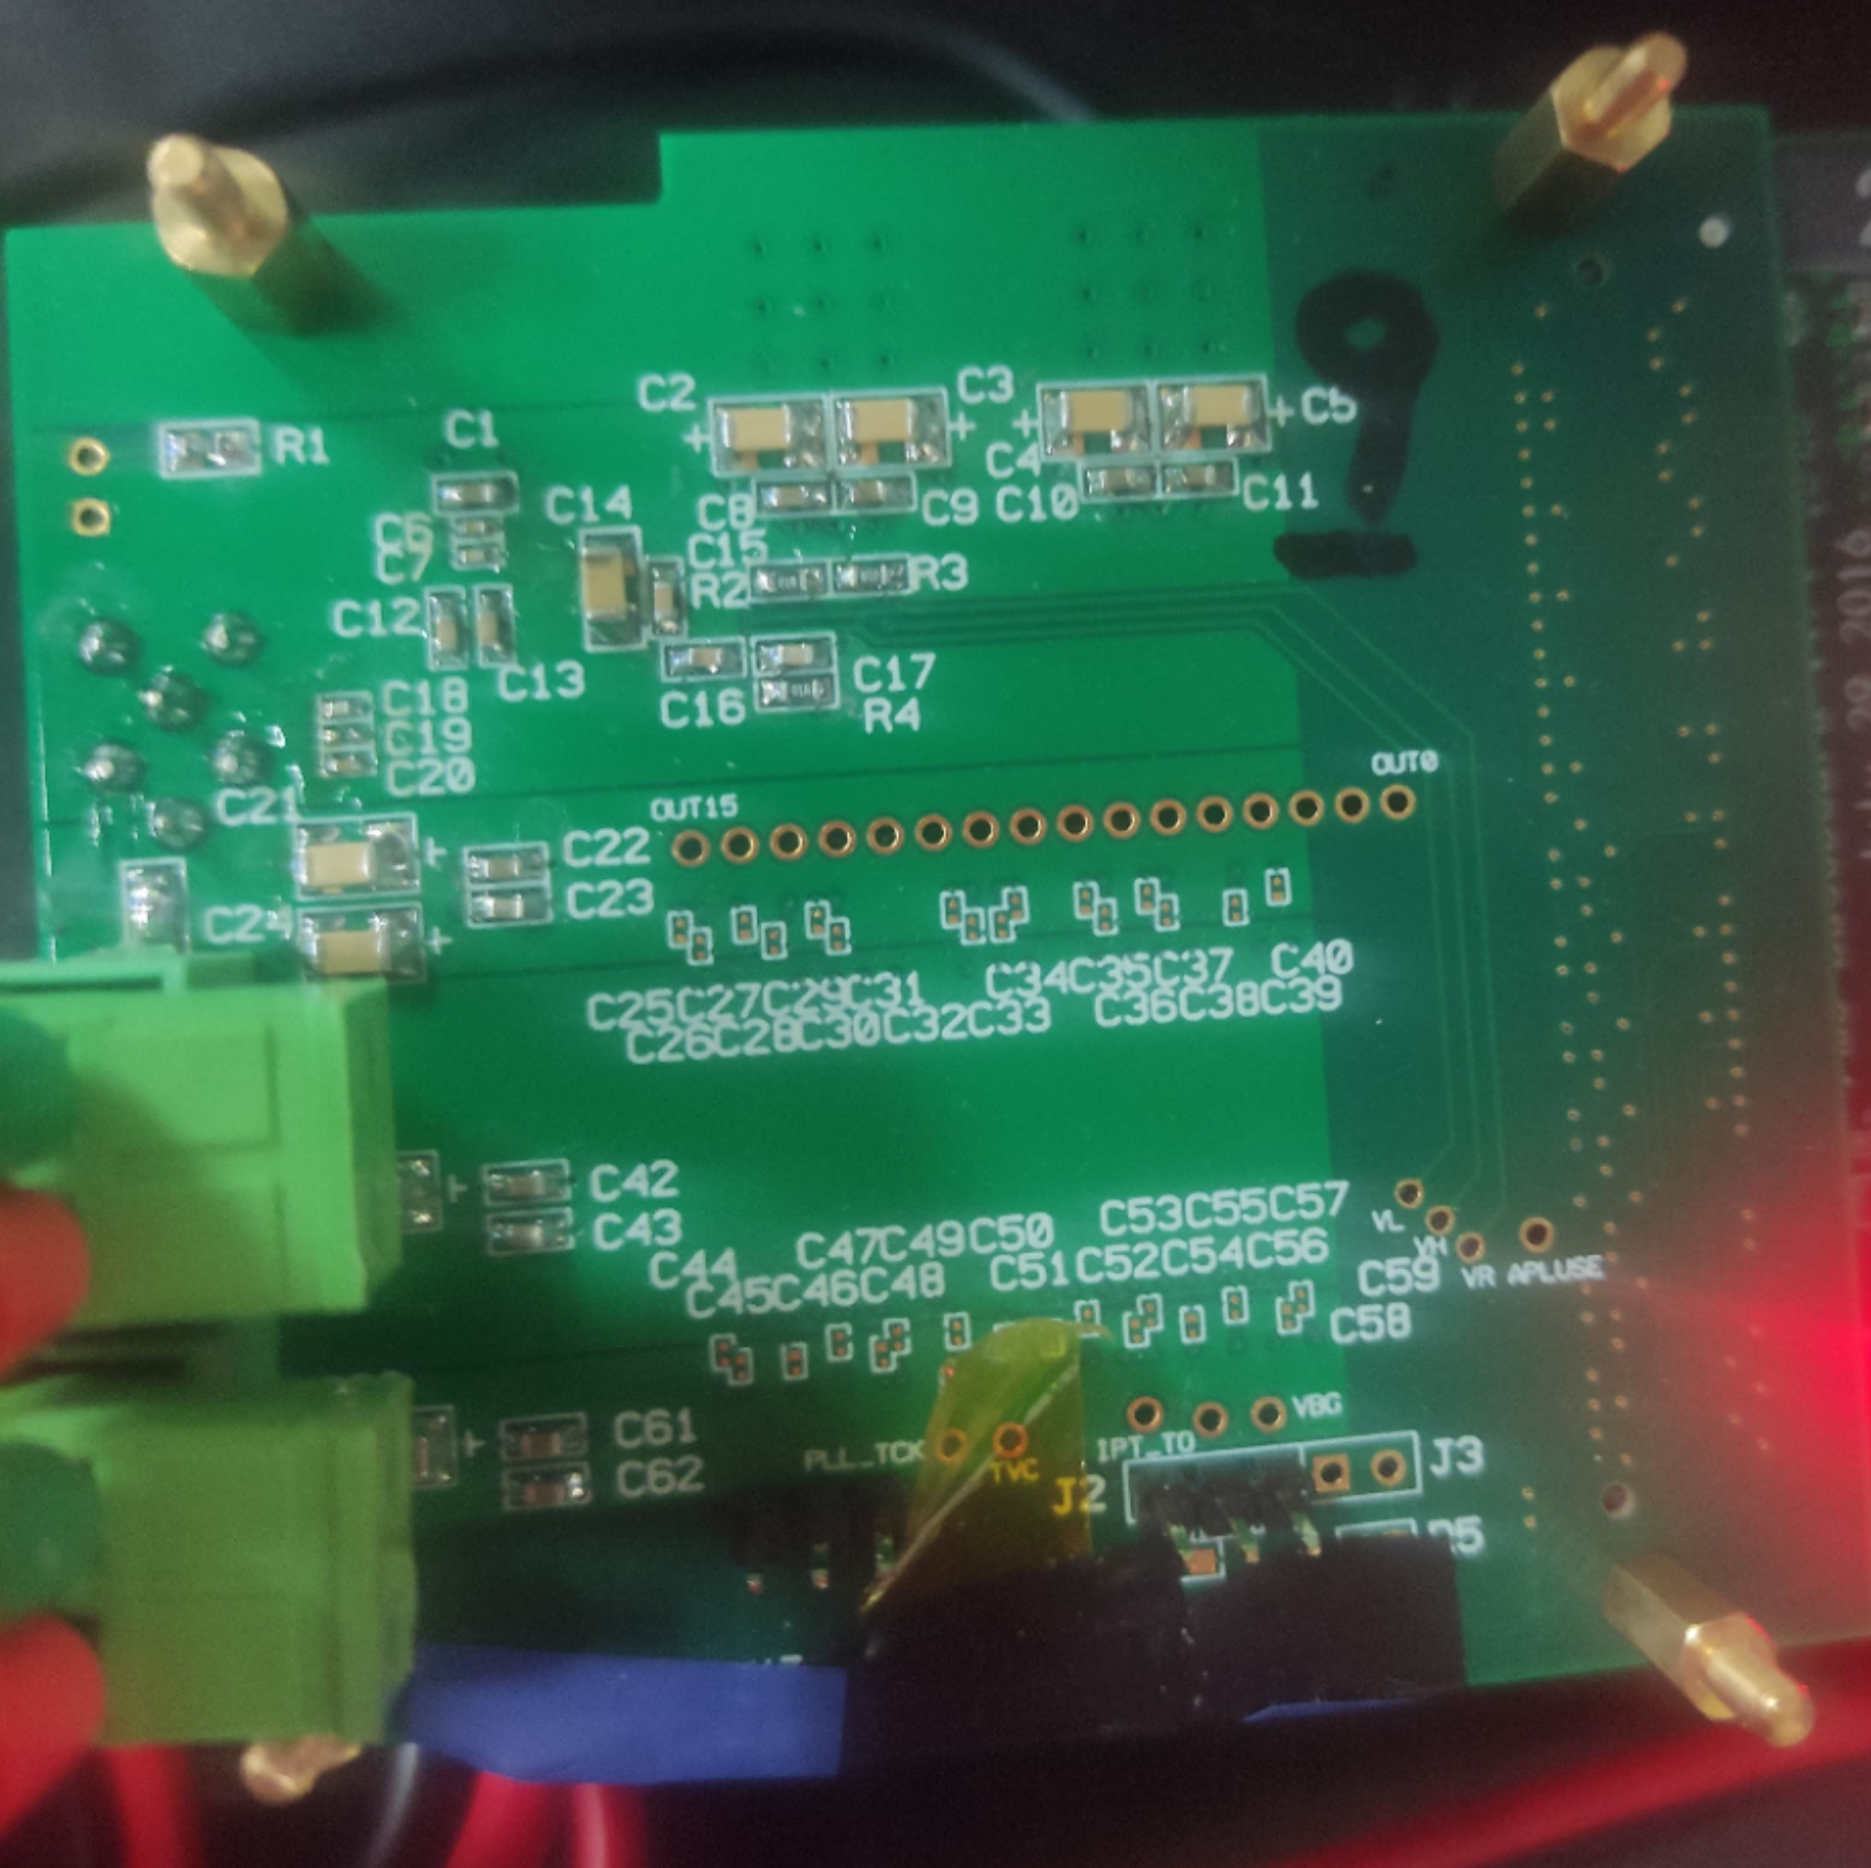
Chip 9 Test
Xiaoxu Zhang 2022/11/17
test board v1.1

Slide 2
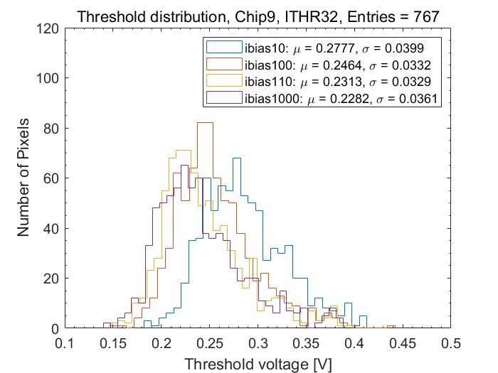
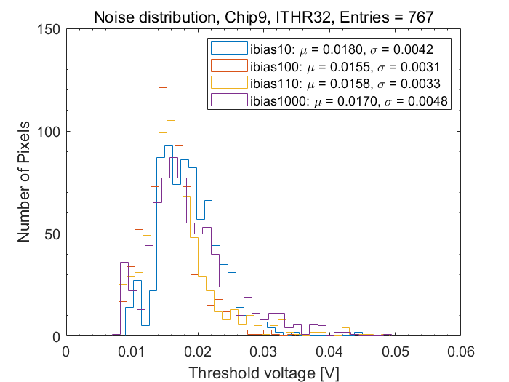
Chip 9 different ibias (ITHR32)
电流DAC0控制码
Ibias | 10 | 100 | 110 | 1000
3V power current [A] | 0.263 | 0.288 | 0.301 | 0.312

Slide 3
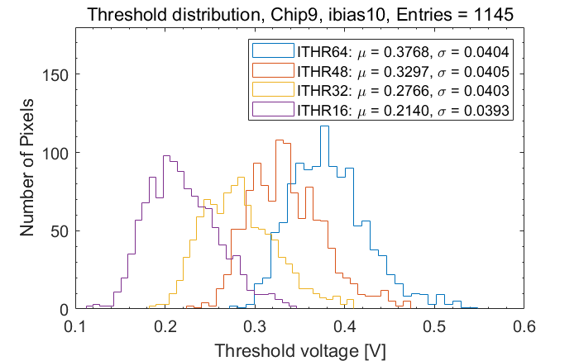
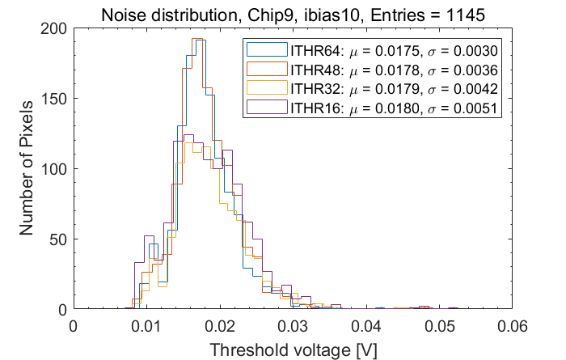
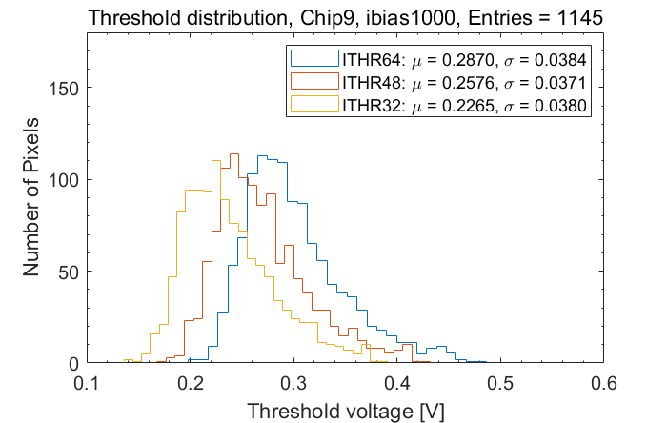
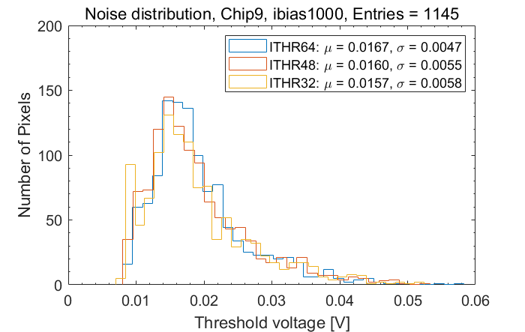
ibias10/1000
different ITHR

Slide 4
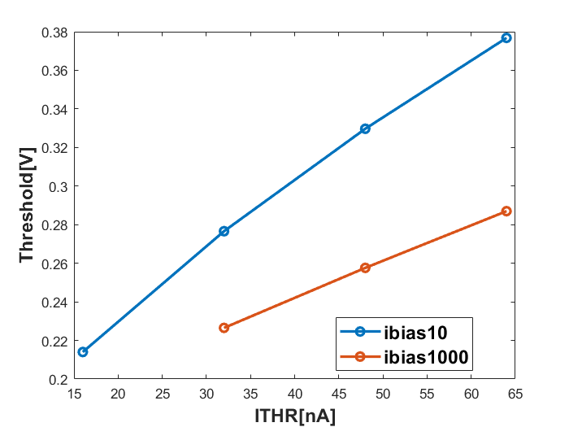
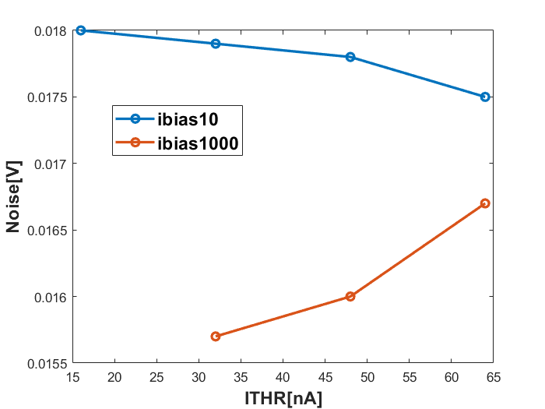
ibias10/1000 different ITHR

Slide 5
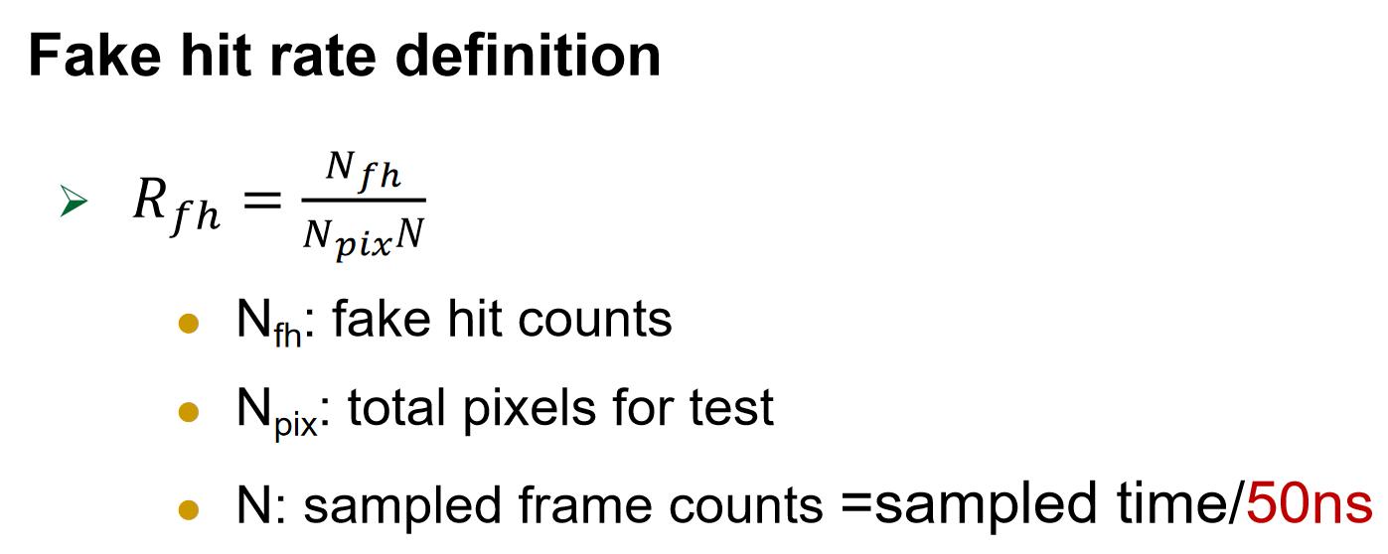
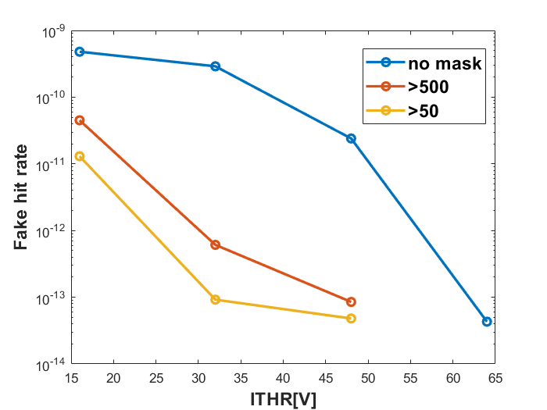
Fake hit rate test
Test process (ibias10)
test 1: no mask pixels, offline 1000s
test 2: mask fake hit pixels(fake hit >500) in test 1, offline 1000s
test 3: mask fake hit pixels(fake hit >50) in test 1, offline 1000s
ITHR | Mask | Fake hit | Sampled time [s] | Fake hit rate
16 | no mask | 5042430 | 1000 | 4.8e-10
 | >500 | 473021 | 1000 | 4.5e-11
 | >50 | 136753 | 1000 | 1.3e-11
32 | no mask | 3069048 | 1000 | 2.9e-10
 | >500 | 6426 | 1000 | 6.1e-13
 | >50 | 961 | 1000 | 9.2e-14
48 | no mask | 250388 | 1000 | 2.4e-11
 | >500 | 889 | 1000 | 8.5e-14
 | >50 | 508 | 1000 | 4.8e-14
64 | no mask | 455 | 1000 | 4.3e-14

