Slide 1
Preliminary waveform selection and charge analysis of beam test data
Yaxin Shen,Mingyi Dong,Guang Zhao, Linghui Wu
Cluster Counting Meeting
Nov 24,2022

Slide 2
Introduction
Waveform selection
Charge distribution
Charge distribution of each channel
Fitted to Landau distribution
Maximum amplitude distribution

Slide 3
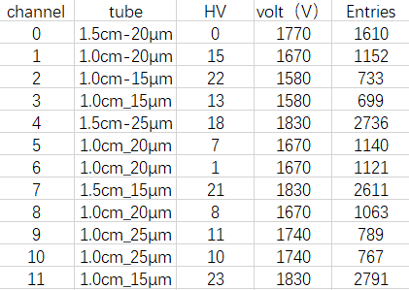
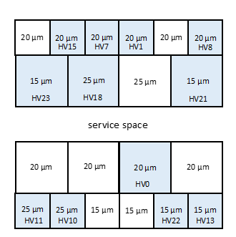
Data file:tbdata_29
Experiment condition: Gas : 80/20
Sampling rate: 1.5Ghz
Angle: 0

Slide 4
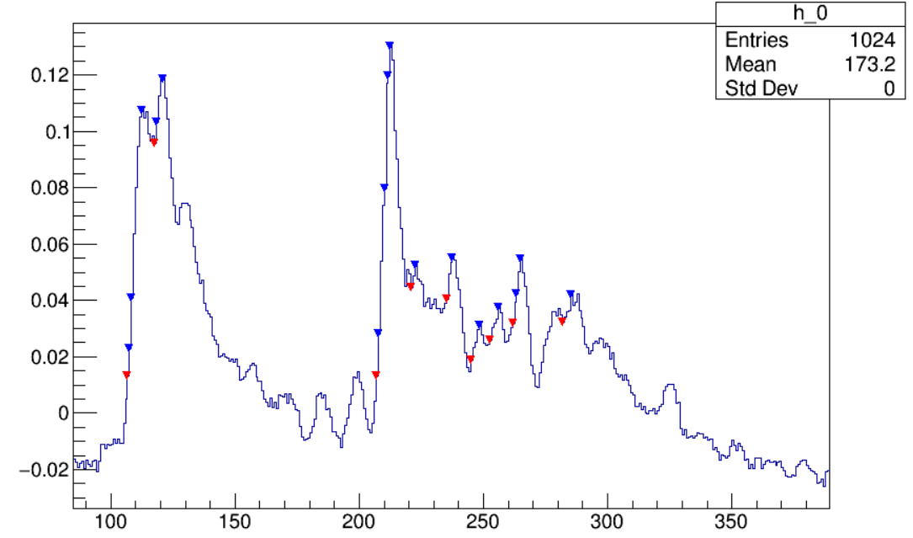
Waveform selection
Select good waveforms for peak finding analysis
Find all the local max of the waveform (>0.015mV)
For each local maximum points, find the nearest early point, whose slope starts to decrease (inflection point)
The Amplitude distance between the local maximum and the inflection points is recorded as the rising edge.
Amplitude (mV)
Time (ns)
The points marked in the figure are local maximum points and inflection points

Slide 5
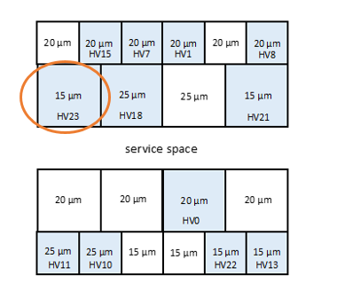
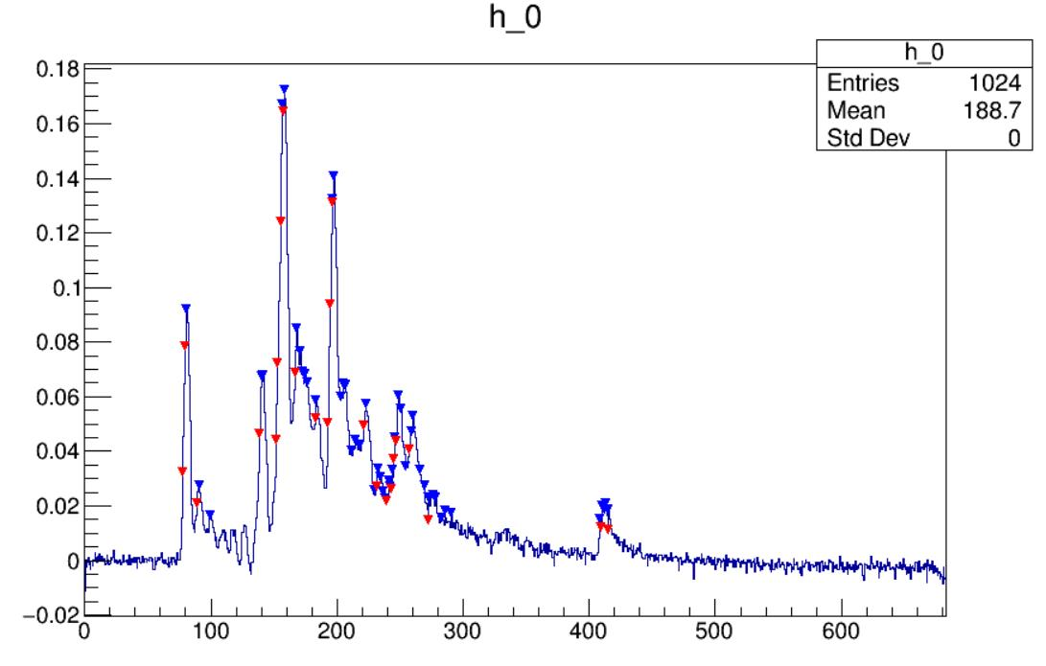
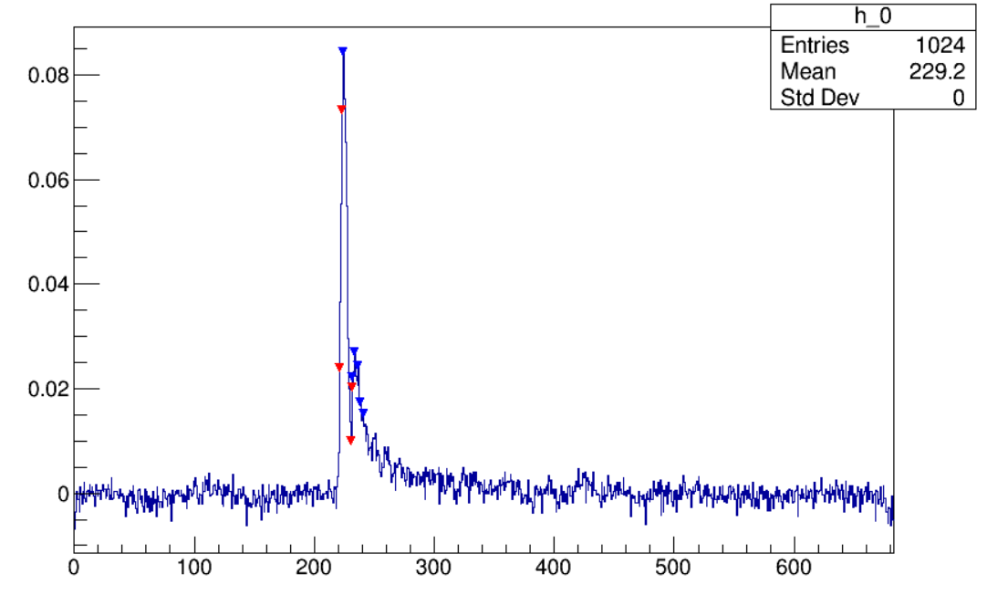
waveform selection
Tube：HV 23
Valid： with maximum amplitude>0.03
Case Ⅰ： good waveforms with multi-peaks(number of rising edges between 0.01 and 0.03mV more than 6).
Total entries | 10000
Valid entries | 2791
Case Ⅰ | 877
Case Ⅱ | 1914
Case Ⅱ：number of rising edges between 0.01 and 0.03mv not more than 6
Case Ⅰ
Case Ⅱ
Amplitude (mV)
Amplitude (mV)
Time (ns)
Time (ns)

Slide 6
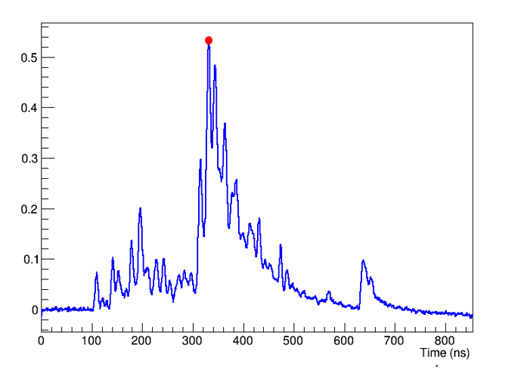
Waveform selection
Charge distribution: add the amplitude values for each point
Time from 50ns to 800ns
Maximum distribution:
The highest point of each waveform amplitude
(marked in red)

Slide 7
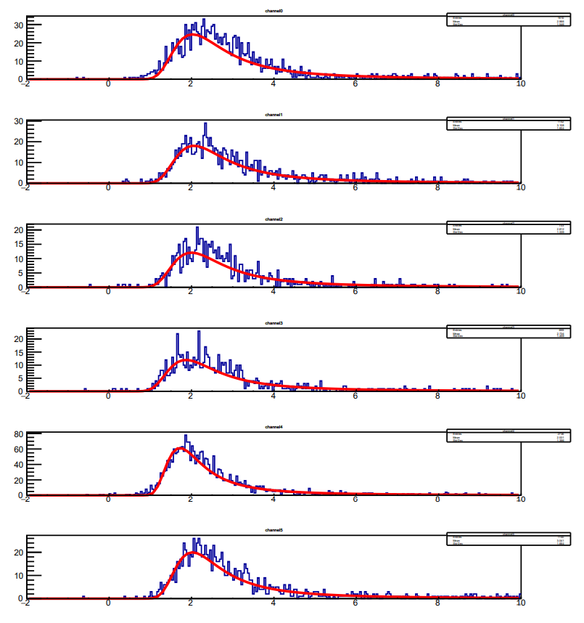
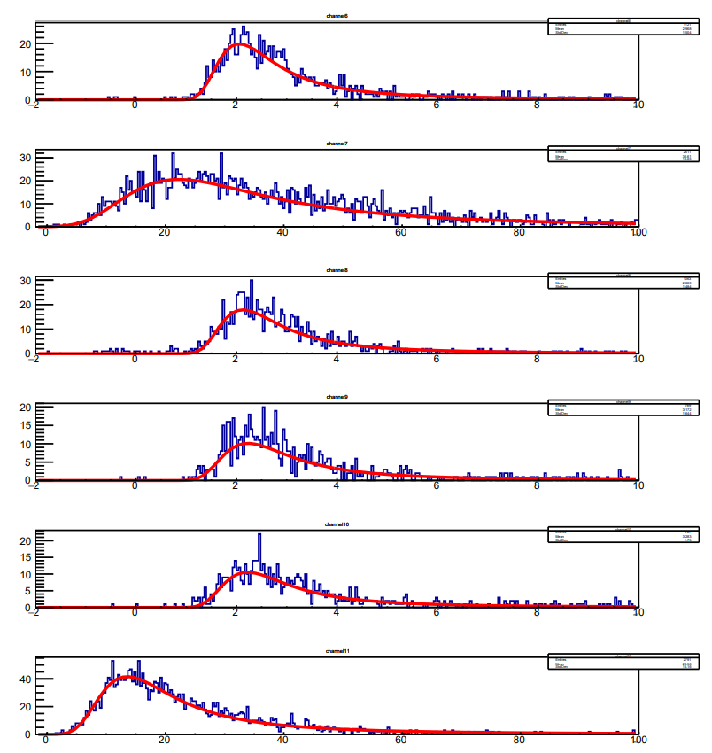
Charge distribution:fitted to Landau distribution
This includes all valid entries(2791).
channel0
channel6
channel1
channel7
channel2
channel8
channel3
channel9
channel4
channel10
channel5
channel11

Slide 8
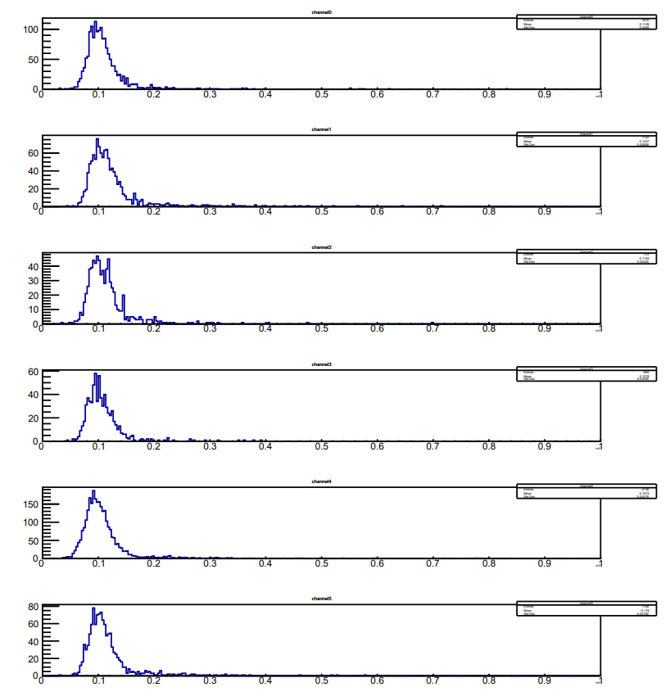
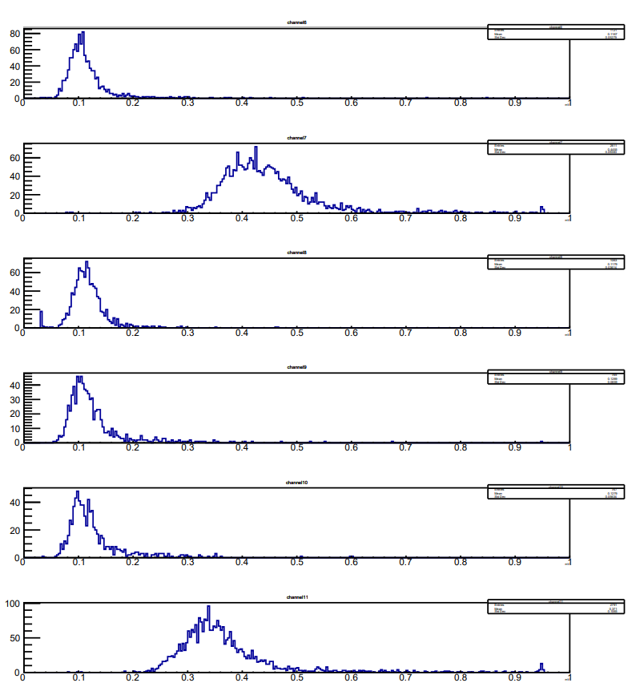
Maximum amplitude distribution: include all value entries(2791).
Channel 0
Channel 6
Channel 1
Channel 7
Channel 2
Channel 8
Channel 3
Channel 9
Channel 4
Channel 10
Channel 5
Channel 11

Slide 9
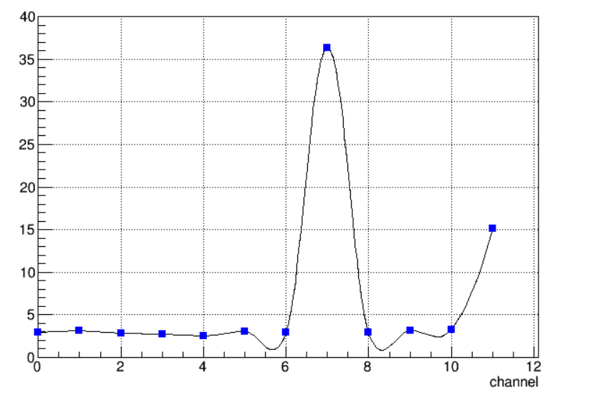
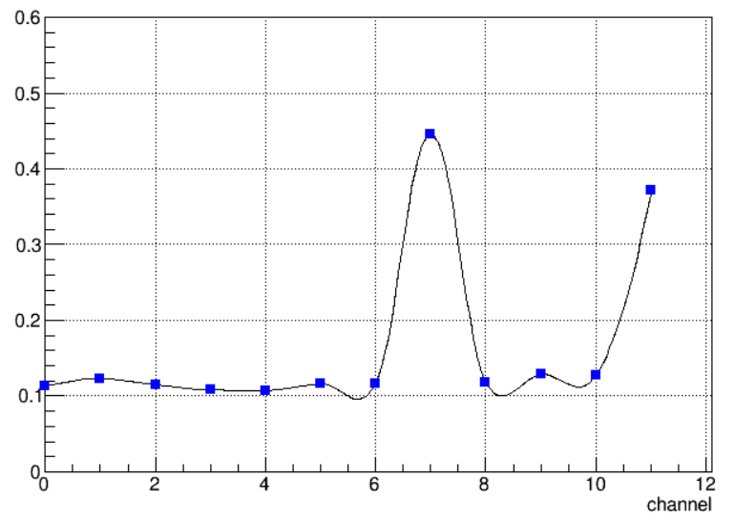
dE/dx vs tube
Maximum amplitude vs tube
q
Amplitude (mV)
Gains of channel7 and 11 are much higher than that of others

Slide 10
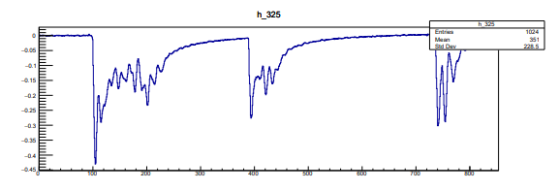
Discussion:
Select a channel with a large mean for drawing waveform(root29,channel11)：
find that some waveforms have more than one big peak

Slide 11
Summary
Preliminary waveform selection performed
Charge distribution and maximum amplitude distribution obtained.
It seems that the gains of channel 7 and 11 are much higher
To do:
Future analysis with peak finding algorithm

