Slide 1
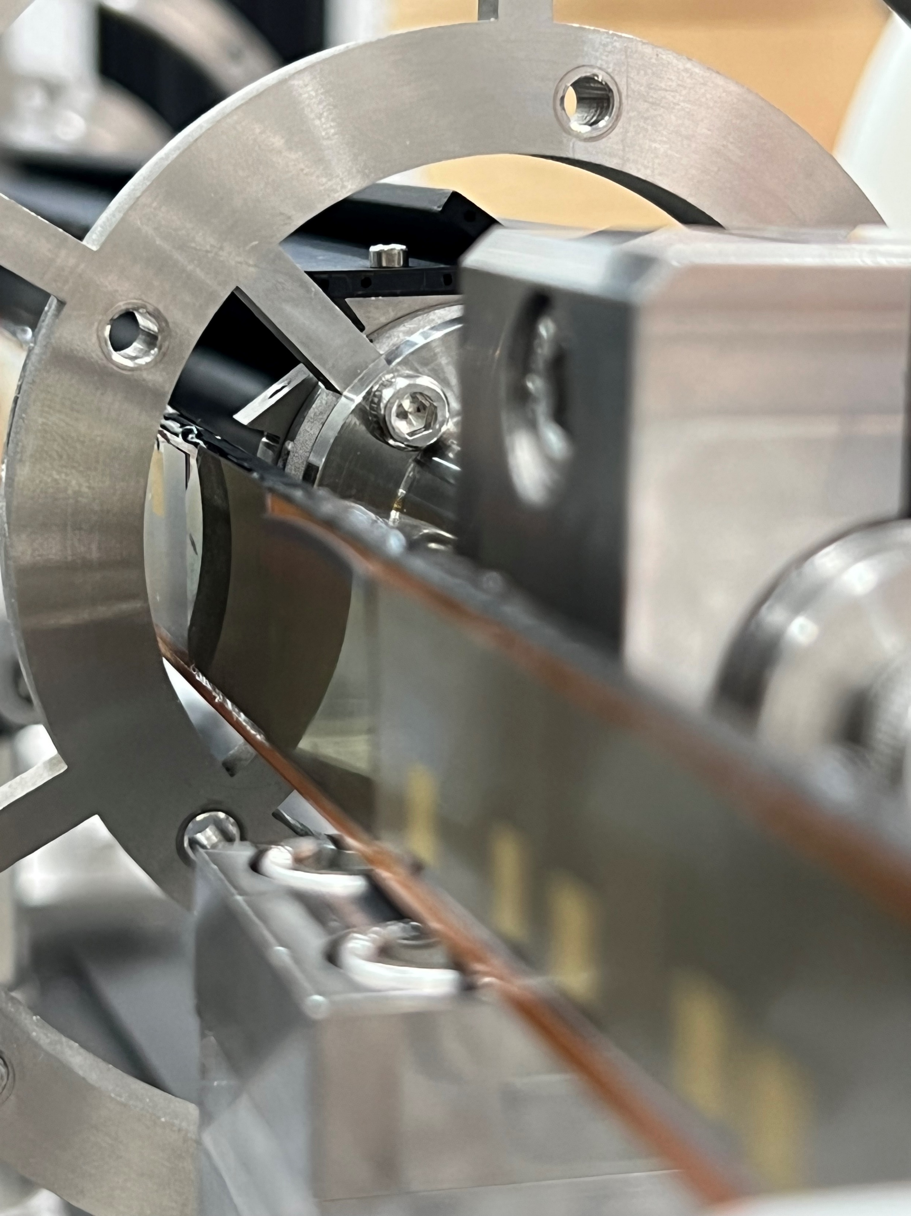
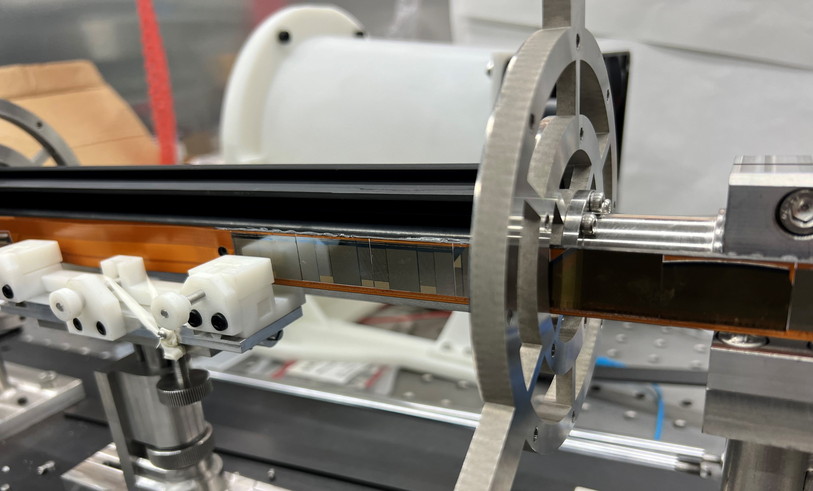
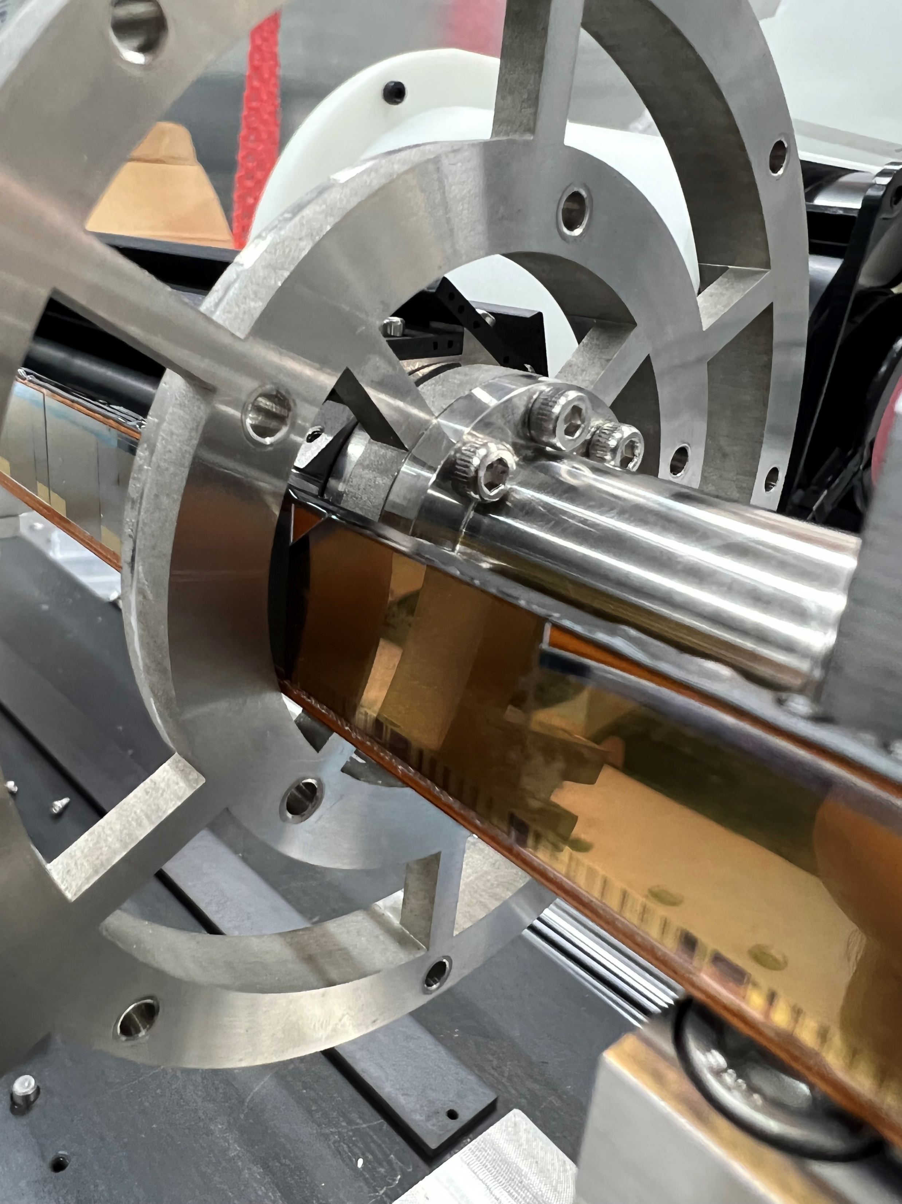
Loading Test:
We have assembled a dummy ladder with some dummy sensors.
Try to load the ladder on the support.
Wire-bonding safe.

Slide 2
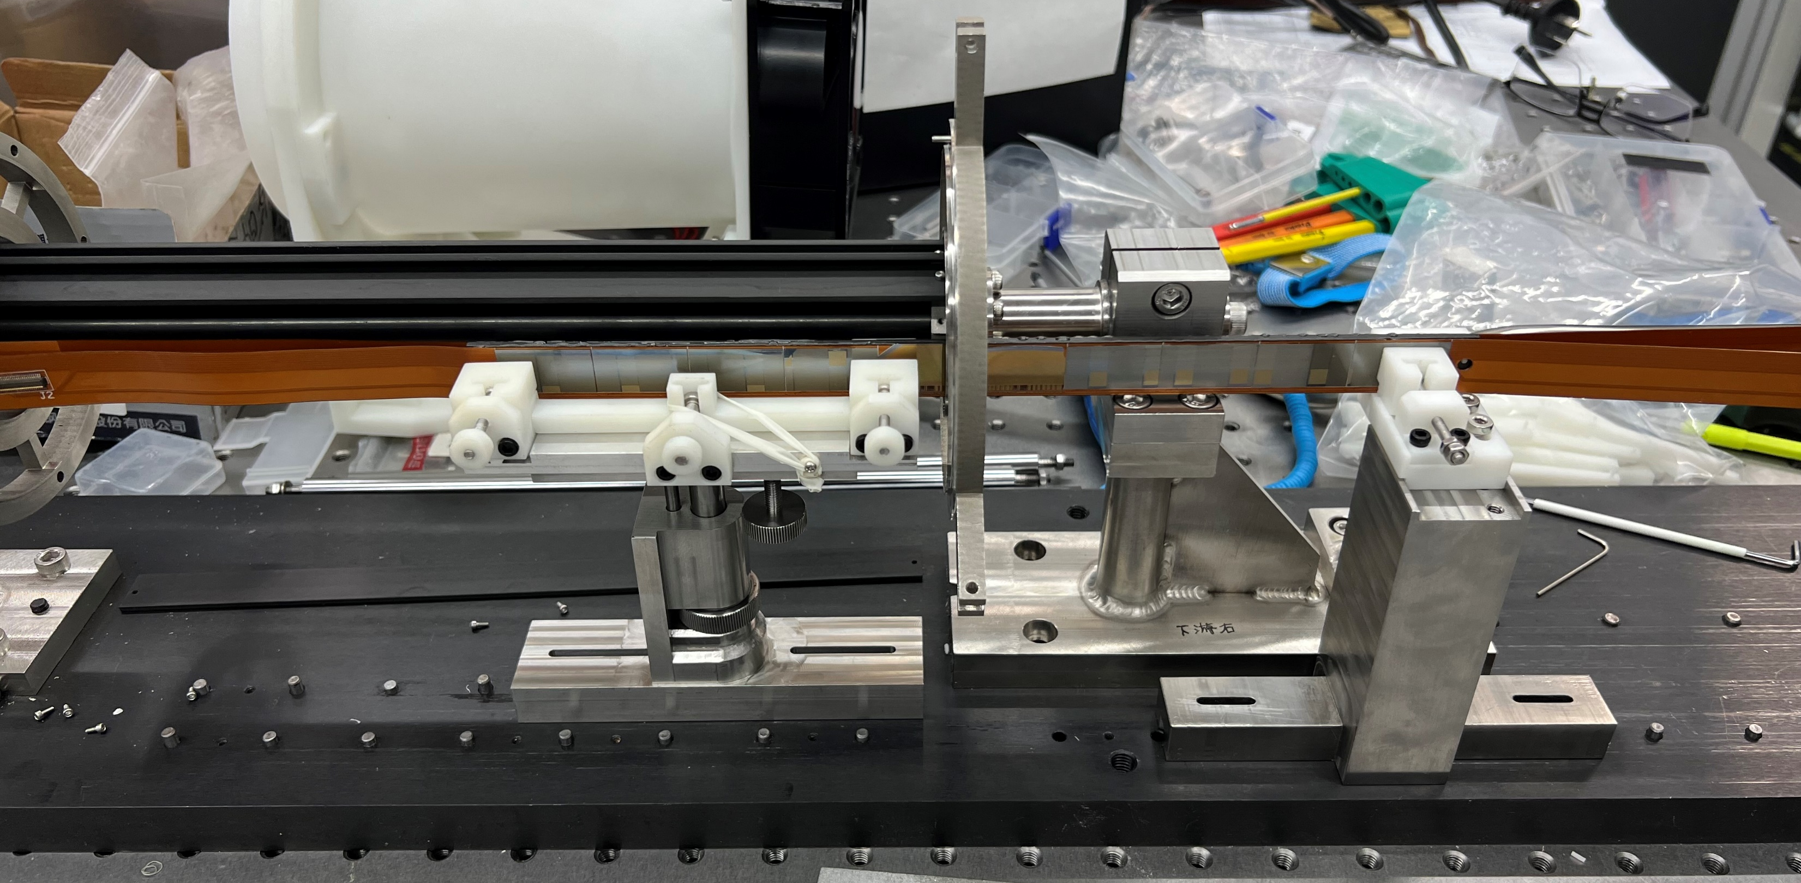
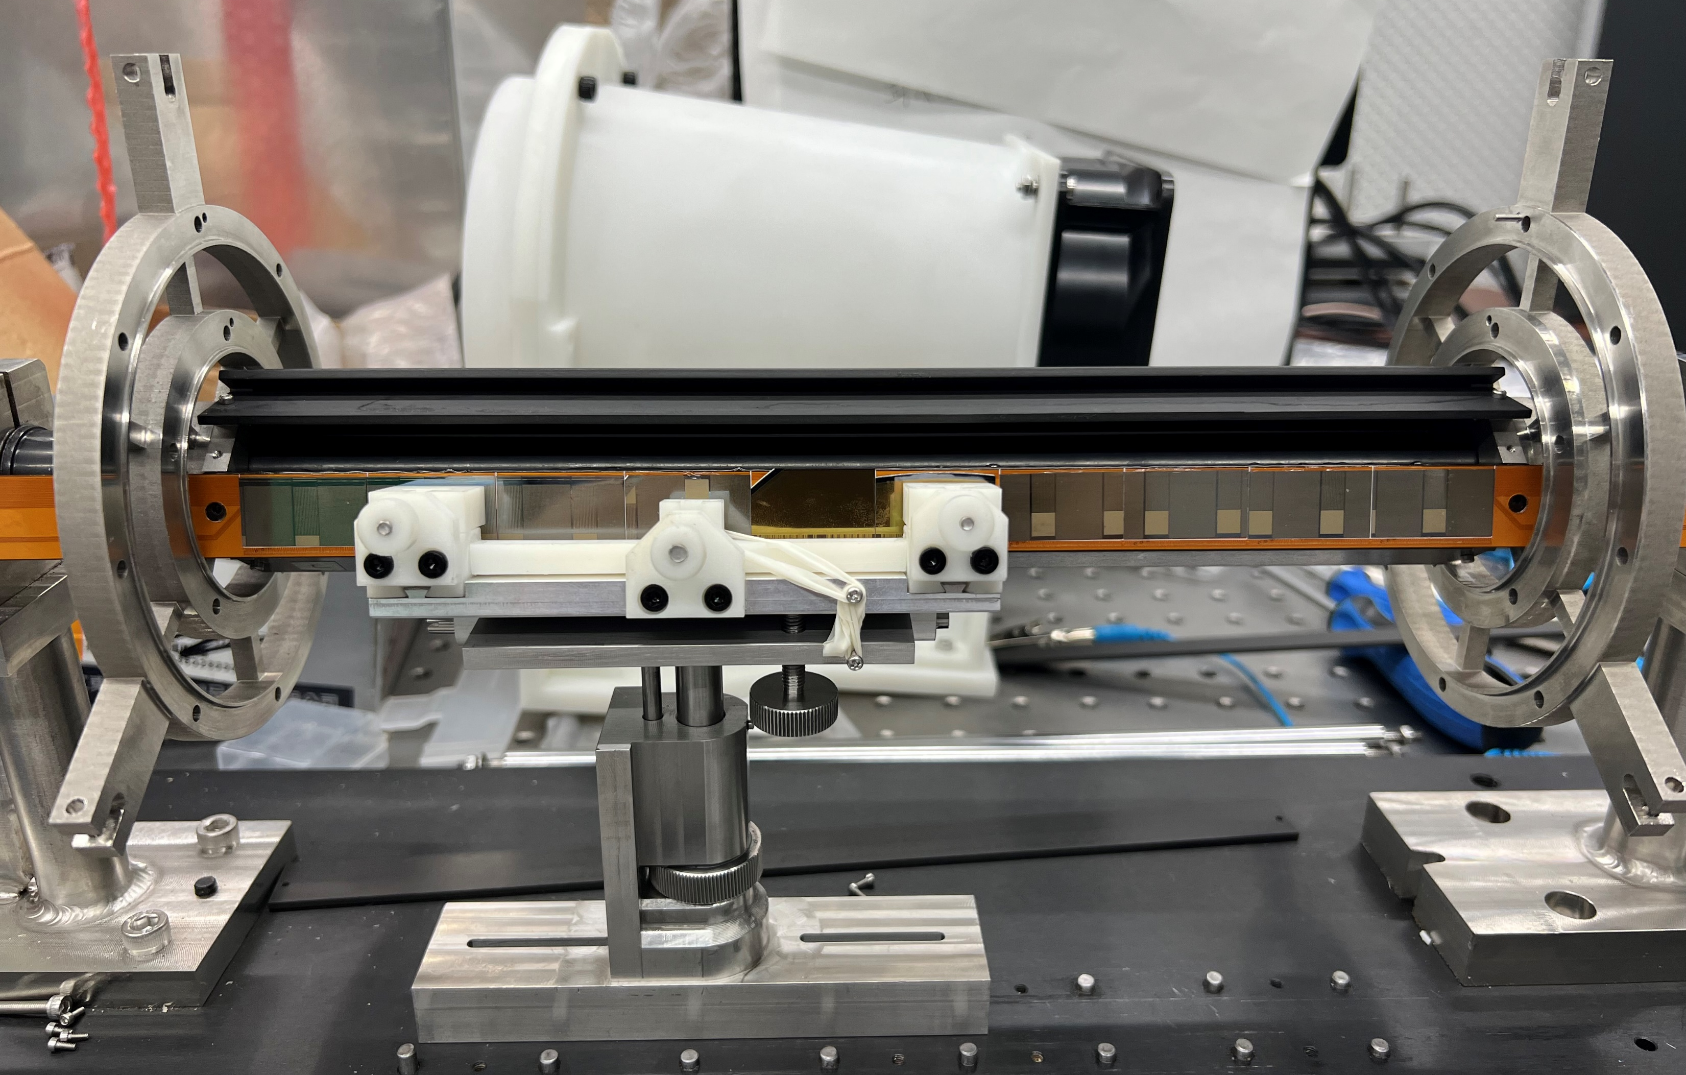
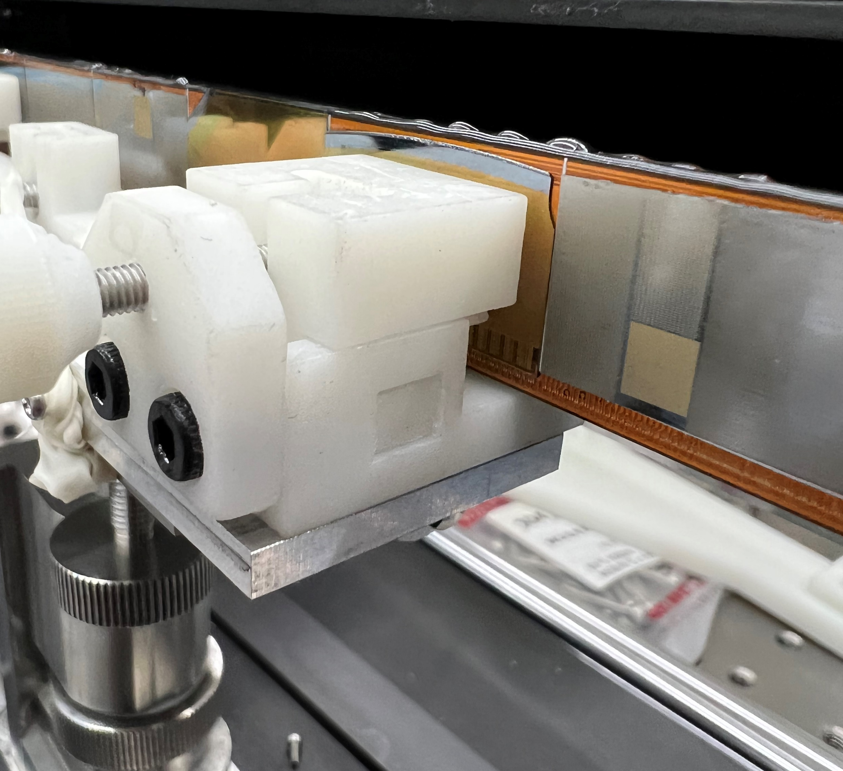
Loading Test:

Slide 3
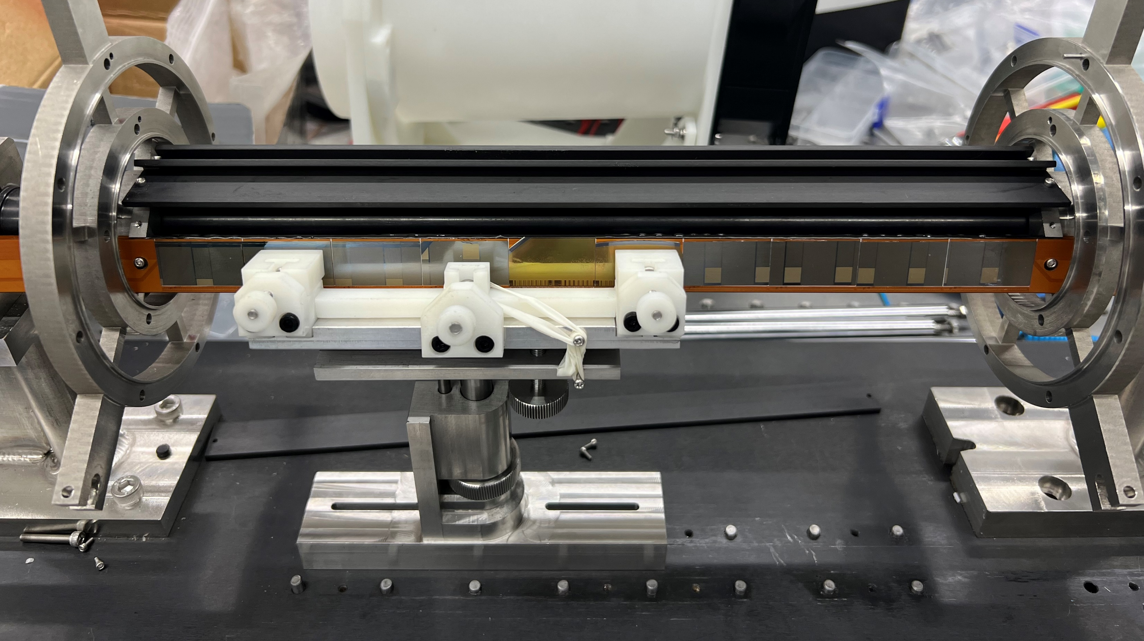
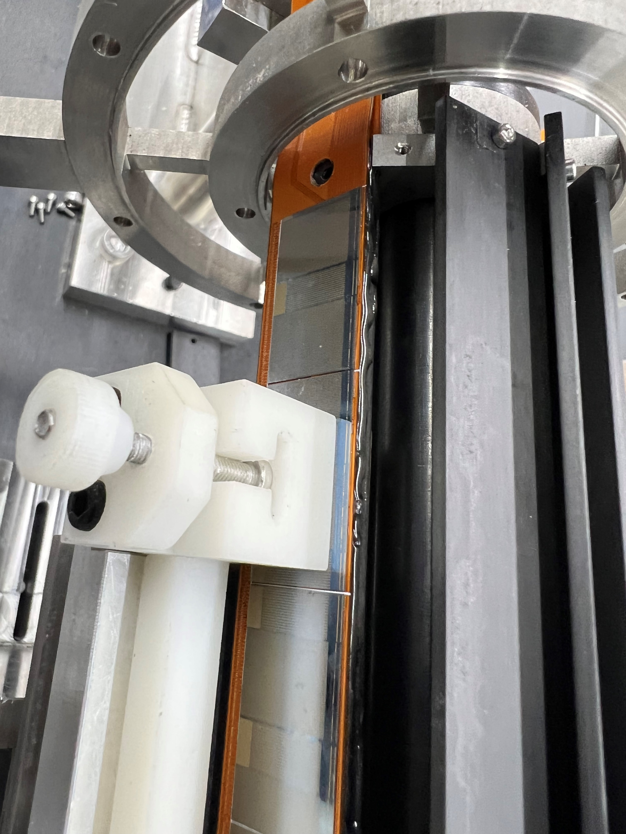
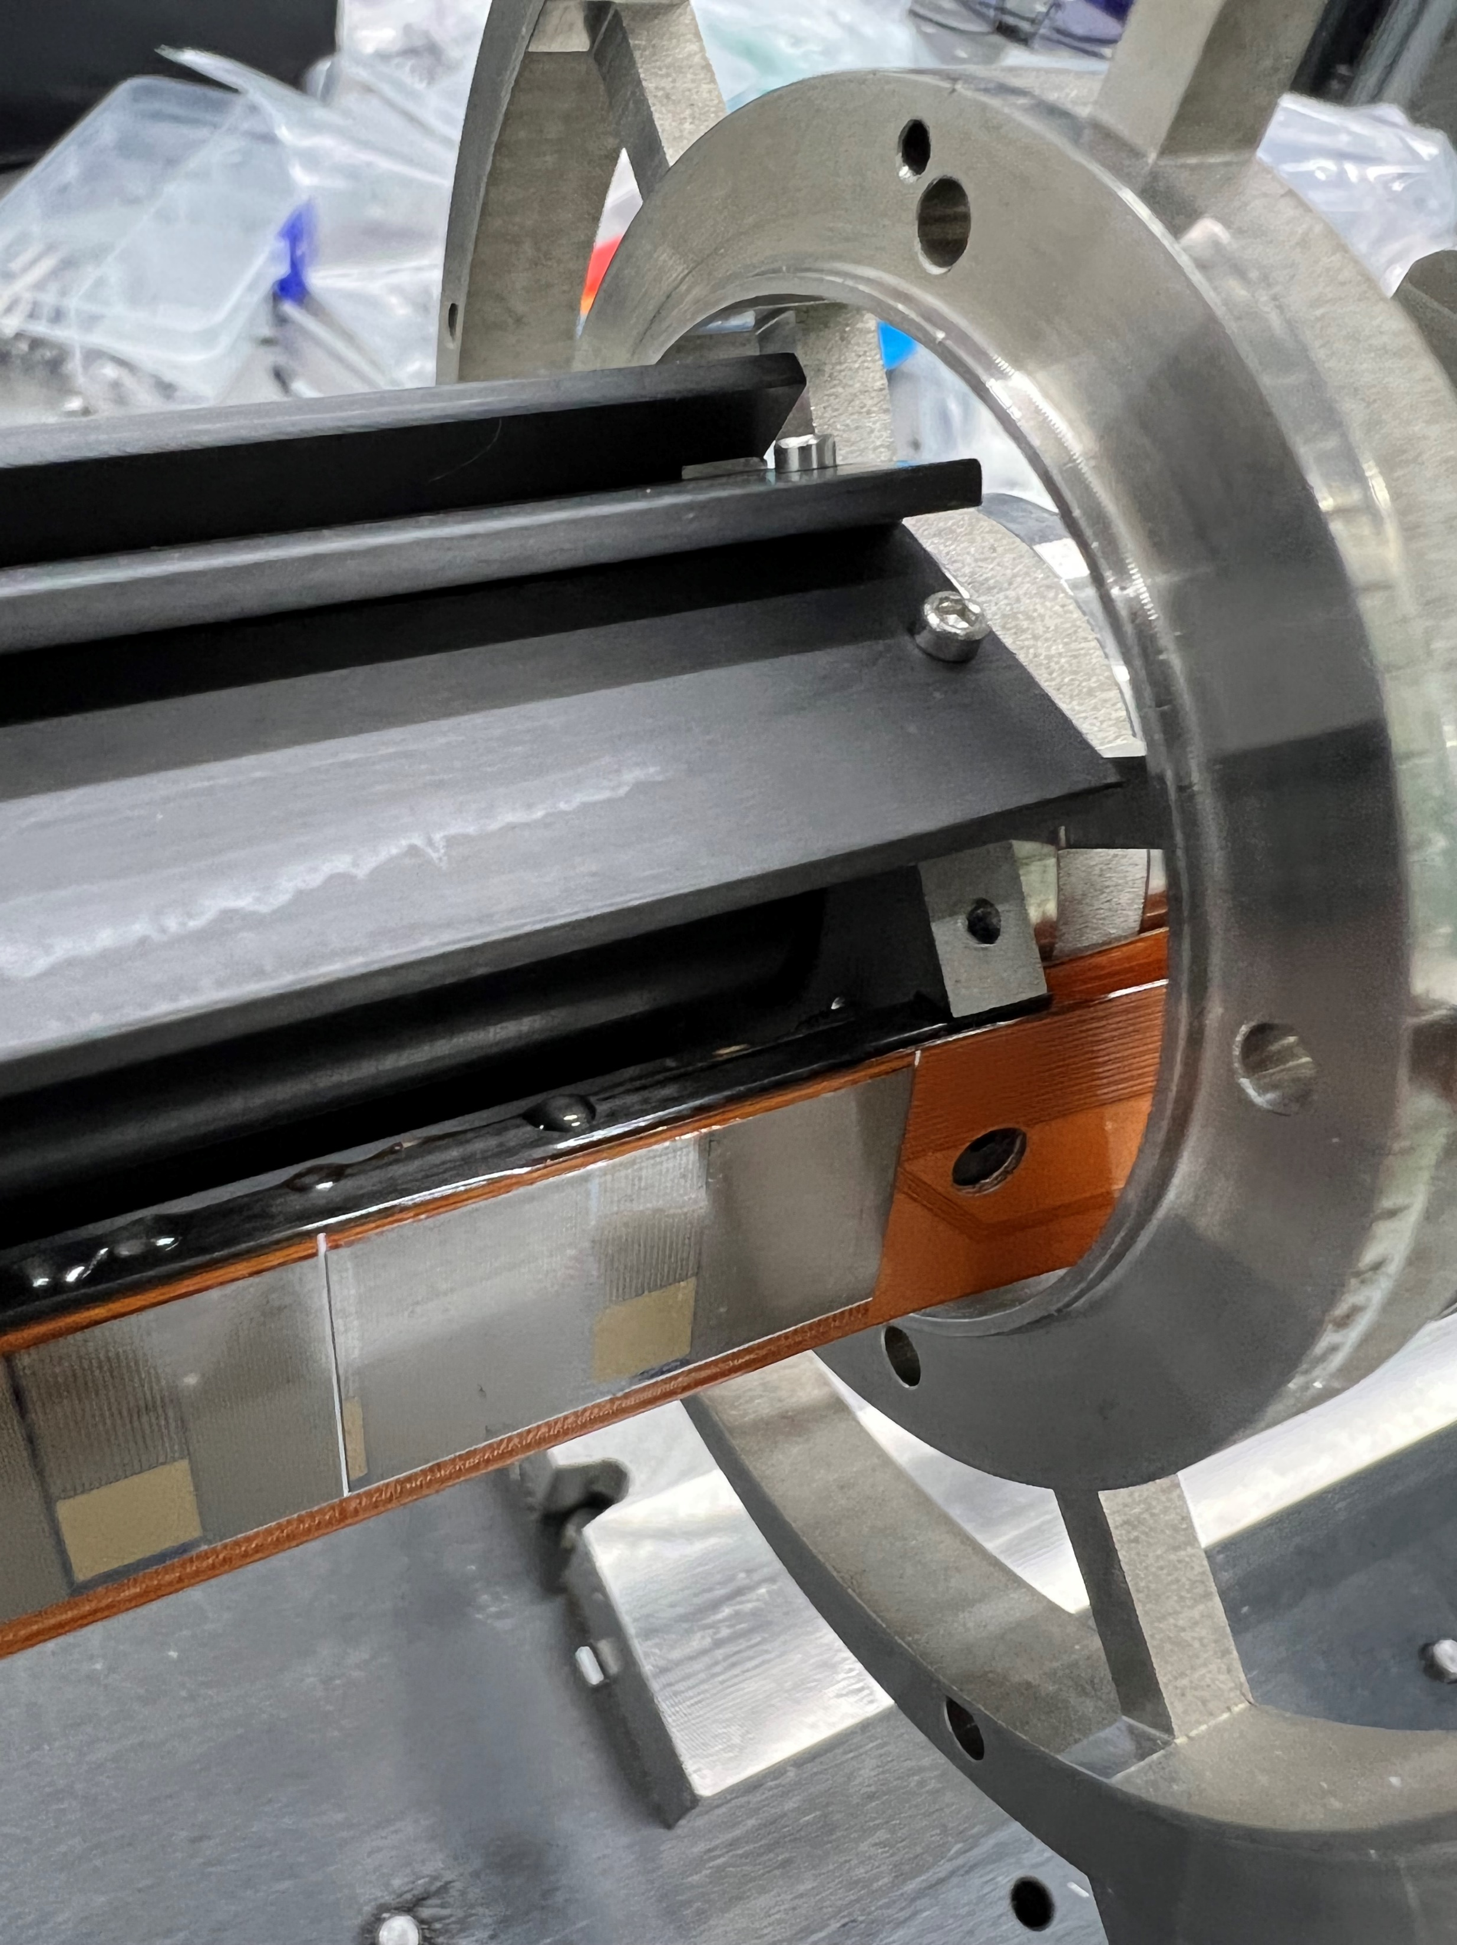
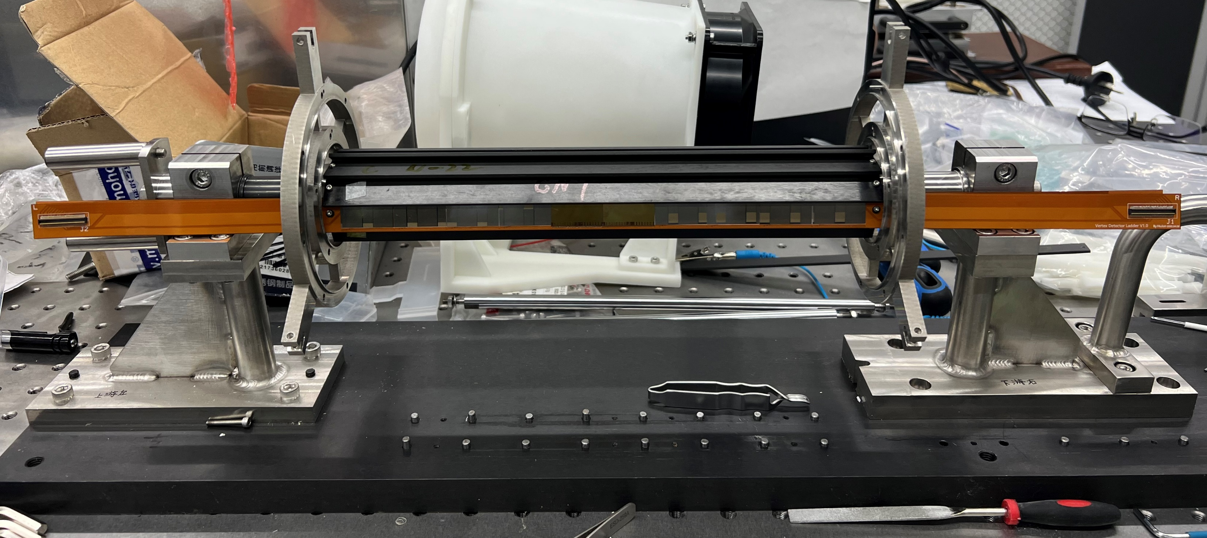
Loading Test: Fix the ladder on the flange

Slide 4
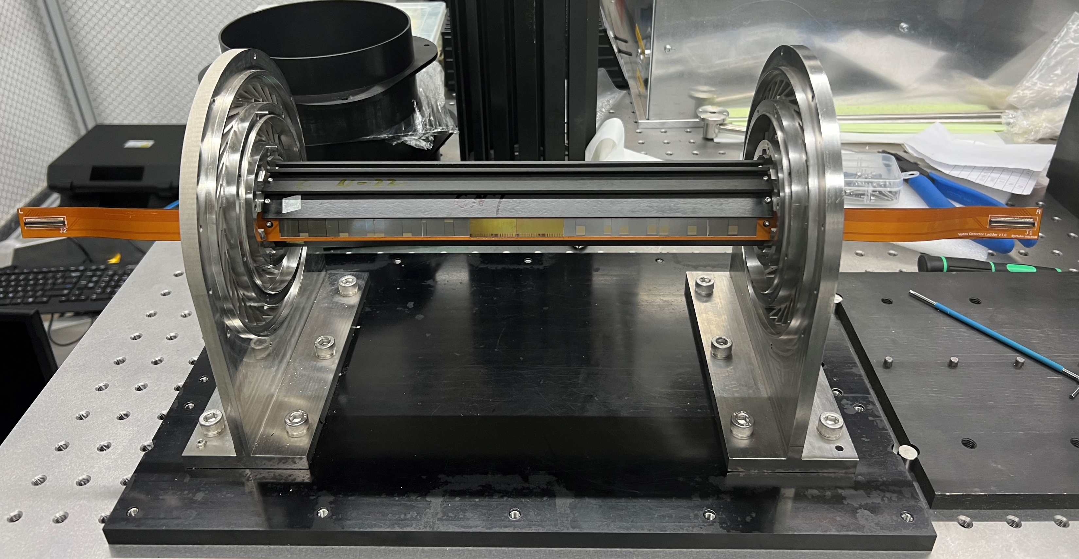
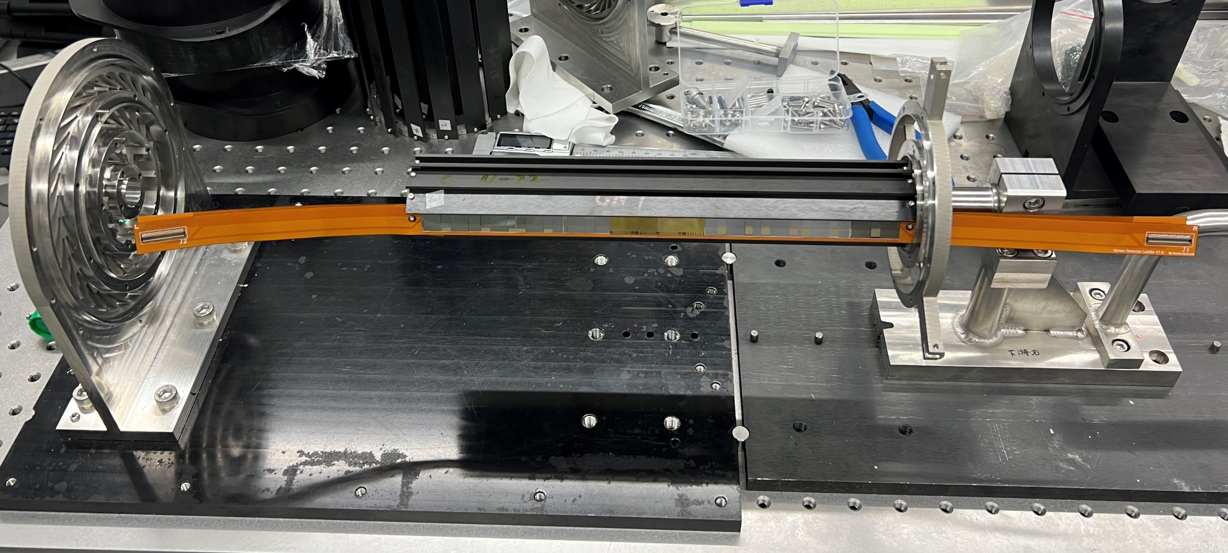
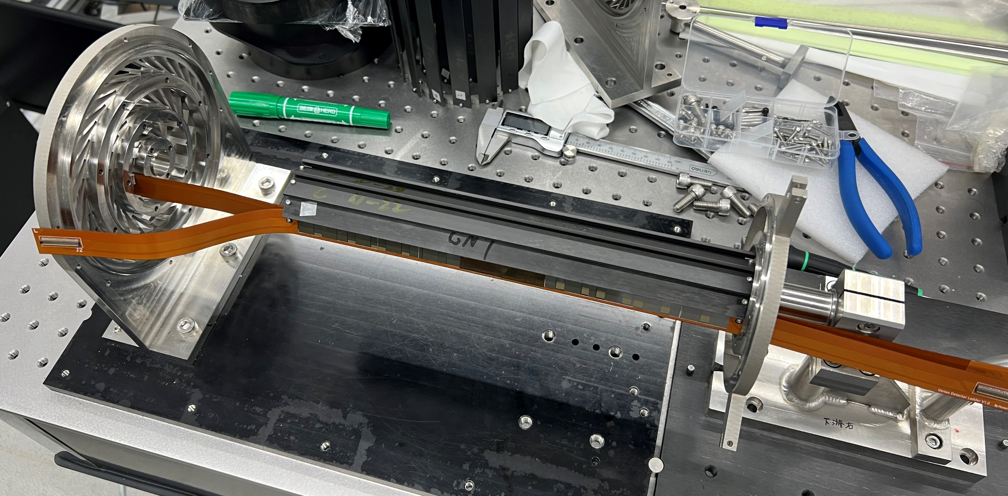
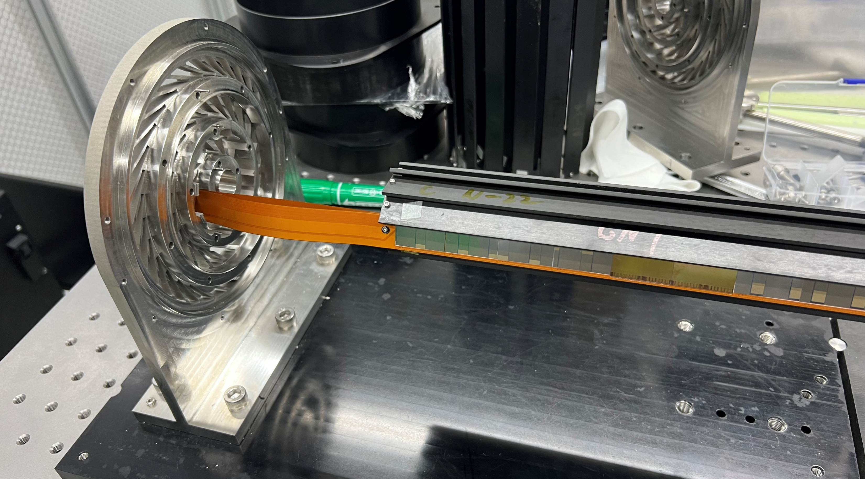
Loading Test:

Slide 5
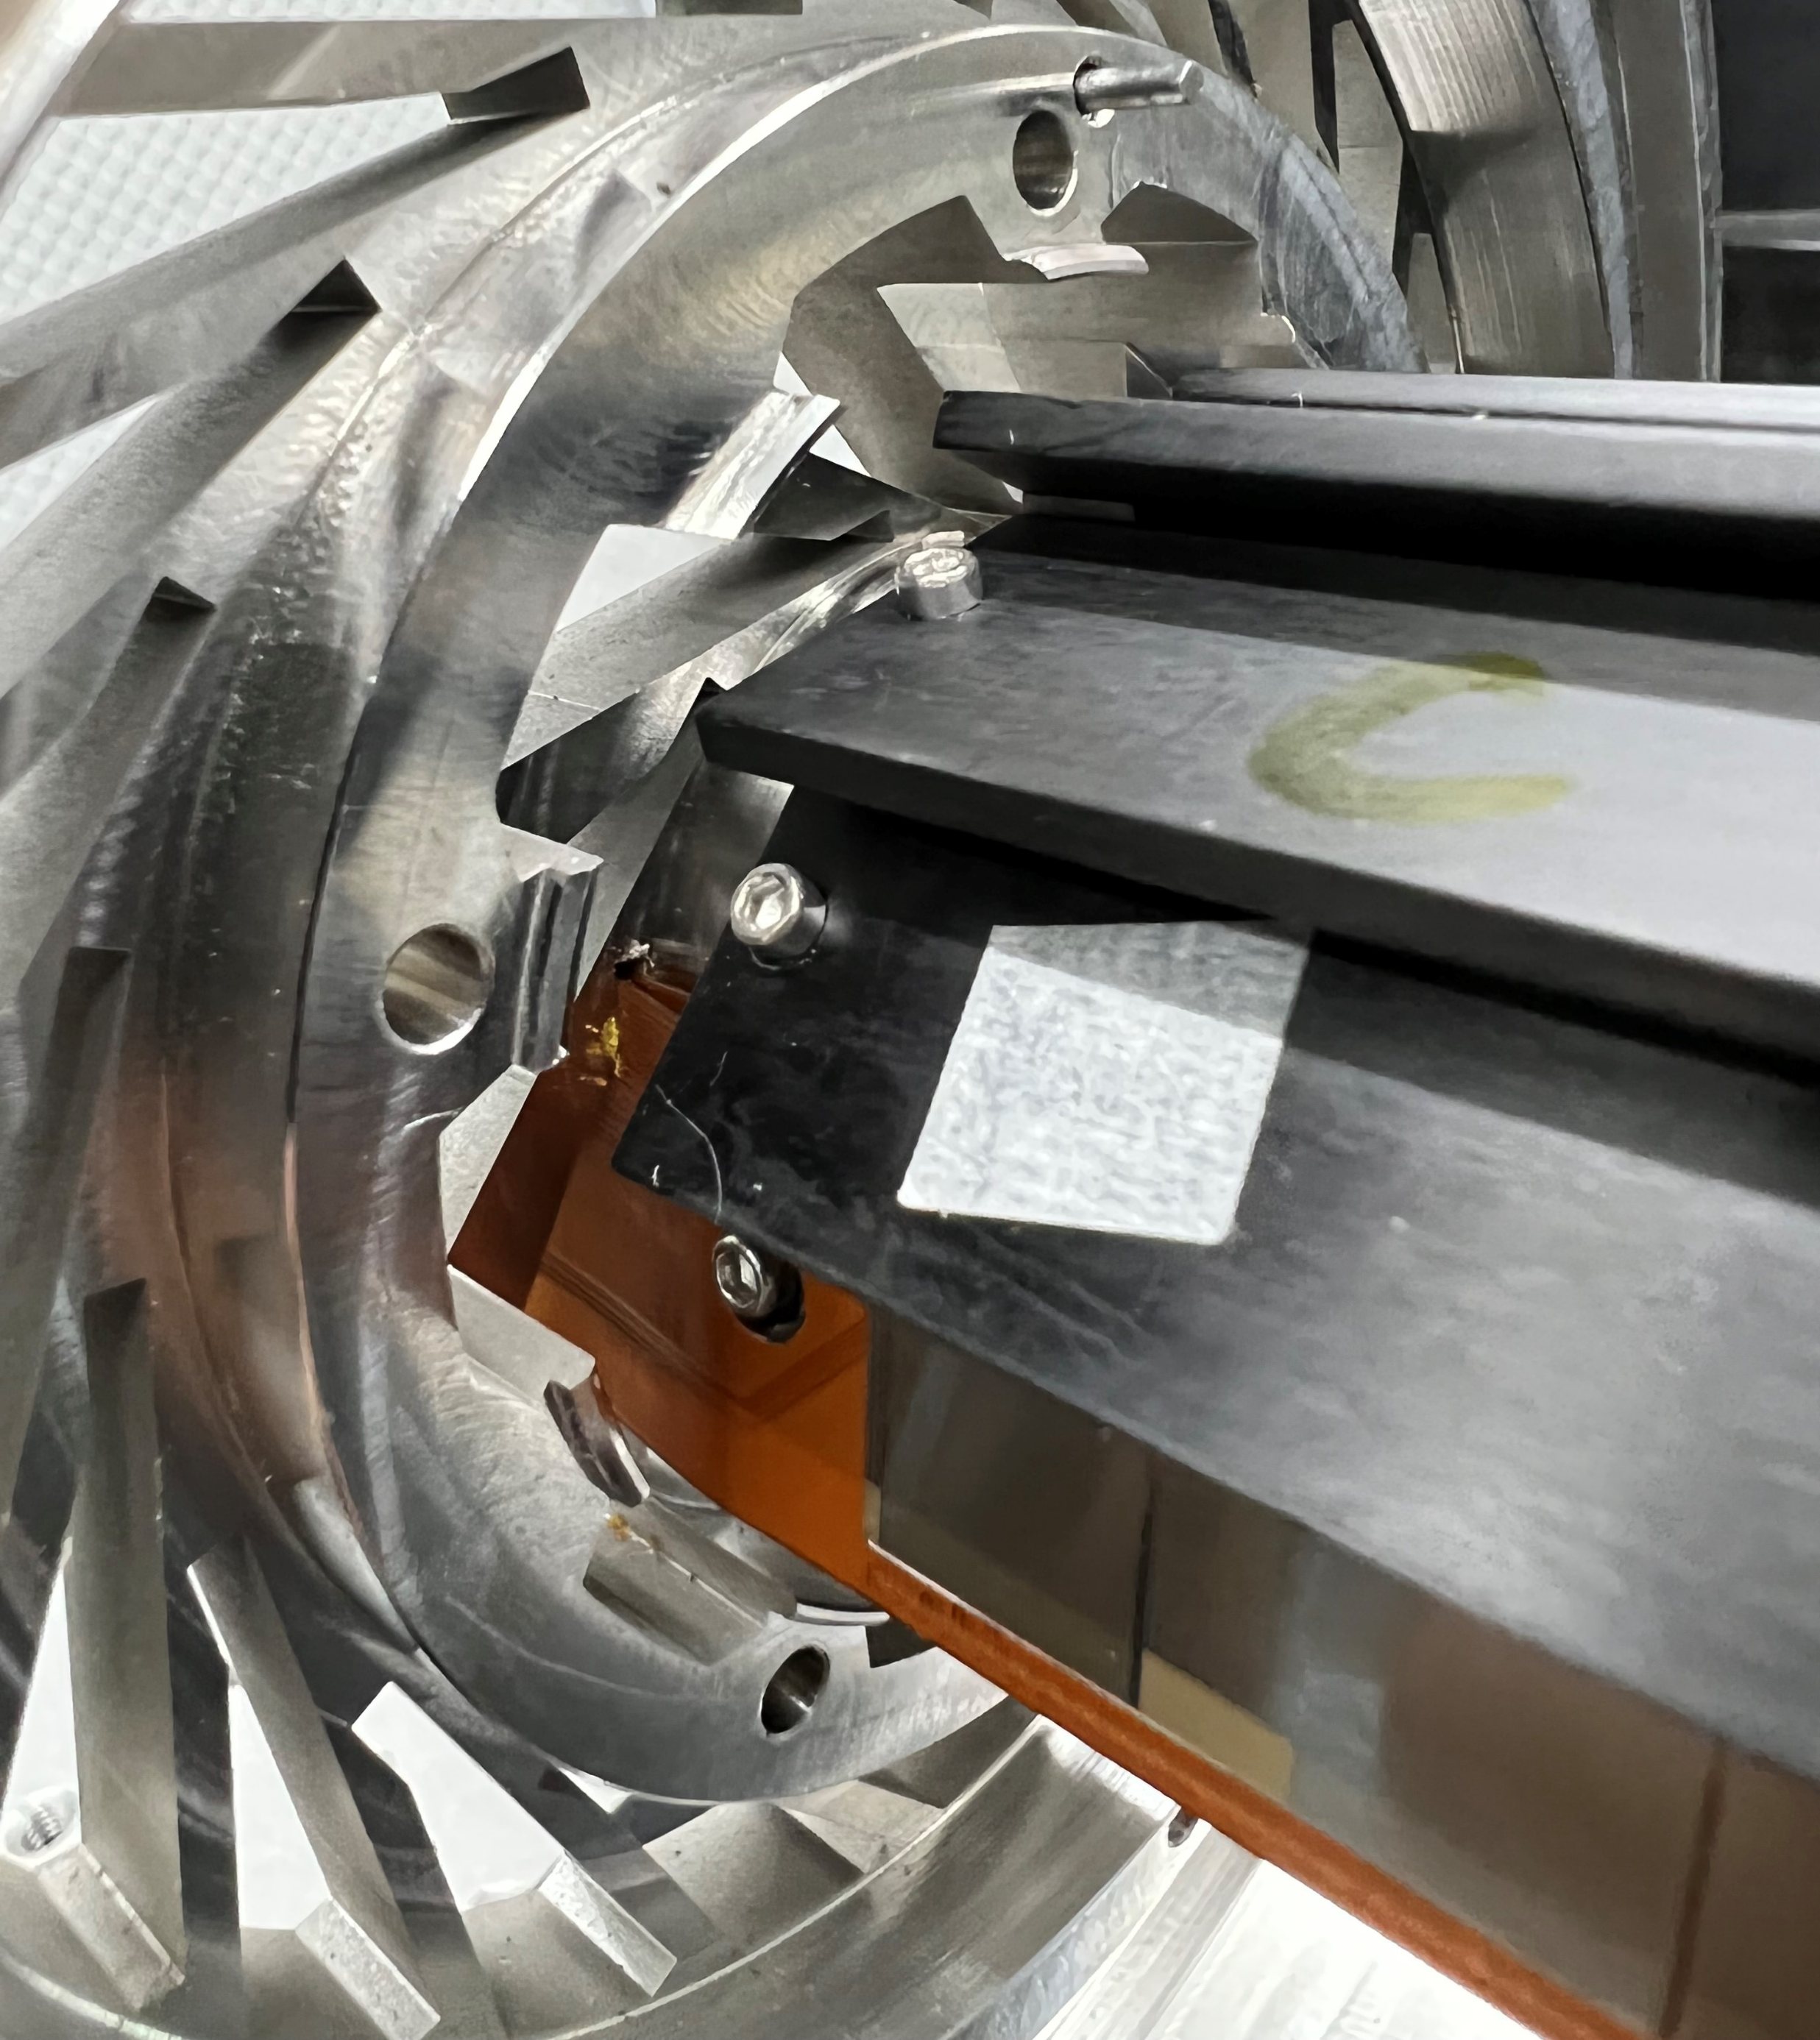
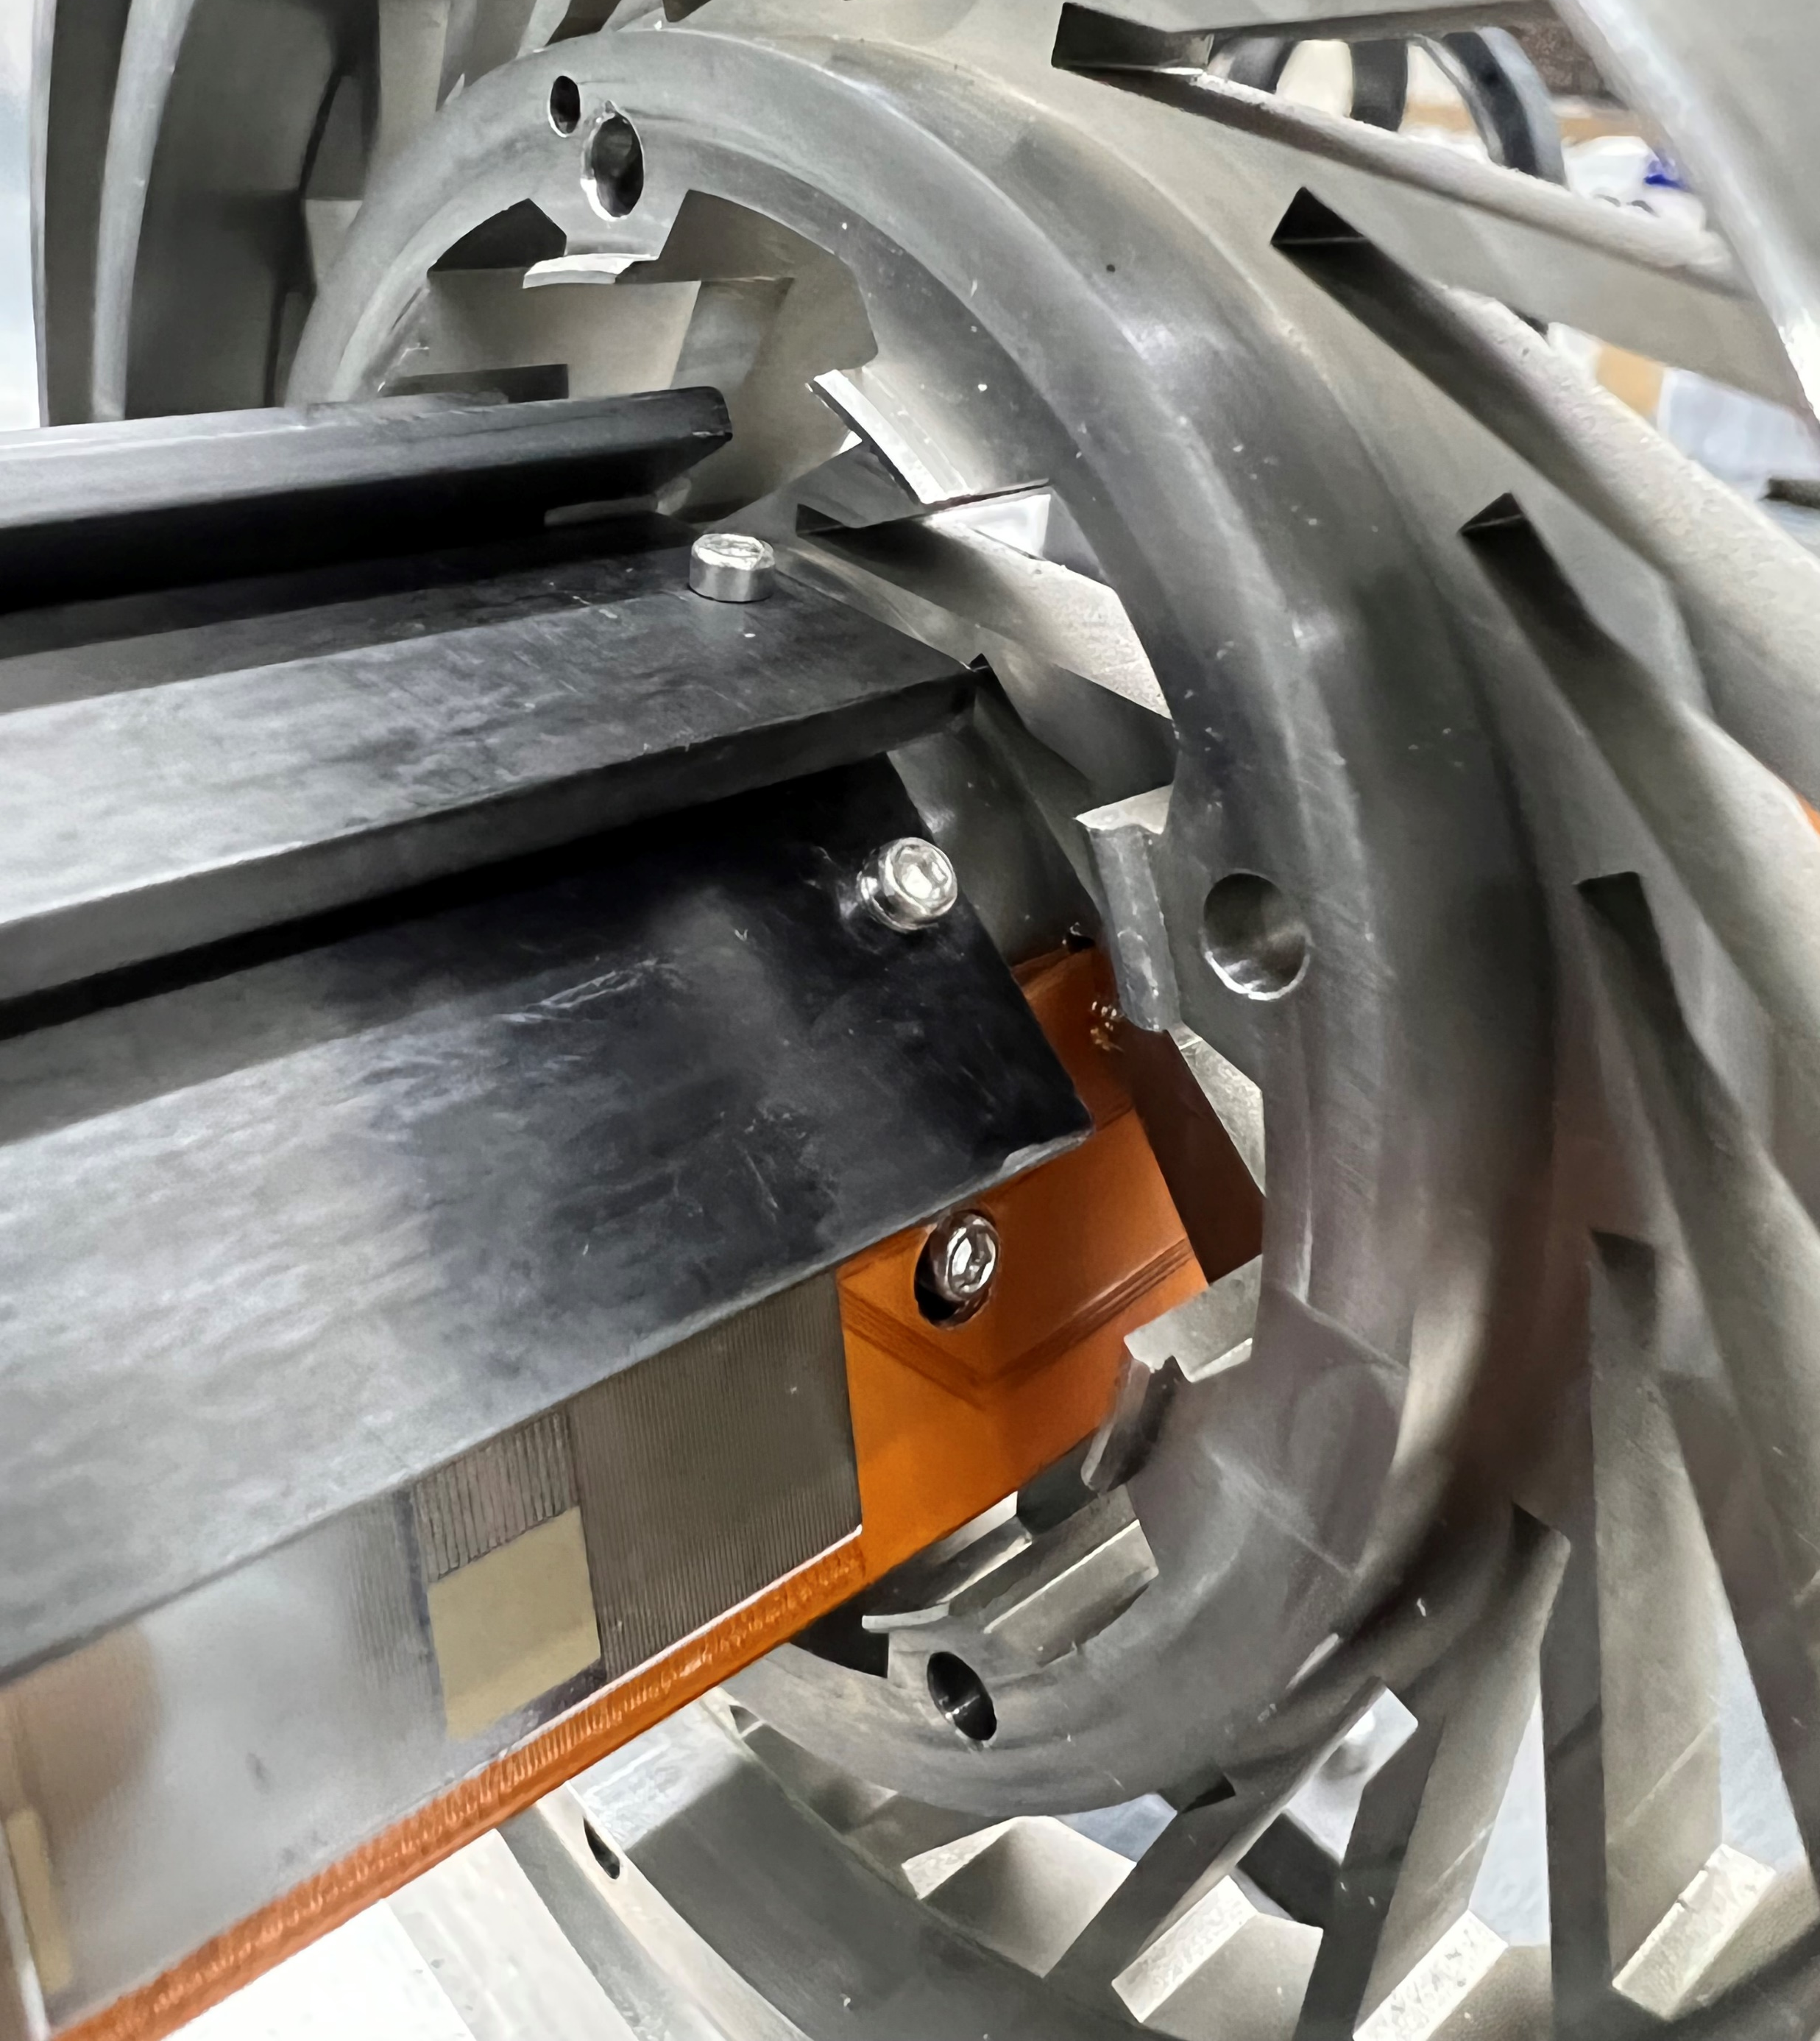
Loading Test:
Successful loading test with inner barrel!
The loading on middle and outer barrel would be much easier than the inner barrel.
This test was done with flex v1.0 (4-layer).
Some difficulties with ladder assembly:
We can only assemble one side until the glue is dry(about 6 hours in room temperature, 10 mins with 80℃).
The vacuum the gantry use is not enough to pick up the flex, we assemble the ladder by hand with a vacuum chuck and some pins.

Slide 6
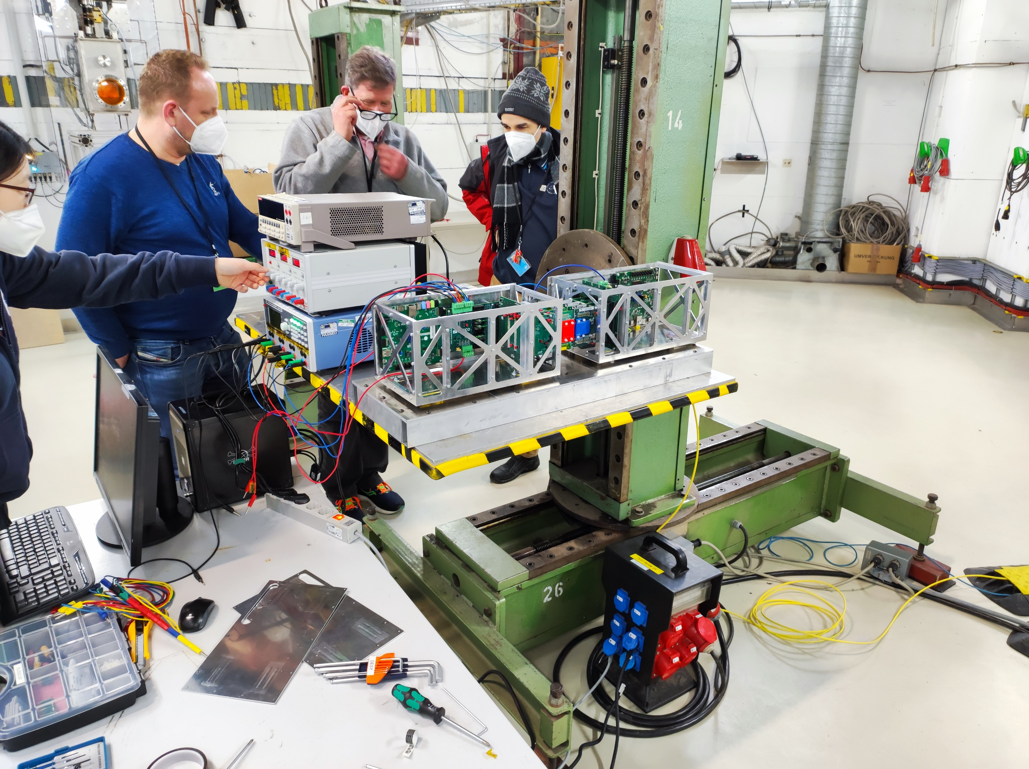
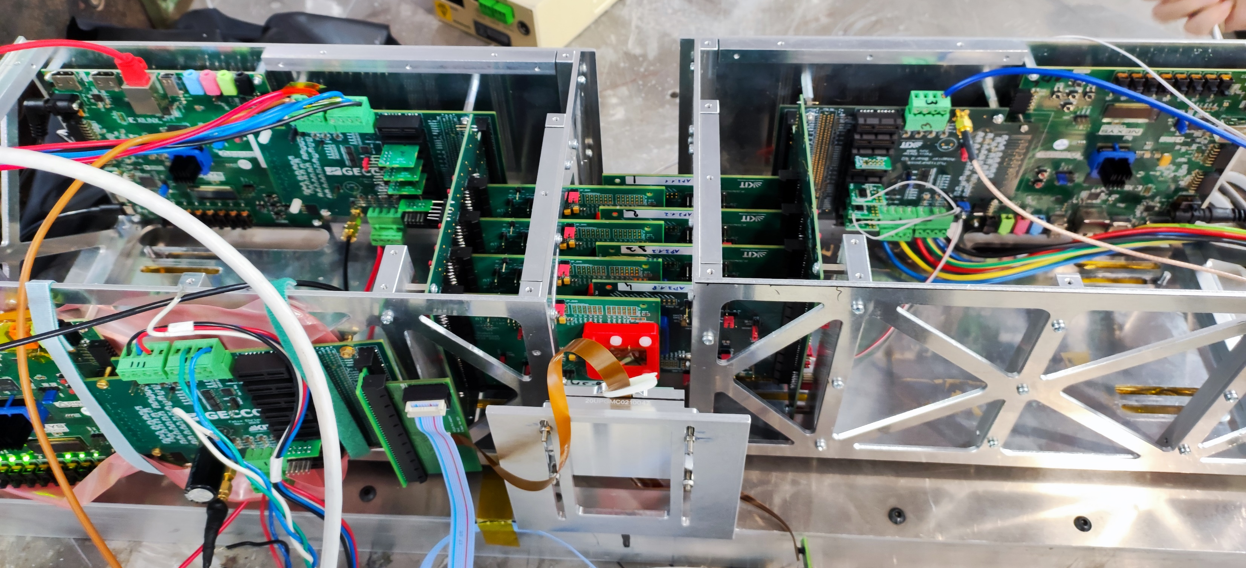
Tools for beamtest in DESY:
CEPC Silicon Tracker beamtest in DESY
The metal support was designed and carried by their team to fix their test board.
We should design and produce our own.
A very large platform to keep the support stable.

Slide 7
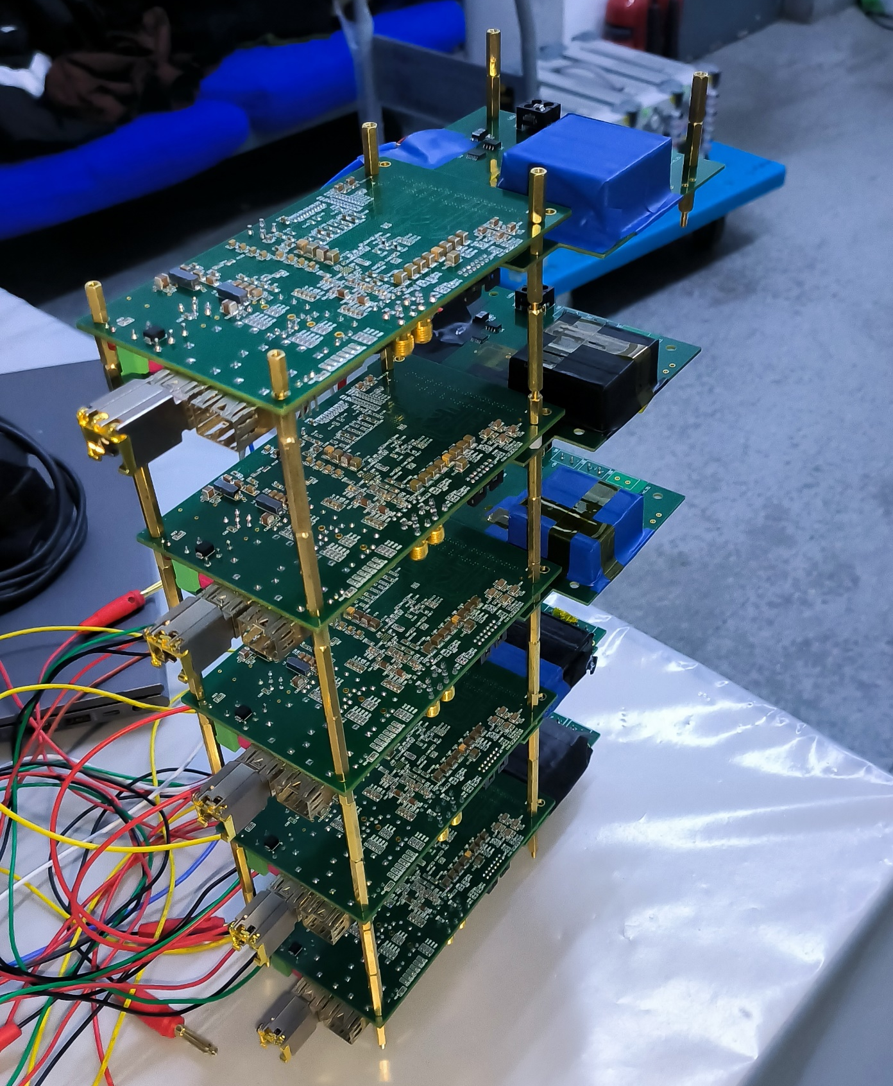
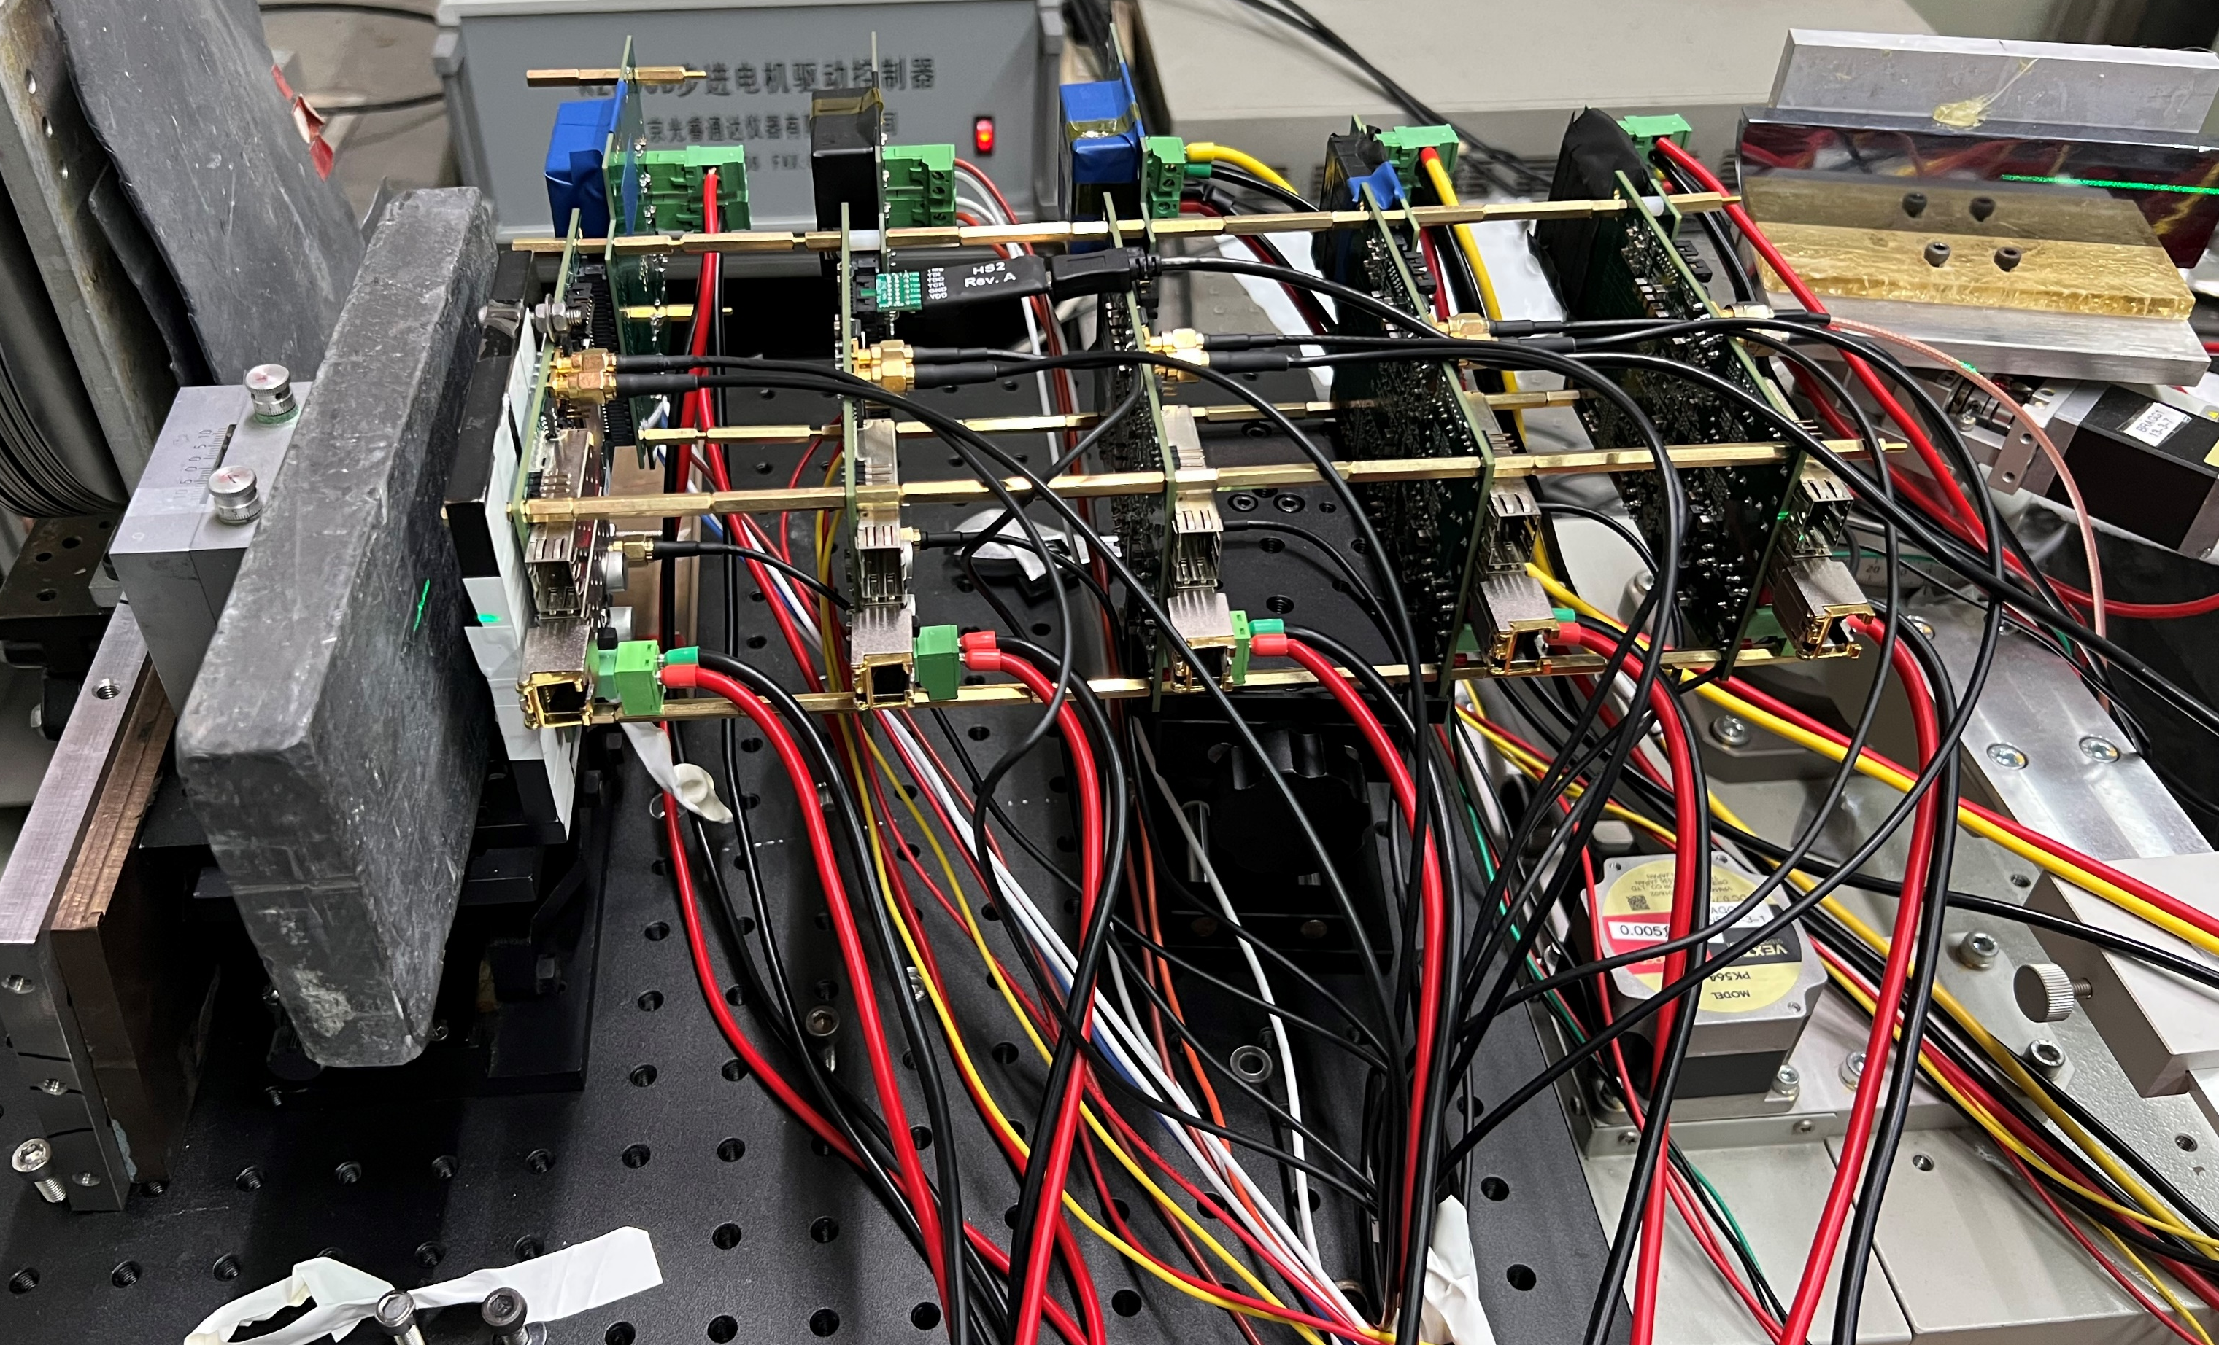
Tools for beamtest in DESY:
What is number of the layers of the support, and the distance between the boards?
Wonder whether we should carry these:
Optical platform
Hex wrench(M2-M5), Screwdriver(M1-M5)
Screws, Nuts and Gaskets(M2-M5)
Pliers
To be filled…
Will deliver a mail to DESY to check whether they could these tools for assembly and loading.

