Slide 1
11/10

Slide 2
Build event
Statics: only have Timestamp, Row&Col
Build event: Cut events and translate origin statics to time&position
Row&Col to Position: mutiple pixel’s size
Timestamp to time:
0101 ..... 0101 .......... 1111
Small:8bit
Big: 28 bit
Time/Clock = (1<<8)*Big_ts + Small_ts
Code:/afs/ihep.ac.cn/users/h/huyiming/knossos_i/class

Slide 3
Event build Process
Temp evt
evt repository
Info new
Info n
Evt new
Judge
Info 2
Evt 2
True:Generate Evt
Info 1
Evt 1
Info 0
Evt 0

Slide 4
Temp evt
evt repository
Info new
Info n
Evt new
Judge
Info 2
Evt 2
True:Generate Evt
Info 1
Evt 1
Info 0
Info 0
Evt 0
Clear temp evt
Fil new event

Slide 5
Temp evt
evt repository
Info n+1
Info new
Info n
Judge
Info 2
Evt 2
False:fill curr Evt
Info 1
Evt 1
Info 0
Evt 0

Slide 6
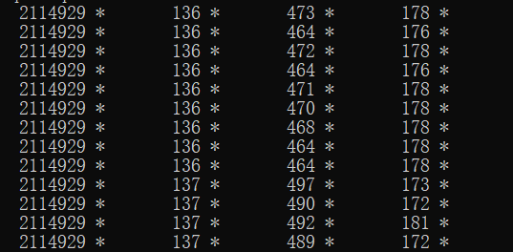
Judgement of Event
timeFPGA
timeChip
row
col
1.Using time as criterion
timegap set as 3 clock

Slide 7
Stack top or bottom
Info contains:
time
chipID
hit Position
Info new
Info n
?compare to top or bottom
Info 2
Info 1
Info 0

Slide 8
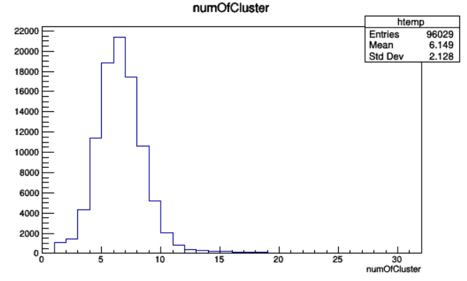
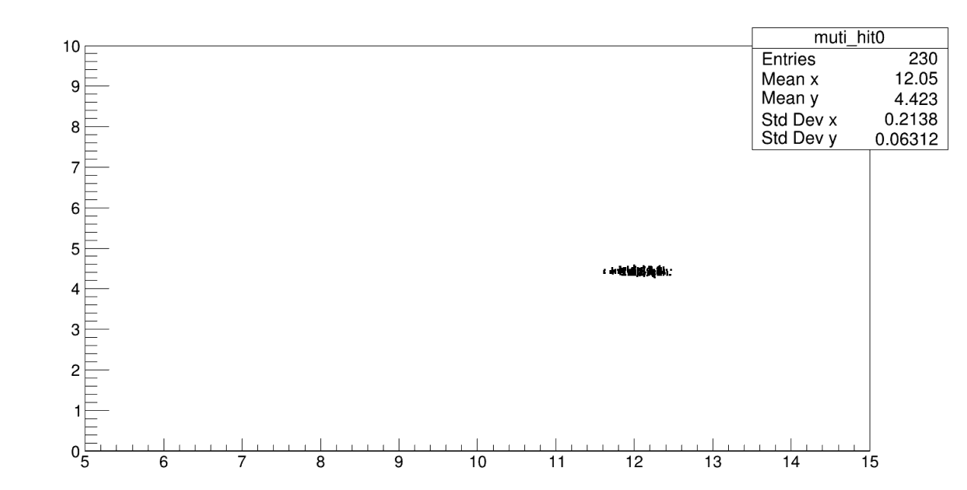
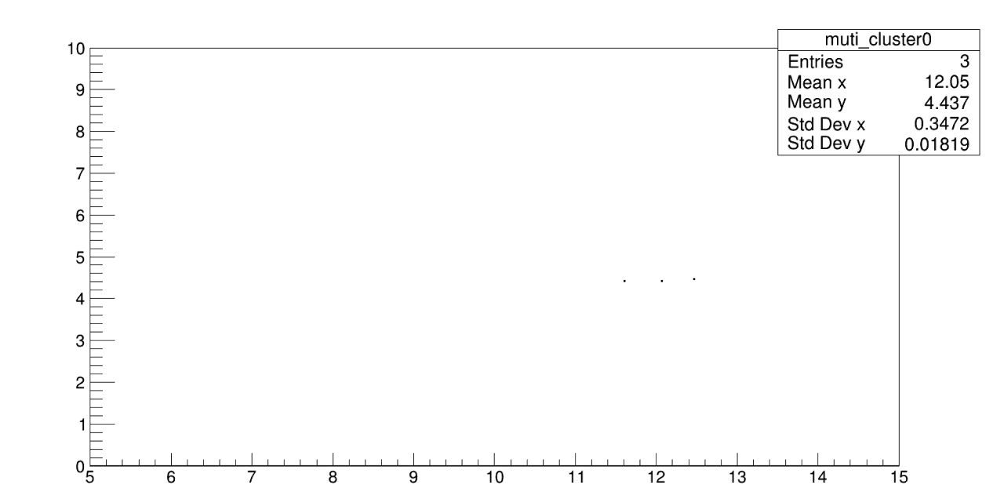
Charge sharing

Slide 11
Mutiple cores
Events build need single core, so just build events without any other operations.
1 Evt Contains:
EvtID
ChipID (not definitely in order)
Position
Clustering can process in mutiple-cores.
During clustering, If input-hits are too much, may lead some std::alloc error.
One simple way to fix that: Use unordered_map<vector> instead of vector<vector>

Slide 12
Timecamp
signal process
1.chips get hits ： chips share same clock but have diff phase.
2.time_chip stop ：only when signal stop, the chip_time will update
3.send time_chip info to FPGA ：FIFO, 1hit needs 400ns to handle
4.when signal reach, record time_FPGA ：If hits have 20+, time_FPGA Gap≈ 4

Slide 13
1.chip_time alignment
t1
φ1=t2-t1
t2
φ2=0
t3
φ3=t2-t3
t4
φ4=t2-t4
256
time_align[ i ] = （time[ i ]+φi）% 256

Slide 14
consider err
phase difference may have error, let it be 2 chip_clock;
When time_FPGA difference < criterian，
chip_time(align) difference < phase difference+1
consider as same evt

Slide 15
Special situation
timeFPGA update by reach time, can’t used to judge such situation
trade - offs: $abs(t1−t2) ∈ [0,3] ∪[252,255]$ is same evt

Slide 16
Judge of event
Y
generate new evt
time_FPGA gap > n1
generate
new evt
Y
N
time_FPGA gap > n2
fill into old evt
N

Slide 17
Results
Set time_chip criterian: no evts found
Check the phase difference of different chips
particle reach time may not ignorant
Only set time_FPGA criterian: find many evts

