Slide 1
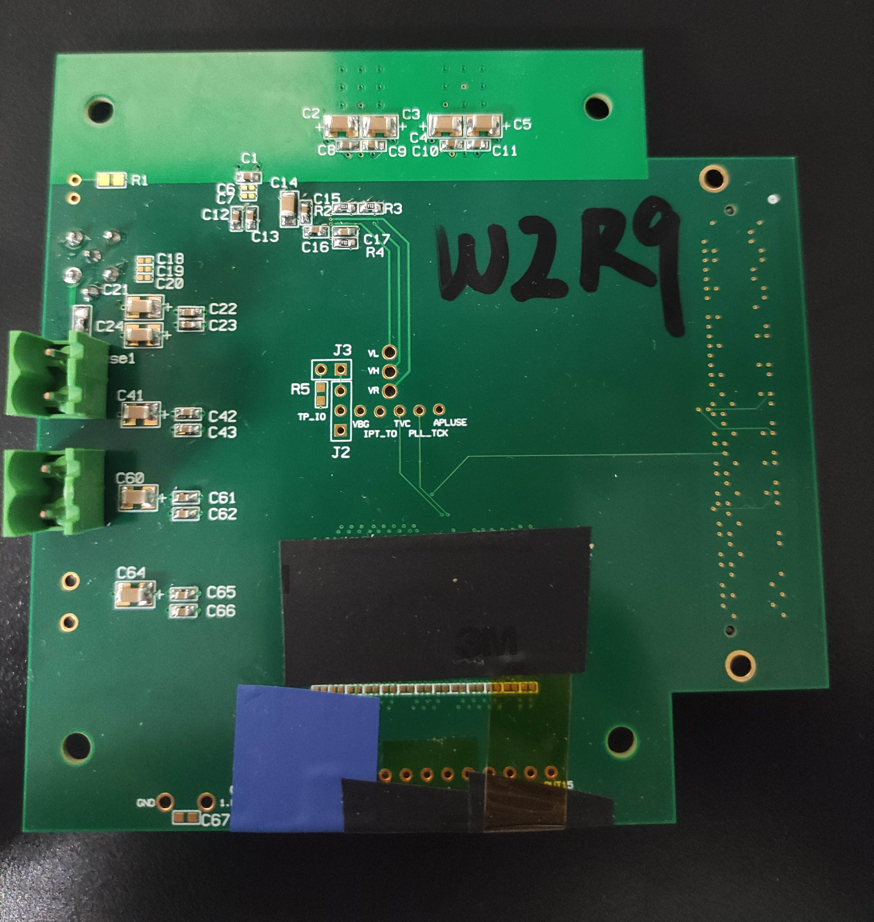
Chip W2R3/W2R9/W2R10/W2R12 Test
Xiaoxu Zhang 2022/11/24
insulated copper column holes
place covered by black friction tape
hole, back of chip
test board v1.21

Slide 2
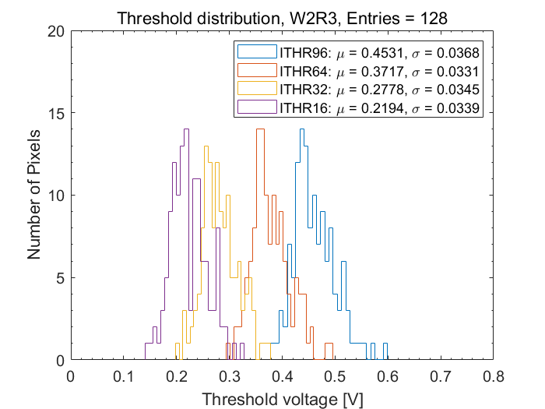
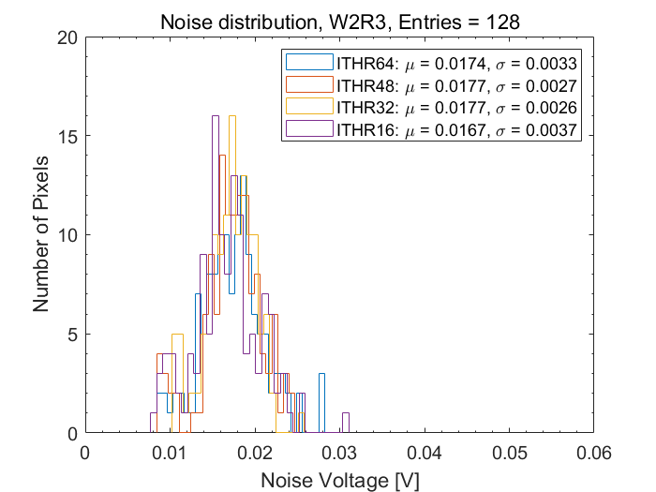
Chip W2R3
Power current [A] |  |  | Bias Voltage [V]
3V | 1.8A | 1.8D | VBG | VL | VH | VR | VCLIP | VCASP | VCASN | VCASN2
0.003 | 0.065 | 0.144 | 0.752 | 0.47 | 1.599 | 1.65 | 0.021 | 0.031 | 0.532 | 0.566

Slide 3
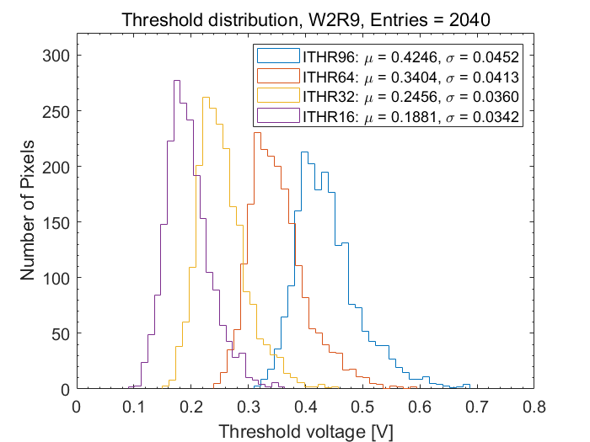
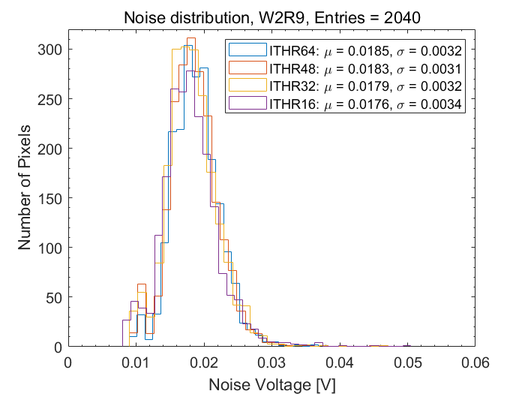
Chip W2R9
column 350 apulse, no data
Power current [A] | Bias Voltage [V]
3V | VBG | VL | VH | VR | VCLIP | VCASP | VCASN | VCASN2
0.214 | 0.765 | 0.47 | 1.6 | 1.65 | 0.02 | 0.03 | 0.529 | 0.569

Slide 4
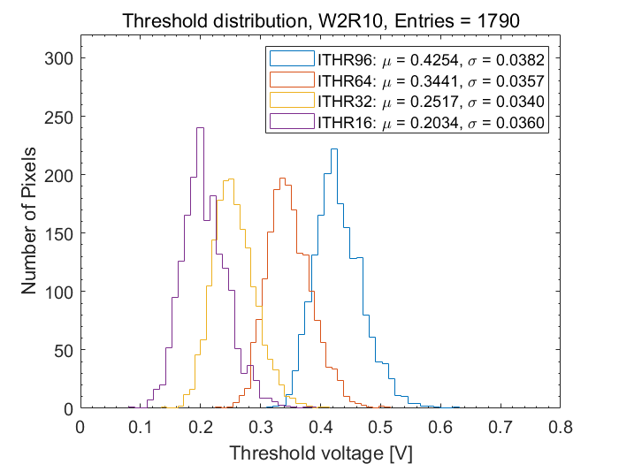
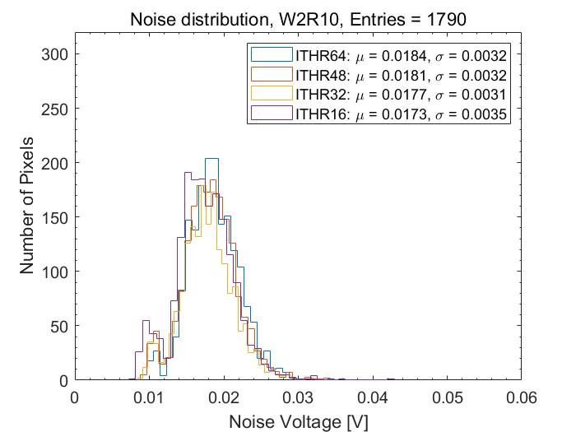
Chip W2R10
Power current [A] | Bias Voltage [V]
3V | VBG | VL | VH | VR | VCLIP | VCASP | VCASN | VCASN2
0.266 | 0.755 | 0.47 | 1.6 | 1.65 | 0.02 | 0.03 | 0.529 | 0.563

Slide 5
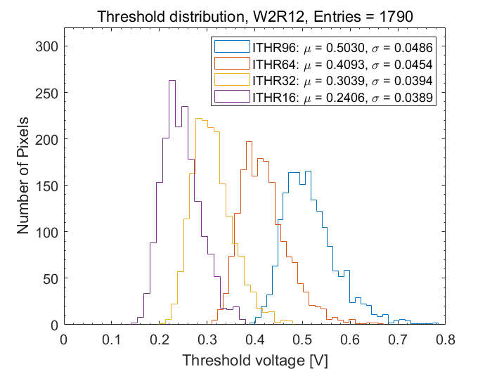
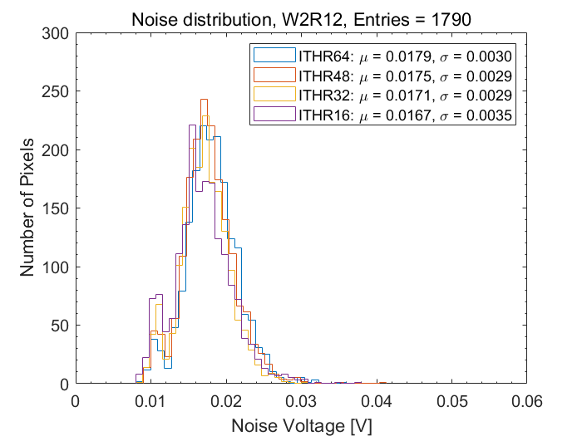
Chip W2R12
Power current [A] | Bias Voltage [V]
3V | VBG | VL | VH | VR | VCLIP | VCASP | VCASN | VCASN2
0.211 | 0.752 | 0.47 | 1.599 | 1.651 | 0.021 | 0.031 | 0.523 | 0.564

Slide 6
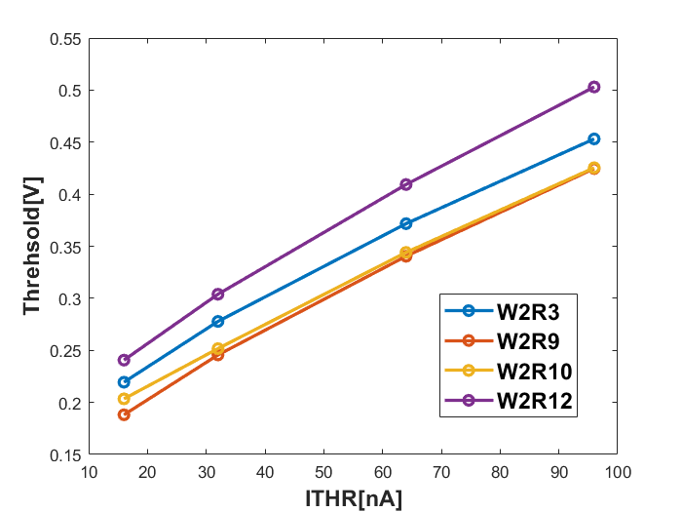
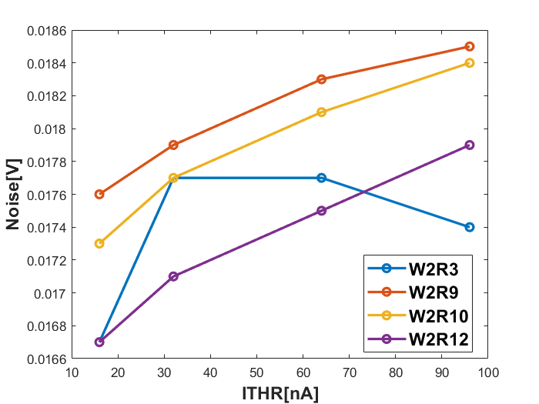
Modified, ITHR32, Threshold
W9R1: 0.1537V
W9R2: 0.1470V
ITHR32

Slide 7
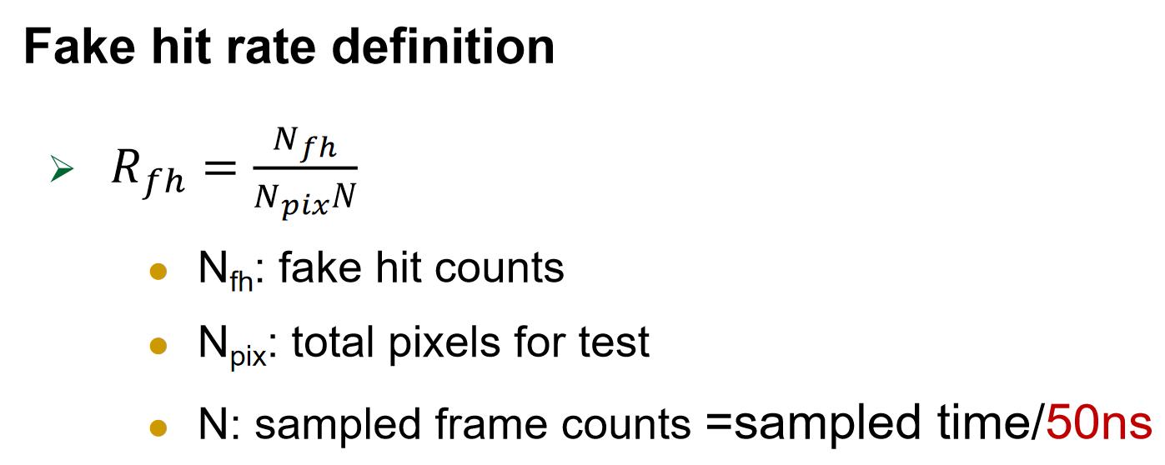
Fake hit rate test
Test process (ITHR32)
test 1: no mask pixels, offline 500s
test 2: mask fake hit pixels(fake hit >25) in test 1, offline 500s
ITHR32
Chip | Mask pixels | Fake hit | Sampled time [s] | Fake hit rate
W2R3 | no mask | 80067 | 500 | 1.53e-11
 | 9 | 306 | 500 | 5.84e-14
W2R9 | no mask | 5485053 | 500 | 1.05e-9
 | 39 | 729 | 500 | 1.39e-13
W2R10 | no mask | 5675439 | 500 | 1.08e-9
 | 37 | 697 | 500 | 1.33e-13
W2R12 | no mask | 5460389 | 500 | 1.04e-9
 | 6 | 261 | 500 | 4.98e-14

