Slide 1
CERN forum on IHEP career opportunities
Career Opportunities of Nuclear Technology and Applications Division
Mohan Li
2/12/2022

Slide 2
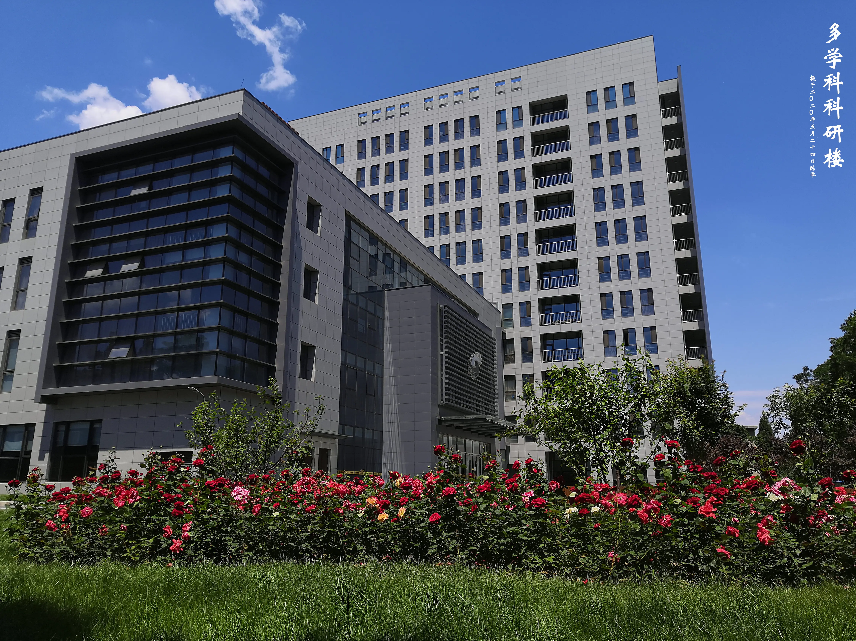
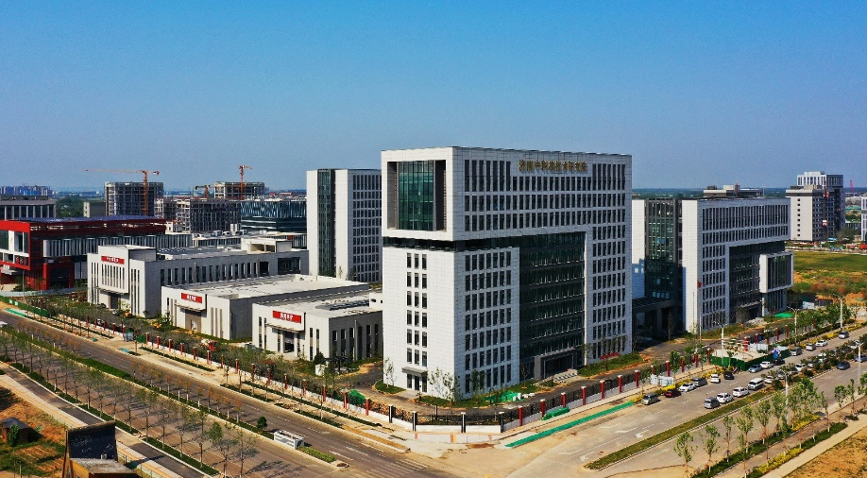
Introduction
Our mission: Nuclear Technology and Applications Division (NTAD) is an application-oriented, non-profit R&D affiliation of the IHEP, aiming at technology transfer and product industrialization
Our areas: Medical imaging devices for pre-clinical research and diagnosis, irradiation accelerators, industrial CT, radiation safety monitoring, low-toxic tumor therapy nano-medicine, etc.
Beijing office
Jinan Laboratory

Slide 3
Introduction
Staff and graduate students: 105 in total
Full-time faculties: 58
Post doctorate: 2
Graduate students: 25
Exchanged students: 16
Others: 4
Our focus: device and technology for:
Imaging for clinic diagnosis and life science
Nondestructive testing (NDT) for industry and laboratory
Radiation safety monitoring
Advanced compact accelerator

Slide 4
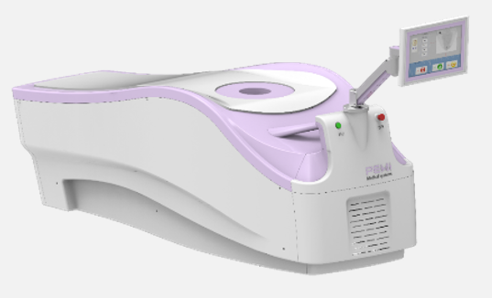
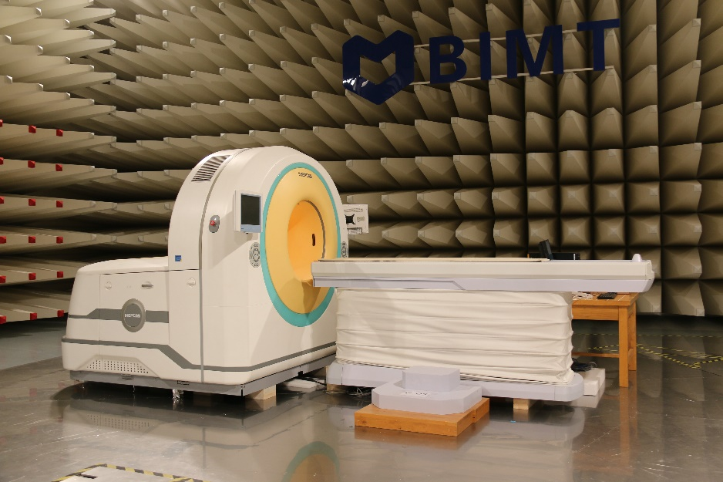
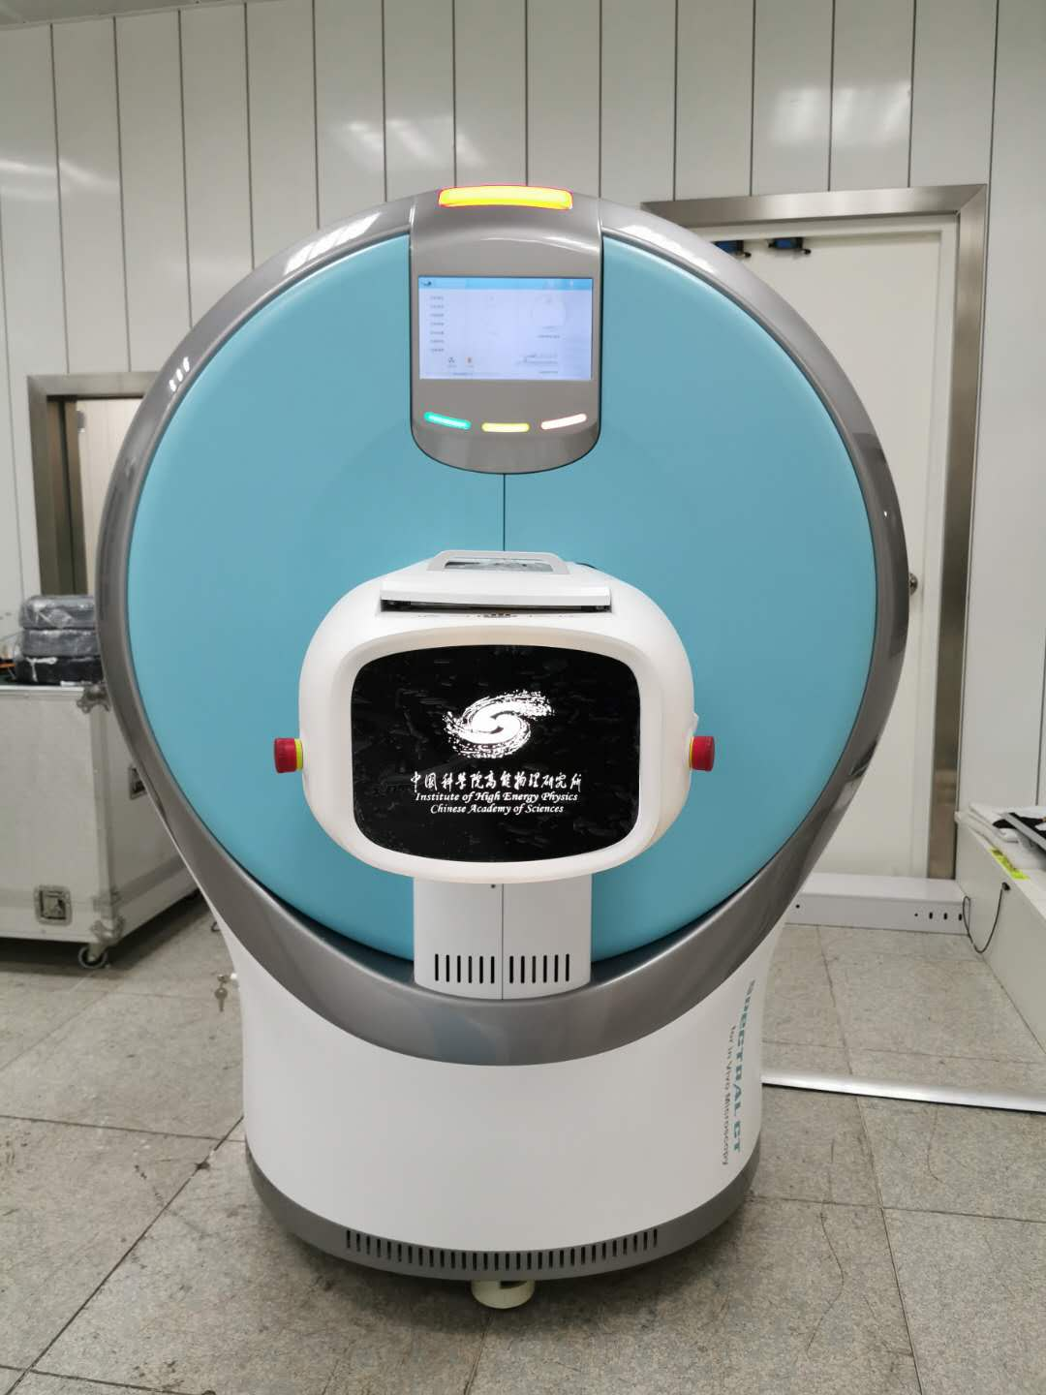
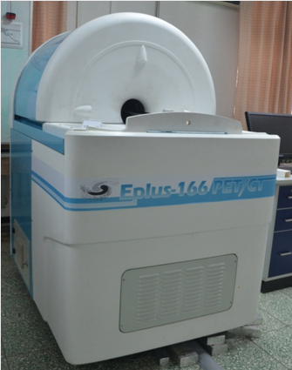
Our Achievements
Imaging devices for diagnosis and pre-clinical research
Positron Emission Mammography
(with CFDA registration)
Positron Emission Tomography (PET)
Small animal PET/CT
Spectral CT for small animals

Slide 5
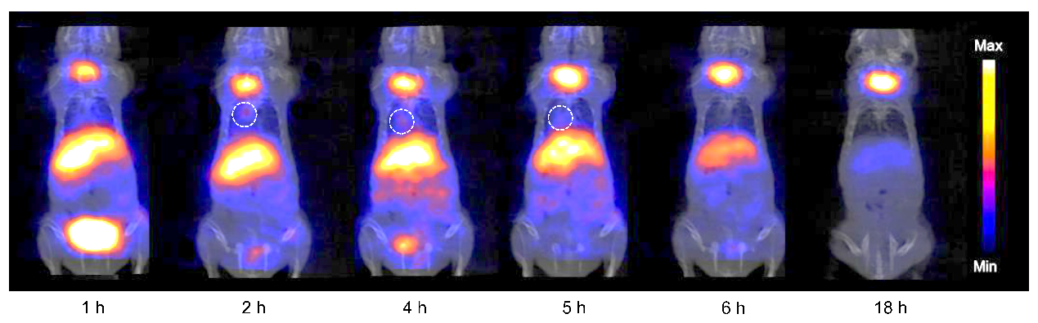
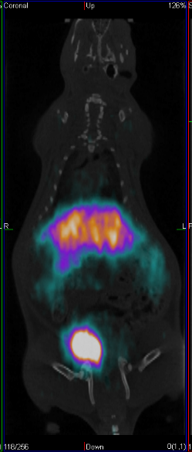
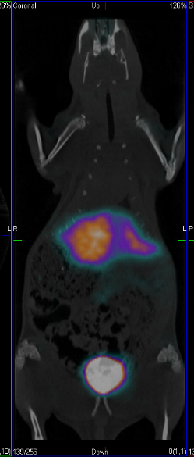
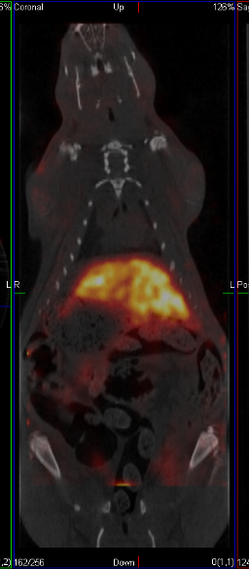
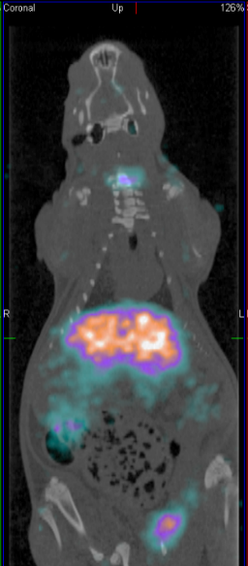
Our Achievements
Molecular probe
Rat PET and SPECT imaging
Rat lung cancer PET imaging
^{99m}Tc SPECT
⁶⁸Ga PET
⁶⁴Cu PET
¹²⁴I PET
Nude mouse lung cancer PET imaging

Slide 6

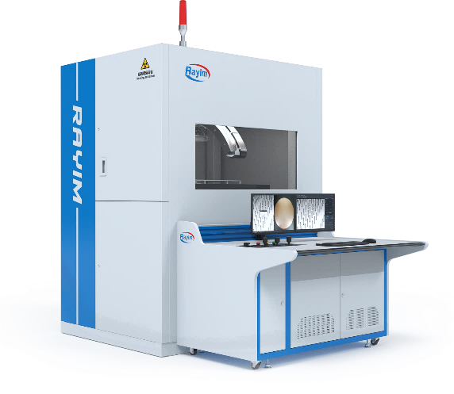
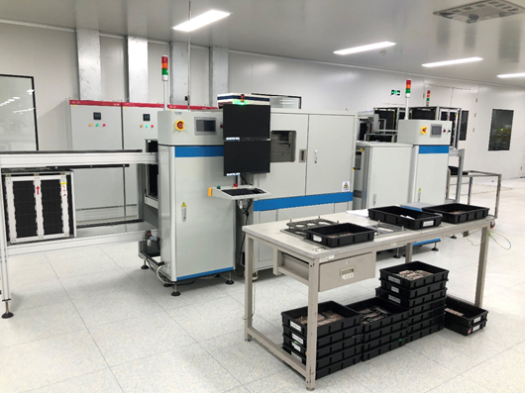
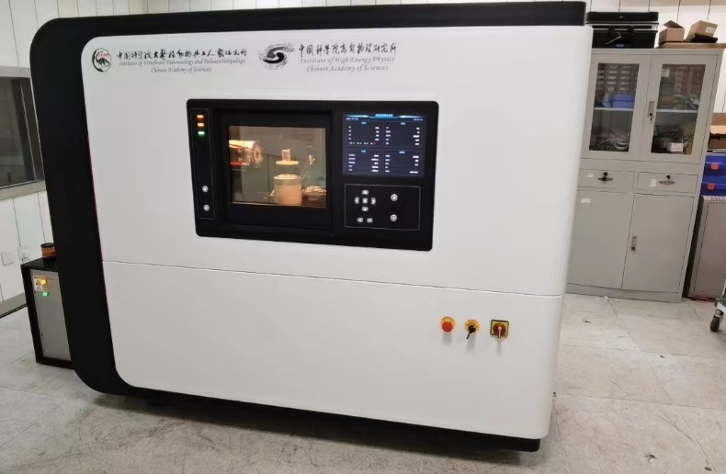
Our Achievements
CT equipment for industry and laboratory
Computed Laminography
Computed Laminography for IGBT testing
Spectral nanoCT

Slide 7
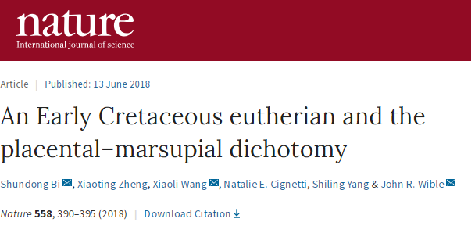
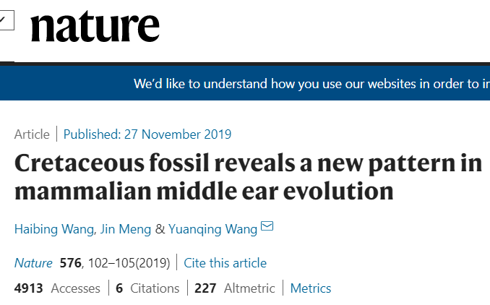
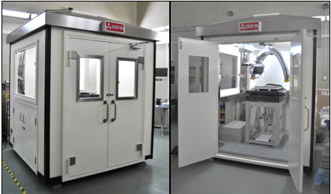
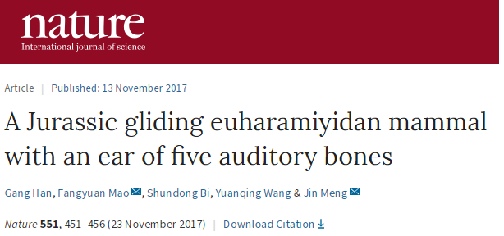
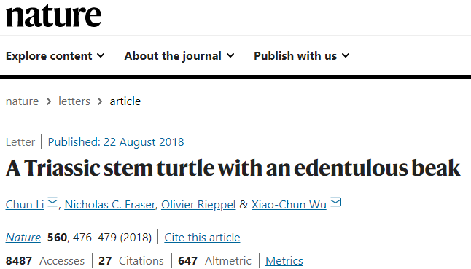
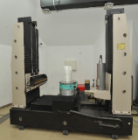
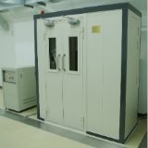
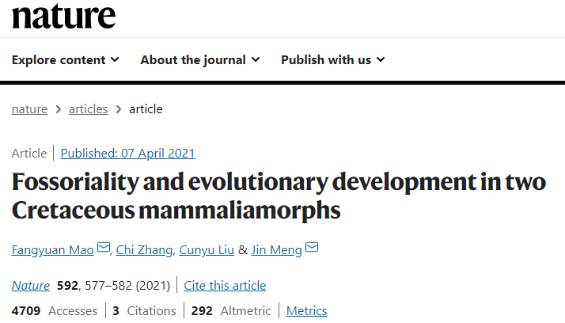
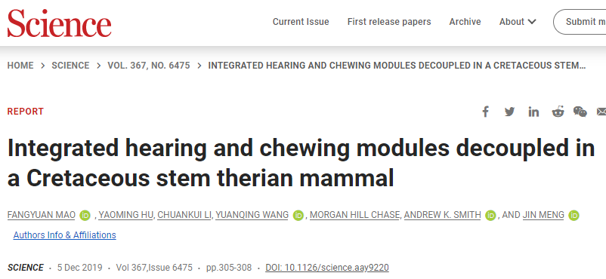
Our Achievements
CT equipment for laboratory
Dedicated fossil CT

Slide 8
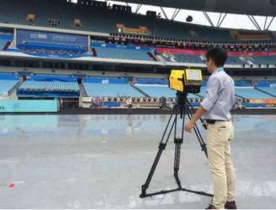
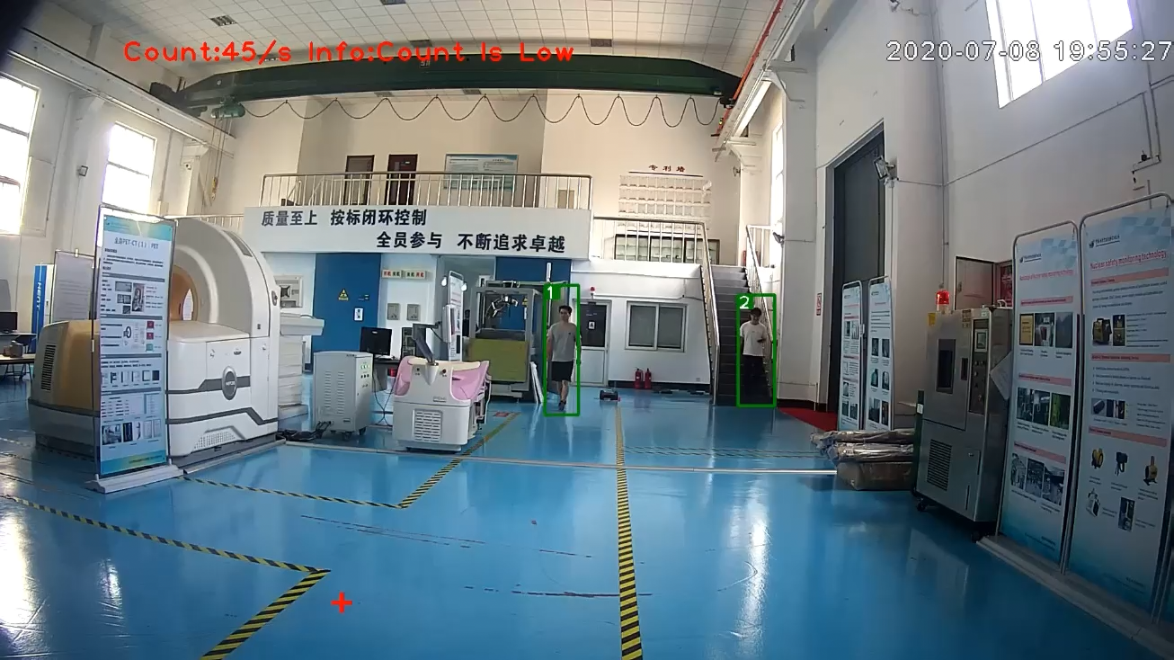
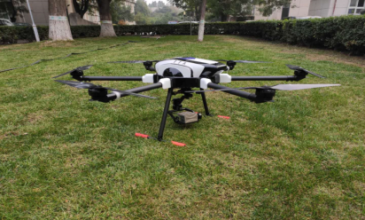
Our Achievements
Radiation safety monitoring
Public radiation safety support
Neural network based radiation source detection and tracking
UAV carried radiation detector

Slide 9
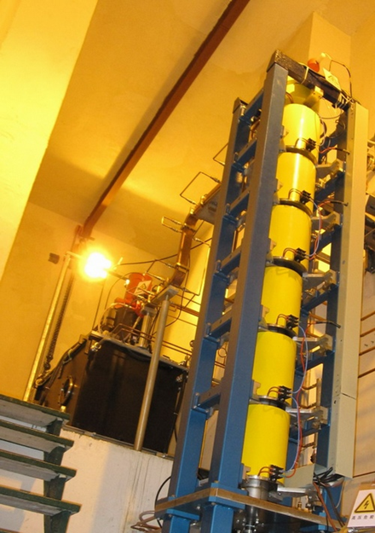
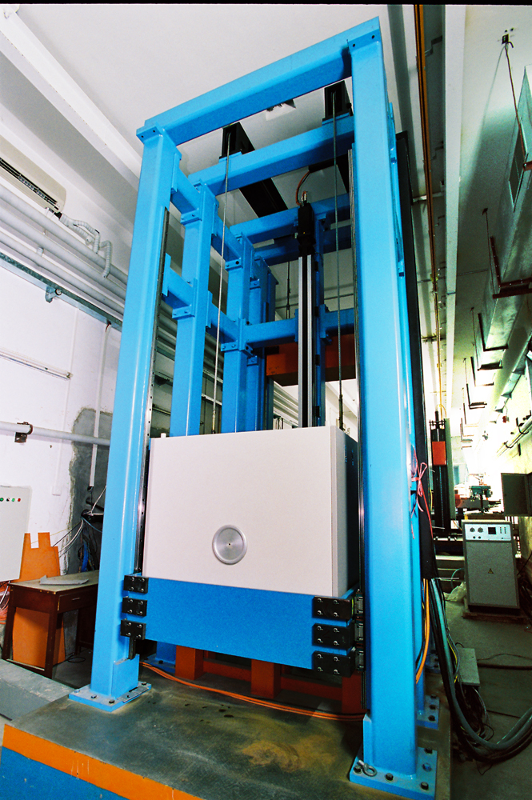
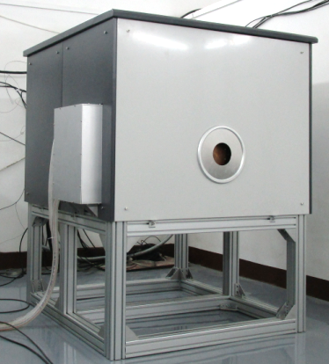
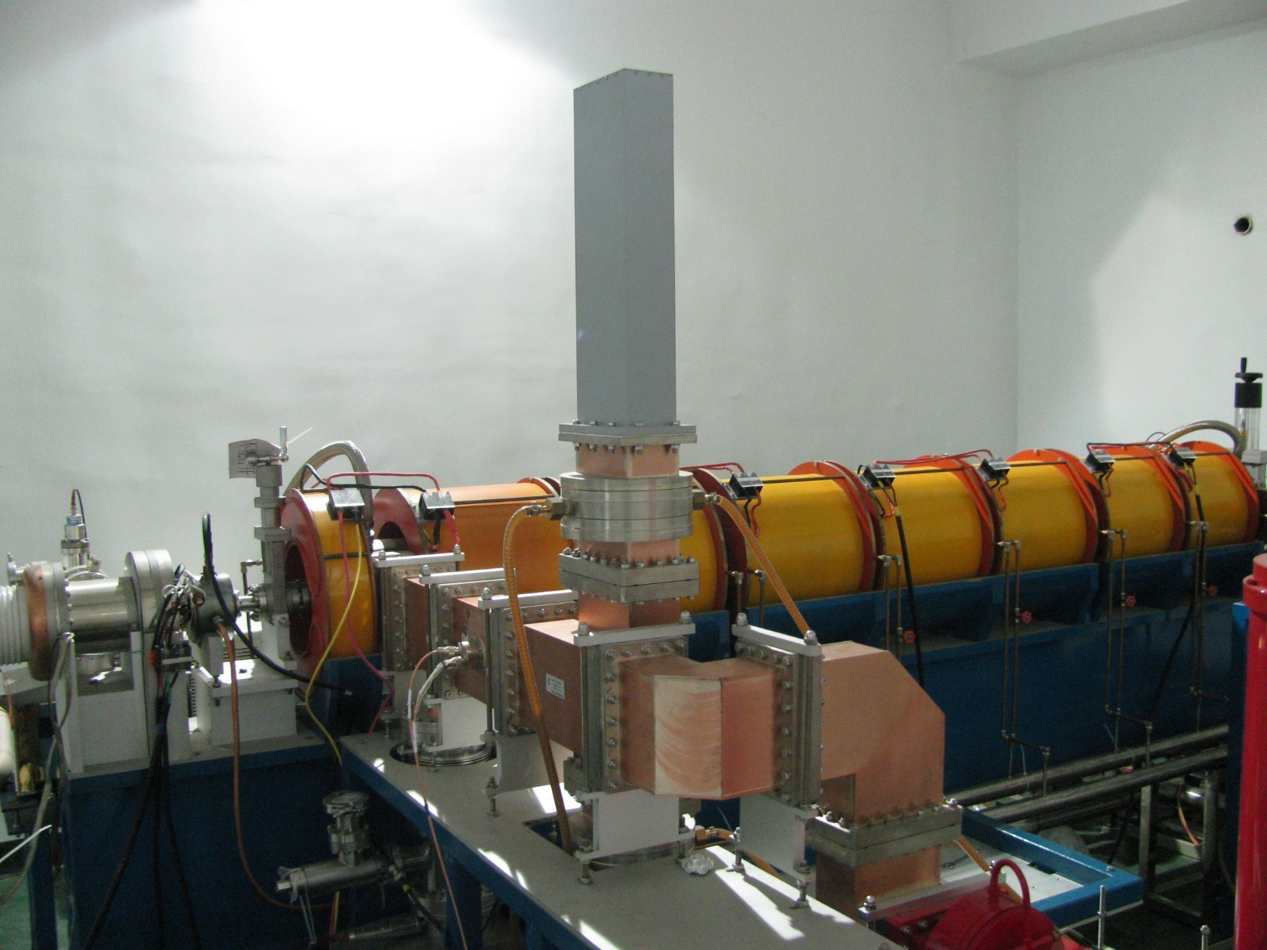
Our Achievements
Accelerators
L-band 10MeV industrial irradiation accelerator
9MeV accelerator X-ray source
S-band 10MeV industrial irradiation accelerator
6MeV accelerator X-ray source

Slide 10
Position Description
Opening: Professor
Research area: Nuclear medical imaging technology
Professional background requirements:
Professor or equivalent rank
Experienced in PET/SPECT algorithm or instrumentation

Slide 11
Position Description
Opening: Associate professor
Research area: Nuclear medical imaging technology
Professional background requirements:
Associate professor or post doctorate experience abroad
Experienced in PET/SPECT algorithm or instrumentation

Slide 12
Position Description
Opening: Associate professor
Research area: Radiation detector and system R&D
Professional background requirements:
Associate professor or post doctorate experience abroad
Experienced in advanced radiation detector R&D

Slide 13
Position Description
Opening: Post doctorate
Research area: X-ray imaging technology
Professional background requirements:
1) CT imaging theories, including reconstruction and data correction or 2) frontier basic research of physics and mathematics
Innovative technology research of static CT and spectral CT, their applications in industry and medicine

Slide 14
Position Description
Opening: Post doctorate
Research area: Nuclear detection and imaging
Professional background requirements:
Nuclear detection technology research and detection system development
Majoring in physics, nuclear science and technology, biomedical engineering; being familiar with particle physics and nuclear physics
Good communication and cooperation

Slide 15
Position Description
Opening: Post doctorate
Research area: Molecular probe
Professional background requirements:
Frontier research of chemistry of radioactive medicine
Diagnosis and treatment dual-purpose radioactive probe design and synthesis

Slide 16
Position Description
Opening: Post doctorate
Research area: Accelerator technology and application
Professional background requirements:
Advanced accelerator technology research and application
Majoring in accelerator physics, accelerator technology and other relative area
Experienced in accelerator system and key component R&D

Slide 17
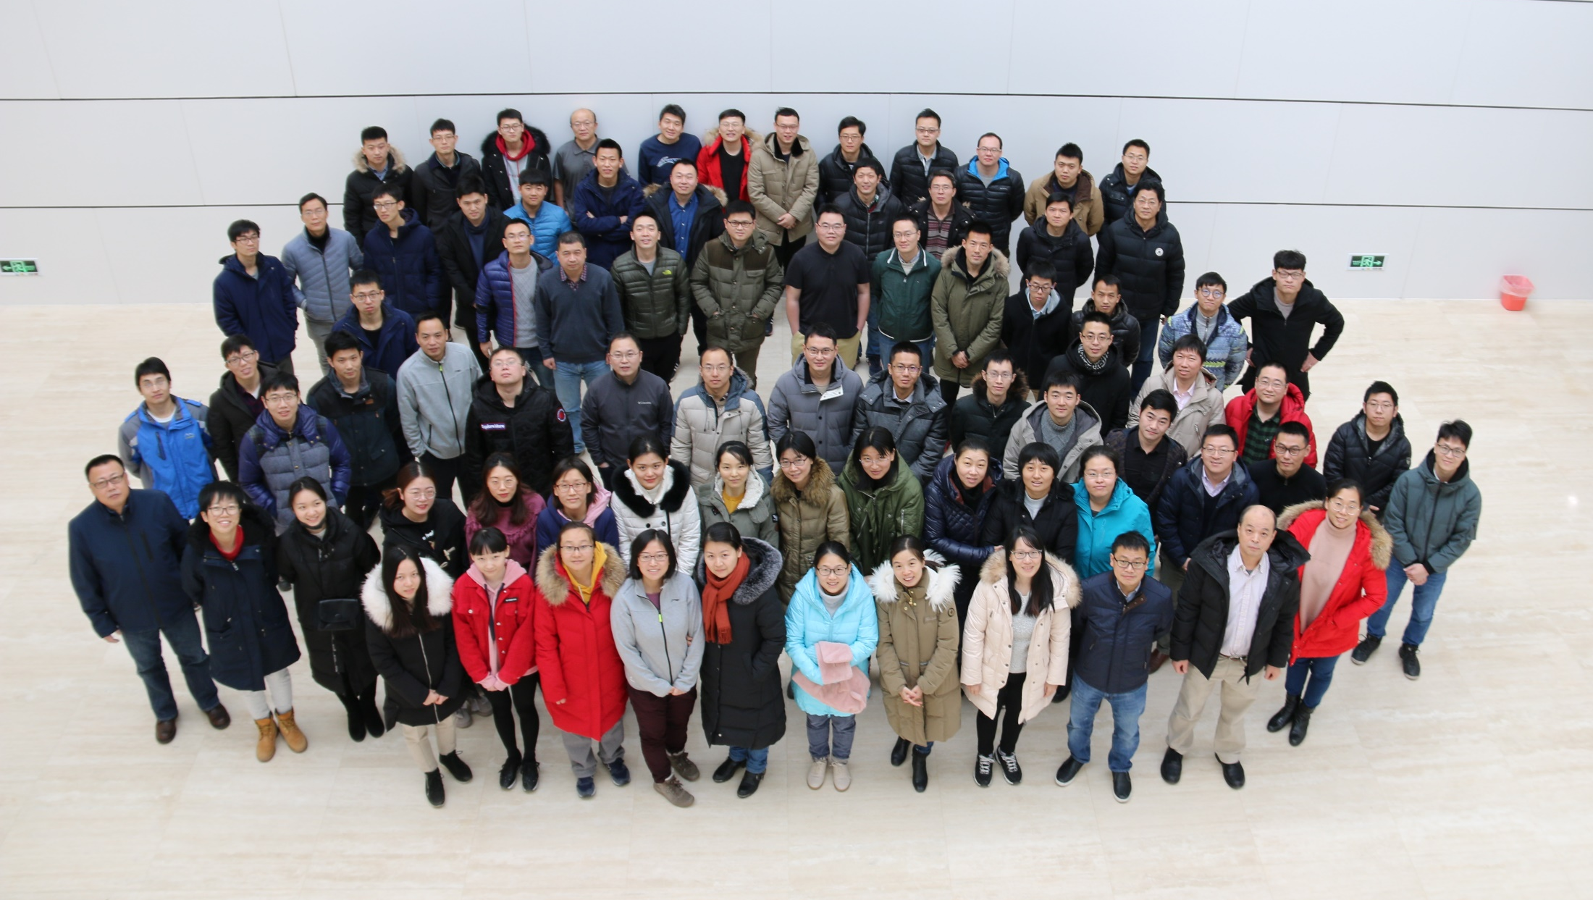
Welcome to join us!
Dr. Wei, Cunfeng, Director of NTAD
Email: weicf@ihep.ac.cn

