Slide 1
New 10 Chips Test
test board v1.21
Xiaoxu Zhang 2022/12/01
Chip | 1.8A resistance[Ω] | 1.8D resistance[Ω] | 1.8A current[A] | 1.8D current[A] | VBG[V] | VCLIP[V] | VCASP[V] | VCASN[V] | VCASN2[V] | VH VL VR | Problem
W9R3 | 32.62k | 4.447k | 0.049 | 0.152 | 0.748 | 0.082 | 0.03 | 0.516 | 0.555 | normal
W9R4 | 4.625k | 4.769k | 0.049 | 0.149 | 0.755 | 0.02 | 0.086 | 0.528 | 0.56 | normal
W9R5 | 33.03k | 4.418k | 0.069 | 0.146 | 0.742 |  |  |  |  | 0 | DAC
W9R6 | 32.88k | 4.254k | 0.046 | 0.148 | 0.74 | 0.02 | 0.098 | 0.491 | 0.522 | normal
W2R10 | 12.28k | 1.5 | 0.05 | 0.148 | 0.765 | 0.02 | 0.03 | 0.537 | 0.575 | normal
W2R18 | 33.02k | 4.529k |  |  |  |  |  |  |  |  | short circuit
W2R19 | 33.18k | 4.288k | 0.037 | 0.153 | 0.743 | 0.02 | 0.03 | 0.52 | 0.557 | normal
W2R26 | 12.53k | 4.549k | 0.052 | 0.139 | 0.752 | 0.02 | 0.03 | 0.524 | 0.555 | normal
W2R28 | 1 | 4.523k | 0.054 | 0.152 | 0.74 | 0.02 | 0.03 | 0.517 | 0.555 | normal
W2R29 | 33.18k | 4.323k | 0.061 | 0.147 | 0.735 |  |  |  |  | 0 | DAC

Slide 2
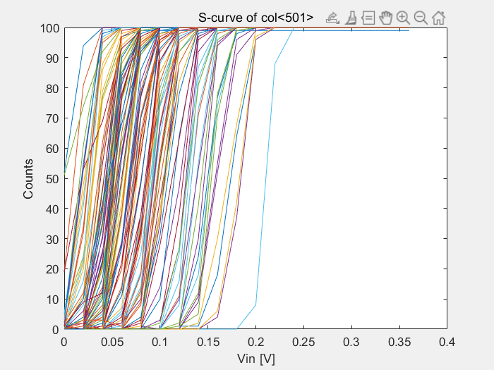
Chip W9R3
no apulse: no output
apulse but vin=0: output
maybe caused by crosstalk
ITHR32

Slide 3
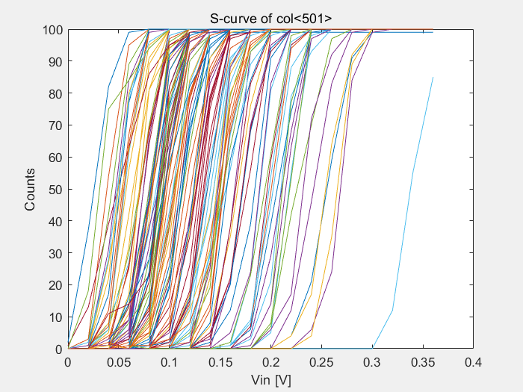
PSUB electrical grounding

Slide 4
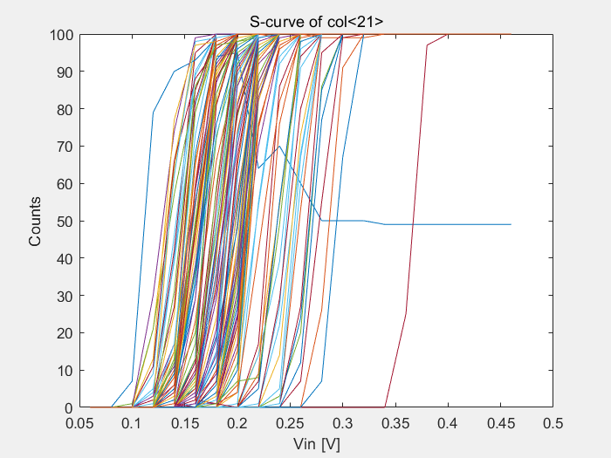
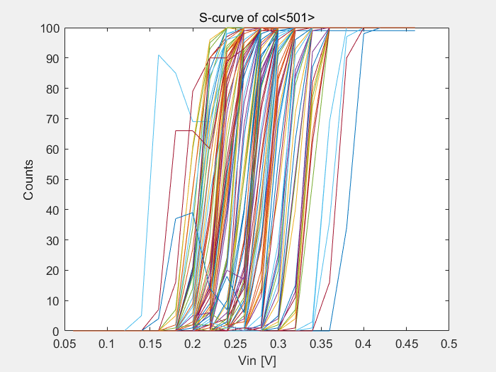
Chip W9R4
threshold get lager with column number

