Slide 1
Grid Certificate & VOMS
Xuantong Zhang, CC-IHEP
On behalf of JUNO DCI Group

Slide 2
Outline
Introduction of the Grid certificate structure,
How to apply for a personal CA,
How to register VOMS,
Create a DIRAC-proxy.

Slide 3
Introduction
The Grid Authentication Model,
JUNO DCI provides distributed computing and storage resources.
Every resource has its own local user lists.
The Grid certificate is a personal certification system for DCI users using distributed resources by mapping Grid users to local user pool.
For Users,
A CA certificate, used for provide your personal information. You need use it to prove you are yourself.
For Resource Sites,
Sites need to recognized the authenticated users and provided authorized resources.
For DCI Service,
An Authentication and Authorization Infrastructure (AAI) need to be build for users and resources sites.

Slide 4
AuthN/AuthZ Model
Certificate Authority (CA)
Authorization Providers
(VOMS or IAM)
Access DIRAC and Resources

Slide 5
Step 1
Certificate Authority (CA)
Step1: Apply for a CA certificate
Authorization Providers
(VOMS or IAM)
Access DIRAC and Resources

Slide 6
Digital Certificate
A digital certificate (X.509) is normally used as a personal identity for each user.
Trusted by the organizations in Grid,
Can be applied from Certificate Authority (CA) in many countries.
Usually need to provide your personal information and apply on a webpage.
Grid recognized CA examples:
IHEP
IHEP Grid Computing Certification Authority (Link)
INFN
FAQ (Link)
Wiki INFN (Link)
CNRS
Request (Link)
Germany
CA at Karlsruhe Institute of Technology (Link)
Or find other CAs for you at igtf.net.

Slide 7
CA Certificate
Take IHEP CA as an example, details in link,
Contact the CA web page and access the request form,
Follow instructions to fill application and submit,
Receive your personal certificate in p12 file format by the link in email.
Export the personal certificate to your browser.
About your personal certificate,
A p12 file composes 2 part,
Public key, so called `cert`,
Private key, so called `key`.
You need to convert a certificate from p12 to pem file format.
This will split your certificate by cert and key part.

Slide 8
CA Certificate Exercise
Try it:
Upload your p12 file to cluster.
At cluster, create .globus directory mkdir ~/.globus
Extract public key from p12 openssl pkcs12 –in <certificates>.p12 –clcerts –nokeys –out ~/.globus/usercert.pem
Extract private key from p12 openssl pkcs12 –in <certificates>.p12 –nocerts –out ~/.globus/userkey.pem
Change the access rights for your keys chmod 644 ~/.globus/usercert.pem chmod 400 ~/.globus/userkey.pem
Browse your personal certificate information openssl x509 -in usercert.pem -noout -text

Slide 9
Step 2
Certificate Authority (CA)
Authorization Providers
(VOMS or IAM)
Step2: Register in VOMS/IAM
Access DIRAC and Resources

Slide 10
Authorization Providers: VOMS
Virtual Organization (VO),
A VO is a physical resource provider.
JUNO VO provides DCI resources.
Virtual Organization Membership Services (VOMS),
Create user groups for VO.
Create different roles among existing groups.
Generate VOMS proxy for users to access VO resources.
Before the end of 2023, another system, Identity and Access Management (IAM), will replace VOMS as future VO authorization provider.

Slide 11
VOMS Proxy
About VOMS proxy,
Personal certificate is not directly exposed,
Most of Grids use temporary certificates (proxies),
Normal lifetime 12h,
Proxies are certificates digitally signed by the original certificate or another proxy (delegation),
Stored proxies may be used to renew other proxies.
CA
Digitally Signed by CA
Digitally Signed by User Cert
Digitally Signed by Prev. Cert
…
Self signed

Slide 12
VOMS Usage
For a JUNO DCI user,
At first time you use DCI, Register yourself in VOMS with your personal certificate at https://voms.ihep.ac.cn:8443.
Select JUNO VO,
Follow instructions to fill application,
Read and allow AUP,
Receive the confirmation email and confirm,
Receive the message email about your accepted application.
At each time you use DCI services and resources in cluster, generate VOMS proxy each time.

Slide 13
VOMS Exercise
Try it:
Look at your VOMS personal information at VOMS user home.
At cluster, generate VOMS proxy voms-proxy-init --voms juno
Get your proxy info by voms-proxy-info --all
Check your proxy credential by openssl x509 -in /tmp/x509up_u$(id -u) -noout –text
For IHEP EOS user,
The EOS identification priority is Grid cert > local user, so when you set the globus environment, `eos` command will inform you to type in your Grid password.
230207 18:16:02 25149 cryptossl_X509CreateProxy: Your identity: /C=CN/O=HEP/O=IHEP/OU=CC/CN=Xuantong Zhang
Enter PEM pass phrase:
If you do not want to use grid user identity just tape Enter without input password.
Or you can rename your Grid certs by `mv ~/.globus/ ~/.globus.juno/` to always use local user identity.

Slide 14
Step 3
Certificate Authority (CA)
Authorization Providers
(VOMS or IAM)
Access DIRAC and Resources
Step3: Use DIRAC with VOMS

Slide 15
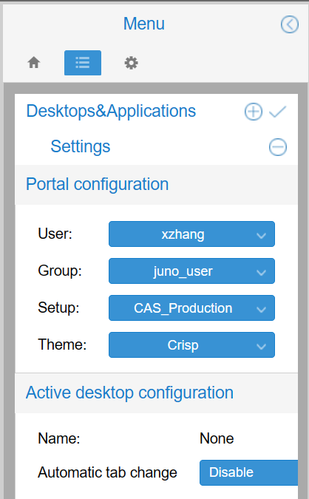
DIRAC Proxy
DIRAC also uses VOMS proxy to identify users,
Both for login DIRAC and use DIRAC working on resources.
DIRAC will synchronize your user information from VOMS to DIRAC registry system.
Access DIRAC,
On webpage, use your personal certificate in browser.
At cluster, generate DIRAC proxy, which is almost same method as VOMS proxy.

Slide 16
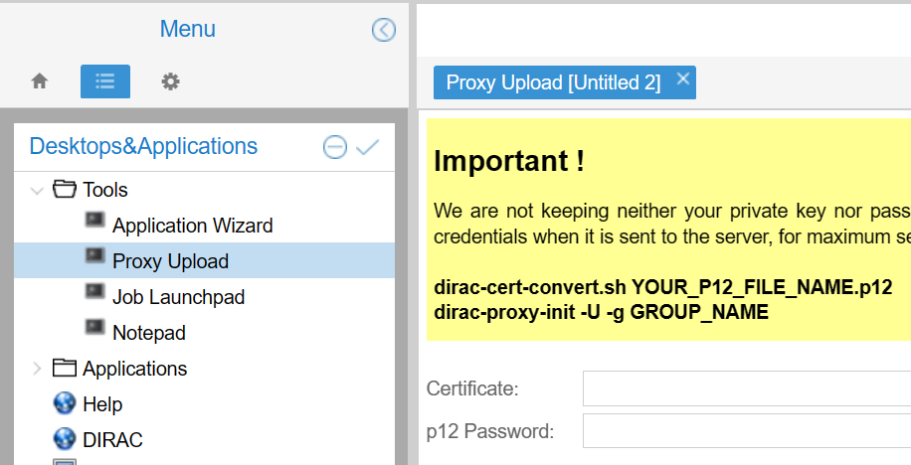
DIRAC Proxy Exercise
Try it:
Access DIRAC webpage with your personal certificate.
Upload your own proxy to DIRAC.
At cluster, generate your DIRAC proxy source /cvmfs/dcomputing.ihep.ac.cn/ dirac-proxy-init -g juno_user
Check your DIRAC proxy dirac-proxy-info

Slide 17
Thank you!

