Slide 1
DIRAC Web Interface
Xiaomei Zhang
On behalf of JUNO DCI group
JUNO DCI Tutorial in kaiping, Feb 8, 2023

Slide 2
Purposes of DIRAC web interface
Check tasks and jobs status
Check site status
Simple job submission

Slide 3
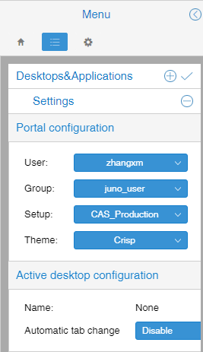
DIRAC web GUI
User certificate must be loaded on your browser
https://dirac.ihep.ac.cn/DIRAC/
https://prod-dirac.ihep.ac.cn/DIRAC
Check your membership is recognised

Slide 4
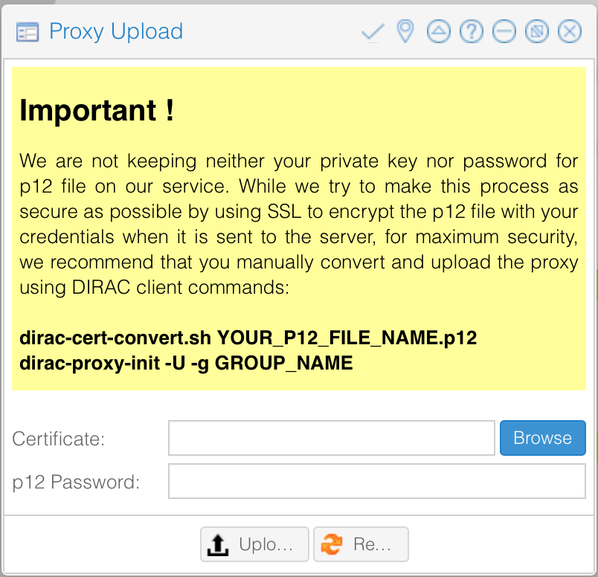
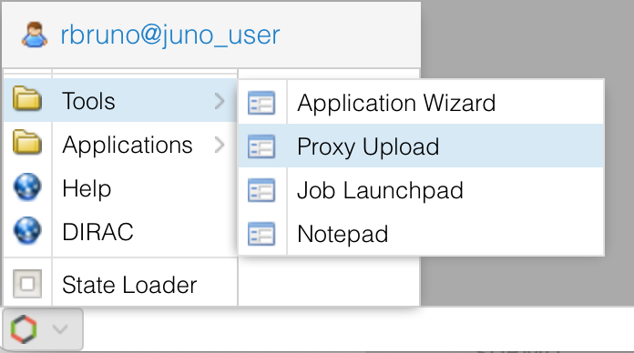
Proxy upload
Normally we use DIRAC client commands to upload proxy:
dirac-cert-convert your_p12_file_name.p12
dirac-proxy-init -g dirac_user
********

Slide 5
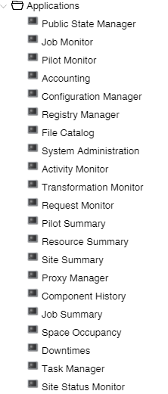
Check status of your proxy
The proxy can be deleted and created again

Slide 6
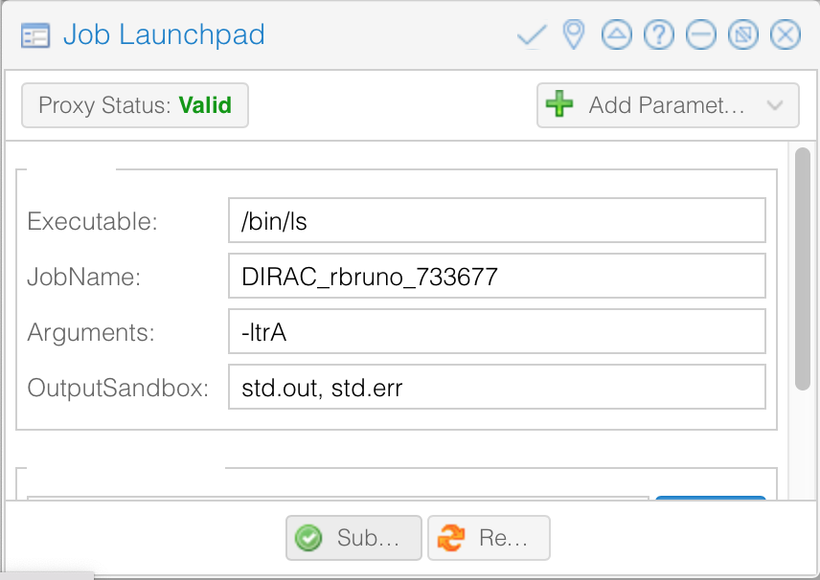
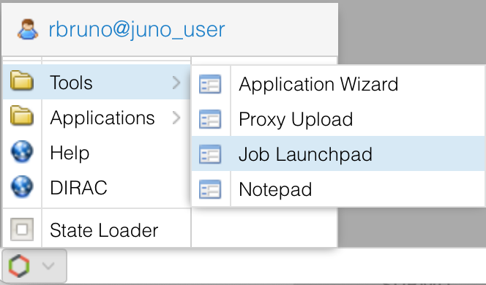
Job Launchpad
Green after uploading proxy, see slide before

Slide 7
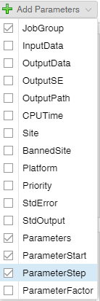
Exercise: submit jobs
Submit a job
Change “Executable”, “Arguments”, “OutputSandbox”, “site”, “jobGroup” to see the difference
Submit multi-jobs with parameters
Guide in the next slide
Submit a job with your own shell script
Guide in the next slide
Use more parameters to define your jobs

Slide 8
Information of sites and SE
Data Center | Site name | SE
IHEP | GRID.IHEP.cn | IHEP-STORM, IHEP-JUNOEOS
CNAF | GRID.INFN-CNAF.it | CNAF-STORM
IN2P3 | GRID.IN2P3.fr | IN2P3-DCACHE
JINR | GRID.JINR-CONDOR.ru | JINR-EOS
CLUSTER.CSNS.cn……

Slide 9
Use parameters to submit multi-jobs
You can use Parameters/ParameterStart/ParmeterStep to submit more than one job in one submission
the values of parameters can be:
a list (strings or numbers)
Parameters = {"first","second","third","fourth","fifth"};
an integer, in this case the attributes ParameterStart and ParameterStep must be defined as integers to create the list of job parameters
Jobs will be created corresponding to the Parameters list values
Other JDL attributes can contain “%s” placeholder. For each generated job this placeholder will be replaced by one of the values in the Parameters list

Slide 10
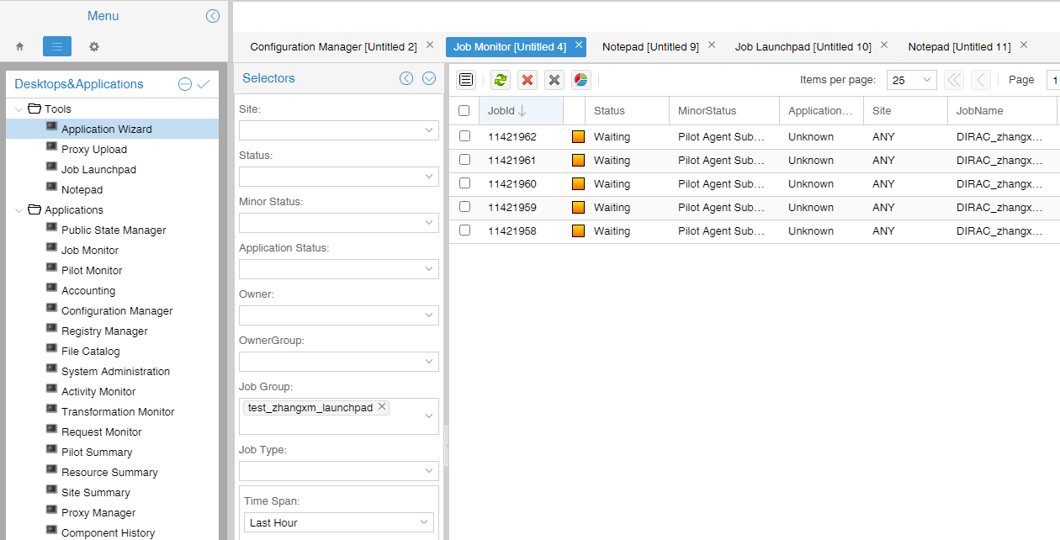
Check your jobs
Select your job with job Group, if you defined when submitting
You can also select jobs with “time”, “owner”……

Slide 11
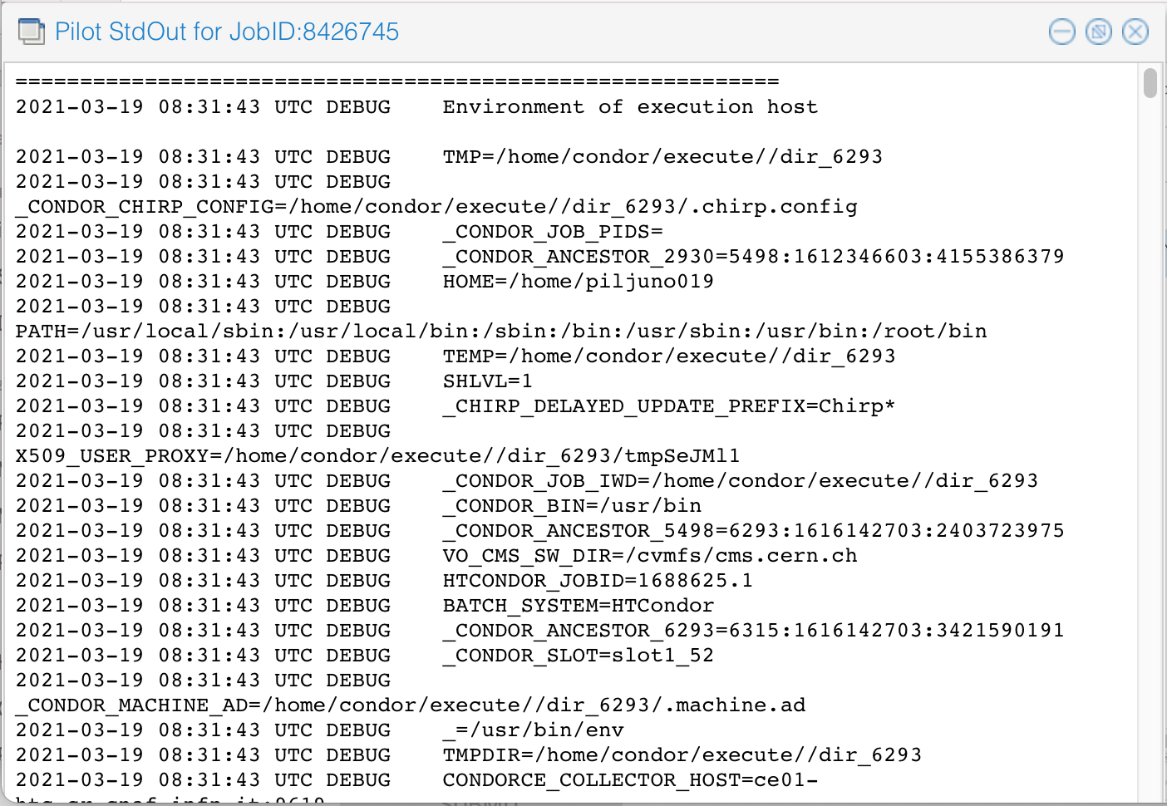
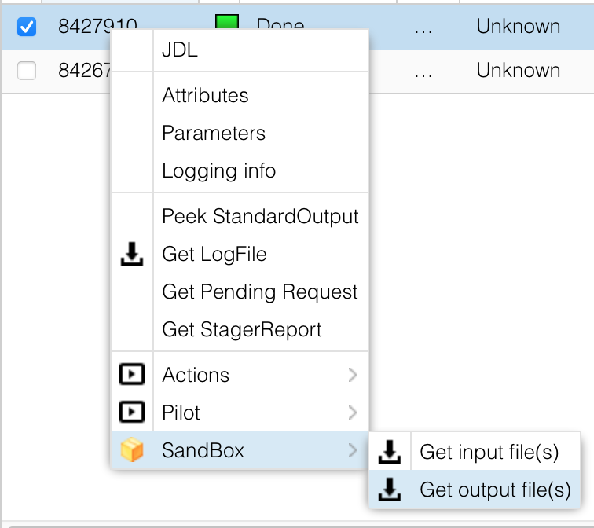
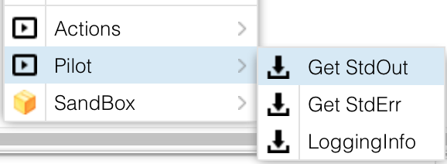
Job output
Right click
Get output
Download .tar.gz file to get complete output files

Slide 12
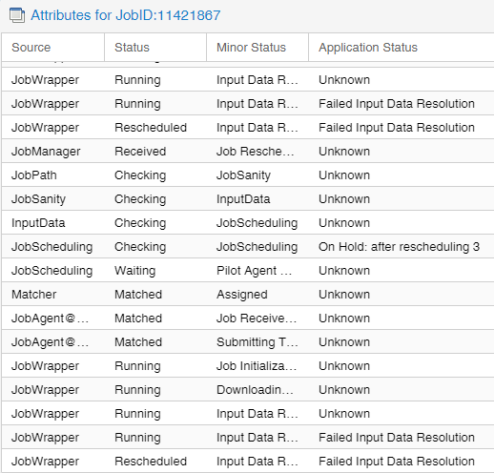
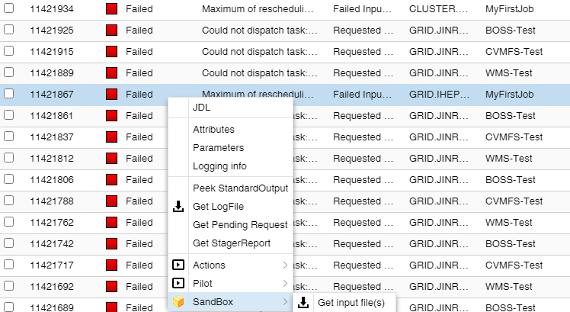
Failed jobs
If your jobs failed, try to use logging info and log files to find out reason

Slide 13
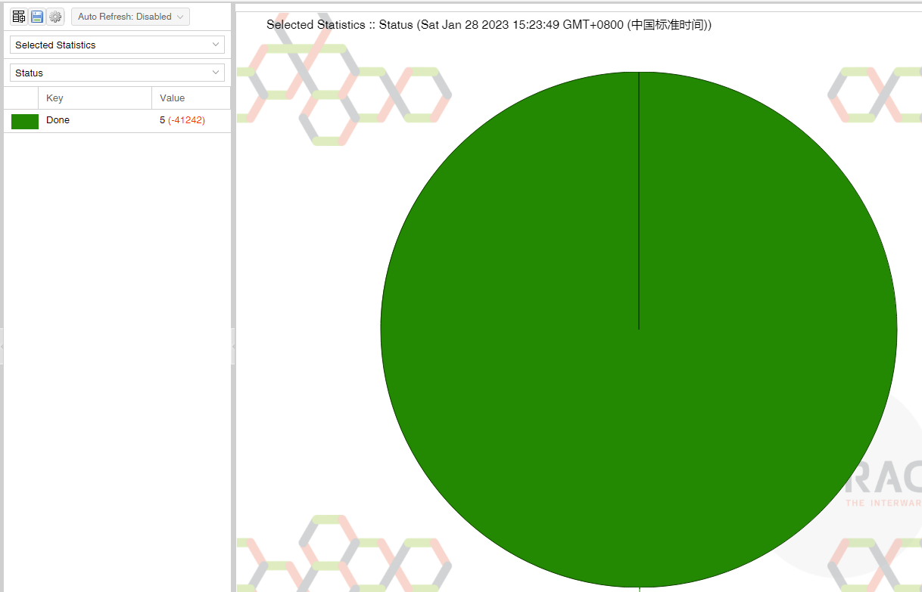
Exercise: check jobs
Check your job status from job monitoring
With “JobGroup”, “Owner”, “Time” filters
Try to get statistics of your jobs
Quite useful to give an overview when you submit >100 jobs

Slide 14
More exercises
Use other parts: “Accounting”
Try to understand other failed jobs and find out reasons
Try to create your own desktop
……

