Slide 1
Data Management System
Xuantong Zhang, CC-IHEP
On behalf of JUNO DCI group

Slide 2
Outline
Introduction,
Using DMS with DFC CLI,
Using DMS with DIRAC DMS Commands,
Using DMS with API,

Slide 3
Introduction

Slide 4


Local? Remote?
On Shell
ls /path/to/my/file.root
Where is my files?
I know local files, but Remote files?
Local Scene
Local cluster
List file command
Return file list
Local storage

Slide 5

Remote Data?
Remote Data:
  In different storage,
  With different data path,
  By different access protocol.
How can I manage my file in different storage?
Remote Data Scene
The file I want:
file.root
???
Local cluster
Download/Upload
Transfer
Remote storage A
Remote storage B
root://A/B/C/file.root
https://D/E/file.root

Slide 6

Data Management System
DIRAC Data Management System (DMS):
  A namespace for all remote files, with uniform name methods,
  User interface for upload/download/transfer.
I give the file name and DMS will do the rest!
I want to download:
file.root
file.root
In A is:
root://A/B/C/file.root
In B is:
https://D/E/file.root
Let me download it for you!
Local cluster
DMS
Remote storage A
Remote storage B
root://A/B/C/file.root
https://D/E/file.root

Slide 7
DMS Concepts
I want to download:
file.root
Local cluster
Location | SE Name
China | IHEP-JUNOEOS IHEP-STORM
Russia | JINR-EOS
Italy | CNAF-STORM
France | IN2P3-DCACHE
Storage Element (SE):
Distributed data storage site,
Store users data and produced data.
JUNO DCI has 4 main SEs.
DMS
Remote storage A
Remote storage B
root://A/B/C/file.root
https://D/E/file.root

Slide 8
DMS Concepts
I want to download:
file.root
Local cluster
Logic File Name (LFN):
File name in DMS File Catalog,
Every file has a single, independent file name,
Same name method as Linux file path.
Examples:
/juno/user/z/zhangxt/f.root
/juno/production/muon/
/juno/raw/testfile
…
DMS
Remote storage A
Remote storage B
root://A/B/C/file.root
https://D/E/file.root

Slide 9
DMS Concepts
I want to download:
file.root
Local cluster
Replica:
1 file copy stored in a specified SE.
1 replica corresponded to 1 LFN.
1 LFN may have N replicas in N SEs.
Example:
LFN /juno/user/z/zhangxt/f.root has 2 replicas,
1 replica in IHEP-JUNOEOS,
1 replica in CNAF-STORM.
DMS
Remote storage A
Remote storage B
root://A/B/C/file.root
https://D/E/file.root

Slide 10
DMS Concepts
I want to download:
file.root
Local cluster
Replicate:
Copy files from A SE to B SE.
Will create a new replicas in SE B, so files will have 2 replicas: one in SE A, one in SE B.
Example:
Replicate /juno/user/z/zhangxt/f.root from IHEP-JUNOEOS to JINR-EOS, then there will be 3 replicas,
1 replica in IHEP-JUNOEOS,
1 replica in CNAF-STORM,
1 new replica in JINR-EOS.
DMS
Remote storage A
Remote storage B
root://A/B/C/file.root
https://D/E/file.root

Slide 11
Advanced DMS Concepts
I want to download:
file.root
Local cluster
Physical File Name (PFN):
File name actually exists in SE, usually is a protocol URL.
Can be accessed by Grid tools.
1 replicas has 1 PFN.
Useful for advanced users.
Example:
LFN:/juno/user/z/zhangxt/f.root,
PFN:
  In IHEP-JUNOEOS, http://junoeos01.ihep.ac.cn:1094//eos/juno/dirac/juno/user/z/zhangxt/f.root,
  In CNAF-STORM, root://xfer-archive-03.cr.cnaf.infn.it:1094//production/storm/dirac/juno/user/z/zhangxt/f.root.
DMS
Remote storage A
Remote storage B
root://A/B/C/file.root
https://D/E/file.root

Slide 12
Training Contents
Learning data management methods:
  List files,
  Upload files,
  Download files,
  Set metadata for files,
  Search files by metadata,
  Transfer files, between SEs,
  Transfer mass files by transfer job.
Learning data management tools:
  File catalog command line interface,
  Data management commands,
  Data management Python API.

Slide 13
Preparation
Before we start, source DIRAC environment and ready the dirac-proxy.
# source environment
$ source /cvmfs/dcomputing.ihep.ac.cn/dirac/IHEPDIRAC/bashrc
# generate proxy
$ dirac-proxy-init -g juno_user
Generating proxy...
Enter Certificate password: ******
Added VOMS attribute /juno
Uploading proxy..
Proxy generated:
subject : /C=CN/O=HEP/O=IHEP/OU=CC/CN=Xuantong Zhang/CN=30890023/CN=2909154912
issuer : /C=CN/O=HEP/O=IHEP/OU=CC/CN=Xuantong Zhang/CN=30890023
identity : /C=CN/O=HEP/O=IHEP/OU=CC/CN=Xuantong Zhang
timeleft : 23:53:59
DIRAC group : juno_user
path : /tmp/x509up_u10664
username : xzhang
properties : NormalUser, JobMonitor
VOMS : True
VOMS fqan : ['/juno']
Proxies uploaded:
DN | Group | Until (GMT)
/C=CN/O=HEP/O=IHEP/OU=CC/CN=Xuantong Zhang | | 2023/09/06 08:42

Slide 14
Command Line Interface

Slide 15
Command Line Interface (CLI)
DFC Command Line Interface (CLI) is used to perform all data management operations.
  A file-system-liked command line interface.
    Similar as EOS command line interface.
  Supply basic file management commands,
    cd, ls, rm, mkdir, chown…
  Supply Grid file management commands,
    replicas, replicate, mata, dataset…
Note:
  DFC CLI recommended for basic file upload/copy and browsing LFN, please do not use it to remove files.

Slide 16
Command Line Interface (CLI)
Try it:
  Start the CLI with the DIRAC command,
  Call for help of all commands,
  Call for help of one specific command.
(base) $ dirac-dms-filecatalog-cli
Starting FileCatalog client
FC:/>
FC:/> help
Available commands:
EOF : Handler for EOF ( Ctrl D ) signal - perform quit
…
…
FC:/> help pwd
pwd : rint out the current directory
usage: pwd
Start CLI
Call for help for all commands
Call for help for one specific command

Slide 17
CLI Basic Commands
Basic file system commands:
  Listing/changing/creating directory and changing ownership and permission,
  Similar to Linux file system.
# usage: cd <path>
: cd -
FC:/>cd /juno/user/z/zhangxt/
# usage: mkdir <path>
FC:/juno/user/z/zhangxt>mkdir tutor
Successfully created directory: /juno/user/z/zhangxt/tutor
# usage: ls [-ltrnSh] <path>
FC:/juno/user/z/zhangxt>ls –l cc422
-rwxr-xr-x 1 xzhang juno_user 67 2021-04-22 08:20:46 cc422
# usage: chmod [-R] <mode> <path>
FC:/>chmod 600 cc422
# usage: chown [-R] <owner> <path>
FC:/>chown zhangxm cc422
FC:/juno/user/z/zhangxt>ls –l cc422
-rw------- 0 zhangxm juno_user 67 2021-07-07 09:19:34 cc422
Change directory
Create a directory
List a directory and files
Change the permission of a file
Change the ownership of a file

Slide 18
CLI File Copy Commands
File copy commands,
  Upload a file from local and download a file to local.
  Replicate files and show the replicas.
Upload a local file to a SE
# usage: add <lfn> <local_file> <SE> [<guid>]
FC:/juno/user/z/zhangxt/tutor>add tutorupload /etc/hostname IHEP-STORM
File /juno/user/z/zhangxt/tutor/tutorupload successfully uploaded to the IHEP-STORM SE
# usage: get <lfn> [<local_directory>]
FC:/juno/user/z/zhangxt/tutor>get tutorupload
File /juno/user/z/zhangxt/tutor/tutorupload successfully downloaded
# usage: replicas <lfn>
FC:/juno/user/z/zhangxt/tutor>replicas tutorupload
lfn: /juno/user/z/zhangxt/tutor/tutorupload
IHEP-STORM srm://storm.ihep.ac.cn:8444/srm/managerv2?SFN=//juno/user/z/zhangxt/tutor/tutorupload
# usage: replicate <LFN> <SE> [<SourceSE>]
FC:/juno/user/z/zhangxt/tutor>replicate tutorupload CNAF-STORM
{'Failed': {},
'Successful': {'/juno/user/z/zhangxt/tutor/tutorupload': {'register': 0.05047893524169922,
'replicate': 11.522407054901123}}}
File /juno/user/z/zhangxt/tutor/tutorupload successfully replicated to the CNAF-STORM SE
Download a local file to a SE
Show replicas of a file
Replicate file between SEs

Slide 19
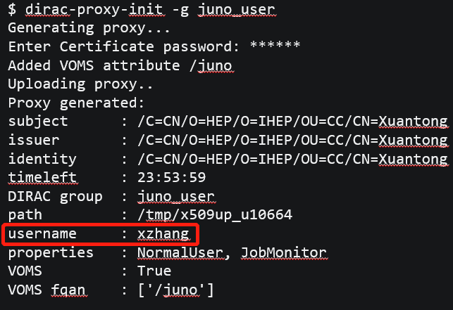
CLI Commands Exercise
Try it:
  Change directory to the users path: /juno/user/,
  Create your own personal path by your username in DIRAC under coordinate first letter path, like: /juno/user/y/yourname/,
  Upload a random file from local to IHEP-JUNOEOS by your own path.
  Show replicas of your uploaded file.
  Replicate the uploaded file to CNAF-STORM.
  Show again the replicas of your uploaded file.
  Download your file to a local path.
Exercise Time

Slide 20
CLI Metadata Commands
Metadata methods:
  Metadata is `the data that provide information about other data`, like:
    Size, created/modified time, ownership, permission, guid, checksum……
  In DFC, besides standard metadata, metadata system supports user defining their own metadata on both file and directory.
DFC supports:
  Create metadata index,
  Set/remove metadata to a metadata index,
  Find file/path by metadata.
Note:
  File metadata and directory metadata is different.

Slide 21
CLI Metadata Commands
# usage: meta show
FC:/juno/user/z/zhangxt> meta show
FileMetaFields : {'count': 'INT', 'status': 'INT', 'userdata': 'INT’, ……}
DirectoryMetaFields : {'test1': 'VARCHAR(128)', 'test0': ‘INT’, ……}
# usage: meta index [-d|-f|-r] <metaname> [<metatype>]
FC:/juno/user/z/zhangxt>meta index –f tutorMetaName string
Added metadata field tutorMetaName of type string
# usage: meta set <path> <metaname> <metavalue> [<metaname> <metavalue> ...]
FC:/juno/user/z/zhangxt> meta set ccc2 tutorMetaName tutorMetaValue
/juno/user/z/zhangxt/ccc2 {'tutorMetaName': 'tutorMetaValue’}
# usage: meta get [-e] [<path>]
FC:/juno/user/z/zhangxt> meta get ccc2
tutorMetaName : tutorMetaValue
vo : juno
# usage: meta remove <path> <metaname> [<metaname> ...]
FC:/juno/user/z/zhangxt> meta remove ccc2 tutorMetaName
Show all meta indices
Create a meta index
Set a metadata for file/path
Get all metadata for a file/path
remove a metadata for a file/path

Slide 22
CLI Commands Exercise 2
Try extended exercise:
  Try to add a random meta value for meta name of `tutorMetaName` to your file.
  Use `help find` command to learn how to search files by metadata.
  Find your file by `find` command.
Exercise Time

Slide 23
Data Management System Commands

Slide 24
Data Management System Commands
Data Management System Commands (DMS commands) are a series of Linux commands for data management.
  Supply similar commands as CLI,
    upload/download/replicas/replicate/metadata…
  Some advance commands,
    Removing replicas, resolving PFN, SE status…
  Mass data management.
Try it:
  Use `dirac-dms-xxx --help` command to get command introduction.
dirac-dms-add-file dirac-dms-get-file dirac-dms-remove-files
dirac-dms-catalog-metadata dirac-dms-lfn-accessURL dirac-dms-remove-replicas
dirac-dms-change-replica-status dirac-dms-lfn-metadata dirac-dms-replica-metadata
dirac-dms-clean-directory dirac-dms-lfn-replicas dirac-dms-replicate-and-register-request
dirac-dms-create-archive-request dirac-dms-move-replica-request dirac-dms-replicate-lfn
dirac-dms-create-moving-request dirac-dms-pfn-accessURL dirac-dms-resolve-guid
dirac-dms-create-removal-request dirac-dms-pfn-metadata dirac-dms-set-replica-status
dirac-dms-data-size dirac-dms-protocol-matrix dirac-dms-show-se-status
dirac-dms-directory-sync dirac-dms-put-and-register-request dirac-dms-user-lfns
dirac-dms-filecatalog-cli dirac-dms-remove-catalog-files dirac-dms-user-quota
dirac-dms-find-lfns dirac-dms-remove-catalog-replicas

Slide 25
DMS Basic Commands
Basic file management command:
  Upload, download, replicate files.
Upload a local file to a SE
# usage: dirac-dms-add-file [option|cfgfile] ... LFN Path SE [GUID]
$ dirac-dms-add-file /juno/user/z/zhangxt/hostname /etc/hostname IHEP-STORM
Uploading /juno/user/z/zhangxt/hostname
Successfully uploaded file to IHEP-STORM
# usage: dirac-dms-get-file [option|cfgfile] ... LFN ...
$ dirac-dms-get-file /juno/user/z/zhangxt/hostname
{'Failed': {},
'Successful': {'/juno/user/z/zhangxt/hostname': '/afs/ihep.ac.cn/users/z/zhangxuantong/hostname’}}
# usage: dirac-dms-lfn-replicas [option|cfgfile] ... LFN ...
$ dirac-dms-lfn-replicas /juno/user/z/zhangxt/hostname
LFN StorageElement URL
================================================
/juno/user/z/zhangxt/hostname IHEP-STORM srm://storm.ihep.ac.cn:8444/srm/managerv2?SFN=//juno/user/z/zhangxt/hostname
# usage: dirac-dms-replicate-lfn [option|cfgfile] ... LFN Dest [Source [Cache]]
$ dirac-dms-replicate-lfn /juno/user/z/zhangxt/hostname CNAF-STORM
{'Failed': {},
'Successful': {'/juno/user/z/zhangxt/hostname': {'register': 0.05473589897155762,
'replicate': 11.213376998901367}}}
Download a file to local
Show replicas of an LFN file
Replicate between SEs

Slide 26
DMS Remove Commands
The best replicas removal methods for data management:
  Remove one replica, remove all replicas.
Remember to use this command to delete files.
Remove one replica on one SE
# usage: dirac-dms-remove-replicas <LFN | fileContainingLFNs> SE [SE]
$ dirac-dms-remove-replicas /juno/user/z/zhangxt/hostname CNAF-STORM
Successfully removed CNAF-STORM replica of /juno/user/z/zhangxt/hostname
# usage: dirac-dms-remove-files <LFN | fileContainingLFNs>
$ dirac-dms-remove-files /juno/user/z/zhangxt/hostname
Successfully removed 1 files
Remove all replicas on all SEs

Slide 27
DMS Metadata Commands
Querying files by metadata:
  Search by metadata with key/value pair,
  Search by path and size.
Search by metadata
# usage: dirac-dms-find-lfns [options] metaspec [metaspec ...]
$ dirac-dms-find-lfns Path=/juno/user/z/zhangxt/ tutorMetaName=juno
/juno/user/z/zhangxt/ccc2
$ dirac-dms-find-lfns Path=/juno/user/z/zhangxt/ "Size<30"
/juno/user/z/zhangxt/ddd2
/juno/user/z/zhangxt/hhhh
…
…
Search by path and size

Slide 28
DMS Commands Exercise
Try it:
  Upload a local file to IHEP-JUNOEOS with `dirac-dms-add-file`.
  Use `dirac-dms-filecatalog-cli` to see what you have uploaded.
  Download this file by `dirac-dms-get-file`.
  Replicate this file to CNAF-STORM by `dirac-dms-replicate-lfn`.
  Remove the replica on CNAF-STORM.
  Remove all replicas on all SEs.
Try extended exercise:
  Search your file with the metadata you set in the last section.
  Search your file with path and size.
Exercise Time

Slide 29
DMS Mass Files Commands
To upload mass files,
  Mass Files Management commands developed by DCI group,
  Mass upload, mass removal.
Upload mass files
# usage: ihepdirac-dms-add-dir [option|cfgfile] DFCDir LocalDir SE
$ ihepdirac-dms-add-dir /juno/user/z/zhangxt/bin/ bin/ IHEP-STORM
27 files will be added to DFC "/juno/user/z/zhangxt/bin/"
27 files added to DFC
# usage: ihepdirac-dms-rm-dir-replicas [option|cfgfile] DFCDir SE
$ ihepdirac-dms-rm-dir-replicas /juno/user/z/zhangxt/bin/ CNAF-STORM
Removing replicas from dir: /juno/user/z/zhangxt/bin/
Removing replicas of 27 files from dir "/juno/user/z/zhangxt/bin/"
1 directories and 27 files deleted
# usage: ihepdirac-dms-rm-dir [option|cfgfile] DFCDir
$ ihepdirac-dms-rm-dir /juno/user/z/zhangxt/bin/
# usage: dirac-dms-clean-directory <lfn | fileContainingLfns> <SE> <status>
$ dirac-dms-clean-directory /juno/user/z/zhangxt/bin/ IHEP-STORM```````
Remove mass replicas on one SE
Remove all files replicas in a path on all SEs
Remove all files replicas recursively in a path on one SE

Slide 30
DMS Command Exercise 2
Try it:
  Upload all local files in a directory to your user path in IHEP-JUNOEOS.
  Remove your replicas in IHEP-JUNOEOS.
Exercise Time

Slide 31
Advanced Commands and Tricks

Slide 32
Mass File Transfer
Transformation request:
  Supported file batch,
    LFN directory path,
    Metadata,
  Needs to give a transfer request name.
Transfer by directory
# usage: ihepdirac-transformation-transfer-dir TransferName DFCDir SourceSE DestSE
$ ihepdirac-transformation-transfer-dir transfer_jinr_ihep_2022 /juno/production/muon/prd010 IHEP-JUNOEOS JINR-EOS
# usage: ihepdirac-transformation-transfer-metadata TransformationName MetaTransfer TargetSE
$ ihepdirac-transformation-transfer-metadata Meassurements_DAQ_CNAF juno_transfer=Pmt/container/Meassurements CNAF-STORM
Transfer by metadata
Transformation Monitor on DIRAC webpage

Slide 33
Files Registering
To register file already in SE, but not in DIRAC file catalog.
Two conditions:
  You have same files in local path.
    E.g. upload files from local to EOS.
    Use `ihepdirac-dms-register-files` and `ihepdirac-dms-register-dir`.
  You do not have same file in local path.
    E.g. local jobs generate files directly into EOS.
    Use `ihepdirac-dms-scan-unregistered`.
    SRM SEs are not available.
Register by local files and file list
# usage: ihepdirac-dms-register-files /DFC/path /local/path /local/path/to/filelist TargetSE
$ ihepdirac-dms-register-files /juno/user/z/zhangxt/bin/ ~/bin/ ~/binlist IHEP-JUNOEOS
# usage: ihepdirac-dms-register-dir /DFC/path /local/path TargetSE
$ ihepdirac-dms-register-dir /juno/user/z/zhangxt/bin/ ~/bin/ IHEP-JUNOEOS
# usage: ihepdirac-dms-scan-unregistered –r both /DFC/path TargetSE
$ ihepdirac-dms-scan-unregistered –r both /juno/user/z/zhangxt/bin/ IHEP-JUNOEOS
Register by local files
Register by LFN path

Slide 34
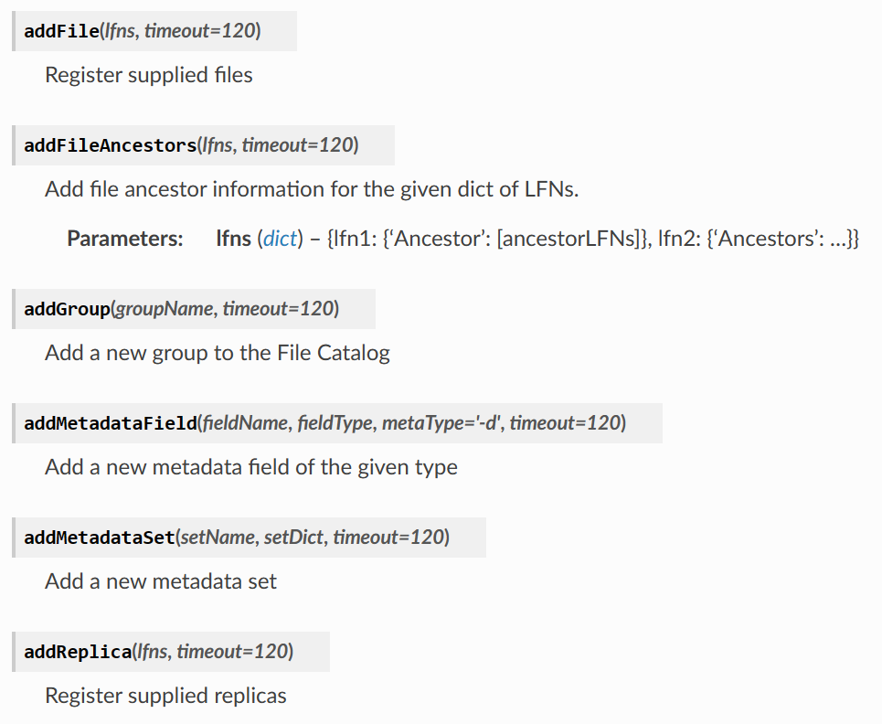
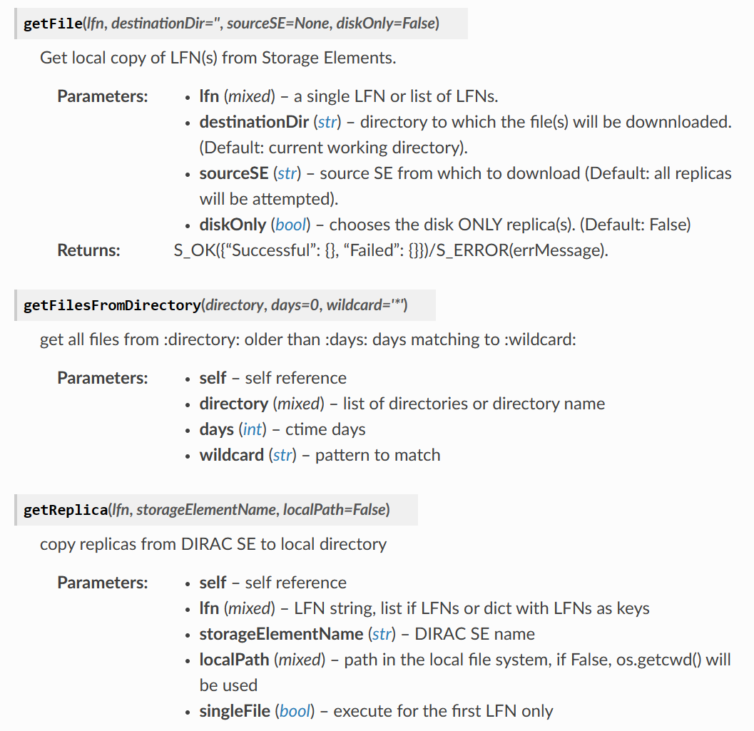
Python APIs for Data Management
Python APIs for DFC and DMS is supplied by DIRAC,
  DFC API documentation: FileCatalogClient — DIRAC Documentation
  DMS API documentation: DataManager — DIRAC Documentation
API for DFC
from DIRAC.Resources.Catalog.FileCatalogClient import FileCatalogClient
fcc = FileCatalogClient('DataManagement/FileCatalog')
from DIRAC.DataManagementSystem.Client.DataManager import DataManager
dm = DataManager()
API for DMS

Slide 35
Access Files by Grid Tools
Grid tools:
  A tools-kit for Grid data management,
    gfal2, fts3, xrd, davis…
  It is the base of DIRAC system.
Take gfal2 and xrd commands as an example.
# gfal2 tools
$ gfal-ls root://junoeos01.ihep.ac.cn:1094//eos/juno/dirac/juno/user/z/zhangxt
$ gfal-copy root://junoeos01.ihep.ac.cn:1094//eos/juno/dirac/juno/user/z/zhangxt/ccc2 /local/path
# xrd tools
$ xrdfs root://junoeos01.ihep.ac.cn:1094/ ls /eos/juno/dirac/juno/user/z/zhangxt
$ xrdcp root://junoeos01.ihep.ac.cn:1094//eos/juno/dirac/juno/user/z/zhangxt/ccc2 /local/path

Slide 36
Homework Exercise
Try it:
  Upload a directory with files in it and submit a transfer request with LFN path to do the transfer.
  Set the directory metadata, and submit a transfer request by metadata.
  Remove the replicas with `dirac-dms-filecatalog-cli` and use `gfal-ls` to see if it is also removed in SE. Those files are called ‘dark files’.
  Register those dark files to DIRAC with register commands.
  Have fun with python API. If you can properly use it, you are welcomed to join the JUNO DCI group!
Homework Time

Slide 37
Thank You!

