Slide 1
Issues of beam-beam effects for CEPC and international synergy
Yuan Zhang
CEPC DAY, Dec. 19, 2022
Contributors:
Na Wang(IHEP),
Chuntao Lin(IASF),
Kazuhito Ohmi(KEK),
Demin Zhou(KEK)
Mikhail Zobov(INFN/LNF),
Mauro Migliorati(SAPIENZA - Università di Roma),
Dmitry Shatilov (BINP)

Slide 2
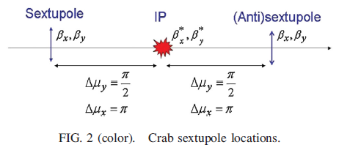
Crab-waist collision
P. Raimondi , 2nd SuperB Workshop, March 2006
M. Zobov et al., PRL 104, 174801 (2010)

Slide 3
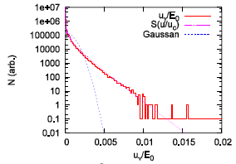
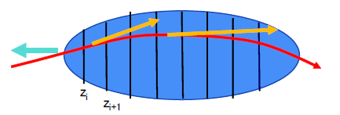
Beamstrahlung Effect & 3D flip-flop
V. I. Telnov, PRL 110, 114801 (2013)
A. Bogomyagkov et al., Phys. Rev. ST Accel. Beams 17, 041004 (2014)
D. Shatilov, ICFA Beam Dyn. Newslett. 72, 30 (2017).
Synchrotron radiation during beam-beam interaction
High energy photon -> Momentum acceptance -> Lifetime
Longer bunch length and Higher energy spread
Beam blowup: 3D flip-flop

Slide 4
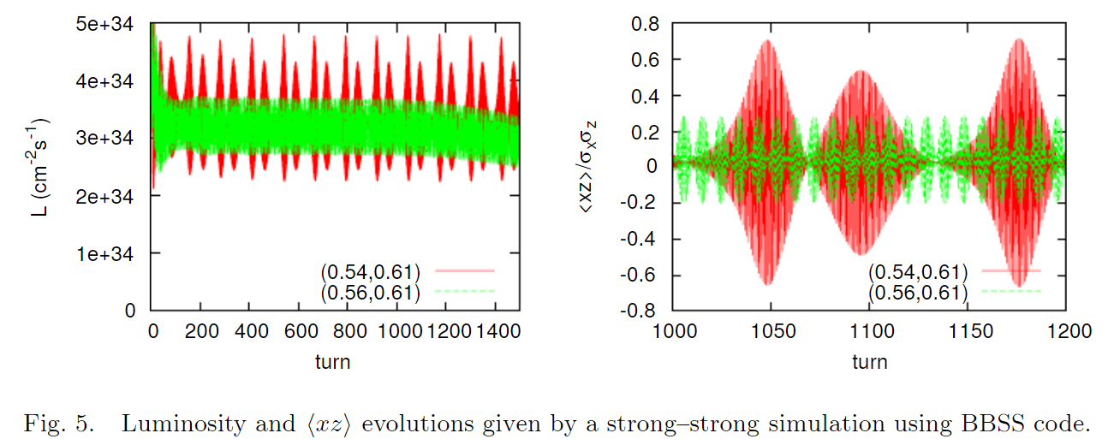
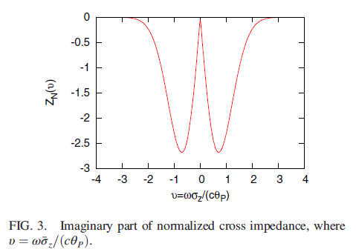
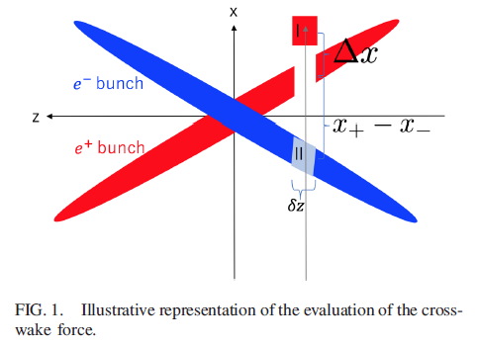
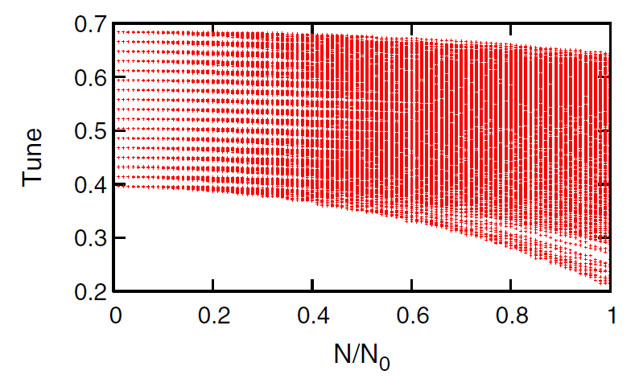
Coherent Beam-Beam Instability with a Large Crossing Angle
K. Ohmi, Int. J. Mod. Phys. A, 31, 1644014 (2016).
K. Ohmi and et al., PRL 119, 134801 (2017)
N. Kuroo et al, PHYS. REV. ACCEL. BEAMS 21, 031002 (2018)
K. Ohmi, eeFACT 2018

Slide 5
Why have we started with the longitudinal impedance and transverse impedance?
1. In the collision scheme with Crab Waist and Large Piwinski Angle the luminosity and tune shifts strongly depend on the bunch length
2. For the future circular colliders with extreme beam parameters in collision several new effects become important such as beamstrahlung, coherent X-Z instability and 3D flip-flop. The longitudinal beam dynamics plays an essential role for these effects
3. Considering transverse impeadance is very natural:
Why not transverse impedance, since longitudinal impedance is included
Transverse impedance change the coherent betatron tune

Slide 6
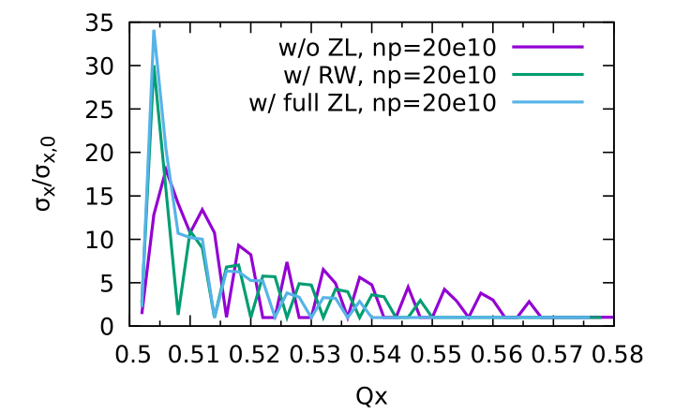
Idea of using harmonic cavities
Eur. Phys. J. Plus (2021) 136:1190
doi:10.18429/JACoW-IPAC2021-MOXC01
FCCee
Lower synchrotron tune
Higher order X-Z resonances
Landau damping due to higher synchrotron frequency spread
Longer bunches reduce the horizontal tune shift, which helps in suppressing the X-Z instability.
Longer bunches in collision result in a smaller energy spread due to beamstrahlung.
With full impedance, it is all stable
（Qx: 0.554-0.576/0.001）
$σ_{z}$ = 18 mm (CDR: 12 mm)
$σ_{p}$ = 9.2e-4 (CDR: 13e-4)

Slide 7
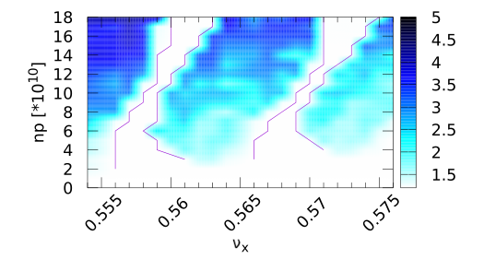
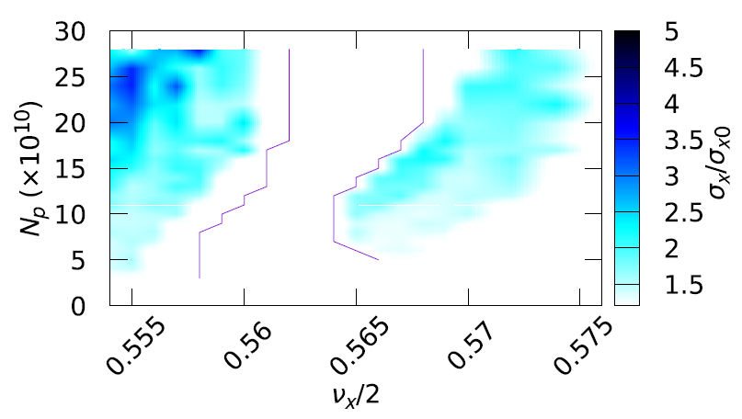
Higher Momentum Compaction
D. Shatilov, 133rd FCC-ee optics design meeting
Eur. Phys. J. Plus (2021) 136:1190
doi:10.18429/JACoW-IPAC2021-MOXC01
FCCee
Switching from ${60}^{∘}/{60}^{∘}$ to ${45}^{∘}/{45}^{∘}$ for arc cell lattice has been proposed for FCC-ee Z. To restore the luminosity of CDR, higher bunch population (28e10) has been proposed.
FODO CELL: ${60}^{∘}/{60}^{∘}$
FODO CELL: ${45}^{∘}/{45}^{∘}$

Slide 8
Effect of Chromaticity on X-Z instability
https://doi.org/10.1140/epjti/s40485-022-00084-z
Y. Zhang et al., FCC WEEK 2022
FCCee
Non-zero tune chromaticity bring new resonance
In the high order resonance region (0.5+n*nus), some resonance may be suppressed or weakened
Future work：
Analysis work considering linear tune chromaticity
Simulation work considering realistic chromaticity (from lattice model)

Slide 9
Analysis with PWD
C. Lin, K. Ohmi and Y. Zhang, PRAB 25, 011001 (2022)
Azimuthal Mode Expansion
Synchro-betatron motion in Arc
Action Discretization
Momentum Kick due to localized Wake force(beam-beam)
Stability analysis of
For example,

Slide 10
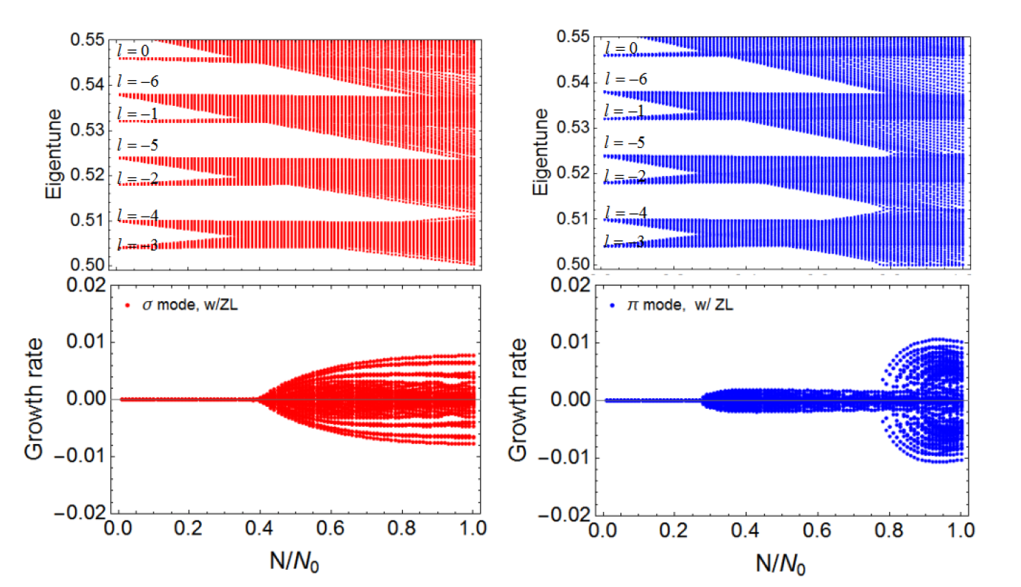
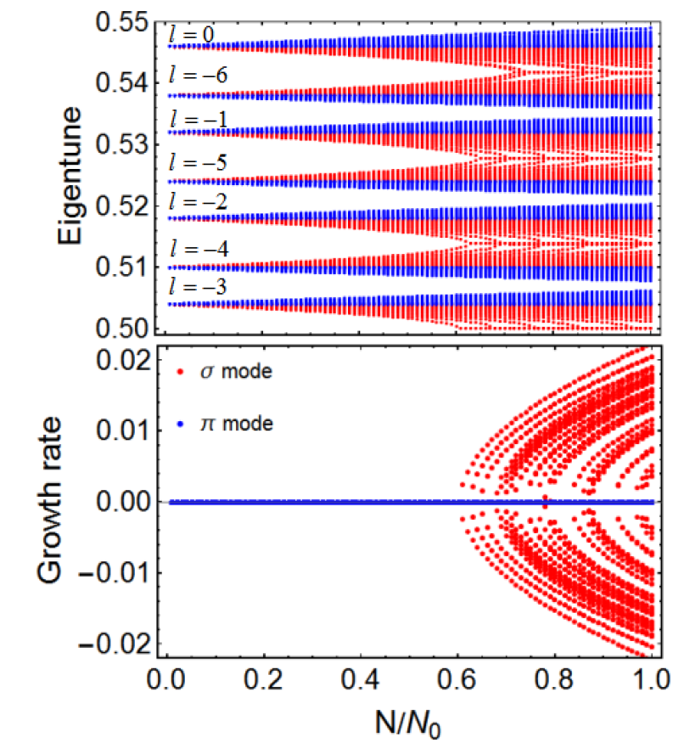
Eigen-Mode Analysis w/o and w/ ZL
C. Lin, K. Ohmi and Y. Zhang, PRAB 25, 011001 (2022)
$ν_{x}$=0.546, CEPC CDR
w/o ZL
w/ ZL, $σ$
w/ ZL, $π$

Slide 11
Blank Page

Slide 12
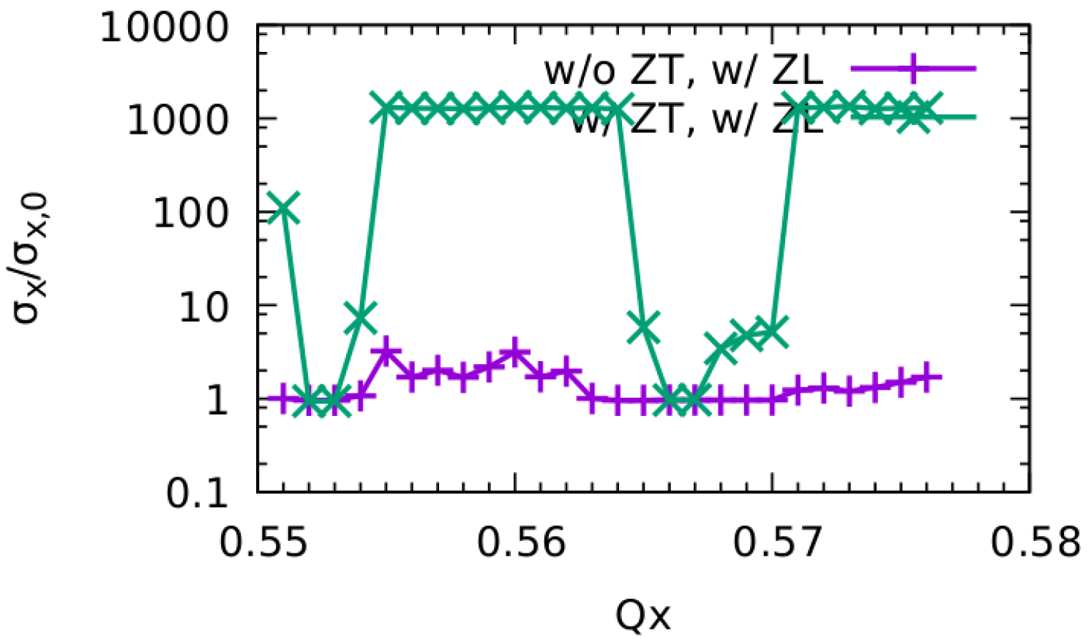
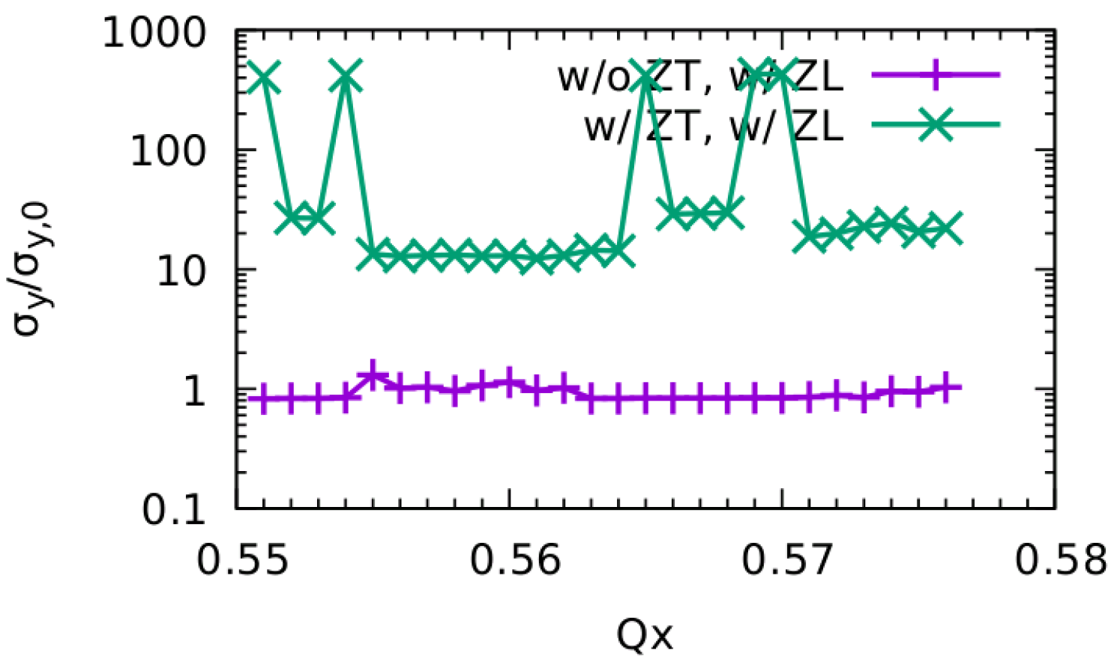
Z, w/ ZT
2022-Jun, CEPC-IARC
no stable working points
There exist very strong blowup in both X/Y direction

Slide 13
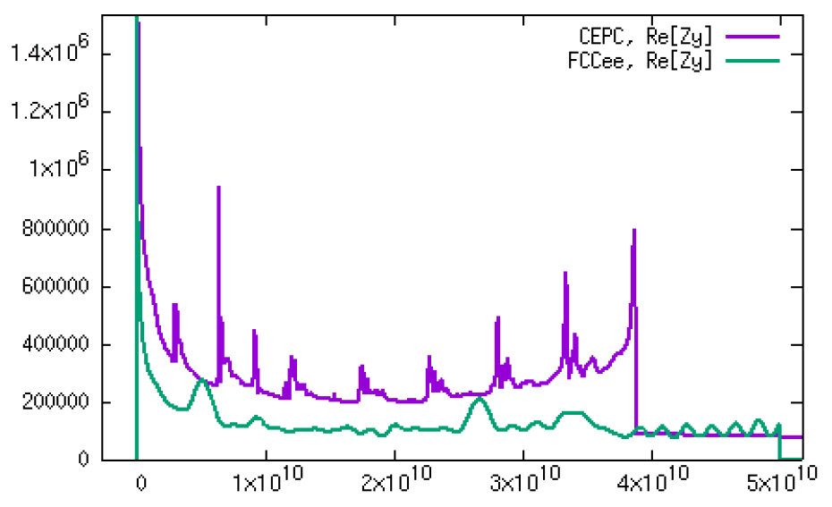
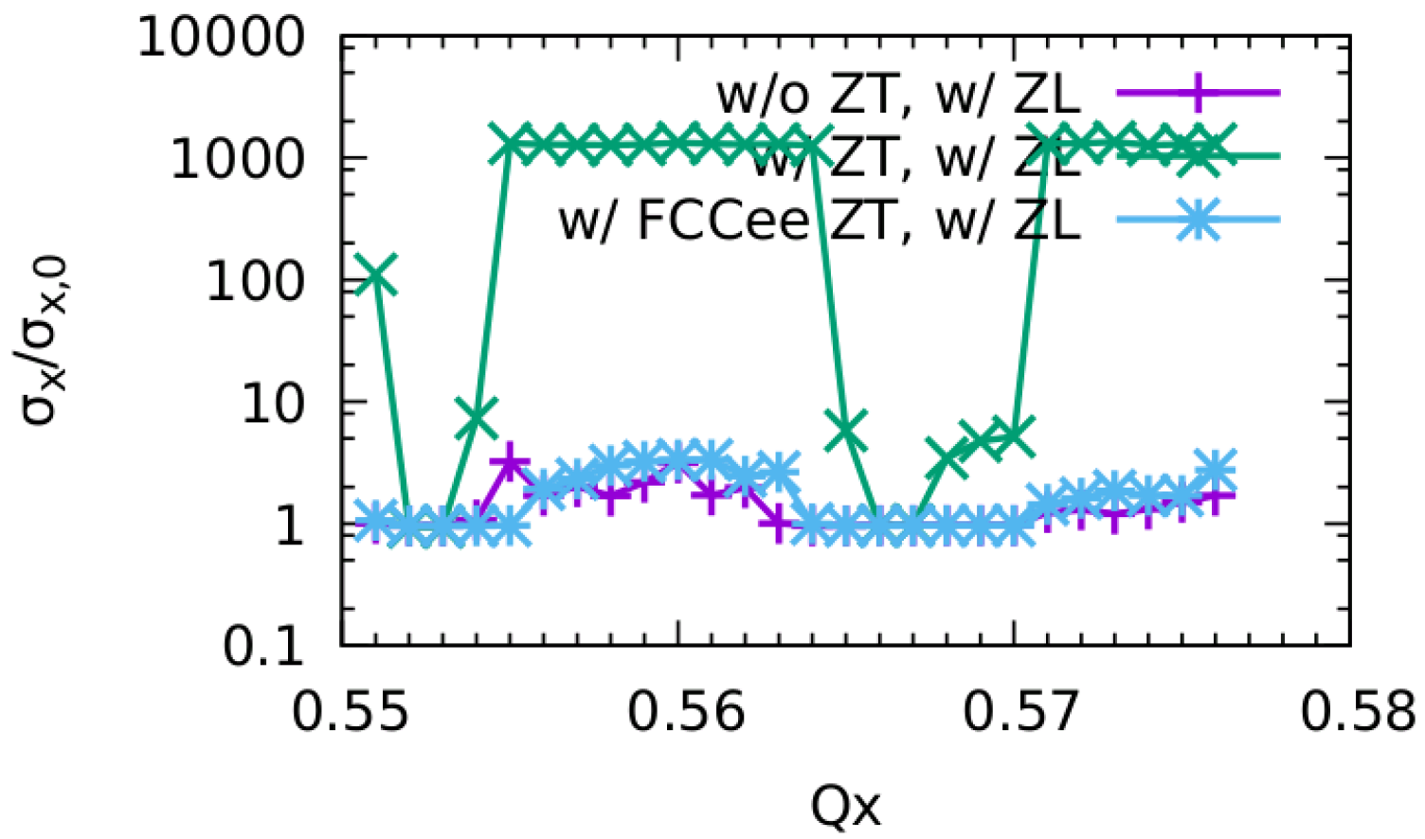
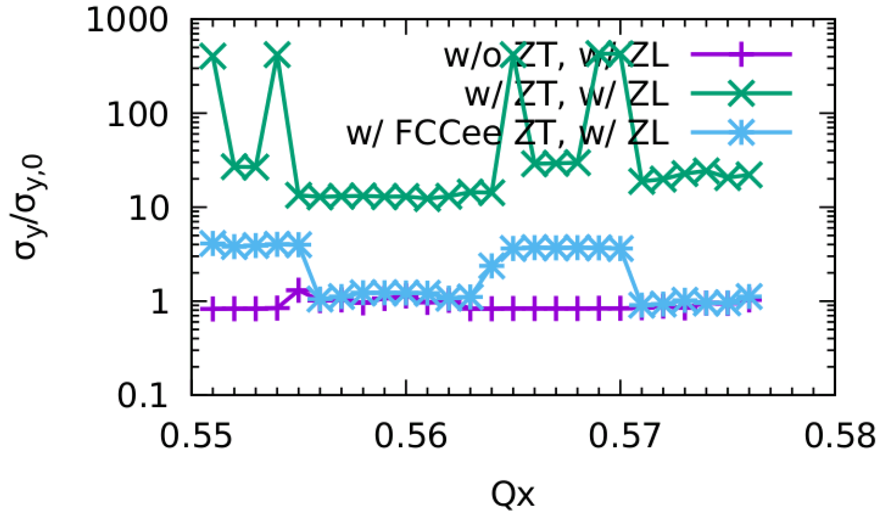
w/ ZT of FCCee
2022-Jun, CEPC-IARC
Horizontal is stable
Vertical is still unstable, but much weaker

Slide 14
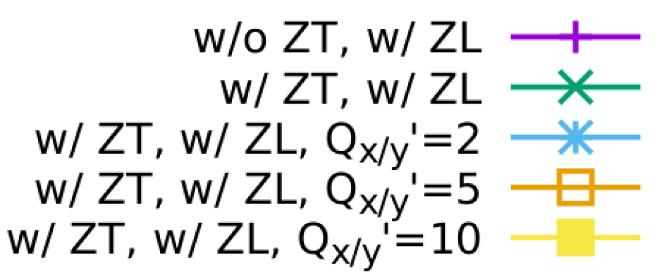
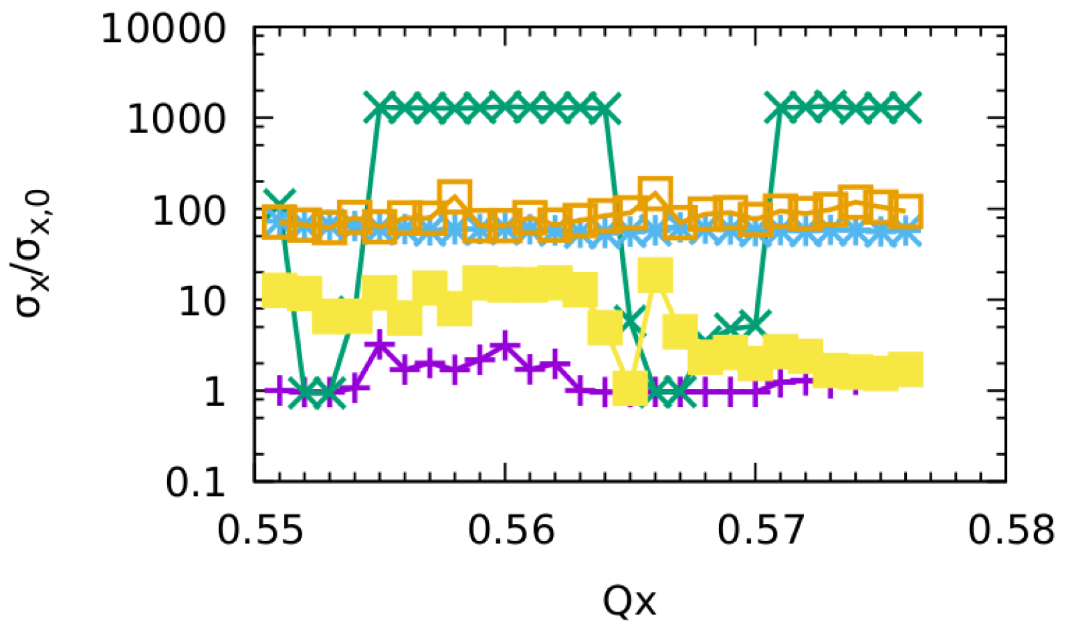
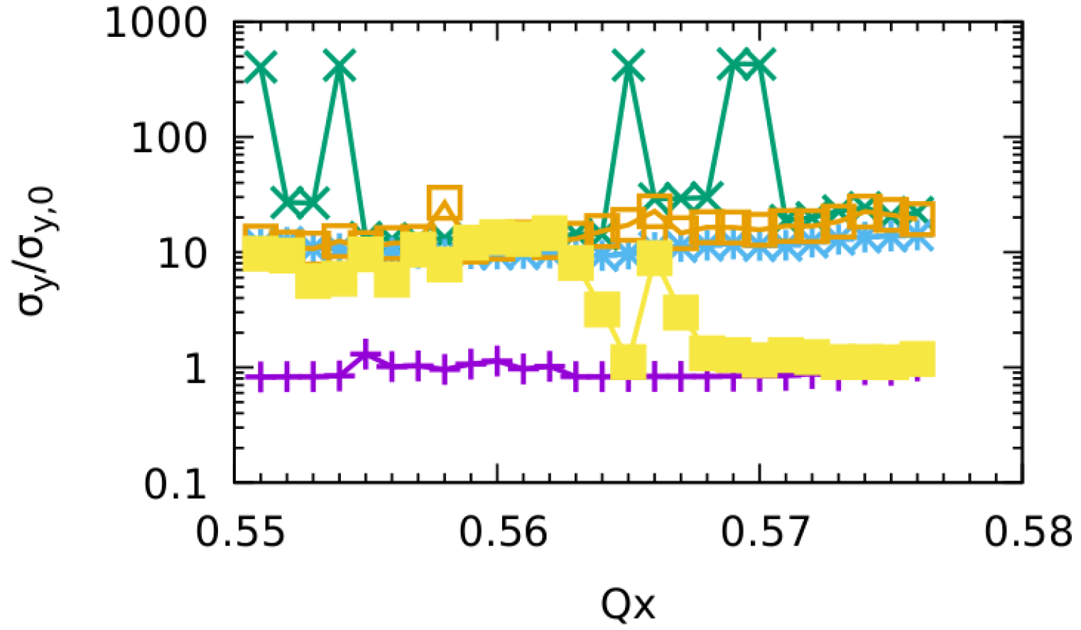
Tune Chromaticity
2022-Jun, CEPC-IARC
Even the tune chromaticity could suppress the instability, there still exist clear beam size blowup.

Slide 15
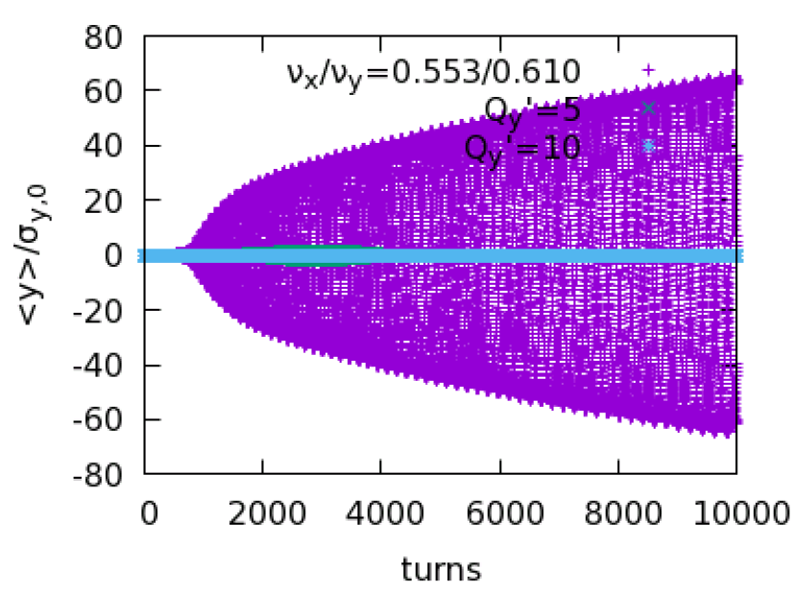
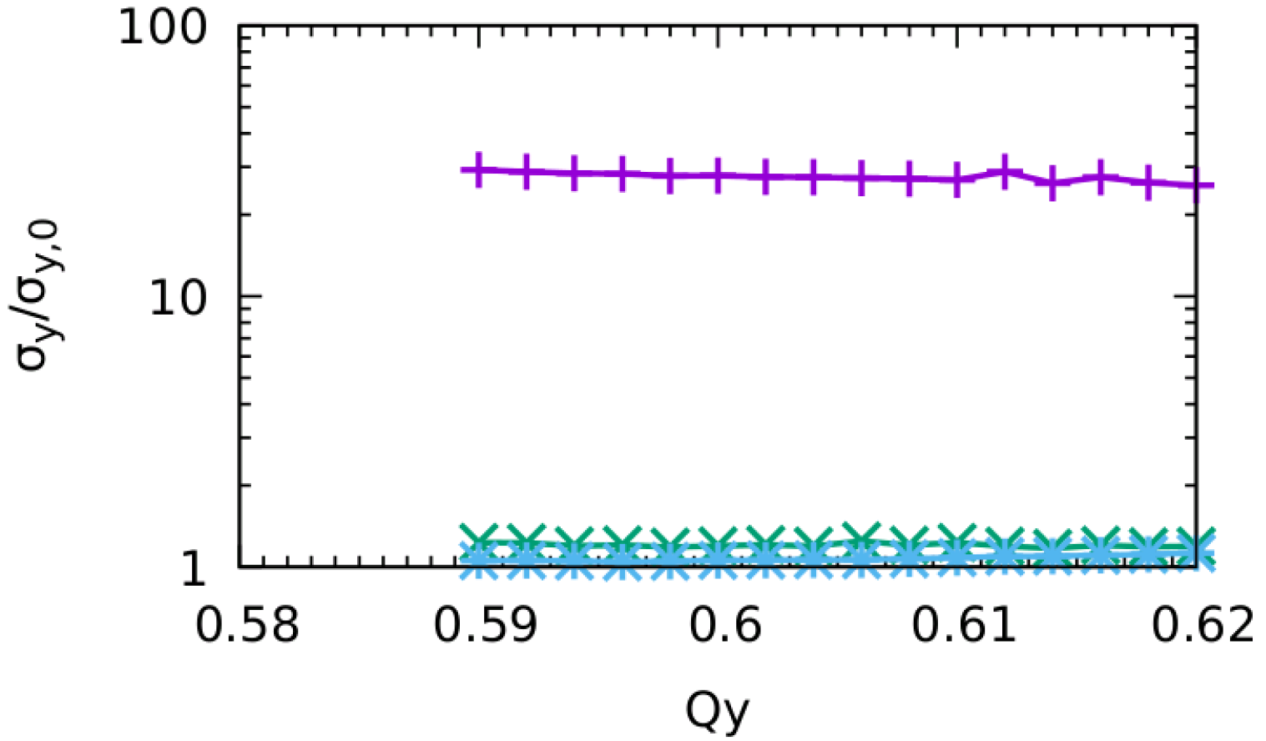
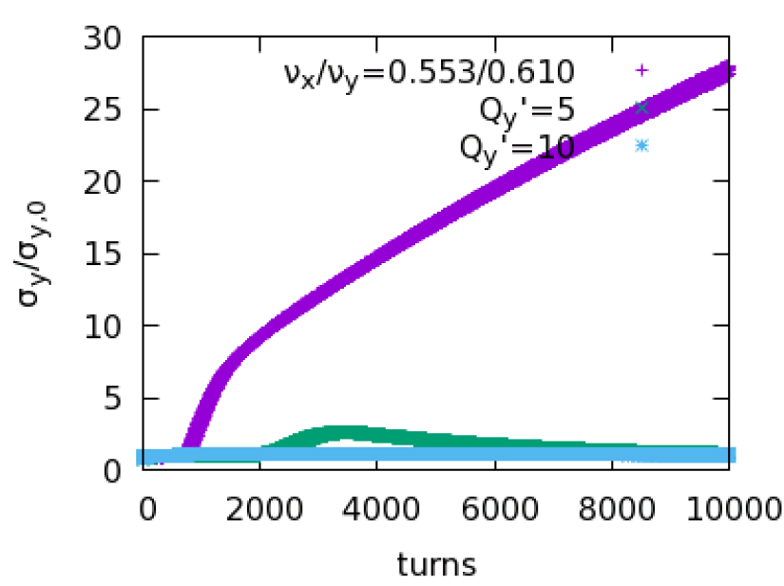
Only with Vertical tune chromaticity (Qy’)
2022-Jun, CEPC-IARC
Qy’=10 could help mitigate the vertical instability

Slide 16
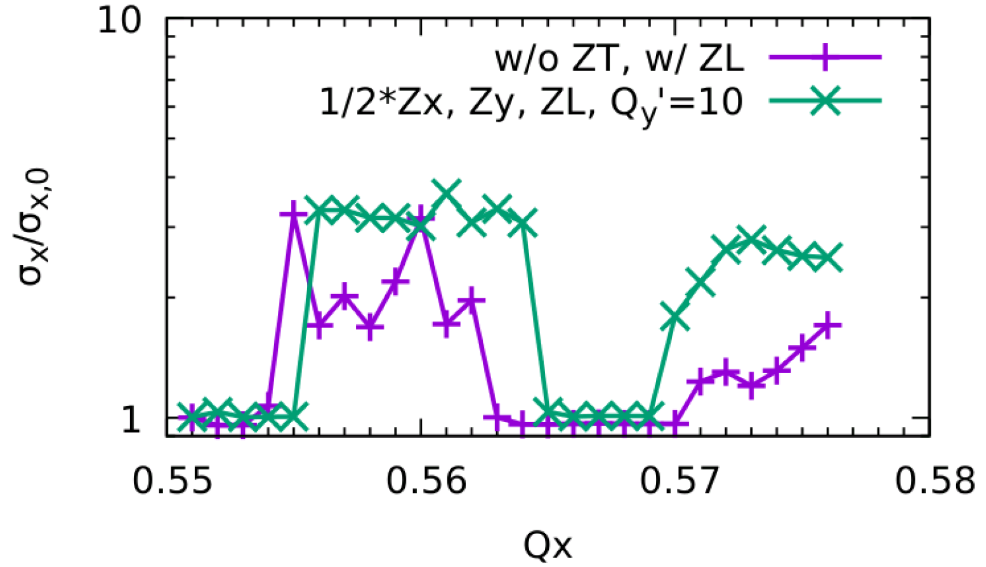
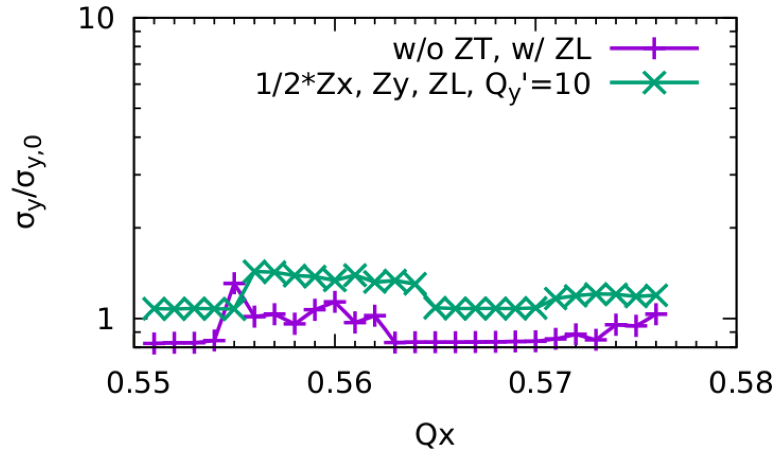
Zx*1/2 + Qy’=10
2022-Jun, CEPC-IARC
? Vacuum Chamber: Circular -> Elliptical
There does not exist dipole exponential growth in both X and Y direction
However the stable horizontal tune area is too limited (0.003)

Slide 17
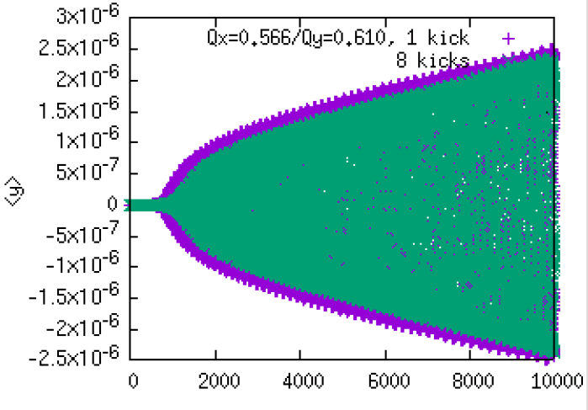
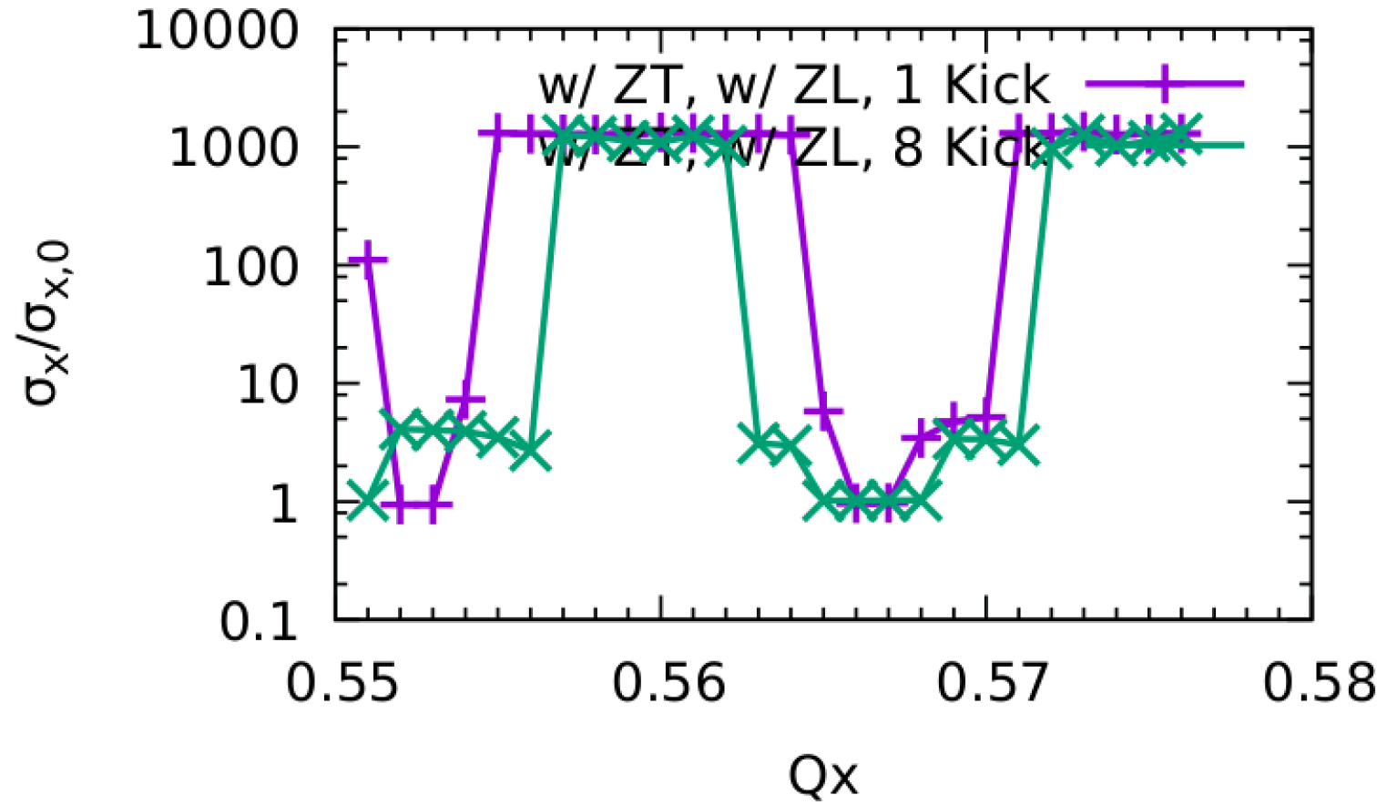
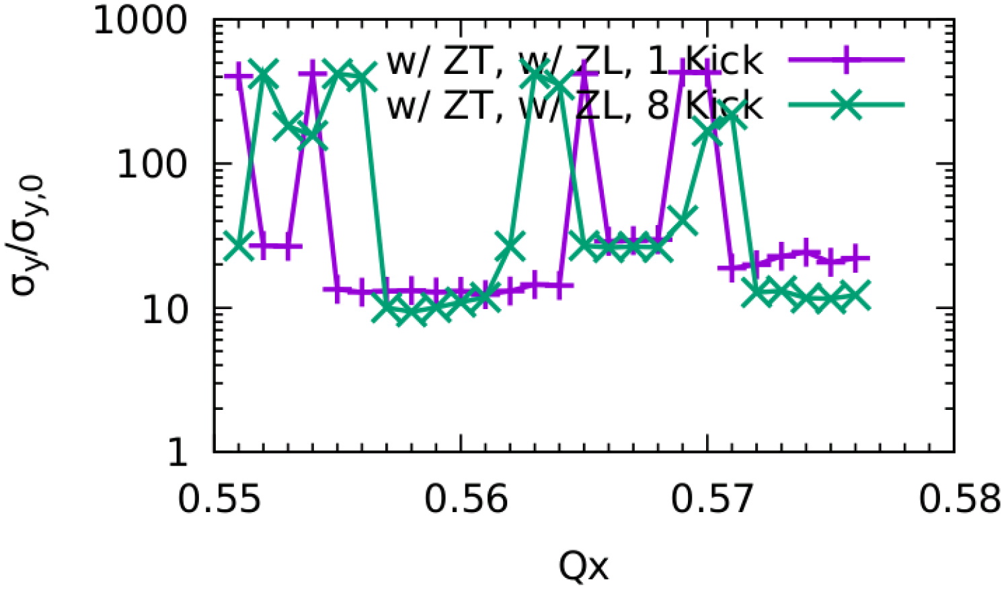
Distributed ZT on 8 positions
2022-Jun, CEPC-IARC
The instability in Horizontal direction is weakened,
comparing to only 1 kick
There does not exist very clear effect in Y
? Azimuthal mode number

Slide 18
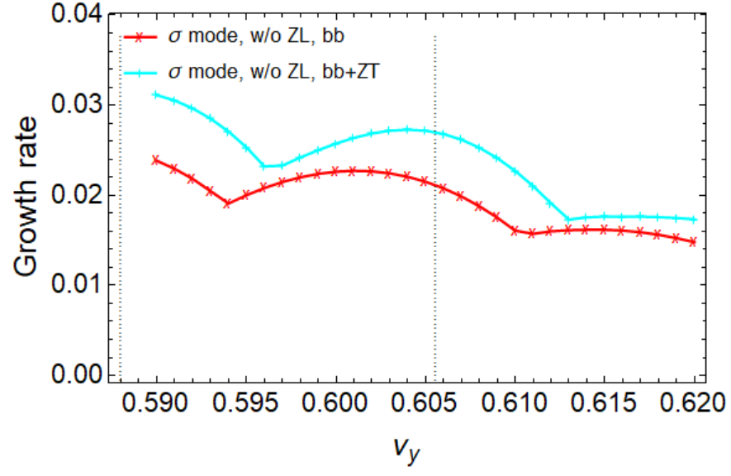
Intitial Analysis - Local Beam-Beam Model
2022-Jun, CEPC-IARC
Chuntao Li and Na Wang (IHEP)
In horizontal direction, considering ZX
the instability growth rate is faster,
unstable tune area increases
In vertical direction,
pure beam-beam is unstable due to ignorance of strong nonlinearity ?
It is also found enhance of instability when considering ZY

Slide 19
Status at IARC

Slide 20
Blank page

Slide 21
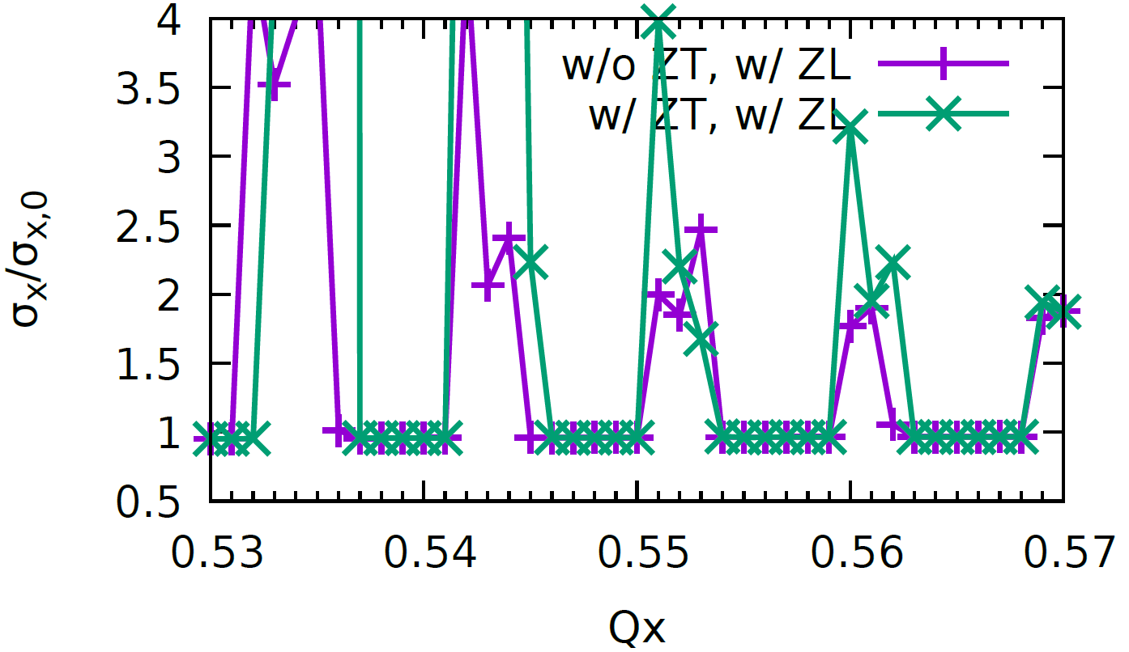
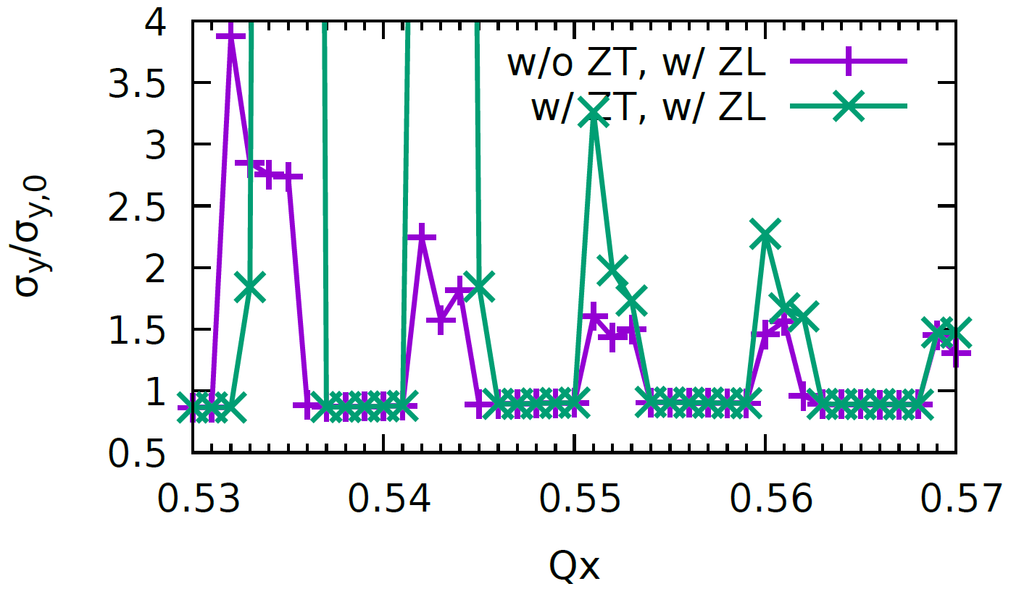
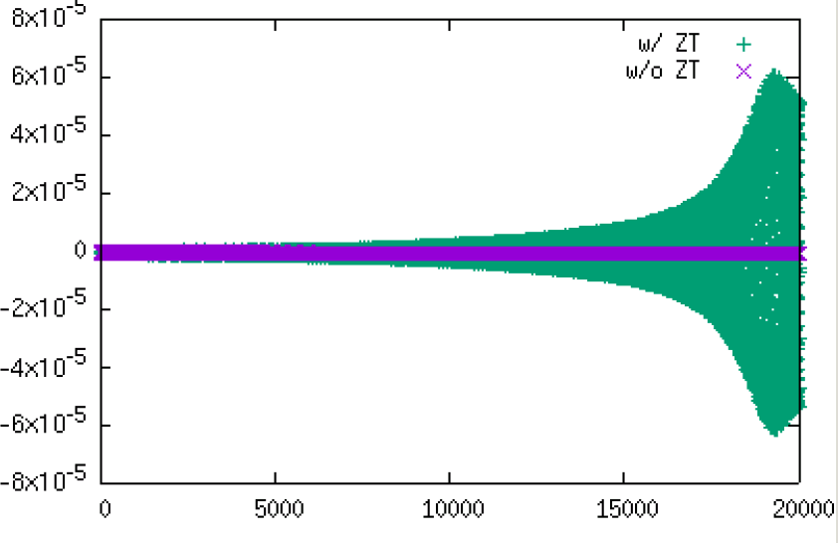
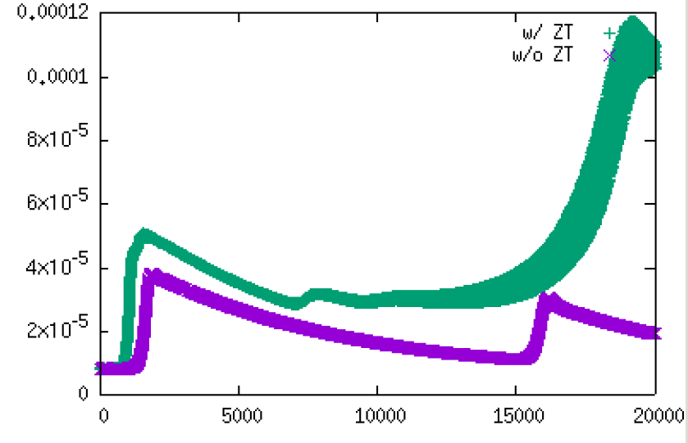
Collision Stability considering ZT
no clear effect in stability region considering the present transverse impedance.
Combined X-Z instability and TMCI instability
FCCee, presented at FCCweek 2022
<x> @ Qx=0.544
$σ_{x}$ @ Qx=0.544

Slide 22
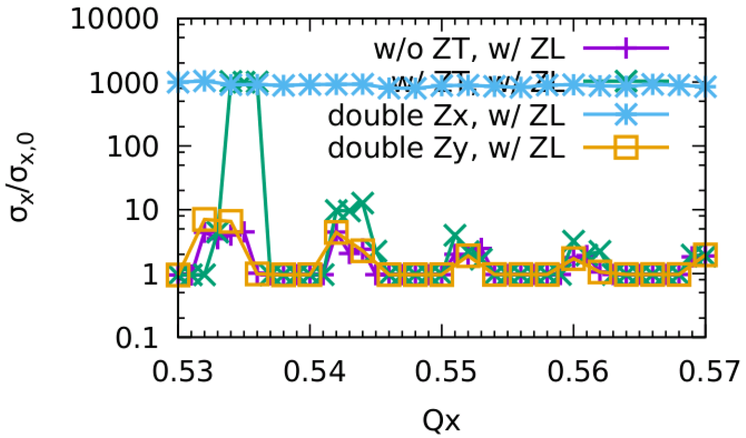
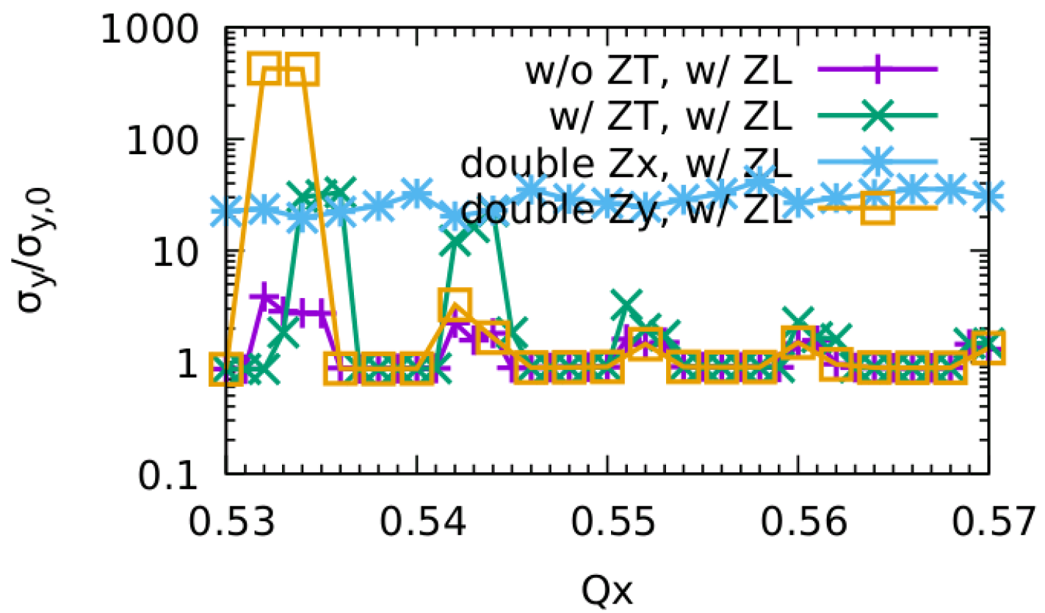
If we double ZT,
FCCee, presented at FCCweek 2022
There does not exist stable tune area
It seems the TMCI instead of X-Z instability dominates

Slide 23
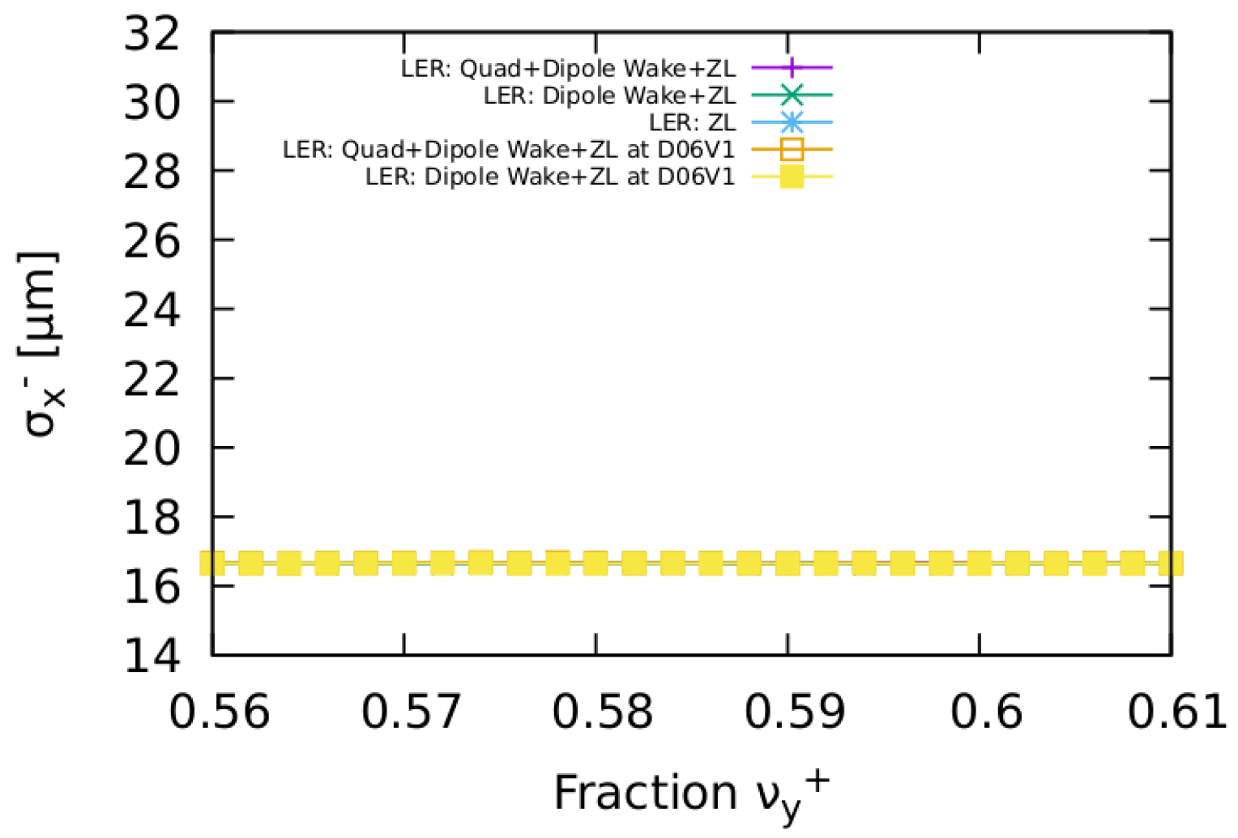
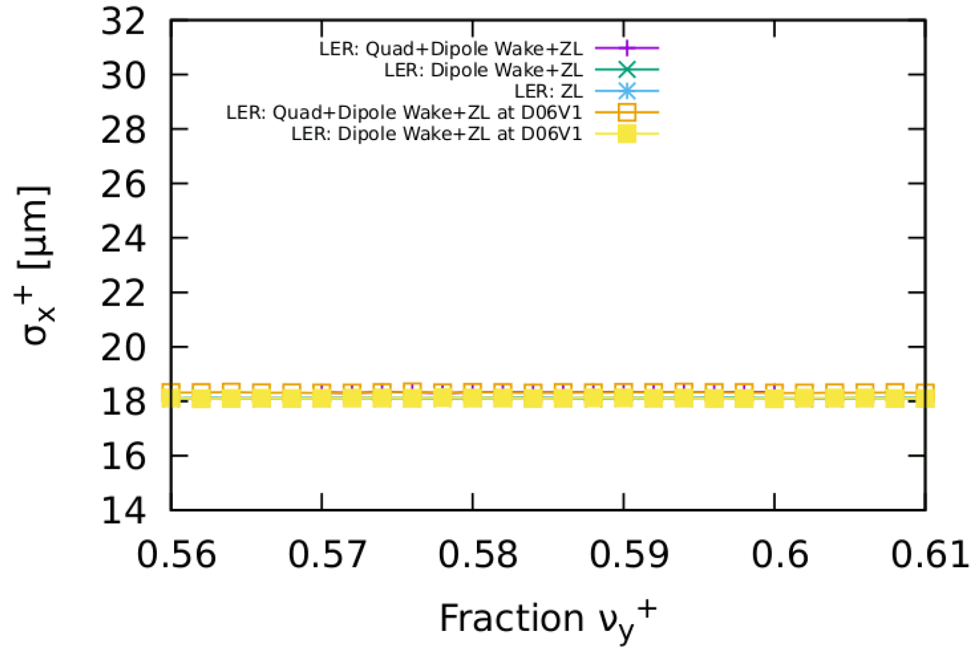
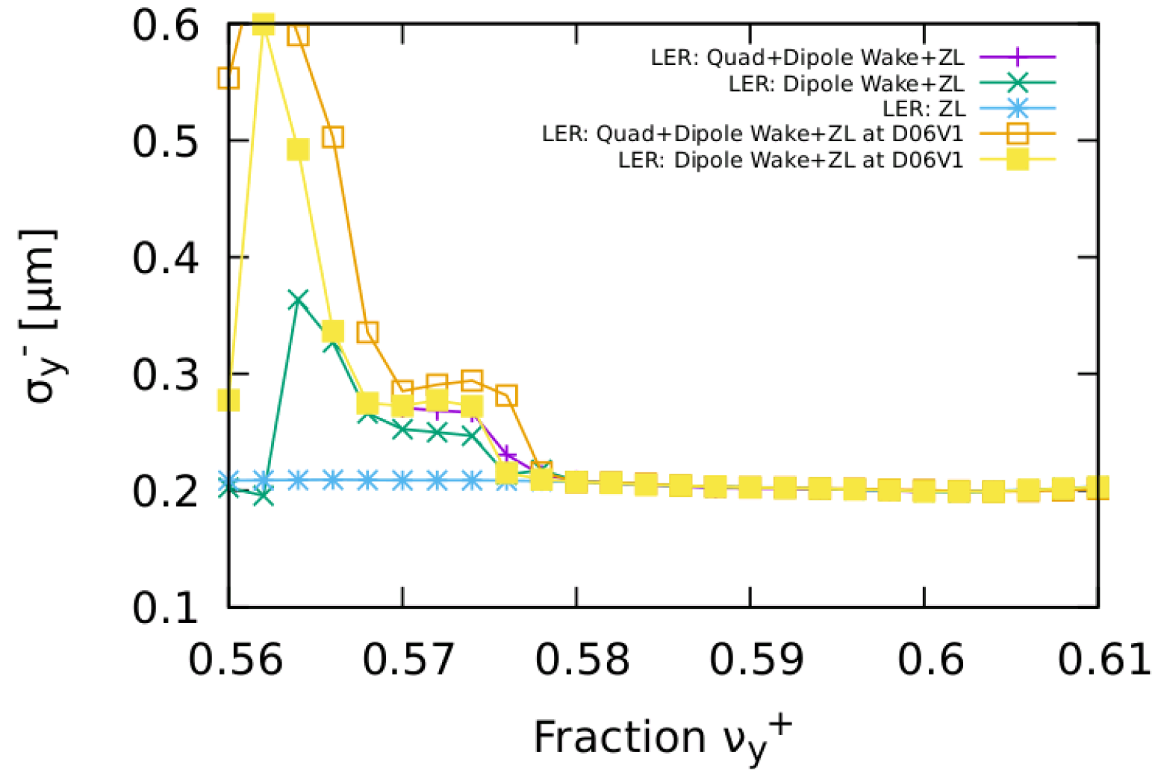
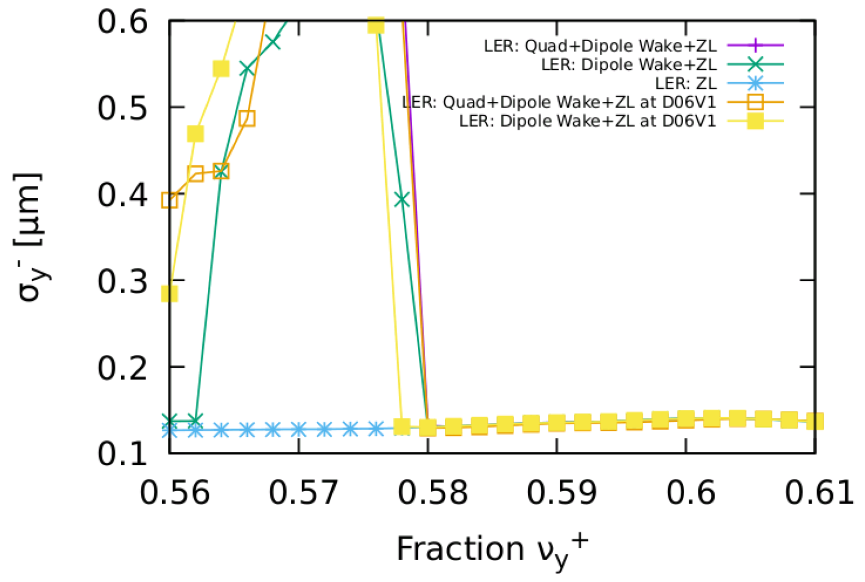
qdzxzyzl/ZL/zxzyzl, scan nuy
SKEKB LER nuy scan
Collision versus $ν_{y,0}^{+}$
$$ν_{x,0}^{+}=0.525$$
presented at FCCweek 2022
and
SKEKB ITF BB Workgroup meeting
* There exist vertical instability except we only consider longitudinal wake.
* It does not matter that he local transverse is put at IP or D06V1.

Slide 24
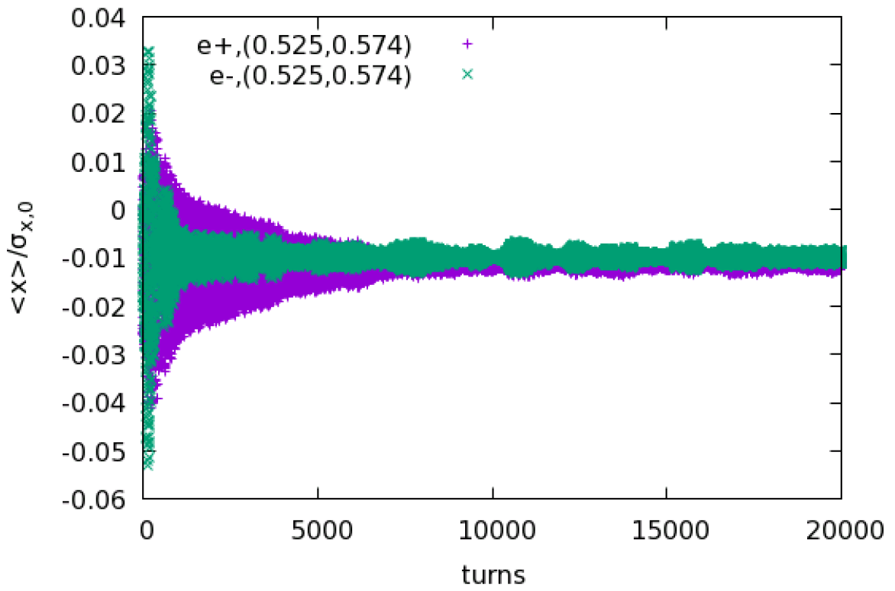
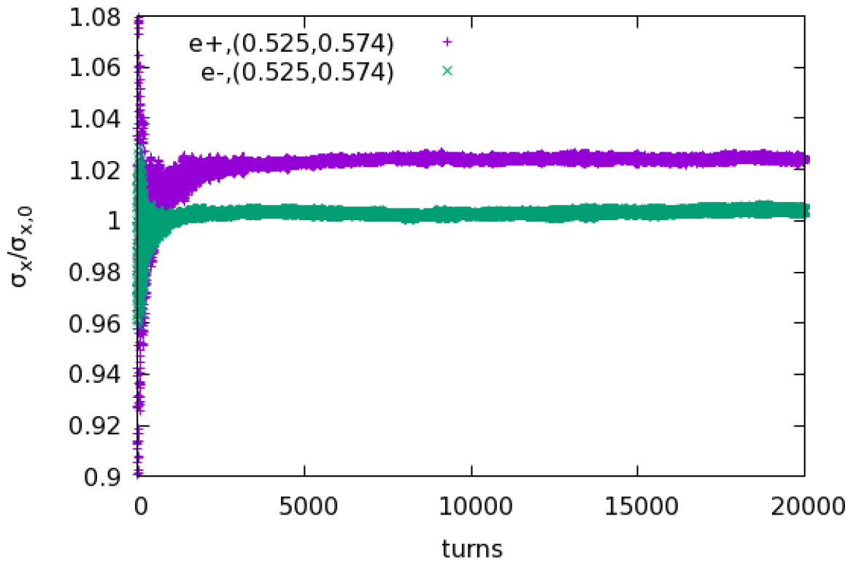
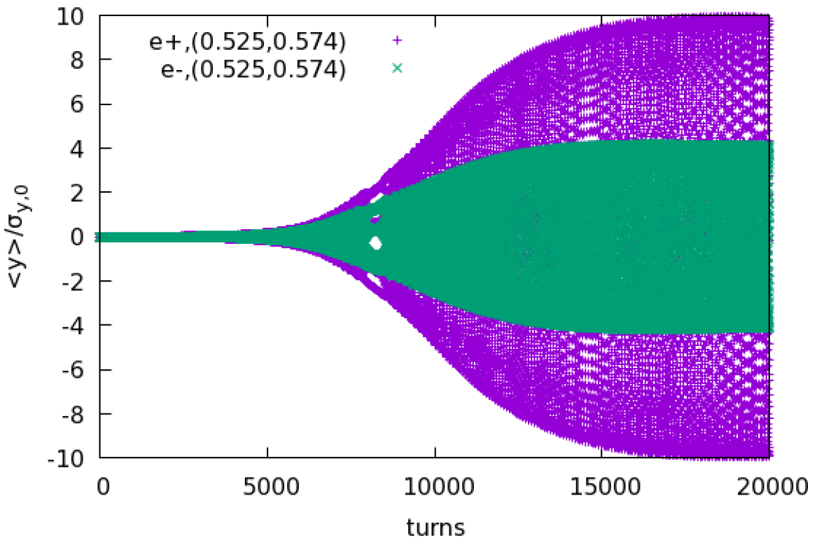
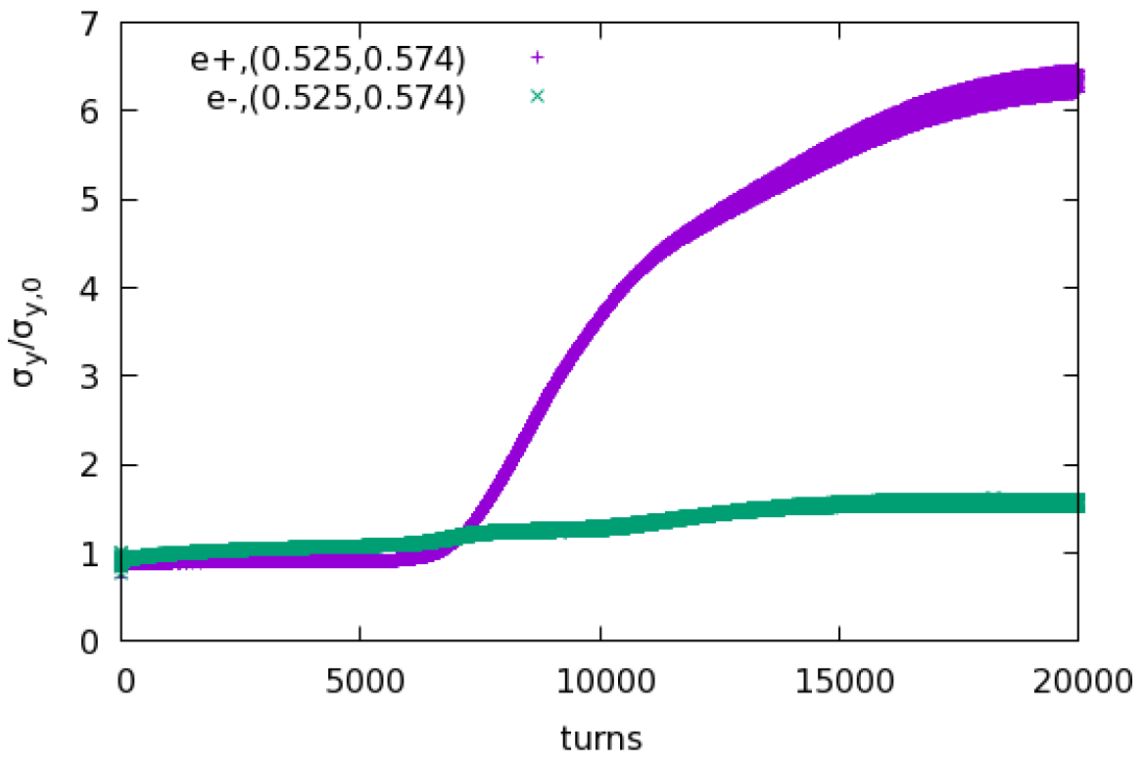
LER: dipole+quad wake + ZL, HER: ZL
SKEKB
presented at FCCweek 2022
and
SKEKB ITF BB Workgroup meeting

Slide 25
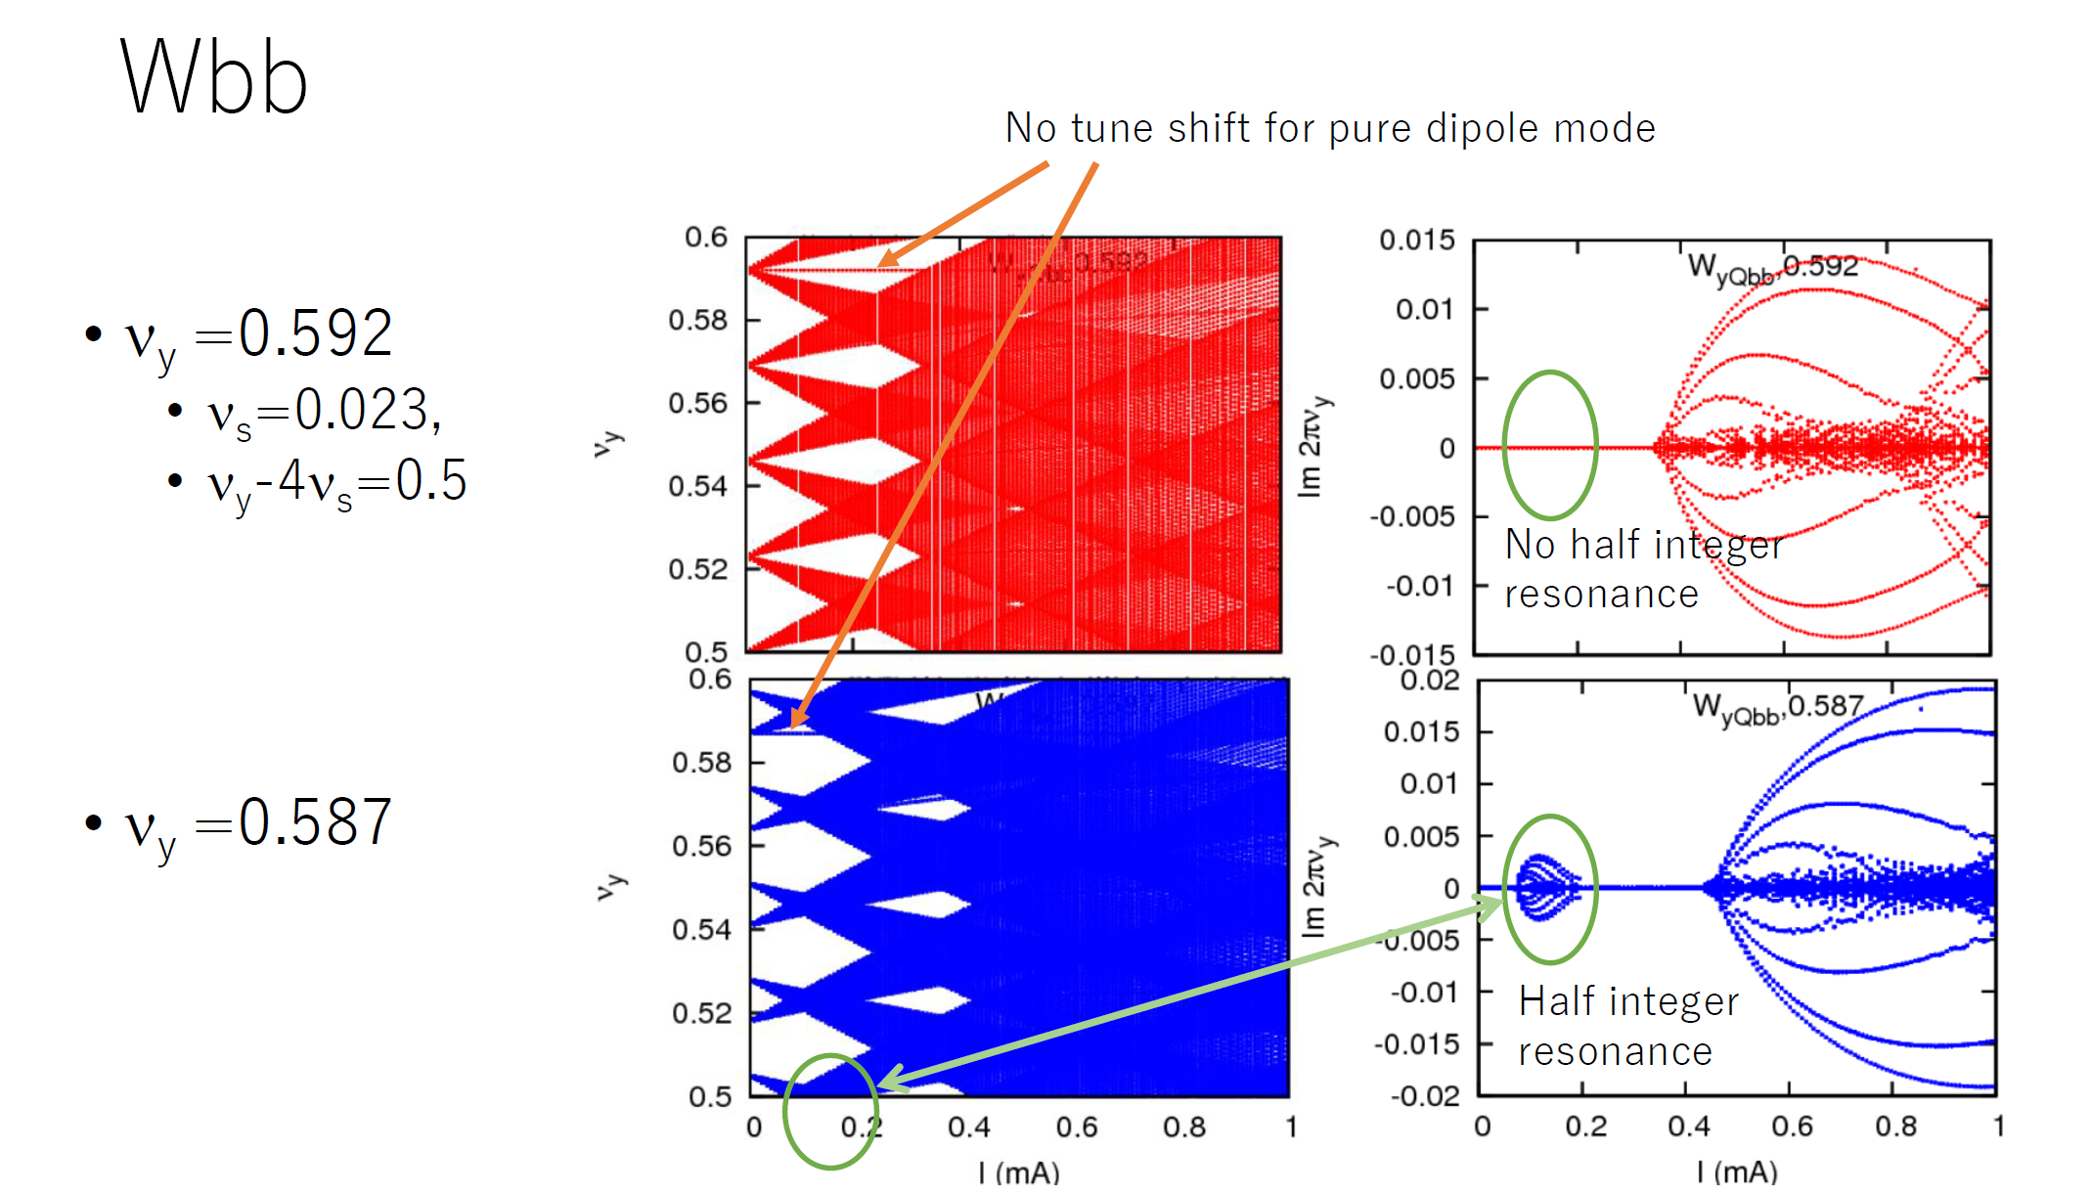
K. Ohmi, BB workgroup meeting, (2022-Jun-30)

Slide 26
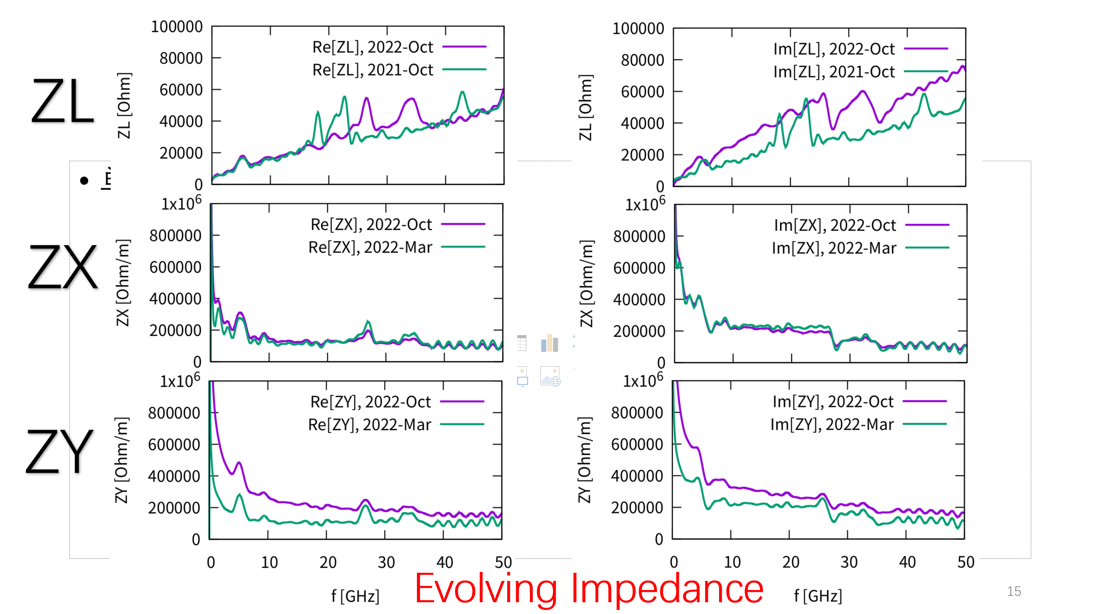
FCCee-Update
Presented at FCCIS Workshop, 2022-Dec

Slide 27
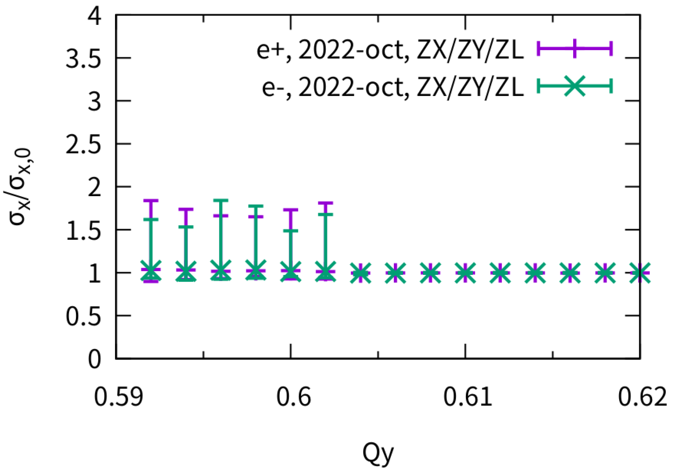
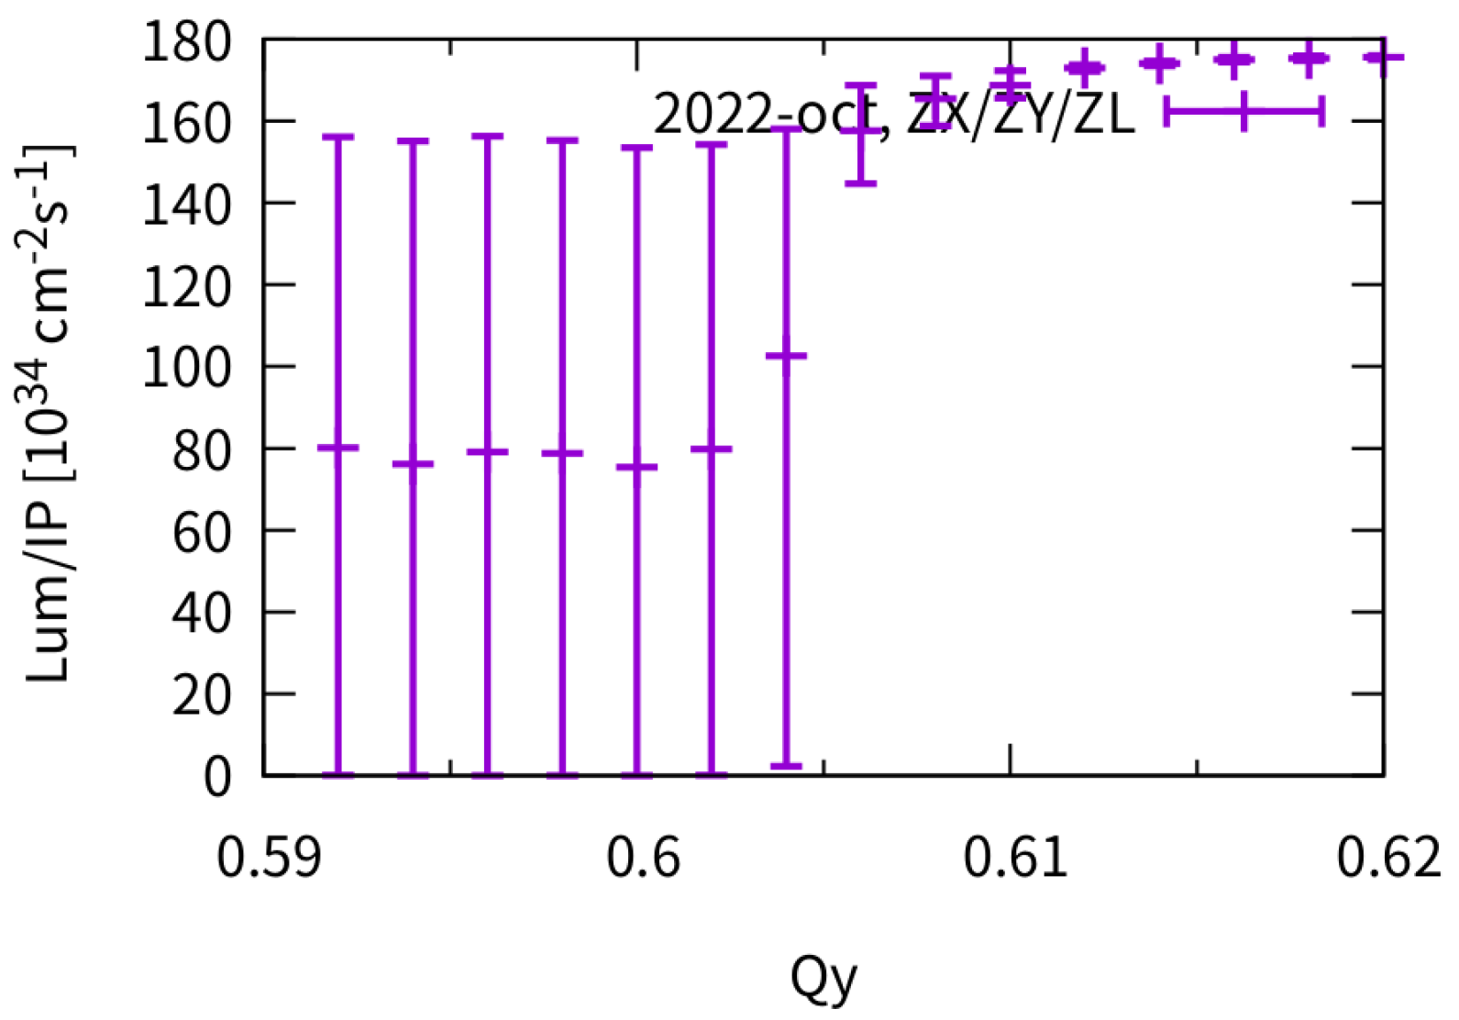
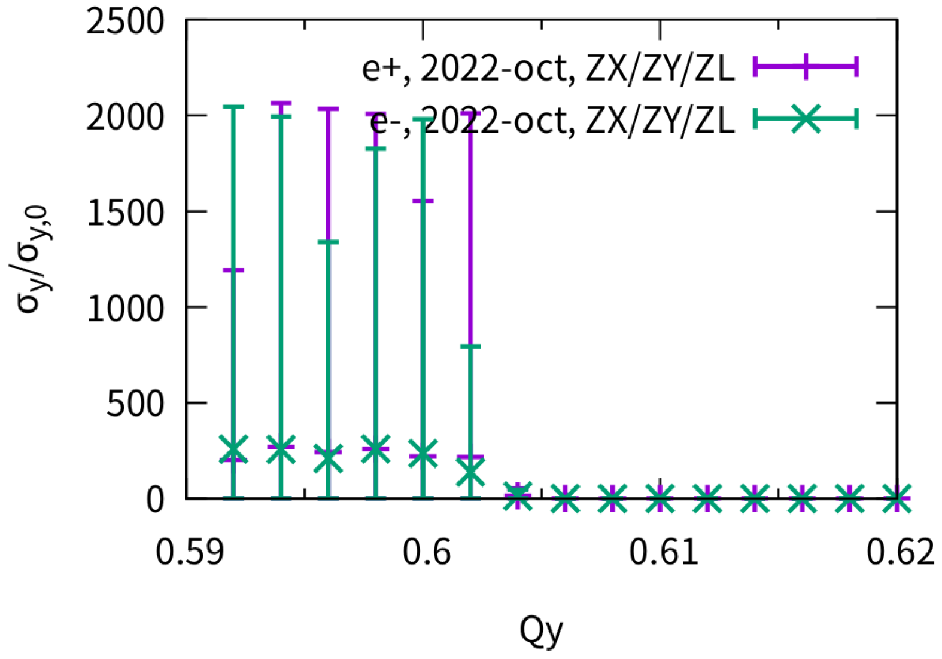
Vertical tune scan
Presented at FCCIS Workshop, 2022-Dec
Qx=0.556

Slide 28
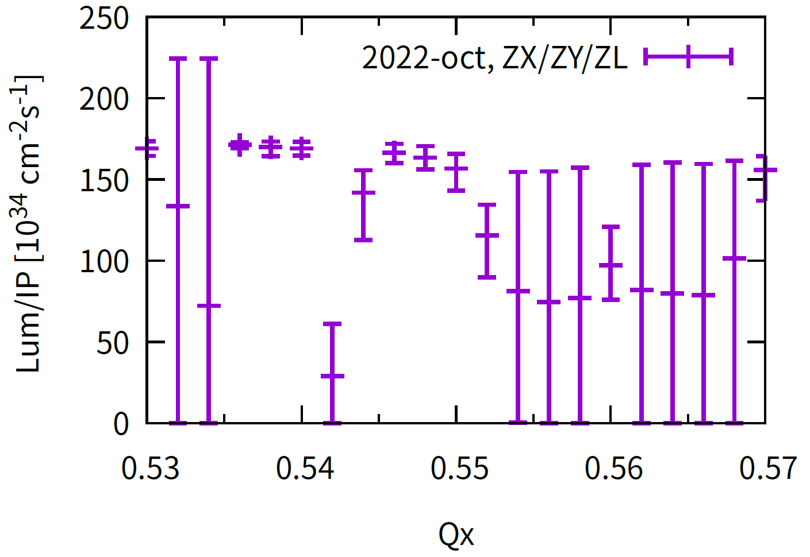
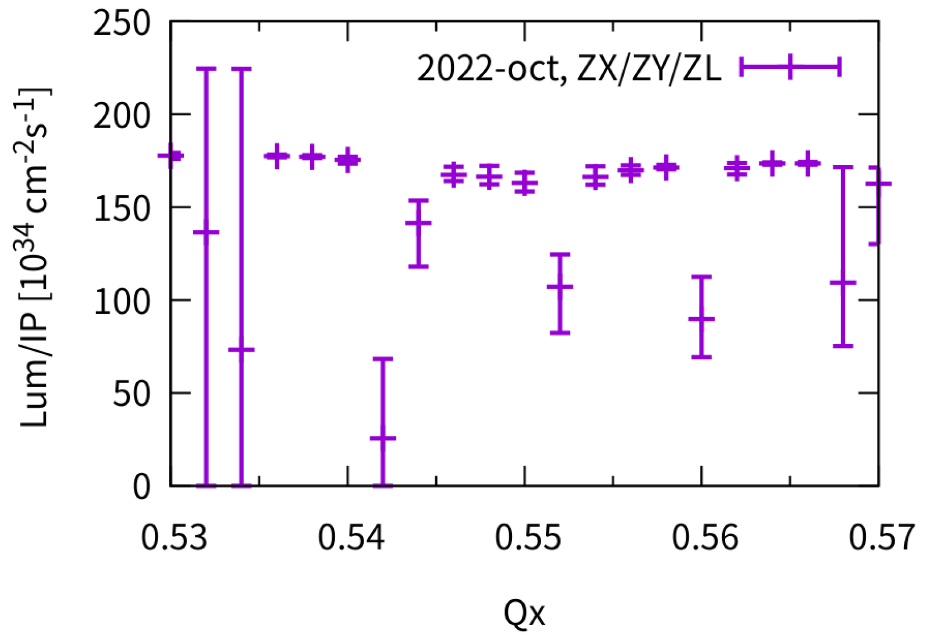
Horizontal scan at different Qy
Presented at FCCIS Workshop, 2022-Dec
Qy=0.60
Qy=0.61

Slide 29
CEPC Only Zx(+ZL) @ Qx=0.562
Behavior at unstable working point
CEPC WORKSHOP, 2022-OCT
It has been simulated that w/o BS (but keep same bunch length), the TMCI-like instability would not appear.
X-Z instability is first excited
Bunch length is shorter
X-TMCI-like instability is then excited
Y is blowup due to stronger beam-beam interaction

Slide 30
CEPC Only Zy(+ZL) Qx=0.567
Behavior at unstable working point
CEPC WORKSHOP, 2022-OCT
It has been simulated that w/o BS (but keep same bunch length), the X-Z instability would not appear.
$σ$ mode
Y-TMCI-like instability is first excited
Bunch length is shorter
X-Z instability is excited
Stronger Y blowup due to strong beam-beam

Slide 31
Effect of Vertical Chromaticity (Lum & $σ_{y}$)
CEPC WORKSHOP, 2022-OCT
Qy’~10 could help suppress the strong TMCI-like instability induced by BB+ZT
ZX+ZY+ZL, Qx=0.567
Qy’=0
Qy’=5
Qy’=10

Slide 32
Effect of different vertical tune (Qy+=0.610)
CEPC WORKSHOP, 2022-OCT
Qy Difference > 0.01 could help suppress instability with Qy’=5
Thanks: K. Oide, K. Ohmi
Qy’=0
Qy’=5

Slide 33
Different Horizontal tune
CEPC WORKSHOP, 2022-OCT
Asymmetric
Symmetric
Qx+=0.567

Slide 34
Some analysis results of mitigation method
Mini-workshop on impedance modeling and impedance effects at SuperKEKB and future colliders, 2022-Dec
Symmetrical tunes
Asymmetrical tunes
Vertical Chromaticity
$$|λ|$$

Slide 35
Blank page

Slide 36
New 50MW Parameters, Increase Bunch Population from 14e10->21e10
Dou Wang
 | Higgs | Z | W | ttbar
Number of IPs | 2
Circumference (km) | 100.0
SR power per beam (MW) | 50
Half crossing angle at IP (mrad) | 16.5
Bending radius (km) | 10.7
Energy (GeV) | 120 | 45.5 | 80 | 180
Energy loss per turn (GeV) | 1.8 | 0.037 | 0.357 | 9.1
Damping time τ_{x}/τ_{y}/τ_{z}(ms) | 44.6/44.6/22.3 | 816/816/408 | 150/150/75 | 13.2/13.2/6.6
Piwinski angle | 4.88 | 24.23 | 5.98 | 1.23
Bunch number | 446 | 13038 | 2162 | 58
Bunch spacing (ns) | 355 (53% gap) | 23 (10% gap) | 154 | 2714 (53% gap)
Bunch population (10¹¹) | 1.3 | 2.14 | 1.35 | 2.0
Beam current (mA) | 27.8 | 1340.9 | 140.2 | 5.5
Phase advance of arc FODO (°) | 90 | 60 | 60 | 90
Momentum compaction (10⁻⁵) | 0.71 | 1.43 | 1.43 | 0.71
Beta functions at IP β _{x}*/β _{y}* (m/mm) | 0.3/1 | 0.13/0.9 | 0.21/1 | 1.04/2.7
Emittance ε_{x}/ε_{y} (nm/pm) | 0.64/1.3 | 0.27/1.4 | 0.87/1.7 | 1.4/4.7
Betatron tune ν_{x}/ν_{y} | 445/445 | 266/267 | 266/266 | 445/445
Beam size at IP σ_{x} /σ_{y} (um/nm) | 14/36 | 6/35 | 13/42 | 39/113
Bunch length (natural/total) (mm) | 2.3/4.1 | 2.7/10.6 | 2.5/4.9 | 2.2/2.9
Energy spread (natural/total) (%) | 0.10/0.17 | 0.04/0.15 | 0.07/0.14 | 0.15/0.20
Energy acceptance (DA/RF) (%) | 1.6/2.2 | 1.3/1.5 | 1.2/2.5 | 2.0/2.6
Beam-beam parameters ξ_{x} /ξ_{y} | 0.015/0.11 | 0.0045/0.13 | 0.012/0.113 | 0.071/0.1
RF voltage (GV) | 2.2 | 0.1 | 0.7 | 10
RF frequency (MHz) | 650
Longitudinal tune ν_{s} | 0.049 | 0.032 | 0.062 | 0.078
Beam lifetime (bhabha/beamstrahlung) (min) | 39/40 | 86/400 | 60/700 | 81/23
Beam lifetime (min) | 20 | 71 | 55 | 18
Hour glass Factor | 0.9 | 0.97 | 0.9 | 0.89
Luminosity per IP (10³⁴/cm²/s) | 8.3 | 192 | 26.7 | 0.8

Slide 37
New 50MW Parameters
Single Bunch TMCI threshold ~ 24e10 considering beamstrahlung length without beam-beam interaction
Qx’=5 does not help
Qx’=5 + diffnux does not help
Only ZX

Slide 38
New 50MW Parameters
Qx’=5 does not help
Qx’=5 + diffnux does not help

Slide 39
Impedance development
Na Wang
Continuously updating along with the development of the hardware designs
Naturally increase with more elements included.

Slide 40
Higgs:Lifetime w/ and w/o beambeam
Realistic lattice w/o and w/ beam-beam
Huiping Geng and Yiwei Wang
50k turns, 1k macro-particles @injection point
w/o bb
w/ bb
Survival particles:
1000
Survival particles:
861

Slide 41
Higgs: Lifetime optimization
Realistic lattice w/ beam-beam
Huiping Geng and Yiwei Wang
NIMA 959 (2020) 163517
Diffusion Map Analysis
50k turns, 1k macro-particles @injection point
32 families of sextupoles in Arc
Survival particles:
962

Slide 42
Summary
Combined phenomenon of transverse impedance and beam-beam interaction is studied by simulation and analysis
CEPC
FCCee
SuperKEKB
Collaboration is helpful
Future is challenging and expected to be fruitful
X/Y tune scan, bootstrapping
…

