Slide 1
国家重点研发计划
R&D and Verification of Key Technologies for a High Energy Circular Electron-Positron Collider
Zhijun Liang for CEPC MOST2 vertex detector team

Slide 2
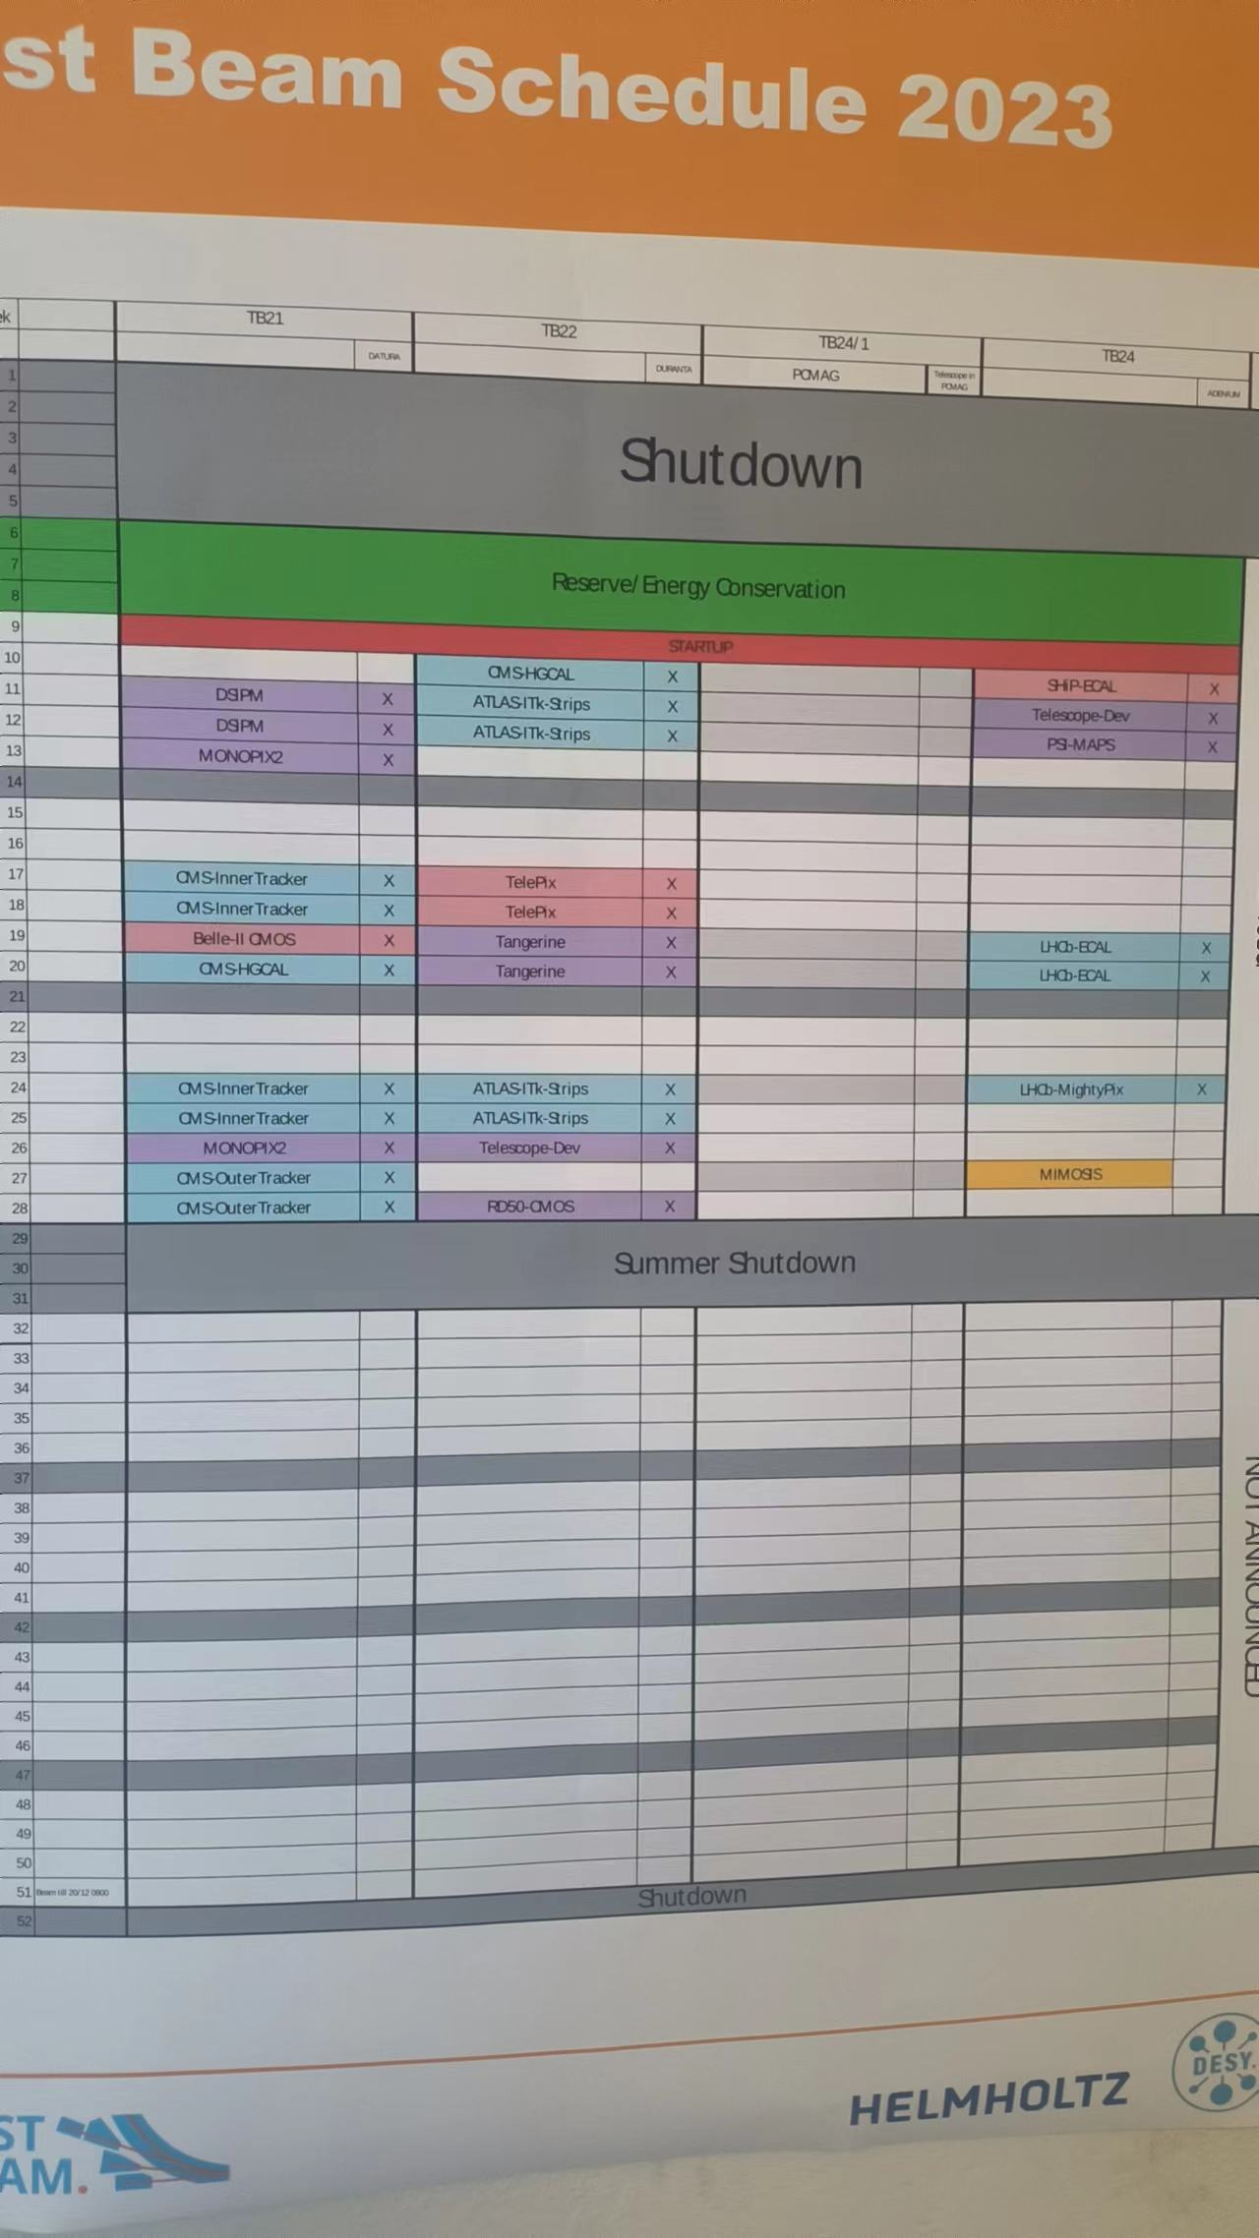
Next milestone
Testbeam at DESY (Dec 8th ~ Dec 22nd )
Telescope with 6 single chip boards (v1.21)
Take 11 boards ( for replacements)
Full vertex detector prototype
Aim for detector assembly at Feb 2023
Next Test beam oppotunity at DESY in Apr
Schedule another testbeam at BSRF
Depending on the status of ladder readout

Slide 3
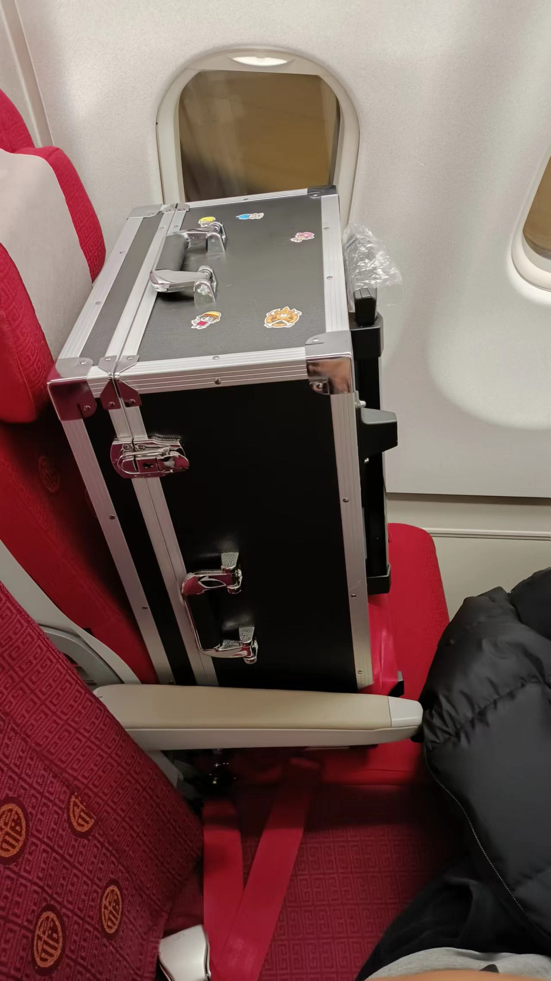
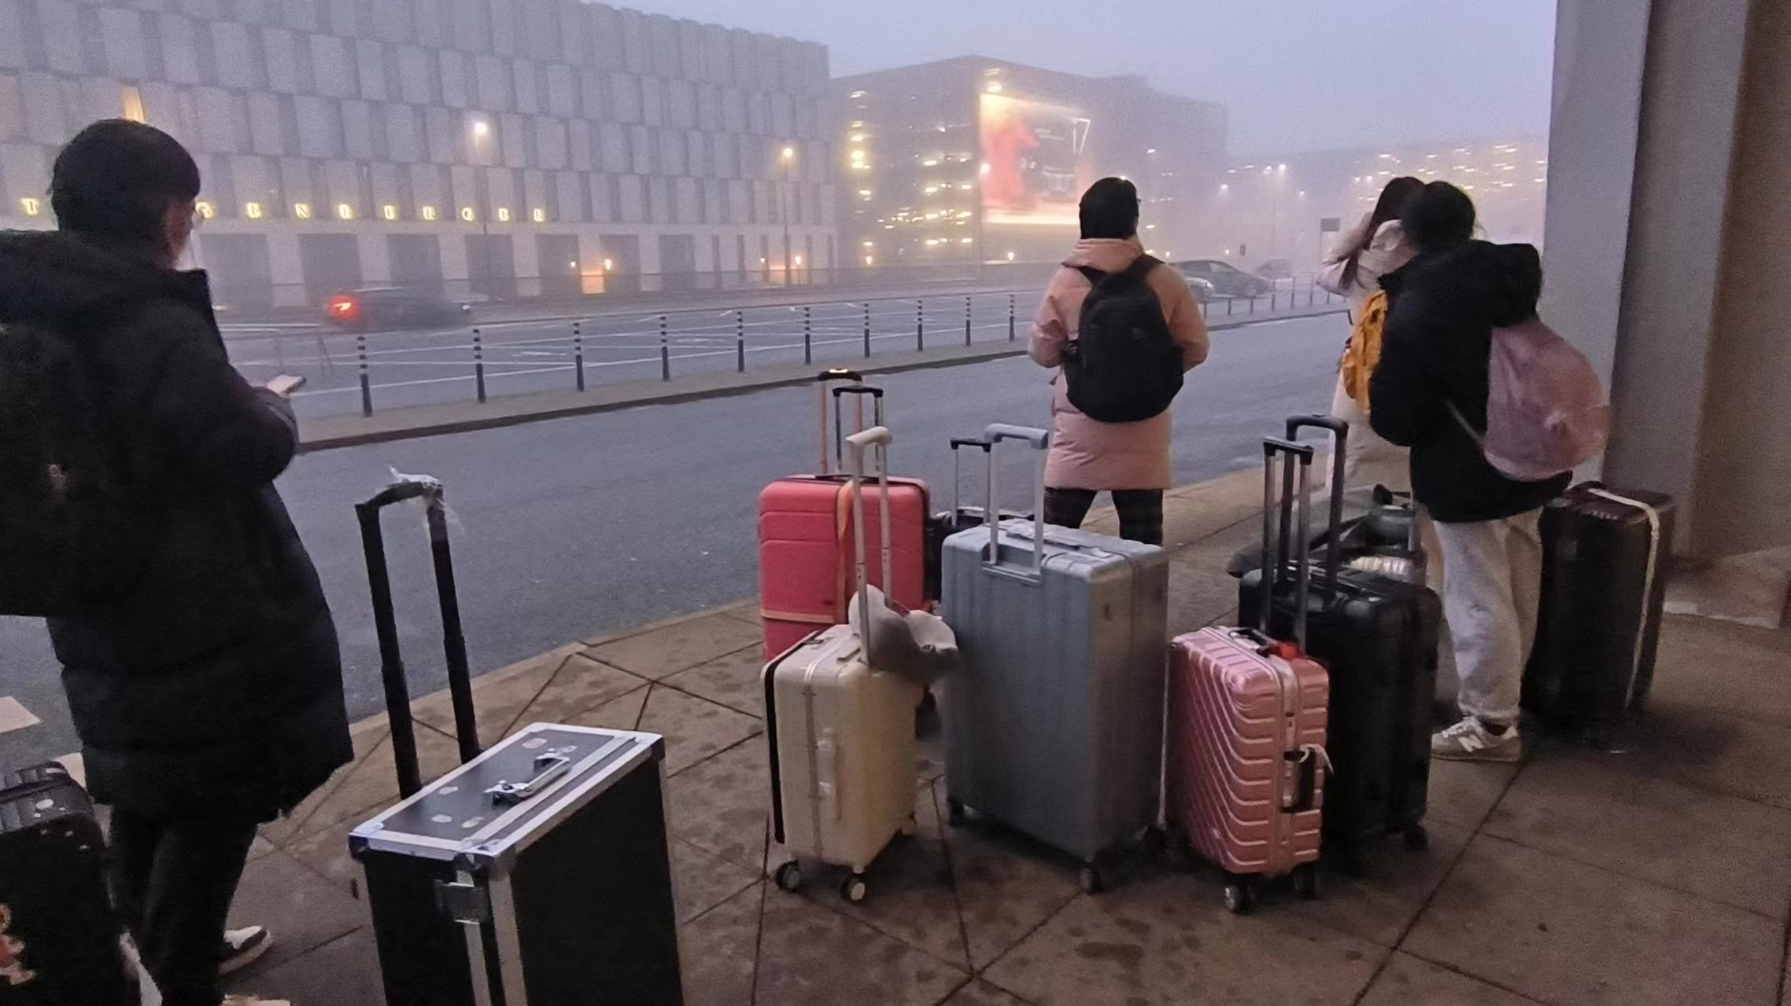
Traveling

Slide 4
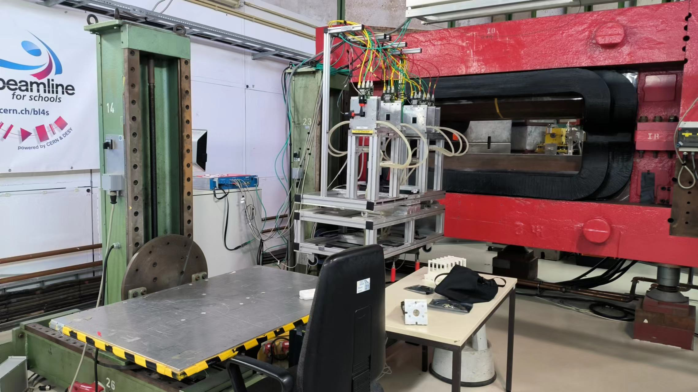
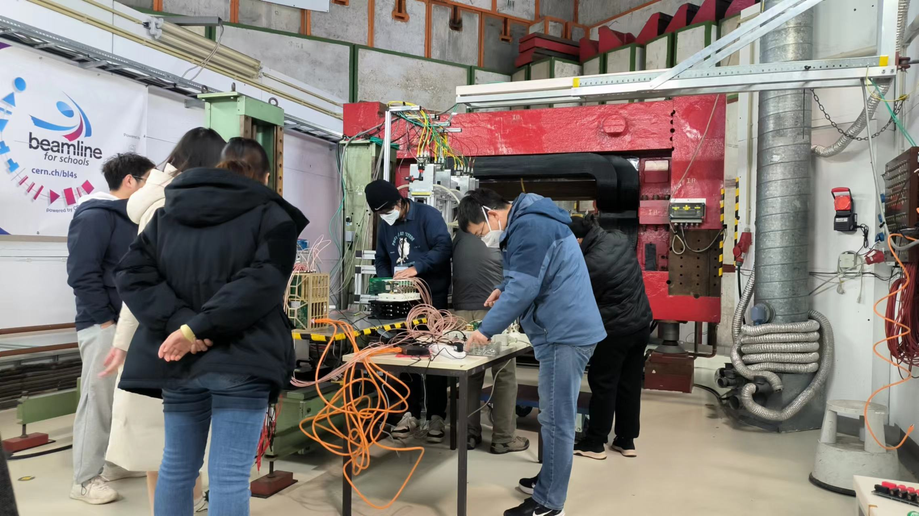
testbeam hall at DESY : TB21

Slide 5
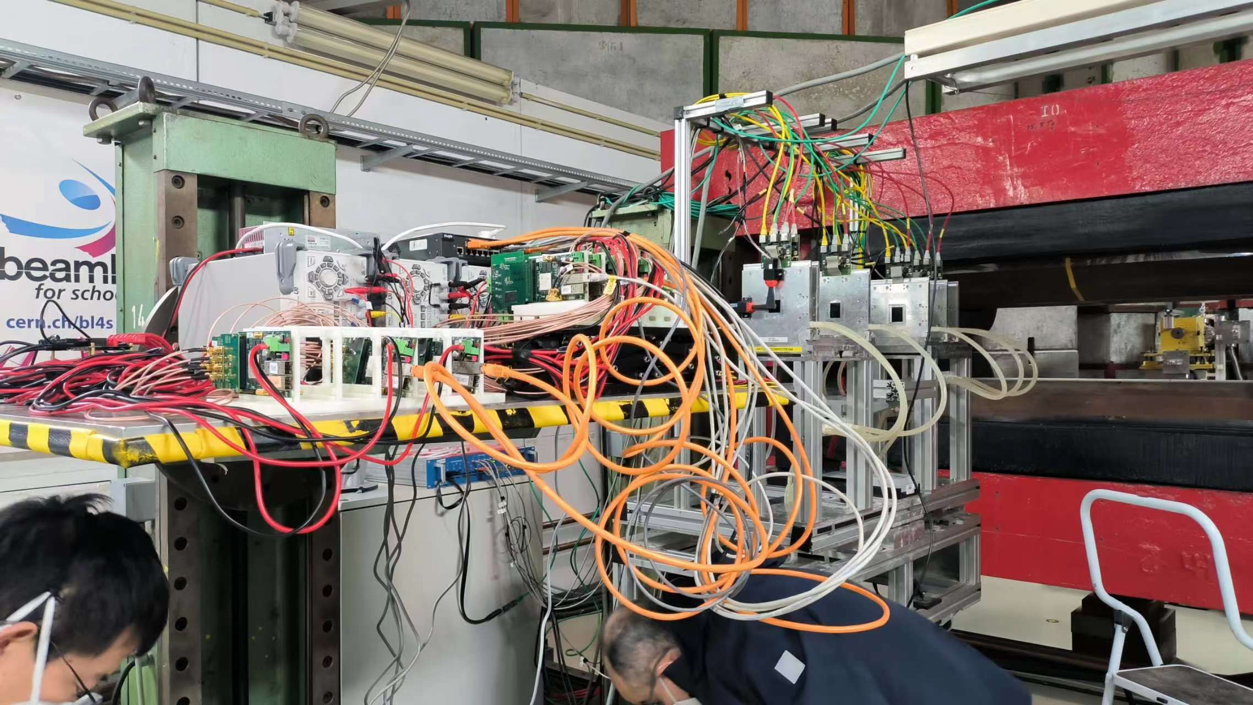
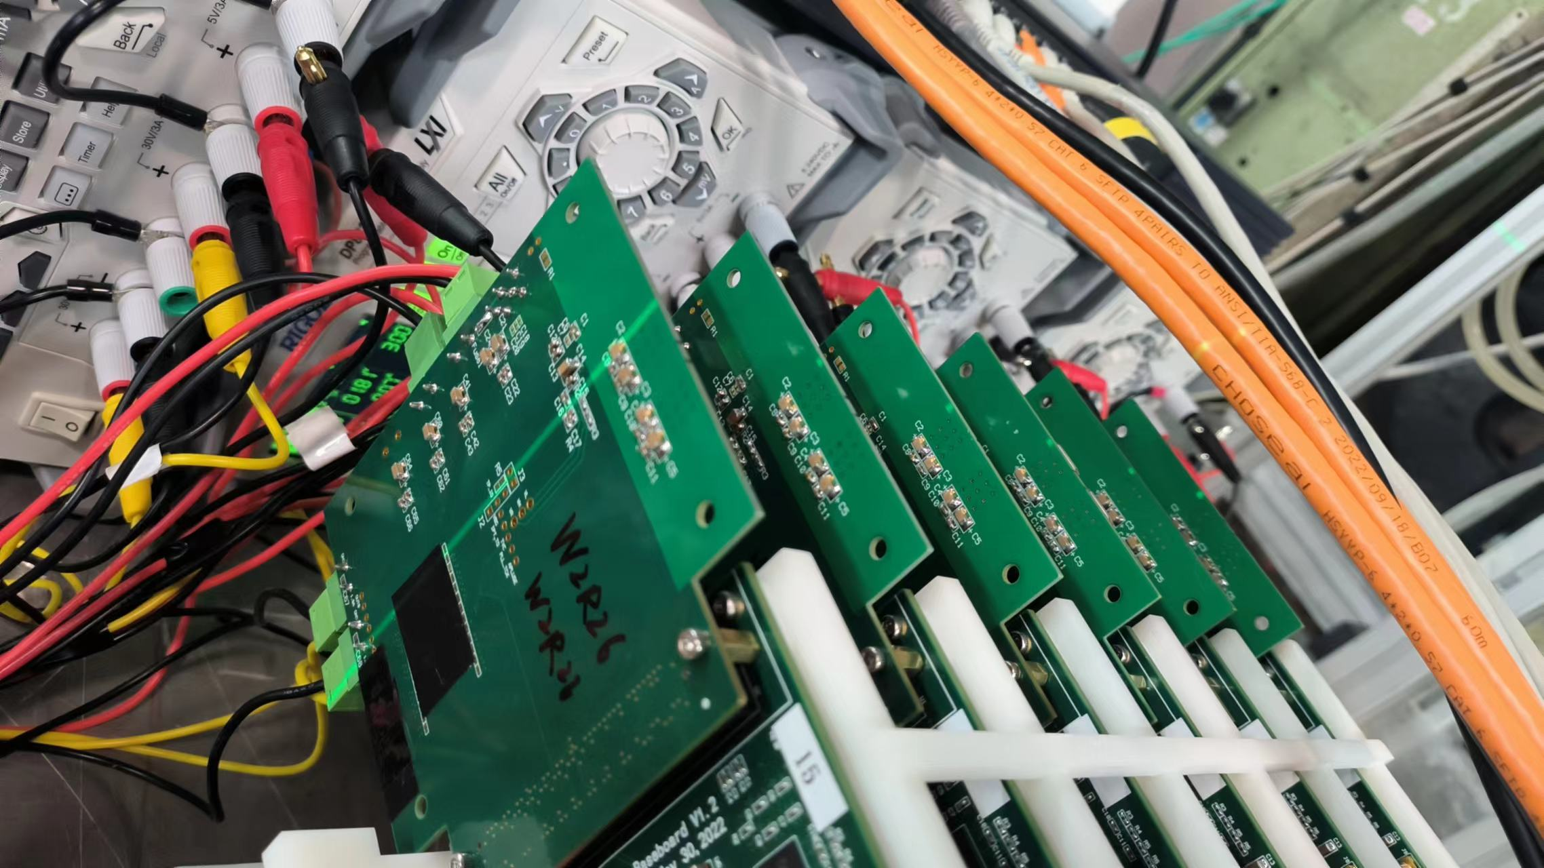
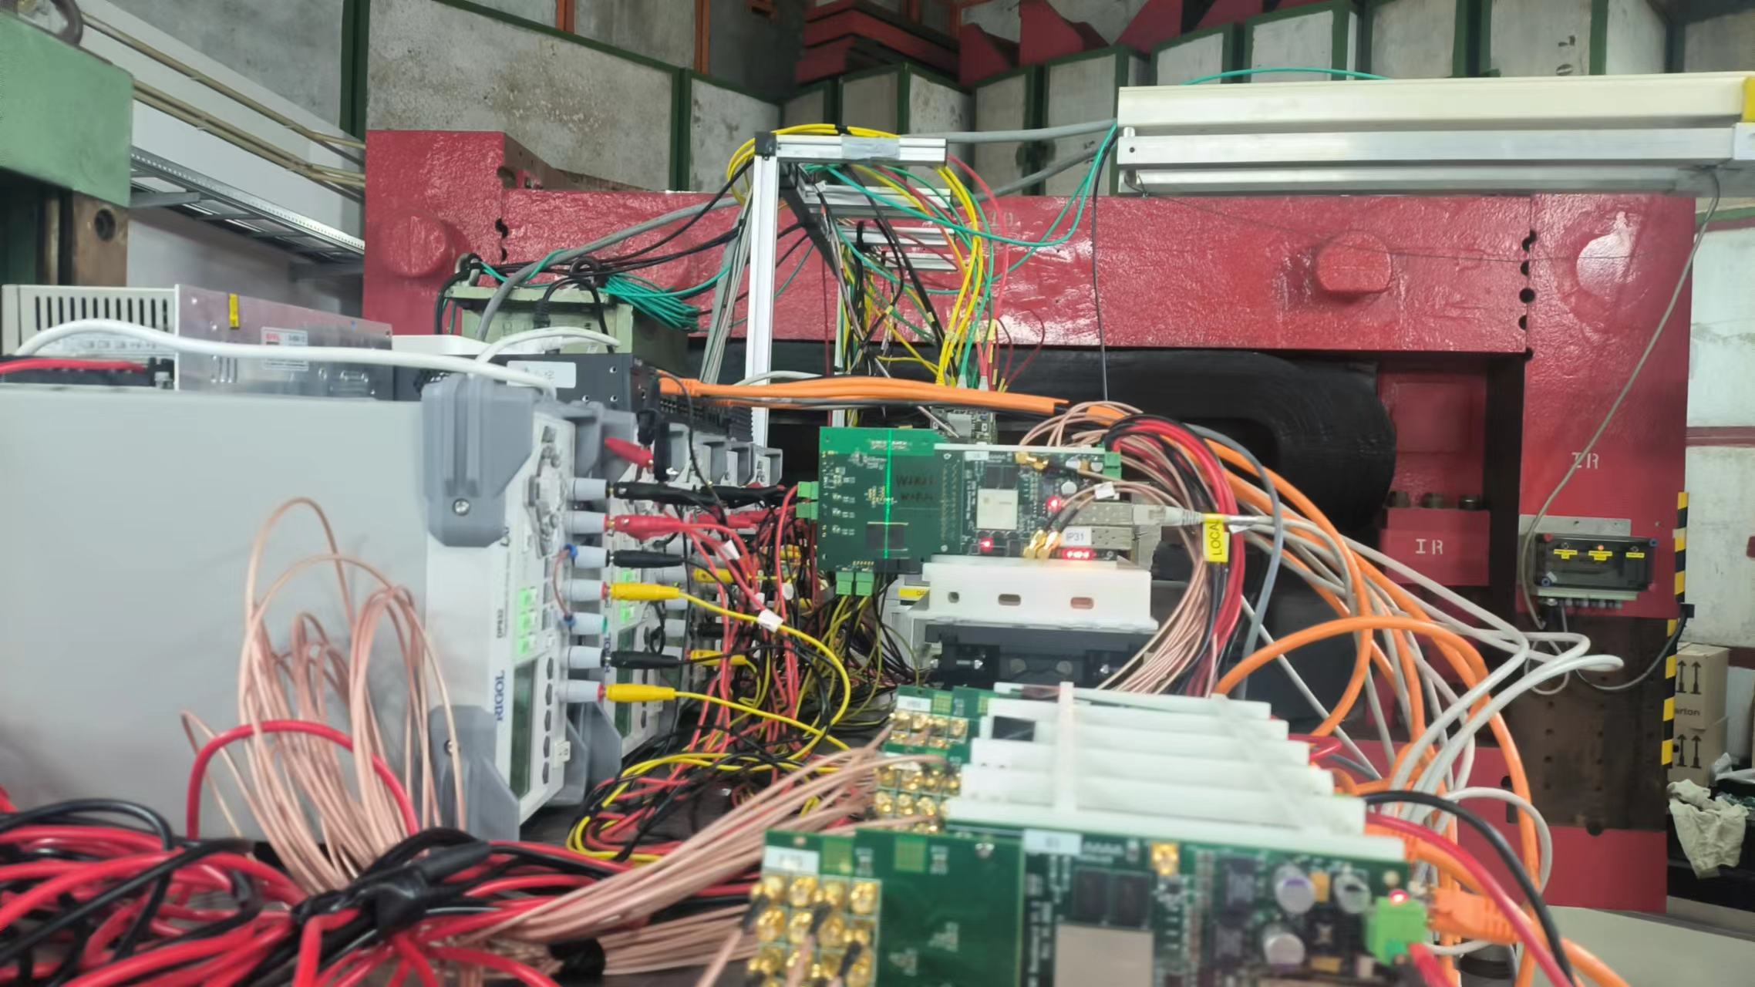
Testbeam Setup
6 boards with Std TJ process chip
ITHR ~32

Slide 6
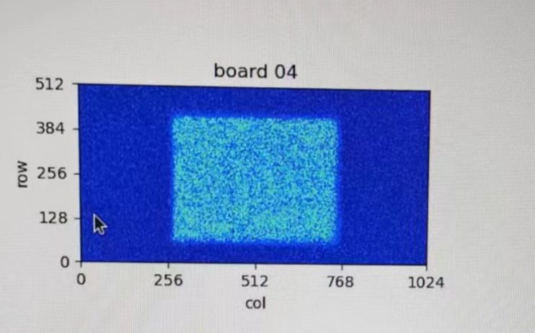
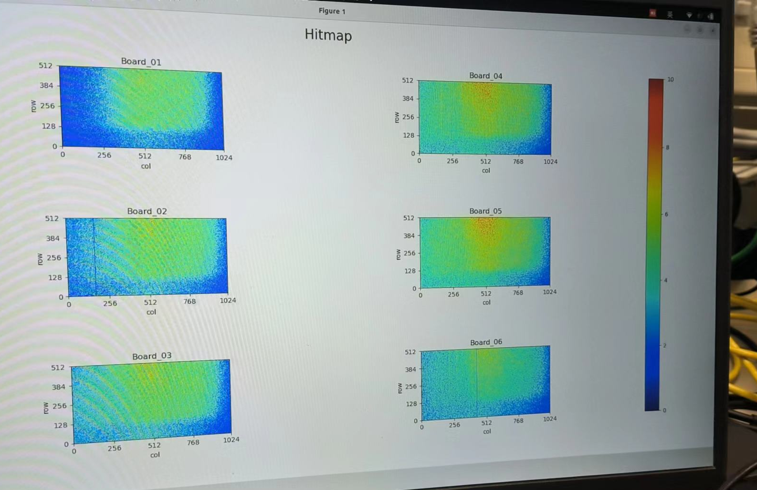
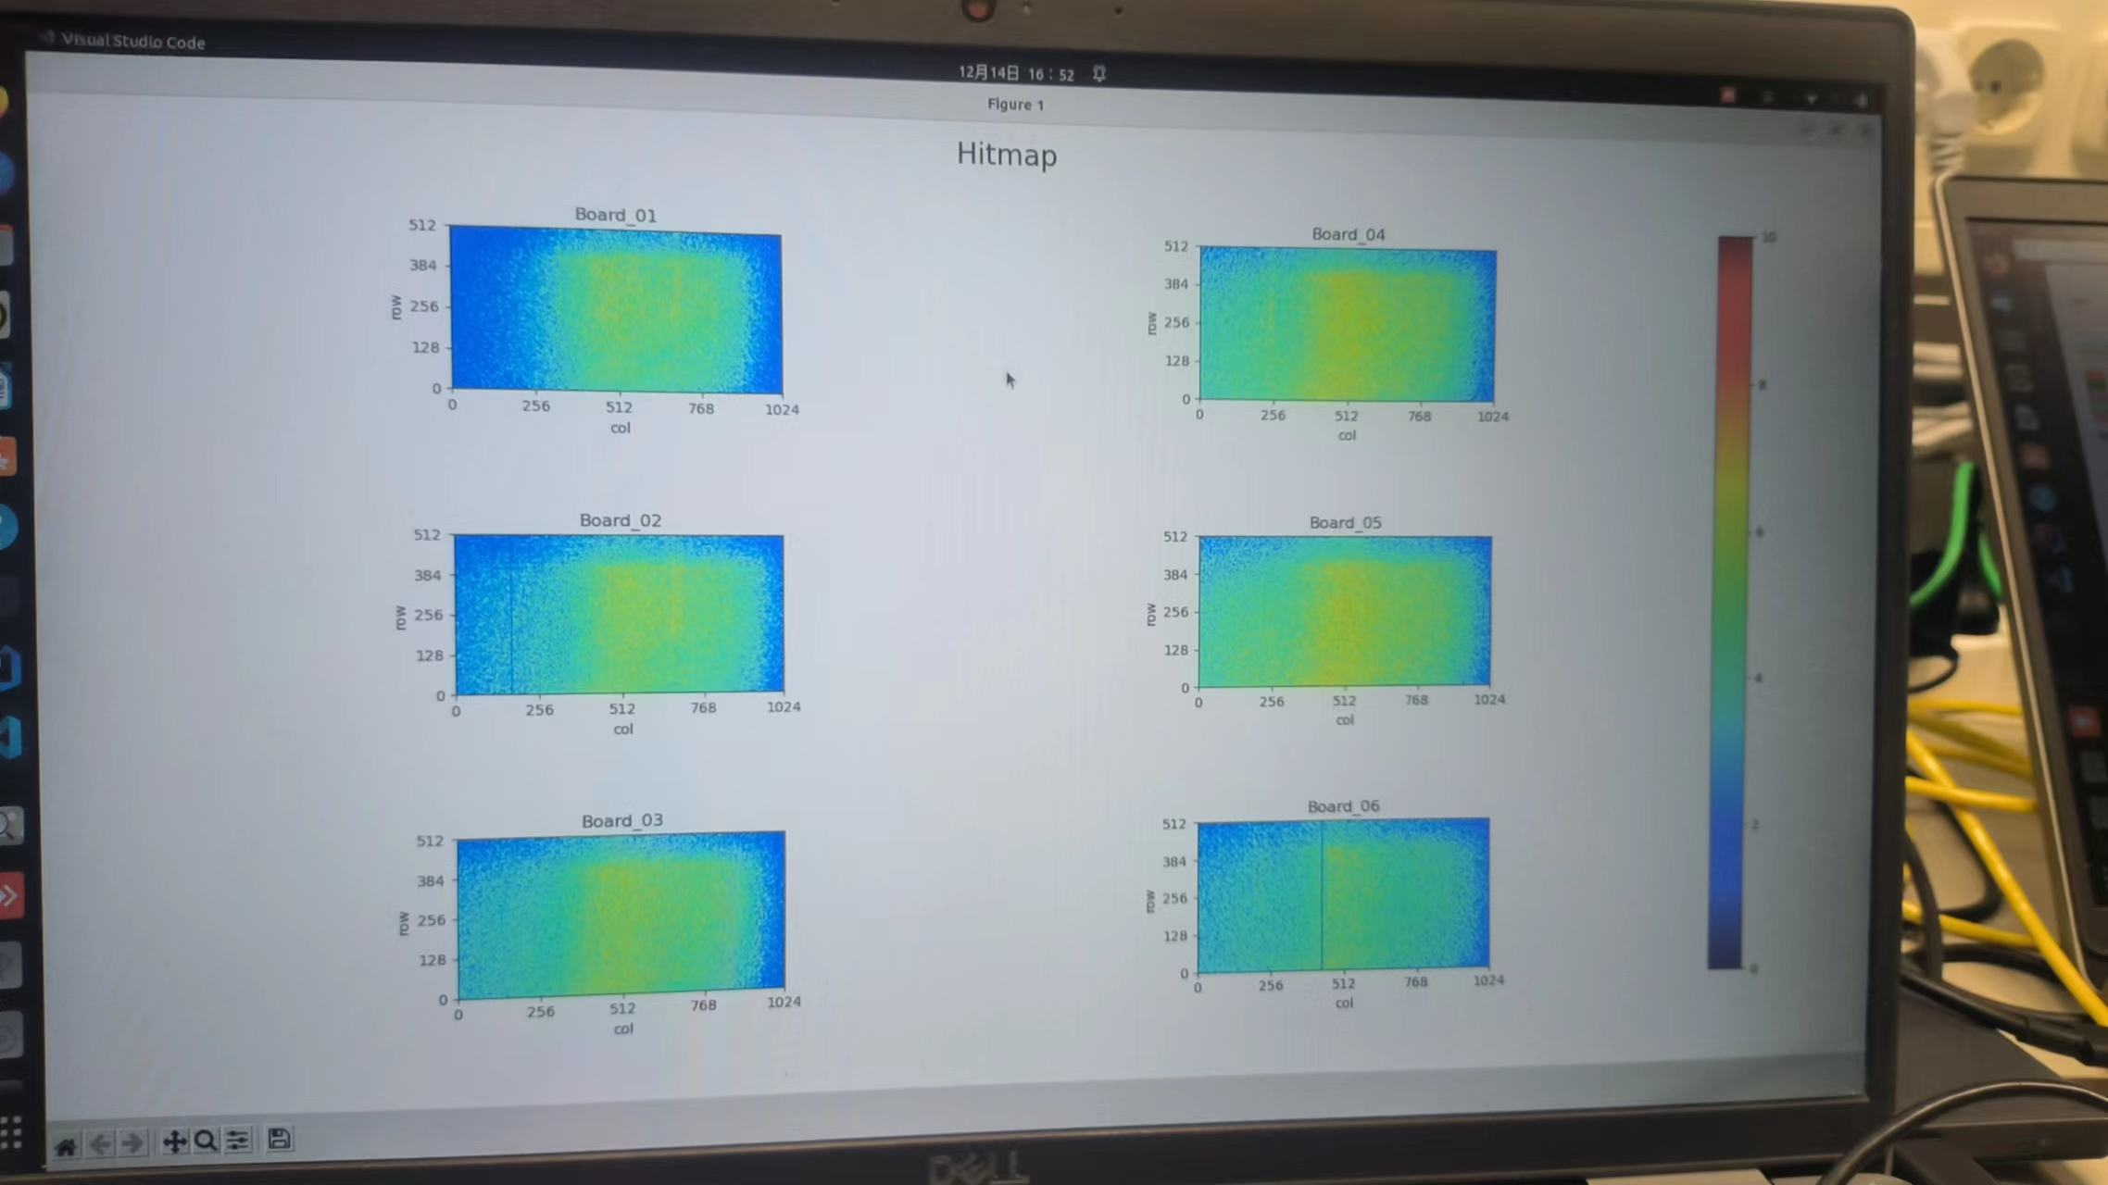
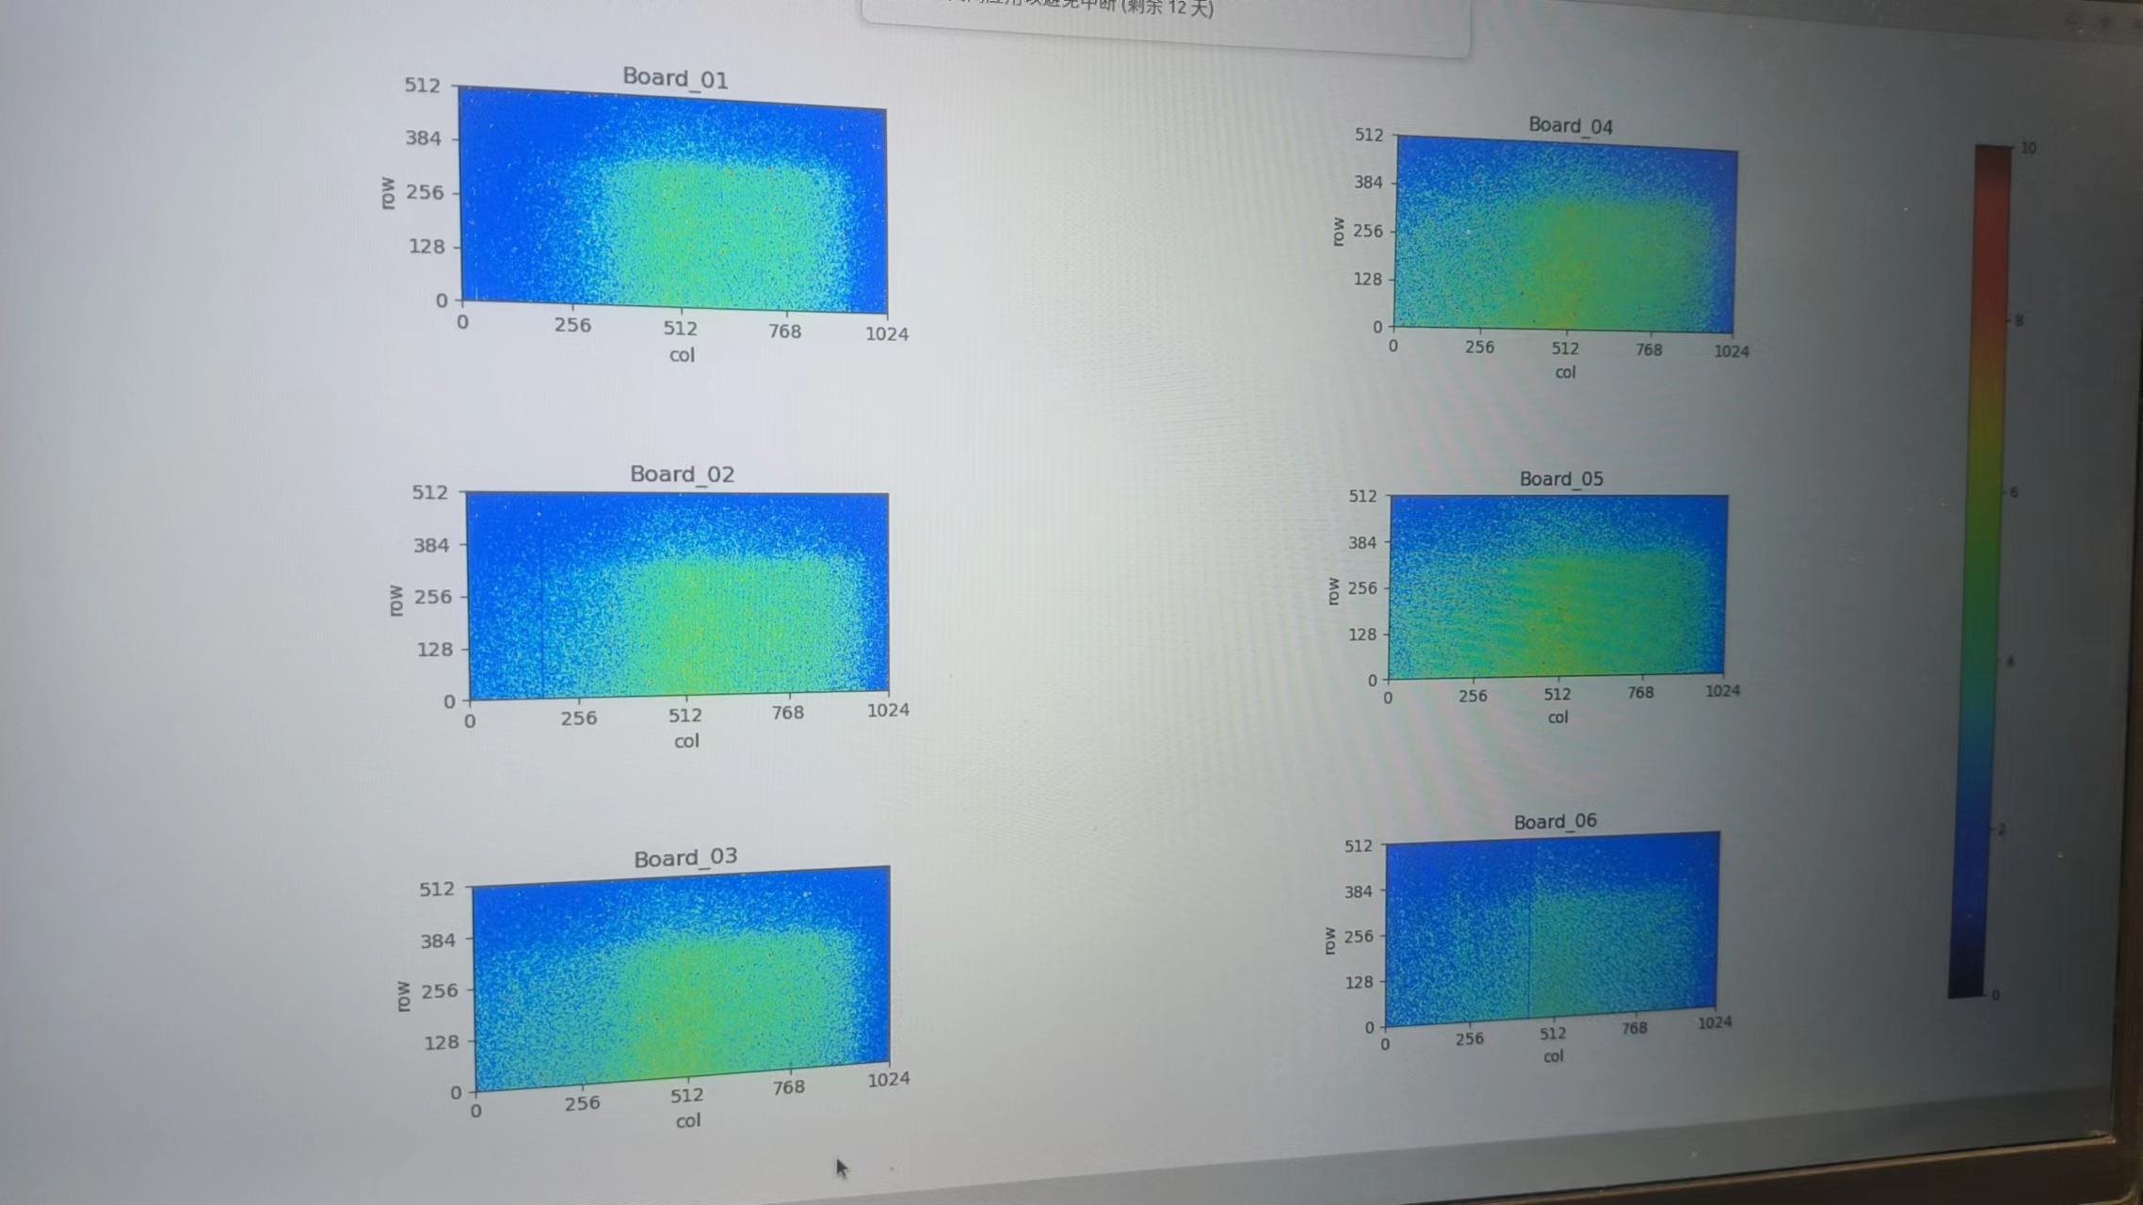
Hit maps
Should aim for middle of the chip
Data taking yesterday was a bit height
5GeV electron beam
Y:-10 mm
Y:-7.5 mm
Y:-5 mm

Slide 7
Now: 5GeV run, 6 STD chip, ITHR ~300e-

