Slide 1
The intrinsic coupling resonances, non-linear resonances and snake resonances in the HIAF-BRing
李民祥
Notes:
大家好，我是李民祥。今天我要讲的题目是通过让平衡极化率达到80%以上来维持对撞环中电子束的极化率在整个对撞时间内都大于80%。

Slide 2
The comment
The essence of this new fixed field SibS scheme is to allow the spin tune to vary within a limited range during the ramp, instead of being constant as with the fixed strength SibS. I think that this point should be highlighted in the introduction and/or conclusion.While it is shown that this scheme allows to avoid the intrinsic vertical resonances, intrinsic coupling resonances, snake resonances or non-linear resonances are not discussed. Intrinsic coupling resonances will probably impose a tight tolerance on the transverse tunes and coupling correction, which was not studied in this paper (e.g. by introducing random quadrupole tilts and implementing a correction scheme). Concerning the snake / non-linear resonances, one might argue that due to the fast ramping rate, most high order resonance will have a rather weak effect on the beam polarisation, but it should be spelled out properly in the manuscript.

Slide 3
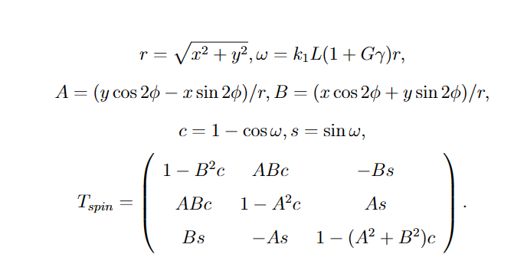
The intrinsic coupling resonances
固有耦合共振是由四极铁倾斜导致的退极化共振
$$\frac{d\overset{⃑}{s}}{dt}=\frac{e}{γm}\overset{⃑}{s}×\left[\left(1+Gγ\right){\overset{⃑}{B}}_{⊥}+\left(1+G\right){\overset{⃑}{B}}_{∥}\right]$$
$${\left(\begin{matrix}s_{1} \\ s_{2} \\ s_{3}\end{matrix}\right)}_{i}$$
$${\left(\begin{matrix}s_{1} \\ s_{2} \\ s_{3}\end{matrix}\right)}_{f}$$
磁铁倾斜对自旋传输的影响可以分为：
对横向运动(闭轨)的影响(非理想共振)√
对自旋传输矩阵形式的影响。
$$\overset{⃑}{B}\left(x,y,s\right)$$
四极铁绕s轴旋转φ角后的磁场：
自旋传输矩阵的形式相应的变化为：

Slide 4
The non-linear resonances
非线性共振是由二四极铁的高阶场引起的退极化共振
高阶场对横向运动的影响：SixTrack
高阶场对应的自旋传输矩阵：
高阶场的大小来源于磁铁样机的测磁数据

Slide 5
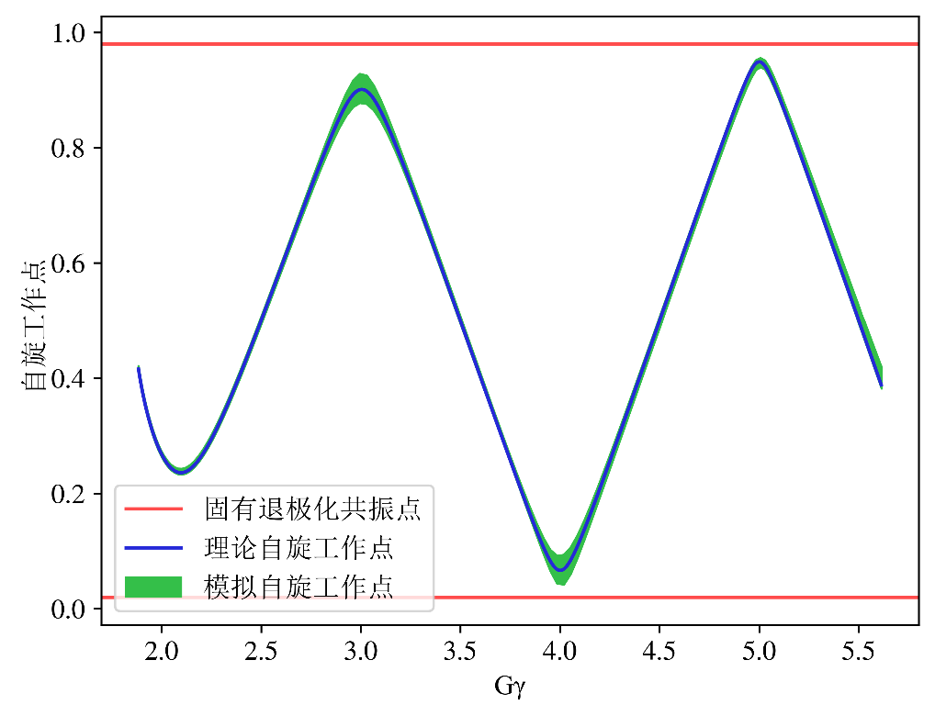
The snake resonances
西伯利亚蛇共振是由西伯利亚蛇本身引入的退极化共振
共振条件：
$$v_{spin}=k±lv_{y}$$
$max(v_{spin})$: 0.958
其中， $k$和$l$($l$>1)是整数， $v_{y}$=9.98
$$l$$ | snake共振点
2 | 0.04,0.96
3 | 0.06,0.94
4 | 0.08,0.92
$min(v_{spin})$: 0.038
极化束在20%强度snake下穿越了一次二阶snake共振，极化率92%（25%强度，极化率97%）。
二阶snake共振

Slide 6
其他退极化共振对极化加速方案的影响
退极化共振 | 固有耦合退极化共振 | 高阶退极化共振 | 西伯利亚蛇共振
程序模拟/分析 | $$A=\left(y\cos{2φ}−x\sin{2φ}\right)/r$$ B$=\left(x\cos{2φ}+y\sin{2φ}\right)/r$ $$ωδs=\left(1+Gγ\right)k_{1}L_{1}r$$ | $$A=2xy/r^{2}$$ $$B=\left(x^{2}−y^{2}\right)/r^{2}$$ $ωδs=\frac{1}{2}\left(1+Gγ\right)k_{2}L_{2}r^{2}$； $$A=\left(3x^{2}y−y^{3}\right)/r^{3}$$ $$B=\left(x^{3}−3xy^{2}\right)/r^{3}$$ $$ωδs=\frac{1}{6}\left(1+Gγ\right)k_{3}L_{3}r^{3}$$ | $v_{spin}=k±lv_{y}$， 自旋工作点间隙 $$\left[0\right.,\left.0.038\right)∪\left(0.958\right.,\left.1\right]$$ $v_{y}$=9.98穿越了2阶西伯利亚蛇共振
 | $$r=\sqrt{x^{2}+y^{2}}$$ $$c_{n}=1−\cos{ωδs},s_{n}=\sin{ωδs}$$ $$\left[\begin{matrix}1−B^{2}c_{n} & ABc_{n} & −Bc_{n} \\ ABc_{n} & 1−A^{2}c_{n} & As_{n} \\ Bs_{n} & −As_{n} & 1−\left(A^{2}+B^{2}\right)c_{n}\end{matrix}\right]$$
对方案最终极化率的影响 | 小于0.1% | 约1% | 影响 已在方案内
其他退极化共振对极化加速方案的影响基本可以忽略（＜测量精度）

Slide 7
总结
固有耦合共振与非线性共振可以添加到多粒子自旋追踪模拟程序中得出这些共振对极化维持方案的影响。
固有耦合共振与非线性共振对极化率的影响基本可以忽略，符合预期。西伯利亚蛇共振不影响极化损失(＜10%)目标的实现。
作为线性退极化共振（固有共振与非理性共振）的补充，以上退极化共振的影响添加到了文章中。

Slide 8
谢谢！

