Slide 1
TaichuPix3 testbeam in TB21 at DESY
CEPC vertex group
wuty@ihep.ac.cn

Slide 2
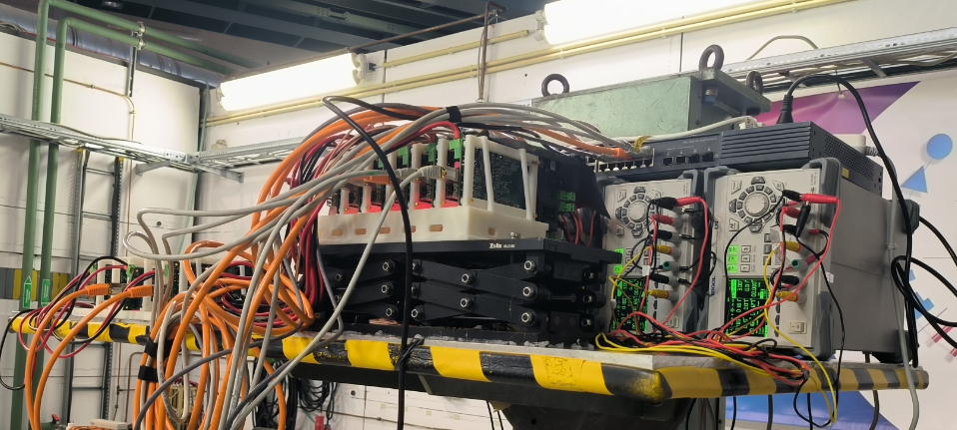
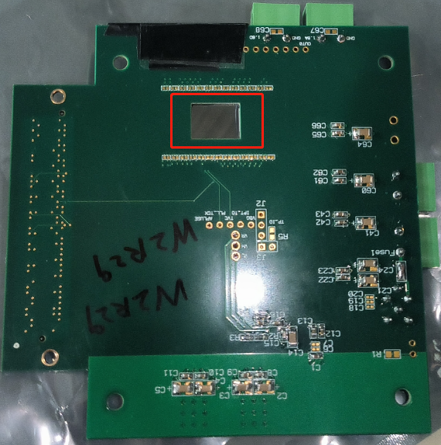
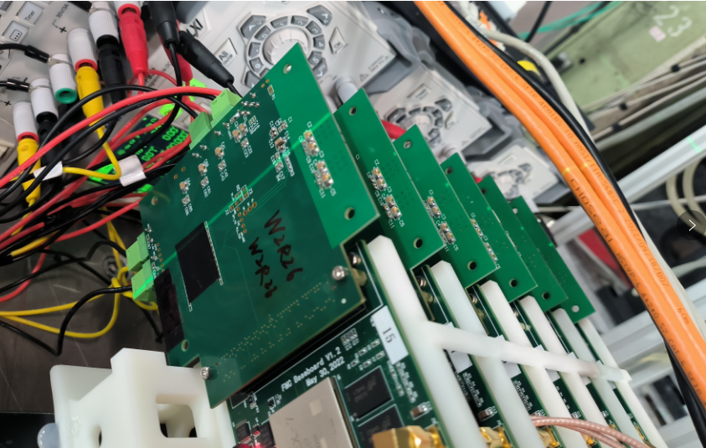
Setup of TCPX3
Board6
Board3
Board2
Board5
Board1
Board4
A open window in backside of PCB with a size of 12mm x 9mm
15.9 mm
25.7 mm
TCPX3

Slide 3
Overview of testbeam
Dec.12-Dec. 17:(SETUP 1)
1-6: w2r3, w2r11, w2r12, w2r10, w2r29, w2r26
Dec. 17:(SETUP 2)
1-6: w2r3, w9r3, w9R4， w9R6, w2r29, w2r12
Dec. 18-Dec.19(SETUP 3)
1-6: w2r3, w9r5, w9R4, w9R6, w2r29, w2r12
Dec. 20- Dec.22(SETUP 4)
1-6: w2r3, w9r5, w2R11, w9R6, w2r29, w2r12
The beam energy was tested from 3GeV 4GeV 5GeV 5.4GeV 6GeV
W9R3 had a higher noisy pixels and replaced with W9R5
W9R4 was easy to lose analog current and replaced with W2R11

Slide 4
Threshold scan
With SETUP 4.（ w2r3, w9r5, w2R11, w9R6, w2r29, w2r12)
Scan ITHR of board 5（W2R29）with10 16 24 32 48 64 96; 4GeV ;30min for each run; keep the rest of boards unchanged
Scan ITHR of board 2（W9R5）with16 24 32 48 64 96; 4GeV ;30min for each run;keep the rest of boards unchanged
W9R5: the spitial resolution is 5.45 at ITHR16 when chi2 is 8
W2R29: the resolution goes to 6.05 at ITHR10 when chi2 is 8
Chip | VBG[V] | ITHR16 Threshold[V] | ITHR32 Threshold[V] | ITHR64 Threshold[V] | ITHR96 Threshold[V] | ITHR16 mask pixels | ITHR32 mask pixels
W2R29 | 0.740 | 0.2654 | 0.3345 | 0.4468 | 0.5452 | 82 | 1
W9R5 | 0.737 | 0.1596 | 0.1983 | 0.2683 | 0.3113 | 26 | 4

Slide 5
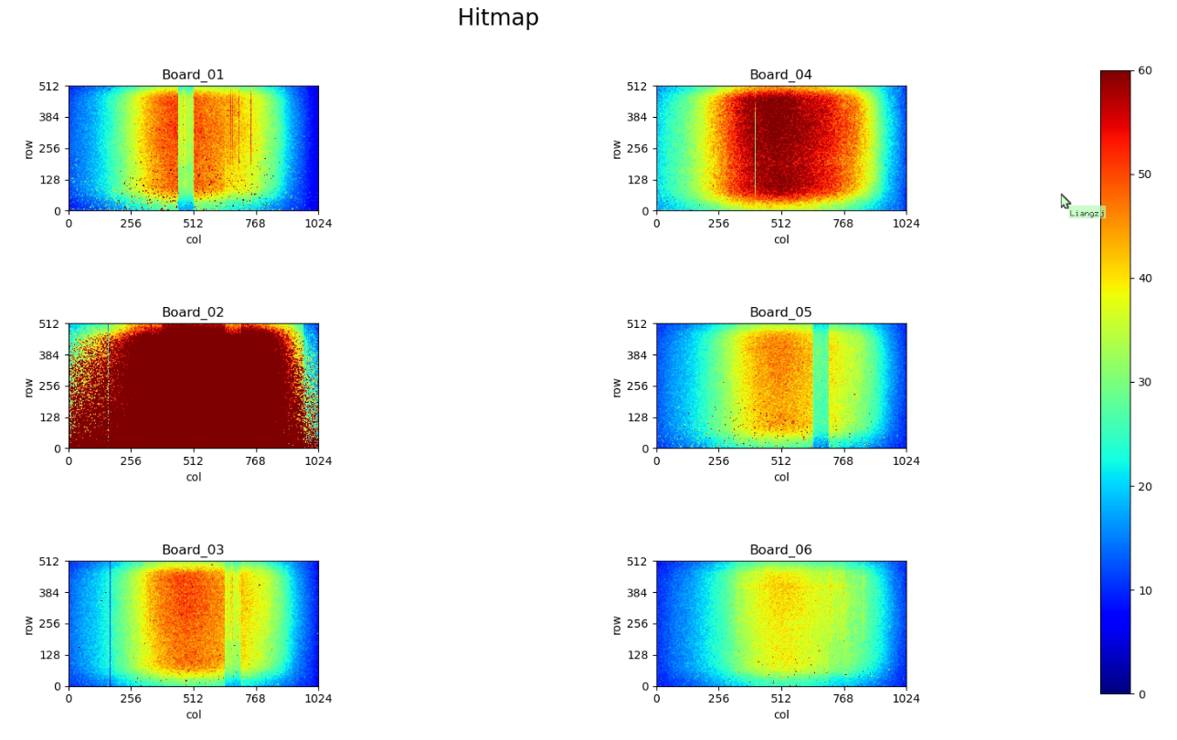
Data lost
for 4GeV, high data rate, it is easy to lose data in 22 min
For 5GeV, lower data rate, it is easy to lose data in 90 min at the end of the day.

Slide 6
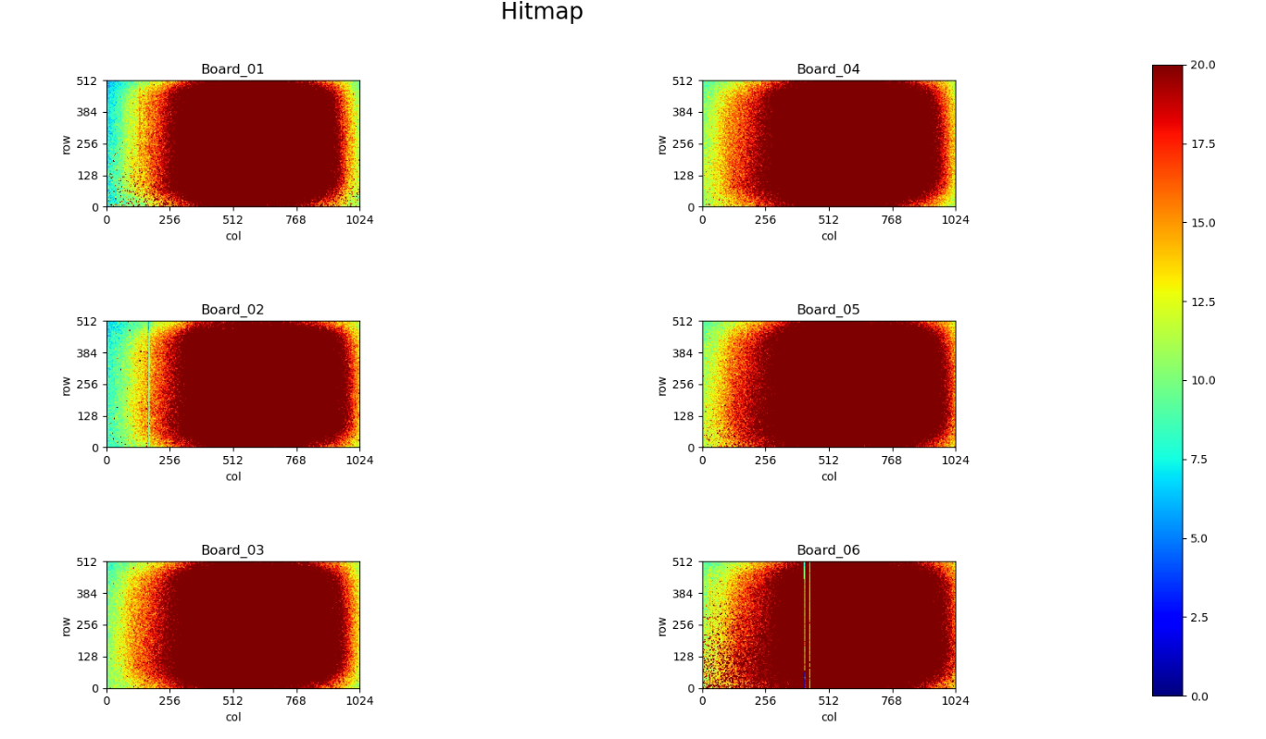
Hitmap of 3 GeV beam
6 layers of hit map are fine .

Slide 7
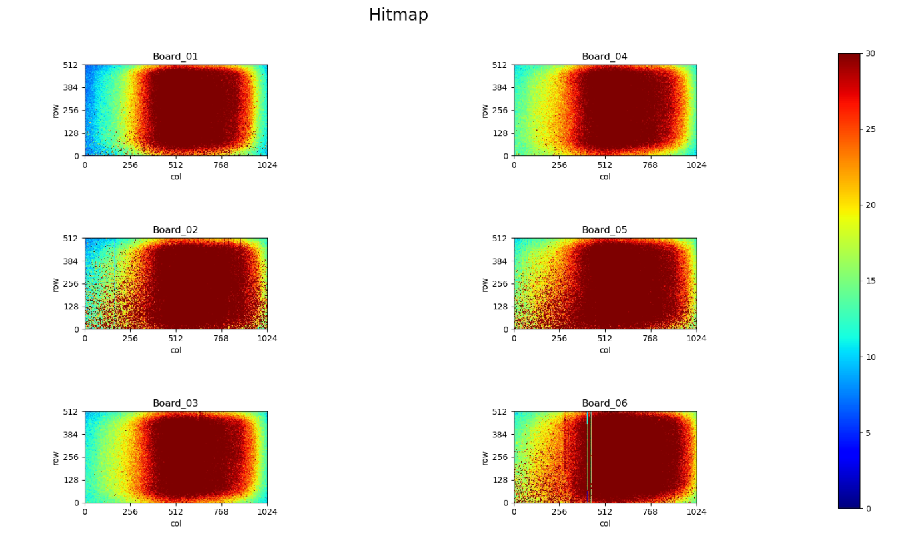
Hitmap of 4 GeV beam
6 layers of hit map are fine .

Slide 8
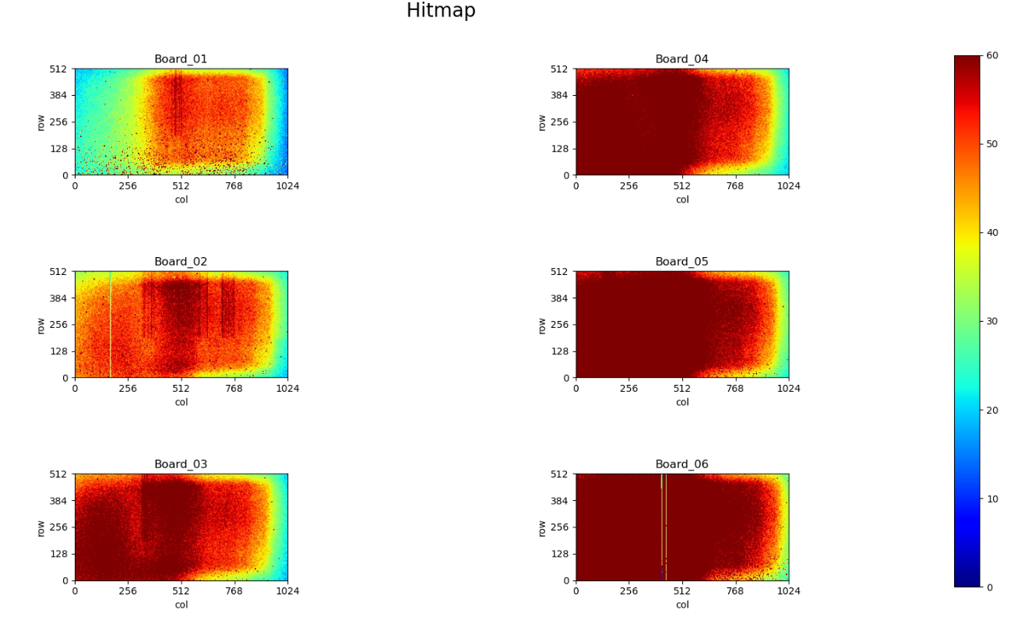
Hitmap of 5 GeV beam
The hitmap are quite different, and with wired strips

Slide 9
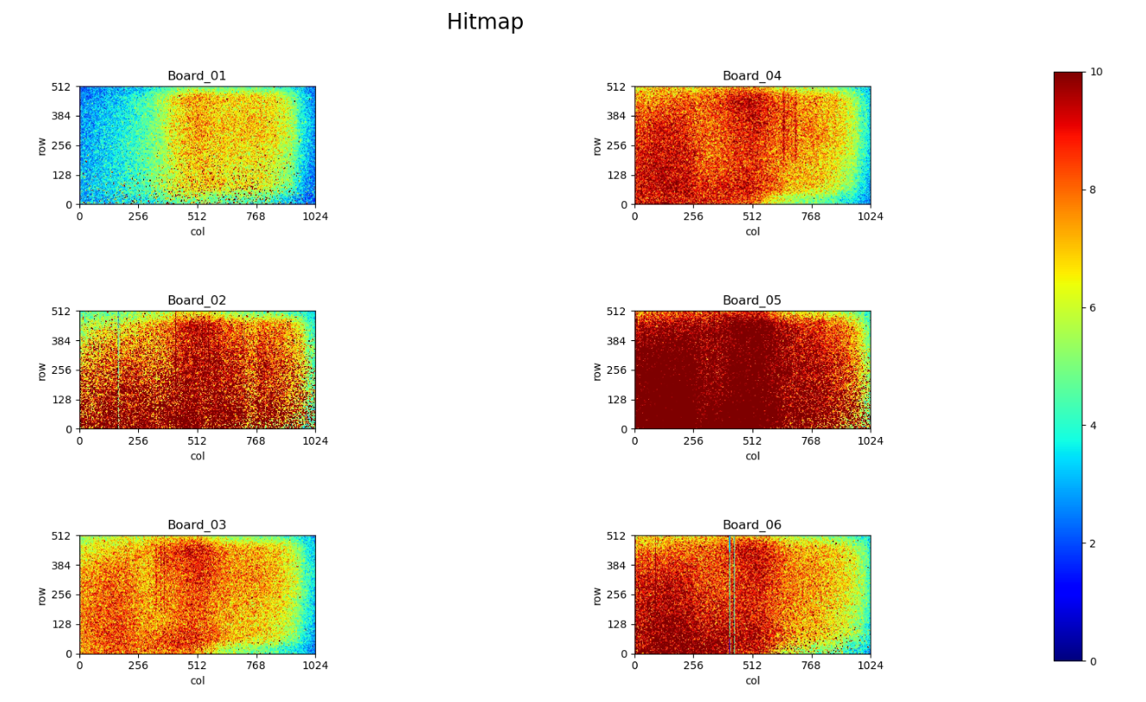
Hitmap of 5.4 GeV beam
The hitmap are the same as 5GeV, the backside boards records more hits.(Boards 2 &5 are set with lower threshold than the rest)

Slide 10
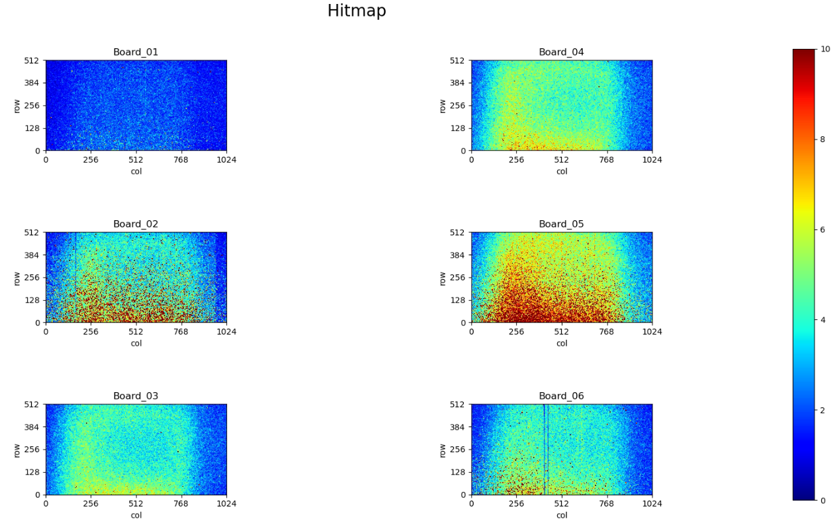
Hitmap of 6 GeV beam
From the hitmap, the position of beam spot is off to the initial one. west-east direction moves from 1.8 to -4.3.

