Slide 1
Requirements and optimization of the CEPC SC quadrupoles design
Yiwei Wang, Yingshun Zhu, Minxian Li, Haoyu Shi, Sha Bai
CEPC day, Jan 18, 2023, IHEP

Slide 2
Outline
Requirements
Status of design
Further work and optimizations

Slide 3
Requirements of the CEPC SC quadrupoles
Beam dynamics
gradient, length, field error, alignment, stability…
Machine detector interface
backgrounds, heating…

Slide 4
Requirements of the CEPC SC quadrupoles
To greatly squeeze the beam for high luminosity, compact high gradient final focus quadrupole magnets are required on both sides of IP points.
TDR requirements of CEPC Final Focus quadrupoles are based on L* of 1.9 m, beam crossing angle of 33 mrad.
TDR requirements of Interaction Region quadrupole magnets for Higgs
Magnet | Central field gradient (T/m) | Magnetic length (m) | Width of GFR (mm) | Outer diameter of beam pipe (mm) | Dipole field | Minimal distance between two aperture beam lines (mm) | high order field harmonics
Q1a | 142.3 | 1.21 | 14.92 | 26 or 28 | <30 Gs | 62.71 | <5×10⁻⁴
Q1b | 85.4 | 1.21 | 18.17 | 31 | <30 Gs | 105.28 | <5×10⁻⁴
Q2 | 96.7 | 1.5 | 24.48 | 40 | <30 Gs | 155.11 | <5×10⁻⁴
w/o dipole correctors

Slide 5
Design of Q1a
Minimal distance between two aperture beam lines: 62.71 mm
Outer radius of beam pipe: 13 or 14 mm
Leaving space for helium vessel, quadrupole coil radius: 20 mm
It is challenging to meet stringent design requirement
High field gradient: 142.3 T/m
Magnetic field crosstalk between two apertures:
Dipole field <30 Gs, high order field harmonics <5×10⁻⁴
Limited radial space in the magnet middle:
R: [20mm, 31.36mm], only 11.36mm available

Slide 6
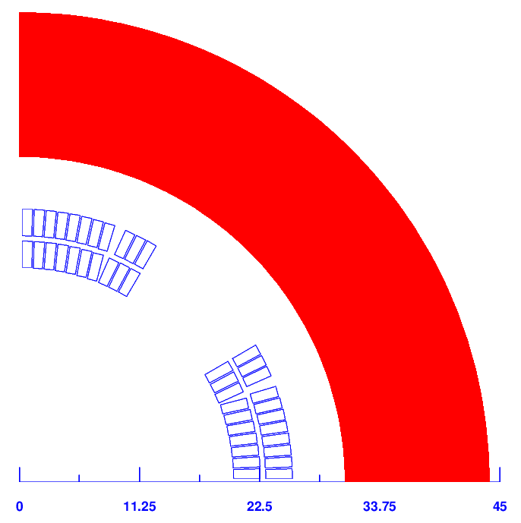
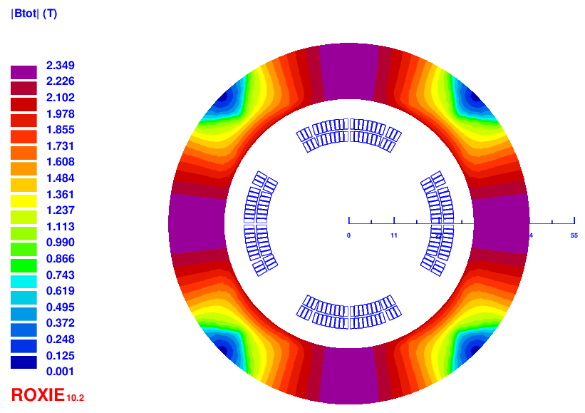
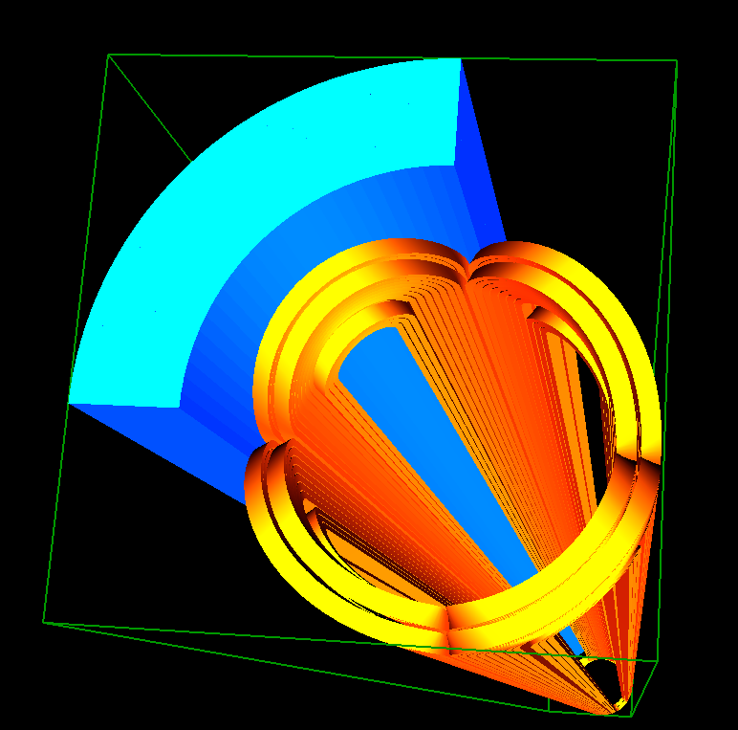
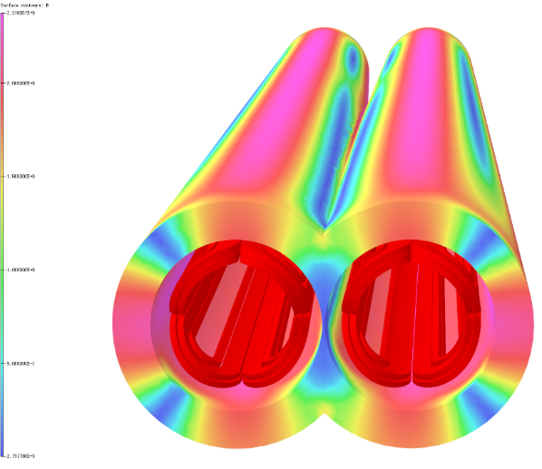
Q1a design with iron
The field harmonics as a result of field crosstalk is smaller than 1×10⁻⁴.
Dipole field at aperture center is smaller than 20 Gs. Compared with iron-free design, the excitation current is reduced to 2020A @4.2K.
Double aperture cos2θ quadrupole with iron yoke shared by two apertures, with crossing angle 33mrad.
The design of Q1a meet the requirements with quadrupole stay alone.

Slide 7
Status of the SC quadrupole design
For CEPC superconducting quadrupole magnets, it is challenging to meet stringent design requirements, including limited space, magnetic field crosstalk between two apertures, field gradients up to 142T/m.
All the design requirements are met with quadrupole stay alone.
Three design options have been studied for Q1a using high luminosity parameters with L*=1.9m: Cos2θ coil, CCT coil, Serpentine coil.
Cos2θ coil has higher magnetic efficiency, lower current and low coil peak field.
Cos2θ coil as baseline design, CCT and Serpentine coil as alternative design.
Study and research on key technologies of 0.5m single aperture quadrupole model (136T/m, NbTi) is in progress; Its manufacture is completed, and cryogenic test at 4.2K in vertical Dewar is in preparation.

Slide 8
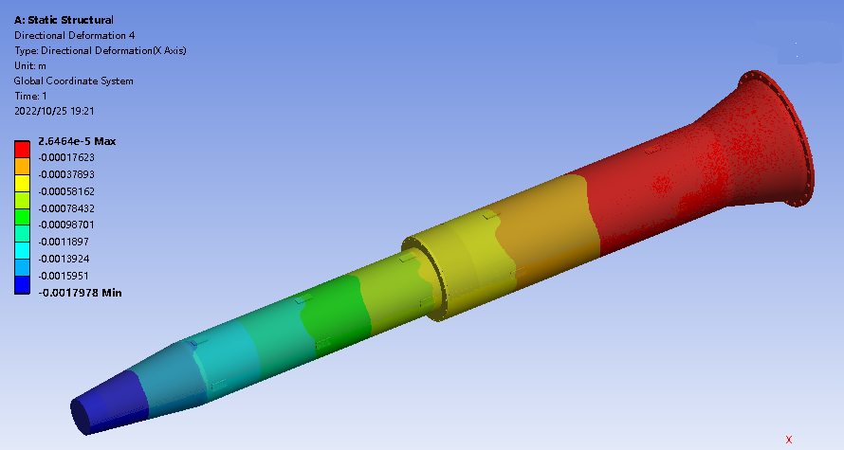
Deformation of the cryostat
Due to the gravity and Lorentz force with detector solenoid operation
Max deformation of the cryostat on y ~2mm.
The magnets will be pre-aligned with compensation of the absolute displacement.
Magnet support | Max. displacement of cryostat (mm)
 | Horizontal | Vertical
TDR s-o support | 0.08 | 1.79
Fz1
Fz2
Fz3
Max deformation on y ~2mm
G

Slide 9
Deformation of the magnets
The magnets will be pre-aligned with compensation of the absolute displacement.
The deformation of Q1A, Q1B and Q2 is much less than the alignment requirement 100um from beam dynamics simulation at room temperature. (need to check deformation of the magnets at SC temperature)
Q1a
Q1b
Magnet support | uneven deformation in Q1a (um) |  | uneven deformation in Q1b (um) |  | uneven deformation in Q2 (um)
 | Horizontal | Vertical | Horizontal | Vertical | Horizontal | Vertical
TDR s-o support | 1.2 | 5 | 3.5 | 15 | 4 | 14

Slide 10
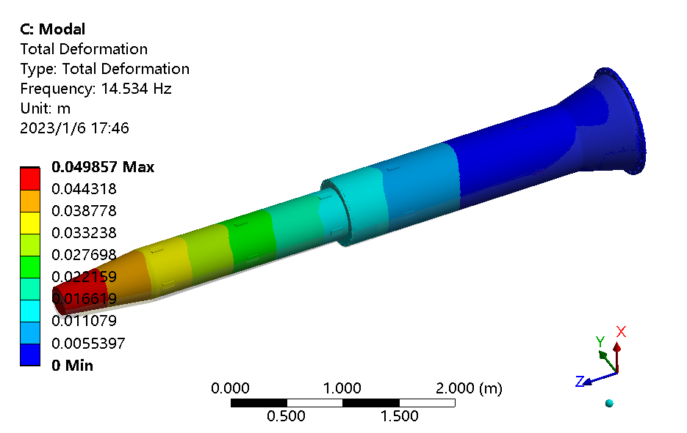
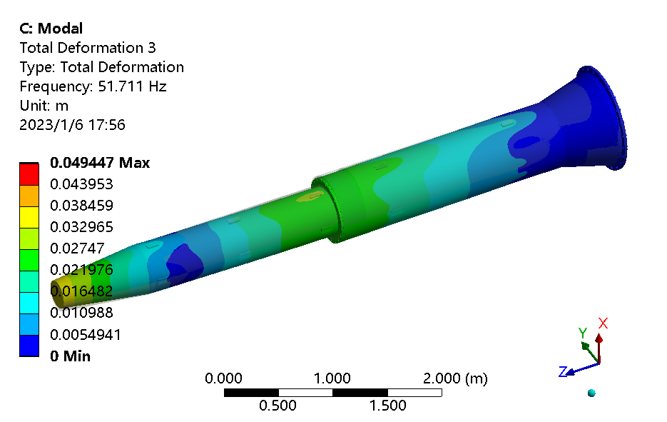
Stability of the magnet position
Modal analysis
The 1st natural frequency is14.5 Hz, integral vertical sway.
No. of order | Frequency (Hz) | Mode
1 | 14.5 | Integral vertical sway
2 | 14.9 | Integral horizontal sway
3 | 51.7 | Integral vertical wave
4 | 53.7 | Integral horizontal wave
5 | 89.7 | Vertical wave of helium vessel
6 | 91.4 | Horizon wave of helium vessel
The 1st mode of cryostat
The 3rd mode of cryostat

Slide 11
Beam background of the dipole field in Q1a (estimation)
Q1a starts at -3.11m.
If the dipole exists, the particles would be bended from here, some SR photons would be generated.
If a photon generated here could hit the beam pipe at point A, all the photons generated closer to IP must hit the beam pipe after A.
Only considered the bending angle, no opening angle.
Only considered the SR photons, no secondaries.
Only considered the backgrounds, no deposited power (heating)
Let’s assume the dipole = 500Gs.
The bending radius should be 2400m.
The radius at IP(from Q1a to Q1a) is 10mm, 0.01m.
Therefore, a photon generated at -3.11m could hit the beam pipe at 6.92m from the generation point, which is 3.81m downstream of the IP, somewhere in Q1b. Consider that the radius of the pipe in Q1b is larger than in Q1a, it should be a little bit further.
Q1a
Q1a
IP
Let’s assume the dipole = 5Gs.
The bending radius should be 240000m, larger than the bending radius of the beam(which is ~10000m). Then the SR photons could hit the beam pipe at the first bending magnet downstream, which is ~100m from the IP.
Beam background: It would be considered as safe if the SR photons could not hit the central beam pipe(-1.11m~1.11m).
Which means if the dipole components in Q1a smaller than 1347Gs.
Heating: The requirement should be much stricter.
With dipole correctors, the integrated field of the dipole filed can be corrected and the its effect on beam dynamics will not be an issue.

Slide 12
Further work and optimization
Background and heating of the synchrotron radiation from all kinds of IR magnets including the solenoid
Deformation of the magnets at SC temperature
Install correctors
With dipole correctors, the integrated field of the dipole filed can be corrected and the its effect on beam dynamics will not be an issue.
If the requirement of heating at dipole field much larger than 30gs, the iron yoke could be removed or thinner?
Optimization of the quadrupole parameters aiming an even smaller betay*
Length, gradient, distance of the quads, different pieces

Slide 13
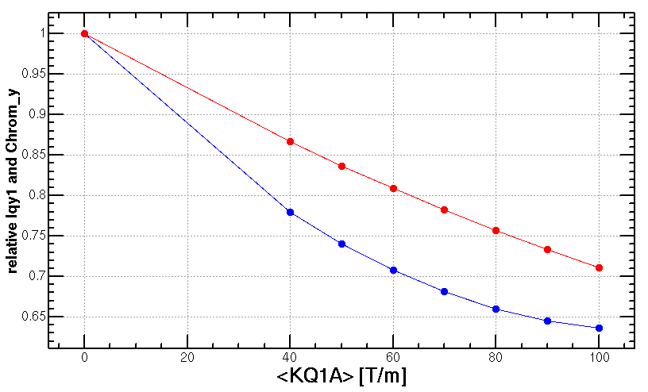
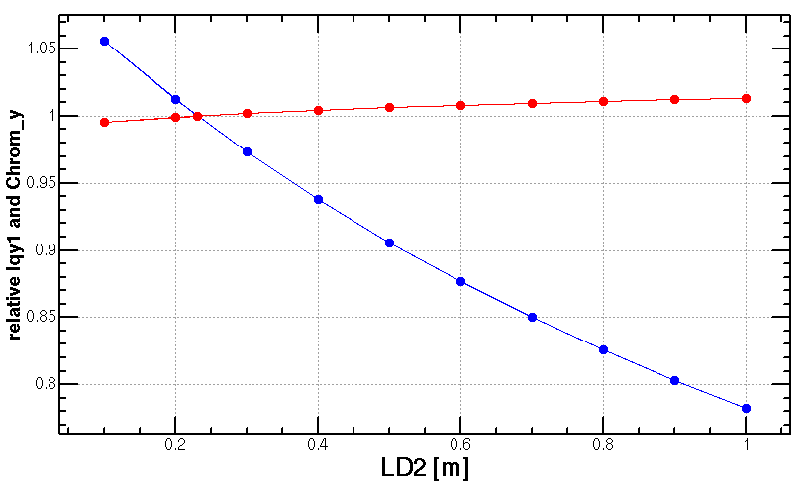
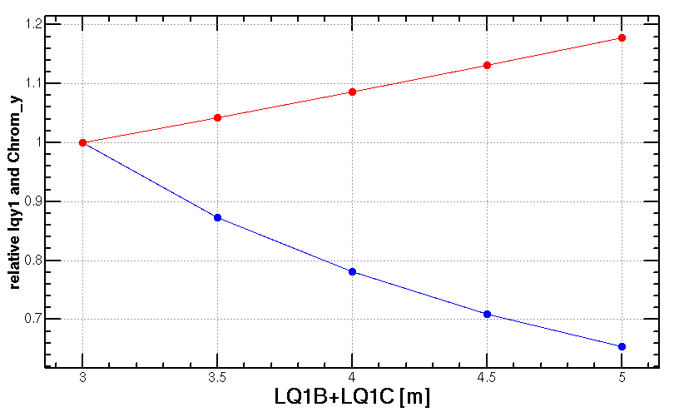
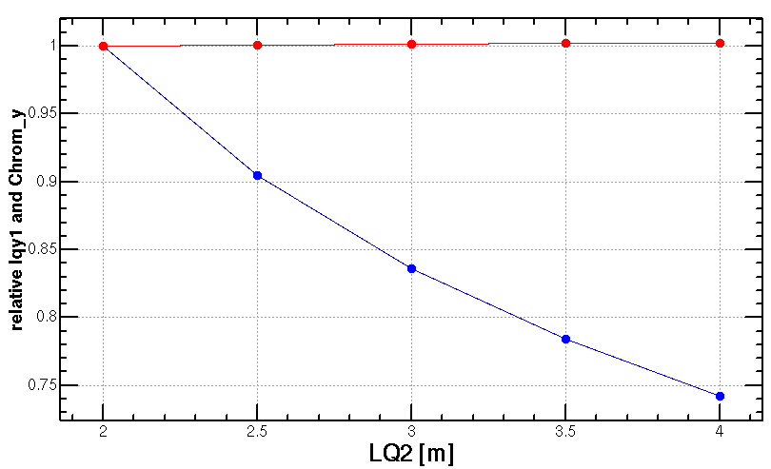
Optimization of SC quadrupole parameters
Add weak quadrupole coils
Distance of Q1 and Q2
Radiation power y
Chromaticity y
length of Q1
length of Q2
Yiwei Wang, IAS2020
LQ1A +LQ1B [m]

Slide 14
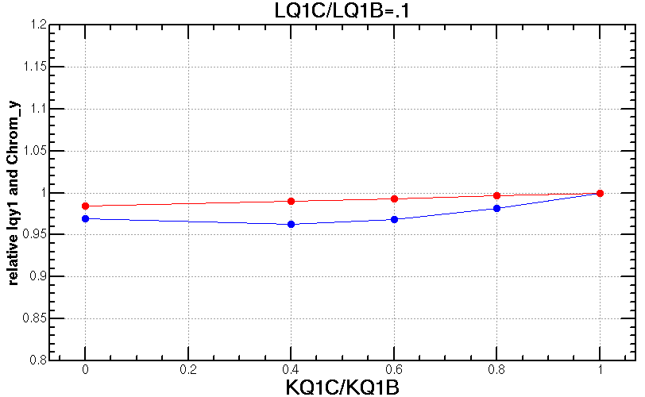
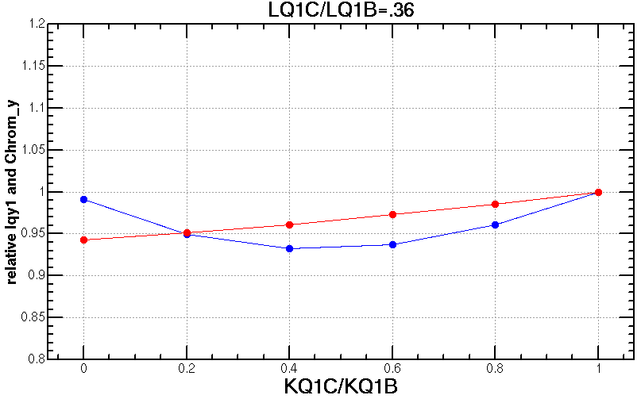
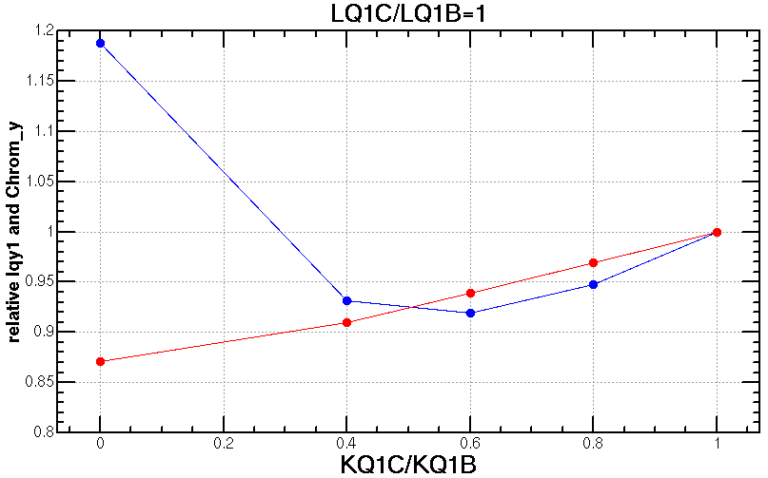
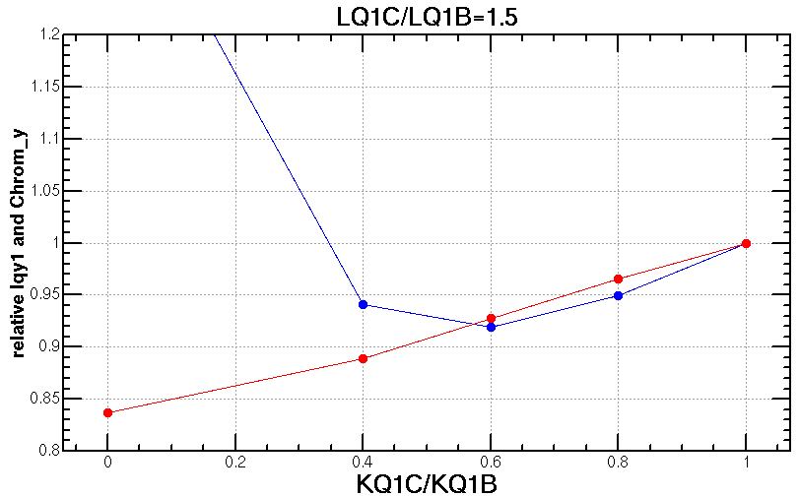
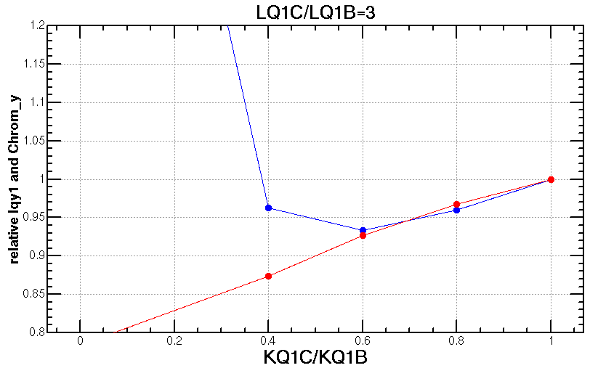
Optimization of SC quadrupole parameters
Different strength ratio of Q1A and Q1B with different length ratio of Q1A and Q1B when keep total length of Q1A+Q1B
Yiwei Wang, IAS2020
LQ1B/LQ1A=0.1
LQ1B/LQ1A=0.36
LQ1B/LQ1A=1
Radiation power y
Chromaticity y
KQ1B/KQ1A
KQ1B/KQ1A
KQ1B/KQ1A
LQ1B/LQ1A=1.5
LQ1B/LQ1A=3
Minimum of radiation power occurs at KQ1B/KQ1A≈0.6
Different length of Q1A and Q1B doesn’t affect much on the minimum of the power
Provide more freedom of the FD technical design
Shorter and stronger Q1A help on the DA.
KQ1B/KQ1A
KQ1B/KQ1A

Slide 15
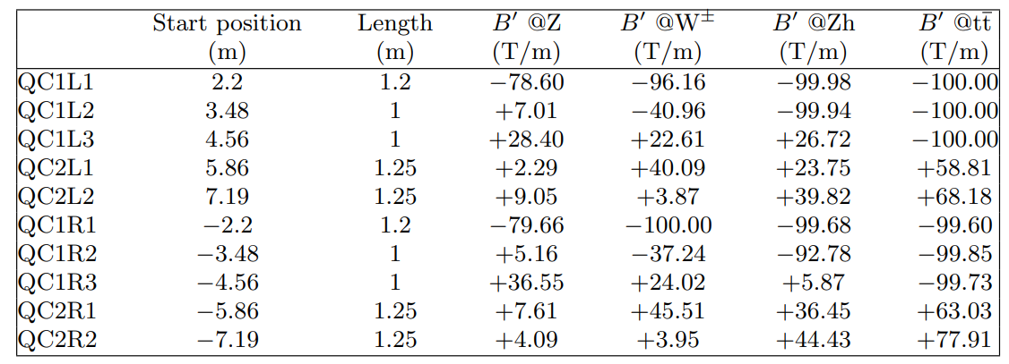
SC quadrupole parameters of FCC-ee and CEPC
Free length to IP L∗ (m) 2.2
Solenoid field at IP (T) 2.0
Full crossing angle at IP θ (mrad) 30
Quadrupoles | Distance from IP [m] | L [m] | Strength [T/m]
 |  |  | Z | W | Higgs | ttbar
Q1AIRU | 1.9 | 1.21 | -110 | -94 | -141 | -141
Q1BIRU | 3.19 | 1.21 | +65 | -56 | -85 | -59
Q2IRU | 4.7 | 1.5 | 0 | +63 | +95 | -51
Q3IRU | 7.2 | 3 | +2 | 0 | 0 | +40
Q1AIRD | -1.9 | 1.21 | -110 | -95 | -142 | -142
Q1BIRD | -3.19 | 1.21 | +65 | -57 | -85 | -64
Q2IRD | -4.7 | 1.5 | 0 | +64 | +96 | -47
Q3IRD | -7.2 | 3 | +2 | 0 | 0 | +40
Free length to IP L∗ (m) 1.9
Solenoid field at IP (T) 3.0(ttbar/higgs/W) 2.0(Z)
Full crossing angle at IP θ (mrad) 33

Slide 16
Summary
The design requirements are met with quadrupole stay alone.
The deformation of Q1A, Q1B and Q2 due to the gravity and Lorentz force with detector solenoid operation, is much less than the alignment requirement 100um from beam dynamics simulation.
Further work and optimization
Background considered the SR photons secondaries.
Deposited power of from all kinds of IR magnets
Deformation of the magnets at SC temperature
Gradient and length aiming an even smaller betay*

Slide 17
backup

Slide 18
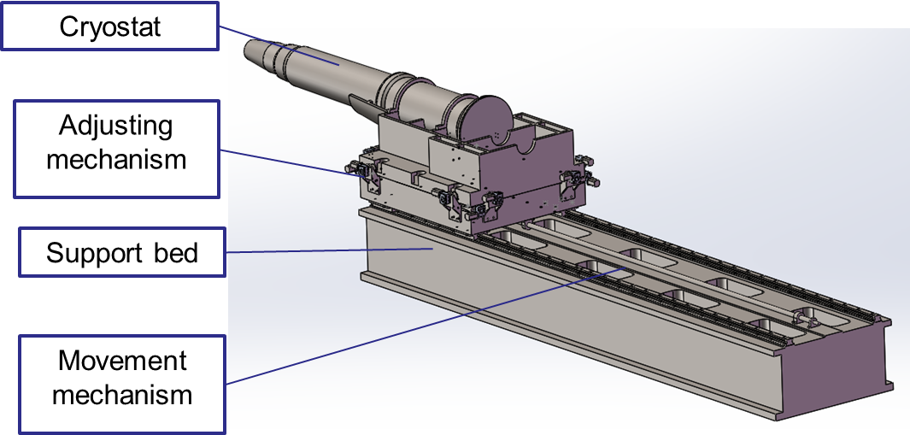
SC magnet support system
The superconducting quadruples for TDR are longer, and the structure of cryostat and SCQ has been updated.
The cryostat is about 5.6m long. The cantilever length is 5283mm.
SC quadruples become 3 parts:Q1a,Q1b,Q2.
Thermal shield
Helium vessel
Q2
Vacuum vessel
Q1b
Q1a
Anti-solenoid
Support rods

Slide 19
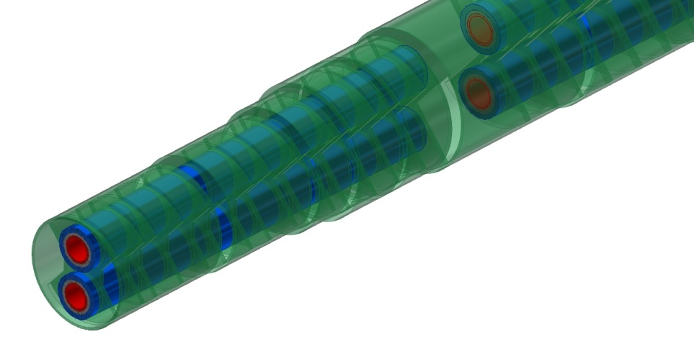
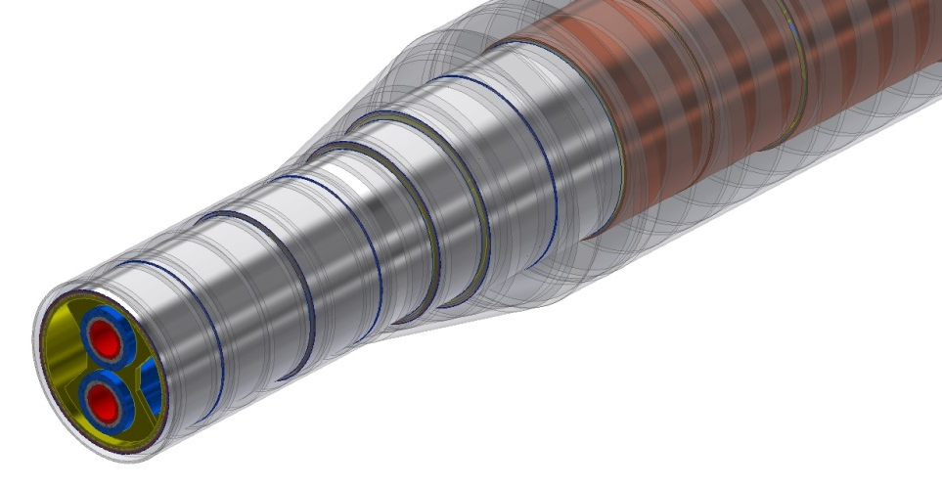
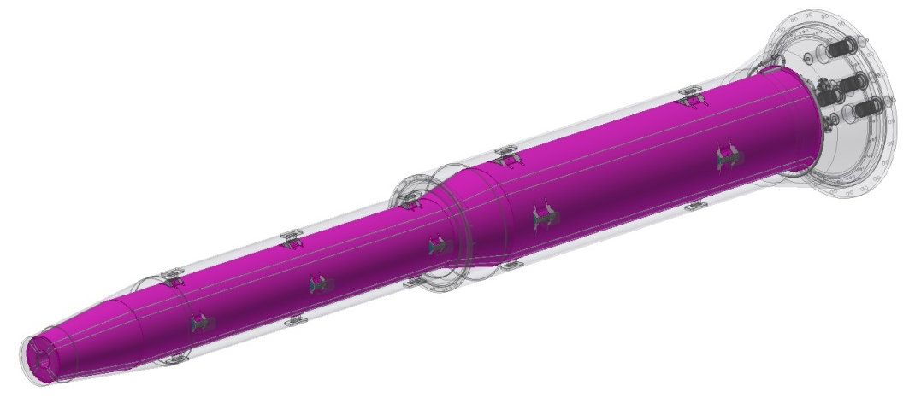
SC magnet support system
Magnets to helium vessels
Skeleton with outer ring support can minimize weight and reducing deformation.
Helium vessel to vacuum vessel
Support blocks, 60mm x 20mm.
Aim: minimize the SC magnets deformation, enhance stability.
Sketch of skeleton support
Models | materials
Q1a/Q1b/Q2 | Nb-Ti alloy+ SS + FeCoV
Anti-solenoid | SS + Cu + AL
Vessels | SS
Magnet supports | SS
Vacuum chamber | SS
Sketch of support blocks

