Slide 1
  Magnet Power Supply System Design
  for CEPC TDR
  Bin Chen ( On Behalf of Power Supply Group )
  CEPC Day ( January 18th , 2023 )

Slide 2
Content
  Magnet power supply system design for CEPC ( TDR )
  Power supply R&D
  Summary

Slide 3
Magnet power supply system design for CEPC ( TDR )
  Magnet loads of the power supplies for CEPC
    Including the Collider ring, the Booster ring, the Transport Line, the Linac and the Damping ring
    Total magnet quantity ：38159
Collider | Dipole |  | Quadrupole |  | Sextupole | Corrector | Magnet quantity
 | D-aperture | S-aperture | D-aperture | S-aperture
 | 2944 | 226 | 3008 | 1124 | 3176 | 7088 | 17566
Booster | Dipole |  | Quadrupole |  | Sextupole | Corrector
 | 14866 |  | 3458 |  | 0 | 1200 | 19524
Linac | Dipole |  | Quadrupole |  | Solenoids | Corrector
 | 15 |  | 364 |  | 37 | 275 | 691
Damping Ring | Dipole |  | Quadrupole |  | Sextupole | Corrector
 | 38 |  | 78 |  | 24 |  | 140
Transport Line | Dipole |  | Quadrupole |  | Sextupole | Corrector
 | 64 |  | 120 |  | 0 | 54 | 238
Total | 38159

Slide 4
Magnet power supply system design for CEPC ( TDR )
  Design Principles of Power Supply System
    Meet the requirement of the accelerator physics design
    Communicate with magnet system to select optimum magnet parameters, and connection modes to reduce power loss
    Switch mode power supply as the main topology, to reduce the volume, improve the efficiency, and easy to achieve digital control
    Adopt modular design to achieve high current and high voltage output
    The power supply adopts high precision and digital current closed-loop control

Slide 5
Magnet power supply system design for CEPC ( TDR )
  Basic questions for main power supplies
    Main power supplies number selection, One or more converters per sector ( for main B&Q magnet in Collider and Booster）?
    The power supply output voltage rating is limited to 1kV
    Main power supplies location?
    Converters on surface
    Reduced space requirements in tunnel
    Easier and more efficient maintenance
    Higher cost & transmission losses on low voltage line
    Converters in auxiliary tunnel
    More space requirements in tunnel
    More difficult maintenance and longer access
    Lower cable cost and losses

Slide 6
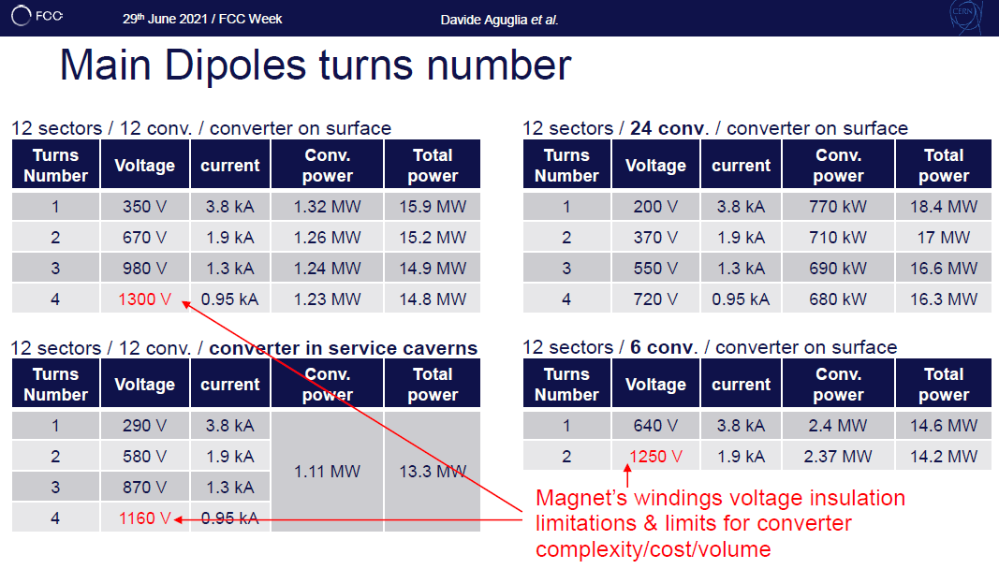
Magnet power supply system design for CEPC ( TDR )
  Basic questions for main power supplies
    Main magnets turns number?
    This choice greatly influences magnet & power supplies designs
    The loss can be reduced by decreasing the magnet excitation current

Slide 7
Magnet power supply system design for CEPC ( TDR )
  Requirement of the power supplies for CEPC
    Total power supply quantity ：13574
Collider | Quantity | Stability /8hours | Output Rating
D-aperture Dipole | 16 | 100ppm | 1300A/500V
S-aperture Dipole | 54 | 100ppm | 150A
D-aperture Quadrupole | 160 | 100ppm | 120A/850V
S-aperture Quadrupole | 608 | 100ppm | 150A
Sextupole | 3180 | 100ppm | 150A
Corrector-H | 7088 | 500ppm | 20A/20V
Total | 11106
Transport Lin | Quantity | Stability /8hours | Output Rating
Dipole1 | 64 | 500ppm | 340A
Quadrupole | 120 | 500ppm | 20A
Corrector | 54 | 500ppm | 25A
Total | 238
Linac | Quantity | Stability /8hours | Output Rating
Dipole | 8 | 500ppm | 280A
Quadrupole | 241 | 500ppm | 180A
Solenoid | 37 | 500ppm | 12A
Corrector | 275 | 500ppm | 40A
Total | 561
Booster | Quantity | Stability/tracking | Output Rating
Dipole | 28 | 500ppm / 0.1% | 520A/890V
Quadrupole | 336 | 500ppm / 0.1% | 180A
Corrector | 1200 | 1000ppm | 25A /20V
Total | 1564
Damping ring | Quantity | Stability /8hours | Output Rating
Dipole1 | 38 | 500ppm | 240A
Quadrupole1 | 65 | 500ppm | 140A
Sextupole | 2 | 500ppm | 10A
Total | 105

Slide 8
Magnet power supply system design for CEPC ( TDR )
  Energy loss in magnets in Collider ( Comparison with FCC )
    The average loss of sextupoles is 0.44 times of the maximum value
    P-magnets = 65.88MW from Magnet System (tt-bar) (56.4MW from FCC CDR)
    P-cables = 19.74MW (tt-bar)
    P-ELmagnets = 85.62 / ηconversion / ηdistribution
    P-ELmagnets = 85.62 / 0.9 / 0.95 = 100.14MW
    The losses of the electrical distribution chain (e.g. magnetisation losses in transformers) is 5% of the power demand
FCC
Storage Ring | Z | W | H | TT
Beam Energy (GeV) | 45.6 | 80.0 | 120.0 | 182.5
Magnet current | 25% | 44% | 66% | 100%
Power ratio | 6% | 19% | 43% | 100%
Dipoles (MW) | 0.8 | 2.6 | 5.8 | 13.3
Quadrupoles (MW) | 1.4 | 4.3 | 9.8 | 22.6
Sextupoles (MW) | 1.3 | 3.9 | 8.9 | 20.5
Correctors (MW) | 0.0 | 0.0 | 0.0 | 0.0
Power cables (MW) | 1.2 | 3.8 | 8.6 | 20.0
Total magnet losses | 4.8 | 14.7 | 33.0 | 76.4
Power demand (MW) | 5.6 | 17.2 | 38.6 | 89.0
CEPC
Storage Ring | Z | W | H | TT
Beam Energy (GeV) | 45.5 | 80.0 | 120.0 | 180.0
Magnet current | 25% | 44% | 67% | 100%
Power ratio | 6% | 20% | 44% | 100%
Dipoles (MW) | 0.76 | 2.35 | 5.29 | 11.90
Quadrupoles (MW) | 2.13 | 6.58 | 14.81 | 33.31
Sextupoles (MW) | 1.28 | 3.96 | 8.91 | 20.04
Correctors (MW) | 0.04 | 0.12 | 0.28 | 0.62
Power cables (MW) | 1.26 | 3.90 | 8.77 | 19.74
Total magnet losses | 5.47 | 16.91 | 38.05 | 85.62
Power demand (MW) | 6.40 | 19.78 | 44.51 | 100.14

Slide 9
Magnet power supply system design for CEPC ( TDR )
  Energy loss in magnets in Booster ( Comparison with FCC )
    Reference：J.-P. Burnet, “Update of the Power Demand for FCC-ee,” FCC Week 2022, Paris (2022); https://indico.cern.ch/event/1064327
FCC
Booster | Z | W | H | TT
Beam Energy (GeV) | 45.6 | 80.0 | 120.0 | 182.5
Magnet current | 25% | 44% | 66% | 100%
Power ratio | 6% | 19% | 43% | 100%
Dipole (MW) | 0.80 | 2.60 | 5.80 | 13.30
Quads (MW) | 1.40 | 4.30 | 9.80 | 22.60
Sextupoles (MW) | 0.60 | 2.00 | 4.40 | 10.25
Power cables (MW) | 1.20 | 3.80 | 8.60 | 20.00
Booster duty cycle | 0.15 | 0.15 | 0.15 | 0.15
Total magnet losses | 0.60 | 1.90 | 4.30 | 9.90
Power demand (MW) | 0.70 | 2.20 | 5.00 | 12.00
CEPC
Booster | Z | W | H | TT
Beam Energy (GeV) | 45.6 | 80.0 | 120.0 | 180.0
Magnet current | 25% | 44% | 67% | 100%
Power ratio | 6% | 20% | 44% | 100%
Dipole (MW) | 0.78 | 2.41 | 5.41 | 12.18
Quads (MW) | 1.06 | 3.25 | 7.31 | 16.44
Correctors (MW) | 0.03 | 0.03 | 0.03 | 0.03
Power cables (MW) | 0.71 | 2.18 | 5.13 | 11.05
Booster duty cycle | 0.46 | 0.22 | 0.47 | 0.28
Total magnet losses | 1.19 | 1.73 | 8.40 | 11.12
Power demand (MW) | 1.39 | 2.02 | 9.83 | 13.00

Slide 10
Magnet power supply system design for CEPC ( TDR )
  Power consumption for CEPC in H mode
Location | Magnet (MW) | PS (MW) | Cable (MW) | Total (MW)
Collider | 29.28 | 4.23 | 8.77 | 42.27
Booster | 5.10 | 0.81 | 2.21 | 8.12
Transport Line | 0.84 | 0.11 | 0.11 | 1.06
Linac | 1.46 | 0.17 | 0.11 | 1.75
Damping Ring | 0.19 | 0.03 | 0.08 | 0.30
IR | 0.00 | 0.03 | 0.23 | 0.26
Total | 36.87 | 5.38 | 11.50 | 53.75

Slide 11
Magnet power supply system design for CEPC ( TDR )
  Budget in magnet power supply system in CEPC
 | CDR |  |  | TDR
 | 数量 | H总价（万元） | tt总价（万元） | 数量 | H总价（万元） | tt总价（万元） | H增量 | tt增量
储存环电源 | 9092 | 45618.00 | 73048.00 | 11106 | 43796.40 | 61782.40 | -3.99% | -15.42%
增强器电源 | 430 | 7349.00 | 12085.00 | 1564 | 7680.00 | 10700.00 | 4.50% | -11.46%
直线电源 | 325 | 1502.00 | 1502.00 | 561 | 1740.40 | 1740.40 | 15.87% | 15.87%
输运线电源 | 238 | 881.80 | 881.80 | 238 | 881.80 | 881.80 | 0.00% | 0.00%
阻尼环电源 | 105 | 313.00 | 313.00 | 105 | 313.00 | 313.00 | 0.00% | 0.00%
负载电缆 |  | 47625.28 | 47625.28 |  | 57293.52 | 57293.52 | 20.30% | 20.30%
DCCT | 9640 | 3168.00 | 3168.00 | 12000 | 3802.50 | 3802.50 | 20.03% | 20.03%
机柜 | 1570 | 942.00 | 942.00 | 1890 | 1134.00 | 1134.00 | 20.38% | 20.38%
静电-电磁分离器 | 48 | 10160.00 | 10160.00 | 32 | 8000.00 | 8000.00 | -21.26% | -21.26%
总价（亿元） |  | 11.76 | 14.97 |  | 12.46 | 14.56 | 6.02% | -2.72%

Slide 12
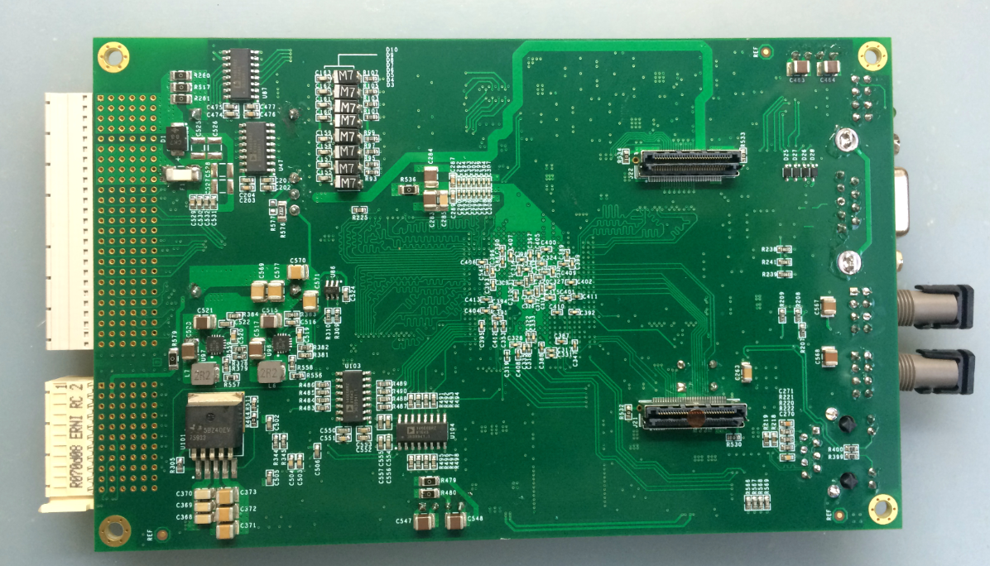
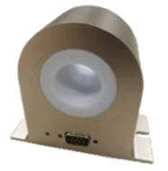
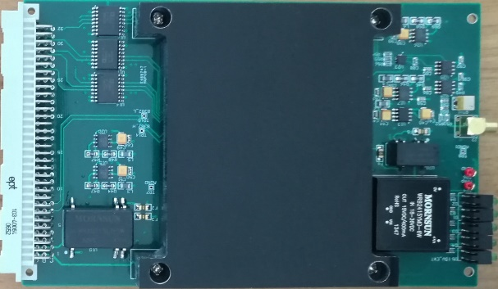
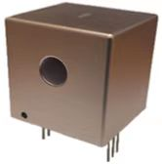
Power supply R&D
  Basic design principles for the power supplies
    Modular design for power supply; Switching mode as the main topology; digital design for all power supplies
  The digital control power supplies are split in three independent parts
    A power part acting as a voltage source or a current source, which is suitable for industrial design and production
    Current transducers （Commercial Product or Self-design)
    Self-designed digital electronics control module, which performs the current regulation, diagnostics, monitoring and local/remote service . It’s standardized for all types of power supply
Functional diagram
DPSCM- Main board and ADC board
Self-design DCCT

Slide 13
Power supply R&D
  SMPS
    Advantages :
    Loss is only during switching
    Efficiency is higher
    Attenuation of harmonics in the range of (tens of kHz)
    Filter size considerably diminishes than its LPS counterpart
    Output transformer operates at switching frequency
    Lighter ferrite core transformer
    Portability increases due to decrease in size
    Disadvantages:
    Increased complexity of control
    Increased EMI/RFI
    Expensive

Slide 14
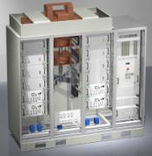
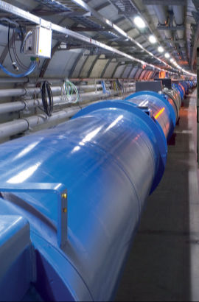
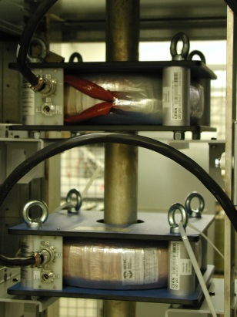
Power supply R&D
  SMPS
Digital Current loop:
promise current with high precision
Voltage loop:
ensuring low voltage ripple
I
B
Iref
Vref
+
e_{I}
Reg.
V
DAC
G(s)
-
e_{V}
F(z)
I_{measured}

Slide 15
Power supply R&D
  High power supply - topology
    Module: three-phase uncontrolled rectifier + H-bridge high-frequency inverter+high-frequency rectifier

Slide 16
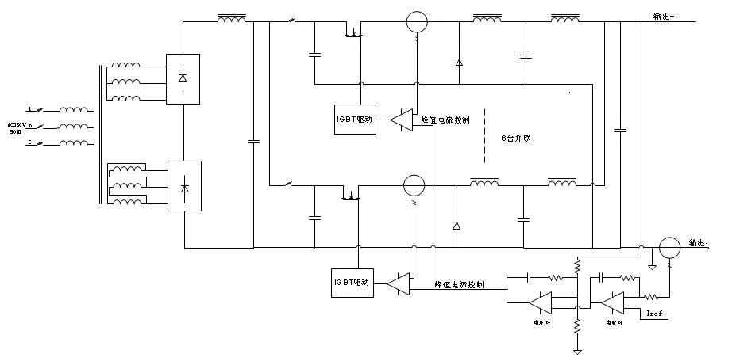
Power supply R&D
  High power supply - topology
    The front dc source of power supply consists of two 12-phase diode rectifier circuits connected in series to form an equivalent 24 - phase power rectifier circuit. In the output part of the power supply, 6 groups of BUCK circuits are used in parallel to form stable current output

Slide 17
Power supply R&D
  Medium power supply - topology
    Three-phase uncontrolled rectifier + single H-bridge inverter
    The type of the H-bridge switch tube: IGBT or MOSFET
  Medium power supply - Closed-loop control
    In order to reduce voltage ripple, it is recommended to adopt three - loop control structure
    Outer loop: digital current loop
    Middle loop: voltage loop
    Inner loop: peak current loop of primary side of high-frequency transformer
    The peak current loop is used to improve the dynamic response of power supply and restrain the fluctuation of the grid

Slide 18
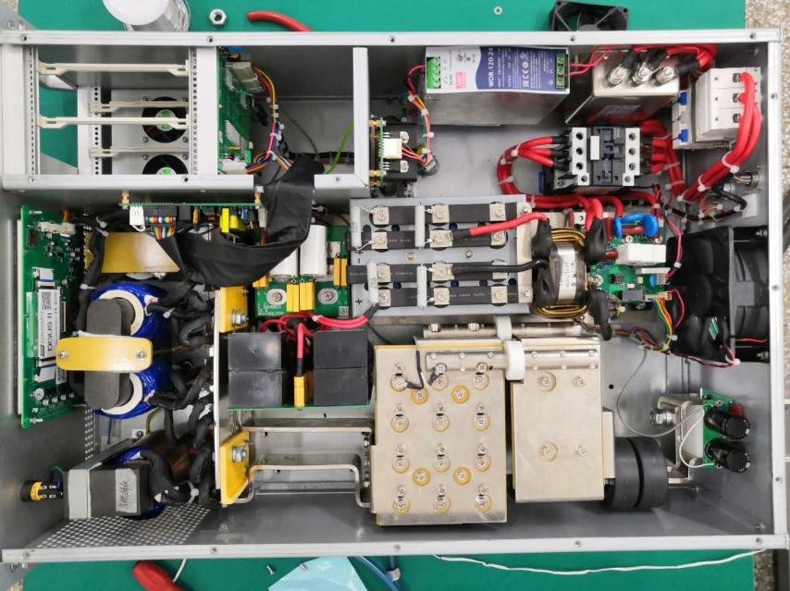
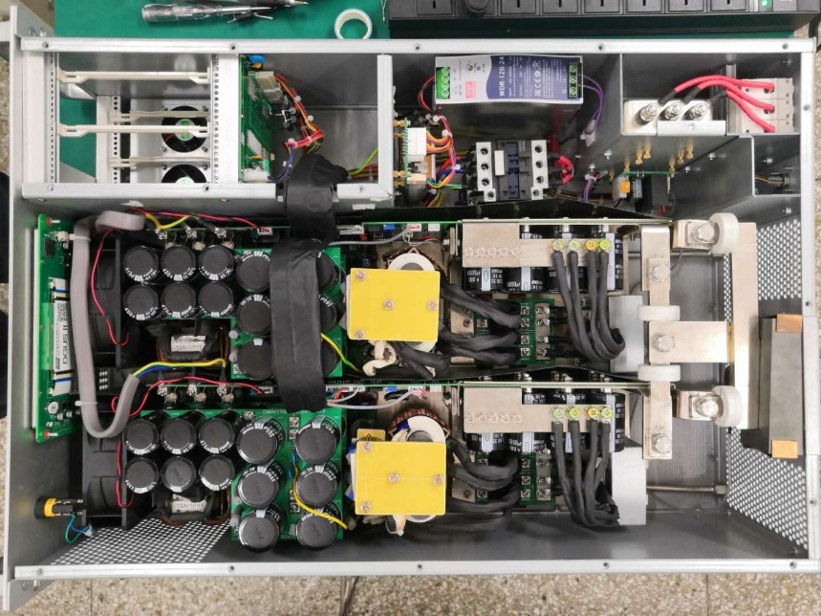
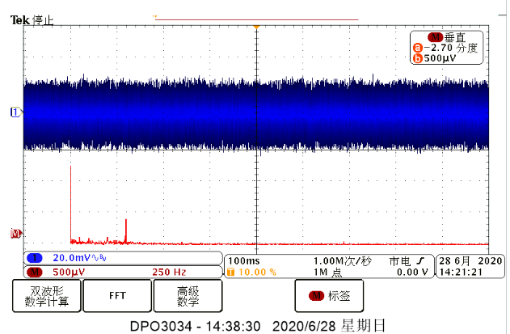
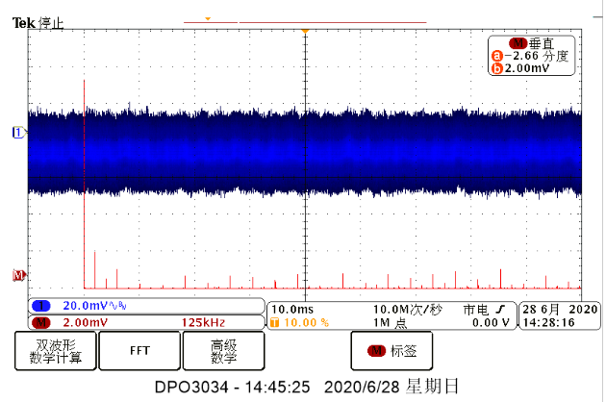
Power supply R&D
  Medium power supply - prototype
IGBT scheme
Dual-module MOSFET scheme

Slide 19
Power supply R&D
  Low power supply - topology
    Single power supply
    DC source + full bridge inverter
    bipolar power supply
    Single-phase uncontrolled rectifier + phase shift full bridge inverter

Slide 20
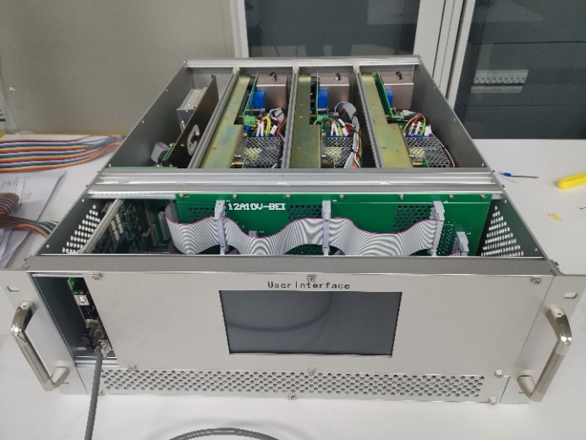
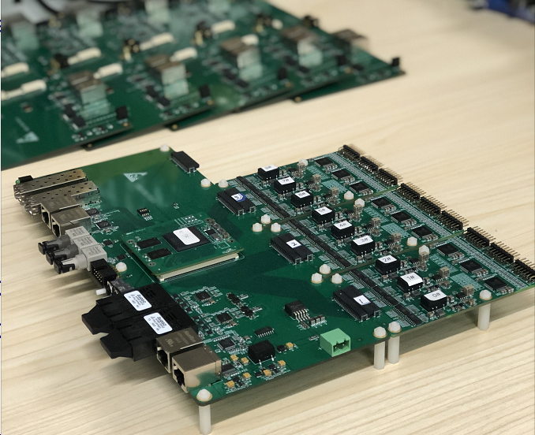
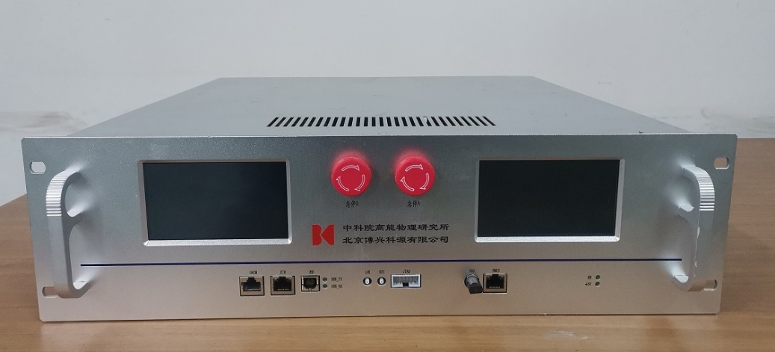
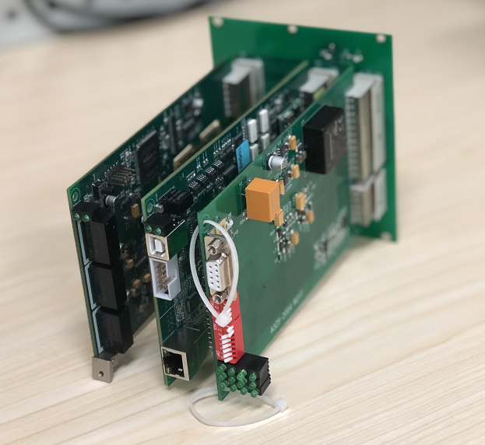
Power supply R&D
  Low power supply - topology
    Multi power supplies share one chassis;
    power supplies in one chassis share one digital controller
    cost effective with respect of chassis and digital controller, and space savings.

Slide 21
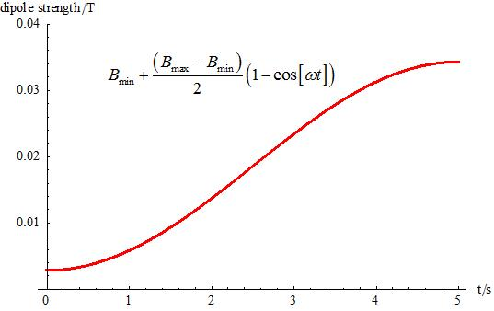
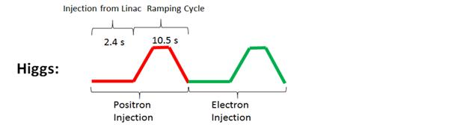
Power supply R&D
  Booster Power Supply
The magnetic field cycle waveform for CEPC booster
 | CEPC | HEPS
Output Rating | 520A/890V | 900A/900V
Stability | 500ppm | 300ppm
Repetitive frequency | 0.08Hz | 1Hz
Stability | 500ppm | 500ppm
tracking error | 0.1% | 0.09%

Slide 22
Power supply R&D
  Booster Power Supply - topology
    AC-DC-AC structure
    Front stage rectifier circuit: diode rectifier + Booster.
    Output stage is the two-quadrant chopper,
    A power control circuit is used to reduce the fluctuation of input power

Slide 23
Power supply R&D
  Booster Power Supply - topology
    Mature Multi – module series technology is adopted for high voltage output

Slide 24
Power supply R&D
  Booster Power Supply-topology
    Output control and Stagger-phase PWM generator circuit

Slide 25
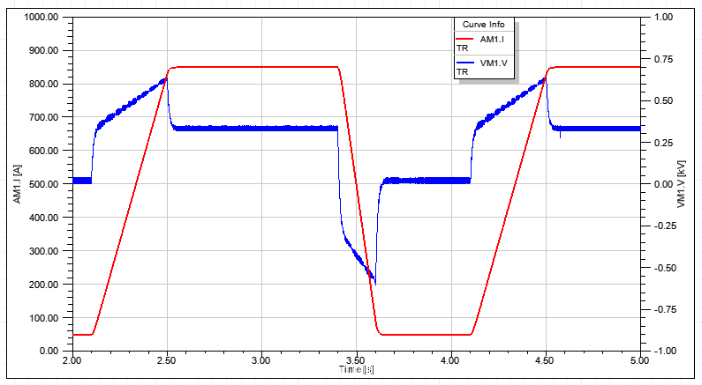
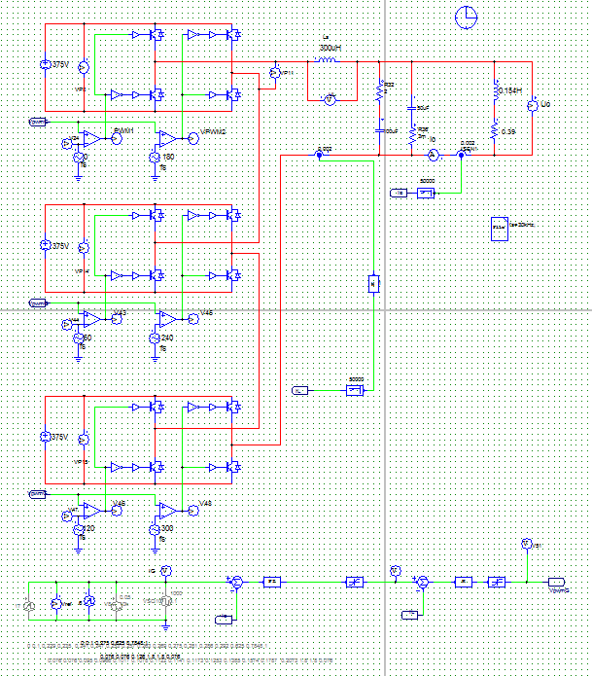
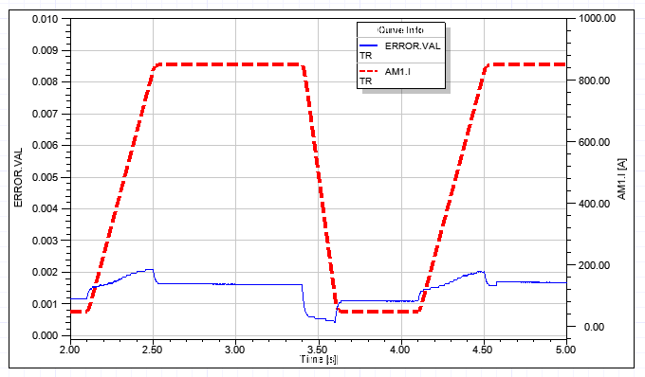
Power supply R&D
  Booster Power Supply - topology
    Simulation
output stage simulation circuit
output current and tracking error waveform

Slide 26
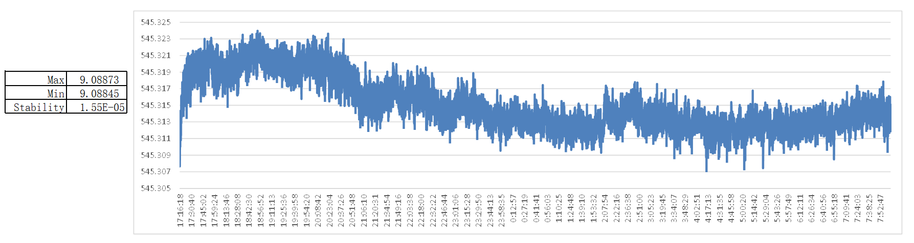
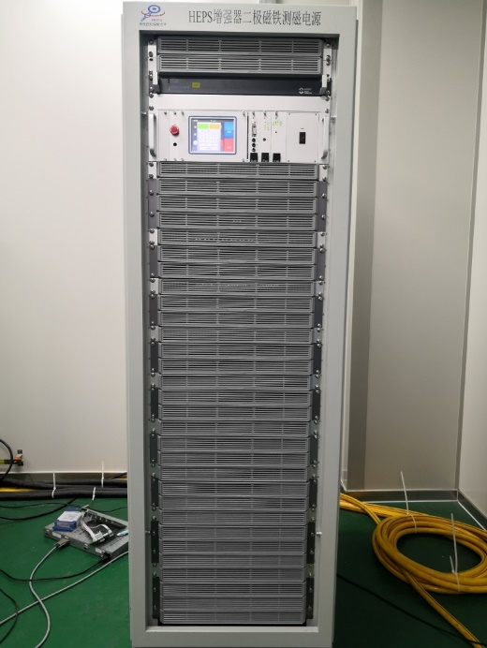
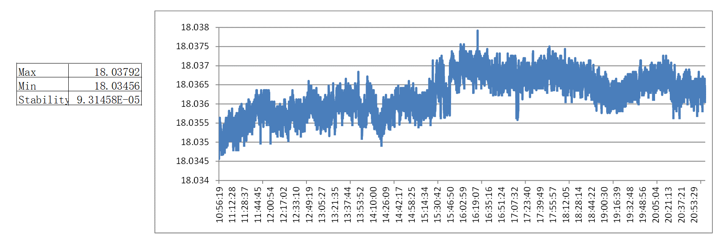
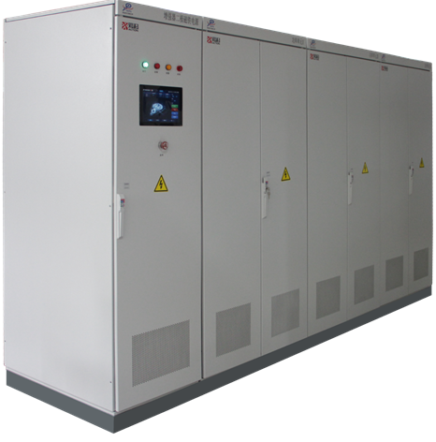
Power supply R&D
  Booster Power Supply - prototype
the stability meets the requirements
Prototype for HEPS magnet Measuring
Current tracking waveform
the formal power supply of HEPS booster magnet

Slide 27
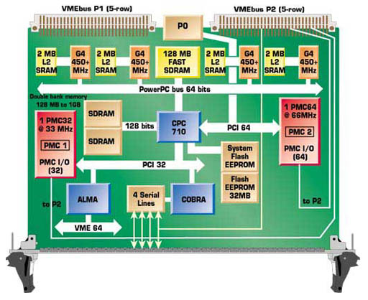
Power supply R&D
  Digital Power Supply Control Module (DPSCM)
    SOPC FPGA： System On a Programmable Chip
    All algorithms and peripherals control entirely implemented in one FPGA
I/O
CPU
Flash
SDRAM
I/O
I/O
I/O
I/O
DSP
I/O
FPGA
FPGA
CPU
DSP
Solution: Replace External Devices
with Programmable Logic

Slide 28
Power supply R&D
  Digital Power Supply Control Module (DPSCM)
    DPSCM-MB: PID + modern
  control theory
    high precision ADC board
  DPSCM-AD: temp control
    the voltage source
  interfacing board DPSC-DA
    the diagnostic board
    DPSCM_MDA

Slide 29
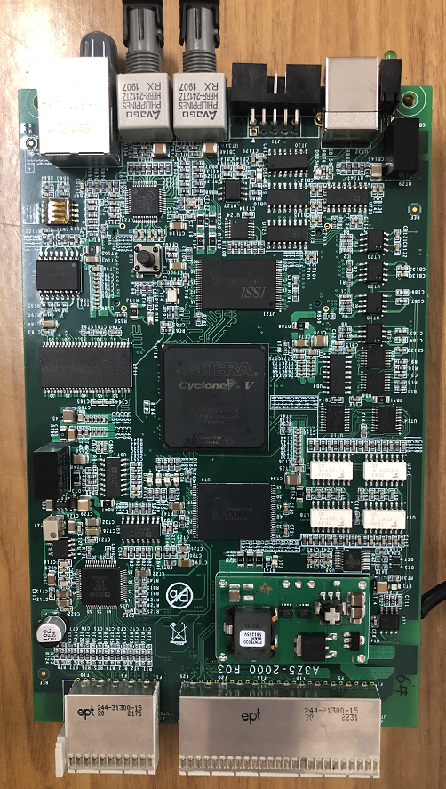
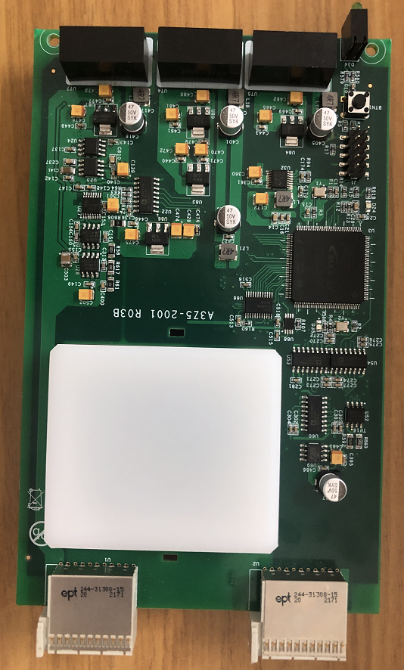
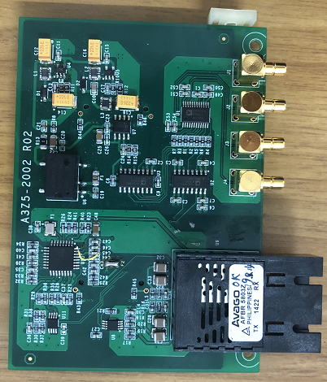
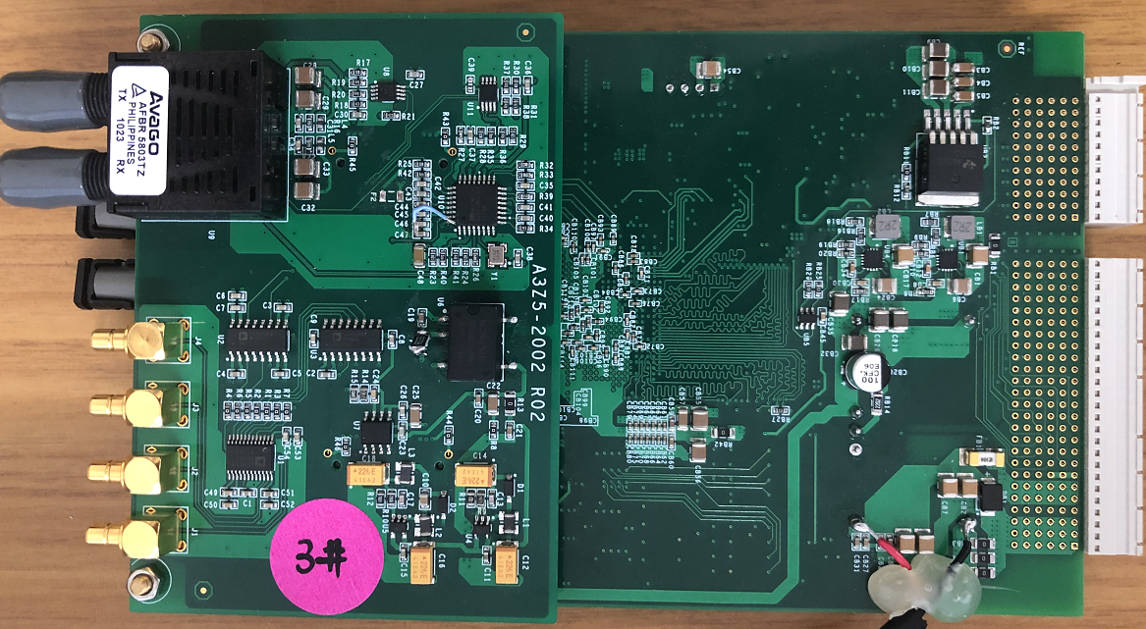
Power supply R&D
  Digital Power Supply Control Module (DPSCM)
    Hardware

Slide 30
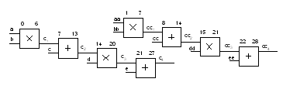
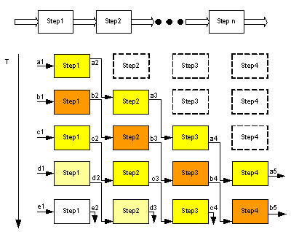
Power supply R&D
  Digital Power Supply Control Module (DPSCM)
    Software
Modular time-sharing multiplexing
Pipeline design

Slide 31
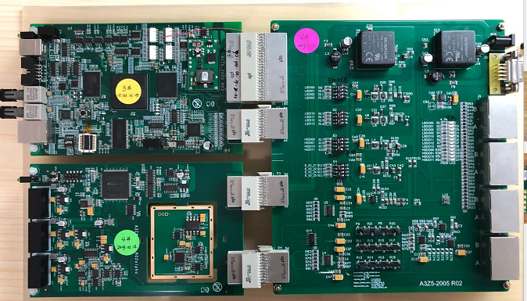
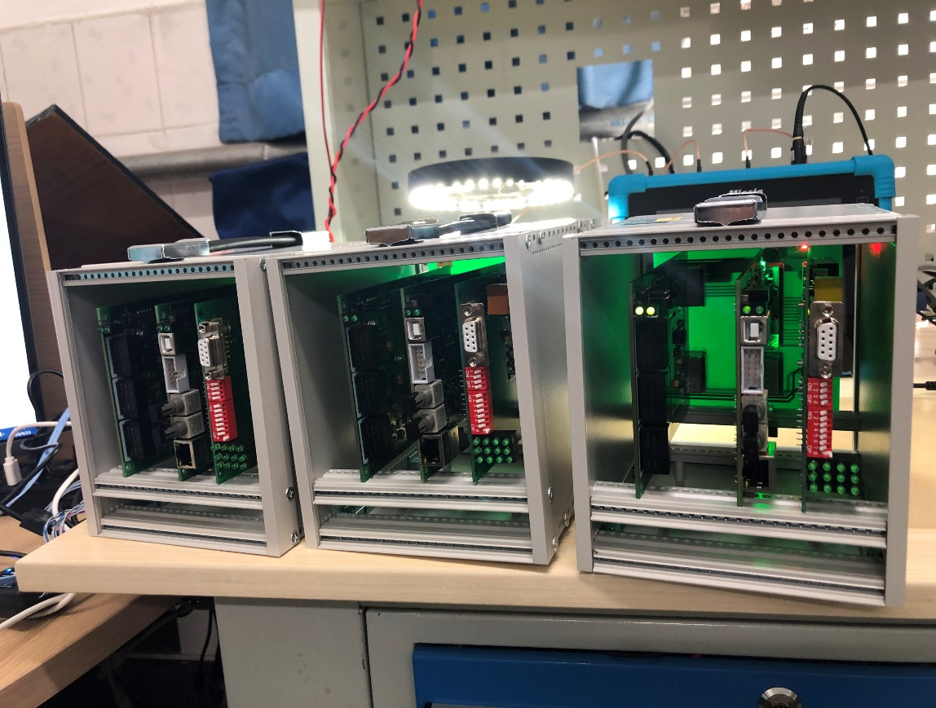
Power supply R&D
  Digital Power Supply Control Module (DPSCM) :
    Test platform ( Closed-loop test system based on simulated load )

Slide 32
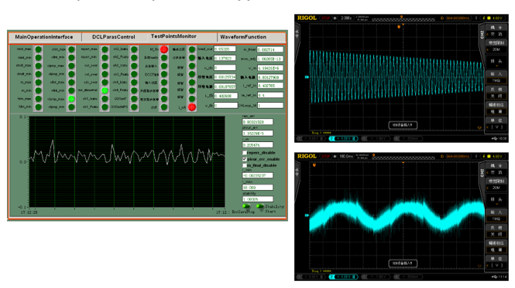
Power supply R&D
  Digital Power Supply Control Module (DPSCM) :
    Classical PID algorithm
    The application of modern control theory
    Application of intelligent control technology: expert knowledge base, fault prediction and intelligent processing; Adaptive adjustment of closed-loop parameters of power supply

Slide 33
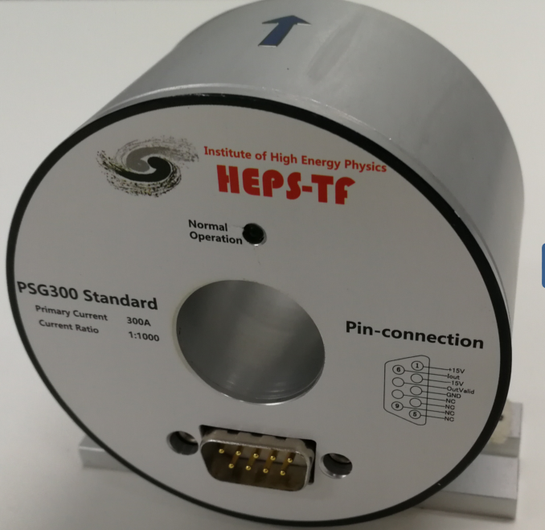
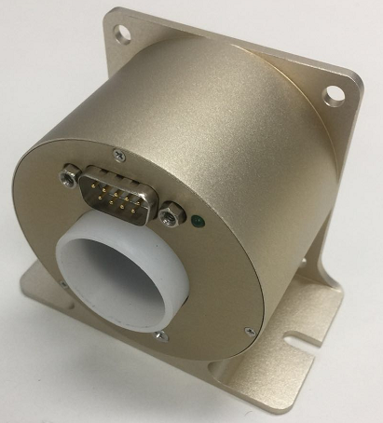
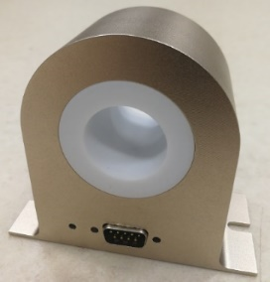
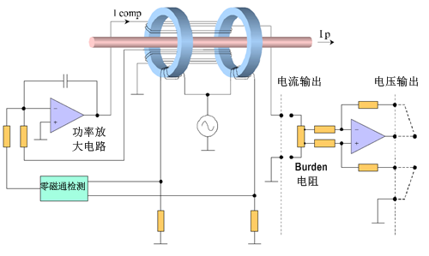
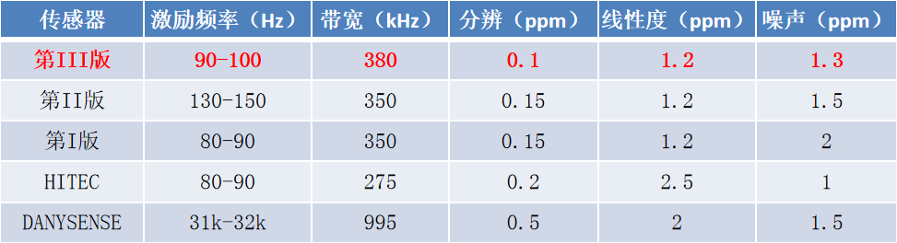
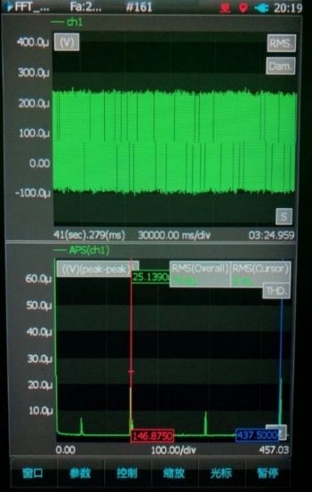
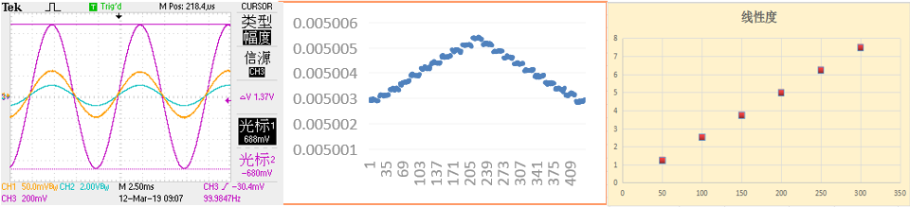
Power supply R&D
  Current transducers– 300A prototype
    Zero flux high precision current transducer
    The current transducer has the characteristics of high linearity, high resolution, high stability and low temperature drift.
可靠性、抗干扰性、稳定性等性能得到极大改善
第I版 （HEPS-TF）
第II版
第III版（HEPS）
带宽
分辨率
线性度
噪声

Slide 34
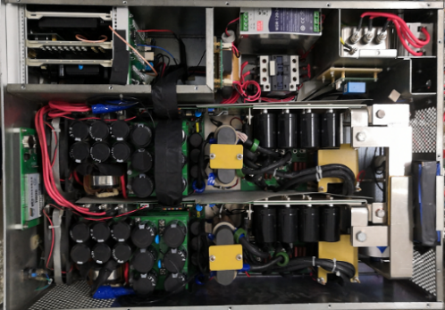
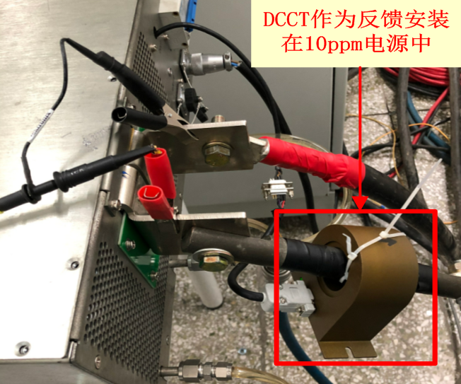
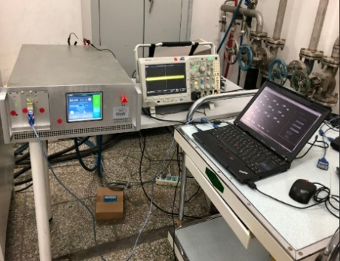
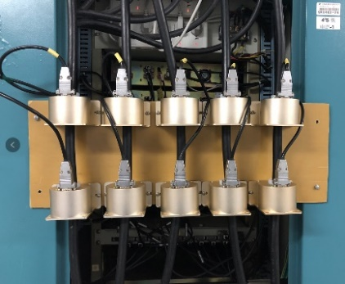
Power supply R&D
  Current transducers– 300A prototype test
    In order to ensure the reliability and stability of the self-made sensor, long-term performance tests have been carried out in different HEPS power sources
    HEPS 10ppm high precision power supply, stability is better than 8ppm

Slide 35
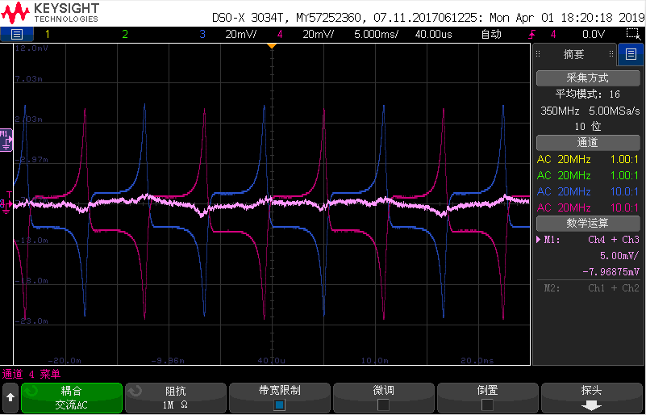
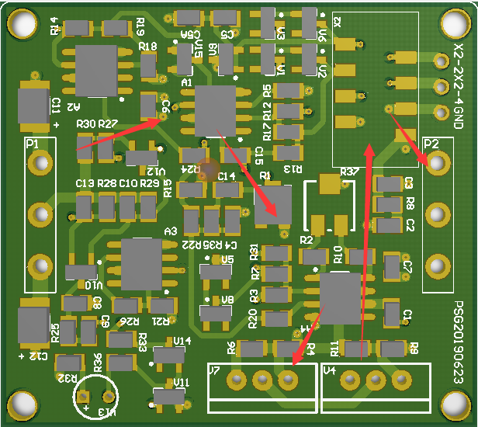
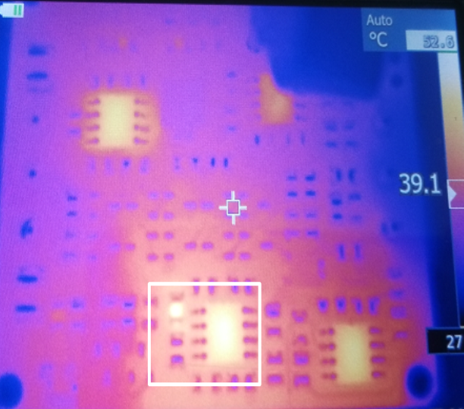





Power supply R&D
  Current transducers– 20A prototype
    On the basis of the 300A: calculation of magnetic circuit parameters, control of circulation noise, structure design.
    20A-DCCT was successfully developed
    Resolution ≤0.5ppm (10uA), linearity ≤1.5ppm, noise ≤1ppm (maximum noise point)

Slide 36
Summary
  According to the latest physical parameters, about 13,574 power supplies are needed to power the magnets.
  Based on the optimized design, the power demand is estimated. Compared with the FCC, there was little difference.
  The design of three kinds of power supply with different power levels is introduced
  The design of two core components of power supply is introduced
  The digital module and current sensor are independently developed and applied in HEPS.

