Slide 1
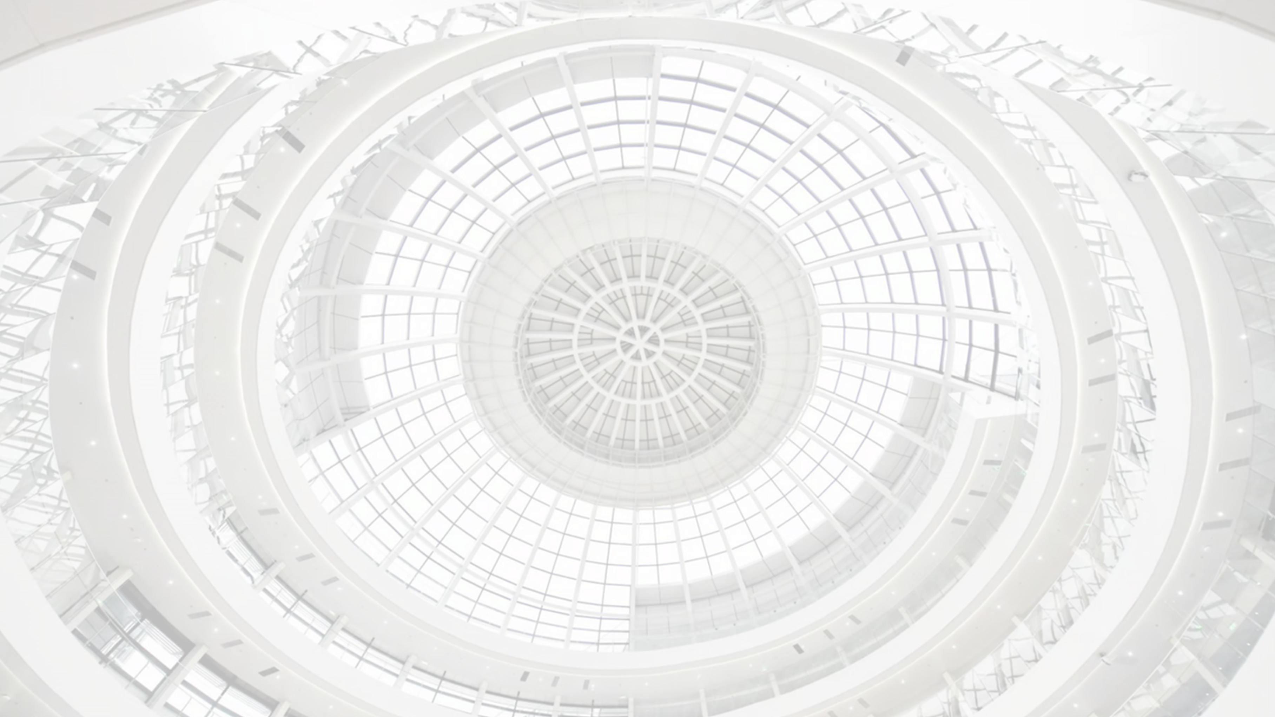


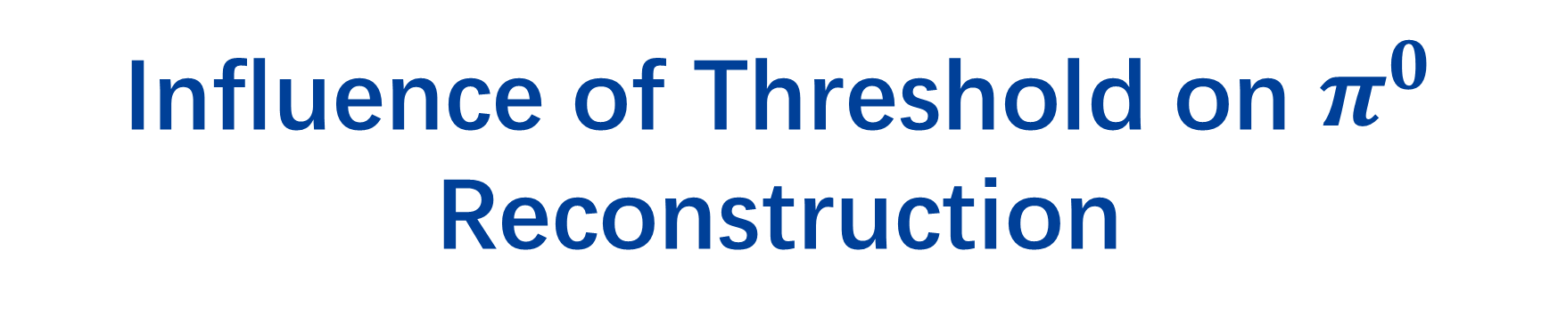
Influence of Threshold on $π^{0}$ Reconstruction
Zhiyu Zhao, Baohua Qi, Yong Liu
2023.01.04

Slide 2
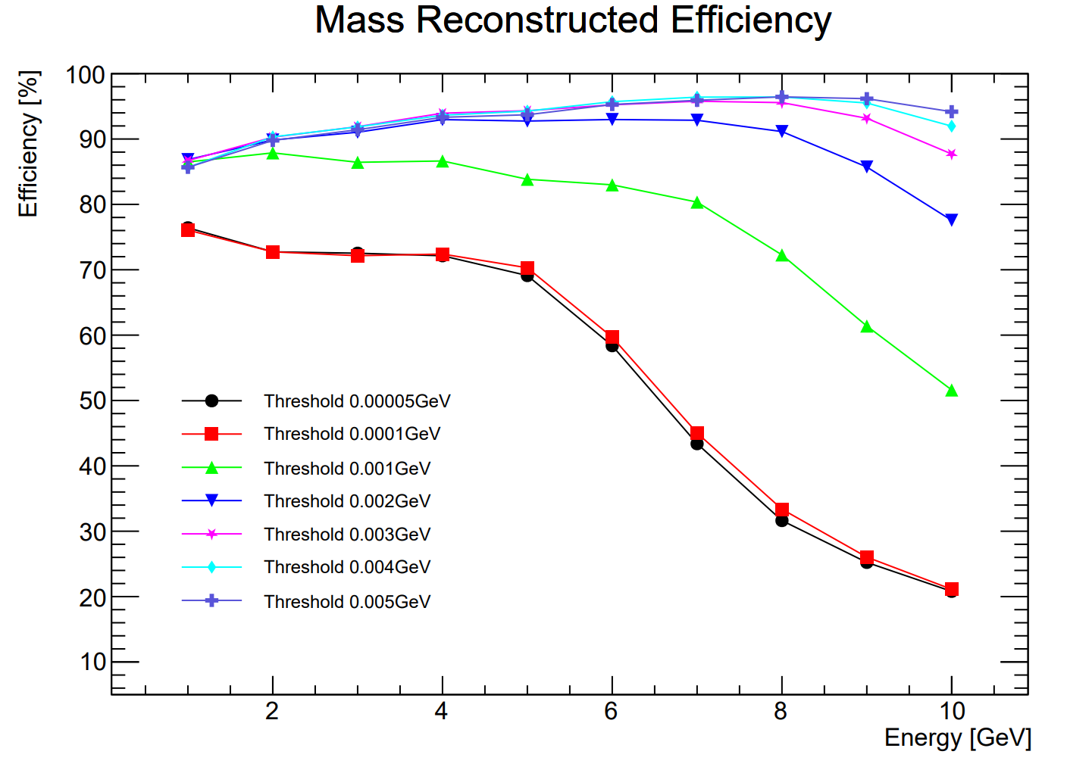
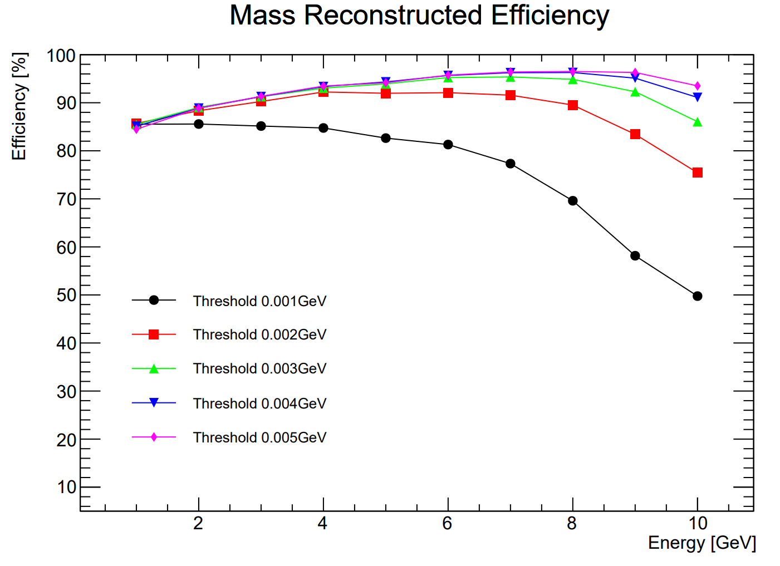
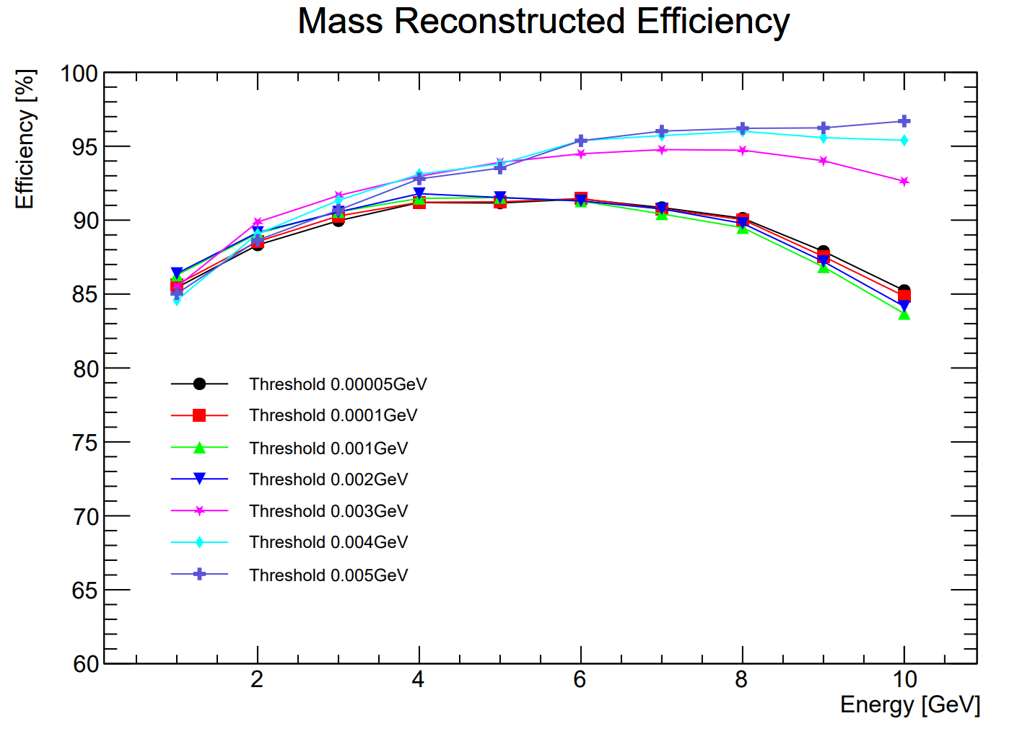
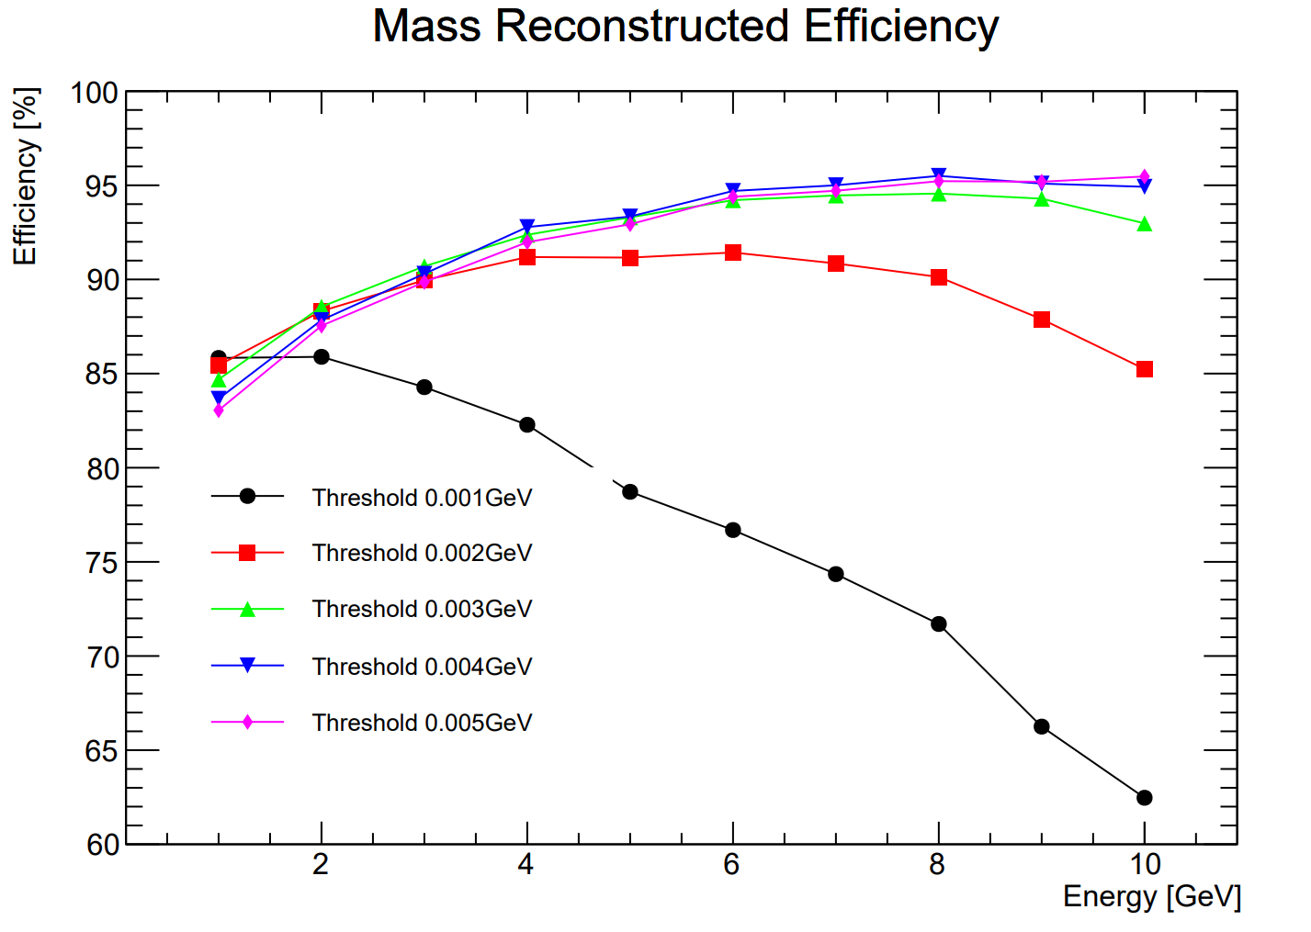
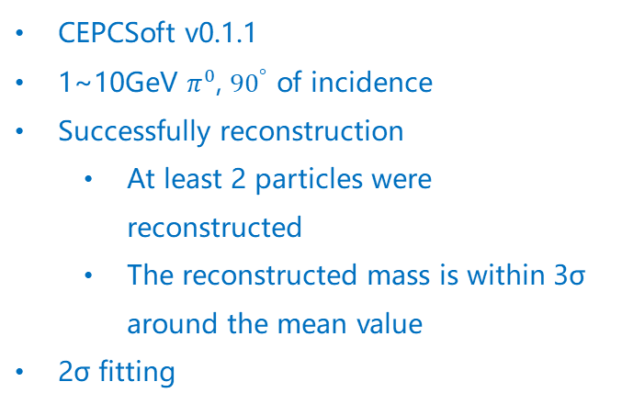
Pion Reconstruction For Different Threshold
CEPCSoft v0.1.1
1~10GeV $π^{0}$, ${90}^{°}$ of incidence
Successfully reconstruction
  At least 2 particles were reconstructed
  The reconstructed mass is within 3σ around the mean value
  2σ fitting
Old Rec
Clustering Threshold
Old Rec
Hits Threshold
Old Rec
  Calibration constant: 1.11
  Hits threshold
New Rec
  Calibration constant: 1
  Hits threshold
  Energy Threshold in Clustering
  Time Threshold
New Rec, from Baohua
Hits Threshold
New Rec
Clustering Threshold

Slide 3
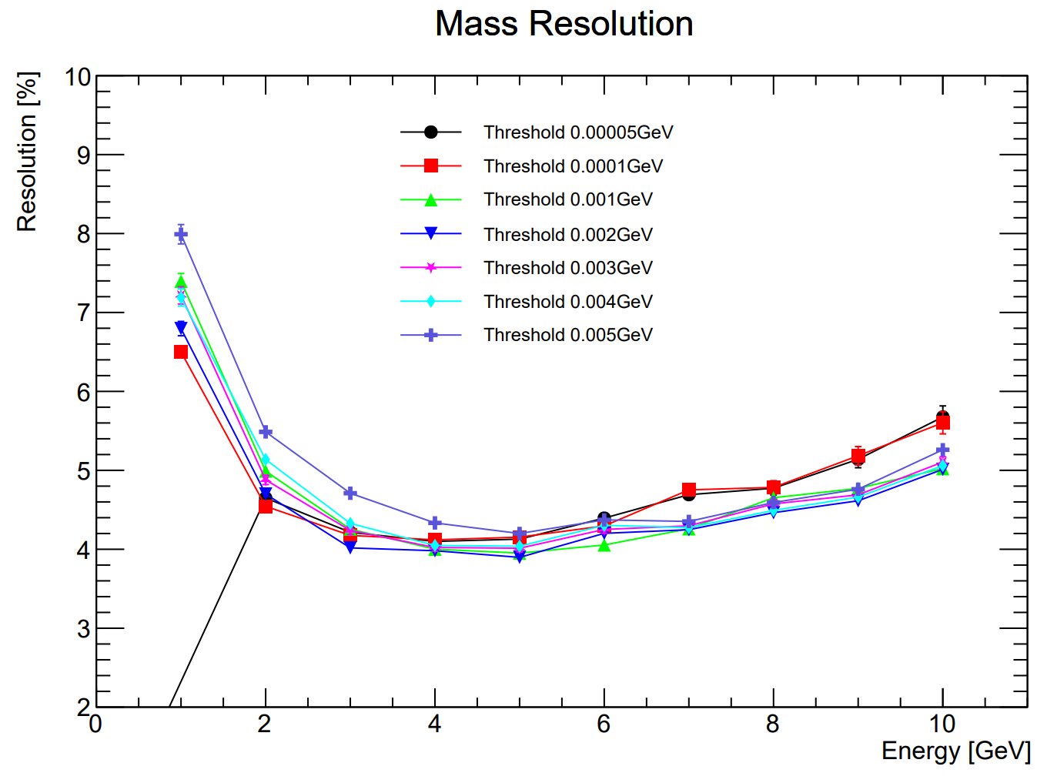
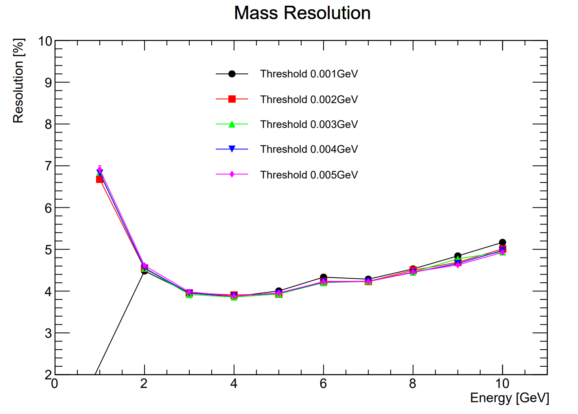
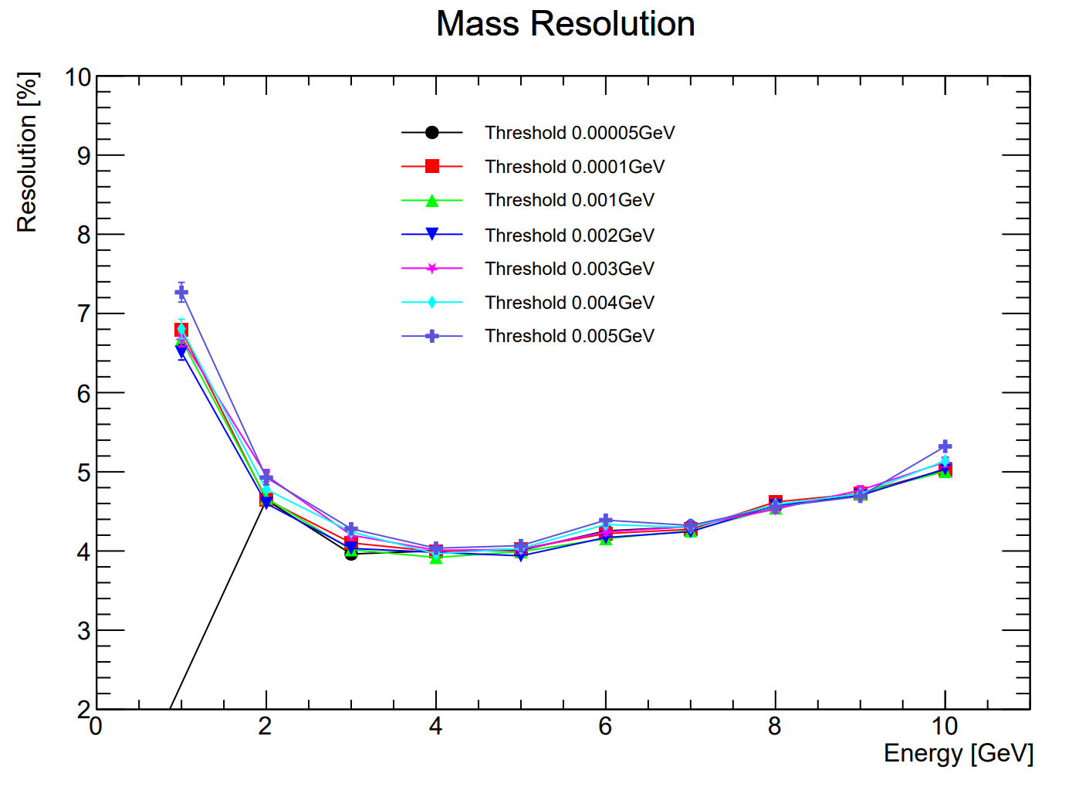
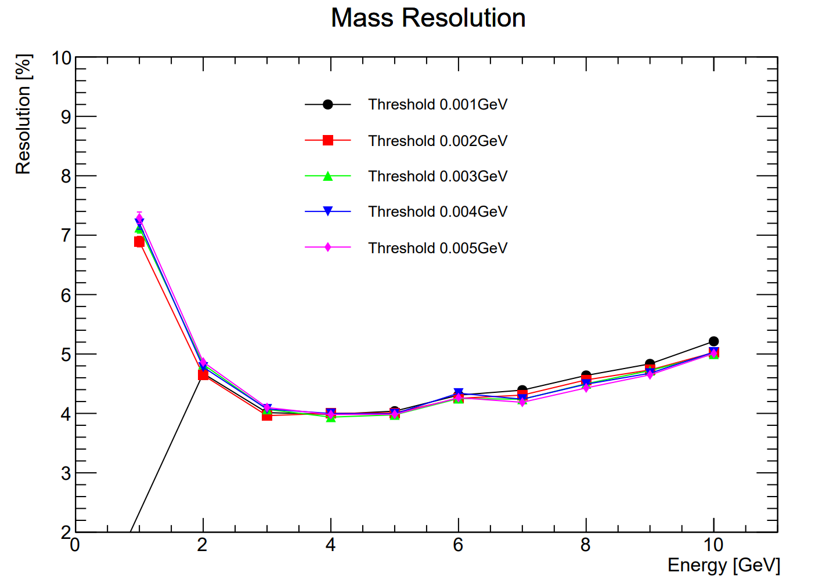
Mass Resolution
Hits Threshold
Clustering Threshold
Old Rec
New Rec

Slide 4
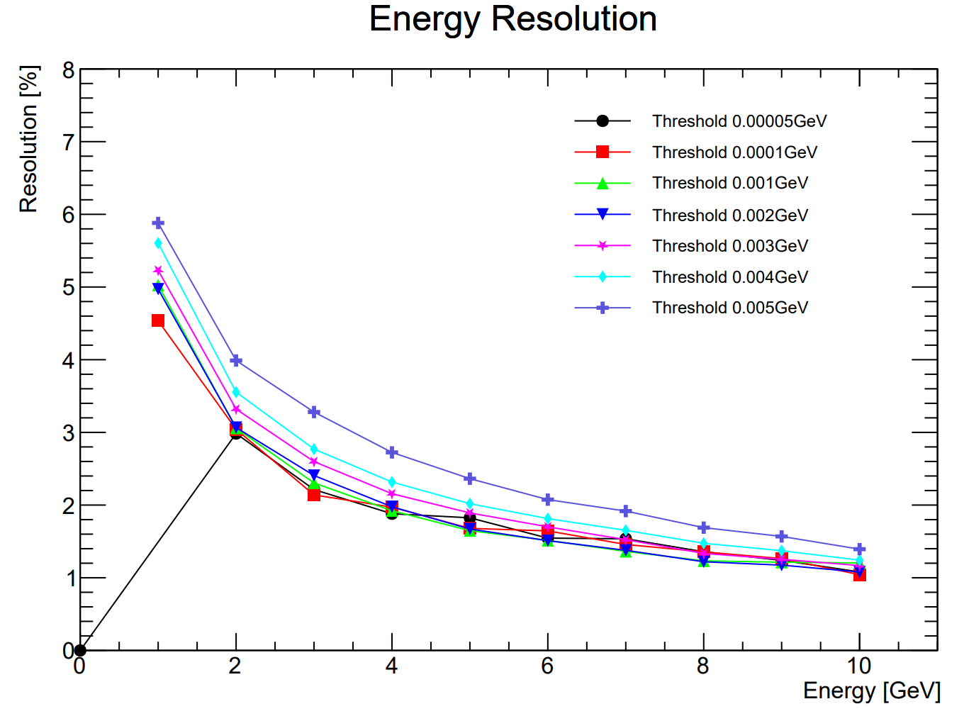
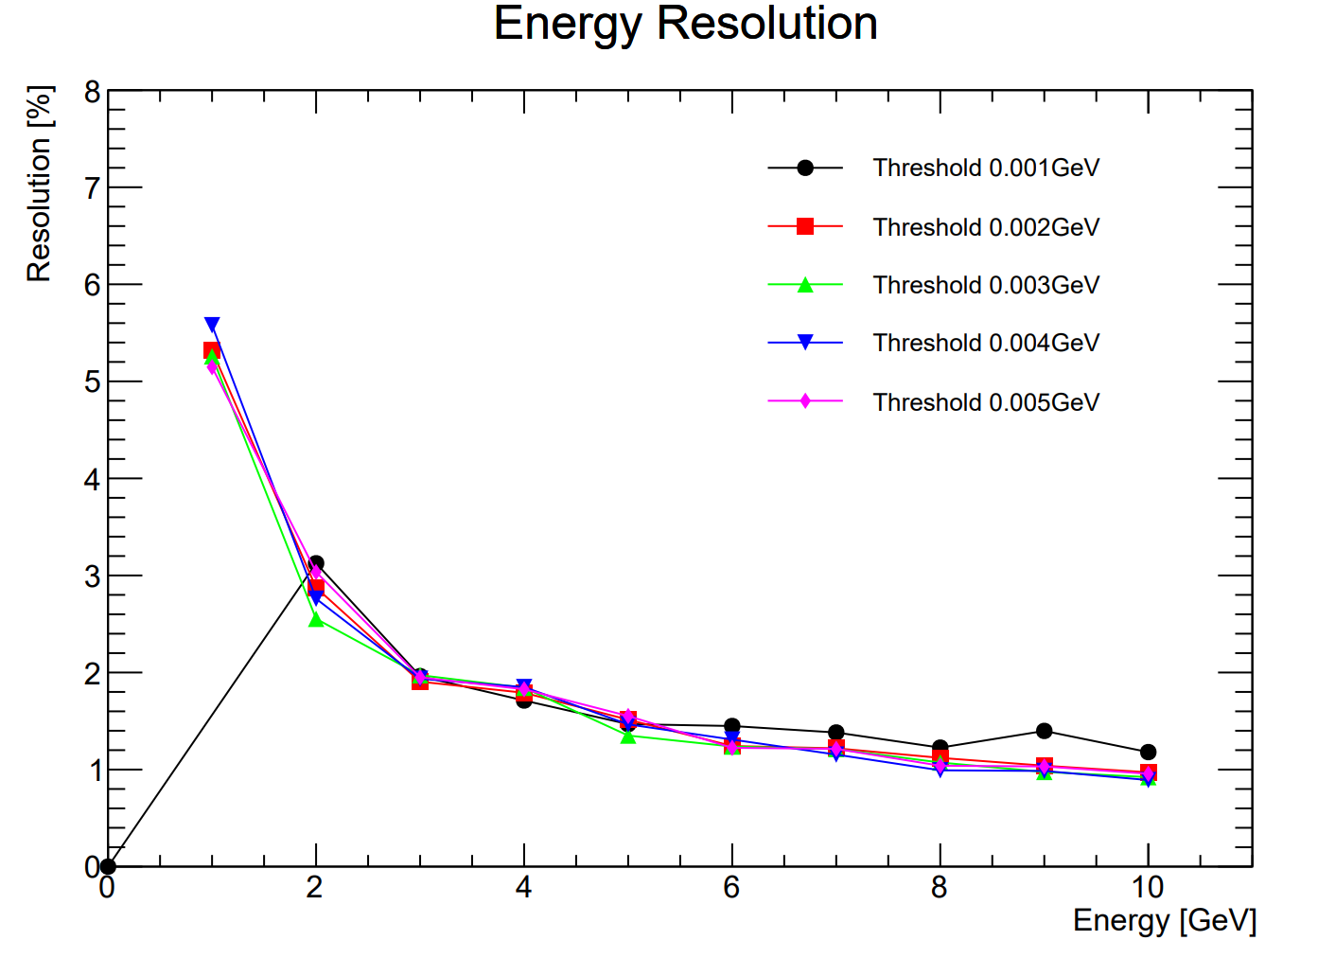
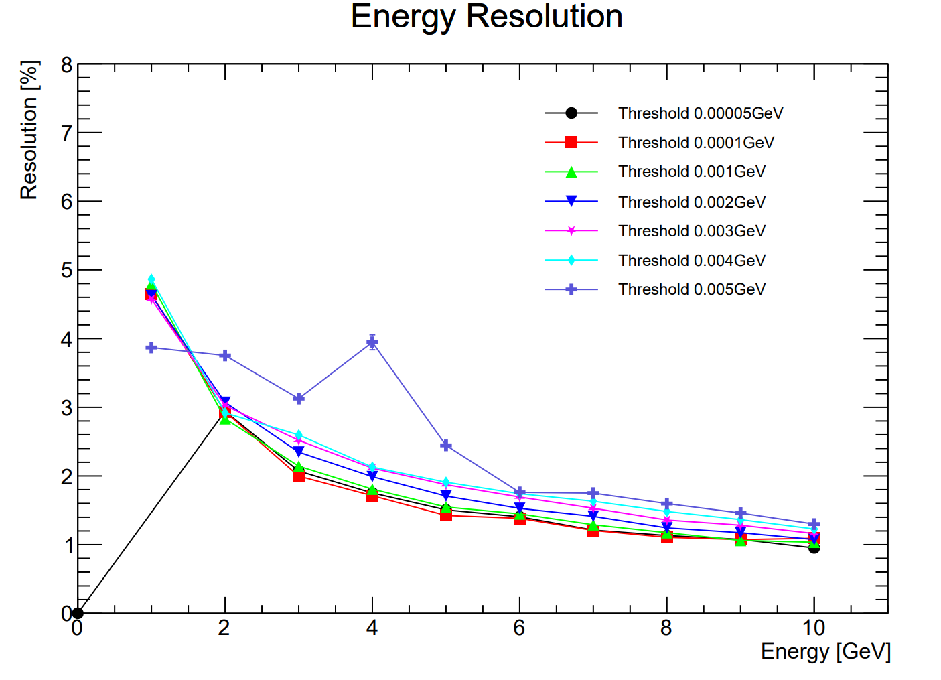
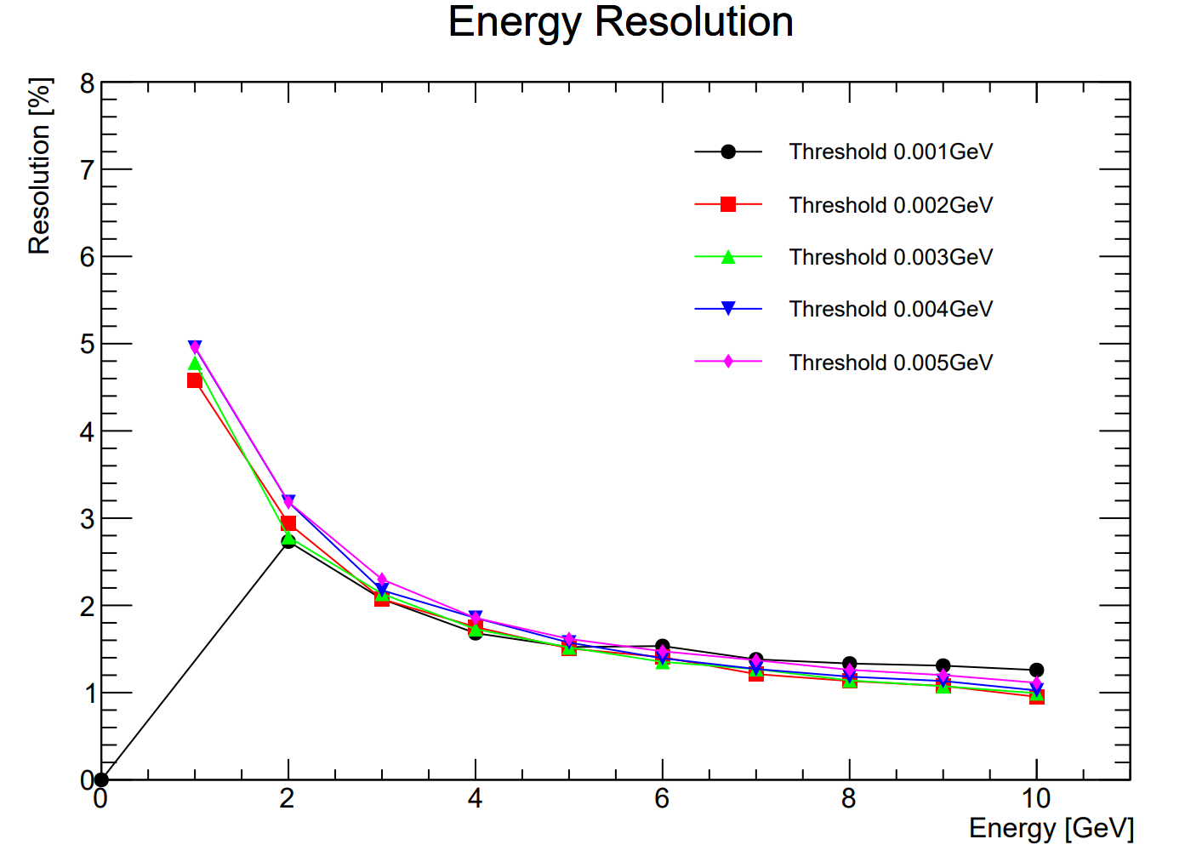
Energy Resolution
Hits Threshold
Clustering Threshold
Old Rec
New Rec

Slide 5
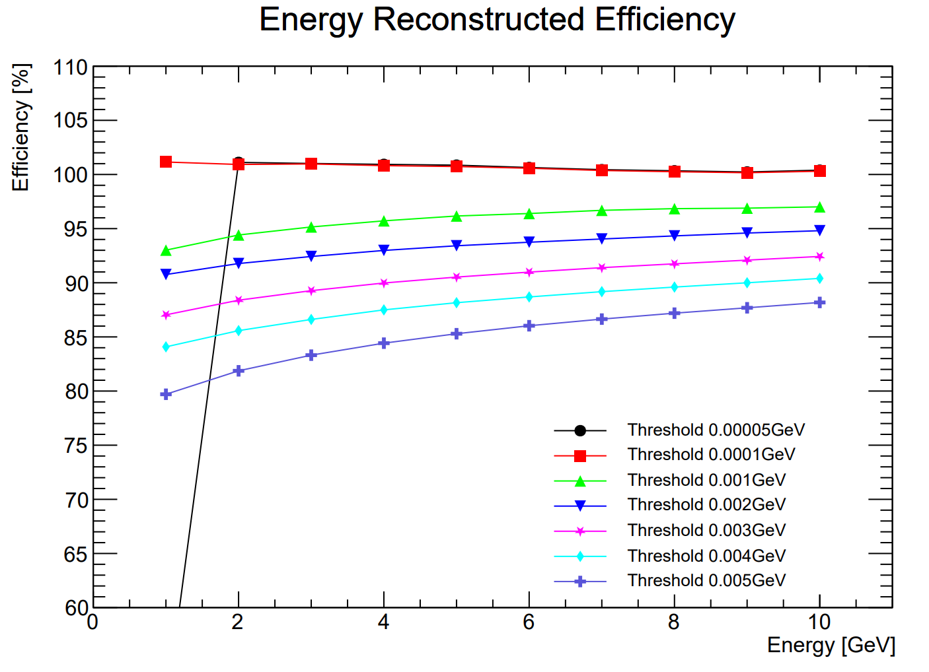
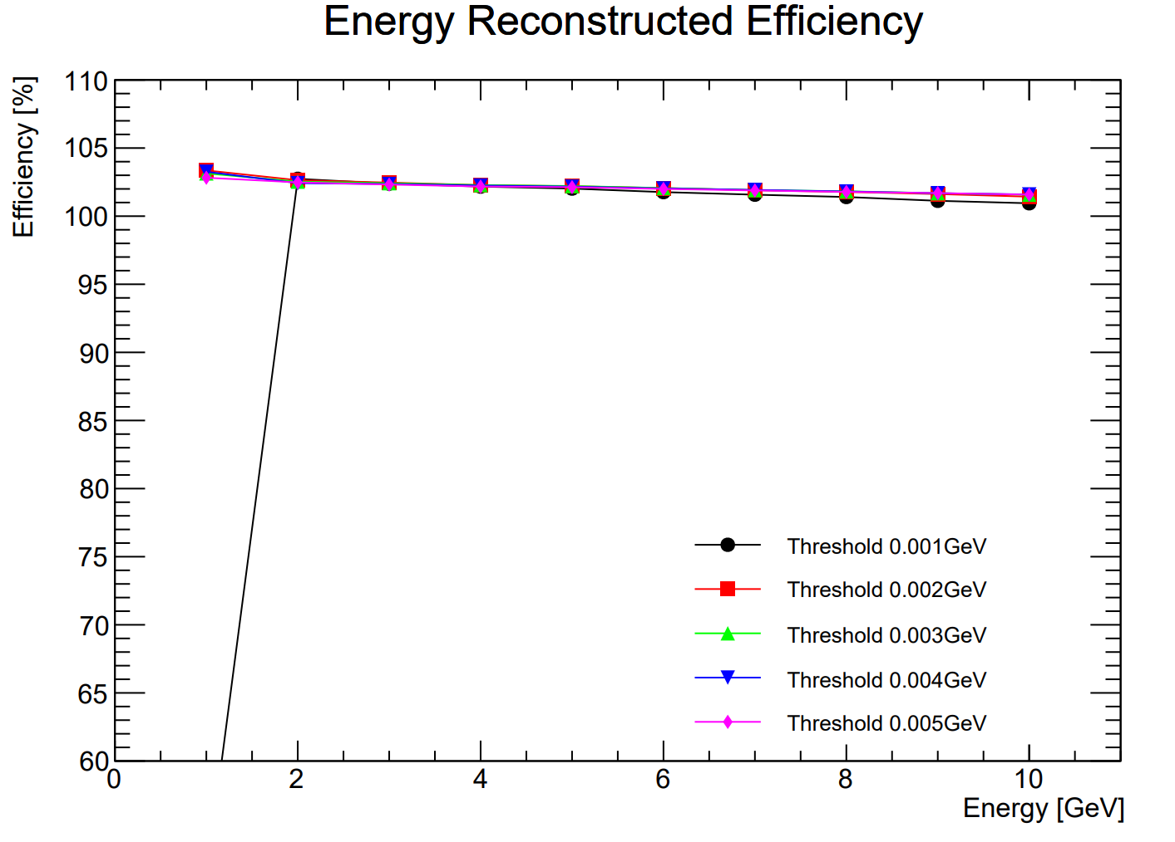
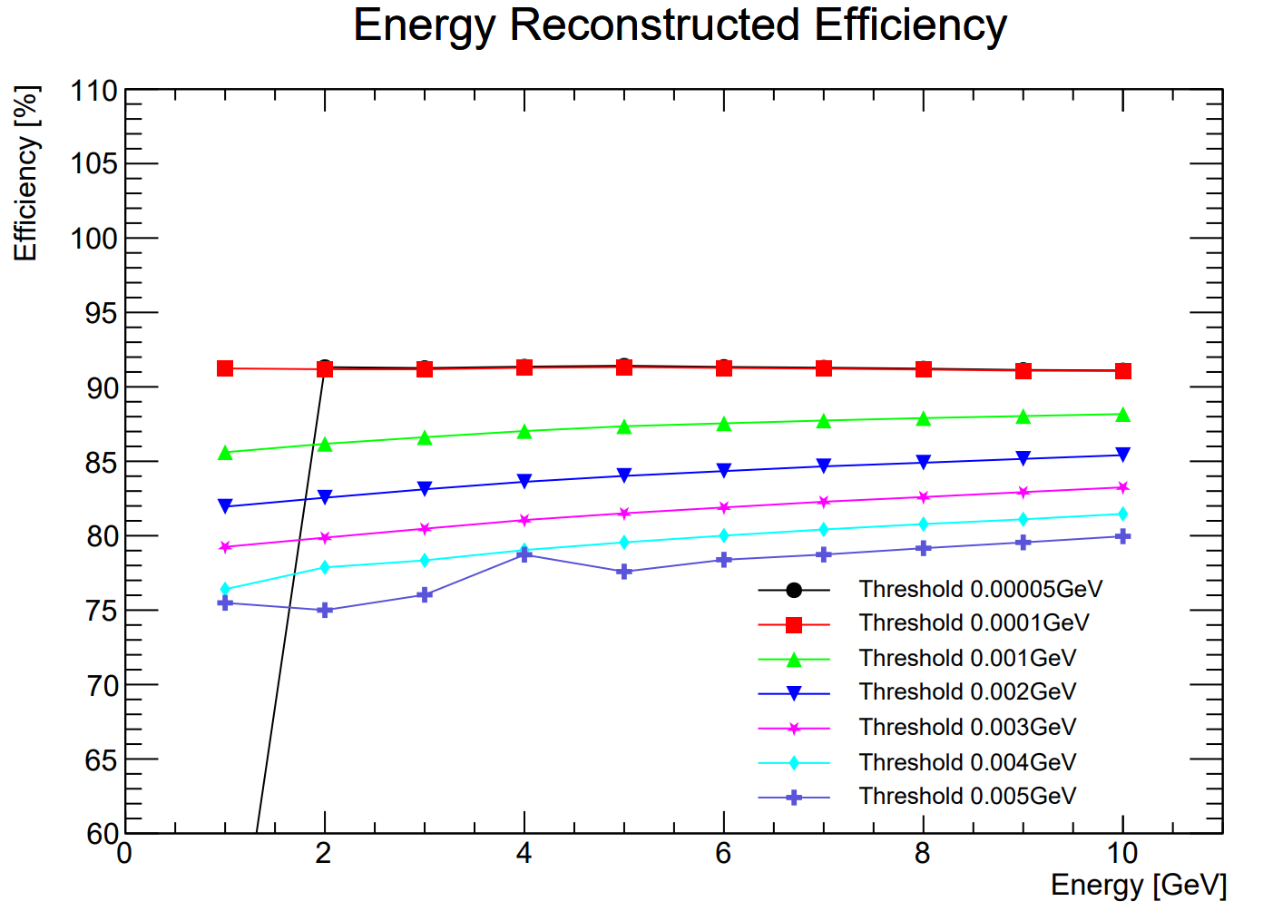
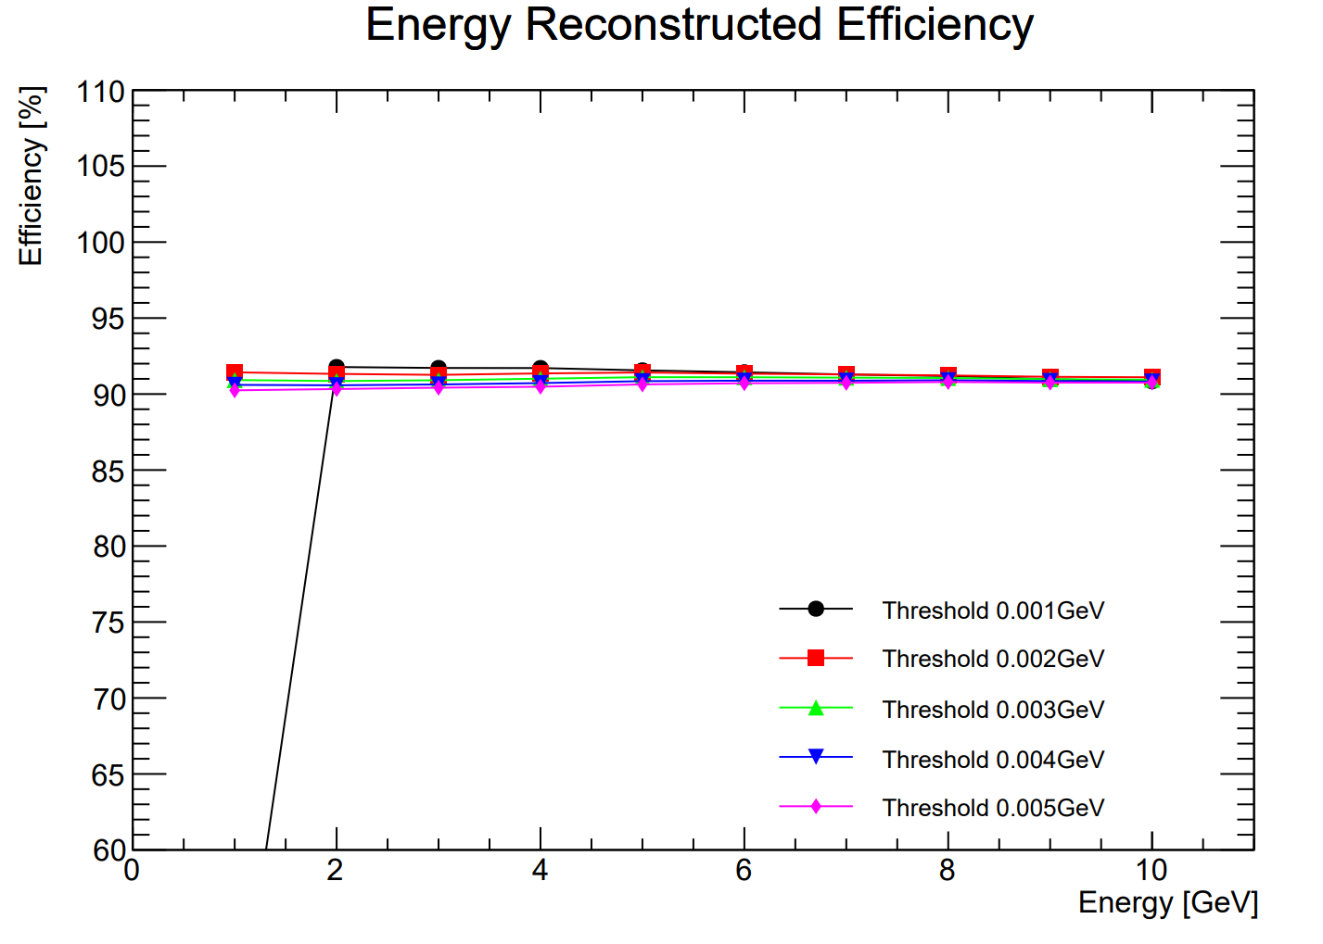
Energy Efficiency
Hits Threshold
Clustering Threshold
Old Rec
New Rec

