Slide 1
Data analysis
2023/1/5

Slide 2
Run0323: ERR check Chi2cut:10
B2= W9R5 iTHR 64 ；B1 W2R3 ITHR 16； B3 W2R11 iTHR 16 ； B4 W9R6 ITHR32； B5 W2R29 ITHR10；B6 W2R12 ITHR16；Beam 4GeV
res k\Eff | 1 | 2 | 3 | 4 | 5 | 6
1 | 0.988755+-0.000101627 | 0.986391+-0.000125668 | 0.985609+-0.000126536 | 0.982462+-0.000140434 | 0.990188+-0.000109729 | 0.990717+-9.52478e-05
2 | 0.99666+-5.56115e-05 | 0.996774+-6.15066e-05 | 0.997531+-5.27244e-05 | 0.996239+-6.54874e-05 | 0.997498+-5.56168e-05 | 0.99645+-5.9075e-05
3 | 0.997881+-4.42504e-05 | 0.998177+-4.68686e-05 | 0.998849+-3.64517e-05 | 0.998072+-4.67568e-05 | 0.998714+-3.99026e-05 | 0.997674+-4.78467e-05
ERR from statics is quite small

Slide 3
Simulation data test
z = 20 +40*j
x,y = Gauss(0,0,025), Gauss(0,0,025) //continuous
Check the Chi2 & residual:
Chi2: the other 5 chips chi2
residual: Fit the tested chip with parameters got from other 5 chips, res =$X_{measure}$-$X_{real}$

Slide 4
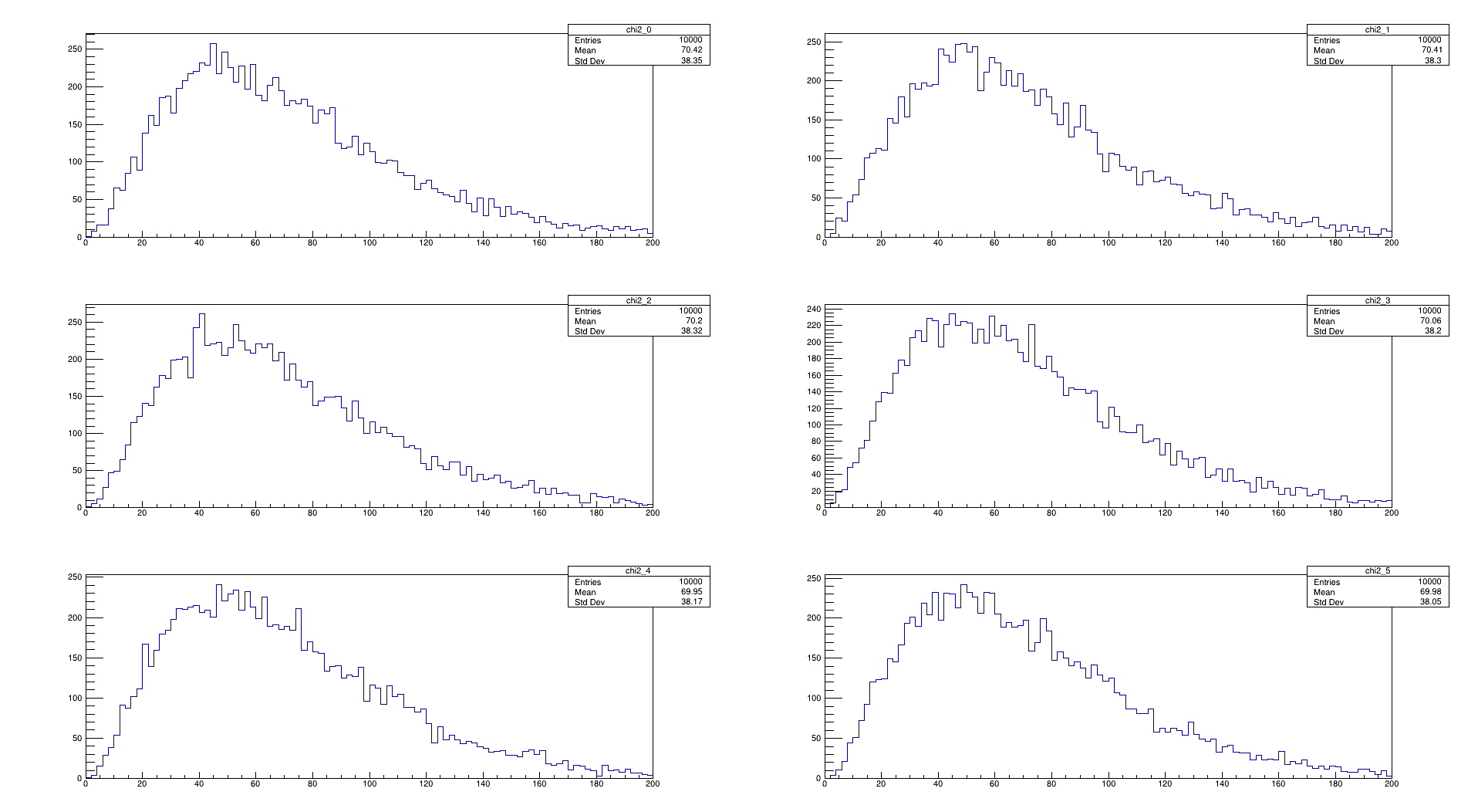
Chi2

Slide 5
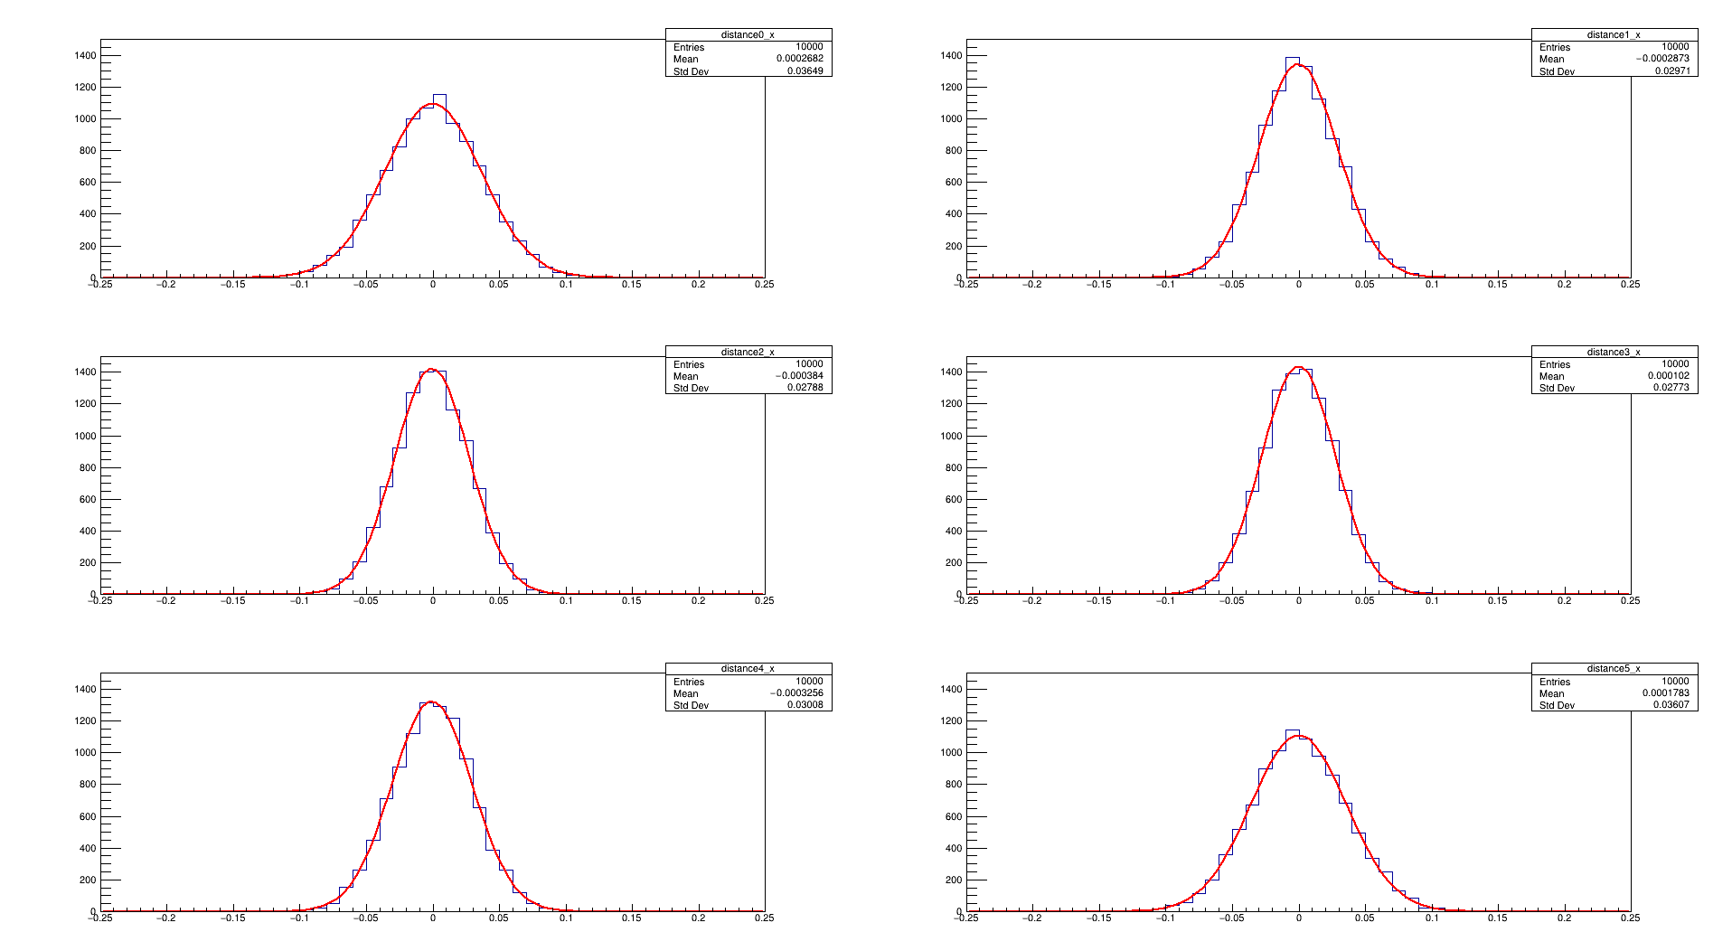
resX

Slide 6
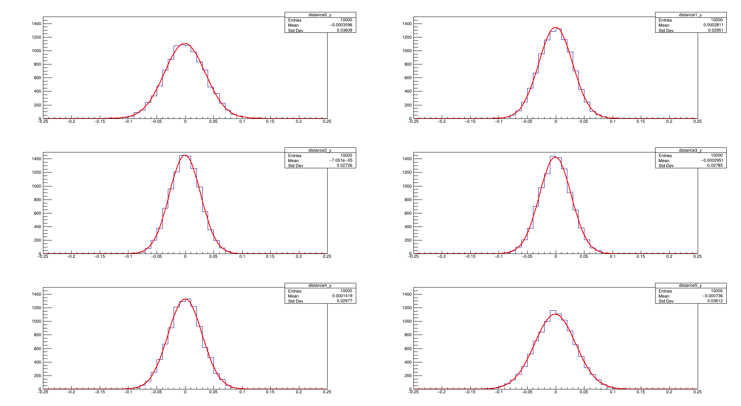
resY

Slide 7
Feature of Chi2 & resolution by simulation
Chi2: tends to be same among chips
Resolution: 1st & last chip is a bit worse than others. about 1.2 magnification

Slide 8
Check Chi2 & res of real data
Difference:
Real Data’s most statics are discrete(single hit cluster);
May lead to Chi2↓ in whole
Real Data processed alignment

Slide 9
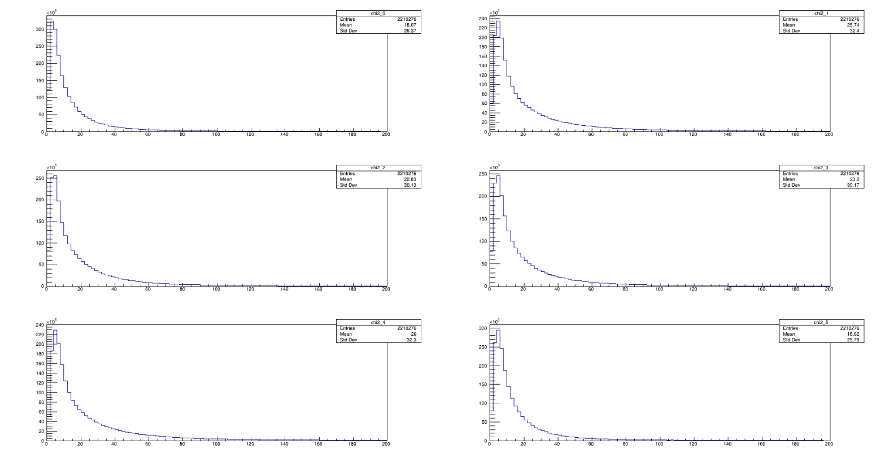
Run0365

Slide 10
ResX: (chi2 no cut)

Slide 11
ResY

Slide 12
Problem
1. Why 1st&last chip’s Chi2 smaller.
2. Why 1st&last chip’s resolution worse.

Slide 13
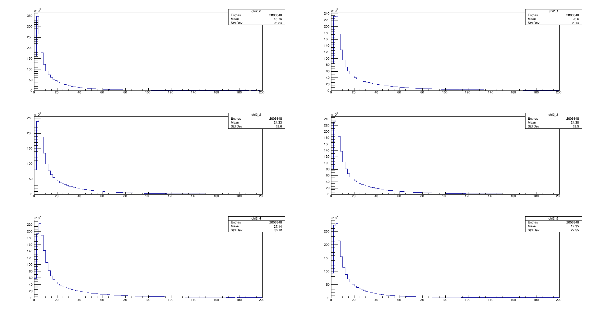
Run0323

Slide 14
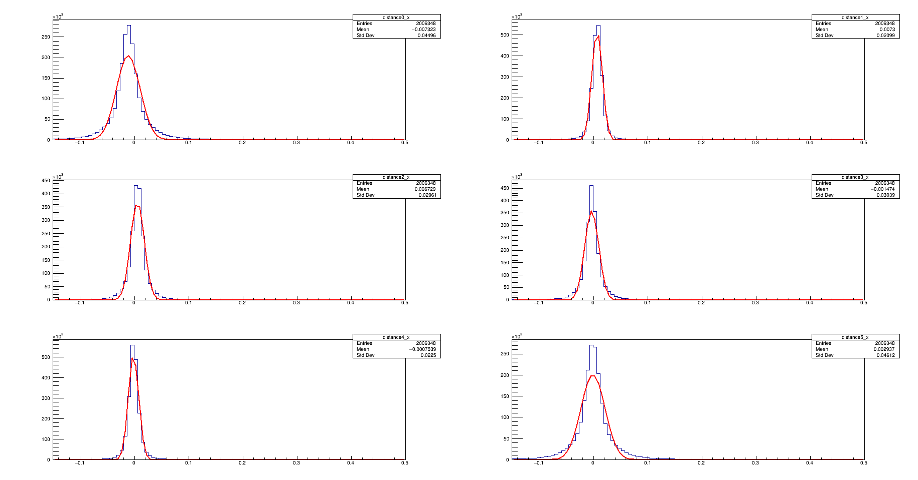

Slide 15
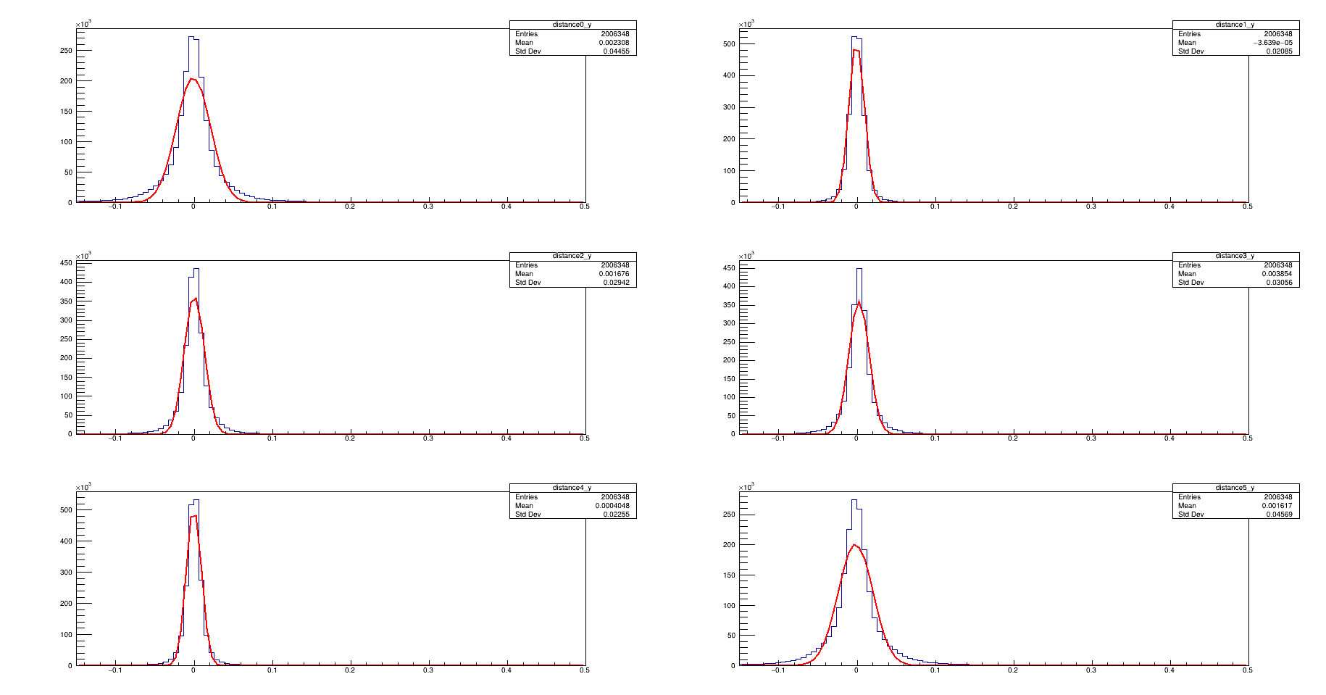

Slide 16
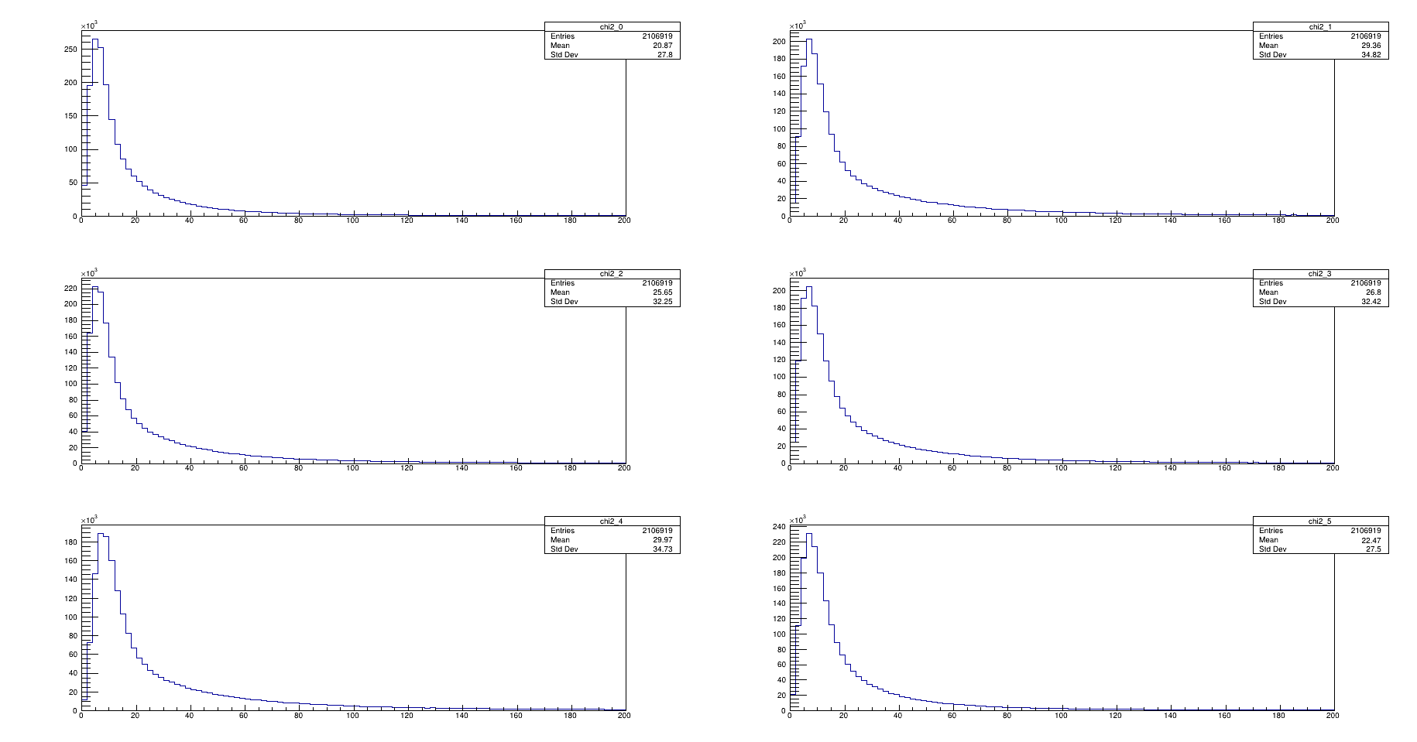
Run0388

Slide 17
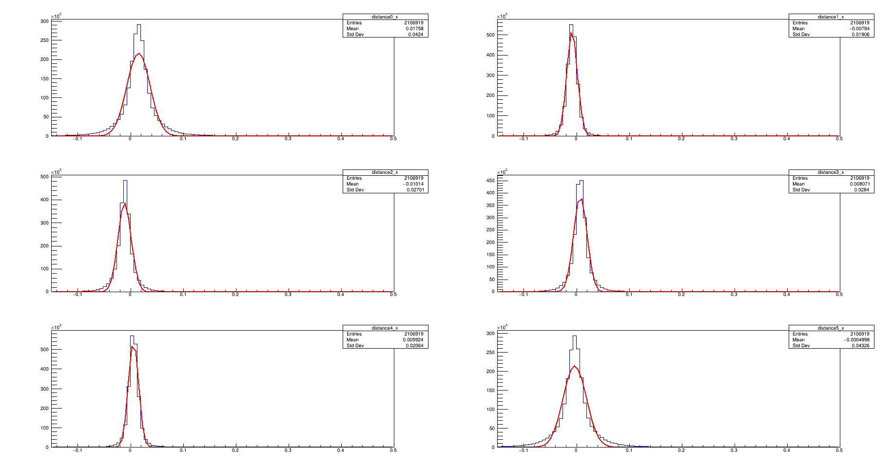

Slide 18
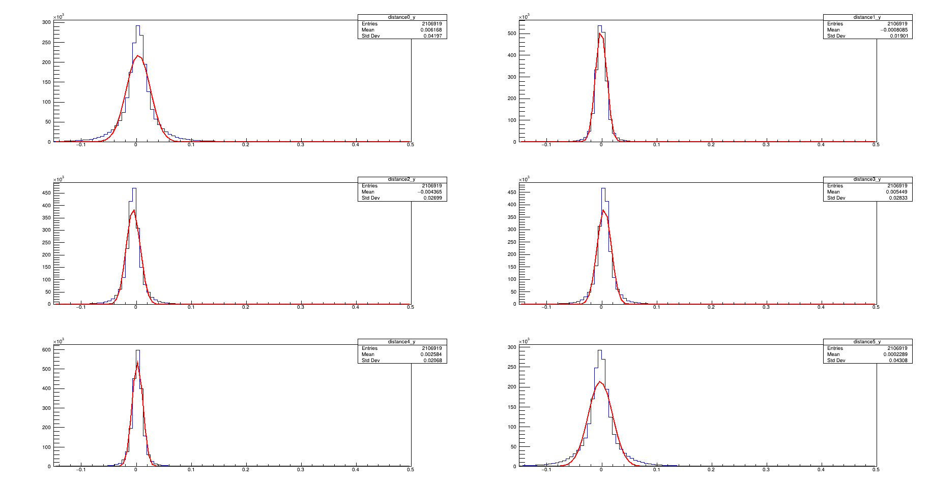

Slide 19
EFF vs Chi2Cut
Chi2 Cut for 5 chip range as {10,5,2}
Residual cut for tested chip is 0.025mm
for 1st and last chip *2.5

Slide 20
Run0323:
B2= W9R5 iTHR 64 ；B1 W2R3 ITHR 16； B3 W2R11 iTHR 16 ； B4 W9R6 ITHR32； B5 W2R29 ITHR10；B6 W2R12 ITHR16；Beam 4GeV
Cut\Eff | 1 | 2 | 3 | 4 | 5 | 6
10 | 0.988755+-0.000101627 | 0.986391+-0.000125668 | 0.985609+-0.000126536 | 0.982462+-0.000140434 | 0.990188+-0.000109729 | 0.990717+-9.52478e-05
5 | 0.994218+-9.36086e-05 | 0.990994+-0.000143084 | 0.992976+-0.000124911 | 0.990726+-0.00014493 | 0.993695+-0.000130917 | 0.994501+-0.000103391
2 | 0.996299+-0.000150698 | 0.992656+-0.000296032 | 0.995433+-0.000236893 | 0.993828+-0.000274067 | 0.995189+-0.000286298 | 0.995751+-0.000213356

Slide 21
Run0365:
B2= W9R5 iTHR16 ；B1 W2R3 ITHR 16； B3 W2R11 iTHR 16 ； B4 W9R6 ITHR32； B5 W2R29 ITHR16；B6 W2R12 ITHR16；Beam 5GeV
Cut\Eff | 1 | 2 | 3 | 4 | 5 | 6
10 | 0.988389+-0.000100604 | 0.985524+-0.000129597 | 0.977433+-0.000153468 | 0.975061+-0.00016315 | 0.989683+-0.000111263 | 0.989998+-9.62044e-05
5 | 0.993191+-0.000105609 | 0.989539+-0.000164293 | 0.989162+-0.000151156 | 0.986578+-0.000174314 | 0.99344+-0.000136245 | 0.993575+-0.000113978
2 | 0.995205+-0.000196783 | 0.991353+-0.00038012 | 0.993366+-0.000280176 | 0.991057+-0.00033651 | 0.994797+-0.00032183 | 0.995298+-0.000242875

Slide 22
Run0324:
B2= W9R5 iTHR 64 ；B1 W2R3 ITHR 16； B3 W2R11 iTHR 16 ； B4 W9R6 ITHR32； B5 W2R29 ITHR24；B6 W2R12 ITHR16；Beam 4GeV
Cut\Eff | 1 | 2 | 3 | 4 | 5 | 6
10 | 0.989214+-8.38508e-05 | 0.987205+-0.000102639 | 0.985921+-0.000105198 | 0.98325+-0.000115305 | 0.989337+-9.5162e-05 | 0.990112+-8.19659e-05
5 | 0.994501+-7.69909e-05 | 0.991889+-0.00011375 | 0.993371+-0.000100997 | 0.990784+-0.000120271 | 0.993552+-0.0001067 | 0.994345+-8.54278e-05
2 | 0.996501+-0.00012403 | 0.993905+-0.000224744 | 0.99585+-0.000185199 | 0.993377+-0.000233538 | 0.995541+-0.000210684 | 0.995912+-0.000163966

Slide 23
Run0325:
B2= W9R5 iTHR 64 ；B1 W2R3 ITHR 16； B3 W2R11 iTHR 16 ； B4 W9R6 ITHR32； B5 W2R29 ITHR32；B6 W2R12 ITHR16；Beam 4GeV
Cut\Eff | 1 | 2 | 3 | 4 | 5 | 6
10 | 0.988308+-9.43279e-05 | 0.987119+-0.00011173 | 0.98503+-0.000117388 | 0.982825+-0.000126152 | 0.987948+-0.000108966 | 0.988544+-9.44565e-05
5 | 0.993729+-8.93341e-05 | 0.991986+-0.000121892 | 0.992934+-0.000111995 | 0.991187+-0.000126228 | 0.992935+-0.000118034 | 0.993275+-9.83761e-05
2 | 0.995777+-0.000147987 | 0.993815+-0.000239645 | 0.9955+-0.000202225 | 0.993622+-0.000241159 | 0.995082+-0.000225119 | 0.995402+-0.000178161

Slide 24
Run0330:
B2= W9R5 iTHR 64 ；B1 W2R3 ITHR 16； B3 W2R11 iTHR 16 ； B4 W9R6 ITHR32； B5 W2R29 ITHR48；B6 W2R12 ITHR16；Beam 4GV
Cut\Eff | 1 | 2 | 3 | 4 | 5 | 6
10 | 0.990687+-8.97757e-05 | 0.988912+-0.000108739 | 0.986766+-0.000115756 | 0.984797+-0.000123918 | 0.988581+-0.000110073 | 0.989576+-9.46724e-05
5 | 0.995311+-8.11333e-05 | 0.993002+-0.000115742 | 0.993669+-0.000106898 | 0.992097+-0.000119431 | 0.993504+-0.000110778 | 0.994336+-8.9972e-05
2 | 0.997115+-0.000126322 | 0.994615+-0.000218162 | 0.995905+-0.000183867 | 0.994043+-0.000221181 | 0.995349+-0.000197124 | 0.996394+-0.000144796

Slide 25
Run0331:
B2= W9R5 iTHR 64 ；B1 W2R3 ITHR 16； B3 W2R11 iTHR 16 ； B4 W9R6 ITHR32； B5 W2R29 ITHR64；B6 W2R12 ITHR16；Beam 4GV
Cut\Eff | 1 | 2 | 3 | 4 | 5 | 6
10 | 0.990406+-9.19262e-05 | 0.988755+-0.000110699 | 0.986502+-0.000118152 | 0.984556+-0.000126185 | 0.987747+-0.000114908 | 0.989021+-9.77364e-05
5 | 0.995331+-8.25697e-05 | 0.992738+-0.000120125 | 0.993869+-0.000107201 | 0.99198+-0.000122316 | 0.993275+-0.000113834 | 0.994034+-9.33001e-05
2 | 0.996995+-0.000133791 | 0.994507+-0.000227246 | 0.996063+-0.000185617 | 0.994546+-0.000217404 | 0.995112+-0.000203187 | 0.996061+-0.000153479

Slide 26
Run0336:
B2= W9R5 iTHR 64 ；B1 W2R3 ITHR 16； B3 W2R11 iTHR 16 ； B4 W9R6 ITHR32； B5 W2R29 ITHR96；B6 W2R12 ITHR16；Beam 4GV
Cut\Eff | 1 | 2 | 3 | 4 | 5 | 6
10 | 0.989928+-8.23621e-05 | 0.98833+-9.90981e-05 | 0.98615+-0.000105104 | 0.983664+-0.0001138 | 0.986319+-0.000106217 | 0.987782+-8.98965e-05
5 | 0.994999+-7.58218e-05 | 0.992541+-0.000108222 | 0.993648+-9.69934e-05 | 0.991585+-0.00011092 | 0.992606+-0.000104521 | 0.993103+-8.80403e-05
2 | 0.996775+-0.000125988 | 0.994127+-0.000213378 | 0.995951+-0.000170751 | 0.994117+-0.000203098 | 0.995169+-0.000176684 | 0.995411+-0.000146094

Slide 27
Chip5 EFF
Cut\Thresh | 10 | 16 | 24 | 32 | 48 | 64
10 | 0.990188 | 0.989683 | 0.989337 | 0.988581 | 0.987747 | 0.986319
5 | 0.993695 | 0.993440 | 0.993552 | 0.993504 | 0.993275 | 0.992606
2 | 0.995189 | 0.994797 | 0.995541 | 0.995349 | 0.995112 | 0.995169

