Slide 1
Simultaneous track finding and track fitting
Yao ZHANG¹ , Ye YUAN^{1,2} , Haiyong JIANG² , Zhibin YANG¹
1. Institute of High Energy Physics, Chinese Academy of Sciences, Beijing
2. University of Chinese Academy of Sciences
Jan 12, 2023
Speaker: Zhibin Yang

Slide 2
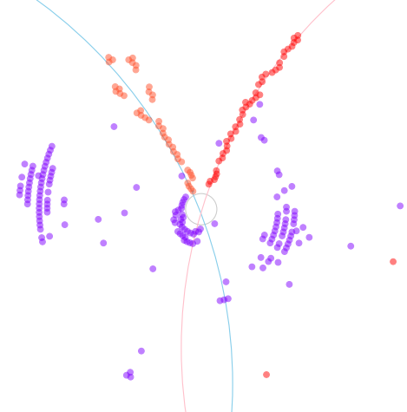
Outline
Background and Motivation
BESIII MDC
GNN approaches
Model structure
Point cloud data
PointNet and PointNet++
Clustering and fitting network
Current Results
training
Clustering
fitting
Difficulties and next step
Clustering problem
Inform physics knowledge attempt
GNN as supplement network for noise classification
Summary

Slide 3
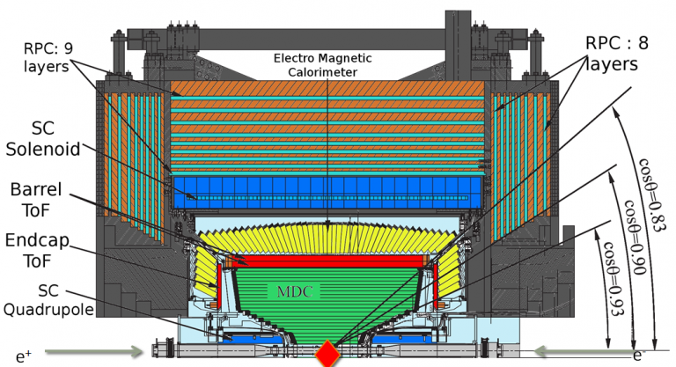
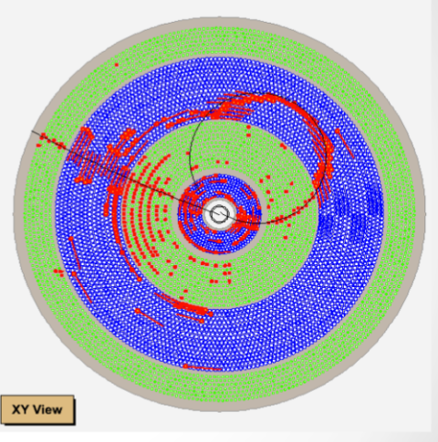
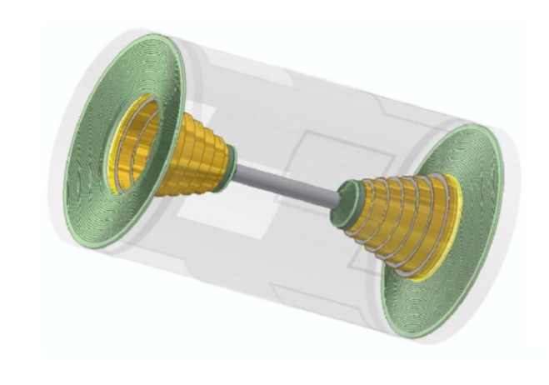
BESIII Main Drift Chamber
Low tracking efficiency and performance for special events
Low transverse momentum
Large dip angle
Secondary vertex
Higher background and noise with the upgrade of BEPCII
The optimization of the tradition tracking algorithm could be risky and challenging
Aim of our work
Explore the new tracking method with novel technics
Hit clustering with the auxiliary of the track parameter regression （Parallel “track finding and fitting” with neural network）
Experiment independent tracking with 2-D measurement (drift chamber)

Slide 4
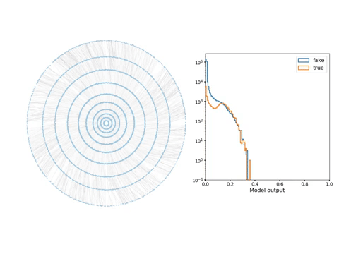
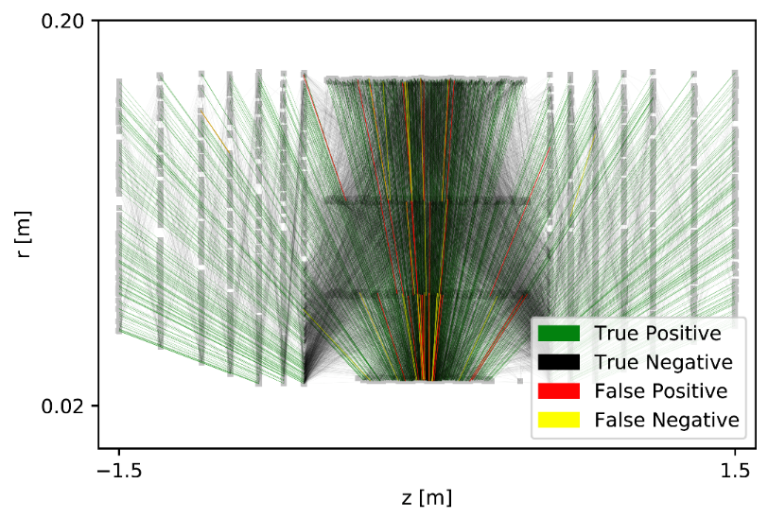
Graph Neural Networks on Track Reconstruction
Graph Neural Networks for Particle Reconstruction in High Energy Physics Detectors has been brought up since 2019 (Exa.Trkx)
Aim: High-luminosity scaling problem
Pros:
Graphs can capture inherent sparsity of much physics data
Cons:
Graph construction is needed
Poor result on clustering

Slide 5
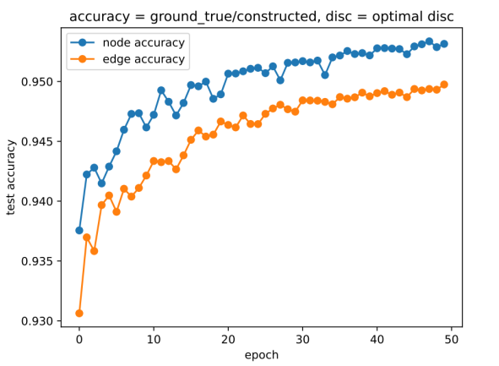
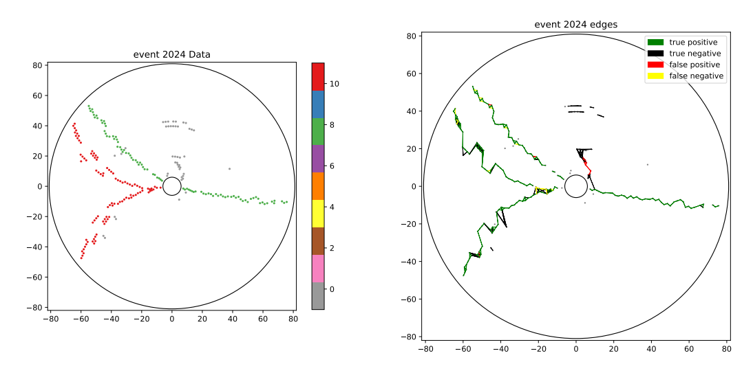
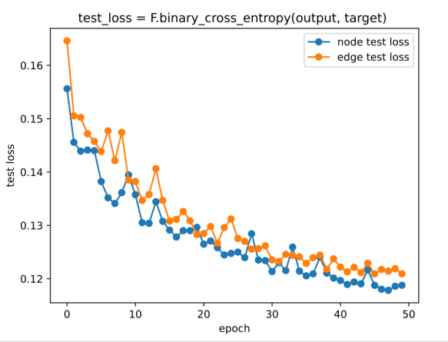
Graph Neural Networks on Track Reconstruction
Our GNN attempts
Good at noise-signal classification
Bad at clustering
Worse results compare to silicon detector data

Slide 6
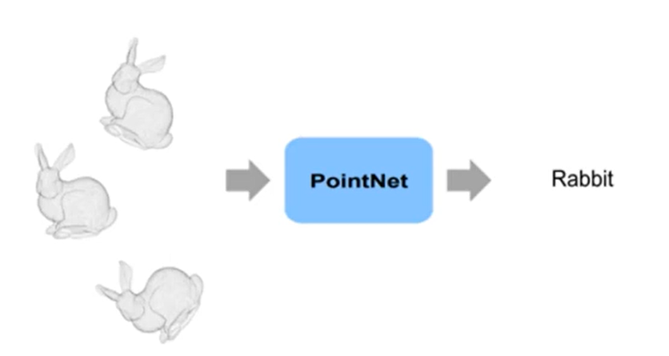
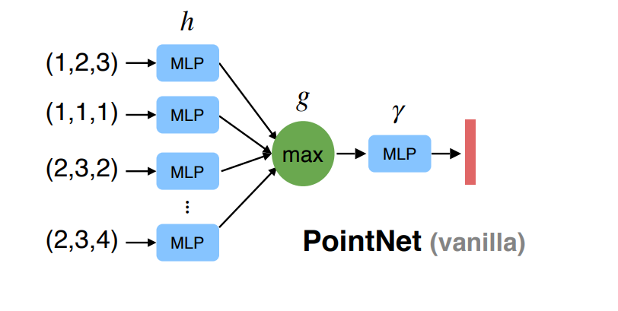
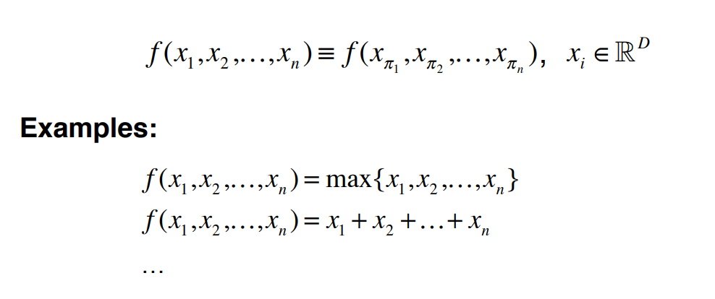
Point cloud data and PointNet
Point cloud data
Unordered point set as input
Invariance under geometric transformations

Slide 7
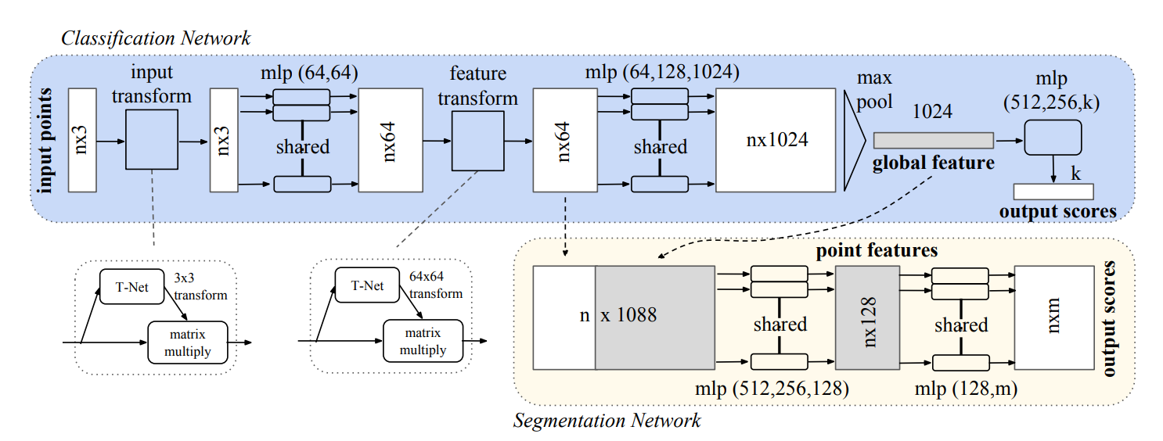
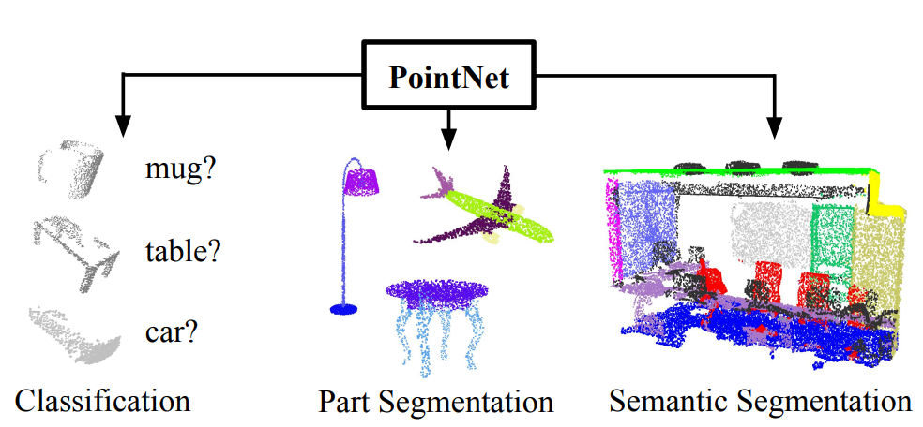
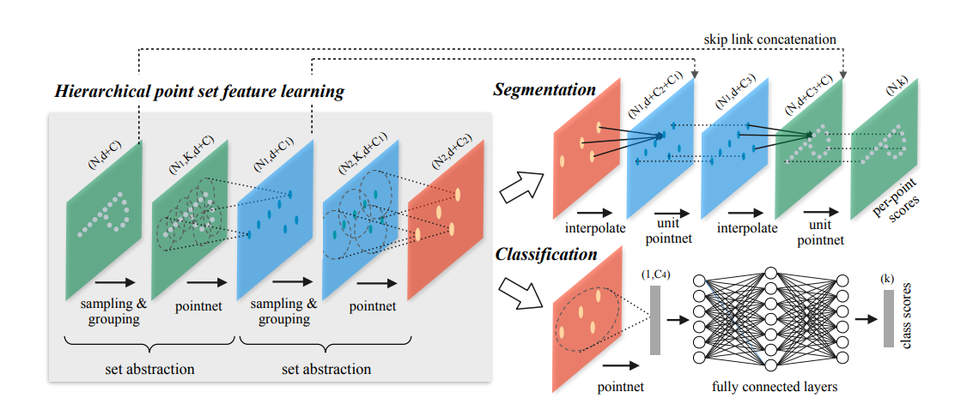
PointNet and PointNet++
PointNet [1] drawbacks:
does not capture local structures
PointNet++ [2]
added hierarchical structure to capture local features

Slide 8
Our Model
PointNet model on BESIII (Main Drift Chamber data)
Input data：Hits(wirePos_x, wirePos_y, rawDriftTime)
Output:
1. track index prediction for each hit (clustering)
2. track parameters for each predicted track (fitting)
Model:

Slide 9
Loss function
Clustering loss
Cross entropy loss for hits clustering
Binary entropy loss of the classification for default numbers of clusters
Track parameters loss
Frobenius Norm Loss

Slide 10
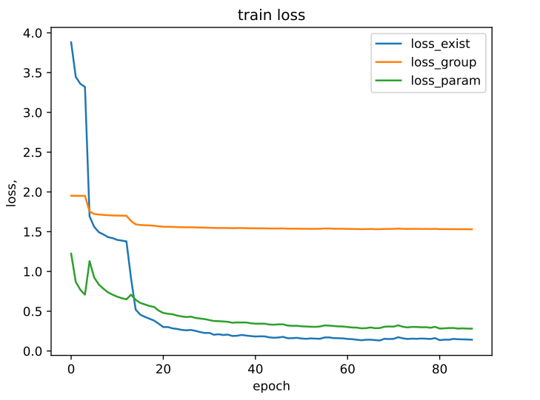
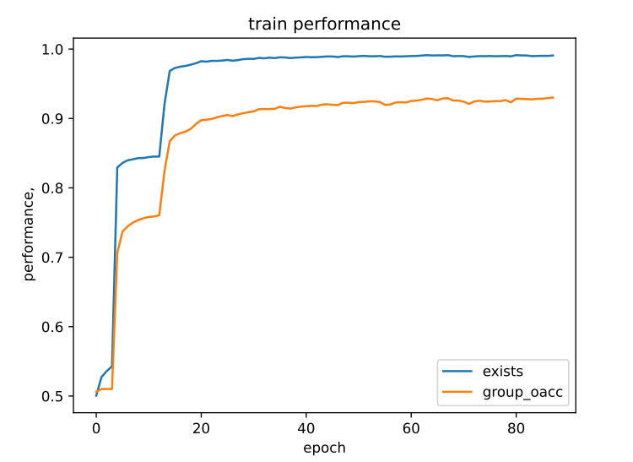
Training results on PointNet model
Data set:
Training: 120k rhoPi events
Validation: 15k rhoPi events (validate every 5 epochs)

Slide 11
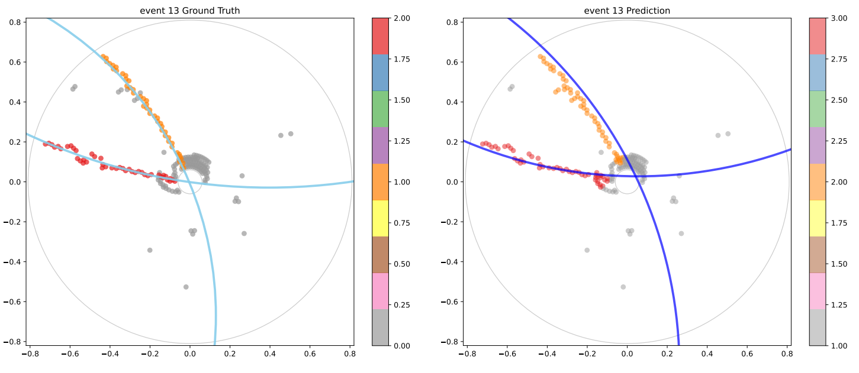
Clustering performance parameter definition
Hits efficiency:
Hits purity:
Tracks efficiency:
Test set1 (15k events)：
Hit eff: 93.33%
Hit purity: 92.08%
Track eff: 93.83%
Test set2 (44k events)：
Hit eff: 93.2%
Hit purity: 92.01%
Track eff: 93.8%

Slide 12
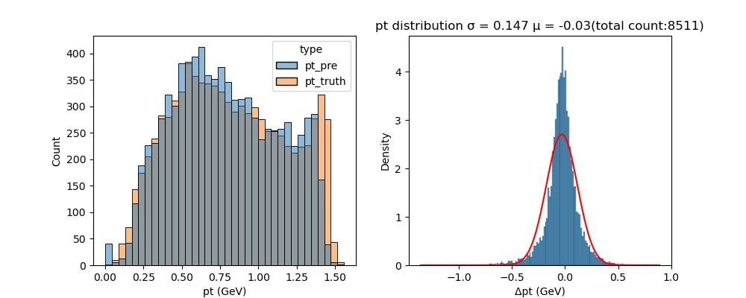
Fitting performance results
Pt distribution

Slide 13
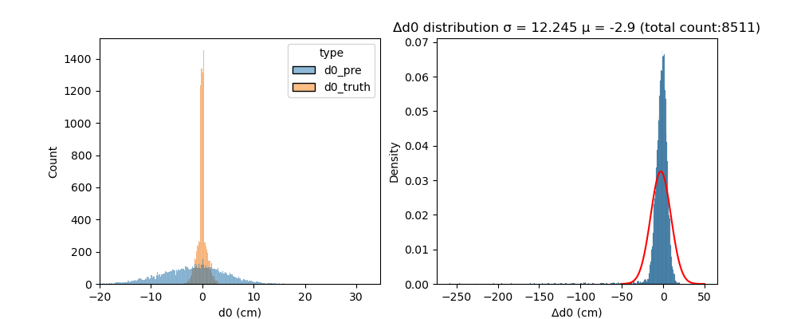
Fitting performance results
d0 distribution

Slide 14
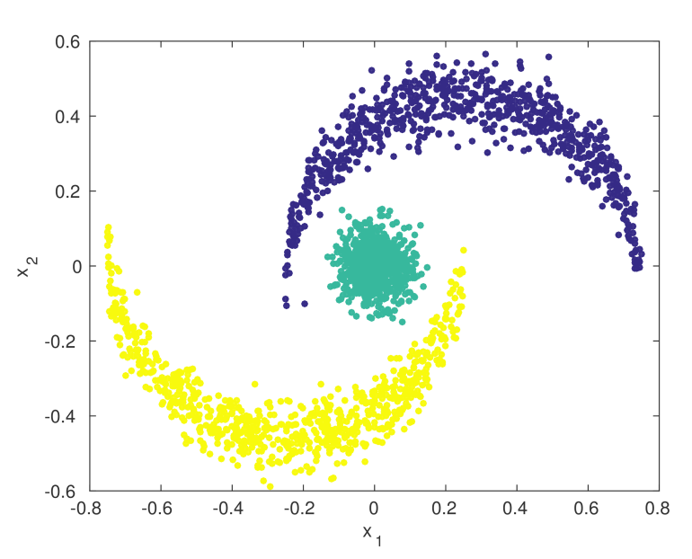
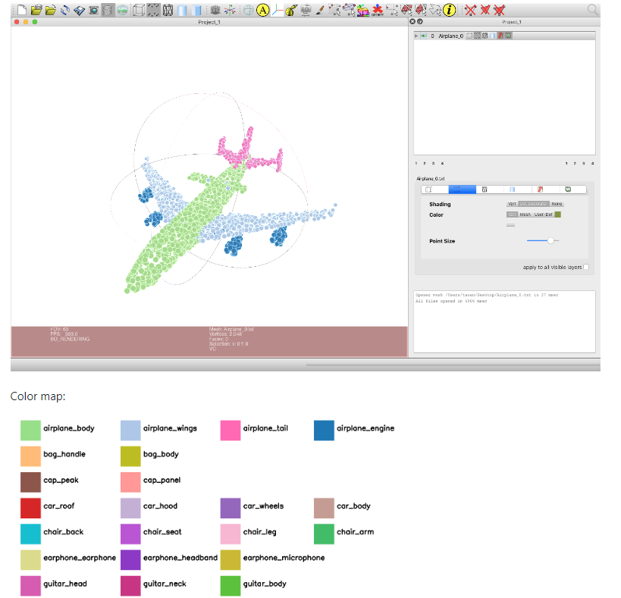
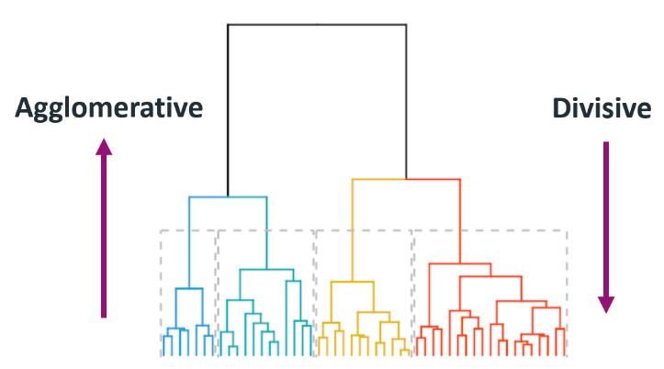
Difficulties and next step
Clustering problem
The numbers of tracks in every event are not sure, it’s more like a unsupervised machine learning.
It’s different from the segmentation problem in PointNet.
Possible solution:
Kernel Spectral Clustering
Hierachical Clustering

Slide 15
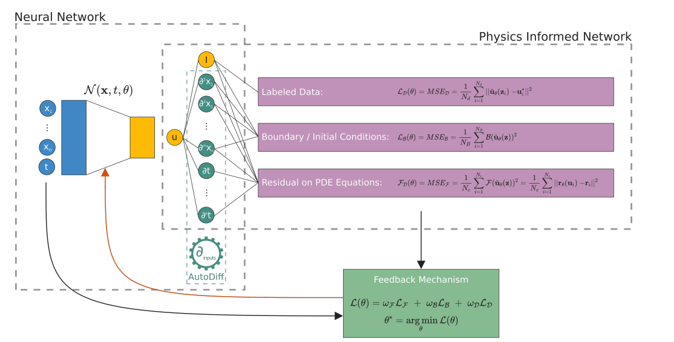
Difficulties and next step
2. Inform physics knowledge attempt
New loss function:
Sum distance from hits to track
(x, y) are wire positions, (cx, cy) are the center of the track circle, r is the radius of the track circle
Similar idea in Physics-informed neural networks [3]

Slide 16
Summary
We propose a novel neural network approach for drift chamber tracking
An end-to-end multi-trajectory tracking
Hit clustering and track estimation simultaneously
Preliminary performance of this work is promising

