Slide 1






国家重点研发计划
R&D and Verification of Key Technologies for a High Energy Circular Electron-Positron Collider
Zhijun Liang for CEPC MOST2 vertex detector team

Slide 2
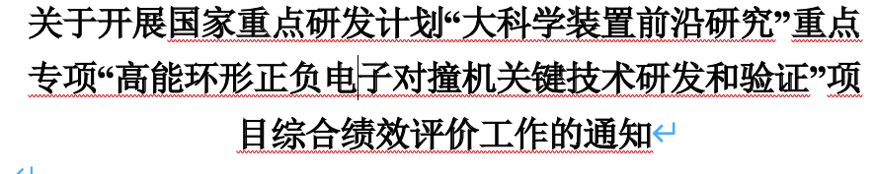
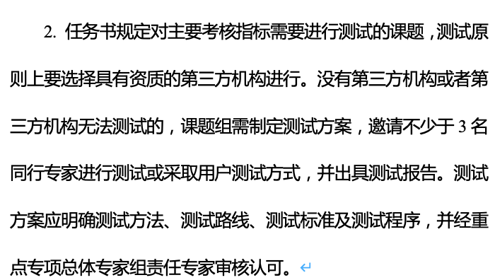
News on MOST2 project
Project timescale （执行期）： up to April 30th ,2023
June 20 –July 21: submission of final reports and review report into MOST2 system
  Reviews on silicon task 2 and reviews on MOST2 project are likely take place in May/June
  Final reports needs to be ready
  Reviews on key parameter (考核指标）

Slide 3
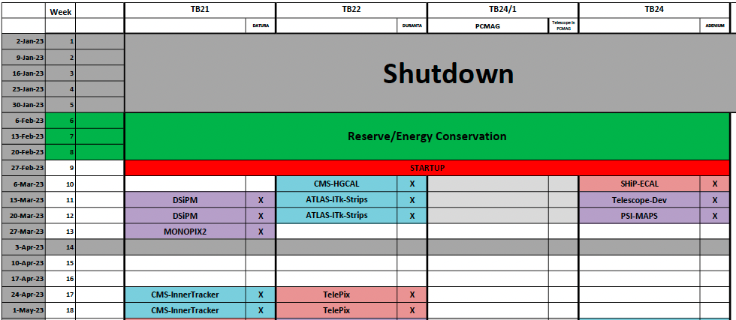
Time line for prototype
Barrel Prototype:
  January : debugging the flex communication
  February: Ladder assembly and testing
  March: Detector assembly
  Early April: Testbeam at BSRF
  Apr 10- Apr 21: Testbeam at DESY

Slide 4
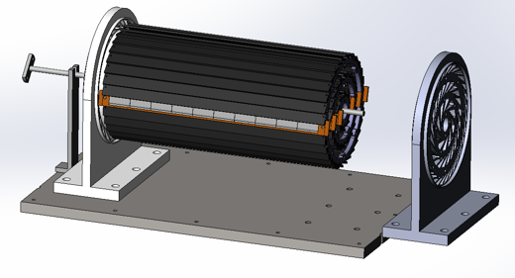
Plan for February
2nd round of flex production :
  submitted, expected to get ~20 more flex in one month (2 metal layer and 4 metal layer)
2nd round of Taichu chip delivery (expect to arrive in 1~2 weeks)
  Wafer level testing, thinning to 100um, dicing
Focus on assembly and testing ladder
  Goal: 12 flexes needed for prototype, 6~10 flex needed for flex based telescope
  Aiming to build 10~12 ladder with 4 metal-layer flex (at least 2 chips on each flex )
  Build ~6 ladder with 2 metal layer flex
  Testing for ladder
    Electronics tests
    Laser tests
    Beta tests

Slide 5
Publication plan
Taichu2 Laser test (NIMA): almost ready for submission
DESY Test beam 1st paper: submission date: before February 15th (!!!)
Paper about prototype testbeam : before May 15th (!!!)
Electronics for ladder and prototype (JINST): (should published before Sep 30th )
Paper about the prototype : (should published before Sep 30th )
Paper of TaichuPix3: (should published before Sep 30th )
Document about irradiation hardness: Before May (!!!)
Final report (结题科技报告）(Before May). (!!!)

