Slide 1
Beta source test for TaichuPix3 FLEX BOARD
Tianya Wu
wuty@ihep.ac.cn
2023.02.02

Slide 2
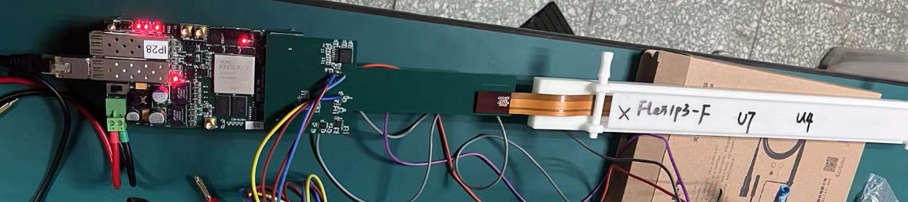
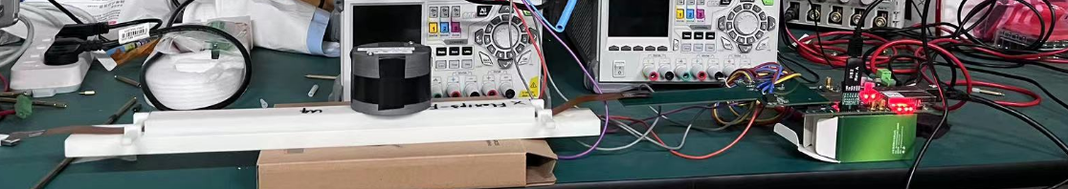
Setup
^{FPGA board}
^{flex with TaichuPix3}
^{Interposer adapter board}
⁹⁰Sr; 54M Bq;
place above flex directly

Slide 3
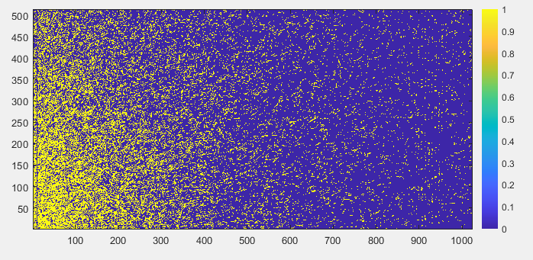
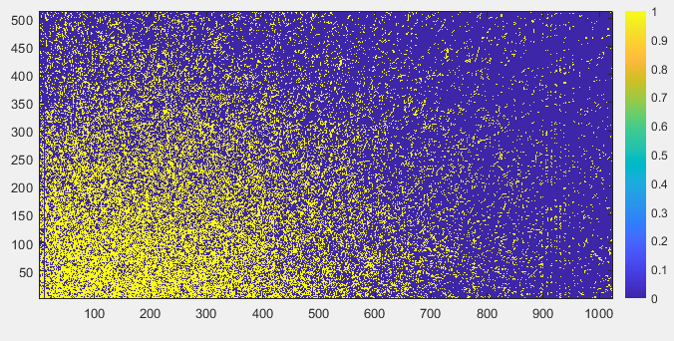
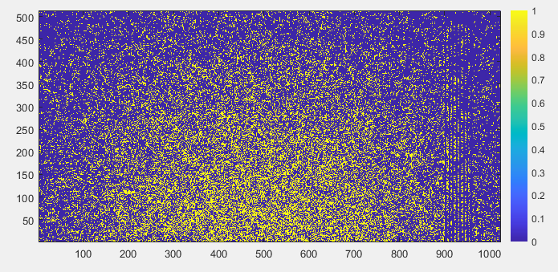
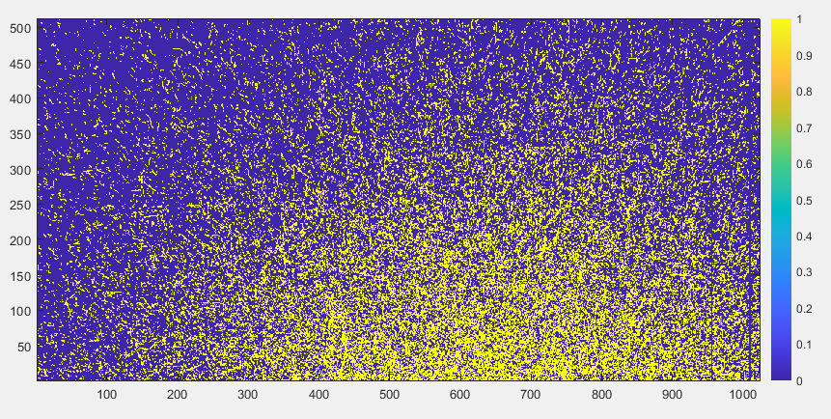
Hitmap
ITHR =126；Power condition：1.8V/0.118A; 1.8V/0.114A; 12V/0.303 ; Data taking for 30s; CLK=15.625MHz
^{Position 1}
^{Position 2}
^{Position 3}
^{Position 4}

Slide 4
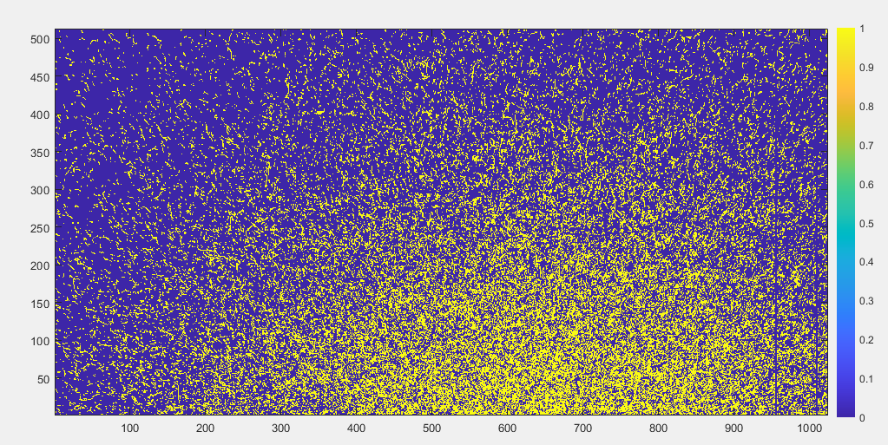
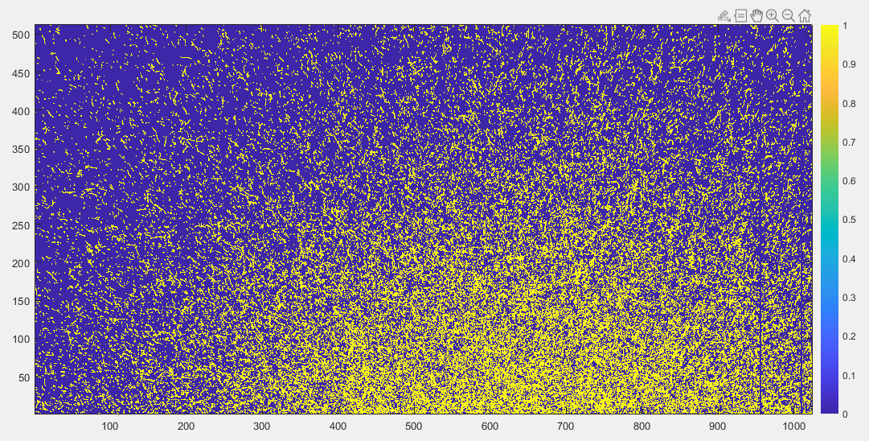
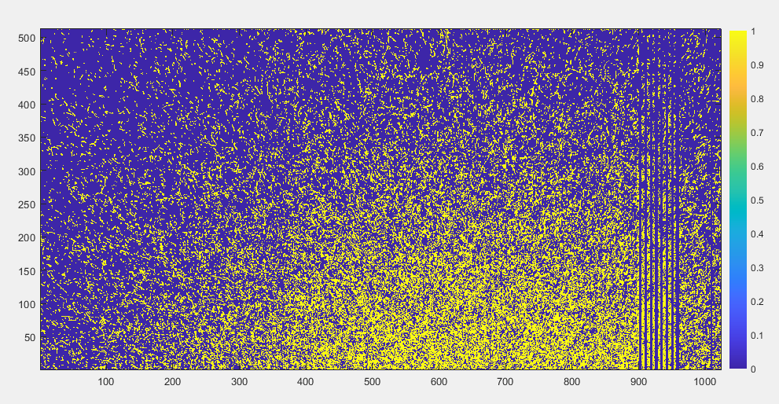
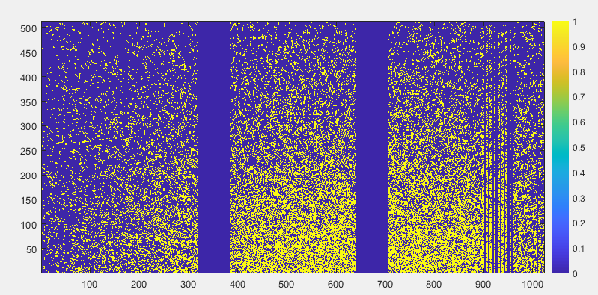
Hitmap
^{ITHR 126}
^{maximum=6}
^{ITHR 126}
^{ITHR 96}
^{maximum=7}
^{ITHR 64}
^{maximum=227}
ITHR 64 data taking after a while

Slide 5
Thanks for your attention!

