Slide 1
Axially deformed relativistic Hartree-Fock-Bogoliubov model and the applications in unstable nuclei
Long, Wen Hui (longwh@lzu.edu.cn)
Lanzhou University
第二届“无中微子双贝塔衰变及相关物理研讨会”,珠海（2023.05.19-22）

Slide 2
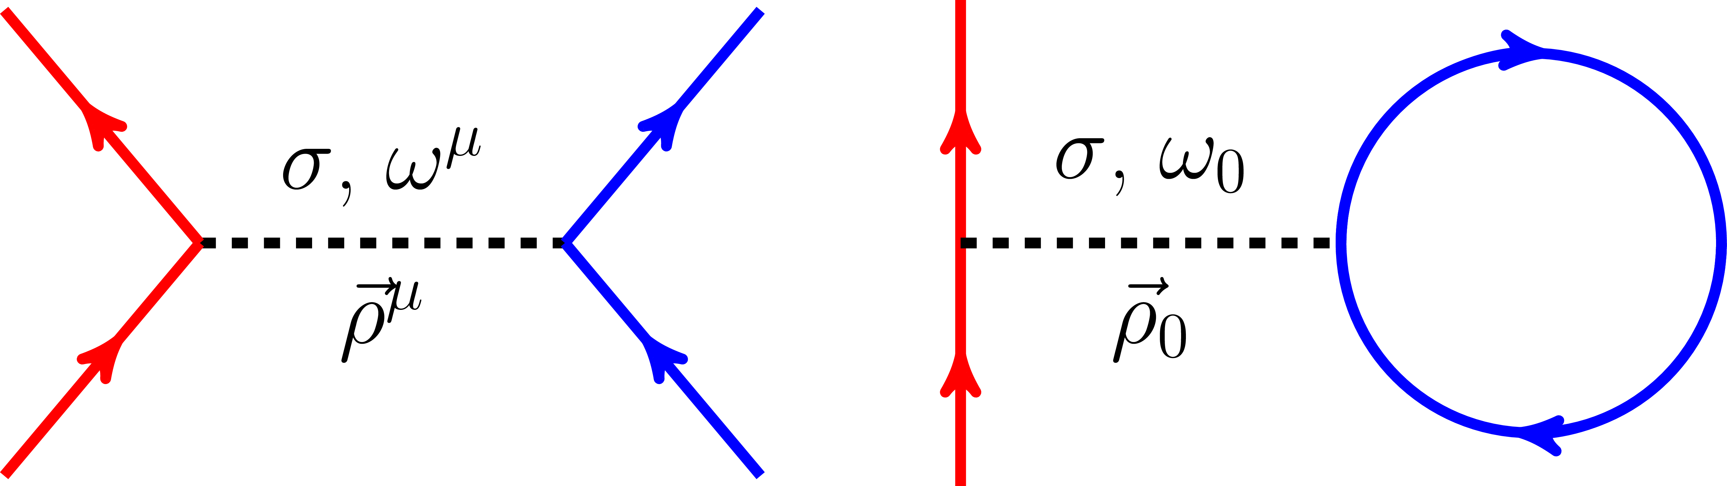
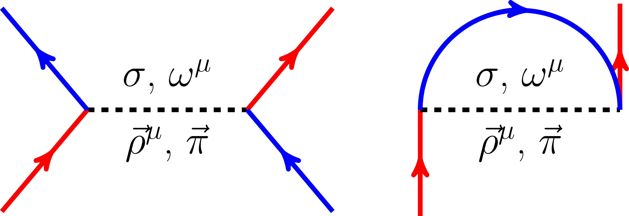
Relativistic Hartree-Fock approach
Background
Nuclear force: meson propagated diagrams ➔ Effective meson fields
Fock terms: exchange correlations between fermions
直接项 (Hartree 项)
交换项 (Fock 项)
Nuclear force contains the central, spin-orbit and tensor force components, etc.
  Spin-orbit couplings is naturally included due to the covariant scheme of the relativity
  $π$-meson, that was supposed to the most important one in propagating nuclear force, contributes only via the Fock terms, and is taken as the main origin of tensor force
Relativistic Hartree-Fock (RHF) theory: Bouyssy (1987), Bernardos (1993), Shi (1995), Marcos (2004), Long (2004-now)
  Fock terms can introduce more many-body correlations, like $π$-PV and $ρ$-T couplings
  Tensor force components are introduced automatically by meson-propagated diagrams
Jiang, Yang, Sun, WHL, Gu, PRC 91, 034326 (2015); Zong, Sun, CPC 42, 024101 (2018)
Wang, Zhao, Liang, WHL, PRC 98, 034313 (2018); Wang, Naito, Liang, WHL, PRC 101, 064306 (2020)

Slide 3

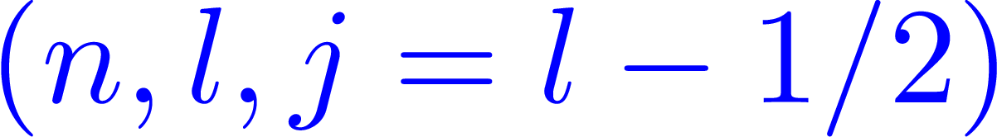
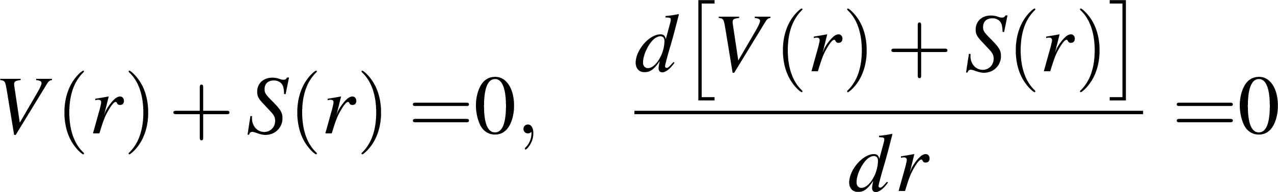
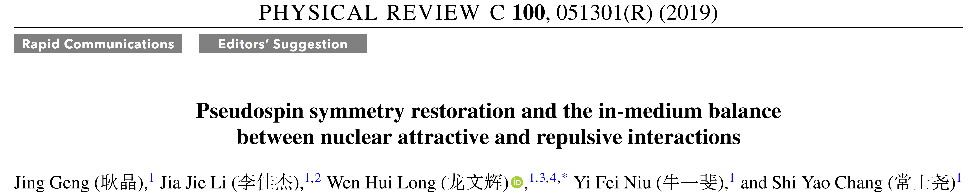
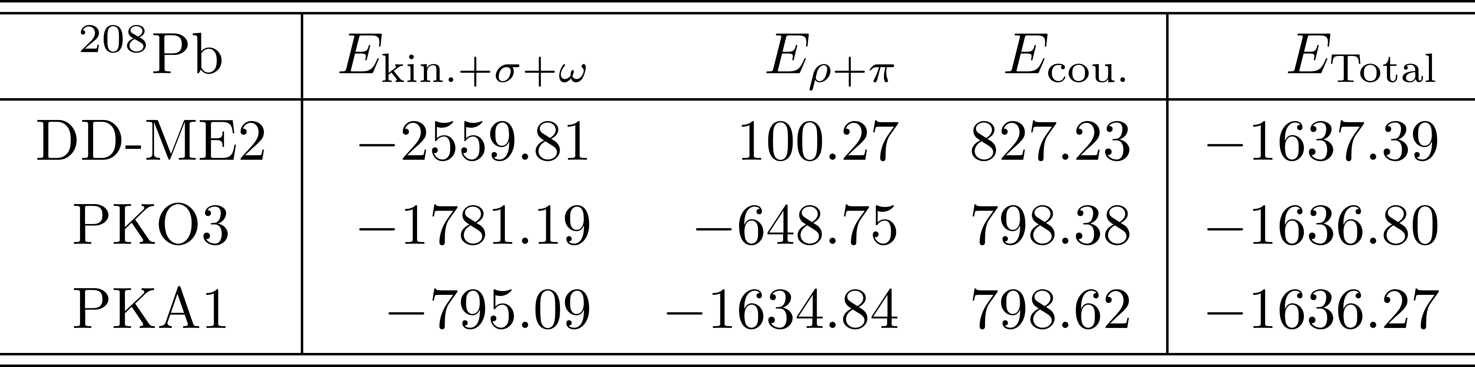
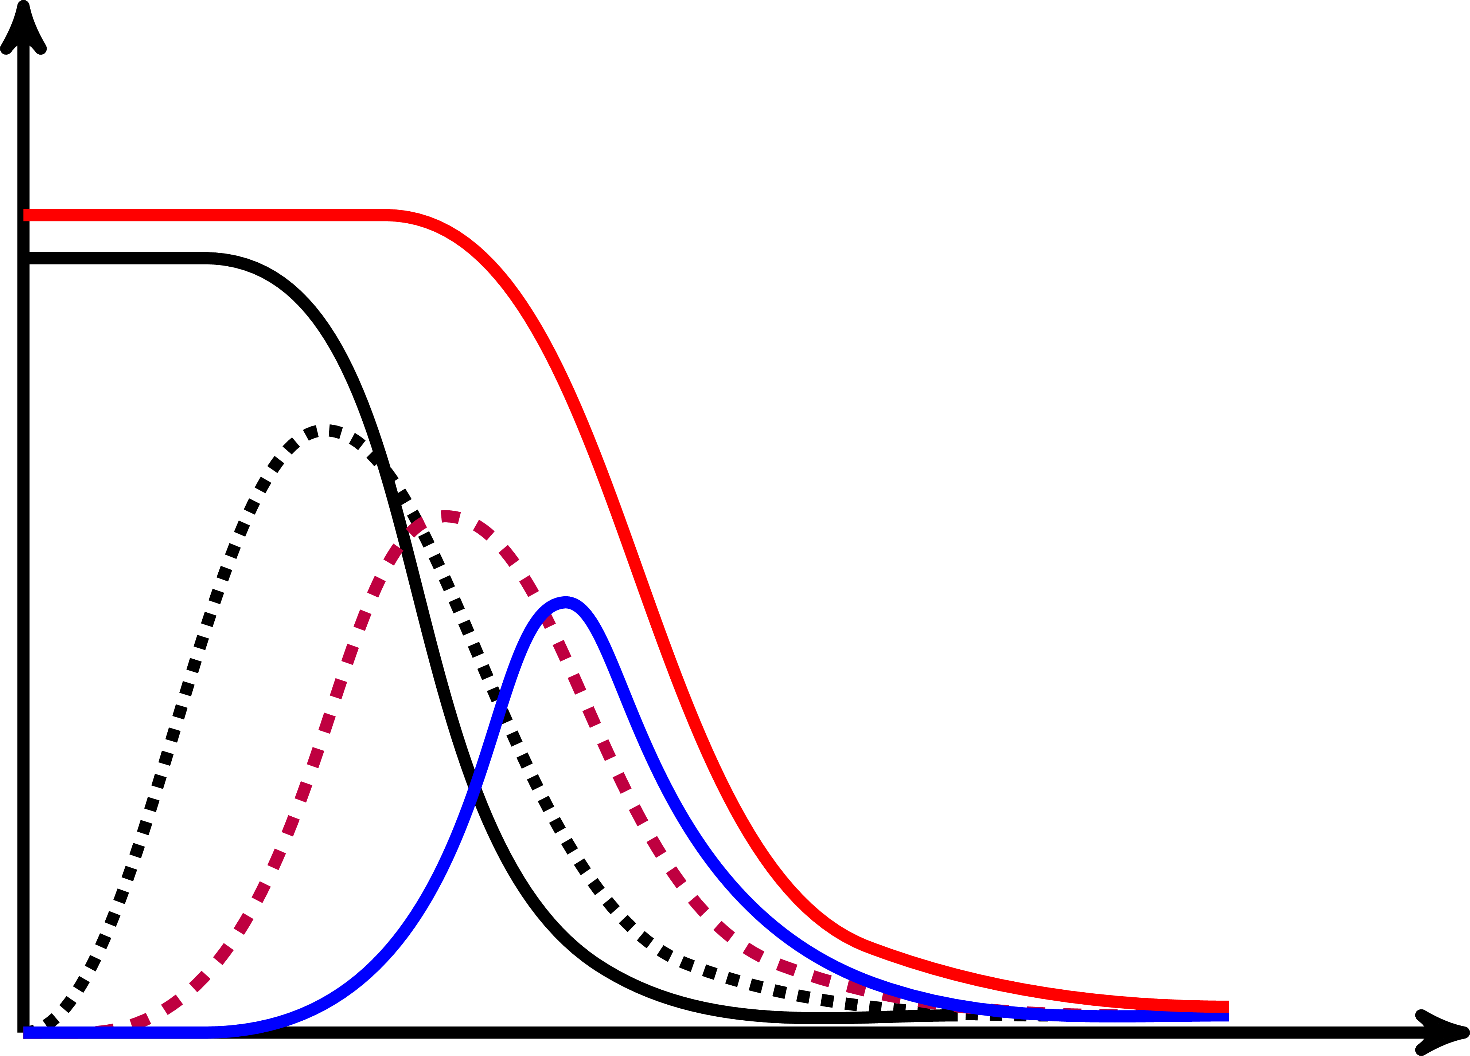
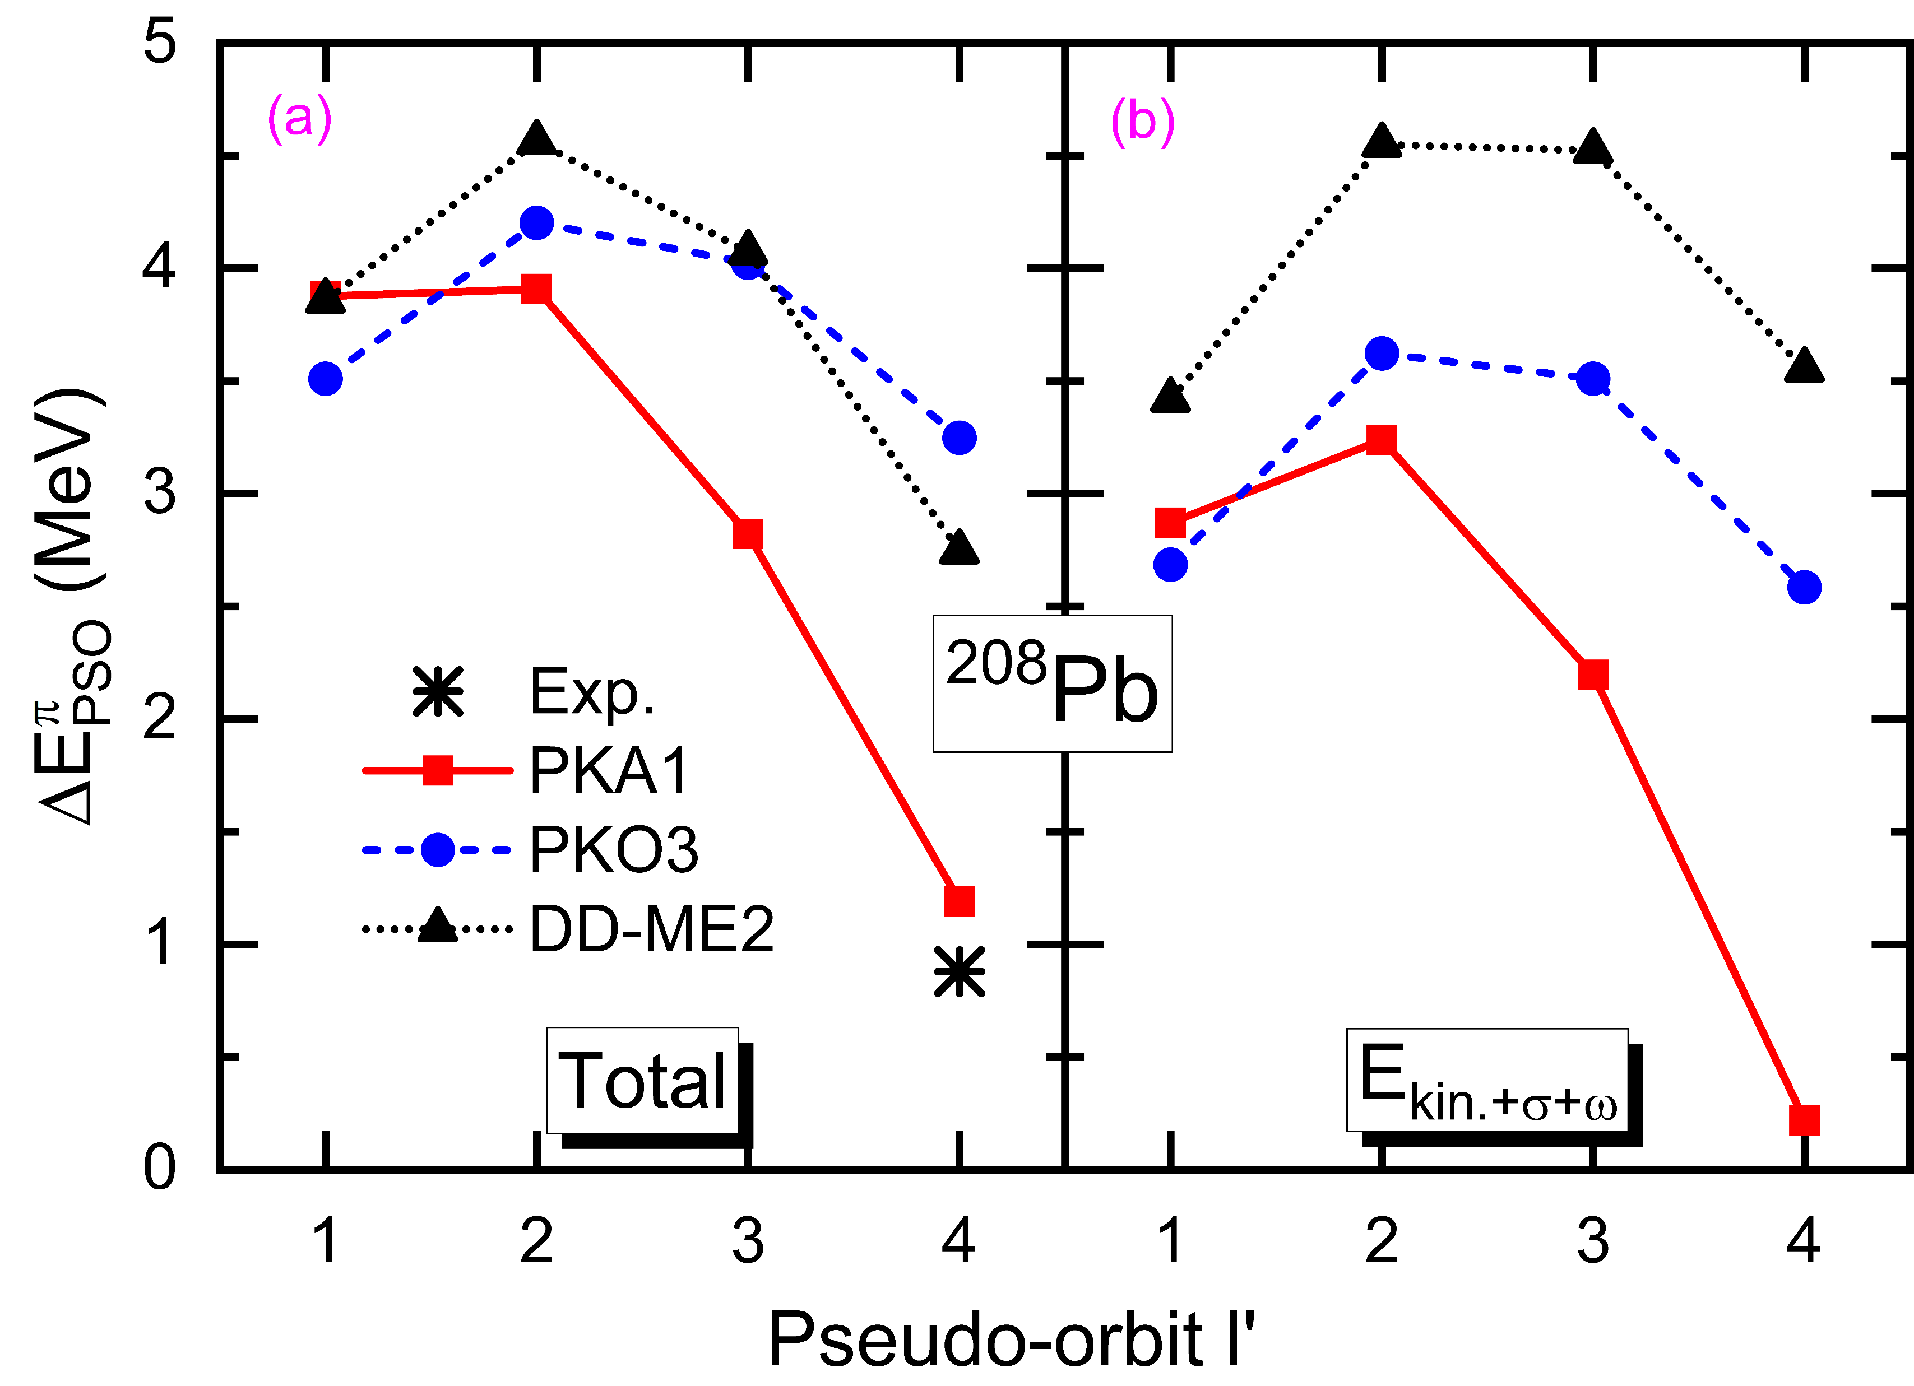
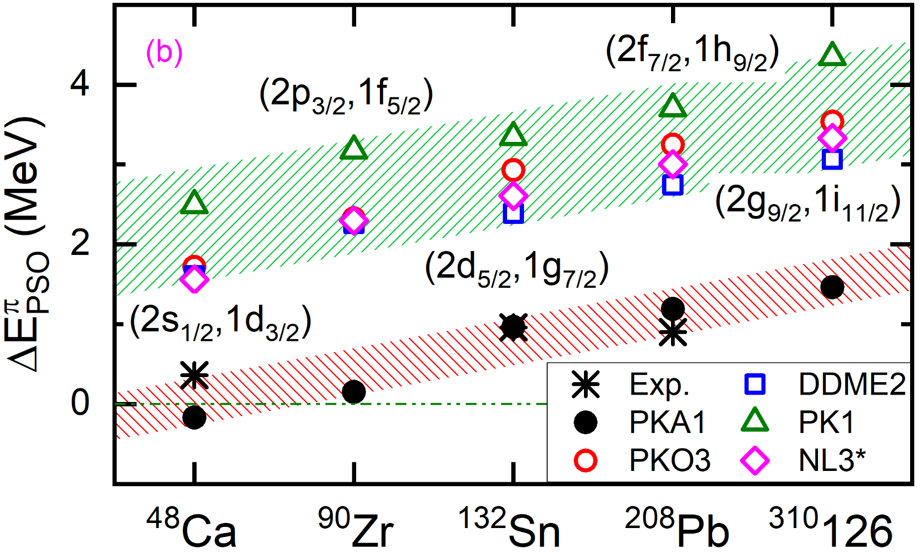
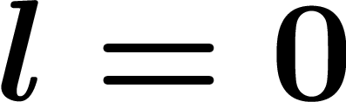





Pseudo-spin symmetry (PSS) restoration
Background
Hecht, Adler, NPA 137, 129 (1969); Arima, Harvey, Shimizu, PLB 30, 517 (1969)
PSS conservation condition and the hint
Delicate balance between nuclear attraction & repulsions
赝轨道 $l’$
Ginocchio (1997, 2005); Meng (1998)
Nuclear binding
Nuclear in-medium effects
原子核密度分布 $ρ_{b}$

Slide 4
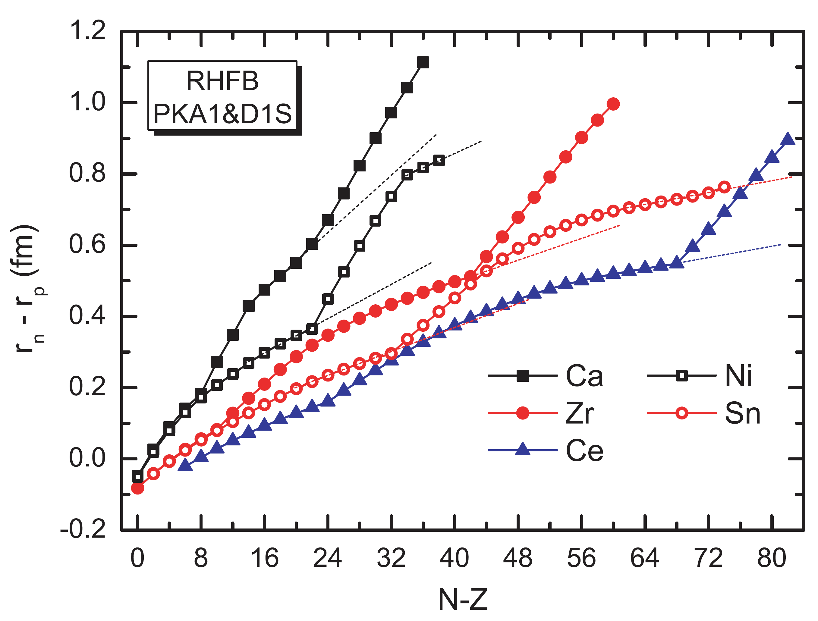
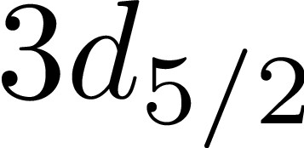
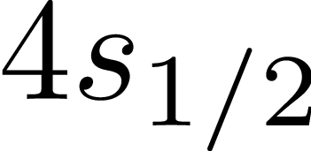
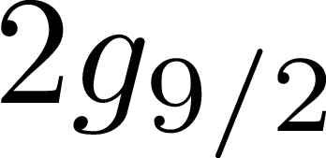
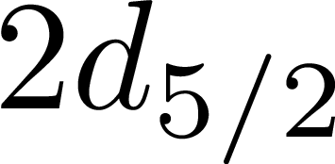
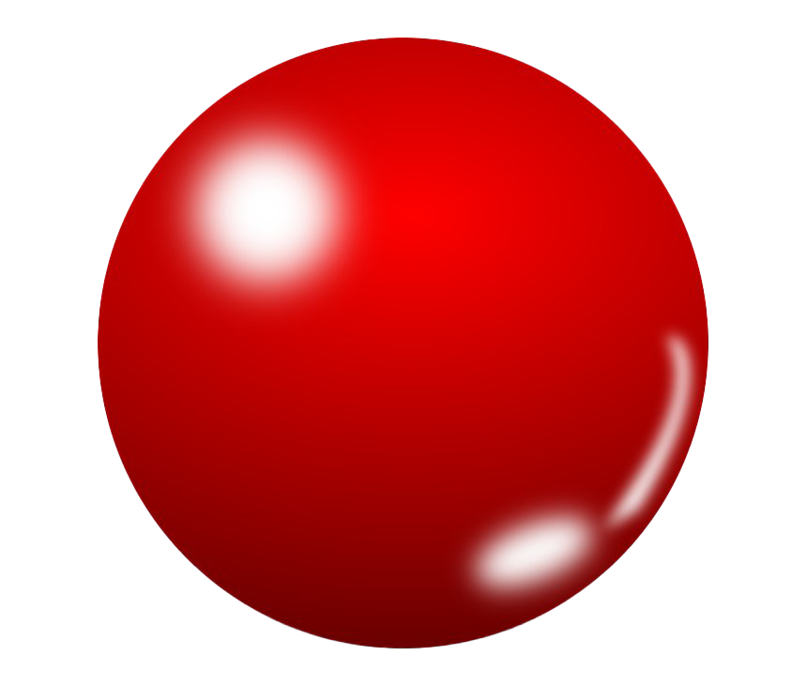
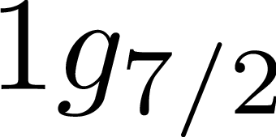
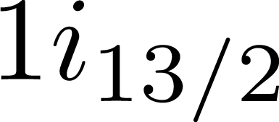
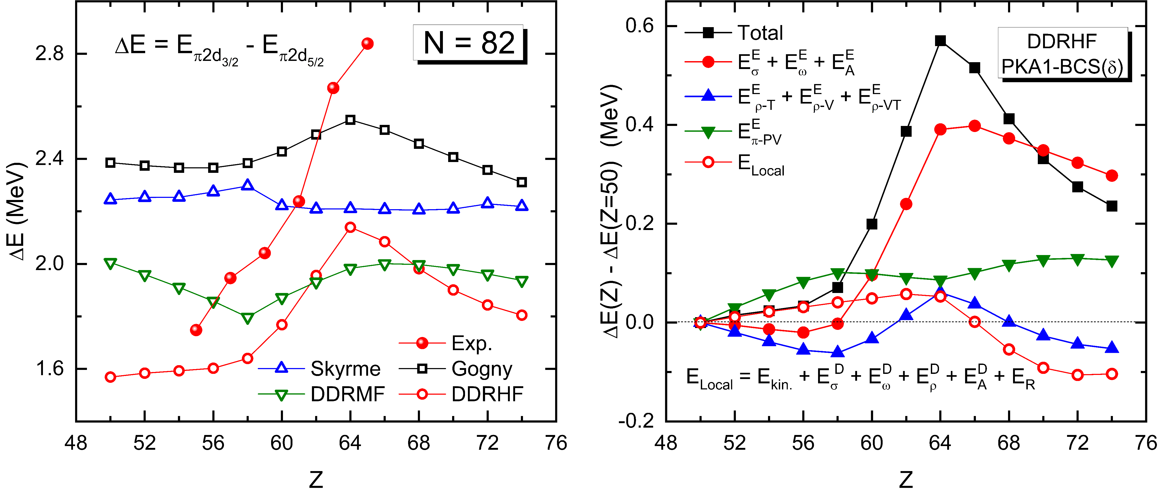
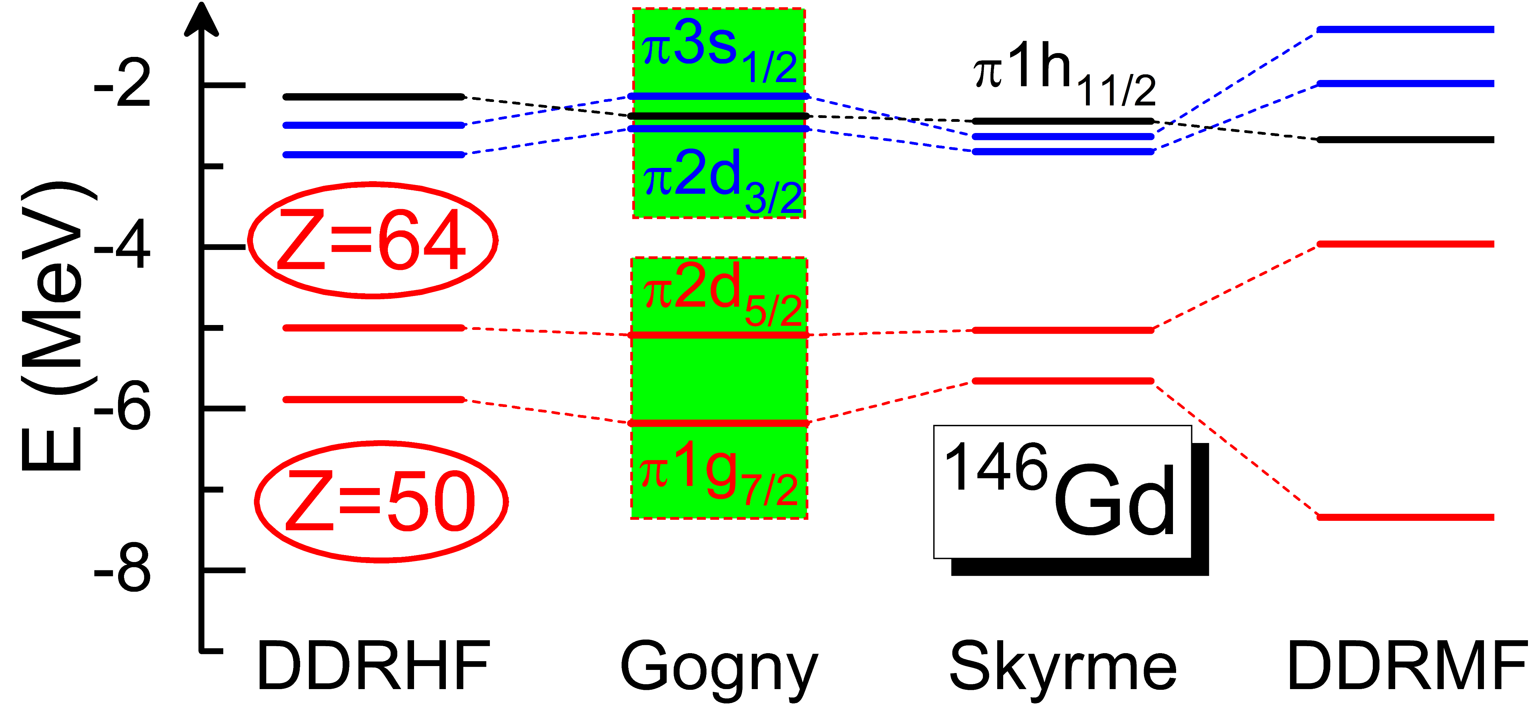
PSS vs Halo and Shell Occurrence
Background
PSS restoration and halo occurrence
WHL, Ring, Meng, Giai, Bertulani, PRC 81, 031302(R) (2010)
PSS & squeezed N=126 shell connected by np interactions
Proton PSS
Breaking
Proton PSS
Restored
N=126
Z=58
N=126
Z=50
Z=50
$ρ$-T coupling plays an important role via Fock terms
PSS restoration and sub-shell Z=64
Essential role played by Fock terms
PLB 680, 428 (2009)

Slide 5
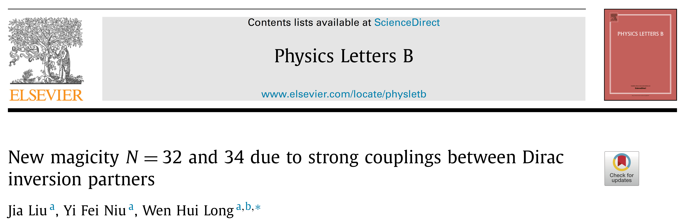
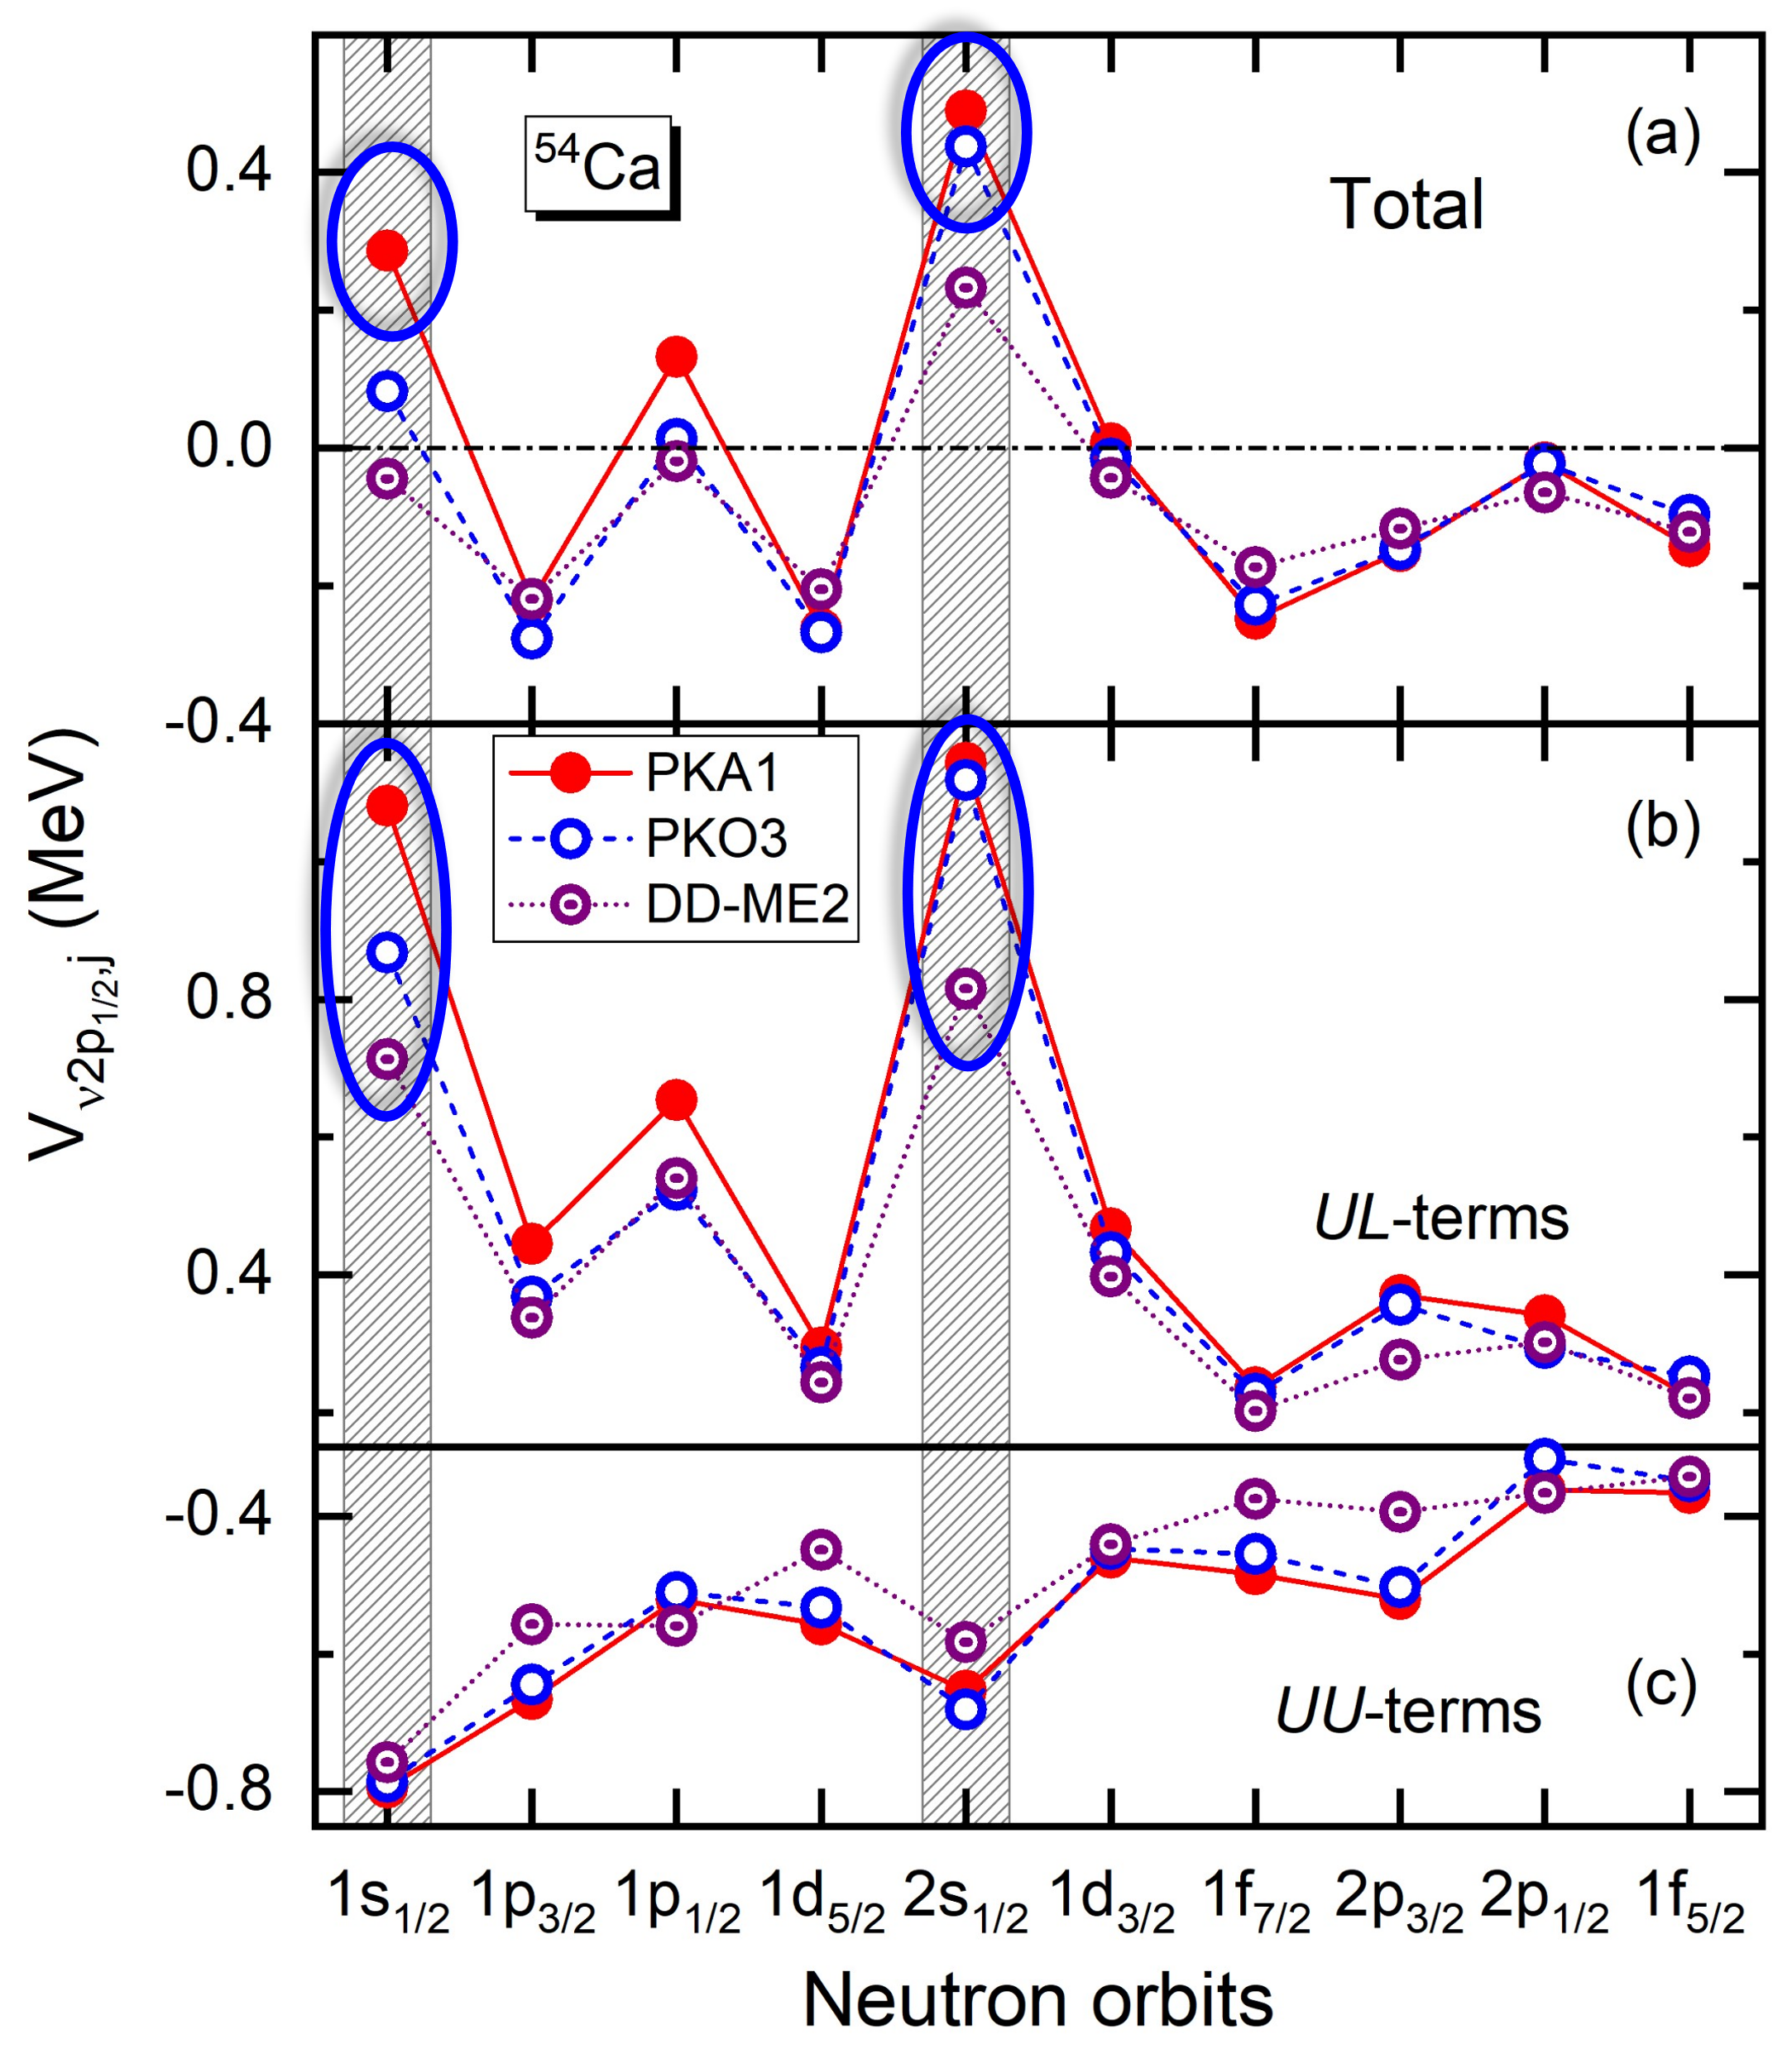
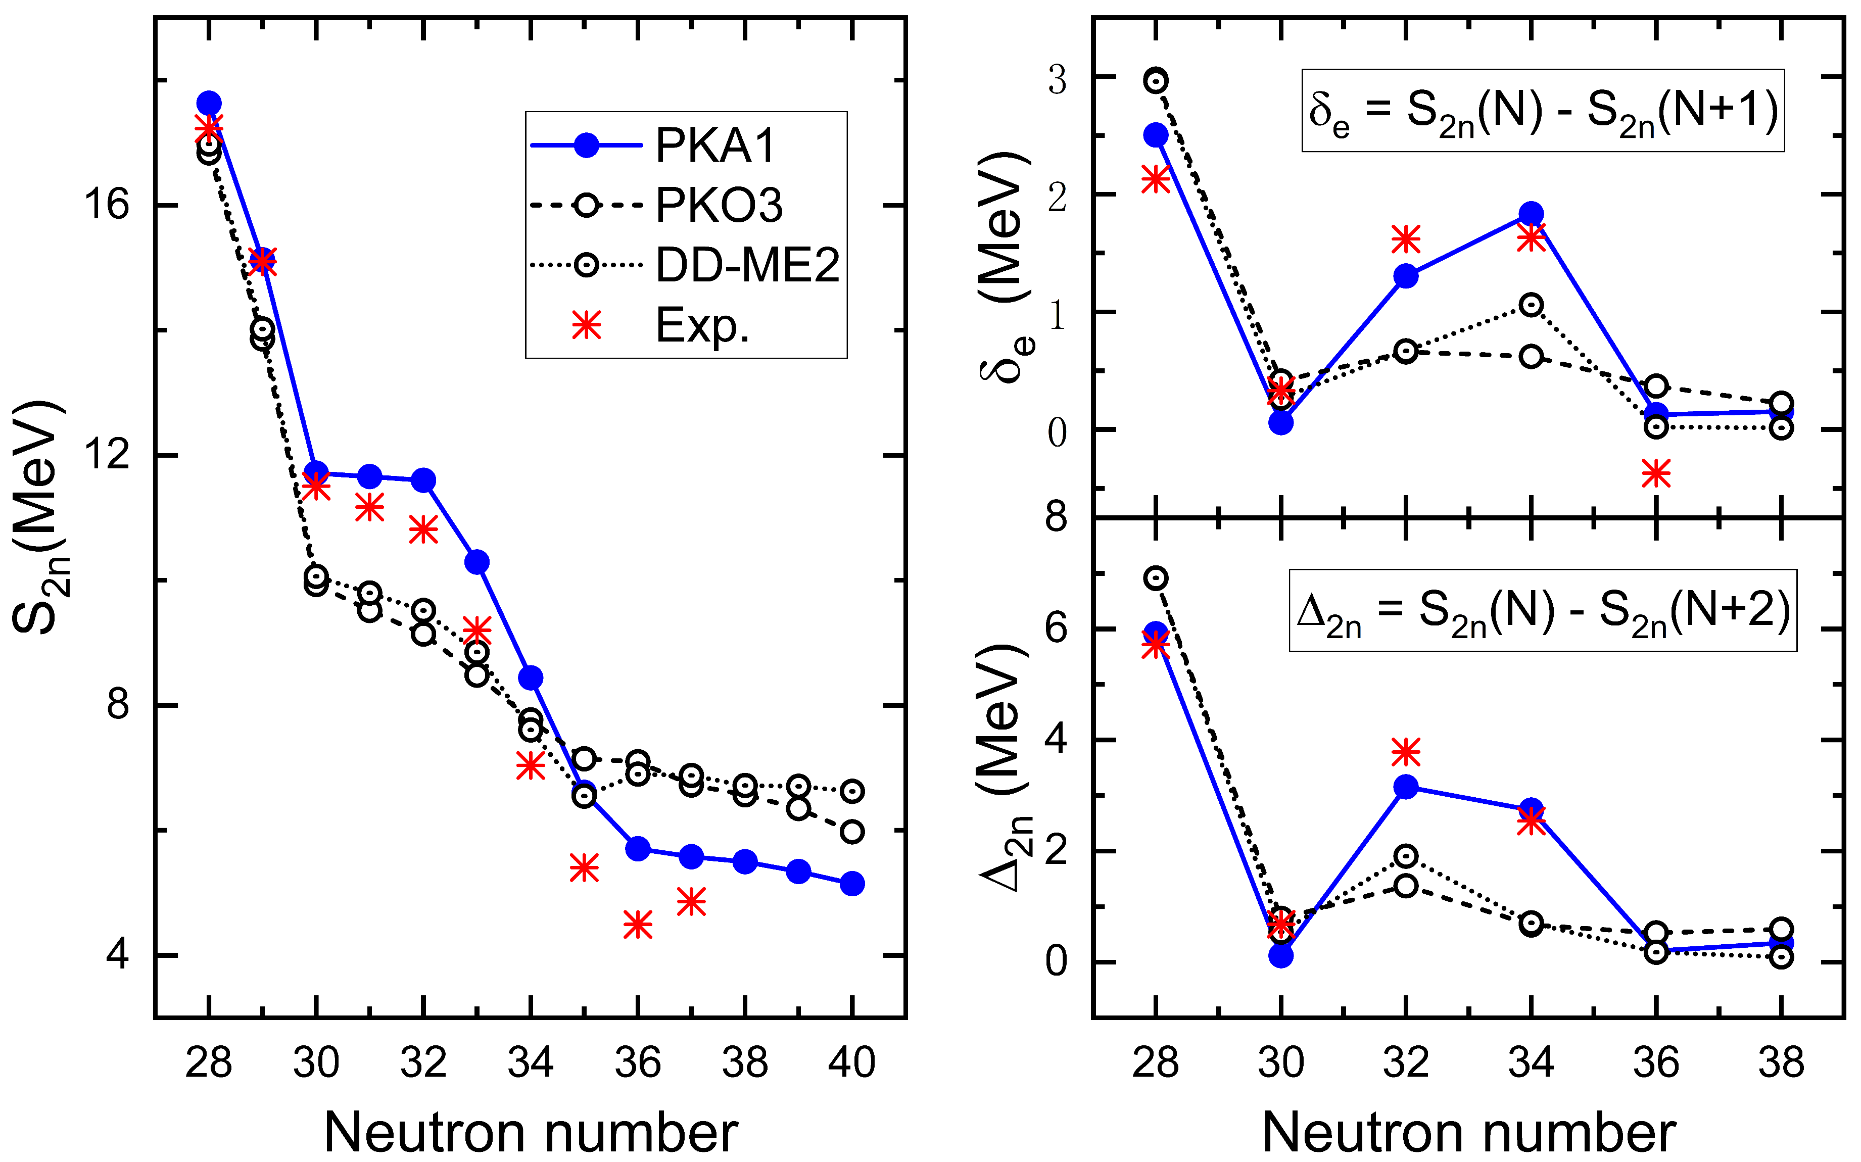
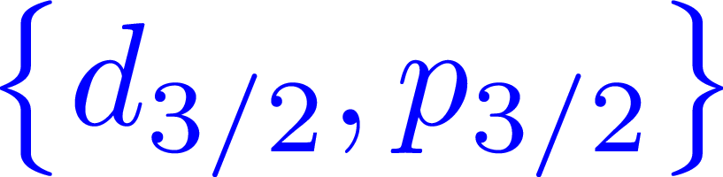


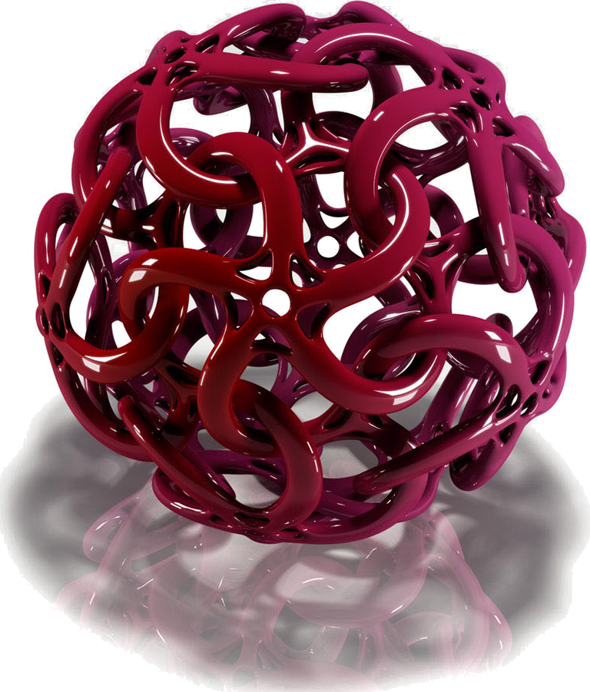





New magicity N=32 & 34
Background
New magicity in ^{52, 54}Ca
上分量
下分量
$$l=0$$
$$l=1$$
上分量
下分量
PKA1 contains $π$-PV and $ρ$-T couplings
$$l′=1$$
$$l′=0$$
$$s_{1/2}$$
$$p_{1/2}$$
DIPs $\left(s_{1/2}, p_{1/2}\right)$ 波函数的特殊狄拉克形式
Dirac inversion partners (DIPs)
PLB 806, 135524 (2020)
Exp.: Chinese Physics C 41 (2017); Phys. Rev. Lett. 121, 022506 (2018).

Slide 6
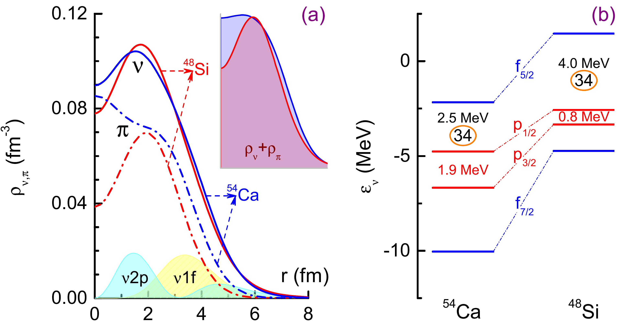
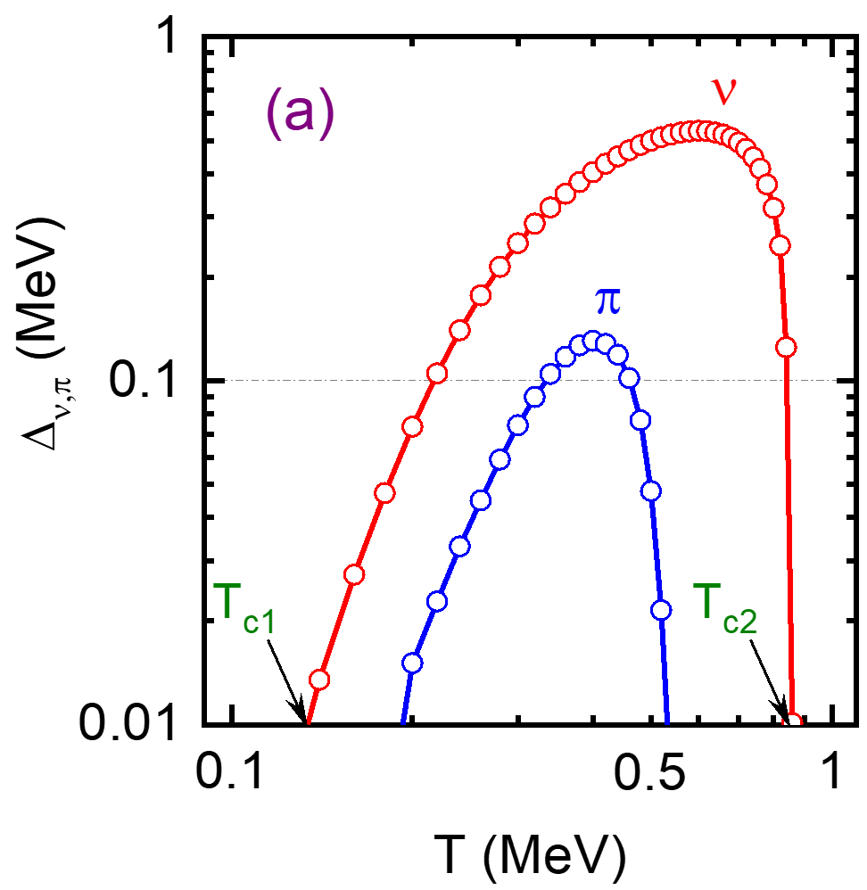
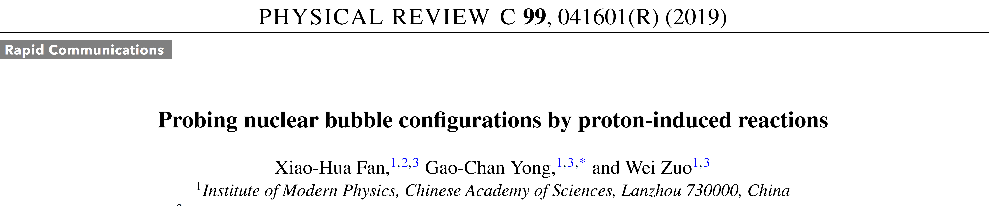
⁴⁸Si: typical candidate of novelity
Background
⁴⁸Si is predicted to have dual bubble-like structure and doubly magic nature
质子诱导反应探索原子核气泡结构
Along the beam direction, more energetic protons are emitted with a bubble configuration in the arget

Slide 7
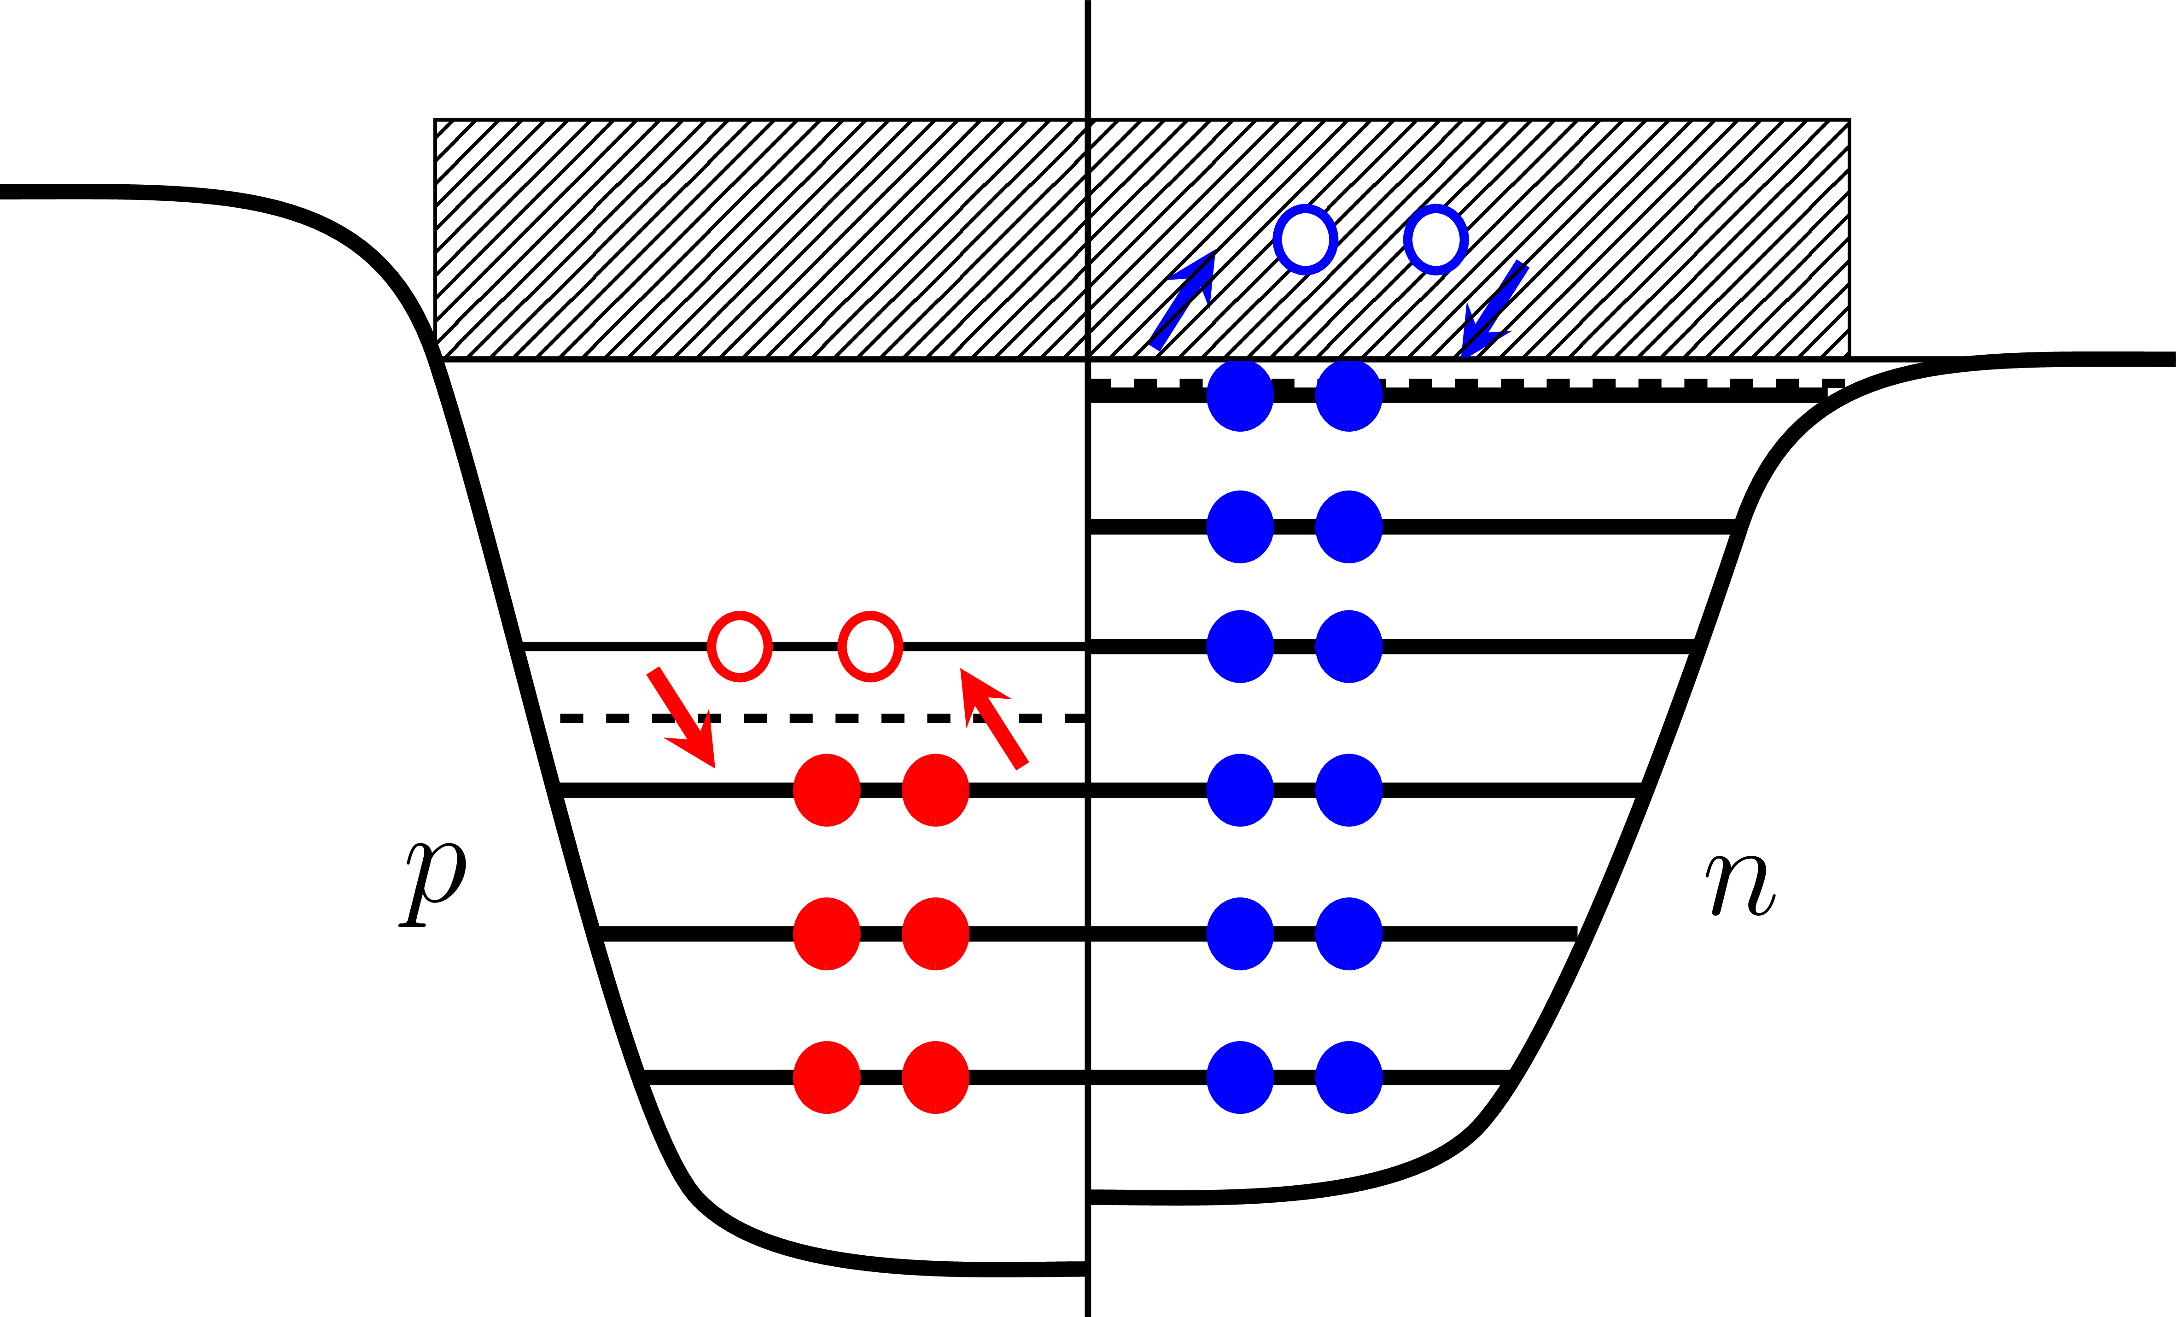
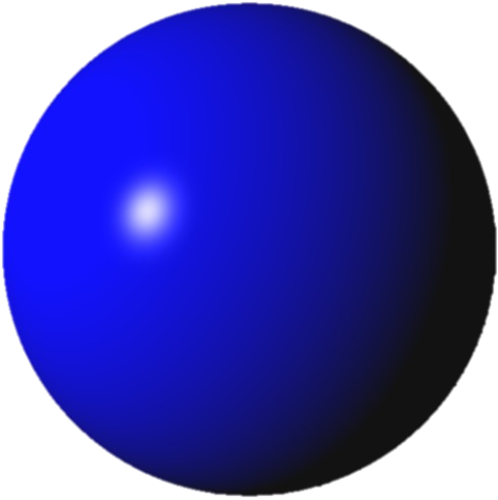

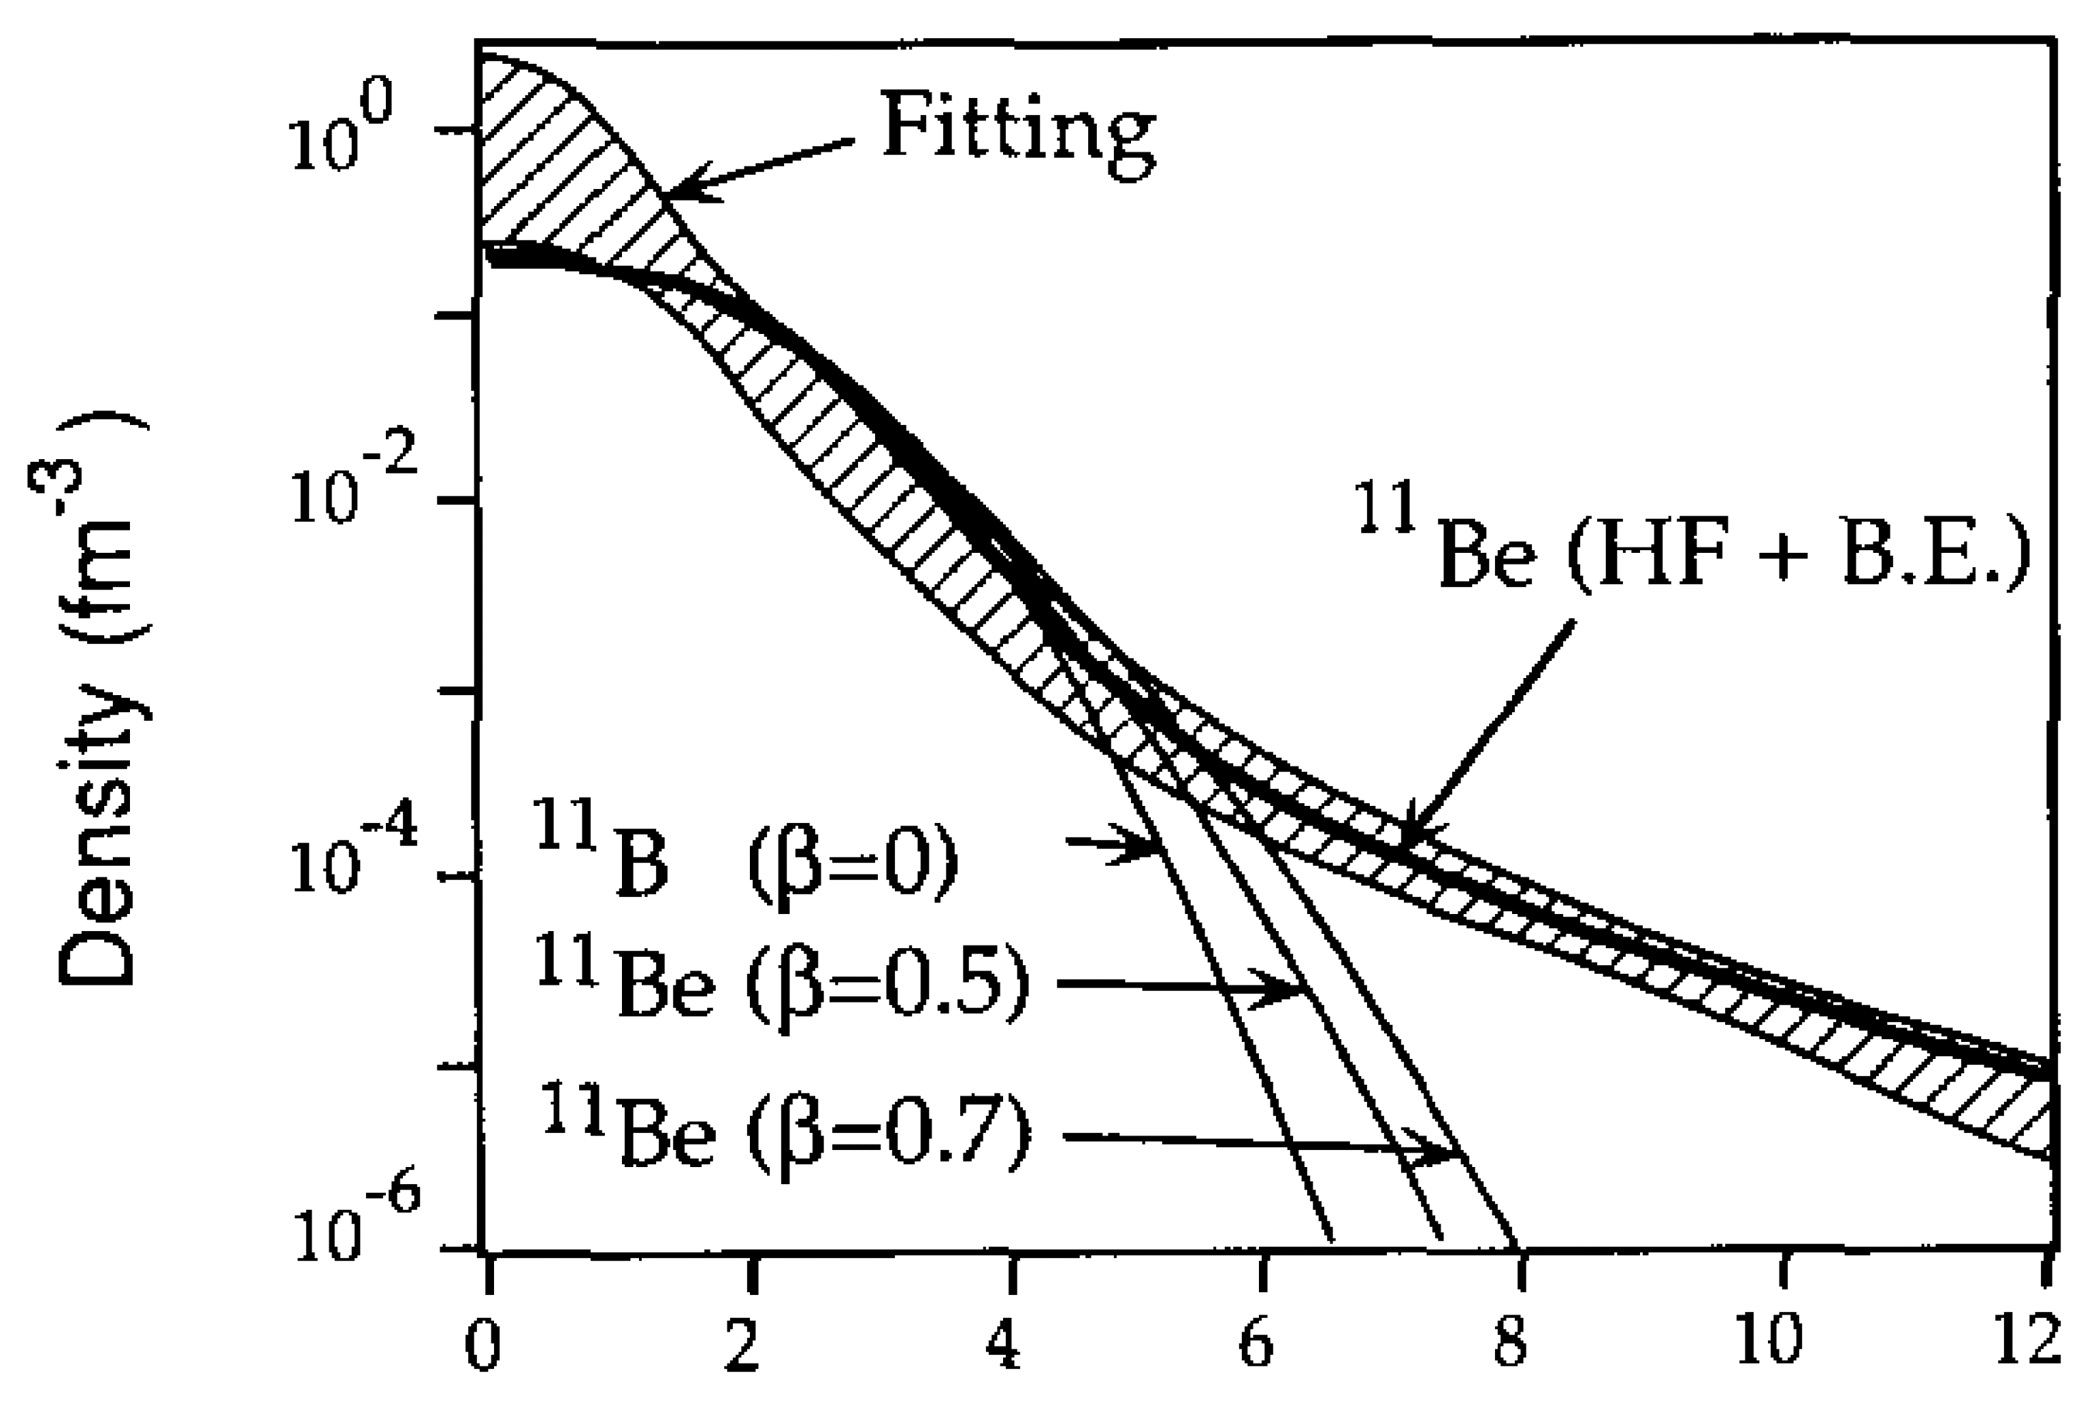
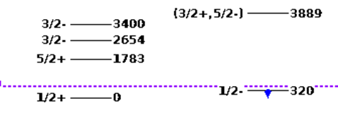
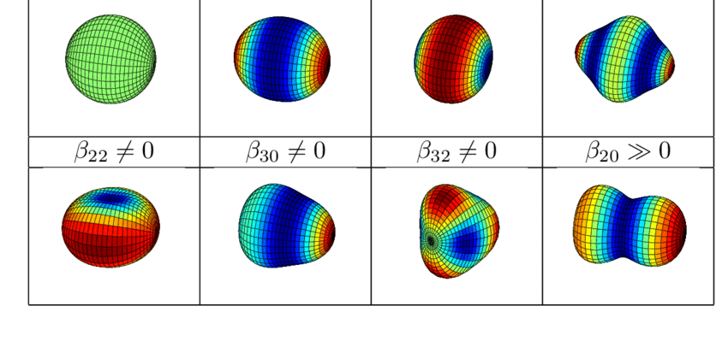
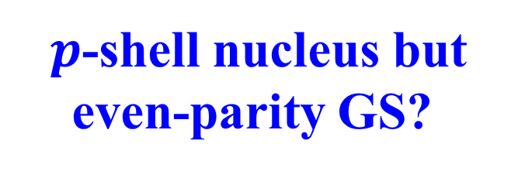
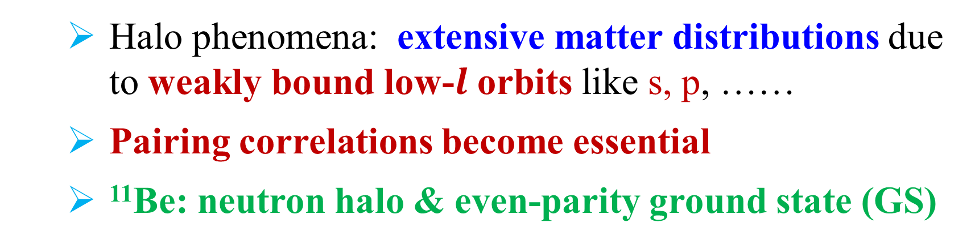
Challenges in unstable nuclei
Motivations
Unstable Nuclei: weakly bound many-body systems
Microscopic systems reaching the limit of binding
Novel nuclear phenomena: weak binding mechanism
Halo phenomena: extensive matter distributions due to weakly bound low-$l$ orbits like s, p, ……
Pairing correlations become essential
¹¹Be: neutron halo & even-parity ground state (GS)
Halo
$p$-shell nucleus but even-parity GS?
Wilkinson, Alburger, PR 113,563 (1959)
Donovan et al., PR 123, 589 (1961); Alburger et al., PR 136, B916 (1964); Deutsch et al., PLB 28, 178 (1968)
Talmi, Unna, PRL 4, 469 (1960)
Fukada et al, PLB 268, 339 (1991); Aumann et al., PRL 84, 35 (2000); Schmit et al. PRL 108, 192701 (2012)
Deformation

Slide 8
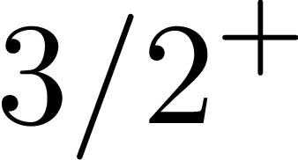
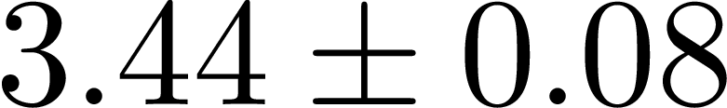
Halo phenomena in Carbon isotopes
Motivations
One-neutron halo in ¹⁹C is proved experimentally but not for ¹⁷C
  Narrow longitudinal momentum peak and large cross section
Bazin et al., PRL 74, 3569 (1995); Bazin et al., PRC 57, 2156 (1998)
  Halo radius in ¹⁹C: from $5.5±0.3$ fm (1999’s Exp.) to $6.4±0.7$fm (2016’s Exp.)
Nakamura et al., PRL 83, 1112 (1999); Kanungo et al., PRL 117, 102501 (2016)
  Ground state of ¹⁷C is : $d$-wave
Suzuki et al., PLB 666, 222 (2008)
Two-neutron halo in ²²C: significantly larger cross section than ^{19, 20}C
  Matter radius： fm
Togano et al., PLB 761, 412 (2016)
Deformation effects & inversion of sd states: halo is shrunk
Sun, Zhao, Zhou, PLB 785, 530 (2018)
Deformation effects and halo occurrence in C isotopes
Fock terms may bring some difference!

Slide 9
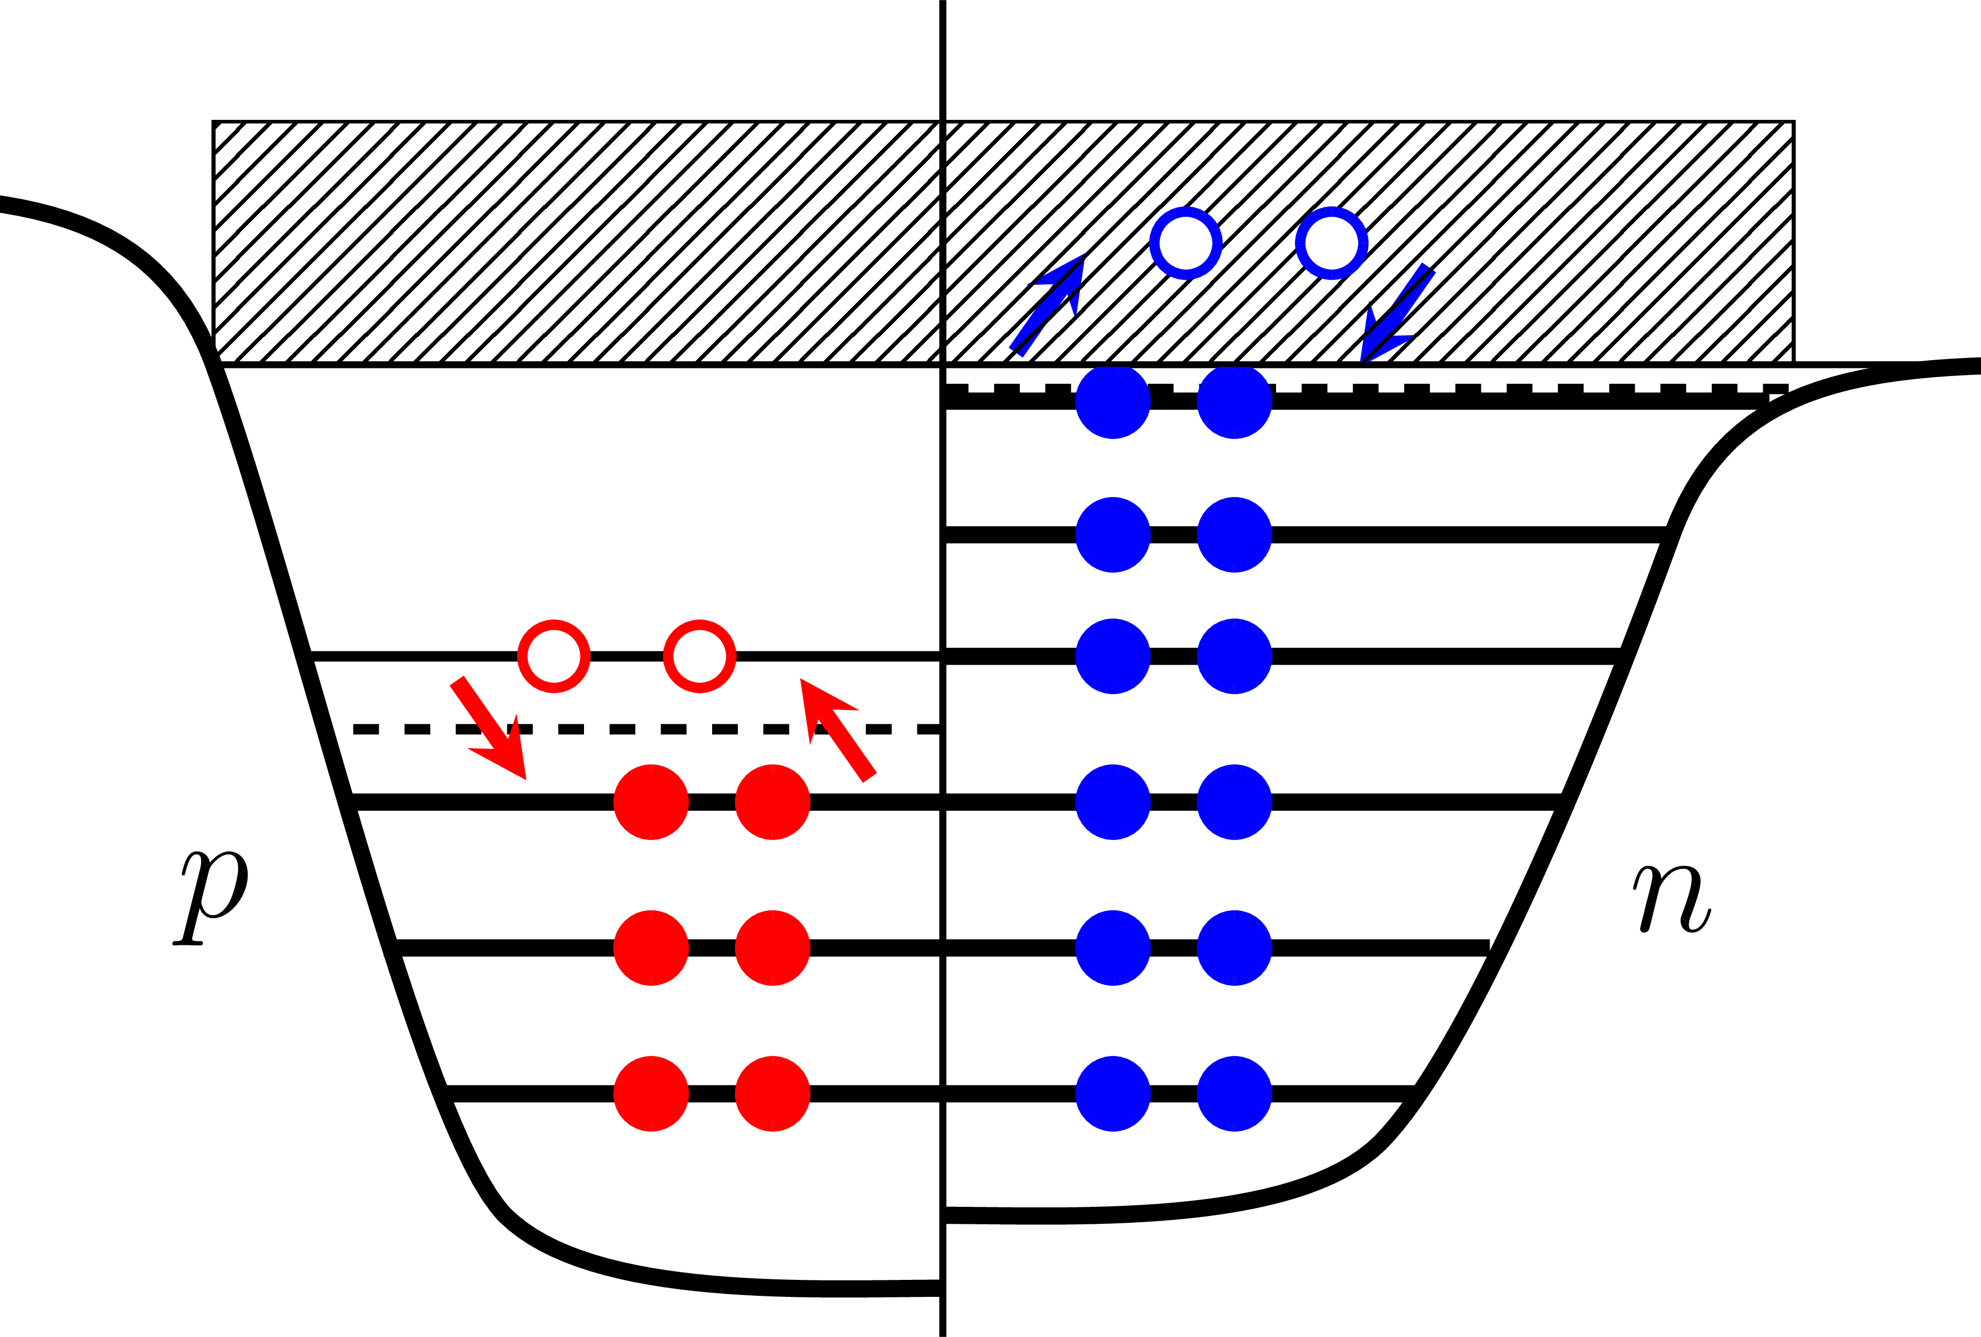
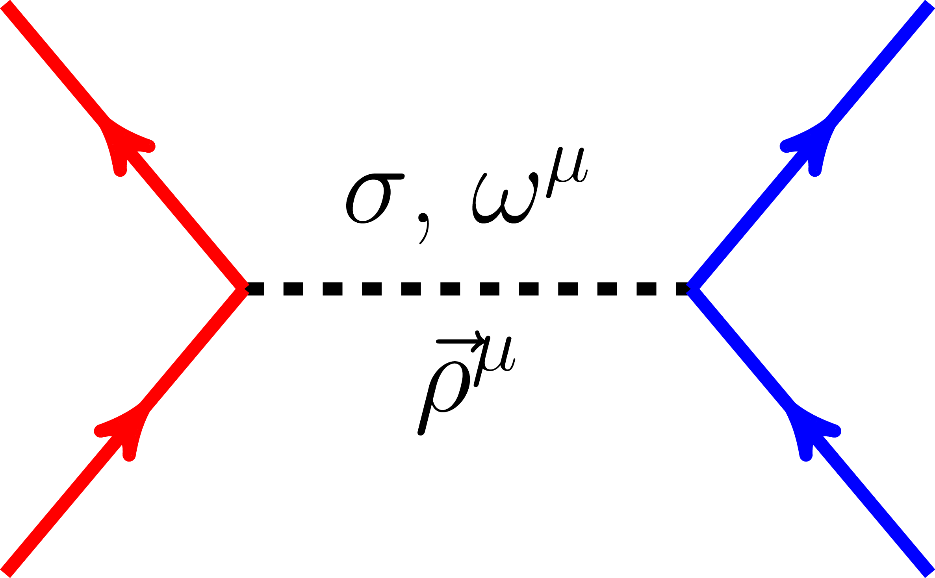
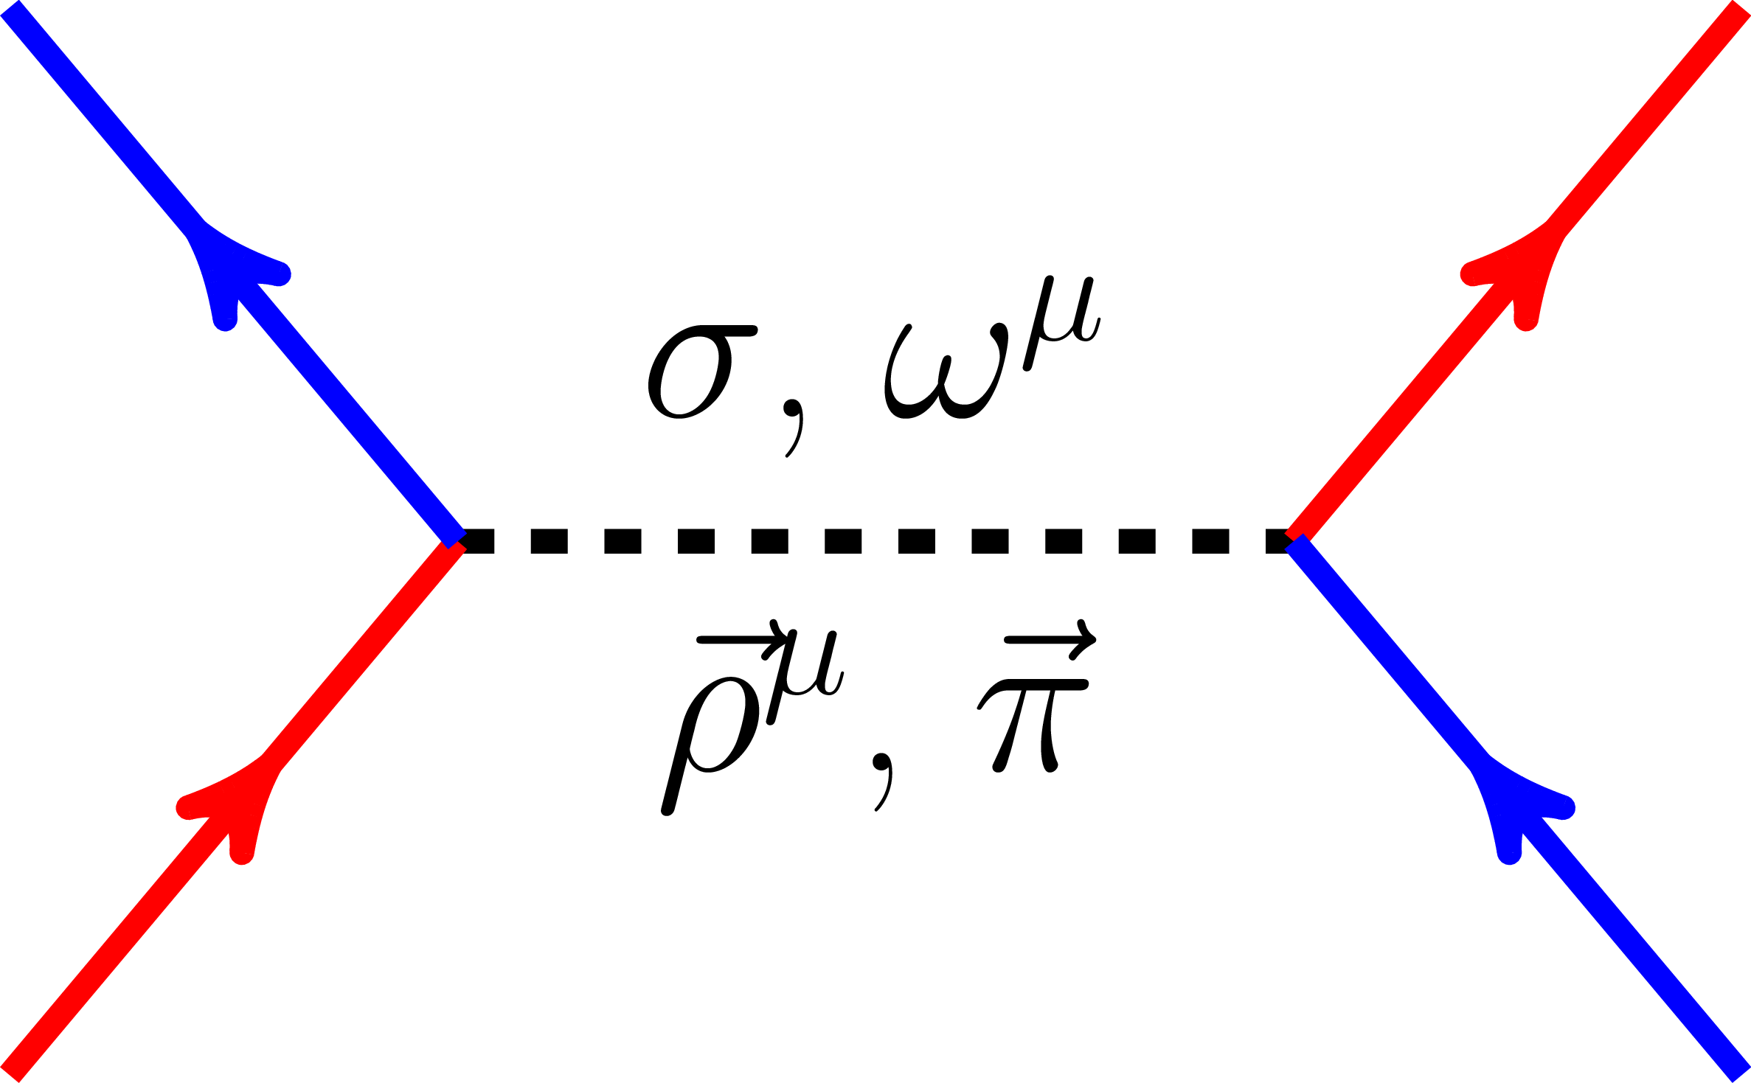
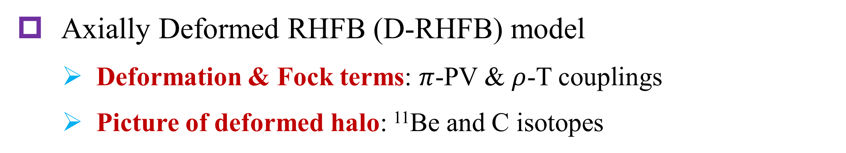
Extension of RHF model for deformed nuclei
Motivations
Spherical relativistic Hartree-Fock-Bogoliubov (RHFB) model
  Bogoliubov scheme is adopted to deal with weak binding mechanism
Continuum
Pairing
Hartree
Fock
WHL et al., PRC 81, 024308 (2010)
Axially deformed RHF (D-RHF) model
  Tensor force effects in deformed nuclei
Geng, Xiang, Sun, WHL, PRC 101, 064302 (2020)
Axially Deformed RHFB (D-RHFB) model
  Deformation & Fock terms: $π$-PV & $ρ$-T couplings
  Picture of deformed halo: ¹¹Be and C isotopes
Geng, WHL, PRC 105, 034329 (2022)
Structures of Unstable nuclei
Shape decoupling between halo and Core commonly exist? E.g., ⁴⁴Mg
Zhou, Meng, Ring, Zhao PRC 82, 011301 (R) (2011)

Slide 10
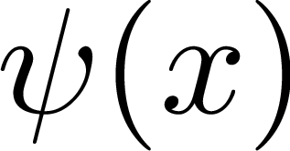
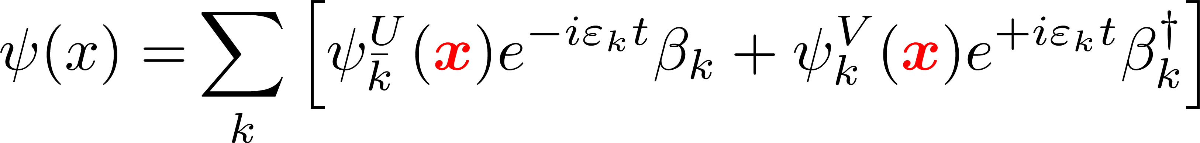
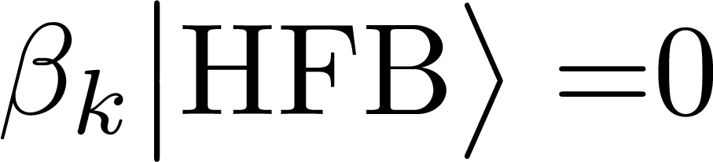
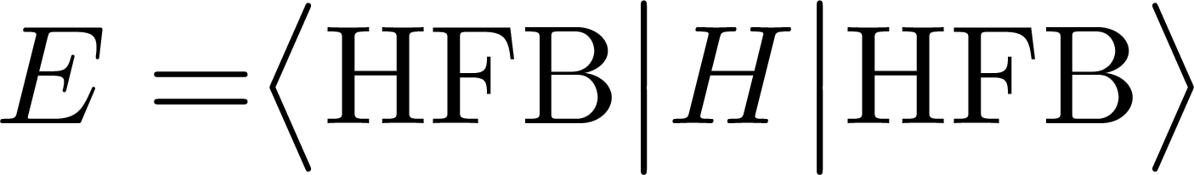
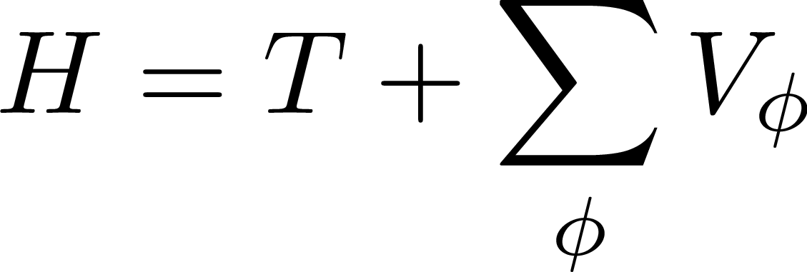
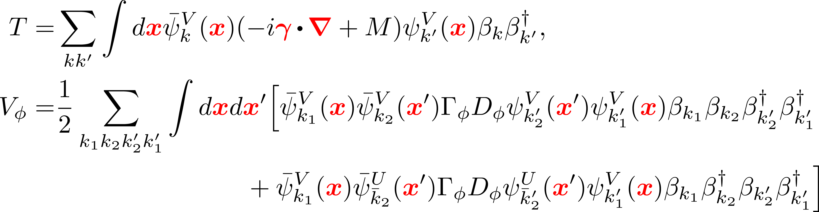
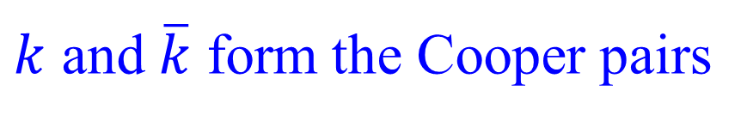
RHFB framework
Model
Quantizing nucleon field in Bogoliubov quasi-particle space
Bogoliubov GS
$k$ and $\overline{k}$ form the Cooper pairs
RHFB Energy functional: with
Kinetic energy
Fock
Potential energy
Hartree
Pairing energy
No exchange terms
In practice, finite range Gogny force D1S is adopted as the pairing force
Full RHFB framework is ready for further extension

Slide 11
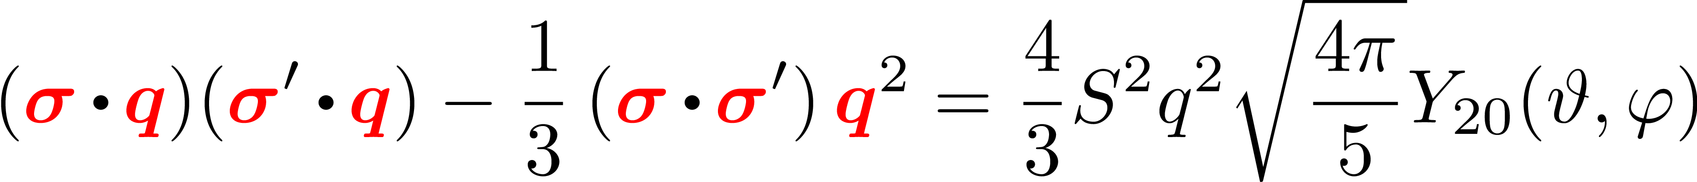
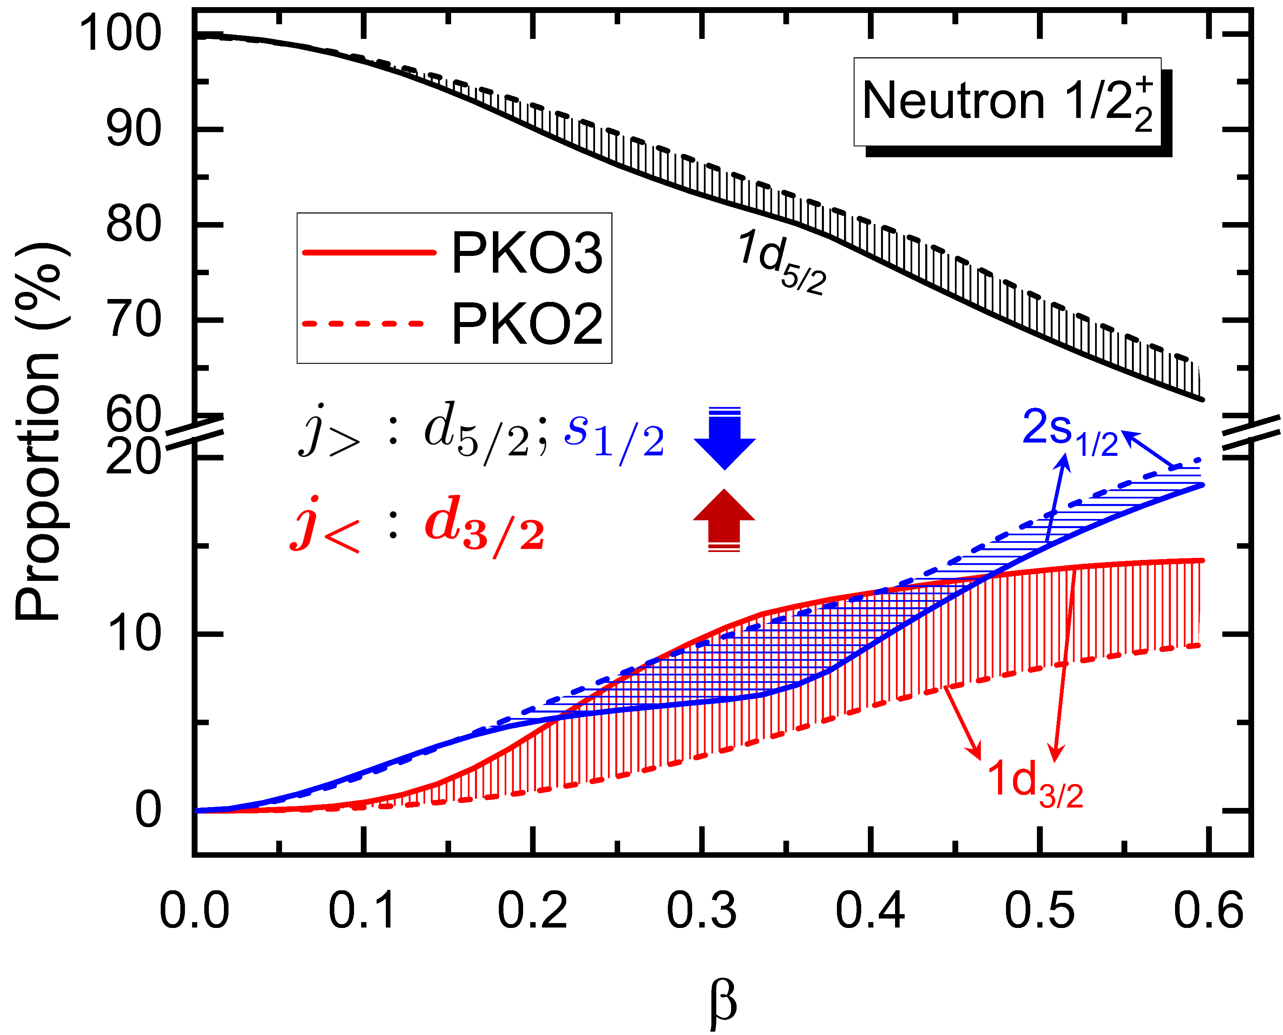













Deformation and $π$-PV & $ρ$-T couplings
²⁰Ne
$π$-PV & $ρ$-T couplings contribute only via the Fock terms
$π$-PV：
More correlations can be involved, coupled with nuclear deformation
$ρ$-T：
PKO2
w/o $π$
sd 壳
PKO3
w/ $π$
8
PRC 101, 064302 (2020).
Tensor force component in $π$-PV coupling leads to more mixing of 1d_{3/2}

Slide 12













Orbital mixing in deformed s.p. states
¹¹Be
Spherical Dirac Woods-Saxon (DWS) base
Zhou, Meng, Ring, PRC 68, 034323 (2003)
$π$ for parity
  Correct asymptotic behaviors: essential for unstable nuclei
Spherical DWS Base
  Convenient for understanding the deformation effects: orbital mixing
Expansion of canonical wave functional
Canonical single-particle (s.p.) energy: centroid and correlated terms
Binding feature of spherical $κ$-component
Revealing shape evolution trend Orbital mixing
$h_{aa′}$: s.p. Hamiltonian $a=\left(nκ\right)$
Geng, Niu, WHL, CPC 47, 044102 (2023)

Slide 13










Even-parity GS for p-shell nucleus: ¹¹Be
¹¹Be
PKA1 reproduces even-parity GS with notable prolate deformation
Even Parity
Odd Parity
20
Weak deformation effects
8
Geng, Niu, WHL, CPC 47, 044102 (2023)
Even-Parity GS: $π$-PV & $ρ$-T couplings play a key role by enhancing the deformation effects
Experimental Ref. value: 0.32 MeV
Effects of Fock terms

Slide 14




Even-parity GS of ¹¹Be: deformation effects
¹¹Be
$π$-PV & $ρ$-T: enhance the couplings of even-parity ${1/2}_{2}^{+}$ state with the core
orbital
inversion

Slide 15
Neutron halo in¹¹Be: deformation effects
¹¹Be
Even-parity ${1/2}_{2}^{+}$ state dominate the neutron halo
attractive
correlation
Specifically s-wave forms the halo, while attractive correlation terms stabilize the halo
Uniform interpretation for even-parity GS and neutron halo in ¹¹Be
Geng, Niu, WHL, CPC 47, 044102 (2023)

Slide 16





Bulk properties
C isotopes
PKO3 can precisely describe the binding energy and radii
Blocked orbit in the calculations
M. Wang et al., CPC 41, 030003 (2017)
GS $J^{π}$ for ¹⁷C is reproduced but not for ¹⁹C
Exp.: PRL 117, 102501 (2016); PLB 761, 412 (2016);
PK1: NPA 1003, 122011 (2020).

Slide 17

One- and two-neutron separation energies
PKO3 well reproduces the data: pairing force $1.23×$ D1S
Discrepancy for ²¹C is more obvious than the others

Slide 18







Halo picture in ²²C
²²C
Shape decoupling between core and halo is found for ²²C
Prolate
Determine halo shape
Continuum effects are essential for halo formation
$π$-meson seems to play a delicate role, we are thinking

Slide 19









Halo picture for ¹⁹C: 1/2⁺ oblate minimum
¹⁹C
1/2⁺ oblate minimum shows rather extensive neutron distribution
Prolate
Oblate
More evident continuum effects
Current calculations give 3/2⁺ GS for ¹⁹C

Slide 20







¹⁹C: GS with 3/2⁺
Continuum seems to dominate the halo
Prolate
Oblate
Slightly less pronounced halo than ²²C

Slide 21

Conclusions and Perspectives
Axially deformed RHFB is developed for studying the structure of unstable nuclei
  A uniform RHFB framework is provided, which makes the extension convenient
  Qualitatively, $π$-PV & $ρ$-T couplings may enhance the deformation effects
Geng, WHL, PRC 105, 034329 (2022)
Even-parity GS and neutron halo are reproduced by PKA1
Geng, Niu, WHL, CPC 47, 044102 (2023)
Enhanced deformation effects by $π$-PV and $ρ$-T couplings via Fock terms
Halo phenomena in C isotopes: Continuum effects are substantial
  ²²C shows notable halo, which has different shape from the core. For 19C, the 1/2⁺ minimum shows even more evident halo structure, which needs to be clarified.
Octupole deformation, shell model based on RHF ➔ nuclear decay, …
Thank you for your attentions!

