Slide 1
Neutrinoless double beta decay in SD pair shell model
S.Y.Zhang(张思遥)
Collaborator ：
Nankai University: Prof. Yanan Luo, Dr. Huaitong Xue, Dr. Ziwen Li
University of Notre Dame: Dr. Bingcheng He
2023.05.22 Zhuhai

Slide 2
Outline
1
General background of neutrinoless double beta decay
2
Theoretical framework
The NME of Neutrinoless double beta decay
SD pair shell model
3
Some results
4
Summary

Slide 3
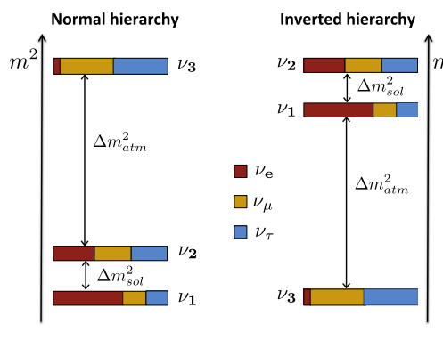
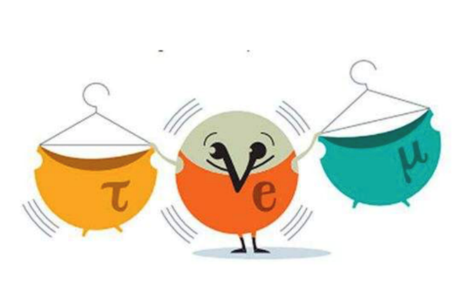
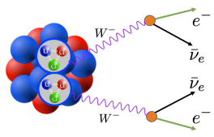
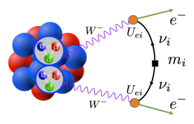
Background
The mixing angle between the neutrino eigenstates
Difference value of the square of mass
Hierarchy
Absolute neutrino-mass
Lepton number conservation？
Dirac or Majorana?
The absolute neutrino-mass scale
J. Phys. G: Nucl. Part. Phys. 43 084001(2016)
Physics beyond the standard model
Prog. Part. Nuclear. Phys. 126, 103965 (2022)

Slide 4
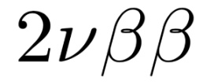
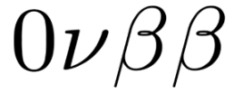
Double beta decay
Usually light particles

Slide 5
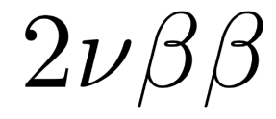
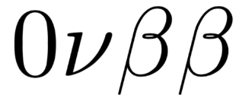
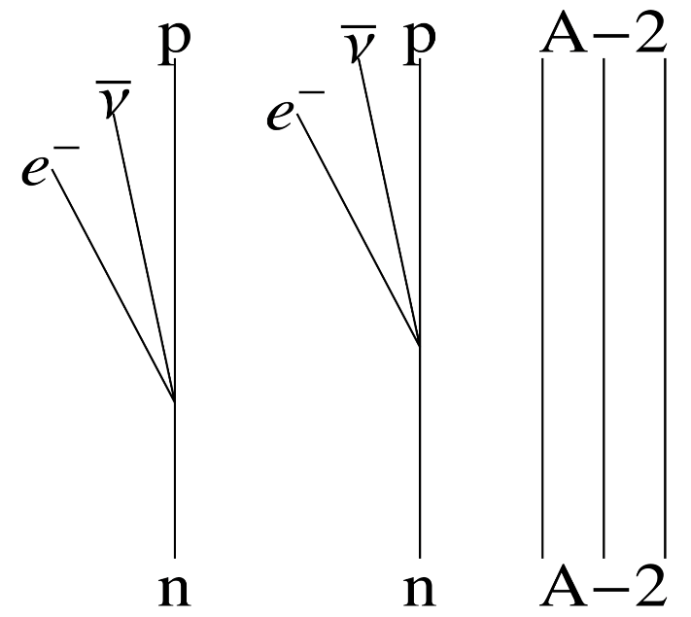
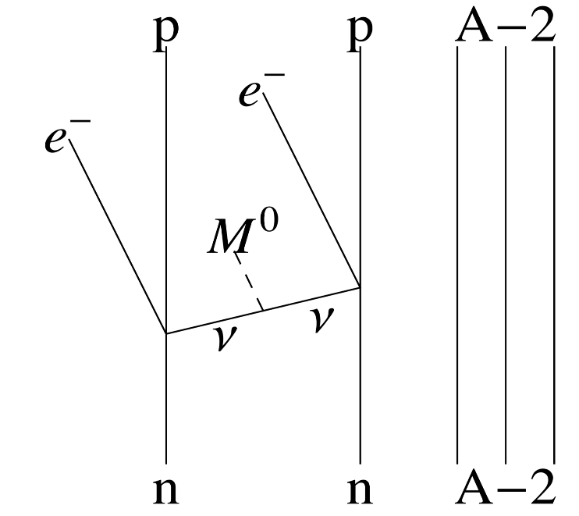
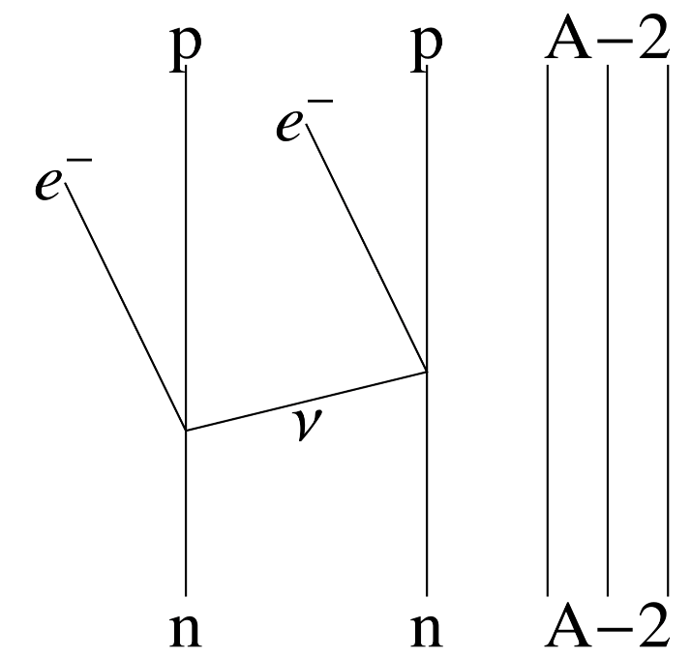
Double beta decay

Slide 6
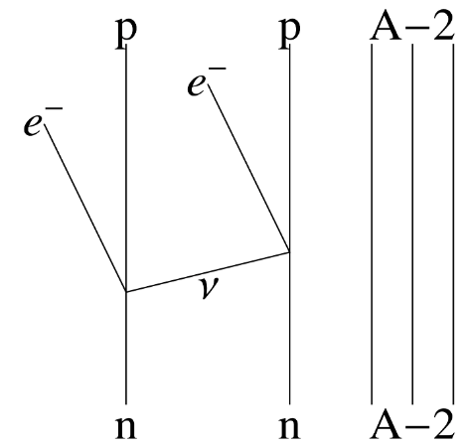
Neutrinoless Double beta decay
The eﬀective Hamiltonian
lepton currents
G is the Fermi constant
Cabibbo angle
nuclear currents
S matrix
Neutrino propagator

Slide 7
Neutrinoless Double beta decay
Neglect small neutrino masses
Closure approximation
The impulse approximation

Slide 8
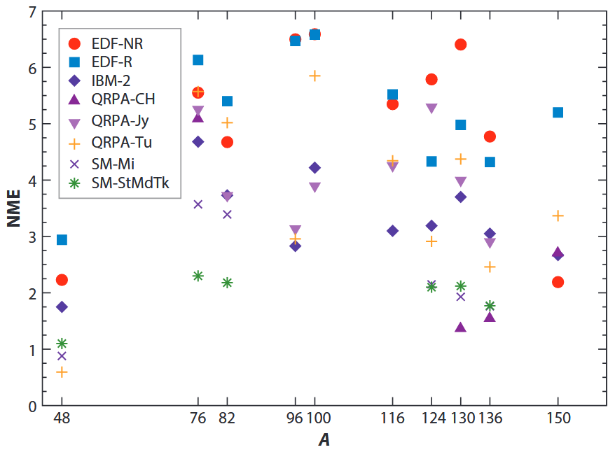
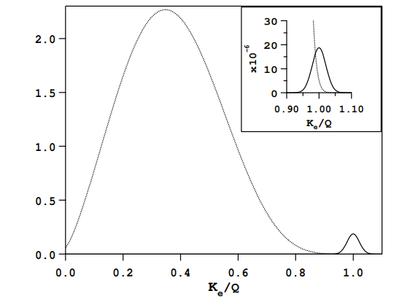
Half-life
nuclear matrix element
phase space factor
effective neutrino mass
SDPSM

Slide 9
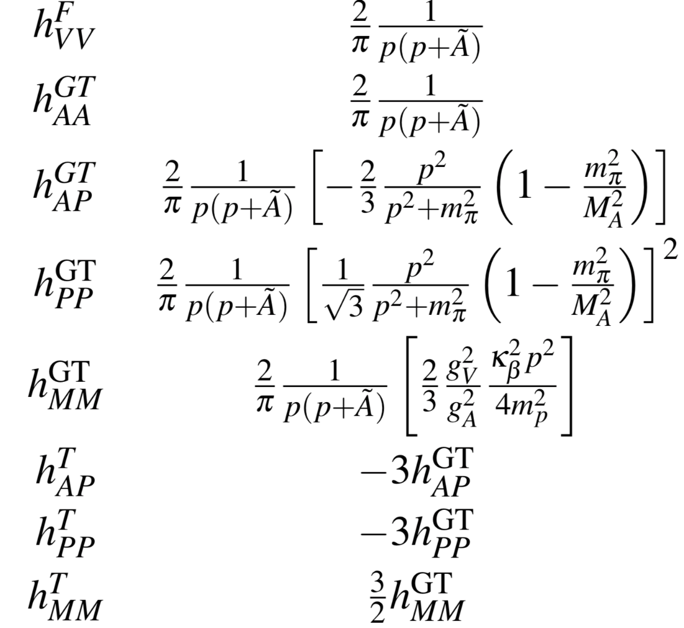
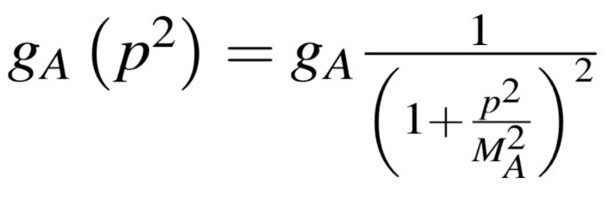
NME
NPSM
Transition operator
Leading term
Finite nucleon size（FNS）
HOC term
short-range correction (SRC)
Simkovic F. et,al PRC, 1999, 60(5): 055502

Slide 10
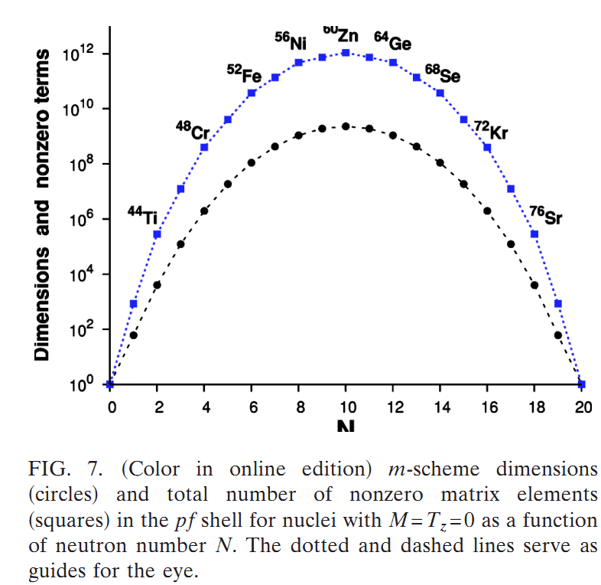
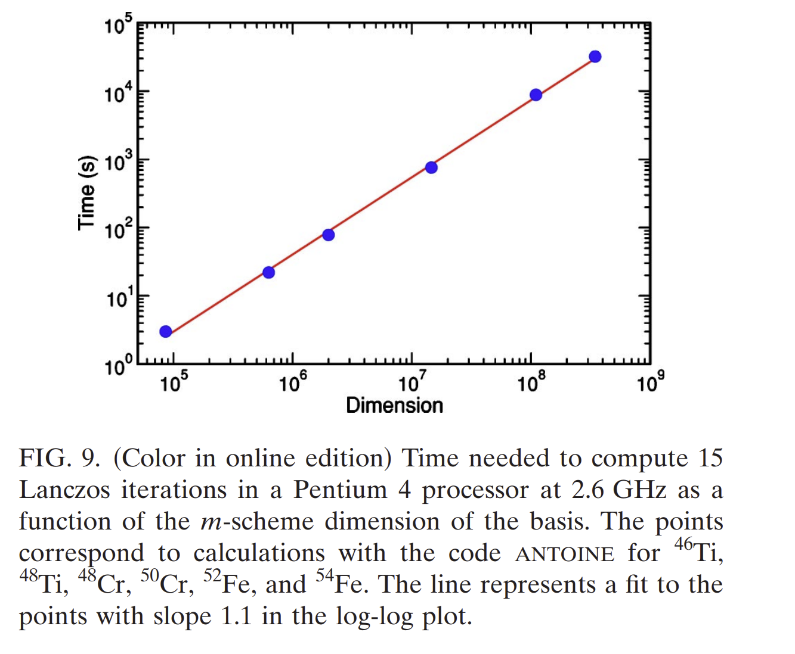
SDPSM
Shell Model（SM）
For residue interaction nucleon, tend to coupled to pairs
Nucleon Pair Shell Mode（NPSM）
Truncated to SD pairs
SD Pair Shell Model（SDPSM）
Caurier et al. Rev. Mod. Phys., 77, 2 (2005)

Slide 11
NPSM
Two operator contraction
Two operator coupled：
Clebsch-Gordon
Two uncoupled operator contraction：
Two coupled operator contraction ：

Slide 12
NPSM
Three operator contraction
Three operator contraction
Fermion or Boson operator contraction
6-J coefficient
Time reversal operator

Slide 13
NPSM
NPSM
Pair operator
non-collective p-p pairs
non-collective p-h pairs
By non-collective pair superposition
A collective pair of angular momentum r
structure
coefficient
collective p-h pair
collective multipole pair
N paris operator coupled
General WICK theory
Normal order

Slide 14
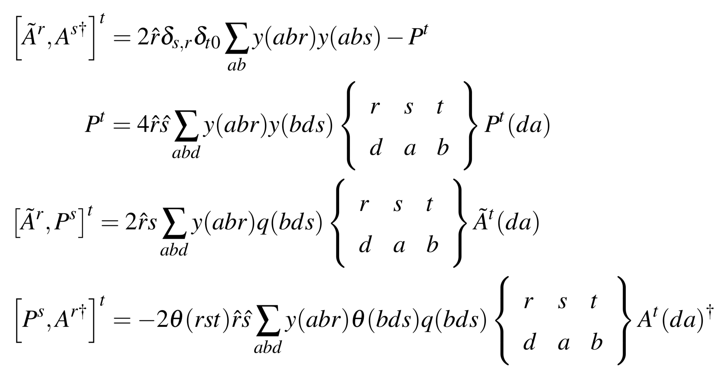
NPSM
NPSM
NPSM
Commutator for pair operators
Commutator for coupled pair operators:

Slide 15
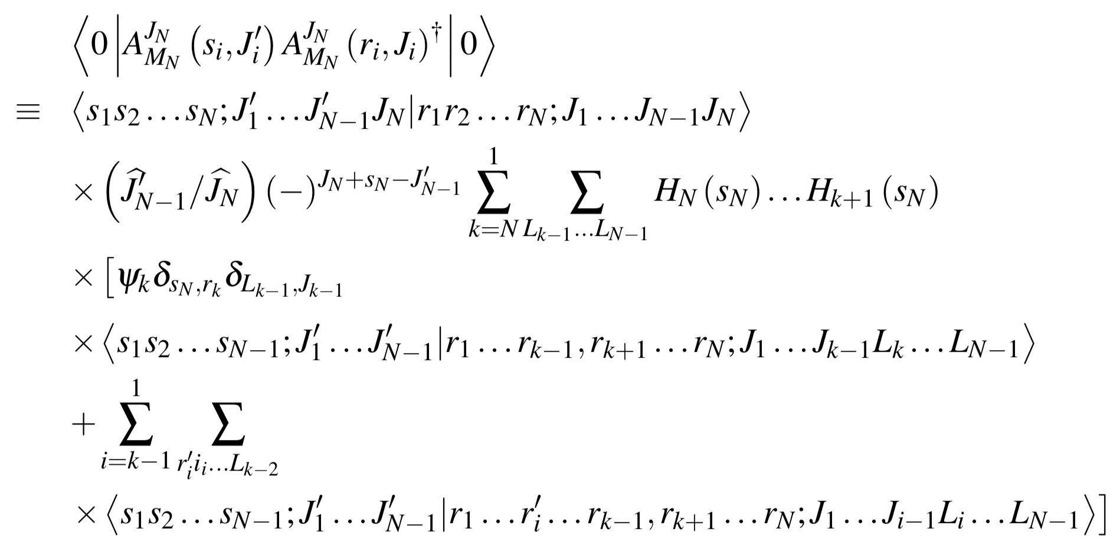
N pair basis overlap
NPSM

Slide 16
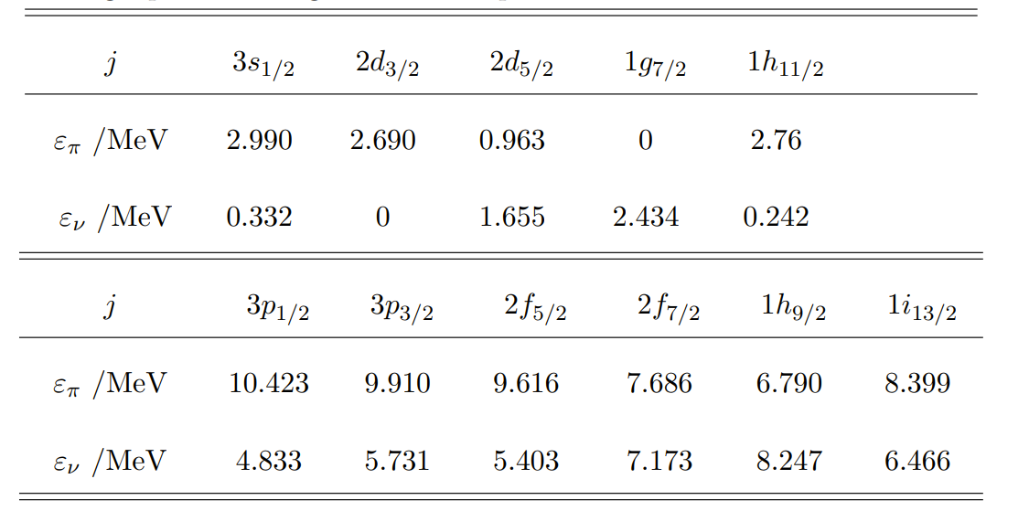
BCS
NPSM
Single-particle energies 50-126
Single-particle energies 50-82
W. J. Baldridge, Phys. Rev. C 18, 530 (1978)

Slide 17
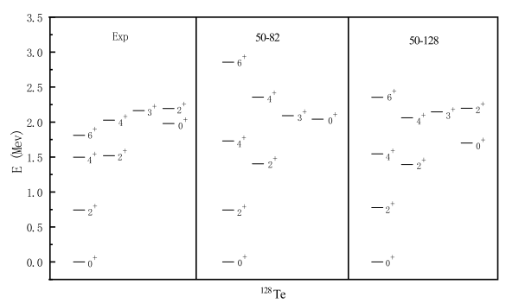
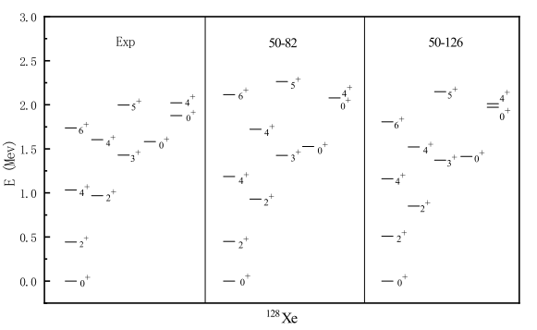
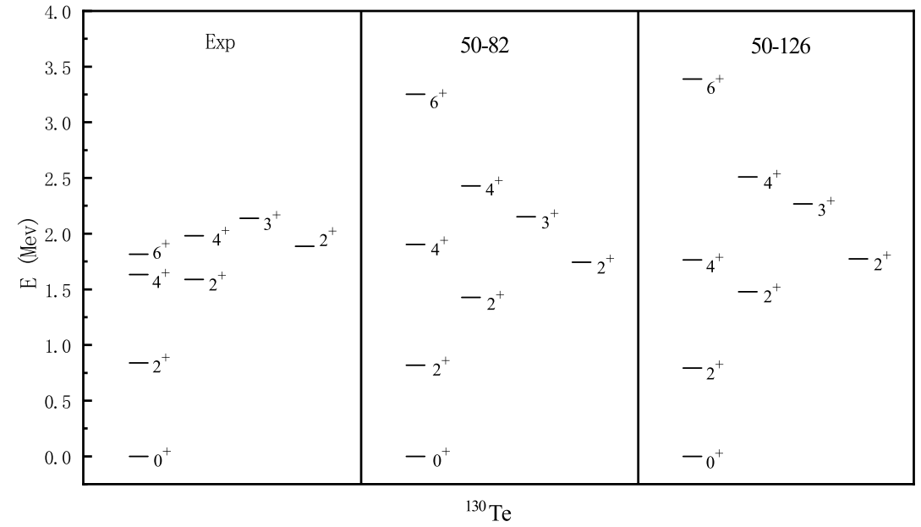
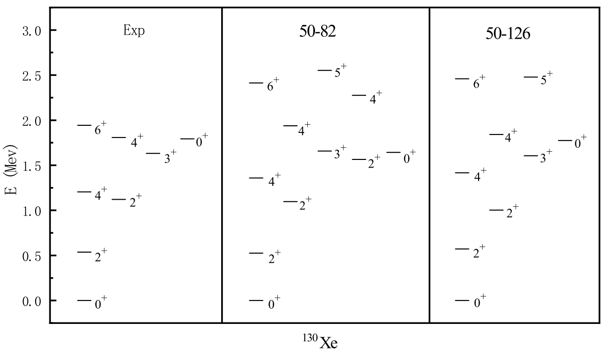
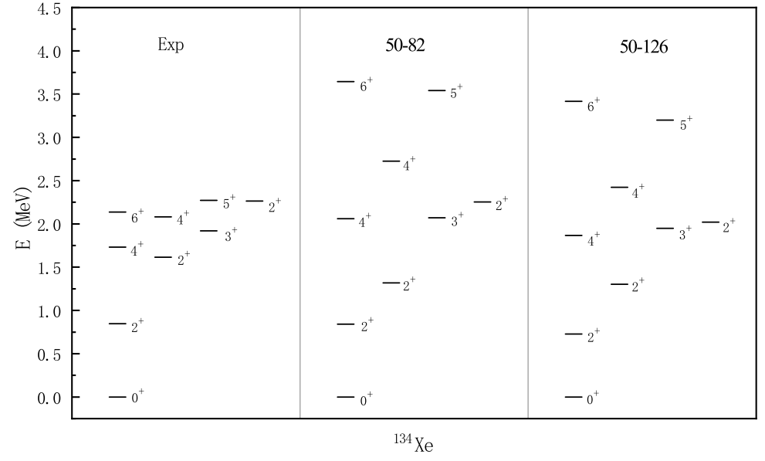
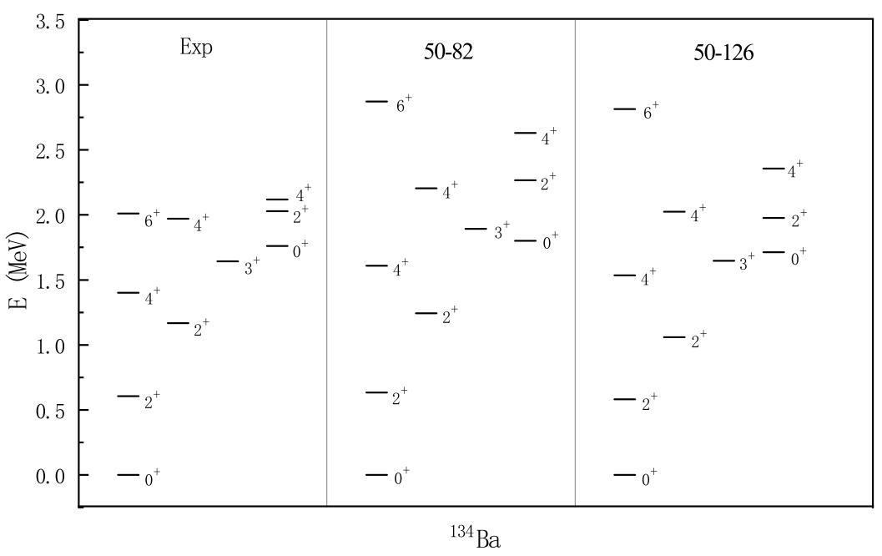
low-lying levels-BCS
NPSM

Slide 18
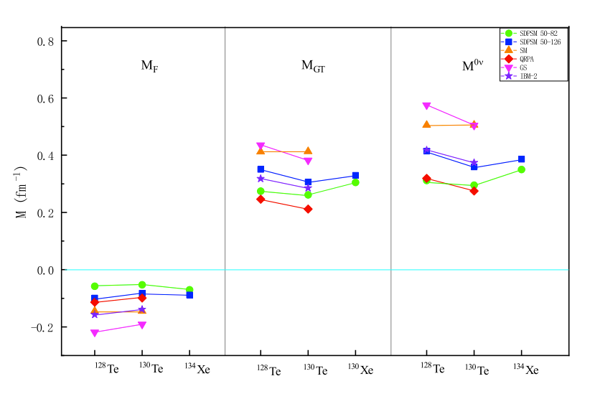
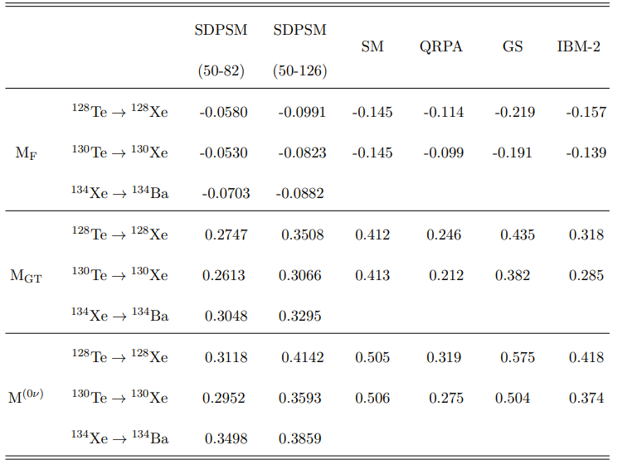
NME-Two leading terms
NPSM

Slide 19
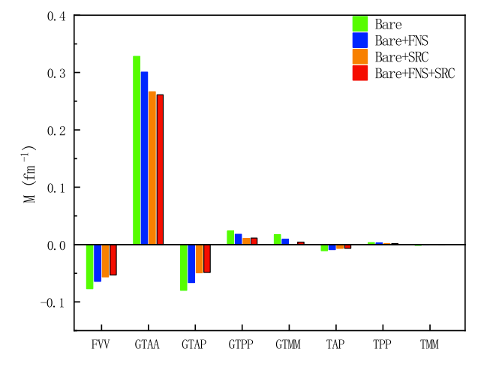
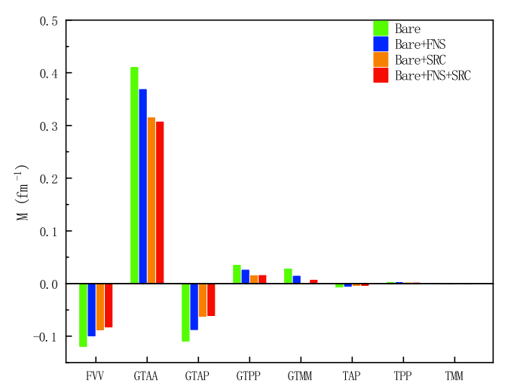
NME
NPSM
in 50-82 shell
in 50-126 shell

Slide 20
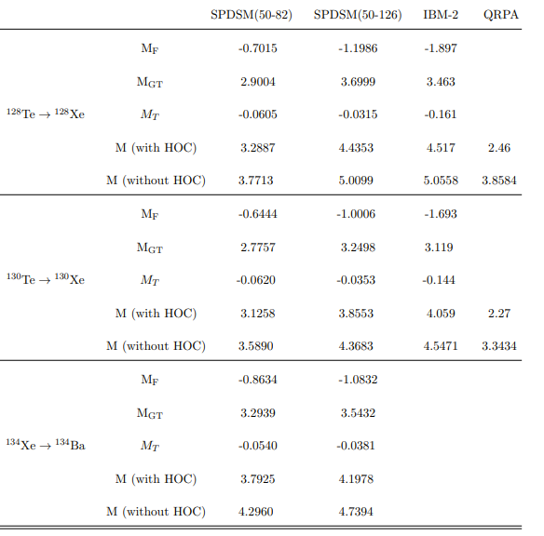
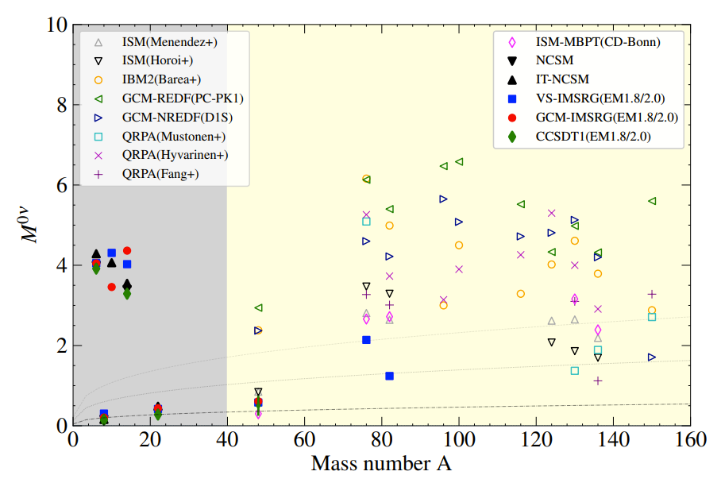
NME
NPSM

Slide 21
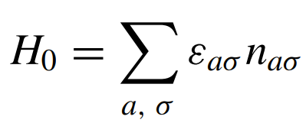
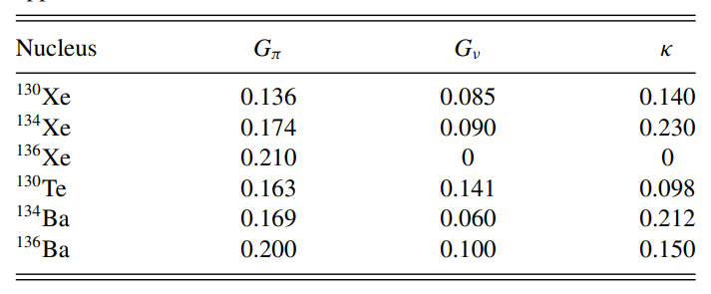
SDI
NPSM
Parameters in the SDI
Y.-A. Luo, J.-Q. Chen, and J. Draayer, Nucl. Phys. A669, 101 (2000).

Slide 22
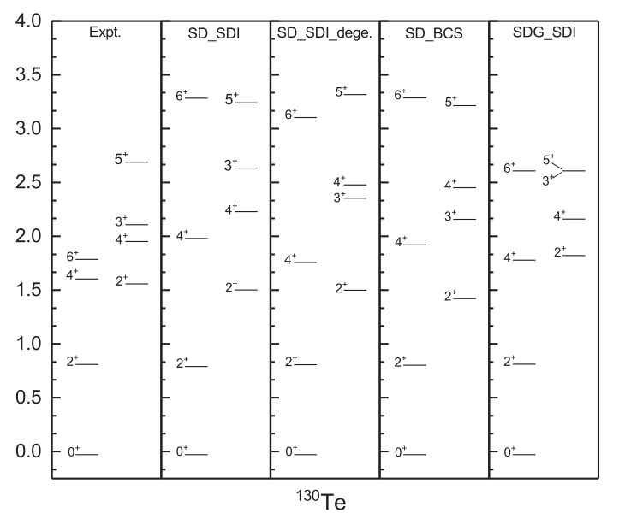
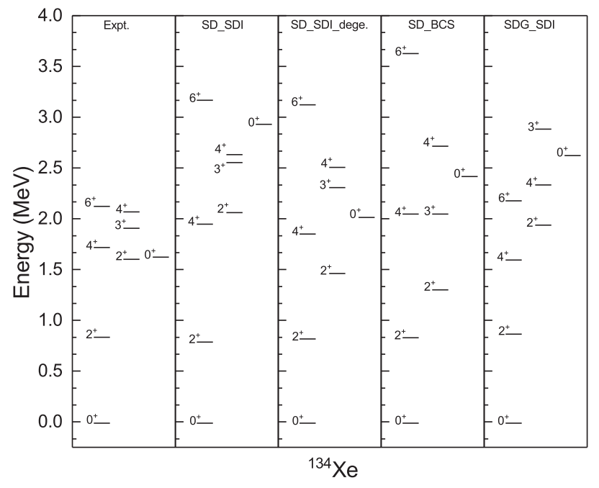
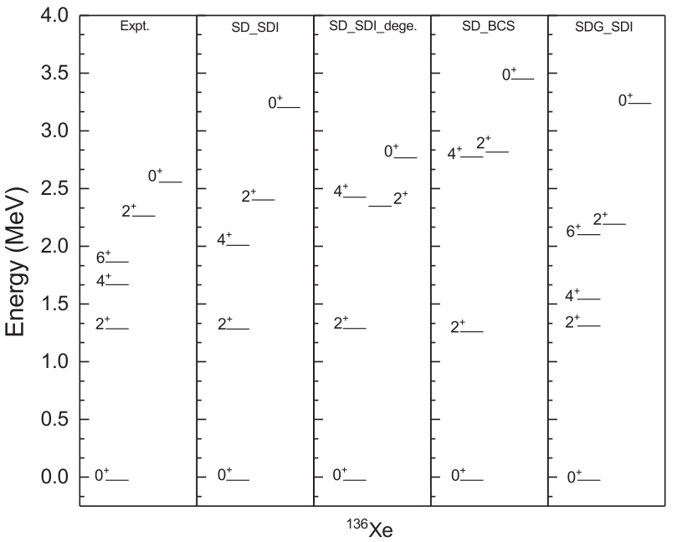
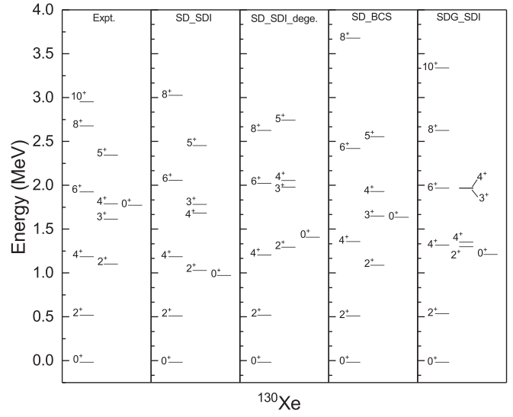
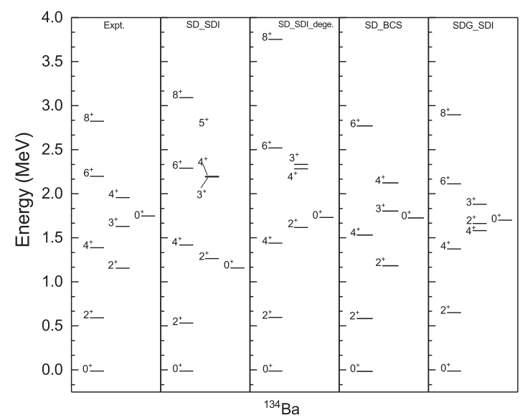
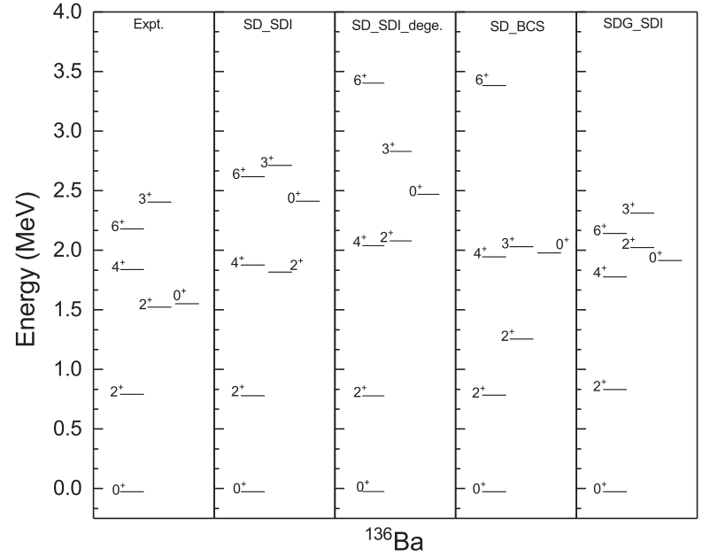
Low-lying levels - SDI
NPSM
URL https://www.nndc.bnl.gov

Slide 23
NME-Ratios
NPSM
T. Tomoda, Rep. Prog. Phys. 54, 53 (1991).

Slide 24
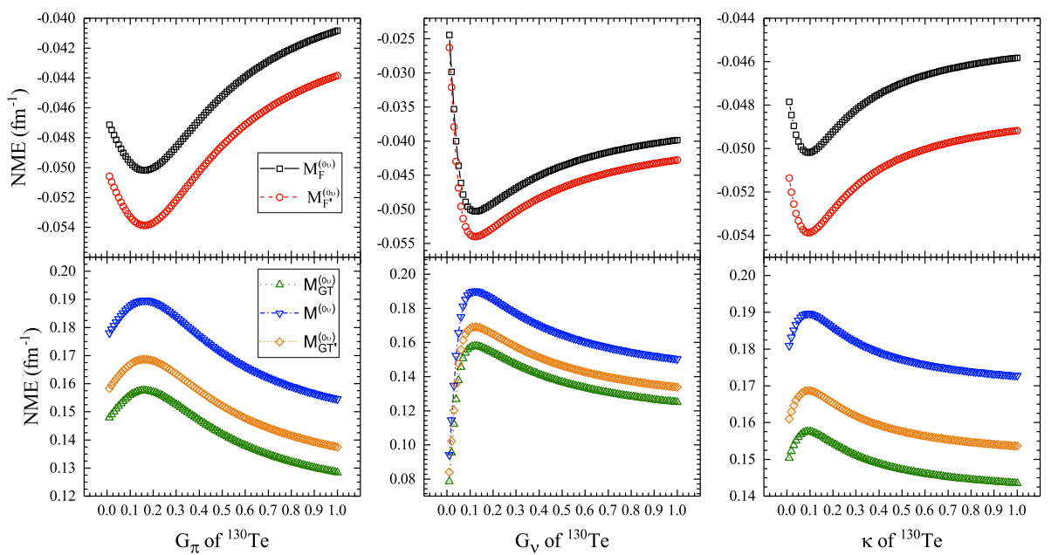
NME
NPSM

Slide 25
Summary
SDPSM can reproduce the neutrinoless double beta decay matrix element well
Calculate the two leading terms and six higher-order contributions
FNS and SRC have depressed influence.
BCS and SDI are agreement with each other for the result.
Larger model space can increase the NME,while added G pairs have no change for NME.
The matrix element is sensitive to the pairing interaction strength

Slide 26
Next Step plan
Calculate more nuclear .such as 150Nd
Calculate the contribution of transition matrix elements of each excited state.
…
Thanks for your attention！

Slide 28
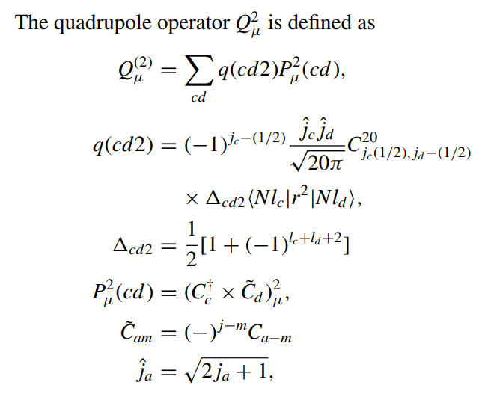
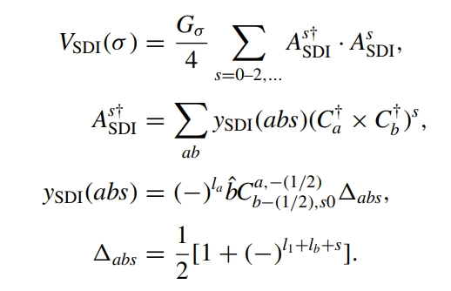
SDI

Slide 29
BCS

Slide 30
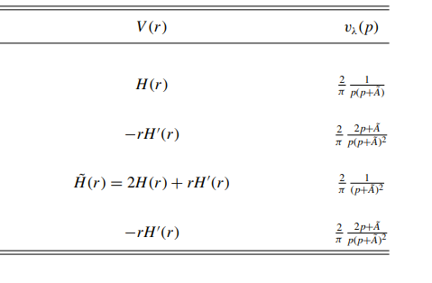
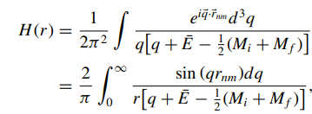
The ratios

