Slide 1
Measurement of the absolute neutrino mass in cosmology
Yvonne Y. Y. Wong
UNSW Sydney
第二届无中微子双贝塔衰变及相关物理研讨会, 2023年5月19日-23日

Slide 2
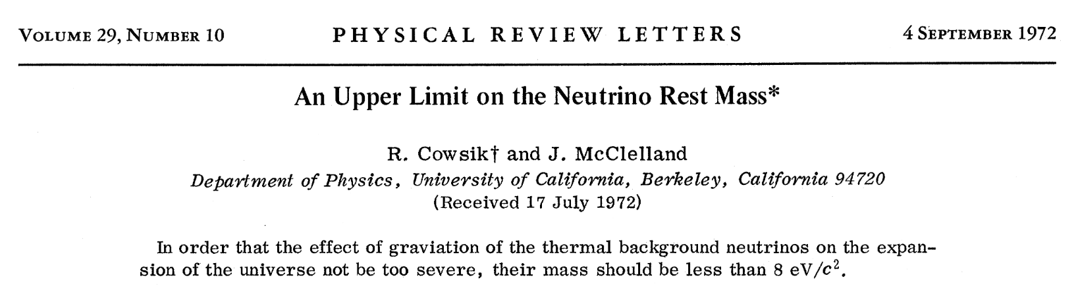
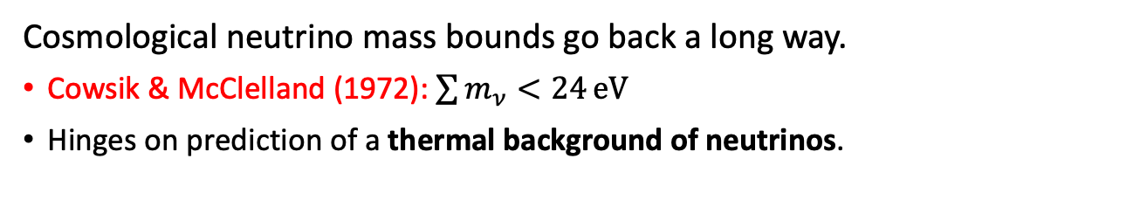
Measuring neutrino masses with cosmology…
Cosmological neutrino mass bounds go back a long way.
Cowsik & McClelland (1972): $\sum{m_{ν}<24}eV$
Hinges on prediction of a thermal background of neutrinos.

Slide 3
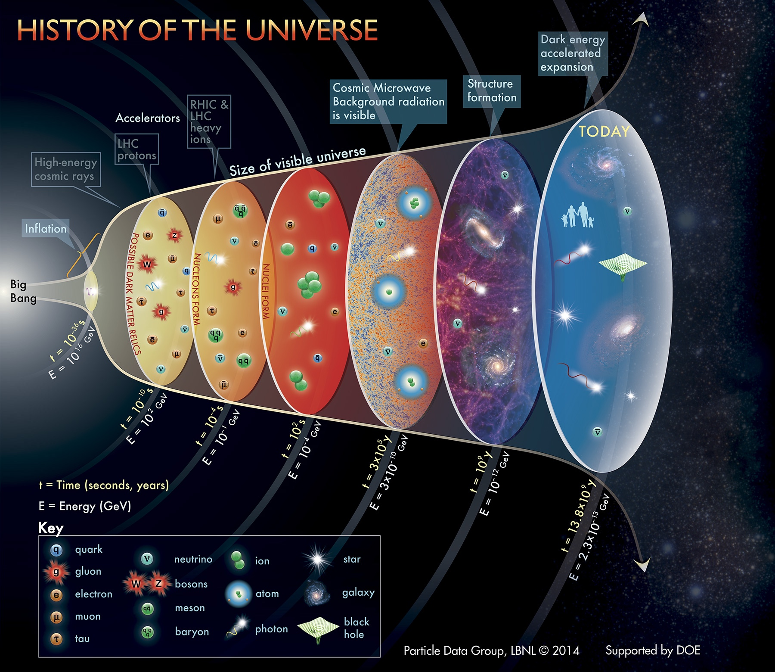
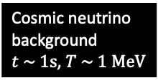
Primordial nucleo-synthesis
Cosmic neutrino background $t \sim 1s$, $T \sim 1 MeV$

Slide 4
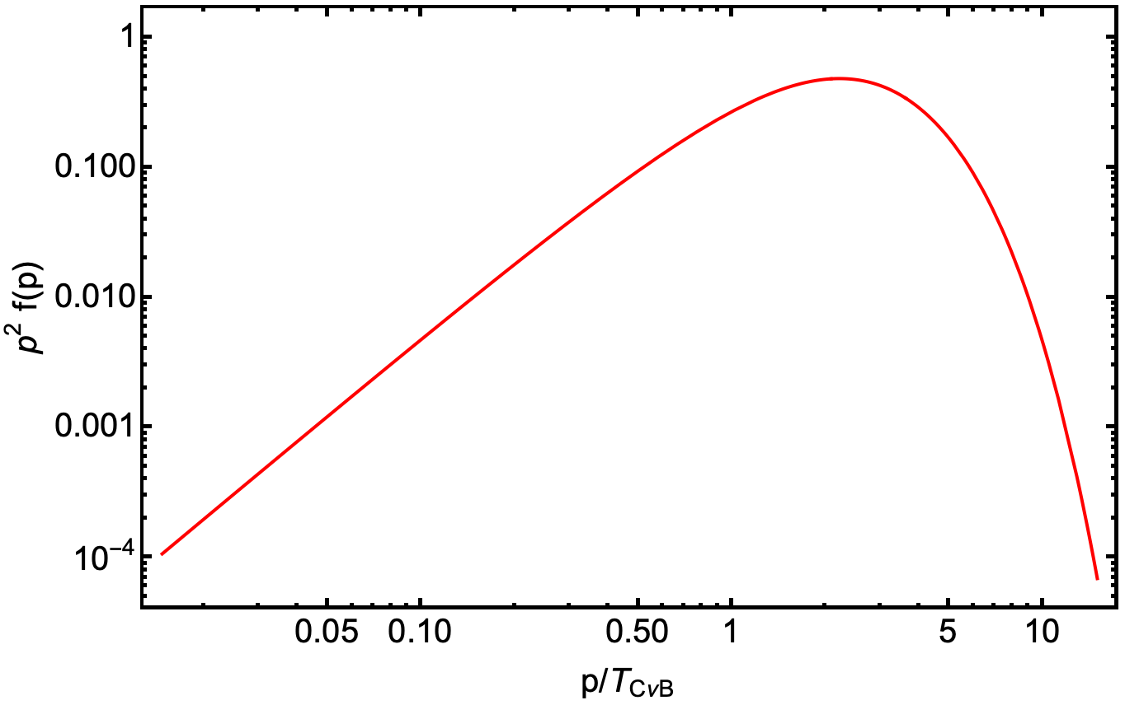
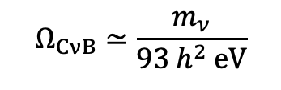
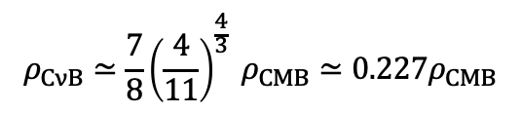

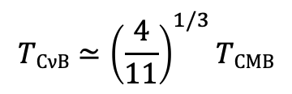


The cosmic neutrino background…
Standard model predictions
Per family of
neutrinos
+antineutrinos
Relativistic Fermi-Dirac
distribution
Number density:
Energy density:
Relativistic (if $T_{CνB}≫m_{ν}$):
Non-rel (if $T_{CνB}≪m_{ν}$):
$$nCνB≃110 {cm}^{−3}$$
Per family
Temperature:
after $e^{+}e^{−}→γγ$
$$TCνB≃{\left(\frac{4}{11}\right)}^{1/3}TCMB$$
$$ρ_{CνB}≃\frac{7}{8}{\left(\frac{4}{11}\right)}^{\frac{4}{3}} ρ_{CMB}≃0.227ρ_{CMB}$$
$$Ω_{CνB}≃\frac{m_{ν}}{93 h^{2} eV}$$
Neutrino (hot) dark matter
Reduced Hubble parameter

Slide 5

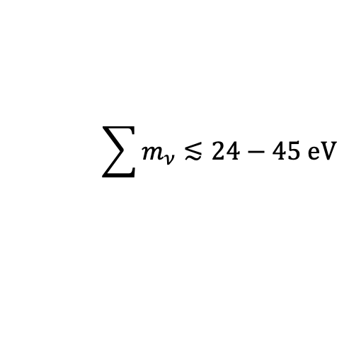

The cosmic neutrino background…
Standard model predictions
Per family of
neutrinos
+antineutrinos
Relativistic Fermi-Dirac
distribution
Number density:
Energy density:
Relativistic (if $T_{CνB}≫m_{ν}$):
Non-rel (if $T_{CνB}≪m_{ν}$):
$$nCνB≃110 {cm}^{−3}$$
Per family
Temperature:
after $e^{+}e^{−}→γγ$
$$TCνB≃{\left(\frac{4}{11}\right)}^{1/3}TCMB$$
$$ρ_{CνB}≃\frac{7}{8}{\left(\frac{4}{11}\right)}^{\frac{4}{3}} ρ_{CMB}≃0.227ρ_{CMB}$$
Demand no
overclosure
$$Ω_{CνB}≃\frac{m_{ν}}{93 h^{2} eV}$$
$$\sum{m_{ν}}≲24−45 eV$$
Neutrino (hot) dark matter
$$Ω_{CνB}≲1$$
Depending on $h$
Reduced Hubble parameter

Slide 6
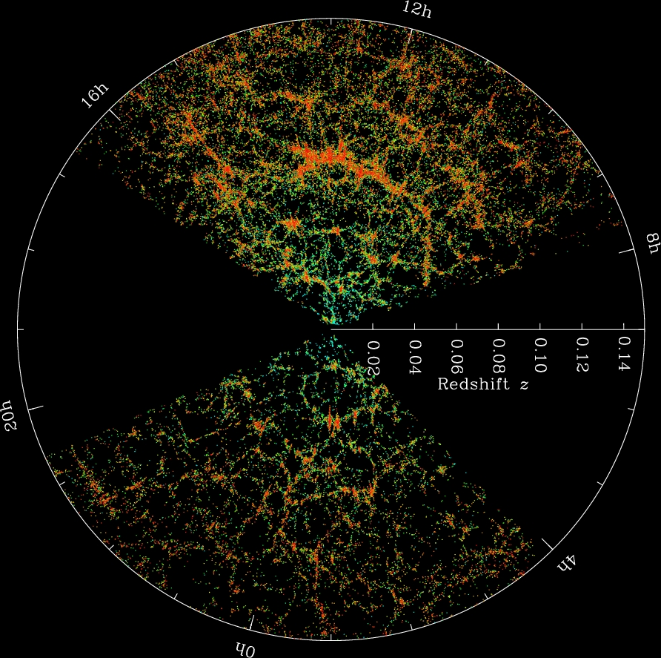
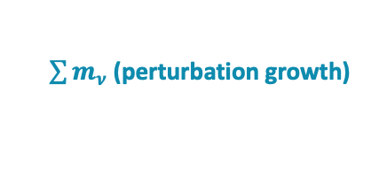
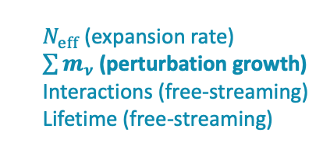

Modern cosmological neutrino mass bounds...
… are based on how the properties of the C𝜈B affect the events that take place after its formation.
Light element abundances
CMB anisotropies
Large-scale matter distribution
Properties of the C𝜈B probed:
$N_{eff}$ (expansion rate)
$\sum{m_{ν}}$ (perturbation growth)
Interactions (free-streaming)
Lifetime (free-streaming)
$N_{eff}$ (expansion rate)
$\sum{m_{ν}}$ (perturbation growth)

Slide 7
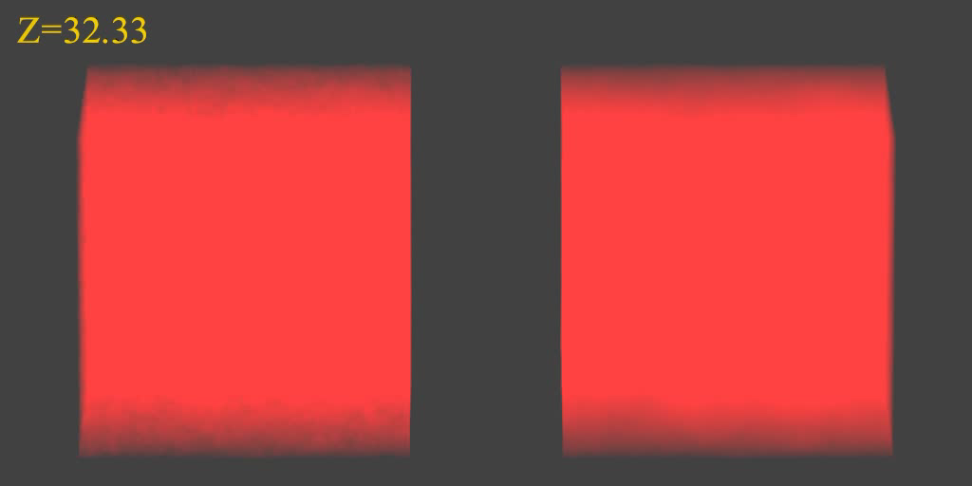

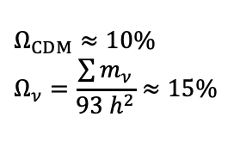
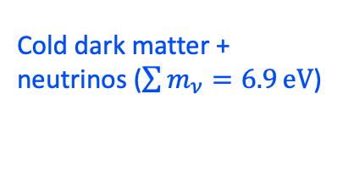


Neutrino masses & perturbation growth...
Cold dark matter only
Cold dark matter + neutrinos ($\sum{m_{ν}=6.9}eV$)
$$Ω_{CDM}≈10\%$$
$$Ω_{ν}=\frac{\sum{m_{ν}}}{93 h^{2}}≈15\%$$
$$Ω_{CDM}≈25\%$$
$$256 h^{−1}\text{Mpc}$$
Simulations by Troels Haugbølle

Slide 8
Neutrino masses & perturbation growth...
Cold dark matter only
Cold dark matter + neutrinos ($\sum{m_{ν}=6.9}eV$)
$$Ω_{CDM}≈10\%$$
$$Ω_{ν}=\frac{\sum{m_{ν}}}{93 h^{2}}≈15\%$$
$$Ω_{CDM}≈25\%$$
$$256 h^{−1}\text{Mpc}$$
Simulations by Troels Haugbølle

Slide 9
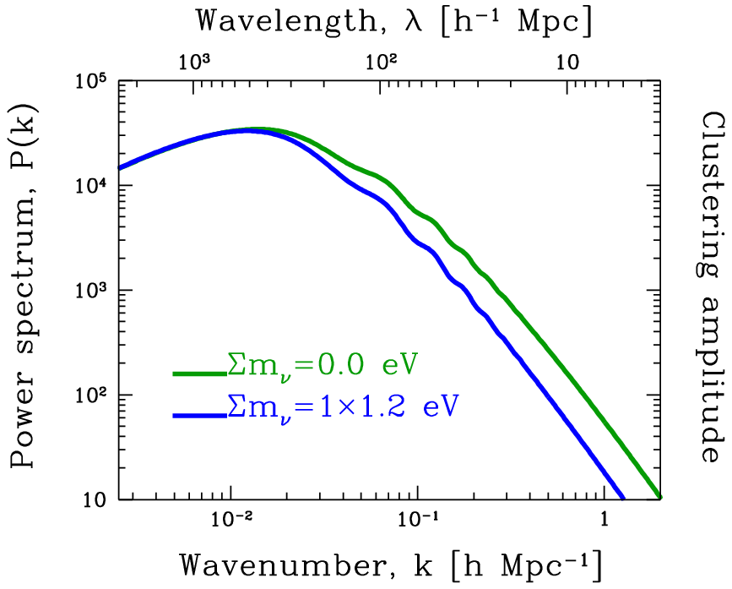
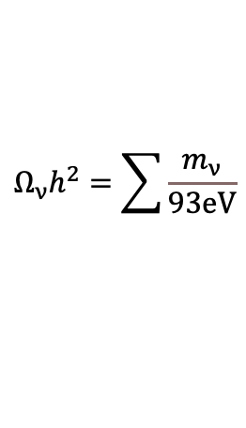

Large-scale matter power spectrum…
From linear perturbation theory
Suppression of
power due to free-
streaming induced
potential decay
Replace some CDM
with massive neutrinos
Large-scale matter power spectrum, P(k)
f_{ν} = Neutrino fraction
$$\frac{ΔP}{P}∝8f_{ν}≡8\frac{Ω_{ν}}{Ω_{m}}$$
$$Ω_{ν}h^{2}=\sum{\frac{m_{ν}}{93eV}}$$

Slide 10
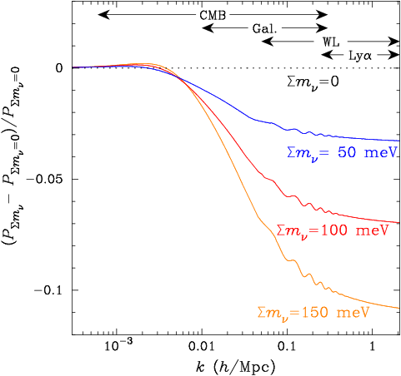
Large-scale matter power spectrum…
The larger the mass sum, the larger the suppression.
Relative power spectrum

Slide 11
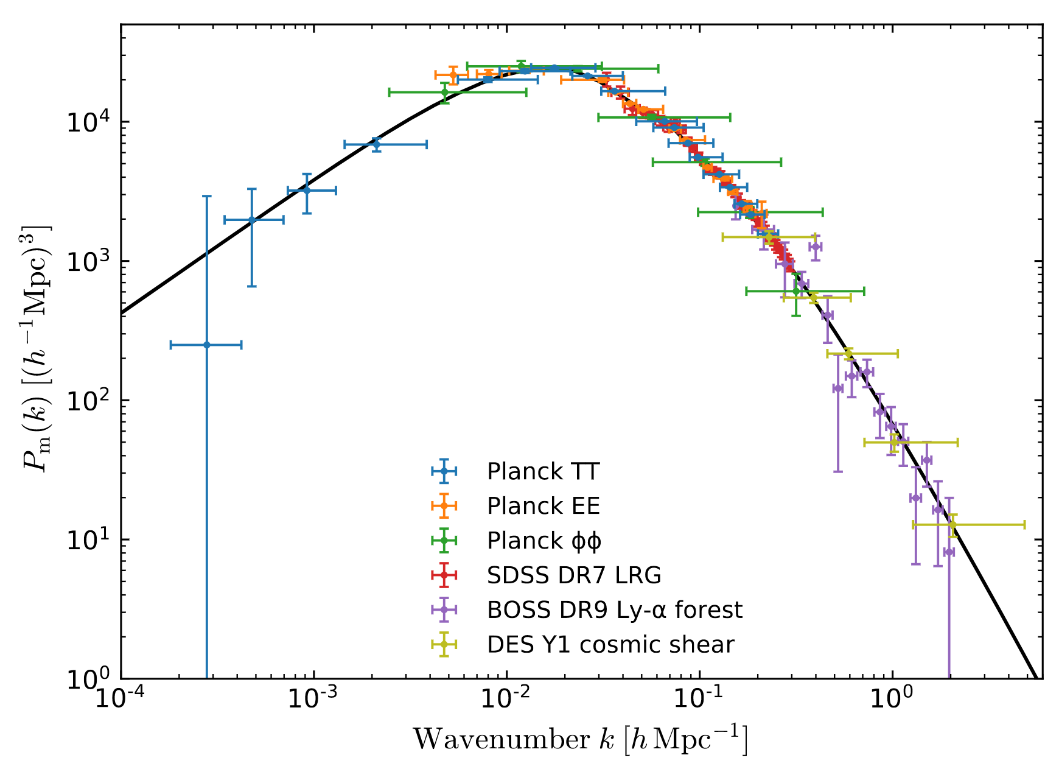
Who can measure it?
Large-scale power spectrum measurements circa 2018
Akrami et al. 2018

Slide 12
Who can measure it?
Galaxy clustering
/BAO
Cosmic
shear
CMB lensing
potential
(z~3-4)
Cluster
abundance
Large-scale matter power spectrum, P(k)
CMB “primary” (z~1000)
Lyman-α
(z~2-4)

Slide 13



Who can measure it?
$$ω_{m}$$
+ geometry
Physical matter
density
Galaxy clustering
/BAO
Cosmic
shear
CMB lensing
potential
(z~3-4)
“Anchor”
𝛬CDM model
parameters
Cluster
abundance
Large-scale matter power spectrum, P(k)
$$σ_{8},Ω_{m}$$
$$\begin{matrix}ω_{m},ω_{b},n_{s}, \\ A_{s},τ,h\end{matrix}$$
CMB “primary” (z~1000)
Lyman-α
(z~2-4)
Small-scale
fluctuation
amplitude

Slide 14
Linear vs nonlinear…
Nonlinear @ z=0
Calculable to O(1)% using
linear perturbation theory
@ z=0
Galaxy clustering
/BAO
Cosmic
shear
CMB lensing
potential
(z~3-4)
Cluster
abundance
Large-scale matter power spectrum, P(k)
CMB “primary” (z~1000)
Lyman-α
(z~2-4)

Slide 15
Linear vs nonlinear…
Nonlinear @ z=0
Calculable to O(1)% using
linear perturbation theory
@ z=0
Galaxy clustering
/BAO
Cosmic
shear
CMB lensing
potential
(z~3-4)
z=1
z=3
Cluster
abundance
Large-scale matter power spectrum, P(k)
CMB “primary” (z~1000)
Lyman-α
(z~2-4)

Slide 16
There are nonlinearities and nonlinearities…
 | Nonlinear Dark matter (collisionless) | Baryonic astrophysics @ k ~ O(1)/Mpc | Empirical tracers or proxies
BAO | Mild | No | Mild
Cosmic shear | Yes | No | No
Galaxy power spectrum | Yes | No | Assume galaxy number density tracks DM density
Cluster abundance | Yes | No | X-ray temperature, cluster richness as proxies for cluster mass
Lyman alpha | Yes | Hydrogen distribution | No
Calculable from first principles (i.e., described by a Lagrangian)? | Yes | No | No

Slide 17

Constraints on the neutrino mass sum…
𝛬CDM+neutrino mass 7-parameter fit; 95% C.L. on $∑mν$ in [eV].
 |  | +CMB lensing | +BAO (non-CMB) | +CMB lensing+BAO
Planck2018 TT+lowE | 0.54 | 0.44 | 0.16 | 0.13
2015 number | 0.72 | 0.68 | 0.21 | n/a
Planck2018 TT +lowE+TE+EE | 0.26 | 0.24 | 0.13 | 0.12
Planck2018 TT +lowE+TE+EE [CamSpec] | 0.38 | 0.27 | n/a | 0.13
2015 number | 0.49 | 0.59 | 0.17 | n/a
Two different high-ℓ
likelihood functions
Planck2015 TT+lowP+Lyα
$$∑m_{ν}<0.13 eV$$
Aghanim et al. [Planck] 2018
Ade et al. [Planck] 2015
Palanque-Delabrouille et al. 2015

Slide 18
Do you need to believe any of it?
Or to what extent should you trust these bounds?

Slide 19
There are certainly assumptions…
To even constrain neutrino mass cosmologically, there must be a cosmic neutrino background to begin with.
There is no reason to think that this is not the case:
  Cosmological data is consistent with there being 3 neutrino families.
  Also consistent with them not interacting much amongst themselves or with other constituents.
But even then there are caveats and some (small) room for play.

Slide 20
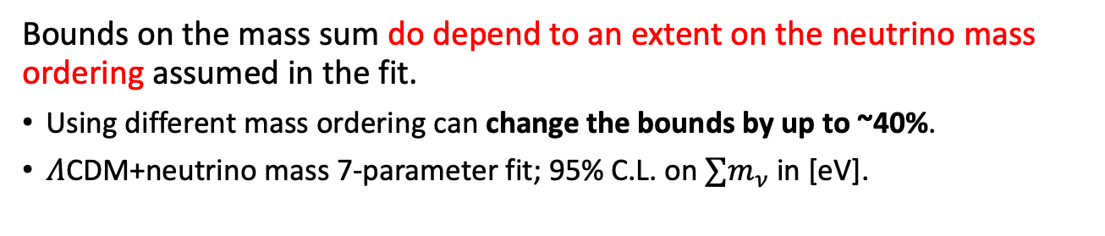

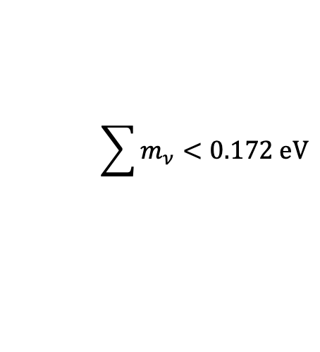
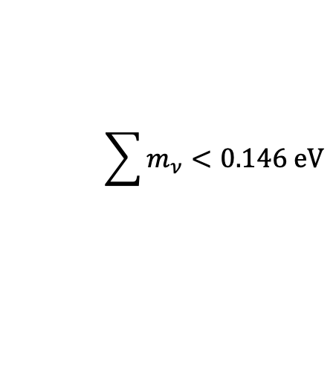
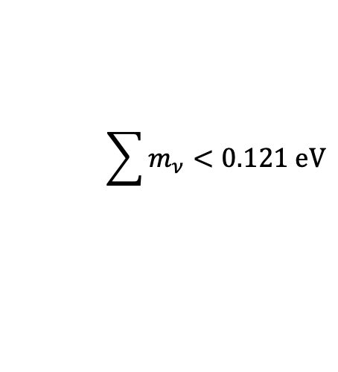
Caveat 1: which mass ordering...
Bounds on the mass sum do depend to an extent on the neutrino mass ordering assumed in the fit.
Using different mass ordering can change the bounds by up to ~40%.
𝛬CDM+neutrino mass 7-parameter fit; 95% C.L. on $∑m_{ν}$ in [eV].
Planck 2018 TT+TE+EE+
lowE+lensing+BAO
$$\sum{m_{ν}}<0.121 eV$$
Degenerate
$$\sum{m_{ν}}<0.146 eV$$
Normal hierarchy
Official Planck benchmark:
$$∑m_{ν}<0.12 eV$$
$$\sum{m_{ν}}<0.172 eV$$
Inverted hierarchy
Roy Choudhury & Hannestad 2019

Slide 21

Caveat 2: model dependence...
Official Planck benchmark:
$$∑m_{ν}<0.12 eV$$
All bounds so far come from a 𝛬CDM+neutrino 7-parameter fit.
Can test for how adding more fit parameters change the bound.
Model | Degenerate | Normal | Inverted
Baseline 𝛬CDM+Σm_{ν} | 0.121 | 0.146 | 0.172
+ r | 0.115 | 0.142 | 0.167
+ w | 0.186 | 0.215 | 0.230
+ w₀w_{a} | 0.249 | 0.256 | 0.276
+ w₀w_{a} , w(z) > -1 | 0.096 | 0.129 | 0.157
+ Ω_{k} | 0.150 | 0.173 | 0.198
Primordial
tensors
Dynamical
dark energy
Spatial
curvature
Roy Choudhury
& Hannestad 2019
This sort of game can buy you a factor ~2 relaxation, but typically no more.
But it does not always work in the desired direction → blame it on Bayesian stats.

Slide 22




Blame it on Bayesian statistics…
These X% credible intervals correspond to the fractional area under the 1D marginalised posterior.
They depend on what degeneracy directions the additional parameters bring into the game.
New parameter
New parameter
$$∑m_{ν}$$
$$∑m_{ν}$$
Marginalise (i.e., integrate) over new parameter
Relaxed bound on $∑m_{ν}$
Tighter bound on $∑m_{ν}$

Slide 23
Caveat 3: more data ≠ improved bounds…
Sometimes the extra data do bring in genuinely new physics info.
  The resulting improvements are noticeably big.
  You need to pay attention to these.
Marginally improved bounds (~20%) could be real physical effects, but are sometimes just accidents of marginal incompatibility of the different data sets
  The inference process (and even how we define X% bounds) can end up turning the incompatibility into an “improved measurement”.
  → It could easily have gone the other way to become a “worse measurement”.
  You really shouldn’t read too much into these.

Slide 24
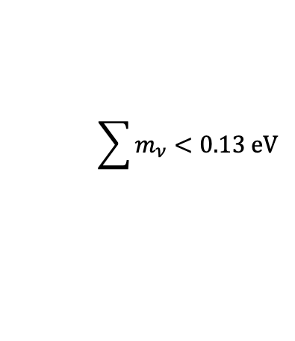
Constraints on the neutrino mass sum…
𝛬CDM+neutrino mass 7-parameter fit; 95% C.L. on $∑mν$ in [eV].
 |  | +CMB lensing | +BAO (non-CMB) | +CMB lensing+BAO
Planck2018 TT+lowE | 0.54 | 0.44 | 0.16 | 0.13
2015 number | 0.72 | 0.68 | 0.21 | n/a
Planck2018 TT +lowE+TE+EE | 0.26 | 0.24 | 0.13 | 0.12
Planck2018 TT +lowE+TE+EE [CamSpec] | 0.38 | 0.27 | n/a | 0.13
2015 number | 0.49 | 0.59 | 0.17 | n/a
Two different high-ℓ
likelihood functions
Planck2015 TT+lowP+Lyα
$$\sum{m_{ν}}<0.13 eV$$
Aghanim et al. [Planck] 2018
Ade et al. [Planck] 2015
Palanque-Delabrouille et al. 2015

Slide 25
Constraints on the neutrino mass sum…
𝛬CDM+neutrino mass 7-parameter fit; 95% C.L. on $∑mν$ in [eV].
 |  | +CMB lensing | +BAO (non-CMB) | +CMB lensing+BAO
Planck2018 TT+lowE | 0.54 | 0.44 | 0.16 | 0.13
2015 number | 0.72 | 0.68 | 0.21 | n/a
Planck2018 TT +lowE+TE+EE | 0.26 | 0.24 | 0.13 | 0.12
Planck2018 TT +lowE+TE+EE [CamSpec] | 0.38 | 0.27 | n/a | 0.13
2015 number | 0.49 | 0.59 | 0.17 | n/a
Two different high-ℓ
likelihood functions
Planck2015 TT+lowP+Lyα
$$\sum{m_{ν}}<0.13 eV$$
Aghanim et al. [Planck] 2018
Ade et al. [Planck] 2015
Palanque-Delabrouille et al. 2015

Slide 26
Caveat 3: more data ≠ improved bounds…
Sometimes the extra data do bring in genuinely new physics info.
  The resulting improvements are noticeably big.
  You need to pay attention to these.
Marginally improved bounds (~20%) could be real physical effects, but are sometimes just accidents of marginal incompatibility of the different data sets
  The inference process (and even how we define X% bounds) can end up translating the incompatibility into an “improved measurement”.
  → It could easily have gone the other way to become a “worse measurement”.
  You really shouldn’t read too much into these.

Slide 27
Constraints on the neutrino mass sum…
𝛬CDM+neutrino mass 7-parameter fit; 95% C.L. on $∑mν$ in [eV].
 |  | +CMB lensing | +BAO (non-CMB) | +CMB lensing+BAO
Planck2018 TT+lowE | 0.54 | 0.44 | 0.16 | 0.13
2015 number | 0.72 | 0.68 | 0.21 | n/a
Planck2018 TT +lowE+TE+EE | 0.26 | 0.24 | 0.13 | 0.12
Planck2018 TT +lowE+TE+EE [CamSpec] | 0.38 | 0.27 | n/a | 0.13
2015 number | 0.49 | 0.59 | 0.17 | n/a
Two different high-ℓ
likelihood functions
Planck2015 TT+lowP+Lyα
$$\sum{m_{ν}}<0.13 eV$$
Aghanim et al. [Planck] 2018
Ade et al. [Planck] 2015
Palanque-Delabrouille et al. 2015

Slide 28
Caveat 4: non-standard neutrino physics…
You can also alter the physics and properties of the C𝜈B to physically relax cosmological constraints.
Neutrino decay
Neutrino spectral distortion
Late-time neutrino mass generation
…
These “physics” games can usually buy you more room for play, provided you are happy to accept the non-standard neutrino physics.

Slide 29
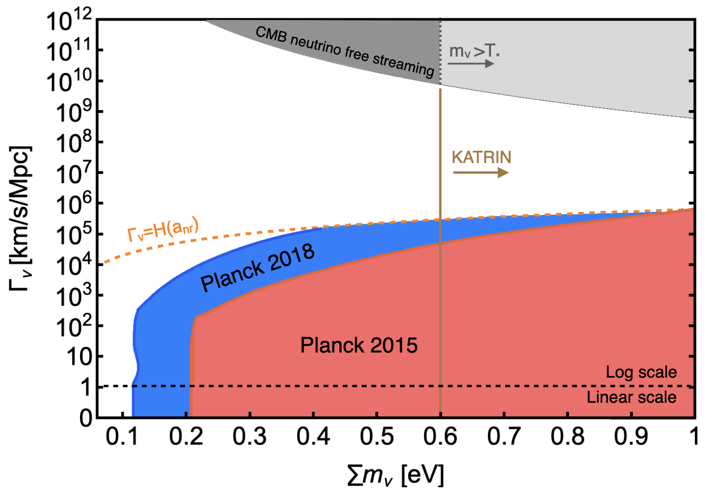


Non-relativistic neutrino decay…
Official Planck benchmark:
$$∑m_{ν}<0.12 eV$$
… into dark radiation
If neutrinos decay with a lifetime
$$τ_{ν}∼0.1 Myr$$
Limitation of the analysis
then it is possible to accommodate
$$∑m_{ν}≲0.42 eV$$
Planck+BAO+SN
Abellán, Chacko, Dev, Du, Poulin & Tsai 2022

Slide 30
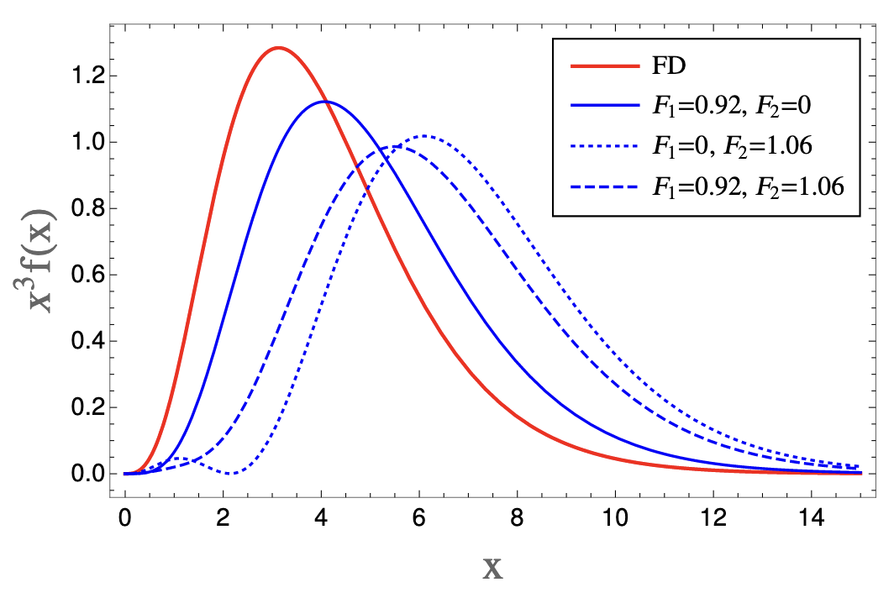
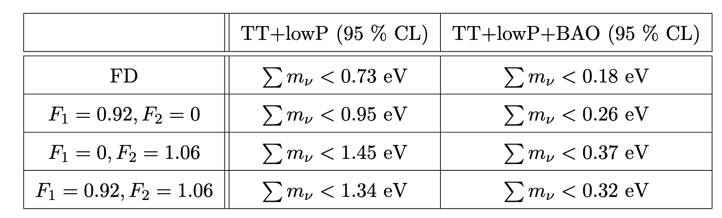
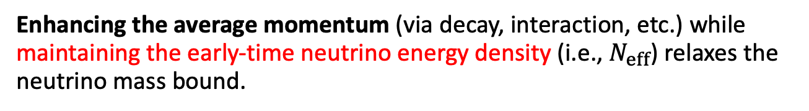
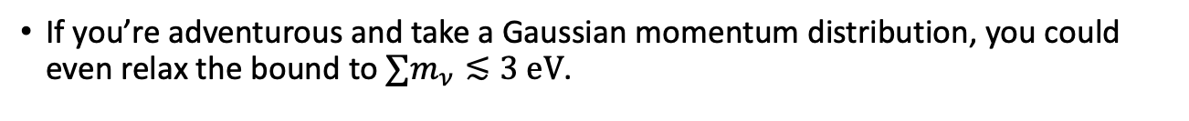
Neutrino spectral distortion…
Enhancing the average momentum (via decay, interaction, etc.) while maintaining the early-time neutrino energy density (i.e., $N_{eff}$) relaxes the neutrino mass bound.
Planck 2015
Oldengott, Barenboim, Kahlen, Salvado & Schwarz 2019
If you’re adventurous and take a Gaussian momentum distribution, you could even relax the bound to $∑m_{ν}≲3 eV$.
Alvey, Escudero & Sabti 2022

Slide 31
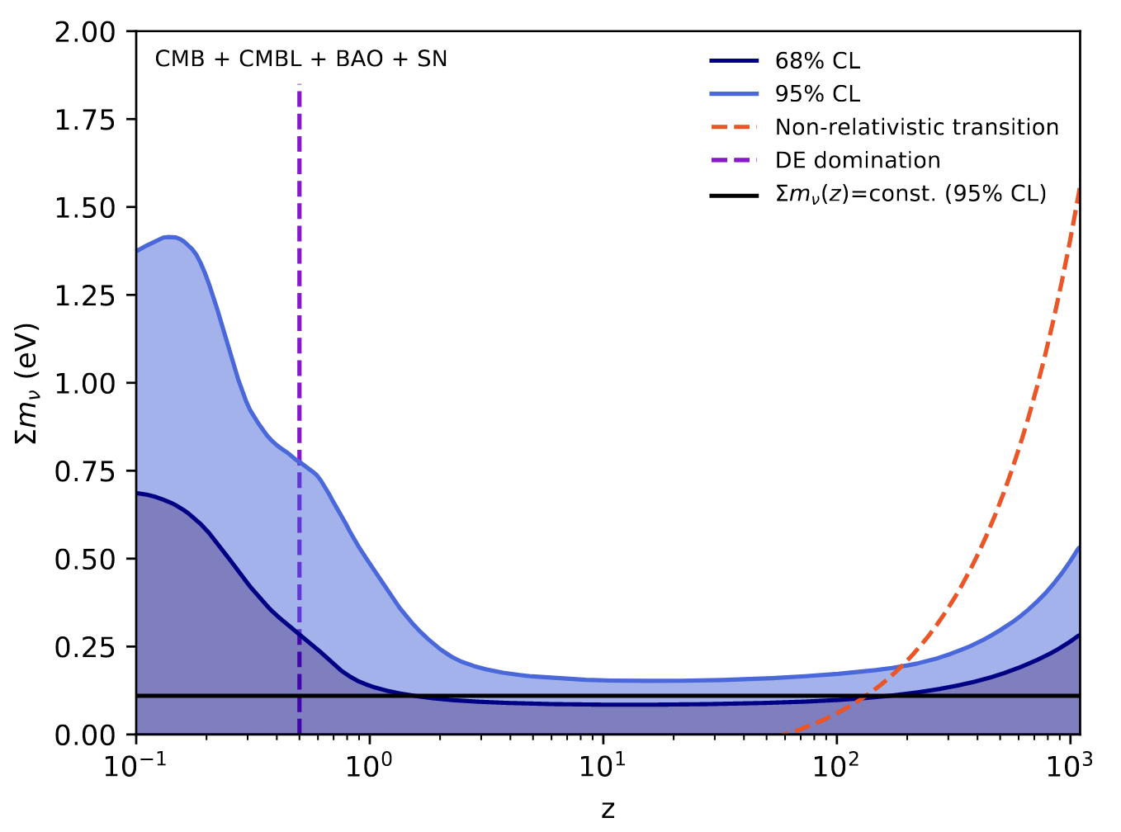
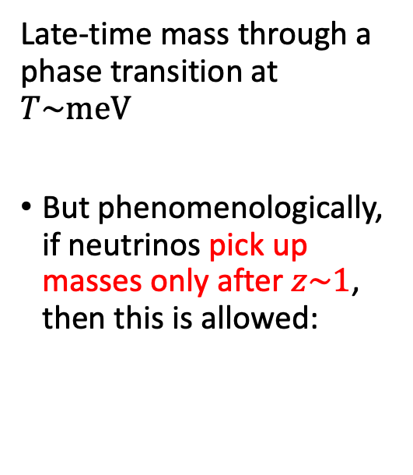

Late-time 𝜈 mass generation…
Official Planck benchmark:
$$∑m_{ν}<0.12 eV$$
Late-time mass through a phase transition at $T\sim meV$
But phenomenologically, if neutrinos pick up masses only after $z\sim 1$, then this is allowed:
Dvali & Funcke 2016
$$∑m_{ν}≲1.46 eV$$
Lorenz, Funcke, Löffler & Calabrese 2021

Slide 32
Take-home message…
Probably the best you can do now re cosmological neutrino mass bounds is to treat them as ballpark figures.
You can evade the tightest constraints to a good extent, but it’s not like anything goes.
In the same vein, please do not over-interpret bounds.
  That second significant digit doesn’t mean much.
  Anything from marginal incompatibility of data sets to a bad choice of fit parameters/priors could shift bounds by 10-20%.

Slide 33
Future probes…

Slide 34
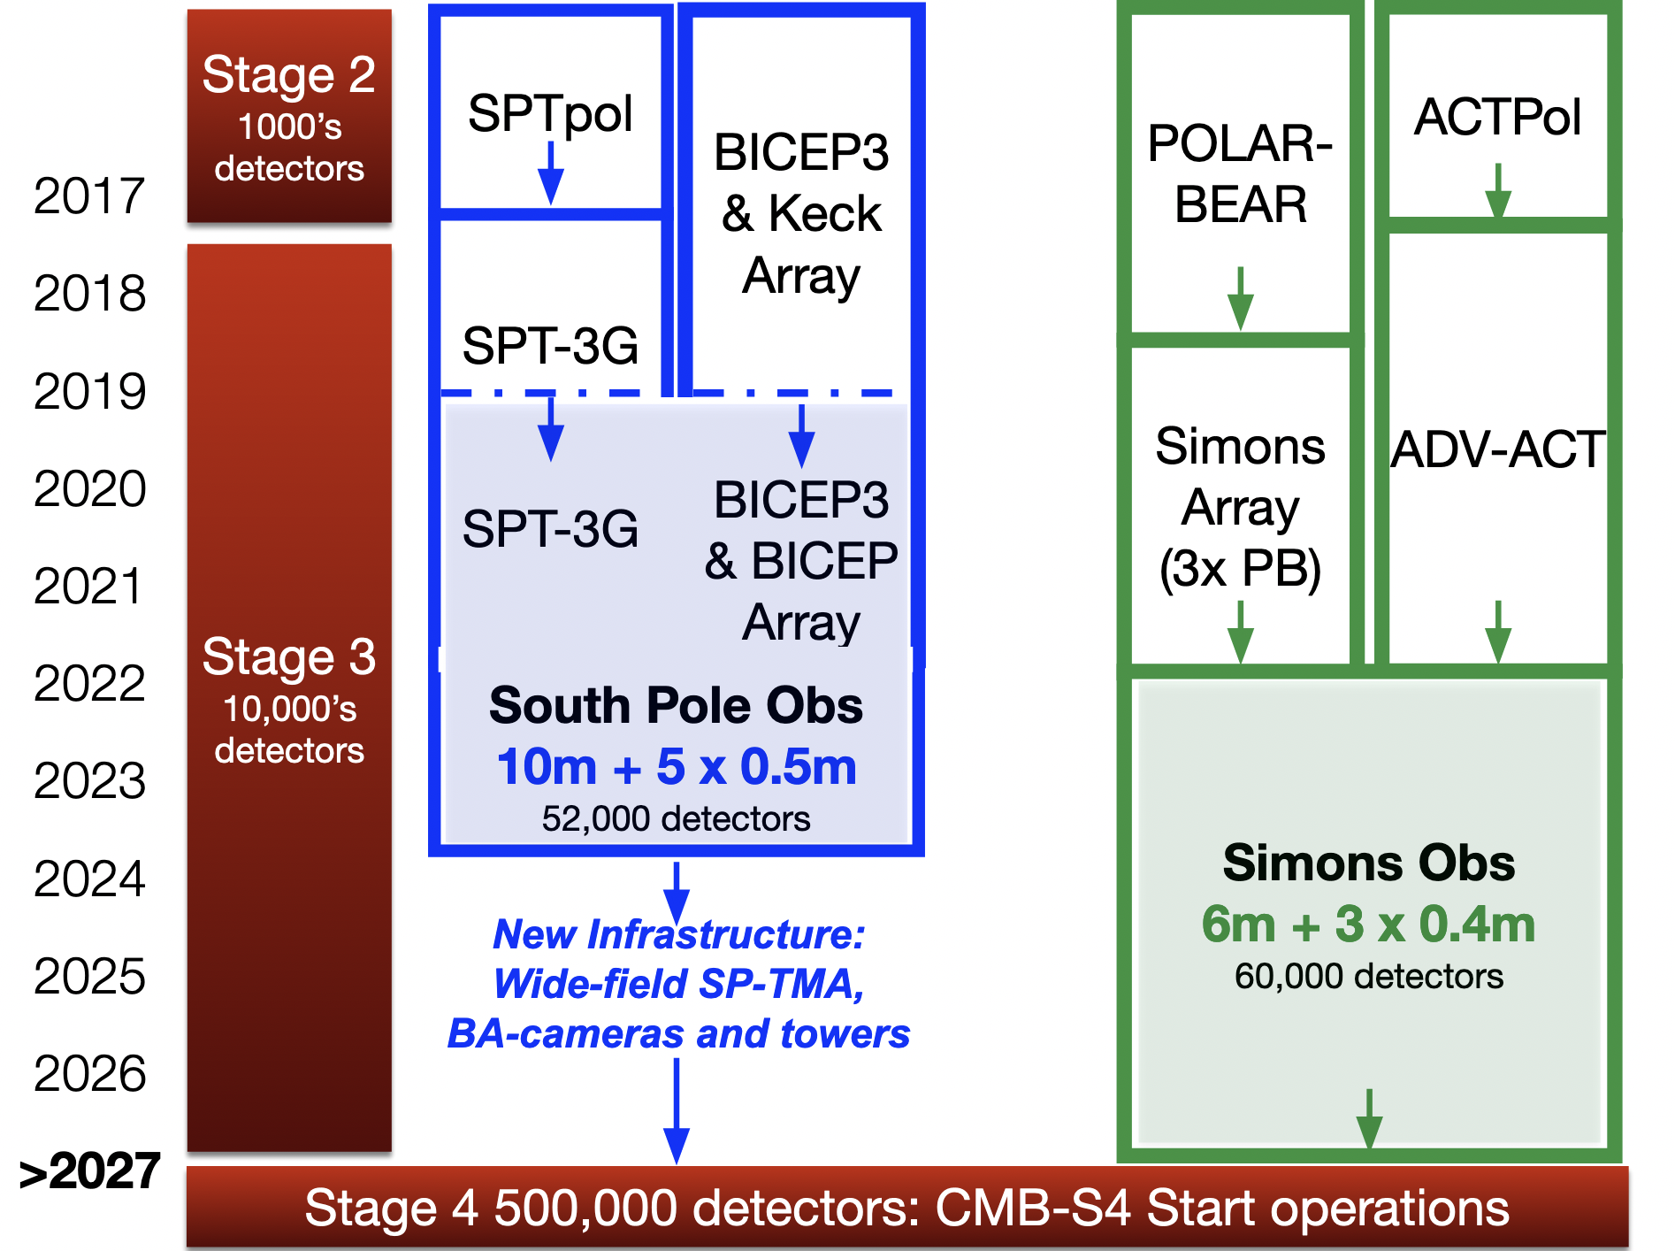
What to expect in the future?
CMB
observations
John Carlstrom

Slide 35
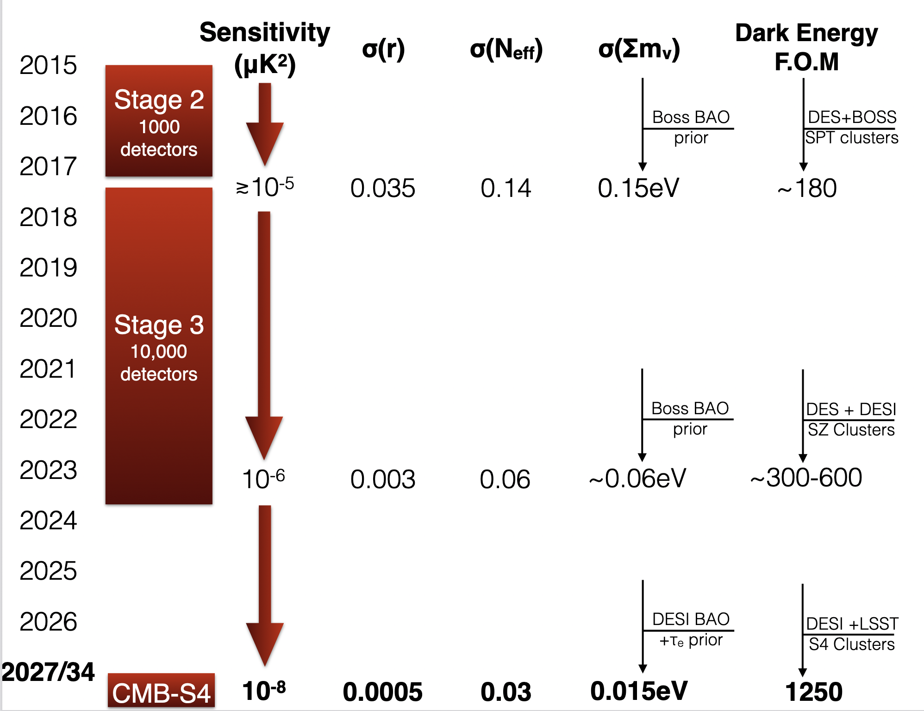
What to expect in the future?
CMB
observations
2027/34
John Carlstrom

Slide 36
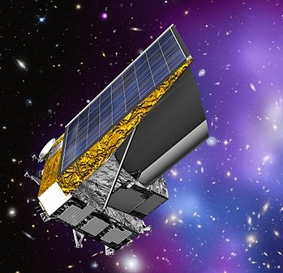
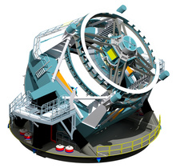

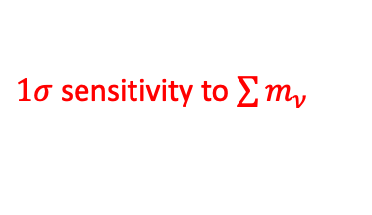


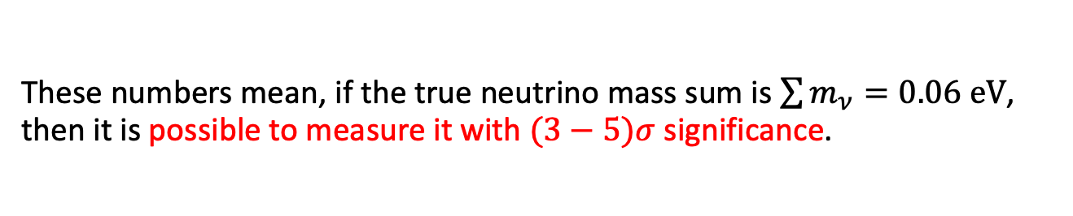


What to expect in the future?
Galaxies, cosmic shear, clusters, etc.
$1σ$ sensitivity to $\sum{m_{ν}}$
$1σ$ sensitivity to $N_{eff}$
ESA Euclid
2024
$$0.011 −0.02 eV$$
$$0.05$$
LSST
2024
$$0.015 eV$$
$$0.05$$
These numbers mean, if the true neutrino mass sum is $\sum{m_{ν}=0.06 eV}$, then it is possible to measure it with $(3−5)σ$ significance.

Slide 37
Do you need to believe these forecasts?
Yes and no.
Forecasts are just that: an estimate of what an instrument can do under an assumed set of conditions*.
  * including our ability to predict theoretically the observables given an underlying cosmology theory.
  Clearly, some observables are inherently under better control than others (see nonlinearities slide).
So, again, your best bet is to treat these forecasted sensitivities as ballpark figures.

Slide 38
What it takes for me (Y³W) to believe it?
Suppose one of these future probes announces a cosmological detection of the neutrino mass sum. Would I believe it?
I might pay attention, depending on who is announcing it (again, refer to nonlinearities slide).
But I won’t believe any of it until multiple observations/data combinations point to the same mass sum value with some statistical significance.

Slide 39
Summary…
These is no doubt that neutrino masses induce some non-trivial effects on cosmological observables.
You can even turn this around and use cosmological observables to “measure” the neutrino mass.
But please please please don’t over-interpret bounds or forecasted sensitivities. They are best treated as ballpark figures.
Until multiple observations have measured the same neutrino mass sum value, take all “measurements” cum grano salis.

Slide 40
Extra slides…

Slide 41
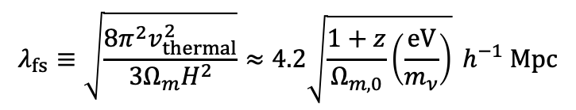

Why? Free-streaming suppression…
Neutrino thermal motion prevents efficient on small length scales.
$$v_{themal}=\frac{T_{CνB}}{m_{ν}}≈50 \left(1+z\right)\left(\frac{eV}{m_{ν}}\right)km s^{−1}$$
𝜈
𝜈
c
c
Gravitational
potential wells
𝜈
𝜈
c
c
Free-streaming scale
(at any one time):
$$λ_{fs}≡\sqrt{\frac{8π^{2}v_{thermal}^{2}}{3Ω_{m}H^{2}}}≈4.2\sqrt{\frac{1+z}{Ω_{m,0}}\left(\frac{eV}{m_{ν}}\right)} h^{−1} Mpc$$

Slide 42
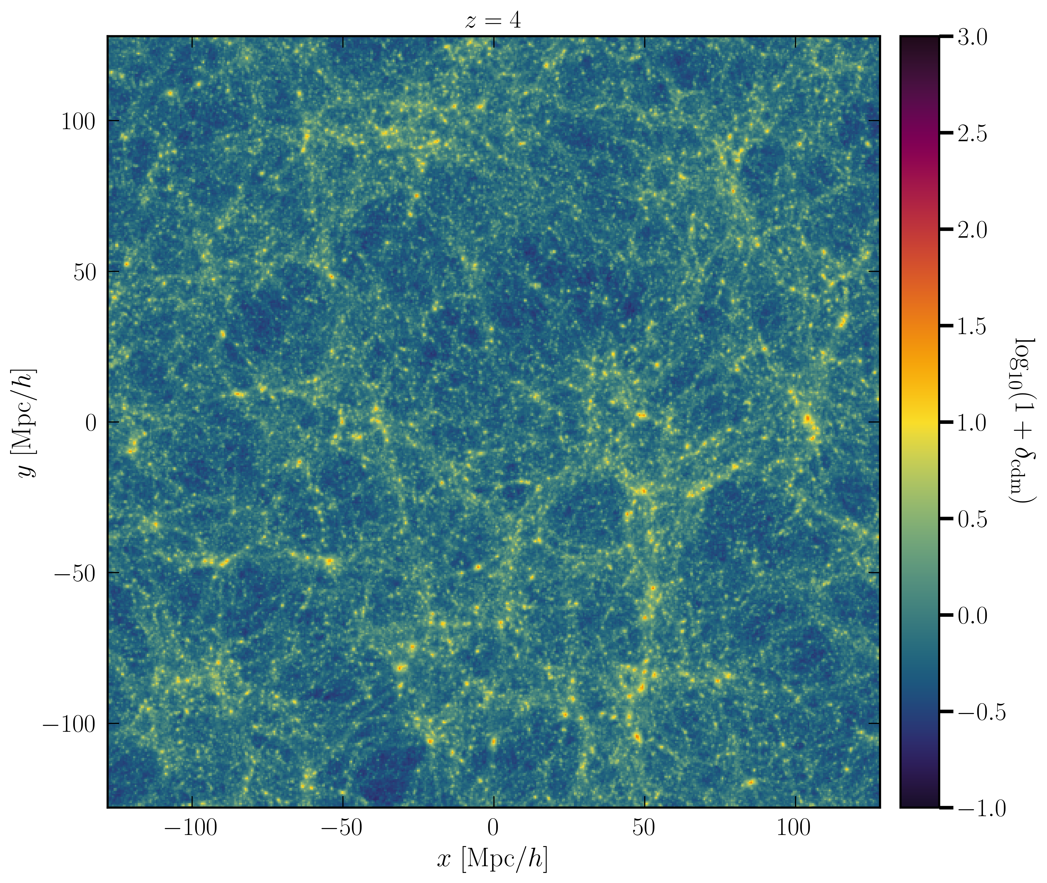
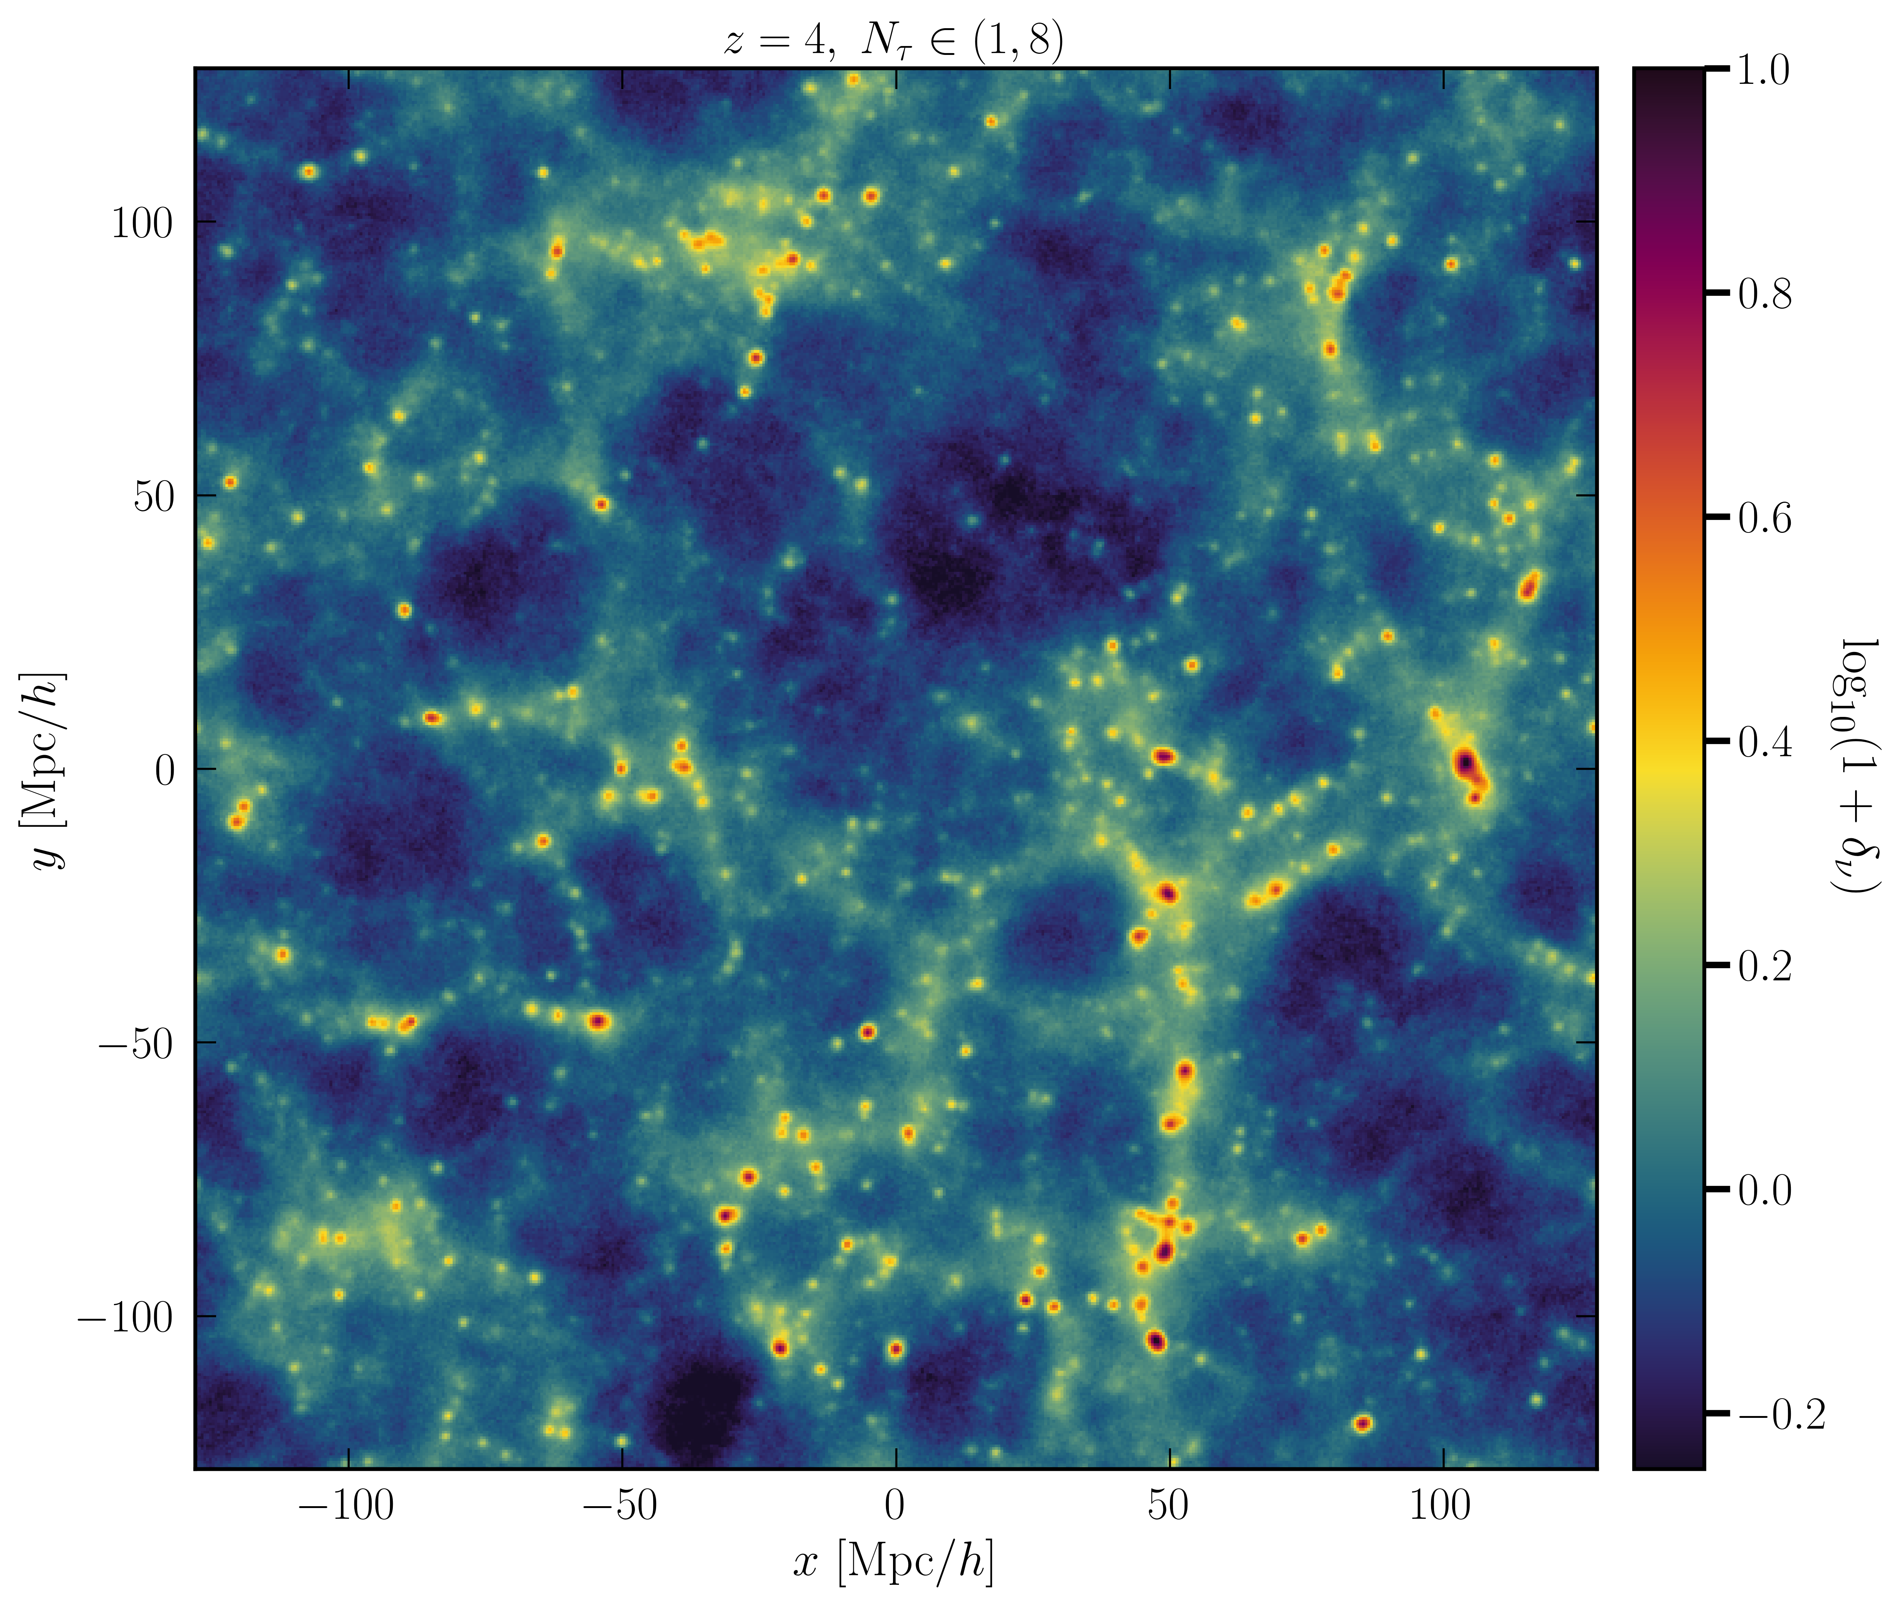
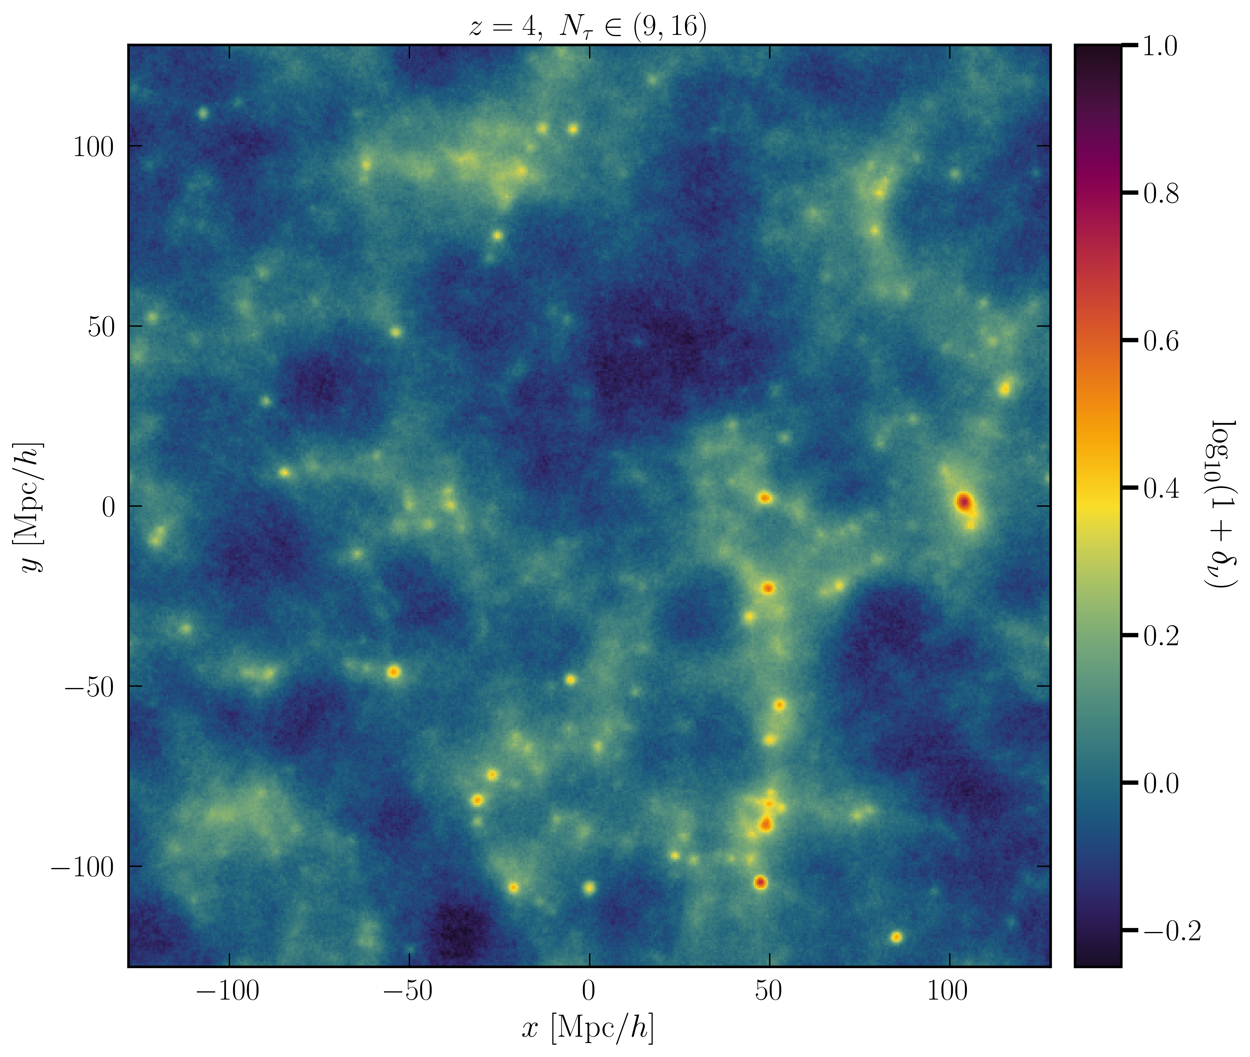
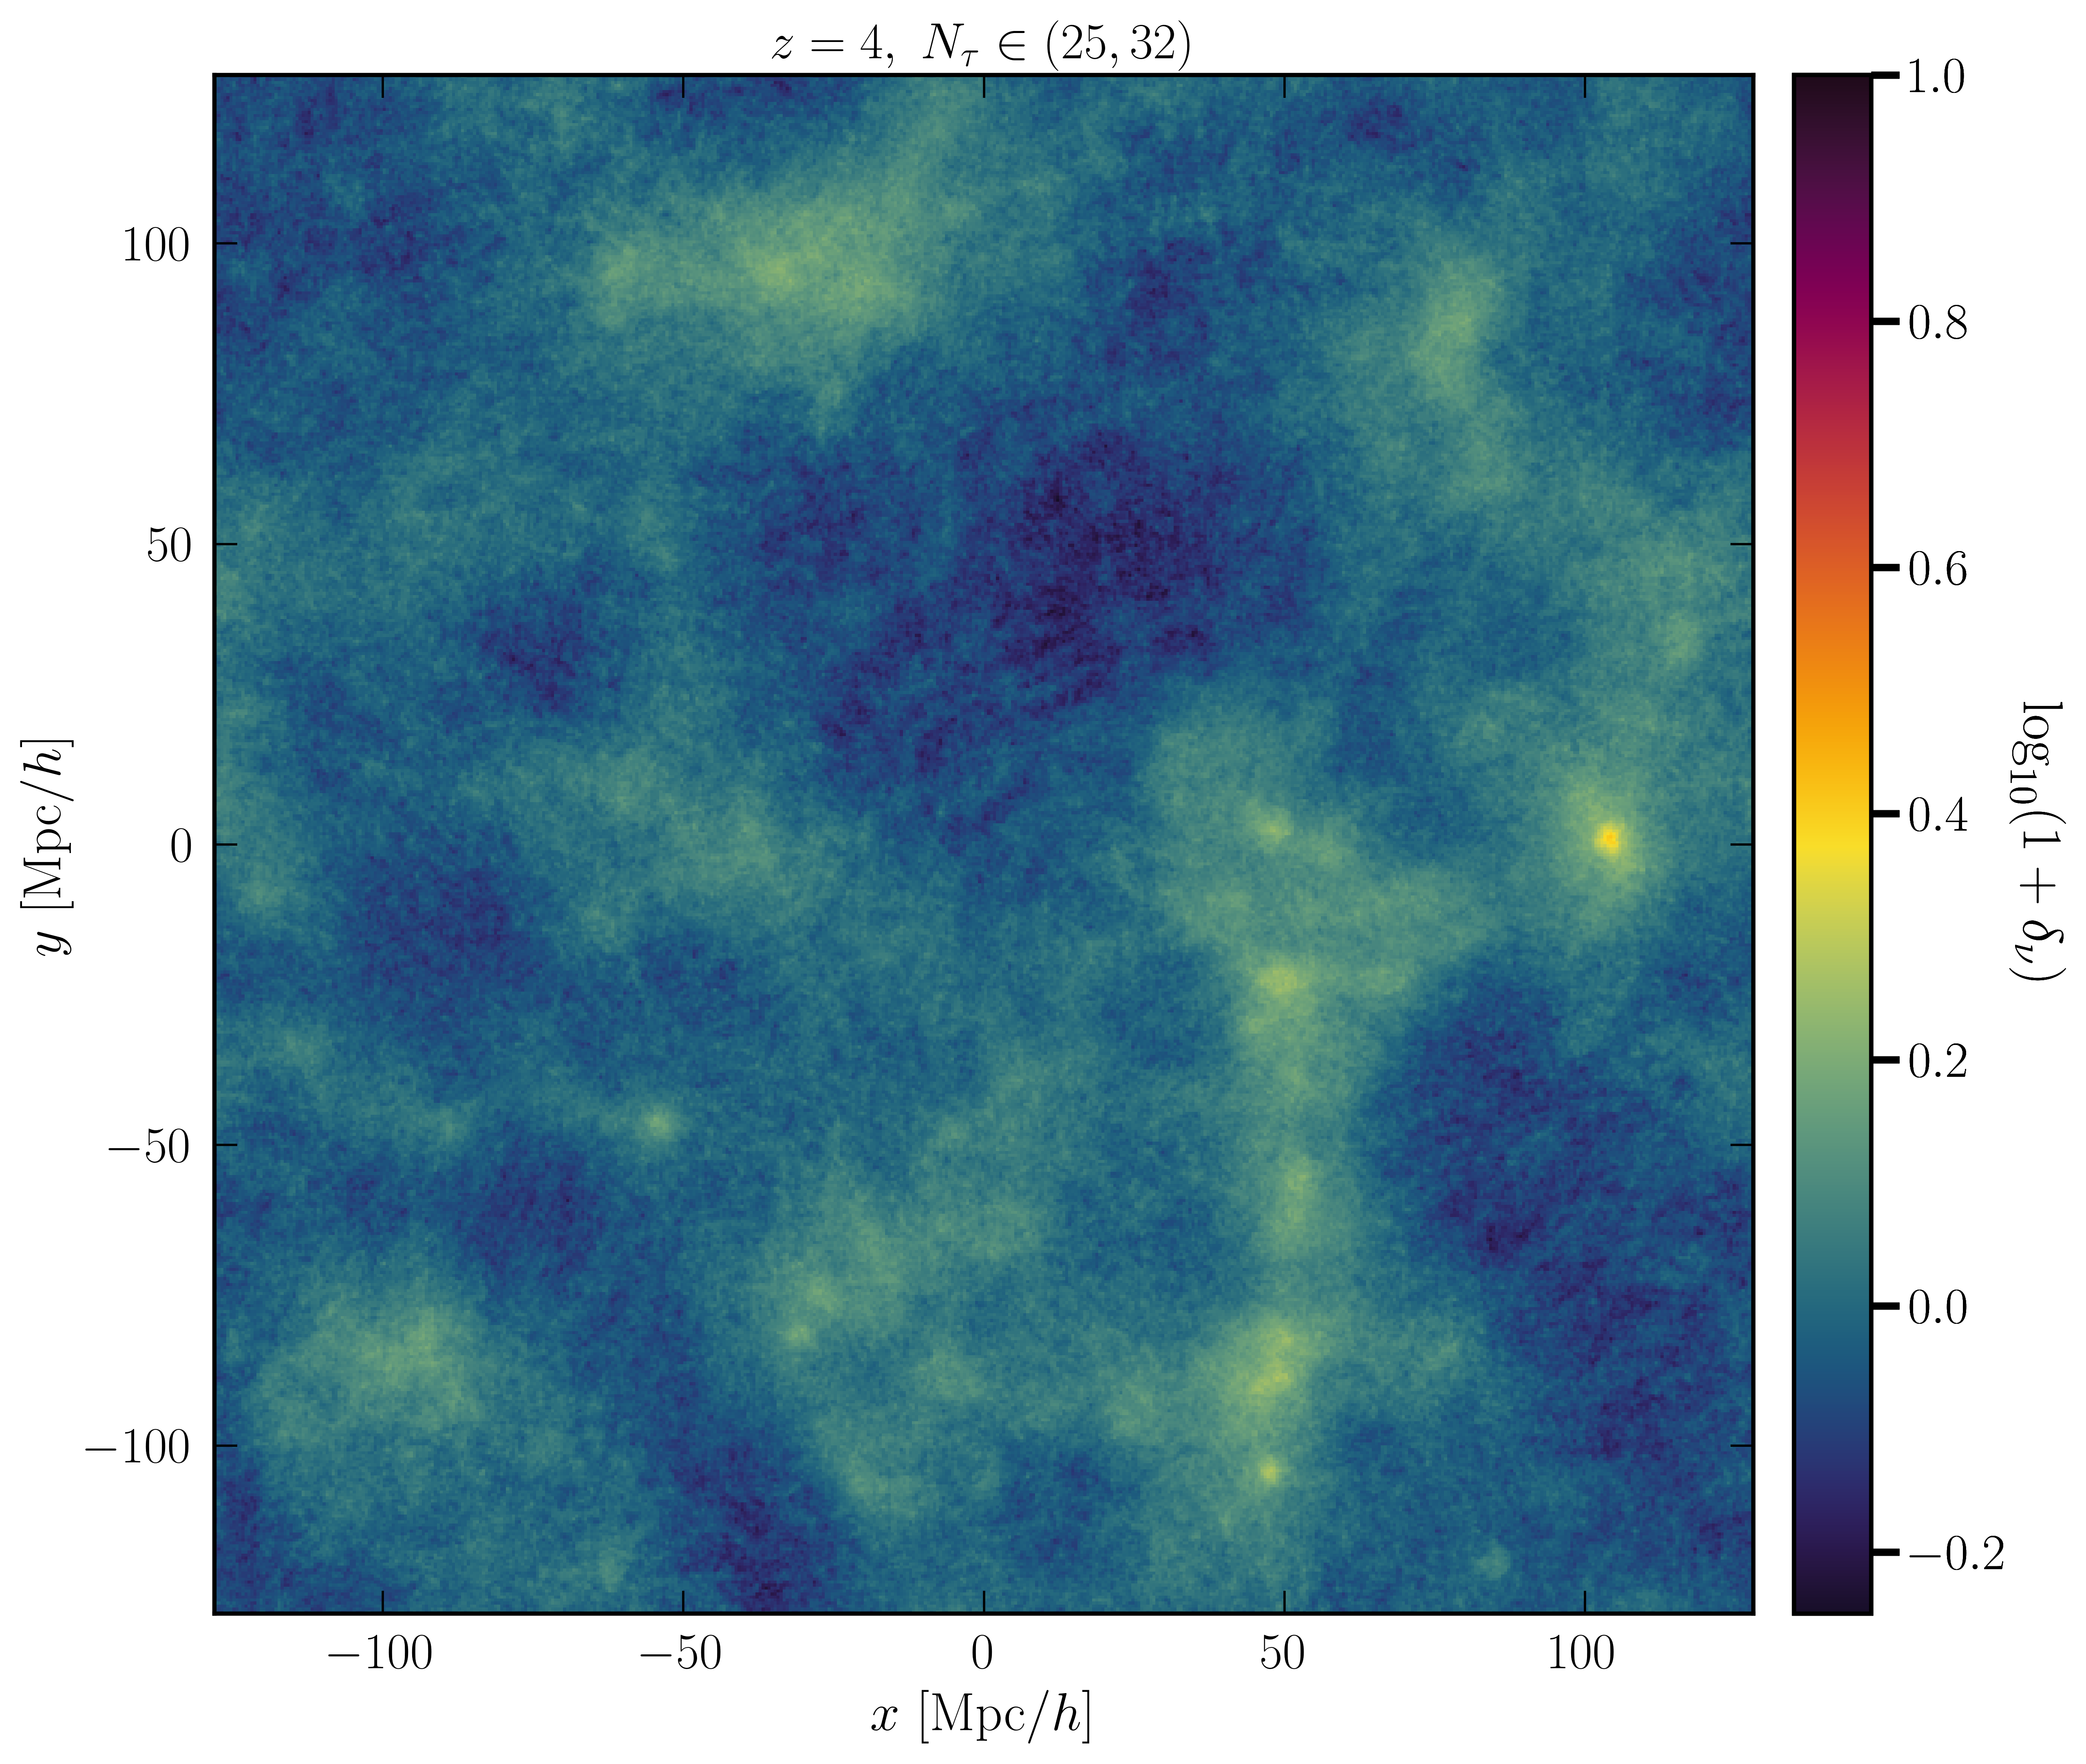
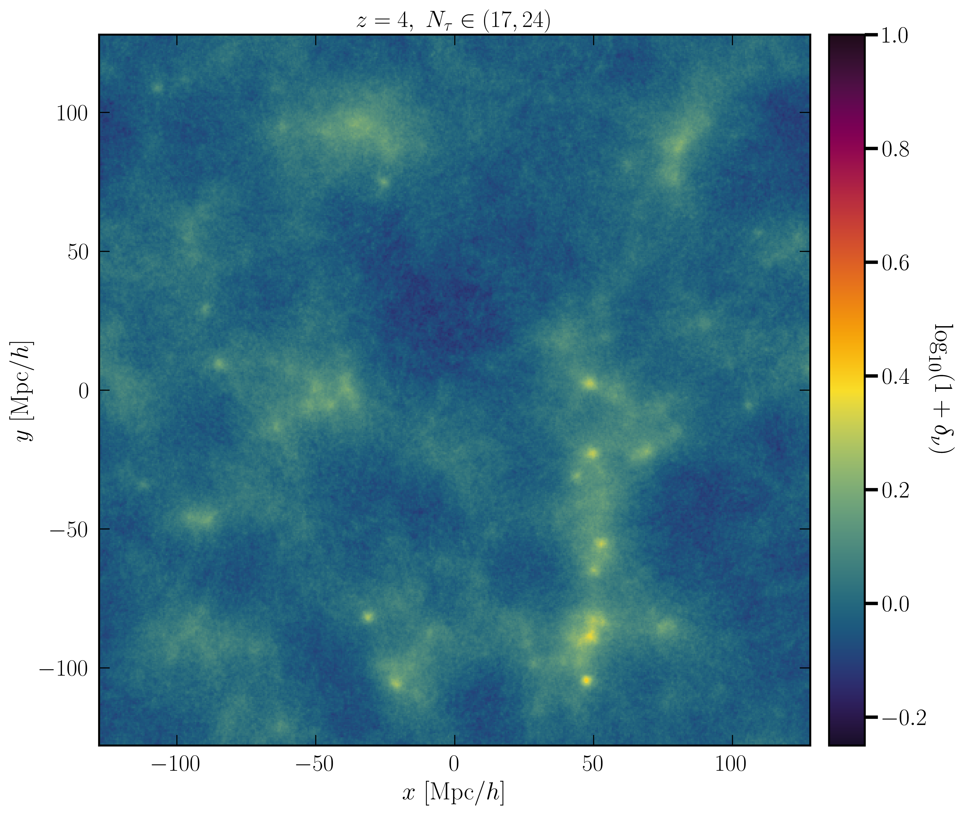
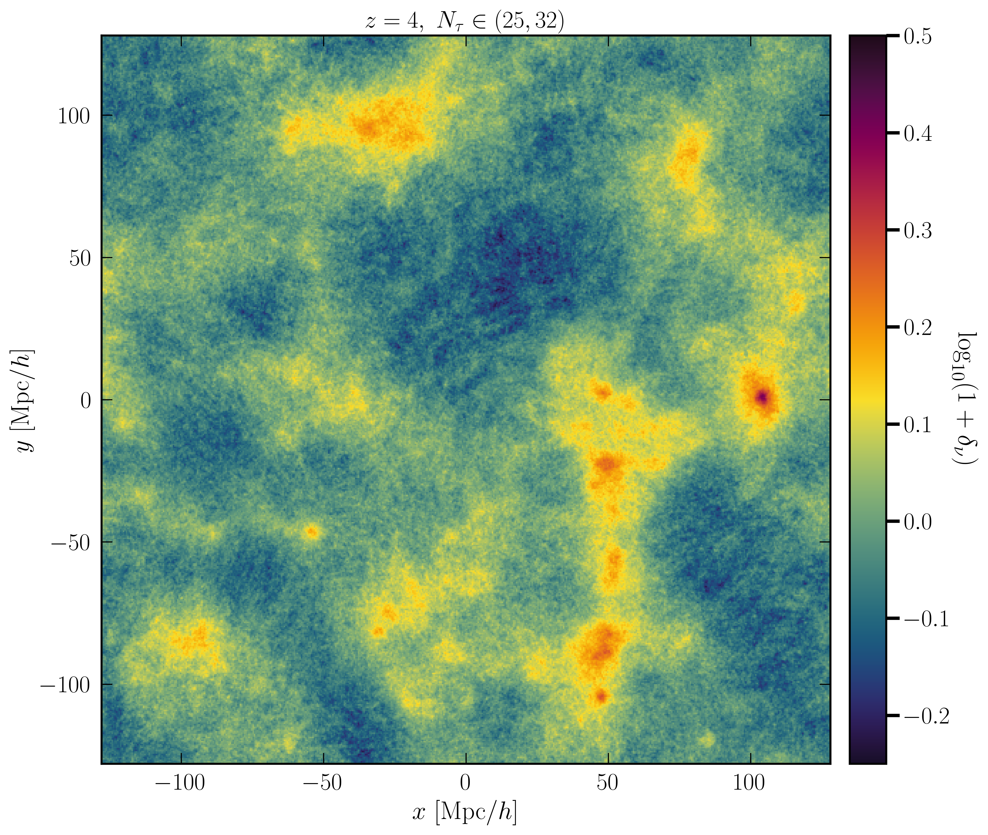

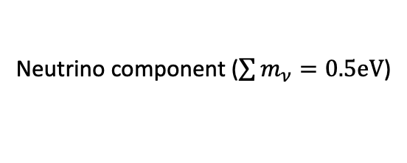
Increasing neutrino momentum
Cold dark matter component
$$256 h^{−1}\text{Mpc}$$
N-body code: Gadget-Hybrid:
Chen, Mosbech, Upadhye & Y³W, in prep
Post-processing/graphics: G. Pierobon
Neutrino component ($\sum{m_{ν}}=0.5eV$)

Slide 43


A neutrino and a cold DM particle encounter 2 gravitational potential wells of different physical sizes in an expanding universe:
𝜈
𝜈
c
c
𝜈
𝜈
c
c
Some time later…
$${λ≫λ}_{fs}$$
$${λ≪λ}_{fs}$$
c
Only CDM clusters
𝜈
c
𝜈
c
𝜈
c
𝜈
c
𝜈
Potential decays
Potential stays the same depth
Free-streaming induces gravitational potential decay on length scales $λ≪λ\text{FS}$.

Slide 44



$$\left|δ\right|≡\left|\frac{δρ}{ρ}\right|$$
$$\left|δ\right|≡\left|\frac{δρ}{ρ}\right|$$
Perturbation spectrum
(depth of “potential wells”)
Some time later
Large scales
Small scales
CDM-only universe
A cold+neutrino DM universe
$$k$$
$$k$$
Perturbation wavenumber
Perturbation wavenumber
The presence of neutrino dark matter induces a step-like feature in the spectrum of gravitational potential wells.

Slide 45
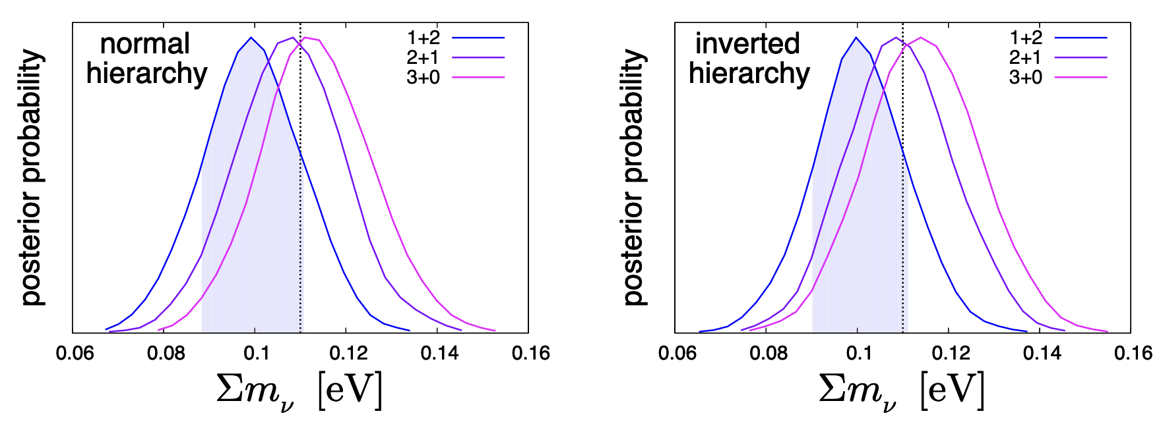

Can you discern the mass spectrum?
Not for Euclid-like sensitivity.
Fiducial model has 3 degenerate neutrinos
Fitting 3 different mass spectra against fiducial data shows no statistically significant difference.
Fiducial $∑m_{ν}=0.11eV$
Hamann, Hannestad & Y³W 2012

Slide 46
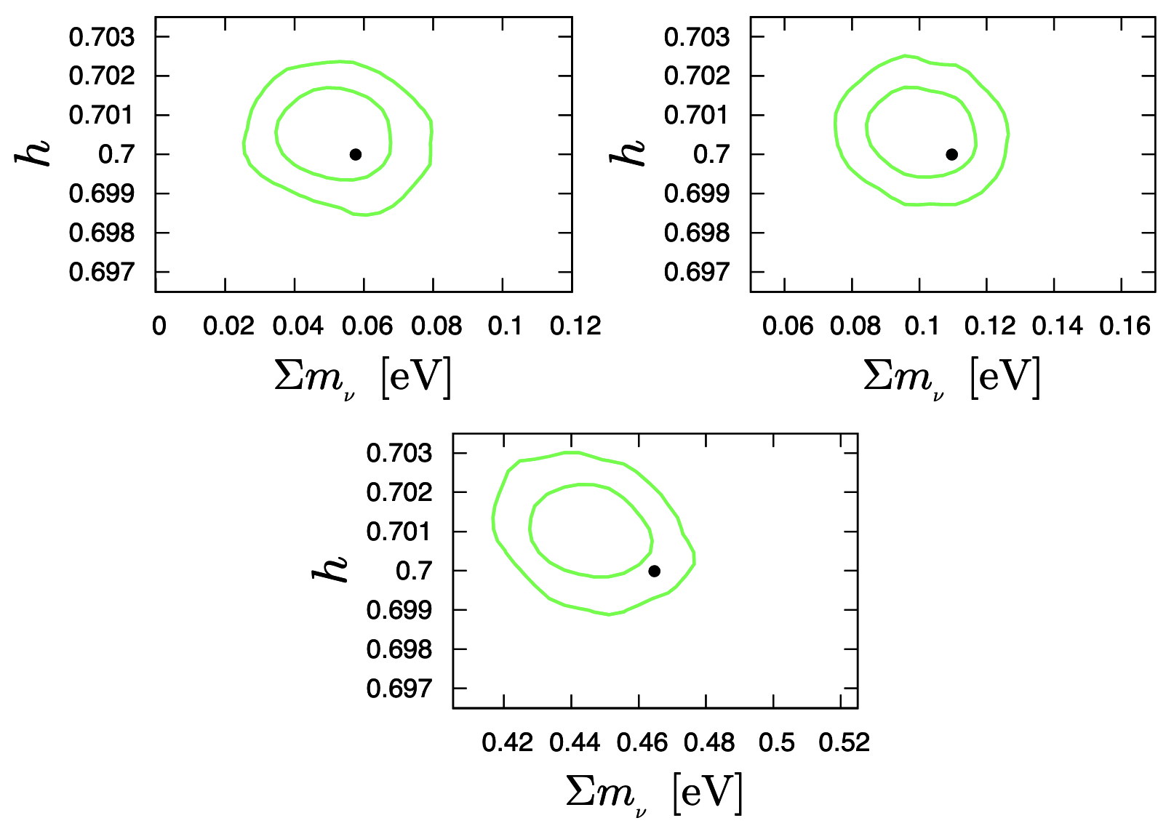
Can you discern time evolution?
The presence of massive neutrinos leads in theory to a unique, time-dependent suppression of the matter power spectrum.
In practice, a Euclid-like survey will not be able to pin this down with statistical significance.
Fiducial data = correct time-dependence; Fit = no time-dependence.
Fiducial
model
Hamann, Hannestad & Y³W 2012

