Slide 1
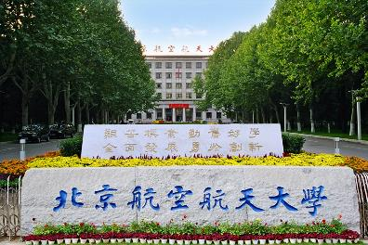
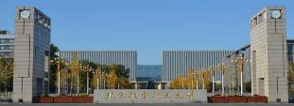
Hadron-hadron interactions in covariant baryon chiral perturbation theory
Li-Sheng Geng（耿立升）@ Beihang U.
第二届“无中微子双贝塔衰变及相关物理研讨会” 、珠海

Slide 2
Four fundamental interactions in Nature
F= $\frac{kq_{1}q_{2}}{r^{2}}$
F= $\frac{Gm_{1}m_{2}}{r^{2}}$
F=q$\vec{v}×\vec{B}$
F=……………
….
F=$G_{F}$

Slide 3
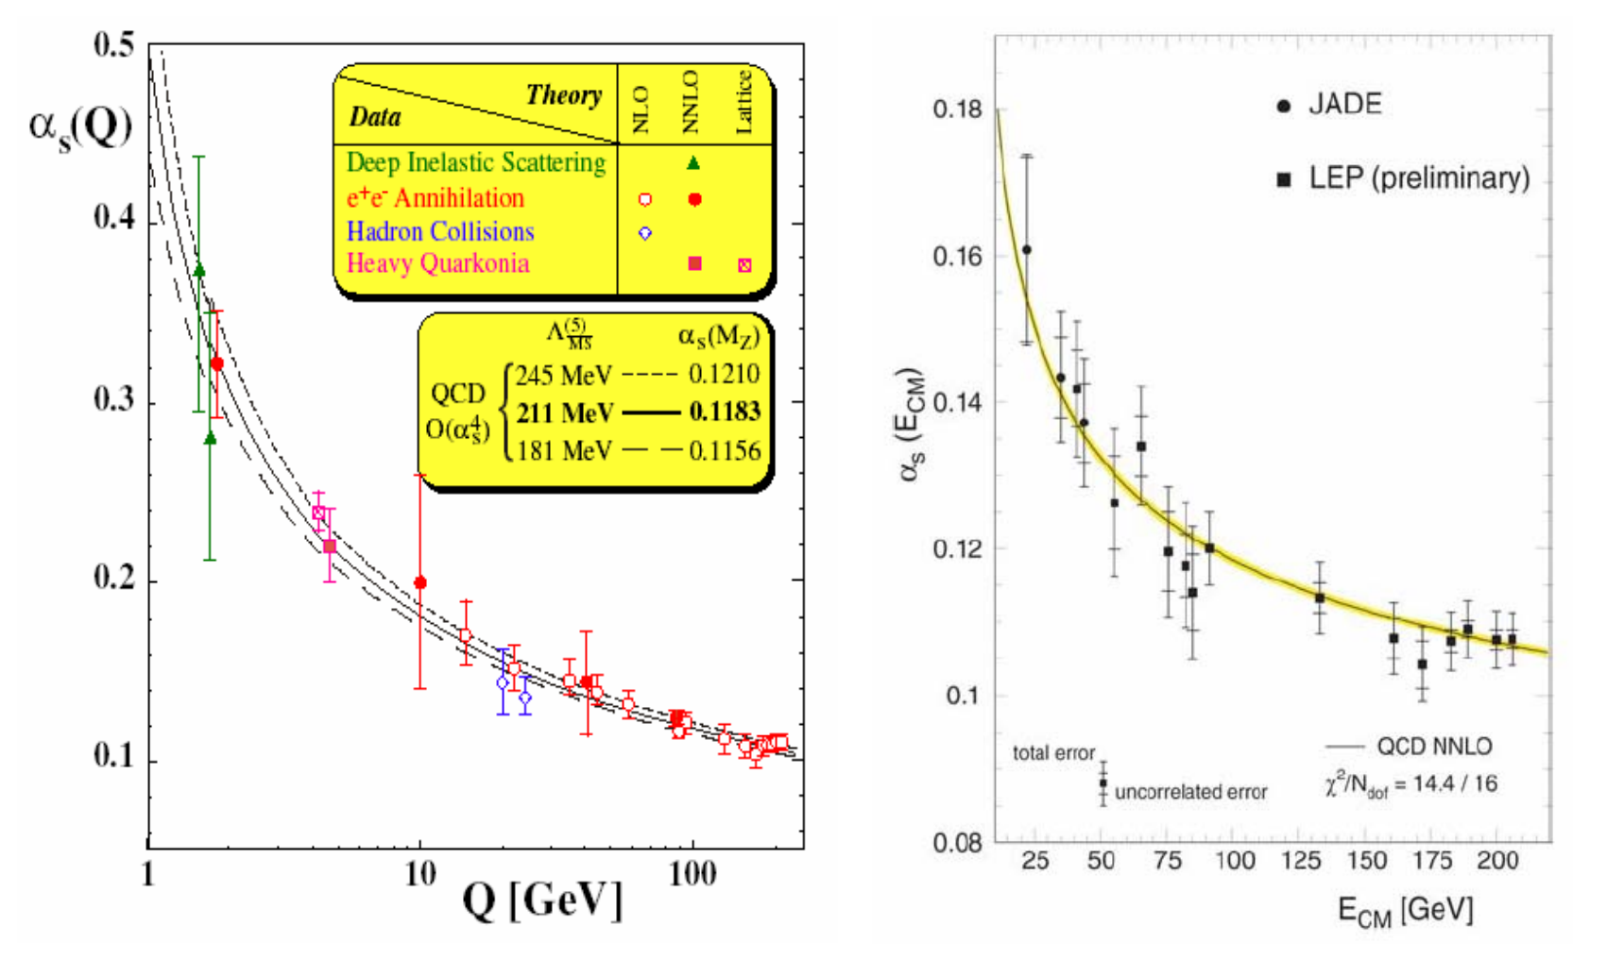
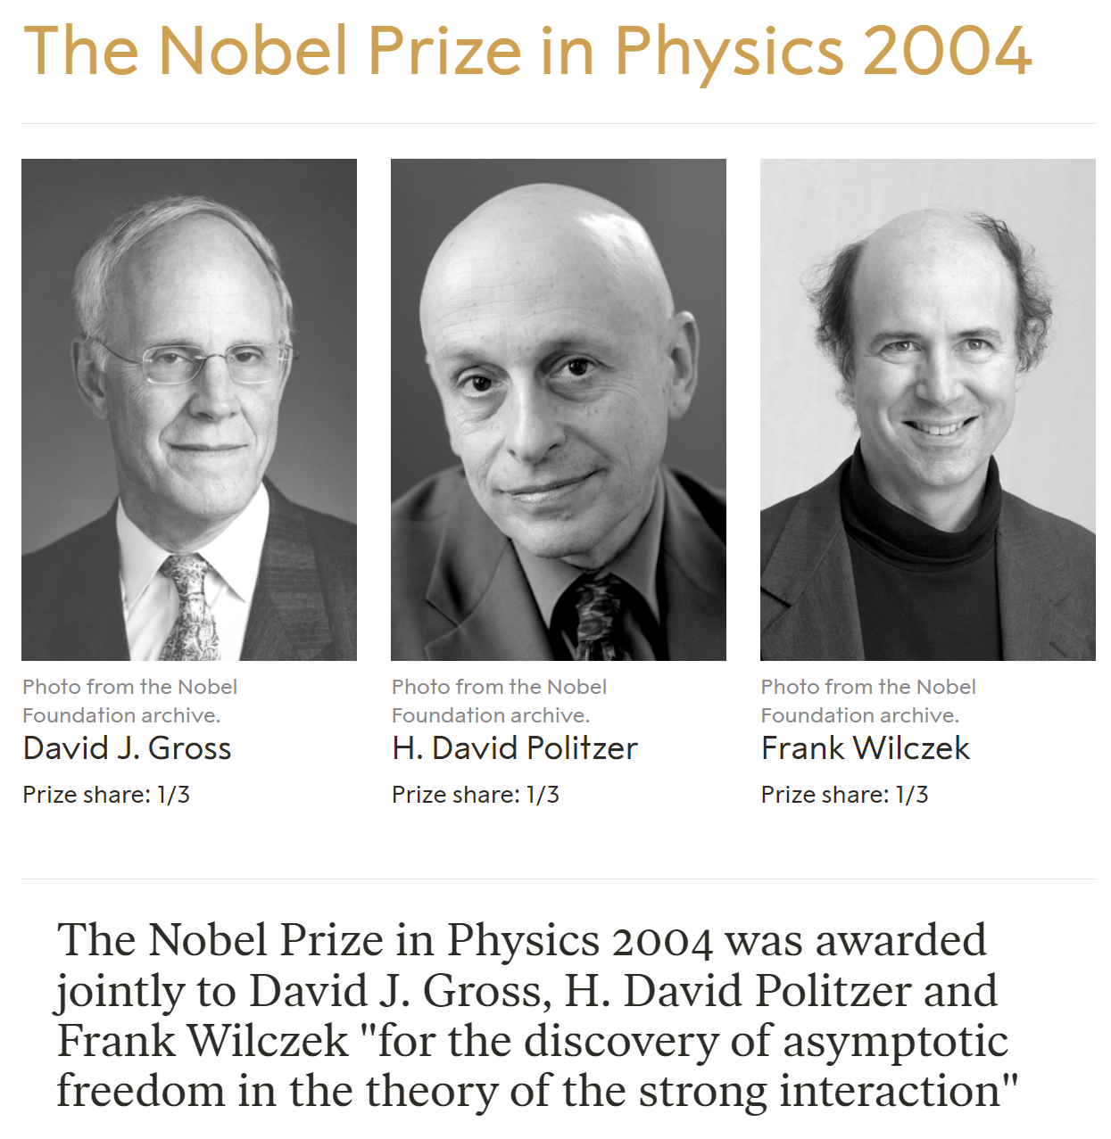
QCD: the theory of the strong interaction
Asymptotic Freedom
Color confinement
Millennium Problems
Yang–Mills and Mass Gap
Experiment and computer simulations suggest the existence of a "mass gap" in the solution to the quantum versions of the Yang-Mills equations. But no proof of this property is known.

Slide 4
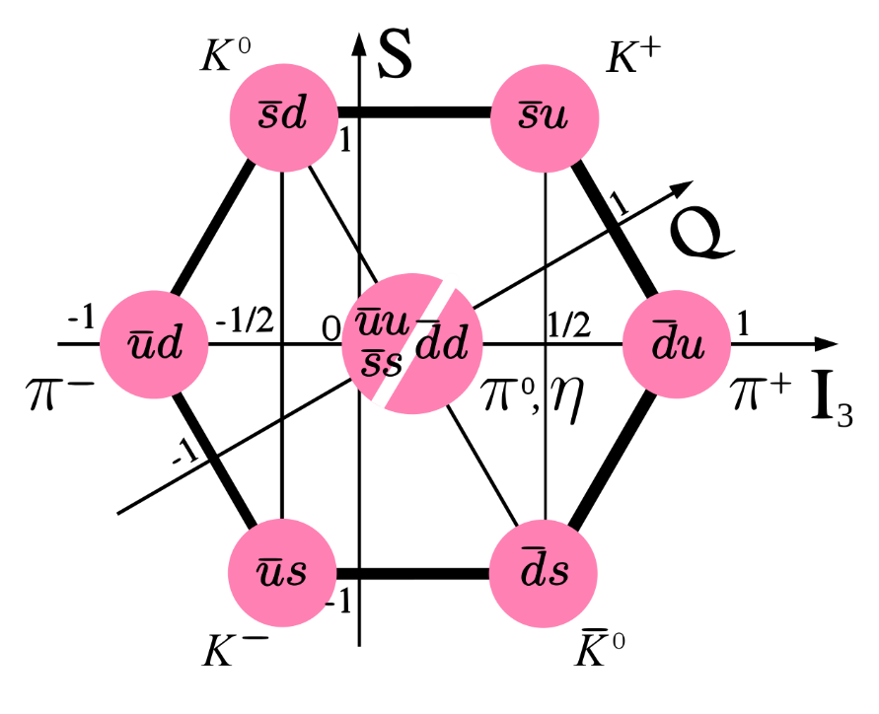
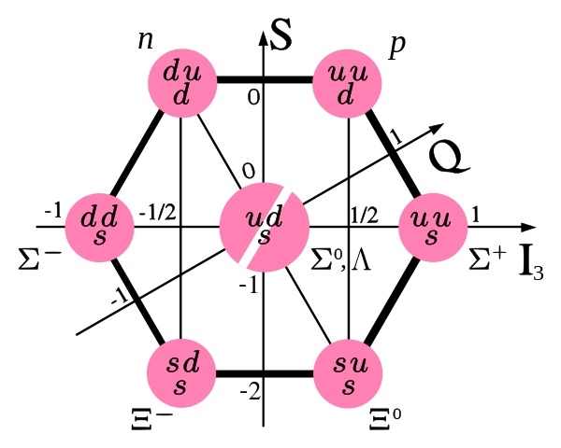
Color confinement: quarks confined into hadrons
meson-meson
$$π−π$$
𝜋−𝜋
meson-baryon
$$π−N$$
𝜋−𝑁
baryon-baryon
$$N−N$$
𝑵−𝑵

Slide 5
Systematic studies of hadron-hadron interactions in rBChPT
Nucleon-nucleon interaction in the 3S1-3D1 coupled channel for a pion mass of 469 MeV
PLB833(2022)137347
Relativistic high precision chiral nuclear forces
PRL128(2022)142002
u
d
Renormalizability of leading order covariant chiral NN interaction
CPC45(2021)054101
Non-perturbative two-pion exchange contributions
PRC105(2022)014003
NN
Relativistic Chiral Description of the 1S0 NN Scattering CPL38(2021)062101
Perturbative two-pion exchange contributions
PRC102(2020)054001
Pion-mass dependence of the NN interaction
PLB809(2020)135745
Meson-baryon scattering up to one-loop
PRD99(2019)054024
PRL130(2023) 071902
Leading order relativistic chiral NN interaction
CPC42(2018)014103
Covariant chiral NN contact
Lagrangians up to N3LO
PRC99(2019)024004
First high-precision relativistic chiral nuclear force
leading order
next-to-next-to-leading order
Strangeness S= − 2 BB interactions and femtoscopic correlation functions
CPC47(2023)024108
u
d
Test of the YN interaction of the leading order covariant ChEFT
PRC105(2022)035203
s
Strangeness S = − 3 and S = − 4 BB interactions
PRC103(2021)025201
YN&YY
Strangeness S = − 2 BB interactions PRC98(2018)065203
Strangeness S = − 1 YN interactions
PRC98(2018)065203
Leading order relativistic YN interactions
CPC42(2018)014105
Strangeness S = −1 YN scattering in covariant ChEFT
PRD94(2016) 014029
Notes:
过去的几年，我们在协变手征理论的框架下，系统研究了强子-强子相互作用

Slide 6
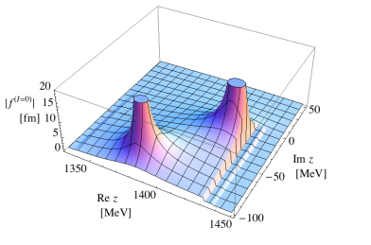
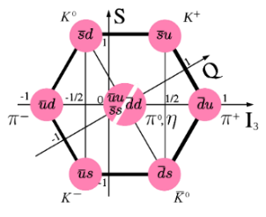
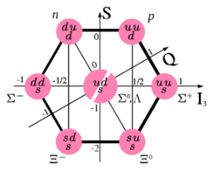
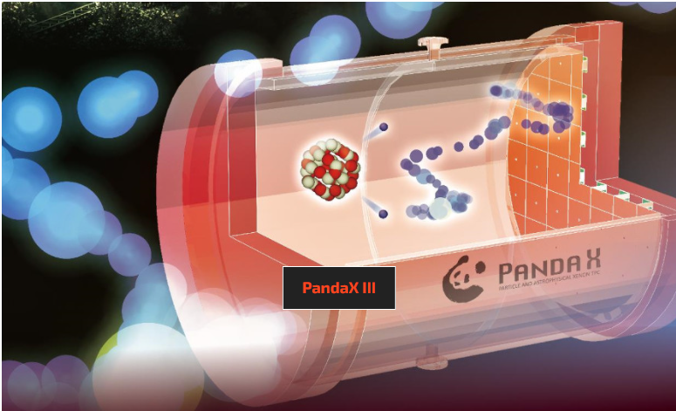
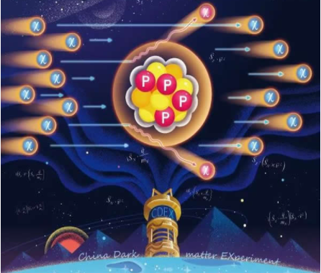
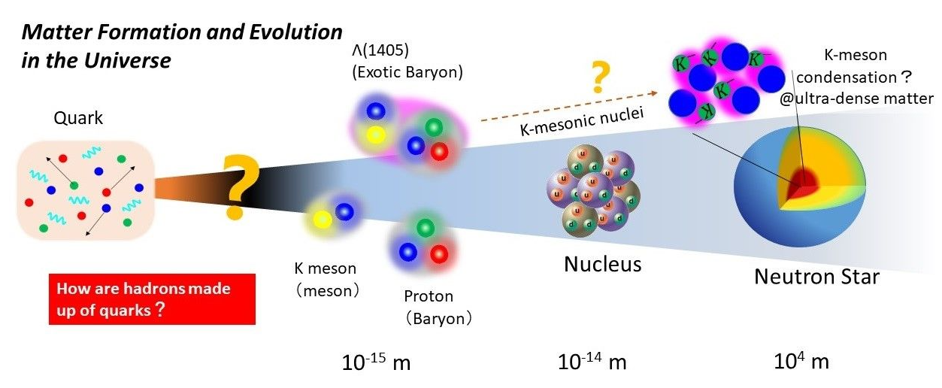
Meson-baryon interactions
Geng et al., PRD99(2019)054024
Geng et al., PRL130(2023) 071902
$Λ$(1405)双峰结构
Spectroscopy
N(1440), N(1535), Λ(1380), Λ(1405), Σ(1385)…
“PandaX”
“CDEX”,“盘古”实验
Baryon sigma terms
Kaon condensation
n
p
n
p
n
p
n
p
n
Λ
K

Slide 7
Contents
Why relativistic/covariant chiral nuclear forces
Two-fold purposes
First relativistic high-precision chiral nuclear force
Summary and outlook

Slide 8
Contents
Why relativistic/covariant chiral nuclear forces
Two-fold purposes
First relativistic high-precision chiral nuclear force
Summary and outlook

Slide 9
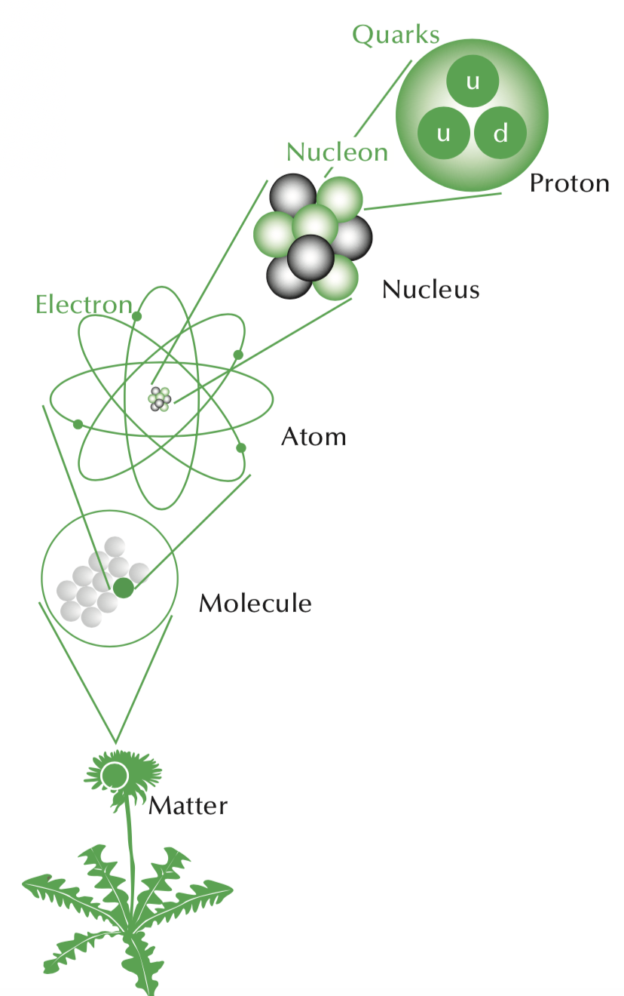
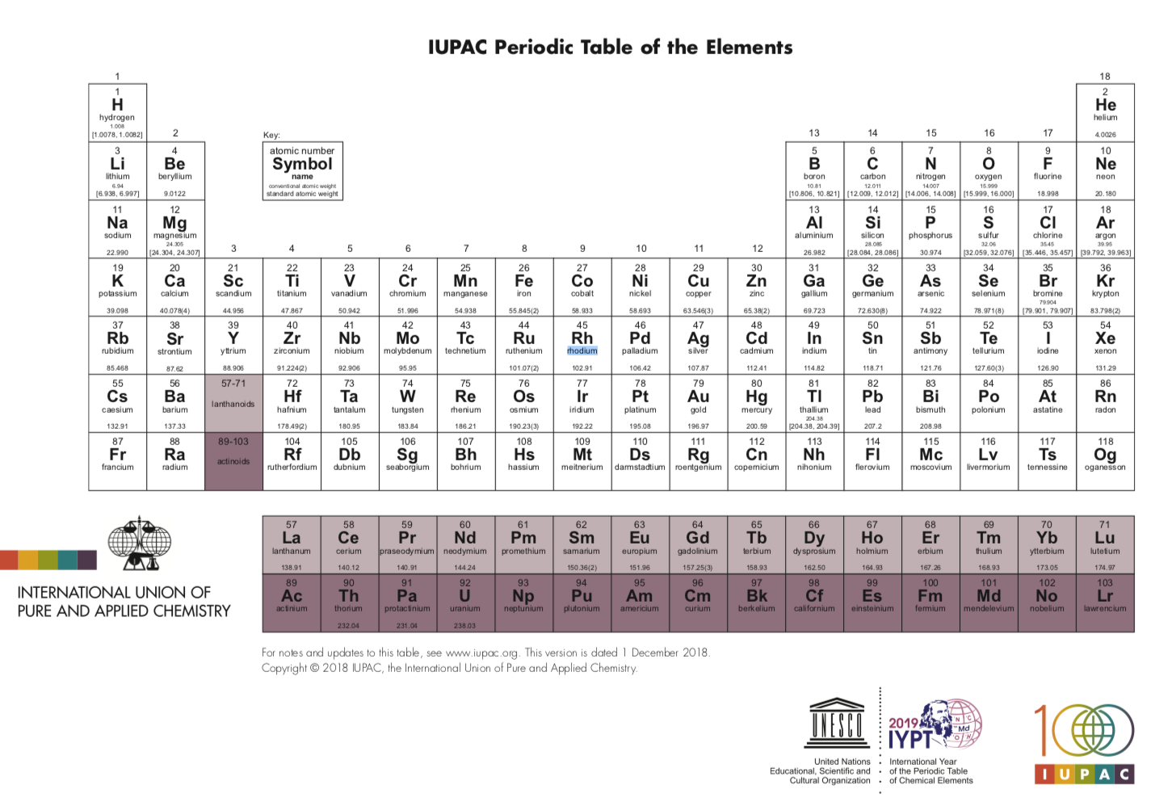
Physics: constituents, interactions, and Motion
10⁻¹⁵
10⁻¹⁴
10⁻¹⁰
10⁻⁶
Nuclei are essential building blocks of Matter!
10⁻¹
Notes:
We know all the matter we are familiar with are built from atoms, which are composed of nuclei and electrons, while nuclei consist of protons and neutrons

Slide 10
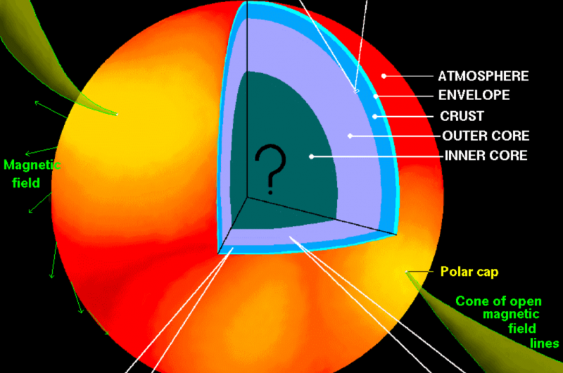
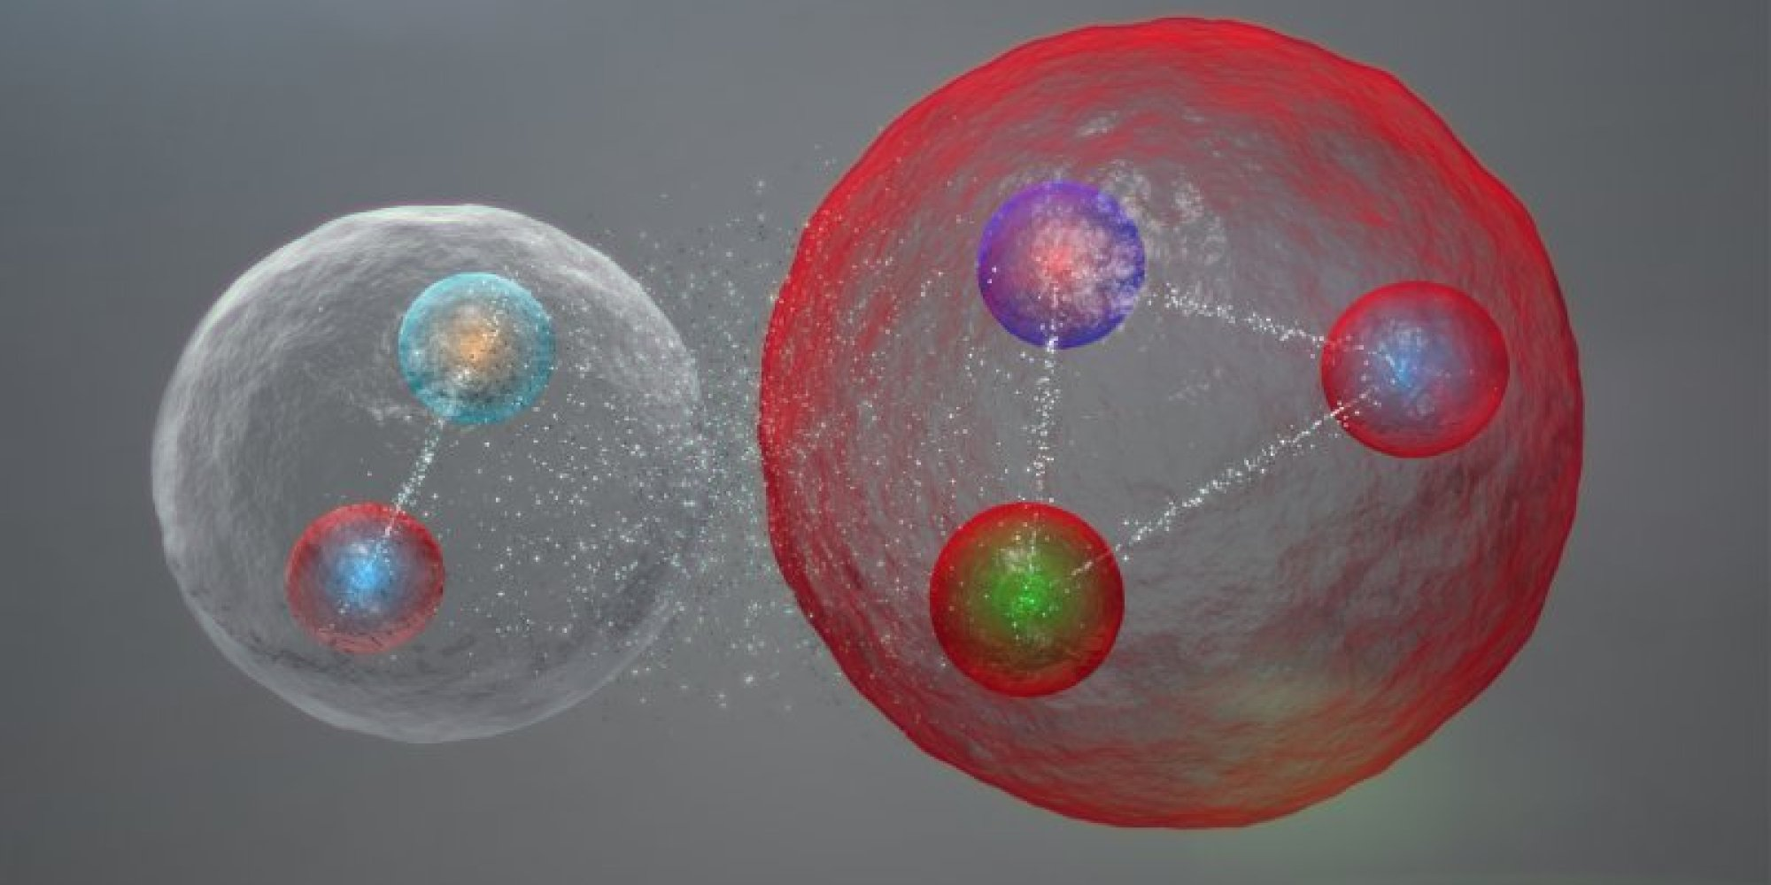
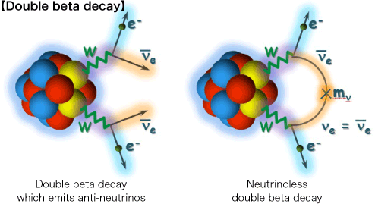
NN—most important input for microscopic understanding of nuclei
Nuclear Chart
Nuclear structure, reactions
Nuclear astrophysics
Exotic hadrons~deuteron
Searches for BSM physics

Slide 11
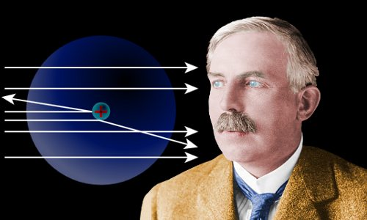
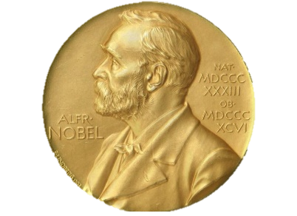
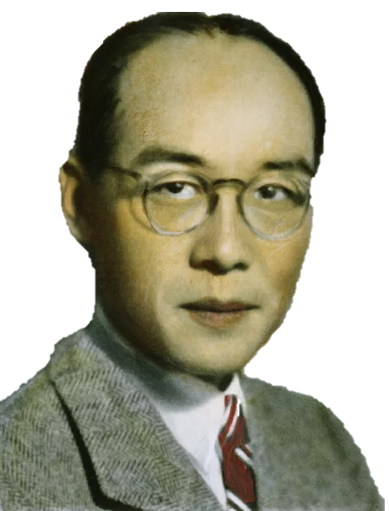
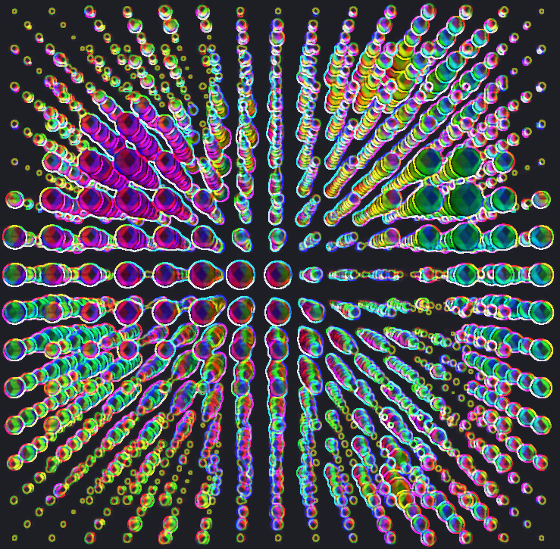
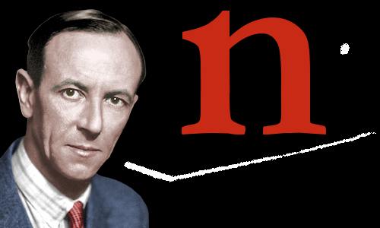
核力发展简史
A brief account of the long history: three milestones
中子发现90周年
Philos. Mag. 1919.
Proc. Phys. Math. Soc. Jap., 1935.
Phys. Rev. D, 1974.
PRL128(2022)142002
LQCD
北京小组
$$\left({Δ−λ}^{2}\right)U=0$$
Neutron
ChEFT
1918
1932
1935
1960s
1974
1990
2022
Proton
Meson theory
Lattice QCD
rChEFT
Pheno. NF
Nature, 1932.
AP, N.Y. 1968; NPA,1976; …
PLB,1990; NPB,1991; PLB,1992.

Slide 12
Why chiral （effective field theory)
Chiral perturbation theory—low energy EFT of QCD
Because of quark confinement and asymptotic freedom, low energy QCD can not be solved perturbatively
Maps quark (u, d, s) dof’s to those of the asymptotic states, hadrons
Allows a perturbative formulation of low energy QCD in powers of external momenta and light quark masses, by utilizing chiral symmetry and its breaking pattern (the third feature of QCD)
Development—Trilogy
1979, pion-pion, Weinberg
1989, to the one-baryon sector, Gasser, Sainio, Svarc
1990/91/92, to NN/NNN, Weinberg—very successful
Rev. Mod. Phys. 81(2009)1773；Phys. Rept. 503(2011)1; Rev. Mod. Phys. 92 (2020) 025004
Steven Weinberg
Nobel Prize in Physics in 1979

Slide 13
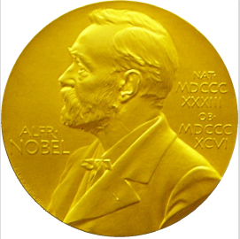
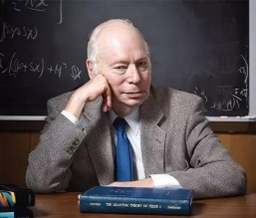
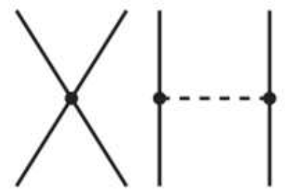
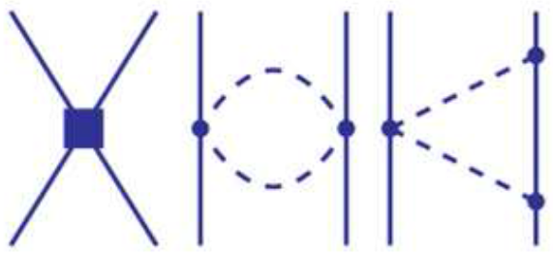
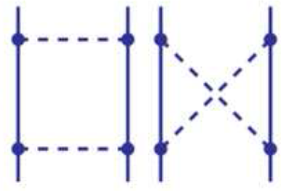
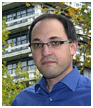
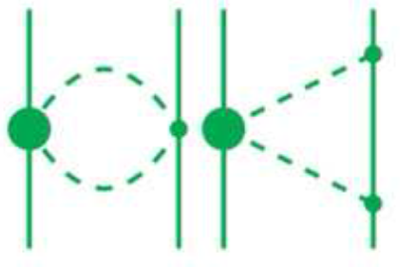
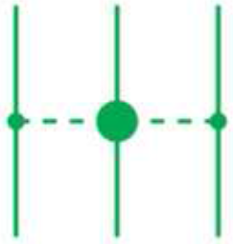
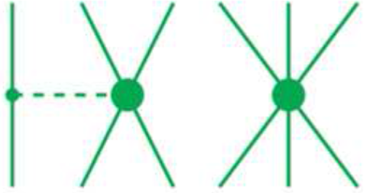
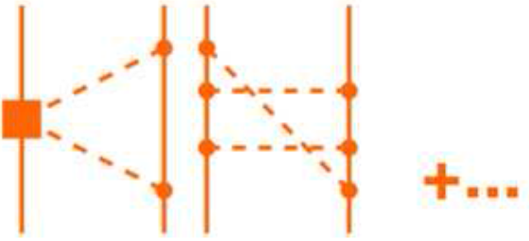
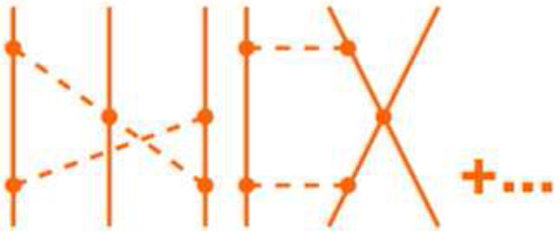
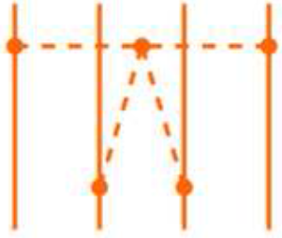
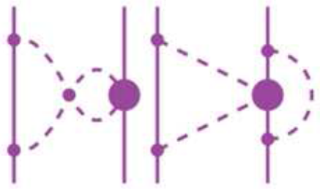
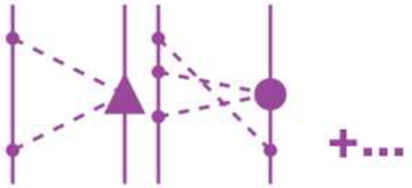
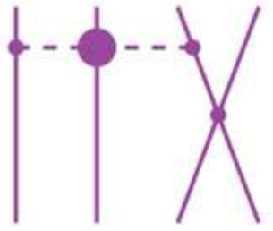
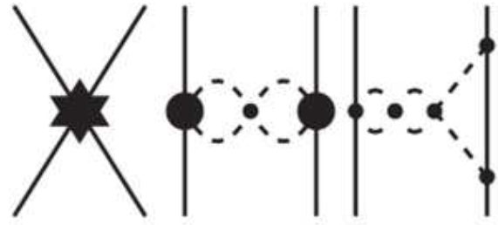
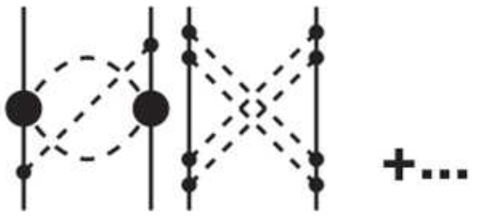
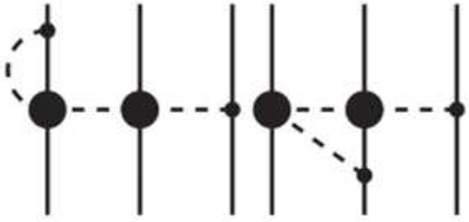
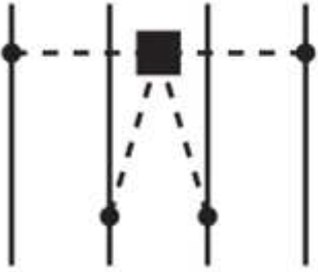
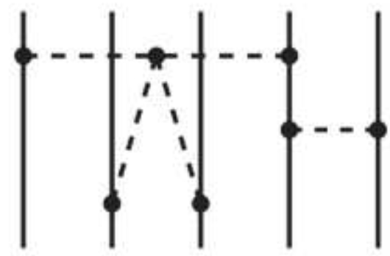
非相对论手征核力—核力发展史的里程碑
A highly competitive field: chiral nuclear force
2NF
1990 2N LO
$LO$($Q^{0}$)
S. Weinberg, PLB1990, NPB1990
1994 3N LO
1997 2N $NLO$
$NLO$($Q^{2}$)
Steven Weinberg
van Kolck
Kaiser
U. Van Kolck et al, PLB1992, PRL1994
3NF
N. Kaiser et al, NPA1997
2000 2N $N^{2}LO$
Key issuges：non-relativisitic（others ： slow convergence，non-renormalizable，etc）
$N^{2}LO$($Q^{3}$)
U. Van Kolck et al, PRC1994
U. Van Kolck et al, PRC1994
4NF
2003 2N $N^{3}LO$
E. Epelbaum et al, NPA1998,2000
2007 3N $N^{3}LO$
$N^{3}LO$($Q^{4}$)
R. Machleidt et al. PRC2003
S. Ishikwas et al. PRC2007
E. Epelbaum EPJA2007
Epelbaum
Machleidt
E. Epelbaum et al. NPA2005
V. Bernard et al. PRC2007
2015 2N $N^{4}LO$
$N^{4}LO$($Q^{5}$)
R. Machleidt et al. PRC2015
H. Krebs et al, PRC2012,2013
5NF
E. Epelbaum et al. PRL2015
NOT COMPLETE
…
$N^{5}LO$($Q^{6}$)
R. Machleidt et al. PRC2015
NOT COMPLETE
Philipps
Savage
Adopted from Front.in Phys. 8 (2020) 57
Notes:
1990年前后，诺奖得主Weinberg提出利用非相对论手征微扰理论构建核力，获得巨大成功。随后，经过一大批理论物理学家长达30余年的发展与完善，手征核力已成为目前核物理第一性原理研究的重要输入量。但传统手征核力不满足洛伦兹对称性，无法用于相对论第一性原理计算。

Slide 14
Advantages of chiral forces
1
Closer link with QCD
2
Systematic/order-by-order improvements
3
Consistent descriptions of two/three/four body interactions on the same footing
4
Quantifiable uncertainties-- PRA83(2011)040001

Slide 15
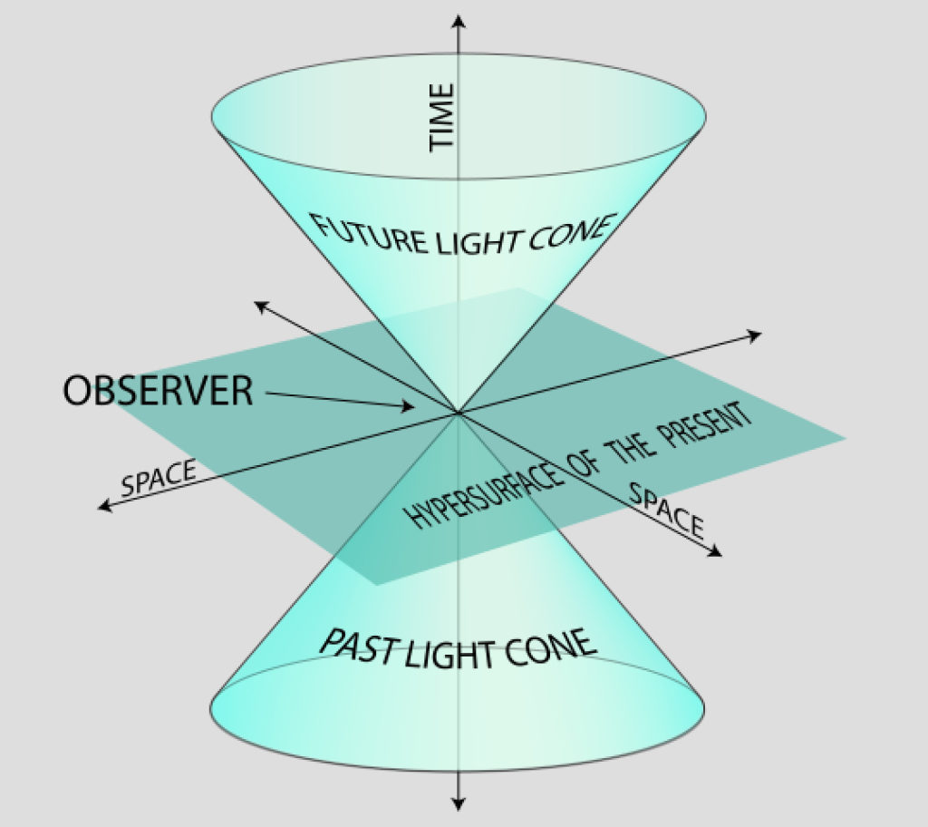
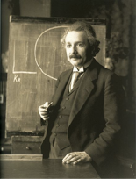
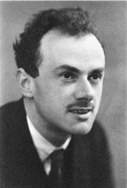
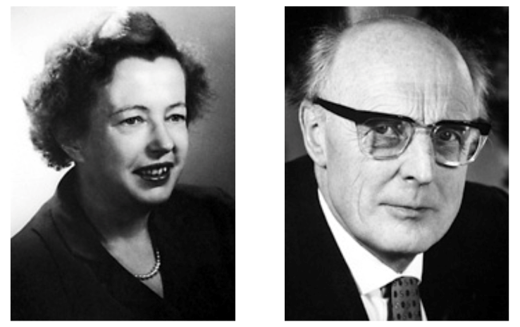
Why relativistic/covariant
Lorentz invariance is one of the most important symmetries in Nature.
Both kinematical and dynamical relativistic corrections self-consistently included
Relativistic approaches successful in explaining fine structures
Atomic and molecular systems: why gold is yellow
Nuclear system：spin-orbit splitting, pseudospin symmetry，covariant DFT
One-baryon sector：magnetic moments、masses、sigma terms
Meson-baryon scattering:
Einstein
Dirac
Mayer
Jensen
Arima

Slide 16
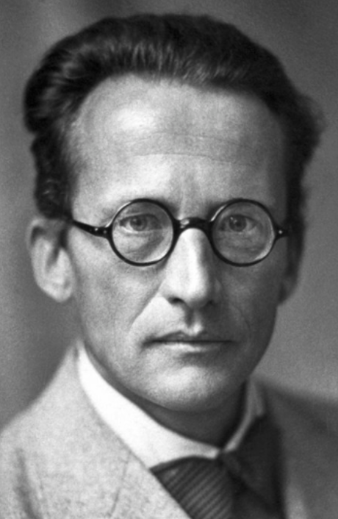
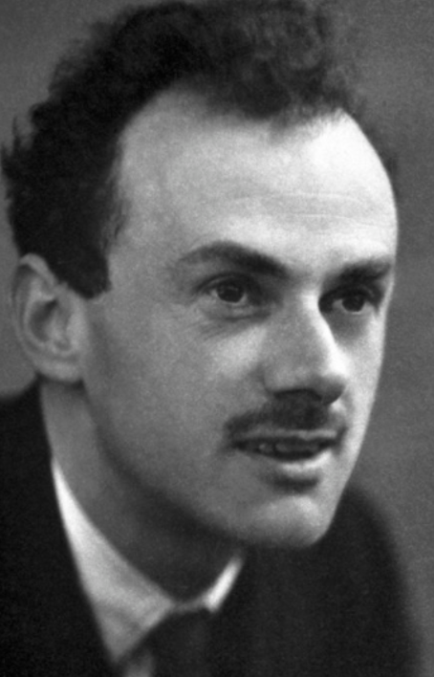
From Schroedinger Eq. to Dirac Eq.
1926
It has to be covariant
(satisfies special relativity)
1928
Notes:
我来举两个例子，来解释一下我刚才的论断。1926年，薛定谔写下了薛定谔方程来描述微观粒子的运动。人们立刻意识到薛定谔方程不满足狭义相对论的要求，因而开始寻找满足协变性的薛定谔方程。1928年，Dirac得到了正确的方程，即Dirac方程。

Slide 17
From Schroedinger Eq. to Dirac Eq.
Important implications
1932 Exp.
Electrons have spin ½ if they satisfy SR.
Electrons have antiparticles – positrons
…

Slide 18
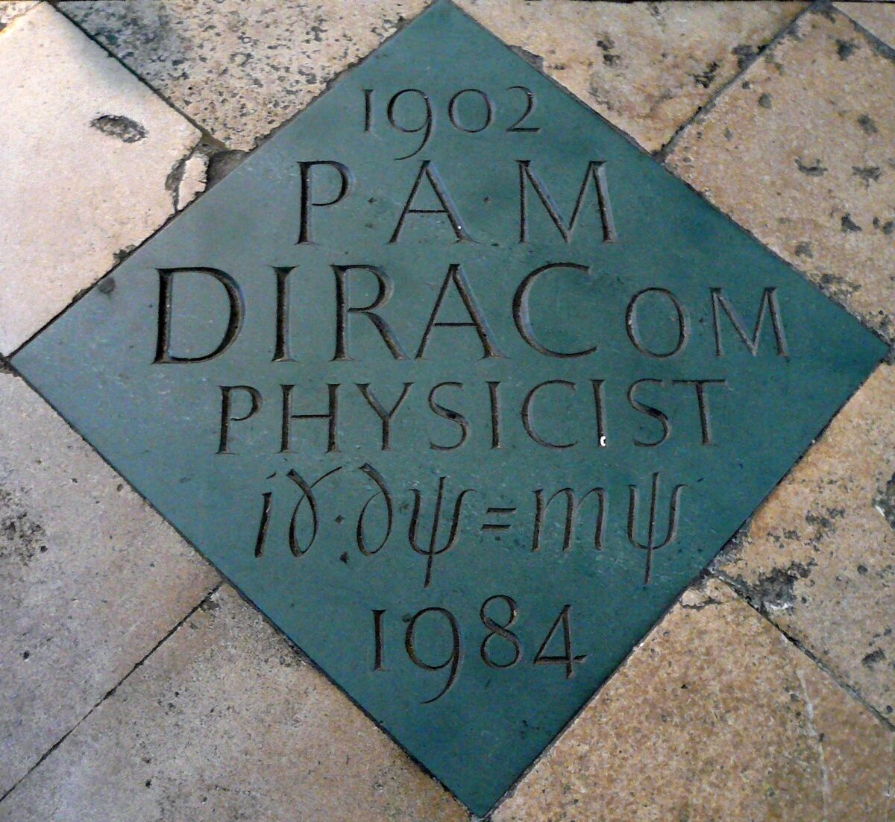
From Schroedinger Eq. to Dirac Eq.
威斯敏斯特教堂
Notes:
1933年，薛定谔和狄拉克分享了当年的诺贝尔物理学奖，狄拉克方程也被刻在了威斯敏斯特教堂的地面上

Slide 19
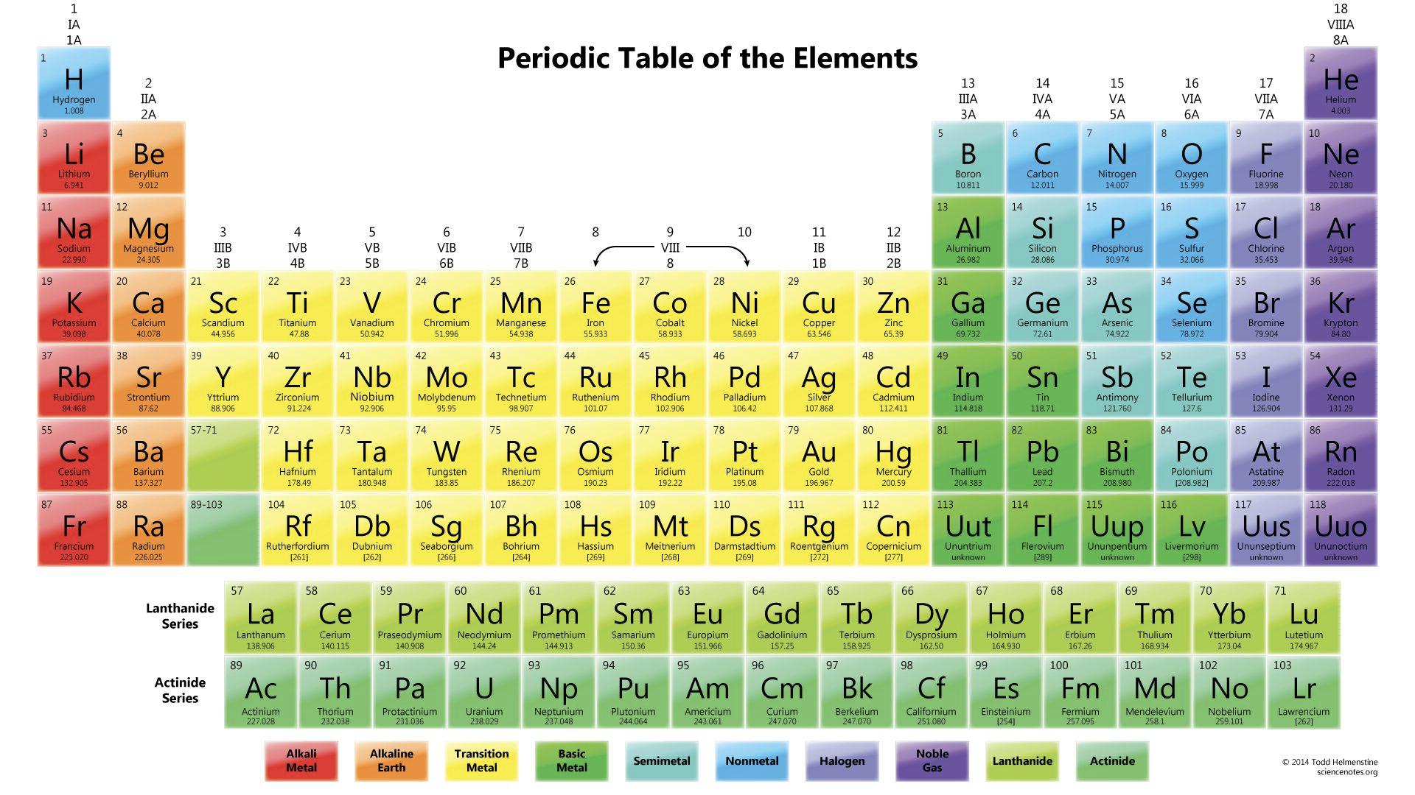
Why Gold is golden, and Silver is white
Notes:
接下来我们来看另外一个例子：金和银属于元素周期表的同一族，按理说化学性质应该一样，为什么一个是金黄色，一个是银白色？

Slide 20
Sliver
银
Only Quantum
Gold
金
+ Relativity
5s
6s
+ Relativity
3.7eV
(335nm)
2.4eV
(516.5nm)
Should be the same color!
4d
5d
(Z=47)
(Z=79)
Optical wave length (可见光)
335nm
380nm
516.5nm
750nm
Absorbed
Reflected (Gold，金)
Reflected (Sliver，银)
Notes:
确实，如果只考虑量子力学，金和银外层的电子壳层非常相似，而考虑相对论效应后，银的能级差变为335nm, 而金的变为516.nm。我们知道可见光的波长在380到750nm之间，因此银不吸收可见光，而金吸收可见光的蓝光波段

Slide 21
Sliver
银
Only Quantum
Gold
金
+ Relativity
5s
6s
+ Relativity
3.7eV
(335nm)
2.4eV
(516.5nm)
Should be the same color!
4d
5d
(Z=47)
(Z=79)
Gold shines golden, and sliver is dark white due to both effects of Quantum Mechanics and Relativity.
Blue is absorbed.
No Absorption.
White
Golden yellow
Notes:
从而根据三原色原理，金显示为金黄色，银显示为银白色

Slide 22
Contents
Why relativistic/covariant chiral nuclear forces
Two-fold purposes
First relativistic high-precision chiral nuclear force
Summary and outlook

Slide 23
P1: inputs for ab initio covariant nuclear physics studies
workflow
Trend
arXiv:2212.11064v1

Slide 24
NN
YN
YN
P2: inputs for studies of hypernuclei and neutron stars
H-dibaryon?
Hyperon puzzle
Three-D nuclear chart
Inoue PRL 106 (2011) 162002
Lonardoni PRL 114 (2015) 092301
Kaneta M, Tohoku University, Japan)

Slide 25
Contents
Why relativistic/covariant chiral nuclear forces
Two-fold purposes
First relativistic high-precision chiral nuclear force
Summary and outlook

Slide 26
How to become relativistic/covariant
Dirac spinors and algebra (instead of non-relativistic wave functions and Pauli matrices)
$$u(p,s)=N_{p}\left(\begin{matrix}1 \\ \frac{σ⋅p}{ε_{p}}\end{matrix}\right)χ_{s}, N_{p}=\sqrt{\frac{ε_{p}}{2M_{N}}}$$
Covariant power counting (vs. the Weinberg PC)
Covariant scattering equation (instead of Lippmann-Schwinger eq.)
$𝒯\left(p^{′},p∣W\right)=𝒜\left(p^{′},p∣W\right)+∫\frac{d^{4}k}{\left(2π^{4}\right)}𝒜\left(p^{′},k∣W\right)G(k∣W)𝒯(k,p∣W)$
$$G(k∣W)=\frac{i}{{\left[γ^{μ}{(W+k)}_{μ}−m_{N}+iε\right]}^{\left(1\right)}{\left[γ^{μ}{(W−k)}_{μ}−m_{N}+iε\right]}^{\left(2\right)}}$$

Slide 27
Power counting rules
NR: simply count the (even) number of three-derivatives
$N_{d}$ is the number of ,$\overset{⃡}{∂}=\vec{∂}−\overset{⃖}{∂}$
Nucleon field: $ψ= \left({p \atop n}\right)\sim O\left(p^{0}\right),$ Nucleon mass: $m\sim O\left(p^{0}\right),$
Dirac matrices: $Γ∈\left\{1, γ_{μ}, γ_{5}γ_{μ}, σ_{μν}\sim O\left(p^{0}\right),γ_{5}\sim O\left(p^{1}\right)\right\}$
Covariant derivative: $∂\left(\overline{ψ}Γψ\right)\sim O(p^{1})$, $\left(\overline{ψ}\overset{⃡}{∂}ψ\right)\sim O\left(p^{0}\right)$, except $\left(\overline{ψ}σ_{μν}ψ\right)\left(\overline{ψ}{\overset{⃡}{∂}}^{μ}Γψ\right)\sim O\left(p^{1}\right),(\overline{ψ}γ_{5}γ_{μ}ψ)(\overline{ψ}{\overset{⃡}{∂}}^{μ}Γψ)\sim O(p^{1})$
Treatment for covariant derivative:
-Expansion of such structure:
-up to $O\left(q^{2}\right) :n=0,1$;
-up to $O\left(q^{4}\right) :n=0,1,2.$
1
2
4
3

Slide 28
Highly nontrivial
Non-Relativistic leading order box diagram
Relativistic leading order box diagram
$$𝒜=$$
Loop integral
$$×$$
Bilinear
Bilnear (114 项)
and more...
Loop integrals—— scalar and tensor (29 terms)
$$A_{0},B_{0},B_{00},C_{0},C_{1},C_{2},C_{00},C_{11},C_{12},C_{22},D_{0},D_{1},D_{2},D_{00},D_{11},D_{12},D_{22},D_{23}$$
Numerical accuracy and singularity
$D_{11},D_{12},D_{22},D_{23}$ coefficients diverge
$\frac{1}{1−{\cos{θ}}^{2}}$
Hardware accuracy
${(\frac{p_{off}}{M_{N}})}^{n}≈{10}^{−3n}$
$$θ$$

Slide 29
Accurate relativistic chiral NN interaction up to NNLO
2NF
Three key ingredients
$LO$($Q^{0}$)
Four nucleon (baryon) vertices:
PRC99(2019)024004
Meson-baryon vertices:
PRD99(2019)054024
PRL130(2023)071902
Two-meson exchanges
PRC102(2020)054001
PRC105(2022)014003
X.L Ren, CPC2018
$NLO$($Q^{2}$)
Y. Xiao, PRC2020
C.X. Wang, 2110.05278
3NF
J.X. Lu, 2111.07766
$N^{2}LO$($Q^{3}$)
Y. Xiao, PRC2020
C.X. Wang, 2110.05278
J.X. Lu, 2111.07766
$N^{3}LO$($Q^{4}$)
$N^{4}LO$($Q^{5}$)

Slide 30
NNLO high precision relativistic chiral force
Contact contributions: 19 LECs fitted to the phase shifts of all the 12 partial waves with $J≤2$ at $E_{lab}=1,5,10,25,50,100,150,200 MeV$ (96 data points in total)
Pion-exchanges: TPE fixed from pion-nucleon scattering, OPE fixed from pion decay and nucleon beta decay—parameter free (chiral dynamics)
Y.-H. Chen, D.-L. Yao, and H. Q. Zheng, Phys. Rev. D 87, 054019 (2013)

Slide 31
Fit results for $J≤2$ partial waves
NR-N3LO-Idaho: Machleidt and D. R. Entem, Phys. Rept.503, 1 (2011); NR-N3LO-EKM: E. Epelbaum, H. Krebs, and U. G. Meißner, Eur. Phys. J.A51,53 (2015)

Slide 32
Fit results for $J≤2$ partial waves
NR-N3LO-Idaho: Machleidt and D. R. Entem, Phys. Rept.503, 1 (2011); NR-N3LO-EKM: E. Epelbaum, H. Krebs, and U. G. Meißner, Eur. Phys. J.A51,53 (2015)

Slide 33
Better for higher partial waves
 | Total | $${}^{3}D_{3}$$ | $${}^{1}F_{3}$$ | $${}^{3}F_{3}$$ | $${}^{3}F_{4}$$ | $${}^{3}G_{3}$$ | $$ε_{3}$$ | $${}^{1}G_{4}$$ | $${}^{3}G_{4}$$
NNLO | $$0.98$$ | $$0.03$$ | $$0.03$$ | $$0.21$$ | $$0.70$$ | $$0.00$$ | $$0.01$$ | $$0.00$$ | $$0.00$$
NR-$N^{3}$LO-EKM | $$3.00$$ | $$0.56$$ | $$1.44$$ | $$0.28$$ | $$0.54$$ | $$0.01$$ | $$0.01$$ | $$0.03$$ | $$0.13$$
Notes:
为了更好地展示相对论效应，我们来看一下高阶分波，他们完全由单pi和两pi交换给出，没有任何参数。我们发现，相对论计算尽管是次次领头阶，但比非相对论次次次领头阶对这些分波相移的描述还要好，展示了相对论效应的贡献

Slide 34
Essential features:
Relativistic
Faster convergence
More renormalizable
More
natural

Slide 35
Faster convergence
Relativistic and non-relativistic description of scattering phaseshifts
$(0≤j≤4,T_{lab}≤200 MeV$)
Forces | Relativistic N2LO Geng et al. | NR N3LO Epelbaum et al
$$χ^{2}$$ | 17.57 | 19.08

Slide 36
Renormalization Group Invariance
A fundamental feature of EFT that physics at low-energy/long-distance scales is insensitive to the details at high-energy/short-distance scales
The NN interaction can be considered properly renormalized when the calculated observables are independent of the cutoff scale within the range of validity of the ChEFT or involves a small residual cutoff dependence due to the truncation of the chiral expansion.
AASS fellow
J.J. Sakurai Prize
Peter Lepage
In the language of Wilson’s renormalization group, this means that the LECs must run with the cutoff scale in such a way that the scattering amplitude becomes renormalization group invariant (RGI)
Nobel Prize 1982
Kenneth G. Wilson
Notes:
可重整是对有效场论的一个基本要求。对于核力来说，就是要求计算的可观测量对动量截断的依赖要比较弱。

Slide 37
RGI vs. self-similarity
Notes:
重整化群不变性有点类似自相似，即当你观察一个系统时，不管所用的放大镜的放大倍数增大多少倍，应该看到一样的物理。

Slide 38
RGI-Heated discussions
Key issues
Whether RGI is essential?
How to realize it?
Key references
Kaplan
APS fellow, NAS Member
van Kolck
APS fellow
A New expansion for nucleon-nucleon interactions, David B. Kaplan et al., PLB424 (1998) 390
Towards a perturbative theory of nuclear forces, S.R. Beane et al., NPA700 (2002) 377
How to renormalize the Schrodinger equation, P. Lepage, nucl-th/9706029
Epelbaum
APS fellow
Machleidt
APS fellow
Notes:
这是在手征核力核力领域争论异常激烈的一个问题。不同的人有不同的观点，这里我就不详细介绍了。

Slide 39
More renormalizable: 3P0
TLAB = 10 MeV
TLAB = 50 MeV
³P₀
Nogga et al, PRC(2005)
B. W. Long et al, PRC(2011)
M. P. Valderrama, PRC(2011)
M. C. Birse, PoS CD(2009)
C.X. Wang et al. CPC45,054101
Notes:
我们来看一个研究的比较多的分波，3P0。这两张图的纵坐标都是分波相移，横坐标是动量截断，不同的颜色对应的是不同实验室能量。从左图可以看到，温伯格手征核力随动量截断的演化非常剧烈，而右图表明，相对论手征核力具有重整化群不变性。

Slide 40
LO NR cannot describe 1S0—unnatural
U. van Kolck
APS fellow
Member of Academia Europaea
2020 Herman Feshbach Prize
Large variance of phase shifts from ${60}^{∘}$ to $−{10}^{∘}$
Scattering length $(a=23.7fm)$ much larger than the pion Compton wave length
Zero amplitude around $k_{0}∼340$ $MeV$
Virtual bound state around $iγ=−i10MeV$
PHYSICAL REVIEW C 97, 024001 (2018)
Notes:
接下来介绍一下自然性。这里的自然性是指，对于一个微扰理论，有些量应该在领头阶就能得到描述，比如核力的1s0分波，正如欧洲科学院院士van Kolck指出的那样，温伯格手征核力在领头阶完全无法描述1S0分波，所以是不自然的。

Slide 41
Relativistic more natural
U. van Kolck
APS fellow
Member of Academia Europaea
2020 Herman Feshbach Prize
Large variance of phase shifts from ${60}^{∘}$ to $−{10}^{∘}$
Scattering length $(a=23.7fm)$ much larger than the pion Compton wave length
Zero amplitude around $k_{0}∼340$ $MeV$
Virtual bound state around $iγ=−i10MeV$
Chin.Phys.Lett. 38 (2021) 062101
Notes:
而相对论手征核力则没有这个问题，所以更自然。

Slide 42
Contents
Why relativistic/covariant chiral nuclear forces
Two-fold purposes
First relativistic high-precision chiral nuclear force
Summary and outlook

Slide 43
Summary：high-precision rela. chiral nuclearforce
Beijing-Munich
2022
1990/91 Weinberg
1994, Van Kolck
2003, Machleidt
2015, Epelbaum
Non-relativistic chiral force
Relativistic chiral force
LO NN, Weinberg, PLB251 (1990) 288
NN potential with Delta at N2LO, Ordonez, Ray, U. van Kolck, PRL72 (1994) 1982
Relativistic NN potential at N2LO,Lu, Wang, Xiao, Geng*, Meng, Ring, PRL128 (2022) 142002
Accurate NN potential at N3LO,
Entem and Machleidt,PRC68(2003)041001
Precision NN potential at N4LO, Epelbaum, Krebs, Meißner, PRL115 (2015)122301

Slide 44
Outlook: opportunities in rela. ab initio studies
Observables (structure, reaction, nuclear astrophysics)
Many-body methods (QMC, MBPT, DFT,ML)
Relativistic chiral forces/currents
Workflow
Notes:
按照从头计算的路线图，这只是万里长征的第一步，后面还有很多工作要做，欢迎感兴趣的同学和同仁的加入

Slide 45
Outlook: a better understanding of saturation
Wei-Jiang Zou, Jun-Xu Lu, Pen-Wei Zhao, Li-Sheng Geng, Jie Meng, In preparation

Slide 46
Outlook: solution to some systematic problems
Larger binding
Smaller radii
Witold Nazarewicz, APS fellow
PHYSICAL REVIEW C 91, 051301(R) (2015)
Notes:
也有望为解决当前非相对论从头计算遇到的一些系统性困难提供新的见解

Slide 47
Outlook: neutrinoless double beta decay
Notes:
也有望为解决当前非相对论从头计算遇到的一些系统性困难提供新的见解

Slide 48
Collaborators
Beihang University: Jun-Xu Lu, Yang-Xiao, Chun-Xuan Wang, Kai-Wen Li, Xiu-Lei Ren, Zhi-Wei Liu, Jing Song, Qian-Qian Bai, Pavon Valderrama
Peking University: Jie Meng
Sichuan University: Bing-Wei Long
Institute of Modern Physics: Ju-jun Xie
Technical University of Munich: Peter Ring
Funding agencies
Notes:
最后感谢所有的合作者和基金委、教育部、学校的资助。

Slide 49
Thanks a lot for your attention
Notes:
感谢大家的倾听

Slide 50
Relativistic effects and three-body interactions
Y.L. Yang,P.W. Zhao Phys.Lett.B 835 (2022) 137587

Slide 51
Promising three-body potential
L. Girlanda, A. Kievsky, M. Viviani and L.E. Marcucci，PRC 99 (2019) 054003
“Fit results in the leading order of the relativistic counting to a set of cross section and polarization p − d observables at 3 MeV proton energy, for Λ = 200 − 500 MeV (red bands) as compared to the purely two-body AV18 interaction (dashed, black lines) and to the AV18+UIX two- and three-nucleon interaction (dashed-dotted, blue lines). “
Ay puzzle– a 32 year old persistent problem!

Slide 52
1. 科学意义和国内外研究现状
Microscopic optical potential based on relativistic chiral nuclear force
Optical Model by co-operation between China Nuclear Data Center & Tuebingen University
http://www.nuclear.csdb.cn/ctom/
Ruirui Xu,* Zhongyu Ma, Yue Zhang, and Yuan Tian, E. N. E. van Dalen and H. Müther
PRC85, 034613 (2012);
PRC94, 034606 (2016);
NPA744 (2004) 227–248.
1 High precision relativistic chiral nuclear force.
2 Full Dirac space
3. DBHF or DRHBc for nuclear density
4. Uncertainties estimated by the Bayesian model
Novelties:

Slide 53
Jinping Underground Nuclear Astrophysics Experiment(JUNA)
$^{25}Mg(p,γ)^{26}Al$ Sci. Bull. 67, 125–132 (2022)
$^{19} F(p,αγ)^{16}O$ PRL 127 (2021)152702
$^{13}C(α,n) ^{16}O$ PRL129 (2022) 132701
$^{12}C(α,γ)^{16}O$
$^{19}F(p,γ)^{16}O$ Nature 610 (2022) 7933, 656-660

Slide 54
Why covariant/relativistic
Lorentz invariance or relativistic corrections might play an important role in speeding up the convergence of ChEFT
T_{lab} [MeV] | 1 | 50 | 100 | 150 | 200 | 250 | 300
P_{cm} [MeV/c] | 21.67 | 153.22 | 216.68 | 265.38 | 306.43 | 342.60 | 375.30
P_{cm}/M_{N} | 0.023c | 0.16c | 0.23c | 0.28c | 0.33c | 0.36c | 0.40c
In comparison m_{π}/m_{N}=138/939~0.15

Slide 55
NNLO relativistic chiral nuclear force
LECs at different orders (natural size)
10⁴GeV⁻²
Fitting quality（comparable to NR-N3LO）
NR-N3LO-EKM: E. Epelbaum, H. Krebs, and U. G. Meißner, Eur. Phys. J.A51,53 (2015)

Slide 56
Whether four-neutron resonance exists?

Slide 57
Much better than Bonn potentials
R. Machleidt, K. Holinde, C. Elster, Phys.Rept. 149 (1987) 1-89—2427 citations

Slide 59
Central to developments in nuclear physics
Remain central to developments in the field of nuclear physics
Announcing major discoveries/opening up new avenues of research
7/41
chiral EFT
Epelbaum, Nogga, Glöckle, Kamada, Meißner, Witała Phys. Rev. C 66, 064001 (2002)
Ordóñez, Ray, van Kolck Phys. Rev. C 53, 2086 (1996)
Entem, Machleidt Phys. Rev. C 68, 041001 (2003)
realistic
Stoks, Klomp, Terheggen, Swart Phys. Rev. C 49, 2950 (1994)
Wiringa, Stoks, Schiavilla Phys. Rev. C 51, 38 (1995)
R. Machleidt Phys. Rev. C 63, 024001 (2001)
Stoks, Klomp, Rentmeester, Swart Phys. Rev. C 48, 792 (1993)
Notes:
为了说明高精度核力在核物理发展中的重要地位，我们来看一个例子。PRC是核物理的主流期刊。2020年，为了庆祝建刊50周年，选取了41篇里程碑文章，其中的7篇是关于构建高精度核力的，并且有三篇是关于手征核力的。

Slide 60
Always at the frontiers of nuclear physics
十二五”国家重大科技基础设施
“强流重离子加速器装置“|impcas.ac.cn)
Facility for Rare Isotope Beams at Michigan State University
Experimental nuclear physics
map the nuclear landscape,
understand the forces that bind nucleons into nuclei,
answer questions about the astrophysical origin of nuclear matter,
address societal needs related to nuclear science and technology.
认识原子核内有效相互作用。
探索宇宙中从铁到铀元素的来源
粒子辐照应用研究
Notes:
认识原子核内的有效相互作用一直是核物理大科学装置的主要科学目标，如我国的十四五国家重大科技基础设施HIAF和美国的FRIB

Slide 61
What is high precision
full data
standard $3σ$
self-consistent $3σ$
high precision
neutron-proton
proton-proton
R. Navarro Perez, J.E. Amaro, E. Ruiz Arriola: Phys.Rev.C 89 (2014) 064006
8125
6713
Notes:
我的报告题目中有一个关键词是高精度。那什么是高精度呢？简单来说，高精度就是该核力能对7,800个核子核子散射可观测量的描述达到卡方每自由度接近于1的程度

Slide 62
Why high precision—ab initio structure studies
Initial configurations
Hoyle state
of Carbon
Notes:
那为什么需要高精度呢，是因为我们希望进行第一性原理核结构与核反应研究。举一个例子：C12的霍伊尔态（即第二个0+态）对碳元素的合成至关重要。2012年发表在PRL的文章展示了如何基于手征核力及第一性原理计算，自洽的得到这个态。

Slide 63
Why high precision—ab initio reaction studies
Initial state clusters
S-wave phase-shifts
D-wave phase-shifts
Notes:
2016年，发表在Nature上的文章展示了如何基于手征核力，定量计算alpha-alpha散射相移，开启了从头计算核反应的新篇章。

Slide 64
Why uncertainty estimates important
PRA editorial: Uncertainty estimates—PRA83(2011)040001
If the authors claim high accuracy, or improvements on the accuracy of previous work.
If the primary motivation for the paper is to make comparisons with present or future high precision experimental measurements.
If the primary motivation is to provide interpolations or extrapolations of known experimental measurements.
Bayesian Uncertainty quantification
What is BUQEYE? - BUQEYE Collaboration
Dick Furnstahl
Daniel Phillips
Notes:
这里我强调一下理论研究为什么需要给出误差估计
2011，发表在PRA的一篇编辑评论指出，所有的理论计算都应该给出误差估计，特别是如果作者的主要目的是这里面所列的三条。此后，美国成立了多学科交叉的两个研究团队，推动定量误差估计在核物理中的应用，而手征核力刚好就能给出具有统计意义的误差估计。

