Slide 1
基于密度泛函理论对双贝塔衰变
和中间态的研究
白春林
四川大学物理学院
第二届无中微子双贝塔衰变及相关物理研讨会 珠海

Slide 2
Collaborators
D.L. Fang, IMP, CAS, China
H. Q. Zhang, CIAE. China
H. Sagawa, Aizu Univ. and RIKEN, Japan
M.J. Yang, SCU

Slide 3
outline
Research of DBD by HFB+QRPA
Present status of QRPA study on the intermediate states
SRPA research on the GT states
Summary and perspective

Slide 4
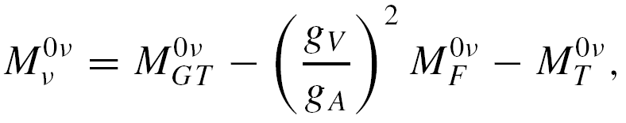
Calculation of NME in nuclear physics

Slide 5
Factors largely affect 0vNME as I know
Deformation
pn pairing
Song, Yao, Ring, Meng, PRC 90(2014)
M.T. Mustonen, J.Engel, PRC 87(2013)
Others…

Slide 6
Intermediate states
Realistic excitation is the superposition of single-particle excitations in (Q)RPA model.
Closed-shell RPA
Open-shell QRPA
Bogolyubov transformation

Slide 7
HFB+QRPA theory for open-shell nuclei I
HFB+pnQRPA in canonical basis
Receive p-h contribution
Receive p-p
contribution
Transition strength:

Slide 8
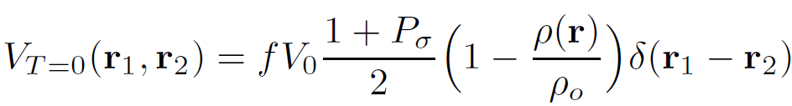
Skyrme pairing force used in HFB+QRPA
Skyrme effective interactions
The surface pairing interaction:
The strength of T=1 pairing is determined to fit the pairing gap.
The strength of the T=0 pairing is not yet determined, so f is
treated as a free Parameter at present.

Slide 9
QRPA results on the 2vββ matrix elements

Slide 10
Strength of pn pairing
Nuclei | 76Ge | 82Se | 130Te | 136Xe
w/o tensor | 0.90 | 0.866 | 1.0495 | 0.92
w/i tensor | 1.075 | 1.0375 | 1.274 | 1.21135

Slide 11
0vββ NME for ⁷⁶Ge

Slide 12
0vββ NME for ⁸²Se

Slide 13
0vββ NME for ¹³⁰Te

Slide 14
0vββ NME for ¹³⁶Xe

Slide 15
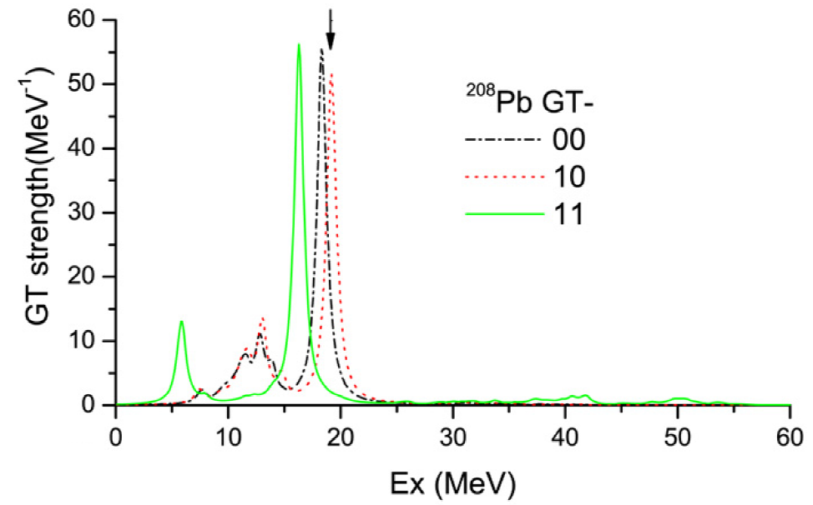
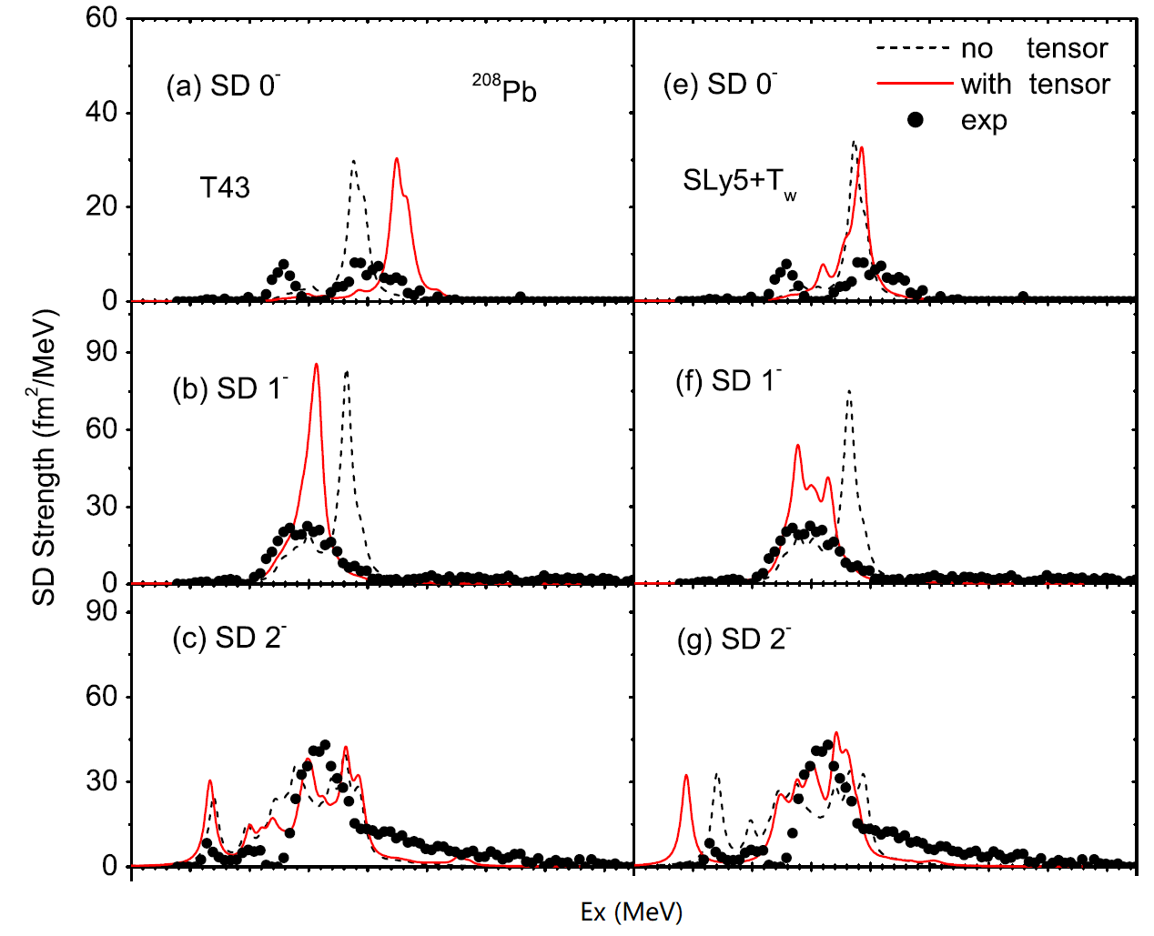
Mechanism of tensor force
1⁺
2⁻
Bai, Sagawa, Zhang, Zhang, Colo, Xu, 675(2009)
Bai, Zhang, Sagawa, Zhang, Colo, Xu, PRL 105(2010)

Slide 16
0vββ NME
nuclei | f | w/o tensor |  |  | w/i tensor
 |  | GT | FM | total | GT | FM | total
⁷⁶Ge | 0.90 | 4.38 | 1.50 | 5.88 | 5.00 | 1.52 | 6.52
 | 1.075 | 3.48 | 1.50 | 4.98 | 4.15 | 1.53 | 5.68
⁸²Se | 0.866 | 4.30 | 1.49 | 5.79 | 4.80 | 1.51 | 6.31
 | 1.0375 | 3.59 | 1.50 | 5.09 | 4.12 | 1.51 | 5.63
¹³⁰Te | 1.0495 | 4.33 | 1.82 | 6.15 | 5.56 | 1.96 | 7.52
 | 1.274 | 2.76 | 1.83 | 4.59 | 3.78 | 1.97 | 5.75
¹³⁶Xe | 0.92 | 1.54 | 0.50 | 2.04 | 2.06 | 0.59 | 2.65
 | 1.2113 | 0.91 | 0.51 | 1.42 | 1.29 | 0.59 | 1.88

Slide 17
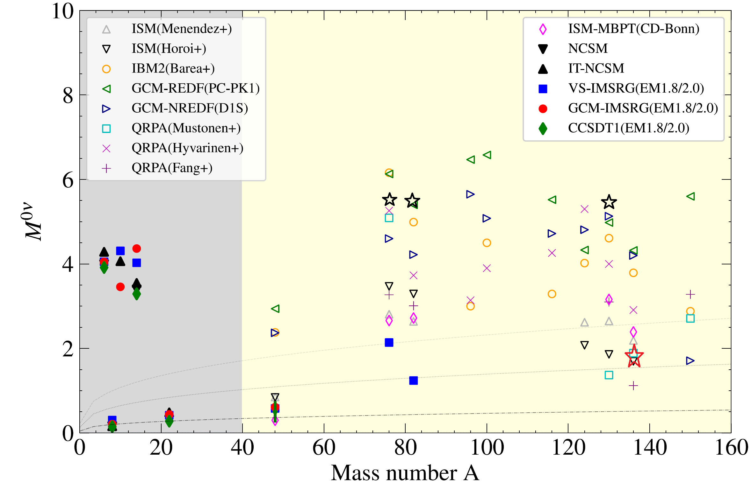
0vββ NME
J.M. Yao, J.Meng, P. Ring, PPNP 126, 103965(2022)

Slide 18
Small Summary
Tensor force affects largely the strength of IS pairing in fitting M_{2v}.
In studying 0νββ, the different IS pairing changing the M_{0v} largely.
The tensor force affect most M_{0v} through 1⁺ , 2⁺intermediate state.
Tensor force
1⁺ GT
IS pairing
M_{2v}
1⁺ state
20%
M_{0v}

Slide 19
Status of QRPA research on GT states
Bare g_{A} = 1.273
Quenched g_{A} = q g_{A}
q=0.6±0.2 QRPA
q≈0.32 IBM-2
q=0.45∽0.74 SM
D. Navas-Nicolas, P. Sarriguren, PRC 91, 024317(2015)

Slide 20
Methods of improving quenching factor
Fragmentation width
Coupling to continuum
Coupling to higher configurations
Configuration Mixing
Particle-Vibration-Coupling
Second RPA

Slide 21
Configuration Mixing
G.F. Bertsch, I. Hamamoto, PRC 26, 1323(1982).
Takayanagi, Shimizu, A. Arima, NPA481, 313(1988)

Slide 22
RPA+PVC
Y.F. Niu, G.Colo, M.Brenna, P.F. Bortignon, J.Meng, PRC 85, 034314(2012)

Slide 23
SRPA model
Yang, Bai, Sagawa,Zhang, PRC 103, 054308(2021).

Slide 24
Effect on 0⁺ states
Gambacurta, Grasso, and Catara, PRC 81, 054312(2010)
Yang, Bai, Sagawa, Zhang, PRC 103, 054308(2021).

Slide 25
SRPA on electric 2⁺ and 3⁻
B(E2)=0.55
M.J. Yang, C.L. Bai, H. Sagawa, H.Q. Zhang, PRC 103, 054308(2021).

Slide 26
SRPA studies on GT
D.Gambancurta, M.Grasso, J.Engel, PRL 125,212501(2021)

Slide 27
SRPA study on GT
D. Gambacurta, M. Grasso, PRC 105, 014321(2022)

Slide 28
Our studies with SRPA
M.J.Yang, C.L.Bai, H.Sagawa, H.Q.Zhang, PRC 106, 014319(2022)

Slide 29
About the Quenching in GT strength
M.J.Yang, C.L.Bai, H.Sagawa, C.L.Bai, PRC 106, 014319(2022)

Slide 30
SRPA Research on beta-decay
M.J. Yang, H.Sagawa, C.L.Bai, H.Q. Zhang, PRC 107, 014325(2023)

Slide 31
SRPA Research on beta-decay
M.J. Yang, H.Sagawa, C.L.Bai, H.Q. Zhang, PRC 107, 014325(2023)

Slide 32
Summary and perspective
The 1+ states is important for IS pairing and then M_{2v} and M_{0v}
The strength expanding is needed for GT
SRPA with tensor force can reproduce the GT Resonances , improve largely the quenching factor and beta decay description
SQRPA should be developed for double-beta decay
Deformation will be included

Slide 33
Thank your for your attention!

