Slide 1
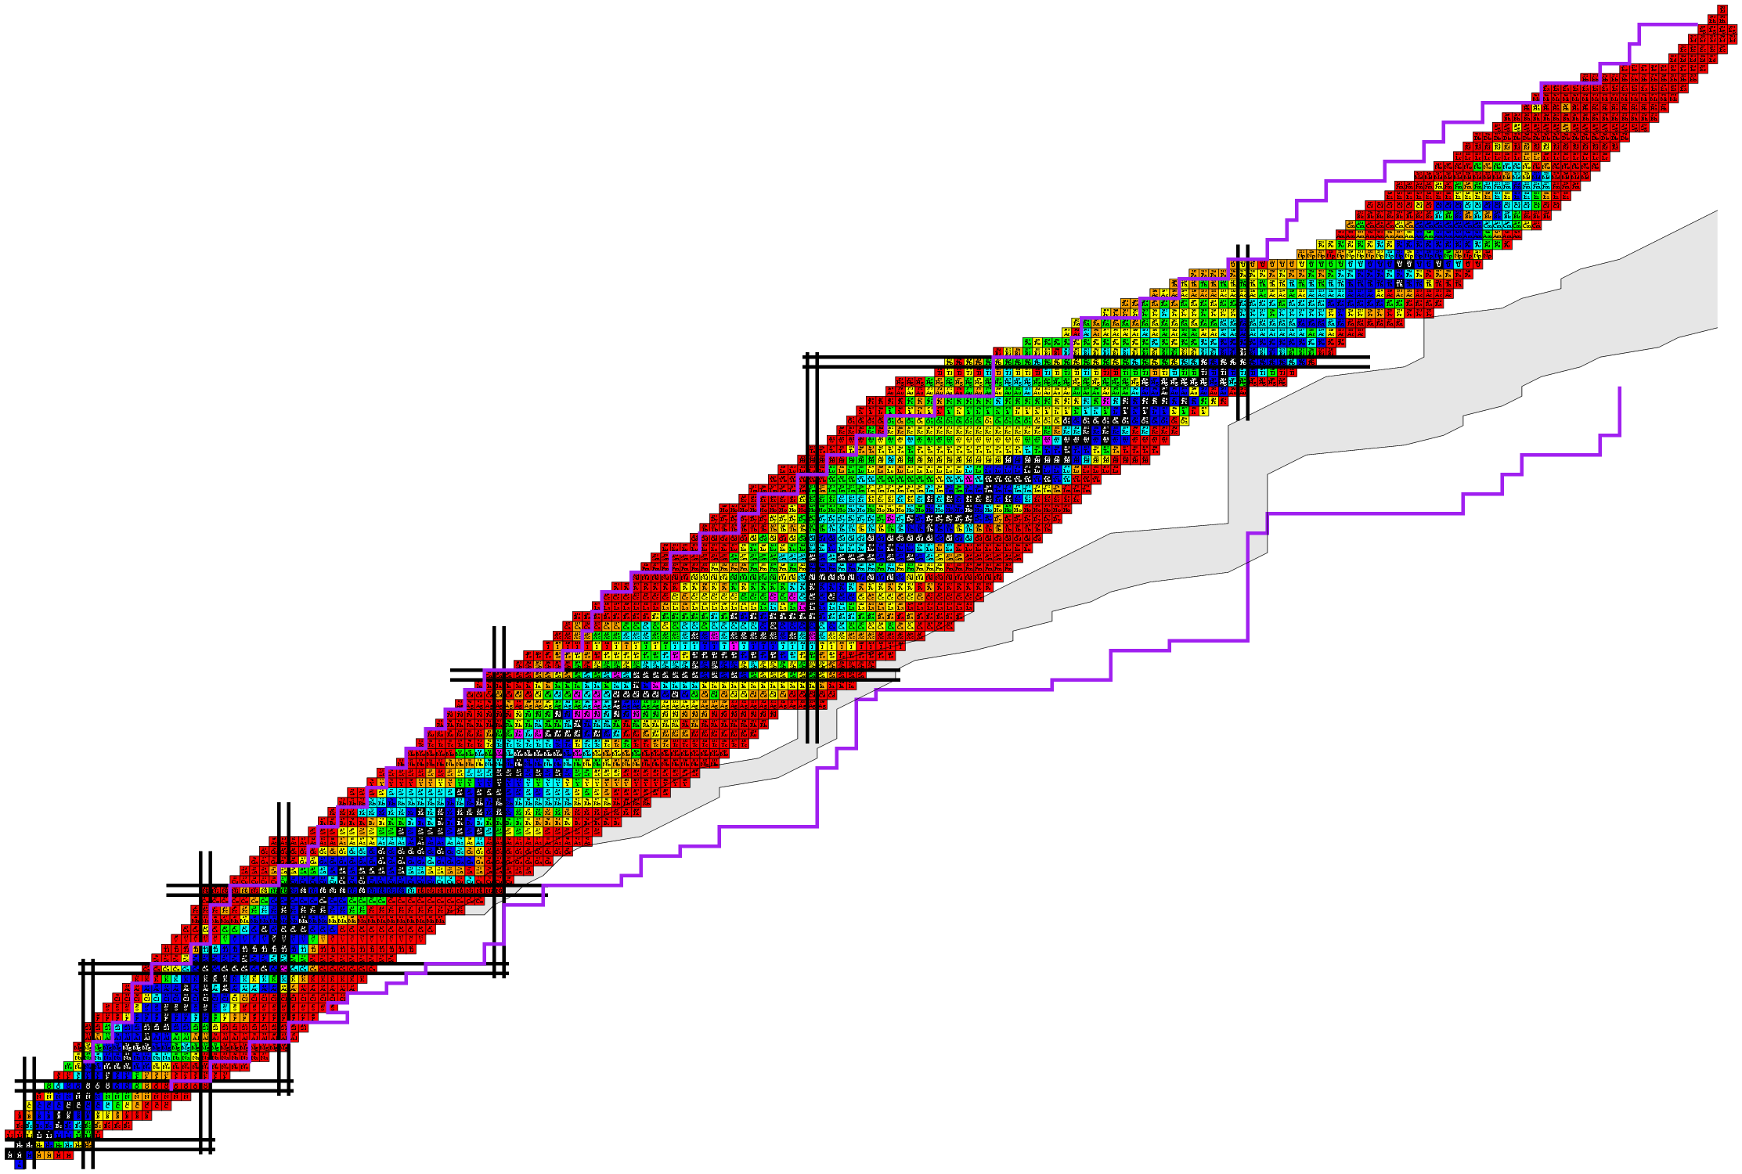

0𝜈𝛽𝛽-decay nuclear matrix elements: uncertainty from pairing interactions
第二届无中微子双贝塔衰变及相关物理研讨会
May 19th – 23rd 2023, Zhuhai
Yifei Niu 牛一斐
Lanzhou University

Slide 2
Outline
Introduction
Theoretical Framework
Uncertainties from pairing interactions
Summary and Perspective

Slide 3
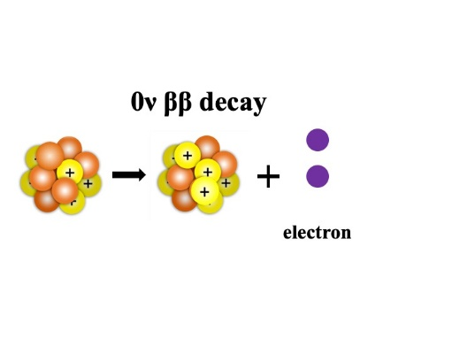
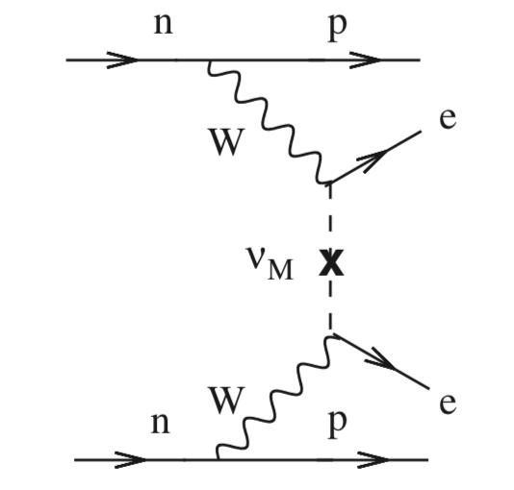
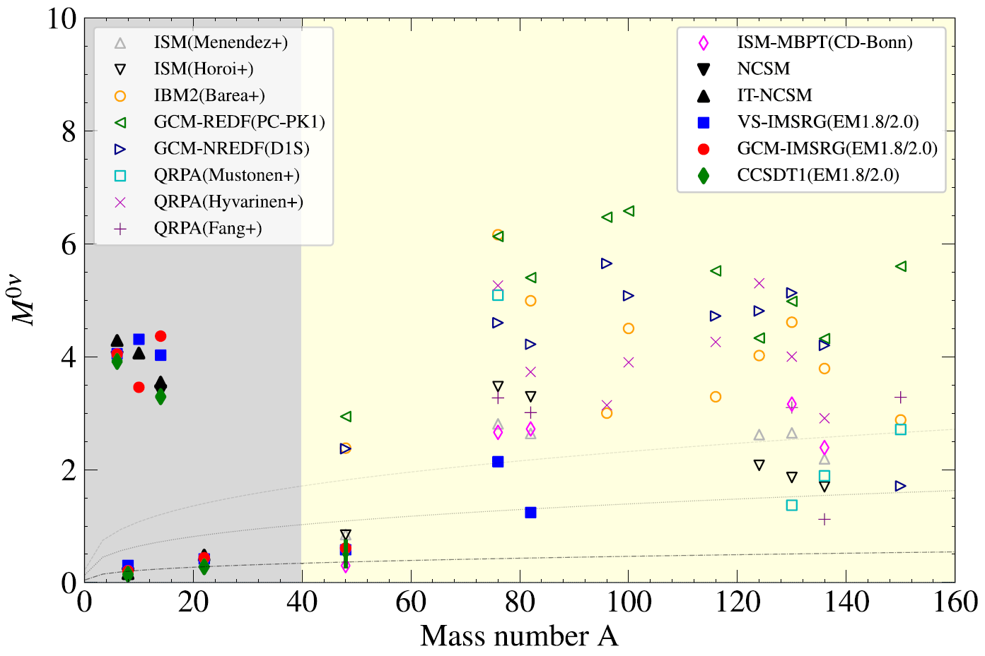

Neutrinoless double beta decay
0νββ decay
Neutrino
Majorana or Dirac nature?
Neutrino Mass
Lepton number conservation
F. T. Avignone, et al., Rev. Mod. Phys. 80, 481 (2008)
Challenge to nuclear physicists:
$${\left(T_{1/2}^{0ν}\right)}^{−1}=G_{0ν}{\left|M^{0ν}\right|}^{2}m_{ββ}^{2}$$
Discrepancies of nuclear matrix elements (NMEs) obtained by different nuclear models are large!
J. M. Yao, J. Meng, Y. F. Niu, and P. Ring, Prog. Phys. Nucl. Phys. 126, 103965 (2022)

Slide 4
Uncertainties of NMEs
To understand the discrepancies, great efforts have been made to analyze the uncertainties of NMEs
Uncertainty sources
  The axial-vector coupling constant g_{A} : g_{A}=1 or 1.25
  The two-nucleon short-range correlations (s.r.c.) : UCOM / Jastrow
  The higher order terms of the nucleon current : weak- magnetism and pseudoscalar couplings
  The finite size of the nucleon: nucleon form factors
  The size of the model space: 2/3/4 oscillator shells (QRPA)
  The closure approximation
…
These uncertainties were studied within
Quasiparticle Random Phase Approximation (QRPA)
F. Šimkovic et al. Phys. Rev. C 60, 055502 (1999)
V. A. Rodin et al. Nucl. Phys. A 766, 107 (2006)
F. Šimkovic et al. Phys. Rev. C 77, 045503 (2008)
Interacting Shell Model (ISM)
E. Caurier et al. Phys. Rev. Lett. 052503, 100 (2008)
J. Menéndez et al. Nucl. Phys. A 818, 139 (2009)

Slide 5
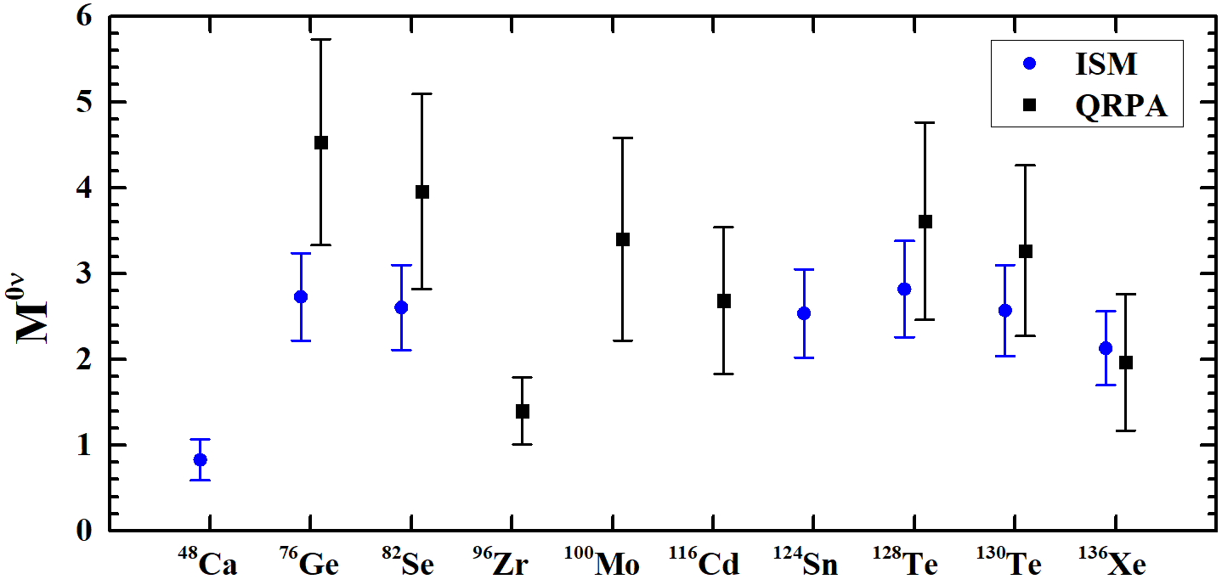
Uncertainties of NMEs
To understand the discrepancies, great efforts have been made to analyze the uncertainties of NMEs
The NMEs of QRPA and ISM with error bar evaluated from those uncertainties
data from
J. Menéndez et al. Nucl. Phys. A 818, 139 (2009)
for shell model
F. Šimkovic et al. Phys. Rev. C 77, 045503 (2008)
for QRPA

Slide 6
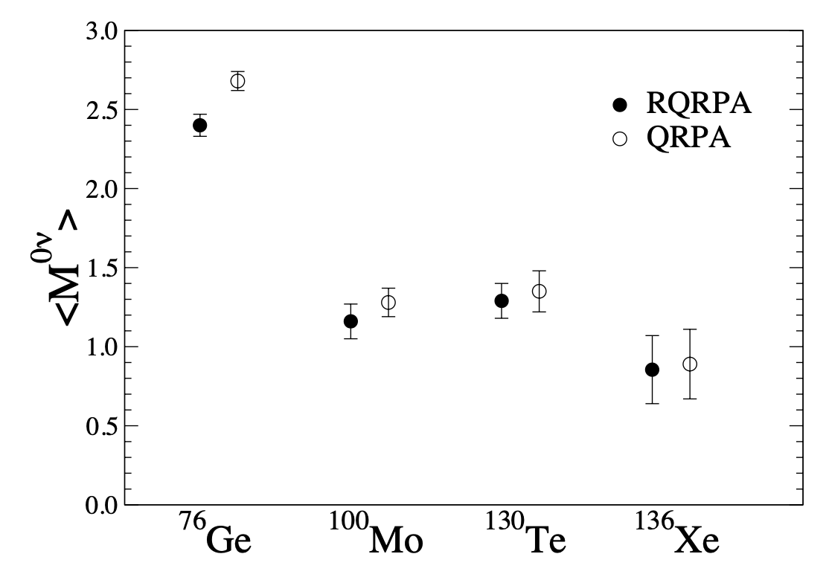
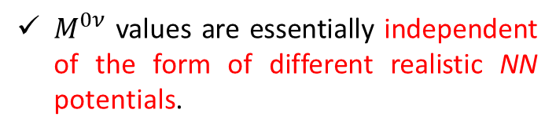
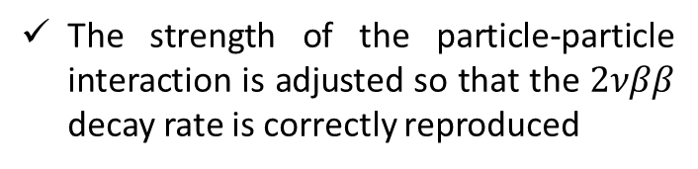
Uncertainties of NMEs: Nuclear interactions (ph)
Uncertainty sources: nuclear interactions --- particle-hole channel
G-matrix QRPA:
Mean field: Coulomb corrected Woods-Saxon potential
Residual interaction: Bonn, Argonne, Nijmegen renormalized by Brückner G matrix
Averaged over three potentials and three choices of the s.p. space
The strength of the particle-particle interaction is adjusted so that the $2νββ$ decay rate is correctly reproduced
$M^{0ν}$ values are essentially independent of the form of different realistic NN potentials.
V. A. Rodin, F. Šimkovic , et al. Phys. Rev. C 68, 044302 (2003)

Slide 7
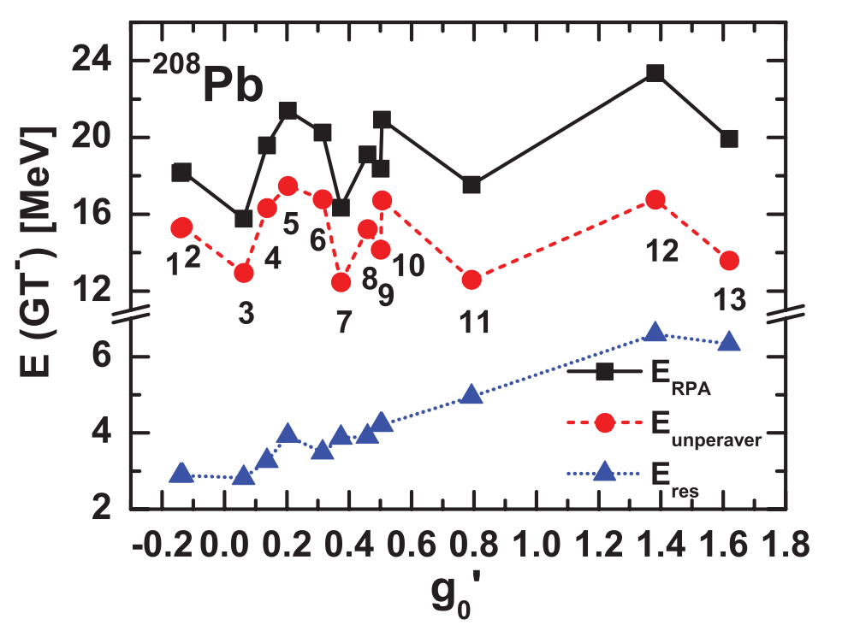
Uncertainties of NMEs: Nuclear interactions (ph)
Uncertainty sources: nuclear interactions --- particle-hole channel
Self-consistent QRPA:
Mean field, residual interaction: same interaction from energy density functionals
Particle-hole (ph) channel
Ikeda sum rule fulfilled
Hundreds of Skyrme interactions:
Nucleon effective mass $m^{∗}$ : single-particle level density near Fermi level
Landau parameter $g_{0}^{′}$: the strength of spin-isospin part of nuclear interactions
Y. F. Niu et al. Phys. Rev. C 85, 034313 (2012)

Slide 8
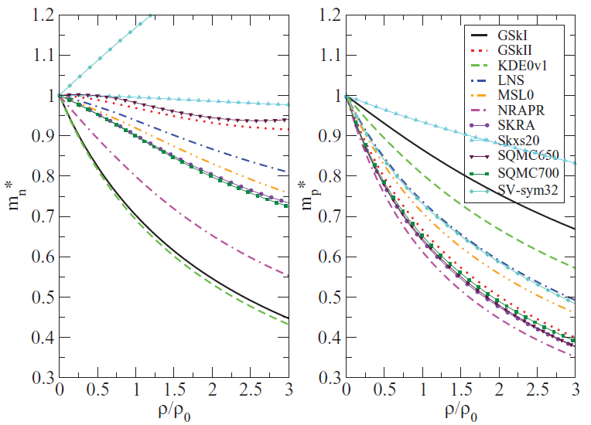
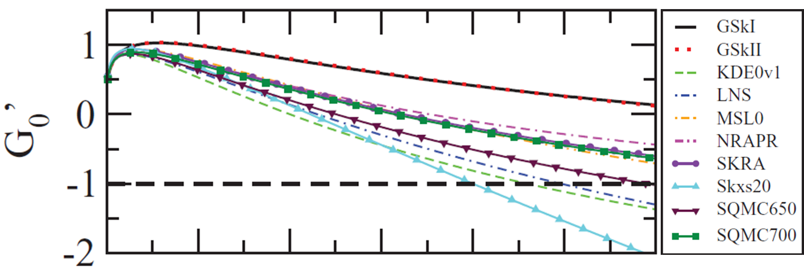
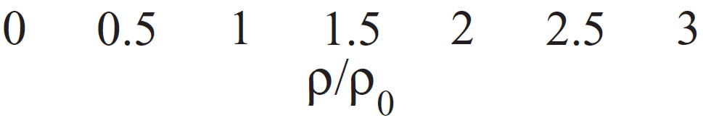
Uncertainties of NMEs: Nuclear interactions (ph)
Uncertainty sources: nuclear interactions --- particle-hole channel
Self-consistent QRPA:
Mead field, residual interaction: same interaction from energy density functionals
Particle-hole (ph) channel
Ikeda sum rule fulfilled
Hundreds of Skyrme interactions:
Nucleon effective mass $m^{∗}$ : single-particle level density near Fermi level
Landau parameter $g_{0}^{′}$: the strength of spin-isospin part of nuclear interactions
M. Dutra et al. Phys. Rev. C 85, 035201 (2012)

Slide 9
Uncertainties of NMEs: Nuclear interactions (ph)
Uncertainty sources: nuclear interactions --- particle-hole channel
Self-consistent QRPA:
Mean field, residual interaction: same interaction from energy density functionals
Particle-hole (ph) channel
Ikeda sum rule fulfilled
Hundreds of Skyrme interactions:
Nucleon effective mass $m^{∗}$ : single-particle level density near Fermi level
Landau parameter $g_{0}^{′}$: the strength of spin-isospin part of nuclear interactions
What are the uncertainties caused by different Skyrme interactions with a wide span over nucleon effective mass and Landau parameter?
M. Dutra et al. Phys. Rev. C 85, 035201 (2012)

Slide 10
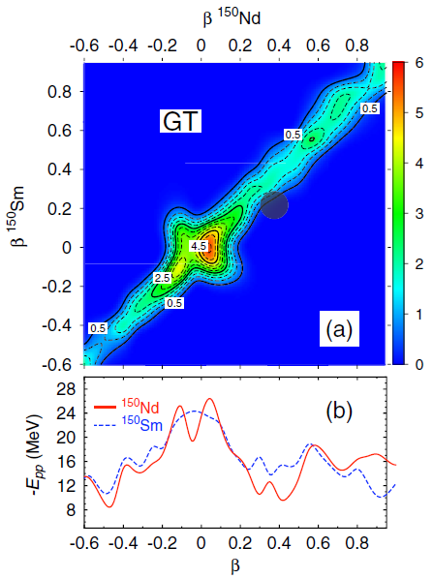
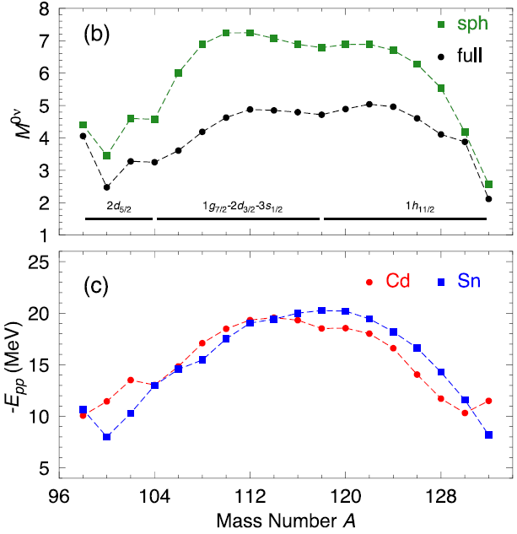
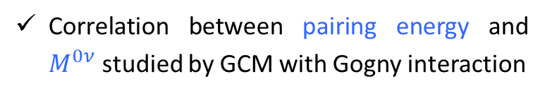
Uncertainties of NMEs: Nuclear interactions (pp)
Uncertainty sources: nuclear interactions --- particle-particle channel
Correlation between pairing energy and $M^{0ν}$ studied by GCM with Gogny interaction
T. R. Rodríguez et al. Phys. Lett. B 719, 174 (2013); Phys. Rev. Lett. 105, 252503 (2010)

Slide 11
Uncertainties of NMEs: Nuclear interactions (pp)
Uncertainty sources: nuclear interactions --- particle-particle channel
Correlation between pairing energy and $M^{0ν}$ studied by GCM with Gogny interaction
What are the uncertainties caused by different particle-particle interactions?
T. R. Rodríguez et al. Phys. Lett. B 719, 174 (2013); Phys. Rev. Lett. 105, 252503 (2010)

Slide 12

Motivation
In order to study the uncertainties caused by particle-hole channel and particle-particle channel of nuclear effective interaction, we need self-consistent QRPA models with large variety of different interactions
Self-consistent QRPA for $M^{0ν}$ and $M^{2ν}$
Spherical Skyrme QRPA
J. Terasaki, Phys. Rev. C 86, 021301(R) (2012); Phys. Rev. C 102, 044303 (2020)
Axially deformed Skyrme QRPA (matrix diagonalization / finite amplitude method)
M. T. Mustonen and J. Engel, Phys. Rev. C 87, 064302 (2013)
N. Hinohara and J. Engel, Phys. Rev. C 105, 044314 (2022)
Spherical relativistic QRPA
N. Popara, A. Ravlić, and N. Paar, Phys. Rev. C 105, 064315 (2022)
Uncertainties from nuclear effective interactions are not discussed so far
In this work:
With self-consistent Skyrme QRPA, we study the NMEs for ⁷⁶Ge, ⁸²Se, ¹²⁸Te, ¹³⁰Te, and ¹³⁶Xe. The uncertainties from nuclear effective interaction will be emphasized.
ph channel: 18 Skyrme interactions
pp channel: 2 kinds of pairing forces

Slide 13
Outline
Introduction
Theoretical Framework
Uncertainties from pairing interactions
Quasiparticle vibration coupling effects (preliminary)
Summary and Perspective

Slide 14
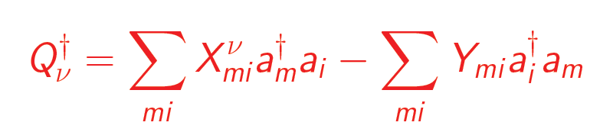

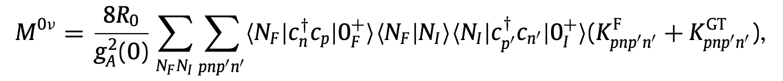
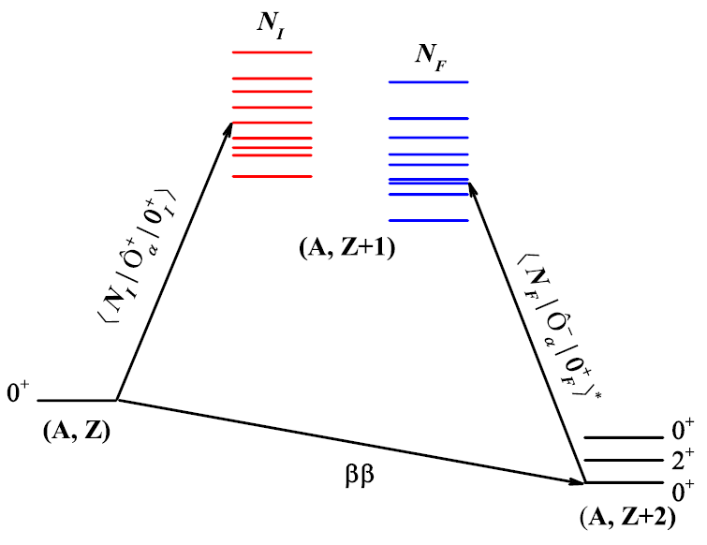
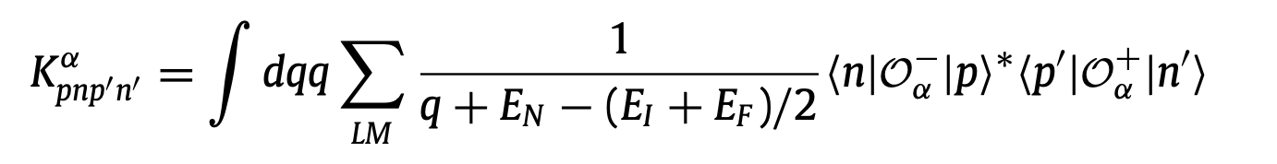
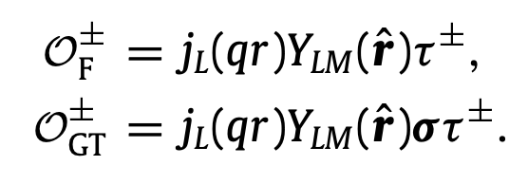
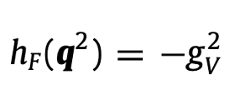
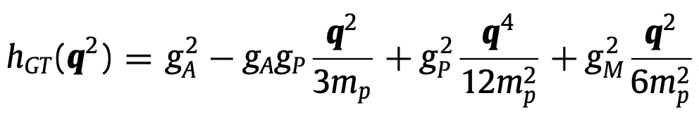
NME calculated by QRPA
QRPA: widely used for the description of spin-isospin excitations
The RPA excited state is generated by
Full 1p1h configuration space ⇒
almost whole nuclear chart
NME
overlap factor
induced current

Slide 15
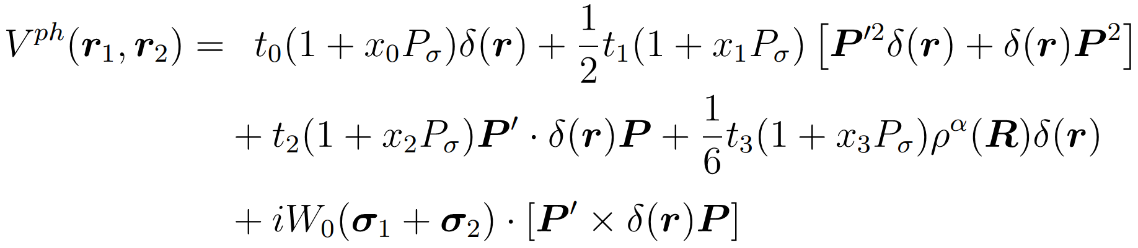
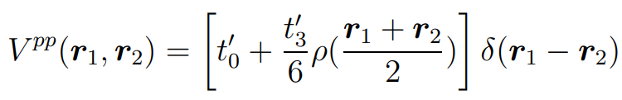
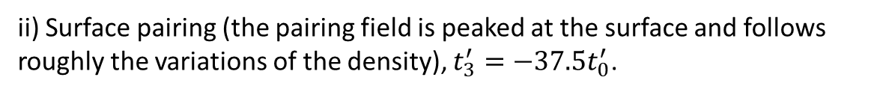

Nuclear effective interaction
ph channel: Skyrme interaction
pp channel: $δ$ interaction
i) Volume pairing (the pairing field follows the shape of the density), $t_{3}^{′}=0$.
ii) Surface pairing (the pairing field is peaked at the surface and follows roughly the variations of the density), $t_{3}^{′}=−37.5t_{0}^{′}$.
The pairing strengths are determined by fitting the experimental pairing gap.
K. Bennaceur, J. Dobaczewski, Comput. Phys. Comm. 168, 96 (2005)

Slide 16
Outline
Introduction
Theoretical Framework
Uncertainties from pairing interactions
Summary and Perspective

Slide 17
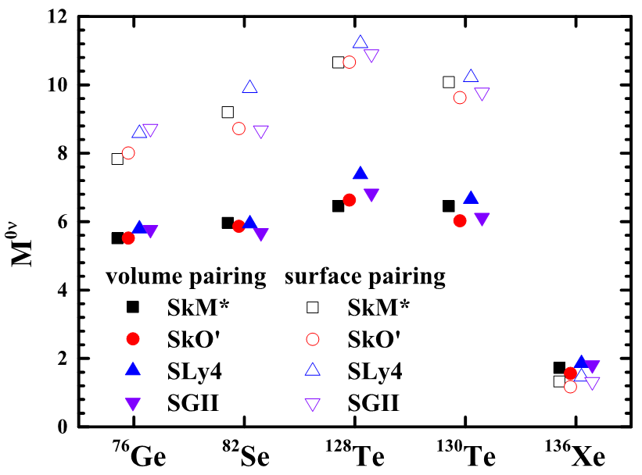
$M^{0ν}$ by different ph and pp interactions
For the same kind of pp interaction, $M^{0ν}$ obtained by different ph interactions are close.
Except for ¹³⁶Xe, $M^{0ν}$ calculated by surface pairing are larger.

Slide 18
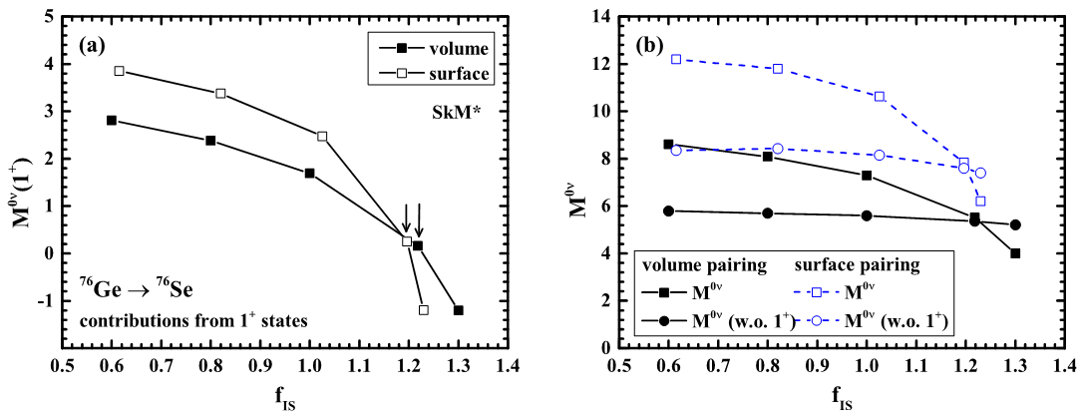
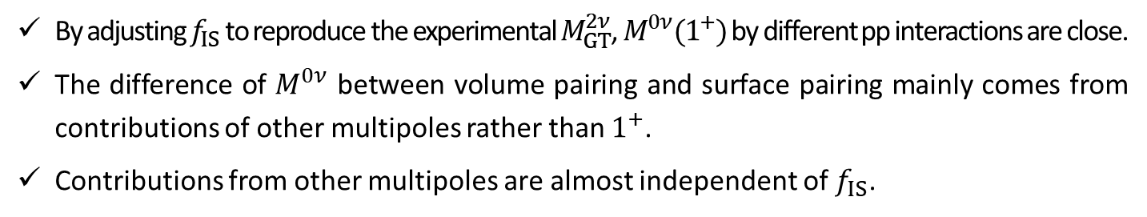
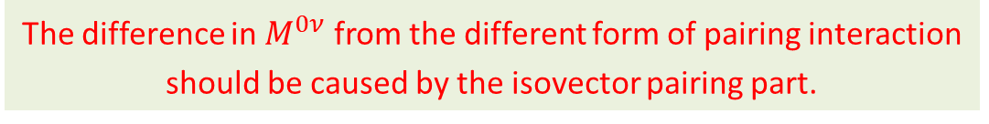
Isoscalar pairing dependence of $M^{0ν}$
By adjusting $f_{IS}$ to reproduce the experimental $M_{GT}^{2ν}$, $M^{0ν}(1^{+})$ by different pp interactions are close.
The difference of $M^{0ν}$ between volume pairing and surface pairing mainly comes from contributions of other multipoles rather than $1^{+}$.
Contributions from other multipoles are almost independent of $f_{IS}$.
The difference in $M^{0ν}$ from the different form of pairing interaction should be caused by the isovector pairing part.

Slide 19
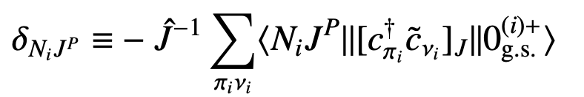
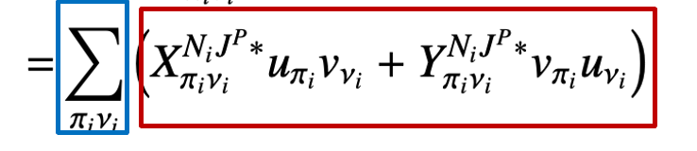
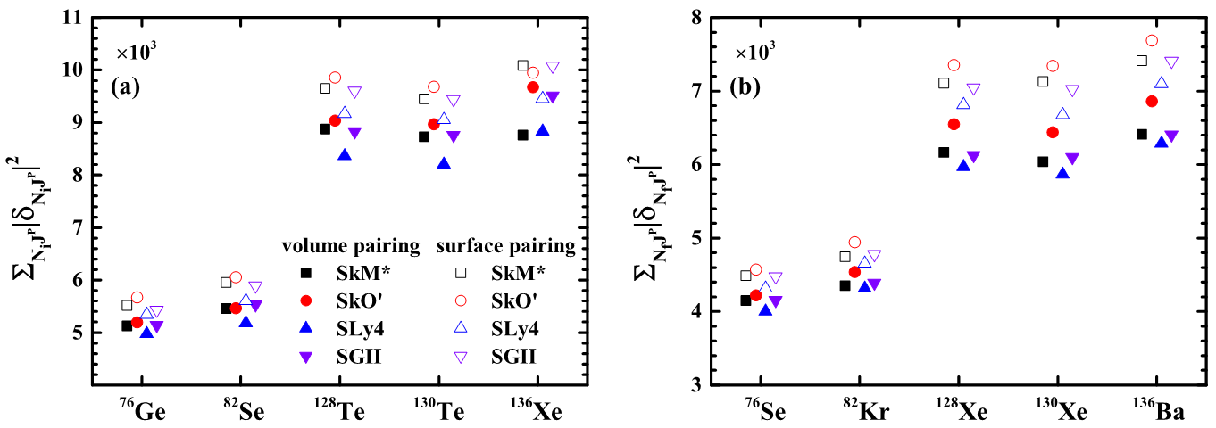
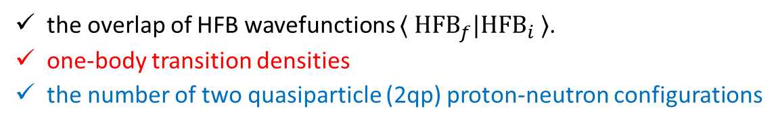
Isovector pairing effects
Isovector pairing plays its role on NME through the following factors
the overlap of HFB wavefunctions $⟨ {HFB}_{f}|{HFB}_{i} ⟩$.
one-body transition densities
the number of two quasiparticle (2qp) proton-neutron configurations
The distribution of occupation probability is more diffuse for the surface pairing than the volume pairing.
Larger configuration space

Slide 20
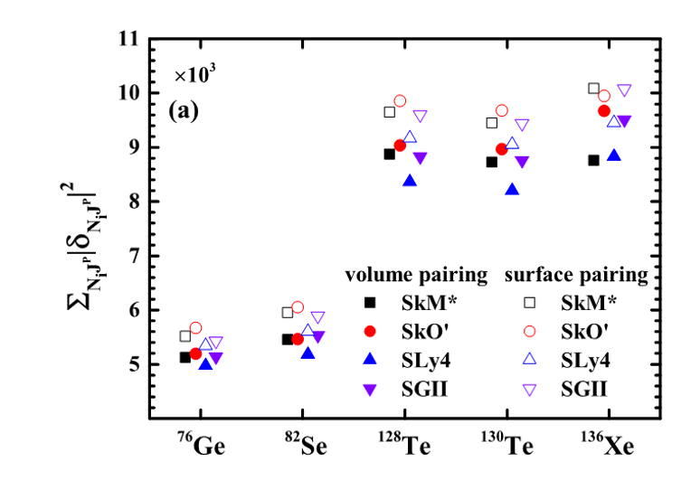
Isovector pairing effects
Isovector pairing plays its role on NME through the following factors
the overlap of HFB wavefunctions $⟨ {HFB}_{f}|{HFB}_{i} ⟩$.
one-body transition densities
the number of two quasiparticle (2qp) proton-neutron configurations
⁷⁶Ge, ⁸²Se, ^{128,130}Te:
for volume and surface pairing
¹³⁶Xe:
for volume pairing
for surface pairing

Slide 21
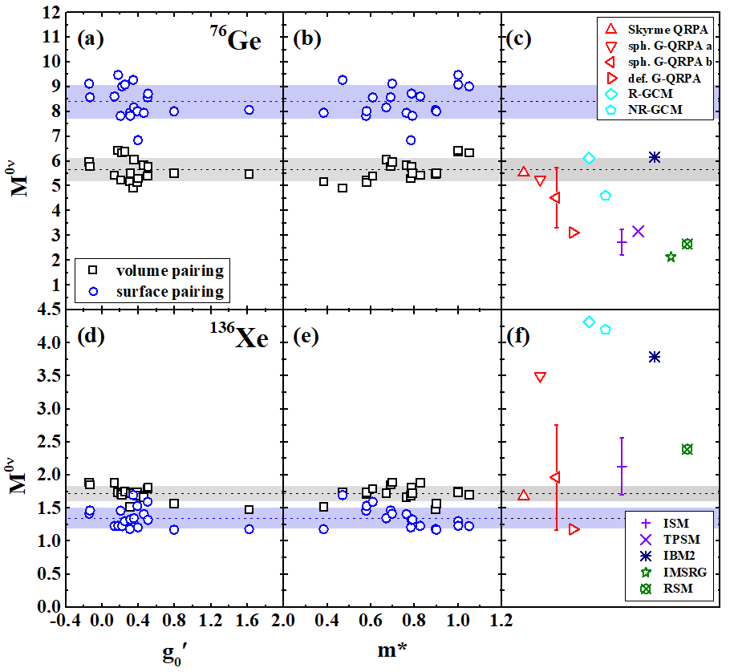
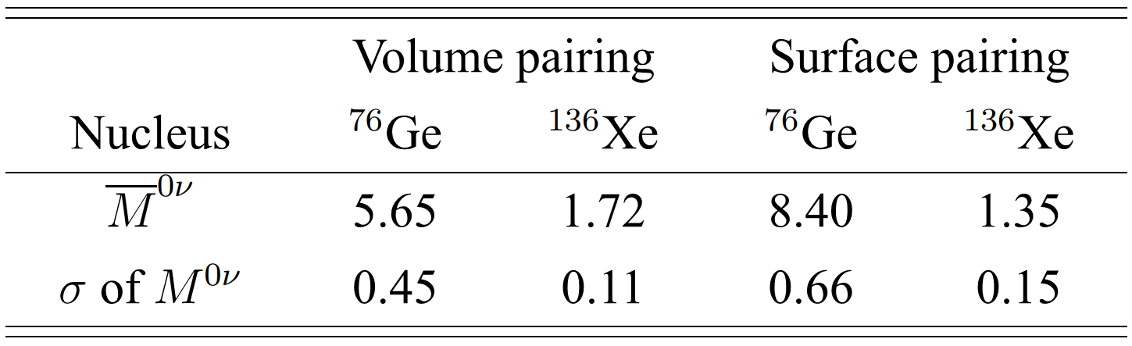
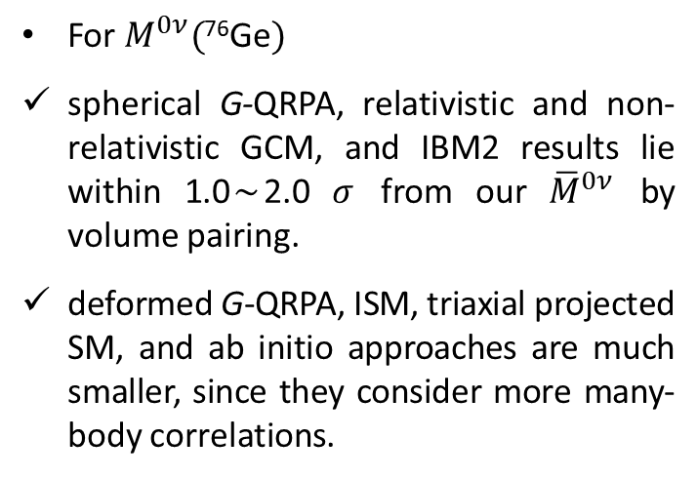
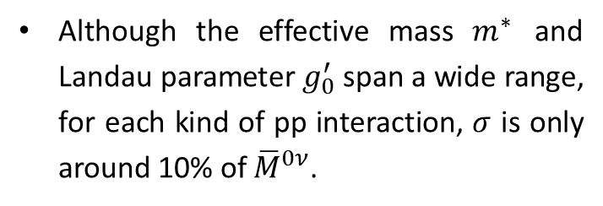
$M^{0ν}$ by 18 Skyrme interactions
Although the effective mass $m^{∗}$ and Landau parameter $g_{0}^{′}$ span a wide range, for each kind of pp interaction, $σ$ is only around 10% of ${\overline{M}}^{0ν}$.
For $M^{0ν}($⁷⁶Ge$)$
spherical G-QRPA, relativistic and non-relativistic GCM, and IBM2 results lie within 1.0$∼$2.0 $σ$ from our ${\overline{M}}^{0ν}$ by volume pairing.
deformed G-QRPA, ISM, triaxial projected SM, and ab initio approaches are much smaller, since they consider more many-body correlations.

Slide 22
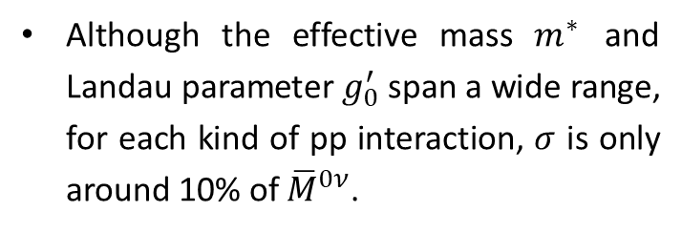
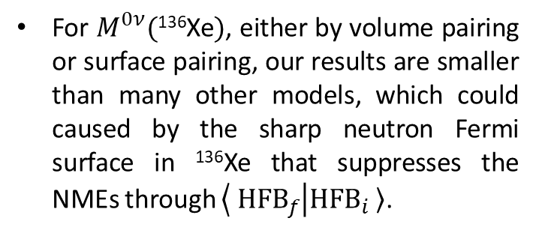
$M^{0ν}$ by 18 Skyrme interactions
Although the effective mass $m^{∗}$ and Landau parameter $g_{0}^{′}$ span a wide range, for each kind of pp interaction, $σ$ is only around 10% of ${\overline{M}}^{0ν}$.
For $M^{0ν}($¹³⁶Xe$)$, either by volume pairing or surface pairing, our results are smaller than many other models, which could caused by the sharp neutron Fermi surface in ¹³⁶Xe that suppresses the NMEs through $⟨ {HFB}_{f} | {HFB}_{i} 〉$.
W. L. Lv, Y. F. Niu, D.L. Fang, J. M. Yao, C. L. Bai, and J. Meng, arXiv:2302.04423

Slide 23
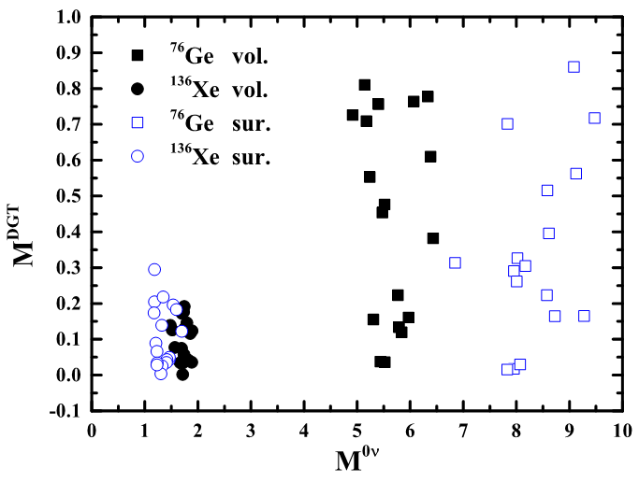
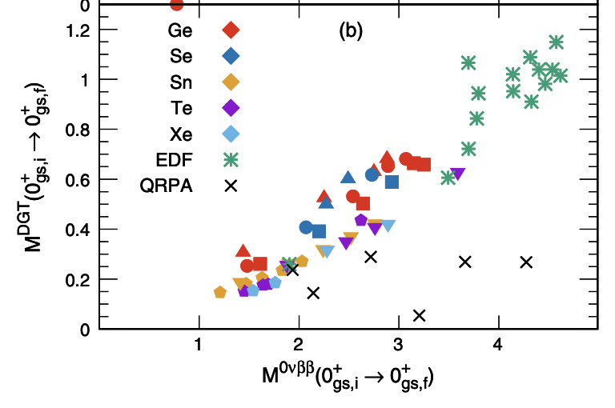
Correlation between $M^{DGT}$ and $M^{0ν}$
N. Shimizu et al. Phys. Rev. Lett. 120, 142502 (2018)
$M^{DGT}$ is strongly affected by the choice of ph interactions. There seems no correlation between $M^{DGT}$ and $M^{0ν}$ in QRPA model.

Slide 24
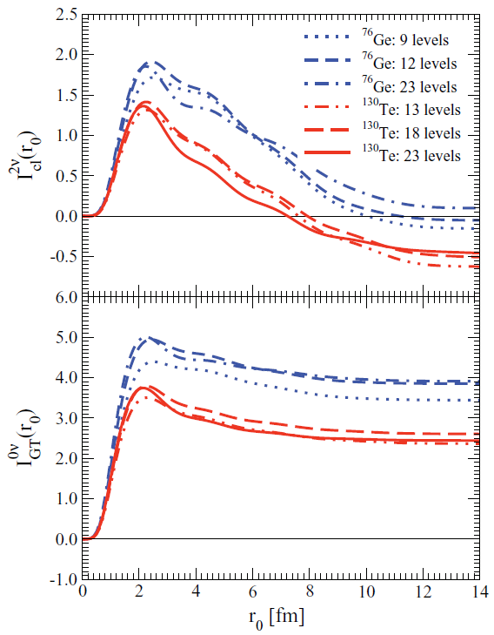
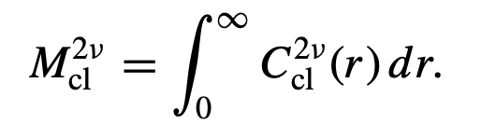
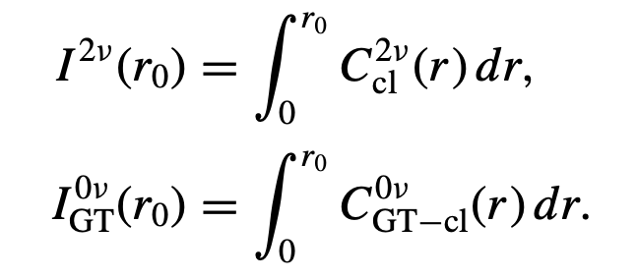

Correlation between $M^{DGT}$ and $M^{0ν}$
F. Šimkovic et al. Phys. Rev. C 83, 015502 (2011)
$M^{DGT}$ : both short range and long range physics matter.
$M^{0ν}$ : only short range physics matters.

Slide 25
Outline
Introduction
Theoretical Framework
Uncertainties from pairing interactions
Summary and Perspective

Slide 26
Summary and Perspectives
Summary
Uncertainties raising from nuclear effective interactions within Skyrme QRPA model are investigated
  NME are not sensitive to ph interactions
  NME are very sensitive to pp interactions: surface pairing with more diffused Fermi surface gives larger NMEs.
Perspective
Which pairing is more suitable for NME calculation?
  Besides the mean pairing gaps, other constraints on the pairing interactions need to be considered.

Slide 27
Acknowledgment
Collaborators
Lv Wanli Lanzhou University
Bai Chunlin Sichuan University
Fang Dongliang Insitute of Modern Physics
Meng Jie Peking University
Yao Jiangming Sun Yat-sen University
Thank you!

Slide 28
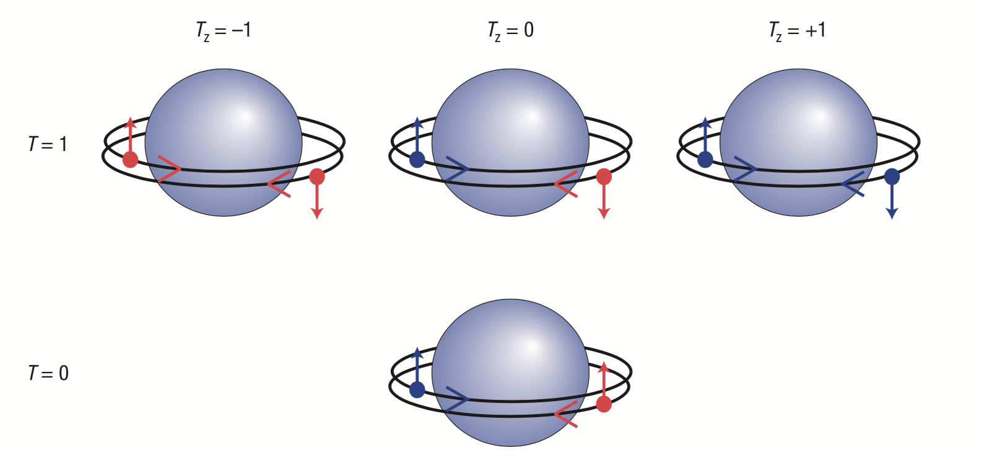
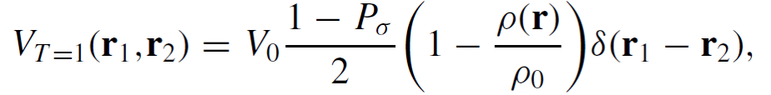
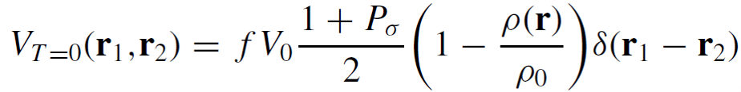
Isovector and isoscalar pairing
PP
PN
NN
g.s.
Fermi 0⁺
g.s.
PN
Gamow-Teller (GT) 1⁺
Warner et al., Nature Physics 2, 311 (2006)
Isovector Pairing
Isoscalar Pairing
For ground state: pairing strength adjusted to reproduce empirical pairing gap.
For GT: the same form as IV pairing, but with an adjustable pairing strength f.

Slide 29
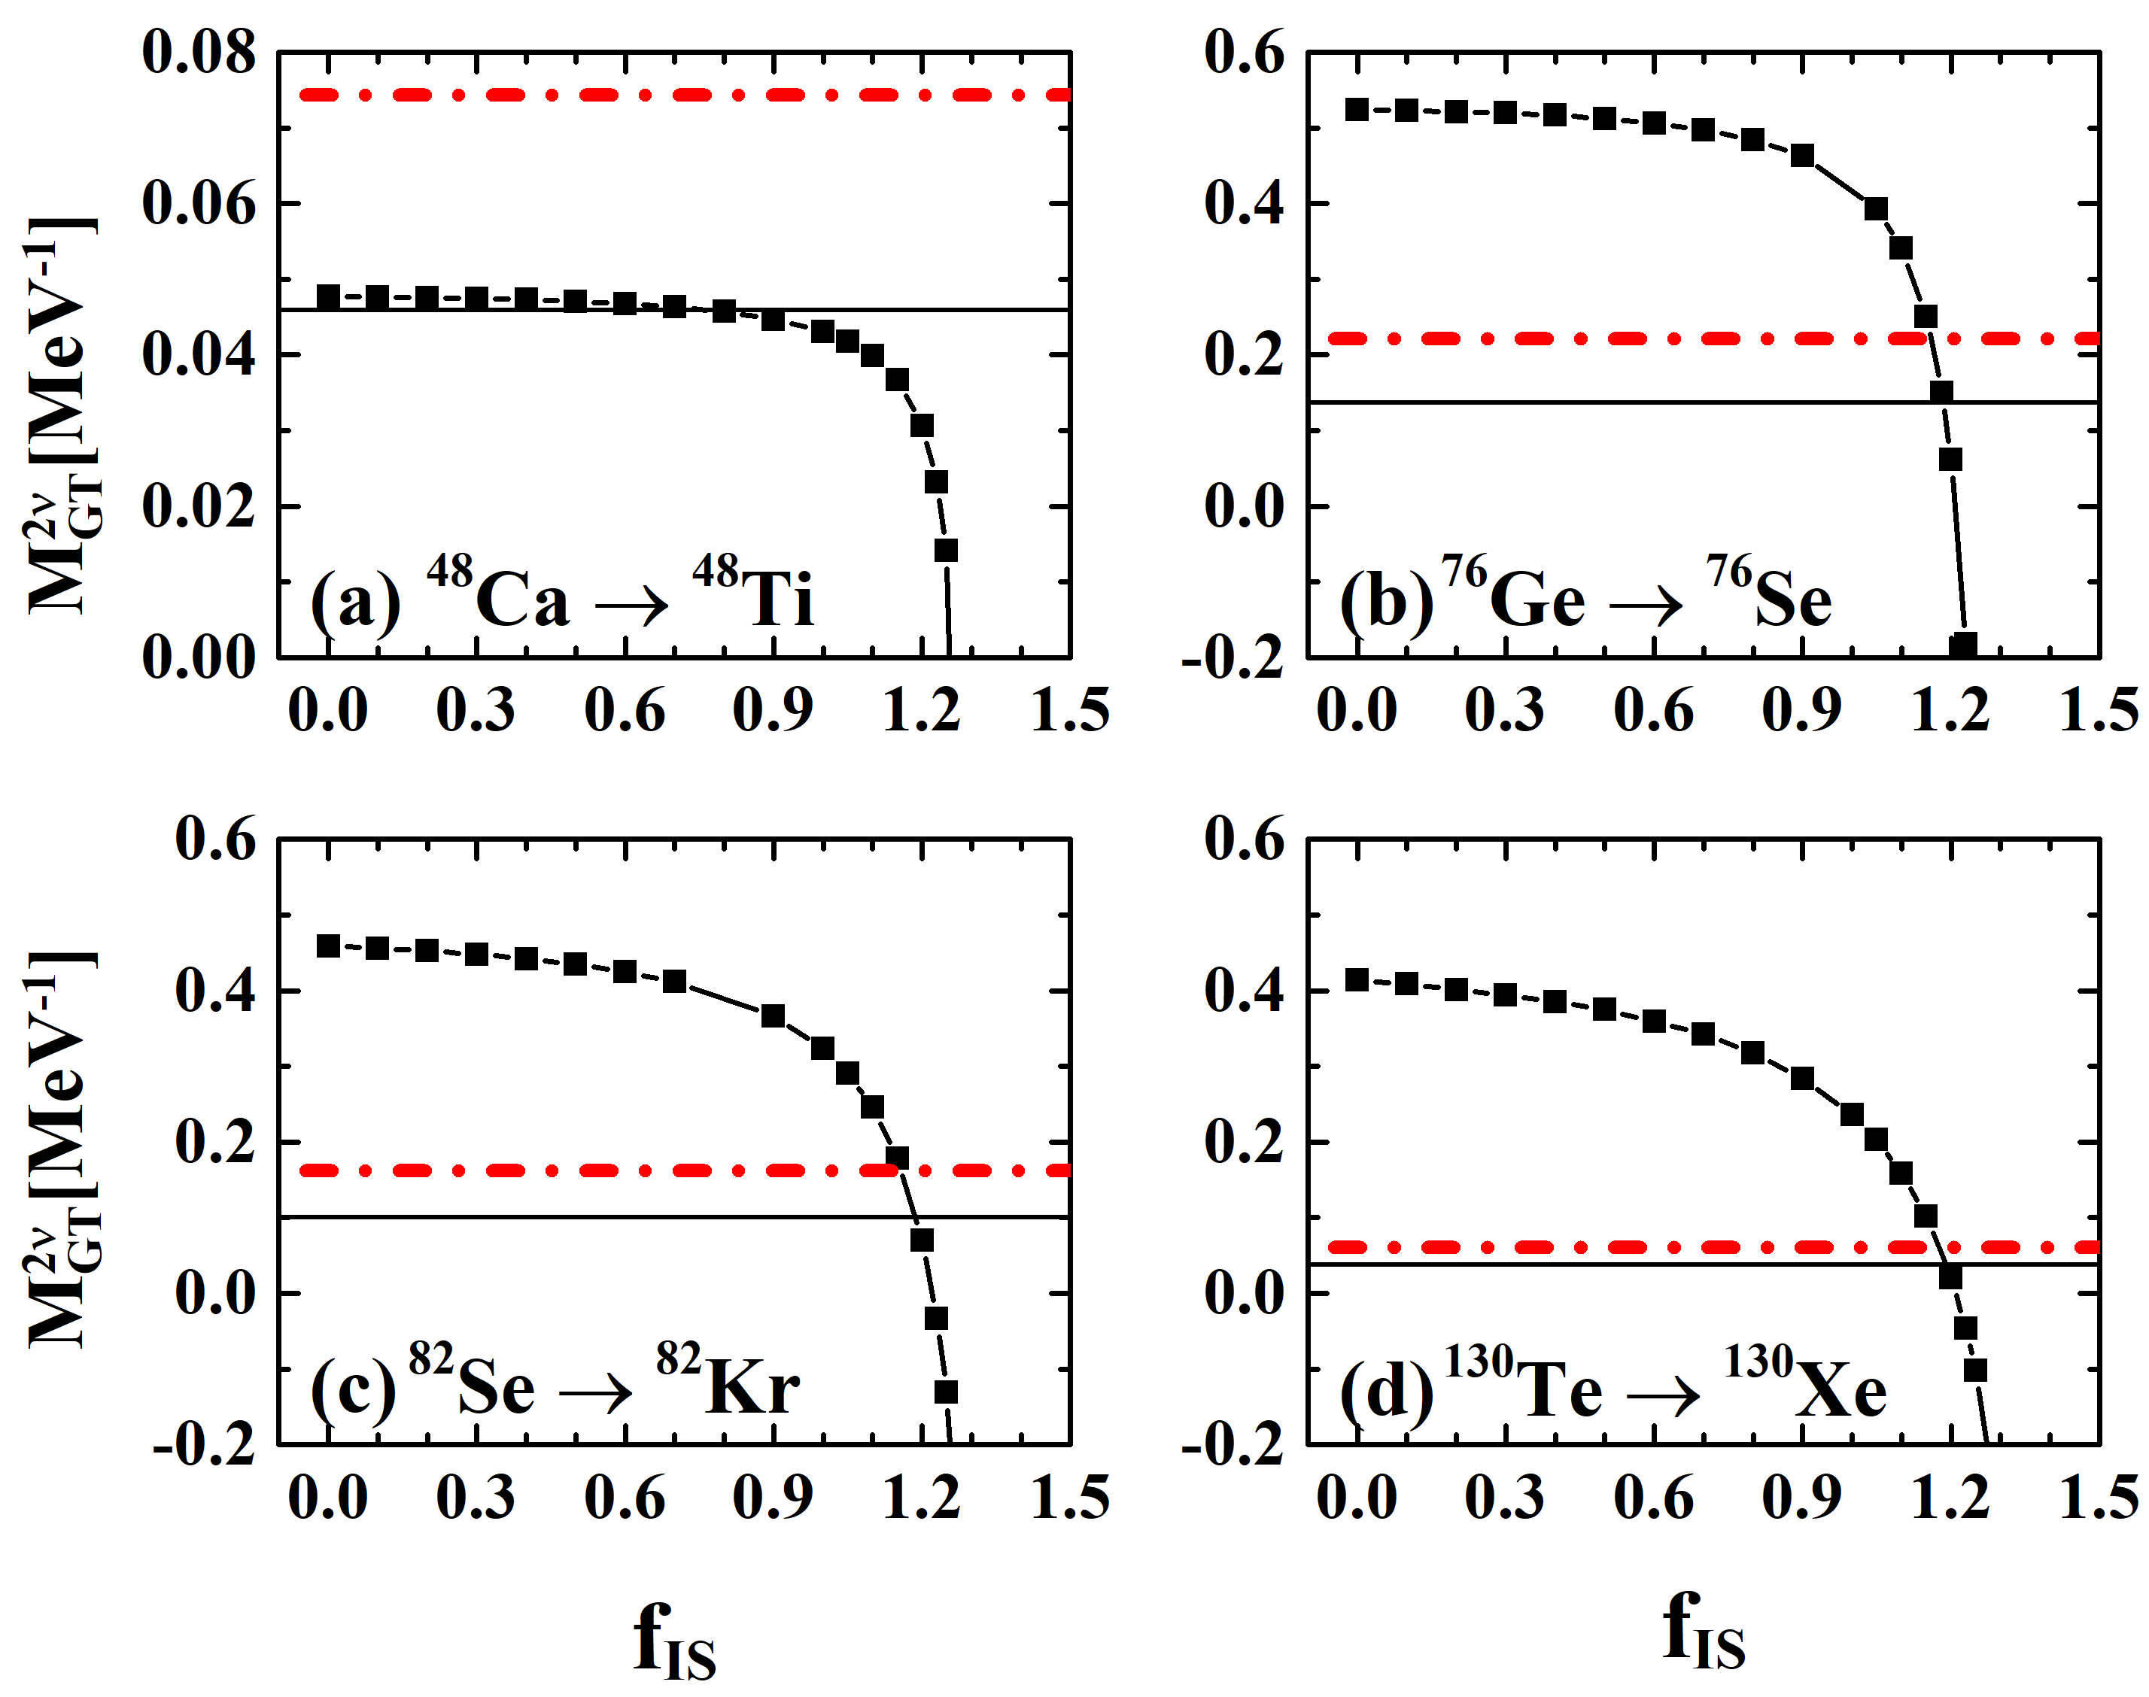
Determination of isoscalar pairing strength
QRPA SkO’
Exp. NME with g_{A}=1.0
Exp. NME with g_{A}=1.27
                Lv, YFN, et al., PRC 105, 044331 (2022)
The isoscalar pairing strength can be determined by reproducing the experimental NME of 2 neutrino double beta decay $M2ν$.

Slide 30
Determination of isoscalar pairing strength
QRPA SkO’
Exp. NME with g_{A}=1.0
Exp. NME with g_{A}=1.27
                Lv, YFN, et al., PRC 105, 044331 (2022)
There is an uncertainty due to the quenching of axial vector coupling constant g_{A}.

Slide 31
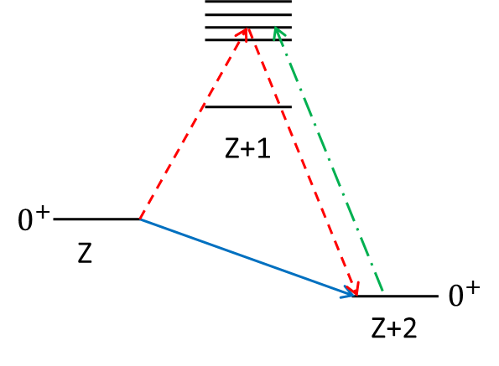


Isospin symmetry and isovector pairing strength
2 neutrino double beta decay
Fermi transition $\sum_{k}{τ_{k}^{−}}$.
just changes isospin projection
doesn’t change total isospin.
Its contribution to $2νββ$ decay should be zero due to isospin symmetry.
Fermi
GT+
GT-
Fermi
isospin
T
T-2
QRPA calculation: isospin symmetry is almost satisfied

Slide 32


Isospin symmetry and isovector pairing strength
To further restore the isospin symmetry, the isovector proton-neutron pairing strength can be determined by requiring $M2ν$(Fermi)=0.
                Simkovic et al., PRC 87, 045501 (2013)

Slide 33


Deformation effect
QRPA calculation with a realistic interaction
¹⁵⁰Nd: strongly deformed nucleus
                Fang et al., PRC 82, 051301(R) (2010)
NME is suppressed by about 40% as compared with QRPA result for ¹⁵⁰Nd obtained with neglect of deformation, mainly due to the overlap between the quasiparticle vacua of initial and final nucleus.

Slide 34

NME status by QRPA models
Different treatment of overlap
spherical
Different pairing strength
deformation
deformation
deformation
?
deformation
Systematic small values of Stoica: higher-order QRPA correlations
Figure by Lv Wanli
Notes:
Difference between Jyvaskyla and Tubingen for 82Se and 100Mo?
Universal underestimation of Stoiica?
Difference between Terasaki and Engel for SkM* for 130Te and 136Xe?

Slide 35

Comparison between QRPA and shell model
                Terasaki and Iwata, arXiv: 2104.08250v2 (2021)
To compensate the drawbacks of each model, a phenomenological way is proposed to modify each result by introducing an enhancing or quenching factor.
With this factor, the predicted NMEs by the two models, which originally differ from each other by a factor of two, agree with each other.

Slide 36






Double β decay
$${}_{Z}^{A}X→{}_{Z+2}^{A}Y+2e^{−}+2{\overline{ν}}_{e}$$
$$T_{1/2}\sim {10}^{18−24}yr$$
second order process
A. S. Barabash, Phys. Rev. C 81, 035501 (2010)

Slide 37



Double β decay
$${}_{Z}^{A}X→{}_{Z+2}^{A}Y+2e^{−}+2{\overline{ν}}_{e}$$
second order process
$$T_{1/2}\sim {10}^{18−24}yr$$
first observed in 1987 for ⁸²Se
A. S. Barabash, Phys. Rev. C 81, 035501 (2010)
ββ-decay candidates:
even-even nucleus (Z, A)
pairing forces make it more bound than its (Z+1, A) neighbor, but less so than the (Z+2, A) nuclide.
《无中微子双贝塔衰变实验》科学出版社(2020)

Slide 38




Importance of 0ν2β
Neutrino mass hierarchy
Neutrino oscillation experiment
Solar neutrino experiment:
$m_{2}^{2}−m_{1}^{2}=7.5×{10}^{−5} eV^{2}$
Atmospheric neutrino experiment:
$|m_{3}^{2}−m_{2}^{2}|=2.4×{10}^{−3} eV^{2}$
Ahmad PRL 89, 011301 (2002)
Fukuda PRL 81, 1562 (1998)
Neutrinoless double β decay
Majorana CP phase
KamLAND-Zen Collaboration, Phys. Rev. Lett, 117, 082503 (2016)

Slide 39









Formalism: Isoscalar pairing
Isoscalar pairing
1. No experimental constraint on isoscalar pairing
2. Important for $B\left({GT}^{−}\right) ,$ β-decay half-lives and $M_{GT}^{2ν}$.
M. K. Cheoun, et al., Nucl. Phys A 561, 74 (1993)
C. L. Bai, et al., Phys. Rev. C 90, 054335 (2014)
Y. F. Niu, et al., Phys. Lett. B 780, 325 (2018)
(IS)
(IV)
($f_{IS}$ is free)
IS

Slide 40



Isospin symmetry and isovector pairing strength
2 neutrino double beta decay
Fermi transition $\sum_{k}{τ_{k}^{−}}$.
just changes isospin projection
doesn’t change total isospin.
Its contribution to $2νββ$ decay should be zero due to isospin symmetry.
Fermi
GT+
GT-
Fermi
isospin
T
T-2
Self-consistent QRPA calculation: isospin symmetry is restored
the same interaction is used for ground state and excited states calculation
$$h_{kk^{′}}=\frac{δE_{HF}}{δρ_{kk^{′}} },$$
$V_{res.}^{mi,nj}=\frac{δ^{2}E_{HF}}{δρ_{mi}δρ_{nj}}$,
where
$E_{HF} = ⟨ Φ | H_{eff} | Φ ⟩$.

Slide 41

Isospin symmetry and isovector pairing strength
2 neutrino double beta decay
Fermi transition $\sum_{k}{τ_{k}^{−}}$.
just changes isospin projection
doesn’t change total isospin.
Its contribution to $2νββ$ decay should be zero due to isospin symmetry.
Fermi
GT+
GT-
Fermi
isospin
T
T-2
Non-self-consistent QRPA calculation:
The isovector pairing strength can be determined by requiring $M2ν$(Fermi)=0.

Slide 42

NME status by QRPA models
Different treatment of overlap
Different pairing strength
deformation
deformation
Different
interaction
Systematic small values of Stoica: higher-order QRPA correlations
Figure by Lv Wanli
Notes:
Difference between Jyvaskyla and Tubingen for 82Se and 100Mo?
Universal underestimation of Stoiica?
Difference between Terasaki and Engel for SkM* for 130Te and 136Xe?

Slide 43

Isospin symmetry and isovector pairing strength
The effect of isospin symmetry restoration on $0νββ M^{0ν}$
Fermi-type
ISR: isospin symmetry restoration
MSp I: model space I
MSp II: model space II
Gamow-Teller-type
                Fang et al., PRC 92, 044301 (2015)
With restoration
the Fermi-type matrix elements are reduced by about 15-20%
the more important Gamow-Teller-type matrix elements remain the same

Slide 44




Self-consistent QRPA based on Skyrme density functional
Self-consistent QRPA approach:
the same interaction is used for ground state and excited states calculation
$$h_{kk^{′}}=\frac{δE_{HF}}{δρ_{kk^{′}} } ,$$
QRPA
similar
$V_{res.}^{mi,nj}=\frac{δ^{2}E_{HF}}{δρ_{mi}δρ_{nj}}$,
QRPA
similar
where
$E_{HF} = ⟨ Φ | H_{eff} | Φ ⟩$.
deformation effect
N=82 shell closure
                Mustonen and Engel, PRC 87, 064302 (2013)

Slide 45



Formulae
QRPA+QPVC

Slide 46
Outline
Introduction
Theoretical Framework
Uncertainties from pairing interactions
Quasiparticle vibration coupling effects (preliminary)
Summary and Perspective

Slide 47
Discrepancy between QRPA and shell model
Uncertainty sources:
  Many-body approximations
  The size of the model space
Shell model: 1p1h, 2p2h, … , npnh configurations.
QRPA : complete single particle levels.

Slide 48


Quasiparticle vibration coupling approach
RPA
Second RPA
drozdz et al., PR 197, 1 (1990);
Gambacurta et al., PRC 81, 054312 (2010)
RPA + PVC (particle vibration coupling)
Low-lying vibration phonons |N>
RPA+PVC model based on Skyrme DFT
RPA+PVC model based on relativistic DFT
Colo et al., PRC 50, 1496 (1994); Niu et al., PRC 85, 034314 (2012)
Litvinova et al., PRC 75,064308 (2007)
48

Slide 49


$M^{2ν}$ by QRPA+QPVC
$M^{2ν}$ calculated by QRPA and QRPA+QPVC as a function of isoscalar pairing strength

Slide 50







$M^{0ν}$ by QRPA+QPVC
Contribution from different $J^{π}$ to $M^{0ν}$
QRPA:
$f_{IS}=1.05$, $M^{2ν}=0.100$
$f_{IS}=1.00$, $M^{2ν}=0.138$
QRPA+QPVC:
$f_{IS}=1.00$, $M^{2ν}=0.102$
QRPA:
$f_{IS}=1.05$, $M^{0ν}=3.432$
$f_{IS}=1.00$, $M^{0ν}=3.777$
QRPA+QPVC:
$f_{IS}=1.00$, $M^{0ν}=3.808$

Slide 51

Transition strengths by QRPA+QPVC

Slide 52

Transition strengths by QRPA+QPVC

Slide 53

Running sum of $M^{0ν}$

Slide 54

Running sum of $M^{0ν}$

