Slide 1
Neutrinoless double beta decay in the Type-I Seesaw model
Based on, Fang, YFL, Zhang
2112.12779 & 2305.xxxxx
Yu-Feng Li (李玉峰)
Institute of High Energy Physics &
University of Chinese Academy of Sciences
2023-05-20@珠海
第二届“无中微子双贝塔衰变及相关物理研讨会”

Slide 2
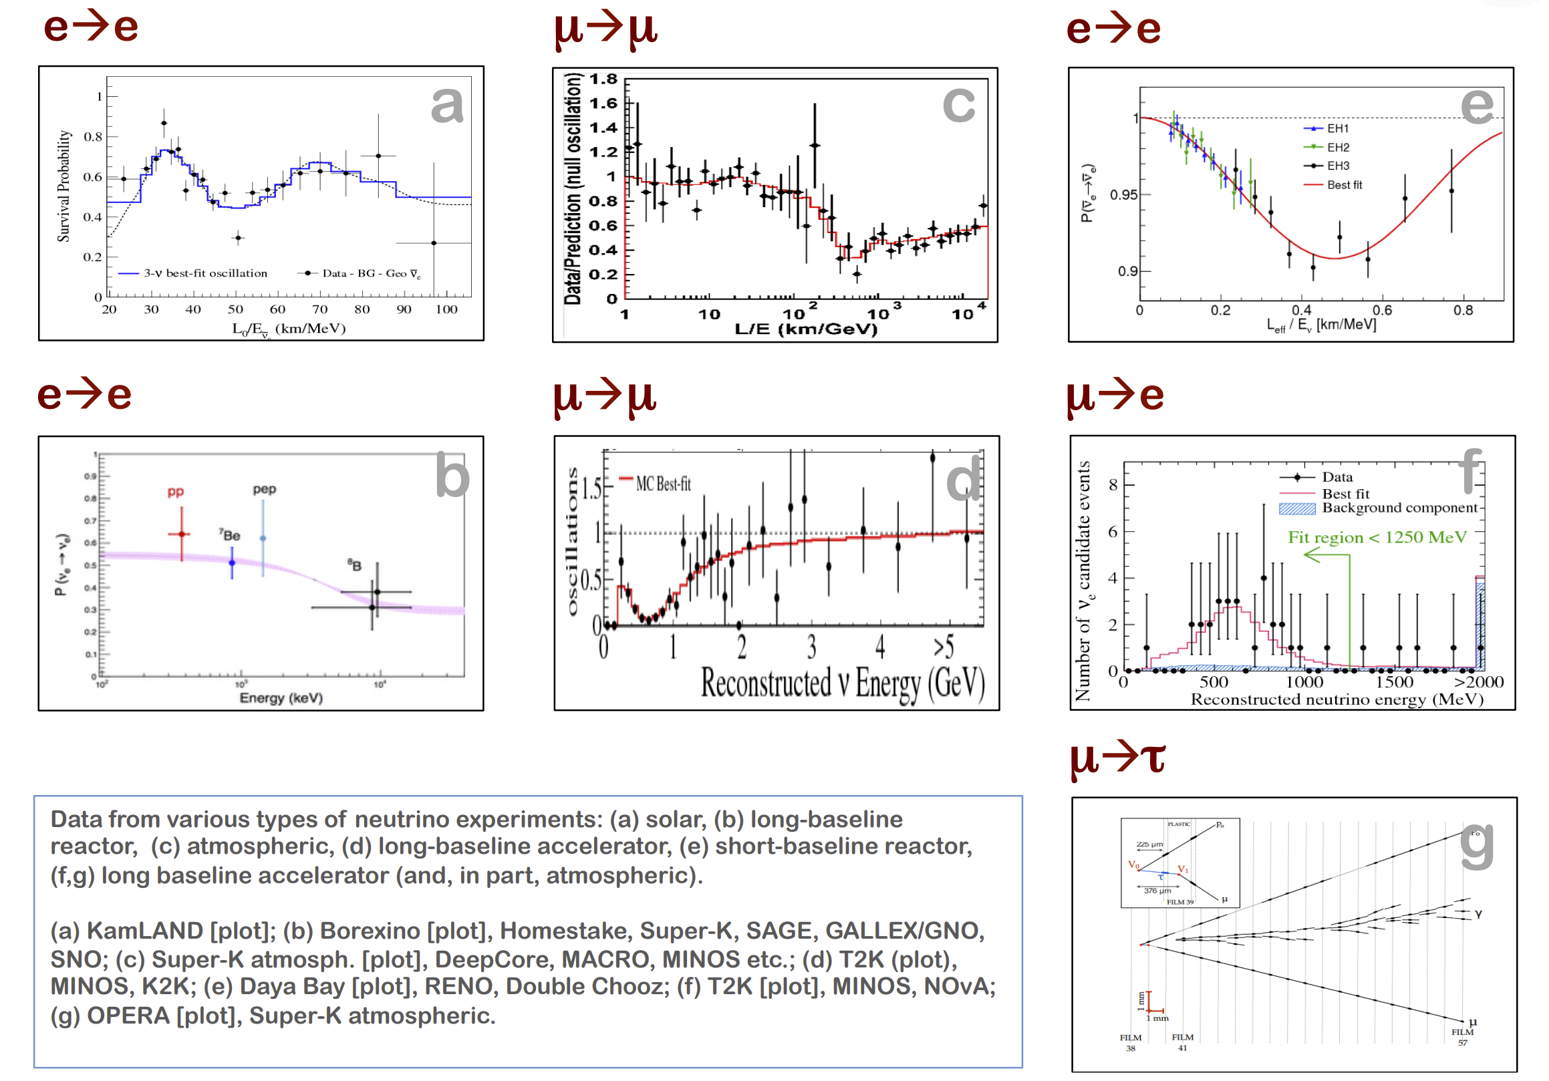
νs do oscillate!
From Lisi

Slide 3
The current global picture
5 parameters: measured with high precision
Mass ordering & CP violation to be determined

Slide 4
Neutrino mass spectrum

Slide 5
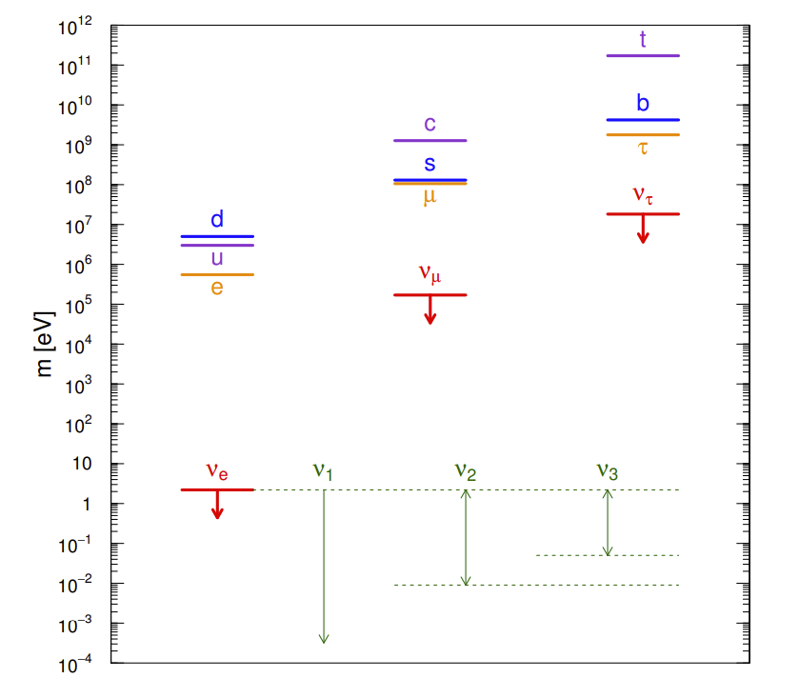
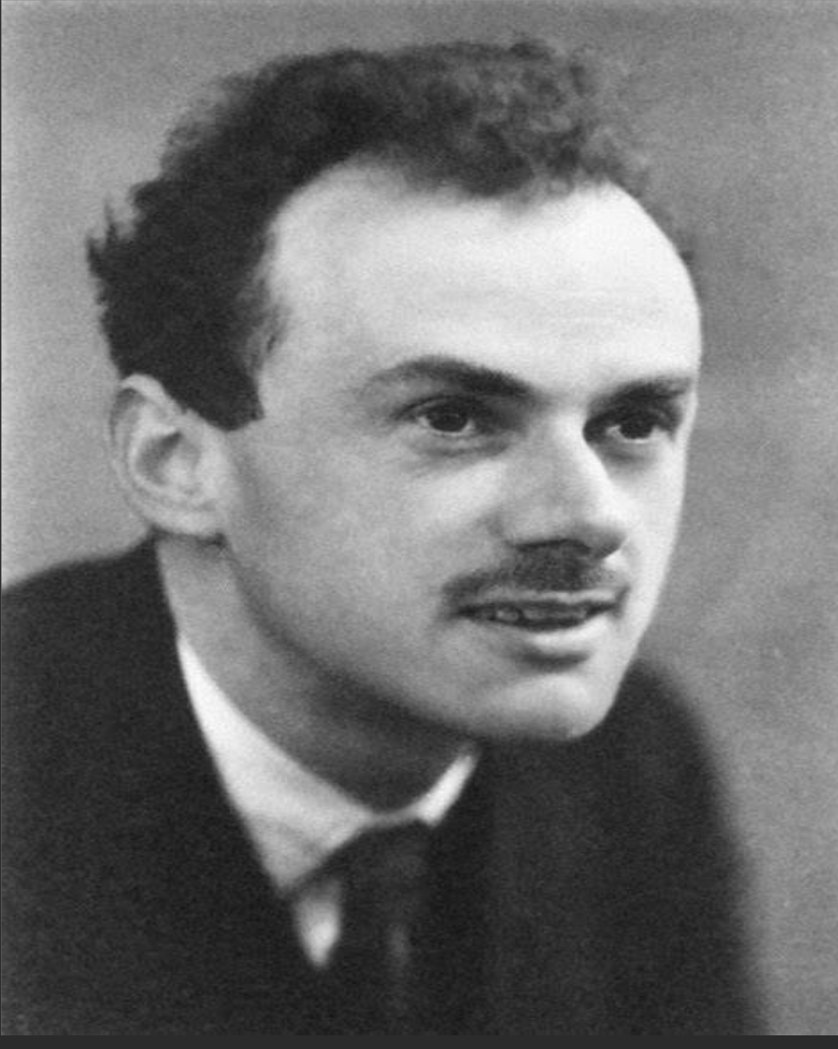
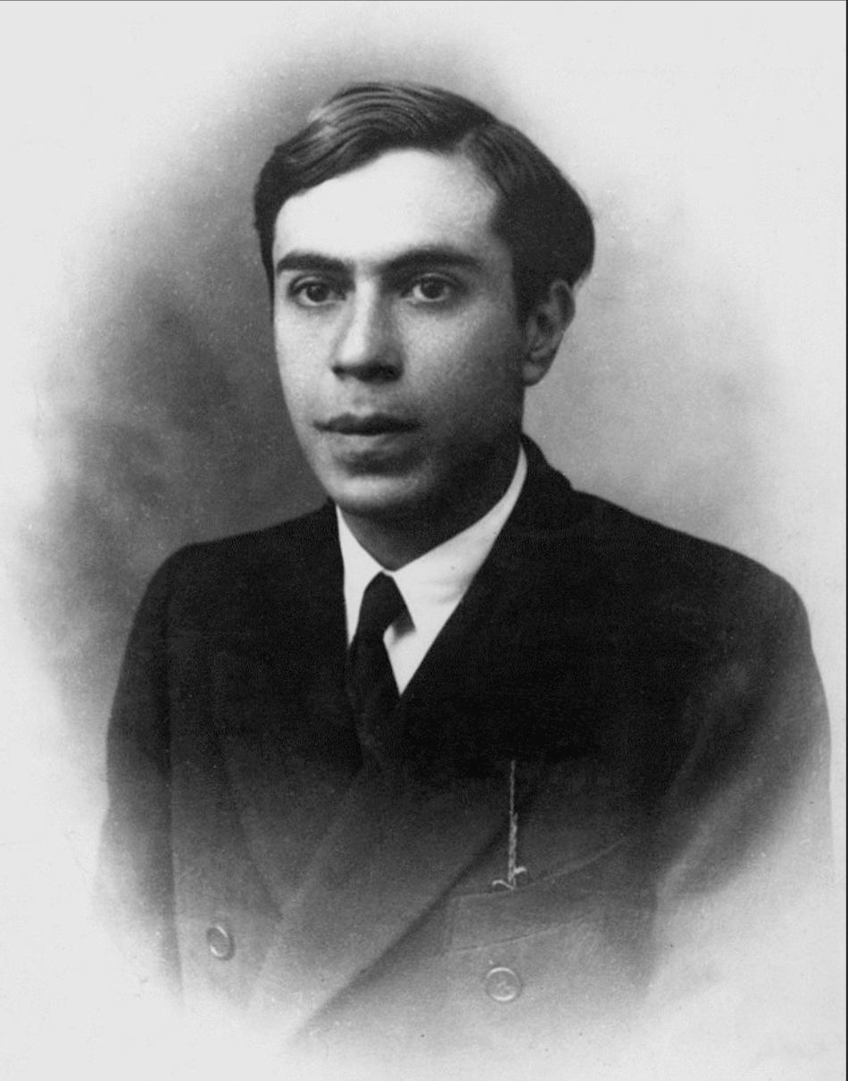
ν masses: Dirac versus Majorana
Two possibilities to define neutrino mass:
Dirac mass
Majorana mass
Left & right handed ν’s
Lepton number conservation
Only left handed ν’s
Lepton number violation

Slide 6
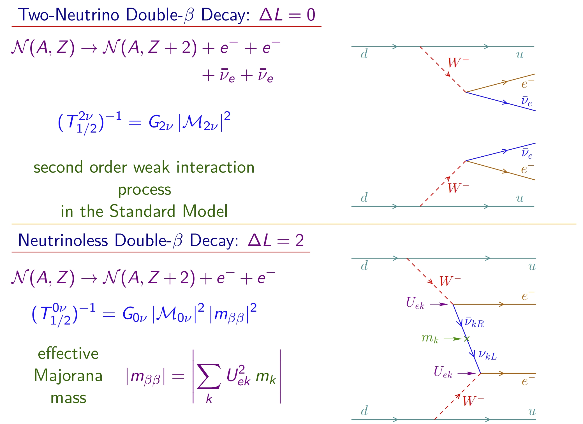
Double beta decay
Goeppert Mayer (1935)
Furry (1939)
See recent reviews: 2203.12169, 2203.12169, 1902.04097 etc.

Slide 7
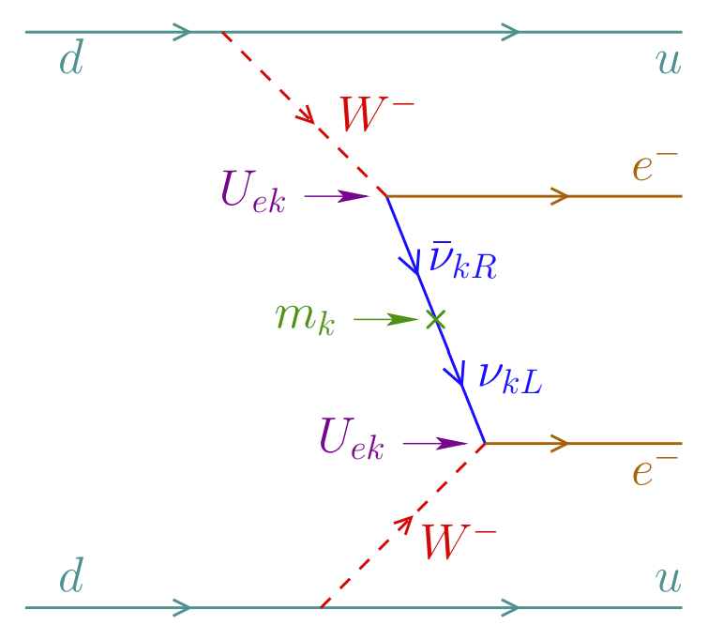

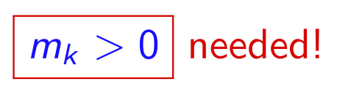
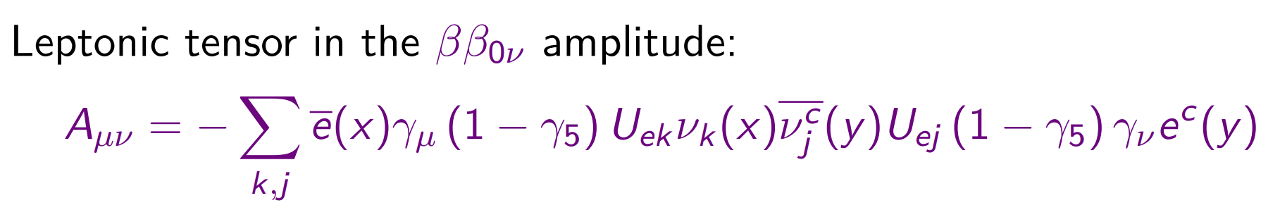
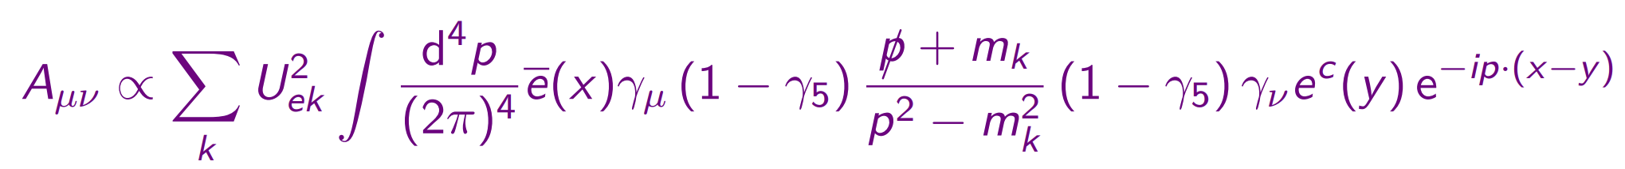
The 𝟎ν𝟐𝜷-decay rate
gives a propagator only if ν and ν^{c} are the same field
Majorana neutrinos
→
For light active neutrinos:

Slide 8
Effective Majorana Neutrino Mass
7 out of 9 parameters of light Majorana neutrinos !
Neutrino oscillation and non-oscillation measurements contribute to the prediction of m_{𝜷𝜷} !

Slide 9
m_{𝜷𝜷} : Decomposition
Three different regions:
QD:
m_{1/3}>10 meV
Hierarchical:
m_{1/3}<1 meV
Cancelation:
[1, 10] meV
1505.00978

Slide 10
Fine structure: towards the meV goal
The critical threshold point could serve as the ultimate goal for 0ν2𝜷 searches.
The possibility of falling into the well is very small.
Have unique (otherwise impossible) constraints on non-oscillation parameters
J. Cao, et al, 1908.08355

Slide 11
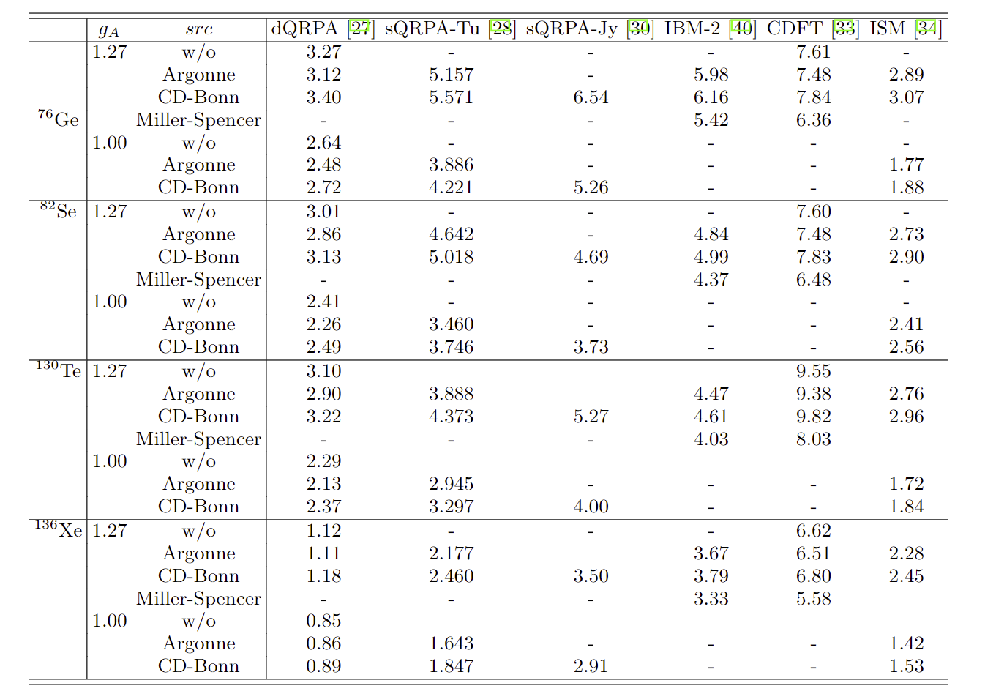
Nuclear Matrix Element (light νs)

Slide 12
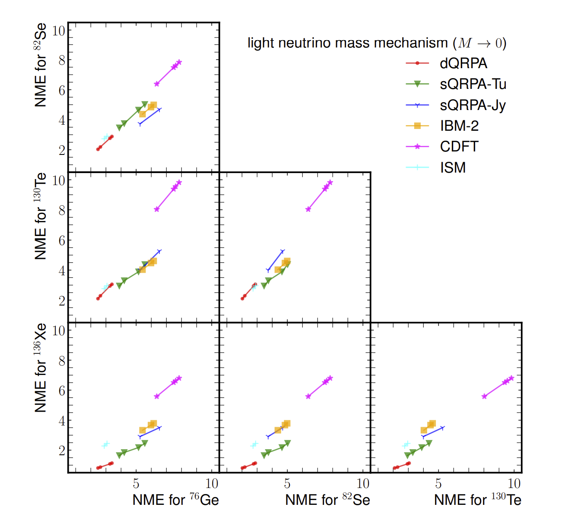
Nuclear Matrix Element (light νs)
Fang, YFL, Zhang, (2023)
Correlation of different isotopes
Each model has rather small uncertainty
Different models differ by a factor of 3
CDFT tends to have the largest values
ISM predicts most of the lowest values
QRPA has the lowest value for Xe

Slide 13
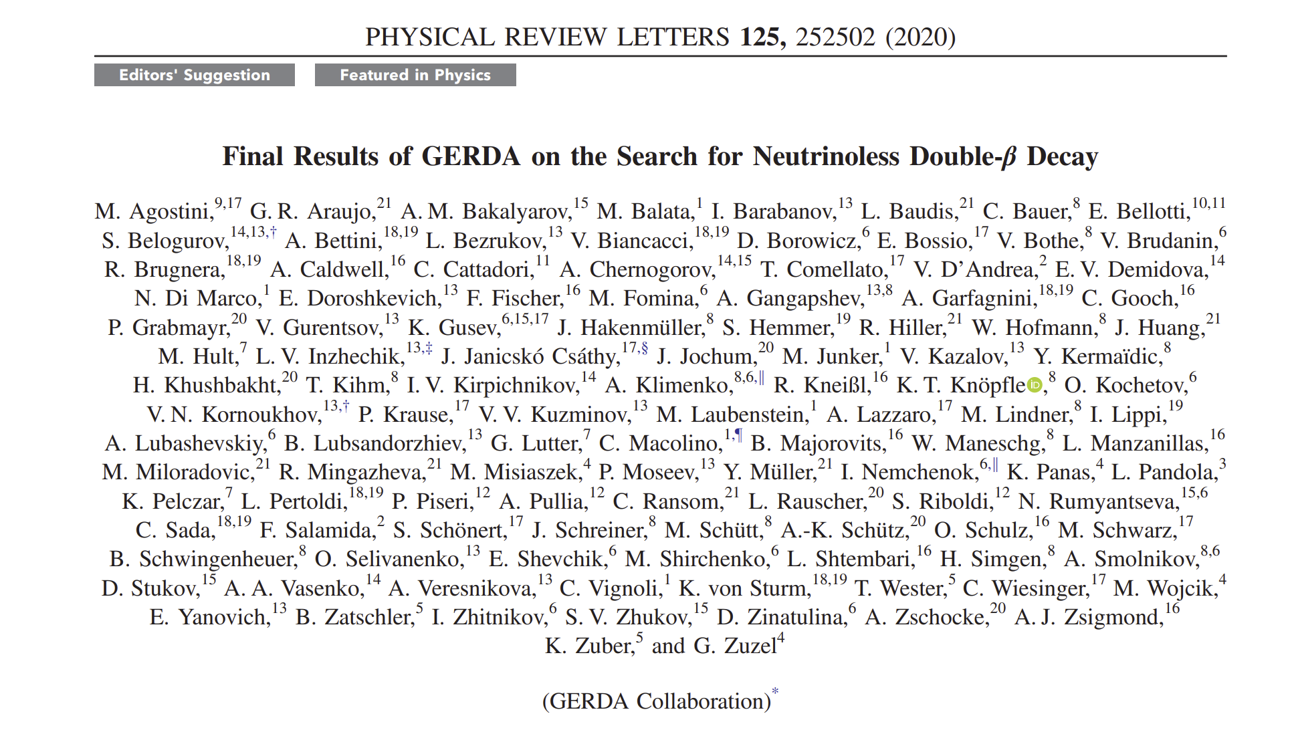
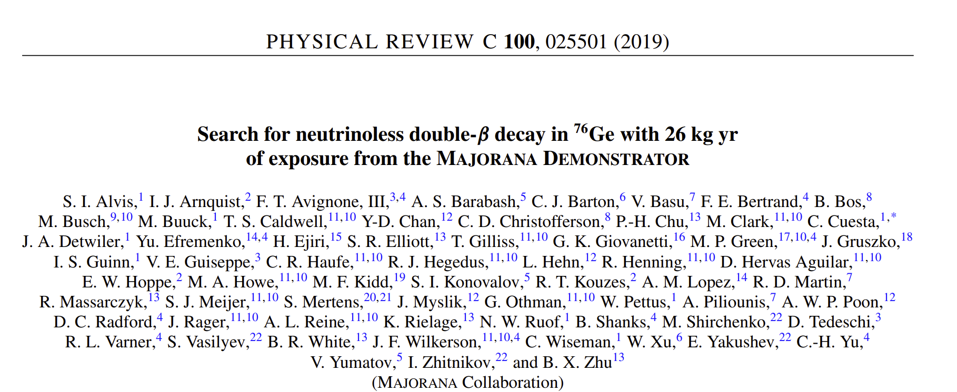
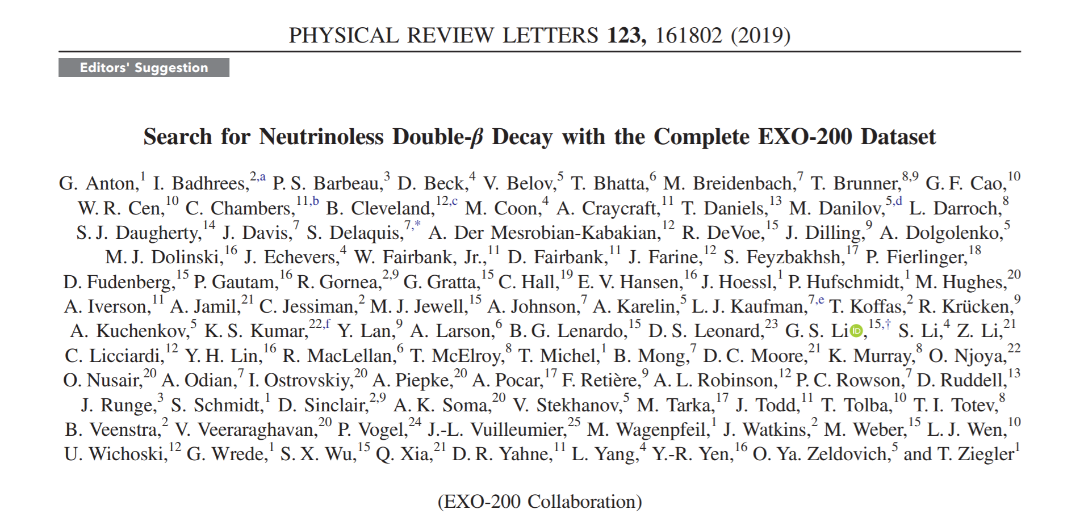
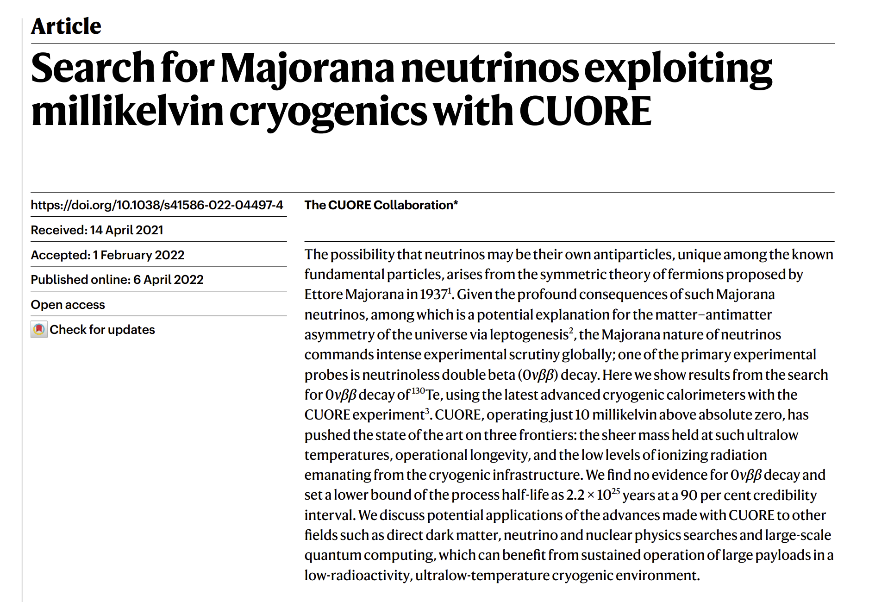
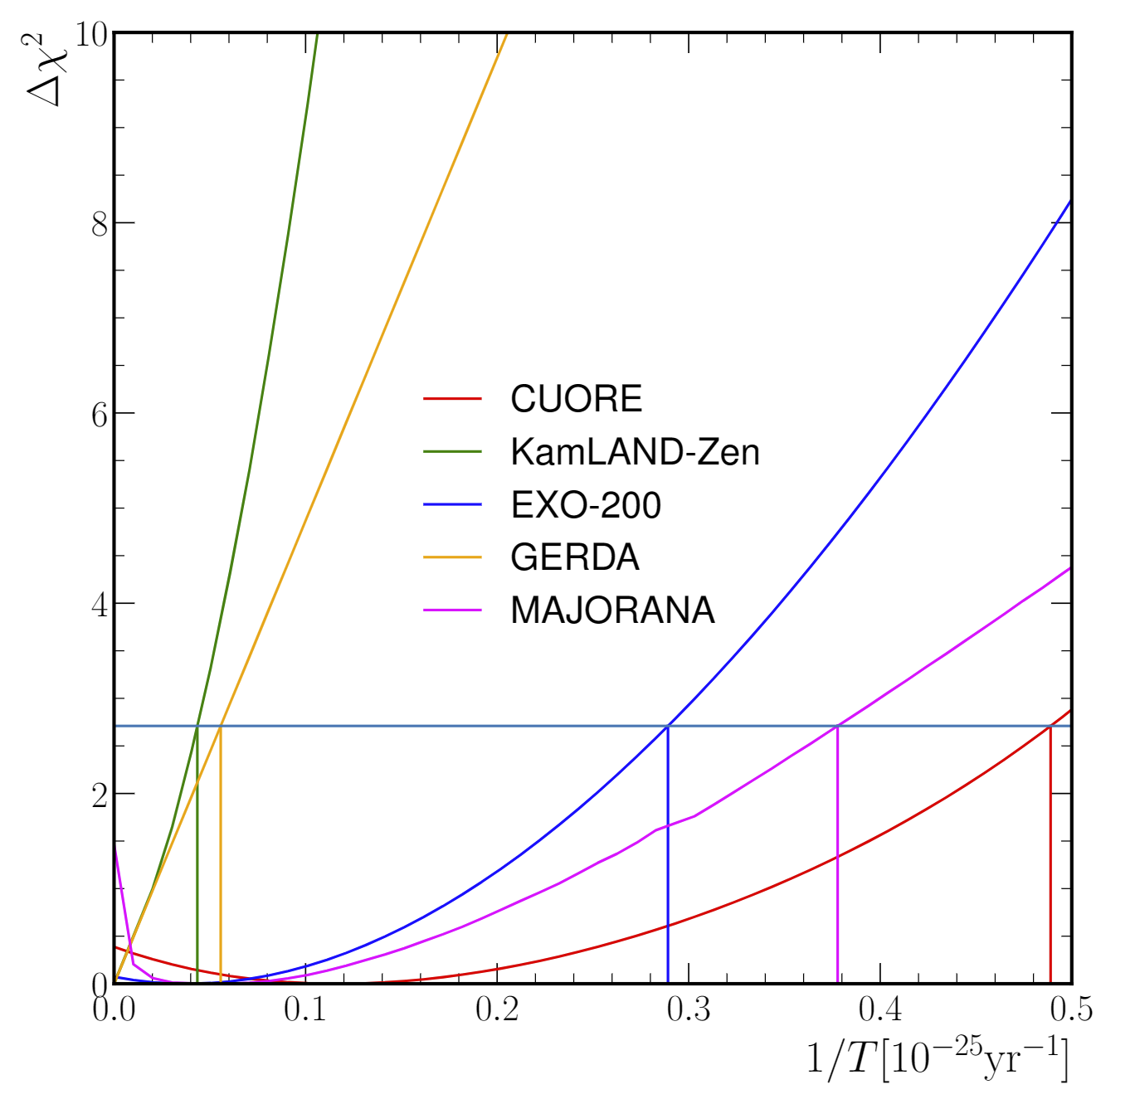
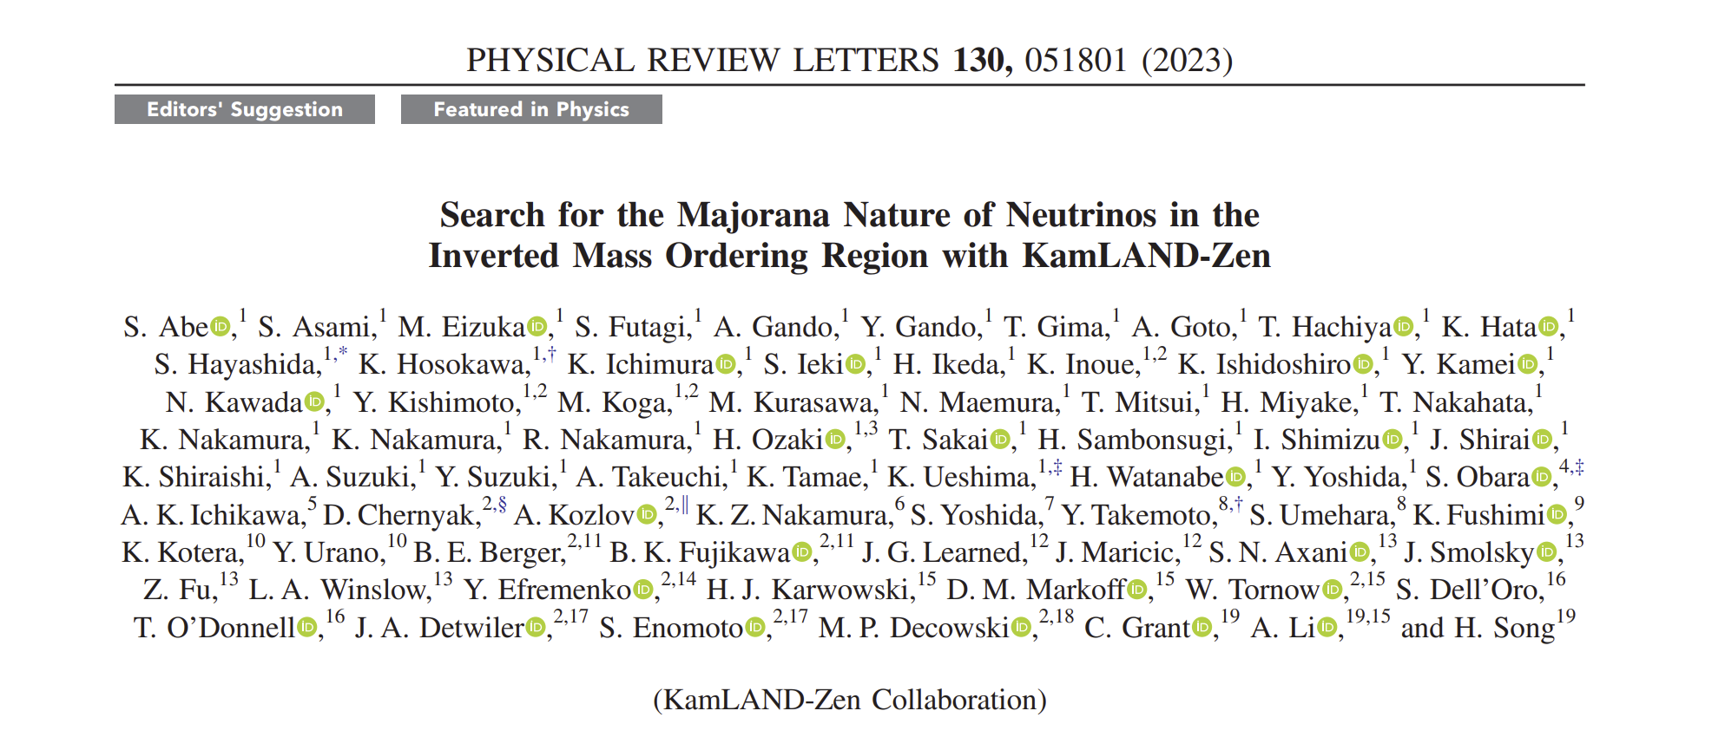
Current experimental results

Slide 14
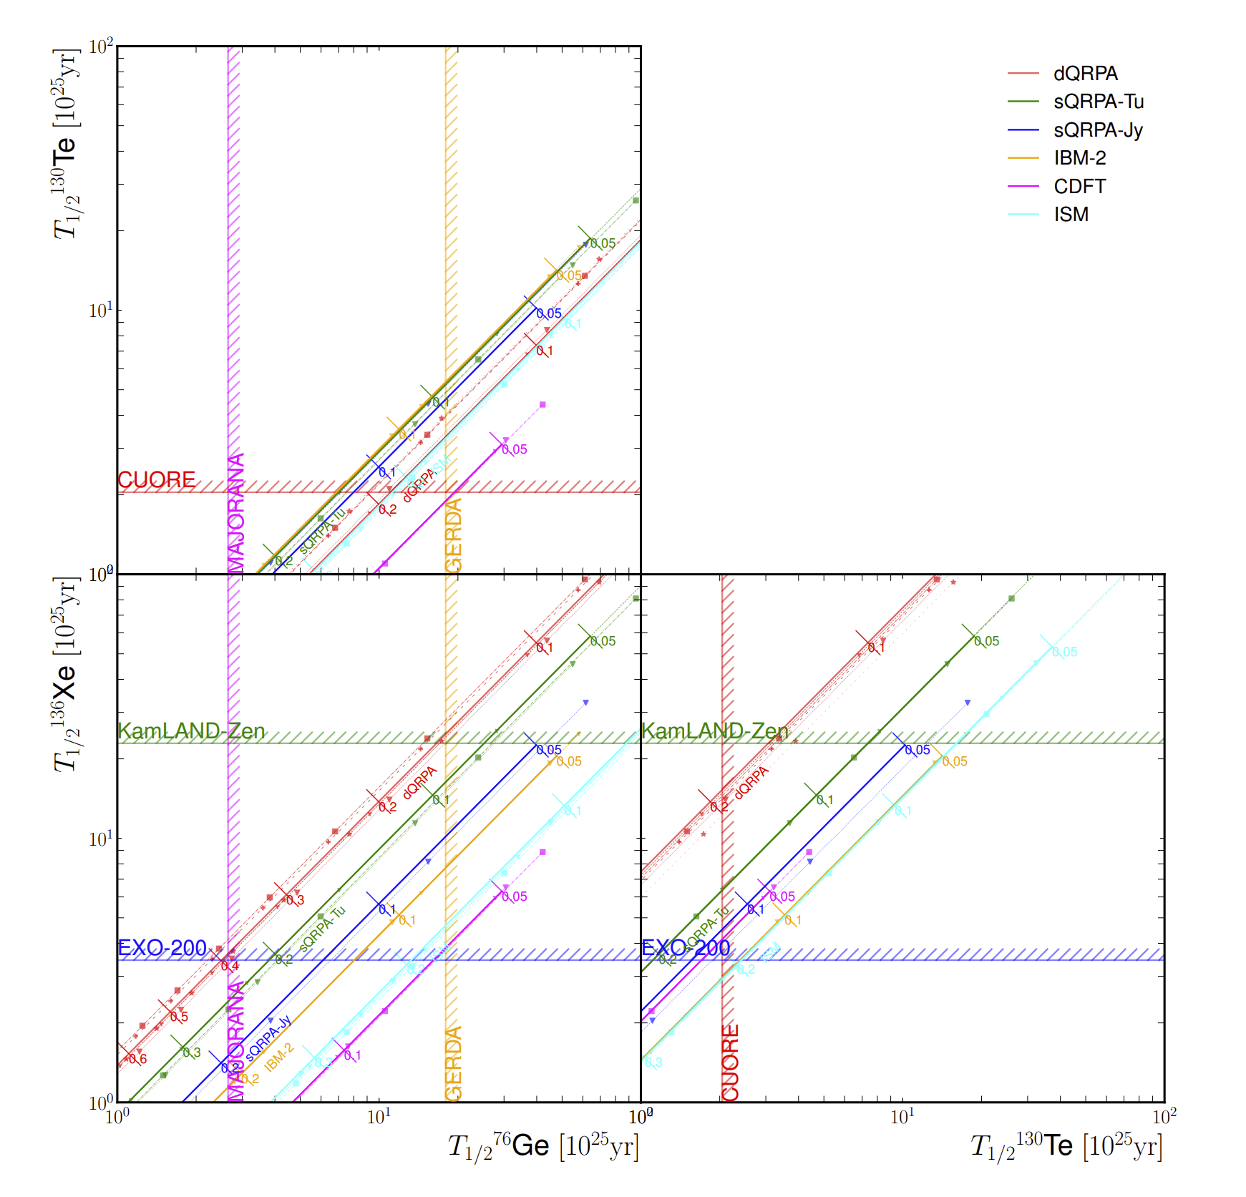
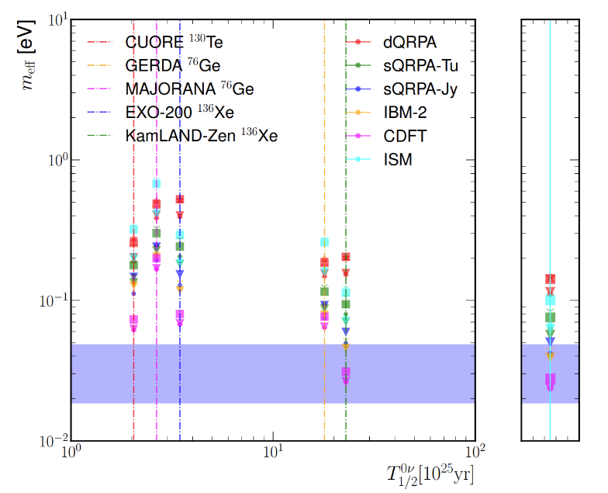
Current experimental results
Results of Both Ge & Xe have reached 100 meV
KamLAND-Zen even entered the boundary of IMO (50 meV)
Important implications on the parameter space, and even additional contributions!
Fang, YFL, Zhang, (2023)

Slide 15
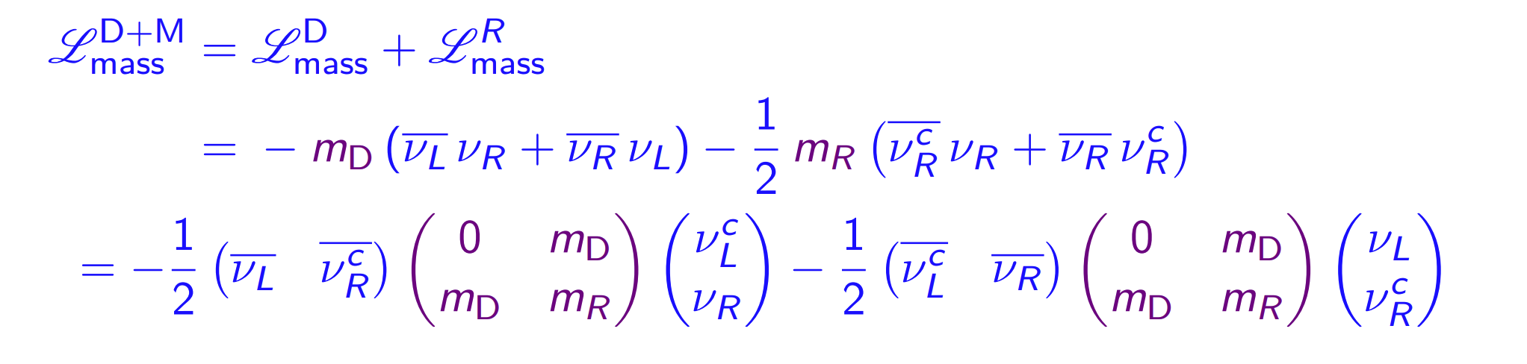
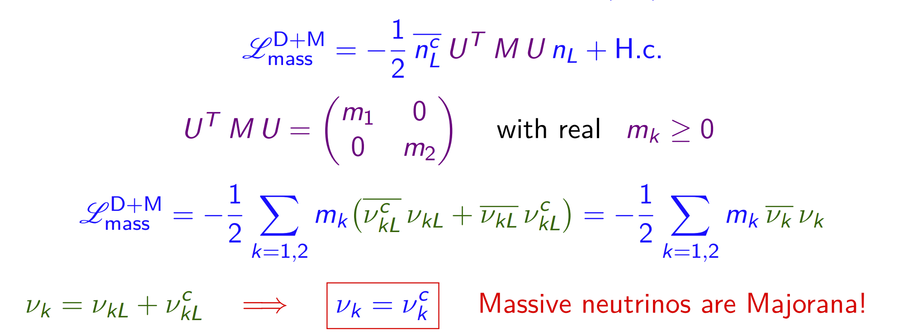
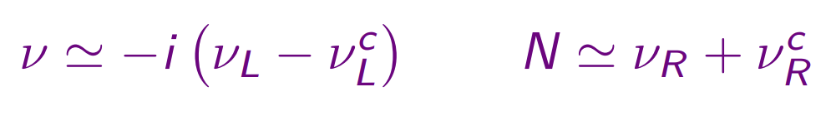
Dirac and Majorana mass Lagrangian

Slide 16


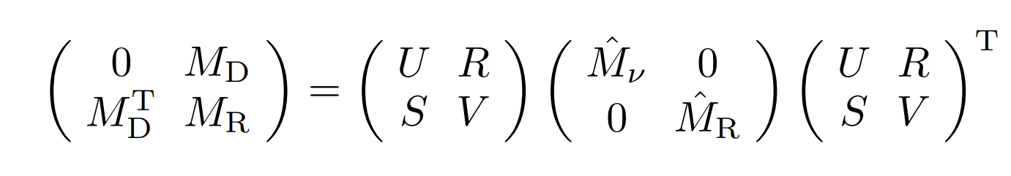
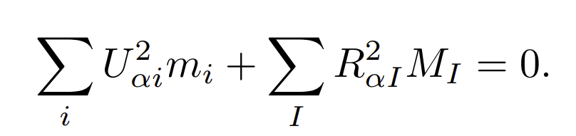
Seesaw Mechanism
The smallness of light neutrino masses ←
In general, the light and heavy mass eigenstates are mixed:
Exact seesaw relation:
Connection of the low energy and high energy parameters
A minimal (3+2) seesaw: two heavy neutrinos (hep-ph/0208157)
“Seesaw fair play rule” [0706.0052]: one massless active neutrino !
Seesaw:

Slide 17
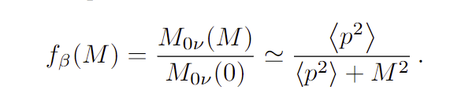
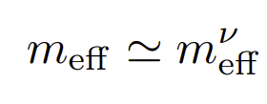
How to include heavy neutrinos?
To include the contribution of heavy neutrinos (aka, right handed neutrinos, or sterile neutrinos):
Mass Dependent Nuclear Matrix Elements
(a) When the masses are small enough
(b) When the masses are large enough
(c) One light enough & others large enough (e.g., eV sterile neutrino)
(d) Minimal 3+2 seesaw for a general study
Faessler et al, 1408.6077
See also 2303.04168
e.g., Xing, 0907.3014
Fang, YFL, Zhang, 2112.12779

Slide 18
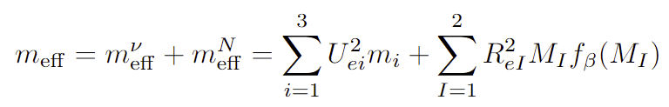
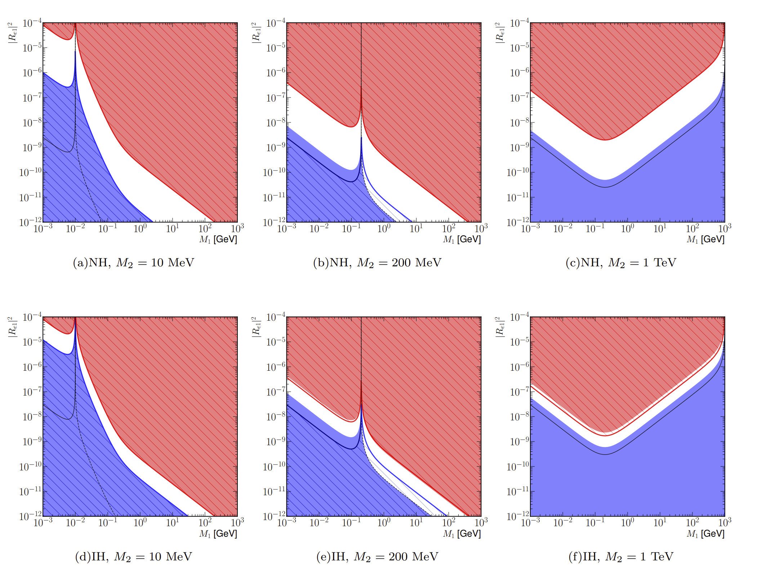
Generalized m_{𝜷𝜷}
Fang, YFL, Zhang, 2112.12779

Slide 19
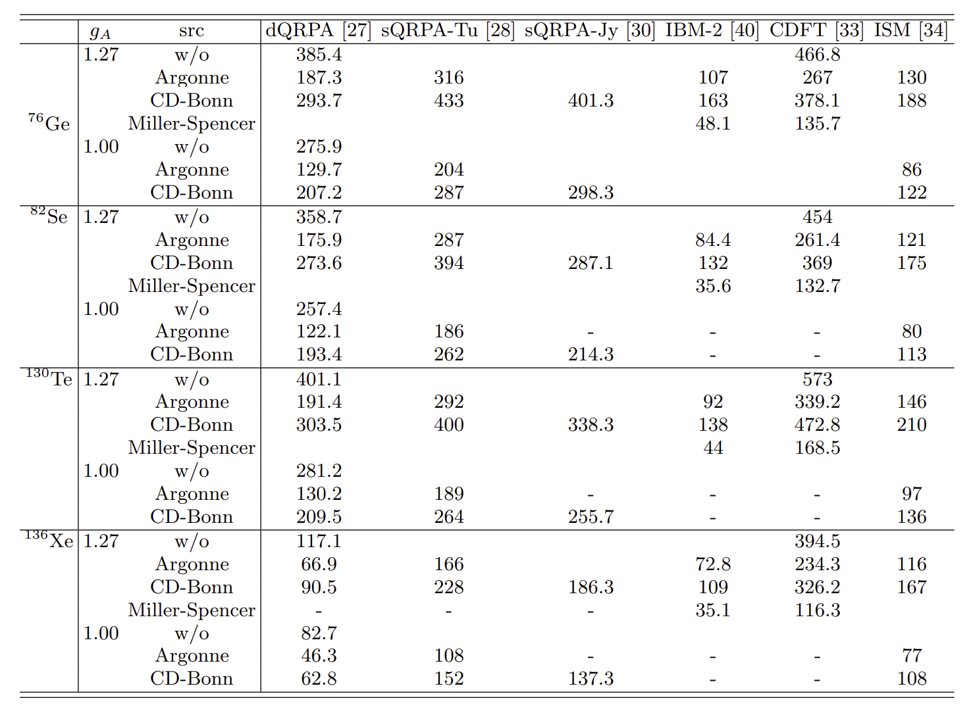
Nuclear Matrix Element (heavy νs)

Slide 20
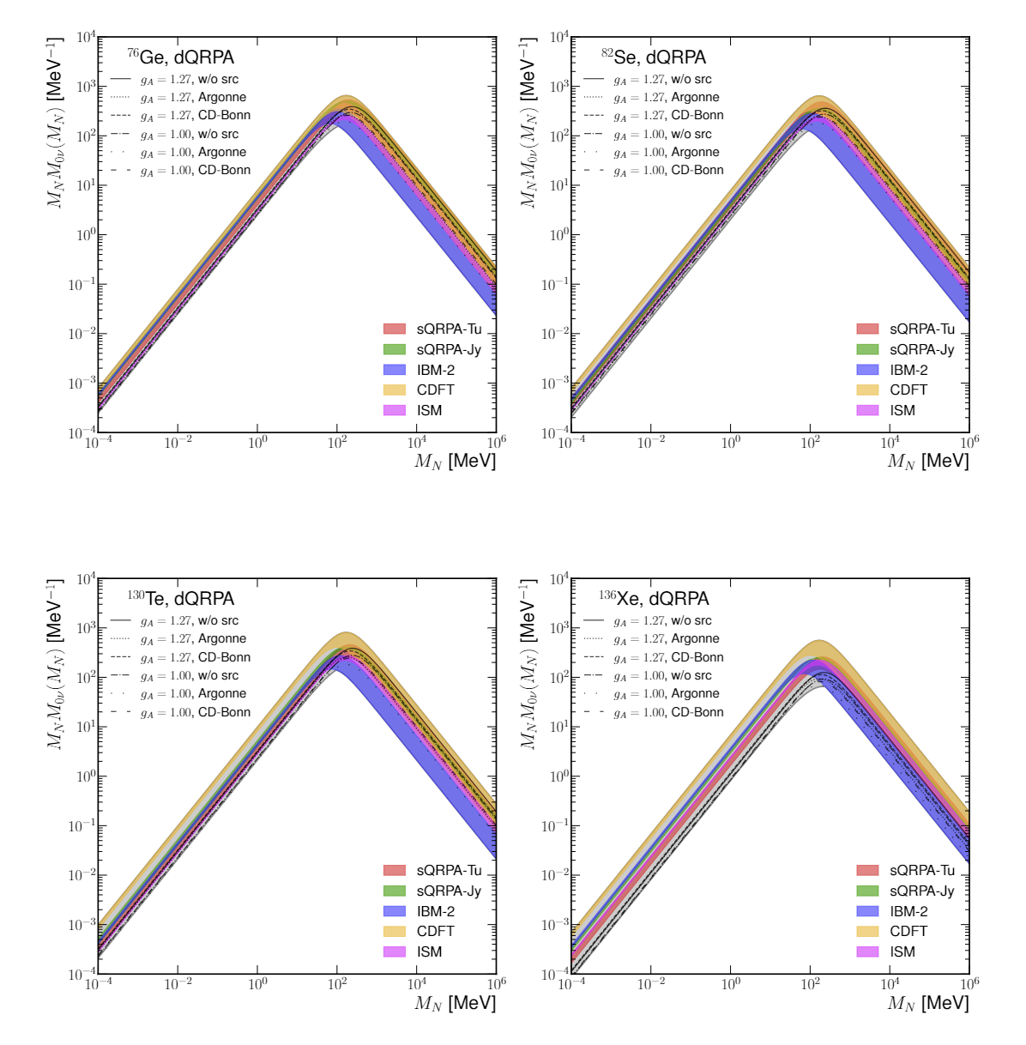
Mass Dependent Nuclear Matrix Elements
dQRPA: Numerical calculation
Others: interpolation with two extreme values
dQRPA, agrees with ISM for light νs and tends to be consistent with CDFT for heavy νs
At high mass region, IBM-2 tends to have the smallest values
Fang, YFL, Zhang (2023)

Slide 21
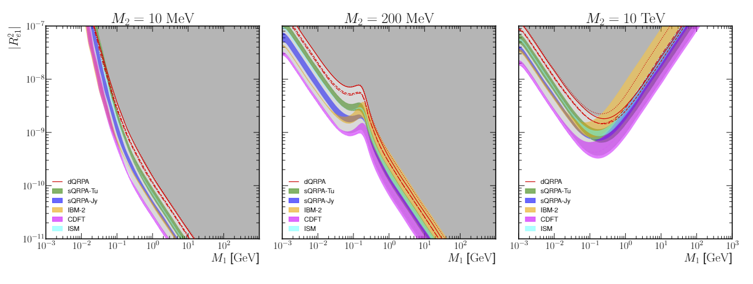
Minimal seesaw: current limits
Normal ordering
Fang, YFL, Zhang, To appear
Different choices of parameters and models are scanned (not as Guassian)
Both the 𝟎ν𝟐𝜷-decay and oscillation data are used
Interpretations of three benchmark scenarios: two different roles!

Slide 22
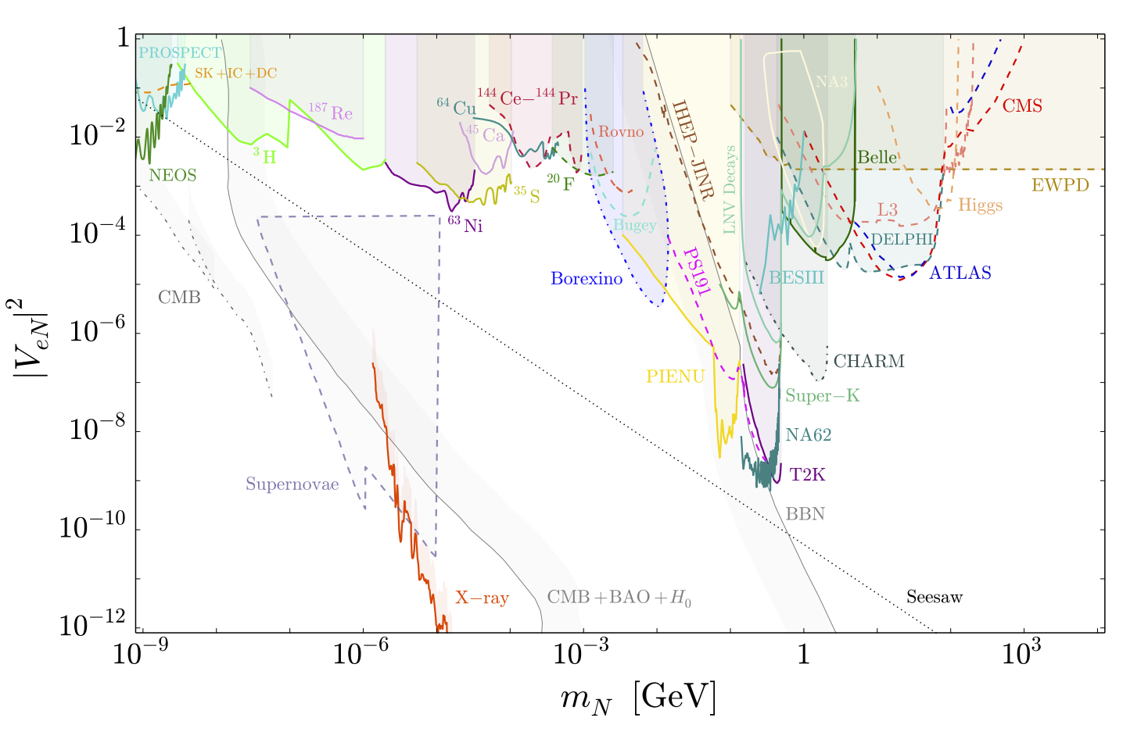
Heavy νs: different probes
Bolton, Deppisch, Dev, arXiv:1912.03058

Slide 23
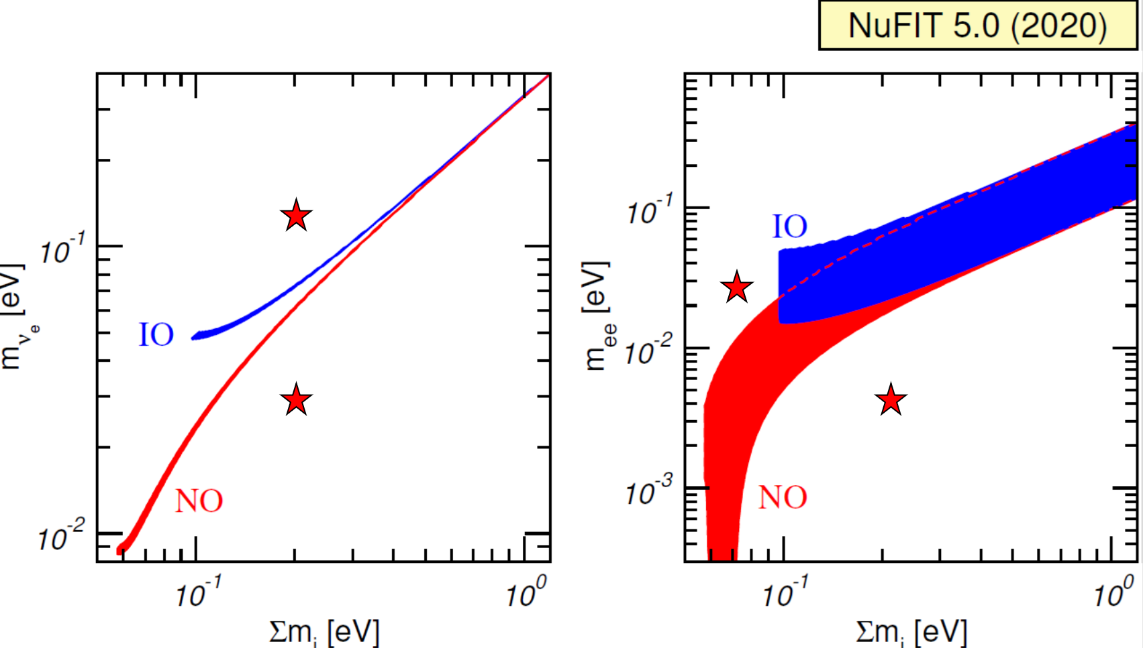
Conclusion
Neutrino-less double decay:
A smoking gun of the neutrino Majorana nature!
In the type-I seesaw model, we have obtained the experimental limits on the seesaw parameters by using
  a) the 𝟎ν𝟐𝜷 data and neutrino oscillation data,
  b) global model predictions of nuclear matrix elements,
c) and seesaw relation of light and heavy neutrino masses.
After the observation of 𝟎ν𝟐𝜷, what is the true mechanism for neutrino mass generation and the 𝟎ν𝟐𝜷 process ?

Slide 24
Thank you!

Slide 25
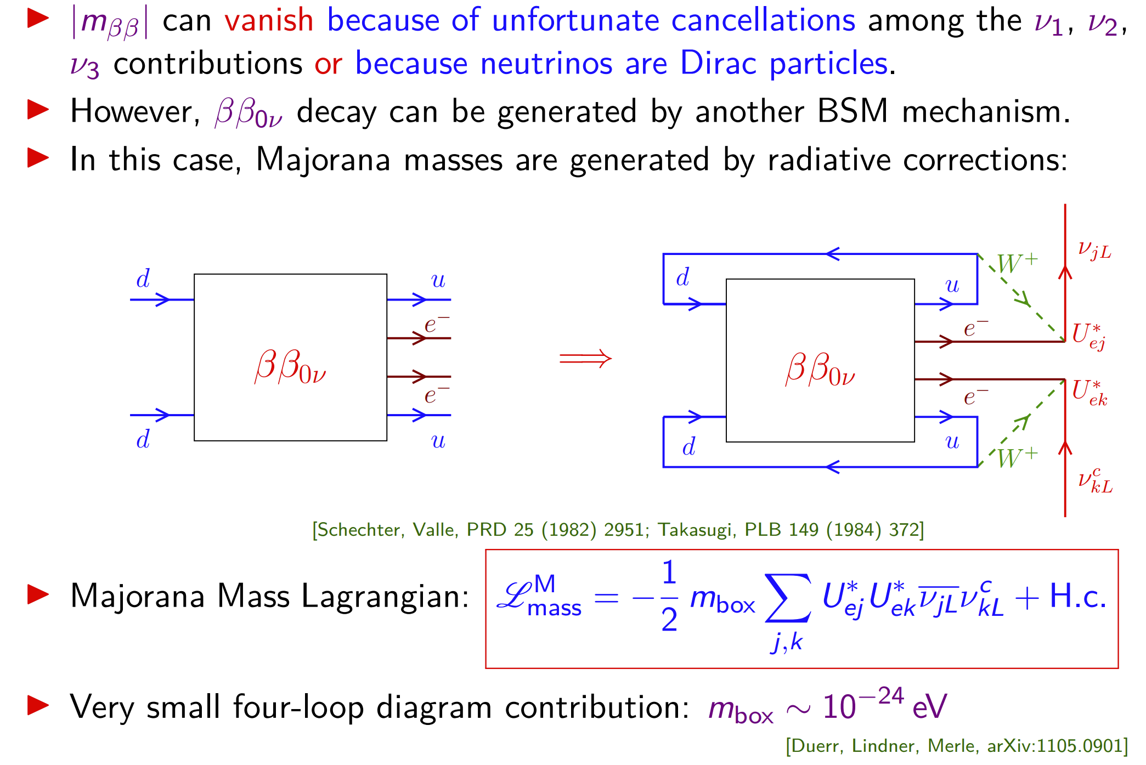
Schechter-Valle theorem
Liu, Zhang, Zhou 10⁻²⁸ eV (2016)

Slide 26
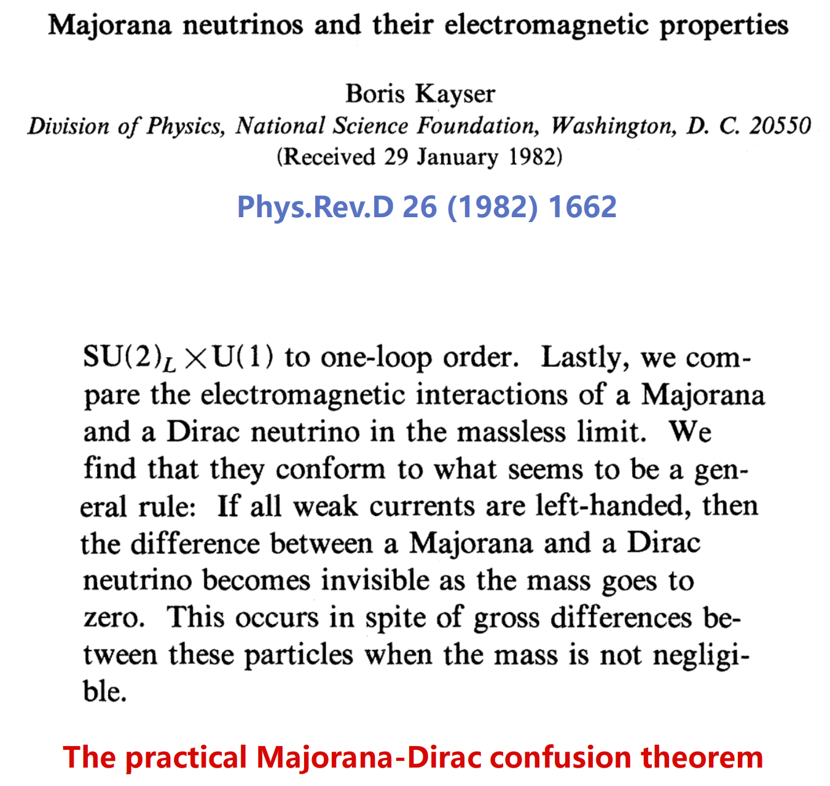
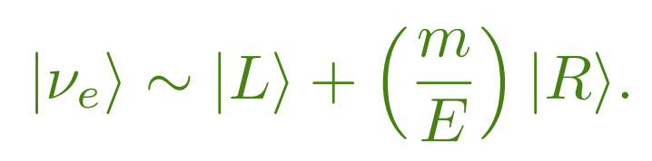
Majorana-Dirac confusion theorem
Practical Majorana-Dirac Confusion Theorem
Only left-handed weak interactions exist
Experiments with neutrinos of negative helicity and antineutrinos of positive helicity
The Majorana Dirac difference ~ m²_{ν}
Best Bet: 𝟎ν𝟐𝜷-decay

Slide 27
Other mechanisms
From Rodejohann

Slide 28
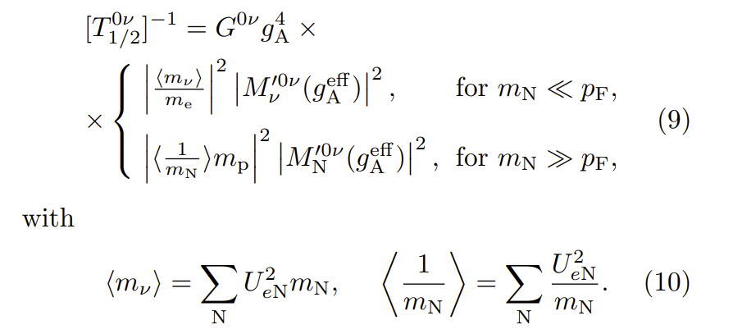
Convention of nuclear matrix element

Slide 29
Absolute neutrino masses: beta-decay
Future Prospect:
KATRIN: 200 meV
Systematic limit: ~100 meV
Project 8: 40 meV
2105.08533
<0.8 eV (90 C.L.)
Snowmass 2021

Slide 30
Absolute neutrino masses: cosmology
PDG 2020
Cosmology: sum of neutrino masses
Data sets and model dependence
Current best limit: ~120 meV
Future projection → 60 meV
1903.03689

Slide 31
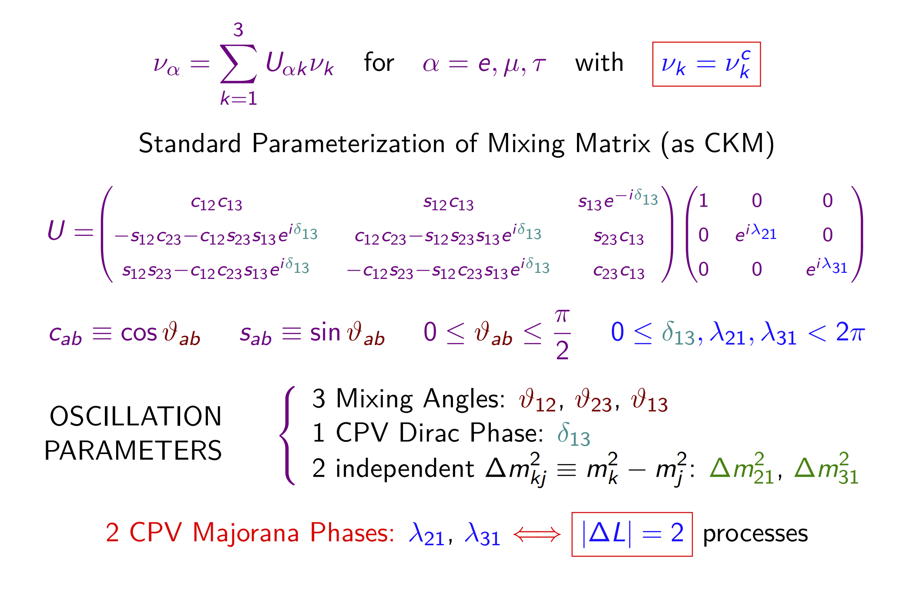
Low energy 3ν mixing

